Slide 1



A Case for Richer Cross-layer Abstractions:
Bridging the Semantic Gap with
Expressive Memory
Nandita Vijaykumar
Abhilasha Jain, Diptesh Majumdar, Kevin Hsieh, Gennady Pekhimenko
Eiman Ebrahimi, Nastaran Hajinazar, Phillip B. Gibbons, Onur Mutlu

Slide 2
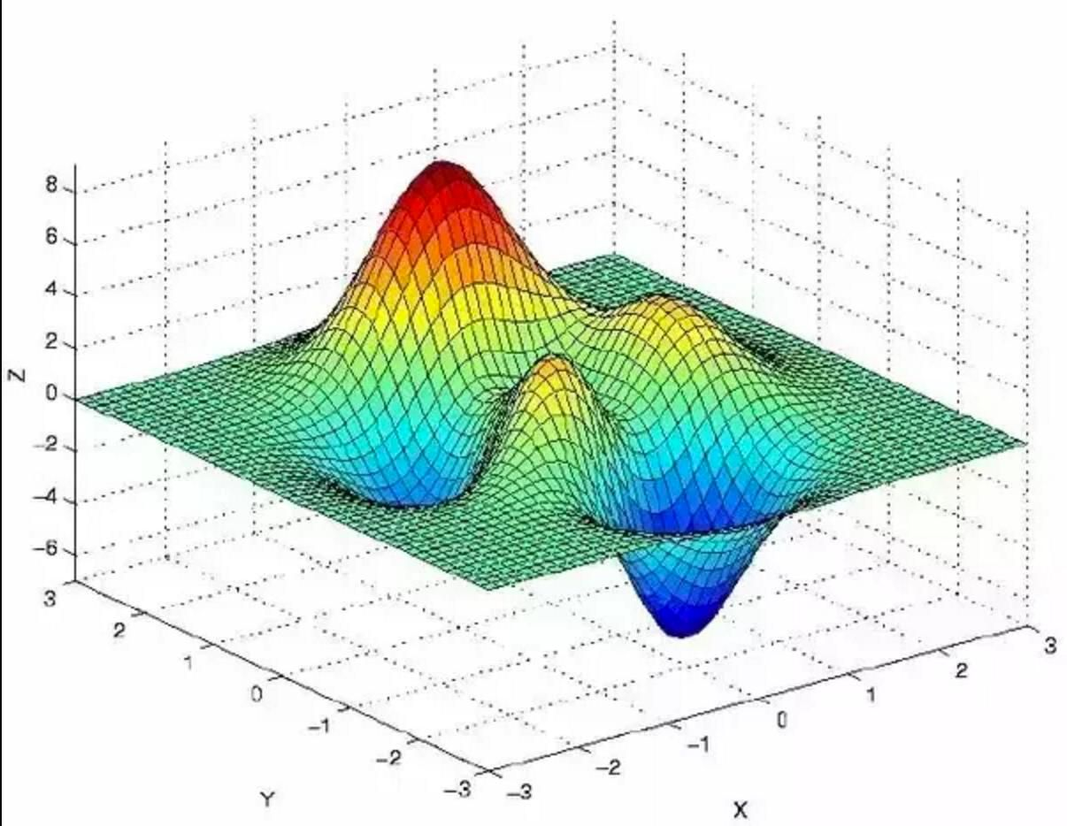


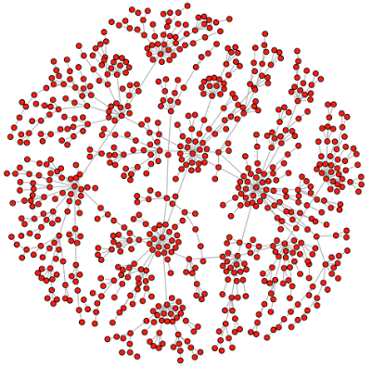






Applications
Today’s cross-layer abstractions are designed
to primarily convey functionality,
not to aid performance optimization
ISA
Virtual Memory
Hardware

Slide 3

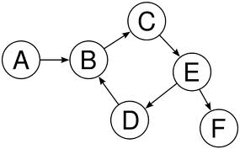



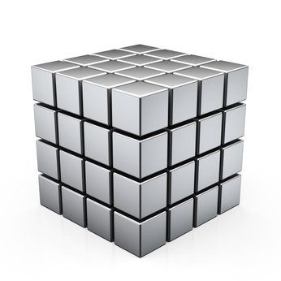

The narrow abstractions lose key information
Code Optimizations
Access Patterns
Integer
Data Structures
Char
Float
Data Type
Instructions
Memory Addresses
100011111…
101010011…

Slide 4

Consequence 1: The Hardware Approach
We design hardware to infer and predict program behavior to optimize for performance
Caches
Memory Controller
Prefetcher
  Performance on the table

Slide 5

Consequence 2: The Software Approach
Software is tuned to the specifics of hardware architecture when optimizing for performance
Cache space available?
How many DRAM banks?
  Programmability
  Portability
Hardware optimizations?

Slide 6
With growing HW/SW sophistication,
traditional interfaces limit optimization effectiveness
Time for a richer interface
between hardware and software?

Slide 7


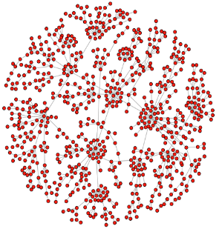
Higher-level
Program
Semantics
Expressive
Memory
“XMem”
ISA
Virtual Memory

Slide 8
A fresh approach to traditional optimizations
Cache Management
Data Placement in DRAM
Data Compression
Approximation
DRAM Cache Management
NVM Management
NUCA/NUMA Optimizations
….
Programmability
Portability
Resource Efficiency

Slide 9
A Case for Richer Cross-layer Abstractions:
Bridging the Semantic Gap with
Expressive Memory
Nandita Vijaykumar
Abhilasha Jain, Diptesh Majumdar, Kevin Hsieh, Gennady Pekhimenko
Eiman Ebrahimi, Nastaran Hajinazar, Phillip B. Gibbons, Onur Mutlu

