Slide 1
A Case for Richer Cross-layer Abstractions: Bridging the Semantic Gap with Expressive Memory
Nandita Vijaykumar
Abhilasha Jain, Diptesh Majumdar, Kevin Hsieh, Gennady Pekhimenko
Eiman Ebrahimi, Nastaran Hajinazar, Phillip B. Gibbons, Onur Mutlu

Slide 2
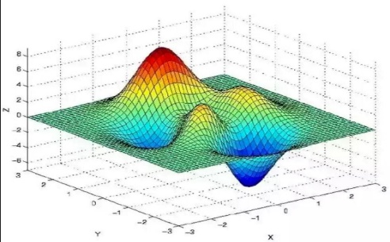
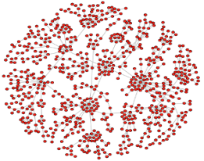
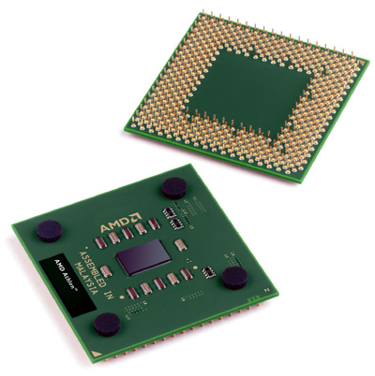
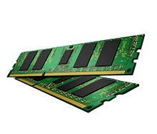
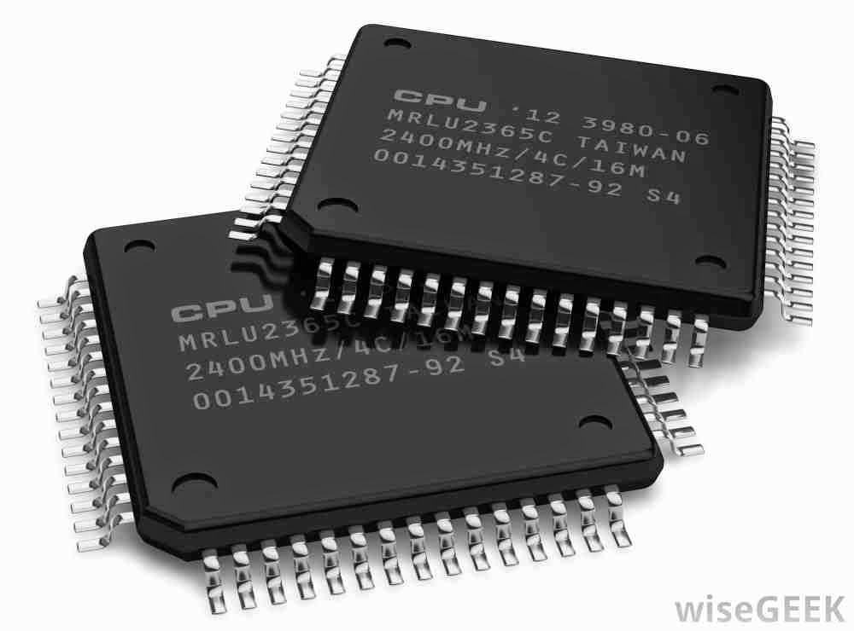
SW Optimization
Functionality
Software
Performance?
HW-SW Interfaces
(ISA & Virtual Memory)
Hardware
HW Optimization

Slide 3
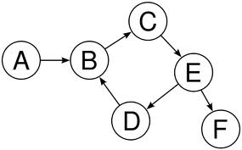
Higher-level information is not visible to HW
Code Optimizations
Access Patterns
Data Structures
Float
Integer
Software
Char
Data Type
Hardware
100011111…
101010011…
Instructions
Memory Addresses

Slide 4
Performance
Functionality
Software
Higher-level
Program
Semantics
Expressive
Memory
“XMem”
ISA
Virtual Memory
Hardware

Slide 5
Outline
Why do we need a richer cross-layer abstraction?
Designing Expressive Memory (XMem)
Evaluation (with a focus on one use case)

Slide 6
Performance optimization in hardware

Slide 7
What we do today: We design hardware to infer and predict program behavior to optimize for performance
Caches
Memory Controllers
Prefetchers

Slide 8
With a richer abstraction: SW can provide program information can significantly help hardware
Float
Integer
Data Type/Layout
Char
Data Structures
Access Patterns
Software
Hardware
Data Placement
Data Compression
Prefetcher

Slide 9
Benefits of a richer abstraction:
Express:
Data structures
Access semantics
Data types
Working set
Reuse
Access frequency
…..
Optimizations:
Cache Management
Data Placement in DRAM
Data Compression
Approximation
DRAM Cache Management
NVM Management
NUCA/NUMA Optimizations
….

Slide 10
Optimizing for performance in software

Slide 11
What we do today: Use platform-specific optimizations to tune SW
Example: SW-based cache optimizations
SW optimizations make assumptions regarding HW resources
Tune working set
Significant portability and programmability challenges
8MB cache
6MB cache

Slide 12
With a richer interface: HW can alleviate burden on SW
SW only expresses program information
System/HW handles
optimizing for specific system details
e.g. exact cache size, memory organization,
NUMA organization
Working set
Reuse

Slide 13
Benefits of a richer abstraction:
Express:
Data structures
Access semantics
Data types
Working set
Reuse
Access frequency
…..
Optimizations:
Cache Management
Data Placement in DRAM
Data Compression
Approximation
DRAM Cache Management
NVM Management
NUCA/NUMA Optimizations
….
Performance
HW optimizations
SW optimizations
Programmability
Portability

Slide 14
SW information in HW is proven to be useful, but..
Lots of research on hints/directives to hardware and HW-SW co-designs
Cache hints, Prefetcher hints, Annotations for data placement, …
Downsides:
Not scalable – can’t add new instructions for each optimization
Not portable – make assumptions about underlying resources
These downsides significantly limit adoption of otherwise useful approaches

Slide 15
Our Goal:
Design a rich, general, unifying abstraction
between HW and SW for performance

Slide 16
Outline
Why do we need a richer cross-layer abstraction?
Designing Expressive Memory (XMem)
Evaluation (with a focus on one use case)

Slide 17
Key design goals
Supplemental and hint-based only
General and extensible
Architecture-agnostic
Low overhead

Slide 18
An Overview of Expressive Memory
Application
Interface to Application
System to summarize and save program information
Expressive
Memory
Interface to System/Architecture
Memory Controller
Prefetcher
OS
Caches
. . .
DRAM Cache

Slide 19
Challenge 1: Generality and architecture-agnosticism
General,
High-level
Application
Data structures,
data type, access patterns, …
Interface to Application
Expressive
Memory
Architecture-specific, Low-level
What to prefetch?
Which data to cache?
Interface to System/Architecture
Memory Controller
Prefetcher
OS
Caches
. . .
DRAM Cache

Slide 20
Challenge 2: Tracking changing program properties with low overhead
Program behavior keeps changing:
Data structures are accessed differently in different phases
New data structures are allocated
We want to convey lots of information!
Application
Expressive Memory
Dynamic interface that continually tracks program behavior
System/Architecture
Potentially very high storage/communication overhead at run time

Slide 21
A new HW-SW abstraction
Application
Software
Atom:1
Memory
Region
Atom: 2
Memory
Region
Atom: 3
Memory
Region
Hardware
System/Architecture

Slide 22
The Atom: A closer look
Unique Atom ID
A hardware-software abstraction to convey program semantics
Data Value Properties:
INT, FLOAT, CHAR,…
COMPRESSIBLE, APPROXIMABLE
Access Properties:
Read-Write Characteristics
Access Pattern
Access Intensity (“Hotness”)
3) Data Locality:
Working Set
Reuse
4) ….
Atom: X
Program
Attributes
Mapping
State
Atom
Valid/invalid at current execution point

Slide 23
The three Atom operators
Atom
Atom
2) MAP/UNMAP
1) CREATE
Program
Attributes
Mapping
State
3) ACTIVATE/DEACTIVATE

Slide 24
Using Atoms to express program semantics
A = malloc ( size );
Atom1 = CreateAtom( “INT”, “Regular”, …);
MapAtom( Atom1, A, size );
ActivateAtom(Atom1);
….
….
Atom2 = CreateAtom( “INT”, “Irregular”, …);
UnMapAtom( Atom1, A, size);
MapAtom( Atom2, A, size );
ActivateAtom(Atom2);
Memory Region A
(3D Array)
Atom: 1
Attributes cannot be changed
Atom: 2

Slide 25
Implementing the Atom
Compile Time (CREATE)
Load Time (CREATE)
Run Time (MAP and ACTIVATE)

Slide 26
Compile Time (CREATE)
A = malloc ( size );
Atom1 = CreateAtom( “INT”, “Regular”, …);
MapAtom( Atom1, A, size );
ActivateAtom(Atom1);
….
….
Atom2 = CreateAtom( “INT”, “Irregular”, …);
UnMapAtom( Atom1, A, size);
MapAtom( Atom2, A, size );
ActivateAtom(Atom2);
Atom: 1
Program
Attributes 1
High overhead operations are handled at compile time
Atom: 2
Program
Attributes 2
Compiler
Compiler
Atom Segment
in Object File

Slide 27
Load Time (CREATE)
Atom Segment
in Object File
Architecture-agnostic,
general
Architecture-specific,
low-level
OS
Attribute Translator
Atom ID
Attributes
…
Cache
Controllers
Prefetcher
Memory Controller

Slide 28
Run Time (MAP and ACTIVATE)
A = malloc ( size );
Atom1 = CreateAtom( “INT”, “Regular”, …);
MapAtom( Atom1, A, size );
ActivateAtom(Atom1);
….
….
Atom2 = CreateAtom( “INT”, “Irregular”, …);
UnMapAtom( Atom1, A, size);
MapAtom( Atom2, A, size );
ActivateAtom(Atom2);
Application
Design challenge:
How to do this with low overhead?
New insts in ISA
Expressive
Memory
OS
Caches
Memory Controller
. . .
Prefetcher
DRAM Cache

Slide 29
Outline
Why do we need a richer cross-layer abstraction?
Designing Expressive Memory (XMem)
Evaluation (with a focus on one use case)

Slide 30
A fresh approach to traditional optimizations
Express:
Data structures
Access semantics
Data types
Working set
Reuse
Access frequency
…..
Optimizations:
Cache Management
Data Placement in DRAM
Data Compression
Approximation
DRAM Cache Management
NVM Management
NUCA/NUMA Optimizations
….
Performance
HW optimizations
SW optimizations
Programmability
Portability

Slide 31
Use Case 1: Improving portability of SW cache optimization
SW-based cache optimizations try to fit the working set in the cache
Examples: hash-join partitioning, cache tiling, stencil pipelining
machine learning, computer vision, numerical analysis, etc.)
A
B
C

Slide 32
Methodology (Use Case 1)
Evaluation Infrastructure: Zsim, DRAMSim2
Workloads: Polybench
System Parameters:
Core: 3.6 GHz, Westmere-like OOO, 4-wide issue, 128-entry ROB
L1 Cache: 32KB Inst and 32KB Data, 8 ways, 4 cycles, LRU
L2 Cache: 128KB private per core, 8 ways, 8 cycles, DRRIP
L3 Cache: 8MB (1MB/core, partitioned), 16 ways, 27 cycles, DRRIP
Prefetcher: Multi-stride prefetcher at L3, 16 strides
Memory: DRAM DDR3-1066, 2 channels, 1 rank/channel, 8 banks/rank, 17GB/s
(2.1GB/s/core), FR-FCFS, open-row policy

Slide 33
Correctly sizing the working set is critical
Gemm
Cache Thrashing
Execution
Time
71%
Bigger is better
(more reuse)
Tile Size (kB)
Optimal tile size depends on available cache space:
This causes portability and programmability challenges

Slide 34
Leveraging Expressive Memory for cache tiling
SW expresses program-level semantic information
Map tile to an atom, specifying high reuse and tile size
HW manages cache space to optimize for performance
If tile size < available cache space: default policy
If tile size > available cache space: pin a part of the tile, prefetch the rest (avoid thrashing)

Slide 35
Cache tiling with Expressive Memory
Gemm
Execution
Time
47%
Tile Size (kB)
Knowledge of locality semantics enables more intelligent cache management
Improves portability and programmability

Slide 36
Results across more workloads
Normalized Exec. Time
Tile Size in kB
Baseline
Expressive Memory

Slide 37
More in the paper
Use Case 2: Leveraging data structure semantics to enable more intelligent OS-based page placement
More details on the implementation
Overhead analysis
Other use cases of XMem

Slide 38
Conclusion
General and architecture-agnostic interface to SW to express program semantics
Software
Higher-level
Program
Semantics
Expressive
Memory
“XMem”
ISA
Virtual Memory
Key program information to aid system/HW components in optimization
Hardware

Slide 39
A Case for Richer Cross-layer Abstractions: Bridging the Semantic Gap with Expressive Memory
Nandita Vijaykumar
Abhilasha Jain, Diptesh Majumdar, Kevin Hsieh, Gennady Pekhimenko
Eiman Ebrahimi, Nastaran Hajinazar, Phillip B. Gibbons, Onur Mutlu

