Slide 1


Optimizing DRAM Timing for the Common-Case
Adaptive-Latency DRAM
Donghyuk Lee
Yoongu Kim, Gennady Pekhimenko, Samira Khan,
Vivek Seshadri, Kevin Chang, Onur Mutlu
Notes:
Hello, my name is Donghyuk Lee.
Today, I will talk about “Adaptive-Latency DRAM which optimizes DRAM timings for the common-case”.
This work is done in collaboration with my co-authors from Carnegie Mellon University.

Slide 2
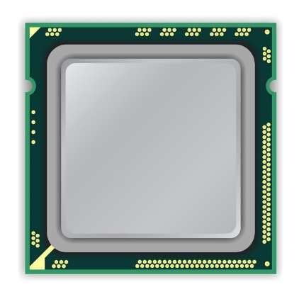
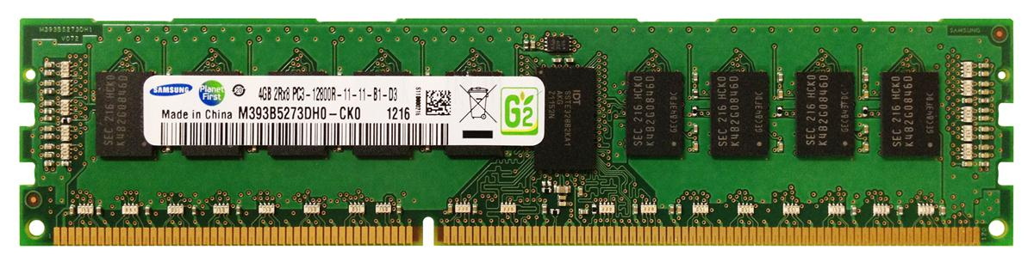
Runtime: 527min
x86 CPU
SPEC
mcf
Runtime: 477min
Apache
GUPS
Memcached
Parsec
-10.5% (no error)
MemCtrl
Timing Parameters
(11 – 11 – 28)
DRAM Module
(8 – 8 – 19)
DDR3 1600MT/s (11-11-28)
Notes:
A system consists of a processor and DRAM based-memory system that are connected by memory channel.
DRAM has many timing parameters as minimum number of clock cycles between commands.
Memory controller follows these timing parameters when accessing DRAM.
We execute a benchmark with using the standard timing parameters.
Then, we intentionally reduce the timing parameters and execute same benchmark again.
When comparing these two cases, we observe significant performance improvement by reducing timing parameters, for example, 10% performance improvement for spec mcf benchmark.
Without any errors.-----

Slide 3
Reducing DRAM Timing
Why can we reduce DRAM timing parameters without any errors?
Notes:
I will mostly talk about reducing DRAM timing parameters.
Before explaining the details of our work, I would provide high level questions and our answers.
First question is why reducing DRAM timing parameters works?
Our observation is that DRAM timing parameters are overly conservative and
dictated by the slowest DRAM chip at the highest operating temperature.
Second question is how much we can reduce DRAM timing parameters?
Our DRAM latency characterization shows that it depends on the operating temperature and DRAM chip.
Third question is whether this approach is safe?
Our answer is Yes.
We exploit only the extra margin in timing parameters.
We perform 33 day long evaluation with reduced timing parameters and observed no errors.
Let me explain details about our work.

Slide 4
Executive Summary
Observations
  DRAM timing parameters are dictated by the worst-case cell (smallest cell across all products at highest temperature)
  DRAM operates at lower temperature than the worst case
Idea: Adaptive-Latency DRAM
  Optimizes DRAM timing parameters for the common case (typical DIMM operating at low temperatures)
Analysis: Characterization of 115 DIMMs
  Great potential to lower DRAM timing parameters (17 – 54%) without any errors
Real System Performance Evaluation
  Significant performance improvement (14% for memory-intensive workloads) without errors (33 days)
Notes:
Let me conclude
DRAM timing parameters are dictated by the worst case cell.
We propose Adaptive-Latency DRAM that optimizes DRAM timing parameters for common cases
Our characterization shows the significant potential to lower DRAM timing parameters.
Our real system evaluation shows that our mechanism provides significant performance improvement without introducing errors.

Slide 5
1. DRAM Operation Basics
2. Reasons for Timing Margin in DRAM
3. Key Observations
4. Adaptive-Latency DRAM
5. DRAM Characterization
6. Real System Performance Evaluation
Notes:
This is the outline. I will first briefly explain DRAM operation and two reasons of timing margin in DRAM.
Then, we will talk about our three key mechanisms and propose our mechanism, Adaptive-Latency DRAM.
Then, we will provide the DRAM latency characterization results and real system performance evaluation results.
Let me start from DRAM operation.

Slide 6
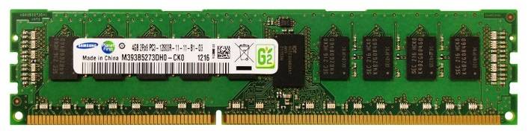
DRAM Stores Data as Charge
DRAM Cell
Three steps of charge movement
1. Sensing
2. Restore
3. Precharge
Sense-Amplifier
Notes:
The right figure shows DRAM organization which is consists of DRAM cells and sense-amplifiers.
There are three steps for accessing DRAM.
First, when DRAM selects one of rows in its cell array, the selected cells drive their charge to sense-amplifiers.
Then, sense-amplifiers detect the charge, recognizing data of cells.
We call this operation as sensing.
Second, after sensing data from DRAM cells, sense-amplifiers drive charge to the cells for reconstructing original data.
We call this operation as restore.
Third, after restoring the cell data, DRAM deselects the accessed row and puts the sense-amplifiers to original state for next access.
We call this operation as precharge.
As shown in these three steps, DRAM operation is charge movement between cell and sense-amplifier.

Slide 7
DRAM Charge over Time
Cell
Cell
Data 1
charge
Sense-Amplifier
Sense-Amplifier
Data 0
Timing Parameters
Sensing
Restore
time
In theory
margin
In practice
Why does DRAM need the extra timing margin?
Notes:
Timing parameters exist to ensure sufficient movement of charge.
The figure shows the timeline for accessing DRAM in X-axis and Y-axis shows the charge amount in DRAM cell and sense-amplifier.
When selecting a row of cells, each cell drives their charge toward to the corresponding sense-amplifier.
If driven charge is more than enough to detect the data, the sense-amplifier starts to restore data by driving charge toward the cell.
This restore operation finishes when the cell is fully charged.
Ideally, DRAM timing parameters are just enough for the sufficient movement of charge.
However, in practice, there are large margin in DRAM timing parameters.
Why are these margin required?

Slide 8
1. DRAM Operation Basics
2. Reasons for Timing Margin in DRAM
3. Key Observations
4. Adaptive-Latency DRAM
5. DRAM Characterization
6. Real System Performance Evaluation
Notes:
This is the outline. I will first briefly explain DRAM operation and two reasons of timing margin in DRAM.
Then, we will talk about our three key mechanisms and propose our mechanism, Adaptive-Latency DRAM.
Then, we will provide the DRAM latency characterization results and real system performance evaluation results.
Let me start from DRAM operation.

Slide 9
Two Reasons for Timing Margin
1. Process Variation
  DRAM cells are not equal
  Leads to extra timing margin for cell that can store small amount of charge
`
1. Process Variation
  DRAM cells are not equal
  Leads to extra timing margin for a cell that can store a large amount of charge
1. Process Variation
  DRAM cells are not equal
  Leads to extra timing margin for a cell that can store a large amount of charge
2. Temperature Dependence
  DRAM leaks more charge at higher temperature
  Leads to extra timing margin when operating at low temperature
Notes:
There are two reasons for the margin in DRAM timing parameters.
First is process variation and second is temperature dependence.
Let me introduce the first factor, process variation.

Slide 10
DRAM Cells are Not Equal
Ideal
Real
Smallest Cell
Largest Cell
Same Size ➔
Different Size ➔
Large variation in cell size ➔
Same Charge ➔
Different Charge ➔
Large variation in charge ➔
Same Latency
Different Latency
Large variation in access latency
Notes:
Ideally, DRAM would have uniform cells which have same size, thereby having same access latency.
Unfortunately, due to process variation, each cell has different size, thereby having different access latency.
Therefore, DRAM shows large variation in both charge amount in its cell and access latency to its cell.

Slide 11
Process Variation
DRAM Cell
❶ Cell Capacitance
❷ Contact Resistance
Capacitor
❸ Transistor Performance
Small cell can store small charge
Bitline
Contact
Small cell capacitance
High contact resistance
Slow access transistor
Access Transistor
ACCESS
➔ High access latency
Notes:
Ideally, DRAM would have uniform cells which have same size, thereby having same access latency.
Unfortunately, due to process variation, each cell has different size, thereby having different access latency.
Therefore, DRAM shows large variation in both charge amount in its cell and access latency to its cell.

Slide 12
Two Reasons for Timing Margin
1. Process Variation
  DRAM cells are not equal
  Leads to extra timing margin for a cell that can store a large amount of charge
`
2. Temperature Dependence
  DRAM leaks more charge at higher temperature
  Leads to extra timing margin for cells that operate at the low temperature
2. Temperature Dependence
  DRAM leaks more charge at higher temperature
  Leads to extra timing margin for cells that operate at the high temperature
2. Temperature Dependence
  DRAM leaks more charge at higher temperature
  Leads to extra timing margin for cells that operate at the high temperature
Notes:
Let me introduce the second factor temperature dependence.

Slide 13

Charge Leakage $∝$ Temperature
Room Temp.
Hot Temp. (85°C)
Cells store small charge at high temperature
and large charge at low temperature
→ Large variation in access latency
Small Leakage
Large Leakage
Notes:
DRAM leakage increases the variation.
DRAM loses their charge over time and loses more charge at higher temperature.
Therefore, DRAM cell has smallest charge when operating at hot temperature, for example 85C which is the highest temperature guaranteed by DRAM standard.
This temperature dependence increases the variation in DRAM cell charge.

Slide 14
DRAM Timing Parameters
DRAM timing parameters are dictated by the worst-case
  The smallest cell with the smallest charge in all DRAM products
  Operating at the highest temperature
Large timing margin for the common-case

Slide 15
Our Approach
We optimize DRAM timing parameters for the common-case
  The smallest cell with the smallest charge in a DRAM module
  Operating at the current temperature
Common-case cell has extra charge than the worst-case cell
Can lower latency for the common-case

Slide 16
1. DRAM Operation Basics
2. Reasons for Timing Margin in DRAM
3. Key Observations
4. Adaptive-Latency DRAM
5. DRAM Characterization
6. Real System Performance Evaluation
Notes:
This is the outline. I will first briefly explain DRAM operation and two reasons of timing margin in DRAM.
Then, we will talk about our three key mechanisms and propose our mechanism, Adaptive-Latency DRAM.
Then, we will provide the DRAM latency characterization results and real system performance evaluation results.
Let me start from DRAM operation.

Slide 17
Key Observations
1. Sensing
Sense cells with extra charge faster
→ Lower sensing latency
2. Restore
No need to fully restore cells with extra charge
→ Lower restore latency
3. Precharge
No need to fully precharge bitlines for cells with extra charge
→ Lower precharge latency
Notes:
Remember there are three steps in DRAM operation, sensing, restore, and precharge.
In all these steps, the excessive charge enables potential timing parameter reduction.
Let me introduce these three scenarios in order.

Slide 18
Observation 1. Faster Sensing
115 DIMM
Characterization
Typical DIMM at
Low Temperature
Timing
(tRCD)
17% ↓
No Errors
More Charge
Strong Charge
Flow
Faster Sensing
Typical DIMM at Low Temperature
➔ More charge ➔ Faster sensing
Notes:
First step in DRAM operation is sensing.
In typical case, there are more charge in DRAM cell compared to the worst case.
The excessive charge enables stronger charge drive to sense-amplifier.
Then, sense-amplifier can detect data of DRAM cell fast, thereby complete sensing operation fast.
In our DRAM latency profiling results of 115 DRAM modules,
we observe that 17% potential reduction for the corresponding timing parameters of sensing.
As a result, more charge in typical cases lead to fast sensing.

Slide 19
Observation 2. Reducing Restore Time
115 DIMM
Characterization
Typical DIMM at
Low Temperature
Read (tRAS)
37% ↓
Write (tWR)
54% ↓
No Errors
Larger Cell &
Less Leakage ➔
Extra Charge
No Need to Fully
Restore Charge
Typical DIMM at lower temperature
➔ More charge ➔ Restore time reduction
Notes:
Second step in DRAM operation is restore.
Due to larger size and less leakage, typical DRAM cells have more charge than the worst cell.
Even though typical DRAM does not restore the excessive charge during restore operation,
eventually the typical cell has more charge than the worst case cell, guaranteeing reliable operations.
By reducing this restore time in DRAM read/write, our DRAM latency characterization shows significant potential to reduce corresponding timing parameters. For example, 37% for read and 54% for write.
As a result, more charge in typical cases enables restore time reduction.

Slide 20
Observation 3. Reducing Precharge Time
Typical DIMM at Lower Temperature
Sensing
Half
Precharge
Empty (0V)
Full (Vdd)
Bitline
Sense-Amplifier
Precharge ?
– Setting bitline to half-full charge
Notes:
Third step is precharge. Previously we explained the precharge simply as going back to original state.
Let me introduce more details about precharge.
To detect data in DRAM cell, DRAM has sense-amplifier and wire connection to the bitline.
DRAM preserve their a bit of data in two charge state, empty and fully charged.
During sensing and restore, the bitline moves to either of these two states.
After finishing the access, the bitline should be go back to the half of these two state.
We call this precharge. Unfortunately, bitline is usually long by connecting hundred of cells such that it takes long time for precharge.

Slide 21
Observation 3. Reducing Precharge Time
Access Full Cell
Access Empty Cell
115 DIMM
Characterization
Timing
(tRP)
35% ↓
No Errors
Not Fully Precharged
More Charge
➔ Strong Sensing
Half
Empty (0V)
Full (Vdd)
bitline
Typical DIMM at Lower Temperature
➔ More charge ➔ Precharge time reduction
Notes:
Let us observe the impact of reducing precharge with a simple example.
The sense-amplifier first accesses an empty cell then not fully precharged by reducing corresponding timing parameter.
Then DRAM next access a fully charged cell.
Due to the bias in the bitline, it takes longer time to access the fully charged cell.
However, if the cell has much excessive charge, the strong charge flow overcomes the bias in the bitline, leading to reliable access.
Our DRAM latency evaluation shows that in typical case, we can reduce corresponding timing parameter by 35% without errors.
Therefore, more charge in typical cases enables precharge time reduction.

Slide 22
Key Observations
1. Sensing
Sense cells with extra charge faster
→ Lower sensing latency
2. Restore
No need to fully restore cells with extra charge
→ Lower restore latency
3. Precharge
No need to fully precharge bitlines for cells with extra charge
→ Lower precharge latency
Notes:
Remember there are three steps in DRAM operation, sensing, restore, and precharge.
In all these steps, the excessive charge enables potential timing parameter reduction.
Let me introduce these three scenarios in order.

Slide 23
1. DRAM Operation Basics
2. Reasons for Timing Margin in DRAM
3. Key Observations
4. Adaptive-Latency DRAM
5. DRAM Characterization
6. Real System Performance Evaluation
Notes:
This is the outline. I will first briefly explain DRAM operation and two reasons of timing margin in DRAM.
Then, we will talk about our three key mechanisms and propose our mechanism, Adaptive-Latency DRAM.
Then, we will provide the DRAM latency characterization results and real system performance evaluation results.
Let me start from DRAM operation.

Slide 24
Adaptive-Latency DRAM
Key idea
  Optimize DRAM timing parameters online
Two components
  DRAM manufacturer profiles multiple sets of reliable DRAM timing parameters at different temperatures for each DIMM
  System monitors DRAM temperature & uses appropriate DRAM timing parameters
reliable DRAM timing parameters
DRAM temperature

Slide 25
1. DRAM Operation Basics
2. Reasons for Timing Margin in DRAM
3. Key Observations
4. Adaptive-Latency DRAM
5. DRAM Characterization
6. Real System Performance Evaluation
Notes:
This is the outline. I will first briefly explain DRAM operation and two reasons of timing margin in DRAM.
Then, we will talk about our three key mechanisms and propose our mechanism, Adaptive-Latency DRAM.
Then, we will provide the DRAM latency characterization results and real system performance evaluation results.
Let me start from DRAM operation.

Slide 26
DRAM Temperature
DRAM temperature measurement
  Server cluster: Operates at under 34°C
  Desktop: Operates at under 50°C
  DRAM standard optimized for 85°C
DRAM operates at low temperatures in the common-case
Previous works – DRAM temperature is low
  El-Sayed+ SIGMETRICS 2012
  Liu+ ISCA 2007
Previous works – Maintain DRAM temperature low
  David+ ICAC 2011
  Liu+ ISCA 2007
  Zhu+ ITHERM 2008

Slide 27
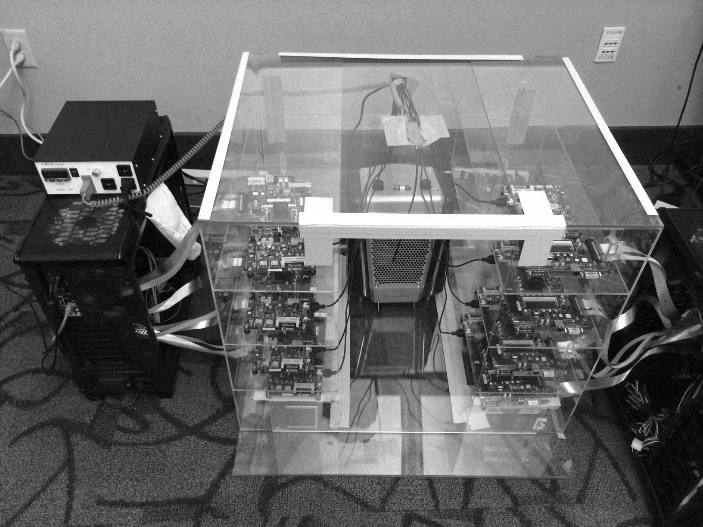
DRAM Testing Infrastructure
Temperature
Controller
FPGAs
Heater
FPGAs
PC
Notes:
This is the photo of our infrastructure, that we built mostly from scratch.
For higher throughput, we employ eight FPGAs, all of which are enclosed in thermally-regulated environment.

Slide 28
Test Pattern
Single cache line test (Read/Write)
time
Write
Access
Verify
Refresh Interval: 64–512ms
Overlapping multiple single cache line tests to simulate power noise and coupling
time
. . .
. . .
. . .
Write
Access
Access
Access
Verify
Verify
Refresh Interval: 64–512ms

Slide 29
Control Factors
Timing parameters
  Sensing: tRCD
  Restore: tRAS (read), tWR(write)
  Precharge: tRP
Temperature: 55 – 85°C
Refresh interval: 64 – 512ms
  Longer refresh interval leads to smaller charge
  Standard refresh interval: 64ms

Slide 30
1. Timings ↔ Charge
Temperature: 85°C/Refresh Interval: 64, 128, 256, 512ms
10⁵
Sensing
Restore
Restore
Precharge
(Read)
(Write)
10⁴
10³
Errors
10²
10
0
More charge enables
more timing parameter reduction

Slide 31
2. Timings ↔ Temperature
Temperature: 55, 65, 75, 85°C/Refresh Interval: 512ms
10⁵
Sensing
Restore
Restore
Precharge
(Read)
(Write)
10⁴
10³
Errors
10²
10
0
Lower temperature enables
more timing parameter reduction

Slide 32
3. Summary of 115 DIMMs
Latency reduction for read & write (55°C)
  Read Latency: 32.7%
  Write Latency: 55.1%
Latency reduction for each timing parameter (55°C)
  Sensing: 17.3%
  Restore: 37.3% (read), 54.8% (write)
  Precharge: 35.2%

Slide 33
1. DRAM Operation Basics
2. Reasons for Timing Margin in DRAM
3. Key Observations
4. Adaptive-Latency DRAM
5. DRAM Characterization
6. Real System Performance Evaluation
Notes:
This is the outline. I will first briefly explain DRAM operation and two reasons of timing margin in DRAM.
Then, we will talk about our three key mechanisms and propose our mechanism, Adaptive-Latency DRAM.
Then, we will provide the DRAM latency characterization results and real system performance evaluation results.
Let me start from DRAM operation.

Slide 34
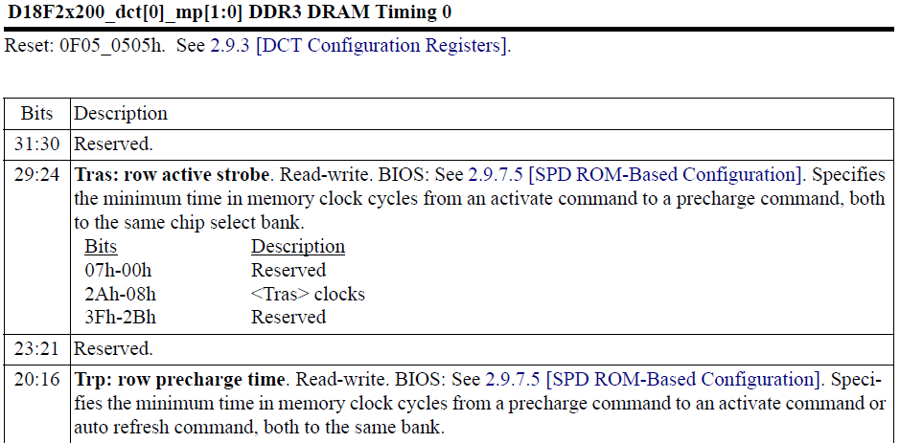
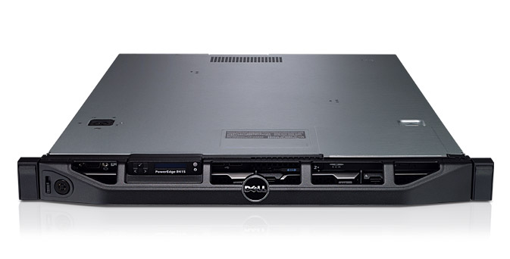
Real System Evaluation Method
System
  CPU: AMD 4386 ( 8 Cores, 3.1GHz, 8MB LLC)
  DRAM: 4GByte DDR3-1600 (800Mhz Clock)
  OS: Linux
  Storage: 128GByte SSD
Workload
  35 applications from SPEC, STREAM, Parsec, Memcached, Apache, GUPS

Slide 35
Single-Core Evaluation
Average
Improvement
6.7%
Performance Improvement
5.0%
1.4%
all-35-workload
AL-DRAM improves performance on a real system

Slide 36
Multi-Core Evaluation
Average
Improvement
14.0%
10.4%
Performance Improvement
2.9%
all-35-workload
AL-DRAM provides higher performance for
multi-programmed & multi-threaded workloads

Slide 37
Conclusion
Observations
  DRAM timing parameters are dictated by the worst-case cell (smallest cell across all products at highest temperature)
  DRAM operates at lower temperature than the worst case
Idea: Adaptive-Latency DRAM
  Optimizes DRAM timing parameters for the common case (typical DIMM operating at low temperatures)
Analysis: Characterization of 115 DIMMs
  Great potential to lower DRAM timing parameters (17 – 54%) without any errors
Real System Performance Evaluation
  Significant performance improvement (14% for memory-intensive workloads) without errors (33 days)
Notes:
Let me conclude
DRAM timing parameters are dictated by the worst case cell.
We propose Adaptive-Latency DRAM that optimizes DRAM timing parameters for common cases
Our characterization shows the significant potential to lower DRAM timing parameters.
Our real system evaluation shows that our mechanism provides significant performance improvement without introducing errors.

Slide 38
Optimizing DRAM Timing for the Common-Case
Adaptive-Latency DRAM
Donghyuk Lee
Yoongu Kim, Gennady Pekhimenko, Samira Khan,
Vivek Seshadri, Kevin Chang, Onur Mutlu
Notes:
Thank you.

Slide 39
Backup Slides

Slide 40
Overhead
DRAM Manufacturer
  Additional tests: can be integrated into existing test process (i.e., TCSR test)
DRAM (DIMM)
  Already have in-DRAM temperature sensor (i.e., Low Power DDR)
  Multiple sets of timing parameters can be stored in SPD (Serial Presence Detect)
System Support for AL-DRAM
  Already have ability to change DRAM timing online

Slide 41
Multiple Timing Parameters
tRAS:
Errors
tRCD:
10.0ns
12.5ns
10.0ns
tRP:
12.5ns
10.0ns
10.0ns
Ref. Interval:
200ms
200ms
200ms
Reducing a timing parameter
➔ Reduces potential reduction of other parameters

Slide 42
Temperature ↔ Refresh Interval
More charge than required
Need for reliable operation from other fail mechanisms (i.e., VRT)
Safety-margin ➔ Safe refresh interval
Maximum error-free refresh interval (ms)
64ms SPEC
55°C
65°C
75°C
85°C
Temperature (°C)
Extra charge that can be used for latency reduction

Slide 43
DRAM Cell Organization
Access transistor
Bitline
Cell capacitor
Bitline capacitor
Sense-amplifier

Slide 44
DRAM Cell Operation
Turn-on access transistor
1
4
Precharged to Vdd/2
Access transistor
Leakage
Bitline
Sense
Cell capacitor
Bitline capacitor
Charge-sharing
Fully charged
3
Amplify
Ready to access data
Precharge
2
Sense-amplifier

Slide 45
DRAM Cell Charge Variations
Typical cell
Worst cell
Fast restore
Slow restore
Worst temp.
Fast leak
Smallest
charge
Slowly
leak
Typical temp.
Largest
charge

