Slide 1
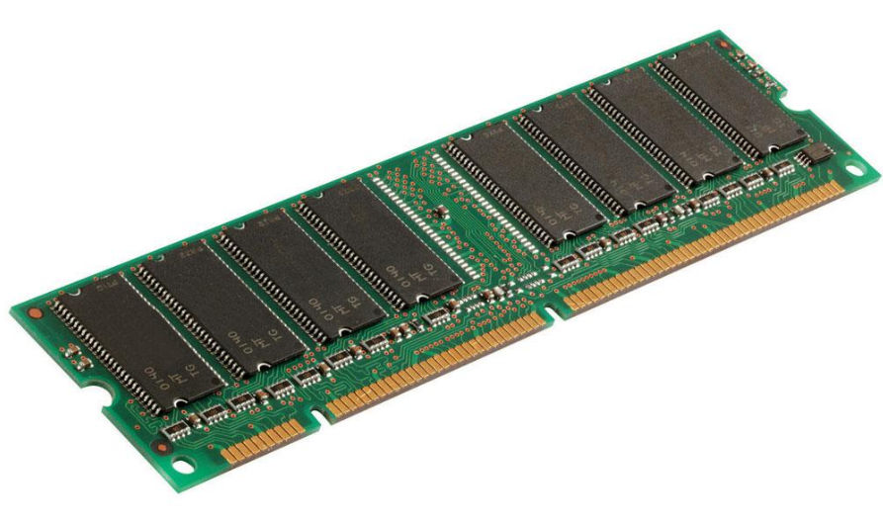
Today, DRAM is just a storage device

Slide 2
Today, DRAM is just a storage device
RowClone: Bulk Data Copy and Initialization Using DRAM
MICRO 2013

Slide 3
Today, DRAM is just a storage device
RowClone: Bulk Data Copy and Initialization Using DRAM
MICRO 2013
Gather-Scatter DRAM: Accelerating Strided Accesses Using DRAM
MICRO 2015

Slide 4
Today, DRAM is just a storage device
RowClone: Bulk Data Copy and Initialization Using DRAM
MICRO 2013
Gather-Scatter DRAM: Accelerating Strided Accesses Using DRAM
MICRO 2015
Ambit: Accelerating Bulk Bitwise Operations Using DRAM
MICRO 2017

Slide 5
Database indices
Search filters
Bulk Bitwise Operations
Database scans
Cryptography
Genome analysis
...

Slide 6
Database indices
Search filters
Bulk Bitwise Operations
Database scans
Cryptography
Genome analysis
...
Processor
Memory
Channel
Throughput of bulk bitwise operations limited
by available memory bandwidth

Slide 7
Ambit
Perform bitwise operations completely inside DRAM chips
Bitwise AND/OR: Simultaneous activation of three rows
Bitwise NOT: Inverters already present in sense amplifiers

Slide 8
Ambit
Perform bitwise operations completely inside DRAM chips
Bitwise AND/OR: Simultaneous activation of three rows
Bitwise NOT: Inverters already present in sense amplifiers
32X
improvement in
raw throughput
35X
reduction in
energy consumed
1% area cost over existing DRAM chips

Slide 9
Ambit
Perform bitwise operations completely inside DRAM chips
Bitwise AND/OR: Simultaneous activation of three rows
Bitwise NOT: Inverters already present in sense amplifiers
32X
improvement in
raw throughput
35X
reduction in
energy consumed
1% area cost over existing DRAM chips
3X-7X
performance improvement
in real-world applications

Slide 10


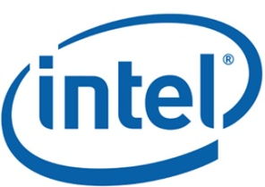


Ambit
In-Memory Accelerator for Bulk Bitwise Operations
Using Commodity DRAM Technology
Vivek Seshadri, Donghyuk Lee, Thomas Mullins, Hasan Hassan, Amirali Boroumand,
Jeremie Kim, Michael A. Kozuch, Onur Mutlu, Phillip B. Gibbons, Todd C. Mowry
Session 3A – Tuesday, 11 AM

