Slide 1
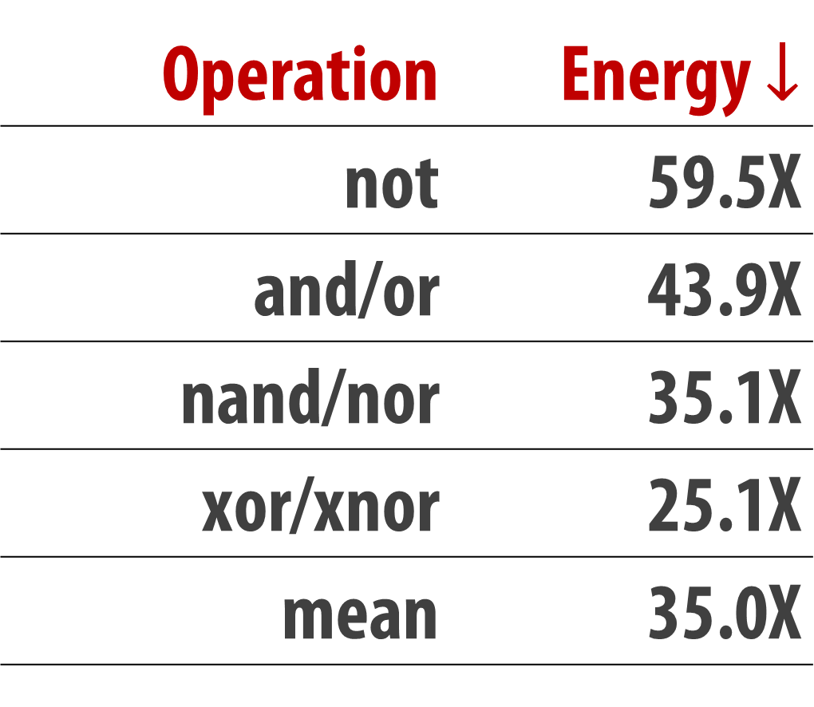
Ambit
In-memory Accelerator for Bulk Bitwise Operations
Using Commodity DRAM Technology
Vivek Seshadri Donghyuk Lee Thomas Mullins Hasan Hassan Amirali Boroumand,
Jeremie Kim Michael A. Kozuch Onur Mutlu Phillip B. Gibbons Todd C. Mowry
Carnegie Mellon University Microsoft Research India NVIDIA Research Intel ETH Zürich
Applications for Bulk Bitwise Operations
Memory Channel Bottleneck
Database indices
Bulk Bitwise Operations
Search filters
Processor
Channel
Memory
Database scans
Cryptography
Limited Bandwidth
High Energy
Genome analysis
...
Our Approach: Perform bitwise operations
completely inside DRAM
[1] Li and Patel, BitWeaving, SIGMOD 2013 [2] Goodwin+, BitFunnel, SIGIR 2017
DRAM Cell + Sense Amp
Ambit AND/OR – Triple-Row Activation (TRA)
Output = AB + BC + CA
C (A or B) + ~C (A and B)
wordline
1
½ V_{DD}
1
½ V_{DD} + δ
1
V_{DD}
capacitor
bitline
A
A
A
access transistor
1
1
1
Designated rows t1, t2, t3 for TRA
Copy data to designated rows
Reserved addresses for reserved rows
  e.g., ACTIVATE reserved address 0
  simultaneous activation of t1, t2, t3
SPICE simulations → TRA highly reliable
B
B
B
enable
Sense Amp
1
1
1
bitline
C
Sense Amp
C
Sense Amp
C
Sense Amp
0
1
enable sense amp
1
Ambit NOT – Dual-Contact Cell
Ambit Energy Savings
activate source
½ V_{DD}
½ V_{DD} + δ
V_{DD}
V_{DD}
Operation | Energy $↓$
not | 59.5X
and/or | 43.9X
nand/nor | 35.1X
xor/xnor | 25.1X
mean | 35.0X
source
data wordline
negation wordline
bitline
activate
n-wordline
dual-contact
cell (DCC)
Sense Amp
enable sense amp
Sense Amp
Sense Amp
Sense Amp
bitline
½ V_{DD}
½ V_{DD}
0
0
DRAM Implementation
Integration with System
Ambit Throughput Improvement
Reserve designated rows in each subarray
Use RowClone to perform data copy
Use separate small row decoder for designated/DCC rows
  Overlap back-to-back activations
  Lower row decoder complexity
Option 1: PCIe device
Option 2: System memory bus
  Same DRAM bus interface
  Avoid CPU-device communication
  CPU Instructions to trigger Ambit
  Existing cache coherence support
Database Bitmap Indices
BitWeaving – Accelerating Database Scans
Number of rows in the database table
Other Applications
Set operations: Ambit better than red-black trees
BitFunnel: accelerating web search document filtering
Cryptography, genome analysis, masked initializations

