Slide 1





Ambit
In-Memory Accelerator for Bulk Bitwise Operations
Using Commodity DRAM Technology
Vivek Seshadri
Donghyuk Lee, Thomas Mullins, Hasan Hassan, Amirali Boroumand, Jeremie Kim, Michael A. Kozuch, Onur Mutlu, Phillip B. Gibbons, Todd C. Mowry

Slide 2
Executive Summary
Problem: Bulk bitwise operations
  present in many applications, e.g., databases, search filters
  existing systems are memory bandwidth limited
Our Proposal: Ambit
  perform bulk bitwise operations completely inside DRAM
  bulk bitwise AND/OR: simultaneous activation of three rows
  bulk bitwise NOT: inverters already in sense amplifiers
  less than 1% area overhead over existing DRAM chips
Results compared to state-of-the-art baseline
  average across seven bulk bitwise operations
    32X performance improvement, 35X energy reduction
  3X-7X performance for real-world data-intensive applications
Notes:
Talk about energy more
Explicitly state the performance improvement numbers
Range for throughput and energy?
Color more? Bulk AND/OR or NOT
Mechanism for NOT – fix the description. (use inverters already in sense amplifiers}?
Cost not coming out – mention the area cost

Slide 3
BitWeaving
(database queries)
Bitmap indices
(database indexing)
BitFunnel
(web search)
Bulk Bitwise Operations
Set operations
DNA
sequence mapping
Encryption algorithms
...
[1] Li and Patel, BitWeaving, SIGMOD 2013
[2] Goodwin+, BitFunnel, SIGIR 2017
Notes:
Add … (signify more applications)
Add references to some works (bitweaving, bitfunnel)

Slide 4
Today, DRAM is just a storage device!
DRAM
Write
Processor
(CPU, GPU, FPGA)
Channel
Read
Throughput of bulk bitwise operations limited by available memory bandwidth

Slide 5
Our Approach
DRAM
Processor
(CPU, GPU, FPGA or PiM)
Channel
Use analog operation of DRAM to perform bitwise operations completely inside memory!

Slide 6
Outline of the talk
1. DRAM Background
2. Ambit-AND-OR: Bitwise AND/OR in DRAM
3. Ambit-NOT: Bitwise NOT in DRAM
4. Ambit Implementation
5. Applications and Evaluation

Slide 7

Inside a DRAM Chip
…
…
…
…
2D Array
of DRAM Cells
…
…
Sense amplifiers
8KB

Slide 8
DRAM Cell Operation
wordline
capacitor
bitline
access transistor
Sense Amp
enable
bitline

Slide 9
DRAM Cell Operation
deviation in bitline voltage
raise wordline
wordline
1
0
V_{DD}
½ V_{DD} + δ
½ V_{DD}
capacitor
bitline
access transistor
connects cell to bitline
cell regains charge
cell loses charge to bitline
Sense Amp
1
0
enable sense amp
enable
bitline
½ V_{DD}
0

Slide 10
Outline of the talk
1. DRAM Background
2. Bitwise AND/OR in DRAM
3. Bitwise NOT in DRAM
4. Ambit Implementation
5. Applications and Evaluation

Slide 11
Triple-Row Activation: Majority Function
1
V_{DD}
½ V_{DD} + δ
0
½ V_{DD}
activate
all three rows
1
0
1
0
Sense Amp
1
0
enable sense amp

Slide 12
Bitwise AND/OR Using Triple-Row Activation
1
V_{DD}
A
1
B
1
C
Sense Amp
1

Slide 13
Bitwise AND/OR Using Triple-Row Activation
1
V_{DD}
A
Output = AB + BC + CA
= C (A OR B) +
~C (A AND B)
1
B
1
Control the value of C to perform bitwise OR or bitwise AND of A and B
C
38X improvement in raw throughput
44X reduction in energy consumption
for bulk bitwise AND/OR operations
Sense Amp
1

Slide 14
Potential Concerns with Triple-Row Activation
With three cells, bitline deviation may not be enough
Process variation: all cells are not equal
Cells leak charge
Memory controller may have to send three addresses
Source data gets destroyed
Spice simulations put these concerns to rest.
(Section 6 in paper)
Address these challenges through implementation
(next slide)
Notes:
*

Slide 15
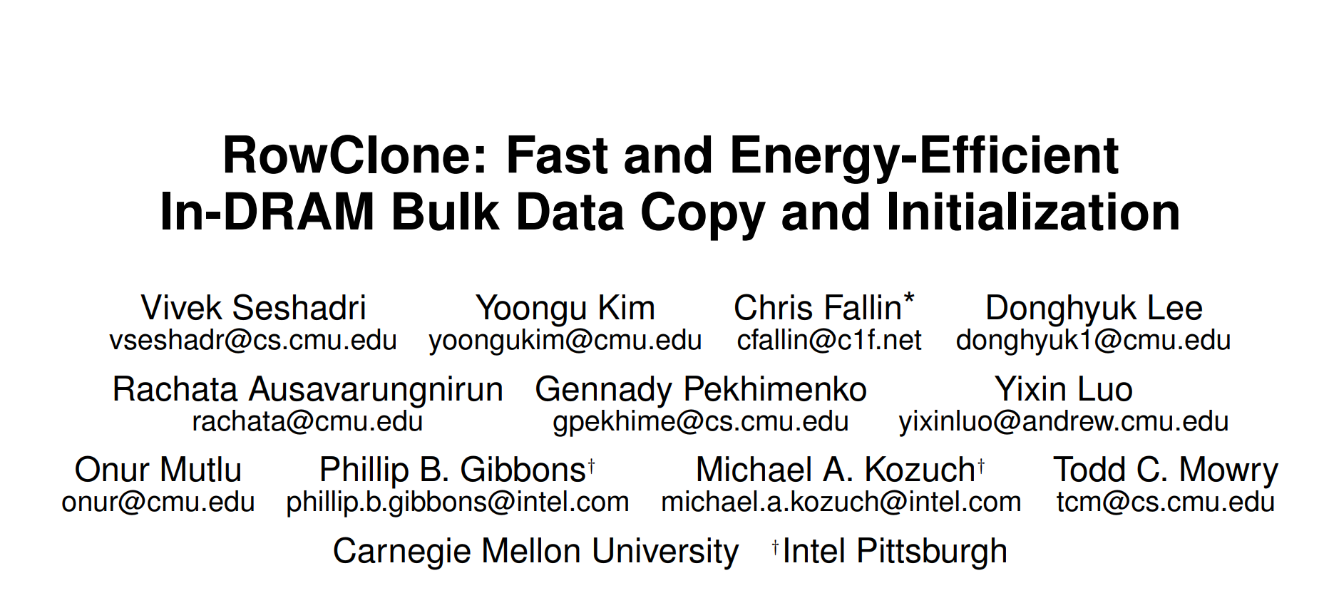
Bulk Bitwise AND/OR in DRAM
Statically reserve three designated rows t1, t2, and t3
Result = row A AND/OR row B
Copy data of row A to row t1
Copy data of row B to row t2
Initialize data of row t3 to 0/1
Activate rows t1/t2/t3 simultaneously
Copy data of row t1/t2/t3 to Result row
Copy data of row A to row t1
Copy data of row B to row t2
Initialize data of row t3 to 0/1
Activate rows t1/t2/t3 simultaneously
Copy data of row t1/t2/t3 to Result row
MICRO 2013
Notes:
* each copy operation takes only 80ns

Slide 16
Bulk Bitwise AND/OR in DRAM
Statically reserve three designated rows t1, t2, and t3
Result = row A AND/OR row B
Copy RowClone data of row A to row t1
Copy RowClone data of row B to row t2
Initialize RowClone data of row t3 to 0/1
Activate rows t1/t2/t3 simultaneously
Copy RowClone data of row t1/t2/t3 to Result row
Copy data of row A to row t1
Copy data of row B to row t2
Initialize data of row t3 to 0/1
Activate rows t1/t2/t3 simultaneously
Copy data of row t1/t2/t3 to Result row
Use RowClone to perform copy and initialization operations completely in DRAM!
Notes:
Replace copies with rowclone once it is mentioned
Tie back to the concerns.
Reiterate speedup numbers
strike copy and make it rowclone

Slide 17
Outline of the talk
1. DRAM Background
2. Bitwise AND/OR in DRAM
3. Bitwise NOT in DRAM
4. Ambit Implementation
5. Applications and Evaluation

Slide 18
Negation Using the Sense Amplifier
Can we copy the negated value from bitline to a DRAM cell?
bitline
Sense Amp
enable
bitline
Notes:
Mark the enable signal to the sense amplifier
Before introducing the dual contact cell, state the key idea

Slide 19
Negation Using the Sense Amplifier
Dual Contact Cell
Regular wordline
Negation wordline
bitline
Sense Amp
enable
bitline
Notes:
Mark the enable signal to the sense amplifier
Before introducing the dual contact cell, state the key idea

Slide 20
Negation Using the Sense Amplifier
V_{DD}
½ V_{DD} + δ
activate source
½ V_{DD}
source
activate
negation wordline
bitline
Sense Amp
enable sense amp
½ V_{DD}
0
bitline
Notes:
Provide the result for NOT
Present all the results after this slide?

Slide 21
Ambit vs. DDR3: Performance and Energy
32X
35X

Slide 22
Outline of the talk
1. DRAM Background
2. Bitwise AND/OR in DRAM
3. Bitwise NOT in DRAM
4. Ambit Implementation
5. Applications and Evaluation

Slide 23
Ambit – Implementation
…
…
…
Regular
Data Rows
Pre-initialized Rows
1
1
1
1
1
1
1
1
0
0
0
0
0
0
0
0
Designated Rows
for Triple Activation
Dual Contact Cells
Sense
Amplifiers
Notes:
Make it clear that this is a subarray
Activate -> activation

Slide 24
Ambit – Implementation
Regular Row Decoder
…
…
…
Regular
Data Rows
Pre-initialized Rows
1
1
1
1
1
1
1
1
0
0
0
0
0
0
0
0
Temporary Rows
for Triple Activate
Bitwise Decoder
Dual Contact Cells
Sense
Amplifiers
Notes:
* Command sequence to perform bitwise AND operation?

Slide 25
Integrating Ambit with the System
PCIe device
  Similar to other accelerators (e.g., GPU)
System memory bus
  Ambit uses the same DRAM command/address interface
Pros and cons discussed in paper (Section 5.4)
Notes:
Make it simpler
Two approaches.

Slide 26
Outline of the talk
1. DRAM Background
2. Bitwise AND/OR in DRAM
3. Bitwise NOT in DRAM
4. Ambit Implementation
5. Applications and Evaluation

Slide 27
Real-world Applications
Methodology (Gem5 simulator)
  Processor: x86, 4 GHz, out-of-order, 64-entry instruction queue
  L1 cache: 32 KB D-cache and 32 KB I-cache, LRU policy
  L2 cache: 2 MB, LRU policy
  Memory controller: FR-FCFS, 8 KB row size
  Main memory: DDR4-2400, 1 channel, 1 rank, 8 bank
Workloads
  Database bitmap indices
  BitWeaving –column scans using bulk bitwise operations
  Set operations – comparing bitvectors with red-black trees
Notes:
Add color
Fix workloads – add set operation workload as well

Slide 28
Bitmap Indices: Performance
6.6X
6.2X
6.3X
5.7X
6.1X
5.4X
Consistent reduction in execution time. 6X on average
Notes:
Add color
Remove “week” and “users”

Slide 29
Speedup offered by Ambit for BitWeaving
select count(*) where c1 < field < c2
Number of rows in the database table
12X
Notes:
Reference bitweaving again
Add color
Fix the tag

Slide 30
Other Details and Results in Paper
Detailed implementation of Ambit
  Changes to DRAM chips
  Optimizations to improve performance
  Error correction codes (open problem)
Detailed SPICE simulation analysis
Comparison to 3D-stacked DRAM
Other applications
  Set operations
  BitFunnel: Web search document filtering
  Masked initialization
  Cryptography
  DNA sequence mapping
Notes:
Add reference to the bitfunnel
Add …
Other details in the paper
Compared to 3D stacking

Slide 31
Conclusion
Problem: Bulk bitwise operations
  present in many applications, e.g., databases, search filters
  existing systems are memory bandwidth limited
Our Proposal: Ambit
  perform bulk bitwise operations completely inside DRAM
  bulk bitwise AND/OR: simultaneous activation of three rows
  bulk bitwise NOT: inverters already in sense amplifiers
  less than 1% area overhead over existing DRAM chips
Results compared to state-of-the-art baseline
  average across seven bulk bitwise operations
    32X performance improvement, 35X energy reduction
  3X-7X performance for real-world data-intensive applications

Slide 32
Ambit
In-Memory Accelerator for Bulk Bitwise Operations
Using Commodity DRAM Technology
Vivek Seshadri
Donghyuk Lee, Thomas Mullins, Hasan Hassan, Amirali Boroumand, Jeremie Kim, Michael A. Kozuch, Onur Mutlu, Phillip B. Gibbons, Todd C. Mowry

Slide 34
Backup Slides

Slide 35
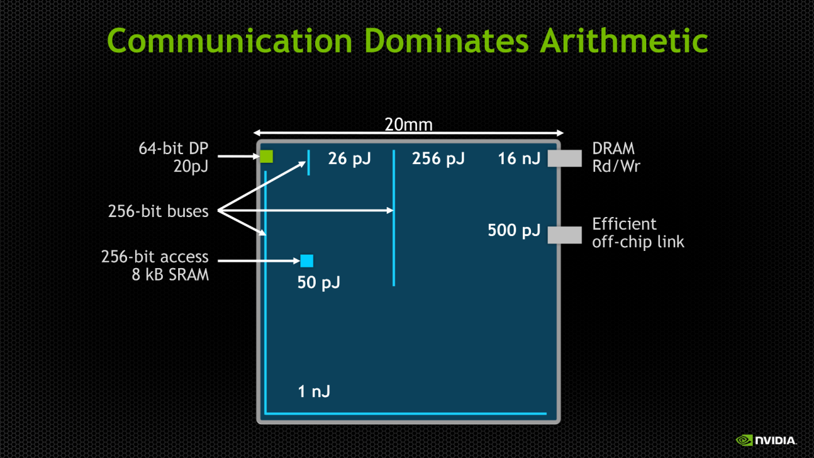
Data movement consumes high energy
src: Bill Dally Keynote, “Challenge for Future Computer Systems,” HIPEAC 2015.

Slide 36
RowClone: In-DRAM Bulk Data Copy (MICRO 2013)
activate
source
1
V_{DD}
½ V_{DD} + δ
0
½ V_{DD}
source
activate
destination
1
0
MICRO 2013
destination
Sense Amp
1
0
enable sense amp
data gets copied source to destination
Notes:
Add MICRO 2013 to the title
Mark source and destination on the slide
Mention the speedup of RowClone mechanism

Slide 37
Today, DRAM is just a storage device!
DRAM
Write (64B)
Processor
Channel
Read (64B)
Can we do more with DRAM?

Slide 38
Ambit – Implementation
Regular Row Decoder
…
…
…
Regular
Data Rows
Pre-initialized Rows
1
1
1
1
1
1
1
1
0
0
0
0
0
0
0
0
Temporary Rows
for Triple Activate
Bitwise Decoder
Reserved
Address 0
Dual Contact Cells
Sense
Amplifiers
Notes:
* Command sequence to perform bitwise AND operation?

Slide 39
Summary of operations
Copy
AND
OR
NOT
…
…
…
…
…
…
Sense amplifiers

Slide 40
Ambit Throughput

Slide 41
Error Correction Code
Need ECC that is homomorphic over bitwise operations
  ECC(A and B) = ECC(A) and ECC(B)
  ECC(A or B) = ECC(A) or ECC(B)
  ECC(not A) = not ECC(A)
Triple Modular Redundancy
  trivially satisfies the above condition
  2X capacity overhead
  Better performance and energy efficiency
  Lower overall cost

