Slide 1




Quantifying and Controlling Impact of Interference at Shared Caches and Main Memory
Application Slowdown Model
Lavanya Subramanian, Vivek Seshadri,
Arnab Ghosh, Samira Khan, Onur Mutlu

Slide 2
Problem:
Interference at Shared Resources
Core
Core
Shared
Cache
Main Memory
Core
Core

Slide 3
Impact of
Shared Resource Interference
gcc (core 1)
mcf (core 1)
Our Goal: Achieve High and Predictable Performance
1. High application slowdowns
2. Unpredictable application slowdowns
Notes:
This graph shows two applications from the SPEC CPU 2006 suite, leslie3d and gcc. These applications are run on either core of a two core system and share main memory. The y-axis shows each application’s slowdown as compared to when the application is run standalone on the same system.
Now, let’s look at leslie3d. It slows down by 2x when run with gcc.
Let’s look at another case when leslie3d is run with another application, mcf. Leslie now slows down by 5.5x, while it slowed down by 2x when run with gcc. Leslie experiences different slowdowns when run with different applications.
More generally, an application’s performance depends on which applications it is running with. Such performance unpredictability is undesirable….

Slide 4
Outline
Quantify Impact of Interference - Slowdown
  Key Observation
  Estimating Cache Access Rate _{Alone}
  ASM: Putting it All Together
  Evaluation
Control Slowdown
  Slowdown-aware Cache Capacity Allocation
  Slowdown-aware Memory Bandwidth Allocation
  Coordinated Cache/Memory Management

Slide 5
Quantifying Impact of
Shared Resource Interference
Alone
(No interference)
time
Execution time
Shared
(With interference)
time
Execution time
Impact of Interference

Slide 6
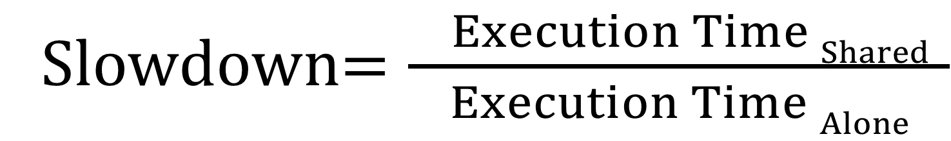
Slowdown: Definition
Slowdown$=\frac{ Execution Time Shared }{Execution Time Alone}$
Notes:
Slowdown of an application is its performance when it is run stand alone on a system to its performance when it is sharing the system with other applications.
An application’s performance when it is sharing the system with other applications can be measured in a straightforward manner. However, measuring an application’s alone performance, without actually running it alone is harder.
This is where are first observation comes in.

Slide 7
Approach: Impact of
Interference on Performance
Alone
(No interference)
time
Execution time
Shared
(With interference)
time
Execution time
Impact of Interference
Our Approach: Estimate impact of interference aggregated over requests
Previous Approach: Estimate impact of interference at a per-request granularity
Difficult to estimate due to request overlap

Slide 8
Outline
Quantify Slowdown
  Key Observation
  Estimating Cache Access Rate _{Alone}
  ASM: Putting it All Together
  Evaluation
Control Slowdown
  Slowdown-aware Cache Capacity Allocation
  Slowdown-aware Memory Bandwidth Allocation
  Coordinated Cache/Memory Management

Slide 9
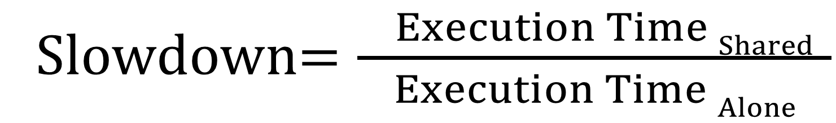
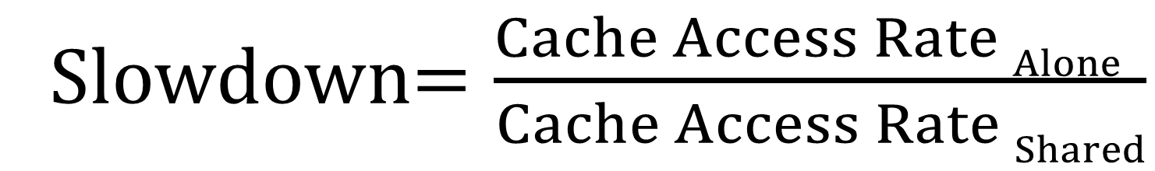
Observation: Shared Cache Access Rate is a Proxy for Performance
Performance ∝ Shared Cache Access rate
Intel Core i5, 4 cores
Difficult
Slowdown$=\frac{Cache Access Rate Alone }{Cache Access Rate Shared}$
Slowdown$=\frac{ Execution Time Shared }{Execution Time Alone}$
Easy
Shared Cache Access Rate _{Alone}
Shared Cache Access Rate _{Shared}

Slide 10
Outline
Quantify Slowdown
  Key Observation
  Estimating Cache Access Rate _{Alone}
  ASM: Putting it All Together
  Evaluation
Control Slowdown
  Slowdown-aware Cache Capacity Allocation
  Slowdown-aware Memory Bandwidth Allocation
  Coordinated Cache/Memory Management

Slide 11
Estimating Cache Access Rate _{Alone}
Core
Core
Shared
Cache
Main Memory
Core
Core
Challenge 2:
Shared cache
capacity interference
Challenge 1:
Main memory
bandwidth interference

Slide 12
Estimating Cache Access Rate _{Alone}
Core
Core
Shared
Cache
Main Memory
Core
Core
Challenge 1:
Main memory
bandwidth interference

Slide 13
Highest Priority Minimizes
Memory Bandwidth Interference
Can minimize impact of main memory interference by giving the application highest priority at the memory controller
(Subramanian et al., HPCA 2013)
Highest priority → Little interference
(almost as if the application were run alone)
Highest priority minimizes interference
Enables estimation of miss service time
(used to account for shared cache interference)
Notes:
We observe that an application’s alone request service rate can be estimated by giving the application highest priority in accessing memory.
Because, when an application has highest priority, it receives little interference from other applications, almost as though the application were run alone.

Slide 14
Estimating Cache Access Rate _{Alone}
Core
Core
Shared
Cache
Main Memory
Core
Core
Challenge 2:
Shared cache
capacity interference

Slide 15
Cache Capacity Contention
Cache
Access Rate
Core
Shared
Cache
Main Memory
Core
Priority
Applications evict each other’s blocks
from the shared cache

Slide 16
Shared Cache Interference is
Hard to Minimize Through Priority
Core
Shared
Cache
Main Memory
Core
Priority
Priority
Many blocks of the blue core
Takes a long time for red core to benefit
from cache priority
Takes effect instantly
Long warmup
Lots of interference to other applications

Slide 17
Our Approach:
Quantify and Remove Cache Interference
Quantify impact of shared cache interference
Remove impact of shared cache interference on CAR_{Alone} estimates

Slide 18
1. Quantify Shared Cache Interference
Cache
Access Rate
Core
Shared
Cache
Main Memory
Core
Priority
Auxiliary Tag Store
Still in auxiliary tag store
Auxiliary Tag Store
Count number of such contention misses

Slide 19
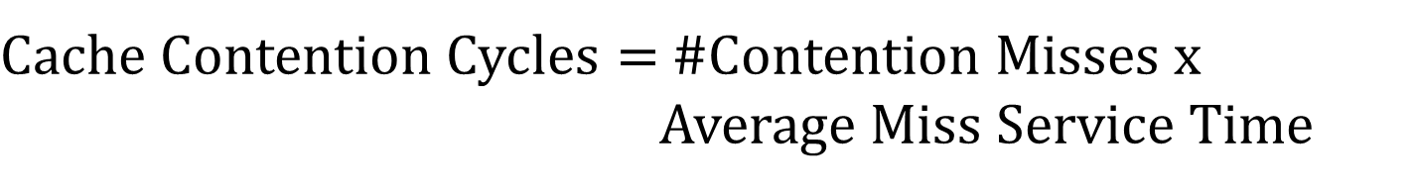
2. Remove Cycles to Serve
Contention Misses from CAR_{Alone} Estimates
$Cache Contention Cycles=$ #Contention Misses x
Average Miss Service Time
From auxiliary tag store
when given high priority
Measured when application is given high priority
Remove cache contention cycles when estimating
Cache Access Rate _{Alone} (CAR _{Alone})

Slide 20
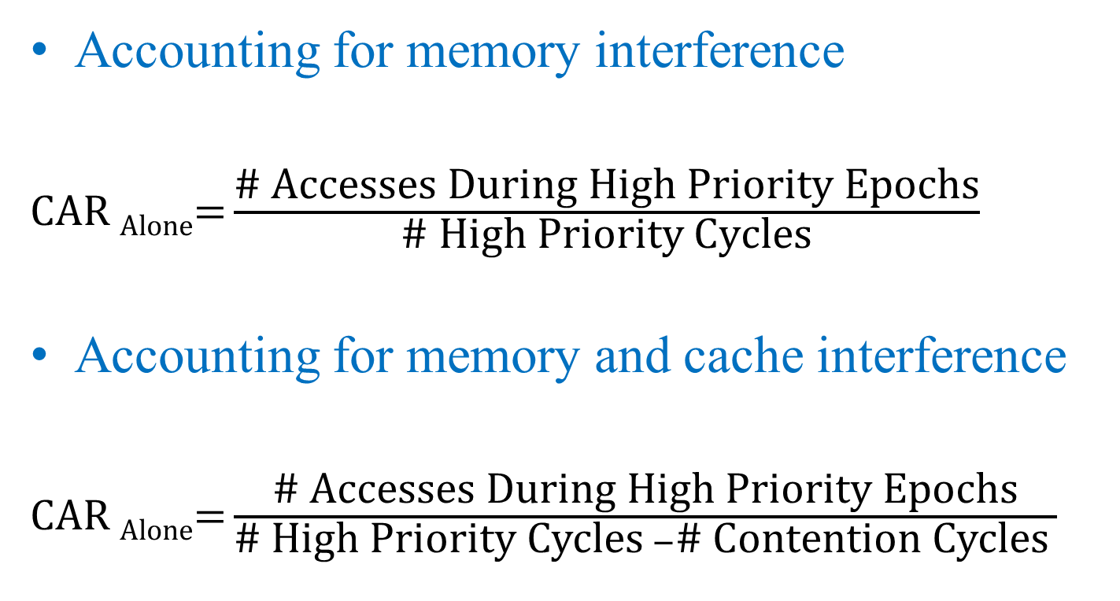
Accounting for Memory and
Shared Cache Interference
Accounting for memory interference
CAR _{Alone}$\text{=}\frac{\text{\# }\text{Accesses} \text{During} \text{High} \text{Priority} \text{Epochs}}{\text{\# }\text{High} \text{Priority} \text{Cycles}}$
Accounting for memory and cache interference
CAR _{Alone}$\text{=}\frac{\text{\# }\text{Accesses} \text{During} \text{High} \text{Priority} \text{Epochs}}{\text{\# }\text{High} \text{Priority} \text{Cycles} −\text{\# }\text{Contention} \text{Cycles} }$

Slide 21
Outline
Quantify Slowdown
  Key Observation
  Estimating Cache Access Rate _{Alone}
  ASM: Putting it All Together
  Evaluation
Control Slowdown
  Slowdown-aware Cache Capacity Allocation
  Slowdown-aware Memory Bandwidth Allocation
  Coordinated Cache/Memory Management

Slide 22
Application Slowdown Model (ASM)
Slowdown$=\frac{Cache Access Rate Alone (CARAlone) }{Cache Access Rate Shared (CARShared) }$

Slide 23
ASM: Interval Based Operation
Interval
Interval
time
Measure CAR_{Shared}
Estimate CAR_{Alone}
Measure CAR_{Shared}
Estimate CAR_{Alone}
Estimate
slowdown
Estimate
slowdown
Notes:
MISE operates on an interval basis.
Execution time is divided into intervals. During an interval, each application’s shared request service rate and alpha are measured.
And alone request service rate is estimated.
At the end of the interval, slowdown is estimated as a function of these three quantities.
This repeats during every interval.
Now, let us look at how each of these quantities is measured/estimated.

Slide 24
A More Accurate and Simple Model
More accurate: Takes into account request overlap behavior
  Implicit through aggregate estimation of cache access rate and miss service time
  Unlike prior works that estimate per-request interference
Simpler hardware: Amenable to set sampling in the auxiliary tag store
  Need to measure only contention miss count
  Unlike prior works that need to know if each request is a contention miss or not

Slide 25
Outline
Quantify Slowdown
  Key Observation
  Estimating Cache Access Rate _{Alone}
  ASM: Putting it All Together
  Evaluation
Control Slowdown
  Slowdown-aware Cache Capacity Allocation
  Slowdown-aware Memory Bandwidth Allocation

Slide 26
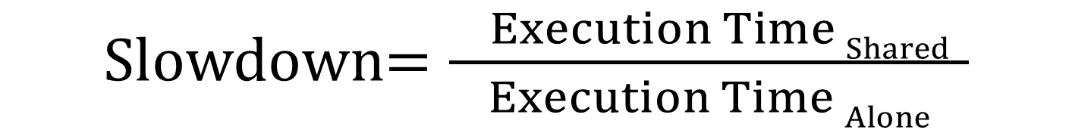
Previous Work on
Slowdown Estimation
Previous work on slowdown estimation
  STFM (Stall Time Fair Memory) Scheduling [Mutlu et al., MICRO ’07]
  FST (Fairness via Source Throttling) [Ebrahimi et al., ASPLOS ’10]
  Per-thread Cycle Accounting [Du Bois et al., HiPEAC ’13]
Basic Idea:
Slowdown$=\frac{ Execution Time Shared }{Execution Time Alone}$
Count interference cycles experienced by each request
Notes:
The most relevant previous works on slowdown estimation are STFM, stall time fair memory scheduling and FST, fairness via source throttling.
FST employs similar mechanisms as STFM for memory-induced slowdown estimation, therefore, I will focus on STFM for the rest of the evaluation.
STFM estimates slowdown as the ratio of alone to shared stall times.
Stall time shared is easy to measure, analogous to shared request service rate
Stall time alone is harder and STFM estimates it by counting the number of cycles an application receives interference from other applications.

Slide 27
Methodology
Configuration of our simulated system
  4 cores
  1 channel, 8 banks/channel
  DDR3 1333 DRAM
  2MB shared cache
Workloads
  SPEC CPU2006 and NAS
  100 multiprogrammed workloads
Notes:
Next, I will quantitatively compare MISE and STFM. Before that, let me present our methodology.
We carry out our evaluations on a 4-core, 1-channel DDR3 1066 DRAM system.
Our workloads are composed of SPEC CPU 2006 applications. We build 300 multiprogrammed workloads from these applications.

Slide 28
Model Accuracy Results
Select applications
Average error of ASM’s slowdown estimates: 10%
Previous models have 29%/40% average error

Slide 29
Outline
Quantify Slowdown
  Key Observation
  Estimating Cache Access Rate _{Alone}
  ASM: Putting it All Together
  Evaluation
Control Slowdown
  Slowdown-aware Cache Capacity Allocation
  Slowdown-aware Memory Bandwidth Allocation
  Coordinated Cache/Memory Management

Slide 30
Outline
Quantify Slowdown
  Key Observation
  Estimating Cache Access Rate _{Alone}
  ASM: Putting it All Together
  Evaluation
Control Slowdown
  Slowdown-aware Cache Capacity Allocation
  Slowdown-aware Memory Bandwidth Allocation
  Coordinated Cache/Memory Management

Slide 31
Cache Capacity Partitioning
Core
Shared
Cache
Main Memory
Core
Previous partitioning schemes mainly focus on miss count reduction
Problem: Does not directly translate to performance and slowdowns

Slide 32
ASM-Cache: Slowdown-aware
Cache Capacity Partitioning
Goal: Achieve high fairness and performance through slowdown-aware cache partitioning
Key Idea: Allocate more cache space to applications whose slowdowns reduce the most with more cache space

Slide 33
Outline
Quantify Slowdown
  Key Observation
  Estimating Cache Access Rate _{Alone}
  ASM: Putting it All Together
  Evaluation
Control Slowdown
  Slowdown-aware Cache Capacity Allocation
  Slowdown-aware Memory Bandwidth Allocation
  Coordinated Cache/Memory Management

Slide 34
Memory Bandwidth Partitioning
Core
Shared
Cache
Main Memory
Core
Goal: Achieve high fairness and performance through slowdown-aware bandwidth partitioning

Slide 35
ASM-Mem: Slowdown-aware
Memory Bandwidth Partitioning
Key Idea: Prioritize an application proportionally to its slowdown
Application i’s requests prioritized at the memory controller for its fraction

Slide 36
Outline
Quantify Slowdown
  Key Observation
  Estimating Cache Access Rate _{Alone}
  ASM: Putting it All Together
  Evaluation
Control Slowdown
  Slowdown-aware Cache Capacity Allocation
  Slowdown-aware Memory Bandwidth Allocation
  Coordinated Cache/Memory Management

Slide 37
Coordinated Resource
Allocation Schemes
Cache capacity-aware
bandwidth allocation
Core
Core
Core
Core
Core
Core
Core
Core
Shared
Cache
Main Memory
Core
Core
Core
Core
Core
Core
Core
Core
1. Employ ASM-Cache to partition cache capacity
2. Drive ASM-Mem with slowdowns from ASM-Cache

Slide 38
Fairness and Performance Results
16-core system 100 workloads
14%/8% unfairness reduction on 1/2 channel systems compared to PARBS+UCP with similar performance

Slide 39
Other Results in the Paper
Distribution of slowdown estimation error
Sensitivity to system parameters
  Core count, memory channel count, cache size
Sensitivity to model parameters
Impact of prefetching
Case study showing ASM’s potential for providing slowdown guarantees

Slide 40
Summary
Problem: Uncontrolled memory interference cause high and unpredictable application slowdowns
Goal: Quantify and control slowdowns
Key Contribution:
  ASM: An accurate slowdown estimation model
  Average error of ASM: 10%
Key Ideas:
  Shared cache access rate is a proxy for performance
  Cache Access Rate _{Alone} can be estimated by minimizing memory interference and quantifying cache interference
Applications of Our Model
  Slowdown-aware cache and memory management to achieve high performance, fairness and performance guarantees
Source Code Release by January 2016

Slide 41
Quantifying and Controlling Impact of Interference at Shared Caches and Main Memory
Application Slowdown Model
Lavanya Subramanian, Vivek Seshadri,
Arnab Ghosh, Samira Khan, Onur Mutlu

Slide 42
Backup

Slide 43
Highest Priority Minimizes
Memory Bandwidth Interference
1. Run alone
Time units
Service order
Request Buffer State
Main Memory
3
2
1
Main Memory
2. Run with another application
Time units
Service order
Request Buffer State
Main Memory
3
2
1
Main Memory
3. Run with another application: highest priority
Time units
Service order
Request Buffer State
Main Memory
3
2
1
Main Memory
Notes:
Here is an example.
An application, let’s call it the red application, is run by itself on a system. Two of its requests are queued at the memory controller request buffers. Since these are the only two requests queued up for main memory at this point, the memory controller schedules them back to back and they are serviced in two time units.
Now, the red application is run with another application, the blue application. The blue application’s request makes its way between two of the red application’s requests. A naïve memory scheduler could potentially schedule the requests in the order in which they arrived, delaying the red application’s second request by one time unit, as compared to when the application was run alone.
Next, let’s consider running the red and blue applications together, but give the red application highest priority. In this case, the memory scheduler schedules the two requests of the red application back to back, servicing them in two time units. Therefore, when the red application is given highest priority, its requests are serviced as though the application were run alone.

Slide 44
Accounting for Queueing
A cycles is a queueing cycle if
  a request from the highest priority application is outstanding and
  the previously scheduled request was from another application
CAR _{Alone}$\text{=}\frac{\text{\# }\text{Accesses} \text{During} \text{High} \text{Priority} \text{Epochs}}{\text{\# }\text{High} \text{Priority} \text{Cycles} −\text{\# }\text{Contention} \text{Cycles} −\text{\#}\text{Queueing} \text{Cycles}}$

Slide 45
Impact of Cache Capacity Contention
Shared Main Memory
Shared Main Memory and Caches
Cache capacity interference causes high application slowdowns

Slide 46
Error with No Sampling

Slide 47
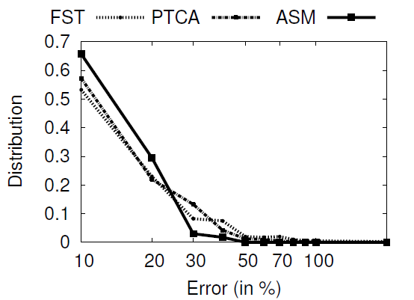
Error Distribution

Slide 48
Miss Service Time Distributions

Slide 49
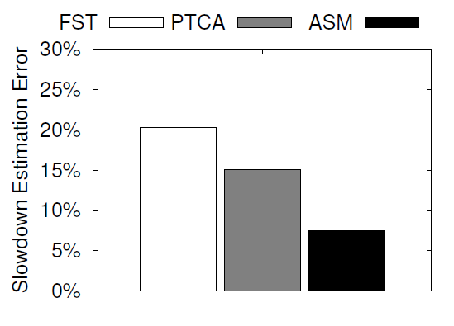
Impact of Prefetching

Slide 50
Sensitivity to
Epoch and Quantum Lengths

Slide 51
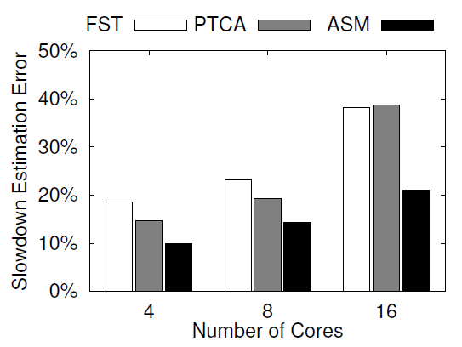
Sensitivity to Core Count

Slide 52
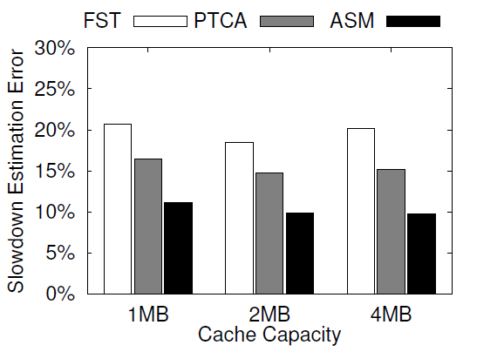
Sensitivity to Cache Capacity

Slide 53
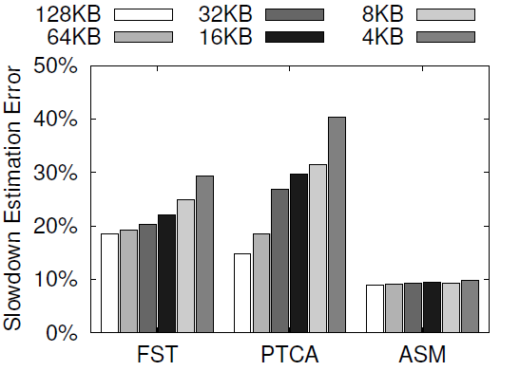
Sensitivity to
Auxiliary Tag Store Sampling

Slide 54
ASM-Cache:
Fairness and Performance Results
Significant fairness benefits across different systems

Slide 55
ASM-Cache:
Fairness and Performance Results

Slide 56
ASM-Mem:
Fairness and Performance Results
Significant fairness benefits across different systems

Slide 57
ASM-QoS: Meeting Slowdown Bounds

Slide 58
Previous Approach: Estimate Interference Experienced Per-Request
Shared
(With interference)
time
Execution time
Req A
Req B
Req C
Request Overlap Makes Interference Estimation Per-Request Difficult

Slide 59
Estimating Performance_{Alone}
Shared
(With interference)
Execution time
Req A
Req B
Request Queued
Req C
Request Served
Difficult to estimate impact of interference per-request due to request overlap

Slide 60
Impact of Interference on Performance
Alone
(No interference)
time
Execution time
Shared
(With interference)
time
Execution time
Impact of Interference
Previous Approach: Estimate impact of interference at a per-request granularity
Difficult to estimate due to request overlap

