Slide 1
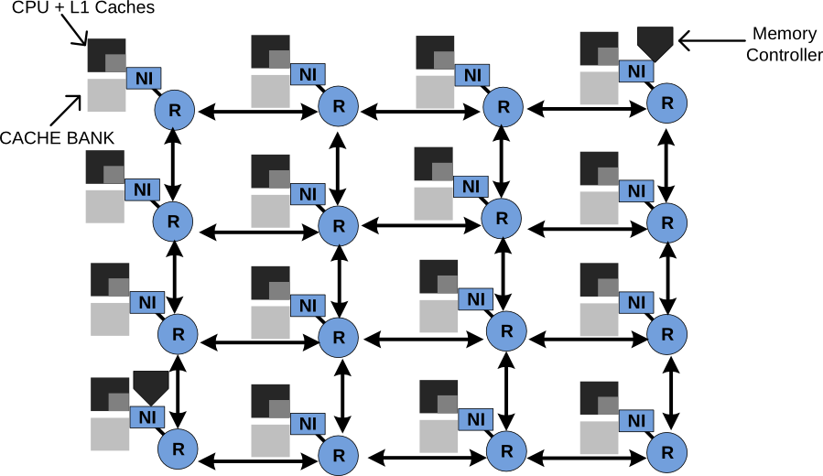
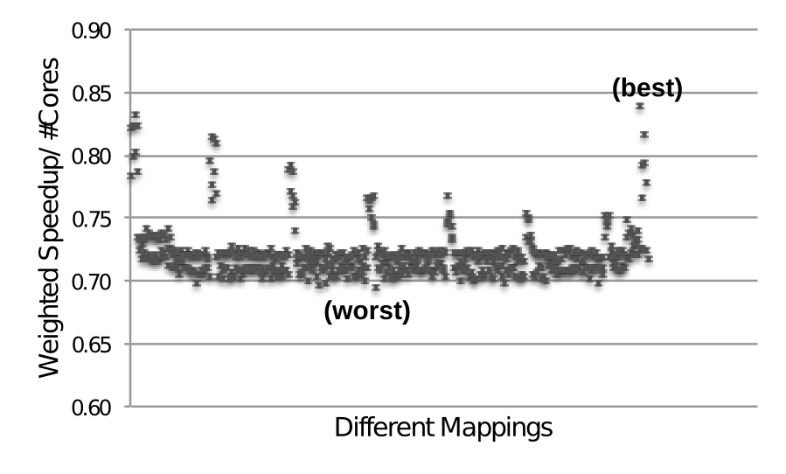
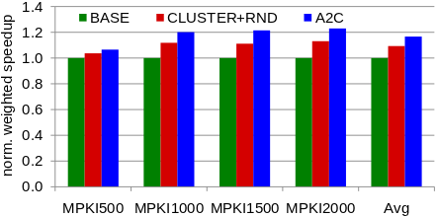
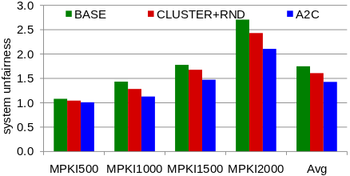
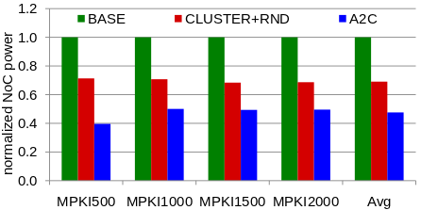
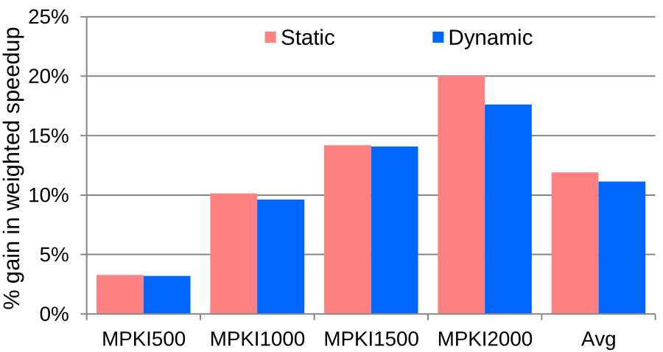
Application-to-Core Mapping Policies to
Reduce Memory Interference in Multi-Core Systems
Reetuparna Das§ Rachata Ausavarungnirun† Onur Mutlu† Akhilesh Kumar‡ Mani Azimi‡
Background and Problems
§University of Michigan †Carnegie Mellon University ‡Intel Labs
Network-on-chip
Problems
Current operating systems are unaware of:
  On-chip interconnect topology
  Application interference characteristics
Unaware of the location of the memory controller
System performance varies with different mappings
Unbalanced Network Load
Our Solution
Key insights
Application-to-Core Mapping Policy
1
Network and memory load are not balanced across the network
Overall performance degrades when applications that interfere significantly with each other get mapped to closeby cores
Some applications benefit significantly from being mapped close to a shared resource
1
Clustering: A sub-network where applications mapped to a cluster
predominantly access resources within that same cluster
Mapping policy across clusters:
- Equally divides the network load among clusters
- Protects interference-sensitive applications from others by assigning them
their own cluster
Mapping policy within a cluster: Maps network-intensive and interference-
sensitive applications close to the memory controller
Dynamically migrate applications between cores
2
2
3
Identifying Sensitive Applications
3
Stall Time per Miss (STPM): average number of cycles a core is stalled because of a cache miss
Applications with high STPM are interference-sensitive
L1 Misses per Thousand Instruction (MPKI)
Applications with high MPKI are network-intensive
Sensitive applications are applications with high STPM and high MPKI
4
Balanced Mapping with Reduced Interference
Radial Inter-cluster Mapping
Key Results
Methodology
Results
Three systems:
Baseline with random mapping (BASE),
Random mapping of applications to cores (CLUSTER+RND)
Our final system with application-to-core (A2C)
Number of Cores | 60
L1 Cache | 32KB per core. 4 ways, 2-cycle latency
L2 Cache | 256KB per core, 16 ways, 6-cycle latency
MSHR | 32 entries
Main Memory | 4GB. 160-cycle latency 4 channels at 16GB/s
Network Router | 4 VCs per port, 4 flits per VC 2-stage wormhole
Network Topology | 8x8 mesh, 128 bit bi-directional links
Memory Management | 4KB physical and virtual page 512 entries TLB CLOCK page allocation and replacement
Performance
Fairness
NoC Power
Static A2C vs Dynamic A2C

