Slide 1
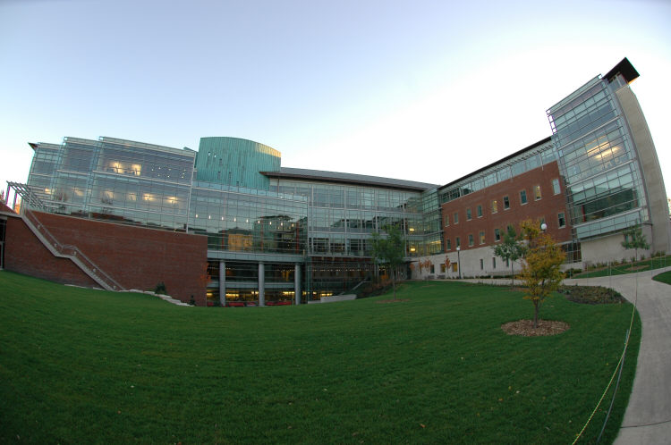
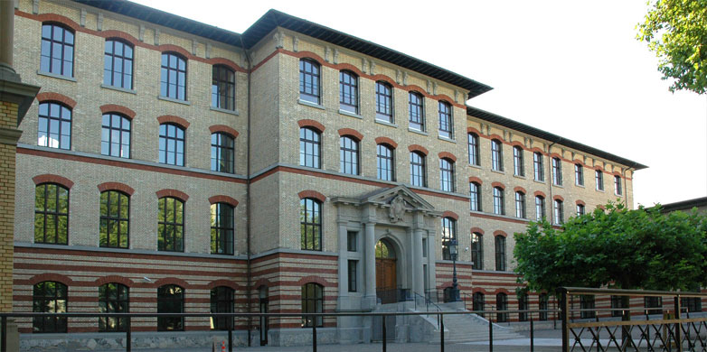
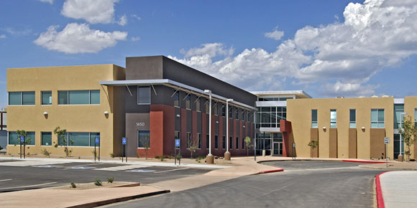


Automatic Generation of Warp-Level Primitives and Atomic Instruction for Fast and Portable Parallel Reduction on GPU
Simon Garcia De Gonzalo and Sitao Huang (University of Illinois at Urbana–Champaign),
Juan Gomez-Luna (Swiss Federal Institute of Technology(ETH) Zurich), Simon Hammond (Sandia National Laboratories),
Onur Mutlu (Swiss Federal Institute of Technology (ETH) Zurich), Wen-mei Hwu (University of Illinois at Urbana–Champaign)

Slide 2
Motivation
HPC and Cloud is heavily dominated by Graphics Processing Units.
GPU programing strategies:
  APIs: CUDA, OpenCL
  Libraries: Thrust, CUB
  High-level frameworks: Kokkos, Raja, Tangram
  DSLs: Halide, Lift, Pencil
All of the above need to deal with GPU performance portability
  Implementation of atomic operations
  Evolving Instruction set architecture (ISA)
Low-level architecture differences have a direct effect on what software algorithm is optimal for a particular problem.

Slide 3
Tangram
Kernel Synthesis framework for Performance Portable Programming
  Provide representations for SIMD utilization (Vector primitive)
  Provide an architectural hierarchy model to guide composition
  Exhaustive space exploration, tuning parameters
  Targets multiple backend

Slide 4
The Problem: Parallel Reduction
Fundamental building block
  Histogram
  Scan
  and many more
Performance is heavily depends on hand-written code that takes advantage of the latest hardware improvements

Slide 5
Current Approaches
Library developers:
  Constantly adapting and upgrading
  Backward compatible by preserving previous implementations
    An ever expanding code-base
Kokkos and Raja:
  In-house or third-party library (Hand written)
DSLs:
  Abstraction for low level GPU instruction
  Single source code different optimization (Tiling, unrolling, etc..)
  Lack support for atomics operaton on different memory spaces (Global vs Shared)

Slide 6
Contributions
Addition of new Tangram extensions and AST transformations
Automatic generation of:
  Global memory atomics
  Shared memory atomics
  Warp-shuffle instruction
Compare against other approaches:
  Hand-written (Nvidia CUB)
  High-Level frameworks (Kokkos)
  OpenMP 4.0

Slide 7
Tangram: Parallel Reduction
1 __codelet
2 int sum(const Array<1,int> in) {
3 unsigned len = in.Size();
4 int accum = 0;
5 for(unsigned i=0; i < len; in.Stride()) {
6 accum += in[i];
7 }
8 return accum;
9 }
1 __codelet
2 int sum(const Array<1,int> in) {
3 Vector vthread();
4 __shared int partial[vthread.MaxSize()];
5 __shared int tmp[in.Size()];
6 int val = 0;
7 val = (vthread.ThreadId() < in.Size()) ? in[vthread.ThreadId()] : 0;
8 tmp[vthread.ThreadId()] = val;
9 for(int offset = vthread.MaxSize()/2; offset > 0; offset /= 2){
10 val += (vthread.LaneId() + offset < vthread.Size()) ?
11 tmp[vthread.ThreadId()+offset] : 0;
12 tmp[vthread.ThreadId()] = val;
13 }
14 if(in.Size() != vthread.MaxSize() && in.Size()/vthread.MaxSize() > 0){
15 if(vthread.LaneId() == 0)
16 partial[vthread.VectorId()] = val;
17 if(vthread.VectorId() == 0){
18 val = (vthread.ThreadId() <= (in.Size() / vthread.MaxSize())) ?
19 partial[vthread.LaneId()] : 0;
20 for(int offset = vthread.MaxSize()/2; offset > 0; offset /= 2){
21 val += (vthread.LaneId() + offset < vthread.Size()) ?
22 partial[vthread.ThreadId()+offset] : 0;
23 partial[vthread.ThreadId()] = val;
24 }
25 }
26 }
27 return val;
28 }
11
13
15
0
1
2
3
4
5
6
7
10
12
14
8
9
+
+
10
20
26
22
24
14
13
15
4
6
8
4
5
6
7
12
(a) Atomic autonomous codelet
+
+
12
16
12
15
10
12
44
48
36
39
26
28
14
6
7
15
1 __codelet
2 int sum(const Array<1,int> in) {
3 __tunable unsigned p;
4 unsigned len = in.Size();
5 unsigned tile = (len+p-1)/p;
6 Sequence start(…);
7 Sequence end(…);
8 Sequence inc(…)
9 Map map( sum, partition(in, p, start, inc, end));
10 map.atomicAdd();
11 return sum(map);
12 }
+
+
28
13
28
27
25
22
18
29
92
15
84
75
65
54
7
42
92
28
+
120
92
Tiled:
Strided:
(b) Compound codelet
(c) Atomic cooperative codelet
Tangram Reduction Codelets

Slide 8
Distribution
Architecture Hierarchy
Grid
Tiled
Strided
Tiled
Strided
Tiled
Tiled
Compute
…
Scalar
Parallel
…
Block
Scalar
Parallel
Thread

Slide 9
Distribution
Architecture Hierarchy
Grid
Tiled
Strided
Tiled
Strided
Compute
Tiled
Scalar
Parallel
…
Block
Tiled
Thread
Scalar
Parallel
…

Slide 10
Distribution
Architecture Hierarchy
Grid
Grid
Tiled
Strided
Tiled
Strided
Compute
Tiled
…
Block
Scalar
Parallel
Block
Tiled
Thread
Thread
Scalar
Parallel
…
2nd Kernel

Slide 11
Distribution
Architecture Hierarchy
Grid
Tiled
Strided
Strided
Compute
Tiled
Scalar
Parallel
…
Block
Tiled
Tiled
Kernel 2
Grid
Tiled
Parallel
Block
Thread
Scalar
Thread
Scalar
Parallel
…

Slide 12
Distribution
Architecture Hierarchy
Grid
Tiled
Strided
Tiled
Compute
Tiled
Scalar
Parallel
…
Block
Strided
Tiled
Tiled
Kernel 2
Kernel 2
Grid
Tiled
Block
Thread
Tiled
Parallel
Parallel
Scalar
Thread
Scalar
Scalar
Scalar
Parallel
…
Parallel

Slide 13
Distribution
Architecture Hierarchy
Grid
Tiled
Strided
Tiled
Compute
Tiled
Scalar
Parallel
…
Block
Strided
Tiled
Kernel 2
Tiled
Kernel 2
Grid
Tiled
Block
Thread
Tiled
Parallel
Strided
Parallel
Scalar
Scalar
Thread
Scalar
Scalar
Parallel
…
Parallel

Slide 14
Distribution
Architecture Hierarchy
Grid
Tiled
Strided
Tiled
Compute
Tiled
Scalar
Parallel
…
Block
Parallel
…
Tiled
Tiled
Parallel
Kernel 2
Tiled
Kernel 2
Kernel 2
Grid
Tiled
Parallel
Block
Thread
Tiled
Parallel
Strided
Parallel
Scalar
Scalar
Thread

Slide 15
Distribution
Architecture Hierarchy
Grid
Tiled
Strided
Tiled
Compute
Tiled
Scalar
Parallel
…
Block
Parallel
…
Tiled
Kernel 2
Tiled
Kernel 2
Tiled
Kernel 2
Parallel
Grid
Tiled
Block
Thread
Tiled
Parallel
Strided
Parallel
Parallel
Scalar
Scalar
Thread

Slide 16
GPU ISA and Microarchitecture Support
Fermi (2010)
Kepler(2012)
Maxwell (2014)
Pascal (2016)
Fast Global memory Atomics
Warp Shuffle instructions
Fast Share memory atomics
Wider type support for atomics operation
Scope for atomics

Slide 17
1 __codelet
2 int sum(const Array<1,int> in) {
3 unsigned len = in.Size();
4 int accum = 0;
5 for(unsigned i=0; i < len; in.Stride()) {
6 accum += in[i];
7 }
8 return accum;
9 }
1 __codelet
2 int sum(const Array<1,int> in) {
3 Vector vthread();
4 __shared int partial[vthread.MaxSize()];
5 __shared int tmp[in.Size()];
6 int val = 0;
7 val = (vthread.ThreadId() < in.Size()) ? in[vthread.ThreadId()] : 0;
8 tmp[vthread.ThreadId()] = val;
9 for(int offset = vthread.MaxSize()/2; offset > 0; offset /= 2){
10 val += (vthread.LaneId() + offset < vthread.Size()) ?
11 tmp[vthread.ThreadId()+offset] : 0;
12 tmp[vthread.ThreadId()] = val;
13 }
14 if(in.Size() != vthread.MaxSize() && in.Size()/vthread.MaxSize() > 0){
15 if(vthread.LaneId() == 0)
16 partial[vthread.VectorId()] = val;
17 if(vthread.VectorId() == 0){
18 val = (vthread.ThreadId() <= (in.Size() / vthread.MaxSize())) ?
19 partial[vthread.LaneId()] : 0;
20 for(int offset = vthread.MaxSize()/2; offset > 0; offset /= 2){
21 val += (vthread.LaneId() + offset < vthread.Size()) ?
22 partial[vthread.ThreadId()+offset] : 0;
23 partial[vthread.ThreadId()] = val;
24 }
25 }
26 }
27 return val;
28 }
11
13
15
0
1
2
3
4
5
6
7
10
12
14
8
9
+
+
10
20
26
22
24
14
13
15
4
6
8
4
5
6
7
12
(a) Atomic autonomous codelet
+
+
12
16
12
15
10
12
44
48
36
39
26
28
14
6
7
15
1 __codelet
2 int sum(const Array<1,int> in) {
3 __tunable unsigned p;
4 unsigned len = in.Size();
5 unsigned tile = (len+p-1)/p;
6 Sequence start(…);
7 Sequence end(…);
8 Sequence inc(…)
9 Map map( sum, partition(in, p, start, inc, end));
10 map.atomicAdd();
11 return sum(map);
12 }
+
+
28
13
28
27
25
22
18
29
92
15
84
75
65
54
7
42
92
28
+
120
92
Tiled:
Strided:
(b) Compound codelet
(c) Atomic cooperative codelet
Tangram Reduction Codelets

Slide 18
Global Memory Atomics
1 __codelet
2 int sum(const Array<1,int> in) {
3 __tunable unsigned p;
4 unsigned len = in.Size();
5 unsigned tile = (len+p-1)/p;
6 Sequence start(…);
7 Sequence end(…);
8 Sequence inc(…)
9 Map map( sum, partition(in, p, start, inc, end));
10 map.atomicAdd();
11 return sum(map);
12 }
Tiled:
Strided:
(b) Compound codelet

Slide 19
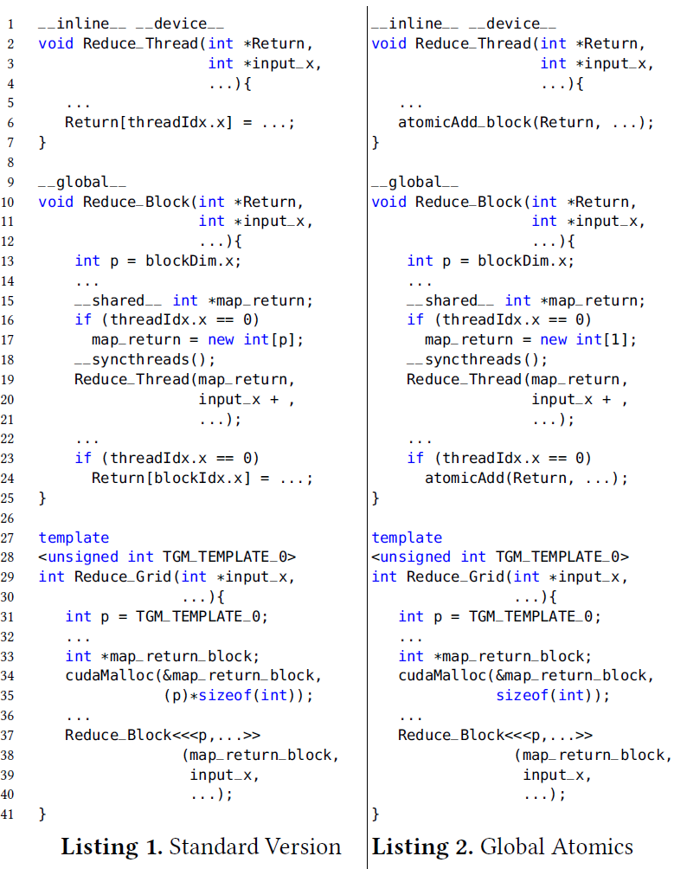
Global Memory Atomics
1 __codelet
2 int sum(const Array<1,int> in) {
3 __tunable unsigned p;
4 unsigned len = in.Size();
5 unsigned tile = (len+p-1)/p;
6 Sequence start(…);
7 Sequence end(…);
8 Sequence inc(…)
9 Map map( sum, partition(in, p, start, inc, end));
10 map.atomicAdd();
11 return sum(map);
12 }
Thread
Tiled:
Block
Strided:
(b) Compound codelet
Grid

Slide 20
Global Memory Atomics
1 __codelet
2 int sum(const Array<1,int> in) {
3 __tunable unsigned p;
4 unsigned len = in.Size();
5 unsigned tile = (len+p-1)/p;
6 Sequence start(…);
7 Sequence end(…);
8 Sequence inc(…)
9 Map map( sum, partition(in, p, start, inc, end));
10 map.atomicAdd();
11 return sum(map);
12 }
Thread
Tiled:
Block
Strided:
(b) Compound codelet
map.atomcAdd()
Grid

Slide 21
Distribution
Architecture Hierarchy
Grid
Tiled
Strided
Tiled
Strided
Tiled
Tiled
Compute
…
Scalar
Parallel
…
Block
Scalar
Parallel
Thread

Slide 22
Distribution
Architecture Hierarchy
Grid
Tiled
Strided
Tiled
Strided
Tiled
Tiled
Strided Read
Strided Read
Strided Read
Tiled Read
Strided Read
Tiled Read
Tiled Read
Tiled Read
Atomic Write
Atomic Write
Atomic Write
Atomic Write
Atomic Write
Atomic Write
Atomic Write
Atomic Write
Compute
Block
…
…
Parallel
…
Scalar
Parallel
Scalar
Parallel
Thread

Slide 23
Distribution
Architecture Hierarchy
Grid
Tiled
Tiled
Strided
Tiled
Tiled
Tiled Read
Strided Read
Strided Read
Strided Read
Tiled Read
Strided Read
Tiled Read
Tiled Read
Atomic Write
Atomic Write
Atomic Write
Atomic Write
Atomic Write
Atomic Write
Atomic Write
Atomic Write
Compute
Block
…
Strided
Parallel
…
Scalar
Parallel
Thread
Scalar
Parallel
…

Slide 24
Distribution
Architecture Hierarchy
Grid
Tiled
Tiled
Strided
Tiled
Tiled
Tiled Read
Strided Read
Strided Read
Strided Read
Tiled Read
Strided Read
Tiled Read
Tiled Read
Atomic Write
Atomic Write
Atomic Write
Atomic Write
Atomic Write
Atomic Write
Atomic Write
Atomic Write
Compute
Block
…
Strided
Parallel
…
Scalar
Parallel
Thread
Tiled_{Atomic}
Grid
Tiled_{Atomic}
Block
Scalar
Strided
Strided
Parallel
Parallel
Scalar
Thread
Scalar
Parallel
…

Slide 25
Distribution
Architecture Hierarchy
Grid
Tiled
Tiled
Strided
Tiled
Tiled
Strided Read
Strided Read
Tiled Read
Strided Read
Tiled Read
Tiled Read
Atomic Write
Atomic Write
Atomic Write
Atomic Write
Atomic Write
Atomic Write
Compute
Block
Strided Read
…
Parallel
…
Scalar
Parallel
Atomic Write
Thread
Tiled
Tiled_{Atomic}
Tiled
Kernel 2
Grid
Kernel 2
Strided_{Atomic}
Block
Scalar
Strided
Parallel
Strided_{Atomic}
Scalar
Thread
Scalar
Scalar

Slide 26
Distribution
Architecture Hierarchy
Grid
Tiled
Tiled
Strided
Tiled
Tiled Read
Strided Read
Strided Read
Tiled Read
Strided Read
Tiled Read
Atomic Write
Atomic Write
Atomic Write
Atomic Write
Atomic Write
Atomic Write
Compute
Block
Strided Read
…
Parallel
…
Scalar
Parallel
Atomic Write
Thread
Tiled_{Atomic}
Tiled_{Atomic}
Tiled
Kernel 2
Tiled_{Atomic}
Grid
Kernel 2
Strided_{Atomic}
Block
Scalar
Strided
Parallel
Strided_{Atomic}
Strided_{Atomic}
Scalar
Thread
Scalar
Scalar
Scalar

Slide 27
Distribution
Architecture Hierarchy
Grid
Tiled
Tiled
Strided
Tiled
Tiled Read
Strided Read
Strided Read
Tiled Read
Strided Read
Tiled Read
Atomic Write
Atomic Write
Atomic Write
Atomic Write
Atomic Write
Atomic Write
Compute
Block
…
Parallel
…
Scalar
Parallel
Thread
Tiled_{Atomic}
Tiled
Kernel 2
Tiled_{Atomic}
Tiled_{Atomic}
Grid
Kernel 2
Strided
Parallel
Strided_{Atomic}
Strided_{Atomic}
Parallel
Block
Scalar
Scalar
Scalar
Thread

Slide 28
GPU ISA and Microarchitecture Support
Fermi (2010)
Kepler(2012)
Maxwell (2014)
Pascal (2016)
Fast Global memory Atomics
Warp Shuffle instructions
Fast Share memory atomics
Wider type support for atomics operation
Scope for atomics

Slide 29
1 __codelet
2 int sum(const Array<1,int> in) {
3 unsigned len = in.Size();
4 int accum = 0;
5 for(unsigned i=0; i < len; in.Stride()) {
6 accum += in[i];
7 }
8 return accum;
9 }
1 __codelet
2 int sum(const Array<1,int> in) {
3 Vector vthread();
4 __shared int partial[vthread.MaxSize()];
5 __shared int tmp[in.Size()];
6 int val = 0;
7 val = (vthread.ThreadId() < in.Size()) ? in[vthread.ThreadId()] : 0;
8 tmp[vthread.ThreadId()] = val;
9 for(int offset = vthread.MaxSize()/2; offset > 0; offset /= 2){
10 val += (vthread.LaneId() + offset < vthread.Size()) ?
11 tmp[vthread.ThreadId()+offset] : 0;
12 tmp[vthread.ThreadId()] = val;
13 }
14 if(in.Size() != vthread.MaxSize() && in.Size()/vthread.MaxSize() > 0){
15 if(vthread.LaneId() == 0)
16 partial[vthread.VectorId()] = val;
17 if(vthread.VectorId() == 0){
18 val = (vthread.ThreadId() <= (in.Size() / vthread.MaxSize())) ?
19 partial[vthread.LaneId()] : 0;
20 for(int offset = vthread.MaxSize()/2; offset > 0; offset /= 2){
21 val += (vthread.LaneId() + offset < vthread.Size()) ?
22 partial[vthread.ThreadId()+offset] : 0;
23 partial[vthread.ThreadId()] = val;
24 }
25 }
26 }
27 return val;
28 }
11
13
15
0
1
2
3
4
5
6
7
10
12
14
8
9
+
+
10
20
26
22
24
14
13
15
4
6
8
4
5
6
7
12
(a) Atomic autonomous codelet
+
+
12
16
12
15
10
12
44
48
36
39
26
28
14
6
7
15
1 __codelet
2 int sum(const Array<1,int> in) {
3 __tunable unsigned p;
4 unsigned len = in.Size();
5 unsigned tile = (len+p-1)/p;
6 Sequence start(…);
7 Sequence end(…);
8 Sequence inc(…)
9 Map map( sum, partition(in, p, start, inc, end));
10 map.atomicAdd();
11 return sum(map);
12 }
+
+
28
13
28
27
25
22
18
29
92
15
84
75
65
54
7
42
92
28
+
120
92
Tiled:
Strided:
(b) Compound codelet
(c) Atomic cooperative codelet
Tangram Reduction Codelets

Slide 30
Shared Atomics
1 __codelet __coop __tag(shared_V1)
2 int sum(const Array<1,int> in) {
3 Vector vthread();
4 __shared _atomicAdd int tmp;
5 int val = 0;
6 val = (vthread.ThreadId() < in.Size()) ? in[vthread.ThreadId()] : 0;
7 tmp = val;
8 return tmp;
9 }
11
13
15
0
1
2
3
4
5
6
7
10
12
14
8
9
120
atomicAdd( )
(a)Atomic for single accumulator
1 __codelet __coop __tag(shared_V2)
2 int sum(const Array<1,int> in) {
3 Vector vthread();
4 __shared _atomicAdd int partial;
5 __shared int tmp[in.Size()];
6 int val = 0;
7 val = (vthread.ThreadId() < in.Size()) ? in[vthread.ThreadId()] : 0;
8 tmp[vthread.ThreadId()] = val;
9 for(int offset = vthread.MaxSize()/2; offset > 0; offset /= 2){
10 val += (vthread.LaneId() + offset < vthread.Size()) ? tmp[vthread.ThreadId()+offset] : 0;
12 tmp[vthread.ThreadId()] = val;
13 }
14 if(in.Size() != vthread.MaxSize() && in.Size()/vthread.MaxSize() > 0){
15 if(vthread.LaneId() == 0)
16 partial = val;
17 if(vthread.VectorId() == 0)
18 val = partial
19 }
20 return val;
21 }
11
13
15
0
1
2
3
4
5
6
7
10
12
14
8
9
+
+
10
20
26
22
24
14
13
15
4
6
8
4
5
6
7
12
+
+
12
16
12
15
10
12
44
48
36
39
26
28
14
6
7
15
+
+
28
13
28
27
25
22
18
29
92
15
84
75
65
54
7
42
atomicAdd( )
120
(b) Atomic for partial results

Slide 31
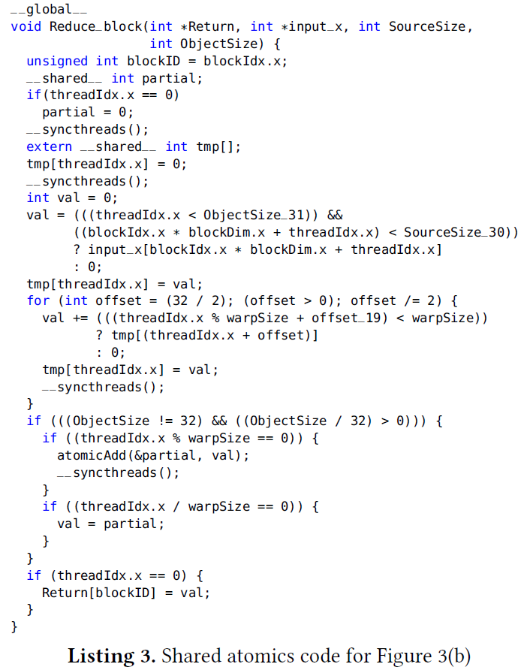
Shared Atomics
1 __codelet __coop __tag(shared_V2)
2 int sum(const Array<1,int> in) {
3 Vector vthread();
4 __shared _atomicAdd int partial;
5 __shared int tmp[in.Size()];
6 int val = 0;
7 val = (vthread.ThreadId() < in.Size()) ? in[vthread.ThreadId()] : 0;
8 tmp[vthread.ThreadId()] = val;
9 for(int offset = vthread.MaxSize()/2; offset > 0; offset /= 2){
val += (vthread.LaneId() + offset < vthread.Size()) ?
tmp[vthread.ThreadId()+offset] : 0;
12 tmp[vthread.ThreadId()] = val;
13 }
14 if(in.Size() != vthread.MaxSize() && in.Size()/vthread.MaxSize() > 0){
15 if(vthread.LaneId() == 0)
16 partial = val;
17 if(vthread.VectorId() == 0)
18 val = partial
19 }
20 return val;
21 }
11
13
15
0
1
2
3
4
5
6
7
10
12
14
8
9
+
+
10
20
26
22
24
14
13
15
4
6
8
4
5
6
7
12
+
+
12
16
12
15
10
12
44
48
36
39
26
28
14
6
7
15
+
+
28
13
28
27
25
22
18
29
92
15
84
75
65
54
7
42
atomicAdd( )
120
(b) Atomic for partial results

Slide 32
Distribution
Architecture Hierarchy
Grid
Tiled
Strided
Tiled
Strided
Tiled
Tiled
Strided Read
Strided Read
Strided Read
Tiled Read
Strided Read
Tiled Read
Tiled Read
Tiled Read
Atomic Write
Atomic Write
Atomic Write
Atomic Write
Atomic Write
Atomic Write
Atomic Write
Atomic Write
Compute
Block
…
…
Parallel
…
Scalar
Parallel
Scalar
Parallel
Thread

Slide 33
Distribution
Architecture Hierarchy
Grid
Tiled
Strided
Tiled
Strided
Tiled
Tiled
Strided Read
Strided Read
Strided Read
Tiled Read
Strided Read
Tiled Read
Tiled Read
Tiled Read
Atomic Write
Atomic Write
Atomic Write
Atomic Write
Atomic Write
Atomic Write
Atomic Write
Atomic Write
Compute
Block
…
…
Parallel
…
Scalar
Parallel
Scalar
Parallel
Thread
Parallel_{SA V1}
Parallel_{SA V1}
Parallel_{SA V2}
Parallel_{SA V2}

Slide 34
Distribution
Architecture Hierarchy
Grid
Tiled
Tiled
Strided
Tiled
Tiled
Strided Read
Strided Read
Strided Read
Tiled Read
Strided Read
Tiled Read
Tiled Read
Tiled Read
Atomic Write
Atomic Write
Atomic Write
Atomic Write
Atomic Write
Atomic Write
Atomic Write
Atomic Write
Compute
Block
…
Strided
…
Parallel
…
Scalar
Parallel
Parallel
Thread
Parallel_{SA V1}
Parallel_{SA V1}
Parallel_{SA V2}
Parallel_{SA V2}
Scalar
Tiled
Kernel 2
Grid
Strided
Parallel_{SAV1}
Block
Scalar
Thread
Parallel_{SA V1}

Slide 35
Distribution
Architecture Hierarchy
Grid
Tiled
Tiled
Strided
Tiled
Tiled
Strided Read
Strided Read
Strided Read
Tiled Read
Strided Read
Tiled Read
Tiled Read
Tiled Read
Atomic Write
Atomic Write
Atomic Write
Atomic Write
Atomic Write
Atomic Write
Atomic Write
Atomic Write
Compute
Block
…
Strided
…
Parallel
…
Scalar
Parallel
Parallel
Thread
Parallel_{SA V1}
Parallel_{SA V1}
Parallel_{SA V2}
Parallel_{SA V2}
Scalar
Tiled
Kernel 2
Tiled
Kernel 2
Grid
Strided
Parallel_{SAV1}
Strided
Parallel_{SAV2}
Block
Thread
Scalar
Scalar
Parallel_{SA V2}

Slide 36
Distribution
Architecture Hierarchy
Grid
Tiled
Tiled
Strided
Tiled
Tiled
Strided Read
Strided Read
Strided Read
Tiled Read
Strided Read
Tiled Read
Tiled Read
Tiled Read
Atomic Write
Atomic Write
Atomic Write
Atomic Write
Atomic Write
Atomic Write
Atomic Write
Atomic Write
Compute
Block
…
…
Parallel
…
Parallel_{SA V1}
Scalar
Parallel
Parallel
Thread
Parallel_{SA V1}
Parallel_{SA V2}
Parallel_{SA V2}
Tiled
Kernel 2
Tiled
Kernel 2
Tiled_{Atomic}
Grid
Strided
Parallel_{SAV1}
Strided
Parallel_{SAV2}
Parallel_{SAV1}
Block
Scalar
Scalar
Thread

Slide 37
Distribution
Architecture Hierarchy
Grid
Tiled
Tiled
Strided
Tiled
Tiled
Strided Read
Strided Read
Strided Read
Tiled Read
Strided Read
Tiled Read
Tiled Read
Tiled Read
Atomic Write
Atomic Write
Atomic Write
Atomic Write
Atomic Write
Atomic Write
Atomic Write
Atomic Write
Compute
Block
…
…
Parallel
…
Parallel_{SA V2}
Scalar
Parallel
Parallel
Thread
Parallel_{SA V1}
Parallel_{SA V2}
Tiled
Kernel 2
Tiled
Kernel 2
Tiled_{Atomic}
Tiled_{Atomic}
Grid
Strided
Parallel_{SAV1}
Strided
Parallel_{SAV2}
Parallel_{SAV1}
Parallel_{SAV2}
Block
Scalar
Scalar
Thread

Slide 38
GPU ISA and Microarchitecture Support
Fermi (2010)
Kepler(2012)
Maxwell (2014)
Pascal (2016)
Fast Global memory Atomics
Warp Shuffle instructions
Fast Share memory atomics
Wider type support for atomics operation
Scope for atomics

Slide 39
1 __codelet
2 int sum(const Array<1,int> in) {
3 unsigned len = in.Size();
4 int accum = 0;
5 for(unsigned i=0; i < len; in.Stride()) {
6 accum += in[i];
7 }
8 return accum;
9 }
1 __codelet
2 int sum(const Array<1,int> in) {
3 Vector vthread();
4 __shared int partial[vthread.MaxSize()];
5 __shared int tmp[in.Size()];
6 int val = 0;
7 val = (vthread.ThreadId() < in.Size()) ? in[vthread.ThreadId()] : 0;
8 tmp[vthread.ThreadId()] = val;
9 for(int offset = vthread.MaxSize()/2; offset > 0; offset /= 2){
10 val += (vthread.LaneId() + offset < vthread.Size()) ?
11 tmp[vthread.ThreadId()+offset] : 0;
12 tmp[vthread.ThreadId()] = val;
13 }
14 if(in.Size() != vthread.MaxSize() && in.Size()/vthread.MaxSize() > 0){
15 if(vthread.LaneId() == 0)
16 partial[vthread.VectorId()] = val;
17 if(vthread.VectorId() == 0){
18 val = (vthread.ThreadId() <= (in.Size() / vthread.MaxSize())) ?
19 partial[vthread.LaneId()] : 0;
20 for(int offset = vthread.MaxSize()/2; offset > 0; offset /= 2){
21 val += (vthread.LaneId() + offset < vthread.Size()) ?
22 partial[vthread.ThreadId()+offset] : 0;
23 partial[vthread.ThreadId()] = val;
24 }
25 }
26 }
27 return val;
28 }
11
13
15
0
1
2
3
4
5
6
7
10
12
14
8
9
+
+
10
20
26
22
24
14
13
15
4
6
8
4
5
6
7
12
(a) Atomic autonomous codelet
+
+
12
16
12
15
10
12
44
48
36
39
26
28
14
6
7
15
1 __codelet
2 int sum(const Array<1,int> in) {
3 __tunable unsigned p;
4 unsigned len = in.Size();
5 unsigned tile = (len+p-1)/p;
6 Sequence start(…);
7 Sequence end(…);
8 Sequence inc(…)
9 Map map( sum, partition(in, p, start, inc, end));
10 map.atomicAdd();
11 return sum(map);
12 }
+
+
28
13
28
27
25
22
18
29
92
15
84
75
65
54
7
42
92
28
+
120
92
Tiled:
Strided:
(b) Compound codelet
(c) Atomic cooperative codelet
Tangram Reduction Codelets

Slide 40
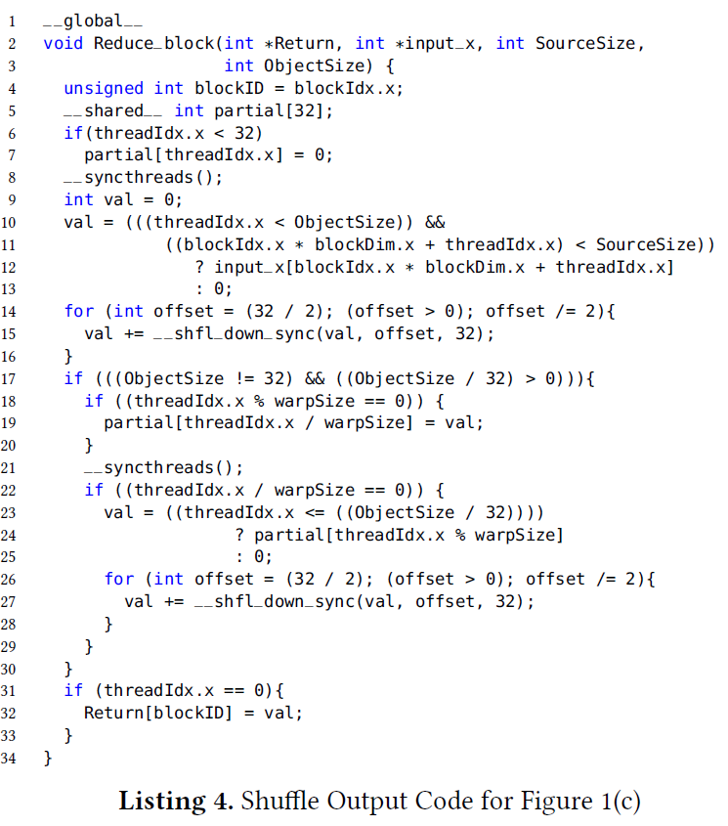
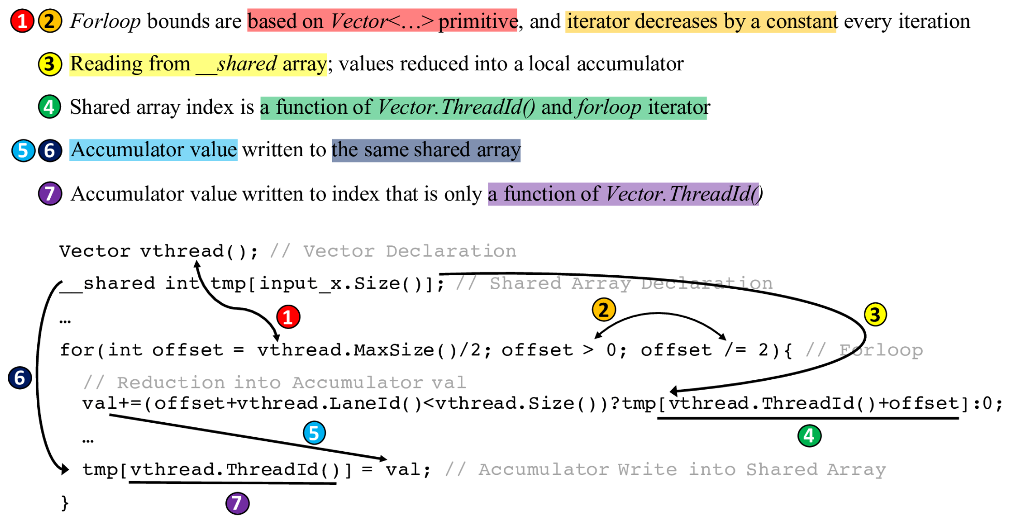
Warp Shuffle Instructions
1 __codelet
2 int sum(const Array<1,int> in) {
3 Vector vthread();
4 __shared int partial[vthread.MaxSize()];
5 __shared int tmp[in.Size()];
6 int val = 0;
7 val = (vthread.ThreadId() < in.Size()) ? in[vthread.ThreadId()] : 0;
8 tmp[vthread.ThreadId()] = val;
9 for(int offset = vthread.MaxSize()/2; offset > 0; offset /= 2){
10 val += (vthread.LaneId() + offset < vthread.Size()) ?
11 tmp[vthread.ThreadId()+offset] : 0;
12 tmp[vthread.ThreadId()] = val;
13 }
14 if(in.Size() != vthread.MaxSize() && in.Size()/vthread.MaxSize() > 0){
15 if(vthread.LaneId() == 0)
16 partial[vthread.VectorId()] = val;
17 if(vthread.VectorId() == 0){
18 val = (vthread.ThreadId() <= (in.Size() / vthread.MaxSize())) ?
19 partial[vthread.LaneId()] : 0;
20 for(int offset = vthread.MaxSize()/2; offset > 0; offset /= 2){
21 val += (vthread.LaneId() + offset < vthread.Size()) ?
22 partial[vthread.ThreadId()+offset] : 0;
23 partial[vthread.ThreadId()] = val;
24 }
25 }
26 }
27 return val;
28 }
(c) Atomic cooperative codelet

Slide 41
Warp Shuffle Instructions
1 __codelet
2 int sum(const Array<1,int> in) {
3 Vector vthread();
4 __shared int partial[vthread.MaxSize()];
5 __shared int tmp[in.Size()];
6 int val = 0;
7 val = (vthread.ThreadId() < in.Size()) ? in[vthread.ThreadId()] : 0;
8 tmp[vthread.ThreadId()] = val;
9 for(int offset = vthread.MaxSize()/2; offset > 0; offset /= 2){
10 val += (vthread.LaneId() + offset < vthread.Size()) ?
11 tmp[vthread.ThreadId()+offset] : 0;
12 tmp[vthread.ThreadId()] = val;
13 }
14 if(in.Size() != vthread.MaxSize() && in.Size()/vthread.MaxSize() > 0){
15 if(vthread.LaneId() == 0)
16 partial[vthread.VectorId()] = val;
17 if(vthread.VectorId() == 0){
18 val = (vthread.ThreadId() <= (in.Size() / vthread.MaxSize())) ?
19 partial[vthread.LaneId()] : 0;
20 for(int offset = vthread.MaxSize()/2; offset > 0; offset /= 2){
21 val += (vthread.LaneId() + offset < vthread.Size()) ?
22 partial[vthread.ThreadId()+offset] : 0;
23 partial[vthread.ThreadId()] = val;
24 }
25 }
26 }
27 return val;
28 }
(c) Atomic cooperative codelet

Slide 42
Distribution
Architecture Hierarchy
Grid
Tiled
Strided
Tiled
Strided
Tiled
Tiled
Strided Read
Strided Read
Strided Read
Tiled Read
Strided Read
Tiled Read
Tiled Read
Tiled Read
Atomic Write
Atomic Write
Atomic Write
Atomic Write
Atomic Write
Atomic Write
Atomic Write
Atomic Write
Compute
Block
…
…
Parallel
…
Scalar
Parallel
Scalar
Parallel
Thread
Parallel_{SA V1}
Parallel_{SA V1}
Parallel_{SA V2}
Parallel_{SA V2}

Slide 43
Distribution
Architecture Hierarchy
Grid
Tiled
Strided
Tiled
Strided
Tiled
Tiled
Strided Read
Strided Read
Strided Read
Tiled Read
Strided Read
Tiled Read
Tiled Read
Tiled Read
Atomic Write
Atomic Write
Atomic Write
Atomic Write
Atomic Write
Atomic Write
Atomic Write
Atomic Write
Compute
Block
…
…
Parallel
…
Scalar
Parallel
Scalar
Parallel
…
Thread
Parallel_{SA V2}
Parallel_{SA V2}
Parallel + Suffle
Parallel_{SA V1}
Parallel_{SA V2 +Sh}
Parallel_{SA V1}

Slide 44
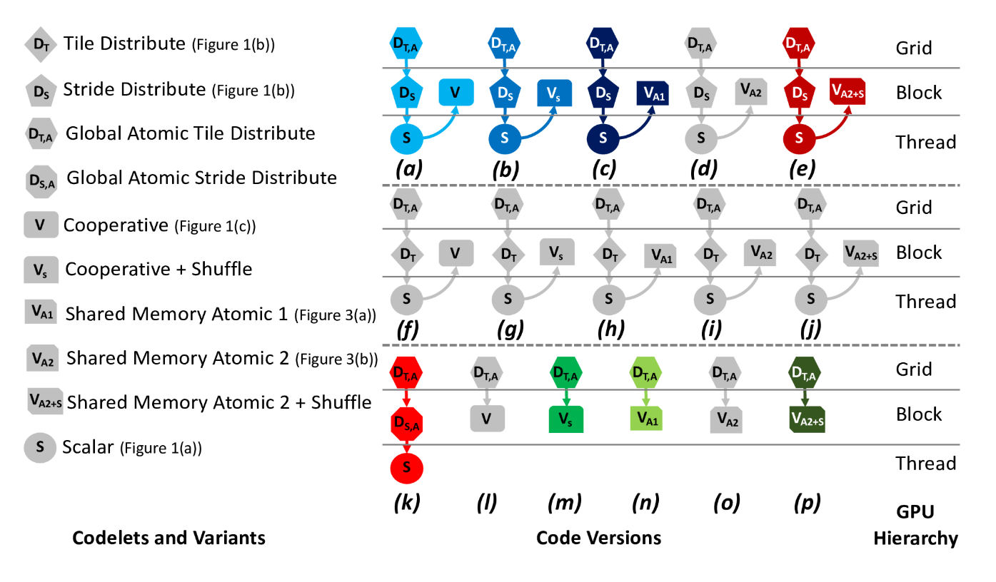
Search Space
Over 85 different versions possible!

Slide 45
Experimental Setup
3 GPU architectures
  Kepler(Titan, Blue Waters)
  Maxwell (Cloud)
  Pascal(Piz Daint)
Compare results against
  NVIDIA CUB 1.8.0
  Kokkos GPU backend
  OpemMP 4.0 reduce pragma
    Dual-socket 8-core 3.5GHz POWER8+
    gcc 5.4.0

Slide 46
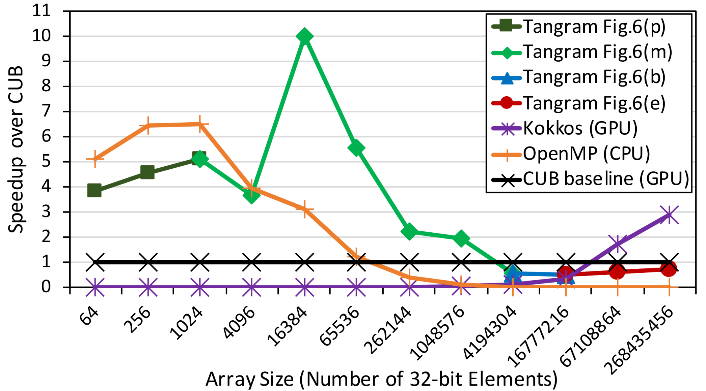
Kepler Results

Slide 47
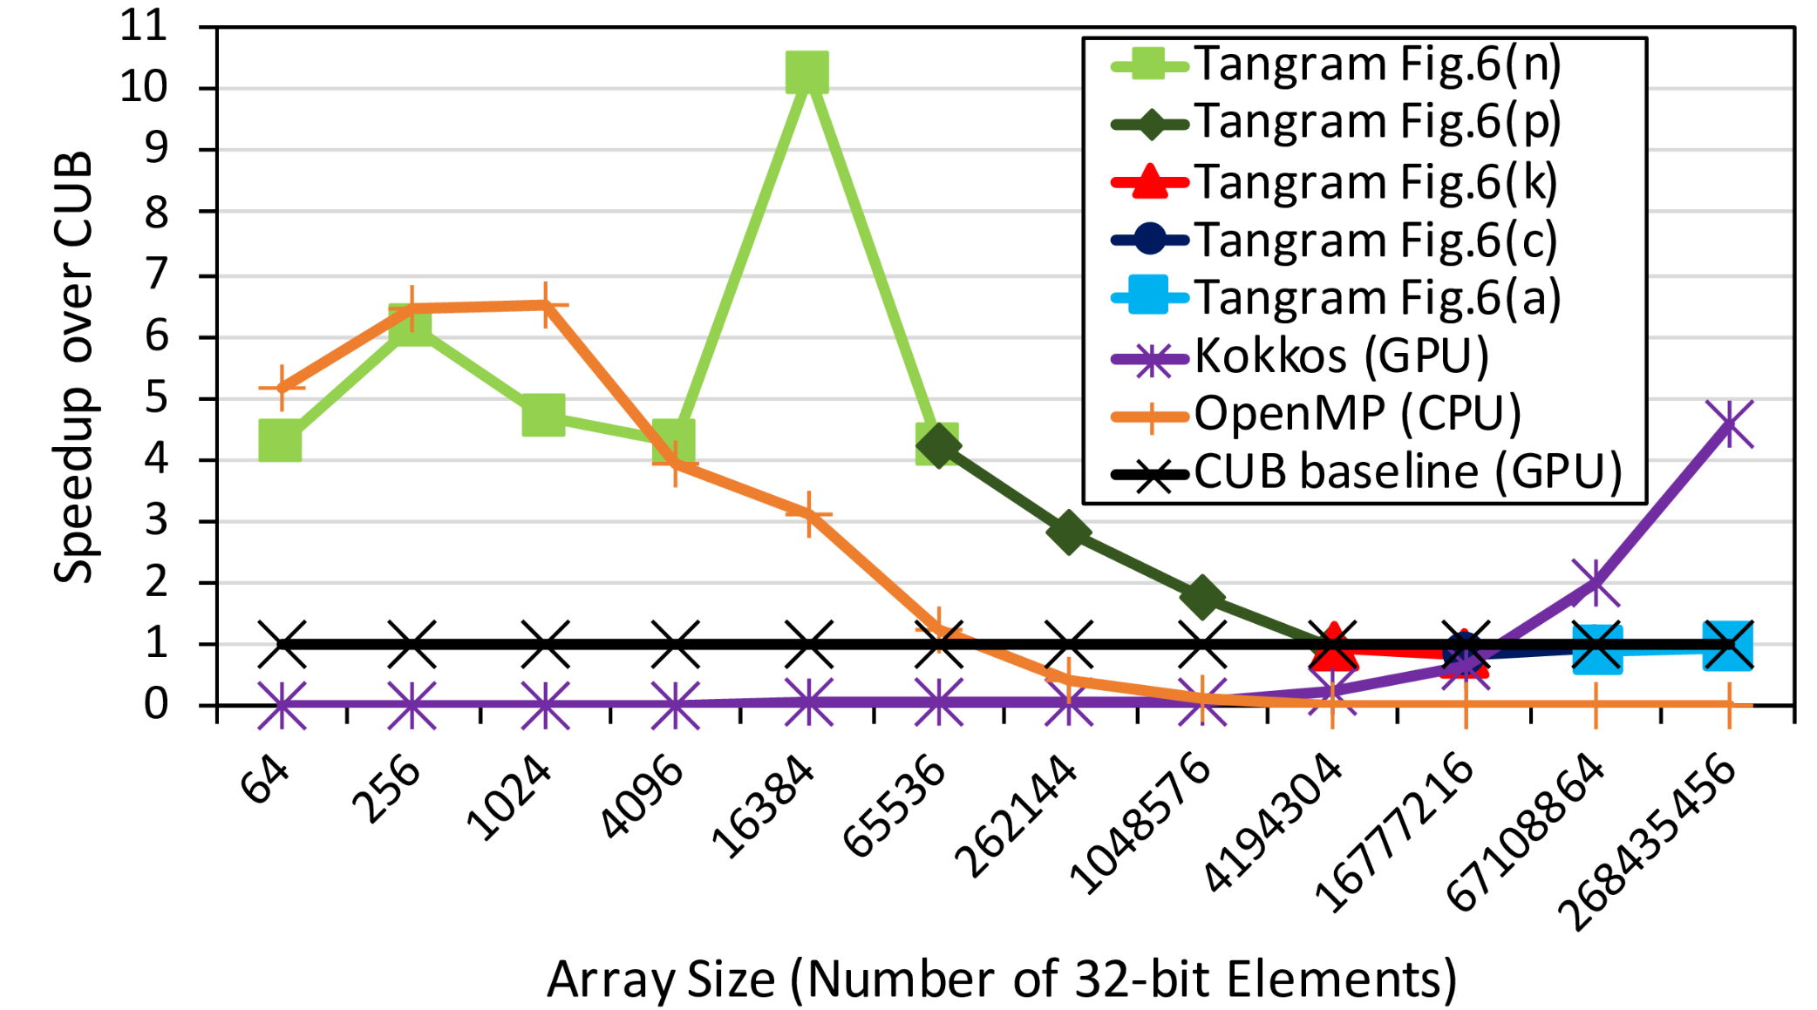
Maxwell Results

Slide 48
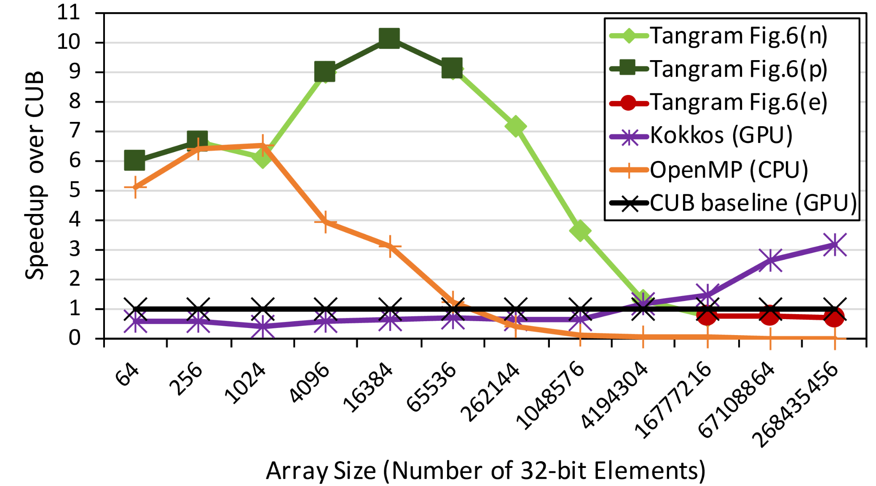
Pascal Results

Slide 49
Future work
Volta
  8 TCU units per SM are available
    Reduction can be express as M x M:
      HPCaML’19 talk
CUDA dynamic parallelism
Multi-GPU

Slide 50
Conclusion
Introduce new high-level API and AST transformation
  Automatic generation of:
    Warp-shuffle instruction
    Global memory atomics
    Shared memory atomics
Implementation of Parallel Reduction
  Compare against CPU OMP, Kokkos, and CUB Library
    Up to 7.8X speedup (2X on average) over CUB

