Slide 1


Banshee: Bandwidth-Efficient DRAM Caching via Software/Hardware Cooperation
Xiangyao Yu¹, Christopher Hughes², Nadathur Satish², Onur Mutlu³, Srinivas Devadas¹
¹MIT ²Intel Labs ³ETH Zürich
Notes:
Good morning.
My name is Xiangyao Yu from CSAIL MIT.
I will present Banshee, a new DRAM cache design that optimizes for DRAM bandwidth efficiency to deliver high performance.
This work is in collaboration with Christopher Hughes and Nadathur Satish from Intel labs, Prof. Onur Mutlu at ETH and my PhD advisor Prof. Srinivas Devadas at MIT.

Slide 2
High-Bandwidth In-Package DRAM
In-package DRAM has
  5X higher bandwidth than off-package DRAM
  Similar latency as off-package DRAM
  Limited capacity (up to 16 GB)
In-package DRAM can be used as a cache
Off-Package
DRAM
Core
In-Package
DRAM
SRAM
Cache Hierarchy
16 GB
384 GB
> 400 GB/s
Memory Controller
90 GB/s
On-Chip
In-Package
* Numbers from Intel Knights Landing
Notes:
A number of modern processors have incorporated 3D-stacked DRAM into the same package as the processor.
The figure on the slide shows the DRAM bandwidth in an Intel knight landing processor.
The in-package DRAM has bandwidth of over 400 GB/s while the off-package DRAM has a bandwidth of only 90 GB/s.
So the in-package DRAM can deliver 5 times higher memory bandwidth than the off-package DRAM.
However, the capacity of in-package DRAM is limited; and its latency is not appreciably lower than off-package DRAM.
One way to exploit in-package DRAM is to use it as a cache.
In order to maximize the performance potential of in-package DRAM, a system needs to fully exploit its high bandwidth.
Previous DRAM cache designs, however, optimized for latency instead of bandwidth efficiency and therefore failed to fully exploit the performance potential of a DRAM cache.

Slide 3
Bandwidth Inefficiency in Existing DRAM Cache Designs
Drawback 1: Metadata traffic (e.g., tags, LRU bits, frequency counters, etc.)
DRAM Cache Traffic Breakdown
Notes:
There are two major drawbacks of previous DRAM cache designs leading to inefficient use of DRAM cache bandwidth.
The first drawback is that previous designs incur significant DRAM traffic for metadata management.
This includes reading and updating tags, LRU bits, or frequency counters.
Due to the large sizes of DRAM caches, the metadata for a DRAM cache does not fit in on-chip SRAM and is typically stored in the DRAM cache itself.
As a result, each DRAM cache access incurs some traffic for accessing the metadata.

Slide 4
Bandwidth Inefficiency in Existing DRAM Cache Designs
Drawback 1: Metadata traffic (e.g., tags, LRU bits, frequency counters, etc.)
Drawback 2: Cache replacement traffic
  Especially for coarse-granularity (e.g., page-granularity) DRAM cache designs
Coarse-Granularity
Fine-Granularity
DRAM Cache Traffic Breakdown
Notes:
The second drawback of previous designs is that they incur significant DRAM traffic for cache replacement.
This is especially true for designs that manage data at coarse granularity, like page granularity.
In this case, a replacement moves a whole page between in-package and off-package DRAM.
Therefore, a replacement is much more expensive than a regular DRAM access which only moves a single cacheline from the corresponding DRAM to the processor.
Frequent DRAM cache replacements incur large amount of unnecessary traffic in both in-package and off-package DRAM.
The figure on this slide shows the DRAM cache traffic breakdown for some previous DRAM cache designs.
The numbers shown here are averaged over 16 benchmarks we evaluated.
As you can see, previous designs incur significant DRAM cache traffic for either metadata management or cache replacement or both.
This incurred extra bandwidth consumption limit the performance of previous designs.

Slide 5
Banshee Improves DRAM Bandwidth Efficiency
Idea 1: Page-table-based contents tracking with efficient translation lookaside buffer (TLB) coherence
  Track contents of DRAM cache using page tables and TLBs
  Lightweight TLB coherence mechanism
This paper
DRAM Cache Traffic Breakdown
Notes:
Different from previous designs, Banshee considers bandwidth efficiency as a first-class design constraint.
Banshee achieves high bandwidth efficiency without degrading access latency.
There are two major ideas in Banshee for maximizing bandwidth efficiency.
First, we propose a new, lightweight TLB coherence mechanism to improve performance of page-table-based DRAM cache designs.
This largely removes the metadata traffic to a DRAM cache for accessing tags.

Slide 6
Banshee Improves DRAM Bandwidth Efficiency
Idea 1: Page-table-based contents tracking with efficient translation lookaside buffer (TLB) coherence
Idea 2: Bandwidth-aware frequency-based replacement (FBR) policy
  Replacement traffic reduction: Limit the rate of DRAM cache replacement
  Metadata traffic reduction: Access metadata for a sampled fraction of memory accesses
This paper
DRAM Cache Traffic Breakdown
Notes:
Second, Banshee reduces unnecessary DRAM cache replacement traffic with a new bandwidth-aware frequency-based replacement policy.
To reduce replacement traffic, Banshee purposely limits the rate of replacement.
To reduce the traffic for reading and updating frequency counters, Banshee accesses these counters for only a fraction of memory accesses.
In the rest of this talk, I will discuss both ideas in Banshee in more detail.

Slide 7
Page-Table-Based DRAM Cache Contents Tracking
Software
Hardware
Track DRAM cache contents using the the virtual memory mechanism
Advantage
  Zero overhead for tag storage and lookup
Disadvantage
  TLB coherence overhead
  Cache replacement overhead
Core
Page Table Entry
…
TLB Entry
PPN
VPN
PPN
…
Page Table
Translation Lookaside Buffer (TLB)
SRAM Cache Hierarchy
Memory Controller
In-Package
DRAM
Off-Package
DRAM
* assuming 4-way set associativity DRAM cache
Notes:
Due to the large size of a DRAM cache, the tags incur large storage overhead.
Previous works have proposed to eliminate tag storage by tracking DRAM cache contents using the virtual memory mechanism.
Specifically, these designs store the mapping of a page, namely, whether and where a page is cached, within the page tables and TLBs.
For these page-table-based designs, tag lookups become free since the TLBs are accessed for every memory access anyway.
One disadvantage of previous page-table-based designs, however, is the overhead of TLB coherence.
Whenever a page is inserted or evicted from the DRAM cache, the new mapping should be reflected in TLBs across all the cores.
In current systems, this requires a global TLB shootdown to enforce that all the TLBs have the latest mapping of a page.
A TLB shootdown takes multiple microseconds to service.
Therefore, frequent TLB shootdowns can severely hurt performance.

Slide 8
Idea 1: Efficient TLB Coherence
Software
Hardware
Track DRAM cache contents using page tables and TLBs
Core
Cached
(1 bit)
Way
(2 bits)
Page Table Entry
…
TLB Entry
PPN
Mapping
VPN
PPN
…
Mapping
Page Table
Translation Lookaside Buffer (TLB)
SRAM Cache Hierarchy
Memory Controller
In-Package
DRAM
Off-Package
DRAM
* Assuming 4-way set-associative DRAM cache
Notes:
The first idea of Banshee is an efficient TLB coherence mechanism, which enforces TLB coherence in batches to amortize its cost.
As shown in the figure on this slide, each entry in a TLB or a page table contains the mapping of the corresponding page.
The mapping includes 1 bit to indicate whether the page is cached, and a few bits to indicate which way the page is cached in.
Every L1 cache miss carries the mapping information with the request through the cache hierarchy.
The mapping is used to determine which DRAM to access at the memory controller, if the request is a miss at the last level cache.

Slide 9
Idea 1: Efficient TLB Coherence
Software
Hardware
Track DRAM cache contents using page tables and TLBs
Maintain latest mapping for recently remapped pages in the Tag Buffer
Core
Cached
(1 bit)
Way
(2 bits)
Page Table Entry
…
TLB Entry
PPN
Mapping
VPN
PPN
…
Mapping
Page Table
Translation Lookaside Buffer (TLB)
SRAM Cache Hierarchy
Tag Buffer
PPN
V
Mapping
Memory Controller
In-Package
DRAM
Off-Package
DRAM
* Assuming 4-way set-associative DRAM cache
Notes:
Banshee maintains a small hardware table, called the Tag Buffer, at the memory controller to store the mapping of pages that are recently inserted to or evicted from the DRAM cache.
When the mapping of a page changes, Banshee does not enforce TLB coherence immediately; instead, the new mapping is inserted to the tag buffer.
Although a request from a core may carry stale mapping derived from a TLB entry, it is always able to find the latest mapping form the Tag Buffer.

Slide 10
Idea 1: Efficient TLB Coherence
Software
Hardware
Track DRAM cache contents using page tables and TLBs
Maintain latest mapping for recently remapped pages in the Tag Buffer
Enforce TLB coherence lazily when the Tag Buffer is full to amortize the cost
Core
Cached
(1 bit)
Way
(2 bits)
Page Table Entry
…
TLB Entry
PPN
Mapping
VPN
PPN
…
Mapping
Page Table
Translation Lookaside Buffer (TLB)
Reverse
Mapping
(Find all PTEs that map to a given PPN)
SRAM Cache Hierarchy
Tag Buffer
PPN
V
Mapping
Memory Controller
In-Package
DRAM
Off-Package
DRAM
* Assuming 4-way set-associative DRAM cache
Notes:
When the Tag Buffer fills up, the mapping information stored in it lazily propagates to page tables and TLBs via software support.
Specifically, a software routine reads the address of each page in the Tag Buffer, and uses the reserve mapping mechanism to locate all page table entries corresponding to that page. Then, the software routine updates these page table entries with the latest mapping.
The reverse mapping mechanism already exists in modern operation systems, so very little extra changes to software are required.
After all the page table entries are updated, the software routine issues a global TLB shootdown to enforce TLB coherence across all the cores.
Although the software routine has some performance overhead for reverse mapping and the global TLB shootdown, this overhead is amortized over a large number of DRAM cache replacements.
According to our evaluation, this lazy TLB coherence mechanism has less than 1% performance overhead, which is very small.

Slide 11
Idea 2: Bandwidth-Aware Cache Replacement
DRAM cache replacement incurs significant DRAM traffic
  Cache replacement traffic
  Metadata traffic (e.g., frequency counter lookups/updates)
Cache Misses
(64 B)
Memory Controller
Off-Package
DRAM
Cache Hits
(64 B)
In-
Package
DRAM
Notes:
The second idea of Banshee is a new bandwidth-aware cache replacement policy.
Banshee uses a frequency-based replacement policy to cache hot pages only.
Banshee has a few types of traffic for in-package and off-package DRAM.
Cache hits and cache misses transfer cachelines from in-package and off-package DRAM, respectively, to the memory controller.

Slide 12
Idea 2: Bandwidth-Aware Cache Replacement
DRAM cache replacement incurs significant DRAM traffic
  Cache replacement traffic
  Metadata traffic (e.g., frequency counter lookups/updates)
Cache Misses
(64 B)
Memory Controller
Off-Package
DRAM
Cache Hits
(64 B)
In-
Package
DRAM
Cache Replacements
(4096 B)
Notes:
A cache replacement transfers a page between in-package and off-package DRAM.
Since a page is much larger than a cacheline, cache replacements can dominate the DRAM bandwidth consumption if cache replacements are frequent.
Replacement traffic can severely hurt performance.

Slide 13
Idea 2: Bandwidth-Aware Cache Replacement
DRAM cache replacement incurs significant DRAM traffic
  Cache replacement traffic
  Metadata traffic (e.g., frequency counter lookups/updates)
Cache Misses
(64 B)
Memory Controller
Off-Package
DRAM
Cache Hits
(64 B)
In-
Package
DRAM
Frequency
Counter
Accesses
Cache Replacements
(4096 B)
Notes:
Another source of inefficiency is the traffic for reading and updating frequency counters.
Due to the large size of in-package DRAM, the frequency counters are stored within the DRAM cache itself.
These counters track how often pages are accessed, and are used to determine when a replacement should happen.
In a standard implementation of frequency-based cache replacement, the frequency counter is accessed for each DRAM access.
This incurs significant metadata traffic which degrades the DRAM cache bandwidth efficiency.

Slide 14
Idea 2: Bandwidth-Aware Cache Replacement
DRAM cache replacement incurs significant DRAM traffic
Limit cache replacement rate
  Replace only when the incoming page’s frequency counter is greater than the victim pages’s counter by a threshold
Cache Misses
(64 B)
Memory Controller
Off-Package
DRAM
Cache Hits
(64 B)
In-
Package
DRAM
Frequency
Counter
Accesses
Limited Cache
Replacements
Notes:
We propose two ideas to reduce the traffic for cache replacement and frequency counter accesses, respectively.
First, Banshee reduces cache replacement traffic by allowing replacement to happen only when the incoming page’s frequency counter is greater than the victim page’s frequency counter by a certain threshold.
This way, a replacement can happen only after a page is accessed by a large enough number of times; and the percentage of replacement traffic out of all the DRAM traffic can be bounded.

Slide 15
Idea 2: Bandwidth-Aware Cache Replacement
DRAM cache replacement incurs significant DRAM traffic
Limit cache replacement rate
Reduce metadata traffic
  Access frequency counters for a randomly sampled fraction of memory accesses
Cache Misses
(64 B)
Memory Controller
Off-Package
DRAM
Cache Hits
(64 B)
In-
Package
DRAM
Sampled
Frequency
Counter
Accesses
Limited Cache
Replacements
Notes:
Second, Banshee does not access the frequency counter for every DRAM cache access, but only for a randomly sampled fraction of DRAM accesses.
We found that a 10% sample rate can significantly reduce metadata traffic without hurting the hit rate of the DRAM cache.
Although it may seem that updating the counters via such sampling leads to inaccurate detection of “hot” pages, the vast majority of applications exhibit some spatial locality.
When a request to a cacheline misses in the DRAM cache, other cachelines belonging to the same page are likely to be accessed soon as well.
Each of these accesses has a chance to update the frequency counter of the page.
In fact, without sampling, we found that counters quickly reach large values but only the high order bits matter for replacement decisions.
Sampling effectively “discards” the need to store and track the low-order bits of each counter, which have little useful information anyway.

Slide 16
Banshee Extensions
Supporting large pages (e.g., 2MB)
  A large page is cached either in its entirety or not at all
Supporting multi-socket processors
  Coherent DRAM caches
  Partitioned DRAM caches
Notes:
In the paper, we also discussed a few extensions of Banshee.
For example, Banshee supports large pages as well as regular 4KB pages.
Banshee can also be implemented in multi-socket processors.
Please read the paper for more details.

Slide 17
Performance Evaluation
ZSim simulator ^{[1]}
16 cores (4-issue, out-of-order, 2.7 GHz)
In-package DRAM (1 GB, 84 GB/s)
Off-package DRAM (21 GB/s)
Tag Buffer
  One Tag Buffer per memory controller (MC)
  1024 entries, 5 KB in size
[1] Sanchez, Daniel, and Christos Kozyrakis. "ZSim: fast and accurate microarchitectural simulation of thousand-core systems." ISCA, 2013.
Notes:
Now I will show you our performance evaluation of Banshee compared to a few previous DRAM cache designs.
We did our evaluation using the zsim multi-core simulator.
We simulated 16 out-of-order cores.
The in-package DRAM has capacity of 1 GB, with bandwidth of 84 GB/s.
The off-package DRAM has bandwidth of 21 GB/s which is a quarter of the in-package DRAM bandwidth.
The modeled system has similar per-core DRAM bandwidth as Intel’s knights landing processor.
Banshee maintains a Tag Buffer within every memory controller.
A Tag Buffer has 1024 entries, and 5 KB in size.
This is very small storage overhead compared to multi-MB on-chip SRAMs.

Slide 18
Speedup (Normalized to off-package DRAM only)
Perfect In-package
DRAM Cache
23% within perfect DRAM cache
15% improvement
Banshee improves performance by 15% on average over the best-previous (i.e., BEAR) latency-optimized DRAM cache design
Notes:
This slide shows the speedup of different DRAM cache designs normalized to a baseline with no in-package DRAM at all.
The rightmost bar is an idealized system with perfect in-package DRAM that has infinite capacity and 100% hit rate.
[click]
On average, Banshee improves performance by 15% over the best-previous latency-optimized DRAM cache designs that we have evaluated.
[click]
The performance of Banshee is within 23% of the perfect in-package DRAM cache.
The main reason of the performance improvement of Banshee is due to its high bandwidth efficiency for both in-package and off-package DRAMs.

Slide 19
DRAM Bandwidth Efficiency
36% in-package DRAM
traffic reduction
In-Package DRAM Cache Traffic Breakdown
Banshee reduces 36% in-package DRAM traffic over the best-previous design
Notes:
This slides shows the DRAM traffic in different DRAM cache designs, in terms of the number of bytes transferred per instruction.
The in-package DRAM traffic is broken down to three portions: the hit traffic, the metadata traffic, and the replacement traffic.
The hit traffic is the only useful data transfer, and the other two can be considered as overhead.
On average, Banshee reduces in-package DRAM traffic by 36% over the best-previous design.

Slide 20
DRAM Bandwidth Efficiency
3% off-package DRAM
traffic reduction
36% in-package DRAM
traffic reduction
In-Package DRAM Cache Traffic Breakdown
Off-Package DRAM Traffic
Banshee reduces 36% in-package DRAM traffic over the best-previous design
Banshee reduces 3% off-package DRAM traffic over the best-previous design
Notes:
At the same time, the off-package DRAM traffic in Banshee is also lower than previous designs.
The major bandwidth inefficiency in off-package DRAM is cache replacement.
As a result, coarse-granularity DRAM cache designs, namely, Unison Cache and Tagless, suffer the most from inefficient off-package DRAM bandwidth utilization.

Slide 21
Effect of Replacement Traffic Reduction
Sampling Frequency Counters
Limiting Cache
Replacement Rate
Limiting replacement rate and sampling frequency counters are both important for bandwidth efficiency in Banshee
Notes:
The figure in this slide shows that both optimizations in Banshee for improving efficiency of cache replacement are important for performance.
The first optimization is limiting replacement rate; and the second optimization is sampling frequency counters.
The leftmost bar is a degraded version of Banshee with LRU replacement policy, therefore neither of the optimizations.
[click]
The middle bar is Banshee with frequency-based replacement, but the frequency counter is accessed for every DRAM access, namely, it only has one of the two optimization.
[click]
The rightmost bar is the default Banshee configuration with both optimizations.
When using the LRU replacement policy, replacement happens for each cache miss, and the performance of Banshee is even worse than the baseline with no DRAM cache.
This is due to the frequent page replacements, which thrashes the DRAM cache bandwidth.
Limiting the replacement rate can significantly reduce replacement traffic compared to LRU, since only hot pages are cached.
Sampling frequency counters can further improve bandwidth efficiency and performance of the system.
This is because sampling can reduce the traffic for reading and updating frequency counters.

Slide 22
More Analysis in the Paper
Performance with large (2 MB) pages
Balancing in- and off-package DRAM bandwidth
Overhead for page table update and TLB coherence
Storing tags in SRAM
Sweep DRAM cache latency and bandwidth
Sampling coefficient
DRAM cache associativity
Notes:
We performed many other performance analyses and sensitivity studies.
Please read the paper for more details.

Slide 23
Summary
Need to optimize for bandwidth efficiency to fully exploit the performance of in-package DRAM
Idea 1: Improving page-table-based DRAM cache designs with efficient Translation Lookaside Buffer (TLB) coherence
Idea 2: Bandwidth-aware frequency-based replacement (FBR) policy
Banshee improves performance by 15% and reduces in-package DRAM traffic by 36% over the best-previous latency-optimized DRAM cache design
Notes:
To summarize.
To fully exploit the new-generation high-bandwidth in-package DRAM, we should design systems that optimize for DRAM bandwidth efficiency.
We propose Banshee, which achieves this goal using two key ideas:
The first idea is an efficient TLB coherence mechanism for page-table-based DRAM cache designs.
The second idea is the bandwidth-aware frequency-based replacement policy.
On average, Banshee improves performance by 15% and reduces in-package DRAM traffic by 36% over the best-previous latency-optimized DRAM cache design we evaluated.
Finally, I want to thank Intel Science and Technology Center on big data for funding this research.
Thank you very much for listening to this talk.
I’m happy to answer questions.

Slide 24
Banshee: Bandwidth-Efficient DRAM Caching via Software/Hardware Cooperation
Xiangyao Yu¹, Christopher Hughes², Nadathur Satish², Onur Mutlu³, Srinivas Devadas¹
¹MIT ²Intel Labs ³ETH Zürich

Slide 25
Backup Slides

Slide 26
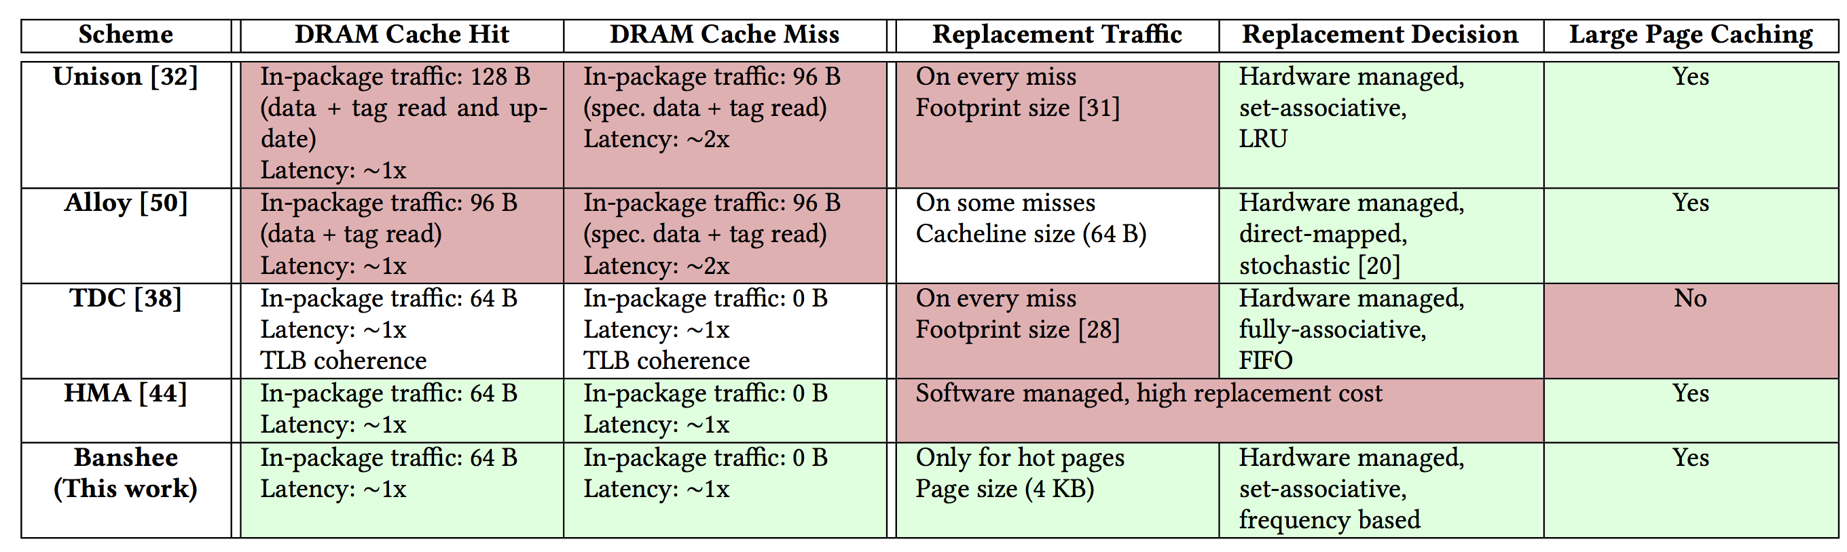
Summary of Operational Characteristics of Different State-of-the-Art DRAM Cache Designs

Slide 27
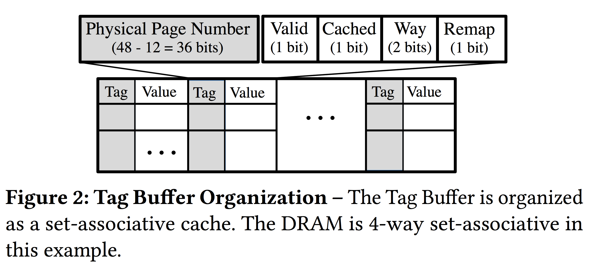
Tag Buffer Organization

Slide 28
DRAM Cache Layout
In-Package DRAM
Data Row Layout
4KB Page
4KB Page
4KB Page
4KB Page
4KB Page
4KB Page
4-way set-associative
…
Metadata Row Layout
…
Row Buffer
Metadata for
One Cache Set
4 cached pages + 5 candidate pages
Metadata for
One Page
Tag
D
Freq Cntr
V

Slide 29
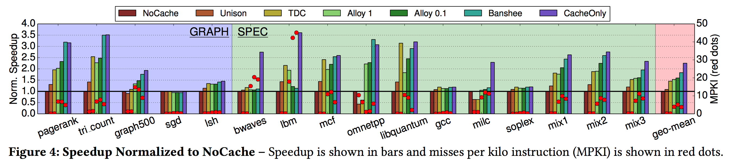
Speedup Normalized to NoCache

Slide 30
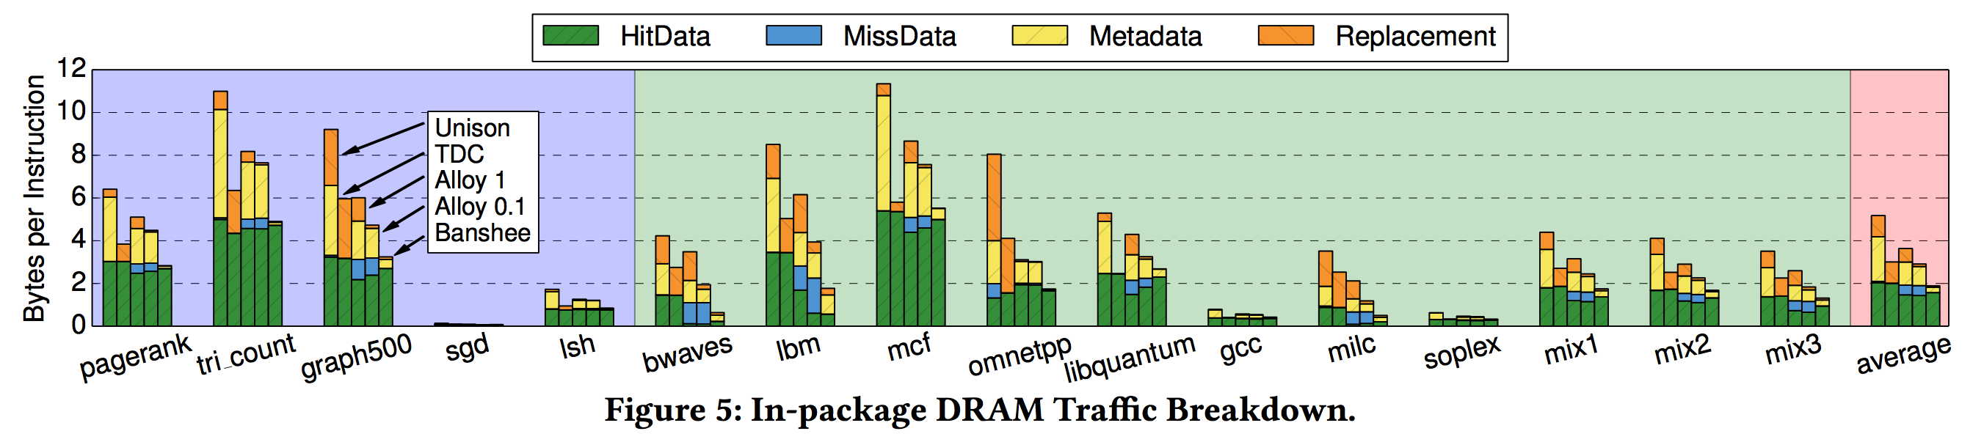
In-Package DRAM Traffic Breakdown

Slide 31
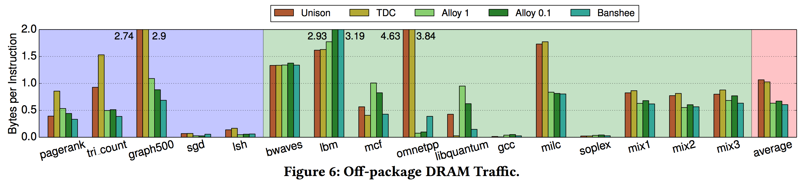
Off-Package DRAM Traffic

Slide 32
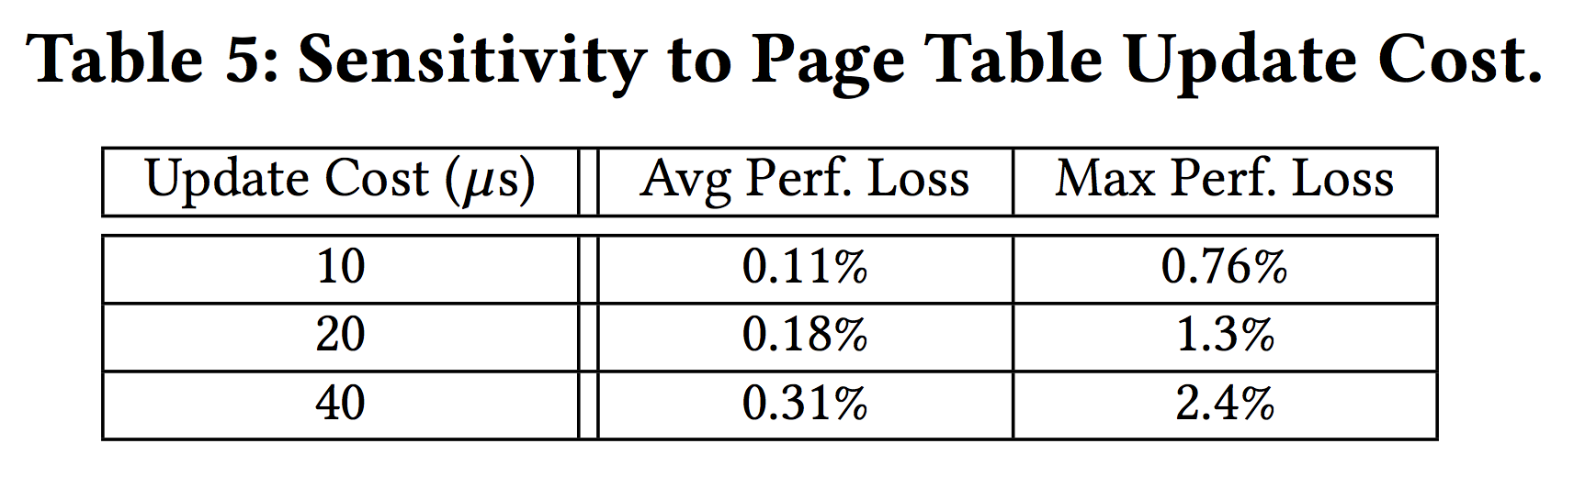
Sensitivity to Page Table Update Cost

Slide 33
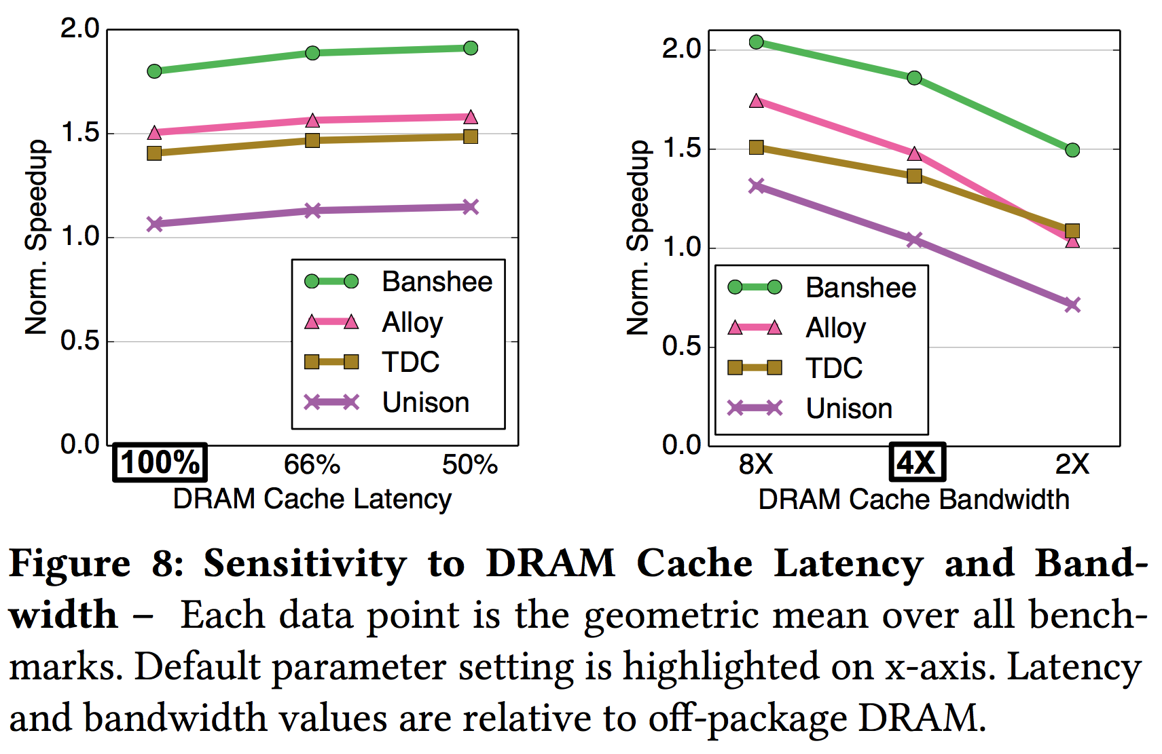
Sensitivity to DRAM Cache Latency and Bandwidth

