Slide 1


Achieving High Performance and Fairness at Low Cost
The Blacklisting Memory Scheduler
Lavanya Subramanian, Donghyuk Lee,
Vivek Seshadri, Harsha Rastogi, Onur Mutlu

Slide 2
Main Memory Interference Problem
Causes interference between applications’ requests
Core
Core
Main Memory
Core
Core

Slide 3
Inter-Application Interference
Results in Performance Degradation
High application slowdowns due to interference

Slide 4
Tackling Inter-Application Interference:
Application-aware Memory Scheduling
Monitor
Rank
Enforce
Ranks
Highest Ranked AID
1
2
Request Buffer
App. ID (AID)
4
Request
2
Req 1
1
=
3
3
Req 2
4
=
1
Req 3
1
=
4
Req 4
1
=
Full ranking increases
critical path latency and area significantly to improve performance and fairness
Req 5
3
=
Req 5
2
=
Req 7
1
=
Req 8
3
=

Slide 5
Performance vs. Fairness vs. Simplicity
Fairness
App-unaware
FRFCFS
App-aware (Ranking)
Ideal
PARBS
Low performance and fairness
ATLAS
TCM
Our Solution
(No Ranking)
Blacklisting
Performance
Is it essential to give up simplicity to optimize for performance and/or fairness?
Complex
Our solution achieves all three goals
Very Simple
Simplicity

Slide 6
Outline
Introduction
Problems with Application-aware Schedulers
Key Observations
The Blacklisting Memory Scheduler Design
Evaluation
Conclusion

Slide 7
Outline
Introduction
Problems with Application-aware Schedulers
Key Observations
The Blacklisting Memory Scheduler Design
Evaluation
Conclusion

Slide 8
Problems with Previous
Application-aware Memory Schedulers
  1. Full ranking increases hardware complexity
  2. Full ranking causes unfair slowdowns

Slide 9
Problems with Previous
Application-aware Memory Schedulers
  1. Full ranking increases hardware complexity
  2. Full ranking causes unfair slowdowns

Slide 10
Ranking Increases Hardware Complexity
Enforce
Ranks
Highest Ranked AID
Monitor
Rank
Next Highest Ranked AID
Request Buffer
App. ID (AID)
Request
1
2
Req 1
1
=
4
Req 2
4
=
2
3
Req 3
1
=
3
Req 4
1
=
1
4
Req 5
3
=
Req 5
4
=
Hardware complexity increases with application/core count
Req 7
1
=
Req 8
3
=

Slide 11
Ranking Increases Hardware Complexity
From synthesis of RTL implementations using a 32nm library
1.8x
8x
Ranking-based application-aware schedulers incur high hardware cost

Slide 12
Problems with Previous
Application-aware Memory Schedulers
  1. Full ranking increases hardware complexity
  2. Full ranking causes unfair slowdowns

Slide 13
Ranking Causes Unfair Slowdowns
GemsFDTD (high memory intensity)
GemsFDTD
sjeng (low memory intensity)
sjeng
Full ordered ranking of applications
GemsFDTD denied request service

Slide 14
Ranking Causes Unfair Slowdowns
GemsFDTD
(high memory intensity)
sjeng
(low memory intensity)
Ranking-based application-aware schedulers cause unfair slowdowns

Slide 15
Problems with Previous
Application-aware Memory Schedulers
  1. Full ranking increases hardware complexity
  2. Full ranking causes unfair slowdowns
Our Goal: Design a memory scheduler with
Low Complexity, High Performance, and Fairness

Slide 16
Outline
Introduction
Problems with application-aware schedulers
Key Observations
The Blacklisting Memory Scheduler Design
Evaluation
Conclusion

Slide 17
Key Observation 1: Group Rather Than Rank
Observation 1: Sufficient to separate applications into two groups, rather than do full ranking
Monitor
Rank
Group
Interference
Causing
1
2
Vulnerable
4
1
2
>
2
3
3
4
3
1
4
Benefit 1: Low complexity compared to ranking

Slide 18
Key Observation 1: Group Rather Than Rank
GemsFDTD (high memory intensity)
No denial of request service
sjeng (low memory intensity)

Slide 19
Key Observation 1: Group Rather Than Rank
GemsFDTD
(high memory intensity)
sjeng
(low memory intensity)
Benefit 2: Lower slowdowns than ranking

Slide 20
Key Observation 1: Group Rather Than Rank
Observation 1: Sufficient to separate applications into two groups, rather than do full ranking
Monitor
Rank
Group
Interference
Causing
1
2
Vulnerable
4
1
2
>
2
3
3
4
3
1
4
How to classify applications into groups?

Slide 21
Key Observation 2
Observation 2: Serving a large number of consecutive requests from an application causes interference
Basic Idea:
Group applications with a large number of consecutive requests as interference-causing → Blacklisting
Deprioritize blacklisted applications
Clear blacklist periodically (1000s of cycles)
Benefits:
Lower complexity
Finer grained grouping decisions → Lower unfairness

Slide 22
Outline
Introduction
Problems with application-aware schedulers
Key Observations
The Blacklisting Memory Scheduler Design
Evaluation
Conclusion

Slide 23
The Blacklisting Memory Scheduler (BLISS)
1. Monitor
1. Monitor
2. Blacklist
1. Monitor
3. Prioritize
3. Prioritize
2. Blacklist
4. Clear Periodically
4. Clear Periodically
Request Buffer
Req
Blacklist
AID
Blacklist
Simple and scalable design
Req 1
0
?
AID1
AID1
AID1
AID1
AID2
0
0
Req 2
1
?
1
0
Req 3
1
AID
Blacklist
1
?
Last Req AID
3
2
1
2
0
Req 4
0
?
0
0
3
0
# Consecutive Requests
1
2
3
4
Last Req AID
3
4
Req 5
0
?
1
1
0
Req 6
0
?
# Consecutive Requests
1
2
0
Req 7
1
?
3
0
Req 8
0
?

Slide 24
Outline
Introduction
Problems with application-aware schedulers
Key Observations
The Blacklisting Memory Scheduler Design
Evaluation
Conclusion

Slide 25
Methodology
Configuration of our simulated baseline system
  24 cores
  4 channels, 8 banks/channel
  DDR3 1066 DRAM
  512 KB private cache/core
Workloads
  SPEC CPU2006, TPC-C, Matlab , NAS
  80 multiprogrammed workloads

Slide 26
Metrics
System Performance:
Fairness:
Complexity:
  Critical path latency and area from synthesis with 32 nm library

Slide 27
Previous Memory Schedulers
FRFCFS [Zuravleff and Robinson, US Patent 1997, Rixner et al., ISCA 2000]
  Prioritizes row-buffer hits and older requests
FRFCFS-Cap [Mutlu and Moscibroda, MICRO 2007]
  Caps number of consecutive row-buffer hits
PARBS [Mutlu and Moscibroda, ISCA 2008]
  Batches oldest requests from each application; prioritizes batch
  Employs ranking within a batch
ATLAS [Kim et al., HPCA 2010]
  Prioritizes applications with low memory-intensity
TCM [Kim et al., MICRO 2010]
  Always prioritizes low memory-intensity applications
  Shuffles thread ranks of high memory-intensity applications
Application-unaware
+ Low complexity
- Low performance and fairness
Application-aware
+ High performance and fairness
- High complexity

Slide 28
Performance and Fairness
5%
21%
Ideal
1. Blacklisting achieves the highest performance
2. Blacklisting balances performance and fairness

Slide 29
Complexity
43%
70%
Ideal
Blacklisting reduces complexity significantly

Slide 30
Performance vs. Fairness vs. Simplicity
Close to fairest
FRFCFS
Fairness
FRFCFS
Ideal
-
Cap
PARBS
ATLAS
Highest performance
TCM
Blacklisting
Performance
Blacklisting is the closest scheduler to ideal
Close to simplest
Simplicity

Slide 31
Summary
Applications’ requests interfere at main memory
Prevalent solution approach
  Application-aware memory request scheduling
Key shortcoming of previous schedulers: Full ranking
  High hardware complexity
  Unfair application slowdowns
Our Solution: Blacklisting memory scheduler
  Sufficient to group applications rather than rank
  Group by tracking number of consecutive requests
Much simpler than application-aware schedulers at higher performance and fairness

Slide 32
Achieving High Performance and Fairness at Low Cost
The Blacklisting Memory Scheduler
Lavanya Subramanian, Donghyuk Lee,
Vivek Seshadri, Harsha Rastogi, Onur Mutlu

Slide 33
Backup Slides

Slide 34
DRAM Memory Organization
Columns
FR-FCFS Memory Scheduler [Zuravleff and Robinson, US Patent ‘97; Rixner et al., ISCA ‘00]
  Row-buffer hit first
  Older request first
Unaware of inter-application interference
Row hit
Row miss
(2-3x latency of row hit)
Bank 0
Bank 1
Bank 2
Bank 3
Bank 0
Bank 1
Bank 2
Bank 3
Rows
Memory Controller
Row Buffer
Row Buffer
Row Buffer
Row Buffer
Row Buffer

Slide 35
Tackling Inter-Application Interference:
Application-aware Memory Scheduling
Monitor application memory access characteristics (e.g., memory intensity)
Rank applications based on memory access characteristics
Prioritize requests at the memory controller, based on ranking

Slide 36
Performance and Fairness
5% higher system performance and 21% lower maximum slowdown than TCM

Slide 37
Complexity Results
Blacklisting achieves
43% lower area than TCM
Blacklisting achieves
70% lower latency than TCM

Slide 38
Understanding Why Blacklisting Works
libquantum
(High memory-intensity application)
calculix
(Low memory-intensity application)
Blacklisting shifts the request distribution towards the right
Blacklisting shifts the request distribution towards the left

Slide 39
Harmonic Speedup

Slide 40
Effect of Workload Memory Intensity

Slide 41
Combining FRFCFS-Cap and Blacklisting

Slide 42
Sensitivity to Blacklisting Threshold

Slide 43
Sensitivity to Clearing Interval

Slide 44
Sensitivity to Core Count

Slide 45
Sensitivity to Channel Count

Slide 46
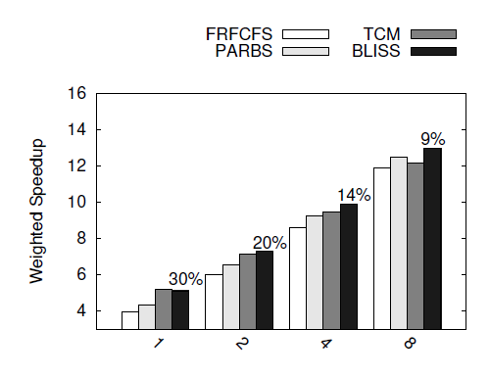
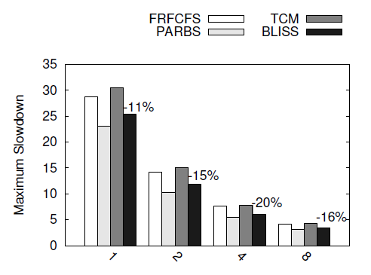
Sensitivity to Channel Count

Slide 47
Breakdown of Benefits

Slide 48
BLISS vs. Criticality-aware Scheduling

Slide 49
Sub-row Interleaving

Slide 50
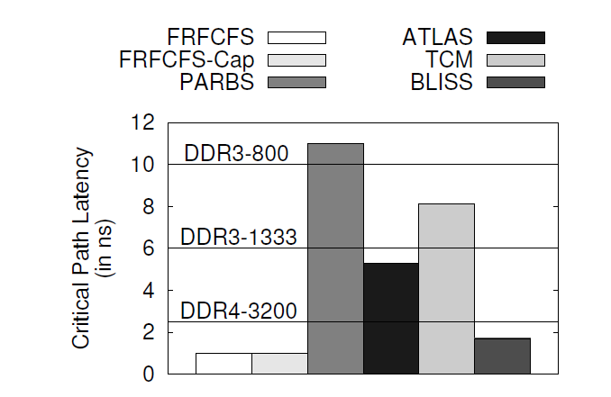
Meeting DDR Timing Requirements

