Slide 1


Bounding Memory Interference Delay in COTS-based Multi-Core Systems
Hyoseung Kim Dionisio de Niz Bjӧrn Andersson
Mark Klein Onur Mutlu Raj Rajkumar

Slide 2
Copyright 2014 Carnegie Mellon University and IEEE
This material is based upon work funded and supported by the Department of Defense under Contract No. FA8721-05-C-0003 with Carnegie Mellon University for the operation of the Software Engineering Institute, a federally funded research and development center.
NO WARRANTY. THIS CARNEGIE MELLON UNIVERSITY AND SOFTWARE ENGINEERING INSTITUTE MATERIAL IS FURNISHED ON AN “AS-IS” BASIS. CARNEGIE MELLON UNIVERSITY MAKES NO WARRANTIES OF ANY KIND, EITHER EXPRESSED OR IMPLIED, AS TO ANY MATTER INCLUDING, BUT NOT LIMITED TO, WARRANTY OF FITNESS FOR PURPOSE OR MERCHANTABILITY, EXCLUSIVITY, OR RESULTS OBTAINED FROM USE OF THE MATERIAL. CARNEGIE MELLON UNIVERSITY DOES NOT MAKE ANY WARRANTY OF ANY KIND WITH RESPECT TO FREEDOM FROM PATENT, TRADEMARK, OR COPYRIGHT INFRINGEMENT.
This material has been approved for public release and unlimited distribution.
This material may be reproduced in its entirety, without modification, and freely distributed in written or electronic form without requesting formal permission. Permission is required for any other use. Requests for permission should be directed to the Software Engineering Institute at permission@sei.cmu.edu.
Carnegie Mellon® is registered in the U.S. Patent and Trademark Office by Carnegie Mellon University.
DM-0001188

Slide 3
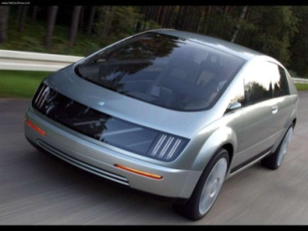

Why Multi-Core Processors?
Processor development trend
  Increasing overall performance by integrating multiple cores
Embedded systems: Actively adopting multi-core CPUs
Automotive:
  Freescale i.MX6 4-core CPU
  NVIDIA Tegra K1 platform
Avionics and defense:
  Rugged Intel i7 single board computers
  Freescale P4080 8-core CPU

Slide 4
Multi-Core Memory System
Core 1
Core 2
Core 3
…
Core P
Cache
Cache
Cache
Cache
Memory
interference
Shared
memory
resources
Memory Controller
DRAM
Bank 1
DRAM
Bank 2
DRAM
Bank 3
…
DRAM
Bank x
An upper bound on the memory interference delay is needed
to check task schedulability
Notes:
Many multi-core systems use DRAM as main memory to meet high performance and capacity demands.
The main memory is shared among all processing cores.
When multiple cores access memory at the same time, they will experience memory interference delays due to the contention.
In order to provide system predictability and check the schedulability, we need to have an upper bound on the interference delay.

Slide 5

Impact of Memory Interference (1/2)
Task execution times with memory attacker tasks
  Intel i7 4-core processor + DDR3-1333 SDRAM 8GB
PARSEC
benchmark
task
Memory
attacker
Memory
attacker
Memory
attacker
Core 1
Core 2
Core 3
Core 4
Cache
Cache
Cache
Cache
DDR3 SDRAM
* S/W cache partitioning is used
Notes:
We had a measurement to see the impact of memory interference delay in a real platform.
We measured the execution time increase due to the interfering memory requests. Intel i7 quad core machine is used in this case and DDR3 DRAM is used. For the workload, we chose the PARSEC benchmarks.
Each of the benchmarks is assigned to Core 1, and measure its execution time when other cores are idle. Then, we run memory attacker tasks on other cores, which generate severe memory interference to Core 1.

Slide 6
Impact of Memory Interference (2/2)
1 attacker → Max 5.5x increase
2 attackers → Max 8.4x increase
3 attackers → Max 12x increase
We should predict, bound and reduce the memory interference delay!
12x increase
observed
Norm. execution time (%)
black-
scholes
body-
track
canneal
ferret
fluid-
animate
freq-
mine
ray-
trace
stream-
cluster
swap-
tions
vips
x264
Notes:
In this graph, the x-axis shows the name of benchmarks and the y-axis shows the execution time normalized to when it runs without any memory interference. When only one attacker tasks was running, we observed at most 5.5 times of execution time increase. When two were running, 8.4times of increase. And three were running, maximum 12 times of execution time increase was observed. Of course, this is an extreme case, but this result shows that the amount of memory interference is non-negligible and we should be able to predict and bound the amount of memory interference delay.

Slide 7
Issues with Memory Models
Q1. Can we assume that each memory request takes
a constant service time?
  The memory access time varies considerably depending on the requested address and the rank/bank/bus states
Q2. Can we assume memory requests are serviced in either Round-Robin or FIFO order?
  Memory requests arriving early may be serviced later than ones arriving later in today’s COTS memory systems
No.
No.
An over-simplified memory model may produce pessimistic or optimistic estimates on the memory interference delay
Notes:
In order to analyze memory interference, we need to have a memory model. There are two issues in modeling a COTS main memory system.
Two questions.
For the first question, the answer is no, because memory access time significantly varies depending on the rank, bank and bus states.
The answer for the second question is also no. Because the memory scheduling policy of memory controller is different from these policies and memory requests arriving early may be serviced later than others arriving later.
Previous work typically made this assumptions and used a simplified memory model. But it may produce pessimistic or optimistic estimates.

Slide 8
Our Approach
Explicitly considers the timing characteristics of major DRAM resources
  Rank/bank/bus timing constraints (JEDEC standard)
  Request re-ordering effect
Bounding memory interference delay for a task
  Combines request-driven and job-driven approaches
Software DRAM bank partitioning awareness
  Analyzes the effect of dedicated and shared DRAM banks
Task’s own memory requests
  Interfering memory requests
  during the job execution
Notes:
Therefore we explicitly consider the timing characteristics of major DRAM resources. We take into account rank, bank and bus timing constraints based on JEDEC DRAM standard. And also we analyze the request reordering effect of the modern memory controller.
By using this realistic model, we bound memory interference delay of a task. We combine two approaches to reduce pessimism in analysis.
Request-driven considers task’s own memory requests and job-driven approach considers the interfering memory requests during the task’s job execution.
We also consider the use of DRAM bank partitioning that is known to reduce memory interference. But as the number of bank partitions is limited, we consider both dedicated and shared bank cases.

Slide 9
Outline
Introduction
Details on DRAM Systems
  DRAM organization
  Memory controller and scheduling policy
  DRAM bank partitioning
Bounding Memory Interference Delay
Evaluation
Conclusion

Slide 10
DRAM Organization
DRAM Rank
Command bus
CHIP
1
CHIP
2
CHIP
3
CHIP
4
CHIP
5
CHIP
6
CHIP
7
CHIP
8
Address bus
Data bus
64-bit
8-bit
DRAM Chip
Bank 8
Bank ...
Command decoder
Bank 1
Columns
Row decoder
Row hit
Command bus
Rows
Row conflict
Row address
Column decoder
Row buffer
Address bus
Column
address
Data bus
8-bit
DRAM access latency varies depending on which row is stored in the row buffer
Notes:
The DRAM system consists of a set of ranks and each rank consists of multiple chips. Each chip has a narrow data width, but by combining the chips in the same rank, the rank provides a wide data width.
Each chip consists of multiple banks. Each bank has a two-dimensional array where memory contents are stored. In order to access a cell in the array, the entire row containing the cell needs to be fetched into the row-buffer first. So when a next request accesses a cell in a row which is already in the row-buffer, it takes short time and it is called row-hit. If a requested cell is not in the row-buffer, the row currently in the buffer needs to be stored and the requested row should be fetched into the row buffer. This takes additional steps and takes long time. And this is called row-conflicts. Therefore, DRAM access latency varies depending on which row is currently in the row buffer.

Slide 11
Memory Controller
Memory requests from CPU cores
Processor
data bus
Request buffer
...
Bank 1
Priority
Queue
Bank 2
Priority
Queue
Bank n
Priority
Queue
Read/
Write
Buffers
Memory scheduler
Bank 1
Scheduler
Bank 2
Scheduler
...
Bank n
Scheduler
Two-level hierarchical
scheduling structure
Channel Scheduler
DRAM address/command buses
DRAM
data bus
Notes:
This is a logical structure of a modern memory controller. Memory requests from processing cores are first stored in the request buffer. The bank index of each request is classified by its physical address and the request is stored in its corresponding bank queue.
The memory scheduler has a two-level hierarchal structure. Each bank has a bank-level scheduler and it selects the highest priority request in its queue. When the highest priority request does not violate any bank-level constraints, it is sent to the channel scheduler. Then channel scheduler selects the highest priority request and services it.

Slide 12
Memory Scheduling Policy
FR-FCFS: First-Ready, First-Come First-Serve
  Goal: maximize DRAM throughput → Maximize row buffer hit rate
Bank 1
Scheduler
Bank 2
Scheduler
...
Bank n
Scheduler
Bank scheduler
  Considers bank timing constraints
  Prioritizes row-hit requests
  In case of tie, prioritizes older requests
Channel scheduler
  Considers channel timing constraints
  Prioritizes older requests
Channel Scheduler
Memory access interference occurs at both bank and channel schedulers
  Intra-bank interference at bank scheduler
  Inter-bank interference at channel scheduler
Notes:
Modern COTS memory controllers use the FR-FCFS policy as their base policy. The goal of this is to maximize DRAM throughput and to do so, it tries to maximize row buffer hit rate.
The bank scheduler considers bank timing constraints and priorities row-hit requests over row conflicts. And in case of tie, it prioritized older requests. The channel scheduler considers channel timing constraints and prioritizes older requests.
Under this policy, memory interference happens at both bank and channel schedulers. Specifically, intra-bank interference happens at the bank scheduler and inter-bank interference happens at the channel scheduler.

Slide 13
DRAM Bank Partitioning
Prevents intra-bank interference by dedicating different DRAM banks to each core
  Can be supported in the OS kernel
(1) w/o bank partitioning
(2) w/ bank partitioning
Core 1
Core 2
Core 1
Core 2
Bank 1
Scheduler
Bank 2
Scheduler
Bank 1
Scheduler
Bank 2
Scheduler
Channel Scheduler
Channel Scheduler
Intra-bank and inter-bank
interference
Only inter-bank interference
Notes:
DRAM bank partitioning is a recently actively studied technique to reduce memory interference. By dedicating different banks to each core, it prevents intra-bank interference. It can be implemented as software in the OS kernel by modifying the memory management subsystem.
Here is an example. Without bank partitioning, each bank can access all the DRAM banks, so memory interference happens at bank and channel scheduler. But with bank partitioning, each core is assigned its own dedicated bank. So no interference happens at the bank scheduler. Therefore only inter-bank interference happens.

Slide 14
Outline
Introduction
Details on DRAM Systems
Bounding Memory Interference Delay
  System Model
  Request-Driven Bounding
  Job-Driven Bounding
  Schedulability Analysis
Evaluation
Conclusion
Notes:
So far we have looked at the details on the modern DRAM systems. Now I will introduce our approach to bound memory interference.

Slide 15
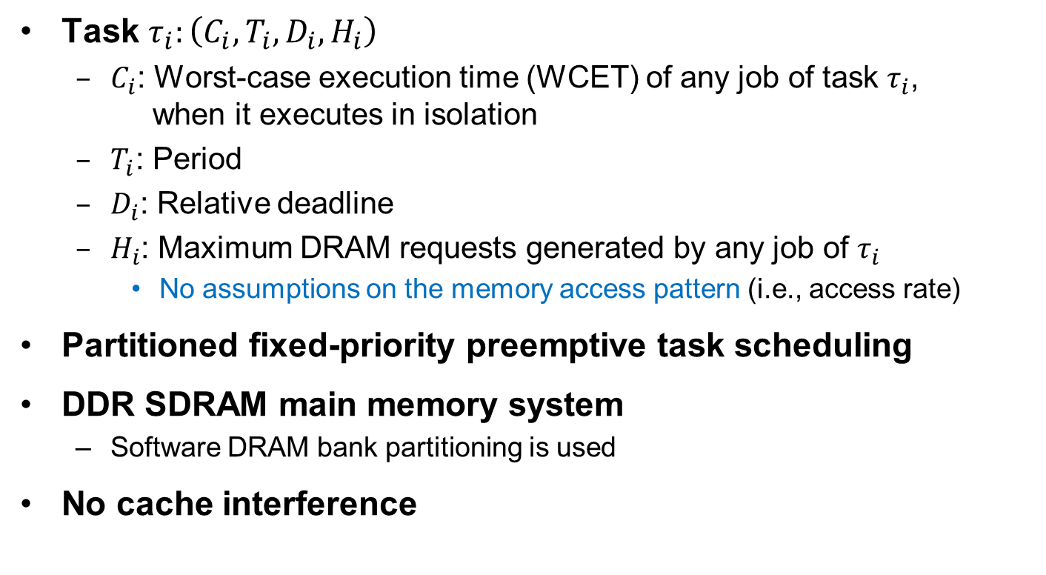
System Model
Task $τ_{i}:\left(C_{i}, T_{i}, D_{i}, H_{i}\right)$
  $C_{i}$: Worst-case execution time (WCET) of any job of task $τ_{i}$,
  when it executes in isolation
  $T_{i}$: Period
  $D_{i}$: Relative deadline
  $H_{i}$: Maximum DRAM requests generated by any job of $τ_{i}$
    No assumptions on the memory access pattern (i.e., access rate)
Partitioned fixed-priority preemptive task scheduling
DDR SDRAM main memory system
  Software DRAM bank partitioning is used
No cache interference
Notes:
For a task model, we consider periodic tasks, and each task is represented by C, T, D, H parameters. C is the worst-case execution time of any job of task when it executes in isolation. In other words, it is the WCET without any external memory interference. T is the period and D is the deadline of task. H is the maximum DRAM requests generated by task itself during its job execution. We do not make any assumptions on the memory access pattern such as memory access rate.
We consider partitioned fixed priority preemptive scheduling.
And we assume the DDR SDRAM main memory system that I explained earlier. We also consider the use of bank partitioning.
We assume that there is no cache interference, which is easily accomplished by cache partitioning. Also it is worth noting that our analysis can be easily combined with cache-related preemption delay analysis because we don’t make any assumptions on the memory access pattern. The additional memory interference due to cache reloads from preemption can be bounded by the number of cache reloads, which is provided by cache-related preemption delay analysis.

Slide 16
Bounding Memory Interference Delay
1. Request-Driven Bounding
2. Job-Driven Bounding
Response-Time Based Schedulability Analysis
Notes:
In order to bound memory interference we use two approaches, request driven and job-driven. Then they are combined by our response-time based schedulability analysis to reduce pessimism in analysis.

Slide 17

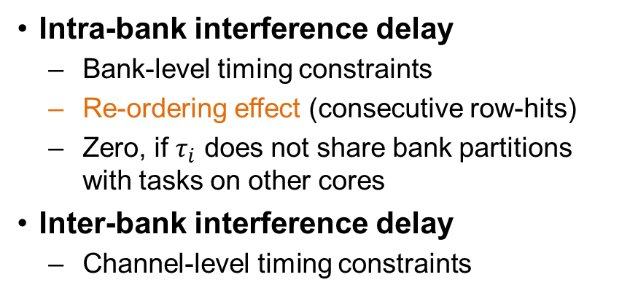
Request-Driven (RD) Approach
Focuses on # of memory requests generated by task itself ($H_{i}$)
Maximum delay imposed on each request
Total interference delay $=H_{i}×\text{(}\text{per}\text{−}\text{request} \text{interference} \text{delay}\text{)}$
Bounded by using DRAM and CPU core params
Not by using task params of other tasks
Per-request interference delay
Intra-bank interference delay
  Bank-level timing constraints
  Re-ordering effect (consecutive row-hits)
  Zero, if $τ_{i}$ does not share bank partitions
  with tasks on other cores
Inter-bank interference delay
  Channel-level timing constraints
Notes:
The request driven approach focuses on the number of memory requests generated by task itself. And it uses the maximum delay imposed on each request. Here this per-request delay is calculated by using DRAM and CPU parameters and it does not use task parameters of other tasks.
Per-request interference delay is the sum of intra-bank and inter-bank interference delay. Intra-bank interference considers bank-level timing constraints defined in the JEDEC standard. And it bounds the request reordering effect by bounding the maximum consecutive row-hit requests. Intra-bank interference is zero, if task does not share any banks with other tasks possibly running in parallel on other cores.
Inter bank interference delay considers channel-level timing constraints including rank and data bus. The total memory interference delay for task tau i is easily obtained by Hi multiplied by per request delay.

Slide 18
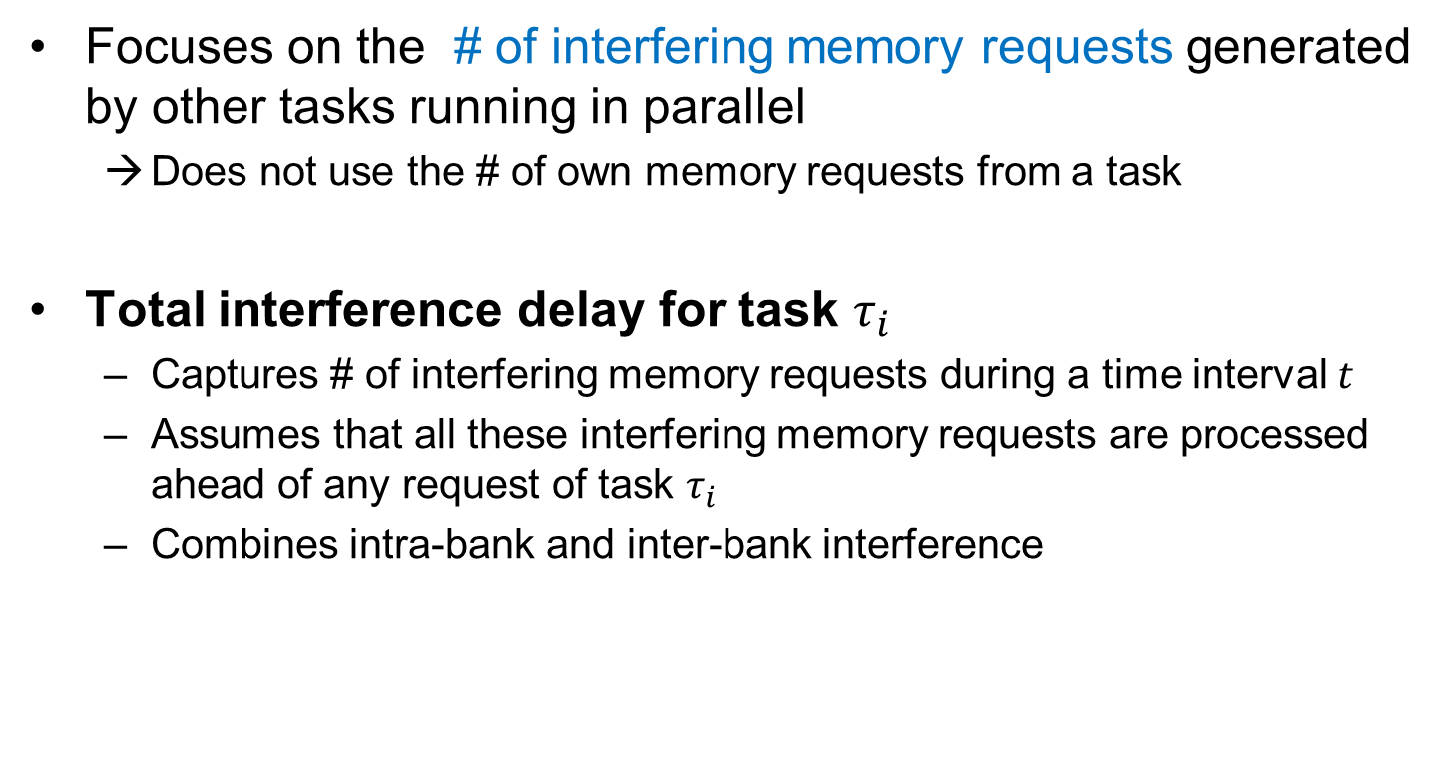
Job-Driven (JD) Approach
Focuses on the # of interfering memory requests generated by other tasks running in parallel
  Does not use the # of own memory requests from a task
Total interference delay for task $τ_{i}$
  Captures # of interfering memory requests during a time interval $t$
  Assumes that all these interfering memory requests are processed ahead of any request of task $τ_{i}$
  Combines intra-bank and inter-bank interference
Notes:
Job-driven approach focuses on the number of interfering memory requests generated by other tasks running in parallel. Unlike request-driven approach, it does not use the number of task’s own memory requests. This approach provides a lower bound than request driven, when task itself generates a lot of memory accesses but other tasks generate less memory requests.
To get total memory interference, it captures the number of interfering requests during a time interval t, and assumes that all these requests are processed ahead of any request of task tau i. So it assumes that task tau i is delayed by all other interfering requests and bounds the delay.

Slide 19
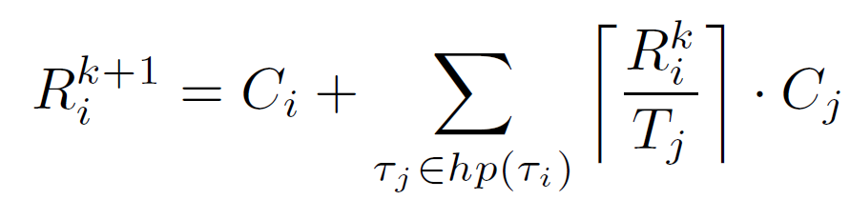
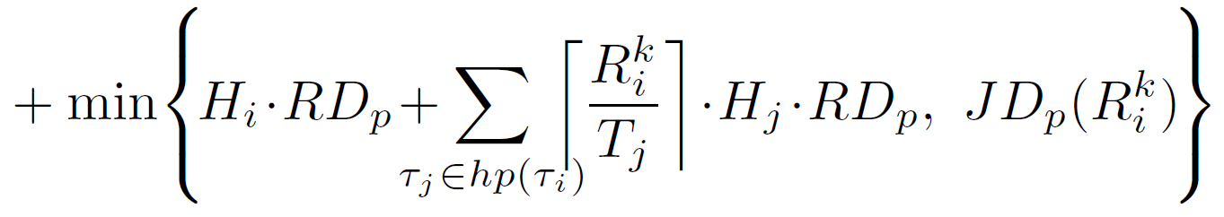
Response-Time Test
Memory interference delay cannot exceed any results from the RD and JD approaches
  We take the smaller result from the two approaches
Extended response-time test
Classical iterative response-time test
Request-Driven (RD)
Approach
Job-Driven (JD)
Approach
Notes:
The memory interference delay cannot exceed any results from the request driven and job driven approaches. So when we check the task schedulability, we take the smaller among the two approaches.
This is our extended response-time test to check schedulability in the presence of memory interference. This is the classical iterative response time test, and we extend by adding this. The first part is the request driven approach and the second part is the job-driven approach. By using this we can take into account the memory interference delay imposed on each task into schedulability test.

Slide 20
Outline
Introduction
Details on DRAM Systems
Bounding Memory Interference Delay
Evaluation
Conclusion

Slide 21
Experimental Setup
Target system
  Linux/RK
  Intel i7-2600 quad-core processor
  DDR3-1333 SDRAM (single channel configuration)
Workload: PARSEC benchmarks
Methodology
  Compare the observed and predicted response times in the presence of memory interference
  Core 1: Each PARSEC benchmark
  Core 2, 3 and 4: Tasks generating interfering memory requests
    Cache partitioning: to avoid cache interference
    Bank partitioning: to test both private and shared banks
Severe and non-severe memory interference
(modified versions of the stream benchmark)
Notes:
Here is the experimental setup. The target system runs Linux/RK as its OS. Linux/RK provides cache and bank partitioning and cache partitioning is used to avoid cache interference in accordance with out assumption. And bank partitioning is used to test both private and shared DRAM bank cases. The target system is equipped with intel i7 quad core processor and DDR3 SDRAM is used as main memory.
We used PARSEC benchmarks as the workloads.
And here is the evaluation methodology. In order to see how effectively our analysis can bound memory interference, we compared the observed and predicted response times in the present of memory interference. We assigned each PARSEC benchmark task on Core 1. And assigned tasks generating interfering memory requests on Core 2, 3 and 4. These interfering tasks have two types, one generates severe and the other one generates non-severe memory interference.

Slide 22
Severe Memory Interference (1 of 2)
Shared DRAM Bank
12x increase due to
memory interference
Observed
Predicted w/o Re-ordering effect
Predicted w/ Re-ordering effect
w/o re-ordering effect
→ overly optimistic
black-
scholes
body-
track
canneal
ferret
fluid-
animate
freq-
mine
ray-
trace
stream-
cluster
swap-
tions
vips
x264
Request re-ordering effect should be considered in COTS memory systems
Notes:
This is the increased response time of each benchmark under severe memory interference. This is the case where shared bank is used. We observed up to 12 times of increase. When we predict the memory interference without considering the reordering effect. The estimates are very optimistic. But our approach which considers re-ordering effect can bound the memory interference. This shows the importance of modeling request reordering effect.

Slide 23
Severe Memory Interference (2 of 2)
Private DRAM Bank
4.1x increase → DRAM bank partitioning
helps reducing the memory interference
Observed
Predicted
black-
scholes
body-
track
canneal
ferret
fluid-
animate
freq-
mine
ray-
trace
stream-
cluster
swap-
tions
vips
x264
Our analysis enables the quantification of the benefit of DRAM bank partitioning
Notes:
This is the case where private DRAM bank is used. We observed up to 4.1 times increase which is much less than the shared bank case. This result shows that bank partitioning helps reducing the amount of memory interference. Our analysis is aware of private bank and bound the memory interference with only 8% of over estimates on average. Also by comparing the shared and the private bank cases, our analysis enables quantifying how much memory interference can be reduced by bank partitioning.

Slide 24
Non-severe Memory Interference
Private DRAM Bank
Average over-estimates are 8% (13% for a shared bank)
Observed
Predicted
black-
scholes
body-
track
canneal
ferret
fluid-
animate
freq-
mine
ray-
trace
stream-
cluster
swap-
tions
vips
x264
Our analysis bounds memory interference delay with low pessimism
under both high and low memory contentions
Notes:
These are the results under non-severe memory interference. The amount of memory interference is much less than the server interference cases. On average, the over estimates from our analysis was 8% for a private bank and 13% for a shared bank. The evaluation results show that our analysis bounds memory interference delay with low pessimism under both high and low memory contentions.s

Slide 25
Conclusions
Analysis for bounding memory interference
  Based on a realistic memory model
    JEDEC DDR3 SDRAM standard
    FR-FCFS policy of the memory controller
    Shared and private DRAM banks
  Combination of the request-driven and job-driven approaches
    Reduces pessimism in analysis (8% under severe interference)
Advantages
  Does not require any modifications to hardware components or application software
  Readily applicable to COTS-based multicore real-time systems
Future work
  Pre-fetcher, multi-channel memory systems
Notes:
We propose an analysis for bounding memory interference delay in a multi-core system with DRAM main memory. Our analysis is based on a realistic memory model which considers JEDEC standard, FR-FCFS memory scheduling policy of modern memory controllers, and shared and private DRAM banks. We used the combination of two approaches, request-driven and job-driven, and this combination reduces the pessimism in analysis.
The advantage of our work is that it does not require any modifications to hardware or application software to provide predictability in memory accesses. So it can be readily applicable to COTS-based multi-core systems.
For future work, we consider the effects of prefetcher units and multi-channel memory systems, because those are very important issues to be solved to provide high performance while providing predictabilityu.

