Slide 1
ChargeCache Reducing DRAM Latency by Exploiting Row Access Locality
Hasan Hassan,
Gennady Pekhimenko,
Nandita Vijaykumar,
Vivek Seshadri, Donghyuk Lee, Oguz Ergin, Onur Mutlu
Notes:
Hello, my name is Hasan Hassan.
Today, I will present you our work named ChargeCache.
This work is done in collaboration with co-authors from Carnegie Mellon University and TOBB University of Economics & Technology.

Slide 2
Executive Summary
Goal: Reduce average DRAM access latency with no modification to the existing DRAM chips
Observations:
A highly-charged DRAM row can be accessed with low latency
A row’s charge is restored when the row is accessed
A recently-accessed row is likely to be accessed again:
Row Level Temporal Locality (RLTL)
Key Idea: Track recently-accessed DRAM rows and use lower timing parameters if such rows are accessed again
ChargeCache:
Low cost & no modifications to the DRAM
Higher performance (8.6-10.6% on average for 8-core)
Lower DRAM energy (7.9% on average)
Notes:
Let’s first take a high level glance at this work.
[CLICK]
DRAM latency is a critical bottleneck for system performance. Given that the DRAM chips are difficult to change, our goal in this work is to reduce average DRAM access latency with no modifications to the existing DRAM chips.
[CLICK]
We achieve that goal by exploiting three key observations.
First, a highly-charged DRAM row can be accessed with low latency.
Second, a row’s charge is restored when the row is accessed.
Third, we find that a recently-accessed row is likely to be accessed again. We call that
Row Level Temporal Locality and we find that many applications, both single-core and multi-core, exhibit that phenomenon.
Based on that we develop the key idea of ChargeCache.
The key idea is to track recently-accessed rows and use lower timing parameters if they are accessed again.
We show that ChargeCache is low cost and requires no modifications to the existing DRAM chips.
According to our evaluations, ChargeCache improves performance between 8.6% and 10.6% on average for 8-core system, depending on the ChargeCache capacity. It also saves 7.9% energy on average.

Slide 3
Outline
1. DRAM Operation Basics
2. Accessing Highly-charged Rows
3. Row Level Temporal Locality (RLTL)
4. ChargeCache
5. Evaluation
6. Conclusion
Notes:
This is the outline of todays talk.
I will first briefly provide necessary background on DRAM operation

Slide 4
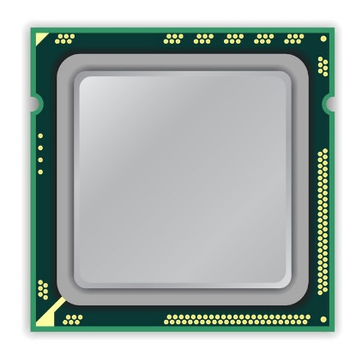
DRAM Stores Data as Charge
DRAM Cell
Three steps of charge movement
MemCtrl
CPU
1. Sensing
2. Restore
3. Precharge
Sense-Amplifier
Notes:
Processors incorporate a Memory Controller which handles the communication with the DRAM module. The memory controller translates processors load/store requests to DRAM commands to perform the corresponding access.
A DRAM chip, which builds up the DRAM module, consists of DRAM cells and Sense Amplifiers as shown in the right-side.
DRAM cells are organized as 2D cell array where the horizontal cells are grouped into DRAM rows.
DRAM Cells store single bit of information by varying the charge amount stored.
There are three main phases of acessing data in DRAM.
First, when a row is selected, the cells of the selected row drive their charge to the sense amplifiers.
The sense amplifiers recognize the stored data based on the amount of charge flowed into them.
This operation is called Sensing.
As you see, DRAM cells lose the data on the Sensing phase. Thus,
To reconstruct the original data, sense
Amplifiers restore the charge of the cells back to their initial level.
Later, the active row can be deselected if needed to put the sense amplifiers back to their initial state and prepare The DRAM for the next access.

Slide 5
DRAM Charge over Time
Ready to Access
Ready to
Precharge
Ready to Access
Charge Level
Cell
Cell
Data 1
charge
Sense-Amplifier
Data 0
Sense
Amplifier
Sensing
Restore
Precharge
time
tRCD
ACT
R/W
PRE
tRAS
Notes:
Let’s look at the same phases from the charge level perspective.
[CLICK]
The figure shows the change of charge levels of a DRAM Cell and Sense Amplifier in Y-axis, and the time in X-axis.
Initially, our cell contains charge that matches the region of Data 1, which can be treated as 0 or 1.
[CLICK]
To access the data stored in the cell, the charge of the sense amplifier should reach «Read to Access Charge Level».
The memory controller initiates Sensing phase by issuing Activate command.
On Sensing, the charge is transferred from the Cell to the Sense-Amplifier.
That slightly increases the charge of the Sense Amplifier. When the Sense Amplifier reaches
The threshold charge to recognize the data, Sensing phase finishes and Restore begins.
[CLICK]
During restore, both the
Sense Amplifier and the DRAM cell are driven back to fully charged state.
At the point where the sense amplifier reaches «ready to access charge level», the
Memory controller is free to issue Read or Write command.
[CLICK]
The time passed since ACT to READ or WRITE is called tRCD. [CLICK]
At the end of restore, the memory controller could issue PRE command if needed. [CLICK]
That triggers the Precharge phase where the Sense Amplifier charge gets back to its pre-sensing value.
The time from the start of the Sensing upon the completion of Restore is called tRAS. [CLICK]
The main takeaway in this slide is that the memory controller accesses DRAM using DRAM commands and determines the Access latency by satisfying the timing parameters.

Slide 6
Outline
1. DRAM Operation Basics
2. Accessing Highly-charged Rows
3. Row Level Temporal Locality (RLTL)
4. ChargeCache
5. Evaluation
6. Conclusion
Notes:
Now, let me explain what is a highly-charged row and how different is accessing it.

Slide 7
Accessing Highly-charged Rows
Ready to Access
Ready to Precharge
Cell
Data 1
charge
Sense-Amplifier
Data 0
Sensing
Restore
Precharge
time
tRCD
ACT
R/W
R/W
PRE
PRE
tRAS
Notes:
The blue dots show the points where the sense amplifier reaches ready to access
And ready to precharge charge levels for a cell with the current initial charge.
Now, Let’s see how these points change when accessing a cell with higher initial charge.
[CLICK]
When the cell’s initial charge is close to the maximum level, Sensing and Restore phases
complete quicker. Hence, READ or WRITE and PRE commands can be issued
Eairlier. That corresponds to reduction on tRCD and tRAS timing parameters.
[CLICK]
Please refer to our paper to get more detailed explanation for that phenomenon.

Slide 8
Observation 1
A highly-charged DRAM row can be accessed with low latency
tRCD: 44%
tRAS: 37%
How does a row become highly-charged?
Notes:
So, we can access highly-charged rows faster.
[CLICK]
According to our SPICE simulations, highly-charged rows can be accessed
With 44% lower tRCD and 37% lower tRAS.
[CLICK]
Now, the question is: «How does a row become highly-charged?»

Slide 9
How Does a Row Become Highly-Charged?
DRAM cells lose charge over time
Two ways of restoring a row’s charge:
Refresh Operation
Access
charge
Refresh
Access
Refresh
time
Notes:
One thing to note is that DRAM cells are leaky, which means they lose charge over time.
To reliably store the data, cell’s charge needs to be restored.
[CLICK]
There are two ways of restoring the charge of the cells in a DRAM row. [CLICK]
The memory controller periodically issues REFRESH commands to continuously preserve data in DRAM.
[CLICK]
Second, as I showed in the previous slides, data accesses also inherently replenish the charge of the Cells.
As a result, we could know that the cell is in highly-charged state, if it was either recently refreshed Or recently-accessed.

Slide 10
Observation 2
A row’s charge is restored when the row is accessed
How likely is a recently-accessed row to be accessed again?
Notes:
So, a row’s charge is restored when the row is accessed.
And now the question is: «How likely is a recently-accessed row to be accessed again?»

Slide 11
Outline
1. DRAM Operation Basics
2. Accessing Highly-charged Rows
3. Row Level Temporal Locality (RLTL)
4. ChargeCache
5. Evaluation
6. Conclusion
Notes:
Our new observation «Row Level Temporal Locality (RLTL)» answers that question.

Slide 12
Row Level Temporal Locality (RLTL)
A recently-accessed DRAM row is likely to be accessed again.
t-RLTL: Fraction of rows that are accessed within time t after their previous access
86%
97%
8ms – RLTL for single-core workloads
8ms – RLTL for eight-core workloads
Notes:
We observe that when DRAM row is accessed, it is likely
to be accessed again. We call this phenomenon Row Level Temporal Locality (RLTL).
We define t-RLTL of an application,
as the fraction of rows that are accessed within time t after their previous access.
If an application has high RLTL for low T time, that application mostly accesses highly-charged DRAM rows, since the rows preserve most of their charge until the next access, which happens in a very Short interval.
Now, I’ll show the RLTL characteristics of 22 single-core workloads that we evaluted.
On Y-axis we have the fraction of accesses and on the X-axis we have the workloads.
[CLICK]
Our results show that, on average, 86% of the accesses are made to rows previously accessed within 8 ms.
Only one application has low RLTL. It is because that application makes very
Few accesses to the memory since it highly benefits from the caches.
For eight-core evaluations, the applications show even higher RLTL, 97%. It is due to the interference that the simultaneously runnning applications create on the memory.

Slide 13
Outline
1. DRAM Operation Basics
2. Accessing Highly-charged Rows
3. Row Level Temporal Locality (RLTL)
4. ChargeCache
5. Evaluation
6. Conclusion
Notes:
Now, I will talk about ChargeCache, the mechanism that we propose to reduce average
DRAM access latency.

Slide 14
Summary of the Observations
A highly-charged DRAM row can be accessed with low latency
A row’s charge is restored when the row is accessed
A recently-accessed DRAM row is likely to be accessed again:
Row Level Temporal Locality (RLTL)
Notes:
Let me first summarize the three observations that ChargeCache is based on.
Highly-charged rows can be accessed with lower latency.
Recall that, If the row is highly-charged, it will proceed through the 2 steps (Sensing, Restore) quicker.
Observation 2: Recall that, when we access a row, the cells in that row first drive their charge
To the sense amplifiers, then Sense Amplifiers drive the cells to
Full charge.
Observation 3: In the previous slide, we saw that application typically have high RLTL. We can exploit That behavior to detect highly-charged rows by keeping track of the rows accessed in near past.

Slide 15
Key Idea
Track recently-accessed DRAM rows and use lower timing parameters if such rows are accessed again
Notes:
The key idea of our mechanism is to
Track recently-accessed DRAM rows and use lower timing parameters
if such rows are accessed again.

Slide 16
ChargeCache Overview
DRAM
:A
Memory Controller
:B
ChargeCache
:C
A
:D
D
:E
:F
Requests:
A
D
A
Use Lower Timings
ChargeCache Miss:
Use Default Timings
ChargeCache Hit:
Notes:
We named our mechanism ChargeCache as it provides a cache-like benefit by reducing access
Latency and does so by taking advantage of the charge level stored in the row.
Now, I will demonstrate how ChargeCache works.
We have ChargeCache inside the Memory Controller.
On the right, you see a respesentation of DRAM where we have rows labeled from A to F.
[CLICK]
When the memory controller receives the first request to row A, it serves that request with typical timing parameters since we have
Nothing in ChargeCache. When
The request completes, it inserts the row address to one of the ChargeCache entries since we know that the row is highly-charged at that time. So, after that point,
The first entry points to Row A.
[CLICK]
The next request targets Row D. The memory controller probes the ChargeCache. It misses since we have only
Row A there. Similarly, Row D is inserted to ChargeCache.
[CLICK]
However, when we receive a request targetting row that we have in ChargeCache, the memory controller knows that the access
Goes to a highly-charged Row and tunes the DRAM Timing parameters to lower the access latency.
If there are not incoming requests to the Rows stored in ChargeCache for a long time, these rows will leak significant
Amount of charge and won’t be highly-charged rows anymore. For that reason, they need to be discarded from ChargeCache. [CLICK]
ChargeCache implements a low-cost mechanism to automatically invalidate its entries to ensure that its entries always
Point to highly-charged rows.

Slide 17
Area and Power Overhead
Modeled with CACTI
Area
~5KB for 128-entry ChargeCache
0.24% of a 4MB Last Level Cache (LLC) area
Power Consumption
0.15 mW on average (static + dynamic)
0.23% of the 4MB LLC power consumption
Notes:
ChargeCache improves average DRAM access latency with low area and
Power consumption overhead. We evaluated that using CACTI tool.
A 128-entry ChargeCache totally requires only approximately 5KB of storage.
That is equal to 0.24% of the area of a 4MB Last Level Cache.
According to our evaluations, ChargeCache consumes only total 0.15 milli watts
Power on average. That is equal to 0.23% of the power consumption of a 4MB LLC.
We conclude that ChargeCache is a low cost mechanism in terms of area requirement and
Power consumption.

Slide 18
Outline
1. DRAM Operation Basics
2. Accessing Highly-charged Rows
3. Row Level Temporal Locality (RLTL)
4. ChargeCache
5. Evaluation
6. Conclusion
Notes:
Now, I will move on to the evaluation part.

Slide 19
Methodology
Simulator
DRAM Simulator (Ramulator [Kim+, CAL’15])
https://github.com/CMU-SAFARI/ramulator
Workloads
22 single-core workloads
SPEC CPU2006, TPC, STREAM
20 multi-programmed 8-core workloads
By randomly choosing from single-core workloads
Execute at least 1 billion representative instructions per core (Pinpoints)
System Parameters
1/8 core system with 4MB LLC
Default tRCD/tRAS of 11/28 cycles
Notes:
To evaluate ChargeCache, we used Ramulator, a cycle-accurate DRAM simulator.
For single-core evaluations, we analyzed 22 workloads from benchmark sets SPEC2006, TPC, and STREAM.
For multi-core evaluations we analyzed 20 multi-programmed workloads by assigning randomly-chosen
Single-core workload to each core.
For all workloads, we executed at least 1 billion representative instructions per core that we obtained using Pinpoints.
We evaluated both single and eight core systems with 4MB shared LLC.
Default tRCD and tRAS timings are 11 and 28 cycles respectively.

Slide 20
Mechanisms Evaluated
Non-Uniform Access Time Memory Controller (NUAT) [Shin+, HPCA’14]
Key idea: Access only recently-refreshed rows with lower timing parameters
Recently-refreshed rows can be accessed faster
Only a small fraction (10-12%) of accesses go to recently-refreshed rows
ChargeCache
Recently-accessed rows can be accessed faster
A large fraction (86-97%) of accesses go to recently-accessed rows (RLTL)
128 entries per core, On hit: tRCD-7, tRAS-20 cycles
Upper Bound: Low Latency DRAM
Works as ChargeCache with 100% Hit Ratio
On all DRAM accesses: tRCD-7, tRAS-20 cycles
Notes:
Besides ChargeCache, we also evaluate Non-uniform access Time Memory Controller
Which was proposed in HPCA’14. It is the most closely related previous work to ChargeCache. The key idea of NUAT is to access only recently-refreshed rows at low latency. The upside
Of this work is that the recently-refreshed rows can be accessed faster.
However, we find that only a small fraction of accesses go to
Recently-refreshed rows. We have detailed analysis on that in our paper.
In contrast, ChargeCache can access recently-accessed rows faster.
We find that a large fraction of accesses go to recently-accessed rows
Due to the RLTL phenomenon. We evaluate ChargeCache with 128-entry
Capacity per core and on Hit we access DRAM with tRCD of 7 cycles and
tRAS of 20 cycles.
As an performance upper bound, we evaluate the performance of Low Latency DRAM which works
Like ChargeCache with 100% hit ratio. In other words, Low Latency DRAM
Has lower default tRCD and tRAS timing parameters for all DRAM accesses,
Which are the same as we have on ChargeCache hit case.

Slide 21
Single-core Performance
NUAT
ChargeCache
ChargeCache + NUAT
LL-DRAM (Upper bound)
ChargeCache improves
single-core performance
Notes:
Lets see how these mechanisms perform in single-core systems.
Here, on the Y-axis we have speedup and on the X-axis we have the workloads.
On this slide I show results for 10 most memory intensive workloads. However, the
Average includes all 22 applications that we evaluate.
As you see, NUAT improves performance slightly as expected.
On the other hand, ChargeCache significantly outperforms NUAT.
When used in combination, ChargeCache and NUAT provides some improvement over ChargeCache alone.
And LL-DRAM shows the maximum level of performance that we can achieve assuming all the rows are Highly-charged.
Generally, ChargeCache performs relatively close to LL-DRAM with a few exceptions. ChargeCache cannot perform As good as LL-DRAM because these workloads have significantly large working set which does not fit well in ChargeCache. We have analysis on ChargeCache with larger capacities in our paper.
So, as a conclusion, we can say that ChargeCache improves single-core performance.

Slide 22
Eight-core Performance
NUAT
2.5%
ChargeCache
9%
ChargeCache + NUAT
LL-DRAM (Upperbound)
13%
ChargeCache significantly improves multi-core performance
Notes:
For eight-core workloads, we again show only results for 10 most memory intensive workloads
And provide average of all 20 multi-programmed workloads we evalated.
NUAT again performs here relatively poorly and achieves only up to 2.5% speedup on average.
ChargeCache performs significantly better than NUAT. With eight-core workloads, ChargeCache
Achieves 9% improvement, on average.
ChargeCache performs better in eight-core systems due to interference that simultaneously running cores create on the main memory subsystem.
ChargeCache and NUAT, can improve the performance more when used together.
And finally LL-DRAM shows the upper bound that we can achieve. ChargeCache covers a relatively large portion of the performance that a LL-DRAM can provide.
We conclude that ChargeCache significantly improves multi-core performance.

Slide 23
DRAM Energy Savings
ChargeCache reduces DRAM energy
Notes:
ChargeCache provides energy savings due to the reduced execution time.
Here we show the average and maximum energy savings on the DRAM subsystem
For both single-core and eight-core evaluations.
ChargeCache can save up to almost 15% energy on the DRAM subsystem.
Note that, we also get system-wide energy savings due to the reduced execution time.
So, we conclude that ChargeCache saves DRAM energy.

Slide 24
Other Results In The Paper
Detailed analysis of the Row Level Temporal Locality phenomenon
ChargeCache hit-rate analysis
Sensitivity studies
Sensitivity to t in t-RLTL
ChargeCache capacity
Notes:
Please check our paper for more results.
In the paper you can find a detailed analysis on RLTL phenomenon.
We also have ChargeCache hit-rate analysis and
Sensitivity studies to t in t-RLTL and ChargeCache capacity.

Slide 25
Outline
1. DRAM Operation Basics
2. Accessing Highly-charged Rows
3. Row Level Temporal Locality (RLTL)
4. ChargeCache
5. Evaluation
6. Conclusion
Notes:
let me conclude

Slide 26
Conclusion
ChargeCache reduces average DRAM access latency at low cost
Observations:
A highly-charged DRAM row can be accessed with low latency
A row’s charge is restored when the row is accessed
A recently-accessed row is likely to be accessed again: Row Level Temporal Locality (RLTL)
Key Idea: Track recently-accessed DRAM rows and use lower timing parameters if such rows are accessed again
ChargeCache:
Low cost & no modifications to the DRAM
Higher performance (8.6-10.6% on average for 8-core)
Lower DRAM energy (7.9% on average)
Source code will be available in May
https://github.com/CMU-SAFARI
Notes:
We proposed a mechanism, ChargeCache, which reduce average DRAM access latency at low cost.
ChargeCache is based on three observations.
First, highly-charged cells complete Sensing and Restore phases faster. So, they can be
Accessed with lower latency.
Second, a row’s charge is restored when it is accessed.
Third, we make a new observation that applications typically exhibit high Row level temporal locality. Which means, a recently-accessed row is likely to be accessed again.
The key idea of ChargeCache is to track recently-accessed DRAM rows and use lower timing parameters if such rows are accessed again.
Our low cost mechanism, ChargeCache, provide significant performance improvement and energy savings without any modifications to the existing DRAM chips.
We plan to release the source code of this work in May.

Slide 27
ChargeCache Reducing DRAM Latency by Exploiting Row Access Locality
Hasan Hassan,
Gennady Pekhimenko,
Nandita Vijaykumar,
Vivek Seshadri, Donghyuk Lee, Oguz Ergin, Onur Mutlu
Notes:
Thanks for your patience. Now, I’m happy to answer any question.

Slide 28
Backup Slides

Slide 29
Detailed Design
Highly-charged Row Address Cache (HCRAC)
1
PRE
Insert Row Address
3
Invalidation Mechanism
2
ACT
Lookup the Address
Notes:
In this slide, I will talk about the detailed design of ChargeCache.
ChargeCache implements a table of highly-charged row addresses which we call Highly-charged Row Address cache. HCRAC is organized
Similar to set-associative caches but we store only the row addresses there. Higher number
Of entries can potentially improve the benefit of ChargeCache further. However, our evaluations
Show ChargeCache also provides significant performance improvement at low cost with small number of Entries such as 128.
ChargeCache mainly performs three operations.
First, whenever the memory controller issues a precharge command,
We insert the address of the precharging row to the table. Since the precharge command
is only associated with the bank address to precharge, but not the active row address, we get the row address from the
registers that the memory controller already stores.
Second, when the memory controller issues Activate, the memory controller looks up
HCRAC with the address of the target row. On hit, which means that a highly-charged row
is detected, the memory controller updates
The timing state for the accessed bank with lower timing parameters. Hence, subsequent READ/WRITE
And Precharge Commands can be issued earlier.
The third operation that ChargeCache performs is automatic invalidation. Entries that point to rows not accessed
For a while have to be discarded from HCRAC since they won’t be in highly-charged state anymore. ChargeCache
implements a low cost invalidation mechanism which is similar to the way refreshes are performed in DRAM.
A Counter points to the next CacheCache entry to be invalidated. Periodically, the entry that this counter points to is invalidated and the counter is incremented. That approach eventually discards all the entries one by one.
Therefore, it can ensure that an entry does not stay in ChargeCache for more than the specified time.
Our simple mechanism performs only these 3 operations.
ChargeCache is a low cost mechanism which reduces average DRAM access latency.

Slide 30
RLTL Distribution

Slide 31
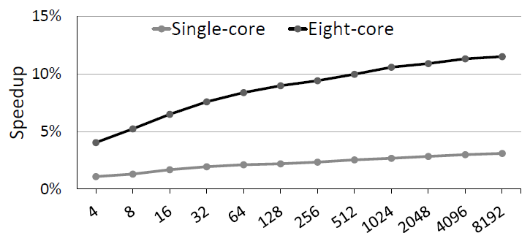
Sensitivity on Capacity

Slide 32
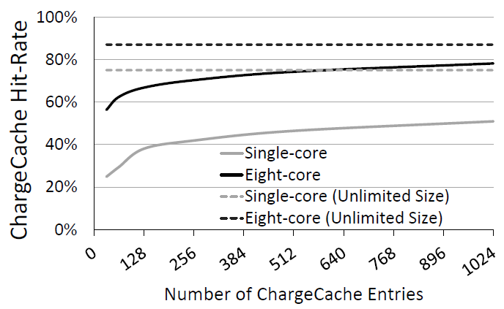
Hit-rate Analysis

Slide 33
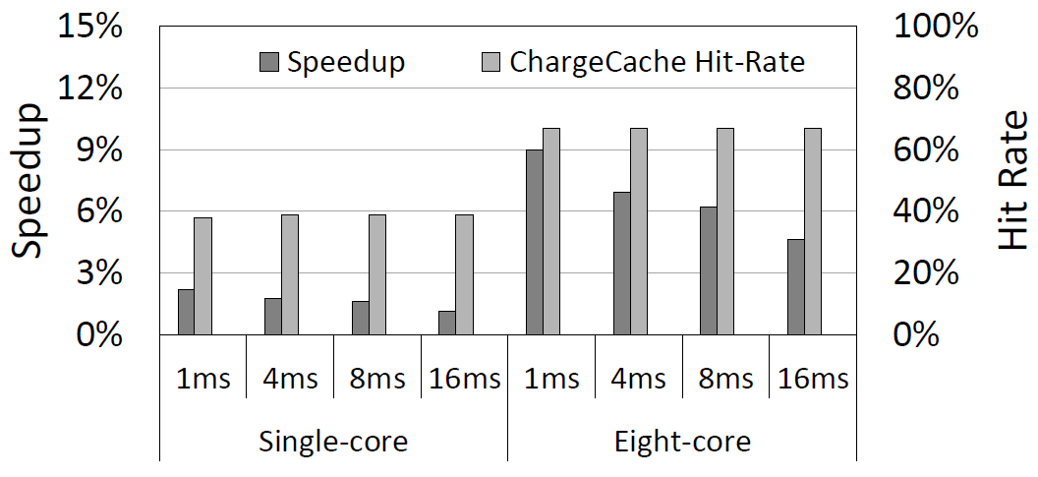
Sensitivity on t-RLTL

