Slide 1


DASH: Deadline-Aware High-Performance Memory Scheduler for Heterogeneous Systems with Hardware Accelerators
Hiroyuki Usui, Lavanya Subramanian
Kevin Chang, Onur Mutlu
DASH source code is available at GitHub
https://github.com/CMU-SAFARI/HWASim
Notes:
Hello, everyone. I am Hiroyuki Usui. Today I will present “DASH: Deadline-Aware High-Performance Memory Scheduler for Heterogeneous Systems with Hardware Accelerators”. This work has been done together with Lavanya Subramanian, Kevin Chang, and Onur Mutlu.

Slide 2
Current SoC Architectures
CPU
CPU
CPU
CPU
HWA
HWA
HWA
Shared Cache
DRAM Controller
DRAM
Heterogeneous agents: CPUs and HWAs
  HWA : Hardware Accelerator
Main memory is shared by CPUs and HWAs → Interference
How to schedule memory requests from CPUs and HWAs
to mitigate interference?
Notes:
Today’s SoCs are usually heterogeneous architecture, which integrates heterogeneous agents, like CPUs and HWAs. CPUs and HWAs share main memory, causing interference among memory requests from Cpus and HWAs. The problem for the heterogeneous systems is how to schedule memory requests from CPUs and HWAs to mitigate interference on the memory controller. We solve this problem in this work.

Slide 3
DASH Scheduler: Executive Summary
Problem: Hardware accelerators (HWAs) and CPUs share the same memory subsystem and interfere with each other in main memory
Goal: Design a memory scheduler that improves CPU performance while meeting HWAs’ deadlines
Challenge: Different HWAs have different memory access characteristics and different deadlines, which current schedulers do not smoothly handle
  Memory-intensive and long-deadline HWAs significantly degrade CPU performance when they become high priority (due to slow progress)
  Short-deadline HWAs sometimes miss their deadlines despite high priority
Solution: DASH Memory Scheduler
  Prioritize HWAs over CPU anytime when the HWA is not making good progress
  Application-aware scheduling for CPUs and HWAs
Key Results:
  1) Improves CPU performance for a wide variety of workloads by 9.5%
  2) Meets 100% deadline met ratio for HWAs
DASH source code freely available on the GitHub
Notes:
Here’s an executive summary. The problem is hardware accelerators and CPUs share the same memory subsystem and interfere with each other.
So, the goal of this work is to design a memory scheduler that improves CPU performance while meeting HWAs’ deadlines.
The challenge to achieve the goal is different HWAs have different memory access characteristics and different deadlines. For example, memory-intensive and long-deadline HWAs significantly degrade CPU performance when they become high priority due to their slow progress. On the other hand, short-deadline HWAs sometimes miss their deadlines despite high priority. Current schedulers do not smoothly handle this difference.
For solution of this challenge, DASH memory scheduler uses 3 key ideas.
First, to meet HWAs’ deadlines, DASH prioritizes HWAs over CPU anytime when the HWA is not making good progress.
Second, however, DASH tries to prevents a HWA from becoming high priority. It is OK to prioritize the HWA over a memory-intensive CPU even when the HWA is making good progress.
Third, DASH prioritizes short-deadline-HWAs over long-deadlin-HWAs and CPUs based on worst-case memory access time estimation.
As the key results, DASH improves CPU performance for a wide variety of different CPU workloads by 9.5% and it achieves 10% deadline met ratio of HWAs.

Slide 4
Outline
Introduction
Problem with Existing Memory Schedulers for Heterogeneous Systems
DASH: Key Ideas
DASH: Scheduling Policy
Evaluation and Results
Conclusion
Notes:
Here’s the outline for my talk. I’ve talked about introduction of heterogeneous systems. Next, I will talk about state-of-the-art memory scheduling for heterogeneous systems.

Slide 5
Outline
Introduction
Problem with Existing Memory Schedulers for Heterogeneous Systems
DASH: Key Ideas
DASH: Scheduling Policy
Evaluation and Results
Conclusion

Slide 6
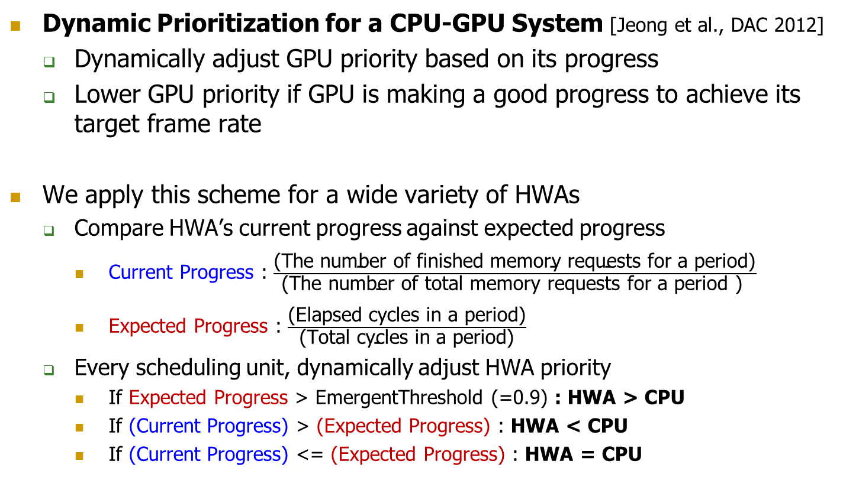
Existing QoS-Aware Scheduling Scheme
Dynamic Prioritization for a CPU-GPU System [Jeong et al., DAC 2012]
  Dynamically adjust GPU priority based on its progress
  Lower GPU priority if GPU is making a good progress to achieve its target frame rate
We apply this scheme for a wide variety of HWAs
  Compare HWA’s current progress against expected progress
    Current Progress : $\frac{\text{(}\text{The} \text{number} \text{of} \text{finished} \text{memory} \text{requests} \text{for} \text{a} \text{period}\text{)}}{\text{(}\text{The} \text{number} \text{of} \text{total} \text{memory} \text{requests} \text{for} \text{a} \text{period}\text{ ) }}$
    Expected Progress : $\frac{\text{(}\text{E}\text{lapsed} \text{cycles} \text{in} \text{a} \text{period}\text{)}}{\text{(}\text{T}\text{otal} \text{cycles} \text{in} \text{a} \text{period}\text{)}}$
  Every scheduling unit, dynamically adjust HWA priority
    If Expected Progress > EmergentThreshold (=0.9) : HWA > CPU
    If (Current Progress) > (Expected Progress) : HWA < CPU
    If (Current Progress) <= (Expected Progress) : HWA = CPU
Notes:
To manage interference between CPU cores and GPUs, a state-of-the-art technique proposes to dynamically adjust memory access priority between CPU cores and GPUs.
They check GPU’s progress and if GPU is making a good progress to achieve its target frame rate, the memory controller lowers GPU priority.
We apply this scheme for a wide variety of HWAs.
The memory controller compare HWA’s current progress against expected progress. We define CurrentProgress as the fraction of the total number of memory requests that have been completed for a period. ExpectedProgress is defined as the fraction of cycles elapsed during a period.
Every scheduling unit, memory controller dynamically adjusts HWA priority.
If current progress is greater than expected progress, it means HWA is making good progress to meet HWA’s deadline, then HWA requests are given lower priority than CPU requests. On the other hands, if current progress is less than or equal to ExpectedProgress, because it means HWA is not on track to meet its deadline, HWA requests are given the same priority as CPU requests. Only when expected progress is greater than EmergentThreshold(=0.90), the HWA requests are given higher priority than CPU requests.

Slide 7

Problems in Dynamic Prioritization
Dynamic Prioritization for a CPU-HWA system
  Compares HWA’s current progress against expected progress
    Current Progress : $\frac{\text{(}\text{The} \text{number} \text{of} \text{finished} \text{memory} \text{requests} \text{for} \text{a} \text{period}\text{)}}{\text{(}\text{The} \text{number} \text{of} \text{total} \text{memory} \text{requests} \text{for} \text{a} \text{period}\text{ ) }}$
    Expected Progress : $\frac{\text{(}\text{E}\text{lapsed} \text{cycles} \text{in} \text{a} \text{period}\text{)}}{\text{(}\text{T}\text{otal} \text{cycles} \text{in} \text{a} \text{period}\text{)}}$
  Every scheduling unit, dynamically adjust HWA priority
    If Expected Progress > EmergentThreshold (=0.9) : HWA > CPU
    If (Current Progress) > (Expected Progress) : HWA < CPU
    If (Current Progress) <= (Expected Progress) : HWA = CPU
An HWA is prioritized over CPU cores only when it is closed to HWA’s deadline
This scheme does not consider the diverse memory access characteristics of
CPUs and HWAs
  It treats each CPU and each HWA equally
The HWA often misses deadlines
Missing opportunities to improve system performance
Notes:
We observe this dynamic prioritization has two major problems. First, An HWA is prioritized over CPU cores only when it is closed to HWA’s deadline. As a result, the HWA often misses deadlines It causes HWA’s deadline miss because available memory bandwidth in remaining time sometimes is not enough to meet the HWA’s deadline.
Second, This scheme does not consider the diverse memory access characteristics of CPUs and HWAs. It treats all HWAs or CPUs equally. It is missing opportunity to improve system performance.

Slide 8
Outline
Introduction
Problem with Existing Memory Schedulers for Heterogeneous Systems
DASH: Key Ideas
DASH: Scheduling Policy
Evaluation and Results
Conclusion
Notes:
Then, I will explain key ideas of DASH scheduler to solve those two problems.

Slide 9
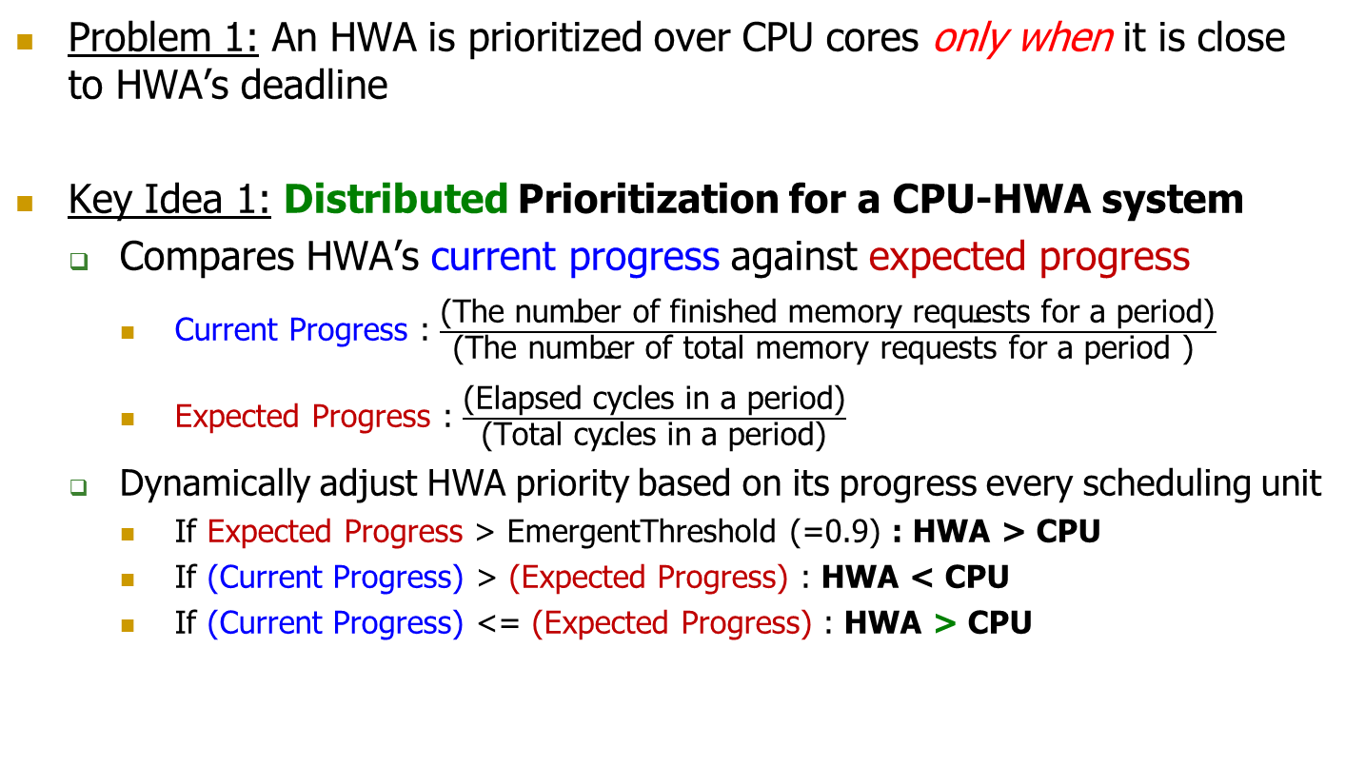
Key Idea 1: Distributed Priority
Problem 1: An HWA is prioritized over CPU cores only when it is close to HWA’s deadline
Key Idea 1: Distributed Prioritization for a CPU-HWA system
  Compares HWA’s current progress against expected progress
    Current Progress : $\frac{\text{(}\text{The} \text{number} \text{of} \text{finished} \text{memory} \text{requests} \text{for} \text{a} \text{period}\text{)}}{\text{(}\text{The} \text{number} \text{of} \text{total} \text{memory} \text{requests} \text{for} \text{a} \text{period}\text{ ) }}$
    Expected Progress : $\frac{\text{(}\text{E}\text{lapsed} \text{cycles} \text{in} \text{a} \text{period}\text{)}}{\text{(}\text{T}\text{otal} \text{cycles} \text{in} \text{a} \text{period}\text{)}}$
  Dynamically adjust HWA priority based on its progress every scheduling unit
    If Expected Progress > EmergentThreshold (=0.9) : HWA > CPU
    If (Current Progress) > (Expected Progress) : HWA < CPU
    If (Current Progress) <= (Expected Progress) : HWA > CPU
  Prioritize HWAs over CPU anytime when the HWA is not making good progress
Notes:
1st key idea is solution for the problem1, which is an HWA is prioritized over CPU cores only when it is closed to HWA’s deadline.
The key idea, distributed prioritization, is very simple modification. We use the same current progress and the expected progress as the existing work. The difference is if the current progress is less than or equal to expected progress, prioritizes HWAs over CPU anytime. So, we distribute high priority over its deadline period.

Slide 10
Example: Scheduling HWA and CPU Requests
Scheduling requests from 2 CPU applications and a HWA
  CPU-A : memory non-intensive application
  CPU-B : memory intensive application
Alone Execution Timeline
time
CPU-A
Computation
COMP.
COMP.
COMP.
Req x1
Req x1
Req x1
DRAM
A
A
A
T
CPU-B
COMP.
STALL
COMP.
Req x7
DRAM
B
B
B
B
B
B
B
Deadline for 10 Requests
HWA
COMP.
COMPUTATION
Req x10
DRAM
H
H
H
H
H
H
H
H
H
H
Period = 20T
Notes:
I explain the distributed priority with a simple example. In the example, we schedule requests from 2 CPU applications and a HWA. CPU-a is memory non-intensive application which generates few requests. CPU-b is memory intensive application which generates more memory requests than CPU-a does. For ease of understanding, we assume all the DRAM requests take T cycles. The HWA’s period is 20T and 10 requests has to be finished by the end of the period. We assume the HWA has double buffer, and if 10 requests are finished by the deadline, the computation of the HWA does not stop.

Slide 11
DASH: Distributed Priority
Distributed Priority (Scheduling unit = 4T)
CPU-A
COMP.
STALL
Req x1
CPU-B
COMP.
STALL
Req x7
HWA
COMP.
COMP.
Req x10
DRAM
H
H
H
H
HWA>CPU
Current : 0 / 10
Expected : 0 / 20
Notes:
By the distributed priority with scheduling unit 4T, at the beginning of the period of the HWA, both current and expected progress are zero, then the priority of HWA is greater than CPUs. Therefore, 4requests of HWAs are served.

Slide 12
DASH: Distributed Priority
Distributed Priority (Scheduling unit = 4T)
CPU-A
COMP.
STALL
COMP.
Req x1
CPU-B
COMP.
STALL
Req x7
HWA
COMP.
COMPUTATION
Req x10
DRAM
H
H
H
H
A
B
B
B
HWA<CPU
Current : 4 / 10
Expected : 5 / 20
Notes:
After 4T cycles, Current progress is four tenth and expected progress is five twentieth. Therefore. Priority of HWA is less than CPU and requests of only CPU-a and CPU-b are served.

Slide 13
DASH: Distributed Priority
Distributed Priority (Scheduling unit = 4T)
CPU-A
COMP.
STALL
COMP.
STALL
Req x1
Req x1
CPU-B
COMP.
STALL
Req x7
HWA
COMP.
COMPUTATION
Req x10
DRAM
H
H
H
H
A
B
B
B
H
H
H
H
HWA>CPU
Current : 4 / 10
Expected : 8 / 20
Notes:
After 8T cycle, the current progress is still four tenth and expected progress is eight twentieth. Because current progress is equal to the expected progress, the priority of HWA is greater than CPU. Therefore, the requests from HWAs are served during this 4T cycles.

Slide 14
DASH: Distributed Priority
Distributed Priority (Scheduling unit = 4T)
CPU-A
COMP.
STALL
COMP.
STALL
COMP.
Req x1
Req x1
Req x1
CPU-B
COMP.
STALL
Req x7
HWA
COMP.
COMPUTATION
Req x10
DRAM
H
H
H
H
A
B
B
B
H
H
H
H
A
B
B
B
HWA<CPU
Current : 8 / 10
Expected : 12 / 20
Notes:
After 12T cycles, Current progress is 8 tenth and expected progress is 12 20th. Because current progress is greater than expected progress, the priority of the HWA is less than CPUs and the requests from CPU-a and b are served

Slide 15
DASH: Distributed Priority
Distributed Priority (Scheduling unit = 4T)
CPU-A
COMP.
STALL
COMP.
STALL
COMP.
COMP.
Req x1
Req x1
Req x1
CPU-B
COMP.
STALL
COMP.
Req x7
HWA
COMP.
COMPUTATION
Req x10
DRAM
H
H
H
H
A
B
B
B
H
H
H
H
A
B
B
B
H
H
A
B
HWA>CPU
Current : 8 / 10
Expected : 16 / 20
Notes:
After 16T cycles, current progress is eight tenth and expected progress is 16 20th, HWA is prioritized than CPUs. So the remaining two requests of HWAs are served first and requests of CPU-a and b are served next.
As a result, the HWA can keep the deadline.

Slide 16
Problem2: Application-unawareness
Problem 2 (Application-unawareness): Existing memory schedulers for heterogeneous systems do no consider the diverse memory access characteristics of CPUs and HWAs
Application-unawareness causes two problems
  Problem 2.1: When a HWA has high priority (i.e., not measuring up to its expected progress), it interferes with all CPU cores for a long time
  Problem 2.2: A HWA with a short period misses its deadlines due to fluctuations in available memory bandwidth (due to priority changes of other HWAs)
Notes:
However, this distributed priority scheme does not solve problem 2. not considering the diverse memory access characteristics of CPUs and HWAs.
In detail, this application-unawareness causes two problems. 1st, when a HWA has high priority, it interferes with all CPU cores for a long time. Second, a HWA with a short deadline period misses its deadline due to fluctuations in available memory bandwidth due to priority changes of other HWAs.
We solve these two problems.

Slide 17
Problem 2.1 and Its Solution
Problem 2.1 Restated: When HWA is low priority, it is deprioritized too much → It becomes high priority as a result and destroys CPU progress
Goal: Avoid making the HWA high priority as much as possible
HWA delays both A and B
CPU-A
COMP.
STALL
COMP.
STALL
Req x1
Req x1
CPU-B
COMP.
STALL
Req x7
HWA
COMP.
COMPUTATION
Req x10
DRAM
H
H
H
H
A
B
B
B
H
H
H
H
High Priority
When high priority, HWA causes all CPUs to stall
When low priority, no HWA request served
Notes:
About problem 2-1, When HWA is low priority, it is deprioritized too much and no HWA request is served. Therefore, in the next scheduling unit, HWA is given high priority and causes all CPUs to stall. It destroys all CPU’s progress.
The goal for the problem is to avoid making the HWA high priority as much as possible.

Slide 18
Key Idea 2.1: Application-aware Scheduling for CPUs
Key Idea 2.1: HWA priority over CPUs should depend on CPU memory intensity
  Not all CPUs are equal
    Memory-intensive cores are much less vulnerable to memory access latency
    Memory-non-intensive cores are much more vulnerable to latency
While HWA has low priority, HWA is prioritized over memory-intensive cores
Distributed Priority
Application-aware Scheduling
DRAM
A
B
B
B
B
H
A
H
H
H
B
B
A > B > H when HWA is low priority
A > H > B
A: Memory-non-intensive, B: Memory-intensive
Notes:
The key idea for the problem is HWA priority over CPUs should depend on CPU memory intensiveness.
As I explained, not all CPUs are equal. Memory-intensive cores are much less vulnerable to memory access latency and memory-non-intensive cores are much more vulnerable to memory access latency. This is because, in memory-intensive cores, a lot of memory requests are waiting, and even if some of requests are served earlier, subsequent requests stall the pipeline again.
Based on this characteristics, while HWA has low priority, HWA is prioritized over memory-intensive cores. Namely, in distributed priority, when HWA is low priority, HWA’s priority is lower than both of CPUs, but with our key-idea, application-aware scheduling, HWA is still prioritized over CPU-B, which is memory-intensive core.

Slide 19
DASH: Application-aware Scheduling
Distributed Priority (Scheduling unit = 4T)
CPU-A
COMP.
STALL
COMP.
STALL
COMP.
COMP.
Req x1
Req x1
Req x1
CPU-B
COMP.
STALL
COMP.
Req x7
HWA
COMP.
High Priority
Low Priority
High Priority
Low Priority
High Priority
Req x10
DRAM
H
H
H
H
A
B
B
B
H
H
H
H
A
B
B
B
H
H
A
B
Notes:
I explain the effect of application-aware scheduling with the same example. At the beginning of the period, both current and expected progress are zero. And HWA is prioritized over CPU-A and B. The four requests of only the HWA are served.

Slide 20
DASH: Application-aware Scheduling
Distributed Priority (Scheduling unit = 4T)
CPU-A
COMP.
STALL
COMP.
STALL
COMP.
COMP.
Req x1
Req x1
Req x1
CPU-B
COMP.
STALL
COMP.
Req x7
HWA
COMP.
High Priority
Low Priority
High Priority
Low Priority
High Priority
Req x10
DRAM
H
H
H
H
A
B
B
B
H
H
H
H
A
B
B
B
H
H
A
B
Application-aware Scheduling (Scheduling unit = 4T)
CPU-A
COMP.
STALL
Req x1
CPU-B
COMP.
STALL
Req x7
HWA
COMP.
High Priority
Req x10
DRAM
H
H
H
H
HWA>CPU-A&B
Current : 0 / 10 Expected : 0 / 20
Notes:
I explain the effect of application-aware scheduling with the same example. At the beginning of the period, both current and expected progress are zero. And HWA is prioritized over CPU-A and B. The four requests of only the HWA are served.

Slide 21
DASH: Application-aware Scheduling
Distributed Priority (Scheduling unit = 4T)
CPU-A
COMP.
STALL
COMP.
STALL
COMP.
COMP.
Req x1
Req x1
Req x1
CPU-B
COMP.
STALL
COMP.
Req x7
HWA
COMP.
High Priority
Low Priority
High Priority
Low Priority
High Priority
Req x10
DRAM
H
H
H
H
A
B
B
B
H
H
H
H
A
B
B
B
H
H
A
B
Application-aware Scheduling (Scheduling unit = 4T)
CPU-A
COMP.
STALL
COMP.
Req x1
CPU-B
COMP.
STALL
Req x7
HWA
COMP.
High Priority
Low Priority
Req x10
DRAM
H
H
H
H
A
H
H
H
CPU-A > HWA > CPU-B
Current : 4 / 10 Expected : 4 / 20
Notes:
After 4T cycle, current progress is 4 10th, it is greater than expected progress, which is 4 20th. Then HWA is given low priority, but still prioritized than memory-intensive CPU-B. As a result, a request from CPU-a is served first. Then three requests from the HWAs are served.

Slide 22
DASH: Application-aware Scheduling
Distributed Priority (Scheduling unit = 4T)
CPU-A
COMP.
STALL
COMP.
STALL
COMP.
COMP.
Req x1
Req x1
Req x1
CPU-B
COMP.
STALL
COMP.
Req x7
HWA
COMP.
High Priority
Low Priority
High Priority
Low Priority
High Priority
Req x10
DRAM
H
H
H
H
A
B
B
B
H
H
H
H
A
B
B
B
H
H
A
B
Application-aware Scheduling (Scheduling unit = 4T)
CPU-A
COMP.
STALL
COMP.
COMP.
Req x1
CPU-B
COMP.
STALL
Req x7
HWA
COMP.
High Priority
Low Priority
Low Priority
Req x10
DRAM
H
H
H
H
A
H
H
H
A
H
H
H
CPU-A > HWA > CPU-B
Current : 7 / 10 Expected : 8 / 20
Notes:
As a result of application-aware scheduling, after 8T cycles, current progress that is 7 10th is still greater than expected progress which is 8 20th. HWA is given low priority, and the requests from CPU-A and HWAs are served.

Slide 23
DASH: Application-aware Scheduling
Distributed Priority (Scheduling unit = 4T)
CPU-A
COMP.
STALL
COMP.
STALL
COMP.
COMP.
Req x1
Req x1
Req x1
CPU-B
COMP.
STALL
COMP.
Req x7
HWA
COMP.
High Priority
Low Priority
High Priority
Low Priority
High Priority
Req x10
DRAM
H
H
H
H
A
B
B
B
H
H
H
H
A
B
B
B
H
H
A
B
Application-aware Scheduling (Scheduling unit = 4T)
CPU-A
COMP.
STALL
COMP.
COMP.
COMP.
Req x1
CPU-B
COMP.
STALL
Req x7
HWA
COMP.
High Priority
Low Priority
Low Priority
Low Priority
Req x10
DRAM
H
H
H
H
A
H
H
H
A
H
H
H
A
B
B
B
CPU-A > HWA > CPU-B
Current : 10 / 10 Expected : 12 / 20
Notes:
After 12T cycles, the HWA finishes 10 requests and the requests of CPU-A and B are served.

Slide 24
DASH: Application-aware Scheduling
Distributed Priority (Scheduling unit = 4T)
CPU-A
COMP.
STALL
COMP.
STALL
COMP.
COMP.
Req x1
Req x1
Req x1
CPU-B
COMP.
STALL
COMP.
Req x7
HWA
COMP.
High Priority
Low Priority
High Priority
Low Priority
High Priority
Req x10
DRAM
H
H
H
H
A
B
B
B
H
H
H
H
A
B
B
B
H
H
A
B
Application-aware Scheduling (Scheduling unit = 4T)
CPU-A
COMP.
STALL
COMP.
COMP.
COMP.
Req x1
Saved Cycles
CPU-B
COMP.
STALL
COMP.
Req x7
HWA
COMP.
High Priority
Low Priority
Low Priority
Low Priority
Low Priority
Req x10
DRAM
H
H
H
H
A
H
H
H
A
H
H
H
A
B
B
B
B
B
B
B
Notes:
Finally, by using application-aware scheduling, we can save these cycles for memory-non-intensive CPU-A.

Slide 25
Problem 2.2 and Its Solution
Problem 2.2: A HWA with a short-deadline-period misses its deadlines due to fluctuations in available memory bandwidth (due to priority changes of other HWAs)
Key Idea 2.2: Estimate the worst-case memory access latency and give a short-deadline-period HWA the highest priority for
(WorstCaseLatency) * (NumberOfRequests) cycles close to its deadline
  WorstCaseLatency = tRC : the minimum time between two DRAM row ACTIVATE commands
 | HWA-A | HWA-B
Period | 63,041 Cycles | 5,447 Cycles
Bandwidth | 8.32 GB/s | 475 MB/s
HWA-A: meets all its deadlines
HWA-B: misses a deadline every 2000 periods
deadline
Period start
(WorstCaseLatency)*(#OfRequests) cycles
Low Priority
High Priority
Notes:
This distributed priority and application-aware scheduling is effective to ensure consistent bandwidth to HWAs that have fairly long periods and HWA with short-deadline-period misses its deadlines due to fluctuations in available bandwidth. For example, We schedule these two HWAs The period length of HWA-A is much longer than that of HWA-B and Bandwidth required by HWA-A is also much greater than bandwidth required by HWA-B. If we schedule these two HWAs with the distributed priority and application-aware scheduling, HWA-A meets all its deadline in spite of its high bandwidth requirement. On the other hand, HWA-B misses a deadline every 2000periods.
The key idea to solve this problem is to estimate the worst case memory access latency and give a short-deadline-period HWA the highest priority for the worst case latency multiplied the number of requests cycles close to its deadline. For the short-deadline-period HWA, at the beginning of the period, the low priority is given. When the remaining time of the period is worst case latency multiplied the number of requests cycles, the highest priority is given to the HWA. In this work, we use tRC as the worst case access latency, which is the minimum time between two DRAM row ACTIVATE commands.

Slide 26
DASH: Summary of Key Ideas
Distributed priority
Application-aware scheduling
Worst-case memory access latency based prioritization

Slide 27
Outline
Introduction
Problem with Existing Memory Schedulers for Heterogeneous Systems
DASH: Key Ideas
DASH: Scheduling Policy
Evaluation and Results
Conclusion
Notes:
Next, I explain the whole scheduling policy of DASH

Slide 28
DASH: Scheduling Policy
DASH scheduling policy
  1. Short-deadline-period HWAs with high priority
  2. Long-deadline-period HWAs with high priority
  3. Memory non-intensive CPU applications
  4. Long-deadline-period HWAs with low priority
  5. Memory-intensive CPU applications
  6. Short-deadline-period HWAs with low priority
Notes:
#These are priority order of state of the art dynamic priority scheme and our DASH scheduling policy. The lower number indicates higher priority. At the baseline policy, #HWAs having high priority is selected first. Then CPUs are scheduled with state-of-the-art scheduling policy for CPUs. HWAs having low priority is at the lowest rank.
This is a priority order of our DASH scheduling policy.
The 1st rank, which indicates the highest priority, is short-deadline-period HWAs with high priority. 2nd is long-deadline-period HWAs with high priority. The third is memory-nonintensive CPU applications. Long-deadline-period HWAs with low priority is still prioritized memory-intensive CPU applications. Short-deadline-period HWAs with low priority is at the lowest rank.
As I explained, memory-intensive CPU applications are less vulnerable to memory access latency, but in some workloads, memory-intensive applications experience unfair slowdown due to long-deadline-period HWAs. Therefore,

Slide 29
DASH: Scheduling Policy
DASH scheduling policy
  1. Short-deadline-period HWAs with high priority
  2. Long-deadline-period HWAs with high priority
  3. Memory non-intensive CPU applications
  4. Long-deadline-period HWAs with low priority
  5. Memory-intensive CPU applications
  6. Short-deadline-period HWAs with low priority
Switch
probabilistically
Notes:
We made an optimization for the scheduling policy. We switch the priorities of rank4 and 5 probabilistically and we adjust the probability for switching dynamically based on its progress. Please see the paper for the detail of this probabilistic switching of priorities.

Slide 30
Outline
Introduction
Problem with Existing Memory Schedulers for Heterogeneous Systems
DASH: Key Ideas
DASH: Scheduling Policy
Evaluation and Results
Conclusion
Notes:
Then, we explain evaluation and results.

Slide 31
Experimental Methodology (1/2)
New Heterogeneous System Simulator
  We have released this at GitHub (https://github.com/CMU-SAFARI/HWASim)
Configurations
  8 CPUs (2.66GHz), 32KB/L1, 4MB Shared/L2
  4 HWAs
  DDR3 1333 DRAM x 2 channels
Workloads
  CPUs: 80 multi-programmed workloads
    SPEC CPU2006, TPC, NAS parallel benchmark
  HWAs:
    Image processing
    Image recognition [Lee+ ICCD 2009] [Viola and Jones CVPR 2001]
Metrics
  CPUs : Weighted Speedup
  HWAs : Deadline met ratio (%)
Notes:
Here’s our experimental methodology. Configurations are 8CPUs and 4HWAs. Memory is DDR3 2channels.
The workloads for CPUs are 80multi-programmed workloads that consists of SPEC CPU2006, TPC, NAS parallel benchmark.
The workloads for HWAs are image processing and image recognition. For image recognition, we evaluate hessian and matching HWAs for SURF and resize image and face detect HWAs.
As metrics, we use weighted speedup for CPU performance and maximum slowdown for CPU fairness. For HWAs, we use deadline met ratio.

Slide 32
Experimental Methodology (2/2)
Parameters of the HWAs
Configurations of 4 HWAs
 | Period | Bandwidth | Deadline Group
IMG : Image Processing | 33 ms | 360MB/s | Long
HES : Hessian | 2 us | 478MB/s | Short
MAT : Matching (1) 20fps | 35.4 us | 8.32 GB/s | Long
MAT : Matching (2) 30fps | 23.6 us | 5.55 GB/s | Long
RSZ : Resize | 46.5 – 5183 us | 2.07 – 3.33 GB/s | Long
DET : Detect | 0.8 – 9.6 us | 1.60 – 1.86 GB/s | Short
 | Configuration
Config-A | IMG x 2, HES, MAT(2)
Config-B | HES, MAT(1), RSZ, DET
Notes:
This is the detailed parameter of the HWAs. IMG is image processing. HES is hessian and MAT is matching HWAs for SURF. RSZ is resize and DET is detect HWAs.
HES and DET are categorized as short-deadline-HWAs for DASH scheduler. The other HWAs are long-dealine-HWAs. We use two configurations of 4HWAs.

Slide 33
Evaluated Memory Schedulers
FRFCFS-St, TCM-St: FRFCFS or TCM with static priority for HWAs
  HWAs always have higher priority than CPUs
  FRFCFS-St: FRFCFS [Zuravleff and Robinson US Patent 1997, Rixner et al. ISCA 2000] for CPUs
    Prioritizes row-buffer hits and older requests
  TCM-St: TCM [Kim+ MICRO 2010] for CPUs
    Always prioritizes memory-non-intensive applications
    Shuffles thread ranks of memory-intensive applications
  FRFCFS-Dyn: FRFCFS with dynamic priority for HWAs [Jeong et al., DAC 2012]
  HWA’s priority is dynamically adjusted based on its progress
    FRFCFS-Dyn0.9: EmergentThreshold = 0.9 for all HWAs (Only after 90% of the HWA’s period elapsed, the HWA has higher priority than CPUs)
    FRFCFS-DynOpt: Each HWA has different EmergentThreshold to meet its deadline
DASH: Distributed Priority + Application-aware scheduling for CPUs + HWAs
  TCM is used for CPUs to classify memory intensity of CPUs
  EmergentThreshold = 0.8 for all HWAs
Config-A |  |  | Config-B
IMG | HES | MAT | HES | MAT | RSZ | DET
0.9 | 0.2 | 0.2 | 0.5 | 0.4 | 0.7 | 0.5
Notes:
Here’s memory schedulers to compare.
First, FRFCFS and TACM with static priority for HWAs. With these schedulers, HWAs always have higher priority than CPUs. For the CPUs, FRFCFS-St prioritizes row-buffer hits and older requests. TCM-St always prioritizes memory-non-intensive applications and shuffles thread ranks of memory-intensive applications.
FRFCFS-Dyn is state-of-the-art scheduling using dynamic priority adjustments for HWAs. We evaluate two variants of the FRFCFS-Dyn with different EmergentThreshold. First, we use an EmergentThreshold value of 0.9 for all HWAs, to achieve high CPU performance. The other is FRFCFS-DynOpt, that is each HWA has different EmergentThreshold to meet its deadline, like this table.
The last is DASH scheduler that apply distributed priority and application-aware scheduling. For DASH, we use TCM for CPUs to classify memory intensity of CPUs and use EmergentThreshold of 0.8 for all HWAs.

Slide 34
Performance and Deadline Met Ratio
Weighted Speedup for CPUs
Deadline Met Ratio (%) for HWAs
 | IMG | HES | MAT | RSZ | DET
FRFCFS-St | 100 | 100 | 100 | 100 | 100
TCM-St | 100 | 100 | 100 | 100 | 100
FRFCFS-Dyn0.9 | 100 | 99.4 | 46.01 | 97.98 | 97.14
FRFCFS-DynOpt | 100 | 100 | 99.997 | 100 | 99.99
DASH | 100 | 100 | 100 | 100 | 100
Notes:
Here is the CPU performance and Deadline met ratio for HWAs. For the graph, x-axis is weighted speedup and Y-axis shows each scheduling policy.
With static priority, all HWAs always meet the deadline, but CPU performance is low. With dynamic priority scheme of EmergentThreshold is 0.9, the CPU performance is improved much, but HWAs frequently misses the deadline. If we use optimized value of Emergent Threshold to meet the HWAs’ deadlines, HWAs almost meets the deadline, but the performance gets low.

Slide 35
Performance and Deadline Met Ratio
Weighted Speedup for CPUs
Deadline Met Ratio (%) for HWAs
DASH achieves 100% deadline met ratio
 | IMG | HES | MAT | RSZ | DET
FRFCFS-St | 100 | 100 | 100 | 100 | 100
TCM-St | 100 | 100 | 100 | 100 | 100
FRFCFS-Dyn0.9 | 100 | 99.4 | 46.01 | 97.98 | 97.14
FRFCFS-DynOpt | 100 | 100 | 99.997 | 100 | 99.99
DASH | 100 | 100 | 100 | 100 | 100
Notes:
On the other hand, out DASH scheduler achieve 100% deadline met ratio and also

Slide 36
Performance and Deadline Met Ratio
Weighted Speedup for CPUs
Deadline Met Ratio (%) for HWAs
+9.5%
DASH achieves 100% deadline met ratio
DASH achieves better performance (+9.5%) than FRFCFS-DynOpt
that meets the most of HWAs’ deadlines (Optimized for HWAs)
 | IMG | HES | MAT | RSZ | DET
FRFCFS-St | 100 | 100 | 100 | 100 | 100
TCM-St | 100 | 100 | 100 | 100 | 100
FRFCFS-Dyn0.9 | 100 | 99.4 | 46.01 | 97.98 | 97.14
FRFCFS-DynOpt | 100 | 100 | 99.997 | 100 | 99.99
DASH | 100 | 100 | 100 | 100 | 100
Notes:
On the other hand, out DASH scheduler achieve 100% deadline met ratio and also achieves better performance (+9.5%) than FRFCFS-DynOpt, which is optimized for HWAs and comparable performance to FRFCFS-Dyn0.9
This result shows our DASH scheduler can improves CPU performance while keeping HWAs’ deadline

Slide 37
Performance and Deadline Met Ratio
Weighted Speedup for CPUs
Deadline Met Ratio (%) for HWAs
+9.5%
DASH achieves 100% deadline met ratio
DASH achieves better performance (+9.5%) than FRFCFS-DynOpt
that meets the most of HWAs’ deadlines (Optimized for HWAs)
DASH achieves comparable performance to FRFCFS-Dyn0.9
that frequently misses HWAs’ deadlines (Optimized for CPUs)
 | IMG | HES | MAT | RSZ | DET
FRFCFS-St | 100 | 100 | 100 | 100 | 100
TCM-St | 100 | 100 | 100 | 100 | 100
FRFCFS-Dyn0.9 | 100 | 99.4 | 46.01 | 97.98 | 97.14
FRFCFS-DynOpt | 100 | 100 | 99.997 | 100 | 99.99
DASH | 100 | 100 | 100 | 100 | 100
Notes:
On the other hand, out DASH scheduler achieve 100% deadline met ratio and also achieves better performance (+9.5%) than FRFCFS-DynOpt, which is optimized for HWAs and comparable performance to FRFCFS-Dyn0.9
This result shows our DASH scheduler can improves CPU performance while keeping HWAs’ deadline

Slide 38
DASH Scheduler: Summary
Problem: Hardware accelerators (HWAs) and CPUs share the same memory subsystem and interfere with each other in main memory
Goal: Design a memory scheduler that improves CPU performance while meeting HWAs’ deadlines
Challenge: Different HWAs have different memory access characteristics and different deadlines, which current schedulers do not smoothly handle
  Memory-intensive and long-deadline HWAs significantly degrade CPU performance when they become high priority (due to slow progress)
  Short-deadline HWAs sometimes miss their deadlines despite high priority
Solution: DASH Memory Scheduler
  Prioritize HWAs over CPU anytime when the HWA is not making good progress
  Application-aware scheduling for CPUs and HWAs
Key Results:
  1) Improves CPU performance for a wide variety of workloads by 9.5%
  2) Meets 100% deadline met ratio for HWAs
DASH source code freely available on the GitHub
Notes:
Here’s an executive summary. The problem is hardware accelerators and CPUs share the same memory subsystem and interfere with each other.
So, the goal of this work is to design a memory scheduler that improves CPU performance while meeting HWAs’ deadlines.
The challenge to achieve the goal is different HWAs have different memory access characteristics and different deadlines. For example, memory-intensive and long-deadline HWAs significantly degrade CPU performance when they become high priority due to their slow progress. On the other hand, short-deadline HWAs sometimes miss their deadlines despite high priority. Current schedulers do not smoothly handle this difference.
For solution of this challenge, DASH memory scheduler uses 3 key ideas.
First, to meet HWAs’ deadlines, DASH prioritizes HWAs over CPU anytime when the HWA is not making good progress.
Second, however, DASH tries to prevents a HWA from becoming high priority. It is OK to prioritize the HWA over a memory-intensive CPU even when the HWA is making good progress.
Third, DASH prioritizes short-deadline-HWAs over long-deadlin-HWAs and CPUs based on worst-case memory access time estimation.
As the key results, DASH improves CPU performance for a wide variety of different CPU workloads by 9.5% and it achieves 10% deadline met ratio of HWAs.

Slide 39
DASH: Deadline-Aware High-Performance Memory Scheduler for Heterogeneous Systems with Hardware Accelerators
Hiroyuki Usui, Lavanya Subramanian
Kevin Chang, Onur Mutlu
DASH source code is available at GitHub
https://github.com/CMU-SAFARI/HWASim
Notes:
Hello, everyone. I am Hiroyuki Usui. Today I will present “DASH: Deadline-Aware High-Performance Memory Scheduler for Heterogeneous Systems with Hardware Accelerators”. This work has been done together with Lavanya Subramanian, Kevin Chang, and Onur Mutlu.

Slide 40
Backup Slides

Slide 41
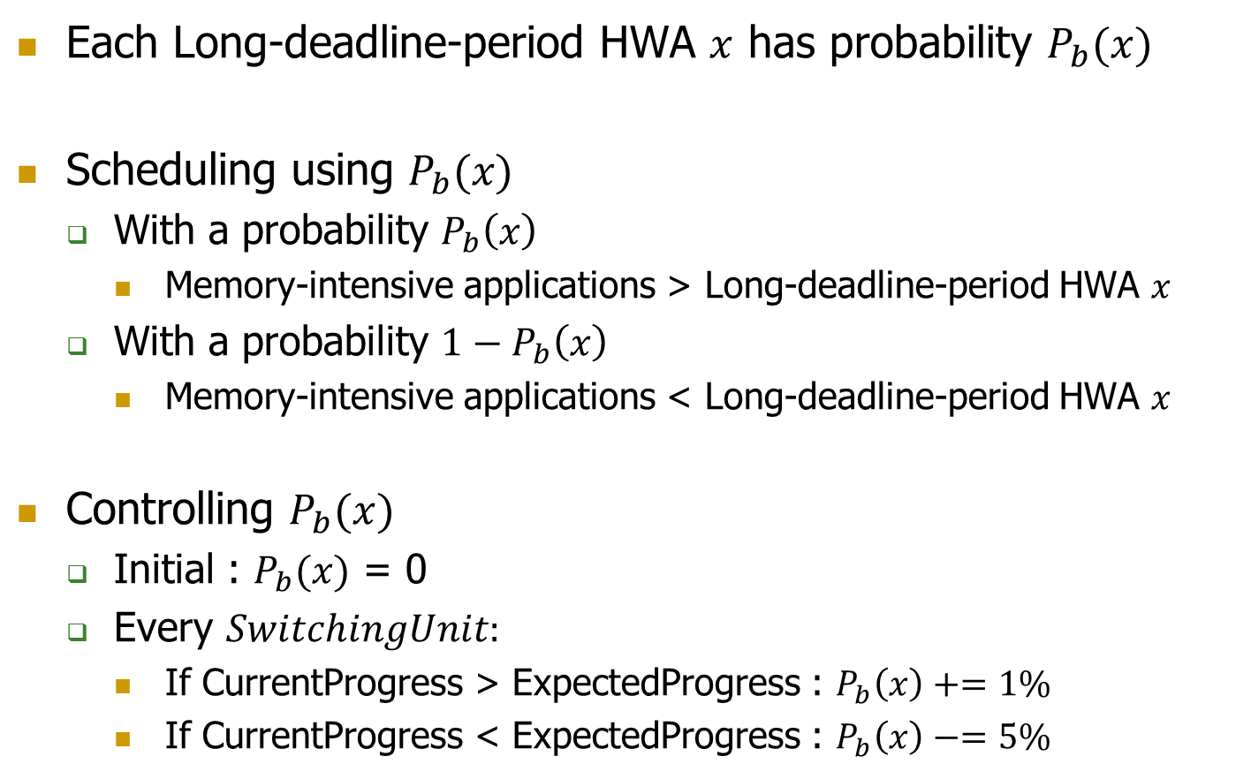
Probabilistic Switching of Priorities
Each Long-deadline-period HWA $x$ has probability $P_{b}(x)$
Scheduling using $P_{b}(x)$
  With a probability $P_{b}\left(x\right)$
    Memory-intensive applications > Long-deadline-period HWA $x$
  With a probability $1−P_{b}\left(x\right)$
    Memory-intensive applications < Long-deadline-period HWA $x$
Controlling $P_{b}(x)$
  Initial : $P_{b}(x)$ = 0
  Every $SwitchingUnit:$
    If CurrentProgress > ExpectedProgress : $P_{b}\left(x\right)+=1\%$
    If CurrentProgress < ExpectedProgress : $P_{b}\left(x\right)−=5\%$

Slide 42
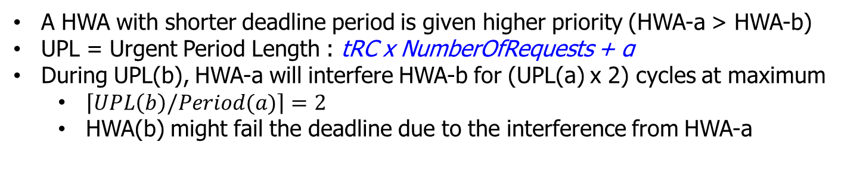
Priorities for Multiple Short-deadline-period HWAs
Period(a)
UPL(a)
HWA-a
Low
High
Low
High
Low
High
High Priority
interfere
interfere
Period(b)
HWA-b
Low Priority
Low
High
UPL(b)
A HWA with shorter deadline period is given higher priority (HWA-a > HWA-b)
  UPL = Urgent Period Length : tRC x NumberOfRequests + α
During UPL(b), HWA-a will interfere HWA-b for (UPL(a) x 2) cycles at maximum
  $\left\lceil UPL\left(b\right)/Period(a)\right\rceil =2$
  HWA(b) might fail the deadline due to the interference from HWA-a

Slide 43
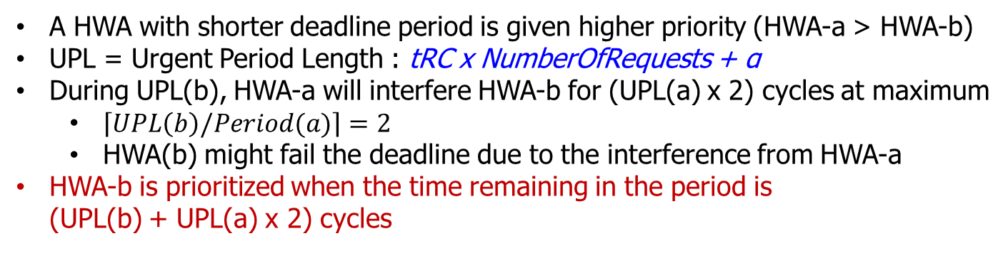
Priorities for Multiple Short-deadline-period HWAs
Period(a)
UPL(a)
HWA-a
Low
High
Low
High
Low
High
High Priority
Period(b)
HWA-b
Low Priority
High
High
Low
High
UPL(b)
A HWA with shorter deadline period is given higher priority (HWA-a > HWA-b)
  UPL = Urgent Period Length : tRC x NumberOfRequests + α
During UPL(b), HWA-a will interfere HWA-b for (UPL(a) x 2) cycles at maximum
  $\left\lceil UPL\left(b\right)/Period(a)\right\rceil =2$
  HWA(b) might fail the deadline due to the interference from HWA-a
HWA-b is prioritized when the time remaining in the period is
(UPL(b) + UPL(a) x 2) cycles

Slide 44
Storage required for DASH
20 bytes for each long-deadline-period HWA
12 bytes for each short-deadline-period HWA
For long-deadline-period HWA
Name | Function
Curr-Req | Number of requests completed in a deadline period
Total-Req | Total Number of requests to be completed in a deadline period
Curr-Cyc | Number of cycles elapsed in a deadline period
Total-Cyc | Total number of cycles in a deadline period
Pb | Probability for the priority switching between memory-intensive applications and HWA
For a short-deadline-period HWA
Name | Function
Priority-Cyc | Indicates when the priority is transitioned to high
Curr-Cyc | Number of cycles elapsed in a deadline period
Total-Cyc | Total number of cycles elapsed in a deadline period

Slide 45
Simulation Parameter Details
SchedulingUnit : 1000 CPU cycles
SwitchingUnit : 500 CPU cycles
ClusterFactor : 0.15
  Fraction of total memory bandwidth allocated to memory-non-intensive CPU applications

Slide 46
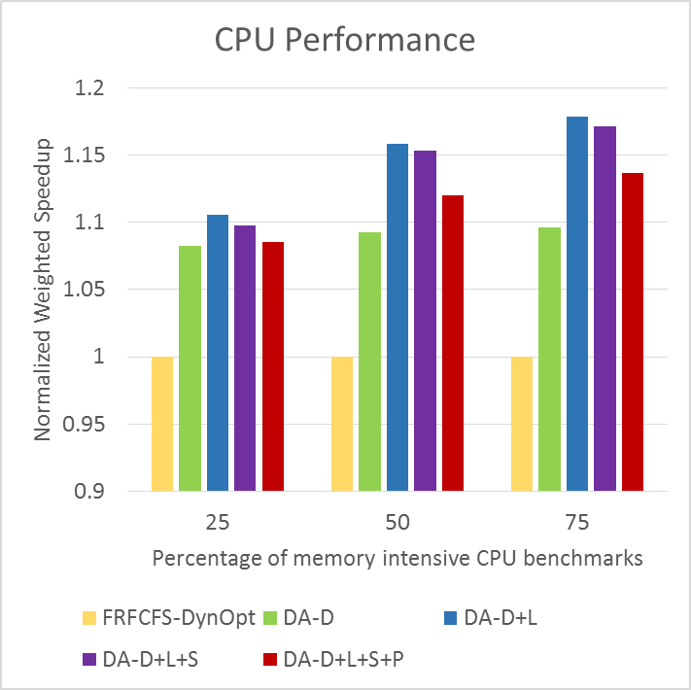
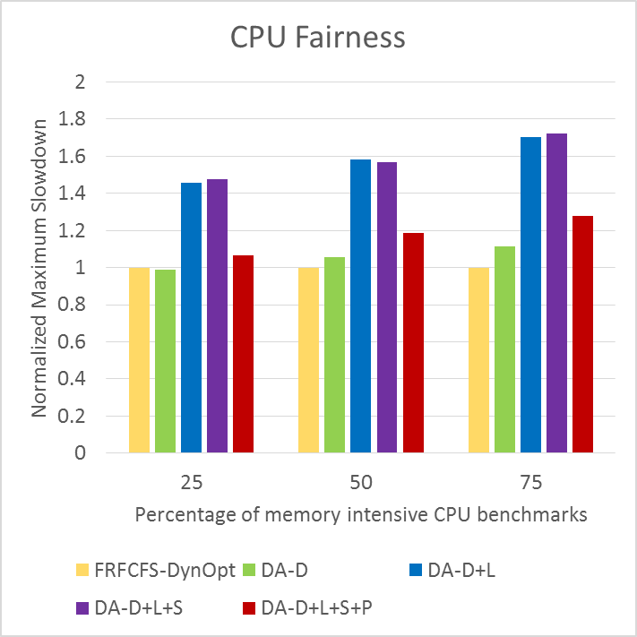
Performance breakdown of DASH
DA-D : Distributed Priority
DA-D+L : DA-D + application-aware priority for CPUs
DA-D+L+S : DA-D+L + worst-case latency based priority for short-deadline HWAs
DA-D+L+S+P (DASH) : DA-D+L+S + probabilistic prioritization
Notes:
Here’s performance breakdown of DASH components. The left graph shows CPU performance and right graph shows CPU fairness, which are normalized to those of FRFCFS-DynOpt. X-axis shows percentage of memory intensive CPU benchmarks of the workloads. Then, 75 shows 75% CPU benchmarks of the workload is memory-intensive.
This green bar shows the case using distributed priority.

Slide 47
Performance breakdown of DASH
DA-D : Distributed Priority
DA-D+L : DA-D + application-aware priority for CPUs
DA-D+L+S : DA-D+L + worst-case latency based priority for short-deadline HWAs
DA-D+L+S+P (DASH) : DA-D+L+S + probabilistic prioritization
Distributed priority improves performance (Max +9.5%)
Notes:
Distributed priority improves CPU performance by 9.5% at the maximum.

Slide 48
Performance breakdown of DASH
DA-D : Distributed Priority
DA-D+L : DA-D + application-aware priority for CPUs
DA-D+L+S : DA-D+L + worst-case latency based priority for short-deadline HWAs
DA-D+L+S+P (DASH) : DA-D+L+S + probabilistic prioritization
Application-aware priority for CPUs improves performance especially
as the memory intensity increases (Max +7.6%)
Notes:
Then, the next blue bar shows distributed priority + application-aware priority for CPUs, which is that HWA is prioritized over memory-intensive CPU applications.Application-aware priority for CPUs can improve performance especially as the memory intensity increase by 7.6% at the maximum.
But, at the same time, CPU fairness gets worse because memory-intensive applications gets slowdown.

Slide 49
Performance breakdown of DASH
DA-D : Distributed Priority
DA-D+L : DA-D + application-aware priority for CPUs
DA-D+L+S : DA-D+L + worst-case latency based priority for short-deadline HWAs
DA-D+L+S+P (DASH) : DA-D+L+S + probabilistic prioritization
Probabilistic prioritization achieves good balance between
performance and fairness
Notes:
The next purple bar shows application-aware scheduling for HWAs, which is worst-case latency based prioritization for short-deadline-HWAs. It does not affect CPU performance much.
The last red bar is full DASH scheduling scheme which is DA-D+L+S along with probabilistic prioritization. It can improve CPU fairness compared and still shows good CPU performance. So, it achieves good balance between performance and fairness.

Slide 50
Performance breakdown of DASH
Deadline Met Ratio
Name | IMG | HES | MAT | RSZ | DET
Deadline group | Long | Short | Long | Long | Short
FRFCFS-DynOpt | 100 | 100 | 99.997 | 100 | 99.99
DA-D | 100 | 99.999 | 100 | 100 | 99.88
DA-D+L | 100 | 99.999 | 100 | 100 | 99.87
DA-D+L+S | 100 | 100 | 100 | 100 | 100
DA-D+L+S+P | 100 | 100 | 100 | 100 | 100
Short-deadline HWAs (HES and DET) misses deadlines on distributed
priority (DA-D) and application-aware priority for CPU (DA-D+L)
Worst-case latency based priority (DA-D+L+S) enables short-deadline
HWAs to meet their deadline
Notes:
This is deadline met ratio of each DASH configuration. By using distributed priority and application-aware priority for CPU, short-deadline-HWAs sometimes fail the deadline. Worst-case latency based priority enables such short-deadline-HWAS to meets their deadline.

Slide 51
Impact of EmergentThreshold
CPU performance sensitivity to EmergentThreshold
DASH can meet all deadlines with a high EmergentThreshold value (=0.8)

Slide 52
Impact of EmergentThreshold
Deadline-met ratio(%) of FRFCFS-Dyn
Emergent Threshold | Config-A |  | Config-B
 | HES | MAT | HES | MAT | RSZ | DET
0-0.1 | 100 | 100 | 100 | 100 | 100 | 100
0.2 | 100 | 99.987 | 100 | 100 | 100 | 100
0.3 | 99.992 | 93.74 | 100 | 100 | 100 | 100
0.4 | 99.971 | 73.179 | 100 | 100 | 100 | 100
0.5 | 99.945 | 55.76 | 99.9996 | 99.751 | 100 | 99.997
0.6 | 99.905 | 44.691 | 99.989 | 94.697 | 100 | 99.96
0.7 | 99.875 | 38.097 | 99.957 | 86.366 | 100 | 99.733
0.8 | 99.831 | 34.098 | 99.906 | 74.69 | 99.886 | 99.004
0.9 | 99.487 | 31.385 | 99.319 | 60.641 | 97.977 | 97.149
1 | 96.653 | 27.32 | 95.798 | 33.449 | 55.773 | 88.425

Slide 53
Impact of EmergentThreshold
Deadline-met ratio(%) of DASH
Emergent Threshold | Config-A |  | Config-B
 | HES | MAT | HES | MAT | RSZ | DET
0-0.8 | 100 | 100 | 100 | 100 | 100 | 100
0.9 | 100 | 99.997 | 100 | 99.993 | 100 | 100
1 | 100 | 68.44 | 100 | 75.83 | 95.93 | 100

Slide 54
Impact of ClusterFactor
CPU performance sensitivity to Cluster Factor
ClusterFactor is an effective knob for trading off CPU performance and fairness

Slide 55
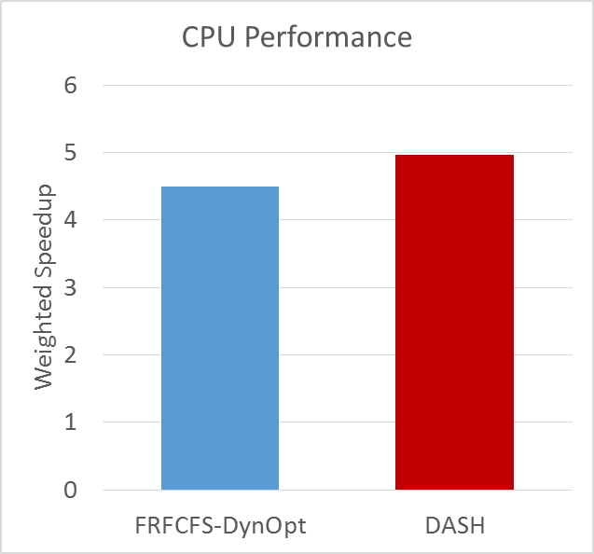
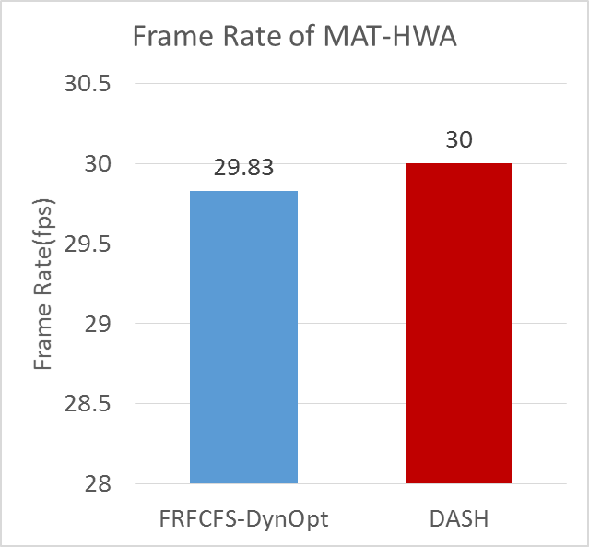
Evaluations with GPUs
8 CPUs + 4 HWA (Config-A) + GPU
  6 GPU traces : 3D mark and game
+10.1%

Slide 56
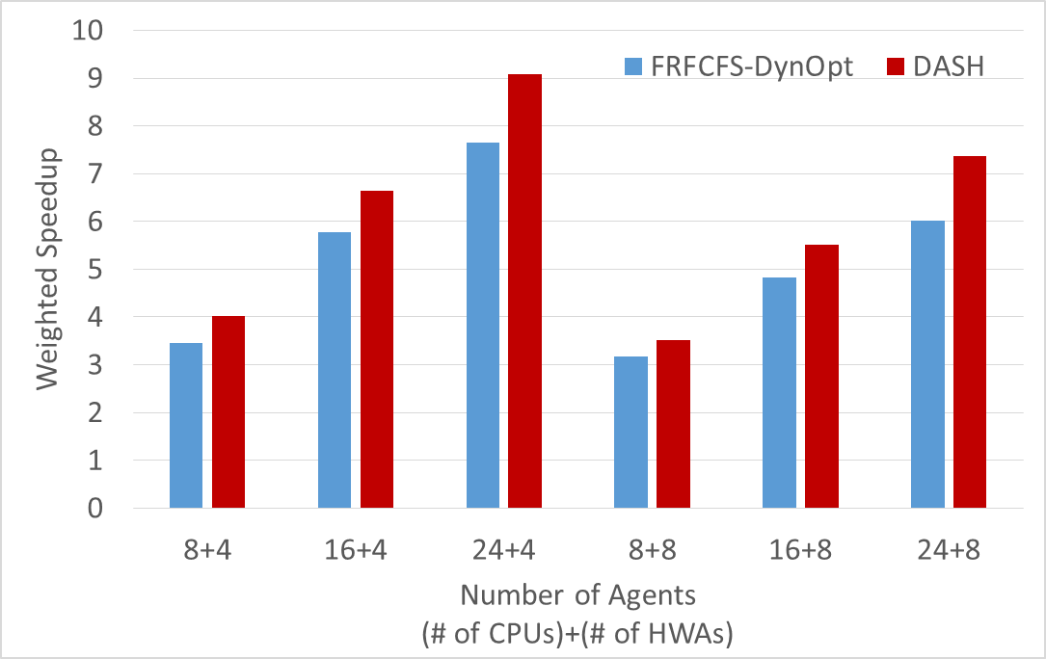
Sensitivity to Number of Agents
As the number of agents increases, DASH achieves greater performance improvement
8HWAs : IMG x 2, MAT x 2, HES x 2, RSZ x 1, DET x 1

Slide 57
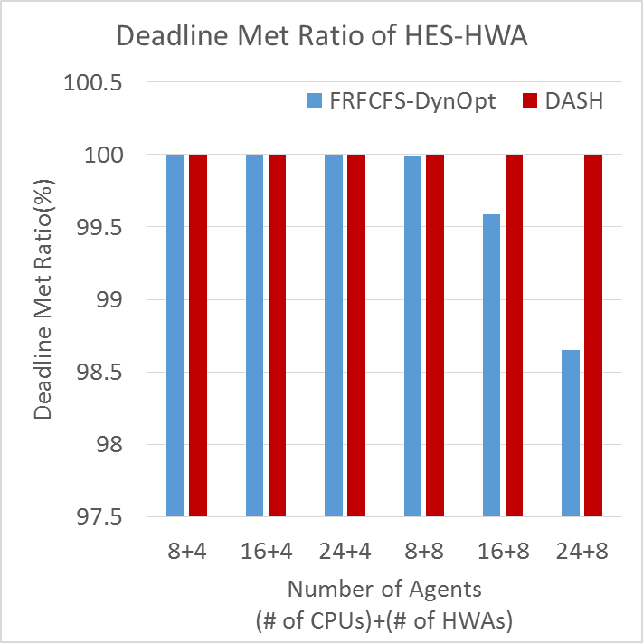
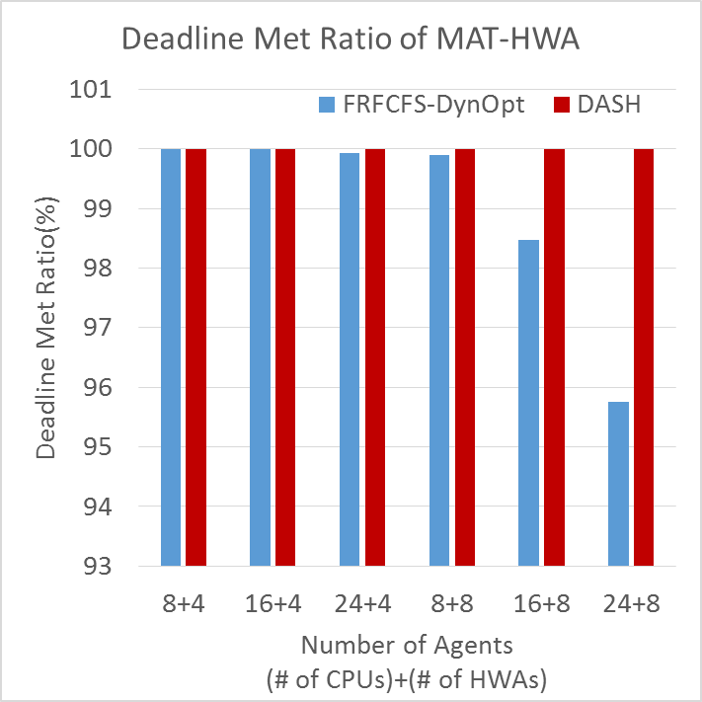
Sensitivity to Number of Agents

Slide 58
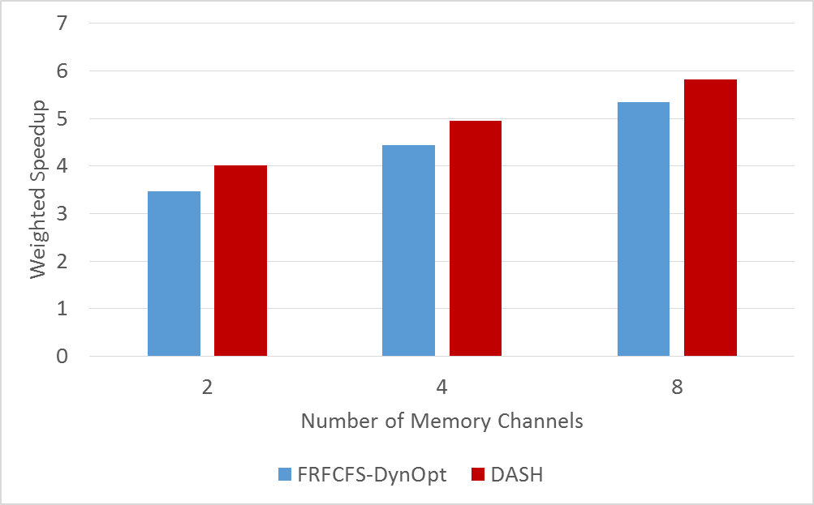
Sensitivity to Number of Channels

Slide 59
DASH: Application-aware scheduling for HWAs
Categorize HWAs as long-deadline-period vs. short-deadline-period statically
Adjust the priorities of each dynamically
  Short-deadline-period HWA: becomes high priority if time remaining in period = tRC x NumberOfRequests + α
  Long-deadline-period HWA: becomes high priority if Current progress ≤ Expected progress
Notes:
Based on the idea, we propose the application-aware scheduling for HWAs. First, we categorize HWAs as long-deadline-period HWA or short-deadline-period statically based on the length of the period. Then we adjust the priorities of each dynamically. For short-deadline-period HWA, it becomes high priority if time remaining in period is worst case access latency, that is tRC, multiplied the number of requests plus some overheads.
For long-deadline-period HWA, it becomes high priority if current progress is less than or equal to expected progress.

Slide 60
DASH Scheduler: Summary
Problem: Hardware accelerators (HWAs) and CPUs share the same memory subsystem and interfere with each other in main memory
Goal: Design a memory scheduler that improves CPU performance while meeting HWAs’ deadlines
Challenge: Different HWAs have different memory access characteristics and different deadlines, which current schedulers do not smoothly handle
  Memory-intensive and long-deadline HWAs significantly degrade system performance when they become high priority (due to slow progress)
  Short-deadline HWAs sometimes miss their deadlines despite high priority
Solution: SQUASH Memory Scheduler uses two key ideas:
  Prevent a HWA from becoming high priority → OK to prioritize the HWA over a memory-intensive core even when the HWA is making good progress
  Prioritize short-deadline HWAs over long-deadline HWAs and CPUs based on worst-case memory access time estimation
Key Results: 1) Improves system performance for a wide variety of different CPU workloads by 9.5%; 2) Achieves 100% deadline met ratio for all HWAs and GPUs

Slide 61
DASH: Key Observations
Not all HWAs are equal
  Memory intensity
    Prioritizing a memory-intensive accelerator over other agents destroys system progress → minimize this possibility
  Deadline : HWAs have deadlines to meet the target performance (e.g., frame rate)
    Long-deadline accelerators are more likely to meet their deadlines
    Short-deadline accelerators are more likely to miss their deadlines
    Scheduling short-deadline accelerators based on worst-case memory access time estimates minimizes deadline misses
Not all CPUs (cores) are equal
  Memory-intensive cores are much less vulnerable to interference
  Memory non-intensive cores are much more vulnerable to interference
  OK to prioritize a HWA over memory-intensive cores to ensure its requests do not become urgent

Slide 62
DASH Summary
A new memory scheduler for heterogeneous SoCs
Goal: Maximize system performance while keeping HWAs’ deadlines
Approach
  Distributed Priority : Prioritizing an HWA when it is not on track to meet its deadline any time
  Application-aware Scheduling
    Treat HWA priority over CPUs differently based on CPU memory intensity
    Treat HWAs differently based on deadline characteristics
Significant system performance and QoS improvement

Slide 63
DASH Scheduler: Summary
Problem: Hardware accelerators (HWAs) and CPUs share the same memory subsystem and interfere with each other in main memory
Goal: Design a memory scheduler that improves CPU performance while meeting HWAs’ deadlines
Challenge: Different HWAs have different memory access characteristics and different deadlines, which current schedulers do not smoothly handle
  Memory-intensive and long-deadline HWAs significantly degrade CPU performance when they become high priority (due to slow progress)
  Short-deadline HWAs sometimes miss their deadlines despite high priority
Solution: DASH Memory Scheduler uses three key ideas:
  Prioritize HWAs over CPU anytime when the HWA is not making good progress
  Prevent a HWA from becoming high priority → OK to prioritize the HWA over a memory-intensive core even when the HWA is making good progress
  Prioritize short-deadline HWAs over long-deadline HWAs and CPUs based on worst-case memory access time estimation
Key Results: 1) Improves CPU performance for a wide variety of different CPU workloads by 9.5%; 2) Achieves 100% deadline met ratio of HWAs
Notes:
Here’s an executive summary. The problem is hardware accelerators and CPUs share the same memory subsystem and interfere with each other.
So, the goal of this work is to design a memory scheduler that improves CPU performance while meeting HWAs’ deadlines.
The challenge to achieve the goal is different HWAs have different memory access characteristics and different deadlines. For example, memory-intensive and long-deadline HWAs significantly degrade system performance

Slide 64
DASH: Scheduling Policy
Baseline: State-of-the-art dynamic priority scheme
  1. HWAs having high priority
  2. CPUs (Using a state-of-the-art scheduling policy)
  3. HWAs having low priority
DASH scheduling policy
  1. Short-deadline-period HWAs with high priority
  2. Long-deadline-period HWAs with high priority
  3. Memory non-intensive CPU applications
  4. Long-deadline-period HWAs with low priority
  5. Memory-intensive CPU applications
  6. Short-deadline-period HWAs with low priority
Notes:
These are priority order of state of the art dynamic priority scheme and our DASH scheduling policy. The lower number indicates higher priority. At the baseline policy, HWAs having high priority is selected first. Then CPUs are scheduled with state-of-the-art scheduling policy for CPUs. HWAs having low priority is at the lowest rank.
In our DASH scheduling policy, the 1st is short-deadline-period HWAs with high priority. 2nd is long-deadline-period HWAs with high priority. The third memory-nonintensive CPU applications. Long-deadline-period HWAs with low priority is still prioritized memory-intensive applications. Short-deadline-period HWAs with low priority is at the lowest rank.
As I explained, memory-intensive CPU applications are less vulnerable to memory access latency, but in some workloads, memory-intensive applications experience unfair slowdown due to long-deadline-period HWAs. Therefore,

Slide 65
DASH: Scheduling Policy
Baseline: State-of-the-art dynamic priority scheme
  1. HWAs having high priority
  2. CPUs (Using a state-of-the-art scheduling policy)
  3. HWAs having low priority
DASH scheduling policy
  1. Short-deadline-period HWAs with high priority
  2. Long-deadline-period HWAs with high priority
  3. Memory non-intensive CPU applications
  4. Long-deadline-period HWAs with low priority
  5. Memory-intensive CPU applications
  6. Short-deadline-period HWAs with low priority
Switch
probabilistically
Notes:
We made an optimization for the scheduling policy. We switch the priorities of rank4 and 5 probabilistically and we adjust the probability for switching dynamically based on its progress. Please see the paper for the detail of this probabilistic switching of priorities.

Slide 66
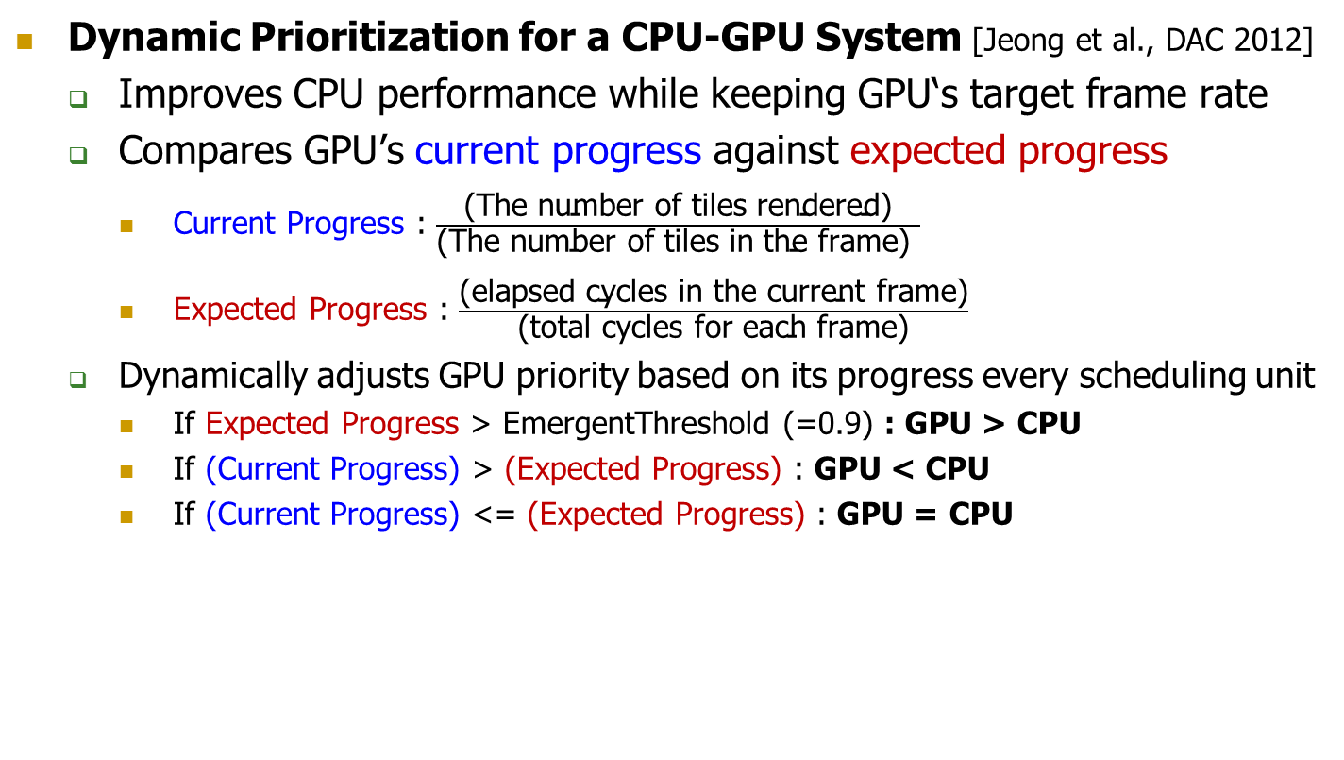
Existing Memory Scheduling for Heterogeneous System
Dynamic Prioritization for a CPU-GPU System [Jeong et al., DAC 2012]
  Improves CPU performance while keeping GPU‘s target frame rate
  Compares GPU’s current progress against expected progress
    Current Progress : $\frac{\text{(}\text{The} \text{number} \text{of} \text{tiles} \text{rendered}\text{)}}{\text{(}\text{The} \text{number} \text{of} \text{tiles} \text{in} \text{the} \text{frame}\text{) }}$
    Expected Progress : $\frac{\text{(}\text{elapsed} \text{cycles} \text{in} \text{the} \text{current} \text{frame}\text{)}}{\text{(}\text{total} \text{cycles} \text{for} \text{each} \text{frame}\text{)}}$
  Dynamically adjusts GPU priority based on its progress every scheduling unit
    If Expected Progress > EmergentThreshold (=0.9) : GPU > CPU
    If (Current Progress) > (Expected Progress) : GPU < CPU
    If (Current Progress) <= (Expected Progress) : GPU = CPU
We adapt this scheme for a wide variety of HWAs
Notes:
Most of the works for the memory scheduling is for the CPU-only systems. To manage interference between CPU cores and GPUs, a state-of-the-art technique proposes to dynamically adjust memory access priority between CPU cores and GPUs.
The goal of the technique is to improve CPU performance while keeping GPU’s target frame rate.
To achieve the goal, they compare GPU’s current progress against expected progress. The current progress is the fraction of tiles rendered in a frame, and the expected progress is the fraction of time elapsed in a period.
If current progress is greater than expected progress, it means GPU is making good progress to keep GPU’s frame rate, then GPU requests are given lower priority than CPU requests. On the other hands, if current progress is less than or equal to ExpectedProgress, because it means GPU is not on track to meet its deadline, GPU requests are given the same priority as CPU requests. Only when expected progress is greater than EmergentThreshold(=0.90), the GPU requests are given higher priority than CPU requests.
We adapt this scheme for a wide variety of HWAs

Slide 67
DASH Scheduler: Summary
Problem: Hardware accelerators (HWAs) and CPUs share the same memory subsystem and interfere with each other in main memory
Goal: Design a memory scheduler that improves CPU performance while meeting HWAs’ deadlines
Challenge: Different HWAs have different memory access characteristics and different deadlines, which current schedulers do not smoothly handle
  Memory-intensive and long-deadline HWAs significantly degrade CPU performance when they become high priority (due to slow progress)
  Short-deadline HWAs sometimes miss their deadlines despite high priority
Solution:
  Prioritize HWAs over CPU anytime when the HWA is not making good progress
  Application-aware scheduling for CPUs and HWAs
Key Results: 1) Improves CPU performance for a wide variety of different CPU workloads by 9.5%; 2) Achieves 100% deadline met ratio of HWAs
Notes:
Here’s an executive summary. The problem is hardware accelerators and CPUs share the same memory subsystem and interfere with each other.
So, the goal of this work is to design a memory scheduler that improves CPU performance while meeting HWAs’ deadlines.
The challenge to achieve the goal is different HWAs have different memory access characteristics and different deadlines. For example, memory-intensive and long-deadline HWAs significantly degrade CPU performance when they become high priority due to their slow progress. On the other hand, short-deadline HWAs sometimes miss their deadlines despite high priority. Current schedulers do not smoothly handle this difference.
For solution of this challenge, DASH memory scheduler uses 3 key ideas.
First, to meet HWAs’ deadlines, DASH prioritizes HWAs over CPU anytime when the HWA is not making good progress.
Second, however, DASH tries to prevents a HWA from becoming high priority. It is OK to prioritize the HWA over a memory-intensive CPU even when the HWA is making good progress.
Third, DASH prioritizes short-deadline-HWAs over long-deadlin-HWAs and CPUs based on worst-case memory access time estimation.
As the key results, DASH improves CPU performance for a wide variety of different CPU workloads by 9.5% and it achieves 10% deadline met ratio of HWAs.

Slide 68
DASH: Deadline-Aware High-Performance Memory Scheduler for Heterogeneous Systems with Hardware Accelerators
Hiroyuki Usui, Lavanya Subramanian
Kevin Chang, Onur Mutlu
Jan 18, 2016
HiPEAC 2016
Notes:
Hello, everyone. I am Hiroyuki Usui. Today I will present “DASH: Deadline-Aware High-Performance Memory Scheduler for Heterogeneous Systems with Hardware Accelerators”. This work has been done together with Lavanya Subramanian, Kevin Chang, and Onur Mutlu.

