Slide 1
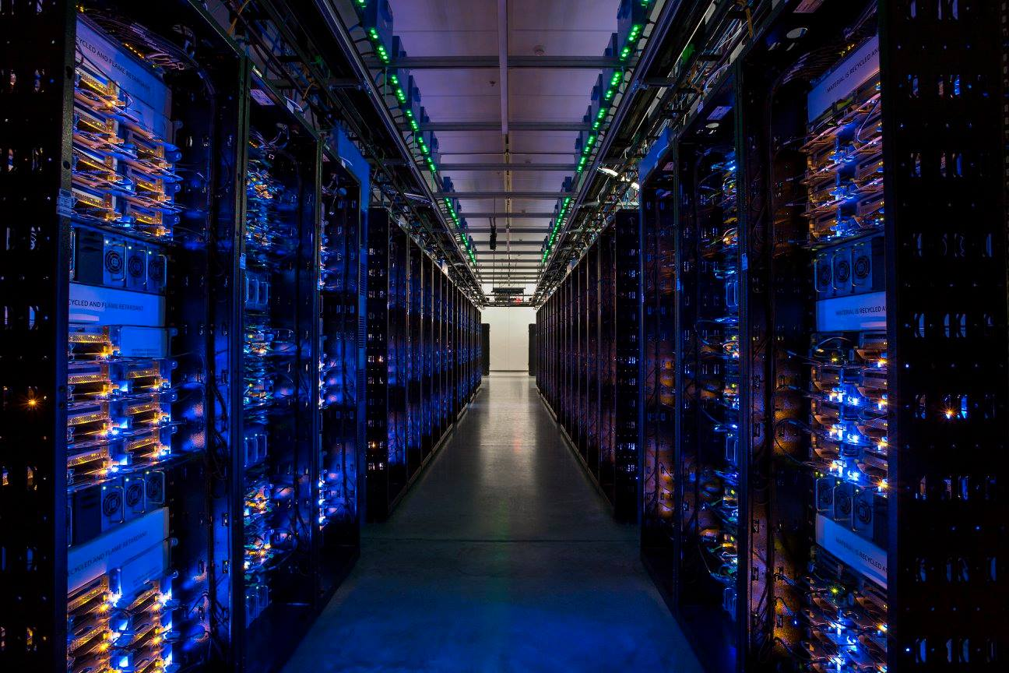
A Large Scale Study of
Data Center Network Reliability
Justin Meza *,•
Tianyin Xu ‡,•
Kaushik Veeraraghavan •
Onur Mutlu †,*
•Facebook *CMU †ETH Zürich ‡UIUC
Notes:
Hi! My name is Justin and and I'm a Research Scientist at Facebook where I work on Disaster Recovery and I'm excited to speak to you today about a large scale study we did of data center network reliability. Part of my work at Facebook is to understand the challenges software designers will face when deploying systems in large scale data centers. And today, I'd like to share with you a couple of the predominant trends we're seeing in the field that make network reliability challenging. In order to set the stage, however, it's important that I first discuss how large scale web services organize their networks. <CLICK>

Slide 2

Notes:
So let’s take a quick look at what happens I take out my mobile phone <CLICK> and open up an app. First, ... <CLICK>

Slide 3


Notes:
<CLICK>

Slide 4
Notes:
... a request is sent to a server in one of several datacenters around the world. To get to the data center, ... <CLICK>

Slide 5
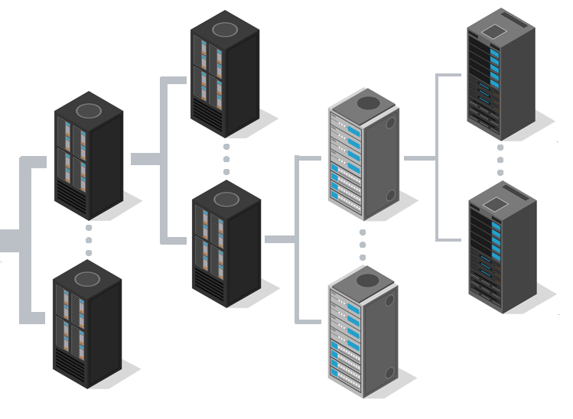
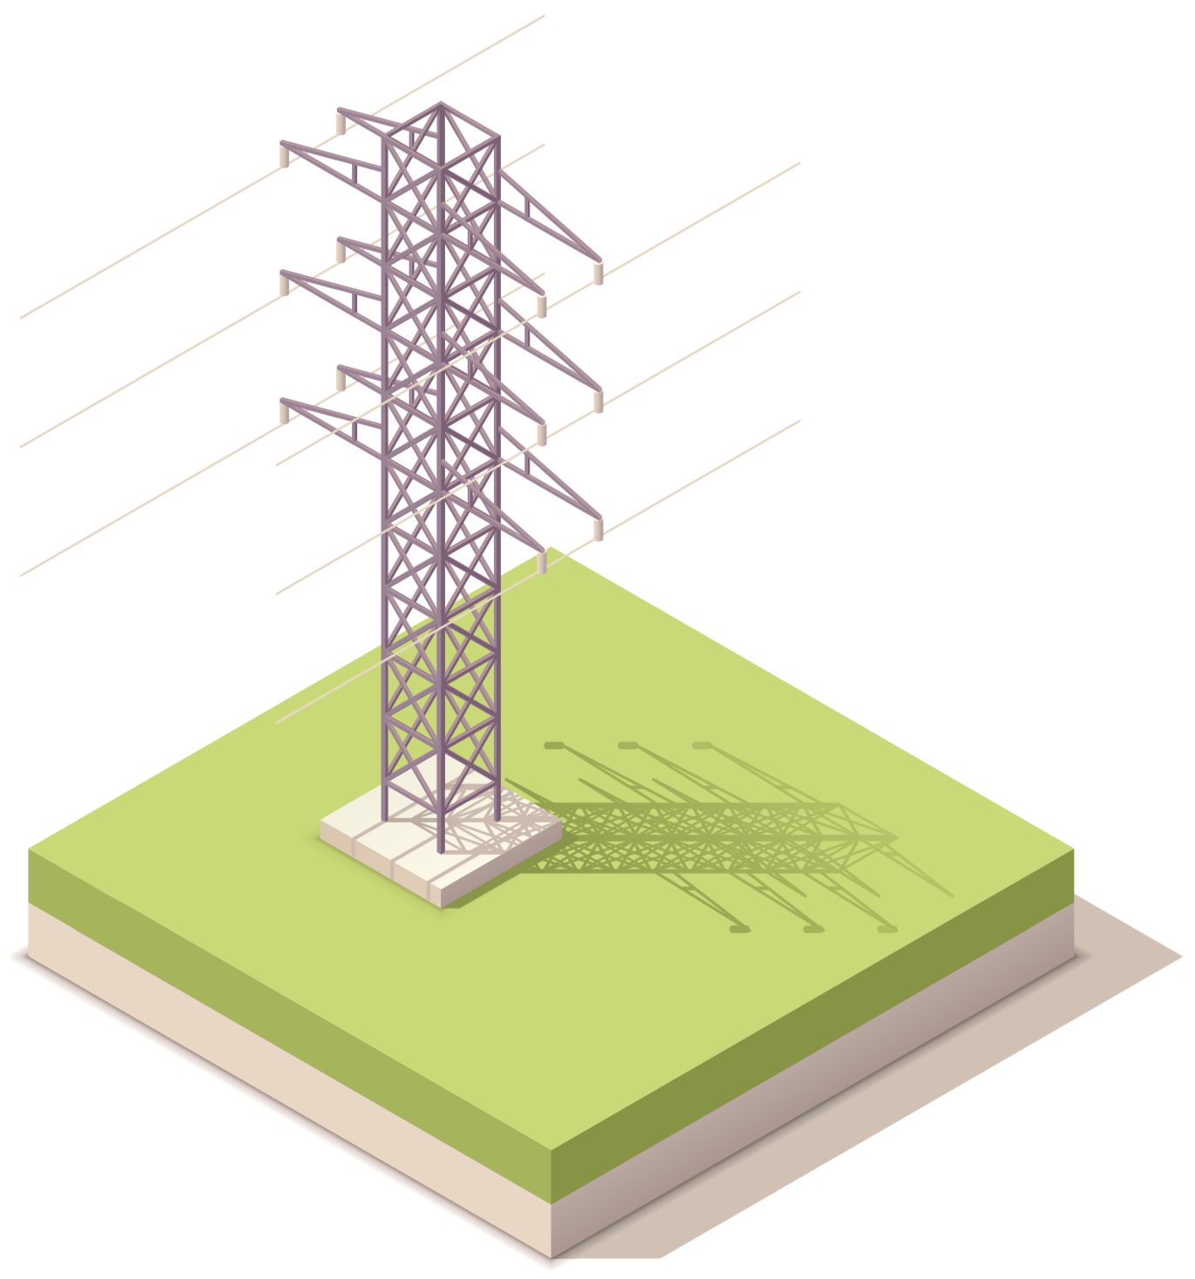
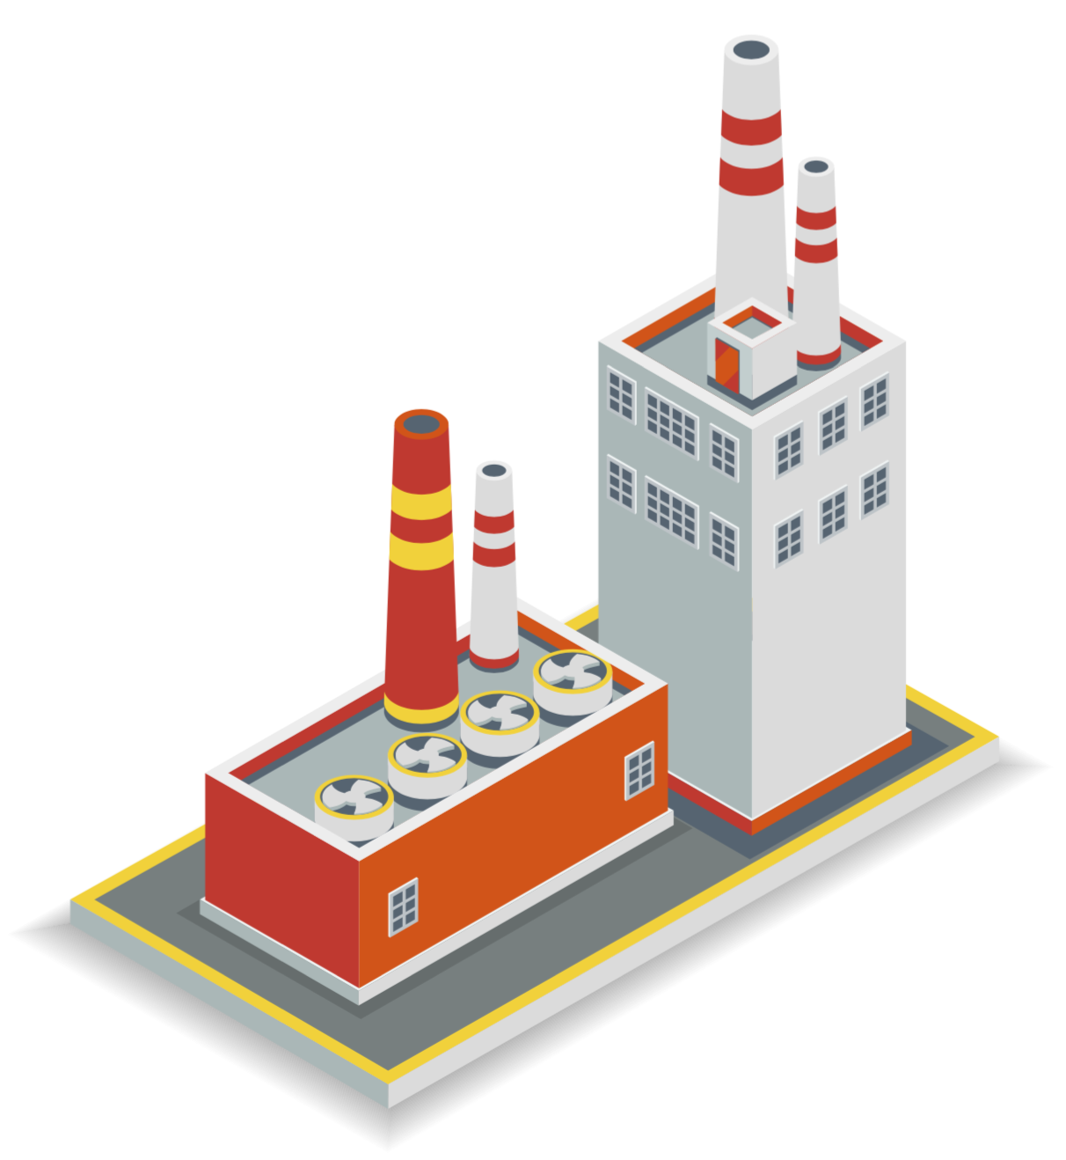
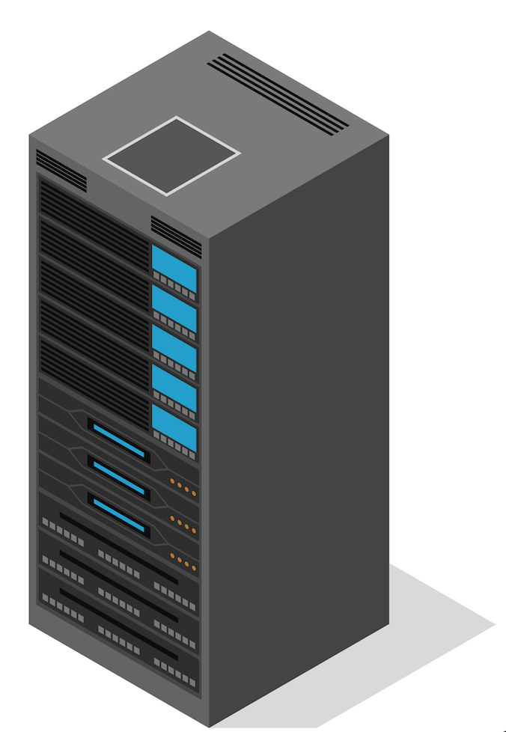
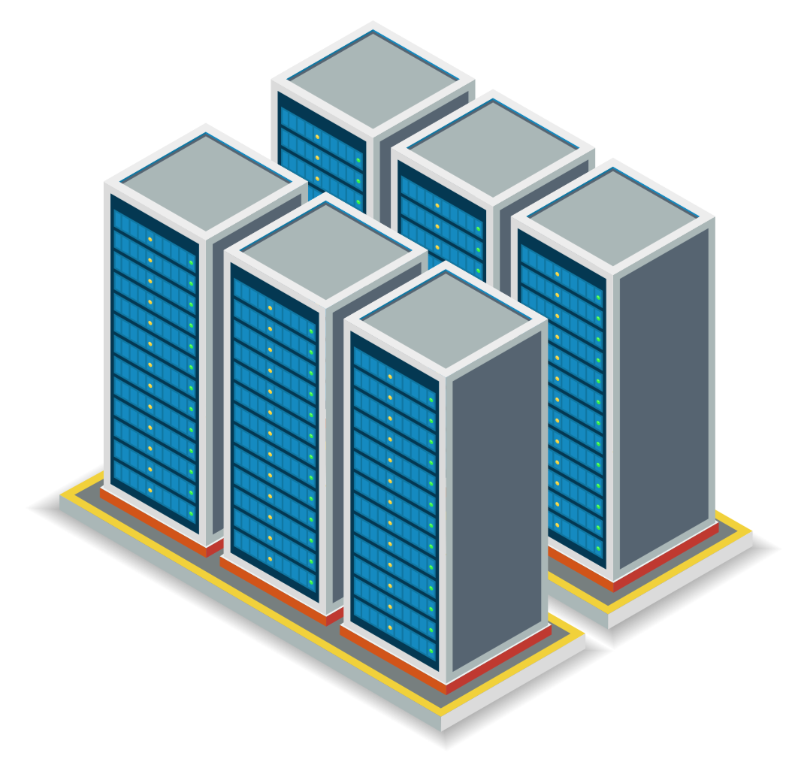
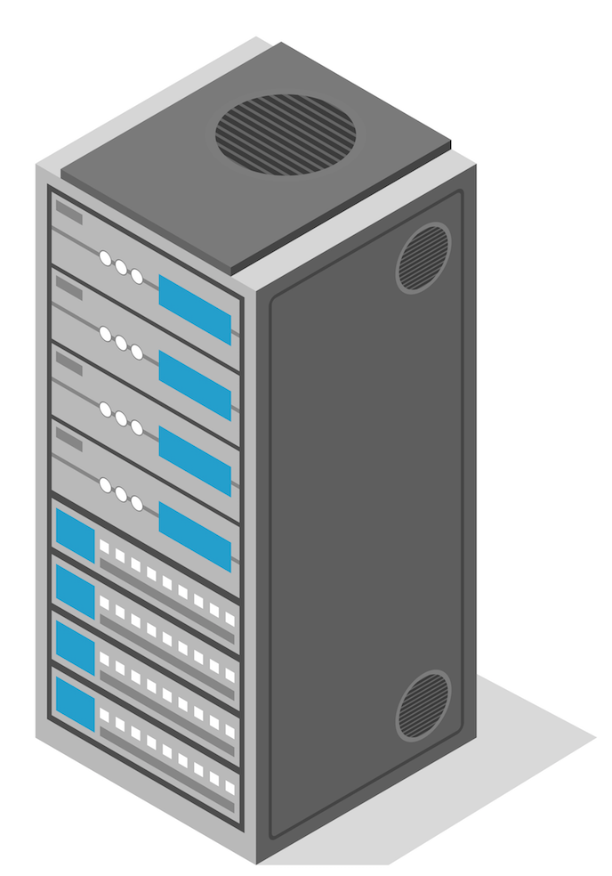
WAN
Internet
ISP
Edge Node
Core Switches
Data Center Fabric
Top of Rack Switch
Notes:
... the request travels over the Internet, to an Internet Service Provider that peers with a Wide Area Network backbone. The request traverses the WAN backbone to get to an Edge Node that runs network load balancing software, typically located in ISPs or colation facilities, and then... <CLICK>

Slide 6
WAN
Internet
ISP
Edge Node
Core Switches
Data Center Fabric
Top of Rack Switch
Notes:
... the request is routed to a data center. The request first arrives at a set of Core switches that provide cross data center connectivity, and, in our newest data centers, traverses through a mesh of switches called the data center fabric. The data center fabric is a software-managed hierarchy of switches that provides reliable connectivity within a data center. The edge of the fabric connects to top of rack switches, which then forward the request to a server running the rack. <CLICK>

Slide 7
WAN
Internet
ISP
Edge Node
Core Switches
Data Center Fabric
Rack Switch
Notes:
Understanding and managing the reliability of large scale networks -- both between data centers and within data centers -- can be challenging. Especially because failure in a portion of the network in one place can affect software systems running on the other side of the globe. In a large scale web service, for example, we'd like to answer questions such as, "Which devices and links pose the biggest risk to reliability?" "How severe are network failures to site reliablity when they occur?", and "How can we plan our network to minimize reliability risk?" <CLICK>

Slide 8
Key takeaways
As DC networks become more software managed,
the next challenge is first and last hop reliability
Growth in geo replicated software drives the need for reliable backbone network capacity planning
Notes:
If there is anything that you take away from this talk, I hope that it is these two points. With a shift toward more software management in our data centers, we have seen a corresponding shift in reliability, with unmanaged and widespread devices in the data center, like core switches and rack switches becoming the next big reliability bottlenecks. In addition, the rapid growth in cross data center traffic has made backbone network reliability planning more important than ever for ensuring good overall site reliability. <CLICK>

Slide 9
Roadmap
Tracking how network failures affect software
A next challenge for data center network reliability
Geo replication and backbone capacity planning
Concluding thoughts
Notes:
In our study, we observe the network from the perspective of the software running on it. So next, I'd like to describe our methodology for tracking service-level reliability during network events. After that, I'll focus on two of the main themes from our work: how, from a software perspective, the reliability of data center network devices is shifting, and how we use backbone capacity planning to improve site reliability. And then I'll conclude. <CLICK>

Slide 10
Network Incidents
cause
Software Failures
that result in
Site Events (SEVs)
Notes:
It's important that I introduce some terminology, as our work differs from some prior large scale data center network studies. At Facebook, network issues are a common occurrence, but not all network issues affect software systems. In our paper, we say that a Network Incident is any event in the network that causes software to fail. A network incident might be an unresponsive port or a bad configuration change, for example. Software failures result in Site Events, or SEVs for short. SEVs can range from small events that impact user experience only briefly, to widespread site outages. I'll refer to network incidents and SEVs interchangeably throughout this talk. <CLICK>

Slide 11
WAN
Internet
ISP
Edge Node
Core Switches
Data Center Fabric
Top of Rack Switch
Notes:
So, for example, our data center network study does NOT include <CLICK> faulty network switches that can be fixed using automated repairs in the fabric network, OR, <CLICK> failure in the network that is masked by geographic replication of services and data. Instead, when examining data center networks, we focus on the network events that cause real-world production software impact. <CLICK>

Slide 12
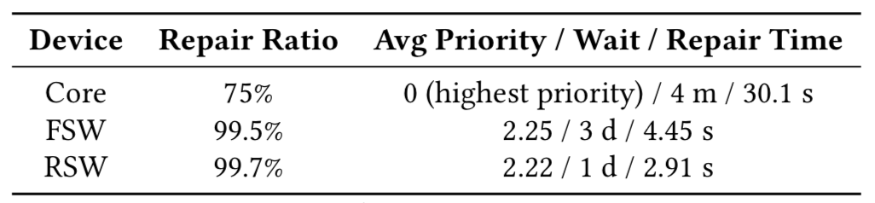

Automated repair
Not deployed on all devices, but highly effective
Top fixes: port failures, config files, switch ping failures
Notes:
As a simple example of network events that don't usually result in software failures, take the automated switch repairs that happen in the data centers we examine. You can see here that while not all devices support automated repairs, some devices, like rack switches, labeled RSWs in the table, can have software repair 99.7% of their events automatically. Common fixes include resetting ports for port ping failures, reloading incorrect configuration files, and rebooting switches that become unresponsive.

Slide 13
SEV reports
Filled out by engineers who fixed the problem
Contain metadata (switch ID, switch type, ...)
Classified based on severity
Continually audited for accuracy and completeness
Notes:
So how do we track when an issue cannot be fixed and affects software? Well, every network incident has a corresponding SEV report that is filled out by an engineer involved in root causing and fixing the issue that caused the software failure. The report contains important metadata that lets us tie software failures back to their network causes. SEV reports also classify the SEV into different severity levels, depending on the incident impact. And SEVs are continually audited by humans for accuracy and completeness. In our study, we analyzed eight years of SEV report data. <CLICK>

Slide 14
Network incidents, not events
Want to know software impact and severity
Events alone don't provide enough context
Often masked by redundancy and automated repairs
We examine a different class of failures
    Software failures resulting from network events
    Top-line impact on software reliability
Notes:
So, to summarize our analysis methodology: We wanted to understand the how network events affect the software running in a large scale web service. Simply monitoring network events, however, does not provide enough context and network events are often masked by redundancy and automated repairs. So, we examine the network incidents captured in SEV reports to understand the reliability trends in data center networks. <CLICK>

Slide 15
Roadmap
Tracking how network failures affect software
A next challenge for data center network reliability
Geo replication and backbone capacity planning
Concluding thoughts
Notes:
Now that I've told you how these data center networks are organized and how we relate network failures to software failures, I will next introduce the first of two network reliability trends that we see as a challenge for modern data centers. It has to do with the changes that are going on within data center networks, so let me start by providing an overview of some of the recent shifts we've been seeing in data center network design. <CLICK>

Slide 16

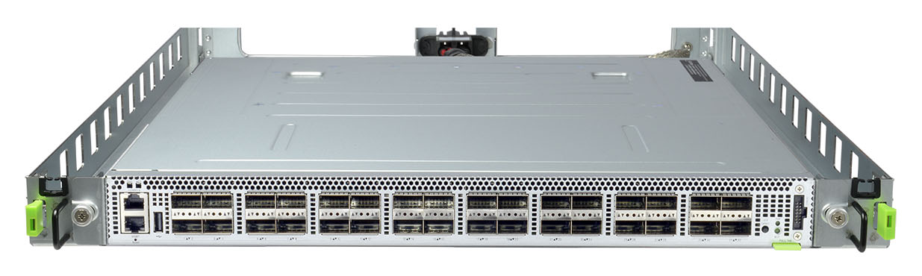
Data center network trends
Simple, custom switches
Software-based fabric networks
Automated repair
Notes:
In the last few years there has been a shift from using big vendor devices with priopriatary firmware and software toward using simple switches built from commodity network chips and connecting those simple switches into a software-based fabric of devices. Devices in the fabric are fungible, meaning that when they go away, software orchestration kicks in to replace them. On top of that, software-based automated repair systems handle the most common failure modes. <CLICK>

Slide 17
Data center network trends
Simple, custom switches
Software-based fabric networks
Automated repair
Notes:
So software is playing an increasing role in data center network reliability. To understand just how much it has improved reliability, we analyzed how our older, cluster-based network design with big vendor switches and fixed topologies compared to our fabric network. <CLICK>

Slide 18
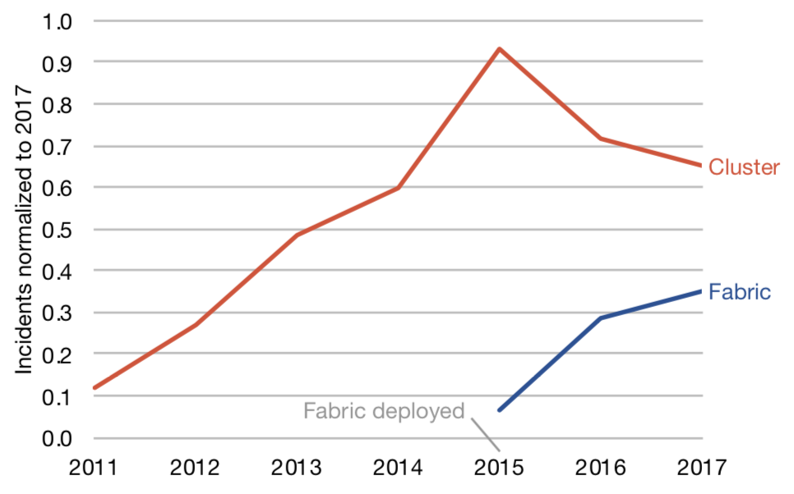
Older cluster-based design
Notes:
This graph shows the number of SEVs for the cluster network design since 2011 normalized to the total number of SEVs in 2017. The way to read this graph is that in 2011, the cluster networks had around 10% of the SEVs as in 2017 and by 2015, cluster networks had nearly the same number of SEVs as 2017. As you can see, ... <CLICK>

Slide 19
Older cluster-based design
Cluster network incidents increased 9x over 4 years
Notes:
... cluster network reliability did not scale well over time, increasing almost 9x in a 4-year period. One of the main reasons for this was the challenge in managing proprietary devices configured in a fixed topology. We needed a more scalable and reliable network design, and data center fabric was the solution. <CLICK>

Slide 20
Cluster versus fabric designs
Notes:
So how did it perform? Well, since its adoption in 2015, the fabric network design has been deployed across our new data centers and is even being retrofitted into older data centers, and represents 60% of our network hardware today. On the graph you can see that even in 2017, in their dwindling numbers, cluster networks still have around twice the incidents compared to fabric networks... <CLICK>

Slide 21
Cluster versus fabric designs
Cluster have 2X total incidents & 2.8X on a per-device level
Notes:
Note that though you see the fabric incidents increasing on the graph, this is because of their broader adoption. To eliminate for this effect, if we normalize by the higher deployment footprint of fabric devices and compare incidents per device, we find that the reliability gap is even larger, with cluster network devices having almost 3 times the incidents as fabric devices. <CLICK>

Slide 22
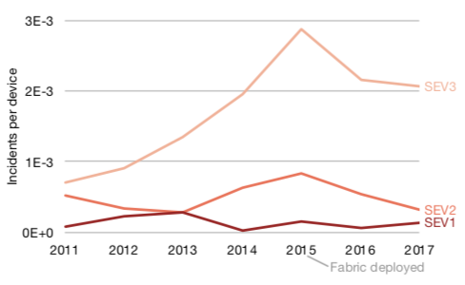
DC fabric has fewer incidents
Reversing the negative software-level reliability trend
Notes:
What's also interesting is that if we look at the top-line reliability of the site, measured using the number of SEVs over time, we can see a corresponding inflecton point in incidents corresponding to when we deployed our fabric design, effectively reversing the negative software-level reliability trend of cluster networks. Here, we're showing the number of SEVs of different severity levels, from the least severe SEVs, at the top, to the most severe SEVs at the bottom. So, with fabric networks being deployed, you might be asking yourself, as my team did, what network events still cause SEVs in Facebook data centers? Well... <CLICK>

Slide 23
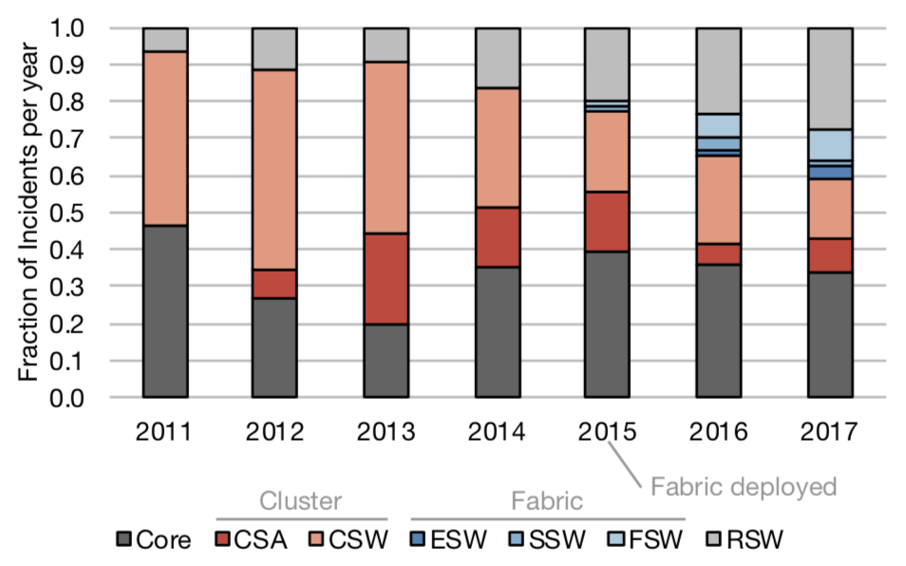
First and last hop reliability
Notes:
Since the adoption of fabric networks in 2015, the predominant source of SEVs has shifted from switches that make up the middle layers of the data center network, shown in red and blue on this graph, to the switches that perform the first and last hop in the data center network: the core switches and the rack switches, shown in gray. <CLICK>

Slide 24
First and last hop reliability
Notes:
The core devices are still built based on vendor hardware, making them challenging to maintain and customize. Compared to software, humans perform slow repairs, and slow repairs mean fewer switches to route requests, more traffic on the remaining switches, and more congestion in the network. <CLICK>

Slide 25
First and last hop reliability
Notes:
On the other hand, rack switches run Facebook's fully customized hardware and software. So what makes them so error prone? <CLICK>

Slide 26
rack switches make up
82%
of network devices
Notes:
The answer is their sheer volume. At Facebook, nearly 82% of network devices are rack switches, and rack switch incident rates are increasing over time. So how problematic are core switches and rack switches when they fail? Well, throughout 2017... <CLICK>

Slide 27
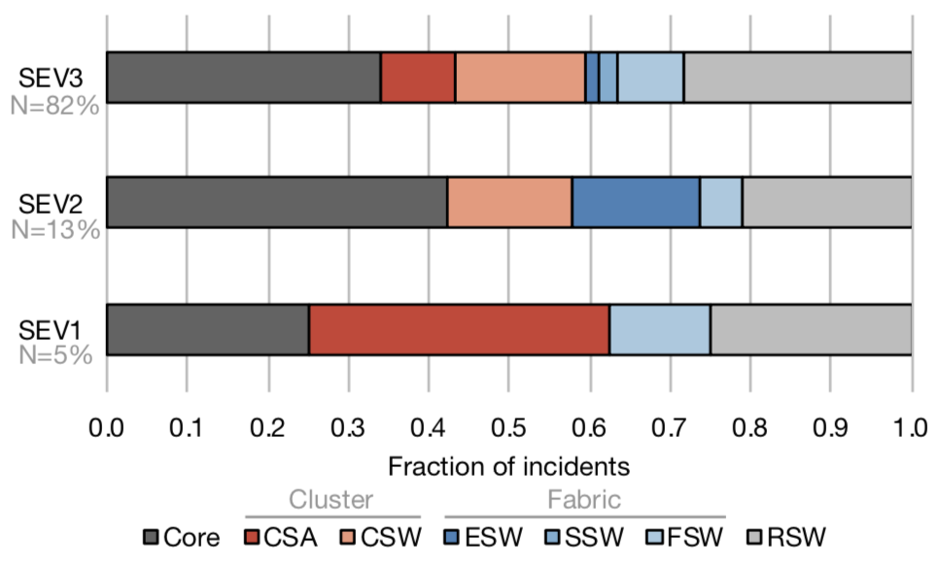
Main cause across all severities
Notes:
Core switch and rack switch failure rates dominated nearly all categories of software incident severity, from small failures, shown at the top, all the way to widespread service outages, shown at the bottom. <CLICK>

Slide 28
Implications for DC networks
More redundant switches is one approach
Make software more resilient
More aggressive automated repairs
Notes:
So what do these findings imply for the design for data center networks? Well, one way to improve reliability might be to build more redundancy into the network by adding additional core and rack switches. However, this can be inefficient, especially when it may involve duplicating 82% of your devices. On the other hand, we can turn to software to help. One approach that works well is designing systems with failure in mind by distributing their capacity across network failure domains. In addition, we can push further in the types of events that automated repairs can handle. There's a catch, however, which is in order to provide the software the feedom it needs to tolerate network failures, we need to make sure the backbone network that connects data centers is planned with failures in mind. <CLICK>

Slide 29
Roadmap
Tracking how network failures affect software
A next challenge for data center network reliability
Geo replication and backbone capacity planning
Concluding thoughts
Notes:
So to recap, I hope that I described how in Facebook's modern data centers, we've found that the first and last hops in the network -- core and rack switches -- pose the next main challenge for software reliability. Next, I'm going to discuss one way that we deal with this challenge through careful backbone capacity planning that takes software-based geo replication into consideration. <CLICK>

Slide 30
Notes:
Now, in order to explain how backbone networks affect the reliability of modern data center services, I need to illustrate the role that the backbone network plays in data centers. For example, in responding to a single request, a web server might access hundreds of services spread across several data centers shown as yellow markers on this map of the world. And all of this cross data center traffic adds up... <CLICK>

Slide 31
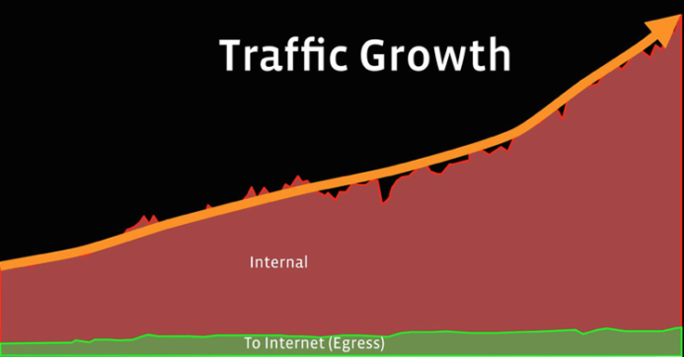
Backbone traffic growth
Notes:
Take a look at this normalized graph, which compares, over the last few years, the amount of traffic on Facebook's backbone coming from "Internal" server-to-server communication across data centers, in red, versus the amount of "Egress" that goes back into the Internet and to users, in green. You can see that Internal traffic is growing at a much faster rate than Egress. So what does this imply for how we manage our backbone? <CLICK>

Slide 32
Notes:
Well, imagine that a core switch fails, or there is a fiber cut in one of our data centers. <CLICK> We need to be prepared to safely shift traffic to the other data centers at a moment's notice, and we have to be certain that the backbone will provide us this flexibility at all times. This is hard to get right for a few reasons... <CLICK>

Slide 33
Data center backbones
Shared resource
Frequent link failures
Capacity planning dictates reliability
Notes:
First, backbone resources are shared and software developers are somewhat notorious for assuming the network is an infinite resource. Second, backbone links failures are happening all the time. When operating enough links, it's not surprising to see failures every few days. Third, the backbone is only as reliable as we plan for it to be, so, in the next few slides I'd like to walk you through how we address some of these challenges. <CLICK>

Slide 34
Measuring backbone reliability
Sent via email for maintenances and outages
Parsed and logged in a database
Used to compute reliability statistics:
    Mean time between failures (MTBF)
    Mean time to repair (MTTR)
Notes:
It all starts with measuring the current reliability of our backbone edge nodes and the links that connect them. For all backbone maintenances, whether planned or unplanned, we recieve emails from vendors that are parsed and logged in a database. We can use these logs to compute reliability statistics for edge nodes and links, such as the mean time between failures and the mean time to repair. <CLICK>

Slide 35
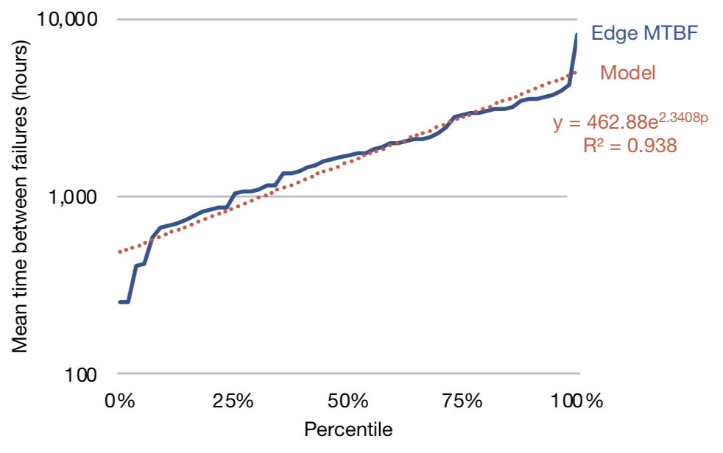
Edge node MTBF distribution
Typical edge node failure rate is on the order of months
Notes:
For example, this graph shows the distribution of mean time between failures, in hours, for all of Facebook's edge nodes. Note that the y axis is in log scale. You can see that typical edge node failure rate is on the order of months. We also build models from this data, shown in red. And we can do the same thing for mean time to repair... <CLICK>

Slide 36
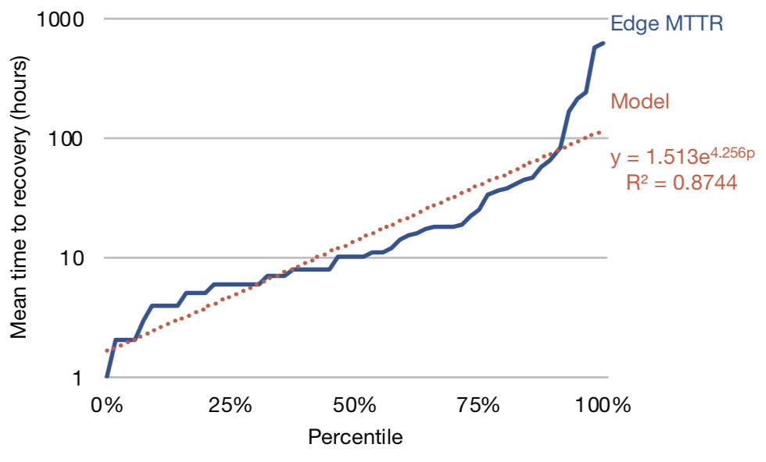
Edge node MTTR distribution
Edge node mean time to repair is on the order of hours
Notes:
Here you can see the distribution for mean times to repair for edge nodes, which are typically on the order of hours. Again, we can model this distribution. We can look at the data in other ways, too, for example... <CLICK>

Slide 37
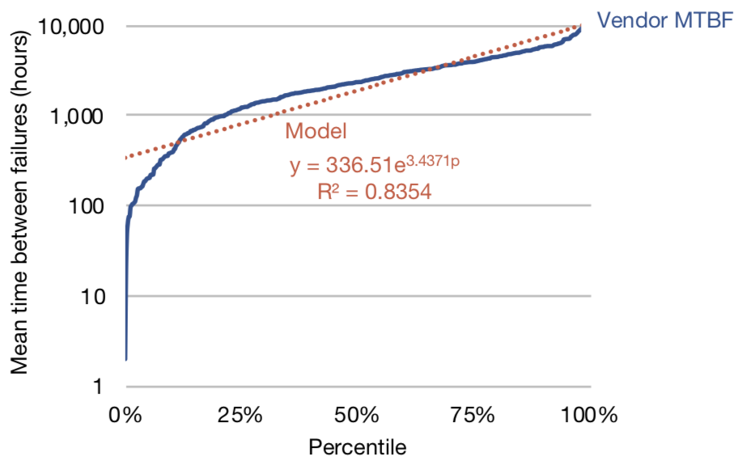
Fiber vendor MTBF distribution
Typical vendor link failure rate is on the order of months
Notes:
We can slice the data by the vendors that supply fiber links, again showing MTBF in log scale. The first thing to notice here is that most links supplied by vendors fail on the order of months. We also noticed some vendors with very high MTBFs. What was going on here? Upon closer inspection, we found that these vendors tend to operate in large metropolitan areas, which reflects how fiber in densely populated areas is easier to maintain than in more rural other areas. <CLICK>

Slide 38
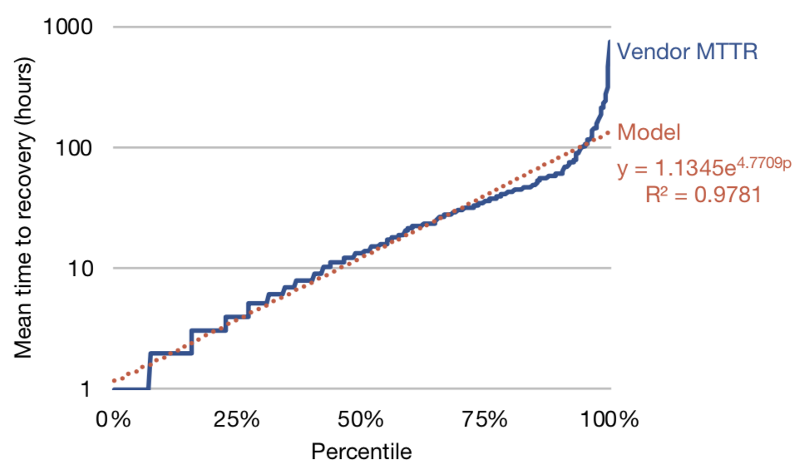
Fiber vendor MTTR distribution
Vendor MTBF and MTTR span multiple orders of magnitude
Notes:
We can also study the mean time to recovery for links supplied by vendors. Most links recover relatively quickly, in hours, but we now see a trend emerge: Across all the vendors, we find multiple orders of magnitude between the vendors with the most reliable links and vendors with the least reliable links. This illustrates the significant, yet not well studied in the literature, role fiber vendors play in backbone reliability. <CLICK>

Slide 39
Minimizing backbone outages
Simulation
objective = six 9's yearly reliability
Capacity plan
Model 2
Node1: Links A, B
Node 2: Links X, Y
Model 3
...
Notes:
Once we have models to describe backbone reliability, we can begin to simulate the reliability of the network. The simulation takes into account similar models to what we present in the paper, in addition to forecasts of backbone network demand. <CLICK>

Slide 40
Minimizing backbone outages
Simulation
objective = six 9's yearly reliability
Capacity plan
Model 2
Node1: Links A, B
Node 2: Links X, Y
Model 3
...
Notes:
I want to emphasize how challenging this is to get right. As we learn more about the operational behavior of our backbone, our simulations become more accurate, and the reliability of our backbone network improves. <CLICK>

Slide 41

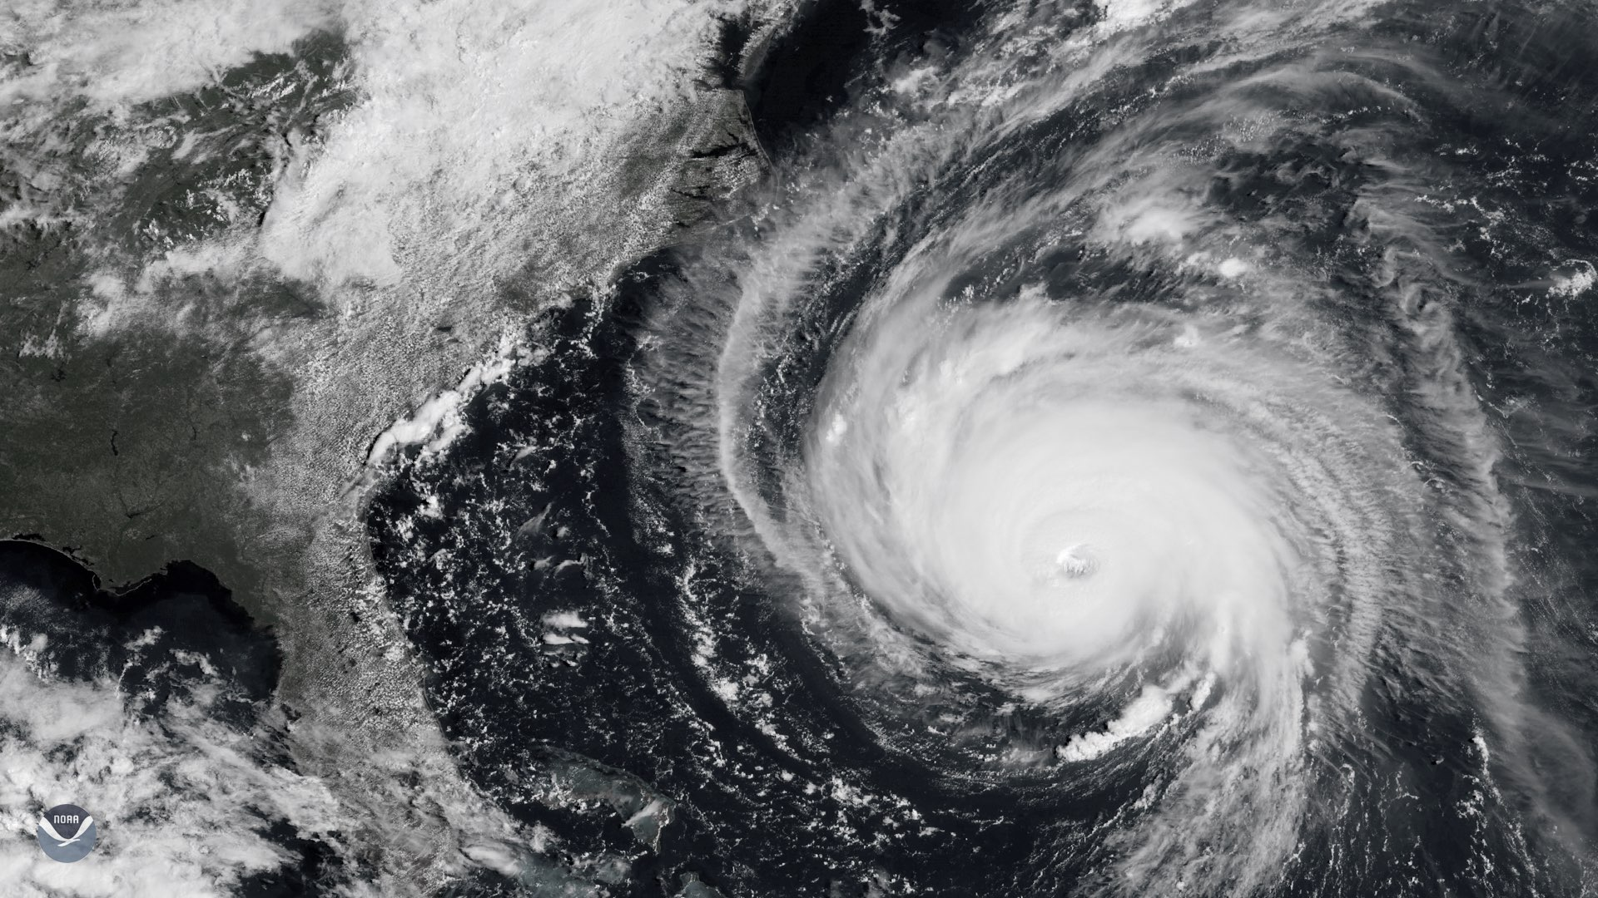
Forest City Data Center
Notes:
To recap, I've motivated the need for backbone reliability to tolerate widespread network outages, and how we try to ensure high backbone reliability. I'd like to tie everything together with a quick story of how the network practices I described enable us to more effectively mitigate disasters. <CLICK>

Slide 42
Forest City Data Center
Notes:
Last month, when Hurricane Florence was hurtling toward our Forest City datacenter, as part of a routine procedure, we redirected production traffic away from Forest City to other data centers to prevent any disruption caused by the hurricane. The process was mostly automated, took on the order of minutes, resulted in no user impact, and was entirely transparent from the network perspective. What enabled this operation – and the hundreds of others like it over the years – to go smoothly, was the careful planning of our data center and backbone networks. <CLICK>

Slide 43
Roadmap
Tracking how network failures affect software
A next challenge for data center network reliability
Geo replication and backbone capacity planning
Concluding thoughts
Notes:
So I've just told you about how Facebook leverages careful backbone network capacity planning to improve the reliability of the site. Next, I'd like to conclude. <CLICK>

Slide 44
Concluding thoughts
First and last hop reliability forces us to rethink how network and software share the task of reliability
Reliable backbone planning is a key enabler for geo replication and software management flexibility
Notes:
As we've seen, with a shift toward more software management in our data centers, we have seen a corresponding shift in reliability, with unmanaged and widespread devices, like core switches and rack switches becoming the next big reliability bottleneck. This has forced us to rethink the roles that network devices and the software that runs on them plays in managing reliability. In addition, the rapid growth in cross data center traffic has made backbone network reliability planning more important than ever. By rigorously planning capacity, we've been able to provide a strong foundation on which to manage the hundreds of geographically distributed systems that power large scale web services. Thank you, and I'd be happy to take any questions.

