Slide 1
Flipping Bits in Memory Without Accessing Them:
DRAM Disturbance Errors
Yoongu Kim
Ross Daly, Jeremie Kim, Chris Fallin, Ji Hye Lee,
Donghyuk Lee, Chris Wilkerson, Konrad Lai, Onur Mutlu
Notes:
Hi, my name is Yoongu Kim. Later today I’ll be presenting “Flipping Bits in Memory Without Accessing Them: An Experimental Study of DRAM Disturbance Errors.”

Slide 2
DRAM Chip
Row
Wordline
Row
Row
Row
Row
Notes:
A DRAM chip consists of many rows of cells. To access a row, it must first be opened by raising the voltage of its wordline. And after the row is accessed, it is closed by lowering the voltage of its wordline. But, we observed that repeatedly opening and closing a row causes errors -- called disturbance errors -- in adjacent rows.

Slide 3
DRAM Chip
Row
Wordline
Row
Opened Row
V_{HIGH}
Row
Row
Notes:
A DRAM chip consists of many rows of cells. To access a row, it must first be opened by raising the voltage of its wordline. And after the row is accessed, it is closed by lowering the voltage of its wordline. But, we observed that repeatedly opening and closing a row causes errors -- called disturbance errors -- in adjacent rows.

Slide 4
DRAM Chip
Row
Wordline
Row
Closed Row
V_{LOW}
Row
Row
Notes:
A DRAM chip consists of many rows of cells. To access a row, it must first be opened by raising the voltage of its wordline. And after the row is accessed, it is closed by lowering the voltage of its wordline. But, we observed that repeatedly opening and closing a row causes errors -- called disturbance errors -- in adjacent rows.

Slide 5
DRAM Chip
Row
Wordline
Row
Opened Row
V_{HIGH}
Row
Row
Notes:
A DRAM chip consists of many rows of cells. To access a row, it must first be opened by raising the voltage of its wordline. And after the row is accessed, it is closed by lowering the voltage of its wordline. But, we observed that repeatedly opening and closing a row causes errors -- called disturbance errors -- in adjacent rows.

Slide 6
DRAM Chip
Row
Wordline
Row
Opened Row
V_{HIGH}
Row
Row
Notes:
A DRAM chip consists of many rows of cells. To access a row, it must first be opened by raising the voltage of its wordline. And after the row is accessed, it is closed by lowering the voltage of its wordline. But, we observed that repeatedly opening and closing a row causes errors -- called disturbance errors -- in adjacent rows.

Slide 7
DRAM Chip
Row
Wordline
Row
Opened Row
V_{HIGH}
Row
Row
Repeatedly opening and closing a row induces disturbance errors in adjacent rows
Notes:
A DRAM chip consists of many rows of cells. To access a row, it must first be opened by raising the voltage of its wordline. And after the row is accessed, it is closed by lowering the voltage of its wordline. But, we observed that repeatedly opening and closing a row causes errors -- called disturbance errors -- in adjacent rows.

Slide 8
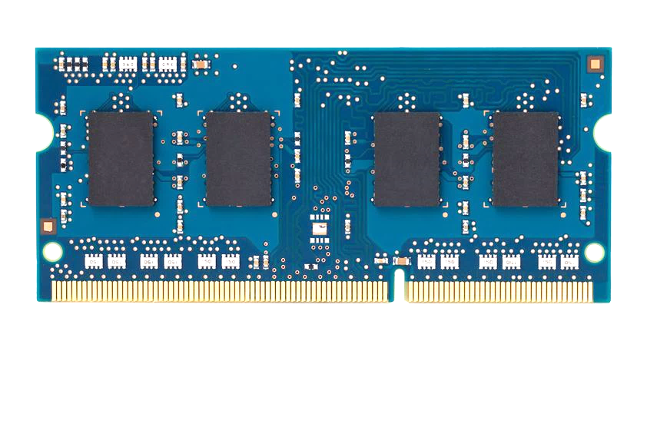
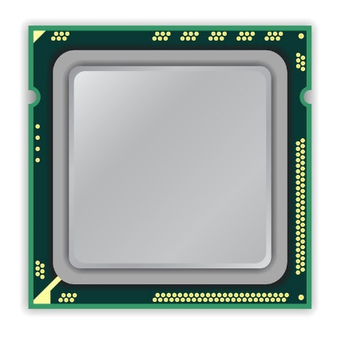
x86 CPU
DRAM Module
loop:
mov (X), %eax
mov (Y), %ebx
clflush (X)
clflush (Y)
mfence
jmp loop
X
Y
Notes:
We demonstrate the errors on multiple x86 systems. Shown to the bottom-left is a “disturbance kernel”. When executed, it forces two rows to be opened and closed one after the other – over and over again. Consequently, it induces many errors in the module.

Slide 9
x86 CPU
DRAM Module
loop:
mov (X), %eax
mov (Y), %ebx
clflush (X)
clflush (Y)
mfence
jmp loop
X
Y
Notes:
We demonstrate the errors on multiple x86 systems. Shown to the bottom-left is a “disturbance kernel”. When executed, it forces two rows to be opened and closed one after the other – over and over again. Consequently, it induces many errors in the module.

Slide 10
x86 CPU
DRAM Module
loop:
mov (X), %eax
mov (Y), %ebx
clflush (X)
clflush (Y)
mfence
jmp loop
X
Y
Notes:
We demonstrate the errors on multiple x86 systems. Shown to the bottom-left is a “disturbance kernel”. When executed, it forces two rows to be opened and closed one after the other – over and over again. Consequently, it induces many errors in the module.

Slide 11
x86 CPU
DRAM Module
loop:
mov (X), %eax
mov (Y), %ebx
clflush (X)
clflush (Y)
mfence
jmp loop
X
Y
Notes:
We demonstrate the errors on multiple x86 systems. Shown to the bottom-left is a “disturbance kernel”. When executed, it forces two rows to be opened and closed one after the other – over and over again. Consequently, it induces many errors in the module.

Slide 12
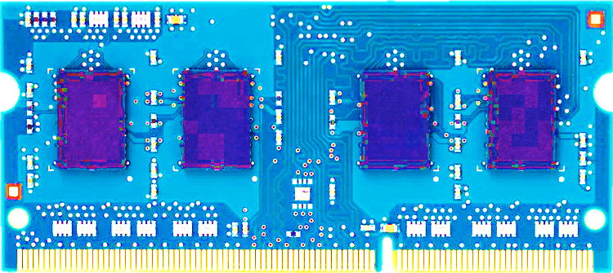
Most Modules At Risk
86%
83%
88%
Notes:
In total, we tested 129 modules from three different manufacturers (shown in blue, red, green) and found errors in 85% of the modules. We show that disturbance errors are a recent phenomenon, affecting modules manufactured only after 2009 or 10. Also, the number of errors in a module can be high as 10 million. Although most modules are vulnerable today, I will discuss solutions to fix this problem.

Slide 13
Most Modules At Risk
86%
83%
88%
After
$$2010$$
After
$$2010$$
After
$$2009$$
Notes:
In total, we tested 129 modules from three different manufacturers (shown in blue, red, green) and found errors in 85% of the modules. We show that disturbance errors are a recent phenomenon, affecting modules manufactured only after 2009 or 10. Also, the number of errors in a module can be high as 10 million. Although most modules are vulnerable today, I will discuss solutions to fix this problem.

Slide 14
Most Modules At Risk
86%
83%
88%
After
$$2010$$
After
$$2010$$
After
$$2009$$
$${10}^{7}$$
Errors
$${10}^{6}$$
Errors
$${10}^{5}$$
Errors
Notes:
In total, we tested 129 modules from three different manufacturers (shown in blue, red, green) and found errors in 85% of the modules. We show that disturbance errors are a recent phenomenon, affecting modules manufactured only after 2009 or 10. Also, the number of errors in a module can be high as 10 million. Although most modules are vulnerable today, I will discuss solutions to fix this problem.

Slide 15
Flipping Bits in Memory Without Accessing Them:
DRAM Disturbance Errors
4:30 PM

