Slide 1
Accelerating Dependent Cache Misses with an Enhanced Memory Controller
Milad Hashemi, Khubaib, Eiman Ebrahimi, Onur Mutlu, Yale N. Patt
June 21, 2016

Slide 2
Overview
Dependent Cache Misses
Enhanced Memory Controller Microarchitecture
Dependence Chain Generation
EMC Performance Evaluation and Analysis
Conclusions

Slide 3
Effective Memory Access Latency
The effective latency of accessing main memory is made up of two components:
  DRAM access latency
  On-chip latency

Slide 4
On-Chip Delay

Slide 5
Dependent Cache Misses
LD [P17] -> P10
MOV P10 -> P7
LD [P7] -> P13
ADD P3, P13 -> P20
LD [P20] -> P2
ADD P2, P3 -> P12

Slide 6
Dependent Cache Misses
The impact of effective memory latency on processor performance is magnified when a cache miss has dependent memory operations that will also result in a cache miss
  Dependent cache misses form chains of long-latency operations that fill the reorder buffer and prevent the core from making forward progress
Important in pointer-based workloads
Dependent cache misses tend to have addresses that are difficult to predict with prefetching

Slide 7
Prefetching and Dependent Cache Misses

Slide 8
Dependence Chains
LD [P17] -> P10
MOV P10 -> P7
LD [P7] -> P13
ADD P13, P3 -> P20
LD [P20] -> P2

Slide 9
Dependence Chain Length

Slide 10
Reducing Effective Memory Access Latency
Transparently reduce memory access latency for these dependent cache misses
  Add compute capability to the memory controller
  Modify the core to automatically identify the operations that are in the dependence chain of a cache miss
  Migrate the dependence chain to the new enhanced memory controller (EMC) for execution when the source data arrives from main-memory
Maintain traditional sequential execution model

Slide 11
Enhanced Memory Controller (EMC) Execution
On Core
On EMC
Op 0: MEM_LD (0xc[R3] -> R1)
Op 1: ADD (R2 + 1 -> R2)
Op 2: MOV (R3→ R5)
Initiate EMC
Execution
Op 3: MEM_LD ([R1] -> R1)
Op 4: SUB (R1 – [R4] -> R1)
Op 5: MEM_LD ([R1] -> R3)
Op 6: MEM_ST (R1-> [R3])
Registers to Core

Slide 12
Quad-Core System

Slide 13
EMC Microarchitecture
No Front-End
16 Physical Registers NOT 256
No Register Renaming
2-Wide NOT 4-Wide
No Floating Point or Vector Pipeline
4kB Streaming Data Cache

Slide 14
Dependence Chain Generation
Cycle:
6
5
1
2
3
0
4
LD [P17] -> P10
LD [P17] -> E0
Live-In Vector:
P3
MOV P10 -> P7
MOV E0 -> E1
Register Remapping Table:
LD [P7] -> P13
LD [E1] -> E2
Core Physical
Register
EMC Physical
Register
P10 | E0
P7 | E1
P13 | E2
P20 | E3
P2 | E4
ADD P3, P13 -> P20
ADD L0, E2 -> E3
LD [P20] -> P2
LD [E3] -> E4

Slide 15
Memory Operations
Virtual Memory Support
  Virtual address translation occurs through a 32-entry TLB per core
  Execution at the EMC is cancelled at a page fault
Loads first query the EMC data cache
  Misses query the LLC in parallel with the memory access
  A miss predictor [Qureshi and Loh: MICRO 2012] is maintained to reduce bandwidth cost
Memory operations are retired in program order back at the core

Slide 16
System Configuration
Quad-Core
  4-wide Issue
  256 Entry Reorder Buffer
  92 Entry Reservation Station
Caches
  32 KB 8-Way Set Associative L1 I/D-Cache
  1MB 8-Way Set Associative Shared Last Level Cache per Core
Non-Uniform Memory Access Latency DDR3 System
  128-Entry Memory Queue
  Batch Scheduling
Prefetchers
  Stream, Markov, Global History Buffer
  Feedback Directed Prefetching: Dynamic Degree 1-32
EMC Compute
  2-wide issue
  2 issue contexts
  Each Context Contains: 16 entry uop buffer, 16 entry physical register file
  4 kB Streaming Data Cache

Slide 17
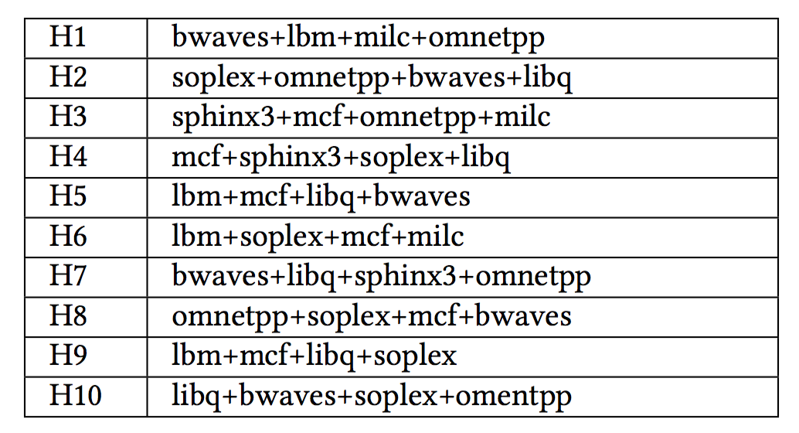
Workloads

Slide 18
Effective Memory Access Latency Reduction

Slide 19
Quad-Core Performance

Slide 20
Quad-Core Performance with Prefetching

Slide 21
Latency Reduction Factors

Slide 22
Row-Buffer Conflict Reduction

Slide 23
EMC Data Cache Hit Rate

Slide 24
Overhead: On-Chip Bandwidth
H1-H10 observe a 33% average increase in data ring messages and a 7% increase in control ring messages
  Sending dependence chains and live-ins to the EMC
  Sending live-outs back to the core

Slide 25
Overhead: Memory Bandwidth

Slide 26
Energy Consumption

Slide 27
Other Information in the Paper
8-core evaluation with multiple distributed memory controllers
Analysis of how the EMC and prefetching interact
EMC sensitivity to increasing memory bandwidth
More details of EMC execution: memory and control operations
5% EMC Area Overhead

Slide 28
Conclusions
Adding an enhanced, compute capable, memory controller to the system results in two benefits:
  EMC generates cache misses faster than the core by bypassing on-chip contention
  EMC increases the likelihood of a memory access hitting an open row buffer
15% average gain in weighted speedup and a 11% reduction in energy consumption over a quad-core baseline with no prefetching
Memory requests issued from the EMC observe a 20% lower latency on average than requests that are issued from the core

Slide 29
Accelerating Dependent Cache Misses with an Enhanced Memory Controller
Milad Hashemi, Khubaib, Eiman Ebrahimi, Onur Mutlu, Yale N. Patt
June 21, 2016

