Slide 1



The Efficacy of
Error Mitigation Techniques for DRAM Retention Failures
Samira Khan, Donghyuk Lee, Yoongu Kim, Alaa R. Alameldeen, Chris Wilkerson, and Onur Mutlu

Slide 2
Motivation
Technology
Scaling
DRAM Cells
DRAM Cells
Scaling DRAM cells results in more failures
Longer manufacture-time tests
Lower yield
Higher cost
Notes:
Here I show an array of DRAM cells. Same as processor scaling, we increase DRAM capacity by packing more cells in the same area. However, scaling cells to smaller technology nodes results in more failures. Some of these failures occur intermittently. In order to detect these failures manufacturers have to perform long tests and discard chips with errors. Which results in lower yield and higher cost.

Slide 3

Vision: Online Profiling
Detect
and
Mitigate
DRAM Cells
System
Detect and mitigate errors after
the system has become operational
Reduces cost of testing, increases yield, enables scaling
What is the effectiveness of system-level
detection and mitigation techniques?
Notes:
In this work, we propose our vision that one solution to solve the scaling problem is online profiling. We propose that Manufacturers will ship DRAM with errors and it is the responsibility of the system to guarantee reliable operation. The system will detect and mitigate errors after the it becomes operational.
It reduces the cost of testing, increases yield and enables scaling.
However, in order to design such a system, we need to know the effectiveness to system-level detection and mitigation techniques. In

Slide 4
Summary
We analyze the efficacy of testing, guardbanding, ECC, and recent techniques
  Using experimental data from real DRAMs
Key Conclusions
  Testing alone cannot guarantee reliable operation
  A combination of ECC, testing, and guardbanding is more effective
  Testing+ECC-based techniques block memory for significant time → Performance degradation
We propose a possible online profiling mechanism
Notes:
In this work, we analyze the efficacy of testing, guardbanding, and ECC system level. using experimental data from real DRAM,
We have two key conclusions: First, testing alone cannot detect all possible failures, and a combination of ECC and other techniques are much more effective.
Second, testing plus ECC based techniques block memory for significant time, resulting in performance degradation for running programs.
Based on our findings, we sketch a possible online profiling mechanism, and discuss potential research challenges and opportunities of such a system.

Slide 5
Outline
DRAM Scaling Problem
Online Profiling as a Solution
Efficacy of System-Level Detection and Mitigation
  Simple Techniques
  Recently Proposed Techniques
Towards an Online Profiling System
Conclusion
Notes:
First, I will talk about DRAM failures and show that how scaling makes things worse. Then I will propose online profiling as a solution to DRAM scaling problem. Next, I will show the efficacy of system-level detection and mitigation techniques. We analyze some very simple techniques and also some recently proposed sophisticated techniques. Based on our analysis, I will present a high-level design for an online profiling system. Finally I will conclude with a summary.

Slide 6
Outline
DRAM Scaling Problem
Online Profiling as a Solution
Efficacy of System-Level Detection and Mitigation
  Simple Techniques
  Recently Proposed Techniques
Towards an Online Profiling System
Conclusion
Notes:
First, I will talk about DRAM failures and show that how scaling makes things worse. Then I will our vision for online profiling as a solution to DRAM scaling problem. Next, I will show the efficacy of system-level detection and mitigation techniques. We analyze some very simple techniques and also some recently proposed sophisticated techniques. Based on our analysis, I will present a high-level design for an online profiling system. Finally I will conclude with a summary.

Slide 7
Retention Failure
DRAM Cells
Notes:
First, let us look at the source of some intermittent failures in DRAM. DRAM cells are organized as a 2D array. Let’s take a look at one individual cell to understand how DRAM cells work.

Slide 8

Retention Failure
Switch
Refreshed
Every 64 ms
Leakage
Capacitor
Retention Time
Retention Time
Refresh Interval
64 ms
Time
Notes:
Each DRAM cell has a capacitor and a switch. DRAM stores data as charge in the capacitor. And the data is accessed by tuning on the switch. However, cells cannot retain their data permanently as the capacitor loses charge over time. The time a cell can retain its data is the retention time of that cell. In order to prevent data loss, DRAM cells are periodically refreshed at every 64 ms. So if a cell can retain data longer than 64 ms, there is no failure. However, sometimes cells lose their charge before 64 ms, resulting in a failure.

Slide 9
Intermittent Retention Failure
DRAM Cells
Some retention failures are intermittent
Two characteristics of intermittent retention failures
1
  Data Pattern Sensitivity
2
  Variable Retention Time
Notes:
Some retention failures are permanent, they always lose their charge and so easy to detect. However, there are some retention failures that occur only intermittently. There are two sources of intermittent failures in DRAM. Data pattern dependence and Variable retention time. We will talk about both of them.

Slide 10

Data Pattern Sensitivity
1
Noise Interference
Failure
0
0
No Failure
0
1
1
Some cells can fail depending on the
data stored in neighboring cells
Notes:
Due to interference between cells, some cells fail depending on the data stored in neighboring cells. This phenomenon is known as data pattern dependence. So it can happen that depending on the data stored in a neighboring cells, one pattern results in no failure, but some other pattern results in failure.

Slide 11
Variable Retention Time
2
Retention time of some cells change
at random points of time
Notes:
There is another source of intermittent failure, called variable retention time. Retention time of some cells change at random points of time. Suppose that one VRT cell moves between two retention time, 32 ms and 512 ms. Depending on the retention time, some time this cell will fail and some time will nor fail.
So let’s see how manufacturers handle this intermittent failures.

Slide 12
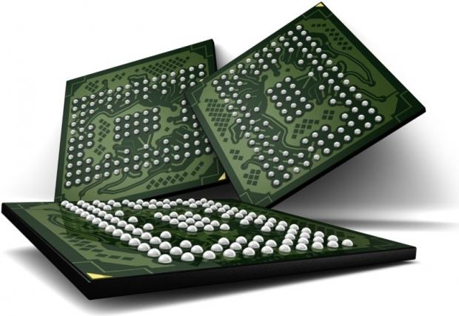
Testing for Retention Failures
Manufacturing Time Testing
PASS
FAIL
Manufacturers perform exhaustive testing
of DRAM Chips
Chips failing the tests are discarded
Notes:
When the manufacturers produce DRAM chips, the perform exhausting testing on the chips. Chips that pass the test are used, Chips that fail the test are either discarded or repaired

Slide 13
DRAM Scaling Problem
Manufacturing Time Testing
PASS
FAIL
More interference in smaller technology nodes leads to lower yield and higher cost
Notes:
However, as the DRAM cells get smaller, there are interference that cause more failures. As a result more chips fail the test, resulting in lower yield and higher cost. This problem is known as DRAM scaling problem. So how can we solve this problem?

Slide 14
Outline
DRAM Scaling Problem
Online Profiling as a Solution
Efficacy of System-Level Detection and Mitigation
  Simple Techniques
  Recently Proposed Techniques
Towards an Online Profiling System
Conclusion
Notes:
Now I will present our vision for an online profiling system to solve to scaling problem

Slide 15
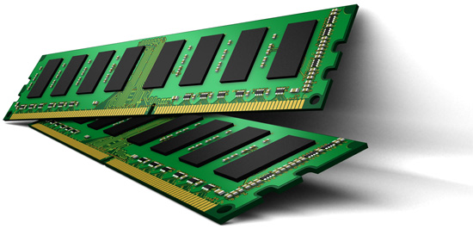
System-Level Online Profiling
Not fully tested during
manufacture-time
Ship modules
with possible failures
2
1
PASS
FAIL
Detect and mitigate
failures online
3
Increases yield, reduces cost, enables scaling
Notes:
We propose that dram manufacturers will not fully test the cram chips. As a result some chips will pass tests with possible failures. Vendors will ship modules with possible failures and the system will detect and mitigate errors to provide the reliability guarantee. This in creases yield, reduces cost, and enables scaling.

Slide 16
System-Level Online Profiling
What is the effectiveness of detection and mitigation techniques for retention failures?
Our goal is to analyze the efficacy of
  1. Simple Techniques
    Testing, Guardbanding, ECC
    2. Recently Proposed Techniques
      ArchShield, RAIDR, SECRET, RAPID, VS-ECC, Hi-ECC
We analyze the effectiveness of these techniques
using experimental data from real DRAM
Notes:
However, in order to design such a system, we need to know the effectiveness of system-level detection and mitigation techniques for retention failures.
Our goal in this paper is to analyze the efficacy of some simple techniques, testing, guardbanding, ECC and some recently proposed techniques published in various conferences. We analyze the effectiveness of these techniques using experimental data from real DRAM chips.

Slide 17
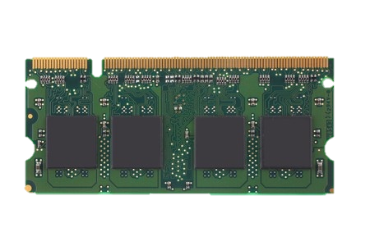
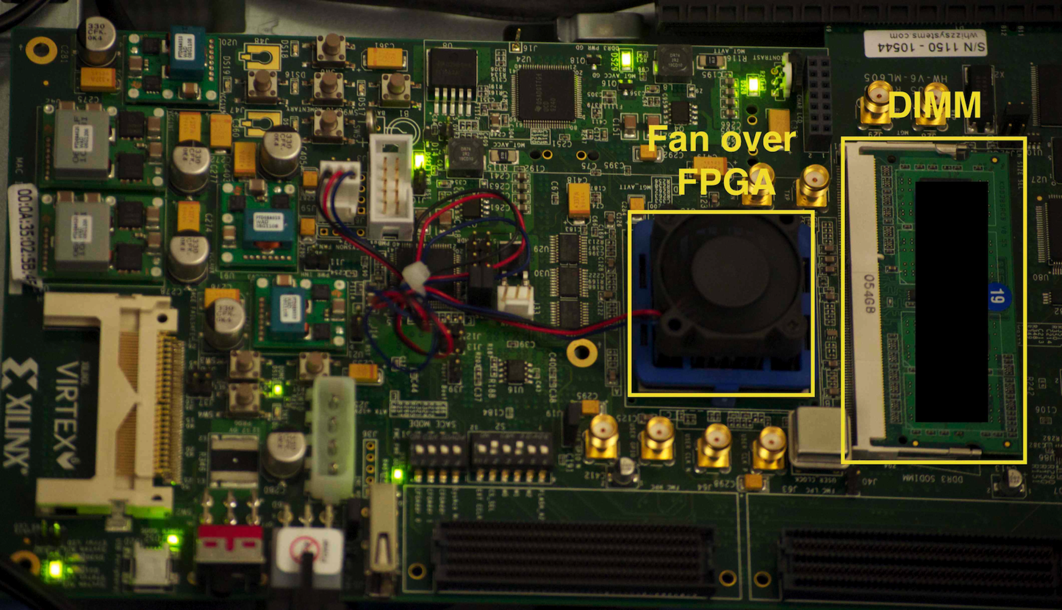
Methodology
FPGA-based testing infrastructure
Evaluated 96 chips from three major vendors
Notes:
Here we show our testing infrastructure. We have used an FPGA-based testing platform. It can test off-the-shelf dram modules. We have evaluated 96 DRAM chips from three major vendors.

Slide 18
Outline
DRAM Scaling Problem
Online Profiling as a Solution
Efficacy of System-Level Detection and Mitigation
  Simple Techniques
  Recently Proposed Techniques
Towards an Online Profiling System
Conclusion
Notes:
We I will present the efficacy of simple techniques.

Slide 19
Efficacy of Simple Techniques
1
  Testing
2
  Guardbanding
3
  Error Correcting Code
Notes:
We analyze three simple techniques. Testing, Guardbanding, and error correcting code.

Slide 20
Testing
1
Write some pattern
in the module
1
Repeat
3
2
Read
and verify
Wait until
refresh interval
Test each module with different patterns for many rounds
Zeros (0000), Ones (1111), Tens (1010), Fives (0101), Random
Notes:
There are three steps in testing. First we write some data patterns in the entire module, then we wait till the refresh interval. Then we read out the entire module and very to content to locate the failures. However, to detect the intermittent failures, we test each module with data patterns for many rounds. The patterns we have tested on all zeros, all ones, tens, fives and random.

Slide 21
Efficacy of Testing
Even after hundreds of rounds, a small number of new cells keep failing
Only a few rounds can discover most of the failures
Testing alone cannot detect all possible failures
Notes:
Here we present the efficacy of testing. In the x axis we have number of rounds of testing and in the y axis we present the number of total failures found so far. We see that there is a sharp increase in number of failures found in first few rounds, then the curves get almost flat, but keep increasing with a small slope.
We make two observations. First, only few rounds of testing can discover most of the errors, Second, even after hundred rounds of tests, a small number of new cells keep failing. We conclude that testing alone cannot detect all possible failures.

Slide 22
Guardbanding
2
Adding a safety-margin on the refresh interval
Can avoid VRT failures
4X Guardband
2X Guardband
Refresh Interval
Effectiveness of guardbanding depends on
the difference between retention times of a cell
Notes:
Guardbanding is a detection technique used by the manufacturers. Guardband adds an extra margin on the refresh interval to avoid variable retention failure.
Let’s see how guard banding works. The nominal refresh interval in DRAM is 64 ms. If a cell moves between two retention states, depending on when tested, the cell can fail or pass. So testing cannot guarantee to detect this failure. However, if we increase the refresh interval and test at 128 ms of refresh interval, now it is guaranteed that the cell will fail and get located. However, there could be some other cell that moves back and forth to a higher retention time. This 2X guardband will
Not be effective for this particular cell. In order to detect this cell, we need to test using 4x guardband.
We conclude that, effectiveness of guardbanding depends on the difference between retention times of cells.

Slide 23
Efficacy of Guardbanding
Notes:
Here I present the effectiveness of Guardbanding. In the x axis we show the retention times of different cells and in the y axis, we present the number of failing cells.

Slide 24
Efficacy of Guardbanding
Notes:
This line represents that the are around 500 cells that exhibit retention time of 3 seconds and 4 seconds.

Slide 25
Efficacy of Guardbanding
Notes:
This next line presents that there are only 2 cells that exhibit retention time of 6 seconds and 19 seconds.

Slide 26
Efficacy of Guardbanding
Most of the cells exhibit closeby retention times
Notes:
However, we find that most of the cells exhibit closeby retention times, so even a small guardband of effective for them.

Slide 27
Efficacy of Guardbanding
There are few cells with large differences in retention times
Even a large guardband (5X) cannot detect
5-15% of the intermittently failing cells
Notes:
But there are also few cells with a large difference in retention times. In our experiments, we find that even 5X guardband cannot detect 5-15% of the intermittently failing cells.

Slide 28
Error Correcting Code
3
Error Correcting Code (ECC)
  Additional information to detect error and correct data
ECC
Notes:
Now I move to our third mechanism error correcting codes. ECC adds additional information to data, in order to detect and correct errors.

Slide 29
Effectiveness of ECC
Notes:
We analyze the effective of ECC in conjunction with other mitigation techniques. In the x axis we show the number of rounds for testing, and in the y axis, we present the probability of new failures.

Slide 30
Effectiveness of ECC
Notes:
First, we show that the probability of new failures decreases with testing, even if we do not have any ECC.

Slide 31
Effectiveness of ECC
Notes:
If we add single error correcting code and then perform testing, reduce the probability of new failure.

Slide 32
Effectiveness of ECC
Combination of techniques
reduces error rate by 10⁷ times
SECDED code reduces error rate by 100 times
Adding a 2X guardband reduces error rate
by 1000 times
A combination of mitigation techniques is much more effective
Notes:
A combination of testing, guardbanding, and ECC further reduces the probability of failure. If we had no testing, just ECC will reduce the error rate by 100 times. Adding guardband reduces the error rate by thousand times. However, combination of technique can reduce the error rate as much as 10^7 times.
We conclude that, combination of techniques are much more effective of providing reliability guarantee.

Slide 33
Outline
DRAM Scaling Problem
Online Profiling as a Solution
Efficacy of System-Level Detection and Mitigation
  Simple Techniques
  Recently Proposed Techniques
Towards an Online Profiling System
Conclusion

Slide 34
Efficacy of Recent Techniques
In the paper
1
  Bit Repair Techniques
2
  Variable-Strength ECC
3
  Higher-Strength ECC
Notes:
We analyze bit repair techniques, variable strength ECC and higher-strength ECC. For time constraints I will just present the 3rd one, but I will give a short summary of the other two techniques.
Essentially bit repair techniques propose to test the modules during boot up and then repair those failures. So the system fails with any new errors that occur after the testing. WE found that even after millions rounds of testing, these systems fail within days.
Variable strength ECC also proposes to use testing at boot up. Then they protect lines with failures with very strong ECC and lines where there are not failures are protected using SECDED code. This system fails if there are two bit errors in lines protected by SECDED. We show this system can provide reliability guarantee, but blocks the memory for hours for high capacity DRAMs, resulting in performance loss

Slide 35
Higher Strength ECC (Hi-ECC)
No testing, use strong ECC
But amortize cost of ECC over larger data chunk
5EC6ED
Can potentially tolerate errors at the cost of higher strength ECC
Notes:
On the other hand, hi-ECC does not use any testing, But uses very strong ECC to protect data. However, it amortizes the cost of ECC by protecting larger data chunks. This system can potentially tolerate error at the cost of higher strength ECC.
//////////////////////////////
ECC needs t*ceil(log(k+ 1)) bits to correct t -bit errors in a k -bit input data
and one more bit to detect t + 1 bit errors.
8B SECDED: 7 + 1 bits
1KB SECDED: 13+1 bits

Slide 36
Efficacy of Hi-ECC
10 Years
Notes:
We found that combining hi-ECC with other mitigation techniques provides an interesting insight. Here in the x axis we show the number of rounds, in the y axis we present the expected to time to to failure for the system. Usually DRAM provides reliable operation guarantee to 10 years.

Slide 37
Efficacy of Hi-ECC
10 Years
Notes:
We show that with 4 bit error correcting codes, we can achieve 10 years lifetime without any testing.

Slide 38
Efficacy of Hi-ECC
After starting with 4EC5ED,
can reduce to 3EC4ED code
after 2 rounds of tests
10 Years
Notes:
However, with 2 rounds f testing, we can reduce the ECC to 3 bit correcting code.

Slide 39
Efficacy of Hi-ECC
Can reduce to DECTED code
after 10 rounds of tests
10 Years
Notes:
With 10 rounds of testing we can reduce to double error correcting codes.

Slide 40
Efficacy of Hi-ECC
Can reduce to SECDED code, after 7000 rounds of tests
(4 hours)
10 Years
Testing can help to reduce
the ECC strength
Notes:
However, we need to perform 7000 rounds of testing, if we want to reduce the ECC to SECDED. However, blocking memory for 4 hours is not practical in a reliable system. We can conclude that if we can design longer tests without performance penalty, we can reduce the ECC strength,

Slide 41
Outline
DRAM Scaling Problem
Online Profiling as a Solution
Efficacy of System-Level Detection and Mitigation
  Simple Techniques
  Recently Proposed Techniques
Towards an Online Profiling System
Conclusion

Slide 42
Towards an Online Profiling System
Key Observations:
Testing alone cannot detect all possible failures
Combination of ECC and other mitigation techniques is much more effective
  But degrades performance
Testing can help to reduce the ECC strength
  Even when starting with a higher strength ECC
Notes:
Our high-level design for online profiling system is based to thee key observations:

Slide 43
Towards an Online Profiling System
Initially Protect DRAM
with Strong ECC
Periodically Test
Parts of DRAM
1
2
Test
ECC
Test
Test
Mitigate errors and
reduce ECC
3
Run tests periodically after a short interval
at smaller regions of memory
Notes:
Based on these observations, we propose that in an online profiling system,

Slide 44
Outline
DRAM Scaling Problem
Online Profiling as a Solution
Efficacy of System-Level Detection and Mitigation
  Simple Techniques
  Recently Proposed Techniques
Towards an Online Profiling System
Conclusion

Slide 45
Conclusion
We analyze the efficacy of testing, guardbanding, ECC, and recent techniques at system-level
  Using experimental data from real DRAMs
Key Conclusions
  Testing alone cannot guarantee reliable operation
  A combination of techniques is more effective
  Testing+ECC-based techniques block memory for significant time → Performance degradation
We propose Online profiling that runs at background without disrupting current programs
  Run periodically at smaller regions of memory
Notes:
However, in order to design such a system, we need to know the effectiveness to system-level detection and mitigation techniques. In this work, using experimental data from real DRAM, we analyze the efficacy of testing, guardbanding, and ECC system level.
We have two key conclusions: First, testing alone cannot detect all possible failures, and a combination of ECC and other techniques are much more effective.
Second, testing plus ECC based techniques block memory for significant time, resulting in performance degradation for running programs.
Based on our findings, we sketch a possible online profiling mechanism, and discuss potential research challenges and opportunities of such a system.

Slide 46
Thank you
Full data set for 96 chips is available at
http://www.ece.cmu.edu/~safari/tools/dram-sigmetrics2014-fulldata.html

Slide 47
The Efficacy of
Error Mitigation Techniques for DRAM Retention Failures
Samira Khan, Donghyuk Lee, Yoongu Kim, Alaa R. Alameldeen, Chris Wilkerson, and Onur Mutlu

Slide 48
Bit Repair Techniques
1
Test DRAM module
at boot up
Mitigate failures by
repairing the bits
1
2
FIXED
These techniques are vulnerable to
new intermittent failures

Slide 49
Efficacy of Bit Repair Techniques

Slide 50
Efficacy of Bit Repair Techniques
System fails within 13 days, even after initial testing of 10⁷ rounds
Will fail immediately even after initial testing of 10⁴ rounds

Slide 51
Efficacy of Bit Repair Techniques
System fails within 23 days, even after initial testing of 10⁷ rounds
Even longer tests are not sufficient
to guarantee reliable operation

Slide 52
Variable-Strength ECC (VS-ECC)
2
Test DRAM module
at boot up
Protect failed lines
with strong ECC
1
2
4EC5ED
SECDED
Will fail as soon as there are
two bit errors in SECDED lines

Slide 53
Efficacy of VS-ECC
10 Years

Slide 54
Efficacy of VS-ECC
10 Years
Memory blocked for 19 minutes in 2GB DRAM

Slide 55
Efficacy of VS-ECC
10 Years
Memory blocked for 7 minutes in 2GB DRAM
With higher capacity DRAM, memory will be blocked for an unacceptable amount of time

Slide 56
Challenges and Opportunities
Challenges:
Performance Overhead
Mitigation Overhead
Opportunities:
Enable Failure-aware Optimizations
Testing

Slide 57
Reduction in Error Rate in all Modules

Slide 58
Difference in Modules

Slide 59
Tested DRAM Modules
Manufacturer | Module Name | Assembly Date (Year-Week) | Number of Chips
A | A1 | 2013-18 | 8
 | A2 | 2012-26 | 8
 | A3 | 2013-18 | 8
 | A4 | 2014-08 | 8
B | B1 | 2012-37 | 8
 | B2 | 2012-37 | 8
 | B3 | 2012-41 | 8
 | B4 | 2012-20 | 8
C | C1 | 2012-29 | 8
 | C2 | 2012-29 | 8
 | C3 | 2013-22 | 8
 | C4 | 2012-29 | 8

Slide 60
Time to Test
Operation | Time (2GB) | Time (64GB)
Write/Read a Row | 667.5 ns | 667.5 ns
Write/Read 2GB Module | 174.98 ms | 5.59 s
1 round , 1 pattern | 413:96 ms | 11.24 s
1 round, 5 patterns | 2.06 s | 56.22 s
1000 rounds, 5 patterns | 34 m | 15.6 hours

Slide 61
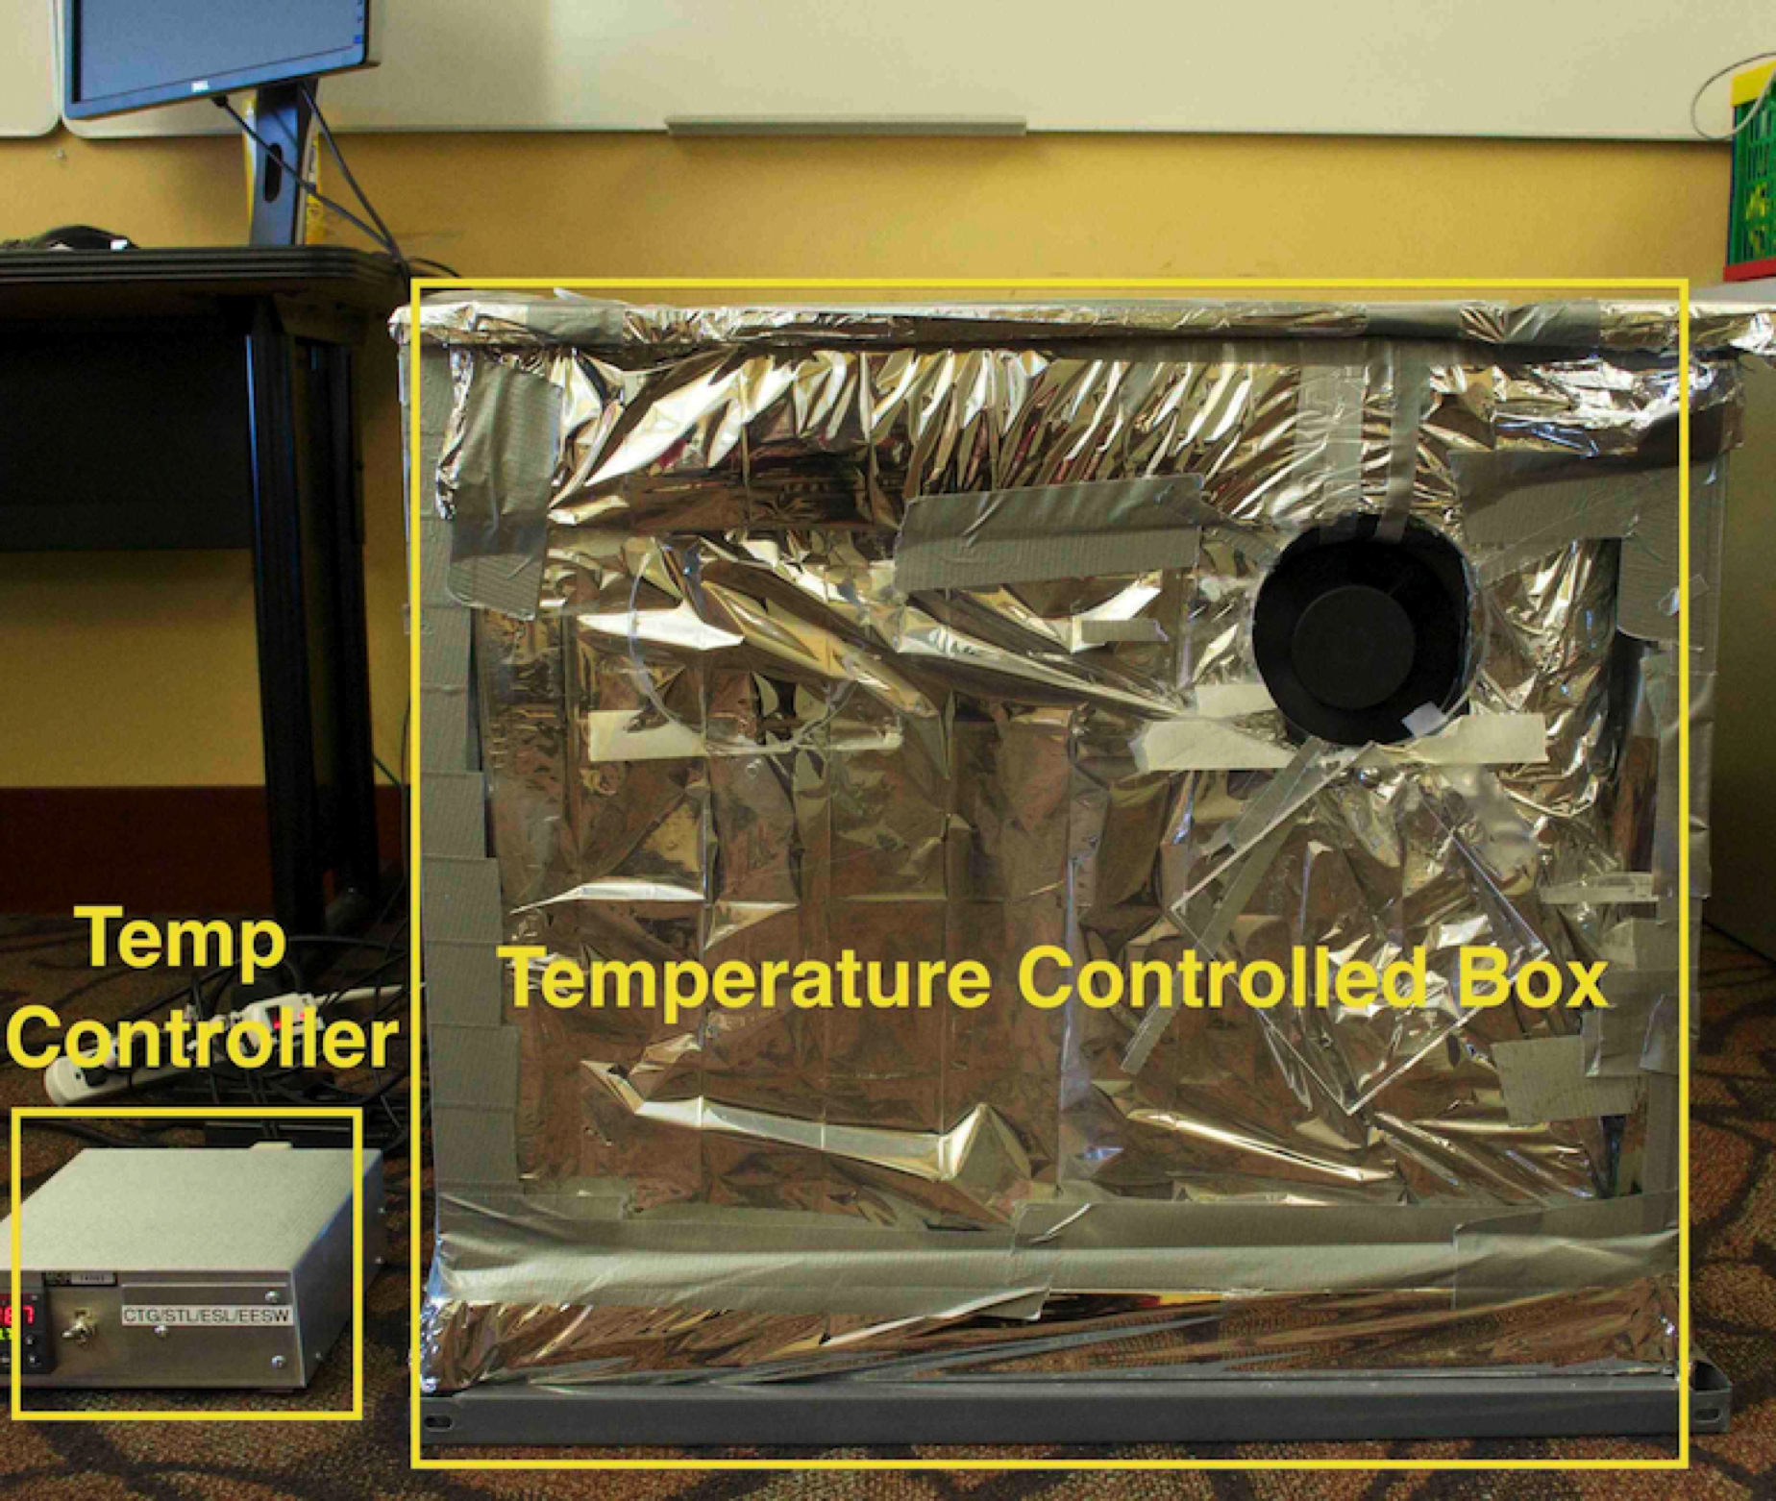
Temperature Controlled Environment

Slide 62
Dependence of Retention Time on Temperature
Fraction of cells that
exhibited retention
time failure
at any tWAIT
for any data pattern
at 50ºC
Normalized retention
times of the same cells
at 55ºC
Best-fit exponential curves
for retention time change
with temperature
Normalized retention
times of the same cells
At 70ºC
Slide Courtesy Onur Mutlu ISCA’13

Slide 63
Dependence of Retention Time on Temperature
Relationship between retention time and temperature is consistently bounded (predictable) within a device
Every 10ºC temperature increase
46.5% reduction in retention time in the worst case

Slide 64
Effect of Temperature
Worst fit curve for retention time at different temperature corresponds to e^-0.0625T , where T is the temperature [ISCA’13]
A 10 C increase in temperature results in a reduction of 1 – e^-0.0625*10 = 46.5%
1 second → 82 ms at 45 C
20 seconds → 1640 ms at 85 C

Slide 65
Characteristics not Dependent on Refresh Interval

Slide 66
Expected Number of Multi-Bit Failures

