Slide 1

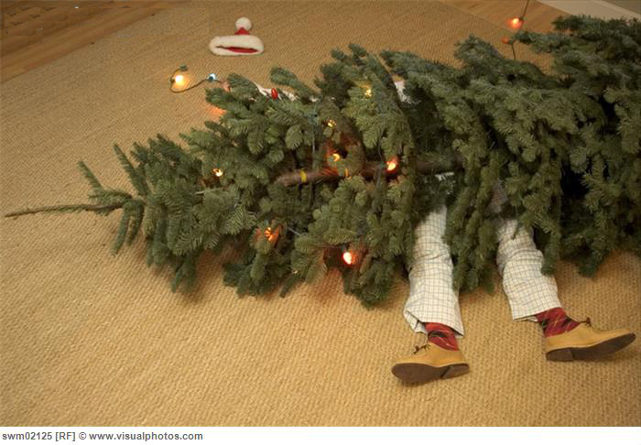
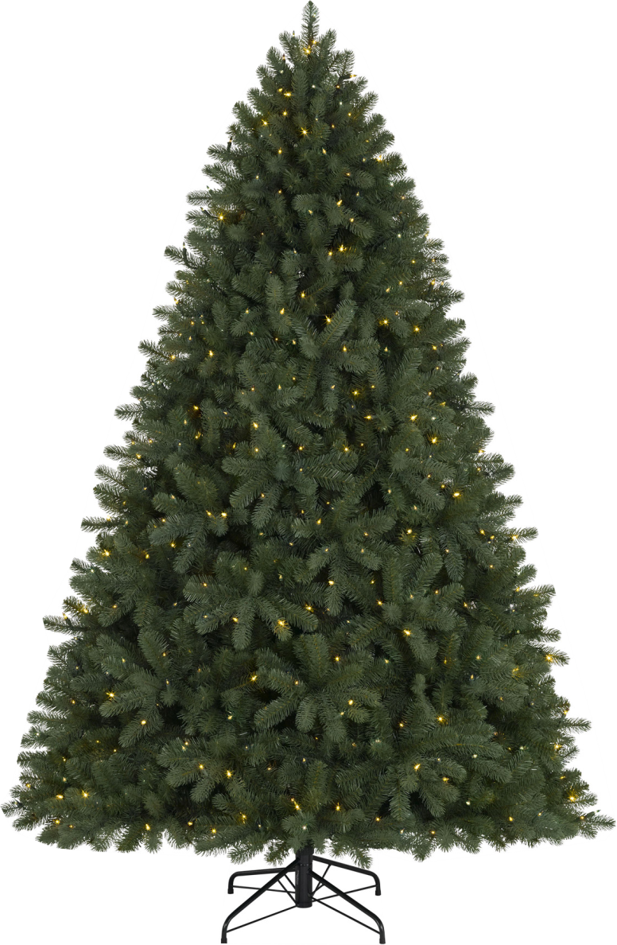












Why Another Memory Control Scheme?
Reads
Writes
…
BLISS [ICCD’14]
Fast Load/Store
(Memory Attribute)
SMS [ISCA’12]
TCM [MICRO’10]
ATLAS [HPCA’10]
PAR-BS [ISCA’08]
Data Persistence
(Storage Attribute)
STFM [MICRO’07]
FR-FCFS [ISCA’00]
Persistent Memory
Notes:
Our work is about a new memory control scheme.
For years, we have generated a variety of memory control schemes. You may be wondering why we need yet another one. If we take a closer look at previous schemes, most of them focus only on reads. This is sound when most conventional applications are read intensive and reads are on their critical execution path.
Unfortunately, with new persistent memory technology, these assumptions no longer hold. Persistent memory is a new tier between traditional main memory and storage with attributes from both. Like main memory, it has a fast load/store interface. Yet different from main memory, it is permanent home of data so it supports the storage property – data persistence.
To ensure data persistence, persistent memory systems need to place careful control over writes.
An unbalanced design that only focuses on reads can be dangerous.

Slide 2



Our Design: Towards A FIRM Tree
Reads
Writes
…
BLISS [ICCD’14]
SMS [ISCA’12]
TCM [MICRO’10]
FIRM [MICRO’14]
ATLAS [HPCA’10]
PAR-BS [ISCA’08]
STFM [MICRO’07]
FR-FCFS [ISCA’00]
Persistent Memory
Notes:
To address this problem, we design a new memory scheduler for persistent memory systems that take into account writes as first-class citizens in memory scheduling. With our design, we can achieve both fair and high-performance memory control in persistent memory systems.

Slide 3
Fairness
Performance
1.2x
vs. the best of
5 previous scheduler designs
Notes:
With our design, we can achieve both fair and high-performance memory control in persistent memory systems.

Slide 4




Details about “FIRM”
Fair and High-Performance
Memory Control for
Persistent Memory Systems
Jishen Zhao
Onur Mutlu
Yuan Xie
HP Labs/Penn State/CMU
CMU
UCSB/Penn State/AMD Research
Presentation: Mon (Dec.15) 3:30 PM
Session 2A
(Room: Dining Hall)
Poster Session: Tue (Dec. 16) 12:00 PM
Notes:
For details of our design, you are welcome to come to our presentation in the afternoon right in this room and our poster tomorrow.

