Slide 1
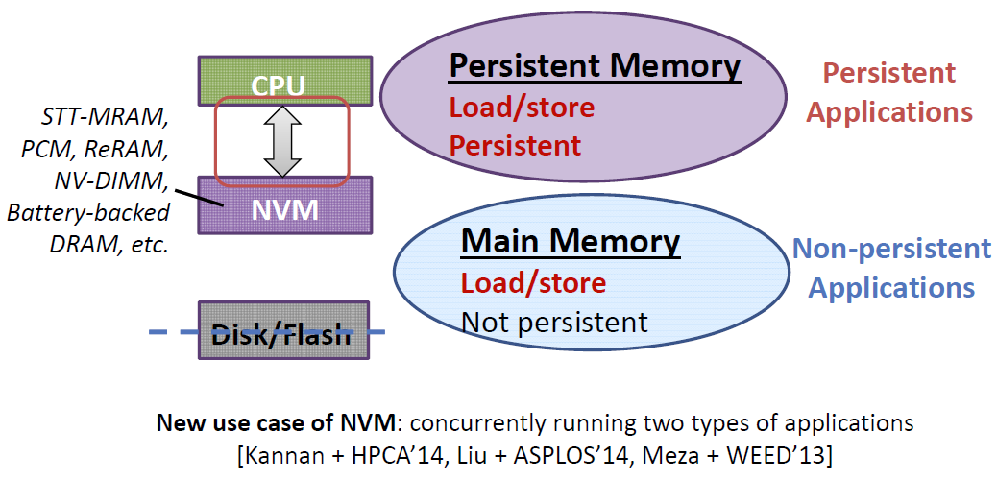
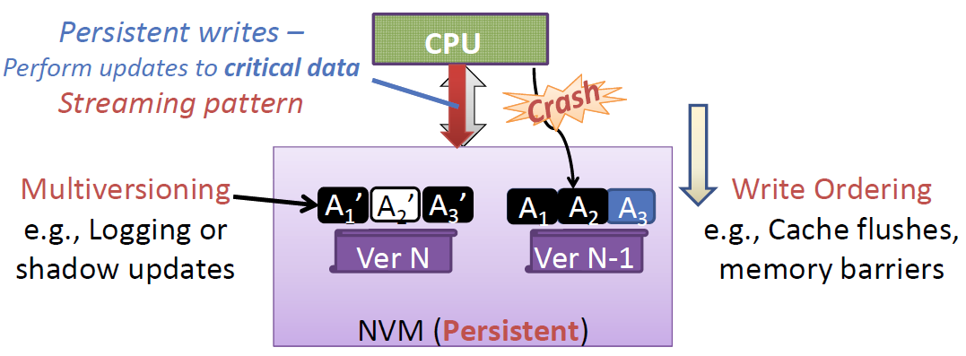
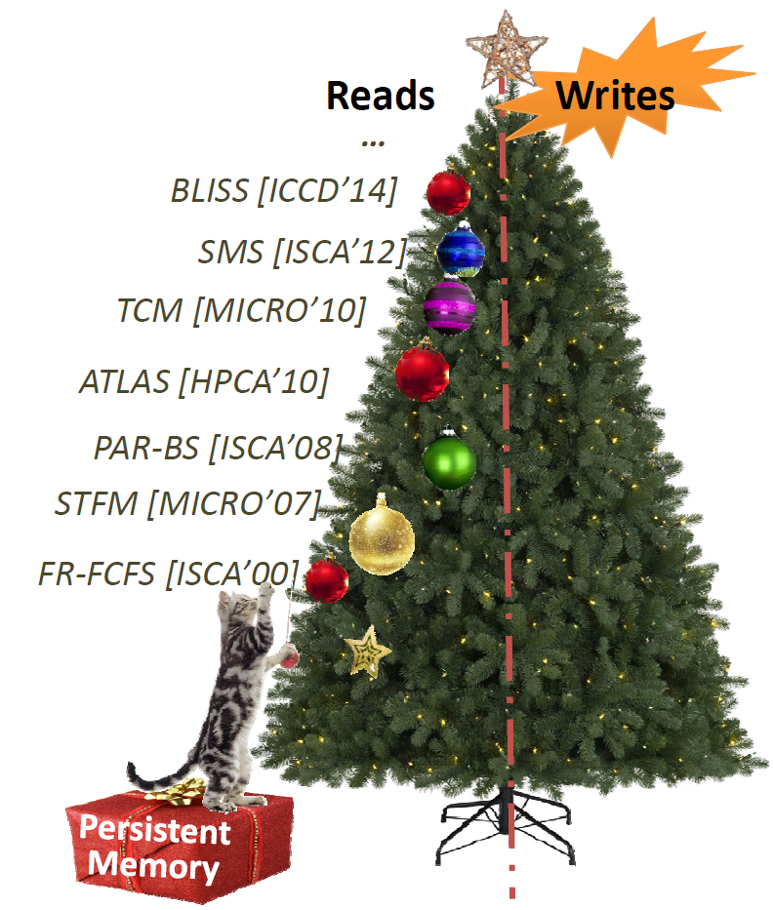
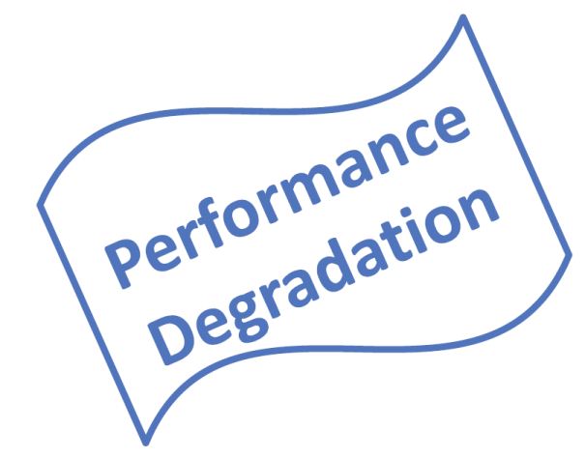
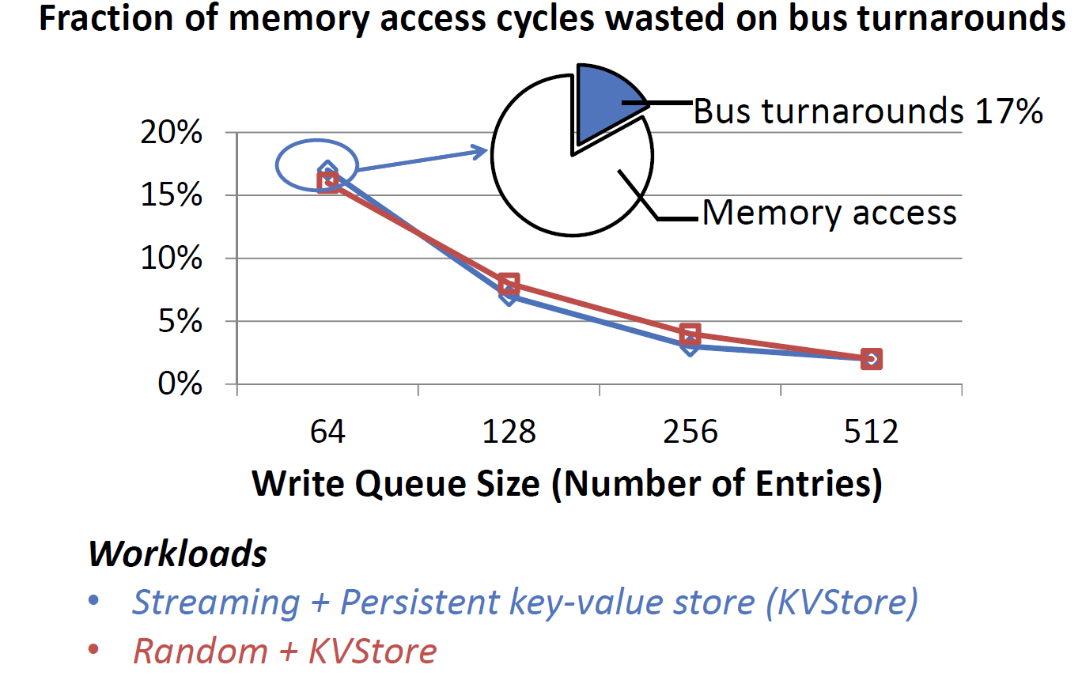
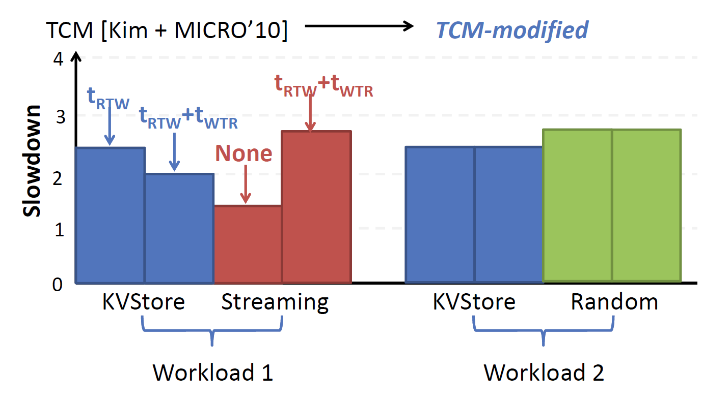
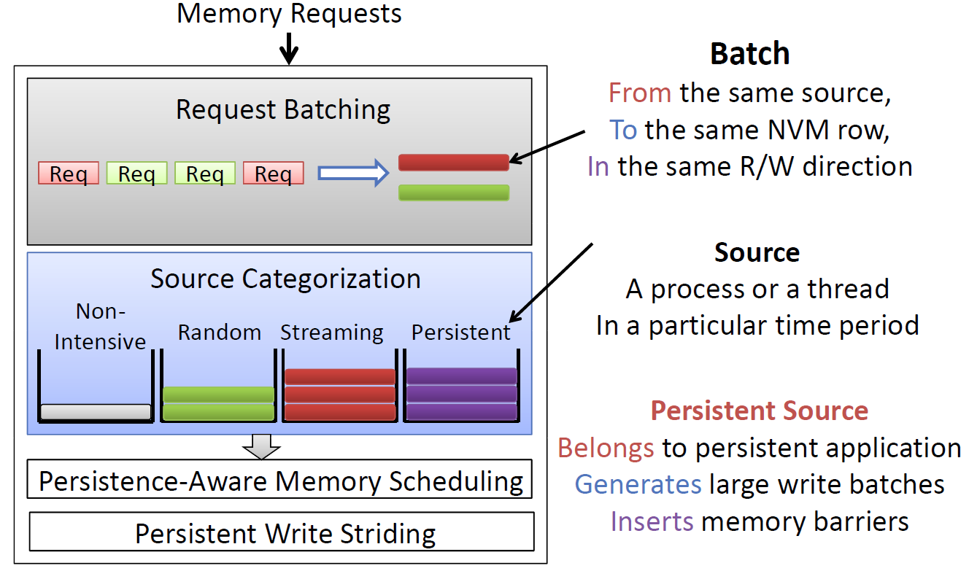
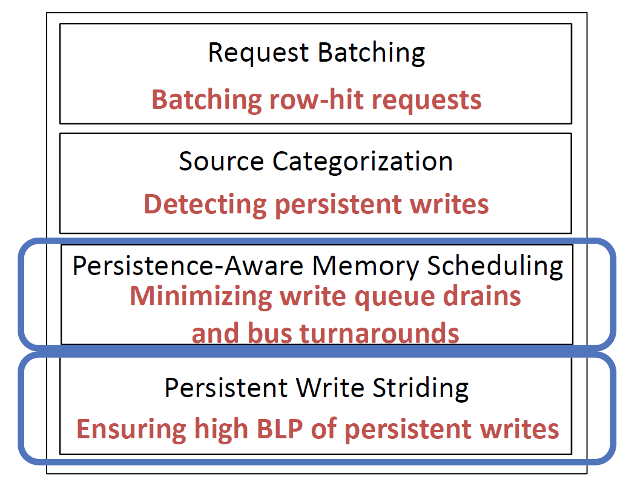
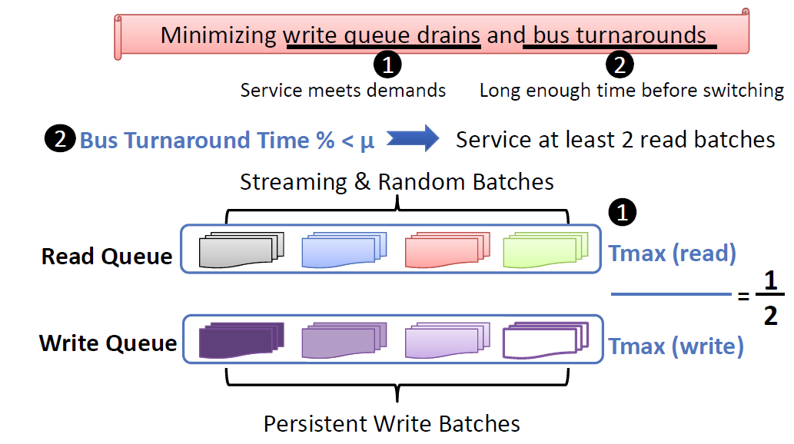
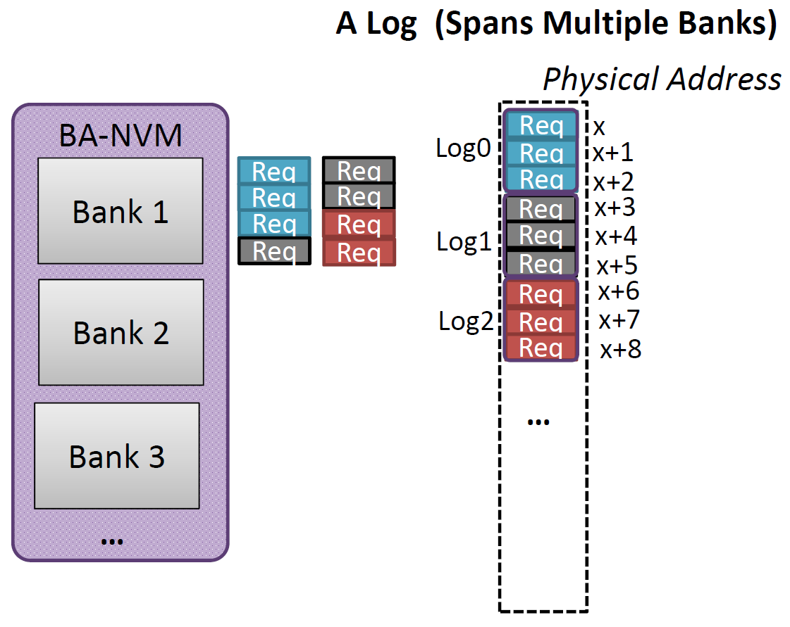
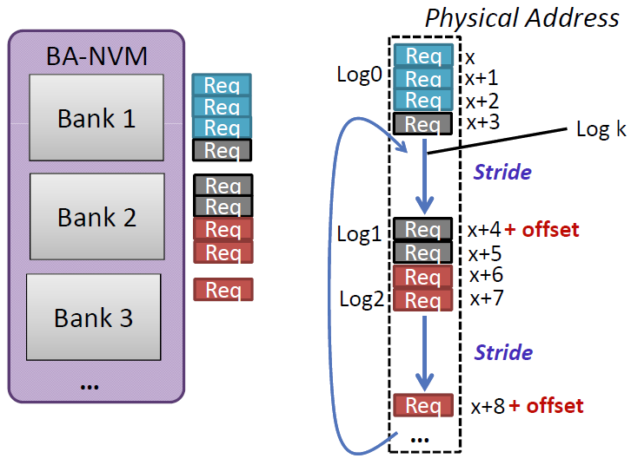
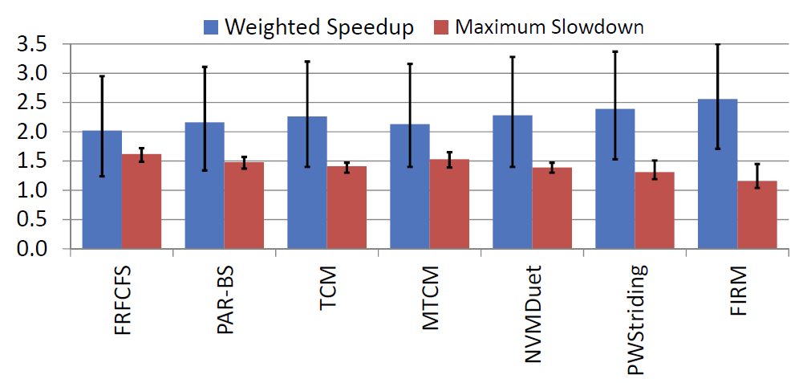
FIRM: Fair and High-Performance Memory Control for Persistent Memory Systems
Jishen Zhao, Onur Mutlu, Yuan Xie
New Use Case of NVMs
Why Another Memory Control Scheme?
Memory Accesses in
Persistent Memory Systems
Persistent Writes
Assumptions Made by Previous Memory Schedulers
Bus Turnaround Overhead
Simple Extension of
Conventional Memory Schedulers
FIRM Components
Persistence-aware Memory Scheduling
Persistent Write Striding
Fairness and Performance

