Slide 1

A Large-Scale Study of
Flash Memory Errors in the Field
      Justin Meza
Qiang Wu
Sanjeev Kumar
Onur Mutlu

Slide 2
Overview
First study of flash reliability:
at a large scale
in the field

Slide 3
Overview
SSD lifecycle
New reliability trends
Access pattern
dependence
Read
disturbance
Temperature

Slide 4

Overview
SSD lifecycle
New reliability trends
Access pattern
dependence
Early detection lifecycle period distinct from hard disk drive lifecycle.
Read
disturbance
Temperature

Slide 5

Overview
SSD lifecycle
New reliability trends
We do not observe the effects of read disturbance errors in the field.
Access pattern
dependence
Read
disturbance
Temperature

Slide 6
Overview
SSD lifecycle
New reliability trends
Access pattern
dependence
Read
disturbance
Throttling SSD usage helps mitigate temperature-induced errors.
Temperature

Slide 7
Overview
SSD lifecycle
New reliability trends
We quantify the effects of the page cache and write amplification in the field.
Access pattern
dependence
Read
disturbance
Temperature

Slide 8
Outline
background and motivation
server SSD architecture
error collection/analysis methodology
SSD reliability trends
summary

Slide 9
Background and
motivation

Slide 10
Flash memory
persistent
high performance
hard disk alternative
used in solid-state drives (SSDs)

Slide 11
Flash memory
persistent
high performance
hard disk alternative
used in solid-state drives (SSDs)
prone to a variety of errors
    wearout, disturbance, retention

Slide 12
Our goal
Understand SSD reliability:
at a large scale
    millions of device-days, across four years
in the field
    realistic workloads and systems

Slide 13
Server SSD
architecture

Slide 14
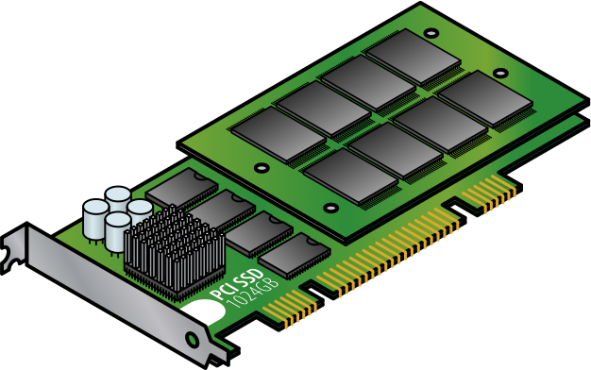
Notes:
Here is a schematic of a server SSD. Unlike the SSD in your computer, server SSDs are connected over PCIe to enable high bandwidth.

Slide 15
PCIe

Slide 16
Flash chips

Slide 17
SSD controller
translates addresses
schedules accesses
performs wear leveling

Slide 18
10011111 11001111 11000011 00001101
10101110 11100101 11111001 01111011
00011001 11011101 11100011 11111000
11011111 01001101 11110000 10111111
00000001 11011110 00000101 01010110
00001011 10000010 11111110 00011100
...
User data
01001100 01001101 11010010 01000000
10011100 10111111 10101111 11000101
ECC metadata
Notes:
Because bit flips are common in flash memory, the SSD controller stores error correcting code metadata alongside user data on the flash chips.

Slide 19
Types of errors
Small errors
10's of flipped bits per KB
silently corrected by SSD controller
Large errors
100's of flipped bits per KB
corrected by host using driver
referred to as SSD failure

Slide 20

Types of errors
Small errors
~10's of flipped bits per KB
silently corrected by SSD controller
We examine large errors (SSD failures) in this study.
Large errors
~100's of flipped bits per KB
corrected by host using driver
refer to as SSD failure

Slide 21
Error collection/
analysis
methodology

Slide 22
SSD data measurement
metrics stored on SSDs
measured across SSD lifetime

Slide 23
SSD characteristics
6 different system configurations
    720GB, 1.2TB, and 3.2TB SSDs
    servers have 1 or 2 SSDs
    this talk: representative systems
6 months to 4 years of operation
15TB to 50TB read and written
Notes:
6 different system configurations
this talk: representative systems
analysis of all systems in paper

Slide 24
Bit error rates (BER)
BER = bit errors per bits transmitted
1 error per 385M bits transmitted to
1 error per 19.6B bits transmitted
    averaged across all SSDs in each system type
10x to 1000x lower than prior studies
    large errors, SSD performs wear leveling

Slide 25
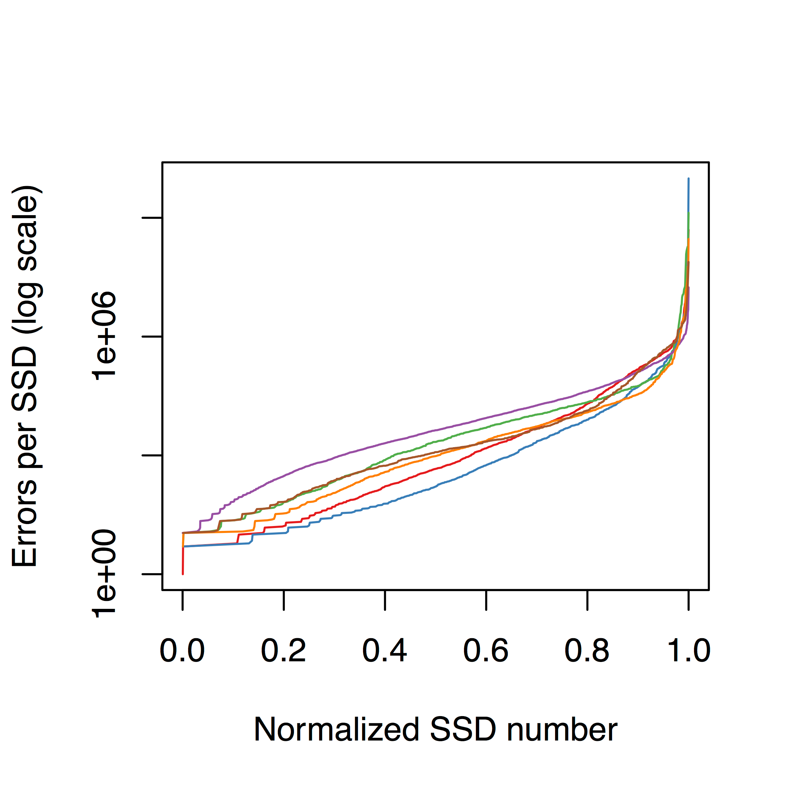
A few SSDs cause most errors

Slide 26
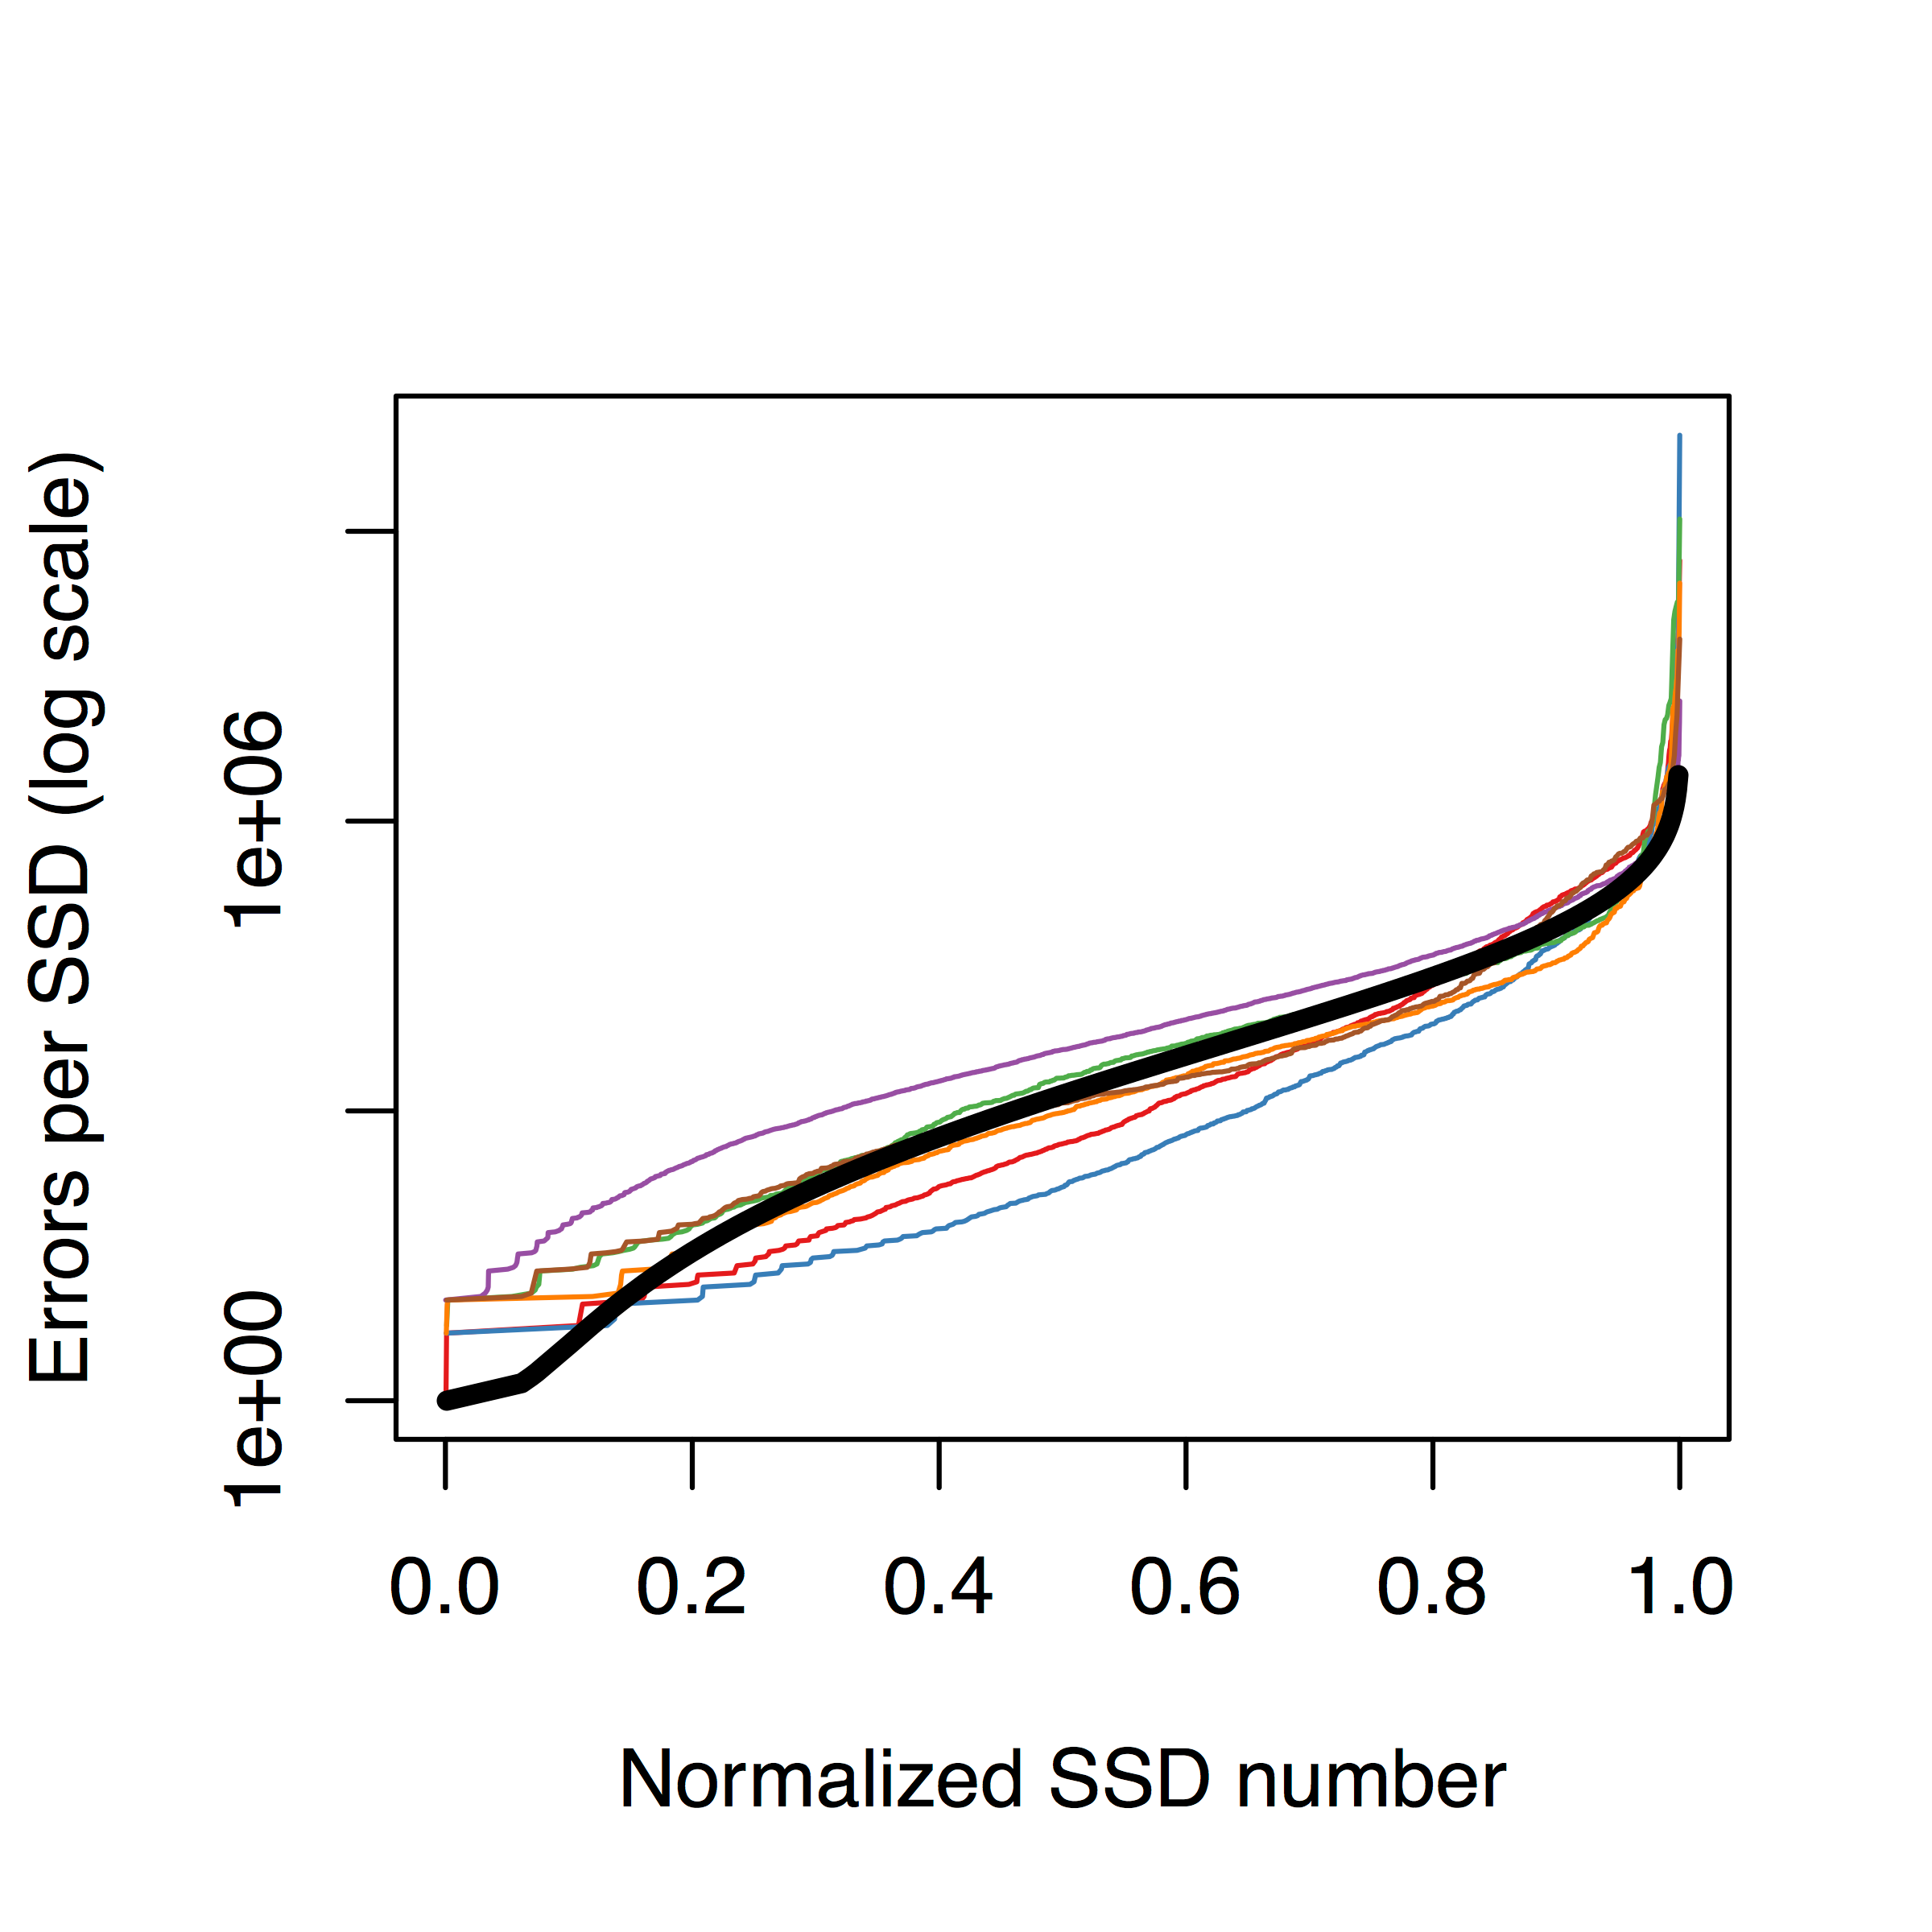
A few SSDs cause most errors

Slide 27
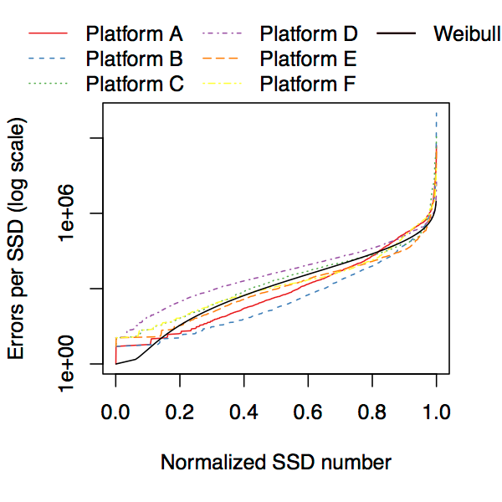
A few SSDs cause most errors
What factors contribute to SSD failures in the field?

Slide 28
Analytical methodology
not feasible to log every error
instead, analyze lifetime counters
snapshot-based analysis
Notes:
Because errors occur so frequently in SSDs, it is not feasible for us to log every error that occurs.
Instead, we analyze lifetime counters that are present in the SSDs we examine that track various metrics such as number of errors that have been corrected, the number of bits read from or written to the SSD and so on.
To account for this, we analyze data by taking a "snapshot" of the current statistics throughout the fleet, group devices by similar characteristics, and examine the error rates of devices in each group. Here's an example.

Slide 30
Errors | 54,326 | 0 | 2 | 10
Data written | 10TB | 2TB | 5TB | 6TB

Slide 31
Errors | 54,326 | 0 | 2 | 10
Data written | 10TB | 2TB | 5TB | 6TB
2014-11-1

Slide 32
Errors | 54,326 | 0 | 2 | 10
Data written | 10TB | 2TB | 5TB | 6TB
2014-11-1
Errors
Data written

Slide 33
Errors | 54,326 | 0 | 2 | 10
Data written | 10TB | 2TB | 5TB | 6TB
2014-11-1
Buckets
Errors
Data written

Slide 34
Errors | 54,326 | 0 | 2 | 10
Data written | 10TB | 2TB | 5TB | 6TB
2014-11-1
Errors
Data written

Slide 35
Errors | 54,326 | 0 | 2 | 10
Data written | 10TB | 2TB | 5TB | 6TB
2014-11-1
Errors
Data written

Slide 36
SSD reliability
trends

Slide 37
SSD lifecycle
New reliability trends
Access pattern
dependence
Read
disturbance
Temperature

Slide 38
SSD lifecycle
New reliability trends
Access pattern
dependence
Read
disturbance
Temperature

Slide 39
Storage lifecycle background:
the
bathtub curve
for disk drives
Failure
rate
Usage
[Schroeder+,FAST'07]

Slide 40
Storage lifecycle background:
the
bathtub curve
for disk drives
Early
failure
period
Wearout
period
Failure
rate
Useful life
period
Usage
[Schroeder+,FAST'07]

Slide 41
Storage lifecycle background:
the
bathtub curve
for disk drives
Early
failure
period
Wearout
period
Do SSDs display similar lifecycle periods?
Failure
rate
Useful life
period
Usage
[Schroeder+,FAST'07]

Slide 42
data written to flash
Use
to examine SSD lifecycle
(time-independent utilization metric)
Notes:
We use data written to flash to examine SSD lifecycle trends.
This is because data written to flash is a time-independent metric for SSD utilization.

Slide 43
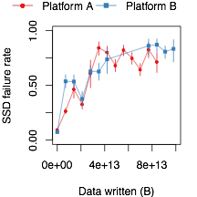
720GB, 1 SSD
720GB, 2 SSDs
0
40
80
Data written (TB)

Slide 44



720GB, 1 SSD
720GB, 2 SSDs
Wearout period
Useful life period
Early failure period
0
40
80
Data written (TB)

Slide 45

720GB, 1 SSD
720GB, 2 SSDs
Wearout period
Early
detection
period
Useful life period
Early failure period
0
40
80
Data written (TB)

Slide 46
SSD lifecycle
New reliability trends
Access pattern
dependence
Early detection lifecycle period distinct from hard disk drive lifecycle.
Read
disturbance
Temperature

Slide 47
SSD lifecycle
New reliability trends
Access pattern
dependence
Read
disturbance
Temperature

Slide 48
Read disturbance
reading data can disturb contents
failure mode identified in lab setting
under adversarial workloads

Slide 49
Read disturbance
Does read disturbance affect SSDs in the field?
reading data can disturb contents
failure mode identified in lab setting
under adversarial workloads

Slide 50
Examine SSDs with
flash R/W
high
ratios
most data read
and
to understand read effects
(isolate effects of read vs. write errors)

Slide 51
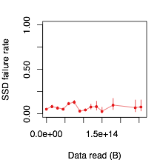
3.2TB, 1 SSD (average R/W = 2.14)
0
100
200
Data read (TB)

Slide 52
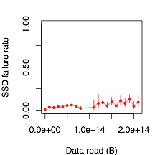
1.2TB, 1 SSD (average R/W = 1.15)
0
100
200
Data read (TB)
Notes:
In both of these examples we observe that there is no large statistically-significant deviation in failure rate between devices that have read a small amount of data and those that have read a large amount of data.
One reason for this could be that the read intensity of a variety of real workloads is not sufficient to induce read disturbance in the SSDs we analyzed.
In addition, this could be due to the fact that the controller on the flash devices we examine is able to detect and tolerate these type of errors before they cause a larger error to occur.

Slide 53
SSD lifecycle
New reliability trends
We do not observe the effects of read disturbance errors in the field.
Access pattern
dependence
Read
disturbance
Temperature

Slide 54
SSD lifecycle
New reliability trends
Access pattern
dependence
Read
disturbance
Temperature

Slide 56
Temperature
sensor

Slide 57
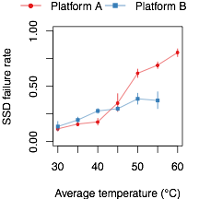
720GB, 1 SSD
720GB, 2 SSDs

Slide 58
High temperature:
may throttle or
shut down

Slide 59
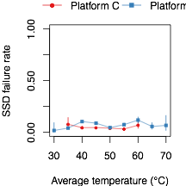
1.2TB, 1 SSD
3.2TB, 1 SSD
Throttling

Slide 60
SSD lifecycle
New reliability trends
Access pattern
dependence
Read
disturbance
Throttling SSD usage helps mitigate temperature-induced errors.
Temperature

Slide 61
SSD lifecycle
New reliability trends
Access pattern
dependence
Read
disturbance
Temperature

Slide 62
Access pattern effects
System buffering
data served from OS caches
decreases SSD usage
Write amplification
updates to small amounts of data
increases erasing and copying

Slide 63
Access pattern effects
System buffering
data served from OS caches
decreases SSD usage
Write amplification
updates to small amounts of data
increases erasing and copying

Slide 64
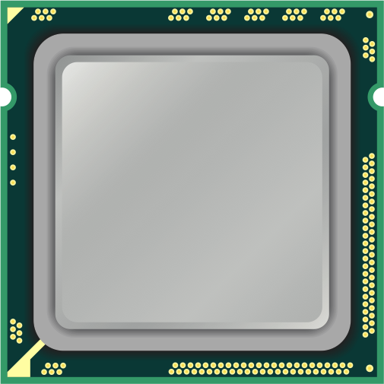

Slide 65
OS

Slide 66
OS
Page cache

Slide 67
OS
Page cache

Slide 68
OS
Page cache

Slide 69
OS
Page cache

Slide 70
OS
Page cache

Slide 71
OS
Page cache

Slide 72
OS
Page cache

Slide 73
System caching reduces
the impact of SSD writes
OS
Page cache

Slide 74
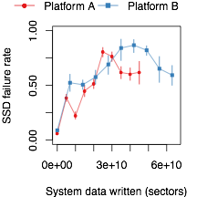
1.2TB, 2 SSDs
3.2TB, 2 SSDs
0
15
30
Data written to OS (TB)

Slide 75
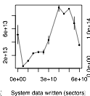
720GB, 2 SSDs
60
Data written to
flash cells (TB)
20
0
15
30
Data written to OS (TB)

Slide 76
Access pattern effects
System buffering
data served from OS caches
decreases SSD usage
Write amplification
updates to small amounts of data
increases erasing and copying

Slide 77
Flash devices use a
translation layer
to locate data
OS

Slide 78
Translation layer
Logical
address
space
Physical
address
space
<offset1, size1>
OS
<offset2, size2>
...

Slide 79
Sparse data layout
more translation metadata
potential for higher write amplification
Notes:
Example: reading/writing a large number of small files.

Slide 80
Dense data layout
less translation metadata
potential for lower write amplification
Notes:
Example: reading/writing a large file.

Slide 81
translation data size
Use
to examine effects of data layout
(relates to application access patterns)

Slide 82
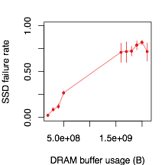
720GB, 1 SSD
Denser
0
1
2
Sparser
Translation data (GB)

Slide 83


Write amplification in the field
Graph search
Key-value store
0.25
0.45
0.25
0.45
Translation data (GB)
Translation data (GB)

Slide 84
SSD lifecycle
New reliability trends
We quantify the effects of the page cache and write amplification in the field.
Access pattern
dependence
Read
disturbance
Temperature

Slide 85
SSD lifecycle
New reliability trends
Access pattern
dependence
Read
disturbance
Temperature

Slide 86
More results in paper
Block erasures and discards
Page copies
Bus power consumption

Slide 87
Summary

Slide 88
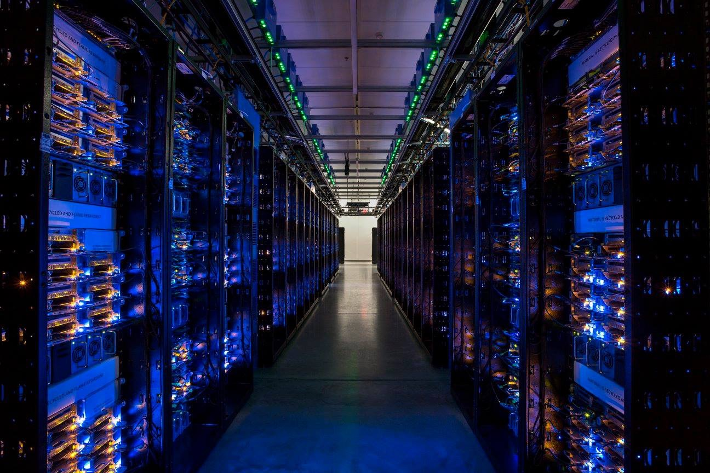
Large scale
In the field

Slide 89
Summary
SSD lifecycle
New reliability trends
Access pattern
dependence
Read
disturbance
Temperature

Slide 90
Summary
SSD lifecycle
New reliability trends
Access pattern
dependence
Early detection lifecycle period distinct from hard disk drive lifecycle.
Read
disturbance
Temperature

Slide 91
Summary
SSD lifecycle
New reliability trends
We do not observe the effects of read disturbance errors in the field.
Access pattern
dependence
Read
disturbance
Temperature

Slide 92
Summary
SSD lifecycle
New reliability trends
Access pattern
dependence
Read
disturbance
Throttling SSD usage helps mitigate temperature-induced errors.
Temperature

Slide 93
Summary
SSD lifecycle
New reliability trends
We quantify the effects of the page cache and write amplification in the field.
Access pattern
dependence
Read
disturbance
Temperature

Slide 94
A Large-Scale Study of
Flash Memory Errors in the Field
      Justin Meza
Qiang Wu
Sanjeev Kumar
Onur Mutlu

Slide 95
Backup slides

Slide 96
System characteristics
SSD capacity | PCIe | Average age (years) | SSDs per server | Average written (TB) | Average read (TB)
720GB | v1, x4 | 2.4 | 1 | 27.2 | 23.8
 |  |  | 2 | 48.5 | 45.1
1.2TB | v2, x4 | 1.6 | 1 | 37.8 | 43.4
 |  |  | 2 | 18.9 | 30.6
3.2TB | v2, x4 | 0.5 | 1 | 23.9 | 51.1
 |  |  | 2 | 14.8 | 18.2
Notes:
So let's take a look at some of the baseline reliability metrics.

Slide 97
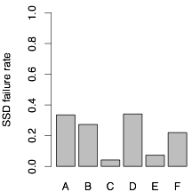
720GB
1.2TB
3.2TB
Devices:
1
2
1
2
1
2

Slide 98
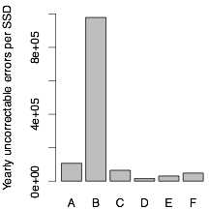
720GB
1.2TB
3.2TB
Devices:
1
2
1
2
1
2

Slide 99
Channels
operate in parallel

Slide 100
DRAM buffer
stores address translations
may buffer writes

Slide 101
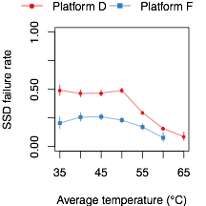
1.2TB, 2 SSDs
3.2TB, 2 SSDs
Early detection
+ throttling

