Slide 1



Read Disturb Errors in MLC NAND Flash Memory:
Characterization, Mitigation, and Recovery
Yu Cai, Yixin Luo, Saugata Ghose,
Erich F. Haratsch*, Ken Mai, Onur Mutlu
Carnegie Mellon University, *Seagate Technology

Slide 2
Executive Summary
Read disturb errors limit flash memory lifetime today
  Apply a high pass-through voltage (V_{pass}) to multiple pages on a read
We characterize read disturb on real NAND flash chips
  Slightly lowering V_{pass} greatly reduces read disturb errors
  Some flash cells are more prone to read disturb
Technique 1: Mitigate read disturb errors online
  V_{pass} Tuning dynamically finds and applies a lowered V_{pass}
  Flash memory lifetime improves by 21%
Technique 2: Recover after failure to prevent data loss
  Read Disturb Oriented Error Recovery (RDR) selectively corrects cells more susceptible to read disturb errors
  Reduces raw bit error rate (RBER) by up to 36%
Notes:
When we read data from one page, we have to apply a high voltage to multiple other flash pages that are connected to this page, and we call this high pass-through voltage.
Over time this high pass-through voltage can alter the values stored in unread flash pages. We call this a read disturb error.
For the first time in open literature, we characterize read disturb on real NAND flash chips, and show that read disturb errors exist in today’s flash chips and is expected to increase in the future.
We make two key observations from the characterization.
Using our characterization, we develop two techniques that can help flash memory tolerate such read disturb errors.

Slide 3
Outline
Background (Problem and Goal)
Key Experimental Observations
Mitigation: V_{pass} Tuning
Recovery: Read Disturb Oriented Error Recovery
Conclusion

Slide 4
Outline
Background (Problem and Goal)
Key Experimental Observations
Mitigation: V_{pass} Tuning
Recovery: Read Disturb Oriented Error Recovery
Conclusion

Slide 5

NAND Flash Memory Background
Flash Memory
Page 0
Read
Block 0
Page 256
……
Page M
Block 1
Block N
Page 1
Page 257
Page M+1
Pass
Page 2
Page 258
Page M+2
Pass
……
……
……
…
Page 255
Pass
Page 511
Page M+255
Flash Controller
Notes:
When we read from one page in a block, we apply a high voltage to all the other pages in the same block. We will explain why later

Slide 6
Flash Cell Array
Row
Block X
Page Y
Column
Sense Amplifiers
Sense Amplifiers
Notes:
Now, let’s zoom in to a single block of flash memory, which consists of an array of flash pages.
Each flash page is written to flash cells located in the same row.
Each row of cells are controlled by the same horizontal wire.
Each column of cells are connected in series with a sense amplifier at the bottom.

Slide 7
Flash Cell
Drain
Floating Gate
Gate
V_{th} = 2.5 V
Source
Floating Gate Transistor
(Flash Cell)
Notes:
Now let’s zoom in again to look at a single flash cell, or, it can also be called, a floating gate transistor.

Slide 8
Flash Read
V_{read} = 2.5 V
V_{th} = 2 V
V_{read} = 2.5 V
V_{th} = 3 V
Gate
1
0
Notes:
Now, if we have two flash cells programmed to different threshold voltages, 2V and 3V, we can distinguish them with a read voltage of 2.5V.
When we apply 2.5V to the gate, since the read voltage is higher than the threshold voltage, …
Now if we look back at this example, we can see that the threshold voltage of each flash cell actually represents the value being stored.

Slide 9
Flash Pass-Through
V_{pass} = 5 V
V_{th} = 2 V
V_{pass} = 5 V
V_{th} = 3 V
Gate
1
1
Notes:
But, for the same cells, when we apply a high voltage to them, regardless of the threshold voltage, any cell will be passed-through.
So we call this voltage pass-through voltage or Vpass

Slide 10
Read from Flash Cell Array
V_{pass} = 5.0 V
Pass (5V)
3.0V
3.8V
3.9V
4.8V
Page 1
V_{read} = 2.5 V
Read (2.5V)
3.5V
2.9V
2.4V
2.1V
Page 2
V_{pass} = 5.0 V
Pass (5V)
2.2V
4.3V
4.6V
1.8V
Page 3
V_{pass} = 5.0 V
Pass (5V)
3.5V
2.3V
1.9V
4.3V
Page 4
Correct values for page 2:
0
0
1
1
Notes:
Now, let’s look at an example array of flash cells.
In this example, we make up threshold voltage numbers for each cell.
Let’s say we want to read from the second page in this array.
So we apply a read voltage of 2.5 V to the second page
And since all the other pages are connected in series, we apply a high pass-through voltage of 5 V to the other pages.
As we can see, the high pass through voltage switches on all the flash pages being passed-through, allowing the sense amplifier to read the values stored in the second page.
In this case, the correct values …

Slide 11
Read Disturb Problem: “Weak Programming” Effect
Pass (5V)
3.0V
3.8V
3.9V
4.8V
Page 1
Pass (5V)
3.5V
2.9V
2.4V
2.1V
Page 2
Read (2.5V)
2.2V
4.3V
4.6V
1.8V
Page 3
Pass (5V)
3.5V
2.3V
1.9V
4.3V
Page 4
Repeatedly read page 3 (or any page other than page 2)
Notes:
However, the high pass through voltage can generate read disturb problem, which we will introduce now.
When we want to read page 3, instead of page 2, this high pass through voltage now needs to be applied on the 2nd page.
When we repeatedly read page 3, the pass through voltage induces a weak programming effect on the second page.

Slide 12
Read Disturb Problem: “Weak Programming” Effect
V_{pass} = 5.0 V
3.0V
3.8V
3.9V
4.8V
Page 1
V_{read} = 2.5 V
3.5V
2.9V
2.4V
2.6V
2.1V
Page 2
V_{pass} = 5.0 V
2.2V
4.3V
4.6V
1.8V
Page 3
V_{pass} = 5.0 V
3.5V
2.3V
1.9V
4.3V
Page 4
Incorrect values from page 2:
0
0
0
1
High pass-through voltage induces “weak-programming” effect
Notes:
As the weak programming effect accumulates, the threshold voltage of each flash cell increases, and the threshold voltage state of a cell can be altered.
In this case, when we read page 2 again, we will read incorrect values from page 2, 0001
Flash vendors conservatively set this pass-through voltage to a high voltage.
However, we find in the paper that it is unnecessary to set to this high, and that reducing this voltage by just a bit will reduce read disturb errors significantly in the future.

Slide 13
Goal: Mitigate and Recover Read Disturb Errors
Read disturb errors: Reading from one page can alter the values stored in other unread pages
Notes:
To this point, we have identified the problem that …
So we set our goal to mitigate and recover these read disturb errors.
Vpass is set conservatively

Slide 14
Outline
Background (Problem and Goal)
Key Experimental Observations
Mitigation: V_{pass} Tuning
Recovery: Read Disturb Oriented Error Recovery
Conclusion
Notes:
To understand read disturb errors, we perform the first experimental study on read disturb errors.

Slide 15
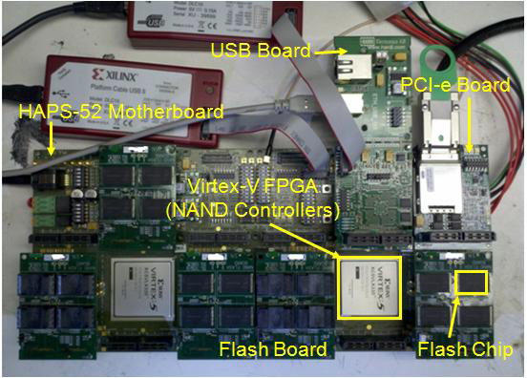
Methodology
FPGA-based flash memory testing platform [Cai+, FCCM ‘11]
Real 20- to 24-nm MLC NAND flash chips
0 to 1M read disturbs
0 to 15K Program/Erase Cycles (PEC)

Slide 16
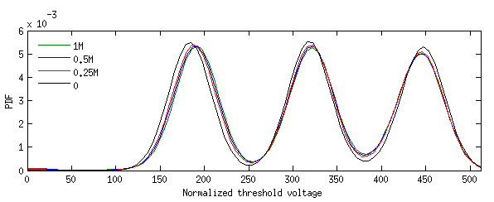
Read Disturb Effect on V_{th} Distribution
× 10⁻³
6
0 (No Read Disturbs)
V_{th} gradually increases with read disturb counts
5
0.25M Read Disturbs
4
0.5M Read Disturbs
PDF
3
1M Read Disturbs
P1 state
P2 state
P3 state
2
1
ER state
0
0
50
100
150
200
250
300
350
400
450
500
Normalized Threshold Voltage
Notes:
In our paper, we characterize the threshold voltage distribution of flash cells before and after read disturb.
The x-axis is normalized threshold voltage, the y-axis is probability density function.
Overall, we can see roughly 3.1 states of threshold voltages, and we call them the ER, P1, P2, and P3 states.
This shows our MLC device has 4 states, and each flash cell can store 2 bits.
Note that only a small fraction of the erased state is visible because the erased state can have negative threshold voltages.
In this figure, we plot 4 lines, each represents the threshold voltage distribution with no read disturbs, after .25M read disturbs, …
The threshold voltage shifts are not very dramatic, so let’s zoom in and take a look.
Now we can see that Vth gradually…
In the paper, we have lots of other results derived from this characterization that we will not cover in this presentation.

Slide 17
Other Experimental Observations
Lower threshold voltage states are affected more by read disturb
Wear-out increases read disturb effect
Notes:
But here we list our key conclusions from these results.
These new observations help us to understand the read disturb effects better.

Slide 18
Reducing The Pass-Through Voltage
  Key Observation 1: Slightly lowering V_{pass} greatly reduces read disturb errors
Notes:
Now let’s look at the effect of reducing pass-through voltage, because, as we have introduced earlier, high pass-through voltage is the main reason for read disturb errors.
We set up an experiment that emulates a reduced the pass through voltage.
We assume an acceptable raw bit error rate of 10^-3, which is typical amount for a flash memory.
And we record the tolerable read disturb count before the raw bit error rate exceeds this amount.
In this figure, the x axis is … y axis is …
We normalize tolerable read disturb count to that of the default pass through voltage, which is 0% on this figure.
As we can see, as we continue to reduce the pass through voltage by 6%, the tolerable read disturb count increases significantly up to 1300x.

Slide 19
Outline
Background (Problem and Goal)
Key Experimental Observations
Mitigation: V_{pass} Tuning
Recovery: Read Disturb Oriented Error Recovery
Conclusion
Notes:
Now that we have developed an understanding of the read disturb phenomenon in flash memory.
Let’s look at how we exploit these observations to mitigate read disturb errors.

Slide 20
Read Disturb Mitigation: V_{pass} Tuning
Key Idea: Dynamically find and apply a lowered V_{pass}
Trade-off for lowering V_{pass}
  Allows more read disturbs
  Induces more read errors
Notes:
To mitigate read disturb errors, we propose Vpass Tuning, whose key idea is to dynamically find and apply a lowered pass-through voltage.
However, lowering the pass through voltage presents a trade off.
First, as we have just described, lowering pass through voltage by a little significantly reduces the read disturb effect.
However, lowering Vpass also induces more read errors, which we will introduce next.

Slide 21
Read Errors Induced by V_{pass} Reduction
Reducing V_{pass} to 4.9V
V_{pass} = 4.9 V
3.0V
3.8V
3.9V
4.8V
Page 1
V_{read} = 2.5 V
3.5V
2.9V
2.4V
2.1V
Page 2
V_{pass} = 4.9 V
2.2V
4.3V
4.6V
1.8V
Page 3
V_{pass} = 4.9 V
3.5V
2.3V
1.9V
4.3V
Page 4
0
0
1
1
Notes:
If we only reduce the pass-through voltage by a little, very few read errors will be generated.
In this example, we reduce Vpass to 4.9V, which is higher than the threshold voltage of any cell that we want to pass through.

Slide 22
Read Errors Induced by V_{pass} Reduction
Reducing V_{pass} to 4.7V
V_{pass} = 4.7 V
3.0V
3.8V
3.9V
4.8V
Page 1
V_{read} = 2.5 V
3.5V
2.9V
2.4V
2.1V
Page 2
V_{pass} = 4.7 V
2.2V
4.3V
4.6V
1.8V
Page 3
V_{pass} = 4.7 V
3.5V
2.3V
1.9V
4.3V
Page 4
Incorrect values from page 2:
0
0
1
0
Notes:
However, as we further reduce the pass through voltage to 4.7V, some cell with higher threshold voltage cannot be correctly passed through, and thus will generate a read error.
In this case, incorrect values are being read from page 2.

Slide 23
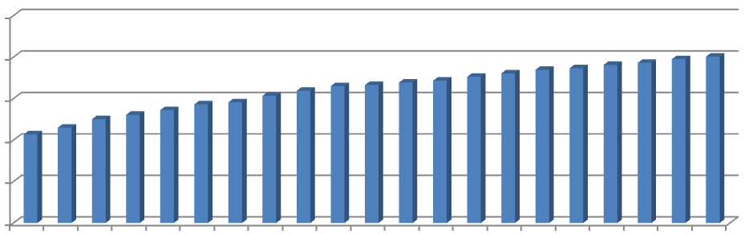
Utilizing the Unused ECC Capability
× 10⁻³
ECC Correction Capability
1.0
Unused ECC capability
RBER
0.8
0.6
0.4
0.2
0
01 02 03 04 05 06 07 08 09 10 11 12 13 14 15 16 17 18 19 20 21
N-day Retention
Huge unused ECC correction capability can be used to tolerate read errors
2. Unused ECC capability decreases over time
Dynamically adjust V_{pass} so that read errors fully utilize the unused ECC capability
Notes:
However, these read errors can be tolerated by the unused ECC capability when the error rate is low, allowing us to reduce read disturb errors when the error rate is high.
In this figure, we plot how raw bit error rate increases over retention age, the time since the data is last programmed.
The x-axis is … y-axis is …
Over time, flash retention errors and read disturb errors are accumulated, so the error rate keeps increasing.
The red line shows …
As we can see, in early retention age, there is huge unused ECC correction capability that can be used to tolerate read errors.
Then over time, the unused ECC capability decreases so we need to readjust Vpass reduction to reduce read errors.
This leads to our Vpass tuning technique that …

Slide 24
V_{pass} Reduction Trade-Off Summary
Conservatively set V_{pass} to a high voltage
  Accumulates more read disturb errors at the end of each refresh interval
  No read errors
Dynamically adjust V_{pass} to unused ECC capability
  Minimize read disturb errors
  Control read errors to be tolerable by ECC
  If read errors exceed ECC capability, read again with a higher V_{pass} to correct read errors
Notes:
Now, let’s summarize and compare the trade-offs for Vpass Reduction.
If we conservatively …, which is what flash vendors do today, we will accumulate lots of read disturb errors at the end of each refresh interval, but we don’t trade-off read errors.
If we dynamically …, we can minimize read disturb errors, and in the mean time control the number of read errors to be tolerable by ECC.
Even if we tune the Vpass too aggressively that the read errors …

Slide 25
V_{pass} Tuning Steps
Perform once for each block every day:
  Estimate unused ECC capability
  Aggressively reduce V_{pass} until read errors exceeds ECC capability
  Gradually increase V_{pass} until read error just becomes less than ECC capability
Notes:
Here, we listed the detailed steps for pass-through voltage tuning.
These steps are performed once for each block every day.
Using these steps, we can maximize the utilization of the unused ECC capability such that read disturb errors are minimized when the error rate is high.

Slide 26
Evaluation of V_{pass} Tuning
19 real workload I/O traces
Assume 7-day refresh period
Similar methodology as before to determine acceptable V_{pass} reduction
Overhead for a 512 GB flash drive:
  128 KB storage overhead for per-block V_{pass} setting and worst-case page
  24.34 sec/day average V_{pass} Tuning overhead
Notes:
… which can be hidden by performing in the background.

Slide 27
V_{pass} Tuning Lifetime Improvements
V_{pass} Tuning
Average lifetime improvement: 21.0%
Notes:
This figure shows the Vpass tuning lifetime improvements.
The length of each bar shows the PE cycle lifetime for each configuration.
The blue bars show our baseline system without Vpass tuning.
The red bars show the lifetime after applying Vpass tuning for each workload.
On average, Vpass tuning improves lifetime by 21%.

Slide 28
Outline
Background (Problem and Goal)
Key Experimental Observations
Mitigation: V_{pass} Tuning
Recovery: Read Disturb Oriented Error Recovery
Conclusion
Notes:
Read disturb errors not only affects flash lifetime, but also increases the risk for data loss.
To recover from read disturb errors, we propose a mechanism call RDR.

Slide 29
Read Disturb Resistance
PDF
N read disturbs
Disturb-Resistant
R
R
N read disturbs
Disturb-Prone
P
P
Normalized V_{th}
Notes:
RDR exploits each cell’s read disturb resistance.
Because of process variation, each cell can be classified as either disturb resistant or disturb prone.
After the same amount of read disturbs, the threshold voltage of a disturb-resistant cell does not change much, but the threshold voltage change of a disturb-prone cell is high.

Slide 30
Observation 2: Some Flash Cells Are
More Prone to Read Disturb
After 250K read disturb:
PDF
Disturb-prone cells have higher threshold voltages
Disturb-resistant cells have lower threshold voltages
ER
P1
R
R
P
P
P
P
Disturb-resistant
→P1 state
Disturb-prone
→ER state
P
P
P
P
R
R
Normalized V_{th}
Notes:
As our fourth observation, we find some flash cells are more prone to read disturb.
Now lets look at an example of the erased and P1 state.
With no read disturb, the threshold voltage of disturb prone and resistant cells are randomly distributed.
After a significant amount of read disturb, the cells redistribute because of read disturb.
At this point, we can see that disturb-prone cells have higher threshold voltages within each state,
And disturb-resistant cells have lower threshold voltages.
Now, if we look at the cells susceptible to errors, which are cells with threshold voltage closer to the boundary.
The disturb-prone cells are from the erased state, and the disturb-resistant cells are from the P1 state.

Slide 31
Read Disturb Oriented Error Recovery (RDR)
Triggered by an uncorrectable flash error
  Back up all valid data in the faulty block
  Disturb the faulty page 100K times (more)
  Compare V_{th}’s before and after read disturb
  Select cells susceptible to flash errors (V_{ref}−σ<V_{th}<V_{ref}−σ)
  Predict among these susceptible cells
    Cells with more V_{th} shifts are disturb-prone → Higher V_{th} state
    Cells with less V_{th} shifts are disturb-resistant → Lower V_{th} state
Notes:
Based on this finding, we propose read disturb oriented error recovery to identify disturb-prone and resistant cells after a failure has happened to recover from read disturb errors.
After an uncorrectable flash error, the following steps are triggered.

Slide 32
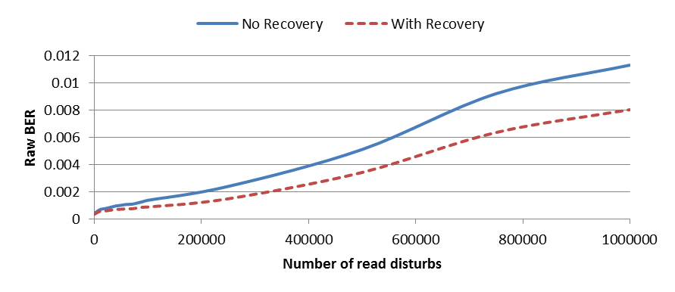
RDR Evaluation
× 10⁻³
12
No Recovery
RDR
10
8
RBER
6
4
2
0
0
0.2M
0.4M
0.6M
0.8M
1M
Read Disturb Count
Reduce total error counts up to 36% @ 1M read disturbs
ECC can be used to correct the remaining errors
Notes:
Finally, we evaluate RDR from 0 to 1M read disturbs.
The x-axis shows the read disturb count, The y-axis shows the raw bit error rate.
The blue curve shows the RBER without RDR, the dotted red curve shows the RBER with RDR.
On average, RDR reduces RBER by 36% and the ECC can be used to correct the remaining errors.

Slide 33
Outline
Background (Problem and Goal)
Key Experimental Observations
Mitigation: V_{pass} Tuning
Recovery: Read Disturb Oriented Error Recovery
Conclusion

Slide 34
Executive Summary
Read disturb errors limit flash memory lifetime today
  Apply a high pass-through voltage (V_{pass}) to multiple pages on a read
We characterize read disturb on real NAND flash chips
  Slightly lowering V_{pass} greatly reduces read disturb errors
  Some flash cells are more prone to read disturb
Technique 1: Mitigate read disturb errors online
  V_{pass} Tuning dynamically finds and applies a lowered V_{pass}
  Flash memory lifetime improves by 21%
Technique 2: Recover after failure to prevent data loss
  Read Disturb Oriented Error Recovery (RDR) selectively corrects cells more susceptible to read disturb errors
  Reduces raw bit error rate (RBER) by up to 36%
Notes:
Emphasize online and after failure

Slide 35
Read Disturb Errors in MLC NAND Flash Memory:
Characterization, Mitigation, and Recovery
Yu Cai, Yixin Luo, Saugata Ghose,
Erich F. Haratsch*, Ken Mai, Onur Mutlu
Carnegie Mellon University, *Seagate Technology

Slide 36
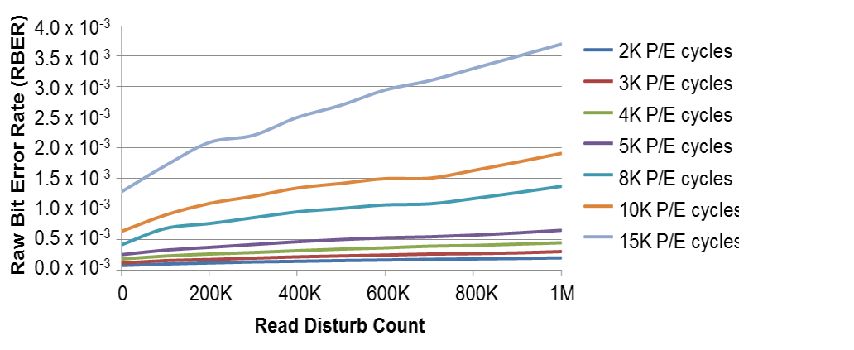
Read Disturb Induced RBER Increases Faster with Higher PEC
Raw Bit Error Rate (RBER)
× 10⁻³
4.0
PEC |  | Slope
 | 15K | 1.90×10⁻⁸
 | 10K | 9.10×10⁻⁹
 | 8K | 7.50×10⁻⁹
 | 5K | 3.74×10⁻⁹
 | 4K | 2.37×10⁻⁹
 | 3K | 1.63×10⁻⁹
 | 2K | 1.00×10⁻⁹
3.5
Faster
3.0
2.5
2.0
1.5
1.0
Slower
0.5
0
0
20K
40K
60K
80K
100K
Read Disturb Count
Notes:
Due to this threshold voltage shift, read disturb effect also induces raw bit errors.
The second observation is …
The figure on the left shows how raw bit error rate changes over read disturb count.
The x-axis is … , the y-axis is the raw bit error rate. Each line shows RBER for a different PE cycle.
First of all, we can see that raw bit error rate increases with read disturb counts, which means more and more errors are accumulated over read disturb.
The table on the right shows slope of each curve on the left.
As we can see, as PE cycle increases, the slope becomes higher, which means the raw bit error rate increases faster.

Slide 37
Threshold Voltage Increases with Read Disturb Count
Showing results for P1 state @ 8K PEC, other states have similar trends
Notes:
In these two figures, we plot the mean and standard deviation of the P1 state threshold voltage distribution.
The x-axis shows the read disturb count from 0 to 1 million. The y-axis shows normalized threshold voltage mean and stdev.

Slide 38
Lower Voltage States Are
More Prone to Read Disturb
ER State
P1 State
Notes:
This is because ER and P1 states have lower threshold voltages

Slide 39
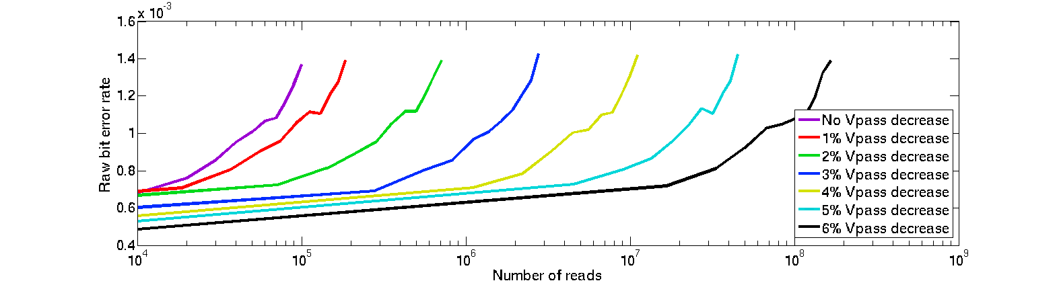
Reducing V_{pass} Increases Tolerable Read Disturb Count
× 10⁻³
RBER
1.6
100%
99%
98%
97%
96%
95%
94%
1.4
1.2
100% V_{pass}
99% V_{pass}
1.0
98% V_{pass}
0.8
97% V_{pass}
96% V_{pass}
0.6
95% V_{pass}
94% V_{pass}
0.4
10⁴
10⁵
10⁶
10⁷
10⁸
10⁹
Read Disturb Count
Pct. V_{pass} Value | 100% | 99% | 98% | 97% | 96% | 95% | 94%
Rd. Disturb. Cnt. | 1x | 1.7x | 6.8x | 22x | 100x | 470x | 1300x

Slide 40
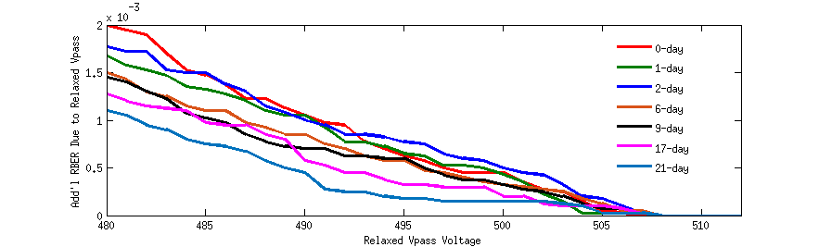
Pass-Through Voltage Reduction Induced Read Error
Addl. RBER Due to Reduced V_{pass}
× 10⁻³
1.0
0-day
0.75
1-day
2-day
6-day
0.5
9-day
17-day
0.25
21-day
0
480
485
490
495
500
505
510
Relaxed V_{pass}

Slide 41
Read Errors Induced by V_{pass} Reduction
Will generate a read error only if:
  Max(V_{th}) > V_{pass}
  Correct read value is 1
These errors do not affect lifetime
  can usually be tolerated by the unused ECC capability
These errors are temporary
  can be corrected (if necessary) by reading with the default V_{pass}
Notes:
Now let’s summarize this type of read error.
A read error will be induced by Vpass reduction, if and only if 1. the maximum threshold voltage in this column is higher than the reduced Vpass. 2. The correct read value on this column is 1.
Note about two important characteristics of these errors.
First, they do not affect lifetime …
Second, …

Slide 42
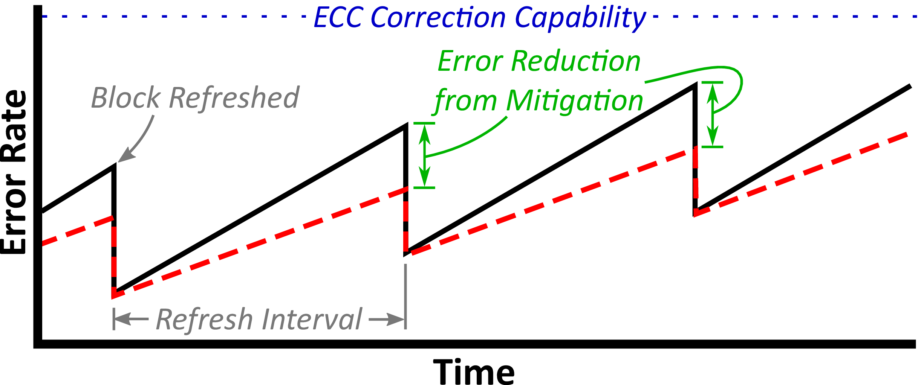
Illustration of V_{pass} Tuning Results
Notes:
Here is an illustration of the pass through voltage tuning results.
Over time, as PE cycle increases, the overall error rate increases.
Within each refresh interval, retention errors and read disturb errors accumulate until they are reset as the block is refreshed.
Our Vpass tuning technique reduces the read disturb errors throughout each refresh interval and hence delaying the time when the error rate exceeds the ECC correction capability, and thus improves flash lifetime.

Slide 43
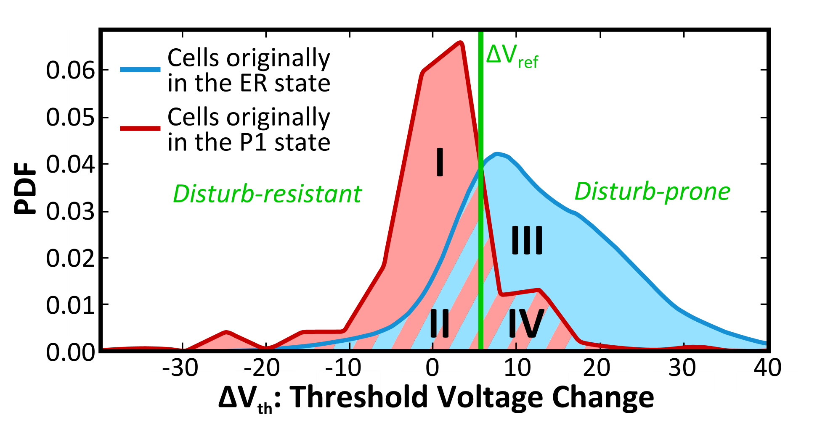
Some Flash Cells Are
More Prone to Read Disturb
Predict to be P1 state
Area I is correct
Area II is 50/50
Predict to be ER state
Area III is correct
Area IV is 50/50
Showing ∆V_{th} with 8K PEC from 250K to 350K read disturbs
Notes:
So, now let’s look at if we can find out the disturb-prone cells.
In this figure, we show the threshold voltage change for the susceptible cells with 8K PEC from 250K to 350K read disturbs.
The blue curve shows cells with Erased state, the red curve shows cells with P1 state.
We can see that if we set a reasonable reference voltage in the middle to separate disturb-prone and resistant cells, we can be correct most of the time.
According to our previous analysis, disturb-resistant cells can be predicted to be P1 state, and disturb-prone cells can be predicted to be ER state.

