Slide 1

FPGA-accelerated Dense Linear Machine Learning:
A Precision-Convergence Trade-off
Kaan Kara, Dan Alistarh, Gustavo Alonso, Onur Mutlu, Ce Zhang

Slide 2
What is the most efficient way of training dense linear models on an FPGA?
FPGAs can handle floating-point, but they are certainly not the best choice.
We have tried: On par with a 10-core Xeon, not a clear win.
Yet!
How about some recent developments in the machine research?
In theory
leads to
Low-precision data EXACTLY the same end-result.

Slide 3



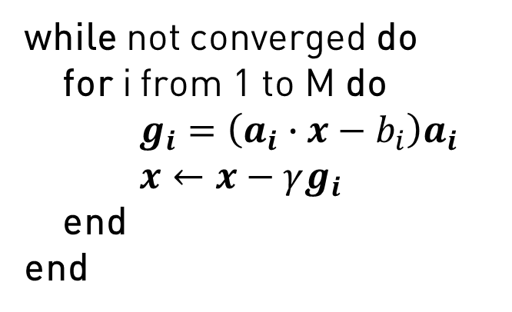
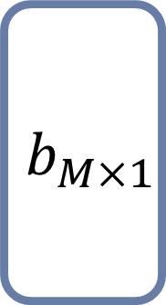
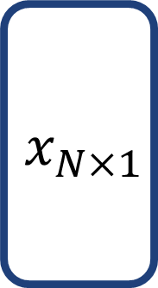
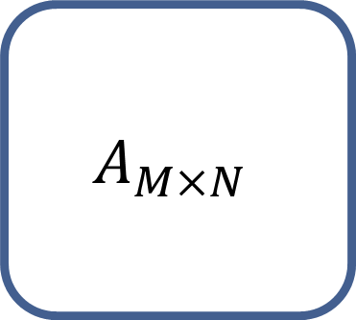
Stochastic Gradient Descent (SGD)
N features
$$A_{M×N}$$
$$x_{N×1}$$
$$b_{M×1}$$
while not converged do
for i from 1 to M do
$g_{i}=\left(a_{i}∙x−b_{i}\right)a_{i}$
$x←x−γg_{i}$
end
end
M samples
x
=
Data Set
Model
Labels
Data Source
DRAM, SSD,
Sensor
Gradient: dot(Ar, x)Ar
Memory
CPU Cache,
DRAM,
FPGA BRAM
Data Ar
Model x
Computation
CPU, GPU, FPGA

Slide 4

Advantage of Low-Precision Data + FPGA
N features
Compress!
$$A$$
$$x_{N×1}$$
$$b_{M×1}$$
while not converged do
for i from 1 to M do
$g_{i}=\left(a_{i}∙x−b_{i}\right)a_{i}$
$x←x−γg_{i}$
end
end
M samples
x
=
Data Set
Model
Labels
Data Source
DRAM, SSD,
Sensor
Gradient: dot(Ar, x)Ar
Memory
CPU Cache,
DRAM,
FPGA BRAM
Data Ar
Model x
Computation
CPU, GPU, FPGA

Slide 5
Key Takeaway
Using an FPGA, we can increase the hardware efficiency while maintaining the statistical efficiency of SGD for dense linear models.
Training
Loss
Training
Loss
Naïve rounding
same quality
Stochastic rounding
faster
Full-precision
Iterations
Execution Time
In practice, the system opens up a multivariate trade-off space:
Data properties, FPGA implementation, SGD parameters…

Slide 6
Outline for the Rest…
Stochastic quantization. Data layout
Target platform: Intel Xeon+FPGA
Implementation: From 32-bit to 1-bit SGD on FPGA.
Evaluation: Main results. Side effects.
Conclusion

Slide 7
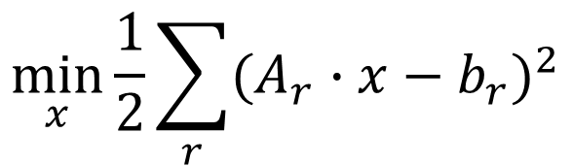

Stochastic Quantization [1]
1
Naive solution: Nearest rounding (=1)
=> Converge to a different solution.
[…. 0.7 ….]
Stochastic rounding: 0 with probability 0.3, 1 with probability 0.7
=> Expectation remains the same. Converge to the same solution.
0
$$\min_{x}{\frac{1}{2}\sum_{r}{{(A_{r}∙x−b_{r})}^{2}}}$$
Gradient
$$g_{i}=\left(a_{i}∙x−b_{i}\right)a_{i}$$
We need 2
independent samples
$$g_{i}=\left({Q_{1}(a}_{i})∙x−b_{i}\right)Q_{2}(a_{i})$$
…and each iteration of the algorithm needs fresh samples.
[1] H Zhang, K Kara, J Li, D Alistarh, J Liu, C Zhang: ZipML: An End-to-end Bitwise Framework for Dense Generalized Linear Models, arXiv:1611.05402

Slide 8
Before the FPGA: The Data Layout
1. Feature
2. Feature
3. Feature
n. Feature
1. Sample
32-bit float value
32-bit float value
32-bit float value
32-bit float value
m. Sample
32-bit float value
32-bit float value
32-bit float value
32-bit float value
Currently slow!
4x compression!
Quantize to 4-bit.
We need 2 independent quantizations!
1. Feature
2. Feature
3. Feature
n. Feature
1 quantization index
1. Sample
4-bit | 4-bit
4-bit | 4-bit
4-bit | 4-bit
4-bit | 4-bit
For each iteration
A new index!
m. Sample
4-bit | 4-bit
4-bit | 4-bit
4-bit | 4-bit
4-bit | 4-bit

Slide 9
Target Platform
Ivy Bridge, Xeon E5-2680 v2
10 cores, 25 MB L3
Intel Xeon+FPGA

Slide 10
Full Precision SGD on FPGA
Data Source
DRAM, SSD,
Sensor
32-bit floating-point: 16 values
Processing rate: 12.8 GB/s
Computation
Custom Logic
Storage Device
FPGA BRAM

Slide 11
Scale out the design for low-precision data!
How can we increase the internal parallelism while maintaining the processing rate?

Slide 12
Challenge + Solution
8-bit: 32 values Q8
4-bit: 64 values Q4
2-bit: 128 values Q2
1-bit: 256 values Q1
=> Scaling out is not trivial!
We can get rid of floating-point arithmetic.
We can further simplify integer arithmetic for lowest precision data.

Slide 13
Trick 1: Selection of quantization levels
U
Select the lower and upper bound [L,U]
Select the size of the interval ∆
∆
All quantized values are integers!
L

Slide 14

This is enough for Q4 and Q8
8-bit: 32 values Q8
4-bit: 64 values Q4
2-bit: 128 values Q2
1-bit: 256 values Q1

Slide 15
Trick 2: Implement Multiplication using Multiplexer
Q2 multiplier
Q1 multiplier

Slide 16
Support for all Qx
Circuit for Q8, Q4 and Q2 SGD
Processing rate: 12.8 GB/s
Circuit for Q1 SGD
Processing rate: 6.4 GB/s

Slide 17
Support for all Qx
Data Type | Logic | DSP | BRAM
float | 38% | 12% | 7%
Q8 | 35% | 25% | 6%
Q4 | 36% | 50% | 6%
Q2, Q1 | 43% | 1% | 6%
Circuit for Q8, Q4 and Q2 SGD
Processing rate: 12.8 GB/s
Circuit for Q1 SGD
Processing rate: 6.4 GB/s

Slide 18
Data sets for evaluation
Name | Size | # Features | # Classes
MNIST | 60,000 | 780 | 10
GISETTE | 6,000 | 5,000 | 2
EPSILON | 10,000 | 2,000 | 2
SYN100 | 10,000 | 100 | Regression
SYN1000 | 10,000 | 1,000 | Regression
Following the Intel legal guidelines on publishing performance numbers, we would like to make the reader aware that results in this publication were generated using preproduction hardware and software, and may not reﬂect the performance of production or future systems.

Slide 19
SGD Performance Improvement
SGD on Synthetic100,
4-bit works
SGD on Synthetic1000,
8-bit works

Slide 20
1-bit also works on some data sets
MNIST
multi-classification accuracy
SGD on MNIST, Digit 7
1-bit works

Slide 21
Naïve Rounding vs. Stochastic Rounding
Stochastic quantization results in unbiased convergence.
Bias

Slide 22
Effect of Step Size
Large step size + Full precision
vs.
Small step size +
Low precision

Slide 23

Conclusion
Highly scalable, parametrizable FPGA-based stochastic gradient descent implementations for doing linear model training.
Open source: www.systems.ethz.ch/fpga/ZipML_SGD
Key Takeaways:
The way to train linear models on FPGA should be through the usage of stochastically rounded, low-precision data.
Multivariate trade-off space: Precision vs. end-to-end runtime, convergence quality, design complexity, data and system properties.

Slide 25

Backup
Why do dense linear models matter?
Workhorse algorithm for regression and classification.
Sparse, high dimensional data sets can be converted into dense ones.
Transfer Learning
Random Features
Why is training speed important?
Often a human-in-the-loop process.
Configuring parameters, selecting features, data dependency etc.
Train
Evaluate

Slide 26
Effect of Reusing Indexes
In practice 8 indexes are enough!

