Slide 1
Kilo-NOC: A Heterogeneous Network-on-Chip Architecture for Scalability and Service Guarantees
Boris Grot, Joel Hestness, Stephen W. Keckler ¹ The University of Texas at Austin ¹ NVIDIA Research | Onur Mutlu Carnegie Mellon University

Slide 2
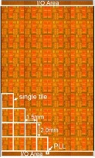

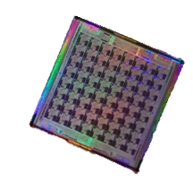
Motivation
Extreme-scale chip-level integration
  Cores
  Cache banks
  Accelerators
  I/O logic
  Network-on-chip (NOC)
10-100 cores today
1000+ assets in the near future

Slide 3
This talk
On-chip networks for the kilo-node era
Kilo-NOC

Slide 4
Kilo-NOC requirements
High efficiency
  Area
  Energy
Good performance
Strong service guarantees

Slide 5
Outline
Limitations of existing NOC technologies
Contributions
  Topology-aware QOS support
  Hybrid flow control
Select results
Summary

Slide 6
Technologies & Limitations (1/2)
Technology: Low-diameter topologies
  Rich connectivity improves performance & energy
  E.g.: flattened butterfly [Micro 07], MECS [HPCA 09]
Scalability obstacle: Buffer demands
  Growth in router radix with network radix
  More buffers per port due to slower wires
Cost: area, energy, delay

Slide 7
Technologies & Limitations (2/2)
Technology: NOC QOS architectures
  No per-flow buffering (shared pool of VCs)
  Simple prioritization and scheduling
  E.g.: GSF [ISCA 08], PVC [Micro 09]
Scalability obstacle: VC demands
  Many VCs to cover long links with slow wires
Cost: buffering, arbitration complexity

Slide 8
Outline
Limitations of existing NOC technologies
Contributions
  Topology-aware QOS support
  Optimized flow control
Select results
Summary

Slide 9
Baseline QOS-enabled CMP
Multiple VMs
sharing a die
Shared resources
(e.g., memory controllers)
VM-private resources
(cores, caches)
Q
QOS-enabled router

Slide 10
Conventional NOC QOS
Contention scenarios:
Shared resources
  memory access
Intra-VM traffic
  shared cache access
Inter-VM traffic
  VM page sharing

Slide 11
Conventional NOC QOS
Contention scenarios:
Shared resources
  memory access
Intra-VM traffic
  shared cache access
Inter-VM traffic
  VM page sharing
Network-wide guarantees without network-wide QOS support

Slide 12
Kilo-NOC QOS
Insight: leverage rich network connectivity
  Naturally reduce interference among flows
  Limit the extent of hardware QOS support
Requires a low-diameter topology
  This work: Multidrop Express Channels (MECS)
  Grot et al., HPCA 2009

Slide 13
Topology-Aware QOS
Dedicated, QOS-enabled regions
  Rest of die: QOS-free
Richly-connected topology
  Traffic isolation
Special routing rules
  Manage interference
QOS-free

Slide 14
Topology-Aware QOS
Dedicated, QOS-enabled regions
  Rest of die: QOS-free
Richly-connected topology
  Traffic isolation
Special routing rules
  Manage interference

Slide 15
Topology-Aware QOS
Dedicated, QOS-enabled regions
  Rest of die: QOS-free
Richly-connected topology
  Traffic isolation
Special routing rules
  Manage interference

Slide 16
Topology-Aware QOS
Dedicated, QOS-enabled regions
  Rest of die: QOS-free
Richly-connected topology
  Traffic isolation
Special routing rules
  Manage interference

Slide 17
Kilo-NOC view
Topology-aware QOS support
  Limit QOS complexity to a fraction of the die
Optimized flow control
  Reduce buffer requirements in QOS-free regions
QOS-free

Slide 18
Traditional Buffer Flow Control
Router-side buffering
  Enough storage to cover the round-trip credit time
E.g.: wormhole, virtual channel flow control

Slide 19
Elastic Buffer Flow Control
Integrate storage directly into links
Kodi et al. [ISCA ’08], Michelogiannakis et al. [HPCA ’09]
  No virtual channels
  Reduced router complexity

Slide 20
Elastic Buffer Flow Control
Integrate storage directly into links
Kodi et al. [ISCA ’08], Michelogiannakis et al. [HPCA ’09]
  Multiple networks for deadlock avoidance
  No savings in end-to-end storage with p2p links

Slide 21
MECS + EB flow control
Insight: EB flow control reduces storage requirements in a MECS network
  Each EB shared by all downstream nodes
Problem: performance suffers

Slide 22
MECS + EB flow control
32%

Slide 23
Hybrid flow control
Combine EB and VC flow control
Long flight time → many buffers/VCs at router port
Allocate VC

Slide 24

Hybrid flow control
Combine EB and VC flow control
Novel JIT VC allocation strategy
  Allocate a VC from an elastic buffer
Allocate VC

Slide 25
Hybrid flow control
Combine EB and VC flow control
Novel JIT VC allocation strategy
  Allocate a VC from an elastic buffer
Benefits
  Shallow, per-message class VCs
  Deadlock freedom without multiple networks
  Performance improvement
Special rules for deadlock avoidance

Slide 26
MECS + hybrid flow control
8%
8x less buffering

Slide 27
Outline
Limitations of existing NOC technologies
Contributions
  Topology-aware QOS support
  Hybrid flow control
Select results
Summary

Slide 28
Evaluation Methodology
Parameter | Value
Technology | 15 nm
Vdd | 0.7 V
System | 1024 tiles: 256 concentrated nodes (64 shared resources)
Networks:
MECS+PVC | VC flow control, QOS support (PVC) at each node
MECS+TAQ | VC flow control, QOS support only in shared regions
MECS+TAQ+EB | EB flow control outside of SRs, Separate Request and Reply networks
K-MECS | Proposed organization: TAQ + hybrid flow control

Slide 29
Area comparison

Slide 30
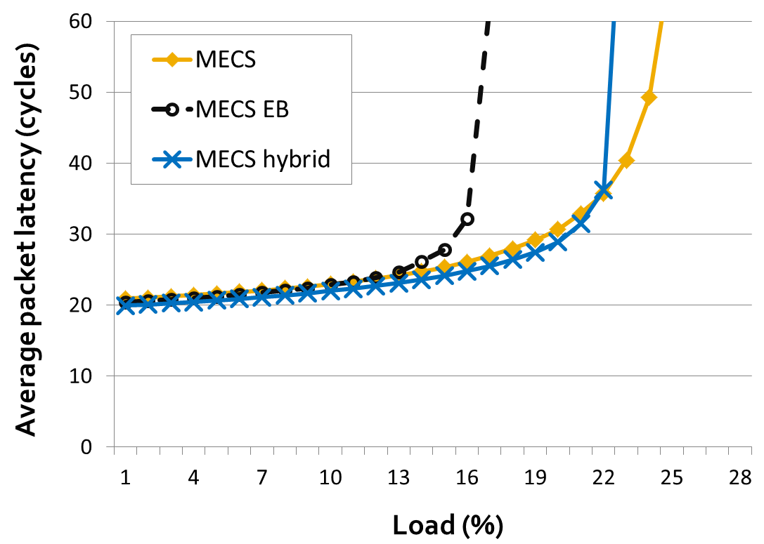
Energy comparison

Slide 31
Summary
Kilo-NOC: a heterogeneous NOC architecture for kilo-node substrates
Topology-aware QOS
  Limits QOS support to a fraction of the die
  Leverages low-diameter topologies
  Improves NOC area- and energy-efficiency
  Provides strong guarantees

Slide 32
Summary
Kilo-NOC: a heterogeneous NOC architecture for kilo-node substrates
Topology-aware QOS
Hybrid flow control
  Enabled by Topology-aware QOS
  Couples VC and EB flow control
  JIT VC allocation
  Reduces VC & buffer requirements

Slide 33
Summary
Kilo-NOC: a heterogeneous NOC architecture for kilo-node substrates
Topology-aware QOS
Hybrid flow control
Bottom line vs MECS+PVC
  45% improvement in area-efficiency
  29% improvement in energy-efficiency
  Comparable QOS strength, performance

