Slide 1
Characterizing Application Memory Error Vulnerability to Optimize Datacenter Cost via Heterogeneous-Reliability Memory
Yixin Luo, Sriram Govindan, Bikash Sharma, Mark Santaniello, Justin Meza, Aman Kansal, Jie Liu, Badriddine Khessib, Kushagra Vaid, Onur Mutlu
Notes:
Thank you for your introduction. I am very glad to be here to present our work “Characterizing Application Memory Error Vulnerability to Optimize Datacenter Cost via Heterogeneous-Reliability Memory”.
This work is done with my coauthors from Carnegie Mellon University and Microsoft.

Slide 2
Executive Summary
Problem: Reliable memory hardware increases cost
Our Goal: Reduce datacenter cost; meet availability target
Observation: Data-intensive applications’ data exhibit a diverse spectrum of tolerance to memory errors
Across applications and within an application
We characterized 3 modern data-intensive applications
Our Proposal: Heterogeneous-reliability memory (HRM)
Store error-tolerant data in less-reliable lower-cost memory
Store error-vulnerable data in more-reliable memory
Major results:
Reduce server hardware cost by 4.7 %
Achieve single server availability target of 99.90 %
Notes:
Here is a summary of our talk.
The focus of this work is on the trade-off between memory cost and reliability. Today’s servers typically rely on reliable memory hardware, which increases cost. So our goal is to find an optimal point in this tradeoff to reduce datacenter cost while meeting reliability target.
In this paper, we first characterized 3 new data-intensive workloads and observed that these applications have a diverse spectrum of tolerance to memory errors.
Based on this observation, we proposed heterogeneous-reliability memory, which stores error-tolerant data in less-reliable but lower-cost memories and stores error-vulnerable data in more reliable memories enabled by sw/hw cooperative techniques.
We evaluated an example HRM system which can reduce server hardware cost by 4.7% while achieving single server availability target of 99.90%. Note that this cost savings can mean million dollar for companies with large-scale datacenters.

Slide 3
Outline
Motivation
Characterizing application memory error tolerance
Key observations
Observation 1: Memory error tolerance varies across applications and within an application
Observation 2: Data can be recovered by software
Heterogeneous-Reliability Memory (HRM)
Evaluation
Notes:
Here is an outline of this talk.

Slide 4
Outline
Motivation
Characterizing application memory error tolerance
Key observations
Observation 1: Memory error tolerance varies across applications and within an application
Observation 2: Data can be recovered by software
Heterogeneous-Reliability Memory (HRM)
Evaluation
Notes:
First, let’s start with the motivation of our work.

Slide 5
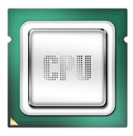
Server Memory Cost is High
Server hardware cost dominates datacenter Total Cost of Ownership (TCO) [Barroso ‘09]
As server memory capacity grows, memory cost becomes the most important component of server hardware costs [Kozyrakis ‘10]
128GB Memory cost
~$140(per 16GB)×8
= ~$1120 *
2 CPUs cost
~$500(per CPU)×2 = ~$1000 *
* Numbers in the year of 2014
Notes:
As we all know, many companies have been trying to reduce datacenter total cost of ownership.
Recent research has shown that server hardware cost dominates datacenter total cost of ownership.
In addition to that, as server memory capacity grows, memory cost can exceed CPU cost and become the most important component of server hardware cost.
For an example server running data-intensive applications with 128 GB memory and 2 CPUs, total memory cost can be higher than total CPU cost.

Slide 6
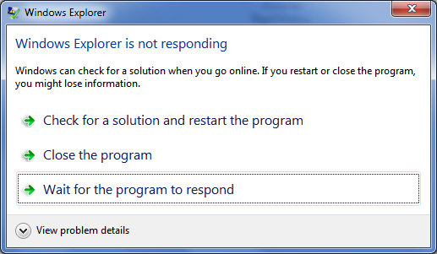
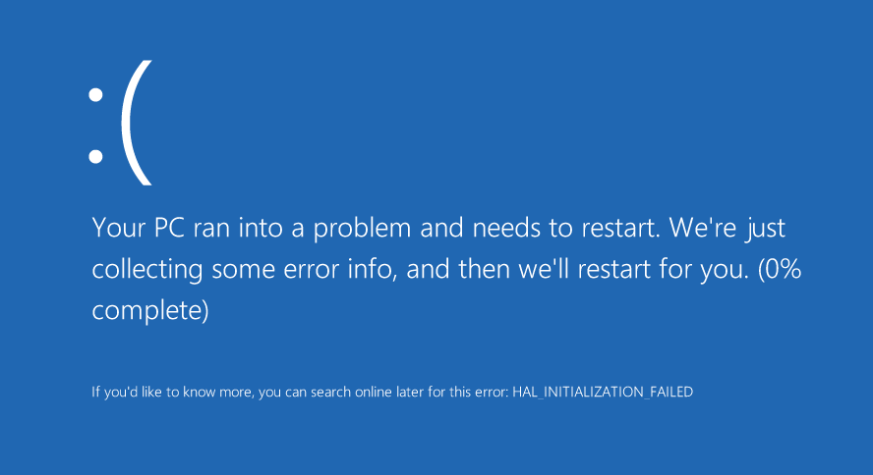
Memory Reliability is Important
System/app
hang or slowdown
System/app crash
Silent data corruption or incorrect app output
Notes:
Apart from memory cost, memory reliability is also important to datacenters.
Memory errors can cause system or applications to hang, slowdown, or crash.
Memory errors can also corrupt user data or generate incorrect application outputs.
To mitigate these memory errors,

Slide 7
Existing Error Mitigation Techniques (I)
Quality assurance tests increase manufacturing cost
Memory testing cost can be a significant fraction of memory cost as memory capacity grows
Notes:
To mitigate these memory errors, various error mitigation techniques are pervasively adopted in server memories.
One technique is the quality assurance tests performed during the manufacturing process. This figure shows the trend how fraction of testing cost over memory cost grows when DRAM chip capacity increases.
We conclude from this figure that testing cost can become a significant fraction of memory cost when its capacity is high.

Slide 8
Existing Error Mitigation Techniques (II)
Error detection and correction increases system cost
Increasing strength
Technique | Detection | Correction | Added capacity | Added logic
NoECC | N/A | N/A | 0.00% | No
Parity | 1 bit | N/A | 1.56% | Low
SEC-DED | 2 bit | 1 bit | 12.5% | Low
Chipkill | 2 chip | 1 chip | 12.5% | High
Parity | 1 bit | N/A | 1.56%
SEC-DED | 2 bit | 1 bit | 12.5%
SEC-DED | 2 bit | 1 bit | 12.5% | Low
Chipkill | 2 chip | 1 chip | 12.5% | High
Stronger error protection techniques have higher cost
Notes:
Another technique is error detection and correction, which stores extra bits in memory and verifies and recovers from memory errors in memory controller using these bits.
The table below shows various error detection and correction techniques along with their associated capacity and logic overhead.
Note that these techniques are ranked with increasing strength of error protection capabilities, from Parity, SEC-DED, to chipkill.
However, this increase in error protection strength requires either extra capacity in memory or extra logic in memory controller.
Both of these overheads increase memory cost in datacenter servers.
We conclude that stronger error protection techniques have higher cost.
For these existing approaches to mitigate memory errors

Slide 9
Shortcomings of Existing Approaches
Uniformly improve memory reliability
Observation 1: Memory error tolerance varies across applications and with an application
Rely only on hardware-level techniques
Observation 2: Once a memory error is detected, most corrupted data can be recovered by software
Goal: Design a new cost-efficient memory system that flexibly matches memory reliability with application memory error tolerance
Notes:
For these existing approaches to mitigate memory errors, we identified that there are two major shortcomings that make them less cost-efficient. Limit their cost-efficiencies.
First, these approaches uniformly improve memory reliability. And second, these approaches rely only on hardware-level techniques.
However, as we will show you later, we find that, for data-intensive applications, memory error tolerance varies for different applications and for different data within an application. We also find that once memory error is detected by hardware, software is able to recover most of the corrupted data.
To overcome these shortcomings and take advantage of the opportunities, we set our goal to design a new cost-efficient memory system that can flexible match memory reliability with application memory error tolerance.
In the following part of this presentation, we will go into details about how we made these observations and how we exploited these observations to reach our goal.

Slide 10
Outline
Motivation
Characterizing application memory error tolerance
Key observations
Observation 1: Memory error tolerance varies across applications and within an application
Observation 2: Data can be recovered by software
Heterogeneous-Reliability Memory (HRM)
Evaluation
Notes:
As the first step towards our goal, we characterized application memory error tolerance.

Slide 11
Characterization Goal
Quantify application memory error tolerance
corrupted
Memory Error Outcomes
Memory Error
x = …010…
x = …110…
Store
Load
Masked by Overwrite
Consumed by Application
x = …000…
if (x != 0) …
Masked by Logic
Incorrect Response
System/App Crash
return x;
or
*x;
✓Correct Result
✗Incorrect Result
Notes:
The goal of our characterization is to quantify application memory error tolerance.
Before we go into details about our characterization, let’s first look at what are the possible outcomes of a memory error and how memory errors evolve into these outcomes.
When a memory error happens on a piece of data in memory, the data will be corrupted. However, if the next access to the corrupted data is a store, a clean data will overwrite the corrupted data and hence generate correct result. On the other hand, if the next access is a load, the corrupted data will be consumed by the application.
In some cases, application logic can mask the data corruption and still generate correct result. While in other cases, if the memory error affects application’s data or control flow, the user will get incorrect result.
In summary, the outcomes of a memory error can either be correct result or incorrect result.
We further breakdown incorrect result in our evaluation into the rate of incorrect query responses and the probability of system/application crash on the affected server.

Slide 12
Characterization Methodology
3 modern data-intensive applications
3 dominant memory regions
Heap – dynamically allocated data
Stack – function parameters and local variables
Private – private heap managed by user
Injected a total of 23,718 memory errors using software debuggers (WinDbg and GDB)
Examined correctness for over 4 billion queries
Application | WebSearch | Memcached | GraphLab
Memory footprint | 46 GB | 35 GB | 4 GB
Notes:
In order to quantify memory error outcomes, we characterized 3 modern data-intensive applications.
WebSearch is an interactive web search workload with 46 GB memory footprint.
Memcached is an in-memory key-value store with 35 GB memory footprint.
GraphLab is a graph mining workload with 4 GB memory footprint.
We further breakdown each application into 3 dominant memory regions, heap, stack and private region.
We use software debuggers to inject memory errors one at a time uniformly to the entire application memory space.
In total, we injected more than 23 thousand memory errors and examined correctness for over 4 billion queries.
Please note that the number of injected errors are used to calculate 90% confidence interval of our characterized probabilities, which we will show can achieve reasonable confidence interval.
Backup slides
Error in each application
Qps of each application

Slide 13
Outline
Motivation
Characterizing application memory error tolerance
Key observations
Observation 1: Memory error tolerance varies across applications and within an application
Observation 2: Data can be recovered by software
Heterogeneous-Reliability Memory (HRM)
Evaluation
Notes:
Next we will present our characterization results and key observations.

Slide 14
Observation 1: Memory Error Tolerance Varies
Across Applications
>10× difference
Showing results for single-bit soft errors
Results for other memory error types can be found in the paper with similar conclusion
Notes:
The first observation from the result is memory error tolerance varies across applications.
This figure shows the probability of system or application crash in case of a single-bit soft error for the 3 characterized applications.
The error bars on the figure shows the 90% confidence interval of each probability.
As we can see, probability of crash varies as much as 10 times across applications.
While today we will only present single-bit soft error results, we have results for other error types including multi-bit soft and hard errors in the paper and the conclusion is similar.

Slide 15
Observation 1: Memory Error Tolerance Varies
Across Applications
>10⁵× difference
Showing results for single-bit soft errors
Results for other memory error types can be found in the paper
Notes:
This is another figure that shows the rate of incorrect responses for the 3 characterized applications.
y-axis is the number of incorrect responses per billion queries in log scale.
Error bars on the figure show the maximum incorrect queries we have observed in an experiment.
As we can see from this figure, rate of incorrect responses varies up to 5 orders of magnitude
Axis don’t use 1.0E+x

Slide 16
Observation 1: Memory Error Tolerance Varies
Across Applications
and Within an Application
>4× difference
Showing results for WebSearch
Results for other workloads can be found in the paper
Notes:
Not only does memory error tolerance varies across applications, but it also varies within an application.
We examined WebSearch as an example, and this figure shows how system or application crash probability varies over different memory regions for WebSearch.
We can see from this figure that a memory error in private memory region is 4 times more probable to result in a crash than a memory error in the stack region.

Slide 17
Observation 1: Memory Error Tolerance Varies
Across Applications
and Within an Application
All averaged at a very low rate
15
Showing results for WebSearch
Results for other workloads can be found in the paper
Notes:
This is another figure that shows incorrect response rates for different memory regions within an application.
Although we only see 1 order of magnitude difference in incorrect response rate, we can see that these incorrect responses all happens at a very low rate.
In fact, many data intensive applications can tolerate a low rate of incorrect responses. These applications include websearch, some in-memory key-value store application such as twitter, and many data mining applications.

Slide 18
Outline
Motivation
Characterizing application memory error tolerance
Key observations
Observation 1: Memory error tolerance varies across applications and within an application
Observation 2: Data can be recovered by software
Heterogeneous-Reliability Memory (HRM)
Evaluation
Notes:
Observation 2: Let me now discuss our second key observation.

Slide 19
Observation 2: Data Can be Recovered by Software
Implicitly and Explicitly
Implicitly recoverable – application intrinsically has a clean copy of the data on disk
Explicitly recoverable – application can create a copy of the data at a low cost (if it has very low write frequency)
Notes:
The second observation we made is that many data can be recovered by software implicitly and explicitly and there are great potential in both.
If the application intrinsically has a clean copy of the data on disk, then we consider it as implicitly recoverable.
If the application can create a copy of the data at a low cost, then we consider it as explicitly recoverable.
The figure below shows WebSearch recoverability which we characterized as an example.
We can see that there is a significant opportunity for software recovery.
82% of websearch address space is implicitly recoverable and 56% is explicitly recoverable.

Slide 20
Outline
Motivation
Characterizing application memory error tolerance
Key observations
Observation 1: Memory error tolerance varies across applications and within an application
Observation 2: Data can be recovered by software
Heterogeneous-Reliability Memory (HRM)
Evaluation
Notes:
Next, we will explain our mechanisms to exploit these observations to achieve our goal

Slide 21
Exploiting Memory Error Tolerance
Heterogeneous-Reliability Memory
Vulnerable data
Vulnerable data
Tolerant data
Tolerant data
Reliable memory
Low-cost memory
Vulnerable data
ECC protected
Well-tested chips
Tolerant data
NoECC or Parity
Less-tested chips
Notes:
As we have shown earlier, either across or within applications, our characterization can identify data that are vulnerable to memory errors and data that are tolerant to memory errors.
To exploit this observation, we would like to map these different data onto different memory modules according to their memory error tolerance.
As an example here, we map vulnerable data to reliable memory to improve reliability, and map tolerant data to low-cost less-reliable memory to exploit its tolerance and lower the cost. We call this mechanism heterogeneous-reliability memory, HRM.
Reliable memory consists of … Low cost memory consists of …
As we will show later, HRM allows us to use weaker error protection in memory, and enables the use of less-tested memory chips to lower the cost of the memory system, while still achieving reasonable single-server reliability target.

Slide 22
Par+R: Parity Detection + Software Recovery
Implicit Recovery
Explicit Recovery
Memory
Memory
Page A
Page A
Page B
Page B
Page B
Memory Error
Memory Error
Write
Copy
Copy
Disk
Disk
Page A
Page A
✓
✓
✗
Intrinsic copy
Write non-intensive
Write intensive
Notes:
As we have also observed earlier, there is a great potential in using software to recover a corrupted data from a copy.
To exploit this observation, we apply Par+R, which stands for Parity detection + software recovery to part of data that are recoverable.
As we have described, if a page has an intrinsic copy of its data in the disk, we use parity memory to detect memory errors in hardware and then correct the error in software by recovering from the disk.
For explicit recovery, we first create a copy of the data by copying the page to disk. Then similarly, we use parity hardware to detect the error and recover with software from the disk.
In order to keep a clean copy of the data, we need to copy the page whenever there is a write to the memory. This can create a high enough overhead so that we do not consider write intensive data as explicitly recoverable.
In conclusion, Par+R can detect and correct a memory error with a low software and hardware overhead.

Slide 23
Heterogeneous-Reliability Memory
App 1 data A
App 1 data B
App 2 data A
App 2 data B
App 3 data A
App 3 data B
Step 1: Characterize and classify application memory error tolerance
App 1 data A
App 2 data A
App 2 data B
App 1 data B
App 3 data A
App 3 data B
Vulnerable
Tolerant
Step 2: Map application data to the HRM system enabled by SW/HW cooperative solutions
Reliable
Unreliable
Reliable memory
Parity memory + software recovery (Par+R)
Low-cost memory
Notes:
Now we have described the key idea of HRM and Par+R, let’s look at our mechanism to put them together.
First, we characterize and classify application data in terms of their memory error tolerance, rank them from vulnerable to tolerant.
Then, we map application data to HRM according to their error tolerance. As an example here, vulnerable data is mapped to reliable memory, tolerable data is mapped to low-cost memory, and recoverable data is mapped to parity memory with Par+R.

Slide 24
Outline
Motivation
Characterizing application memory error tolerance
Key observations
Observation 1: Memory error tolerance varies across applications and within an application
Observation 2: Data can be recovered by software
Heterogeneous-Reliability Memory (HRM)
Evaluation
Notes:
Next, let’s look at our evaluation of our example HRM systems.

Slide 25
Evaluated Systems
Configuration | Mapping |  |  | Pros and Cons
 | Private (36 GB) | Heap (9 GB) | Stack (60 MB)
Typical Server | ECC | ECC | ECC | Reliable but expensive
Consumer PC | NoECC | NoECC | NoECC | Low-cost but unreliable
HRM | Par+R | NoECC | NoECC | Parity only
Less-Tested (L) | NoECC | NoECC | NoECC | Least expensive and reliable
HRM/L | ECC | Par+R | NoECC | Low-cost and reliable HRM
Baseline systems
HRM systems
Notes:
In this table, we listed 5 different configurations.
They differ in how they map their data to different memory.
The first 3 configurations uses well-tested memory.
Typical server applies ECC uniformly for all data. Consumer PC applies NoECC for all data. HRM applies Par+R for Private memory and NoECC for the rest.
The next two configurations uses less-tested memory. Less-tested L applies NoECC and is hence least expensive but also least reliable.
HRM/L is our proposed system which applies HRM design to less-tested memory.

Slide 26
Design Parameters
DRAM/server HW cost [Kozyrakis ‘10] | 30%
NoECC memory cost savings | 11.1%
Parity memory cost savings | 9.7%
Less-tested memory cost savings | 18%±12%
Crash recovery time | 10 mins
Par+R flush threshold | 5 mins
Errors/server/month [Schroeder ‘09] | 2000
Target single server availability | 99.90%
Notes:
Here is a list of our design parameters and assumptions.
We use numbers from recent academic paper and assume memory cost accounts for 30% of the total server hardware cost. We also assume a typical server suffers 2000 errors per month. And our target single server availability is 99.90%.

Slide 27
Evaluation Metrics
Cost
Memory cost savings
Server HW cost savings (both compared with Typical Server)
Reliability
Crashes/server/month
Single server availability
# incorrect/million queries
Notes:
Here is our evaluation metrics which can be grouped into 2 categories. Each corresponds to the goal of our work – cost and reliability.
For the cost metric, we evaluated memory cost savings and server hardware cost savings, both compared with typical server.
For the reliability metric, we evaluated probability of crash and incorrect query rate and single server availability.
Let’s first take a look at two most representative metrics – server hardware cost savings and single server availability.

Slide 28
Improving Server HW Cost Savings
Reducing the use of memory error mitigation techniques in part of memory space can save noticeable amount of server HW cost
Notes:
This figure shows the result for server hardware cost savings. The first HRM system can achieve 2.9% cost savings and the HRM/L system can improve cost savings to 4.7%.
As we can see, reducing even part of memory error mitigation techniques can improve server hardware cost savings.

Slide 29
Achieving Target Availability
Single server availability target: 99.90%
✓
✓
✓
✗
✗
HRM systems are flexible to adjust and can achieve availability target
Notes:
This figure shows single server availability for different evaluated system.
Note that single server availability is different from application availability which directly affects the end users.
Single server failure can be largely masked by existing application level fault tolerant techniques
Going back to the figure, the dotted line shows our single server availability target.
As we can see, both HRM systems are able to achieve the availability target.
Hence we can conclude that HRM systems are flexible to adjust and achieve availability target.

Slide 30
Achieving Acceptable Correctness
HRM systems can achieve acceptable correctness
Notes:
This figure shows incorrect response rates for 5 configurations.
Y axis is number of incorrect responses per million queries in log scale.
As we can see, both HRM systems can achieve acceptable correctness.

Slide 31
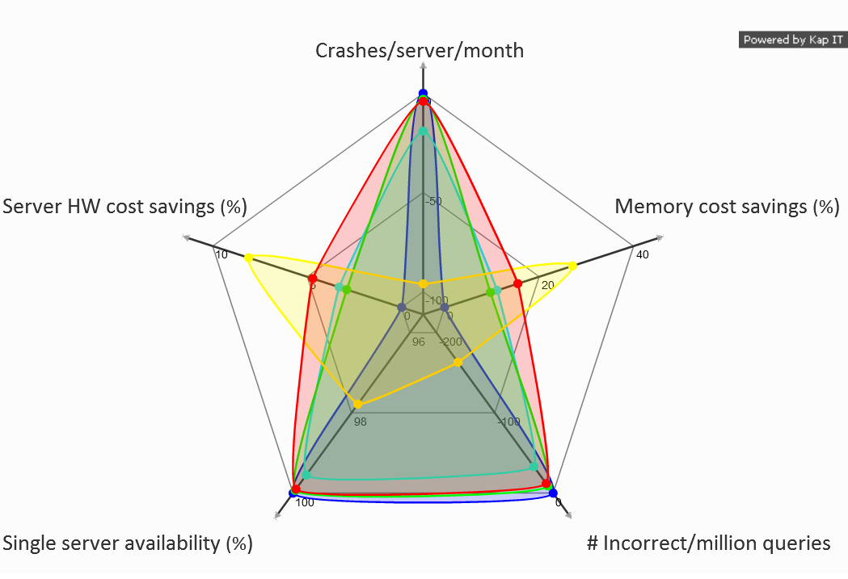
Evaluation Results
Typical Server
Consumer PC
HRM
Less-Tested (L)
HRM/L
Inner is worse
Outer is better
Bigger area means better tradeoff
Notes:
Here is a radar graph for all 5 metrics and systems.
Each axis represents one of the metrics, each closed curve represents the results of the system its color stands for.
We show crashes and incorrect query rates in negative numbers so that, for all of the axes, outer is better.
We conclude that our HRM systems have the largest areas.

Slide 32
Other Results and Findings in the Paper
Characterization of applications’ reactions to memory errors
Finding: Quick-to-crash vs. periodically incorrect behavior
Characterization of most common types of memory errors including single-bit soft/hard errors, multi-bit hard errors
Finding: More severe errors mainly decrease correctness
Characterization of how errors are masked
Finding: Some memory regions are safer than others
Discussion about heterogeneous reliability design dimensions, techniques, and their benefits and tradeoffs
Notes:
We have many other interesting results in the paper including characterization of applications’ reaction to memory errors, other memory error types, how errors are masked, and discussion about HRM design dimensions.

Slide 33
Conclusion
Our Goal: Reduce datacenter cost; meet availability target
Characterized application-level memory error tolerance of 3 modern data-intensive workloads
Proposed Heterogeneous-Reliability Memory (HRM)
Store error-tolerant data in less-reliable lower-cost memory
Store error-vulnerable data in more-reliable memory
Evaluated example HRM systems
Reduce server hardware cost by 4.7 %
Achieve single-server availability target 99.90 %
Notes:
As a conclusion of the talk, we achieved our goal to reduce datacenter cost and meet availability target by characterizing application memory error tolerance and applying proposed heterogeneous reliability memory (HRM).
We also evaluated example HRM systems and showed the benefit.

Slide 34
Characterizing Application Memory Error Vulnerability to Optimize Datacenter Cost via Heterogeneous-Reliability Memory
Yixin Luo, Sriram Govindan, Bikash Sharma, Mark Santaniello, Justin Meza, Aman Kansal, Jie Liu, Badriddine Khessib, Kushagra Vaid, Onur Mutlu

Slide 35
Why use a software debugger?
Speed
Our workloads are relatively long running
WebSearch – 30 minutes
Memcached – 10 minutes
GraphLab – 10 minutes
Our workloads have large memory footprint
WebSearch – 46 GB
Memcached – 35 GB
GraphLab – 4 GB

Slide 36
What are the workload properties?
WebSearch
Repeat a real-world trace of 200,000 queries, with 400 qps
Correctness: Top 4 most relevant documents
Document id
Relevance and popularity
Memcached
30 GB of twitter dataset
Synthetic client workload, at 5,000 rps
90% read requests and 10% write requests
GraphLab
11 million twitter users’ following relations, 1.3 GB dataset
TunkRank algorithm
Correctness: 100 most influential users and their scores

Slide 37
How many errors are injected to each application and each memory region?
WebSearch – 20,576
Memcached – 983
GraphLab – 2,159
Errors injected to each memory region is proportional to their sizes
Application | Private | Heap | Stack | Total
WebSearch | 36 GB | 9 GB | 60 MB | 46 GB
Memcached | N/A | 35 GB | 132 KB | 35 GB
GraphLab | N/A | 4 GB | 132 KB | 4 GB

Slide 38
Does HRM require HW changes
Channel 0
CPU
Mem Ctrl 0
DIMM
ECC
DIMM
ECC
Channel 1*
Mem Ctrl 1*
DIMM
DIMM
Channel 2*
Mem Ctrl 2*
DIMM
DIMM
* Memory controller/Channel without ECC support

Slide 39
What is the injection/monitoring process?
Start
1
(Re)Start App
2
Inject Errors (Soft/Hard)
Repeat
3
Run Client Workload
4
App Crash?
YES
NO
5
Compare Result with Expected Output

Slide 40
Comparison with previous works?
Virtualized and flexible ECC [Yoon ‘10]
Requires changes to the MMU in the processor
Performance overhead ~10% over NoECC
Our work: HRM
Minimal changes to memory controller to enable different ECC on different channels
Low performance overhead
Enables the use of less-tested memory

Slide 41
Other Results

Slide 42
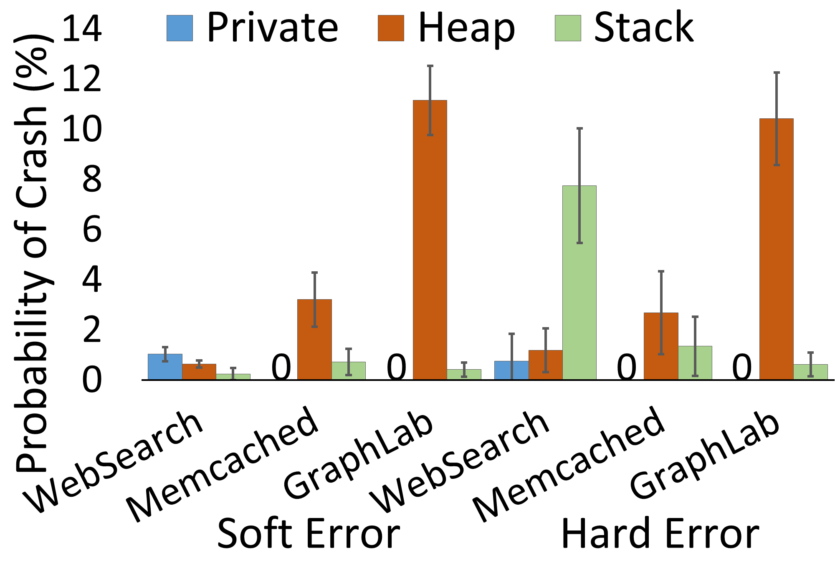
Variation within application

Slide 43
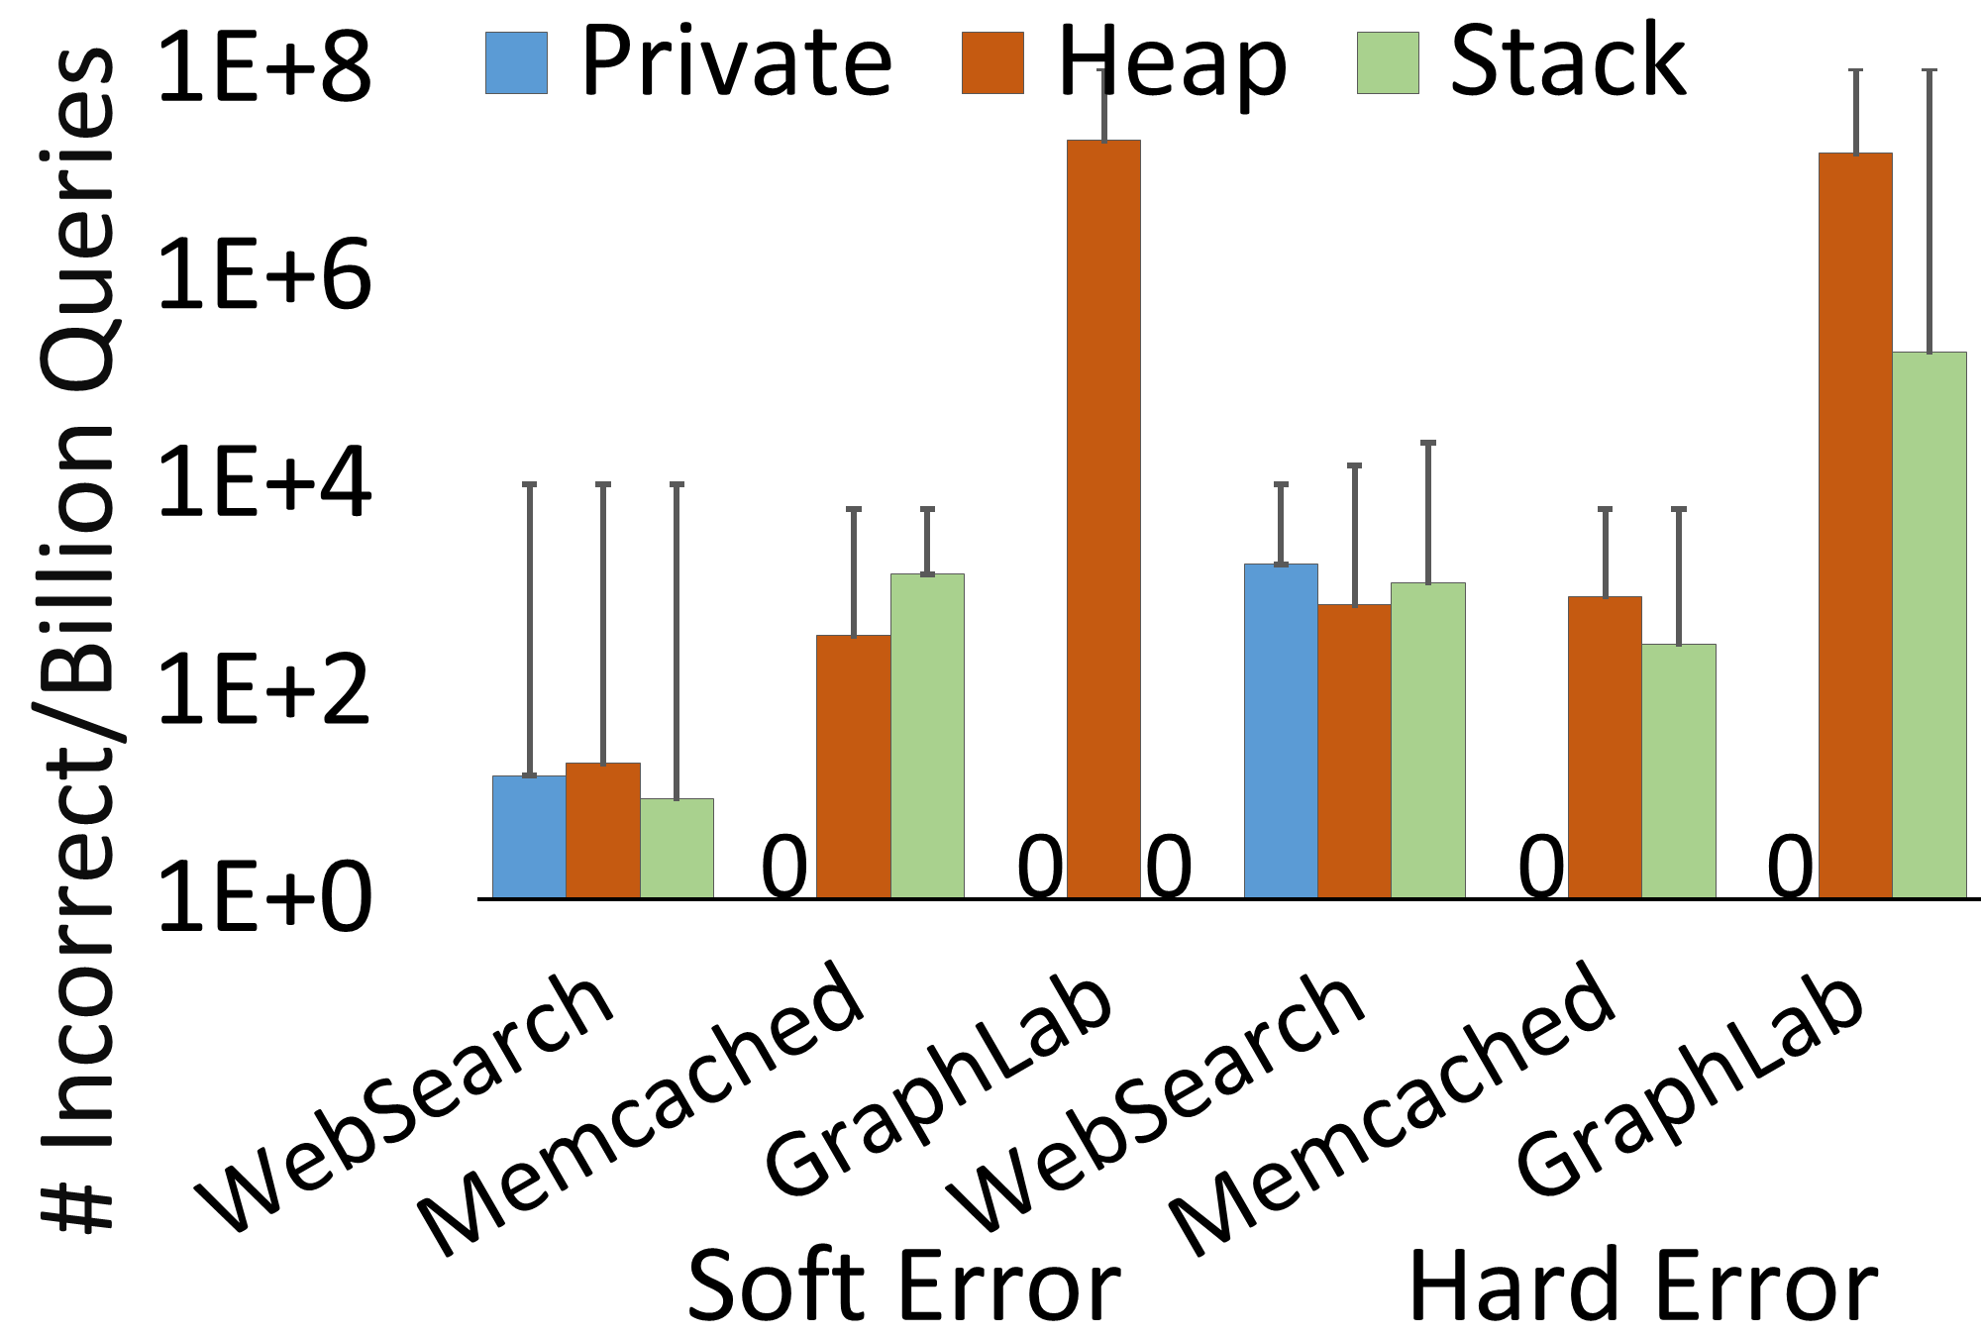
Variation within application

Slide 44
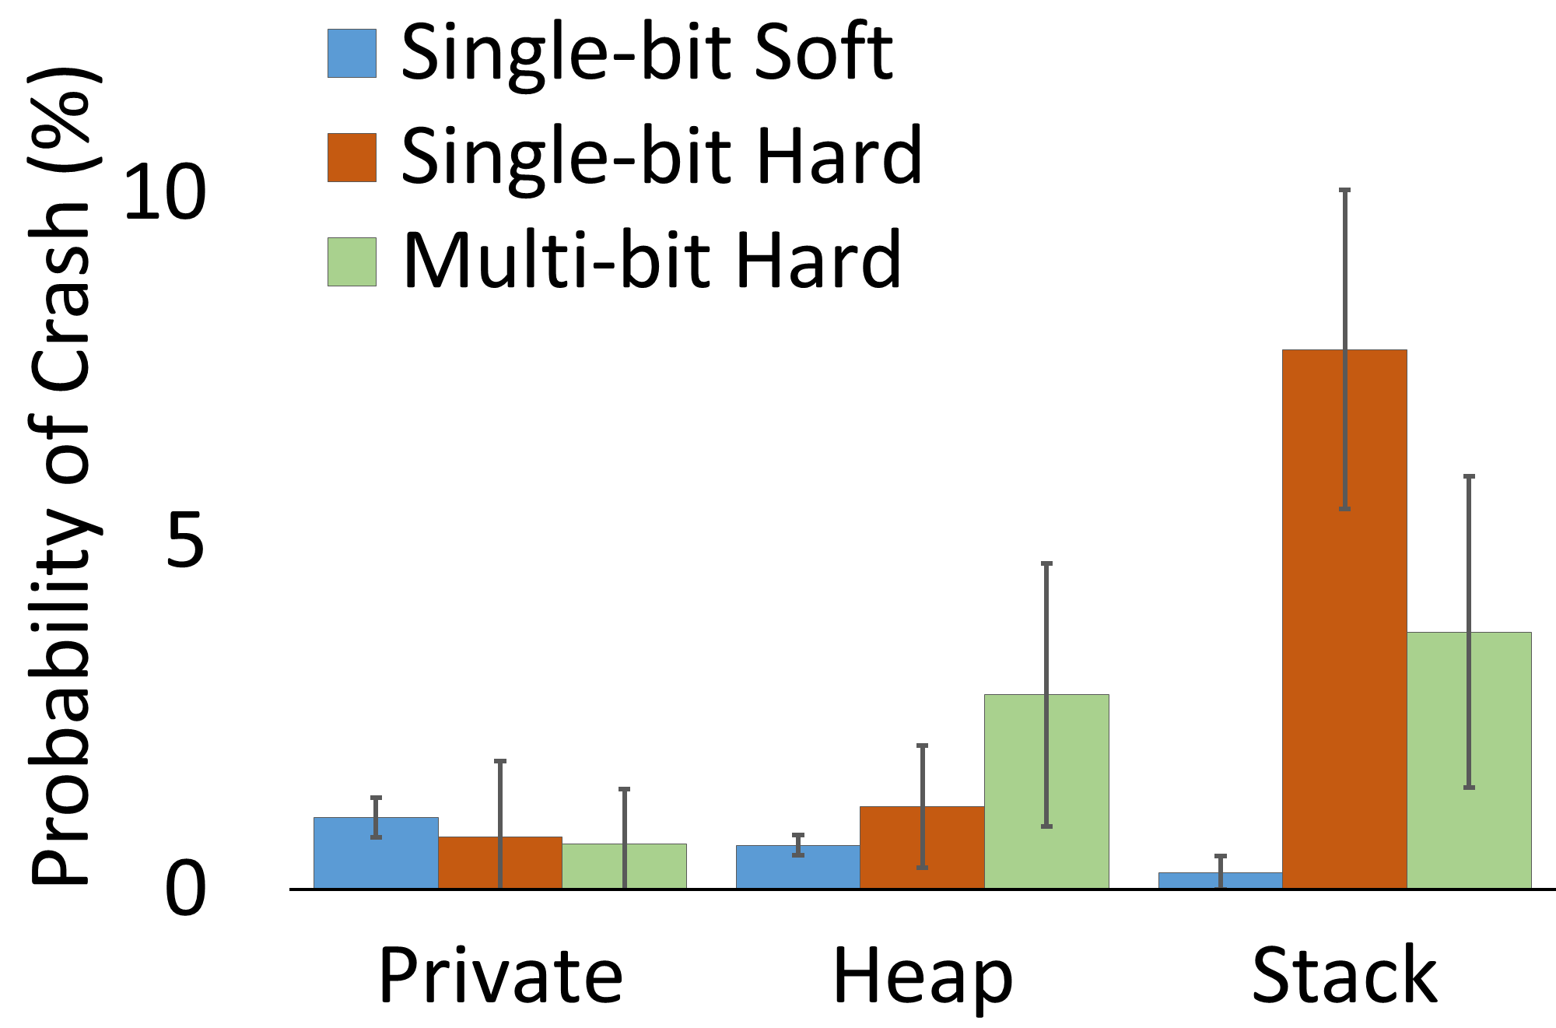
Other types of memory errors

Slide 45
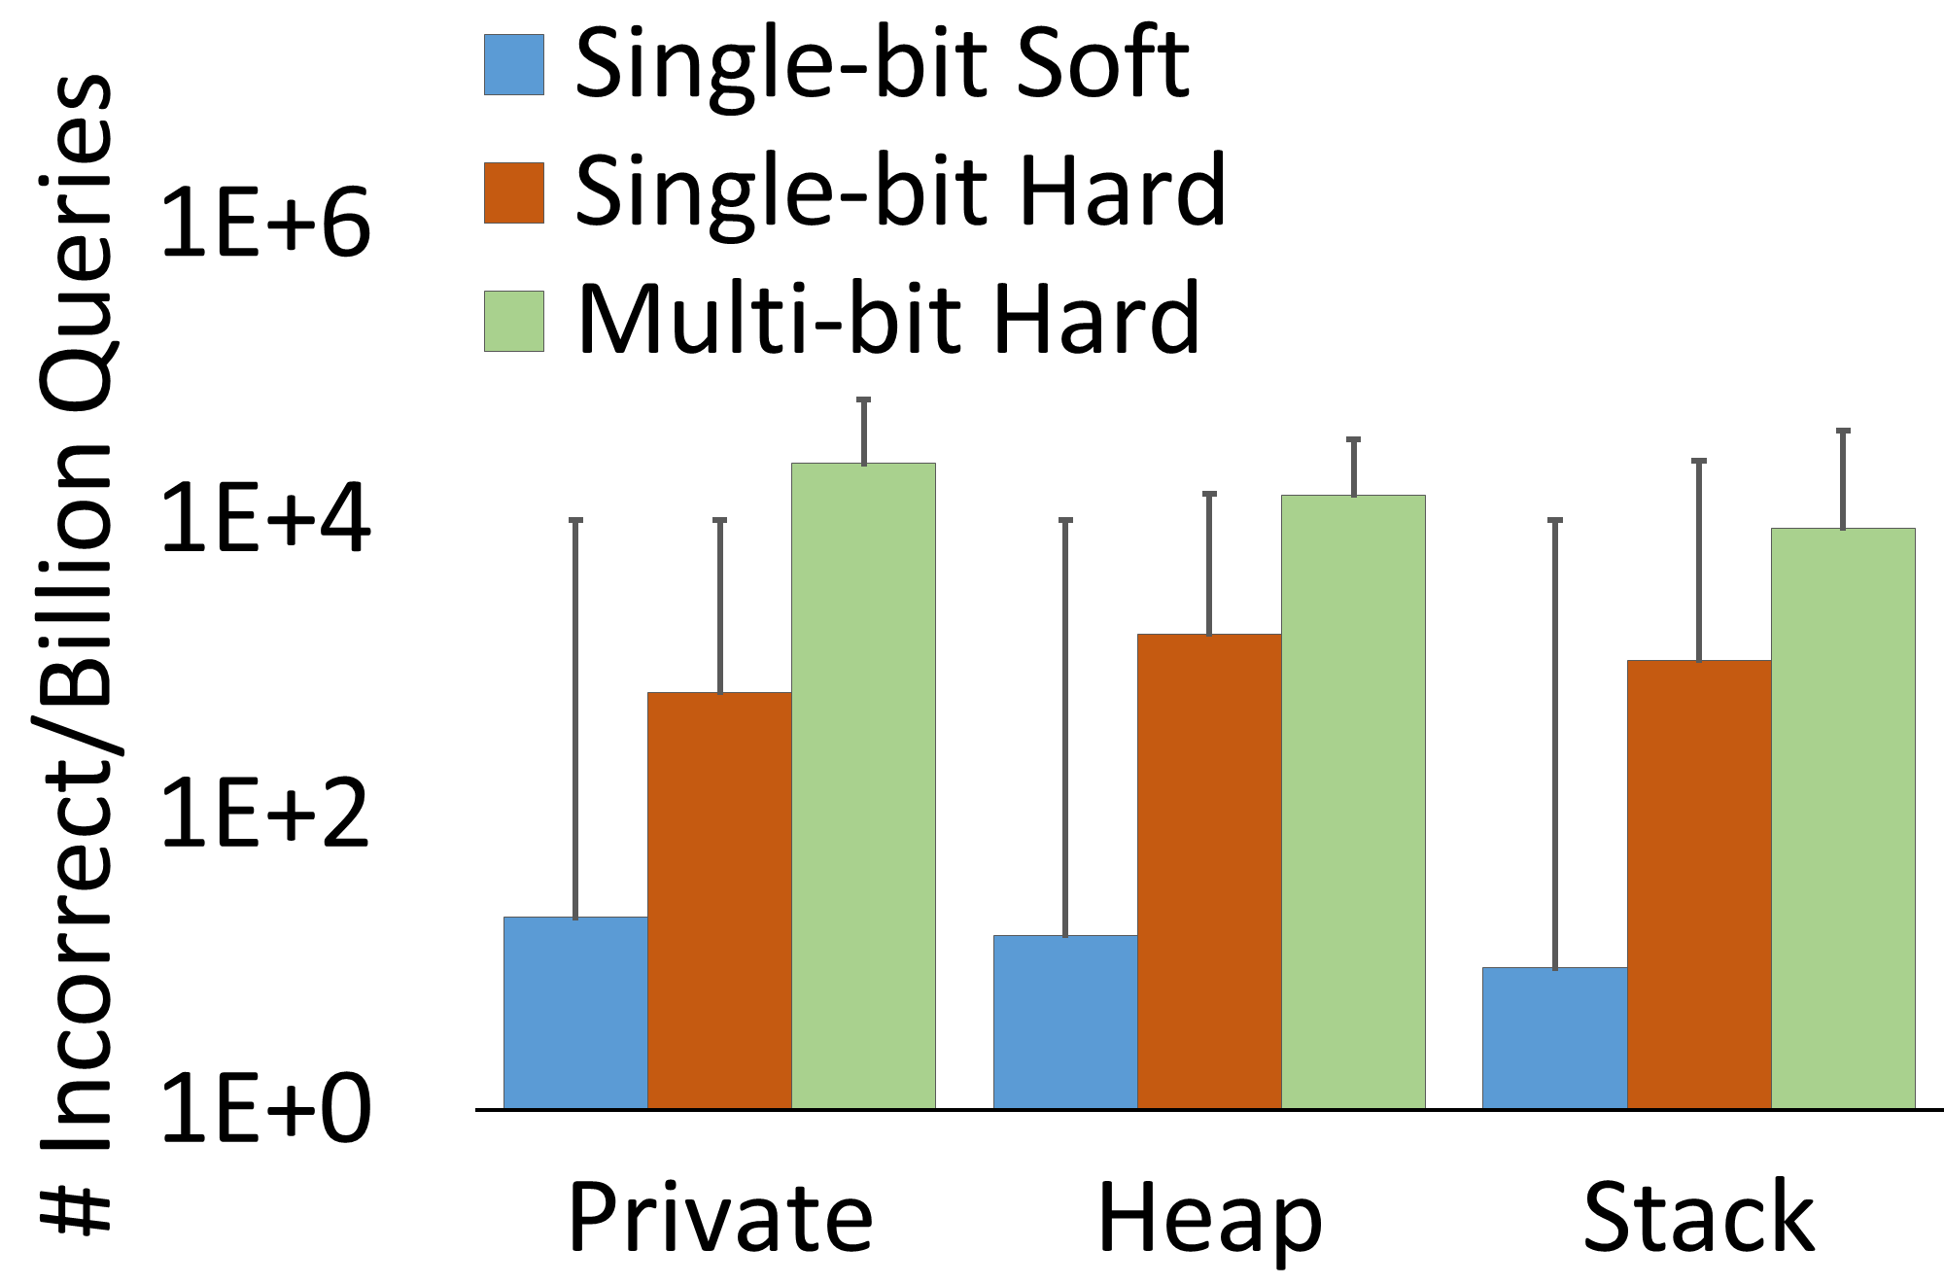
Other types of memory errors

Slide 46
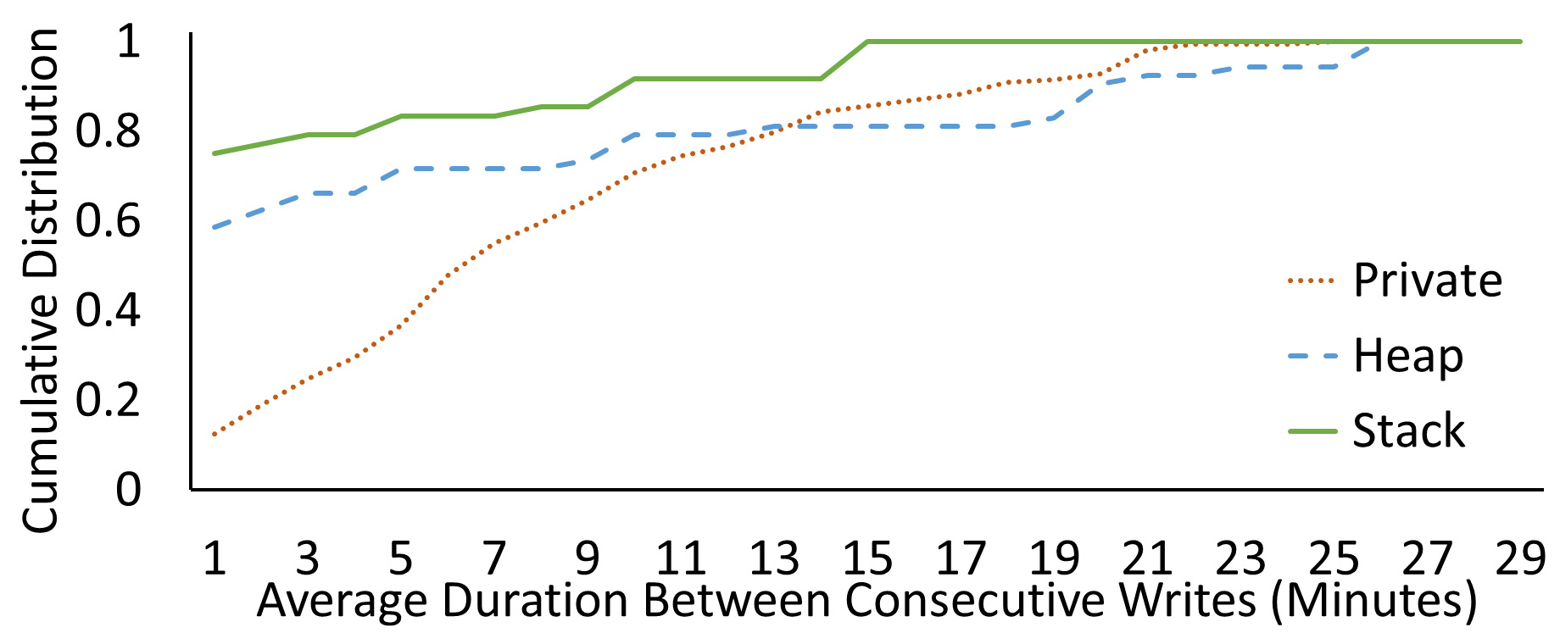
Explicit Recovery

Slide 47
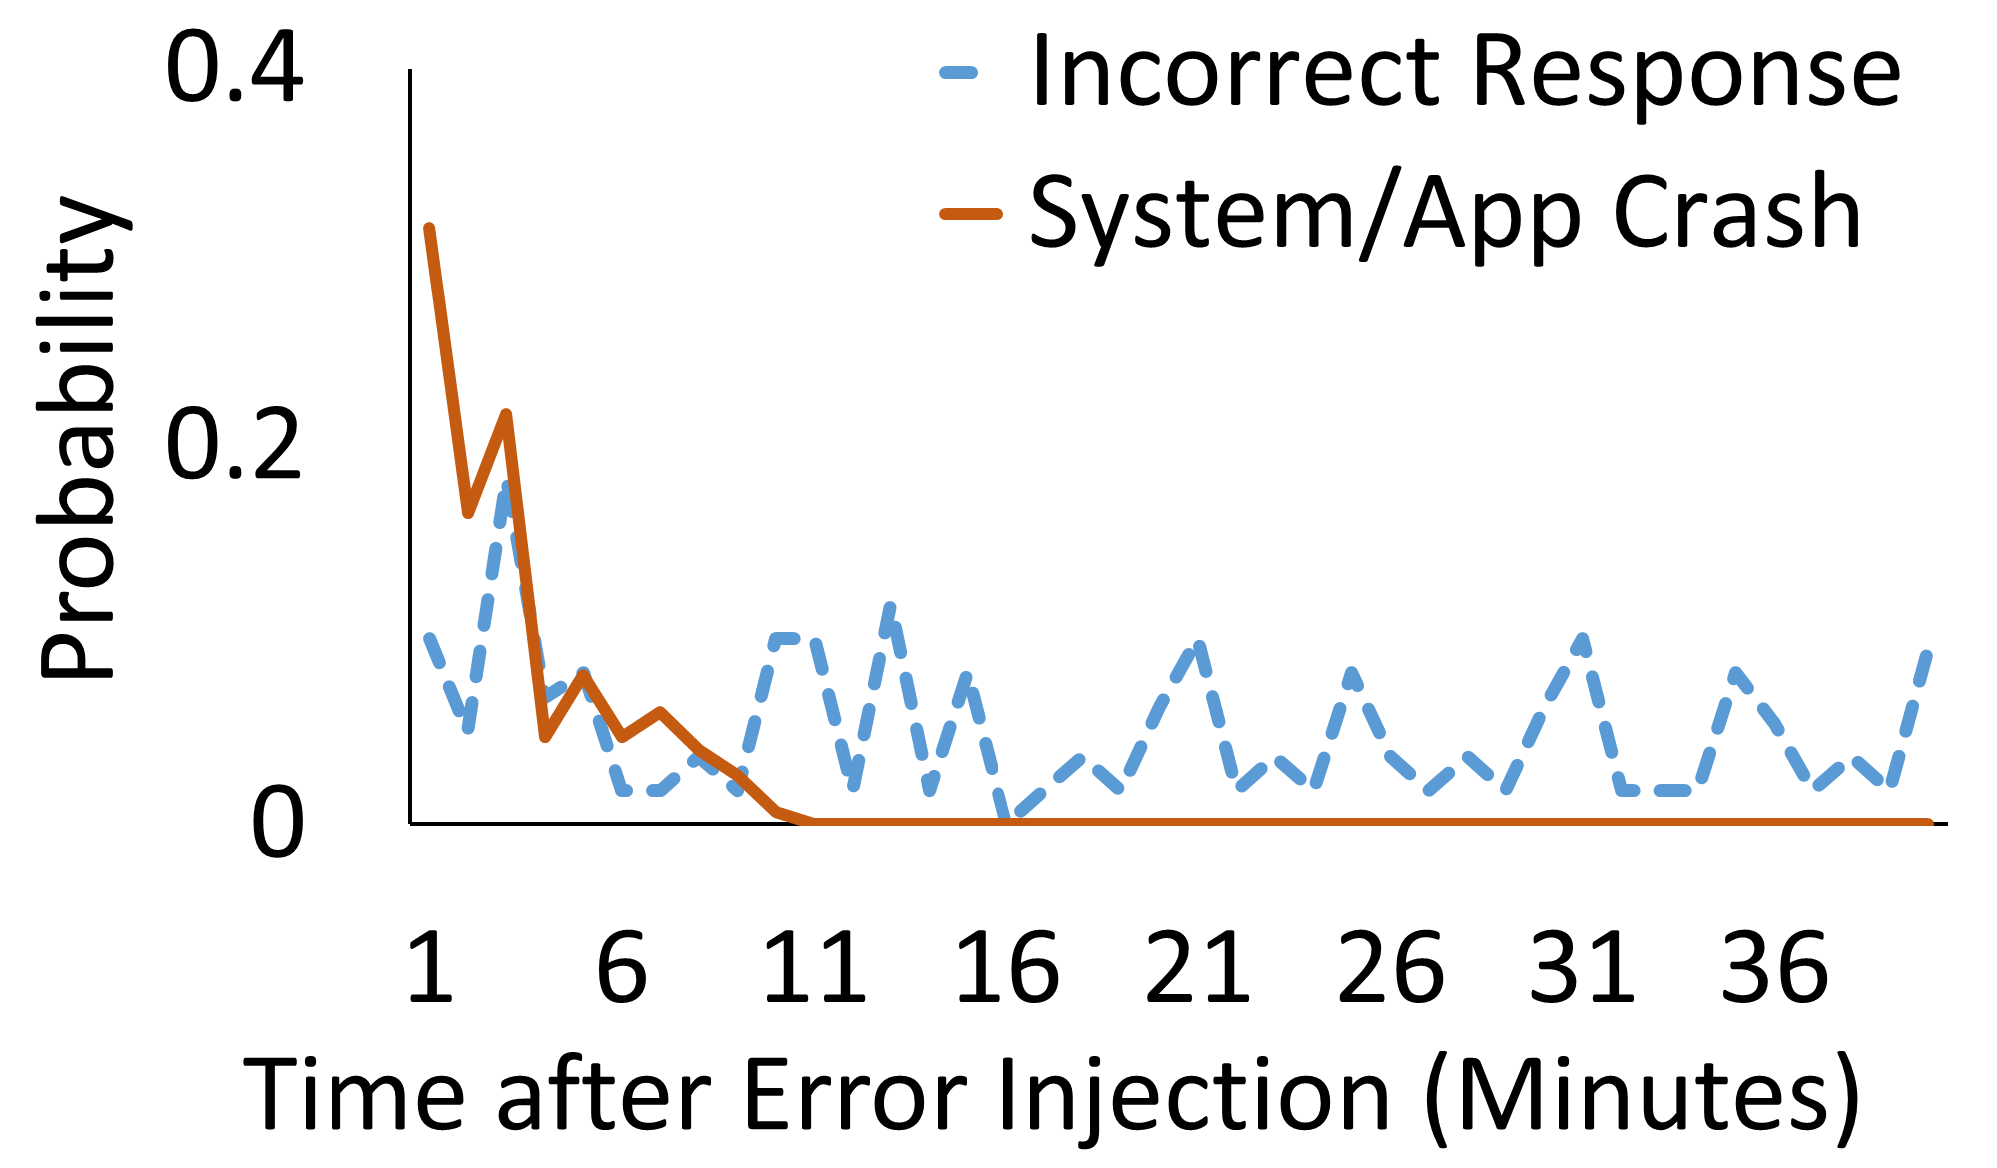
Quick to crash vs. periodic incorrect

Slide 48
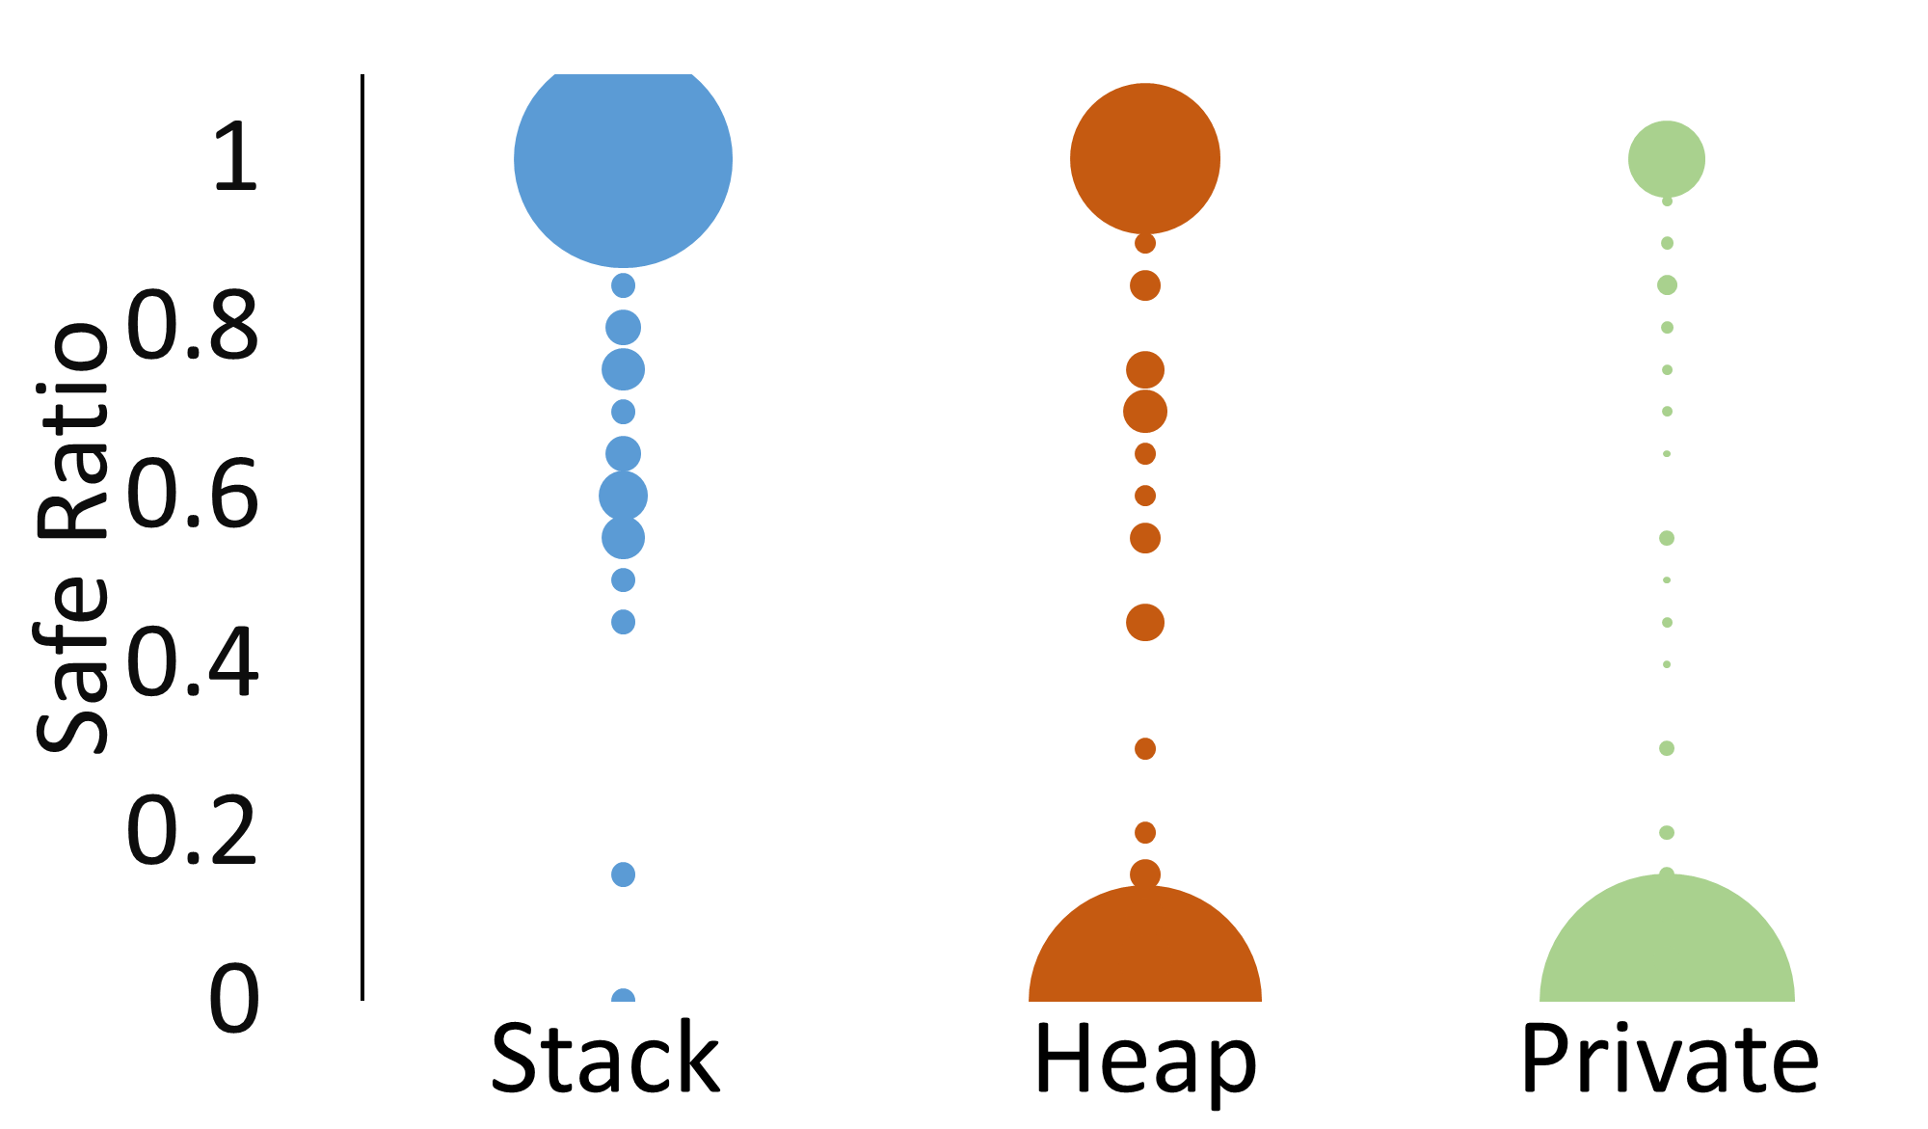
Safe ratio: masked by overwrite

Slide 49
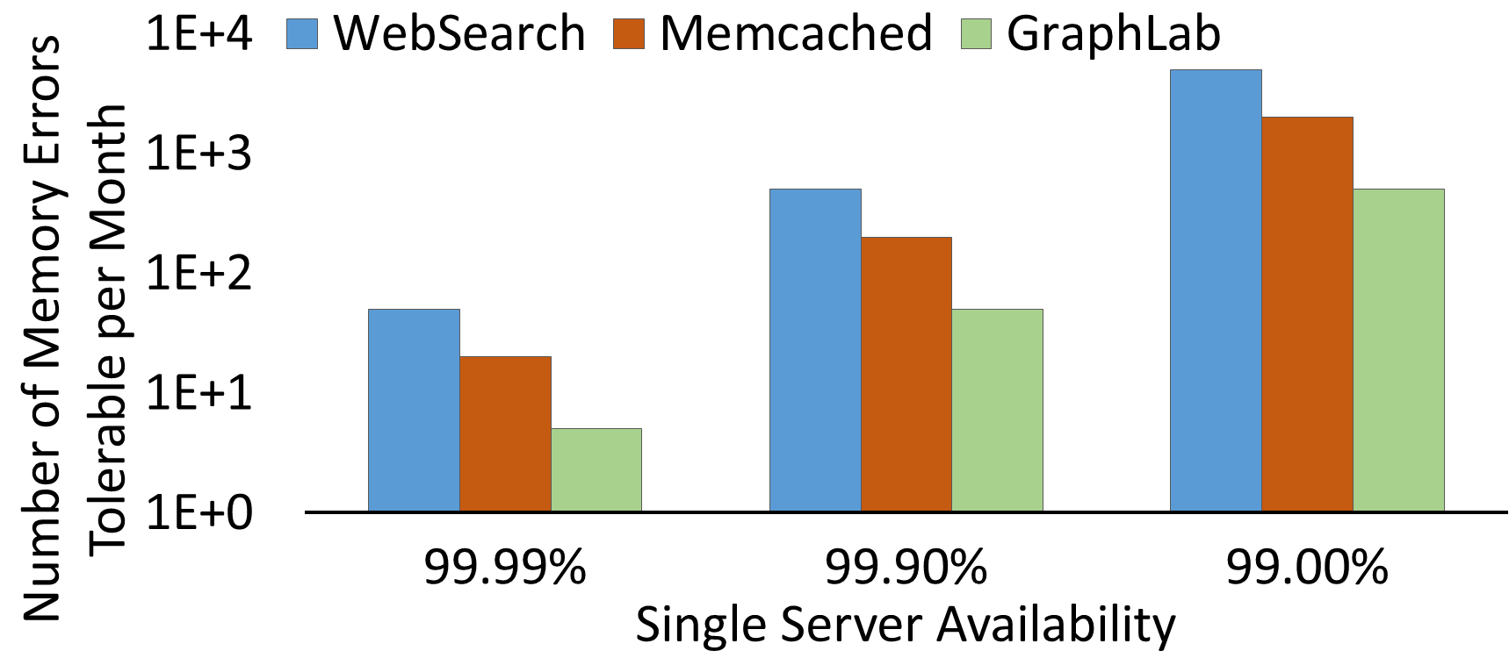
Potential to tolerate memory errors

Slide 50
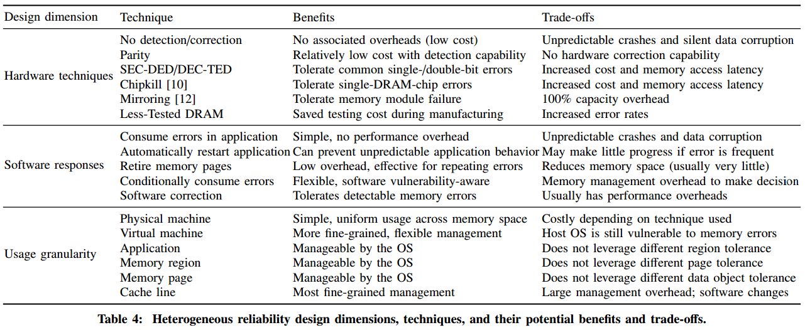
Design dimension

Slide 51
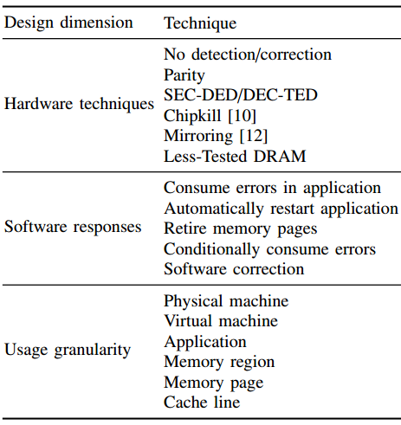
Design dimension

