Slide 1

Improving DRAM Performance, Reliability, and Security by Rigorously Understanding Intrinsic DRAM Operation
Hasan Hassan
SAFARI Live Seminar
15 September 2022
Notes:
My name is Hasan and welcome to this SAFARI Live Seminar. Today, I will talk about the work I’ve done during my PhD.

Slide 2
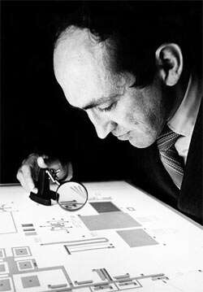
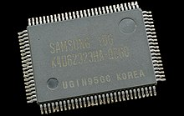
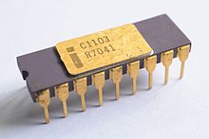
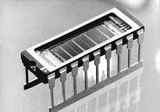
Dynamic Random Access Memory (DRAM)
Dr. Robert Dennard was granted the patent for
one-transistor DRAM cell
The first commercially available DRAM IC
The first
DDR memory prototype
The first SDRAM
Intel 1103
(1Kbit)
Samsung KM48SL2000
(16 Mbit)
Samsung DDR SDRAM
(64 Mbit)
[1968]
[1970]
[1992]
[1997]
Notes:
Let me begin with a quick introduction to DRAM and its history.
Dynamic Random Access Memory (or DRAM) has been prevalently used as the main memory in various computing systems since 1970s.
[CLICK] In 1968, Dennard was granted the patent for one-transistor DRAM cell.
[CLICK] In 1970, the first commercially available DRAM integrated circuit appeared, which had only 1 Kbit capacity.
[CLICK] In 1992, the Samsung developed the first synchronous DRAM, which had 16Mbit capacity.
[CLICK] 5 years later, the DRAM capacity increased to 64Mbit and the first DRAM chip with standardized DDR interface was developed.

Slide 3

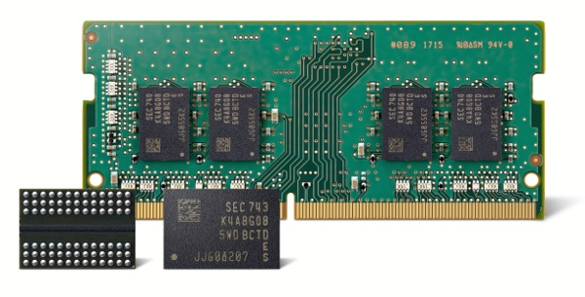






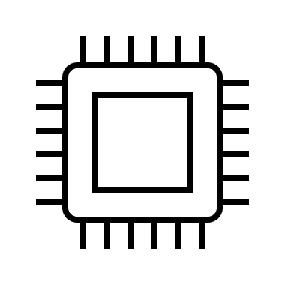


DRAM in 2022
Personal Computers
GPUs
(32Gbit)
Safety-critical systems
Servers
Mobile Devices
DRAM Scaling Challenges
Notes:
DRAM has been prevalently used as the main memory due to its low latency and low cost per bit.
Over the last two decades, DRAM chip density improved greatly due to continuous manufacturing technology node scaling.
Today, [CLICK] we have access to 32Gbit DRAM chips that power various computing systems including GPUs, personal computers, servers, safety-critical systems, and mobile devices
[CLICK] Obviously, it is desirable to increase the DRAM chip density even further for increasing the main memory capacity.
However, transitioning to smaller technology nodes exacerbates the scaling challenges of DRAM.

Slide 4







Scaling Challenges of DRAM Technology
System-Level Problems
DRAM Cell
Performance
Energy Efficiency
DRAM Scaling Problems
Data Integrity
Reliability
Security
Latency
Notes:
What are the scaling challenges of DRAM?
[CLICK] As DRAM cells become smaller and [CLICK] distances between cells reduce, [CLICK] ensuring data integrity becomes an increasingly critical problem. Often, ensuring reliable DRAM operation limits the [CLICK] minimum latency for accessing DRAM. So, typically DRAM vendors make design decisions that affect the Data Integrity vs. Latency tradeoff in DRAM.
[CLICK] Consequently, the DRAM scaling challenges affect the system performance, energy efficiency, reliability, and security.

Slide 5


Our Goals
To combat the system-level implications
of the DRAM scaling challenges:
1
Build an infrastructure for characterization, analysis, and understanding of real DRAM chips
2
Enable new mechanisms for improving DRAM performance, energy consumption, reliability, and security
Notes:
To combat the system-level implications of the DRAM scaling challenges, our goal is to:
[CLICK] First, build an infrastructure for characterization, analysis, and understanding of real DRAM chips
[CLICK] Second, enable new mechanisms for improving DRAM performance, energy efficiency, reliability, and security

Slide 6
Contributions
A flexible and easy-to-use
FPGA-based
DRAM characterization infrastructure
A new methodology for uncovering in-DRAM RowHammer Protection Mechanisms
SoftMC
U-TRR
HPCA’17
MICRO’21
Self-Managing DRAM:
Enabling autonomous and efficient in-DRAM maintenance operations
A low-cost substrate for improving DRAM performance, energy efficiency, and reliability
SMD
CROW
Ongoing
arXiv’22
ISCA’19
Notes:
We make four core contributions to address the scaling challenges of DRAM.
[CLICK] Our first contribution is SoftMC, a flexible and easy-to-use FPGA-based DRAM characterization infrastructure.
[CLICK] Our second contribution, U-TRR, develops a new methodology to uncover the inner workings of in-DRAM RowHammer protection mechanisms for studying their security properties.
[CLICK] Our third contribution is Self-Managing DRAM, a simple interface and DRAM architecture for enabling autonomous and efficient in-DRAM maintenance operations
[CLICK] And finally, our fourth contribution, CROW, is a low-cost substrate for improving DRAM performance, energy efficiency, and reliability

Slide 7
DRAM Background
DRAM Technology, Organization, and Operation
Notes:
Before going deeper into each of the four contributions, I would like to give a brief background on DRAM organization and operation

Slide 8
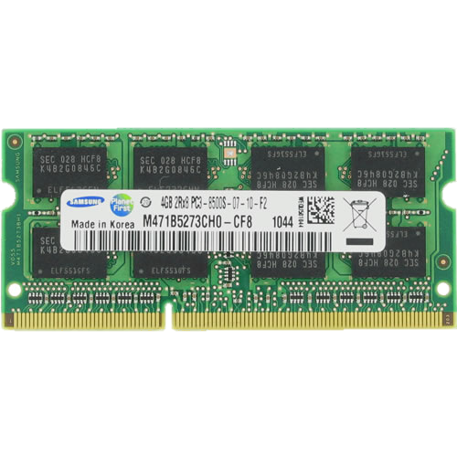
DRAM Organization
DRAM Bank
DRAM Cell
DRAM Row
Memory
Bus
CPU
Memory Controller
Sense Amplifier
Notes:
Here I show a typical system with a CPU and a DRAM module that has several DRAM chips.
Inside a DRAM chip, [CLICK] there are multiple banks, which contain many DRAM cells organized as a two-dimensional array. [CLICK] A DRAM cell stores a single bit of information as electrical charge. In a bank, [CLICK]
the cells are vertically connected to sense amplifiers, which can read the data from the cells and update it if needed. [CLICK] And cells are organized horizontally as DRAM rows.

Slide 9

DRAM Operation
DRAM Bank
Activate
Precharge
Read/Write
Sense Amplifier
Notes:
Now, lets look at DRAM commands that the memory controller issues to access the DRAM.
To perform an access, [CLICK] the memory controller first activates (or opens) a row by issuing an activate command.
[CLICK] The activate command loads row’s data into the sense amplifiers, where the data can be accessed.
[CLICK] After the row is accessed, the memory controller issues [CLICK] a precharge command to close an open row so that a new row can be activated.
This is basically how DRAM is accessed.

Slide 10

DRAM Cell
wordline
and leaky
A single bit is encoded in a small capacitor
access
transistor
capacitor
charge
leakage
paths
Stored data is corrupted
if too much charge leaks
bitline
Notes:
Each DRAM cell encodes data in fundamentally leaky capacitors. Here is a simplified diagram of a DRAM cell, where the capacitor in red stores the data and the access transistor gates access to the data
There are a number of leakage paths by which charge can enter or exit the capacitor.
[CLICK]
The important thing to note is that stored data can be corrupted if too much charge leaks

Slide 11
DRAM Refresh
Refresh Operations
Refresh Window
100%
Vmin
Capacitor voltage (Vdd)
0%
REF
time
REF
REF
Periodic refresh operations preserve stored data
Notes:
Here, we have a simplified diagram of the capacitor voltage over time
[CLICK] We see that the voltage decreases over time in an exponential decay.
There’s a threshold Vmin under which we can no longer guarantee that we will correctly read the data that was originally stored in the cell.
[CLICK]
As long as a cell’s voltage remains above this line, we consider this a retention success.
[CLICK]
However, as soon as the voltage drops below Vmin, we consider this a retention failure
In order to prevent failures from charge leakage known as retention failures, [CLICK] periodic refresh operations are issued to recharge the capacitor voltage. [CLICK] The interval between refresh commands are referred to as the refresh window.

Slide 12
Contributions
A flexible and easy-to-use
FPGA-based
DRAM characterization infrastructure
A new methodology for uncovering in-DRAM RowHammer Protection Mechanisms
SoftMC
U-TRR
HPCA’17
MICRO’21
Self-Managing DRAM:
Enabling autonomous and efficient in-DRAM maintenance operations
A low-cost substrate for improving DRAM performance, energy efficiency, and reliability
SMD
CROW
Ongoing
arXiv’22
ISCA’19
Notes:
I will first introduce our SoftMC infrastructure

Slide 13
Reliability Effects of DRAM Timing Parameters
Many of the factors affecting DRAM reliability and latency
cannot be properly modeled
DRAM
Cell
Sense Amplifier
time
Activate
Read
Precharge
Activate
Ready-to-access
Latency
Precharge
Latency
Activation Latency
SoftMC (HPCA’17)
U-TRR (MICRO’21)
SMD (Ongoing)
CROW (ISCA’19)
Notes:
Many factors that affect DRAM reliability and latency cannot be properly modeled in simulation or analytically.
One such a factor is DRAM access timings.
Here, we illustrate how the charge levels of a DRAM cell and a sense amplifier change when issuing the Activate, Read, and Precharge commands.
The memory controller normally issues these commands by respecting the corresponding timing parameters, here denoted as ready-to-access latency, activation latency, and precharge latency.
[CLICK] What would happen if the memory controller somehow violates the ready-to-access latency?
Issuing the READ command sooner will not provide enough time for the sense amplifier to raise its charge to a level that the data can be reliably access. This may result in reading incorrect data.
[CLICK] Similarly, issuing the PRECHARGE and the next ACTIVATE commands sooner than the designated timing parameters may result in bit flips.

Slide 14






Factors Affecting DRAM Reliability and Latency
DRAM timing violation
Inter-cell interference
Manufacturing process
Temperature
Voltage
We need to perform experimental studies
of real DRAM chips
SoftMC (HPCA’17)
U-TRR (MICRO’21)
SMD (Ongoing)
CROW (ISCA’19)
Notes:
Besides violating DRAM timing parameters, other factors that affect DRAM reliability and latency are:
[CLICK] inter-cell interference
[CLICK] manufacturing process variation
[CLICK] temperature
[CLICK] DRAM supply voltage, and others
[CLICK] Because many of these factors cannot be properly modeled in simulation or analytically,
We need to characterize, analyze, and understand the behavior of real DRAM chips to design, evaluate, and validate mechanisms that could improve DRAM reliability and performance.

Slide 15
Goals of a DRAM Characterization Infrastructure
Flexibility
  Ability to test any DRAM operation
  Ability to test any combination of DRAM operations and custom timing parameters
Ease of use
  Simple programming interface (C++)
  Minimal programming effort and time
  Accessible to a wide range of users
    who may lack experience in hardware design
SoftMC (HPCA’17)
U-TRR (MICRO’21)
SMD (Ongoing)
CROW (ISCA’19)
Notes:
I would like to explain the two goals that we believe a DRAM characterization infrastructure should achieve.
First, a memory testing infrastructure should be flexible so that it can support testing any DRAM operation. A testing infrastructure should enable issuing the DRAM command in any order, with adjustable and precise timing between these commands.
[CLICK]
Second, the infrastructure should be easy to use. It should have simple and intuitive programming interface that minimizes programming effort and time. It also should be accessible to wide-range of users. Even users that lack experience of hardware design should be able to perform DRAM tests.
We designed our infrastructure to achieve these goals.

Slide 16
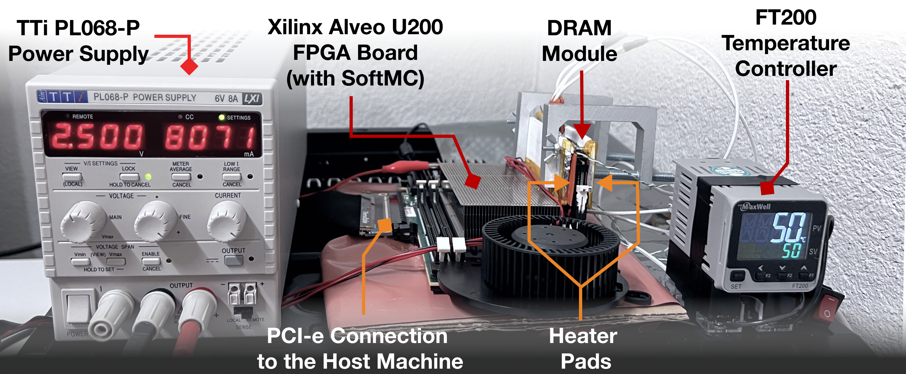
SoftMC: High-Level View
The first publicly-available FPGA-based
DRAM characterization infrastructure
Easily programmable using the SoftMC C++ API
[Yaglikci+, DSN’22]
SoftMC (HPCA’17)
U-TRR (MICRO’21)
SMD (Ongoing)
CROW (ISCA’19)
Notes:
Our infrastructure, SoftMC, [CLICK] is the first publicly available FPGA-based DRAM characterization infrastructure.
[CLICK] SoftMC is easily programmable using its C++ API
[CLICK] This photo shows an example SoftMC setups, where the FPGA runs SoftMC and has a DRAM module attached to it. The SoftMC user controls the experiments with programs that run on the host machine, connected to the FPGA via the PCIe interface. To perform temperature-controlled experiments, this setup sticks two heater pads around the DRAM modules and adjust the temperature of the DRAM chips using a temperature controller. To control DRAM supply voltage, this setup uses an external power supply unit that powers the DRAM module.

Slide 17
Key Components
SoftMC API
PCIe Driver
SoftMC Hardware
SoftMC (HPCA’17)
U-TRR (MICRO’21)
SMD (Ongoing)
CROW (ISCA’19)
Notes:
SoftMC has three key components: [CLICK] the SoftMC API, [CLICK] the PCIe Driver, [CLICK] and the SoftMC Hardware.
[CLICK] Let’s first talk about the SoftMC API

Slide 18
SoftMC API
Writing data to DRAM:
InstructionSequence iseq;
iseq.insert(genACT(bank, row));
iseq.insert(genWAIT(tRCD));
iseq.insert(genWR(bank, col, data));
iseq.insert(genWAIT(tCL + tBL + tWR));
iseq.insert(genPRE(bank));
iseq.insert(genWAIT(tRP));
iseq.insert(genEND());
iseq.execute(fpga);
Instruction generator functions
SoftMC (HPCA’17)
U-TRR (MICRO’21)
SMD (Ongoing)
CROW (ISCA’19)
Notes:
In the SoftMC API, we provide a set of C++ functions and structures that would minimize the programmer’s effort. In this presentation, I won’t go over the API in detail, instead I will demonstrate how the API is used by a simple code example. For more details, please refer to our paper or the source code.
The API provides a set of instruction generator functions. Programmers use these functions to generate instructions that tells the hardware to perform specific operations. For example, genACT generates an instruction to activate a given row from a given bank. genWAIT generates an instruction to tell the hardware to wait for the given number of cycles before executing the next instruction. We also provide functions for generating DRAM write and precharge commands. For more details, please see our paper or our source code documentation
We provide another abstraction, InstructionSequence, a data structure that’s keeps the generates instructions in order, and provides a function to easily send them to the SoftMC hardware. The programmer inserts the instructions to the InstructionSequence, and sends them to the hardware using the execute function.
So, these are the key parts of the API that we offer. Please see our paper for more details.

Slide 19
Key Components
SoftMC API
PCIe Driver
SoftMC Hardware
SoftMC (HPCA’17)
U-TRR (MICRO’21)
SMD (Ongoing)
CROW (ISCA’19)
Notes:
The PCIe driver manages the data transfer between the Host Machine and the FPGA.
[CLICK] Let’s discuss the SoftMC Hardware in more detail.

Slide 20
SoftMC Hardware
Read
Activate
Wait (Ready-to-access Latency)
Instruction Receiver
DDR PHY
Instructions
DRAM
Instruction Dispatcher
Instruction Queue
PCIe Controller
Auto-refresh Controller
Calibration Controller
Host
Machine
Read Capture
Data
SoftMC Hardware (FPGA)
SoftMC (HPCA’17)
U-TRR (MICRO’21)
SMD (Ongoing)
CROW (ISCA’19)
Notes:
This slide depicts the host machine, the DRAM module, and the FPGA that implements the SoftMC hardware.
I would like to show how the hardware operates by an example.
On the host machine, using the SoftMC API that I presented in the previous slide, the programmer generates a set of SoftMC instructions. Then the driver sends these instructions over the PCIe bus to the SoftMC hardware. In the SoftMC hardware, the instructions are buffered in the Instruction Queue. After receiving the entire Instruction Sequence, the Instruction Dispatcher fetches instructions from the queue and executes them.
Let’s assume the first one is an activate instructions, using which we will open a row from the DRAM. For that instruction, the dispatcher creates a corresponding DRAM command, which the DDR PHY unit sends to the DRAM module via the DDR bus. The dispatcher fetches the next instruction. It is a wait instructions that only tells the dispatcher to not fetch any instructions for the next couple of cycles. So this instruction doesn’t send anything to the DRAM. Last, the dispatcher executes a READ instruction, for which a DDR command is sent to the DRAM. In return, the DRAM module sends data back to the DDR PHY. DDR PHY forwards the data to the Read Capture module, which forwards the data further to the Host Machine. This was a demonstration of how the hardware operate in case of reading data from DRAM.
We also have Auto-refresh controller, which the user can set to automatically refresh the DRAM and Calibration Controller which performs task to ensure data integrity of the DDR bus.
That was in high-level a demonstration of our SoftMC design. For more details, please check our paper.

Slide 21
Use Cases
1
Retention Time Distribution Study
2
Evaluating the Effectiveness of
New DRAM Latency Reduction Techniques
SoftMC (HPCA’17)
U-TRR (MICRO’21)
SMD (Ongoing)
CROW (ISCA’19)
Notes:
Using SoftMC, we implement two use cases.
First, we perform a retention time distribution study, in order to validate the correctness of our infrastructure.
[CLICK] Second, we evaluate two recently proposed latency reduction mechanisms and show the effectiveness of SoftMC in validating or refuting recently proposed ideas
Let me describe these two use cases in more detail.

Slide 22
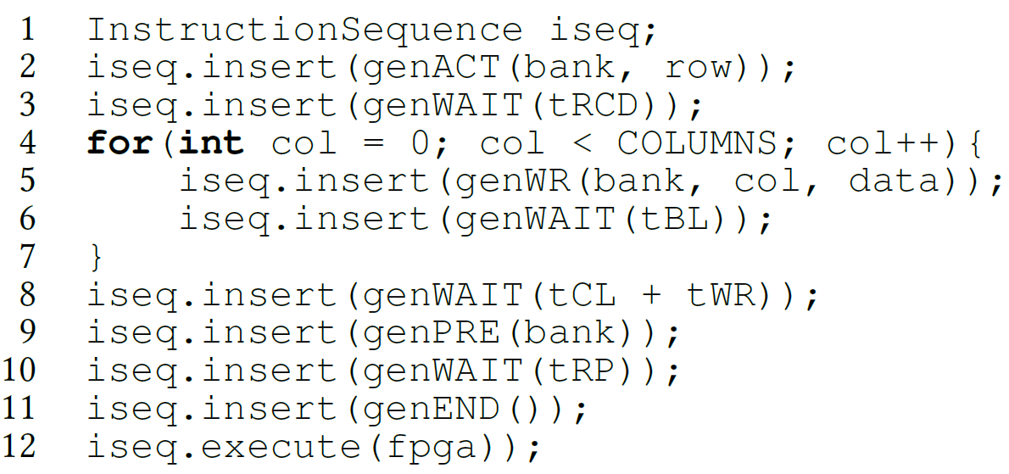
Use Case 1: Retention Time Distribution Study
Write Reference Data to a Row
Wait
(Refresh Interval)
Read Back
Observe Errors
Increase the refresh interval
Can be implemented with just ~100 lines of C++ code
SoftMC (HPCA’17)
U-TRR (MICRO’21)
SMD (Ongoing)
CROW (ISCA’19)
Notes:
Retention Time of a DRAM cell is defined as the interval during which the cell can correctly store the data.
In this test, we experimentally analyze the retention time distribution in three DRAM modules from three different vendors.
Now I will show you how we perform that test using SoftMC. First, we write data reference data pattern to a DRAM row. Then, we wait for some time, which in fact specifies the refresh interval. After that refresh interval, we read the data back from the row, and check it if it still stores the reference data that we previously wrote. Then we repeat the test by increasing the refresh interval. We perform the test on every row in the DRAM module. This entire test could be implemented with about 100 lines of code using SoftMC API.
Now let me show you the results that we obtained from that experiment.

Slide 23
Use Case 1: Results
@ ~20⁰C (room temperature)
Module A
Module B
Module C
Validates the correctness of
the SoftMC Infrastructure
SoftMC (HPCA’17)
U-TRR (MICRO’21)
SMD (Ongoing)
CROW (ISCA’19)
Notes:
Our results match the retention time results reported by prior work. This study validates the correctness of our testing infrastructure.

Slide 24
Use Case 2: Accessing Highly-Charged Cells Faster
NUAT
^{(Shin+, HPCA 2014)}
ChargeCache
^{(Hassan+, HPCA 2016)}
A highly-charged cell can be accessed with low latency
SoftMC (HPCA’17)
U-TRR (MICRO’21)
SMD (Ongoing)
CROW (ISCA’19)
Notes:
Two mechanisms, ChargeCache and Non Uniform Access Time Memory Controller (NUAT) exploit the same key observation to reduce DRAM access latency.
A Highly-charged DRAM cell can be accessed faster, with lower latency. ChargeCache combines this observation with that recently-accessed DRAM cells are in highly-charged state. This is because, when we access a cell, it gets restored as I showed in the first slides. On the other hand, NUAT is based on the observation that recently-refreshed DRAM cells have high amount of charge.
Let me show in the next slide what I mean by highly-charged cell and why it can be accessed with low latency.

Slide 25
Use Case 2: How a Highly-Charged Cell Is Accessed Faster?
0 (refresh)
64 ms
DRAM
Cell
Sense Amplifier
time
Activate
Read
Precharge
Activate
Ready-to-access
Latency
Precharge
Latency
Activation Latency
SoftMC (HPCA’17)
U-TRR (MICRO’21)
SMD (Ongoing)
CROW (ISCA’19)
Notes:
Recall that prior to activate, the DRAM cell is leaking its charge. The two studies we evaluate observe that if the activate is issued when the DRAM cell is highly-charged, which means it is accessed just after the refresh, the access latency can be reduced. Specifically, their mechanisms can reduce Ready to access latency and Activation Latency. Note that, current memory controllers do not have a notion of charge available in the cells and hence they cannot exploit this observation. Their mechanisms extend the memory controller with such ability.
Although we perform separate experiment using SoftMC, to measure the headroom for reduction on these latencies,
In this talk I will only explain the experiment we performed for ready to access latency. I would be happy to discuss our other experiment offline.

Slide 26
Use Case 2: Ready-to-Access Latency Test
Longer wait
Lower cell charge
Shorter wait
Higher cell charge
Write Reference Data
Wait for the
Wait Interval
Read Back
Observe Errors
Change
the Wait Interval
With custom ready-to-access latency parameter
Can be implemented with just ~150 lines of C++ code
SoftMC (HPCA’17)
U-TRR (MICRO’21)
SMD (Ongoing)
CROW (ISCA’19)
Notes:
Here is our methodology for the ready to access latency test.
We start the test similar to retention time distribution study, by writing a reference data. Next, we wait for some time interval. We use this interval to adjust the charge amount stored in the cell. If we wait longer, the cell will leak more charge, and at the end the cell will contain lower charge. If we wait shorter, the cell will contain higher charge.
Next, the read back data from the same location in DRAM that we wrote the reference data to. We perform this read with low ready-to-access latency. Which means, after issuing the activate command, we wait less prior to issuing the read command. Then we compare the data we read with the reference data, and we count the number of errors. We repeat the test through the entire DRAM with different wait intervals.

Slide 27
Use Case 2: Results
Expected Curves
Real Curves
@ 80⁰C temperature
We do not observe the expected latency reduction effect in existing DRAM chips
SoftMC (HPCA’17)
U-TRR (MICRO’21)
SMD (Ongoing)
CROW (ISCA’19)
Notes:
First, I would like to show you what the results should look like based on the idea that highly-charged cells can be accessed faster.
In the x-axis of the figure, we have the wait interval, which you can think as the charge amount of the cell. Going to the left the cell has more charge, going to the right the cell has less charge. On the y-axis we have the number of bytes with at least one bit-flip. The lines represent the number of errors for different ready-to-access latencies, from 6 cycles to just 3 cycles.
If we look at this point, we can see that when a cell has leaked significant portion of its charge, the correct data can be read from the DRAM cell using default ready-to-access latency, which is 6. But, the data cannot be read correctly with low latency. On the other hand, when the cell contains higher amount of charge, it can be accessed correctly also with low latency without any errors.
OK, lets look at our results that we obtained by testing real DRAM chips.
As you see, there is not a considerable distinction among the curves for 6, 5, and 4 cycles of latency, which conflicts with our expectation.
With 3 cycles latency, we have error even when working with very small wait interval. We believe that is because with such a low latency, some of the cells cannot correctly operate regardless of their charge amount.
Based on our experiments using SoftMC, we do not observe the expected latency reduction effect in existing DRAM chips.

Slide 28
Use Case 2: Why Don’t We See the Latency Reduction Effect?
The memory controller cannot externally control when a sense amplifier gets enabled in existing DRAM chips
Ready to Access
Ready to Access
Charge Level
Cell
Data 1
charge
Potential Reduction
Enabling the Sense Amplifier
Sense Amp
Data 0
Fixed Latency!
time
ACT
R/W
SoftMC (HPCA’17)
U-TRR (MICRO’21)
SMD (Ongoing)
CROW (ISCA’19)
Notes:
But, what is the reason behind that? Why don’t we see the latency reduction effect?
Based on our discussion with DRAM manufacturers, we found out that there is a critical timing parameter which cannot be externally controlled my the memory controller. This is the interval between the Activate command, until the sense amplifier gets enabled. Let me explain that with the following example.
Initially, the cell has charge in region of Data 1. With the activate command, the cell shared a portion of its charge with the wire connected to the sense amplifier. This sharing continues until the sense amplifier gets enabled and starts charging the cell back to fully charged state. This time, from the issuing of activate command to the enabling of the sense amplifier is fixed in the DRAM circuit. When the sense amplifier is enabled it brings the cell to highly charged state. And at the time where the cell reaches ready to access charge level, the memory controller can issue the read or write command. And the entire latency from ACT to Read or Write is ready-to-access-latency as I explained in the start of my talk.
Let’s see what happens when we start with initially fully charged cell. Since, the latency to enable the sense amplifier is fixed, after charge sharing, the cell charge reaches almost the same point, and we do not get any room for reduction of ready-to-access latency. However, if we look at the point where the charge sharing gets to the point where the blue line reaches just before enabling the sense amplifier, we see that we have a significant potential for latency reduction.
Using SoftMC, we show that the expected latency reduction effect is not observable in existing DRAM chips.

Slide 29
Research Enabled by SoftMC (from SAFARI)
[MICRO’22, to appear] Yaglikci+, “HIRA: Hidden Row Activation for Reducing Refresh Latency of Off-the-Shelf DRAM Chips”
[DSN’22] Yaglikci+, “Understanding RowHammer Under Reduced Wordline Voltage: An Experimental Study Using Real DRAM Devices”
[MICRO’21] Orosa+, “A Deeper Look into RowHammer’s Sensitivities: Experimental Analysis of Real DRAM Chips and Implications on Future Attacks and Defenses”
[MICRO’21] Hassan+, “Uncovering In-DRAM RowHammer Protection Mechanisms: A New Methodology, Custom RowHammer Patterns, and Implications”
[ISCA’21] Olgun+, “QUAC-TRNG: High-Throughput True Random Number Generation Using Quadruple Row Activation in Commodity DRAM Chips”
[ISCA’21] Orosa+, “CODIC: A Low-Cost Substrate for Enabling Custom In-DRAM Functionalities and Optimizations”
[ISCA’20] Kim+, “Revisiting RowHammer: An Experimental Analysis of Modern Devices and Mitigation Techniques”
[S&P’20] Frigo+, “TRRespass: Exploiting the Many Sides of Target Row Refresh”
[HPCA’19] Kim+, “D-RaNGe: Using Commodity DRAM Devices to Generate True Random Numbers with Low Latency and High Throughput”
[MICRO’19] Koppula+, “EDEN: Enabling Energy-Efficient, High-Performance Deep Neural Network Inference Using Approximate DRAM”
[SIGMETRICS’18] Ghose+, “What Your DRAM Power Models Are Not Telling You: Lessons from a Detailed Experimental Study”
[SIGMETRICS’17] Chang+, “Understanding Reduced-Voltage Operation in Modern DRAM Devices: Experimental Characterization, Analysis, and Mechanisms”
[MICRO’17] Khan+, “Detecting and Mitigating Data-Dependent DRAM Failures by Exploiting Current Memory Content”
[SIGMETRICS’16] Chang+, “Understanding Latency Variation in Modern DRAM Chips: Experimental Characterization, Analysis, and Optimization”
SoftMC (HPCA’17)
U-TRR (MICRO’21)
SMD (Ongoing)
CROW (ISCA’19)
Notes:
Let me quickly show the research that SoftMC has enabled since its release.
[CLICK] this slide shows publications, which use different versions of SoftMC, from our SAFARI research group.
[CLICK] I would like to specifically mention TRRespass because it is related to our second contribution. In TRRespass, my colleagues and I show, for the first time, how to bypass RowHammer Protection mechanisms implemented in current DRAM chips.

Slide 30
Research Enabled by SoftMC (others)
[Applied Sciences’22] Bepary+, “DRAM Retention Behavior with Accelerated Aging in Commercial Chips”
[ETS’21] Farmani+, “RHAT: Efficient RowHammer-Aware Test for Modern DRAM Modules”
[HOST’20] Talukder+, “Towards the Avoidance of Counterfeit Memory: Identifying the DRAM Origin”
[MICRO’19] Gao+, “ComputeDRAM: In-Memory Compute Using Off-the-Shelf DRAMs”
[IEEE Access’19] Talukder+, “PreLatPUF: Exploiting DRAM Latency Variations for Generating Robust Device Signatures”
[ICCE’18] Talukder+, “Exploiting DRAM Latency Variations for Generating True Random Numbers”
SoftMC (HPCA’17)
U-TRR (MICRO’21)
SMD (Ongoing)
CROW (ISCA’19)
Notes:
SoftMC has also contributed to research from other research groups.

Slide 31

Summary
SoftMC
The first publicly-available DRAM characterization infrastructure
Flexible and Easy to Use
Source code available on GitHub:
github.com/CMU-SAFARI/SoftMC
[Yaglikci+, DSN’22]
SoftMC enables many studies, ideas, and methodologies in the design of future memory systems
SoftMC (HPCA’17)
U-TRR (MICRO’21)
SMD (Ongoing)
CROW (ISCA’19)
Notes:
[CLICK] In summary, SoftMC is the first publicly-available DRAM characterization infrastructure
[CLICK] It is flexible and easy to use
[CLICK] The source code of SoftMC is available on GitHub
[CLICK] SoftMC enables many new studies, ideas, and methodologies in the design of future memory systems

Slide 32
Contributions
A flexible and easy-to-use
FPGA-based
DRAM characterization infrastructure
A new methodology for uncovering in-DRAM RowHammer Protection Mechanisms
SoftMC
U-TRR
HPCA’17
MICRO’21
Self-Managing DRAM:
Enabling autonomous and efficient in-DRAM maintenance operations
A low-cost substrate for improving DRAM performance, energy efficiency, and reliability
SMD
CROW
Ongoing
arXiv’22
ISCA’19
Notes:
We will now discuss our second contribution, U-TRR

Slide 33
RowHammer
DRAM Chip
Row 0
Row 0
Victim Row
Row 1
Row 1
Row 1
Victim Row
Row 2
Row 2
Row 2
Row 2
Row 2
Row 2
closed
open
open
Aggressor Row
closed
open
Row 3
Row 3
Row 3
Victim Row
Row 4
Row 4
Victim Row
Repeatedly opening (activating) and closing (precharging)
a DRAM row causes RowHammer bit flips in nearby cells
SoftMC (HPCA’17)
U-TRR (MICRO’21)
SMD (Ongoing)
CROW (ISCA’19)
Notes:
In order to access data from a DRAM row, say row 2, the memory controller must first open or activate the row [CLICK].
After all requests are serviced from row 2, the memory controller must close or precharge the row [CLICK] in order to begin accessing data from another row.
[CLICK] Due to an increase in cell-to-cell interference as a likely result of increased cell packing density, [CLICK] rapidly activating and [CLICK] precharging a DRAM row can result in bit flips in nearby rows [CLICK]
[CLICK] Continuing to access the same row results in even more failures in nearby rows [CLICK]. This phenomenon is known as RowHammer. [CLICK]
We refer to the rapidly accessed row as an aggressor row and the rows containing bit flips as victim rows.

Slide 34


Target Row Refresh (TRR)
DRAM vendors equip their DRAM chips with a proprietary
mitigation mechanisms known as Target Row Refresh (TRR)
Key Idea: TRR refreshes nearby rows upon detecting an aggressor row
TRR-equipped DRAM Chip
Memory
Controller
REF
Row 0
TRR
Row 1
open
closed
Row 2
Row 3
Aggressor detected: Row 2
Row 4
Refresh neighbor rows
TRR-induced refreshes
SoftMC (HPCA’17)
U-TRR (MICRO’21)
SMD (Ongoing)
CROW (ISCA’19)
Notes:
To protect their DRAM chips against RowHammer, DRAM vendors currently implement proprietary RowHammer mitigation mechanisms typically called Target Row Refresh or (TRR)
[CLICK] The key idea of TRR is to refresh nearby rows upon detecting an aggressor row
[CLICK] We demonstrate how TRR operates at a high-level.
[CLICK] The TRR mechanism detects [CLICK] an aggressor row as a result of [CLICK] repeatedly activating and precharging the same row. [CLICK]
[CLICK] To protect the neighbor victim rows from experiencing RowHammer bit flips, [CLICK] TRR refreshes the victim rows by performing TRR-induced refresh operations. TRR refreshes victim rows by piggybacking TRR-induced refreshes to the REFRESH commands that the memory controller periodically issues.

Slide 35
The Problem with TRR
TRR is obscure, undocumented, and proprietary
We cannot easily study the security properties of TRR
SoftMC (HPCA’17)
U-TRR (MICRO’21)
SMD (Ongoing)
CROW (ISCA’19)
Notes:
Although this is how TRR operates at a high level, different vendors implement TRR differently and the exact operation of these TRR mechanisms is unknown. [CLICK] Therefore, TRR is obscure, undocumented, and proprietary
[CLICK] Because of this, today, we cannot easily study the security properties of TRR and make sure it is fully secure

Slide 36
Goal
Study in-DRAM TRR mechanisms to
1
understand how they operate
2
assess their security
3
secure DRAM completely against RowHammer
SoftMC (HPCA’17)
U-TRR (MICRO’21)
SMD (Ongoing)
CROW (ISCA’19)
Notes:
Our goal is to study in-DRAM TRR mechanisms to [CLICK] understand how they operate, [CLICK] asses their security, [CLICK] and secure DRAM completely against RowHammer

Slide 37
U-TRR: Uncovering Inner Workings of TRR
A new methodology to
uncover the inner workings of TRR
Key Idea:
Use data retention failures as a side channel
to detect when a row is refreshed by TRR
SoftMC (HPCA’17)
U-TRR (MICRO’21)
SMD (Ongoing)
CROW (ISCA’19)
Notes:
We propose U-TRR, a new methodology to uncover the inner workings of TRR.
[CLICK] The key idea of U-TRR is to use data retention failures in DRAM as a side channel to detect when a certain row is refreshed by TRR

Slide 38
U-TRR: High-Level Overview
U-TRR has two main components
Row Scout (RS)
Finds a set of DRAM rows that meet certain requirements as needed by TRR-A and identifies the data retention times of these rows
TRR Analyzer (TRR-A)
Uses RS-provided rows to distinguish between TRR-induced and regular refreshes,
and thus builds an understanding of the underlying TRR mechanism
SoftMC (HPCA’17)
U-TRR (MICRO’21)
SMD (Ongoing)
CROW (ISCA’19)
Notes:
U-TRR consists of two main components: Row Scout and TRR Analyzer.
[CLICK] Row Scout finds a set of DRAM rows that meet certain requirements [CLICK], as needed by TRR Analyzer, and identifies [CLICK] the data retention times of these rows
[CLICK] TRR Analyzer uses the rows that Row Scout provides [CLICK] to distinguish between TRR-induced and regular refreshes, and [CLICK] thus builds an understanding of the underlying TRR mechanism

Slide 39


High-Level U-TRR Experiment
data
initialization
issuing a REF command
Retention Failure
Row 0
refresh
Retention Success
5x ACT
Retention Failure
Row 1
100x ACT
Retention Success
refresh
Retention Failure
Row 2
0
T/2
T
We perform many experiments to understand
the operation of different TRR mechanisms
SoftMC (HPCA’17)
U-TRR (MICRO’21)
SMD (Ongoing)
CROW (ISCA’19)
Notes:
I will explain the high-level operation of U-TRR with an example experiment.
Initially, U-TRR identifies a set of DRAM rows that have similar retention times. Let’s assume the retention times of rows 0, 1, 2 are T. In the diagram, we represent the weakest cell in each row with circles.
[CLICK] At time 0, U-TRR initializes the rows with let’s say ones. If the three rows remain closed for T, [CLICK] we expect the weakest cells to lose a significant portion of their charge, as a result we observe retention failures at time T.
[CLICK] However, if any of the rows get refreshed, for example when we issue a REF command at time T/2, the refreshed row should contain correct data at time T.
To test when the TRR mechanisms selects which rows to refresh, we perform multiple experiments where we change the number of times an aggressor row is hammered.
For example, [CLICK] activating row 1 five times may not make the TRR mechanism refresh any of the neighbors.
However, [CLICK] activating row 1 hundred times may trigger neighbor row refreshes. And we can observe this from the retention success on both row 0 and row 2 at time T.
[CLICK] Because different TRR mechanisms operate differently, we need to perform many such experiments to understand how they detect an aggressor row and when they refresh the victim rows.

Slide 40
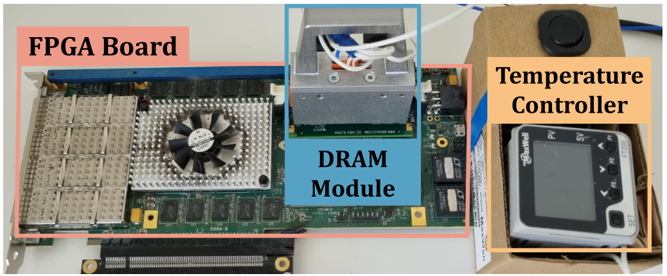
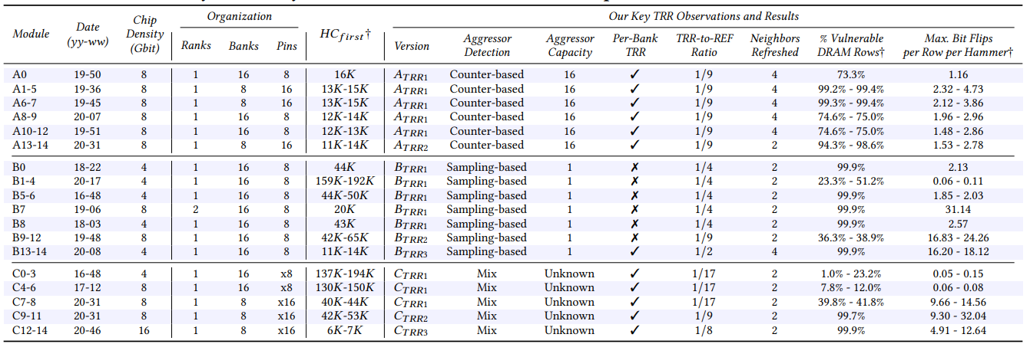




U-TRR: Implementation
We implement U-TRR using SoftMC, modified to support DDR4 DRAM
SoftMC provides fine-grained control over DRAM commands,
timing parameters and temperature
15x Vendor A
DDR4 modules
We analyze 45 DDR4 DRAM modules
from three vendors
15x Vendor B
DDR4 modules
Table 1 in the paper provides more information about the analyzed modules
15x Vendor C
DDR4 modules
SoftMC (HPCA’17)
U-TRR (MICRO’21)
SMD (Ongoing)
CROW (ISCA’19)
Notes:
To implement U-TRR and conduct the DRAM experiments, we use SoftMC, an FPGA-based DRAM testing infrastructure.
We modified SoftMC to support DDR4 modules.
[CLICK] We used SoftMC because it provides fine-grained control over DRAM commands, timing parameters, and temperature.
[CLICK] In our study, we analyzed 15 DDR4 DRAM modules from each of the three major DRAM vendors.
[CLICK] In the paper, we have a table that provides detailed information about the tested modules and here is a glimpse of the table

Slide 41
Case Study: Understanding Vendor A’s TRR
Refresh Types:
Regular Refresh (RR)
TRR-capable Refresh (TREF₁ and TREF₂)
TREF₁
TREF₂
…
RR
RR
RR
RR
RR
RR
RR
RR
RR
RR
RR
RR
RR
RR
RR
RR
time
8x regular refresh
8x regular refresh
Observation: TRR tracks potentially aggressor rows using a Counter Table
Counter Table
TREF₁: Refreshes the victims of row ID with the largest counter value
TREF₂
pointer
row ID
counter value
row ID
counter value
TREF ₂: Refreshes the victims of
row ID that TREF₂ pointer refers to
…
16 entries
row ID
counter value
SoftMC (HPCA’17)
U-TRR (MICRO’21)
SMD (Ongoing)
CROW (ISCA’19)
Notes:
Let’s look one-by-one at the key observations we make regarding each vendor’s TRR implementation. In this talk, I will omit the details about how we used U-TRR to make these observation but you can find those in the paper. I will also talk about one particular TRR mechanism from each vendor, but we found small differences in the TRR mechanism of modules manufactured at different times by the same vendor.
Let’s start with Vendor A.
[CLICK] Vendor A performs 3 types of refresh operations. It performs regular refresh that every DDR4 DRAM does. In addition, the TRR mechanism performs two variation of TRR-capable Refresh commands, we refer to these as TREF1 and TREF2.
[CLICK] In this timeline, each tick represents a REFRESH command that the memory controller periodically issues. [CLICK] During the first 8 REFRESH commands, the DRAM chip performs regular refresh operation. [CLICK] On the 9th REFRESH command, the TRR mechanism performs TRR-capable refresh TREF1, which I will explain shortly. [CLICK] The next 8 REFRESH commands are again used to perform regular refresh and [CLICK] they are followed by TREF2. Overall, the TRR mechanism uses every 9th REFRESH command to perform TREF1 and TREF2 in interleaved manner.
Let me explain the difference between TREF1 and TREF2.
[CLICK] We suspect that Vendor A’s TRR implements a Counter Table to keep track of repeatedly activated, potentially aggressor, rows. The table has 16 entries where each entry contains a row address and a counter value to indicate the accumulated hammer count of the corresponding row.
[CLICK] When performing TREF1, the TRR mechanism refreshes the neighbor rows of the row ID that corresponds to the largest value in the table.
[CLICK] On the other hand, TREF2 uses a pointer that indicates the row ID from the table to refresh its neighbors. After performing TREF2, the TREF2 pointer advances to the next entry in the table in circular manner.

Slide 42
Case Study: Circumventing Vendor A’s TRR
Counter Table
Approach: Ensure an aggressor row
is discarded from the Counter Table
prior to a REF command
A₁
row ID
counter value
A₂
row ID
counter value
…
16 entries
RR
TREF₁
TREF₂
row ID
counter value
…
REF
ACT ([A₁, A₂])
ACT(D₁)
ACT(D₂)
ACT(D₁₆)
REF
N times
N+1 times
N+1 times
N+1 times
A_{i}: aggressor row
D_{i}: dummy row
[A1, A2] not refreshed by TRR
This RowHammer access pattern requires
synchronizing accesses with REF commands
Circumventing Vendor A’s TRR by discarding the actual aggressor rows from the Counter Table
SoftMC (HPCA’17)
U-TRR (MICRO’21)
SMD (Ongoing)
CROW (ISCA’19)
Notes:
Based on these observations, we craft new RowHammer access patterns that circumvent the TRR mechanism of Vendor A.
[CLICK] Our approach in crafting a RowHammer access pattern is to aim for having the attacked aggressor row discarded from the Counter Table prior to a DRAM REFRESH command. With this, our goal is to let TREF1 and TREF2 pick any other row from the Counter Table but not the aggressor row that we actually hammer such that TRR cannot refresh these rows.
To this end, we craft the following access pattern. [CLICK] immediately after a REFRESH command, [CLICK] we hammer two rows A1 and A2 that are one row apart to perform double-sided RowHammer attack. We hammer each row N times.
[CLICK] Then, to discard A1 and A2 from the Counter Table, we hammer 16 different dummy rows N+1 times each. By hammering the dummy rows more than the aggressor rows, we make the TRR replace A1 and A2 in the Counter Table with the dummy rows. The maximum value of N depends on how many hammers can be performed during the time interval between two REFRESH commands.
[CLICK] Doing so, we prevent the TRR mechanism from detecting the aggressor rows since both TREF1 and TREF2 can detect a row from the Counter Table, which contains only dummy rows.
[CLICK] To execute this RowHammer access pattern, it is important to synchronize the accesses with the REFRESH commands to perform aggressor and dummy row hammers at the right time.
[CLICK] We conclude that one can circumvent Vendor A’s TRR mechanism by discarding the actual aggressor rows from the Counter Table by sufficiently hammering a set of dummy rows.

Slide 43
Bypassing TRR with New RowHammer Access Patterns
We craft new RowHammer access patterns
that circumvent TRR of three major DRAM vendors
On the 45 DDR4 modules we test, the new access patterns cause a large number of RowHammer bit flips
SoftMC (HPCA’17)
U-TRR (MICRO’21)
SMD (Ongoing)
CROW (ISCA’19)
Notes:
Leveraging the understanding we develop using U-TRR, [CLICK] we craft new RowHammer access patterns that circumvent the TRR mechanisms of three major DRAM vendors.
[CLICK] We evaluate the effectiveness of these patterns on 45 DDR4 DRAM modules, and we find that the new RowHammer access patterns cause a large number of RowHammer bit flips.

Slide 44
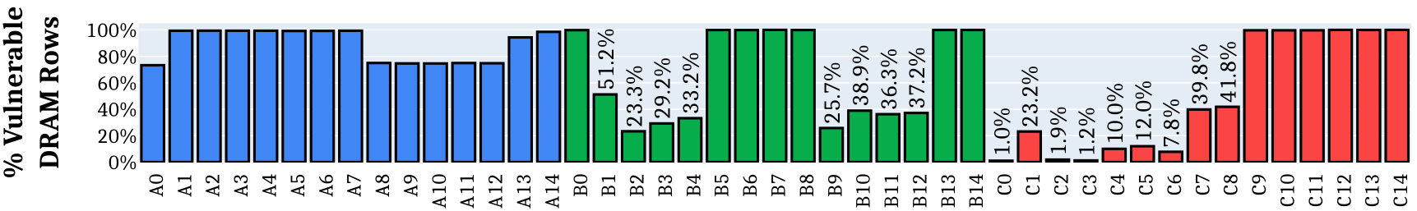
Effect on Individual Rows
All 45 modules we tested are vulnerable
to our new RowHammer access patterns
For many modules, our RowHammer access patterns
cause bit flips in more than 99.9% of the rows
Why are some modules less vulnerable?
Fundamentally less vulnerable to RowHammer
Different TRR mechanisms
Unique row organization
SoftMC (HPCA’17)
U-TRR (MICRO’21)
SMD (Ongoing)
CROW (ISCA’19)
Notes:
Let’s look at the effectiveness of our new RowHammer access patterns at DRAM row granularity.
[CLICK] The plot shows, for each of the 45 modules we test, the fraction of rows that experience at least one RowHammer bit flip compared to all rows in a DRAM bank.
[CLICK] We find that all 45 modules we tested are vulnerable to our new RowHammer access patterns
[CLICK] Further, in 20 of the modules, our RowHammer access patterns cause bit flips in almost all of the rows
[CLICK] But why are some modules less vulnerable? We find that it is because of three main reasons.
[CLICK] First, some modules are fundamentally less vulnerable to RowHammer, in the sense that rows in those modules can tolerate a higher number of hammers before experiencing RowHammer bit flips.
[CLICK] Second, some modules implement a different TRR mechanism that our custom access patterns are not as effective. We believe understanding more those different TRR mechanisms can help crafting more effective rowhammer access patterns.
[CLICK] Third, some modules of Vendor C implement a unique row organization that appears to mitigate RowHammer at DRAM circuit level.

Slide 45
Effect on Individual Rows
All 45 modules we tested are vulnerable
to our new RowHammer access patterns
For many modules, our RowHammer access patterns
cause bit flips in more than 99.9% of the rows
Why are some modules less vulnerable?
Fundamentally less vulnerable to RowHammer
Different TRR mechanisms
Unique row organization
Our access patterns successfully circumvent the TRR implementations of all three major DRAM vendors
SoftMC (HPCA’17)
U-TRR (MICRO’21)
SMD (Ongoing)
CROW (ISCA’19)
Notes:
We conclude that, although some modules are less vulnerable, our access patterns successfully circumvent the TRR implementations of all three major DRAM vendors.

Slide 46
Other Observations and Results in the Paper
More observations on the TRRs of the three vendors
Analysis on the effectiveness of ECC against our RowHammer access patterns
Detailed description of the crafted access patterns
Hammers per aggressor row sensitivity analysis
Observations and results for individual modules
…
SoftMC (HPCA’17)
U-TRR (MICRO’21)
SMD (Ongoing)
CROW (ISCA’19)
Notes:
In the paper,
[CLICK] we have more observations regarding how the TRR mechanisms of the three vendors operate
[CLICK] an analysis on the effectiveness of ECC against our RowHammer access patterns
[CLICK] a detailed description of the RowHammer access patterns we crafted
[CLICK] a sensitivity study on how the number of RowHammer bit flips change when we sweep the number of hammers per aggressor
[CLICK] observations and results for individual DRAM modules,
and more

Slide 47


Summary
Target Row Refresh (TRR):
a set of obscure, undocumented, and proprietary RowHammer mitigation techniques
We cannot easily study the security properties of TRR
Is TRR fully secure? How can we validate its security guarantees?
U-TRR
A new methodology that leverages data retention failures to
uncover the inner workings of TRR and study its security
15x Vendor A
DDR4 modules
All 45 modules we test are vulnerable
15x Vendor B
DDR4 modules
99.9% of rows in a DRAM bank
experience at least one RowHammer bit flip
New RowHammer access patterns
15x Vendor C
DDR4 modules
U-TRR
Up to 7 RowHammer bit flips in
an 8-byte dataword, making ECC ineffective
U-TRR can facilitate the development of new RowHammer attacks
and more secure RowHammer protection mechanisms
SoftMC (HPCA’17)
U-TRR (MICRO’21)
SMD (Ongoing)
CROW (ISCA’19)
Notes:
[CLICK] The RowHammer vulnerability of modern DRAM is a critical reliability and security threat.
[CLICK] The security guarantees of TRR, which is the commonly used RowHammer protection mechanism, cannot be easily studied as TRR is obscure, undocumented, and proprietary.
[CLICK] In this work, our main goal is to answer the following questions. Is TRR fully secure? How can we validate the security guarantees of different TRR mechanisms?
[CLICK] To this end, we propose U-TRR, a new methodology that leverages data retention failures in DRAM to uncover the inner workings of TRR and study its security.
[CLICK] Using U-TRR, we analyze 15 DDR4 DRAM modules from each of the three major DRAM vendors.
[CLICK] Through these analyses, we make several observations regarding the TRR mechanisms implemented in these modules and craft new custom RowHammer access patterns that cause RowHammer bit flips in TRR-protected DRAM modules.
[CLICK] Our results show that: First, all 45 modules that we test across three vendors are vulnerable to our new RowHammer access patterns.
[CLICK] Second, our access pattern cause at least one bit flip in almost all DRAM rows in many modules. This makes system-level RowHammer attacks easier to mount as the attacker would have the ability to cause bit flips in almost any DRAM row
[CLICK] Third, we observe that our access patterns cause up to 7 RowHammer bit flips in a 8-byte dataword, making ECC ineffective and systems equipped with ECC also susceptible to RowHammer attacks
[CLICK] We conclude that TRR does not provide security against RowHammer and can be easily circumvented using the new understanding provided by U-TRR.
[CLICK] We believe and hope that U-TRR will facilitate future research by enabling rigorous and open analysis of RowHammer mitigation mechanisms, leading to the development of both new RowHammer attacks and more secure RowHammer protection mechanisms.

Slide 48
Contributions
A flexible and easy-to-use
FPGA-based
DRAM characterization infrastructure
A new methodology for uncovering in-DRAM RowHammer Protection Mechanisms
SoftMC
U-TRR
HPCA’17
MICRO’21
Self-Managing DRAM:
Enabling autonomous and efficient in-DRAM maintenance operations
A low-cost substrate for improving DRAM performance, energy efficiency, and reliability
SMD
CROW
Ongoing
arXiv’22
ISCA’19
Notes:
Now, let’s discuss our third contributing, Self-Managing DRAM

Slide 49
Problem: The Rigid DRAM Interface
The Memory Controller manages DRAM maintenance operations
Memory Controller
DRAM Refresh
RowHammer Protection
Memory Scrubbing
Changes to maintenance operations are often reflected to the memory controller design, DRAM interface, and other system components
Implementing new maintenance operations
(or modifying the existing ones) is difficult-to-realize
SoftMC (HPCA’17)
U-TRR (MICRO’21)
SMD (Ongoing)
CROW (ISCA’19)
Notes:
Today, the memory controller is in charge of managing DRAM maintenance operation
[CLICK] such as DRAM refresh, RowHammer Protection, and Memory Scrubbing
[CLICK] Because of this, changes to maintenance operations must often be reflected to the design of the memory controller, DRAM interface, and other system components.
[CLICK] This makes implementing new maintenance operations (or modifying the existing ones) difficult-to-realize

Slide 50
A Prime Example: New Features of DDR5
DRAM Refresh
Same Bank Refresh - simultaneously refreshes one bank in each bank group
The new REFsb command requires changes in DRAM interface and memory controller
DDR5 changes are difficult-to-implement as they were only possible after multiple years required to develop a new DRAM standard
RowHammer Protection
Refresh Management (RFM) – memory controller issues the new RFM command to allow DRAM chips more time to perform victim row refresh
The new RFM command requires changes in DRAM interface and memory controller
Memory Scrubbing
In-DRAM Scrubbing – DDR5 uses the on-die ECC to perform periodic scrubbing
The new scrub command requires changes in DRAM interface and memory controller
SoftMC (HPCA’17)
U-TRR (MICRO’21)
SMD (Ongoing)
CROW (ISCA’19)
Notes:
A prime example of recent changes in DRAM maintenance operations is the new features of the DDR5 standard.
[CLICK] First, DDR5 supports the new same bank refresh operation, which simultaneously refreshes one bank in each bank group
[CLICK] For this new operation, DDR5 introduces a new REFsb command, which requires changes in the DRAM interface and the memory controller
[CLICK] Second, to aid RowHammer protection, DDR5 implements Refresh Management (RFM) which simply makes the memory controller allow more time to DRAM chips to perform victim row refresh to mitigate RowHammer bit flips
[CLICK] DDR5 introduces a new RFM command, which requires changes in the DRAM interface and the memory controller
[CLICK] Last, DDR5 enables in-DRAM scrubbing via the on-die ECC that DDR5 chips implement.
[CLICK] To perform periodic scrub operations, the memory controller must periodically issue a new command, implementing which again requires changes in the DRAM interface and the memory controller
[CLICK] We conclude that DDR5 changes are difficult-to-implement as they were only possible after multiple years required to develop a new DRAM standard

Slide 51
SMD: Overview
Self-Managing DRAM (SMD)
enables autonomous in-DRAM maintenance operations
Key Idea:
Prevent the memory controller from accessing DRAM regions that are
under maintenance by rejecting row activation (ACT) commands
command bus
DRAM
Chip
Memory Controller
data bus
ACT_NACK pin
Leveraging the ability to reject an ACT, a maintenance operation
can be implemented completely within a DRAM chip
SoftMC (HPCA’17)
U-TRR (MICRO’21)
SMD (Ongoing)
CROW (ISCA’19)
Notes:
We propose Self-Managing DRAM, or SMD for short.
[CLICK] The key idea of SMD is to prevent the memory controller from accessing DRAM regions that are under maintenance by rejecting row activation commands
[CLICK] To provide a DRAM chip with the ability to reject an activate command, SMD slightly extends the existing interface between the memory controller and the DRAM chips. [CLICK] SMD adds a single negative-acknowledgment (ACT_NACK) pin to a DRAM chip, which the chip uses to signal the memory controller that it rejects the latest activate command.
[CLICK] Leveraging SMD’s ability to reject an activate command, a maintenance operation can be implemented completely within a DRAM chip

Slide 52
SMD: DRAM Bank Architecture
DRAM Bank
Lock Region
Table (LRT)
region 0
lock bit 0
region 1
lock bit 1
lock bit 2
region 2
lock bit 3
region 3
A DRAM bank is divided into configurable-size Lock Regions
SMD marks regions locked for maintenance in the Lock Region Table (LRT)
SMD rejects any ACT command that targets a locked region by sending the memory controller an ACT_NACK signal
SoftMC (HPCA’17)
U-TRR (MICRO’21)
SMD (Ongoing)
CROW (ISCA’19)
Notes:
Performing a maintenance operation on an entire bank would cause a large portion of the DRAM to become inaccessible during the maintenance operation. Therefore, [CLICK] SMD divides a bank into multiple Lock Regions and performs maintenance operations at a smaller granularity. [CLICK] The size of a lock region can be configured at design time.
[CLICK] SMD uses a Lock Region Table to mark locked regions that undergo a maintenance operation.
[CLICK] When the memory controller sends an ACTIVATE command, SMD checks if the row to be activated belongs to a locked region. If so, SMD rejects the ACTIVATE by sending the memory controller an ACT_NACK signal.

Slide 53
SMD: High-Level Operation
LRT
LRT
0 - locked
0 - available
1 - available
1 - available
2 - available
2 - available
3 - available
3 - available
bank 0
lock region 0
time
tRCD
bank 0
lock region 1
tRAS
SoftMC (HPCA’17)
U-TRR (MICRO’21)
SMD (Ongoing)
CROW (ISCA’19)
Notes:
Now, let me explain the high-level operation of SMD.
Let’s assume that the memory controller attempts to activate a row in lock region 0.
[CLICK] When the DRAM receives the ACTIVATE command, SMD checks the LRT table. Because LRT indicates that lock region 0 is locked, [CLICK] SMD sends the memory controller and ACT_NACK signal.
Because the activate is rejected, [CLICK] the memory controller retries the same activate command after the ACT Retry Interval, at which point lock region 0 is available for access.
[CLICK] While waiting to retry the rejected activate command, the memory controller is allowed to attempt activating a row in a different lock region in the same bank or in any lock region in a different bank.

Slide 54
SMD-Based Maintenance Mechanisms
Fixed Rate (SMD-FR)
Variable Rate (SMD-VR)
DRAM
Refresh
skips refreshing rows that
can retain their data for longer than
the default refresh period
uniformly refreshes all DRAM rows with a fixed refresh period
Probabilistic (SMD-PRP)
Deterministic (SMD-DRP)
RowHammer Protection
keeps track of most
frequently activated rows and
performs neighbor row refresh when
activation count threshold is exceeded
Performs neighbor row refresh
with a small probability
on every row activation
Memory
Scrubbing
Periodic Scrubbing (SMD-MS)
periodically scans the entire DRAM for errors and corrects them
SoftMC (HPCA’17)
U-TRR (MICRO’21)
SMD (Ongoing)
CROW (ISCA’19)
Notes:
Using the Self-Managing DRAM architecture, we develop various maintenance mechanisms.
[CLICK] For DRAM refresh, [CLICK] we develop Fixed-Rate Refresh (SMD-FR), which uniformly refreshes all DRAM rows with a fixed refresh period.
[CLICK] Also, we develop Variable Rate Refresh (SMD-VR), which uses retention profiling information to skip refreshing rows that can retain their data correctly for extended periods.
[CLICK] For RowHammer Protection, [CLICK] we develop Probabilistic RowHammer Protection (SMD-PRP), which performs neighbor row refresh with a small probability on every row activation.
[CLICK] Second, we develop Deterministic RowHammer Protection (SMD-DRP), which identifies frequently activated rows and refreshes only their neighbor rows when needed.
[CLICK] Last, we develop a mechanism for memory scrubbing. [CLICK] SMD-MS periodically scans the entire DRAM for errors and corrects them.
Thanks to SMD, all these mechanisms can be implemented completely within DRAM and they can operate together.

Slide 55
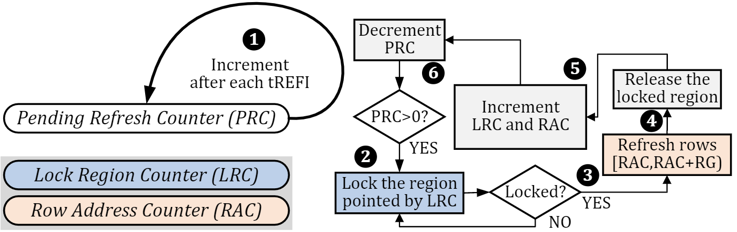
Fixed-Rate Refresh (SMD-FR)
Notes:
TODO: animate and write a script to explain the operation clearly

Slide 56
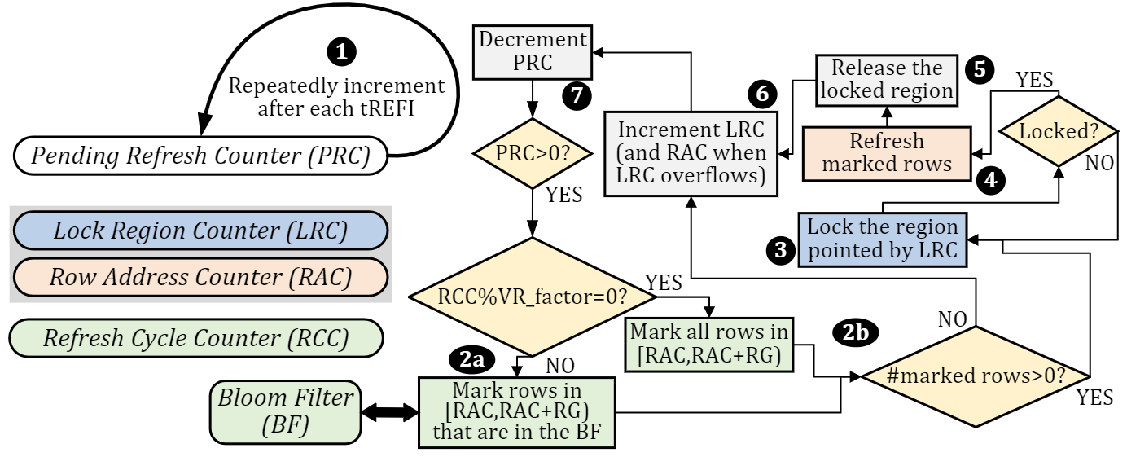
Variable-Rate Refresh (SMD-VR)
Notes:
TODO: animate and write a script to explain the operation clearly

Slide 57
Methodology
Simulators
  Ramulator [Kim+, CAL’15]
  https://github/CMU-SAFARI/ramulator
  DRAMPower [Chandrasekar+, DSD’11]
  https://github.com/tukl-msd/DRAMPower
Workloads
  44 single-core workloads
  SPEC CPU2006, TPC, STREAM, MediaBench
  60 multi-programmed four-core workloads
  By randomly choosing from single-core workloads
System Parameters
  4-channel dual-rank DDR4 DRAM
  32ms default refresh period
SoftMC (HPCA’17)
U-TRR (MICRO’21)
SMD (Ongoing)
CROW (ISCA’19)
Notes:
To evaluate the performance and energy efficiency benefits of SMD, we use Ramulator and DRAMPower, respectively.
[CLICK] We simulate 44 single-core workloads and 60 four-core multi-programmed workloads.
[CLICK] We simulate a system with 4 dual-rank DRAM channels and 32ms refresh period

Slide 58
Single-Core Results
10.0%
9.2%
93.7%
92.0%
+SMD-FR
SMD-VR
SMD-DRP
SMD-MS
SoftMC (HPCA’17)
U-TRR (MICRO’21)
SMD (Ongoing)
CROW (ISCA’19)
Notes:
This plot shows the single-core speedup of the five maintenance mechanisms that we just discussed over conventional DDR4 baseline. With SMD-PRP, SMD-DRP, and SMD-MS, we use SMD-FR as a refresh mechanism as it is very simple to implement.
[CLICK] In addition to the five maintenance mechanisms, the plot also shows the speedup achieved when combining SMD-VR, SMD-DRP, and SMD-MS, represented as SMD-Combined.
We also show the speedup of a hypothetical DRAM that does not require refresh or any other maintenance mechanisms. This NoRefresh DRAM acts as an upperbound for the performance achievable without any DRAM maintenance operations.
We observe that, on average, both SMD-FR and SMD-VR provide significant speedup compared to conventional DDR4 refresh. The overhead of the RowHammer Protection and memory scrubbing mechanisms is small as they achieve similar speedup with SMD-FR.
[CLICK] When combined, SMD-based mechanisms provide 9.2% speedup, which is close to the speedup that the hypothetical NoRefresh DRAM achieves.
[CLICK] This second plot shows the DRAM energy consumption normalized to the conventional DDR4 baseline. We observe that SMD-Combined saves about 6.2% DRAM energy and this is close to the energy savings of the NoRefresh upperbound.

Slide 59
Four-Core Results
10.1%
9.2%
93.8%
92.0%
SMD-based maintenance mechanisms have significant performance and energy efficiency benefits
SoftMC (HPCA’17)
U-TRR (MICRO’21)
SMD (Ongoing)
CROW (ISCA’19)
Notes:
We also evaluate multi-core benefits of SMD-based maintenance mechanisms using a 4-core setup.
We observe that the proposed maintenance mechanisms have performance and energy benefits similar to the single core results.
[CLICK] We conclude that SMD-based maintenance mechanisms have significant performance and energy efficiency benefits across single and multi core workloads.

Slide 60
Sensitivity to Refresh Period
58.4%
51.5%
22.5%
19.5%
SMD-based refresh mechanisms will be even more beneficial in future DRAM chip with low refresh periods
SoftMC (HPCA’17)
U-TRR (MICRO’21)
SMD (Ongoing)
CROW (ISCA’19)
Notes:
Let’s quickly look at how SMD-based refresh mechanisms perform for different refresh periods.
This plot shows the speedup of SMD-FR, SMD-VR, and SMD-Combined when using 64, 32, 16, and 8ms refresh period.
The speedup is normalized to the performance of conventional DDR4 with the respective refresh period.
We observe that SMD-based refresh mechanisms provide greater performance benefits at lower refresh periods.
[CLICK] SMD-Combined achieves 19.5% speedup for 16ms refresh, and 51.5% speedup for 8ms refresh period. In both cases, SMD-Combined performs close to the ideal NoRefresh mechanisms, which shows that SMD eliminates most of the overhead of the refresh operations.
[CLICK] We conclude that SMD-based refresh mechanisms will become even more beneficial to employ in future DRAM chips that are expected to require more frequent refresh.

Slide 61
Hardware Overhead
Interface Modifications
A single ACT_NACK pin per DRAM chip
DRAM Chip Modifications
Lock Region Table incurs only:
  32um2 area overhead (0.001% of a 45.4mm2 DRAM chip)
  0.053ns access latency overhead
Memory Controller Modifications
Changes in request scheduling to handle ACT_NACK signals
No further changes needed for new maintenance operations
The memory controller no longer manages DRAM maintenance
SoftMC (HPCA’17)
U-TRR (MICRO’21)
SMD (Ongoing)
CROW (ISCA’19)
Notes:
Enabling SMD on top of a conventional DRAM chip requires small changes.
[CLICK] First, SMD requires a single ACT_NACK pin per DRAM chip on the interface between the DRAM chips and the memory controller.
[CLICK] Second, inside a DRAM chip, SMD implement a Lock Region Table, which incurs only 32 squared micrometers area overhead.
The Lock Region Table has a very small access time, which has negligible impact on overall DRAM access latency.
[CLICK] And last, SMD requires minor changes in the request scheduling logic of the memory controller to handle the ACK_NACK signals.
[CLICK] Although these changes are necessary to enable SMD, no further changes are needed on the DRAM interface and the memory controller when implementing new maintenance mechanisms in the DRAM chips.
On top of this, SMD simplifies the operation of the memory controller as the memory controller no longer is responsible for periodically issuing DRAM refresh and other maintenance commands.

Slide 62
Other Results in the Paper
Lock region size sensitivity
Comparison to memory controller-based RH protection
Comparison to memory controller-based scrubbing
SMD-DRP maximum activation threshold sensitivity
Victim row window sensitivity
SoftMC (HPCA’17)
U-TRR (MICRO’21)
SMD (Ongoing)
CROW (ISCA’19)

Slide 63
Summary
The three major DRAM maintenance operations:
  Refresh
  RowHammer Protection
  Memory Scrubbing
Source code will be available soon:
github.com/CMU-SAFARI/SelfManagingDRAM
Implementing new maintenance mechanisms often requires difficult-to-realize changes
Our Goal
Ease the process of enabling new DRAM maintenance operations
1
Enable more efficient in-DRAM maintenance operations
2
Self-Managing DRAM (SMD)
Enables implementing new in-DRAM maintenance mechanisms
with no further changes in the DRAM interface and memory controller
SMD-based refresh, RowHammer protection, and scrubbing achieve
9.2% speedup and 6.2% lower DRAM energy vs. conventional DRAM
SoftMC (HPCA’17)
U-TRR (MICRO’21)
SMD (Ongoing)
CROW (ISCA’19)
Notes:
In summary,
[CLICK] The three major DRAM maintenance operations are refresh, RowHammer protection, and memory scrubbing.
[CLICK] We observe that implementing new and efficient maintenance mechanisms often requires difficult-to-realize changes in various system components, including the DRAM interface and the memory controller.
[CLICK] In this work, our goal is to first, ease the process of enabling new DRAM maintenance operations in DRAM and
[CLICK] enable more efficient in-DRAM maintenance operations
[CLICK] To this end, we propose Self-Managing DRAM (or SMD for short), which enables implementing new in-DRAM maintenance mechanisms with no further changes in the DRAM interface and the memory controller
[CLICK] According to our evaluations, SMD-based maintenance mechanisms for refresh, RowHammer protection, and memory scrubbing achieve significant performance and energy efficiency benefits compared to conventional DDR4 DRAM.
[CLICK] The source code of SelfManagingDRAM will be available on github soon.

Slide 64
Contributions
A flexible and easy-to-use
FPGA-based
DRAM characterization infrastructure
A new methodology for uncovering in-DRAM RowHammer Protection Mechanisms
SoftMC
U-TRR
HPCA’17
MICRO’21
Self-Managing DRAM:
Enabling autonomous and efficient in-DRAM maintenance operations
A low-cost substrate for improving DRAM performance, energy efficiency, and reliability
SMD
CROW
Ongoing
arXiv’22
ISCA’19
Notes:
We will now discuss the fourth contribution, Copy-Row DRAM or CROW.

Slide 65
Scaling Challenges of DRAM Technology
System-Level Problems
DRAM Cell
Performance
Energy Efficiency
DRAM Scaling Problems
Data Integrity
Reliability
Security
Latency
SoftMC (HPCA’17)
U-TRR (MICRO’21)
SMD (Ongoing)
CROW (ISCA’19)
Notes:
A quick reminder, we previously discussed the DRAM scaling challenges.
The data integrity and latency problems of DRAM technology scaling affect the system performance, energy efficiency, reliability, and security.

Slide 66
Observation
Modifying the underlying density-optimized DRAM cell array structure may incur
non-negligible area overhead
SoftMC (HPCA’17)
U-TRR (MICRO’21)
SMD (Ongoing)
CROW (ISCA’19)
Notes:
We observe that modifying the density-optimized DRAM cell array structure often incurs high area overhead.
Therefore, it is difficult to efficiently solve the DRAM scaling challenges by directly modifying the underlying DRAM cell array.

Slide 67
Our Goal
1
Lower DRAM latency
No changes to the DRAM cell structure
Only minimal changes to the DRAM chip
2
Reduce refresh overhead
3
Improve DRAM reliability
SoftMC (HPCA’17)
U-TRR (MICRO’21)
SMD (Ongoing)
CROW (ISCA’19)
Notes:
Our goal is to [CLICK] lower the DRAM access latency, reduce the refresh overhead, and improve DRAM reliability [CLICK] with no changes to the DRAM cell architecture, and with only minimal changes to the DRAM chip

Slide 68

Copy-Row DRAM (CROW)
A flexible substrate that enables
new mechanisms for improving DRAM:
Performance
Energy Efficiency
Reliability
Security
Key Idea:
1) efficiently duplicate select rows in DRAM
2) exploit duplicated rows in new mechanisms
SoftMC (HPCA’17)
U-TRR (MICRO’21)
SMD (Ongoing)
CROW (ISCA’19)
Notes:
To this end, we propose Copy-Row DRAM (or CROW), a flexible substrate that enables new mechanisms [CLICK] for improving DRAM performance, energy efficiency, reliability, and security.
[CLICK] The key idea of CROW is to efficiently duplicate select rows in DRAM and exploit duplicated rows in new mechanisms

Slide 69
CROW: High-Level Overview
DRAM Subarray
Memory Controller
CROW-table
CROW enables:
Row Copy: efficiently duplicating data from a regular row to a copy row
Two-row Activation: quick access to a duplicated row
SoftMC (HPCA’17)
U-TRR (MICRO’21)
SMD (Ongoing)
CROW (ISCA’19)
Notes:
Let me give you a high-level overview of the CROW substrate.
[CLICK] A conventional DRAM subarray is organized as illustrated here. CROW makes two key changes in the subarray design.
[CLICK] First, CROW designates a small number of rows in each subarray as copy-rows. We refer to the other rows as regular rows.
Second, CROW splits the row decoder into two to enable independent activation of a regular and a copy row.
[CLICK] With this organization, CROW enables two key operations:
Row copy for efficiently duplicating data from a regular row to a copy row
[CLICK] two-row activation for low latency access to a duplicated row and
We take advantage of these two operations to develop mechanisms for improving DRAM.
To keep track of the duplicated rows, [CLICK] CROW implements a CROW-table in the memory controller.
Next, I will explain these operations in more detail.

Slide 70
CROW Operation 1: Row Copy
DRAM Subarray
ACT-c (copy)
Memory Controller
SoftMC (HPCA’17)
U-TRR (MICRO’21)
SMD (Ongoing)
CROW (ISCA’19)
Notes:
The first of the two operations that CROW enables is copying the content of an entire regular row into a copy row.
To initiate the row copy operation, [CLICK] the memory controller issues the new ACT-c command that CROW provides to the DRAM.
[CLICK] This command first activates a regular row. [CLICK] After the data is latched in the sense amplifiers, [CLICK] the command activates a copy row. This results in the sense amplifiers writing the data of the regular row to both of the open rows.
Let me explain how data is copied from one row to another within the DRAM.

Slide 71
Row Copy: Steps
source row:
1
Activation of the source row
2
Charge sharing
destination row:
3
Beginning of restoration
4
Activation of the destination row
Restoration of both rows
to source data
5
Enables quickly copying
a regular row into a copy row
Sense
Amplifier
SoftMC (HPCA’17)
U-TRR (MICRO’21)
SMD (Ongoing)
CROW (ISCA’19)
Notes:
For simplicity, let’s assume in this slide that DRAM rows have only a single cell.
Here, our goal is to copy data from the source row to the destination row.
There are 5 steps involved. First, [CLICK] the source row is activated.
Following the activation [CLICK], the source row shares its charge with the sense amplifier.
Then, [CLICK] the sense amplifier starts restoration.
At this point, [CLICK] CROW enables the destination row and [CLICK] this results in the sense amplifier restoring both rows to the same value of the source cell.
[CLICK] So, CROW enables quickly copying a regular row into a copy row

Slide 72
CROW Operation 2: Two-Row Activation
DRAM Subarray
ACT-t (two row)
Memory Controller
SoftMC (HPCA’17)
U-TRR (MICRO’21)
SMD (Ongoing)
CROW (ISCA’19)
Notes:
The second operation that CROW enables is simultaneously activating a regular row and a copy row.
[CLICK] The memory controller performs multiple row activation by issuing the other new command ACT-t.
When a regular and copy rows are activated together, [CLICK] if the two rows contain the same data, this operation results in low latency activation.
Let me explain why in the next slide.

Slide 73
Two-Row Activation: Steps
both charged or discharged
1
Activation of two rows
fast
2
Charge sharing
3
Restoration
Enables fast access to data that is duplicated across a regular row and a copy row
Sense
Amplifier
SoftMC (HPCA’17)
U-TRR (MICRO’21)
SMD (Ongoing)
CROW (ISCA’19)
Notes:
Simultaneous multiple row activation operates similarly to the row copy operation.
The difference is that, [CLICK] two rows containing the same data are activated simultaneously. Doing so, [CLICK] both rows share their charge with the sense amplifier. [CLICK] This accelerates charge sharing as two cells together share more charge with the sense amplifier. As a result, [CLICK] the restoration completes sooner, and read/write operations can be services sooner compared to conventional single row activation.
[CLICK] The CROW substrate enables fast access to data that is duplicated across a regular and a copy row

Slide 74
CROW-based Mechanisms
CROW-cache
CROW-ref
Mitigating RowHammer
SoftMC (HPCA’17)
U-TRR (MICRO’21)
SMD (Ongoing)
CROW (ISCA’19)
Notes:
We use CROW to develop three mechanisms. Let’s first discuss CROW-cache.

Slide 75
CROW-cache
Problem: High access latency
Key idea: Use copy rows to enable low-latency access to
most-recently-activated regular rows in a subarray
CROW-cache combines:
  row copy → copy a newly activated regular row into a copy row
  two-row activation → activate the regular row and copy row together on the next access
Reduces activation latency by 38%
SoftMC (HPCA’17)
U-TRR (MICRO’21)
SMD (Ongoing)
CROW (ISCA’19)
Notes:
We use CROW to address the high access latency problem of DRAM by implementing CROW-cache.
[CLICK] The key idea of CROW-cache is to enable low-latency access to the most recently activated regular rows in every subarray.
[CLICK] CROW-cache reduces latency by using both operations that the CROW substrate provides.
First, it uses row copy to copy a newly activated regular row into a copy row.
Second, it uses multiple row activation to activate the regular row and copy row together on the next access
[CLICK] When a recently-activated row is cached in DRAM, CROW-cache activates it with 38% lower latency.
Let me walk you through an example to show how CROW-cache works.

Slide 76
CROW-cache Operation
Request Queue
DRAM Subarray
load row X
[bank conflict]
load row X
1
CROW-table miss
ACT-c
2
Allocate a copy row
ACT-t
CROW-table
3
Issue ACT-c (copy)
Memory Controller
Second activation of row X is faster
copy row 0
row X
1
CROW-table hit
2
Issue ACT-t (two row)
SoftMC (HPCA’17)
U-TRR (MICRO’21)
SMD (Ongoing)
CROW (ISCA’19)
Notes:
[CLICK] In the middle, you see the CROW subarray and [CLICK] the CROW-table from the previous slide. On the right hand side, [CLICK] we show the queue of requests to be serviced, which is initially empty.
In this example, [CLICK] we first get a load request to address X. Since the CROW-table is initially empty, [CLICK] the request misses in the CROW-table. To enable fast access in the future, [CLICK] CROW-cache allocates a copy row for the regular row that corresponds to address X. [CLICK] Then, the memory controller issues an ACT-c command to perform the row copy operation.
[CLICK] Then, let’s assume DRAM receives requests to other rows causing bank conflict which forces row X to be closed.
In the future, [CLICK] when the request queue receives another request to address X, the memory controller finds that [CLICK] X hits in the CROW-cache, and thus [CLICK] issues ACT-t to perform a low latency access.
[CLICK] This is basically how CROW-cache reduces DRAM latency when accessing a row for the second time.

Slide 77
CROW-based Mechanisms
CROW-cache
CROW-ref
Mitigating RowHammer
SoftMC (HPCA’17)
U-TRR (MICRO’21)
SMD (Ongoing)
CROW (ISCA’19)
Notes:
Next, I will explain the CROW-ref mechanism

Slide 78
CROW-ref
Problem: Refresh has high overheads. Weak rows lead to
high refresh rate
  weak row: at least one of the row’s cells cannot retain data correctly when refresh rate is decreased
Key idea: Safely reduce refresh rate by remapping a weak regular row to a strong copy row
CROW-ref uses:
  row copy → copy a weak regular row to a strong copy row
CROW-ref eliminates more than half of the refresh requests
SoftMC (HPCA’17)
U-TRR (MICRO’21)
SMD (Ongoing)
CROW (ISCA’19)
Notes:
DRAM refresh operations have high performance and energy overheads and weak rows prevent reducing the refresh rate.
Here, we define a weak row as a row that has at least one cell that cannot retain data correctly when the refresh interval is increased
We use the CROW substrate to implement CROW-ref whose [CLICK] key idea is to reduce refresh rate by remapping a weak regular row to a strong copy row.
[CLICK] CROW-ref uses the row copy operation to remap a weak regular row to a strong copy row.
[CLICK] Doing so, CROW-ref doubles the refresh interval or in other words eliminates half of the refresh requests that the memory controller must issue.
Let me explain how exactly CROW-ref operates

Slide 79

CROW-ref Operation
Perform retention time profiling
1
strong
strong
Remap weak rows to strong copy rows
2
weak
strong
3
On ACT, check the CROW-table
strong
strong
If remapped, activate a copy row
Retention Time Profiler
4
How many weak rows exist
in a DRAM chip?
SoftMC (HPCA’17)
U-TRR (MICRO’21)
SMD (Ongoing)
CROW (ISCA’19)
Notes:
The operation of CROW-ref is simple.
[CLICK] CROW-ref uses a DRAM retention time profiling mechanism to discover weak rows and [CLICK] stores the remapping information in the CROW-table. [CLICK] When the memory controller needs to activate a row, it first checks the CROW-table to see whether the row has been remapped. If so, [CLICK] it activates the corresponding copy row instead of the weak regular row.
[CLICK] To make this mechanisms work, one question we need to answer is how many weak rows are typically there in a DRAM chip?

Slide 80
Identifying Weak Rows
Weak cells are rare [Liu+, ISCA’13]
weak cell: retention < 256ms
~1000/2³⁸ (32 GiB) failing cells
DRAM Retention Time Profiler
  REAPER [Patel+, ISCA’17]
  PARBOR [Khan+, DSN’16]
  AVATAR [Qureshi+, DSN’15]
  At system boot or during runtime
A few copy rows are sufficient
to halve the refresh rate
SoftMC (HPCA’17)
U-TRR (MICRO’21)
SMD (Ongoing)
CROW (ISCA’19)
Notes:
It turns out that the weak rows are actually very rare. [CLICK] Here, we assume a cell to be weak when it cannot retain data for 256 ms. [CLICK] Prior work reports, on DDR3, when the refresh interval is changed from the default 64ms to 256ms, only about 1000 cells in a 32 GiB fail to retain the data correctly.
Based on this information, [CLICK] we calculate the probability of having a subarray with different numbers of weak rows. The figure plots the probability of having a subarray with at least N weak rows. Although the probability of having a subarray with at least one or two weak rows is quite high, [CLICK] the probability rapidly decreases when we consider more weak rows. This motivates that even a small number of copy rows in a subarray are very likely to be sufficient to remap all weak regular rows.
[CLICK] To detect weak rows, there are several prior works that propose DRAM retention time profilers. CROW-ref can adopt any of these profilers. [CLICK] A profiler can either be used at system boot or during runtime as CROW support the CROW-table to be updated at any time.
[CLICK] Only a few copy rows are sufficient to halve the refresh rate

Slide 81
CROW-based Mechanisms
CROW-cache
CROW-ref
Mitigating RowHammer
SoftMC (HPCA’17)
U-TRR (MICRO’21)
SMD (Ongoing)
CROW (ISCA’19)
Notes:
Last, I will briefly explain the mechanism we develop for mitigating RowHammer

Slide 82
Mitigating RowHammer
victim
aggressor
activate
precharge
victim
Key idea: remap victim rows to copy rows
SoftMC (HPCA’17)
U-TRR (MICRO’21)
SMD (Ongoing)
CROW (ISCA’19)
Notes:
RowHammer is a vulnerability caused mainly by process technology scaling. [CLICK] As the DRAM cells become smaller and get closer to each other, they become more sensitive to electromagnetic interference. RowHammer errors are basically induced by rapidly [CLICK] activating and precharging a row [CLICK]. This operation disturbs the cell in neighbor rows and has a chance to flip some of the bits stored there.
For mitigating RowHammer errors, [CLICK] our key idea is to use the CROW substrate to remap the victim rows to copy rows. This protects the data in the victim rows as the rows get physically moved away from the aggressor row. Please see our paper for a more detailed description of this mechanism.
We leave the evaluation of this mechanism for future work.

Slide 83
Methodology
Simulator
  DRAM Simulator (Ramulator [Kim+, CAL’15])
    https://github.com/CMU-SAFARI/ramulator
Workloads
  44 single-core workloads
    SPEC CPU2006, TPC, STREAM, MediaBench
  160 multi-programmed four-core workloads
    By randomly choosing from single-core workloads
  Execute at least 200 million representative instructions per core
System Parameters
  1/4 core system with 8 MiB LLC
  LPDDR4 main memory
  8 copy rows per 512-row subarray
SoftMC (HPCA’17)
U-TRR (MICRO’21)
SMD (Ongoing)
CROW (ISCA’19)
Notes:
To evaluate the CROW mechanisms, we used Ramulator, which is a cycle-accurate DRAM simulation tool.
[CLICK] We analyze workloads from four benchmark suites, including SPEC CPU 2006.
[CLICK] These are the system parameters and
we implement CROW with 8 copy rows per subarray by default.

Slide 84
CROW-cache Results
7.5%
7.1%
8.2%
6.9%
CROW-cache improves single-/four-core performance and energy
* with 8 copy rows and a 64Gb DRAM chip (sensitivity in paper)
SoftMC (HPCA’17)
U-TRR (MICRO’21)
SMD (Ongoing)
CROW (ISCA’19)
Notes:
Let me start with showing the performance and energy benefits of CROW-cache.
[CLICK] The figure shows the average speedup that CROW-cache provides for single core and four core workloads. For both, CROW-cache provides 7% speedup, which is very close to an ideal hypothetical mechanisms with CROW-cache that has 100% hit rate.
[CLICK] CROW-cache also saves DRAM energy mainly because of reduction in execution time.
[CLICK] So, CROW-cache improves single-core and four core performance and energy

Slide 85
CROW-ref Results
11.9%
7.8%
17.2%
7.1%
CROW-ref significantly reduces the performance and energy overhead of DRAM refresh
* with 8 copy rows and a 64Gb DRAM chip (sensitivity in paper)
SoftMC (HPCA’17)
U-TRR (MICRO’21)
SMD (Ongoing)
CROW (ISCA’19)
Notes:
Let me also quickly show you the performance and energy benefits of CROW-ref.
[CLICK] CROW-ref eliminates many of the DRAM refresh requests, and this leads to 7% speedup for single core workloads and almost 12% speedup for four core workloads.
[CLICK] Eliminating many refreshes also saves significant DRAM energy.
[CLICK] CROW-ref significantly reduces the performance and energy overhead of DRAM refresh

Slide 86
Combining CROW-cache and CROW-ref
17%
20%
23%
22%
CROW-(cache+ref) provides more performance and DRAM energy benefits than each mechanism alone
SoftMC (HPCA’17)
U-TRR (MICRO’21)
SMD (Ongoing)
CROW (ISCA’19)
Notes:
CROW-cache and CROW-ref are complementary to each other. We combine both mechanisms by keeping 8 copy rows per subarray.
The mechanisms perform well when combined with 8 copy rows per subarray because neither of the mechanisms utilize all of the copy rows in many cases. For example, as I’ve shown previously, it is very unlikely to have too many weak rows in a subarray, so CROW-ref does not make use of majority of the copy rows.
[CLICK] Both mechanisms together provide 17% and 20% speedup for single-core and four-core workloads. And they perform close to an ideal mechanism that has a CROW-cache with 100% hit rate and eliminates all DRAM refresh operations.
[CLICK] CROW-cache and CROW-ref together save significant DRAM energy.
[CLICK] We conclude that, CROW-cache and CROW-ref further improve system performance and DRAM energy when combined.

Slide 87
Hardware Overhead
For 8 copy rows and 16 GiB DRAM:
  0.5% DRAM chip area
  1.6% DRAM capacity
  11.3 KiB memory controller storage
CROW is a low-cost substrate
SoftMC (HPCA’17)
U-TRR (MICRO’21)
SMD (Ongoing)
CROW (ISCA’19)
Notes:
CROW incurs modest overheads in the DRAM and the memory controller when using a configuration with 8 copy rows per subarray,
[CLICK] So, CROW is a low-cost substrate.
Please see the paper for a more detailed hardware overhead evaluation.

Slide 88
Other Results in the Paper
Performance and energy sensitivity to:
  Number of copy-rows per subarray
  DRAM chip density
  Last-level cache capacity
CROW-cache with prefetching
CROW-cache compared to other in-DRAM caching mechanisms:
  TL-DRAM [Lee+, HPCA’13]
  SALP [Kim+, ISCA’12]
SoftMC (HPCA’17)
U-TRR (MICRO’21)
SMD (Ongoing)
CROW (ISCA’19)
Notes:
Please also see our paper for more detailed evaluation.
[CLICK] There we have sensitivity studies to the number of copy rows per subarray
Chip density, and last-level cache capacity
Also, we evaluate CROW-cache with a stride prefetcher and
we compare CROW-cache to two prior works that also enable in-DRAM caching.

Slide 89
Summary
Copy-Row DRAM (CROW)
  Introduces copy rows into a subarray
  The benefits of a copy row:
    Efficiently duplicating data from regular row to a copy row
    Quick access to a duplicated row
    Remapping a regular row to a copy row
Use cases of CROW:
  CROW-cache & CROW-ref
  Mitigating RowHammer
  We hope CROW enables many other use cases going forward
Source code available:
github.com/CMU-SAFARI/CROW
SoftMC (HPCA’17)
U-TRR (MICRO’21)
SMD (Ongoing)
CROW (ISCA’19)
Notes:
[CLICK] We propose CROW, an in-DRAM substrate for addressing the three key challenges of DRAM scaling.
[CLICK] CROW introduces copy rows in addition to regular rows in conventional DRAM.
[CLICK] A copy row provides three key benefits.
[CLICK] Using the CROW substrate, we develop CROW-cache to enable in-DRAM caching, CROW-ref to reduce DRAM refresh overhead, and a mechanisms for mitigating RowHammer errors.
We believe CROW will enable many other use cases going forward

Slide 90
Contributions
A flexible and easy-to-use
FPGA-based
DRAM characterization infrastructure
A new methodology for uncovering in-DRAM RowHammer Protection Mechanisms
SoftMC
U-TRR
HPCA’17
MICRO’21
Self-Managing DRAM:
Enabling autonomous and efficient in-DRAM maintenance operations
A low-cost substrate for improving DRAM performance, energy efficiency, and reliability
SMD
CROW
Ongoing
arXiv’22
ISCA’19
Notes:
Now, I would like to conclude my talk.
We discussed four core contributions towards understanding and solving the scaling challenges of DRAM.

Slide 91
Future Research Directions
Deeper DRAM Characterization
  Analyzing cell characteristics of new devices
  Impact of aging
  Low temperature operation
Extending SoftMC
  Supporting other DRAM and NVM standards
Improving RowHammer Attacks & Defenses
  Studying the security properties of RowHammer protection mechanisms
New DRAM Maintenance Mechanisms
  Profiling-based maintenance operations
  Memory controller and in-DRAM processing interoperability
Exploiting in-DRAM Data Movement
  More mechanisms that exploit low-overhead in-DRAM data migration
Notes:
We hope and believe that our contributions will enable future research in understanding the characteristics of current and future memory systems and encourage more innovation in the design of future memory systems.
Some promising research directions are:
[CLICK] more detailed characterization of DRAM behavior
[CLICK] Extending SoftMC to support other DRAM and even NVM standards
[CLICK] Improving RowHammer Attacks and Defenses
[CLICK] Developing more efficient DRAM maintenance mechanisms
[CLICK] and developing new mechanisms that take advantage of in-DRAM data movement mechanisms

Slide 92
Improving DRAM Performance, Reliability, and Security by Rigorously Understanding Intrinsic DRAM Operation
Hasan Hassan
SAFARI Live Seminar
15 September 2022
Notes:
This is the end of my talk. I am now happy to answer any question.

