Slide 1
Self-Optimizing Memory Controllers:
A Reinforcement Learning Approach
Engin Ipek¹, Onur Mutlu¹, Jose F. Martinez², Rich Caruana²
1. Microsoft Research
2. Cornell University

Slide 2
Riding Moore’s Law with CMPs
Goals
  High performance
  Low power
  Manageable HW complexity
  Low cost
Intel
Pentium
Dual Core
Intel
Quad-Core
“Yorkfield”
AMD
Athlon 64
X2
AMD
Quad-Core
“Barcelona”
Proposed
Intel
80-core Chip
2005
2007
2011

Slide 3
Problem: Off-Chip Memory Bandwidth
Pin Count
Transistor Count
25% annual growth
10% annual growth
ITRS 2007 Executive Summary

Slide 4
Problem: Off-Chip Memory Bandwidth
Higher pressure on off-chip interface with each new technology generation
Important to utilize available memory bandwidth efficiently
Need for carefully scheduling memory accesses increases

Slide 5
DRAM Scheduling
Activate
Read
Write
Precharge
Command schedule must obey large set of timing constraints.
Must order commands to maximize throughput and minimize latency.
ScalParC – NU-MineBench
Constraints: tRCD, tCL, tWL, tCCD, tWTR, tWR, tRTP, tRP, tRRD, tRAS, tRC, tFAW …

Slide 6
Existing Memory Controllers
Based on relatively simple, fixed scheduling policies
  Older vs. younger requests, loads vs. stores, most pending …
  Best performer on average: FR-FCFS [Rixner et al, ISCA’00]
    Ready commands over commands that are not ready
    Column commands over row commands
    Older commands over younger commands
Potential shortcomings
  Design relies heavily on expert intuition
  Based on simple rule prioritization – limited sophistication
  Policies are hard-coded – cannot improve by learning new policies

Slide 7
Our Approach
Formulate memory access scheduling as a reinforcement learning problem
Environment
System
State attributes(t)
Agent
State s(t)
Scheduler
Action a(t+1)
Reward r(t)
Scheduled
Command (t+1)
Data bus
Utilization (t)
Associate system states & scheduling decisions with long-term reward values
Schedule the command estimated to yield highest long-term reward in each state
Goal: Learn to choose actions to maximize r₀ + γr₁ + γ²r₂ +… (0≤γ<1)
Continuously update long-term reward values based on feedback from system

Slide 8
RL-Based DRAM Schedulers
Structure, Operation, and Implementation

Slide 9
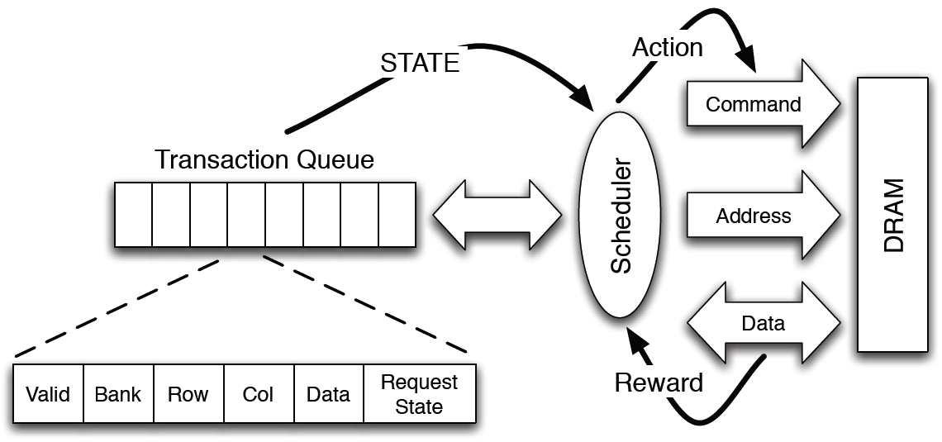
Problem Formulation
Immediate rewards
  +1 when issuing reads/writes
  0 at all other times
State attributes
  Number of reads in TQ
  Number of writes in TQ
  Number of load misses in TQ
  Relative order* among load misses from a core
  Number of pending writes for referenced row
  Number of “oldest”* loads for each core that are pending for referenced row
Actions
  Precharge
  Activate
  Read – load miss
  Read – store miss
  Write
  Nop
*Estimated based on sequence numbers

Slide 10
RL-Based DRAM Scheduling Algorithm
Keep an estimate of long-term reward values Q(s,a) in a table.
Iteratively approximate Q(s,a) based on experience
At the end of each DRAM cycle:
  Take selected action a in current state s
  Observe reward r, transition to state s’
On the next cycle:
  Select action a’
    Schedule random (but legal) command with small probability ε
    Schedule command with highest Q-value, otherwise
  Update Q(s,a) [Sutton & Barto]
  Q(s,a) ← (1- α) Q(s,a) + α(r+ γ Q(s’,a’))
s
a
r
s’
a’
Q(s,a) ← (1- α) Q(s,a) + α(r+ γ Q(s’,a’))
New
Estimate
Old
Estimate
New
Sample

Slide 11
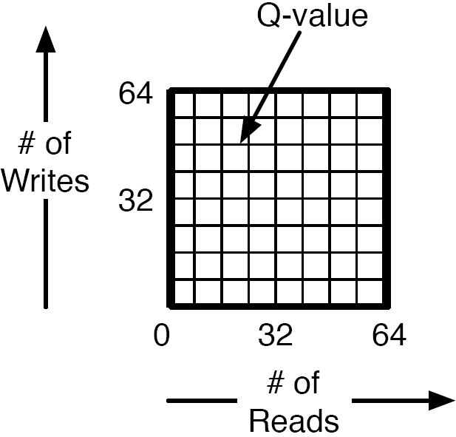
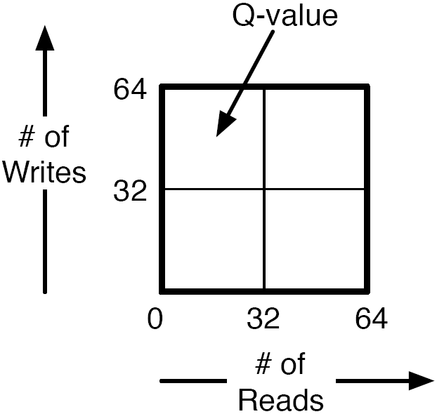
Generalization vs. Resolution
Fine-Grain
Quantization
Resolution
Coarse-Grain
Quantization
Generalization
Less Storage
Overhead
Lower Access
Latency

Slide 12
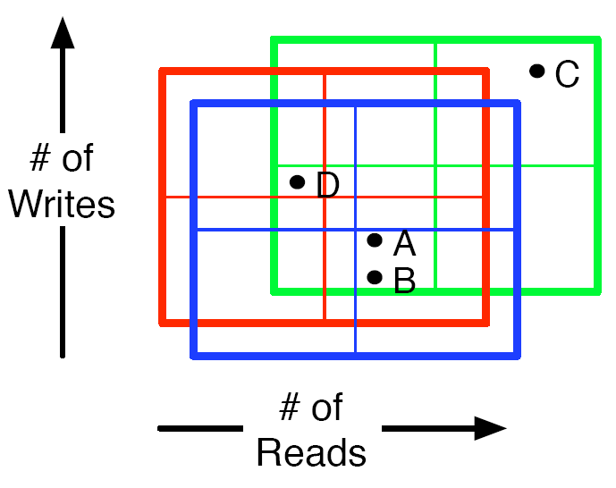
CMAC [Sutton, NIPS’96]

Slide 13
Ensuring Correct Operation
Data integrity
  Restrict scheduling decisions to legal commands
Forward progress
  NOPs not allowed when other legal commands exist
  Rows activated due to pending requests only
  Must issue ≥ 1 read/write to row before it can be precharged
  Waiting time ≥ 10K cycles: timeout policy

Slide 14
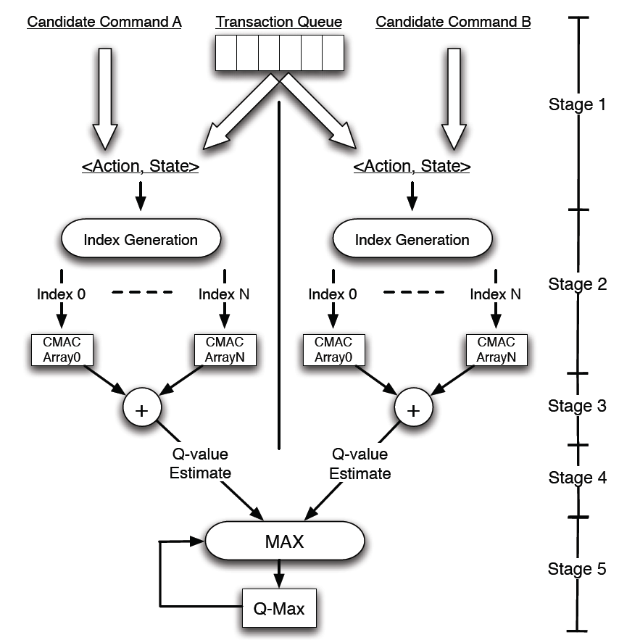
Hardware Implementation
Storage overhead = 32kB

Slide 15
Evaluation

Slide 16
Experimental Setup
Parameter | Value
Frequency | 4GHz
Number of cores | 4, 8, 16
Number of SMT contexts | 2 per core
Fetch/issue/commit width | 4/4/4
Int/FP/Ld/St/Br Units | 2/2/2/2/1
Int/FP Issue Queue Size | 32/32 entries
ROB entries | 96
Int/FP registers | 96/96
Ld/St Queue entries | 24/24
Branch Predictor | A21264
L1 I-Cache | 32KB, 32B, DM, 2-cycle
L1 D-Cache | 32KB, 32B, 2-way, 2-cycle
Coherence Protocol | MESI
Consistency Model | Release Consistency
Parameter | Value
Shared L2 Cache | 4MB, 64B, 8-way, 32 cycles (uncontended)
Write Buffer | 64 entries
Transaction Queue | 64 entries
Peak Data Rate | 6.4, 12.8, 25.6 GB/s
DRAM bus frequency | 400MHz (DDR2-800)
Number of channels | 1, 2, 4
Number of chips | 4 per DIMM
Number of banks | 4 per DRAM chip
Row Buffer Size | 2KB
tRCD/tCL/tCCD/tWTR | 5/5/4/3 DRAM cycles
tWR/tRTP/tRP/tRRD | 6/3/5/3 DRAM cycles
tRP/tRRD/tRAS/tRC | 5/3/18/22 DRAM cycles
Burst Length | 8

Slide 17
Experimental Setup
Benchmark | Suite | Description | Problem Size
ScalParC | NU-MineBench | Decision Tree | 125k pts, 32 attributes
MG | Nas-OpenMP | Multigrid Solver | Class A
CG | Nas-OpenMP | Conjugate Gradient | Class A
Swim-OMP | SPEC-OpenMP | Shallow Water Model | MinneSpec-Large
Equake-OMP | SPEC-OpenMP | Earthquake Model | MinneSpec-Large
Art-OMP | SPEC-OpenMP | Self-Organizing Map | MinneSpec-Large
Ocean | Splash-2 | Ocean Movements | 514x514 ocean
FFT | Splash-2 | Fast Fourier Transform | 1M points
Radix | Splash-2 | Integer Radix Sort | 2M integers

Slide 18
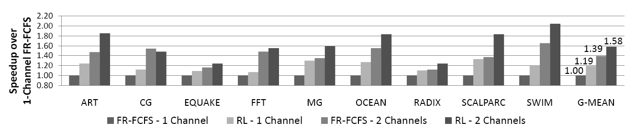
Performance

Slide 19
Other Results (See Paper)
Comparisons against other schedulers
  Extended versions of FR-FCFS
  Fair queuing [Nesbit et al., Micro’06]
Impact of selected attributes
Impact of runtime adaptation
Multi-agent interactions
Sensitivity studies

Slide 20
Conclusions

Slide 21
Contributions and Findings
New approach to designing adaptive memory controllers
  Is based on runtime interaction with real system, not designer assumptions
  Adapts to dynamically changing workload demands
Yields higher-performing schedulers
  19% average speedup over state-of-the-art scheduler (up to 33%)
  Delivers half the speedups achievable by a more expensive, over-provisioned memory system
  Additional 14% improvement when applied to over-provisioned system
Eliminates much of the guesswork and human design effort
  Designer specifies
    What system variables might be useful
    What performance target to optimize, but not how to do it

Slide 22
Self-Optimizing Memory Controllers:
A Reinforcement Learning Approach
Engin Ipek¹, Onur Mutlu¹, Jose F. Martinez², Rich Caruana²
1. Microsoft Research
2. Cornell University

Slide 23
Impact of Selected Attributes

Slide 24
Comparison to QoS-Aware Memory Controllers

Slide 25
Impact of Runtime Adaptation

Slide 26
Performance

Slide 27
Data Bus Utilization

