Slide 1
Improving the Performance of Object-Oriented Languages with Dynamic Predication of Indirect Jumps
José A. Joao*‡
Onur Mutlu‡*
Hyesoon Kim§
Rishi Agarwal†‡
Yale N. Patt*
* HPS Research Group University of Texas at Austin
‡ Computer Architecture Group
Microsoft Research
§ College of Computing
Georgia Institute of Technology
† Dept. of Computer Science and Eng.
IIT Kanpur

Slide 2
Motivation
Polymorphism is a key feature of Object-Oriented Languages
Allows modular, extensible, and flexible software design
Object-Oriented Languages include virtual functions to support polymorphism
Dynamically dispatched function calls based on object type
Virtual functions are usually implemented using indirect jump/call instructions in the ISA
Other programming constructs are also implemented with indirect jumps/calls: switch statements, jump tables, interface calls
Indirect jumps are becoming more frequent with modern languages

Slide 3
Example from DaCapo fop (Java)
Length.class:
Length
protected void computeValue() {}
This indirect call is
hard to predict
public int mvalue() {
if (!bIsComputed)
computeValue();
return millipoints;
}
LinearCombinationLength.class:
LinearCombinationLength
LinearCombinationLength
LinearCombinationLength
LinearCombinationLength
LinearCombinationLength
protected void computeValue() {
// …
setComputedValue(result);
}
PercentLength
PercentLength
PercentLength
PercentLength
PercentLength
PercentLength.class:
protected void computeValue() {
// …
setComputedValue(result1);
}
MixedLength

Slide 4
Predicting Direct Branches vs. Indirect Jumps
A
A
R1 = MEM[R2]
branch R1
N
br.cond TARGET
T
?
TARG
A+1
α
β
δ
ρ
Conditional (Direct) Branch
Indirect Jump
Indirect jumps:
Multiple target addresses → More difficult to predict than conditional (direct) branches
Can degrade performance

Slide 5
The Problem
Most processors predict using the BTB: target of indirect jump = target in previous execution
Stores only one target per jump (already done for conditional branches)
Inaccurate
Indirect jumps usually switch between multiple targets
~50% of indirect jumps are mispredicted
Most history-based indirect jump target predictors add large hardware resources for multiple targets

Slide 6
Indirect Jump Mispredictions
41% of mispredictions due to Indirect Jumps
Data from Intel Core2 Duo processor

Slide 7
Dynamic Indirect Jump Predication (DIP)
A
call R1
DIP-jump
A
Hard to predict
B
C
TARGET 1
TARGET 2
TARGET 3
D
B
nop
p1
E
H
p2
C
G
F
nop
F
p1
p2
G
return
CFM point
Insert select-µops
(φ-nodes in SSA)
I
I
Frequently executed path
Not frequently executed path

Slide 8
Dynamic Predication of Indirect Jumps
The compiler uses control-flow analysis and profiling to identify
DIP-jumps: highly-mispredicted indirect jumps
Control-flow merge (CFM) points
The microarchitecture decides when and what to predicate dynamically
Dynamic target selection

Slide 9
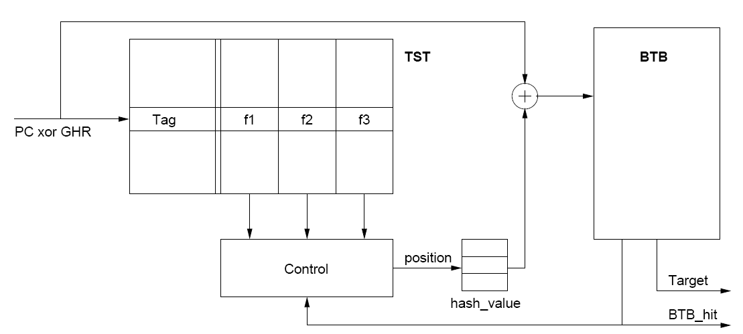
Dynamic Target Selection
Three frequency counters per entry
Associated targets in the BTB
BTB
Branch Target Buffer
3.6KB
Target
Selection
Table
PC
Last target
0 3 1
0 3 1
Most-freq target
Most-freq target
2nd most-freq target
2nd most-freq target
hash2
hash3
To Fetch

Slide 10
Additional DIP Entry/Exit Policies
Single predominant target in the TST
TST has more accurate information
→ Override the target prediction
Nested low confidence DIP-jumps
→ Exit dynamic predication for the earlier jump and re-enter for the later one
Return instructions inside switch statements
Merging address varies with calling site
→ Return CFM points

Slide 11
Methodology
Dynamic profiling tool for DIP-jump and CFM point selection
Cycle-accurate x86 simulator:
Processor configuration
64KB perceptron predictor
4K-entry, 4-way BTB (baseline indirect jump predictor)
Minimum 30-cycle branch misprediction penalty
8-wide, 512-entry instruction window
300-cycle minimum memory latency
2KB 12-bit history enhanced JRS confidence estimator
32 predicate registers, 1 CFM register
Also less aggressive processor (in paper)
Benchmarks: DaCapo suite (Java), matlab, m5, perl
Also evaluated SPEC CPU 2000 and 2006

Slide 12
Indirect Jump Predictors
Tagged Target Cache Predictor (TTC) [P. Chang et al., ISCA 97]
4-way set associative fully-tagged target table
Our version does not store easy-to-predict indirect jumps
Cascaded Predictor [Driesen and Hölzle, MICRO 98, Euro-Par 99]
Hybrid predictor with tables of increasing complexity
3-stage predictor performs best
Virtual Program Counter (VPC) Predictor [Kim et al., ISCA 07]
Predicts indirect jumps using the conditional branch predictor
Stores multiple targets on the BTB, as our target selection logic does

Slide 13
Performance, Power, and Energy
37.8%
2.3%
24.8%
45.5%

Slide 14
DIP vs. Indirect Jump Predictors

Slide 15
Outcome of Executed Indirect Jumps
DIP
used
BTB
correct

Slide 16
Additional Evaluation (in paper)
Static vs. dynamic target selection policies
DIP with more than 2 targets → 2 dynamic targets is best
DIP on top of a baseline with TTC, VPC or Cascaded predictors
Sensitivity to:
Processor configuration
BTB size
TST size and structure
More benchmarks (SPEC CPU 2000 and 2006)

Slide 17
Conclusion
Object-oriented languages use more indirect jumps
Indirect jumps are hard to predict and have already become an important performance limiter
We propose DIP, a cooperative hardware-software technique
Improves performance by 37.8%
Reduces energy by 24.8%
Provides better performance and energy-efficiency than three indirect jump predictors
Incurs low hardware cost (3.6KB) if dynamic predication is already used for conditional branches
Can be an enabler encouraging developers to use object-oriented programming

Slide 18
Thank You!
Questions?

