Slide 1
Software-Based Online Detection of Hardware Defects:
Mechanisms, Architectural Support, and Evaluation
Kypros Constantinides
University of Michigan
Onur Mutlu
Microsoft Research
Todd Austin and Valeria Bertacco
University of Michigan

Slide 2
Reliability Challenges of Technology Scaling
Further scaling
is not profitable
product
cost
1) Cost of built-in defect
tolerance mechanisms
2) Cost of R&D needed to
develop reliable technologies
Cost
reliability
cost
cost per
transistor
reliability
cost
Silicon Process Technology
Suggested Approach
1) Build products out of unreliable components/technologies
2) Provide reliability through very low cost defect-tolerance techniques

Slide 3
Low-cost Online Defect-Tolerance Mechanisms
Remaining Challenge
Online Defect
Detection & Diagnosis
Online
System Repair
Online
System Recovery
Need For Low-Cost
Detection & Diagnosis Mechanisms
Exploit resource redundancy
- Gracefully degrade the
product over time
- The multi-core trend is
supporting this approach
- Low overhead periodic
checkpoint and recovery
- Existing mechanisms:
ReVive + ReViveI/O
SafetyNet
In this work we focus on a low-cost technique for detecting and diagnosing hard silicon defects

Slide 4
Continuous Checking Techniques
Continuously check for execution errors
Shortcomings of continuous checking:
  Redundant computation requires significant extra hardware – high area overhead
  Continuous checking consumes significant energy – pressure on power budget
Dual-Modular Redundancy
Processor Checking
Original
Module
Checker
Main
Processor
Processor
Checker
Copy of the
Module

Slide 5
Periodic Checking Techniques
Periodically stall the processor and check the hardware
  If hardware checking succeeds all previous computation is correct
  Employ checkpointing and roll-back techniques
  Built-In Self-Test (BIST) techniques to check the hardware
On-chip Random Test
Pattern Generation
Shortcomings
Random patterns do not target
any specific testing technique
(fault model)
A lot of patterns are needed for
good coverage
Long testing times
LFSR
Module
Under
Test
Signature
Register
Too slow for online testing – High performance overhead

Slide 6
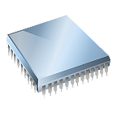
Our Approach – Software-Based Defect Detection
Move the hardware checking overhead to software
Firmware periodically stalls the processor and perform hardware checking
Provide architectural support to the software checking routines
Advantages over hardware-based techniques
- Lower area overhead
- Higher runtime flexibility
- it can support multiple fault models
- dynamic tuning of testing process
- Easier to upgrade (software patches)
FIRMWARE
Periodically stalls the processor and run hardware checking routines
?
Accessibility
Controllability
?
Architectural support to
software-based checking

Slide 7
Access-Control Extensions (ACE) Framework
Architectural support that enables
software access to the processor state
(ACE Hardware)
Special Instructions can access
and control any part of the
processor state
(ACE Instructions)
Firmware can periodically
run directed hardware tests
(ACE Firmware)
Applications
Operating System
Software
ACE Firmware
ACE Extension
ISA
ACE Hardware
Hardware
Processor State
Processor

Slide 8
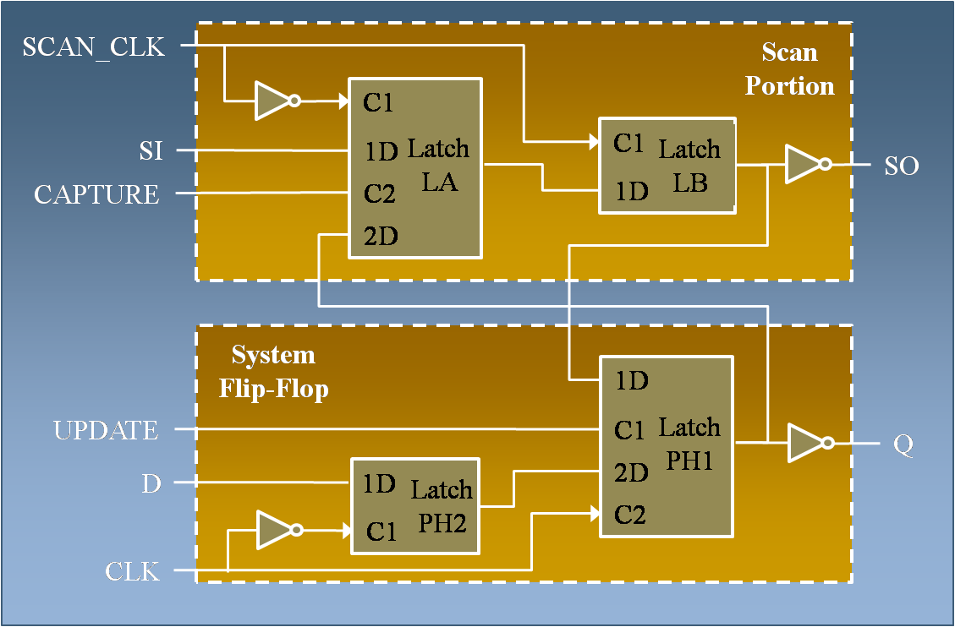
Accessing The Processor State (ACE Hardware)
We leverage the existing full hold-scan chain infrastructure
Full hold-scan chains are employed by most modern processors to improve/automate manufacturing testing
Scan State
(shadow
processor state)
Processor State

Slide 9
Accessing The Processor State (ACE Hardware)
ACE Instructions can move values from the architectural registers to the scan state and vice versa
ACE Instructions can swap data between the scan state and the processor state
ACE Tree
Register File
ACE Node
ACE Node
ACE Node
ACE Node
ACE Node
ACE Node
Scan State
Processor State

Slide 10
Software-based Testing & Diagnosis (ACE Firmware)
ATPG
Automatic test pattern & response generation
Step 1: Load test pattern into scan state
Step 2: 3 cycle atomic test operation
  Cycle 1: Swap scan state with processor state
  Cycle 2: Test cycle
  Cycle 3: Swap scan state with processor state
Step 3: Validate test response
MEMORY
Test Patterns
Test Responses
Register File
ACE Node
ACE Node
ACE Node
ACE Node
ACE Node
ACE Node
Processor State
Test Response
Test Pattern
Scan state
Validation
X
Test Response
Processor State
Test Pattern
Processor state

Slide 11
Timeline of Software-Based Testing
Software-based testing is coupled with a checkpointing and recovery mechanism
Functional software test
Check if the core is capable to run ACE-based testing
Limited fault coverage 60-70%
Very fast < 1000 instructions
Directed ACE-based testing
High-quality testing (ATPG patterns)
High fault coverage ~99%
Runtime < 1M instructions
Checkpoint
Functional Test
ACE-based Test
Checkpoint
COMPUTATION
COMPUTATION
Checkpoint Interval

Slide 12
Experimental Methodology
OpenSPARC T1 CMP – based on Sun’s Niagara
  Synopsys Design Compiler to synthesize the OpenSPARC CMP
  Synopsys TetraMAX ATPG tool for test pattern generation
RTL implementation of ACE framework to get area overhead
Microarchitectural Simulation to get performance overhead
  SESC cycle-accurate simulator
  Simulate a SPARC core enhanced with the ACE framework
Benchmarks from the SPEC CPU2000 suite

Slide 13
Fault Models used for Test Pattern Generation
Stuck-at (0 or 1)
  Industry standard fault model for test pattern generation
  Silicon defects behave as a node stuck at 0 or 1
N-Detect
  Higher probability to detect real hardware defects
  Each stuck-at fault is detected by at least N different patterns
Path-delay
  Test for delay faults that cause timing violations
  Delay fault can be caused due to:
    Manufacturing defects
    Wearout-related defects
    Process variation

Slide 14
Preliminary Functional Testing
Fault injection campaign on a gate-level netlist of a SPARC core
Software functional test – 3 phases (~700 instructions):
  Control flow check
  Register access
  Use all ISA instructions
Functional testing coverage
is low ~ 62%
Undetected faults do not
affect the execution of
ACE firmware
Full coverage provided with further ACE-based testing

Slide 15
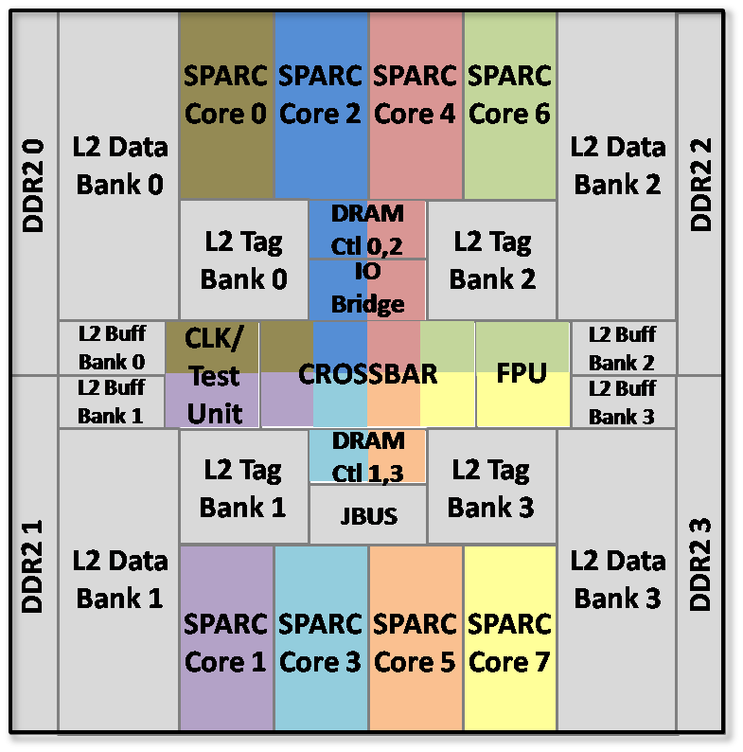
Full-chip Distributed ACE-based Testing
Chip testing is distributed to the eight SPARC cores
Testing for stuck-at and path-delay fault models
Cores [0,1]
Test Instructions: 312K
Coverage: 99.6%
Cores [2,4]
Test Instructions: 468K
Coverage: 98.7%
Cores [3,5]
Test Instructions: 405K
Coverage: 98.8%
Cores [6,7]
Test Instructions: 333K
Coverage: 99.9%

Slide 16
Performance Overhead of ACE-Based Testing
Performance overhead depends on the fault model used to generate patterns
ACE framework is flexible to support test patterns from different fault models
100M Checkpoint Interval
SPEC CPU2000 Average
Higher quality testing

Slide 17
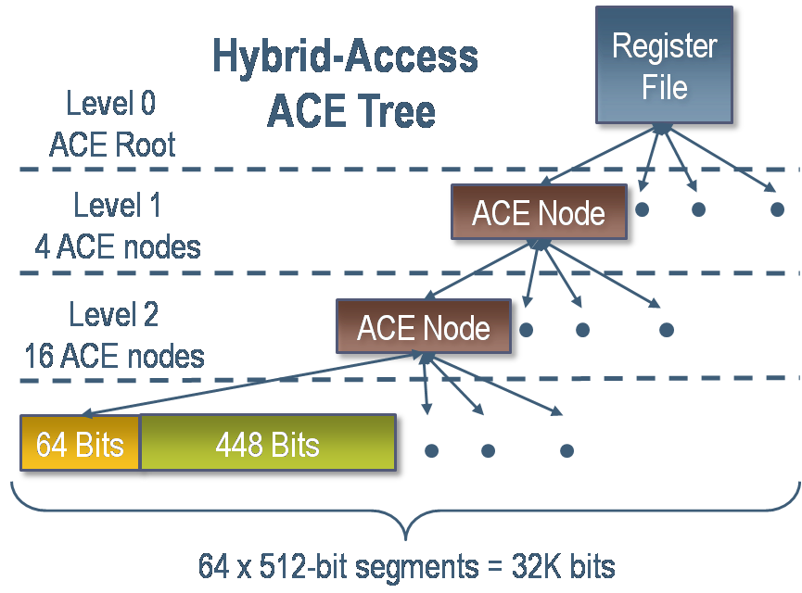
ACE Framework Area Overhead
RTL implementation of
ACE Framework in Verilog
Explored several ACE tree
configurations
8 ACE trees (1 per core)
to cover OpenSPARC
~230K ACE accessible bits
Area Overhead:
0.7% each tree
5.8% for ACE framework

Slide 18
Future Directions – Other Applications
Overhead of ACE framework can be amortized by other applications:
Manufacturing testing
  Lower cost of testing equipment
  Faster testing – testing infrastructure embedded on the chip
Post-Silicon debugging - direct software access to processor state
Online Defect
Detection & Diagnosis
ACE Framework
ACE Firmware
Hardware accessibility & controllability
PROCESSOR
Manufacturing Testing
Post-silicon Debugging

Slide 19
Conclusions
We proposed a novel software-based online defect detection and diagnosis technique
  Low area overhead: 5.8%
  High fault coverage: 99%
  Low performance overhead: 5.5%
Demonstrated the flexibility of the proposed technique to support:
  Dynamic trade-off between performance and reliability
  A number of fault models with varying test quality
The ACE infrastructure can be a unified framework that provides hardware accessibility and controllability to software

Slide 20
Thank You!
Questions?

Slide 21
Performance-Reliability Trade-off
Using more test patterns leads to higher reliability (coverage) but also into higher performance overhead
Software nature of ACE framework enables a flexible runtime tuning between reliability and performance
10% reduction in coverage
46% reduction in
performance overhead

Slide 22
Memory Logging Storage Requirements
Coarse-grain checkpoint intervals of 100M instructions < 10MB

Slide 23
Performance Overhead of I/O-Intensive Applications

Slide 24
ACE Tree Implementation – Area Overhead
RTL implementation of
ACE Tree in Verilog
8 ACE trees (1 per core)
to cover OpenSPARC
~230K bits
Area overhead:
2.3% each ACE tree
18.7% for ACE framework
Direct-Access
ACE Tree
Register File
Level 0
ACE Root
Level 1
2 ACE nodes
ACE Node
Level 2
8 ACE nodes
Level 3
32 ACE nodes
Level4
128 ACE nodes
ACE Node
64 Bits
512 x 64-bit segments = 32K bits

Slide 25
Hybrid ACE Tree – Area Overhead
Hybrid ACE Tree
  Direct-access portion
  Scan chain portion
Area Overhead:
0.7% each tree
5.8% for ACE framework
ACE-based testing latency not affected (serial access to different segments)
Hybrid-Access
ACE Tree
Register File
Level 0
ACE Root
Level 1
4 ACE nodes
ACE Node
Level 2
16 ACE nodes
ACE Node
64 Bits
448 Bits
64 x 512-bit segments = 32K bits

