Slide 1




Low-Cost Inter-Linked Subarrays
(LISA)
Enabling Fast Inter-Subarray Data Movement in DRAM
Kevin Chang
Prashant Nair, Donghyuk Lee, Saugata Ghose,
Moinuddin Qureshi, and Onur Mutlu

Slide 2
Problem: Inefficient Bulk Data Movement
Bulk data movement is a key operation in many applications
  memmove & memcpy: 5% cycles in Google’s datacenter [Kanev+ ISCA’15]
Core
Core
LLC
Memory Controller
src
Channel
Core
Core
64 bits
dst
CPU
Memory
Long latency and high energy

Slide 3
Moving Data Inside DRAM?
8Kb
Bank
512
rows
Subarray 1
Bank
DRAM
cell
Subarray 2
Bank
Subarray 3
…
…
Bank
Subarray N
DRAM
Internal
Data Bus (64b)
Low connectivity in DRAM is the fundamental bottleneck for bulk data movement
Goal: Provide a new substrate to enable
wide connectivity between subarrays

Slide 4

Key Idea and Applications
Low-cost Inter-linked subarrays (LISA)
  Fast bulk data movement between subarrays
  Wide datapath via isolation transistors: 0.8% DRAM chip area
LISA is a versatile substrate → new applications
Subarray 1
…
Subarray 2
  Fast bulk data copy: Copy latency 1.363ms→0.148ms (9.2x)
  → 66% speedup, -55% DRAM energy
  In-DRAM caching: Hot data access latency 48.7ns→21.5ns (2.2x)
  → 5% speedup
  Fast precharge: Precharge latency 13.1ns→5.0ns (2.6x)
  → 8% speedup

Slide 5
Outline
Motivation and Key Idea
DRAM Background
LISA Substrate
  New DRAM Command to Use LISA
Applications of LISA

Slide 6
DRAM Internals
Subarray
Subarray
Bitline
Row Decoder
Wordline
Internal Data Bus
512 x 8Kb
S
S
S
S
64b
P
P
P
P
Row Buffer
Sense amplifier
I/O
S
Bank (16~64 SAs)
P
Precharge unit
8~16 banks per chip

Slide 7
DRAM Operation
1
ACTIVATE: Store the row
into the row buffer
1
1
1
1
2
READ: Select the target
column and drive to I/O
S
S
S
To Bank I/O
S
P
P
P
P
3
PRECHARGE: Reset the bitlines for a new ACTIVATE
V_{dd}/2
Bitline Voltage Level:
V_{dd}

Slide 8
Outline
Motivation and Key Idea
DRAM Background
LISA Substrate
  New DRAM Command to Use LISA
Applications of LISA

Slide 9
Observations
1
Bitlines serve as a bus that is
as wide as a row
S
S
S
S
P
P
P
P
2
Bitlines between subarrays are close but disconnected
Internal Data Bus (64b)
S
S
S
S
P
P
P
P
…

Slide 10

Low-Cost Interlinked Subarrays (LISA)
S
S
S
S
Interconnect bitlines of adjacent subarrays in a bank using
isolation transistors (links)
P
P
P
P
8kb
ON
64b
LISA forms a wide datapath b/w subarrays
S
S
S
S
P
P
P
P
…

Slide 11
New DRAM Command to Use LISA
Row Buffer Movement (RBM): Move a row of data in an activated row buffer to a precharged one
Subarray 1
V_{dd}-Δ
V_{dd}
V_{dd}
Activated
S
S
S
S
P
P
P
P
on
RBM: SA1→SA2
Charge
Sharing
Subarray 2
V_{dd}
V_{dd}/2
V_{dd}/2+Δ
RBM transfers an entire row b/w subarrays
Activated
Precharged
S
S
S
S
Amplify the charge
P
P
P
P
…

Slide 12
RBM Analysis
The range of RBM depends on the DRAM design
  Multiple RBMs to move data across > 3 subarrays
Validated with SPICE using worst-case cells
  NCSU FreePDK 45nm library
4KB data in 8ns (w/ 60% guardband)
→ 500 GB/s, 26x bandwidth of a DDR4-2400 channel
0.8% DRAM chip area overhead [O+ ISCA’14]
Subarray 1
Subarray 2
Subarray 3

Slide 13
Outline
Motivation and Key Idea
DRAM Background
LISA Substrate
  New DRAM Command to Use LISA
Applications of LISA
  1. Rapid Inter-Subarray Copying (RISC)
  2. Variable Latency DRAM (VILLA)
  3. Linked Precharge (LIP)

Slide 14

1. Rapid Inter-Subarray Copying (RISC)
Goal: Efficiently copy a row across subarrays
Key idea: Use RBM to form a new command sequence
Subarray 1
1
src row
Activate src row
S
S
S
S
2
P
P
P
P
RBM SA1→SA2
Subarray 2
Reduces row-copy latency by 9.2x,
DRAM energy by 48.1x
dst row
3
Activate dst row
(write row buffer into dst row)
S
S
S
S
P
P
P
P

Slide 15
Methodology
Cycle-level simulator: Ramulator [CAL’15] https://github.com/CMU-SAFARI/ramulator
CPU: 4 out-of-order cores, 4GHz
L1: 64KB/core, L2: 512KB/core, L3: shared 4MB
DRAM: DDR3-1600, 2 channels
Benchmarks:
  Memory-intensive: TPC, STREAM, SPEC2006, DynoGraph, random
  Copy-intensive: Bootup, forkbench, shell script
50 workloads: Memory- + copy-intensive
Performance metric: Weighted Speedup (WS)

Slide 16
Comparison Points
Baseline: Copy data through CPU (existing systems)
RowClone [Seshadri+ MICRO’13]
  In-DRAM bulk copy scheme
  Fast intra-subarray copying via bitlines
  Slow inter-subarray copying via internal data bus

Slide 17
System Evaluation: RISC
66%
55%
5%
Rapid Inter-Subarray Copying (RISC) using LISA improves system performance
-24%
Degrades bank-level parallelism

Slide 18
2. Variable Latency DRAM (VILLA)
Goal: Reduce DRAM latency with low area overhead
Motivation: Trade-off between area and latency
Long Bitline
(DDRx)
Short Bitline
(RLDRAM)
  Shorter bitlines → faster activate and precharge time
High area overhead: >40%

Slide 19
2. Variable Latency DRAM (VILLA)
Key idea: Reduce access latency of hot data via a heterogeneous DRAM design [Lee+ HPCA’13, Son+ ISCA’13]
VILLA: Add fast subarrays as a cache in each bank
Slow Subarray
512
rows
Challenge: VILLA cache requires frequent movement of data rows
32
rows
Fast Subarray
LISA: Cache rows rapidly from slow to fast subarrays
Reduces hot data access latency by 2.2x
at only 1.6% area overhead
Slow Subarray

Slide 20
System Evaluation: VILLA
50 quad-core workloads: memory-intensive benchmarks
Max: 16%
Avg: 5%
Caching hot data in DRAM using LISA
improves system performance

Slide 21
3. Linked Precharge (LIP)
Problem: The precharge time is limited by the strength of one precharge unit
Linked Precharge (LIP): LISA precharges a subarray using multiple precharge units
S
S
S
S
S
S
S
S
on
P
P
P
P
P
P
P
P
Activated row
Reduces precharge latency by 2.6x
(43% guardband)
Precharging
Linked
Precharging
S
S
S
S
on
S
S
S
S
on
P
P
P
P
P
P
P
P
Conventional DRAM
LISA DRAM

Slide 22
System Evaluation: LIP
50 quad-core workloads: memory-intensive benchmarks
Max: 13%
Avg: 8%
Accelerating precharge using LISA
improves system performance

Slide 23
Other Results in Paper
Combined applications
Single-core results
Sensitivity results
  LLC size
  Number of channels
  Copy distance
Qualitative comparison to other hetero. DRAM
Detailed quantitative comparison to RowClone

Slide 24
Summary
Bulk data movement is inefficient in today’s systems
Low connectivity between subarrays is a bottleneck
Low-cost Inter-linked subarrays (LISA)
  Bridge bitlines of subarrays via isolation transistors
  Wide datapath with 0.8% DRAM chip area
LISA is a versatile substrate → new applications
  Fast bulk data copy: 66% speedup, -55% DRAM energy
  In-DRAM caching: 5% speedup
  Fast precharge: 8% speedup
  LISA can enable other applications
Source code will be available in April https://github.com/CMU-SAFARI

Slide 25
Low-Cost Inter-Linked Subarrays
(LISA)
Enabling Fast Inter-Subarray Data Movement in DRAM
Kevin Chang
Prashant Nair, Donghyuk Lee, Saugata Ghose,
Moinuddin Qureshi, and Onur Mutlu

Slide 26
Backup

Slide 27
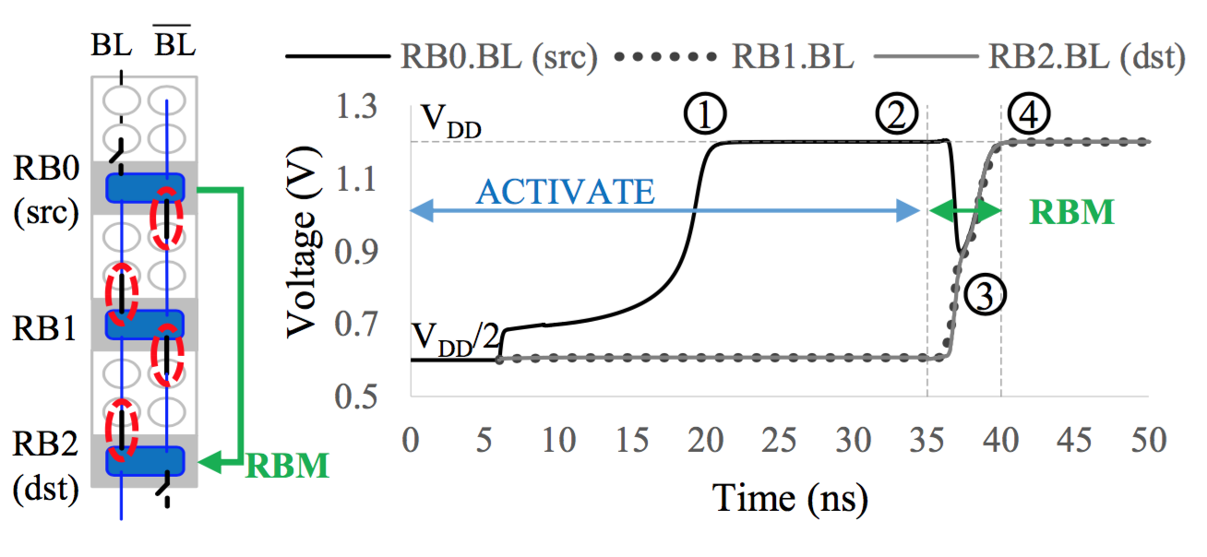
SPICE on RBM

Slide 28
Comparison to Prior Works
Heterogeneous DRAM Designs | TL-DRAM (Lee+ HPCA’13) | CHARM (Son+ ISCA’13) | VILLA
Level of Heterogeneity | Intra- Subarray | Inter- Bank | Inter- Subarray
Caching Latency
Cache Utilization
X
X

Slide 29
Comparison to Prior Works
DRAM Designs | DAS-DRAM (Lu+ MICRO’15) | LISA
Goal | Heterogeneous DRAM design | Substrate for bulk data movement
Enable other applications?
Movement mechanism | Migration cells | Low-cost links
Scalable Copy Latency
X
X

Slide 30
LISA vs. Samsung Patent
S.-Y. Seo,
“Methods of Copying a Page in a Memory Device and Methods of Managing Pages in a Memory System,”
U.S. Patent Application 20140185395, 2014
Only for copying data
Vague. Lack of detail on implementation
  How does data get moved? What are the steps?
No analysis on the latency and energy
No system evaluation

Slide 31
RBM Across 3 Subarrays
Subarray 1
RBM: SA1→SA3
S
S
S
S
P
P
P
P
Subarray 2
S
S
S
S
P
P
P
P
Subarray 3
S
S
S
S
P
P
P
P
Notes:
In this ex, from subarray 1 to 3. SA 1 is activated and the others are precharged. When the links are turned on, the sense amps of both sa 2 and 3 detects the charge difference and further amplify the bitline voltage levels.
We validated the RBM process with a circuit simulator using a 45nm library with worstcase cells and we model RC drop.
To be conservative, if we need to move data across more than 3 subarrays, we can simply invoke multiple RBMs.
Through our SPICE model, we show that RBM can move 4KB in 8ns. We also include 60% latency guardband to account for process and temperature variation. This translates to 500 GB/s bandwidth, 26x higher than a modern channel. All this comes at only 0.8% dram chip area overhead.

Slide 32
Comparison of Inter-Subarray Row Copying
7
15 hops
9x latency and 48x energy reduction
1
Notes:
Here’s a figure comparing the performance of different mechanisms on copying a row of data between two subarrays.
We compare RISC to a prior work (RowClone) that also copies data inside DRAM, but is required to use the narrow DRAM internal data bus to transfer data. We also compare it to a baseline memcpy technique that transfers data across the memory channel.
Y-axis is energy (lower better)
X-axis is latency (lower better)
The numbers on top of RISC show the hop count, which is the number of subarrays between source and destination.
even though the performance degrades as the hop count increases,
RISC reduces the latency by 9x and energy by 48x compared to (row clone) by copying data through the wide datapath,

Slide 33
RISC: Cache Coherence
Data in DRAM may not be up-to-date
MC performs flushes dirty data (src) and invalidates dst
Techniques to accelerate cache coherence
  Dirty-Block Index [Seshadri+ ISCA’14]
Other papers handle the similar issue
[Seshadri+ MICRO’13, CAL’15]

Slide 34
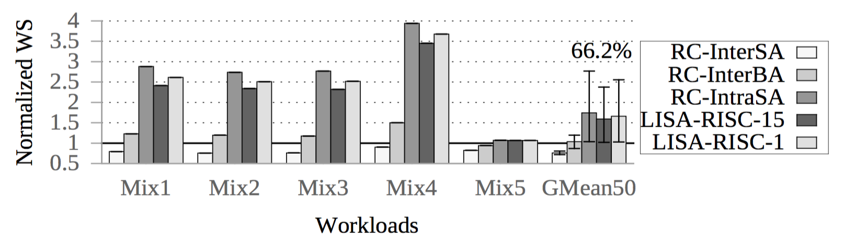
RISC vs. RowClone
4-core results
RowClone

Slide 35
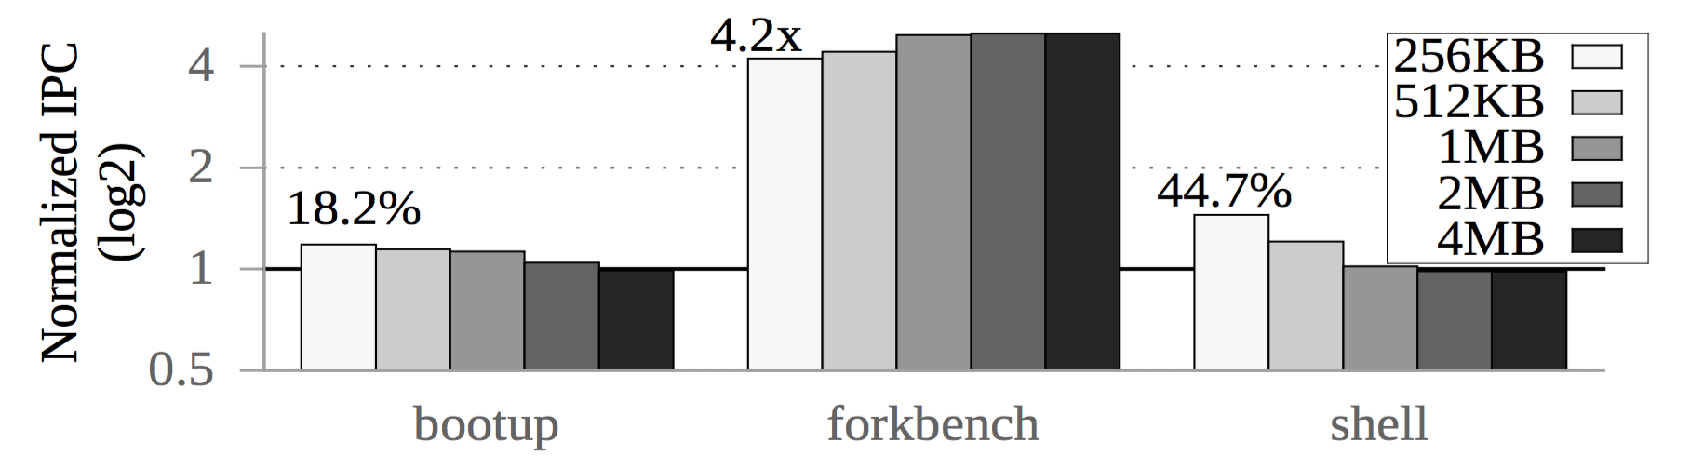
Sensitivity of Cache Size
Single core: RISC vs. baseline as LLC size changes
Baseline: higher cache pollution as LLC size decreases
Forkbench
  RISC: Hit rate – 67% (4MB) to 10% (256KB)
  Base: Hit rate – 20% to 19%

Slide 36
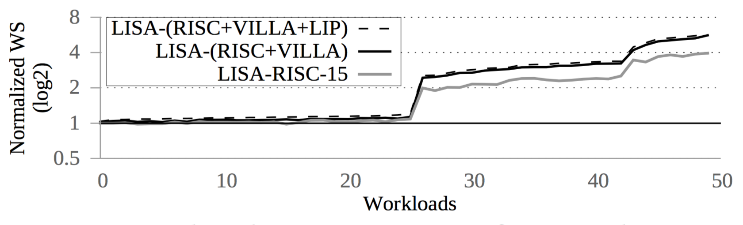
Combined Applications
+8%
+16%
59%

Slide 37
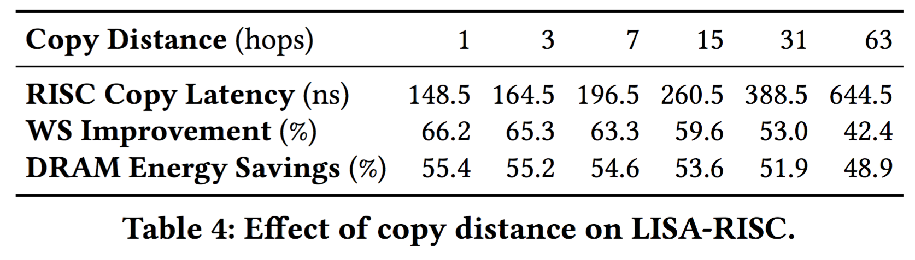
Sensitivity to Copy Distance

Slide 38
VILLA Caching Policy
Benefit-based caching policy [HPCA’13]
  A benefit counter to track # of accesses per cached row
Any caching policy can be applied to VILLA
Configuration
  32 rows inside a fast subarray
  4 fast subarrays per bank
  1.6% area overhead

Slide 39
Area Measurement
Row-Buffer Decoupling by O et al., ISCA’14
28nm DRAM process,
  3 metal layers
  8Gb and 8 banks per device

Slide 40
Other slides

Slide 41


Low-Cost Inter-Linked Subarrays
(LISA)
Enabling Fast Inter-Subarray Data Movement in DRAM
Kevin Chang
Prashant Nair, Donghyuk Lee, Saugata Ghose,
Moinuddin Qureshi, and Onur Mutlu
Notes:
Thank you for introduction.
Today, I’ll present …
This a collaboration work done with my colleagues from CMU and Georgia Tech.

Slide 42
3. Linked Precharge (LIP)
Problem: The precharge time is limited by the strength of one precharge unit (PU)
Linked Precharge (LIP): LISA’s connectivity enables DRAM to utilize additional PUs from other subarrays
S
S
S
S
S
S
S
S
on
P
P
P
P
P
P
P
P
Activated row
Activated row
Precharging
63% precharge latency reduction
(w/ 43% guardband)
Linked
Precharging
S
S
S
S
on
S
S
S
S
on
P
P
P
P
P
P
P
P
Conventional DRAM
LISA DRAM
Notes:
The problem we examine for this application is that the pre time is limited by the drive strength of one precharge unit.
Here’s a figure of two Sas in a bank. The bottom SA is currently activated with a row and the top one is in precharge state. To precharge the bot sa, the MC sends a command to turn on the precharge units in the SA’s row buffer to begin the precharge process.
Each PU is responsible for an activated bitline. Therefore, the pre latency is bounded by the strength of a single precharge unnit.
Since the bitlines can now be connected across subarrays using LISA, we propose LIP, to exploit LISA’ connectivity to accelerate the precharge operation of a subarray by using additional Pus from other subarrays.
Let me demonstrate the process. Here are the same two sas linked by lisa.
The lip process begins by switching on the iso and enabling two Pus per column to simultaneously precharge one set of the activated bitlines,
thus effectively reducing the precharge latency.
Our spice simulation shows that LIP reduces precharge latency by 63% and we add an additional 43% guardband for process and temperature variation.
Our circuit simulation shows that LIP reduces the precharge latency by 63%

Slide 43
Key Idea and Applications
Low-cost Inter-linked subarrays (LISA)
  Fast bulk data movement b/w subarrays
  Wide datapath via isolation transistors: 0.8% DRAM chip area
LISA is a versatile substrate → new applications
  Fast bulk data copy: Copy latency 1.3ms→0.1ms (9x)
  ↑ 66% sys. performance and 55% energy efficiency
  In-DRAM caching: Access latency 48ns→21ns (2x)
  ↑ 5% sys. performance
  Linked precharge: Precharge latency 13ns→5ns (2x)
  ↑ 8% sys. performance
Subarray 1
Subarray 2
Notes:
I’ll start off with a summary of my talk today.
In today’s system, bulk data movement, the movement of 1000s/mils of bytes between two memory locations, is a key operation performed in many applications and operating systems today. The problem is that contemporary systems perform this movement inefficiently by transferring data back-and-forth b/w the cpu and memory.
A strawman approach to this problem is to simply move those bulk data inside dram without transferring them to CPU. However, we find this approach still inefficient and it incurs long latency and high energy.
<C>This is because the connectivity inside DRAM is low, thus serializing bulk data movement.
To tackle this challenge, we introduce a new DRAM design, called LISA, that enables fast and energy efficient bulk data movement inside dram.
The key idea is form a wide datapath within a dram chip by using low cost isolation transistors, which incur a small area overhead of 0.8%.
Using this datapath, we can move a large amount of data inside DRAM efficiently.
As a DRAM substrate, LISA is versatile, enabling many new applications.
We implement and evaluate three of them in detail.
The first one is a new mechanism that reduces latency and dram energy of bulk data copy. Our evaluations show that this mechanism xx on workloads that perform bulk data copy.
The second one is a new in-DRAM caching scheme using a DRAM arch. whose rows have hetero access latencies. This improves average system performance by 5% across many general purpose workloads.
Last but not least, we exploit lisa to accelerate the DRAM precharge operation, resulting in 8% system performance improvement on average across general workloads.
Now let’s take a look at bulk data movement in detail.
Trc=48.75/21.5

Slide 44
Low-Cost Inter-Linked Subarrays (LISA)
Row Decoder
S
S
S
S
P
P
P
P
LISA link
Notes:
We make two major observations.
The bitlines essentially serve as a row-wide bus. B/c Accessing data causes the entire row to transfer to its row buffers through the bitlines.
subarrays are placed in close proximity to each other, thus the bitlines are very close, but are not connected together.
Based on these two observations, we propose Low-Cost inter-linked subarrays (LISA), <CLICK>
that interconnects subarrays by linking their bitlines with iso. And we call each of these iso a lisa link

Slide 45



Slide 46
Key Idea and Applications
Low-cost Inter-linked subarrays (LISA)
  Fast bulk data movement b/w subarrays
  Wide datapath via isolation transistors: 0.8% DRAM chip area
LISA is a versatile substrate → new applications
Subarray 1
…
Subarray 2
  Fast bulk data copy: Copy latency 1.363ms→0.148ms (9.2x)
  +66% speedup and -55% DRAM energy efficiency
  In-DRAM caching: Hot data access latency 48.7ns→21.5ns (2.2x)
  ↑ 5% sys. performance
  Fast precharge: Precharge latency 13.1ns→5ns (2.6x)
  ↑ 8% sys. performance
Notes:
To achieve this goal, we introduce a new DRAM substrate, called LISA, that enables fast and energy efficient bulk data movement b/w subarrays inside dram.
<CLICK-show SA> The key idea is to interconnect the subarrays to form a wide datapath by using low cost isolation transistors,
which incur a small area overhead of 0.8%.
Using this datapath, we can move a large amount of data inside DRAM efficiently.
As a DRAM substrate, LISA is versatile, enabling many new applications.
We implement and evaluate three of them in detail.
1. The first one is a new mechanism that reduces the bulk data copy latency by 9x. Our evaluations show that this mechanism xx on workloads that perform bulk data copy.
2. The second one is a new in-DRAM caching scheme using a DRAM arch. whose rows have hetero access latencies. This reduces the access latency for hot data by 2x, thus improving average system performance by 5% across many general purpose workloads.
3. Last but not least, the lisa substrate for moving data is also good for reducing precharge latency as I’ll explain later in this talk. With a reduction of 2x precharge latency, it alone improves 8% system performance on average across general workloads.
Before I jump into the implementation on our substrate and apps,
I’ll explain the basic dram background in order to understand the design changes.

Slide 47
Moving Data Inside DRAM?
8Kb
Bank
512
rows
Subarray 1
Bank
DRAM
cell
Subarray 2
Bank
Subarray 3
…
…
Bank
Subarray N
DRAM
Internal
Data Bus (64b)
Low connectivity in DRAM is the fundamental bottleneck for bulk data movement
Goal: Provide a new substrate to enable wide connectivity between subarrays
Notes:
<f> 8kb/64b = 128 transfers
One natural question that one may ask is: can’t we just move data inside DRAM to avoid this unnecessary round-trip?
Although this approach cuts some costs, it’s still very inefficient. To understand the reason, we need to take a look
at the basic organization of a dram chip.
A dram chip is divided into multiple bank, where each bank consists of a large number of DRAM cells.
Because accessing one monolithic large array is slow, the cells in a bank are split into many smaller arrays.
Each of them is called a subarray.
A subarray typically has 512 rows of cells, where each row is 8kb wide.
<*>Moving data inside a subarray is easy b/c rows inside a subarray are inter-connected very highly at the 8kb level.
But across the subarrays, they are connected by an internal data bus, that is only 64-bit wide.
So moving a lot of data from one sa to another one has to go through this data bus.
As one can see, even if data transfer occurs inside DRAM, low connectivity in dram becomes
the fundamental bottleneck for bulk data movement.
Therefore, our goal is to design a low cost DRAM substrate
that enables wide connectivity b/w subarrays so that a large amount of data can move efficiently.
We call this substrate…

Slide 48
Low Connectivity in DRAM
Problem: Simply moving data inside DRAM is inefficient
Low connectivity in DRAM is the fundamental bottleneck for bulk data movement
8Kb
Bank
512
rows
Subarray 1
Bank
DRAM
cell
Subarray 2
Bank
Subarray 3
…
…
Bank
Subarray N
DRAM
Internal
Data Bus (64b)
Goal: Provide a new substrate to enable wide connectivity b/w subarrays
Notes:
One natural question that one may ask is: can’t we just move data inside DRAM to avoid this unnecessary round-trip?
Although this approach cuts some costs, it’s still very inefficient. To understand why, we need to take a look
at the basic organization of a dram chip.
A dram chip is divided into multiple bank, where each bank consists of a large number of DRAM cells.
Because accessing one monolithic large array is slow, the cells in a bank are split into many smaller arrays.
Each of them is called a subarray.
A subarray typically has 512 rows of cells, where each row is 8kb wide.
<*>Moving data inside a subarray is easy b/c rows inside a subarray are inter-connected very highly at the 8kb level.
But across the subarrays, they are connected by an internal data bus, that is only 64-bit wide.
So moving a lot of data from one sa to another one has to go through this data bus.
As one can see, even if data transfer occurs inside DRAM, low connectivity in dram becomes
the fundamental bottleneck for bulk data movement.
Therefore, our goal is to design a low cost DRAM substrate
that enables wide connectivity b/w subarrays so that a large amount of data can move efficiently.

Slide 49
Low Connectivity in DRAM
Problem: Simply moving data inside DRAM is inefficient
Low connectivity in DRAM is the fundamental bottleneck for bulk data movement
8Kb
Bank
512
rows
Subarray 1
Bank
DRAM
cell
Subarray 2
Bank
Subarray 3
…
Bank
Subarray N
DRAM
Internal
Data Bus (64b)
Goal: Provide a new substrate to enable wide connectivity between subarrays
Notes:
One natural question that one may ask is: can’t we just move data inside DRAM to avoid this unnecessary round-trip?
Although doing so avoids some costs, it’s still very inefficient. To understand why, we need to take a look
at the basic organization of a dram chip.
A dram chip consists of a large number of DRAM cells.
Because accessing one monolithic large array is slow, the cells are split into many smaller arrays, where each of them is called a subarray.
A subarray typically has 512 rows of cells, where each row is 8kb wide.
Moving data inside a subarray is easy b/c rows inside a subarray are inter-connected at the 8kb level, very highly. But across the subarrays, they are connected by an internal data bus, that is only 64-bit wide.
So if you want to move a lot of data from one sa to another one, you have to go through this bus for a long time.
As one can see, even if data transfer occurs inside DRAM, low connectivity in dram becomes
the fundamental bottleneck for bulk data movement.
Therefore, our goal is to design a low cost DRAM substrate that enables wide connectivity b/w subarrays so that a large amount of data can move efficiently.

