Slide 1

Revisiting Memory Errors in
Large-Scale Production Data Centers
Analysis and Modeling of New Trends from the Field
      Justin Meza
Qiang Wu
Sanjeev Kumar
Onur Mutlu

Slide 2
Overview
Study of DRAM reliability:
on modern devices and workloads
at a large scale in the field

Slide 3
Overview
Error/failure occurrence
New
reliability
trends
Page offlining
at scale
Technology
scaling
Modeling errors
Architecture &
workload

Slide 4

Overview
Error/failure occurrence
New
reliability
trends
Page offlining
at scale
Technology
scaling
Errors follow a power-law distribution and a large number of errors occur due to sockets/channels
Modeling errors
Architecture &
workload
Notes:
Unlike popularly believed, memory errors are not isolated events and can bombard a server, creating a kind of denial of service attack.

Slide 5

Overview
Error/failure occurrence
New
reliability
trends
We find that newer cell fabrication technologies have higher failure rates
Page offlining
at scale
Technology
scaling
Modeling errors
Architecture &
workload

Slide 6
Overview
Error/failure occurrence
New
reliability
trends
Chips per DIMM, transfer width, and workload type (not necessarily CPU/memory utilization) affect reliability
Page offlining
at scale
Technology
scaling
Modeling errors
Architecture &
workload

Slide 7
Overview
Error/failure occurrence
New
reliability
trends
We have made publicly available a statistical model for assessing server memory reliability
Page offlining
at scale
Technology
scaling
Modeling errors
Architecture &
workload

Slide 8
Overview
Error/failure occurrence
New
reliability
trends
First large-scale study of page offlining; real-world limitations of technique
Page offlining
at scale
Technology
scaling
Modeling errors
Architecture &
workload

Slide 9
Outline
background and motivation
server memory organization
error collection/analysis methodology
memory reliability trends
summary

Slide 10
Background and
motivation

Slide 11
DRAM errors are common
examined extensively in prior work
    charged particles, wear-out
    variable retention time (next talk)
error correcting codes
    used to detect and correct errors
    require additional storage overheads

Slide 12
Our goal
Strengthen understanding
of DRAM reliability by studying:
new trends in DRAM errors
    modern devices and workloads
at a large scale
    billions of device-days, across 14 months

Slide 13
Our main contributions
identified new DRAM failure trends
developed a model for DRAM errors
evaluated page offlining at scale

Slide 14
Server memory
organization

Slide 15
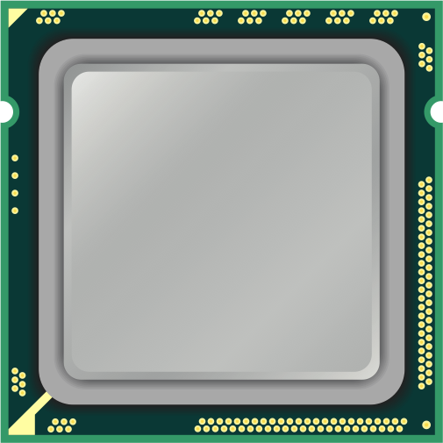

Slide 16
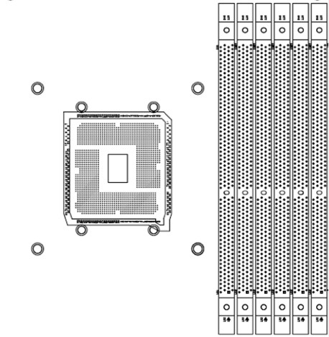
Socket

Slide 17
Memory
channels

Slide 18
DIMM
slots

Slide 19
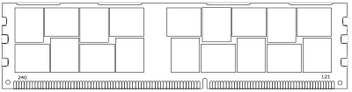
DIMM

Slide 20
Chip

Slide 21
Banks

Slide 22
Rows and
columns

Slide 23
Cell

Slide 24
User data
ECC metadata
additional 12.5% overhead

Slide 25
Reliability events
Fault
the underlying cause of an error
    DRAM cell unreliably stores charge
Error
the manifestation of a fault
permanent: every time
transient: only some of the time

Slide 26
Error collection/
analysis
methodology

Slide 27
DRAM error measurement
measured every correctable error
    across Facebook's fleet
    for 14 months
    metadata associated with each error
parallelized Map-Reduce to process
used R for further analysis

Slide 28
System characteristics
6 different system configurations
    Web, Hadoop, Ingest, Database, Cache, Media
    diverse CPU/memory/storage requirements
modern DRAM devices
    DDR3 communication protocol
        (more aggressive clock frequencies)
    diverse organizations (banks, ranks, ...)
    previously unexamined characteristics
        density, # of chips, transfer width, workload

Slide 29
Memory reliability
trends

Slide 30
Error/failure occurrence
New
reliability
trends
Page offlining
at scale
Technology
scaling
Modeling errors
Architecture &
workload

Slide 31
Error/failure occurrence
New
reliability
trends
Page offlining
at scale
Technology
scaling
Modeling errors
Architecture &
workload

Slide 32
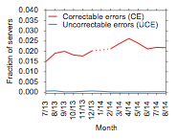
Server error rate
3%
0.03%
Notes:
- Correctable errors occur relatively commonly and affect around 2% of servers each month.

Slide 33
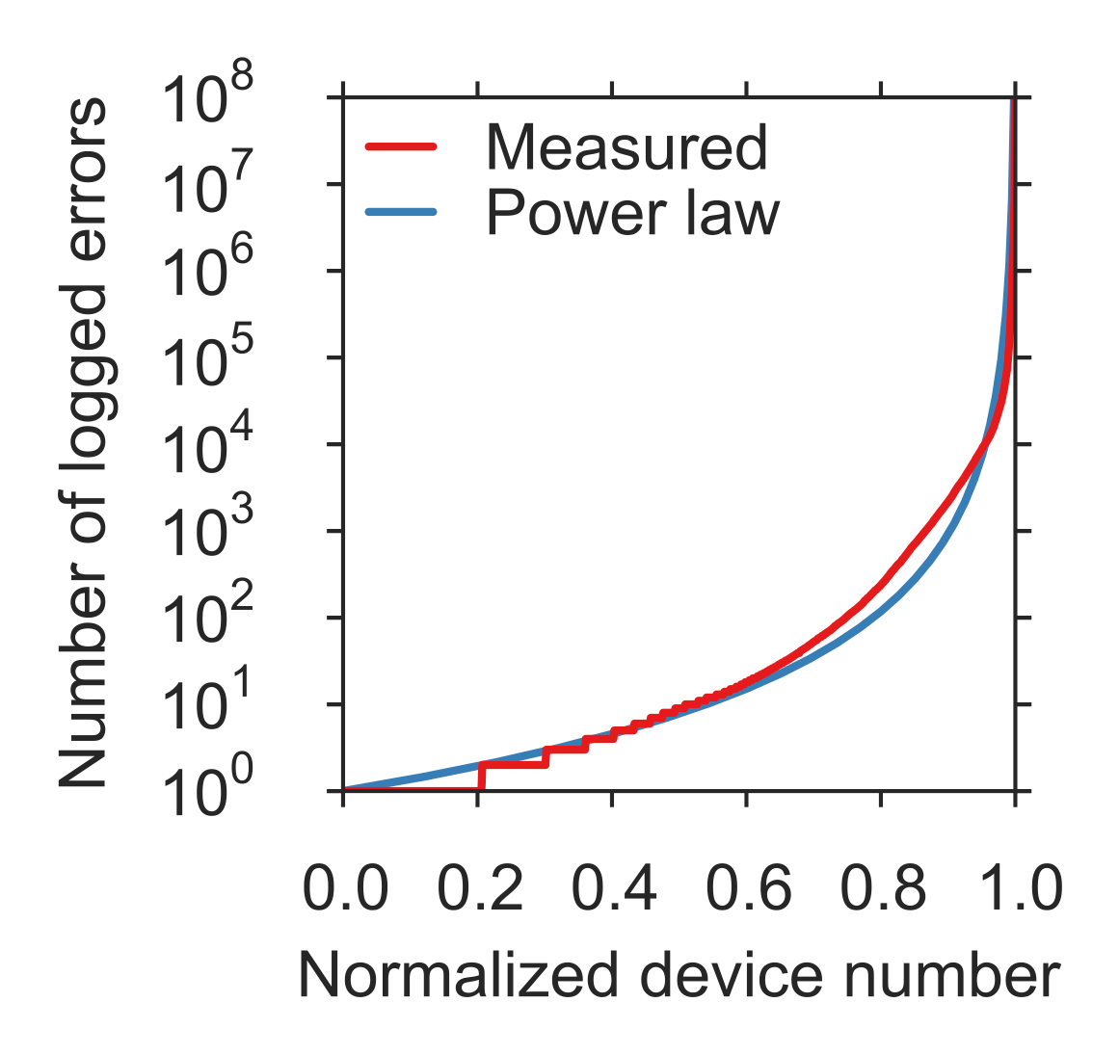
Memory error distribution

Slide 34
Memory error distribution
Decreasing
hazard
rate

Slide 35

Memory error distribution
Decreasing
hazard
rate
How are errors mapped to memory organization?

Slide 36
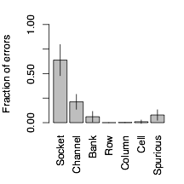
Sockets/channels: many errors

Slide 37

Sockets/channels: many errors
Not mentioned in prior chip-level studies

Slide 38

Sockets/channels: many errors
Not accounted for in prior chip-level studies
At what rate do components fail on servers?

Slide 39
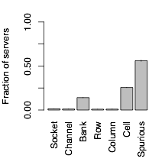
Bank/cell/spurious failures are common

Slide 40

# of servers
# of errors
Denial-of-service–like behavior

Slide 41
# of servers
# of errors
Denial-of-service–like behavior
What factors contribute to memory failures at scale?

Slide 42
Analytical methodology
measure server characteristics
    not feasible to examine every server
    examined all servers with errors (error group)
    sampled servers without errors (control group)
bucket devices based on characteristics
measure relative failure rate
    of error group vs. control group
    within each bucket

Slide 43
Error/failure occurrence
New
reliability
trends
Page offlining
at scale
Technology
scaling
Modeling errors
Architecture &
workload

Slide 44
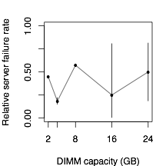
Prior work found
inconclusive trends
with respect to memory capacity

Slide 45

Prior work found
inconclusive trends
with respect to memory capacity
Examine characteristic more closely related to cell fabrication technology

Slide 46
DRAM chip density
Use
to examine technology scaling
(closely related to fabrication technology)

Slide 47
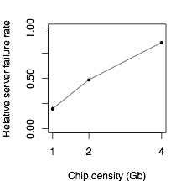

Slide 48
Intuition:
quadratic
increase in
capacity

Slide 49
Error/failure occurrence
New
reliability
trends
We find that newer cell fabrication technologies have higher failure rates
Page offlining
at scale
Technology
scaling
Modeling errors
Architecture &
workload

Slide 50
Error/failure occurrence
New
reliability
trends
Page offlining
at scale
Technology
scaling
Modeling errors
Architecture &
workload

Slide 51
DIMM architecture
chips per DIMM, transfer width
    8 to 48 chips
    x4, x8 = 4 or 8 bits per cycle
electrical implications

Slide 52
DIMM architecture
Does DIMM organization affect memory reliability?
chips per DIMM, transfer width
    8 to 48 chips
    x4, x8 = 4 or 8 bits per cycle
electrical implications

Slide 53
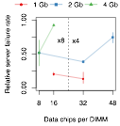

Slide 55
No consistent trend across only chips per DIMM

Slide 59
More chips ➔
higher failure rate

Slide 61
More bits per cycle ➔ higher failure rate

Slide 62
Intuition: increased electrical loading

Slide 63
Workload dependence
prior studies: homogeneous workloads
    web search and scientific
warehouse-scale data centers:
    web, hadoop, ingest, database, cache, media

Slide 64
Workload dependence
prior studies: homogeneous workloads
    web search and scientific
warehouse-scale data centers:
    web, hadoop, ingest, database, cache, media
What affect to heterogeneous workloads have on reliability?

Slide 65
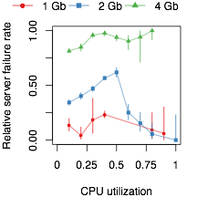
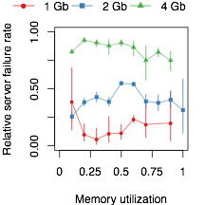

Slide 66
No consistent trend across CPU/memory utilization

Slide 67
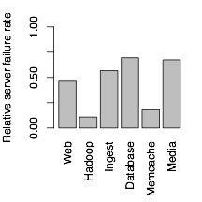

Slide 68
Varies by
up to 6.5x

Slide 69
Error/failure occurrence
New
reliability
trends
Chips per DIMM, transfer width, and workload type (not necessarily CPU/memory utilization) affect reliability
Page offlining
at scale
Technology
scaling
Modeling errors
Architecture &
workload

Slide 70
Error/failure occurrence
New
reliability
trends
Page offlining
at scale
Technology
scaling
Modeling errors
Architecture &
workload

Slide 71
A model for server failure
use statistical regression model
    compare control group vs. error group
    linear regression in R
    trained using data from analysis
enable exploratory analysis
    high perf. vs. low power systems

Slide 72
Density
Memory error
model
Relative
server
failure
rate
Chips
Age
...

Slide 73
Density
Memory error
model
Relative
server
failure
rate
Chips
Age
...

Slide 74

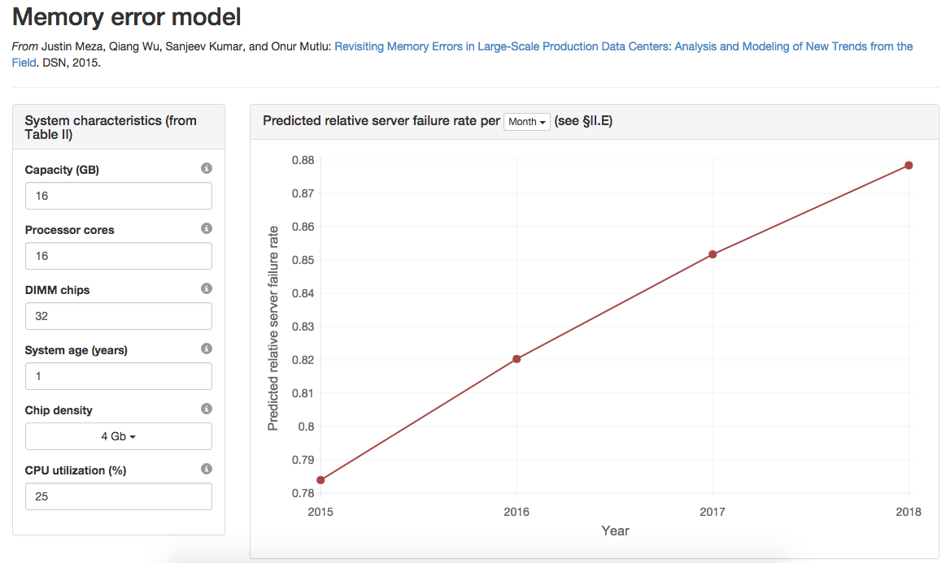

Available online
http://www.ece.cmu.edu/~safari/tools/memerr/

Slide 75
Error/failure occurrence
New
reliability
trends
We have made publicly available a statistical model for assessing server memory reliability
Page offlining
at scale
Technology
scaling
Modeling errors
Architecture &
workload

Slide 76
Error/failure occurrence
New
reliability
trends
Page offlining
at scale
Technology
scaling
Modeling errors
Architecture &
workload

Slide 77
Prior page offlining work
[Tang+,DSN'06] proposed technique
    "retire" faulty pages using OS
    do not allow software to allocate them
[Hwang+,ASPLOS'12] simulated eval.
    error traces from Google and IBM
    recommended retirement on first error
        large number of cell/spurious errors

Slide 78
Prior page off lining work
[Tang+,DSN'06] proposed technique
    "retire" faulty pages using OS
    do not allow software to allocate them
[Hwang+,ASPLOS'12] simulated eval.
    error traces from Google and IBM
    recommended retirement on first error
        large number of cell/spurious errors
How effective is page offlining in the wild?

Slide 79
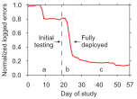
Cluster of
12,276 servers

Slide 80
Cluster of
12,276 servers
-67%

Slide 81
Cluster of
12,276 servers
-67%
Prior work:
-86% to -94%

Slide 82
Cluster of
12,276 servers
-67%
6% of page offlining attempts failed due to OS
Prior work:
-86% to -94%

Slide 83
Error/failure occurrence
New
reliability
trends
First large-scale study of page offlining; real-world limitations of technique
Page offlining
at scale
Technology
scaling
Modeling errors
Architecture &
workload

Slide 84
Error/failure occurrence
New
reliability
trends
Page offlining
at scale
Technology
scaling
Modeling errors
Architecture &
workload

Slide 85
More results in paper
Vendors
Age
Processor cores
Correlation analysis
Memory model case study

Slide 86
Summary

Slide 87
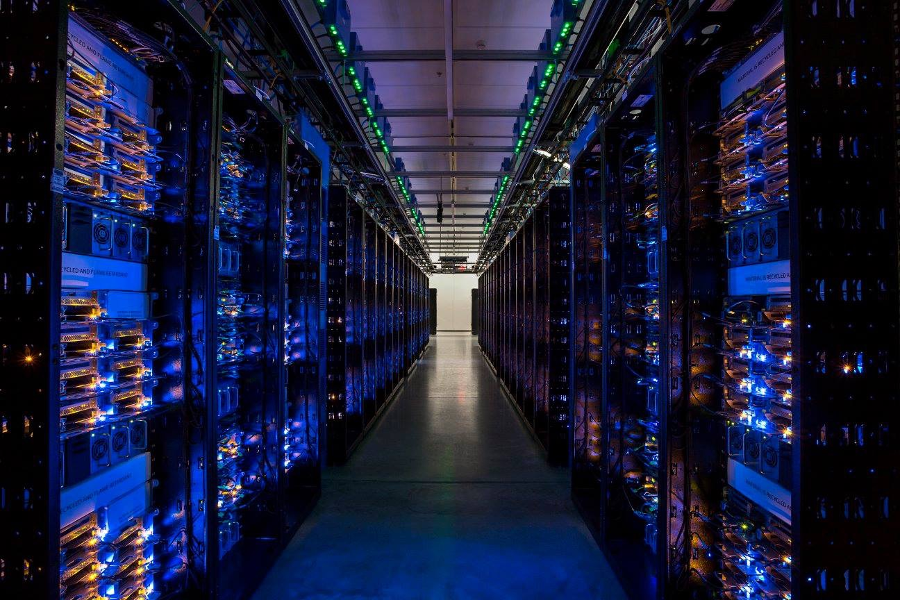
Modern systems
Large scale

Slide 88
Summary
Error/failure occurrence
New
reliability
trends
Page offlining
at scale
Technology
scaling
Modeling errors
Architecture &
workload

Slide 89
Summary
Error/failure occurrence
New
reliability
trends
Page offlining
at scale
Technology
scaling
Errors follow a power-law distribution and a large number of errors occur due to sockets/channels
Modeling errors
Architecture &
workload
Notes:
Unlike popularly believed, memory errors are not isolated events and can bombard a server, creating a kind of denial of service attack.

Slide 90
Summary
Error/failure occurrence
New
reliability
trends
We find that newer cell fabrication technologies have higher failure rates
Page offlining
at scale
Technology
scaling
Modeling errors
Architecture &
workload

Slide 91
Summary
Error/failure occurrence
New
reliability
trends
Chips per DIMM, transfer width, and workload type (not necessarily CPU/memory utilization) affect reliability
Page offlining
at scale
Technology
scaling
Modeling errors
Architecture &
workload

Slide 92
Summary
Error/failure occurrence
New
reliability
trends
We have made publicly available a statistical model for assessing server memory reliability
Page offlining
at scale
Technology
scaling
Modeling errors
Architecture &
workload

Slide 93
Summary
Error/failure occurrence
New
reliability
trends
First large-scale study of page offlining; real-world limitations of technique
Page offlining
at scale
Technology
scaling
Modeling errors
Architecture &
workload

Slide 94
Revisiting Memory Errors in
Large-Scale Production Data Centers
Analysis and Modeling of New Trends from the Field
      Justin Meza
Qiang Wu
Sanjeev Kumar
Onur Mutlu

Slide 95
Backup slides

Slide 96
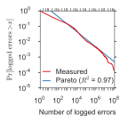
Decreasing hazard rate

Slide 98
Errors | 54,326 | 0 | 2 | 10
Density | 4Gb | 1Gb | 2Gb | 2Gb

Slide 99
Errors | 54,326 | 0 | 2 | 10
Density | 4Gb | 1Gb | 2Gb | 2Gb
Errors
Density

Slide 100
Errors | 54,326 | 0 | 2 | 10
Density | 4Gb | 1Gb | 2Gb | 2Gb
Buckets
Errors
Density

Slide 101
Errors | 54,326 | 0 | 2 | 10
Density | 4Gb | 1Gb | 2Gb | 2Gb
Errors
Density

Slide 102
Errors | 54,326 | 0 | 2 | 10
Density | 4Gb | 1Gb | 2Gb | 2Gb
Errors
Density

Slide 103
Case study

Slide 104

Case study
Inputs
Output

Slide 105
Case study
Does CPUs or density have a higher impact?
Inputs
Output

Slide 106
Exploratory analysis

Slide 107
Exploratory analysis

