Slide 1




Morpheus
Extending the Last Level Cache Capacity in GPU Systems with Idle GPU Core Resources
Sina Darabi, Mohammad Sadrosadati, Joël Lindegger,
Negar Akbarzadeh, Mohammad Hosseini, Jisung Park,
Juan Gómez-Luna, Hamid Sarbazi-Azad, Onur Mutlu
December 23rd 2022
Notes:
Good afternoon, I’m Joel Lindegger, I’m a PhD student in the SAFARI research group at ETH Zurich.
I will present to you our work “Morpheus: Extending the Last Level Cache Capacity in GPU Systems with Idle GPU Core Resources”.
Let me start with a high-level overview. [Click]

Slide 2


Motivation & Goal
Memory-bound GPU applications
leave some cores under-utilized
Our Goal:
Leverage the under-utilized cores
to boost the performance and energy efficiency
of memory-bound applications
Notes:
We observe that memory-bound GPU applications [Click] leave some cores under-utilized.
Our *goal* [Click] is to leverage the under-utilized cores to boost the performance and energy efficiency of memory-bound applications [Click]

Slide 3



Our Work
Morpheus
First technique that leverages some GPU cores’ private memories to extend the total GPU last-level cache (LLC) capacity
Morpheus employs (1) a software helper kernel in cores
and (2) a new hardware unit in the LLC partitions
Morpheus significantly improves performance and energy efficiency of memory-bound GPU applications
and enables a 4x larger LLC with the same LLC hardware
Notes:
To this end, we propose Morpheus [Click], the first technique that leverages some GPU core’s private memories to extend the total GPU last-level cache capacity. [Click]
Morpheus employs a software helper kernel in cores and a new hardware unit in the LLC partitions. [Click]
Morpheus significantly improves performance *and* energy efficiency of memory-bound GPU applications, and enables a 4x larger LLC with the same LLC hardware. [Click]

Slide 4
Outline
Introduction
1
Morpheus: Overview
2
Morpheus Controller
3
Extended LLC Kernel
4
Hit/Miss Prediction
5
Evaluation
6
Conclusion
7
Notes:
Let’s dive into a more detailed introduction. [Click]

Slide 5
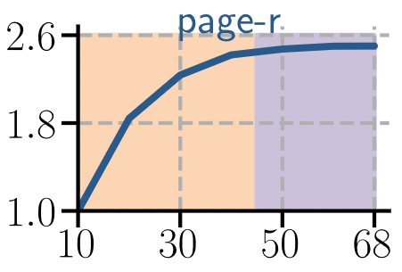
Memory-Bound GPU Applications
Speedup
#GPU Cores
Notes:
To motivate our work, we study memory-bound GPU applications on an NVIDIA RTX 3080. Here we plot speedup on the y-axis, and the number of GPU cores on the x-axis. [Click]

Slide 6
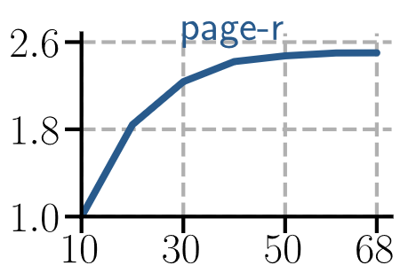
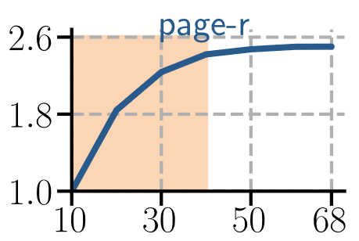
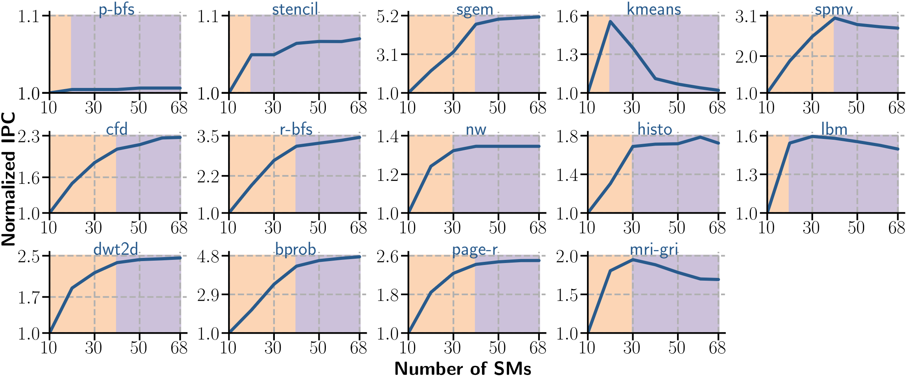
Memory-Bound GPU Applications
Little to no performance benefit
from 40 to 68 cores
Speedup
over 10 cores
#GPU Cores
Good performance benefit
up to 40 cores
Notes:
For a memory-bound application like page rank, we observe [Click] good performance benefits up to for 40 cores, and then [Click] little to no performance benefit from 40 to 68 cores. [Click]
We study an entire range of memory-bound GPU application... [Click]

Slide 7
Memory-Bound GPU Applications
Good performance benefit
Little to no performance benefit
Speedup
over 10 cores
#GPU Cores
Conventional GPUs do not benefit (significantly)
from all cores for memory-bound applications
Notes:
and consistently observe the same pattern:
There are good performance benefits [Click] up to some number of cores,
and then [Click] little to no performance benefits from the remaining cores.
We conclude that [Click] conventional GPUs do *not* benefit from all cores for memory-bound applications. [Click]

Slide 8
Our Goal
Little to no performance benefit
for memory-bound applications
Good performance benefit
GPU Cores
Core
Core
Core
Core
Core
Core
Core
Core
Core
Core
Core
Core
Core
Core
Core
Core
Core
Core
Core
Core
Core
Core
Core
Core
Core
Core
Core
Core
Core
Core
Core
Core
Core
Core
Core
Core
Core
Core
Core
Core
Our Goal
Leverage the under-utilized cores
to boost the performance and energy efficiency
of memory-bound applications
Notes:
So for a given memory-bound application, we have a set of GPU cores which provide [Click] good good performance benefits, and the remaining GPU cores which provide [Click] little to no performance benefits.
Our *goal* [Click] is to leverage these under-utilized cores to improve the performance and energy efficiency of the memory-bound application. [Click]

Slide 9
Outline
Introduction
1
Morpheus: Overview
2
Morpheus Controller
3
Extended LLC Kernel
4
Hit/Miss Prediction
5
Evaluation
6
Conclusion
7
Notes:
To this end we propose Morpheus.
Let’s go into Morpheus’ key idea [Click].

Slide 10
Key Idea
On-Chip Memory
of Conventional GPU
On-Chip Memory
of Morpheus-enabled GPU
Well-Utilized Cores’
Private Memories
Well-Utilized Cores’
Private Memories
Under-Utilized Cores’
Private Memories
Extended LLC
Morpheus
Conventional LLC
Conventional LLC
Morpheus’ Key Idea:
Repurpose under-utilized GPU cores’ private memory
to extend the GPU’s LLC capacity
Notes:
On the [Click] left we have the on-chip memory of a conventional GPU.
We logically divide it between [Click] *well-utilized* cores’ private memories,
[Click] under-utilized cores’ private memories, and
[Click] the conventional LLC.
A [Click] Morpheus enabled GPU has the same well-utilized cores’ private memories and conventional LLC as a conventional GPU.
In contrast, Morpheus [Click] *converts* under-utilized cores’ private memories to *extended LLC*.
And this is Morpheus’ [Click] key idea: Repurposing under-utilized GPU core’s private memory to extend the GPU’s LLC capacity.
Let’s see how this can be implemented [Click].

Slide 11
Performance Benefits of a Larger LLC

Slide 12
Performance Benefits of a Larger LLC
More LLC generally improves performance

Slide 13
Key Idea
On-Chip Memory
of Conventional GPU
On-Chip Memory
of Morpheus-enabled GPU
Well-Utilized Cores’
Private Memories
Well-Utilized Cores’
Private Memories
Under-Utilized Cores’
Private Memories
Extended LLC
Morpheus
Conventional LLC
Conventional LLC
Morpheus’ Key Idea:
Repurpose under-utilized GPU cores’ private memory
to extend the GPU’s LLC capacity

Slide 14
GPU Core Execution Modes in Morpheus
GPU Core
Compute Mode
Cache Mode
Operates Conventionally
Lends Private Memory
to Extend the LLC
Execution Units
Application Kernel
Extended LLC Kernel
L1 Cache
Controller State
Tag Array
Data Array
Shared Memory
Application Data
Register File
Notes:
We introduce two execution modes [Click] for each GPU core,
[Click] compute mode and [Click] cache mode.
A core in compute mode [Click] operates conventionally, so it [Click] executes an application kernel, and use the core’s [Click] private memory (L1 Cache, Shared Memory, Register File) to hold application data.
In contrast, cores in cache mode [Click] lend their on-chip memory to extend the LLC by [Click] executing the extended LLC kernel (which we propose) and [Click] using the core’s private memory to store controller state, tag array and data array.

Slide 15
Serving an LLC Request in Morpheus
Application Kernel
Extended LLC Kernel
Generates LLC Request
Serves Fraction of LLC Requests
Mode
Core operating
in Compute Mode
Core operating
in Cache Mode
Core operating
in Cache Mode
LLC Request
Interconnection Network
LLC Partition
New Hardware Unit
Morpheus Controller
Makes Forwarding Decision
Existing Hardware Unit
Conventional LLC
Serves Fraction of LLC Requests
Notes:
Let’s look at how an LLC request is served in Morpheus.
We have a set of cores [Click] operating in compute mode, and a set of cores [Click] operating in cache mode.
These are connected through an [Click] interconnection network to a set of [Click] LLC partitions.
LLC requests are generated [Click] by cores operating in compute mode and [Click] move over the interconnection network to an LLC partition.
There the LLC request first handle by the *Morpheus controller*, a new hardware unit we propose. The Morpheus controller makes a forwarding decision, and based on that decision it queries either [Click] the existing conventional LLC, or [Click] sends the request to a core operating in cache mode.
After serving the request, the response is sent back [Click] over the interconnection network to the Morpheus controller, and from there [Click] to the core that initiated the request.

Slide 16
Outline
Introduction
1
Morpheus: Overview
2
Morpheus Controller
3
Extended LLC Kernel
4
Hit/Miss Prediction
5
Evaluation
6
Conclusion
7
Notes:
Let’s look at these components in some more detail, starting with the Morpheus controller. [Click]

Slide 17
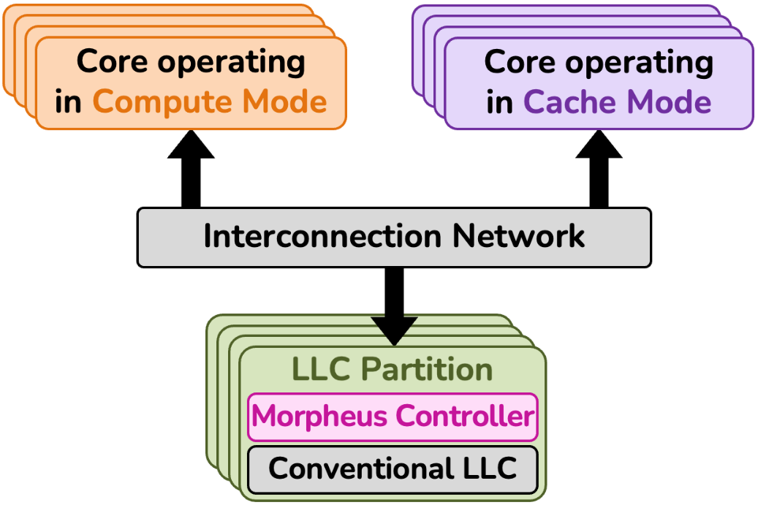
Morpheus Controller
3
1
2
1
Forwarding Decision
Address Separation, Combinational Logic
2
Query Conventional LLC
Simple Forwarding
3
Query Extended LLC
Warp Status Table
Notes:
Recall that the Morpheus controller handles three tasks:
It makes a [Click] forwarding decision, based on which it then either queries the [Click] conventional LLC or the [Click] extended LLC. [Click]

Slide 18
Morpheus Controller
3
1
2
1
Forwarding Decision
Address Separation, Combinational Logic
2
Query Conventional LLC
Simple Forwarding
3
Query Extended LLC
Warp Status Table
Notes:
For the forwarding decision, we propose a simple mechanism called *address separation*, which is implemented as some combinational logic. [Click]

Slide 19
Morpheus Controller
3
1
2
1
Forwarding Decision
Address Separation, Combinational Logic
2
Query Conventional LLC
Physically Co-Located, Simple Forwarding
3
Query Extended LLC
Warp Status Table
Notes:
Querying the conventional LLC is trivial, since it is physically co-located with the Morpheus controller in the LLC partition, so the LLC requests can simply be forwarded for the conventional LLC. [Click]

Slide 20
Morpheus Controller
3
1
2
1
Forwarding Decision
Address Separation, Combinational Logic
2
Query Conventional LLC
Physically Co-Located, Simple Forwarding
3
Query Extended LLC
Warp Status Table
Notes:
In contrast, to query the extended LLC, there needs to be communication over the interconnection network between the Morpheus controller and a core operating in cache mode. It’s at least not immediately clear how this communication should be implemented.
We propose the [Click] *Warp Status Table* to solve this issue.
Let’s look at it in some more detail. [Click]

Slide 21
Morpheus Controller Warp Status Table
Core operating
in Compute Mode
Core operating
in Cache Mode
Regular
Loads/Stores
LLC Requests
Warp Status Table
in the Morpheus Controller
Tracks ongoing requests per set
  E.g., read/write, tag, hit/miss
Memory mapped
Notes:
When a request from a core in compute mode [Click] arrives at the Morpheus controller, it is inserted into the warp status table.
The warp status table [Click] tracks the status of ongoing requests, such as [Click] if a request is a read or a write, the request’s tag, and if the result is a hit or a miss.
Crucially, [Click] the warp status table is memory mapped, so the cores in cache mode can communicate [Click] with the Morpheus controller through regular load/store instructions.[Click]

Slide 22
Outline
Introduction
1
Morpheus: Overview
2
Morpheus Controller
3
Extended LLC Kernel
4
Hit/Miss Prediction
5
Evaluation
6
Conclusion
7
Notes:
We covered the Morpheus controller. Let's look at the extended LLC kernel next. [Click]

Slide 23
GPU Core Execution Modes in Morpheus
GPU Core
Compute Mode
Cache Mode
Operates Conventionally
Lends Private Memory
to Extend the LLC
Execution Units
Application Kernel
Extended LLC Kernel
L1 Cache
Controller State
Tag Array
Data Array
Shared Memory
Application Data
Register File

Slide 24
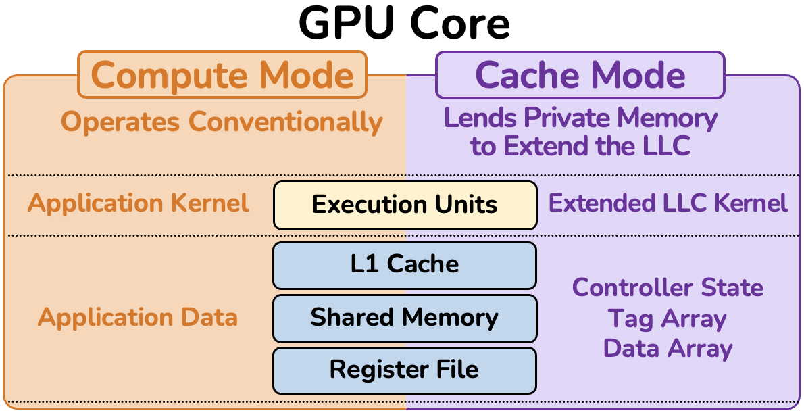
Extended LLC Kernel
Regular Kernel
on Unmodified Core
1
1
2
2
3
3
Repurpose
to Extend LLC
Query L1 Cache
Query L1 Cache
Load/Store Instructions
Query L1 Cache
Load/Store Instructions
Query L1 Cache
Load/Store Instructions
1
1
1
1
Query Shared Memory
Query Shared Memory
Query Shared Memory
Software Engineering
Query Shared Memory
Software Engineering
2
2
2
2
Query Register File
Query Register File
Query Register File
Query Register File
3
3
3
3
Data Layout across Threads for Parallelism
Notes:
Here is a core with the two execution modes I introduced earlier, and on the right cache mode and extended LLC kernel.
Recall that the goal of cache mode is to [Click] repurpose the private memories to extend the LLC capacity, so the extended LLC kernel should serve requests by querying either the [Click] L1 cache, [Click] shared memory, or [Click] the register file.
The the extended LLC kernel should be [Click] a regular kernel and not require any modifications to the core. Let’s see how it works.
The L1 [Click] is already a cache, so it can be queried with regular loads and stores.
The shared memory [Click] is a scratchpad that is addressable like regular memory, so a software cache is a matter of software engineering, but it’s not *conceptually* difficult. We explain these in more detail in our paper.
In contrast, [Click] querying the register file is not intuitive, because it is not usually addressable as regular memory, and it’s not immediately clear how to efficiently retrieve the data. To address this issue, we carefully [Click] lay out data and metadata across threads. Let’s look at this in some more detail. [Click]

Slide 25
Extended LLC via Register File
Extended LLC Set
Tag #0
Block #0
Thread #0 holds
Tag #1
Block #1
Thread #1 holds
Tag #2
Block #2
Thread #2 holds
•••
•••
Tag #31
Block #31
Thread #31 holds
Notes:
Suppose we want to lay out [Click] an extended LLC set of [Click] 32 LLC blocks and [Click] corresponding tags into the register file.
We propose to use one warp register per LLC set to store the tags, so [Click] each thread of the warp holds exactly one tag.
Then to look up a tag in the set, [Click]

Slide 26
Extended LLC via Register File
Extended LLC Set
Tag #0
Block #0
Thread #0 holds
Compare
Tag #1
Block #1
Thread #1 holds
Compare
Tag #2
Block #2
Query Tag
Compare
Thread #2 holds
Compare
•••
•••
Tag #31
Block #31
Thread #31 holds
32 Threads
Operate in Parallel
Notes:
Each thread [Click] compares the query tag to exactly one tag in the set.
Crucially, this strategy allows [Click] 32 threads to operate in parallel.
So this is a single LLC set, being operated by a single warp. [Click]

Slide 27
Extended LLC via Register File
Extended LLC Set
Extended LLC Set
Tag #0
Block #0
Tag #0
Block #0
Thread #0 holds
Thread #0 holds
Match
Tag #1
Block #1
Match
Tag #1
Block #1
Match
Thread #1 holds
Match
Thread #1 holds
Tag #2
Block #2
Tag #2
Block #2
Query Tag
Match
Thread #2 holds
Query Tag
Match
Thread #2 holds
Match
•••
•••
Match
•••
•••
Tag #31
Block #31
Tag #31
Block #31
Thread #31 holds
Thread #31 holds
32 Threads
Operate in Parallel
32 Threads
Operate in Parallel
Extended LLC Set
Extended LLC Set
Tag #0
Block #0
Tag #0
Block #0
Thread #0 holds
Thread #0 holds
Match
Tag #1
Block #1
Match
Tag #1
Block #1
Match
Thread #1 holds
Match
Thread #1 holds
Tag #2
Block #2
Tag #2
Block #2
Query Tag
Match
Thread #2 holds
Query Tag
Match
Thread #2 holds
Match
•••
•••
Match
•••
•••
Tag #31
Block #31
Tag #31
Block #31
Thread #31 holds
Thread #31 holds
32 Threads
Operate in Parallel
32 Threads
Operate in Parallel
Many Warps (e.g., 48)
Operate in Parallel
Notes:
Since there are many hardware warps in a core, we can have [Click] many extended LLC sets in a core.
And crucially, these [Click] can serve requests in parallel.
So overall, there are two levels of parallelism, first within a warp or set, and second across warps or sets. This enables high throughput and efficiency of the extended LLC.

Slide 28
Outline
Introduction
1
Morpheus: Overview
2
Morpheus Controller
3
Extended LLC Kernel
4
Hit/Miss Prediction
5
Evaluation
6
Conclusion
7
Notes:
The components we have covered so far, the Morpheus Controller and Extended LLC Kernel, cover the basic functionality of Morpheus.
To make Morpheus work particularly efficient, we propose multiple optimizations on top of this basic functionality, and I’d like to briefly introduce a particularly interesting one, Hit/Miss prediction. [Click]

Slide 29
LLC Timelines

Slide 30
LLC Timelines
Misses in the extended LLC are particularly expensive
Correctly predicting them can reduce the miss latency significantly

Slide 31
Hit/Miss Predictor
Request for
Extended LLC Address
Request Handling
Bloom Filter Management
Insert Cache Block
into Extended LLC Set
In BF1?
Yes
Query
Extended LLC
Yes
Cache Block
Re-Used
Insert into BF1
Hit?
No
No
Insert into BF2
n := num_elems_in(BF2)
Access DRAM
No
n ≥ associativity
Send Response
from Morpheus Controller
to Requesting Core
Yes
Clear BF1
Done with Request’s Updates
Swap BF1, BF2

Slide 32

Is There A More Sophisticated Hit/Miss Predictor?

Slide 33
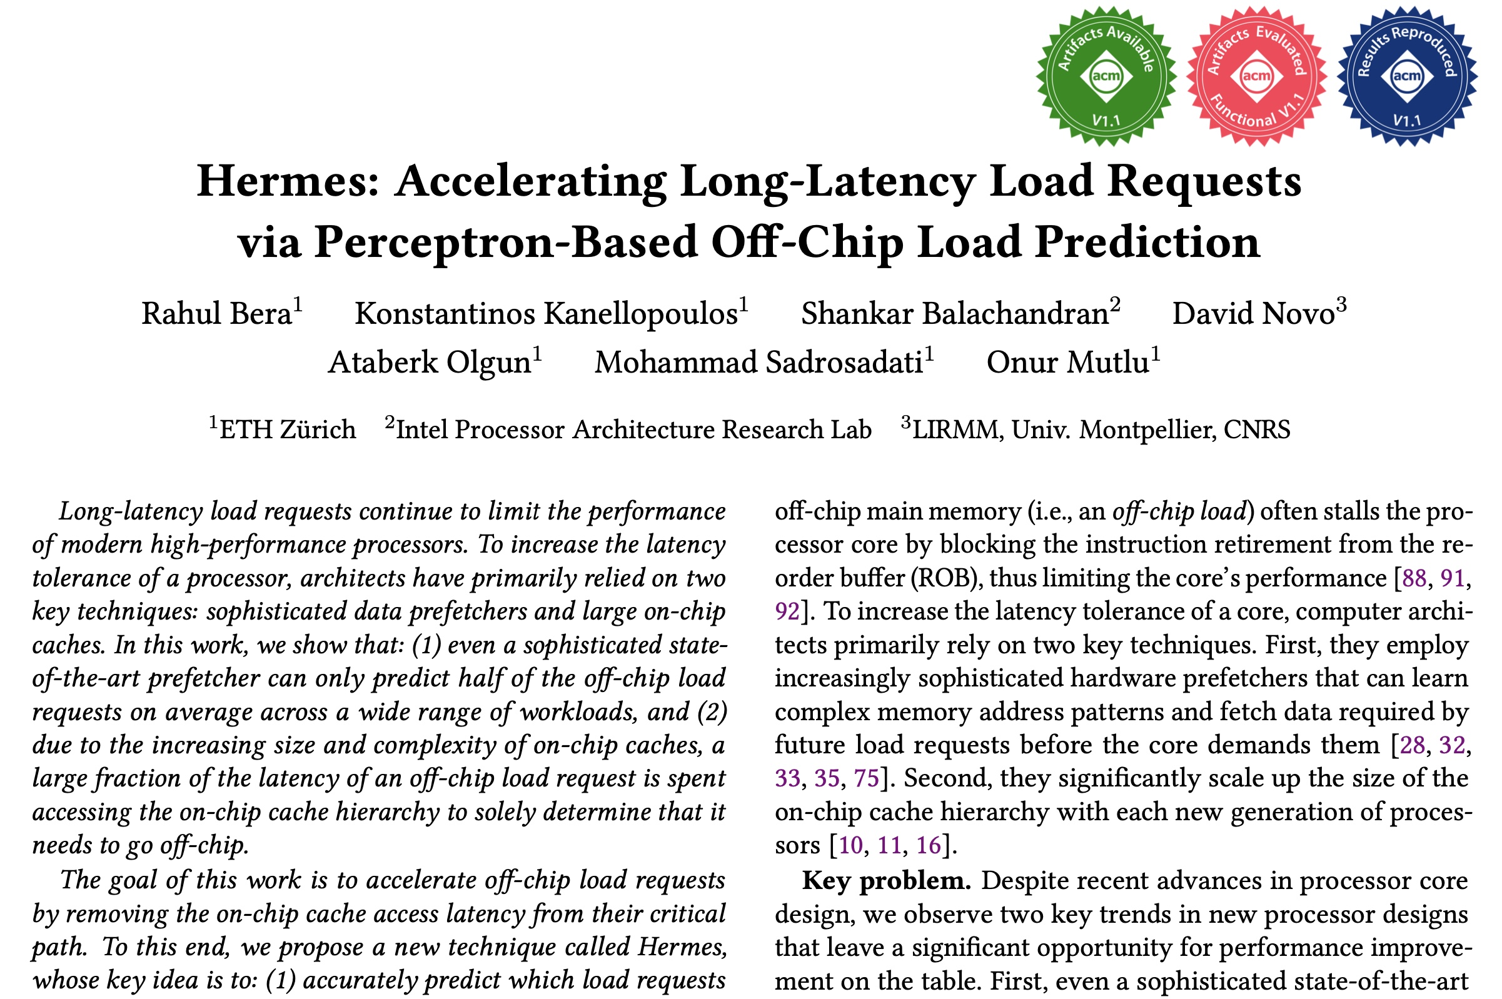
Hermes
https://arxiv.org/pdf/2209.00188.pdf
Bera+, “Hermes: Accelerating Long-Latency Load Requests via Perceptron-Based Off-Chip Load Prediciton”, MICRO ‘22

Slide 34

More in the Morpheus Paper: Mechanisms
Detailed mechanisms
  Morpheus Controller
  Extended LLC kernel
Optimization techniques
  Indirect-MOV
  Cache compression applied to Morpheus
Morpheus on arXiv
Notes:
We explain these mechanisms in detail in our paper,
as well as [Click] optimization techniques we developed or applied to Morpheus.

Slide 35
Outline
Introduction
1
Morpheus: Overview
2
Morpheus Controller
3
Extended LLC Kernel
4
Hit/Miss Prediction
5
Evaluation
6
Conclusion
7
Notes:
Now you hopefully have a good idea of how the different components of Morpheus work.
Let’s dive into the evaluation. [Click]

Slide 36
Methodology
17 representative applications
  14 memory-bound
  3 compute-bound
Experimentally characterize the extended LLC
  On a real NVIDIA RTX 3080, as the extended LLC kernel requires no special hardware
  Capacity, latency, bandwidth, energy/byte of the extended LLC
Simulate a Morpheus-enabled GPU using AccelSim [Khairy+ ISCA’20]
  Performance, energy efficiency, bandwidth utilization
Notes:
We picked 17 representative applications, 14 memory-bound and 3 compute-bound. [Click]
We characterize the extended LLC on a real NVIDIA RTX 3080 GPU. This is possible since it is simply a regular software kernel that requires no modifications to the core.
This yields numbers like capacity, latency, bandwidth and energy/byte of the extended LLC. [Click]
Then we simulate a full Morpheus-enabled GPU using AccelSim. This is necessary for the full GPU, because the Morpheus controller hardware unit doesn’t exist in a real system.
This yields metrics like performance, energy efficiency, and bandwidth utilization of Morpheus. [Click]

Slide 37
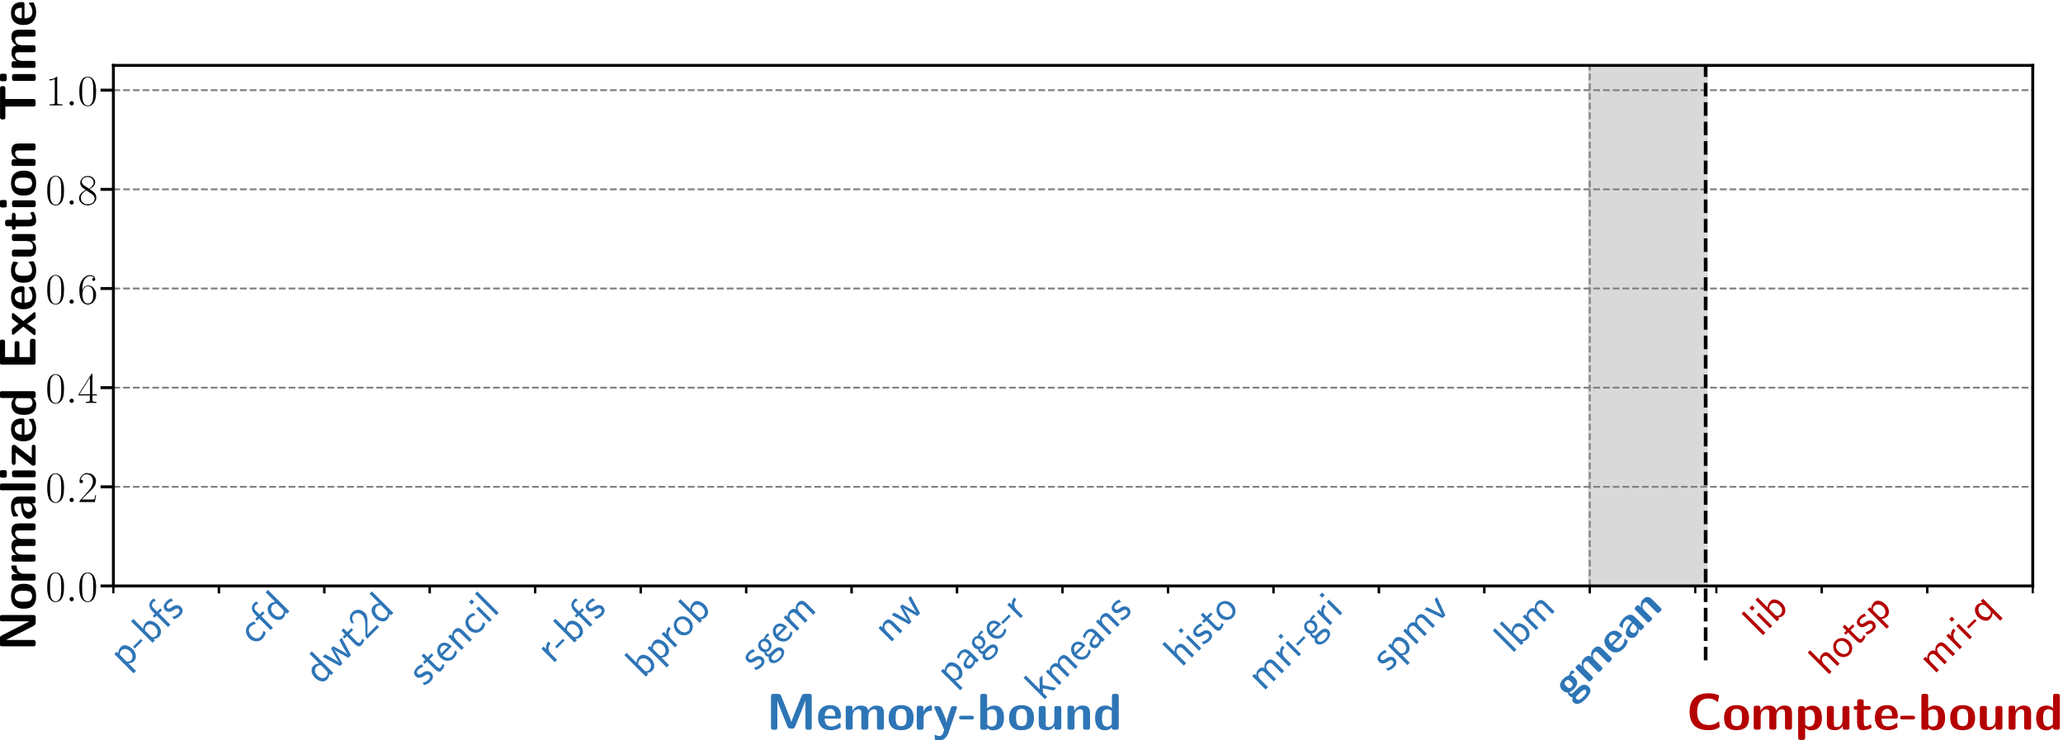
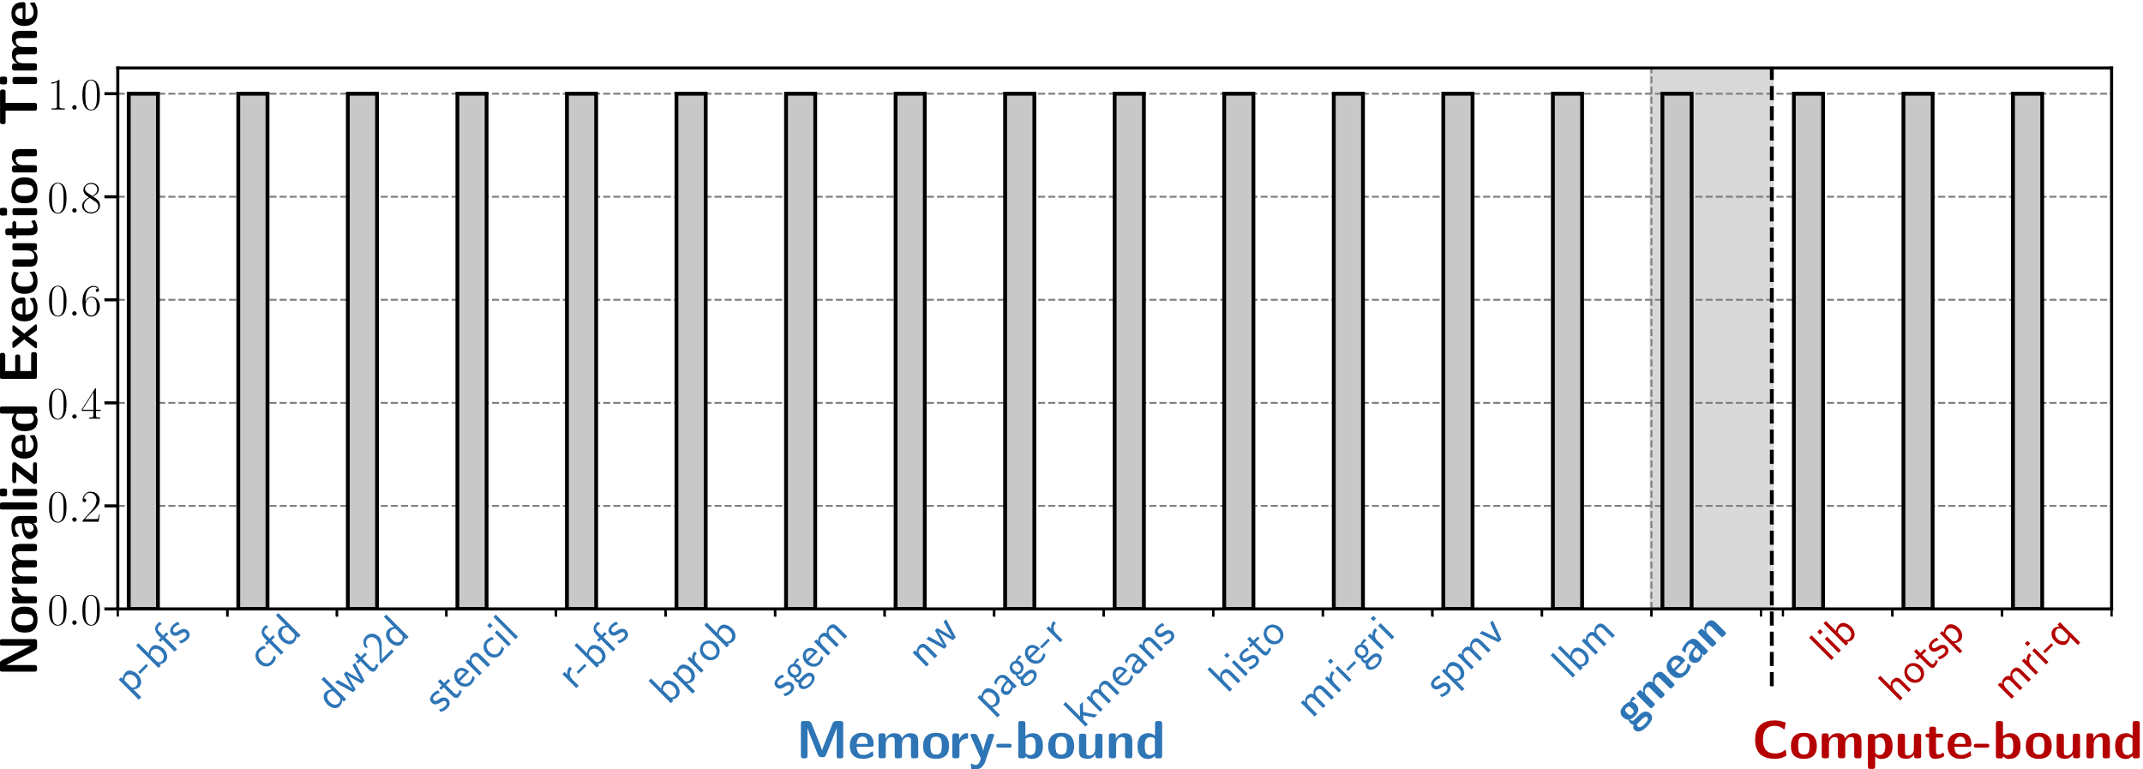
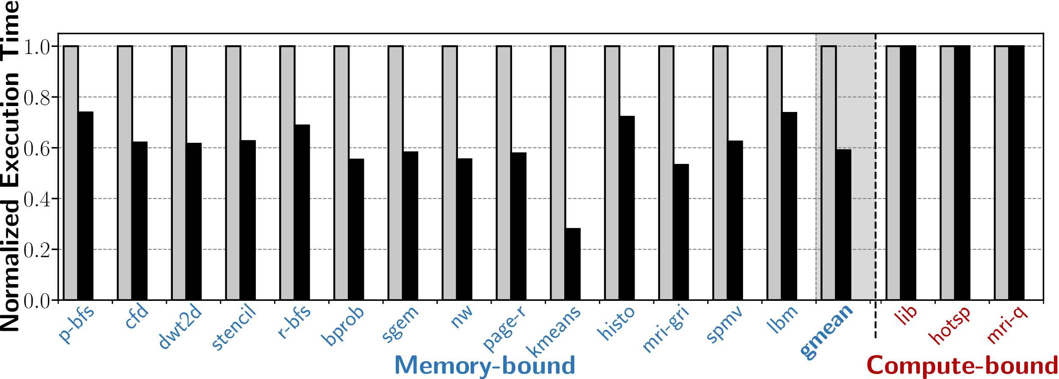
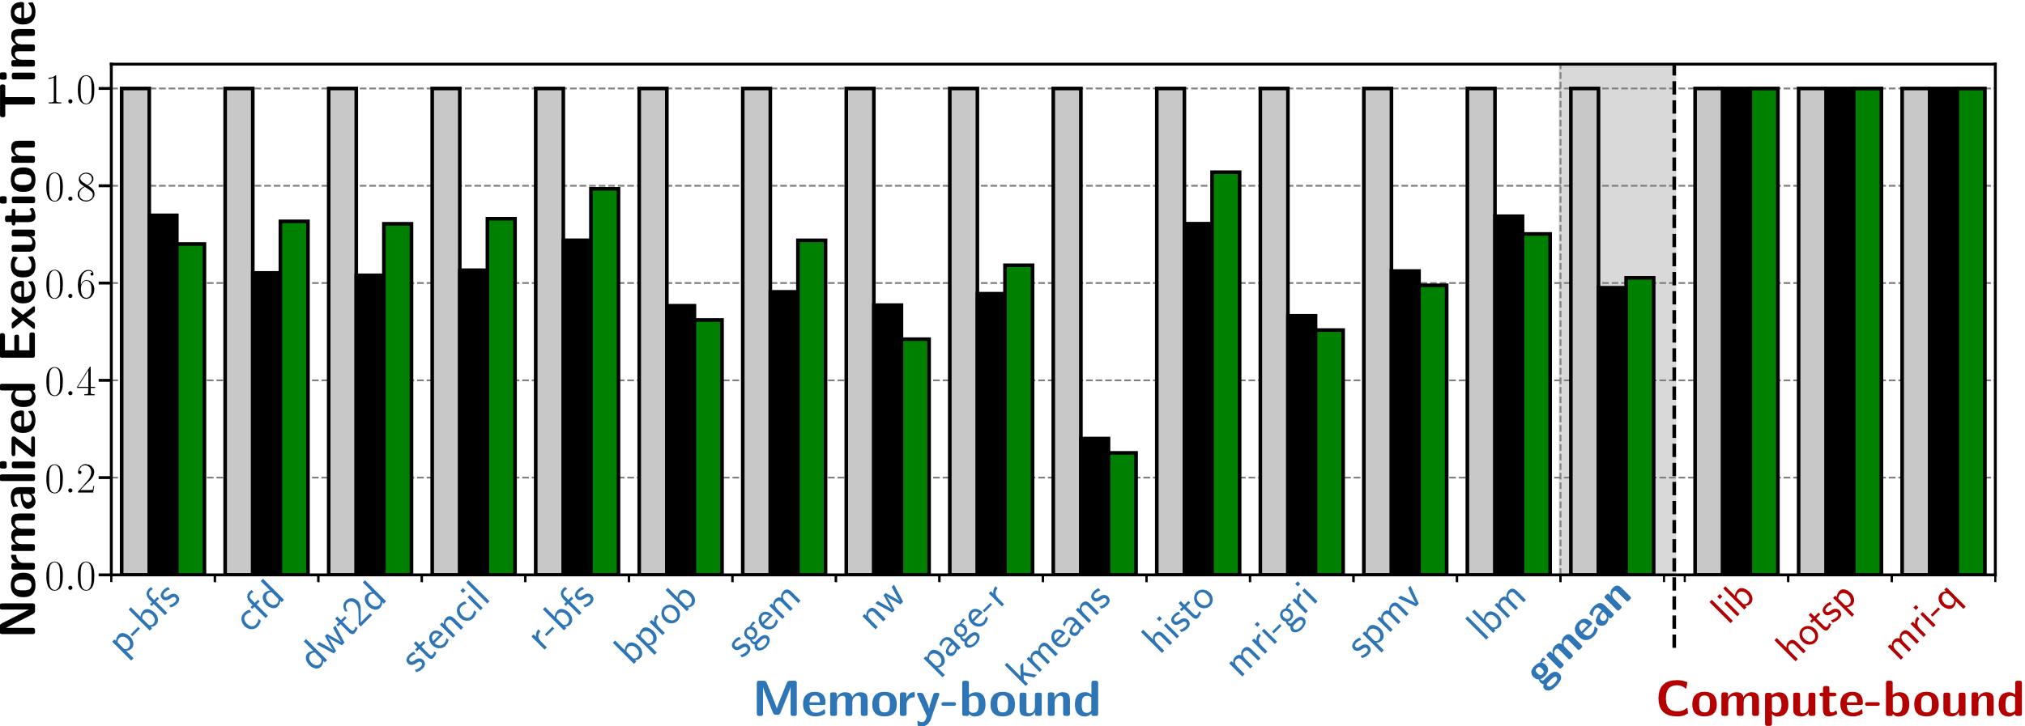
Morpheus Performance
NVIDIA RTX 3080
NVIDIA RTX 3080
4x larger conventional LLC
Morpheus
Lower is Better
Normalized Execution Time
Morpheus performs better than or equal to the baseline for all applications
Notes:
Let’s look at Morpheus’ performance in detail.
We plot [Click] execution time on the y axis, so [Click] lower is better, and the 17 applications [Click] across the x-axis.
We consider an off-the-shelf NVIDIA RTX 3080 GPU [Click] as the baseline and normalize the performance to it for readability.
As an *ideal* baseline, we consider a hypothetical RTX 3080 [Click] with the a 4x larger conventional LLC, without any latency, bandwidth, or energy overheads.
Finally, we plot Morpheus [Click].
We make three key observations.
First, [Click] Morpheus performs better than or equal to the baseline for all applications.
Second, [Click]

Slide 38
Morpheus Performance
NVIDIA RTX 3080
NVIDIA RTX 3080
4x larger conventional LLC
Morpheus
39%
Lower is Better
within 3%
Normalized Execution Time
Morpheus performs better than or equal to the baseline for all applications
Morpheus accelerates memory-bound applications by 39% on average
Morpheus performs within 3% of a 4x larger conventional LLC
Notes:
on average Morpheus [Click] accelerates memory-bound applications by 39%.
Third, [Click] Morpheus performs within 3% of an ideal 4x larger conventional LLC. [Click]

Slide 39
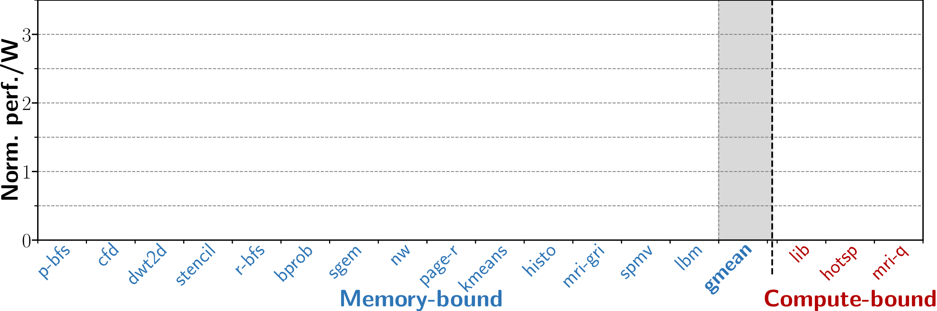
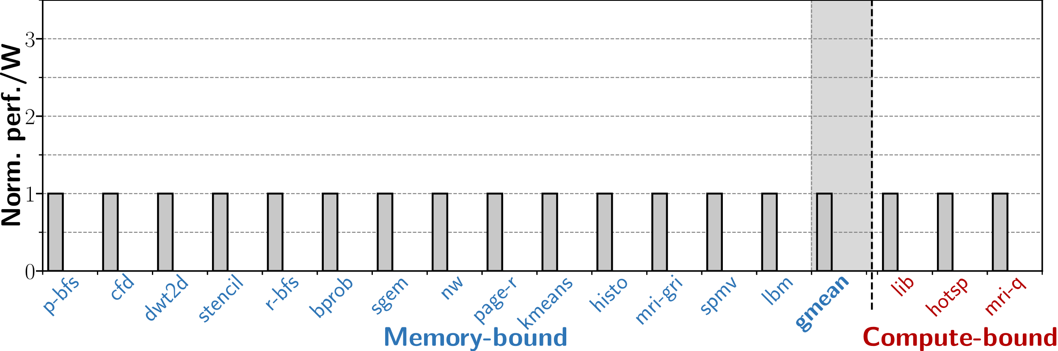
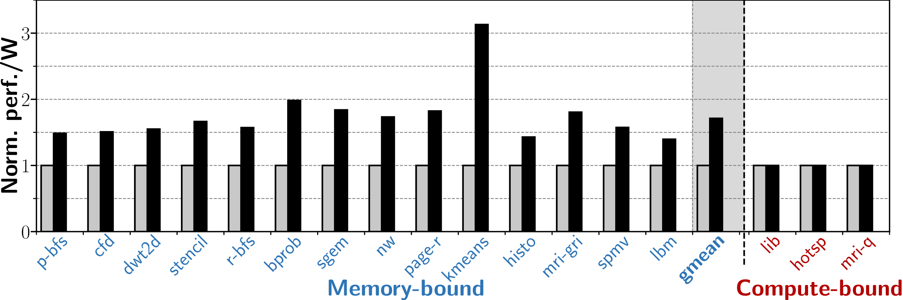
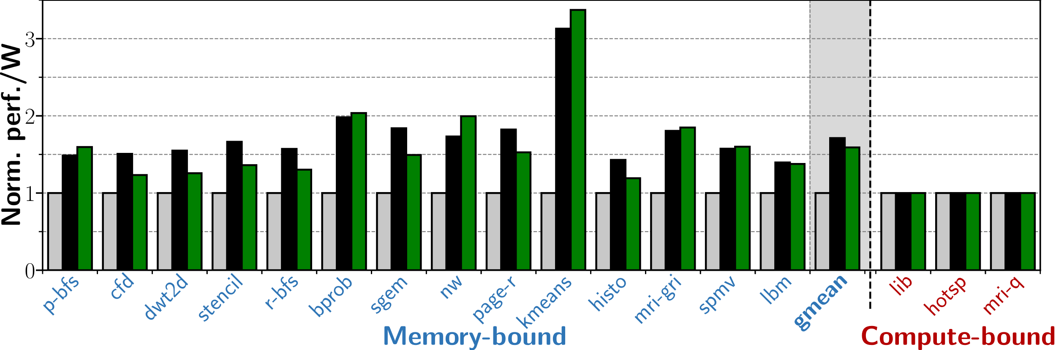
Morpheus Energy Efficiency
NVIDIA RTX 3080
NVIDIA RTX 3080
4x larger conventional LLC
Morpheus
Normalized Perf./W
Higher is Better
Morpheus uses less or the same energy as the baseline for all applications
Notes:
In the same experiment we also [Click] measured the energy efficiency, so [Click] higher is better, for the same [Click] baseline GPU, [Click] 4x larger LLC, and [Click] Morpheus.
We make three key observations.
First, [Click] Morpheus uses less or the same energy to the baseline for all applications
Second, [Click]

Slide 40
Morpheus Energy Efficiency
NVIDIA RTX 3080
NVIDIA RTX 3080
4x larger conventional LLC
Morpheus
Normalized Perf./W
within 6%
Higher is Better
58%
Morpheus uses less or the same energy as the baseline for all applications
Morpheus improves energy efficiency by 58% on average for memory-bound applications
Morpheus’ energy efficiency is within 6% of a 4x larger conventional LLC
Notes:
on average Morpheus [Click] improves energy efficiency by 58% on average for memory-bound applications
Third, [Click] Morpheus’ energy efficiency is within 6% of a 4x larger conventional LLC. [Click]

Slide 41
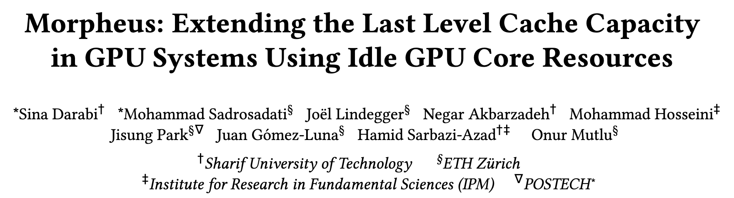
More in the Paper: Evaluation
Notes:
In our paper we have a much more in-depth evaluation, including [Click]

Slide 42
More in the Paper: Evaluation
Characterization of extended LLC on a real GPU
Performance and energy comparisons with more baselines
Total LLC throughput with Morpheus
On-chip and off-chip memory bandwidth utilization
Storage and power overhead analysis
Notes:
A characterization of the extended LLC on a real GPU
[Click] Performance and energy comparisons with more baselines
[Click] The total LLC throughput with Morpheus
[Click] On-chip and off-chip memory bandwidth utilization
[Click] Overhead analysis [Click]

Slide 43
Outline
Introduction
1
Morpheus: Overview
2
Morpheus Controller
3
Extended LLC Kernel
4
Hit/Miss Prediction
5
Evaluation
6
Conclusion
7
Notes:
I will conclude [Click]

Slide 44
Summary
Motivation | Memory-bound GPU applications leave some cores under-utilized
Goal | Leverage the under-utilized cores to boost the performance and energy efficiency of memory-bound applications
Morpheus | First technique that leverages some GPU cores’ private memories to extend the total GPU last-level cache capacity
Key Results | Morpheus outperforms state-of-the-art GPU architectures for memory-bound applications 39% performance improvement (relative to RTX 3080) 58% energy efficiency improvement (relative to RTX 3080) Morpheus performs within 3% of a 4x larger conventional LLC Morpheus provides a 4x larger LLC with the same LLC hardware
Conclusion | Morpheus effectively repurposes the private memory of under-utilized cores to extend the GPU LLC capacity
Notes:
With a short summary.
We observed that [Click] Memory-bound GPU applications leave some cores under-utilized
Our goal [Click] was to leverage the under-utilized cores to boost the performance and energy efficiency of memory-bound applications
We proposed [Click] Morpheus, first technique that leverages some GPU cores’ private memories to extend the total GPU last-level cache capacity.
We have shown that Morpheus [Click] outperforms a state-of-the-art GPU architecture by 39% in terms of performance, and by 58% in terms of energy efficiency for memory-bound workloads. Finall,Morpheus performs within 3% of a 4x larger conventional LLC.
We conclude that [Click] Morpheus efficiently and effectively repurposes the private memory of under-utilized cores to extend the GPU LLC capacity.

Slide 45
Morpheus
Extending the Last Level Cache Capacity in GPU Systems with Idle GPU Core Resources
Sina Darabi, Mohammad Sadrosadati, Joël Lindegger,
Negar Akbarzadeh, Mohammad Hosseini, Jisung Park,
Juan Gómez-Luna, Hamid Sarbazi-Azad, Onur Mutlu
December 23rd 2022
Notes:
Thanks for your attention, I’m happy to take any questions now.

Slide 46
Backup Slides
Performance Benefits of a Larger LLC
Memory-bound vs. Compute-bound Applications
Morpheus’ Logical Data Flow
LLC Timelines
Hit/Miss Predictor
Extended LLC Query Logic Unit
Registerfile Layout
Cache Compression
Indirect-MOV Algorithm
Indirect-MOV Instruction
Extended LLC Characterization
Simulation Parameters
Number of Compute Mode Cores
Morpheus LLC Capacity
Morpheus Energy and Power
Hit/Miss Prediction Benefits
Evaluated Applications
Extended LLC Tag Lookup Algorithm

Slide 47

Performance Benefits of a Larger LLC

Slide 48
Memory-bound vs. Compute-bound Applications

Slide 49
Morpheus’ Logical Data Flow
LLC Request
Morpheus Controller
New Components
Address Separation
Forward
Forward
Conventional LLC
Extended LLC Controller
Address Separation
Forward
Query
Query
Repurposed Components
L1 Cache
Shared Memory
Register File

Slide 50
LLC Timelines

Slide 51
Hit/Miss Predictor
Request for
Extended LLC Address
Request Handling
Bloom Filter Management
Insert Cache Block
into Extended LLC Set
In BF1?
Yes
Query
Extended LLC
Yes
Cache Block
Re-Used
Insert into BF1
Hit?
No
No
Insert into BF2
n := num_elems_in(BF2)
Access DRAM
No
n ≥ associativity
Send Response
from Morpheus Controller
to Requesting Core
Yes
Clear BF1
Done with Request’s Updates
Swap BF1, BF2

Slide 52
Extended LLC Query Logic Unit

Slide 53
Registerfile Layout
Extended LLC’s
Logical Layout
Extended LLC’s
Layout in Register File
48 LLC Sets
48 Warps
Set 0 | Word 0 | … | Word 31 | Metadata
Block 0 |  |  |  | M0
 |  | 32 LLC Blocks
Block 31 |  |  |  | M31
Warp 0 | Thread 0 | … | Thread 31
R0
 |  | 32 Data-Array Registers
R31
R32 |  | 01 Metadata Register
R33
 |  | 09 Auxiliary Registers
R41
…
…
…
4 bytes
Metadata Block M31
…
LRU Counter | D | V | Block Tag
12 bits
2 bits
18 bits
4 bytes

Slide 54
Cache Compression
Extended LLC’s
Logical Layout
Extended LLC’s Layout across Registers with Compression
Set 0 | Word 0 | … | Word 31
Block 0
Block 1
Block 2
Block 3
Warp 0 | Thread 0 |  |  |  | … | Thread 31
R0
R0
R1
R0
R1
R2
R3
High
Compression Level
Low
Compression Level
4 bytes
Uncompressed
1 byte
4 bytes

Slide 55
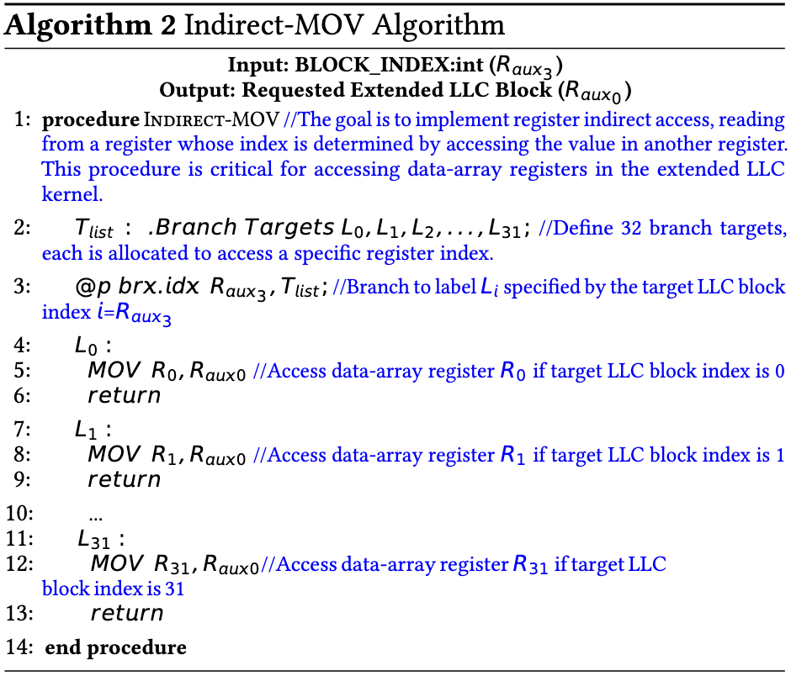
Indirect-MOV Algorithm

Slide 56
Indirect-MOV Instruction

Slide 57
Extended LLC Characterization

Slide 58
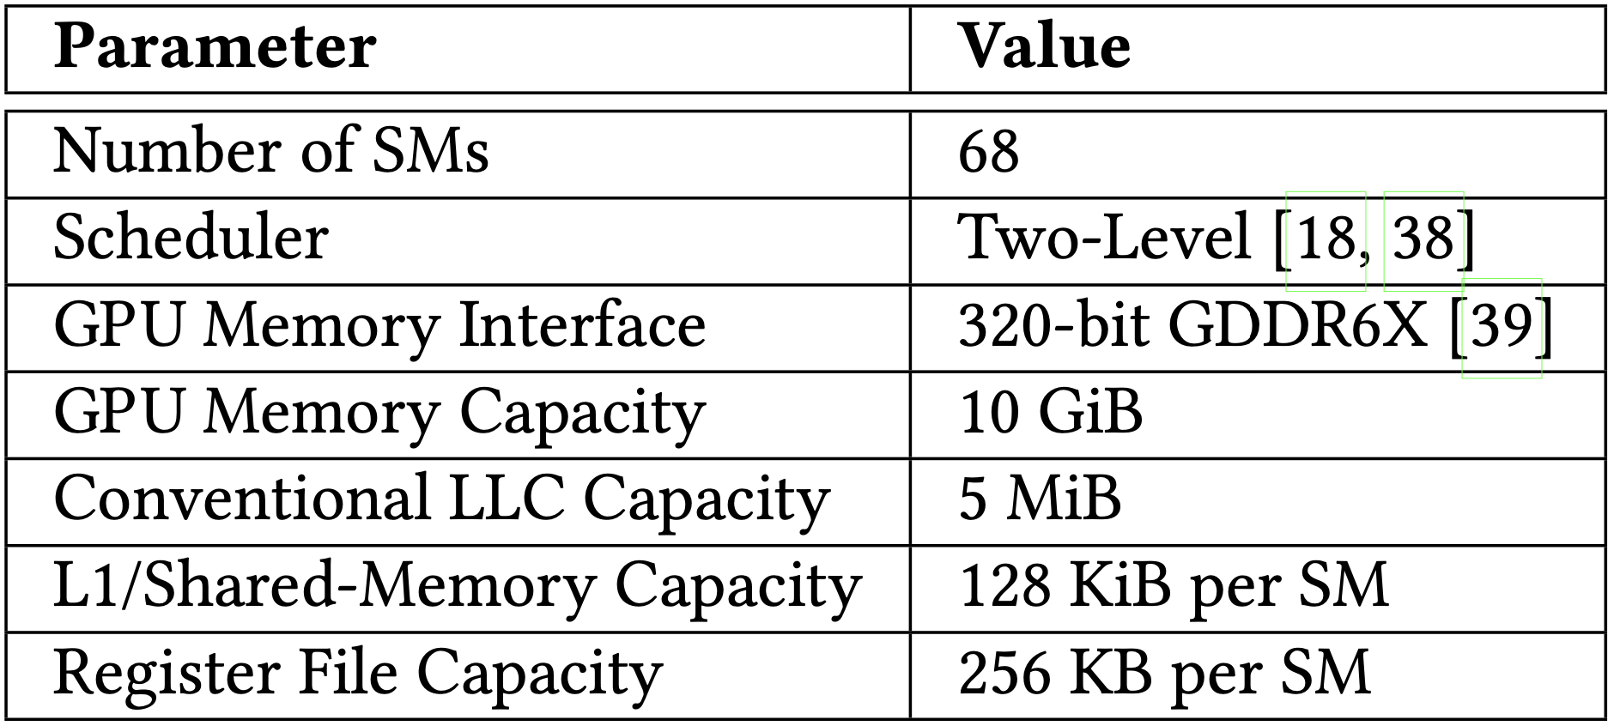
Simulation Parameters
NVIDIA RTX 3080

Slide 59
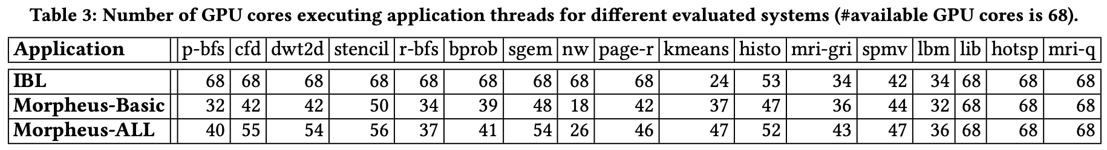
Number of Compute Mode Cores

Slide 60
Morpheus LLC Capacity (NVIDIA RTX 3080)
Conventional LLC: 5 MiB
Extended LLC Per Core in Cache Mode: 328 KiB
  128 KiB from L1
  256 KiB from Register File
    200 KiB useable to extended LLC data
Number of Cache Mode Cores: Application Dependent
  E.g. 50 for Needleman-Wunsch (nw) => 16 MiB
  Theoretically up to 67 => 21.4 MiB

Slide 61
Morpheus Energy and Power

Slide 62
Hit/Miss Prediction Benefits

Slide 63
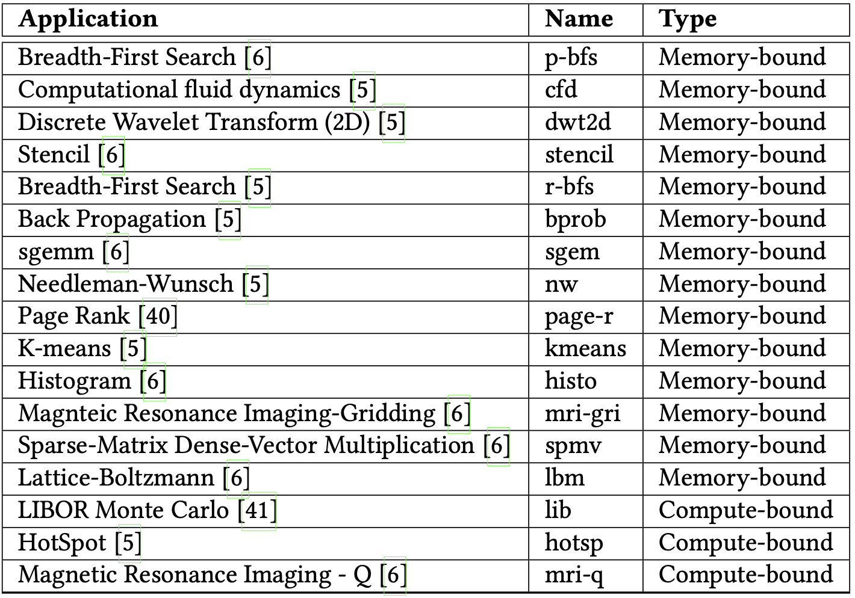
Evaluated Applications

Slide 64
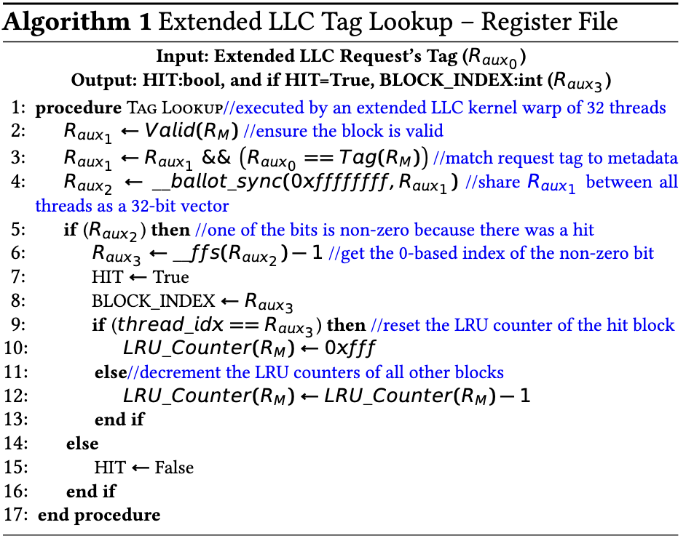
Extended LLC Tag Lookup

