Slide 1


Rethinking the Systems We Design
Onur Mutlu
onur@cmu.edu
September 19, 2014
Yale @ 75

Slide 2
Agenda
Principled Computer Architecture/System Design
How We Violate Those Principles Today
Some Solution Approaches
Concluding Remarks

Slide 3
First, Let’s Start With …
The Real Reason We Are Here Today
Yale @ 35
Notes:
Yale Patt;s picture

Slide 4


Slide 5
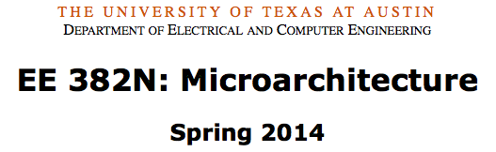
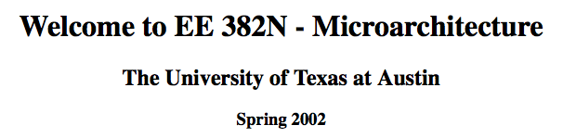
Some Teachings of Yale Patt

Slide 6
Design Principles
Critical path design
Bread and Butter design
Balanced design
from Yale Patt’s EE 382N lecture notes
Notes:
ADD a banner on: slide that has not changed for decades.
Spring 2001
To
Spring 2014

Slide 7
(Micro)architecture Design Principles
Bread and butter design
  Spend time and resources on where it matters (i.e. improving what the machine is designed to do)
  Common case vs. uncommon case
Balanced design
  Balance instruction/data flow through uarch components
  Design to eliminate bottlenecks
Critical path design
  Find the maximum speed path and decrease it
    Break a path into multiple cycles?
from my ECE 740 lecture notes

Slide 8
My Takeaways
Quite reasonable principles
Stated by other principled thinkers in similar or different ways
  E.g., Mike Flynn, “Very High-Speed Computing Systems,” Proc. of IEEE, 1966
  E.g., Gene M. Amdahl, "Validity of the single processor approach to achieving large scale computing capabilities," AFIPS Conference, April 1967.
  E.g., Butler W. Lampson, “Hints for Computer System Design,” SOSP 1983.
  …
Will take the liberty to generalize them in the rest of the talk

Slide 9
The Problem
Systems designed today violate these principles
Some system components individually might not (or might seem not to) violate the principles
But the overall system
  Does not spend time or resources where it matters
  Is grossly imbalanced
  Does not optimize for the critical work/application

Slide 10
Agenda
Principled Computer Architecture/System Design
How We Violate Those Principles Today
Some Solution Approaches
Concluding Remarks

Slide 11
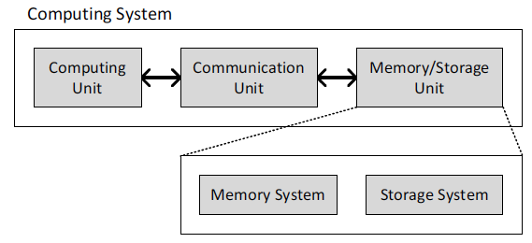



A Computing System
Three key components
Computation
Communication
Storage/memory

Slide 12
Today’s Systems
Are overwhelmingly processor centric
Processor is heavily optimized and is considered the master
Many system-level tradeoffs are constrained or dictated by the processor – all data processed in the processor
Data storage units are dumb slaves and are largely unoptimized (except for some that are on the processor die)

Slide 13
Yet …
“It’s the memory, stupid” (Anonymous DEC engineer)
L2 Misses
Data from Runahead Execution [HPCA 2003]

Slide 14
Yet …
Memory system is the major performance, energy, QoS/predictability and reliability bottleneck in many (most?) workloads
And, it is becoming increasingly so
  Increasing hunger for more data and its (fast) analysis
  Demand to pack and consolidate more on-chip for efficiency
  Memory bandwidth and capacity not scaling as fast as demand
  Demand to guarantee SLAs, QoS, user satisfaction
  DRAM technology is not scaling well to smaller feature sizes, exacerbating energy, reliability, capacity, bandwidth problems

Slide 15
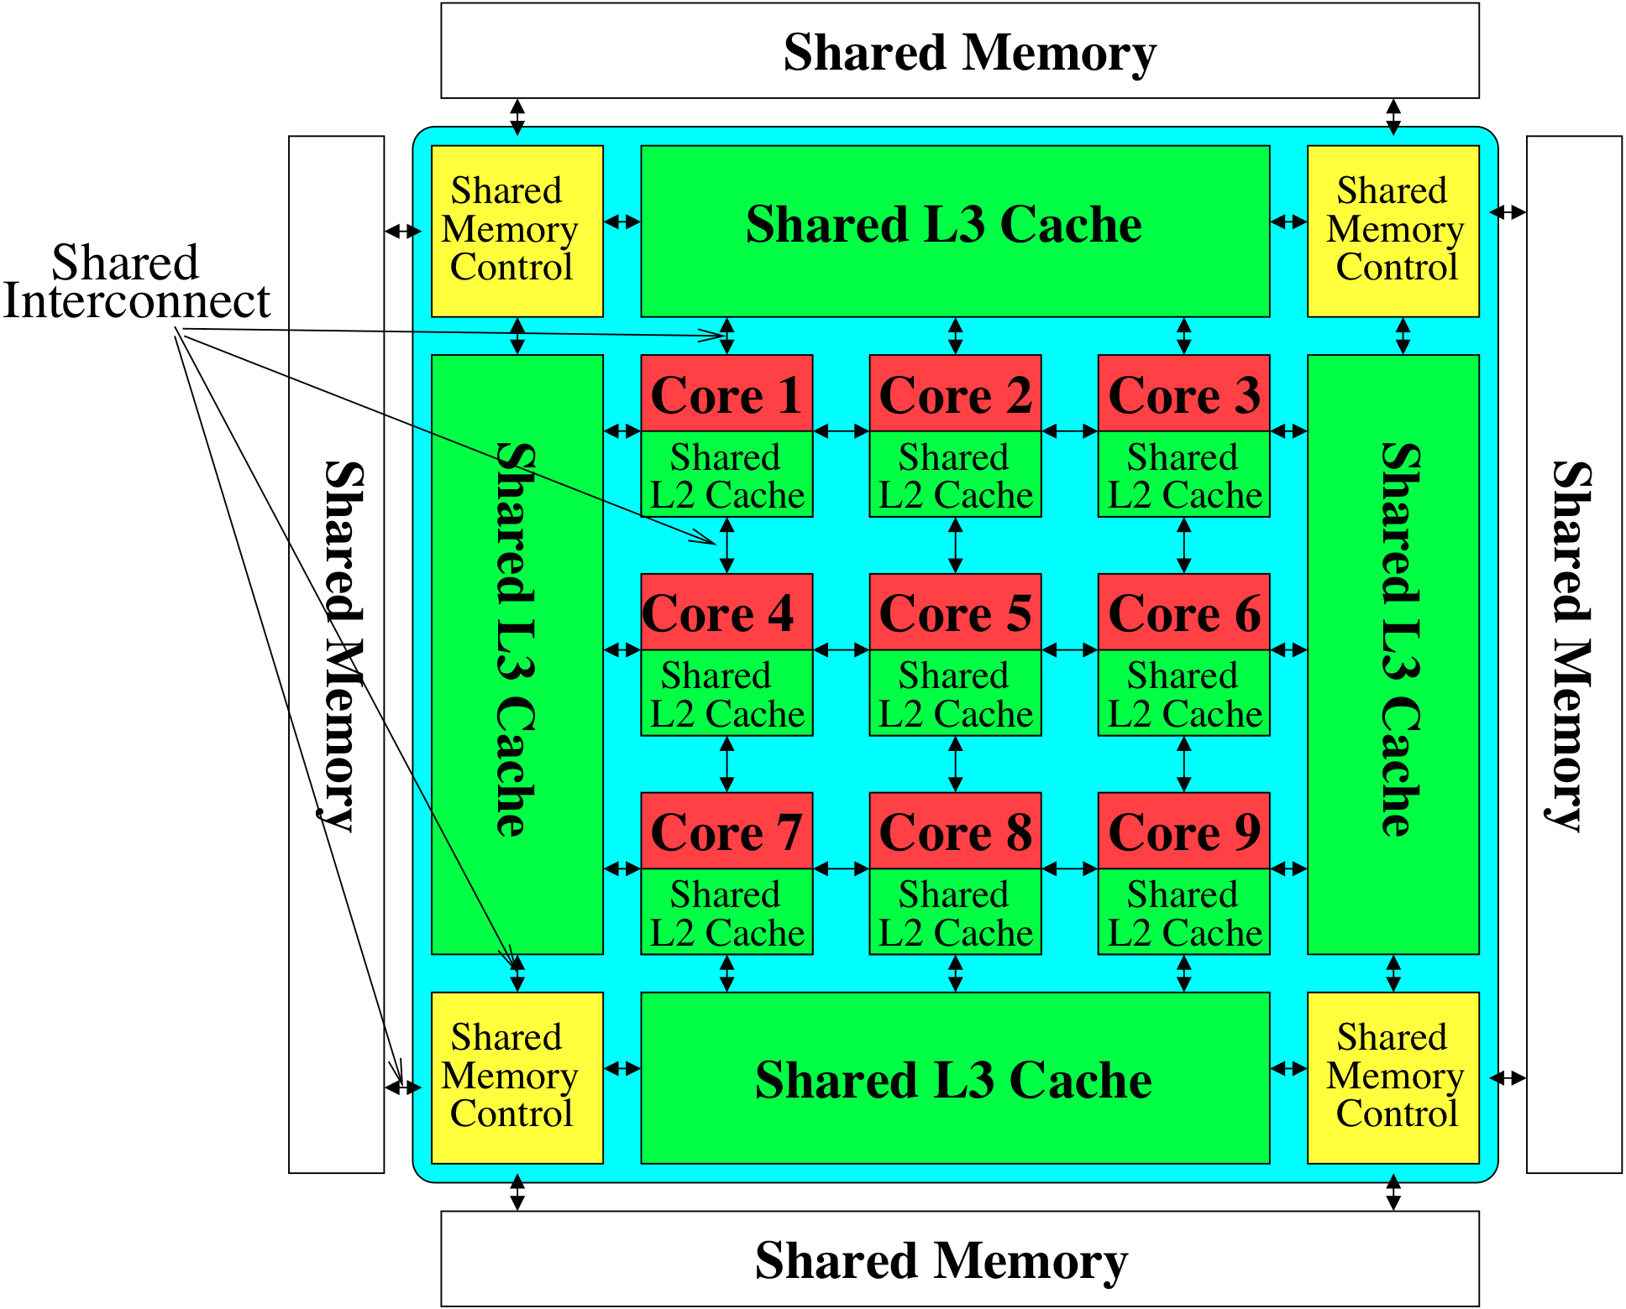
This Processor-Memory Disparity
Leads to designs that
  do not spend time or resources where it matters
  are grossly imbalanced
  do not optimize for the critical work/application
Processor becomes overly complex and bloated
  To tolerate memory related issues
  Complex hierarchies are built just to move and store data within the processor
“The forgotten” memory system becomes dumb and inadequate in many aspects

Slide 16
Several Examples
Bulk data copy (and initialization)
DRAM refresh
Memory reliability
Disparity of working memory and persistent storage
Homogeneous memory
Predictable performance and fairness in memory

Slide 17
Today’s Memory: Bulk Data Copy
1) High latency
Memory
3) Cache pollution
L3
CPU
L2
L1
MC
2) High bandwidth utilization
4) Unwanted data movement
1046ns, 3.6uJ (for 4KB page copy via DMA)

Slide 18
Future: RowClone (In-Memory Copy)
3) No cache pollution
1) Low latency
Memory
L3
CPU
L2
L1
MC
2) Low bandwidth utilization
4) No unwanted data movement
1046ns, 3.6uJ
90ns, 0.04uJ

Slide 19
DRAM Subarray Operation (load one byte)
4 Kbits
Step 1: Activate row
Transfer row
DRAM array
Row Buffer (4 Kbits)
Step 2: Read
Transfer byte onto bus
8 bits
Data Bus
Notes:
say you want a byte

Slide 20
RowClone: In-DRAM Row Copy
4 Kbits
Step 1: Activate row A
Step 2: Activate row B
Transfer row
DRAM array
Transfer
row
0.01% area cost
Row Buffer (4 Kbits)
8 bits
Data Bus
Notes:
copy

Slide 21
RowClone: Latency and Energy Savings
11.6x
74x
Seshadri et al., “RowClone: Fast and Efficient In-DRAM Copy and Initialization of Bulk Data,” MICRO 2013.

Slide 22
End-to-End System Design
Application
How does the software communicate occurrences of bulk copy/initialization to hardware?
Operating System
How to ensure data coherence?
ISA
How to maximize latency and energy savings?
Microarchitecture
DRAM (RowClone)
How to handle data reuse?

Slide 23
RowClone: Overall Performance

Slide 24
RowClone: Multi-Core Performance

Slide 25
Goal: Ultra-Efficient Processing Near Data
CPU
core
CPU
core
mini-CPU
core
GPU
(throughput)
core
GPU
(throughput)
core
video
core
GPU
(throughput)
core
GPU
(throughput)
core
CPU
core
CPU
core
Memory
imaging
core
LLC
Specialized
compute-capability
in memory
Memory Controller
Memory Bus
Memory similar to a “conventional” accelerator

Slide 26
Enabling Ultra-Efficient Search
What is the right partitioning of computation capability?
What is the right low-cost memory substrate?
What memory technologies are the best enablers?
How do we rethink/ease (visual) search algorithms/applications?
Memory
Processor
Core
Database
Cache
Query vector
Interconnect
Results

Slide 27
Several Examples
Bulk data copy (and initialization)
DRAM refresh
Memory reliability
Disparity of working memory and persistent storage
Homogeneous memory
Memory QoS and predictable performance

Slide 28
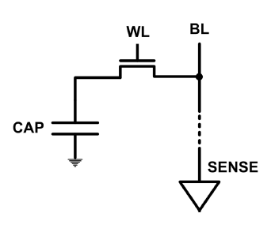
DRAM Refresh
DRAM capacitor charge leaks over time
The memory controller needs to refresh each row periodically to restore charge
  Activate each row every N ms
  Typical N = 64 ms
Downsides of refresh
-- Energy consumption: Each refresh consumes energy
  -- Performance degradation: DRAM rank/bank unavailable while refreshed
  -- QoS/predictability impact: (Long) pause times during refresh
  -- Refresh rate limits DRAM capacity scaling

Slide 29
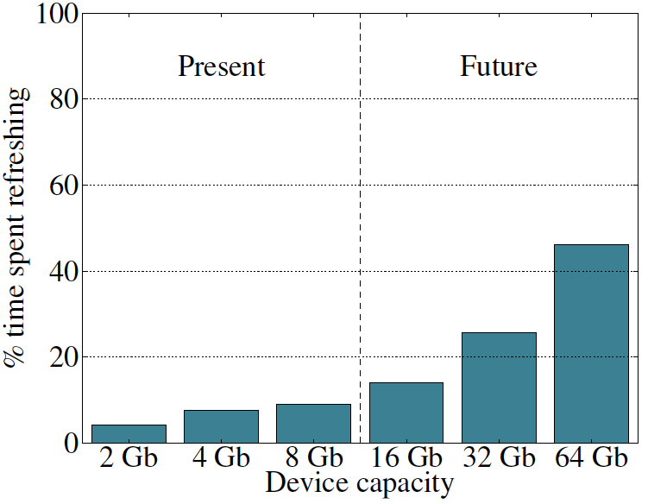
Refresh Overhead: Performance
46%
8%
Liu et al., “RAIDR: Retention-Aware Intelligent DRAM Refresh,” ISCA 2012.

Slide 30
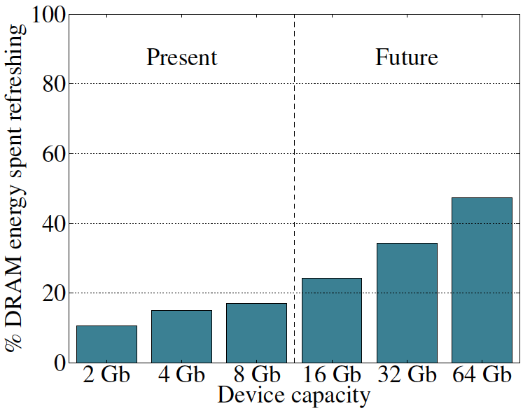
Refresh Overhead: Energy
47%
15%
Liu et al., “RAIDR: Retention-Aware Intelligent DRAM Refresh,” ISCA 2012.

Slide 31

Retention Time Profile of DRAM

Slide 32
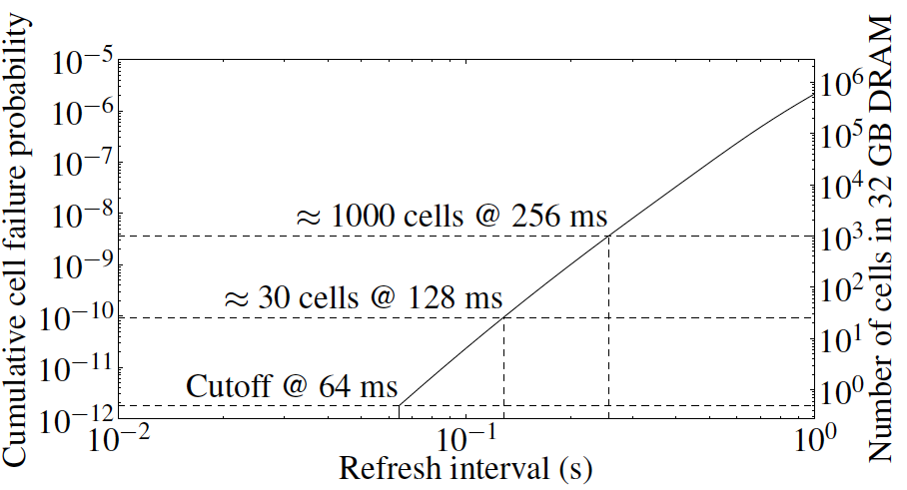
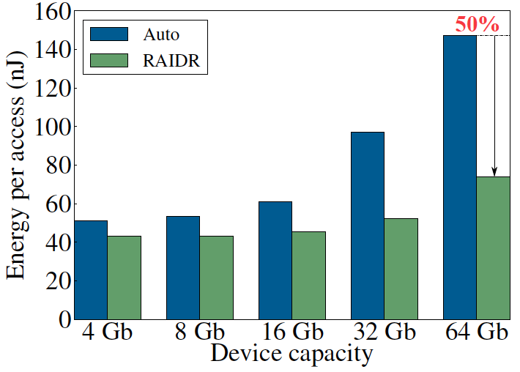
RAIDR: Eliminating Unnecessary Refreshes
Observation: Most DRAM rows can be refreshed much less often without losing data [Kim+, EDL’09][Liu+ ISCA’13]
Key idea: Refresh rows containing weak cells
more frequently, other rows less frequently
  1. Profiling: Profile retention time of all rows
  2. Binning: Store rows into bins by retention time in memory controller
  Efficient storage with Bloom Filters (only 1.25KB for 32GB memory)
  3. Refreshing: Memory controller refreshes rows in different bins at different rates
Results: 8-core, 32GB, SPEC, TPC-C, TPC-H
  74.6% refresh reduction @ 1.25KB storage
  ~16%/20% DRAM dynamic/idle power reduction
  ~9% performance improvement
  Benefits increase with DRAM capacity
Liu et al., “RAIDR: Retention-Aware Intelligent DRAM Refresh,” ISCA 2012.

Slide 33
Several Examples
Bulk data copy (and initialization)
DRAM refresh
Memory reliability
Disparity of working memory and persistent storage
Homogeneous memory
Memory QoS and predictable performance

Slide 34
The DRAM Scaling Problem
DRAM stores charge in a capacitor (charge-based memory)
  Capacitor must be large enough for reliable sensing
  Access transistor should be large enough for low leakage and high retention time
  Scaling beyond 40-35nm (2013) is challenging [ITRS, 2009]
DRAM capacity, cost, and energy/power hard to scale

Slide 35
The DRAM Scaling Problem
DRAM scaling has become a real problem the system should be concerned about
  And, maybe embrace

Slide 36
An Example of The Scaling Problem
Row of Cells
Wordline
Row
Victim Row
Row
Aggressor Row
V_{LOW}
Closed
V_{HIGH}
Opened
Row
Victim Row
Row
Repeatedly opening and closing a row induces disturbance errors in adjacent rows in most real DRAM chips [Kim+ ISCA 2014]

Slide 37
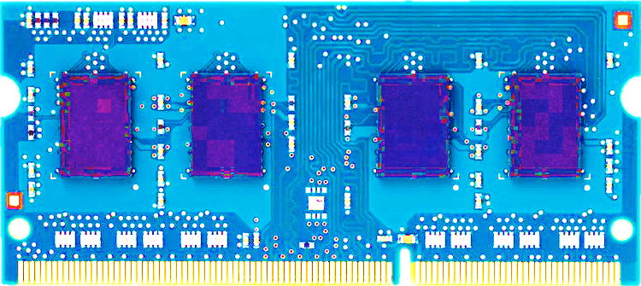
Most DRAM Modules Are at Risk
A company
B company
C company
86%
(37/43)
83%
(45/54)
88%
(28/32)
Up to
1.0×10⁷
errors
Up to
2.7×10⁶
errors
Up to
3.3×10⁵
errors
Kim+, “Flipping Bits in Memory Without Accessing Them: An Experimental Study of DRAM Disturbance Errors,” ISCA 2014.

Slide 38

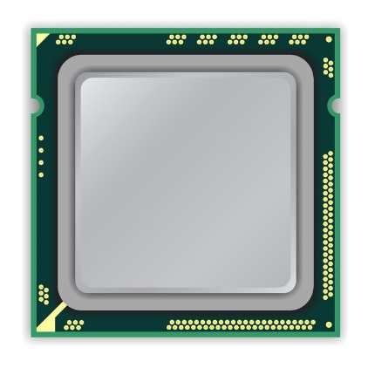
x86 CPU
DRAM Module
loop:
mov (X), %eax
mov (Y), %ebx
clflush (X)
clflush (Y)
mfence
jmp loop
X
Y
Notes:
We demonstrate the errors on multiple x86 systems. Shown to the bottom-left is a “disturbance kernel”. When executed, it forces two rows to be opened and closed one after the other – over and over again. Consequently, it induces many errors in the module.

Slide 39
x86 CPU
DRAM Module
loop:
mov (X), %eax
mov (Y), %ebx
clflush (X)
clflush (Y)
mfence
jmp loop
X
Y
Notes:
We demonstrate the errors on multiple x86 systems. Shown to the bottom-left is a “disturbance kernel”. When executed, it forces two rows to be opened and closed one after the other – over and over again. Consequently, it induces many errors in the module.

Slide 40
x86 CPU
DRAM Module
loop:
mov (X), %eax
mov (Y), %ebx
clflush (X)
clflush (Y)
mfence
jmp loop
X
Y
Notes:
We demonstrate the errors on multiple x86 systems. Shown to the bottom-left is a “disturbance kernel”. When executed, it forces two rows to be opened and closed one after the other – over and over again. Consequently, it induces many errors in the module.

Slide 41
x86 CPU
DRAM Module
loop:
mov (X), %eax
mov (Y), %ebx
clflush (X)
clflush (Y)
mfence
jmp loop
X
Y
Notes:
We demonstrate the errors on multiple x86 systems. Shown to the bottom-left is a “disturbance kernel”. When executed, it forces two rows to be opened and closed one after the other – over and over again. Consequently, it induces many errors in the module.

Slide 42
Observed Errors in Real Systems
In a more controlled environment, we can induce as many as ten million disturbance errors
Disturbance errors are a serious reliability issue
CPU Architecture | Errors | Access-Rate
Intel Haswell (2013) | 22.9K | 12.3M/sec
Intel Ivy Bridge (2012) | 20.7K | 11.7M/sec
Intel Sandy Bridge (2011) | 16.1K | 11.6M/sec
AMD Piledriver (2012) | 59 | 6.1M/sec
Kim+, “Flipping Bits in Memory Without Accessing Them: An Experimental Study of DRAM Disturbance Errors,” ISCA 2014.
Notes:
When we executed the code on four different processors, all four of them yielded errors. Intel Haswell has the most errors, at 23 thousand, because it has the highest rate of accessing DRAM.
Later on, I’ll show that we can induce as many as ten million disturbance errors in a more controlled environment.
From this, we conclude that disturbance errors are a serious reliability issue.

Slide 43
How Do We Solve The Problem?
Tolerate it: Make DRAM and controllers more intelligent
  Just like flash memory and hard disks
Eliminate or minimize it: Replace or (more likely) augment DRAM with a different technology
Embrace it: Design heterogeneous-reliability memories that map error-tolerant data to less reliable portions
…

Slide 44
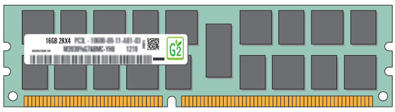
Exploiting Memory Error Tolerance
Heterogeneous-Reliability Memory
Vulnerable data
Vulnerable data
Tolerant data
Tolerant data
Reliable memory
Low-cost memory
Vulnerable data
  On Microsoft’s Web Search application
  Reduces server hardware cost by 4.7 %
  Achieves single server availability target of 99.90 %
ECC protected
Well-tested chips
Tolerant data
NoECC or Parity
Less-tested chips
Notes:
As we have shown earlier, either across or within applications, our characterization can identify data that are vulnerable to memory errors and data that are tolerant to memory errors.
To exploit this observation, we would like to map these different data onto different memory modules according to their memory error tolerance.
As an example here, we map vulnerable data to reliable memory to improve reliability, and map tolerant data to low-cost less-reliable memory to exploit its tolerance and lower the cost. We call this mechanism heterogeneous-reliability memory, HRM.
Reliable memory consists of … Low cost memory consists of …
As we will show later, HRM allows us to use weaker error protection in memory, and enables the use of less-tested memory chips to lower the cost of the memory system, while still achieving reasonable single-server reliability target.

Slide 45
Several Examples
Bulk data copy (and initialization)
DRAM refresh
DRAM reliability
Disparity of working memory and persistent storage
Homogeneous memory
Memory QoS and predictable performance

Slide 46
Agenda
Principled Computer Architecture/System Design
How We Violate Those Principles Today
Some Solution Approaches
Concluding Remarks

Slide 47
Some Directions for the Future
We need to rethink the entire memory/storage system
  Satisfy data-intensive workloads
  Fix many DRAM issues (energy, reliability, …)
  Enable emerging technologies
  Enable a better overall system design
We need to find a better balance between moving data versus moving computation
  Minimize system energy and bandwidth
  Maximize system performance and efficiency
We need to enable system-level memory/storage QoS
  Provide predictable performance
  Build controllable and robust systems

Slide 48
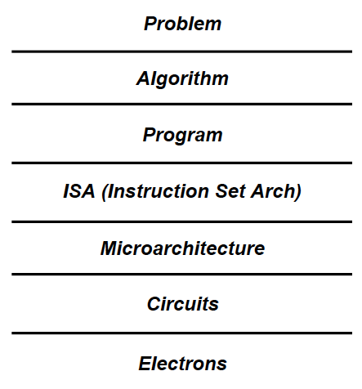
Some Solution Principles (So Far)
More data-centric system design
  Do not center everything around computation units
Better cooperation across layers of the system
  Careful co-design of components and layers: system/arch/device
  More flexible interfaces
Better-than-worst-case design
  Do not optimize for the worst case
  Worst case should not determine the common case
Heterogeneity in design (specialization, asymmetry)
  Enables a more efficient design (No one size fits all)

Slide 49
Agenda
Principled Computer Architecture/System Design
How We Violate Those Principles Today
Some Solution Approaches
Concluding Remarks

Slide 50
Role of the Architect
from Yale Patt’s EE 382N lecture notes

Slide 51

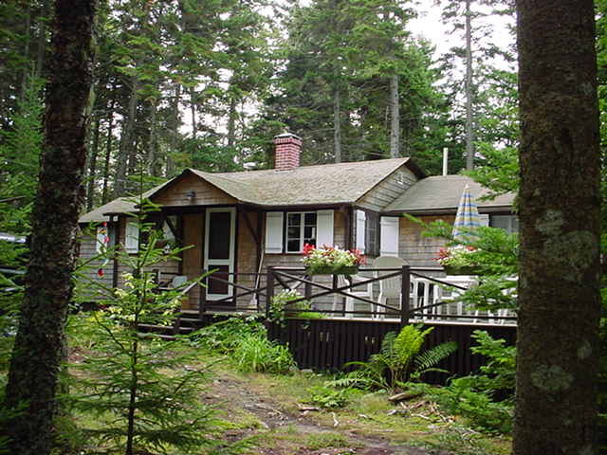
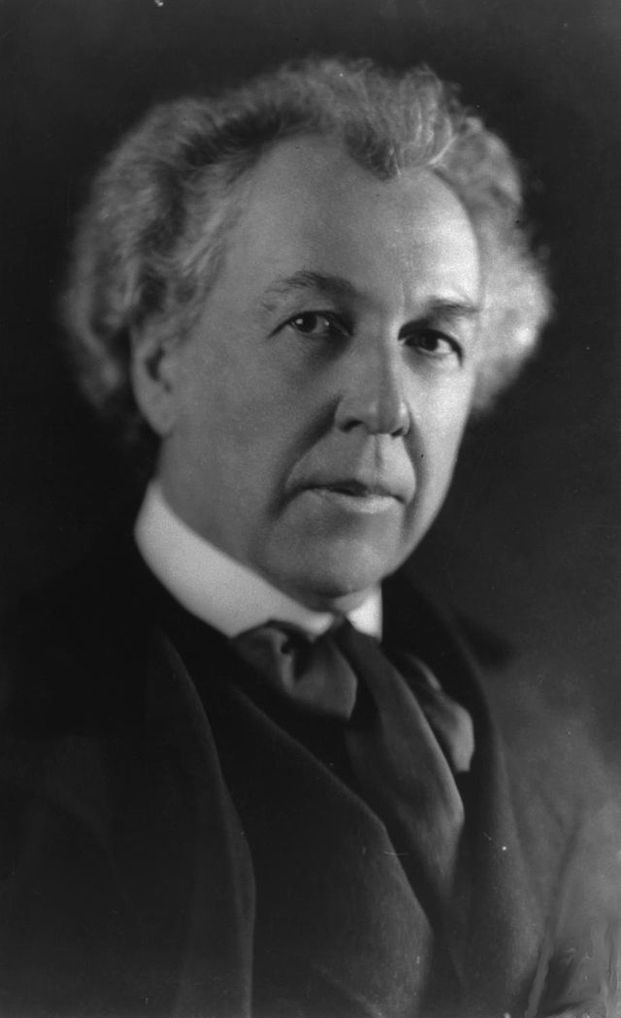
A Quote from Another Famous Architect
“architecture […] based upon principle, and not upon precedent”

Slide 52
Concluding Remarks
It is time to design systems to be more balanced, i.e., more memory-centric
It is time to make memory/storage a priority in system design and optimize it & integrate it better into the system
It is time to design systems to be more focused on critical pieces of work
Future systems will/should be data-centric and memory-centric, with appropriate attention to principles
Notes:
Perhaps we have taken processor-centric system design a bit too far

Slide 53
Finally, people are always telling you:
Think outside the box
from Yale Patt’s EE 382N lecture notes

Slide 54
I prefer: Expand the box
from Yale Patt’s EE 382N lecture notes

Slide 55
Rethinking the Systems We Design
Onur Mutlu
onur@cmu.edu
September 19, 2014
Yale @ 75

