Slide 1
The Non-IID Data Quagmire of Decentralized Machine Learning
ICML 2020
Kevin Hsieh, Amar Phanishayee, Onur Mutlu, Phillip Gibbons

Slide 2
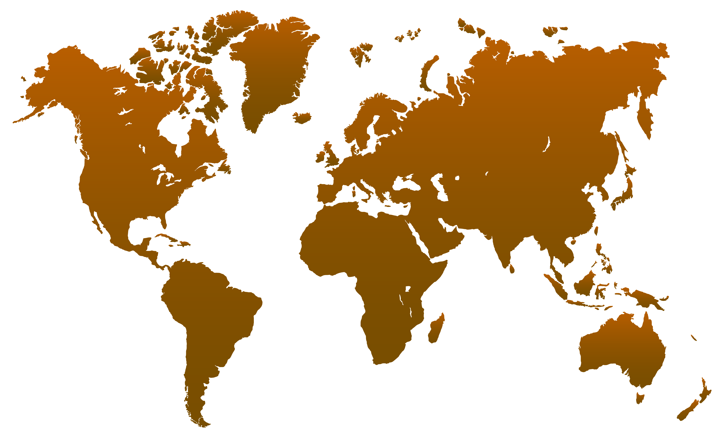
ML Training with Decentralized Data
Geo-Distributed Learning
Federated Learning
Data Sovereignty and Privacy

Slide 3
Major Challenges in Decentralized ML
Geo-Distributed Learning
Federated Learning
Challenge 1: Communication Bottlenecks
Solutions: Federated Averaging, Gaia, Deep Gradient Compression

Slide 4
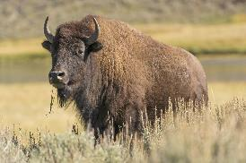
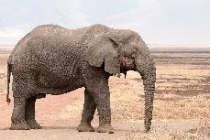
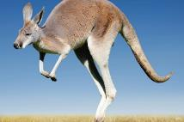
Major Challenges in Decentralized ML
Geo-Distributed Learning
Federated Learning
Challenge 2: Data are often highly skewed (non-iid data)
Solutions: Understudied! Is it a real problem?

Slide 5
Our Work in a Nutshell
Real-World
Dataset
Experimental Study
Proposed Solution

Slide 6
Geographical mammal images from Flickr
736K pictures in 42 mammal classes
Highly skewed labels among
geographic regions
Real-World
Dataset

Slide 7
Skewed data labels are a fundamental and pervasive problem
The problem is even worse for DNNs with batch normalization
The degree of skew determines the difficulty of the problem
Experimental Study

Slide 8
Replace batch normalization with group normalization
SkewScout: communication-efficient decentralized learning over arbitrarily skewed data
Proposed Solution

Slide 9
Real-World Dataset

Slide 10
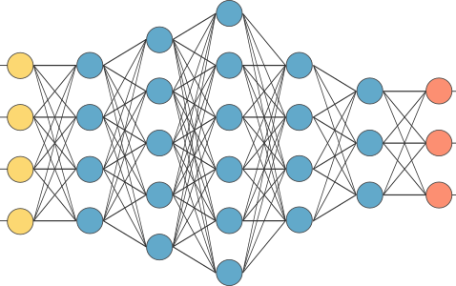
Flickr-Mammal Dataset
42 mammal classes from Open Images and ImageNet
40,000 images per class
Clean images with PNAS [Liu et al.,’18]
Reverse geocoding to country, subcontinent, and continent
https://doi.org/10.5281/zenodo.3676081
736K Pictures with Labels and Geographic Information

Slide 11
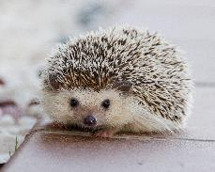
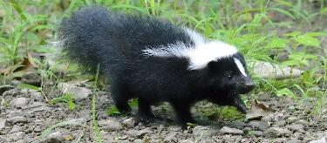
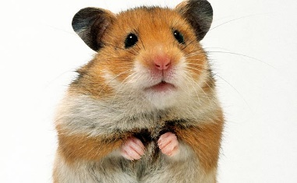
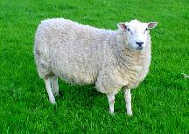
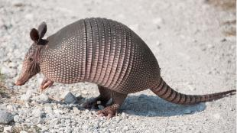
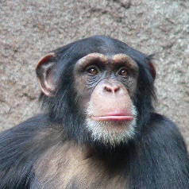
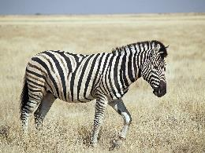
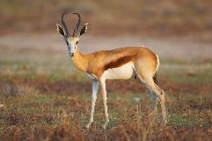
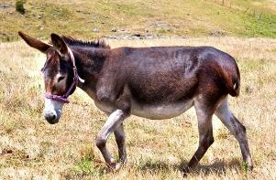
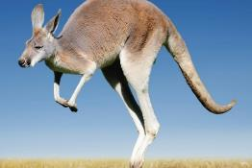
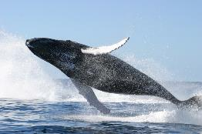
Top-3 Mammals in Each Continent
Each top-3 mammal takes 44-92% share of global images

Slide 12
Label Distribution Across Continents
Vast majority of mammals are dominated by 2-3 continents
The labels are even more skewed among subcontinents

Slide 13
Experimental Study

Slide 14
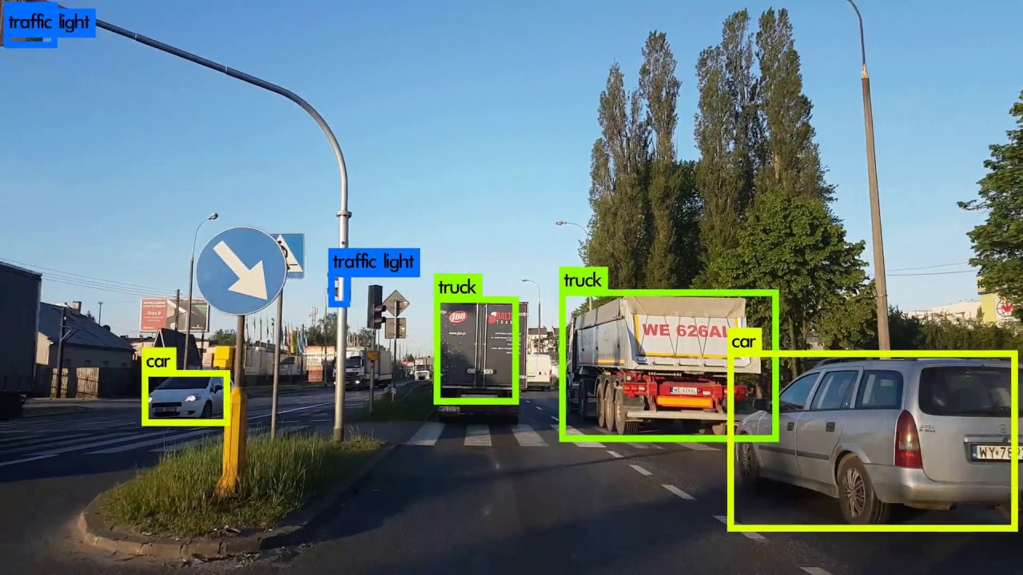
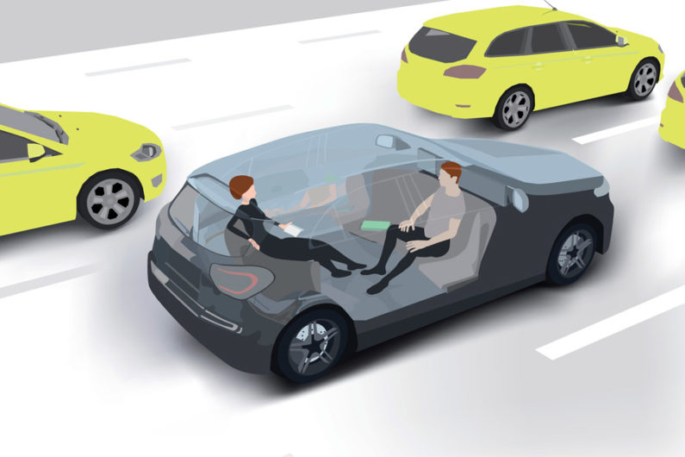
Scope of Experimental Study
ML Application
Decentralized Learning Algorithms
Skewness of Data Label Partitions
×
×
Image Classification (with various DNNs and datasets)
Face recognition
Gaia [NSDI’17]
FederatedAveraging [AISTATS’17]
DeepGradientCompression [ICLR’18]
2-5 Partitions --
more partitions are worse

Slide 15
Results: GoogLeNet over CIFAR-10
All decentralized learning algorithms lose significant accuracy
Tight synchronization (BSP) is accurate but too slow

Slide 16
Similar Results across the Board
Skewed data is a pervasive and fundamental problem
Even BSP loses accuracy for DNNs with Batch Normalization layers
Image Classification (CIFAR-10)
Image Classification
(ImageNet)
Image Classification
(Mammal-Flickr)
Face Recognition
(CASIA and test with LFW)

Slide 17
Degree of Skew is a Key Factor
CIFAR-10 with GN-LeNet
Degree of skew can determine the difficulty of the problem

Slide 18
Batch Normalization ― Problem and Solution

Slide 19
Background: Batch Normalization
[Ioffe & Szegedy, 2015]
Prev Layer
W
BN
Next Layer
Standard normal distribution
(μ = 0, σ = 1) in each minibatch
at training time
Normalize with
estimated global μ and σ
at test time
Batch normalization enables larger learning rates and avoid sharp local minimum (generalize better)

Slide 20
Batch Normalization with Skewed Data
Minibatch Mean Divergence:
||Mean₁ – Mean₂|| / AVG(Mean₁, Mean₂)
CIFAR-10 with BN-LeNet (2 Partitions)
Minibatch μ and σ vary significantly among partitions
Global μ and σ do not work for all partitions

Slide 21
Solution: Use Group Normalization [Wu and He, ECCV’18]
Batch Normalization
Group Normalization
H, W
H, W
C
C
N
N
Designed for small minibatches
We apply as a solution for skewed data

Slide 22
Results with Group Normalization
GroupNorm recovers the accuracy loss for BSP
and reduces accuracy losses for decentralized algorithms

Slide 23
SkewScout: Decentralized learning over arbitrarily skewed data

Slide 24
Overview of SkewScout
Recall that degree of data skew determines difficulty
SkewScout: Adapts communication to the skew-induced accuracy loss
Model Travelling
Accuracy Loss Estimation
Communication Control
Minimize commutation when accuracy loss is acceptable
Work with different decentralized learning algorithms

Slide 25
Evaluation of SkewScout
All data points achieves the same validation accuracy
CIFAR-10 with AlexNet
CIFAR-10 with GoogLeNet
Significant saving over BSP
Only within 1.5X more than Oracle

Slide 26
Key Takeaways
Flickr-Mammal dataset: Highly skewed label distribution in the real world
Skewed data is a pervasive problem
Batch normalization is particularly problematic
SkewScout: adapts decentralized learning over arbitrarily skewed data
Group normalization is a good alternative to batch normalization

