Slide 1
Computer Architecture:
Main Memory (Part I)
Prof. Onur Mutlu
Carnegie Mellon University

Slide 2
Main Memory Lectures
These slides are from the Scalable Memory Systems course taught at ACACES 2013 (July 15-19, 2013)
Course Website:
    http://users.ece.cmu.edu/~omutlu/acaces2013-memory.html
This is the first lecture:
  Lecture 1 (July 15, 2013): DRAM Basics and DRAM Scaling: Trends and Basics (pptx) (pdf)

Slide 3


Scalable Many-Core Memory Systems Lecture 1, Topic 1: DRAM Basics and
DRAM Scaling
Prof. Onur Mutlu
http://www.ece.cmu.edu/~omutlu
onur@cmu.edu
HiPEAC ACACES Summer School 2013
July 15, 2013

Slide 4



The Main Memory System
Main memory is a critical component of all computing systems: server, mobile, embedded, desktop, sensor
Main memory system must scale (in size, technology, efficiency, cost, and management algorithms) to maintain performance growth and technology scaling benefits
Processor
and caches
Main Memory
Storage (SSD/HDD)

Slide 5
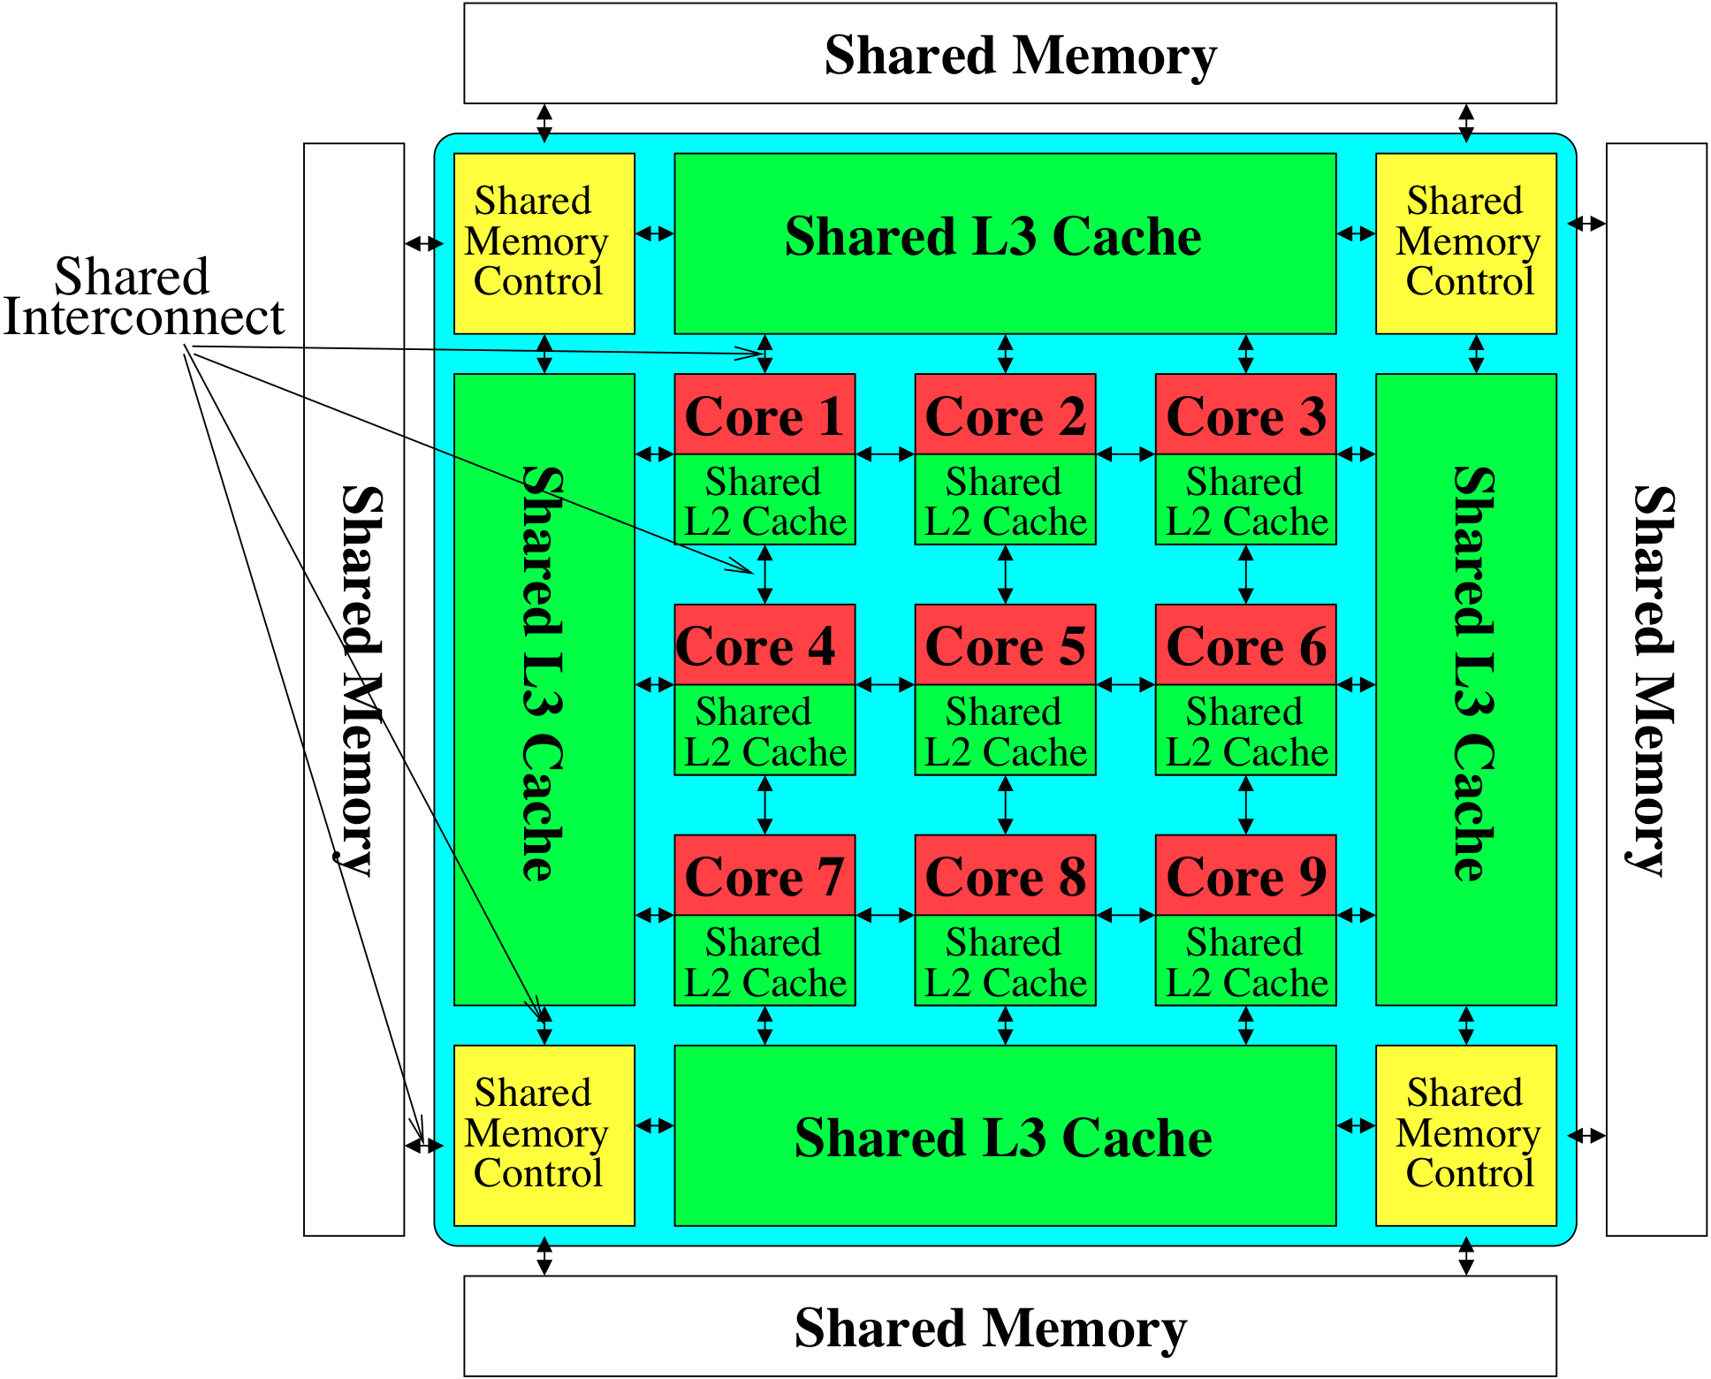
Memory System: A Shared Resource View
Storage

Slide 6
State of the Main Memory System
Recent technology, architecture, and application trends
  lead to new requirements
  exacerbate old requirements
DRAM and memory controllers, as we know them today, are (will be) unlikely to satisfy all requirements
Some emerging non-volatile memory technologies (e.g., PCM) enable new opportunities: memory+storage merging
We need to rethink the main memory system
  to fix DRAM issues and enable emerging technologies
  to satisfy all requirements

Slide 7
Major Trends Affecting Main Memory (I)
Need for main memory capacity, bandwidth, QoS increasing
Main memory energy/power is a key system design concern
DRAM technology scaling is ending

Slide 8
Major Trends Affecting Main Memory (II)
Need for main memory capacity, bandwidth, QoS increasing
  Multi-core: increasing number of cores
  Data-intensive applications: increasing demand/hunger for data
  Consolidation: cloud computing, GPUs, mobile
Main memory energy/power is a key system design concern
DRAM technology scaling is ending

Slide 9
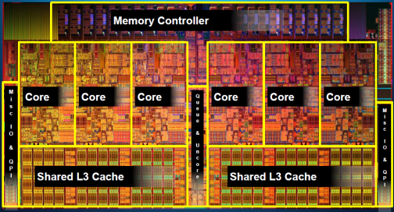
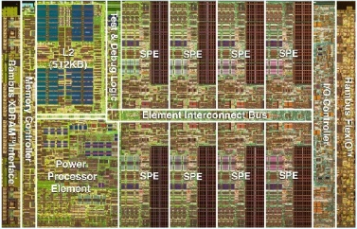
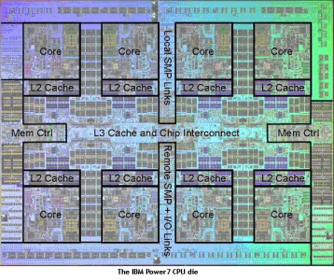
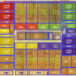
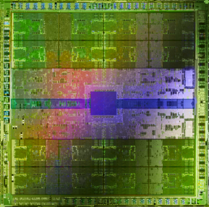
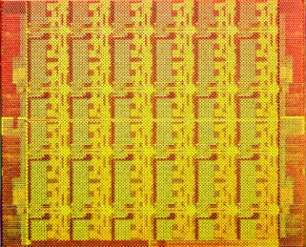
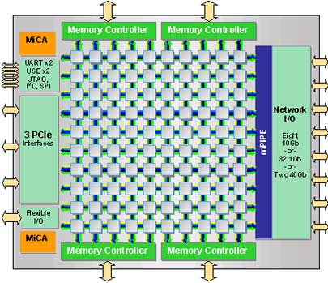
Example Trend: Many Cores on Chip
Simpler and lower power than a single large core
Large scale parallelism on chip
Intel Core i7
8 cores
IBM Cell BE
8+1 cores
IBM POWER7
8 cores
AMD Barcelona
4 cores
Nvidia Fermi
448 “cores”
Intel SCC
48 cores, networked
Tilera TILE Gx
100 cores, networked
Sun Niagara II
8 cores

Slide 10
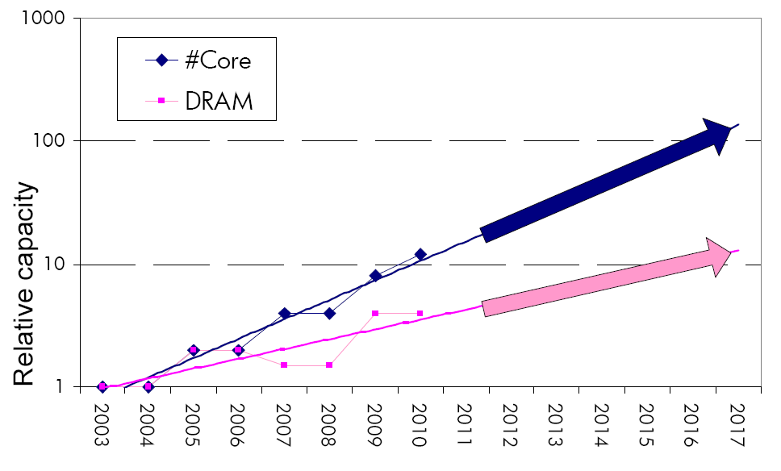
Consequence: The Memory Capacity Gap
Core count doubling ~ every 2 years
DRAM DIMM capacity doubling ~ every 3 years
Memory capacity per core expected to drop by 30% every two years
Trends worse for memory bandwidth per core!

Slide 11
Major Trends Affecting Main Memory (III)
Need for main memory capacity, bandwidth, QoS increasing
Main memory energy/power is a key system design concern
  ~40-50% energy spent in off-chip memory hierarchy [Lefurgy, IEEE Computer 2003]
  DRAM consumes power even when not used (periodic refresh)
DRAM technology scaling is ending

Slide 12
Major Trends Affecting Main Memory (IV)
Need for main memory capacity, bandwidth, QoS increasing
Main memory energy/power is a key system design concern
DRAM technology scaling is ending
  ITRS projects DRAM will not scale easily below X nm
  Scaling has provided many benefits:
    higher capacity (density), lower cost, lower energy

Slide 13
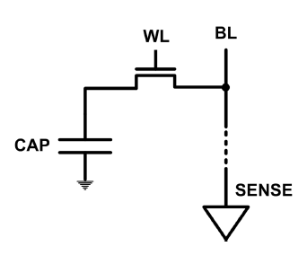
The DRAM Scaling Problem
DRAM stores charge in a capacitor (charge-based memory)
  Capacitor must be large enough for reliable sensing
  Access transistor should be large enough for low leakage and high retention time
  Scaling beyond 40-35nm (2013) is challenging [ITRS, 2009]
DRAM capacity, cost, and energy/power hard to scale

Slide 14
Solutions to the DRAM Scaling Problem
Two potential solutions
  Tolerate DRAM (by taking a fresh look at it)
  Enable emerging memory technologies to eliminate/minimize DRAM
Do both
  Hybrid memory systems

Slide 15
Solution 1: Tolerate DRAM
Overcome DRAM shortcomings with
  System-DRAM co-design
  Novel DRAM architectures, interface, functions
  Better waste management (efficient utilization)
Key issues to tackle
  Reduce refresh energy
  Improve bandwidth and latency
  Reduce waste
  Enable reliability at low cost
Liu, Jaiyen, Veras, Mutlu, “RAIDR: Retention-Aware Intelligent DRAM Refresh,” ISCA 2012.
Kim, Seshadri, Lee+, “A Case for Exploiting Subarray-Level Parallelism in DRAM,” ISCA 2012.
Lee+, “Tiered-Latency DRAM: A Low Latency and Low Cost DRAM Architecture,” HPCA 2013.
Liu+, “An Experimental Study of Data Retention Behavior in Modern DRAM Devices” ISCA’13.
Seshadri+, “RowClone: Fast and Efficient In-DRAM Copy and Initialization of Bulk Data,” 2013.

Slide 16
Solution 2: Emerging Memory Technologies
Some emerging resistive memory technologies seem more scalable than DRAM (and they are non-volatile)
Example: Phase Change Memory
  Expected to scale to 9nm (2022 [ITRS])
  Expected to be denser than DRAM: can store multiple bits/cell
But, emerging technologies have shortcomings as well
  Can they be enabled to replace/augment/surpass DRAM?
Lee, Ipek, Mutlu, Burger, “Architecting Phase Change Memory as a Scalable DRAM Alternative,” ISCA 2009, CACM 2010, Top Picks 2010.
Meza, Chang, Yoon, Mutlu, Ranganathan, “Enabling Efficient and Scalable Hybrid Memories,” IEEE Comp. Arch. Letters 2012.
Yoon, Meza et al., “Row Buffer Locality Aware Caching Policies for Hybrid Memories,” ICCD 2012 Best Paper Award.
Notes:
Even if DRAM continues to scale there could be benefits to examining and enabling these new technologies.

Slide 17
Hybrid Memory Systems
CPU
Meza+, “Enabling Efficient and Scalable Hybrid Memories,” IEEE Comp. Arch. Letters, 2012.
Yoon, Meza et al., “Row Buffer Locality Aware Caching Policies for Hybrid Memories,” ICCD 2012 Best Paper Award.
DRAMCtrl
PCM Ctrl
DRAM
Phase Change Memory (or Tech. X)
Fast, durable
Small,
leaky, volatile,
high-cost
Large, non-volatile, low-cost
Slow, wears out, high active energy
Hardware/software manage data allocation and movement
to achieve the best of multiple technologies

Slide 18
An Orthogonal Issue: Memory Interference
Problem: Memory interference is uncontrolled → uncontrollable, unpredictable, vulnerable system
Goal: We need to control it → Design a QoS-aware system
Solution: Hardware/software cooperative memory QoS
  Hardware designed to provide a configurable fairness substrate
    Application-aware memory scheduling, partitioning, throttling
  Software designed to configure the resources to satisfy different QoS goals
  E.g., fair, programmable memory controllers and on-chip networks provide QoS and predictable performance
  [2007-2012, Top Picks’09,’11a,’11b,’12]

Slide 19
Agenda for Topic 1 (DRAM Scaling)
What Will You Learn in This Course
Main Memory Basics (with a Focus on DRAM)
Major Trends Affecting Main Memory
DRAM Scaling Problem and Solution Directions
Solution Direction 1: System-DRAM Co-Design
Ongoing Research
Summary

Slide 20
What Will You Learn in This Course?
Scalable Many-Core Memory Systems
  July 15-19, 2013
Topic 1: Main memory basics, DRAM scaling
Topic 2: Emerging memory technologies and hybrid memories
Topic 3: Main memory interference and QoS
Topic 4 (unlikely): Cache management
Topic 5 (unlikely): Interconnects
Major Overview Reading:
  Mutlu, “Memory Scaling: A Systems Architecture Perspective,” IMW 2013.

Slide 21
This Course
Will cover many problems and potential solutions related to the design of memory systems in the many core era
The design of the memory system poses many
  Difficult research and engineering problems
  Important fundamental problems
  Industry-relevant problems
Many creative and insightful solutions are needed to solve these problems
Goal: Acquire the basics to develop such solutions (by covering fundamentals and cutting edge research)

Slide 22
Course Information
My Contact Information
  Onur Mutlu
  onur@cmu.edu
  http://users.ece.cmu.edu/~omutlu
  +1-512-658-0891 (my cell phone)
  Find me during breaks and/or email any time.
Website for Course Slides and Papers
  http://users.ece.cmu.edu/~omutlu/acaces2013-memory.html
  http://users.ece.cmu.edu/~omutlu

Slide 23
Readings and Videos

Slide 24
Overview Reading
  Mutlu, “Memory Scaling: A Systems Architecture Perspective,” IMW 2013.
Onur Mutlu,
"Memory Scaling: A Systems Architecture Perspective"
Proceedings of the 5th International Memory Workshop (IMW), Monterey, CA, May 2013. Slides (pptx) (pdf)

Slide 25
Online Slides (Longer Versions)
Topic 1: DRAM Basics and DRAM Scaling
  http://users.ece.cmu.edu/~omutlu/pub/onur-ACACES2013-Topic1-dram-basics-and-scaling.pptx
  http://users.ece.cmu.edu/~omutlu/pub/onur-ACACES2013-Topic1-dram-basics-and-scaling.pdf
Topic 2: Emerging Technologies and Hybrid Memories
  http://users.ece.cmu.edu/~omutlu/pub/onur-ACACES2013-Topic2-emerging-and-hybrid-memory-technologies.pptx
  http://users.ece.cmu.edu/~omutlu/pub/onur-ACACES2013-Topic2-emerging-and-hybrid-memory-technologies.pdf
Topic 3: Memory Interference and QoS-Aware Memory Systems
  http://users.ece.cmu.edu/~omutlu/pub/onur-ACACES2013-Topic3-memory-qos.pptx
  http://users.ece.cmu.edu/~omutlu/pub/onur-ACACES2013-Topic3-memory-qos.pdf

Slide 26
Memory Lecture Videos
Memory Hierarchy (and Introduction to Caches)
  http://www.youtube.com/watch?v=JBdfZ5i21cs&list=PL5PHm2jkkXmidJOd59REog9jDnPDTG6IJ&index=22
Main Memory
  http://www.youtube.com/watch?v=ZLCy3pG7Rc0&list=PL5PHm2jkkXmidJOd59REog9jDnPDTG6IJ&index=25
Memory Controllers, Memory Scheduling, Memory QoS
  http://www.youtube.com/watch?v=ZSotvL3WXmA&list=PL5PHm2jkkXmidJOd59REog9jDnPDTG6IJ&index=26
  http://www.youtube.com/watch?v=1xe2w3_NzmI&list=PL5PHm2jkkXmidJOd59REog9jDnPDTG6IJ&index=27
Emerging Memory Technologies
  http://www.youtube.com/watch?v=LzfOghMKyA0&list=PL5PHm2jkkXmidJOd59REog9jDnPDTG6IJ&index=35
Multiprocessor Correctness and Cache Coherence
  http://www.youtube.com/watch?v=U-VZKMgItDM&list=PL5PHm2jkkXmidJOd59REog9jDnPDTG6IJ&index=32

Slide 27
Readings for Topic 1 (DRAM Scaling)
Lee et al., “Tiered-Latency DRAM: A Low Latency and Low Cost DRAM Architecture,” HPCA 2013.
Liu et al., “RAIDR: Retention-Aware Intelligent DRAM Refresh,” ISCA 2012.
Kim et al., “A Case for Exploiting Subarray-Level Parallelism in DRAM,” ISCA 2012.
Liu et al., “An Experimental Study of Data Retention Behavior in Modern DRAM Devices,” ISCA 2013.
Seshadri et al., “RowClone: Fast and Efficient In-DRAM Copy and Initialization of Bulk Data,” CMU CS Tech Report 2013.
David et al., “Memory Power Management via Dynamic Voltage/Frequency Scaling,” ICAC 2011.
Ipek et al., “Self Optimizing Memory Controllers: A Reinforcement Learning Approach,” ISCA 2008.

Slide 28
Readings for Topic 2 (Emerging Technologies)
Lee, Ipek, Mutlu, Burger, “Architecting Phase Change Memory as a Scalable DRAM Alternative,” ISCA 2009, CACM 2010, Top Picks 2010.
Qureshi et al., “Scalable high performance main memory system using phase-change memory technology,” ISCA 2009.
Meza et al., “Enabling Efficient and Scalable Hybrid Memories,” IEEE Comp. Arch. Letters 2012.
Yoon et al., “Row Buffer Locality Aware Caching Policies for Hybrid Memories,” ICCD 2012 Best Paper Award.
Meza et al., “A Case for Efficient Hardware-Software Cooperative Management of Storage and Memory,” WEED 2013.
Kultursay et al., “Evaluating STT-RAM as an Energy-Efficient Main Memory Alternative,” ISPASS 2013.
Cai et al., “Error Analysis and Retention-Aware Error Management for NAND Flash Memory,” ITJ 2013.

Slide 29
Readings for Topic 3 (Memory QoS)
Moscibroda and Mutlu, “Memory Performance Attacks,” USENIX Security 2007.
Mutlu and Moscibroda, “Stall-Time Fair Memory Access Scheduling,” MICRO 2007.
Mutlu and Moscibroda, “Parallelism-Aware Batch Scheduling,” ISCA 2008, IEEE Micro 2009.
Kim et al., “ATLAS: A Scalable and High-Performance Scheduling Algorithm for Multiple Memory Controllers,” HPCA 2010.
Kim et al., “Thread Cluster Memory Scheduling,” MICRO 2010, IEEE Micro 2011.
Muralidhara et al., “Memory Channel Partitioning,” MICRO 2011.
Ausavarungnirun et al., “Staged Memory Scheduling,” ISCA 2012.
Subramanian et al., “MISE: Providing Performance Predictability and Improving Fairness in Shared Main Memory Systems,” HPCA 2013.
Das et al., “Application-to-Core Mapping Policies to Reduce Memory System Interference in Multi-Core Systems,” HPCA 2013.

Slide 30
Readings for Topic 3 (Memory QoS)
Ebrahimi et al., “Fairness via Source Throttling,” ASPLOS 2010, ACM TOCS 2012.
Lee et al., “Prefetch-Aware DRAM Controllers,” MICRO 2008, IEEE TC 2011.
Ebrahimi et al., “Parallel Application Memory Scheduling,” MICRO 2011.
Ebrahimi et al., “Prefetch-Aware Shared Resource Management for Multi-Core Systems,” ISCA 2011.

Slide 31
Readings in Flash Memory
Yu Cai, Gulay Yalcin, Onur Mutlu, Erich F. Haratsch, Adrian Cristal, Osman Unsal, and Ken Mai,
"Error Analysis and Retention-Aware Error Management for NAND Flash Memory"
Intel Technology Journal (ITJ) Special Issue on Memory Resiliency, Vol. 17, No. 1, May 2013.
Yu Cai, Erich F. Haratsch, Onur Mutlu, and Ken Mai,
"Threshold Voltage Distribution in MLC NAND Flash Memory: Characterization, Analysis and Modeling"
Proceedings of the Design, Automation, and Test in Europe Conference (DATE), Grenoble, France, March 2013. Slides (ppt)
Yu Cai, Gulay Yalcin, Onur Mutlu, Erich F. Haratsch, Adrian Cristal, Osman Unsal, and Ken Mai,
"Flash Correct-and-Refresh: Retention-Aware Error Management for Increased Flash Memory Lifetime"
Proceedings of the 30th IEEE International Conference on Computer Design (ICCD), Montreal, Quebec, Canada, September 2012. Slides (ppt) (pdf)
Yu Cai, Erich F. Haratsch, Onur Mutlu, and Ken Mai,
"Error Patterns in MLC NAND Flash Memory: Measurement, Characterization, and Analysis"
Proceedings of the Design, Automation, and Test in Europe Conference (DATE), Dresden, Germany, March 2012. Slides (ppt)

Slide 32
Online Lectures and More Information
Online Computer Architecture Lectures
  http://www.youtube.com/playlist?list=PL5PHm2jkkXmidJOd59REog9jDnPDTG6IJ
Online Computer Architecture Courses
  Intro: http://www.ece.cmu.edu/~ece447/s13/doku.php
  Advanced: http://www.ece.cmu.edu/~ece740/f11/doku.php
  Advanced: http://www.ece.cmu.edu/~ece742/doku.php
Recent Research Papers
  http://users.ece.cmu.edu/~omutlu/projects.htm
  http://scholar.google.com/citations?user=7XyGUGkAAAAJ&hl=en

Slide 33
Agenda for Topic 1 (DRAM Scaling)
What Will You Learn in This Mini-Lecture Series
Main Memory Basics (with a Focus on DRAM)
Major Trends Affecting Main Memory
DRAM Scaling Problem and Solution Directions
Solution Direction 1: System-DRAM Co-Design
Ongoing Research
Summary

Slide 34
Main Memory

Slide 35
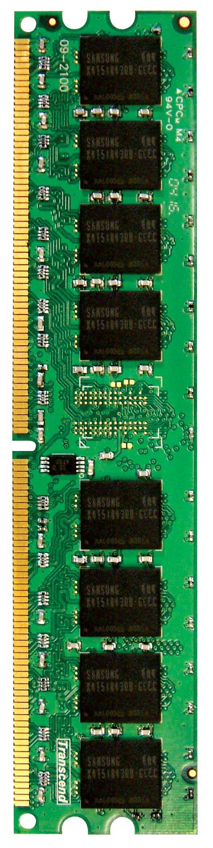
Main Memory in the System
CORE 0
L2 CACHE 1
CORE 1
L2 CACHE 0
SHARED L3 CACHE
DRAM INTERFACE
DRAM MEMORY CONTROLLER
DRAM BANKS
L2 CACHE 2
CORE 3
CORE 2
L2 CACHE 3

Slide 36
Ideal Memory
Zero access time (latency)
Infinite capacity
Zero cost
Infinite bandwidth (to support multiple accesses in parallel)

Slide 37
The Problem
Ideal memory’s requirements oppose each other
Bigger is slower
  Bigger → Takes longer to determine the location
Faster is more expensive
  Memory technology: SRAM vs. DRAM
Higher bandwidth is more expensive
  Need more banks, more ports, higher frequency, or faster technology

Slide 38
Memory Technology: DRAM
Dynamic random access memory
Capacitor charge state indicates stored value
  Whether the capacitor is charged or discharged indicates storage of 1 or 0
  1 capacitor
  1 access transistor
Capacitor leaks through the RC path
  DRAM cell loses charge over time
  DRAM cell needs to be refreshed
  Read Liu et al., “RAIDR: Retention-aware Intelligent DRAM Refresh,” ISCA 2012.
row enable
_bitline

Slide 39
Memory Technology: SRAM
Static random access memory
Two cross coupled inverters store a single bit
  Feedback path enables the stored value to persist in the “cell”
  4 transistors for storage
  2 transistors for access
row select
bitline
_bitline

Slide 40
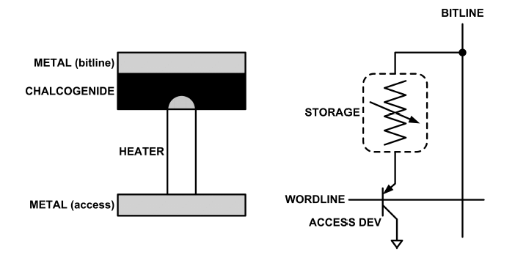
An Aside: Phase Change Memory
Phase change material (chalcogenide glass) exists in two states:
  Amorphous: Low optical reflexivity and high electrical resistivity
  Crystalline: High optical reflexivity and low electrical resistivity
PCM is resistive memory: High resistance (0), Low resistance (1)
Lee, Ipek, Mutlu, Burger, “Architecting Phase Change Memory as a Scalable DRAM Alternative,” ISCA 2009.

Slide 41
Memory Bank: A Fundamental Concept
Interleaving (banking)
  Problem: a single monolithic memory array takes long to access and does not enable multiple accesses in parallel
  Goal: Reduce the latency of memory array access and enable multiple accesses in parallel
  Idea: Divide the array into multiple banks that can be accessed independently (in the same cycle or in consecutive cycles)
    Each bank is smaller than the entire memory storage
    Accesses to different banks can be overlapped
  An issue: How do you map data to different banks? (i.e., how do you interleave data across banks?)

Slide 42
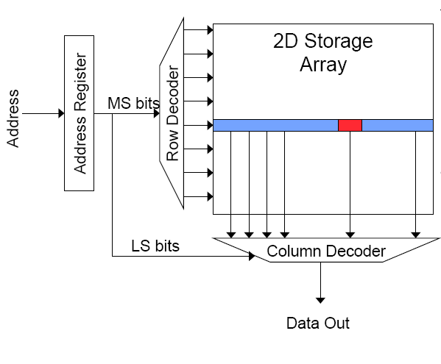
Memory Bank Organization and Operation
Read access sequence:
1. Decode row address & drive word-lines
2. Selected bits drive bit-lines
• Entire row read
3. Amplify row data
4. Decode column address & select subset of row
• Send to output
5. Precharge bit-lines
• For next access

Slide 43
Why Memory Hierarchy?
We want both fast and large
But we cannot achieve both with a single level of memory
Idea: Have multiple levels of storage (progressively bigger and slower as the levels are farther from the processor) and ensure most of the data the processor needs is kept in the fast(er) level(s)

Slide 44
Memory Hierarchy
Fundamental tradeoff
  Fast memory: small
  Large memory: slow
Idea: Memory hierarchy
Latency, cost, size,
bandwidth
Hard Disk
Main
Memory
(DRAM)
CPU
Cache
RF

Slide 45
Caching Basics: Exploit Temporal Locality
Idea: Store recently accessed data in automatically managed fast memory (called cache)
Anticipation: the data will be accessed again soon
Temporal locality principle
  Recently accessed data will be again accessed in the near future
  This is what Maurice Wilkes had in mind:
    Wilkes, “Slave Memories and Dynamic Storage Allocation,” IEEE Trans. On Electronic Computers, 1965.
    “The use is discussed of a fast core memory of, say 32000 words as a slave to a slower core memory of, say, one million words in such a way that in practical cases the effective access time is nearer that of the fast memory than that of the slow memory.”

Slide 46
Caching Basics: Exploit Spatial Locality
Idea: Store addresses adjacent to the recently accessed one in automatically managed fast memory
  Logically divide memory into equal size blocks
  Fetch to cache the accessed block in its entirety
Anticipation: nearby data will be accessed soon
Spatial locality principle
  Nearby data in memory will be accessed in the near future
    E.g., sequential instruction access, array traversal
  This is what IBM 360/85 implemented
    16 Kbyte cache with 64 byte blocks
    Liptay, “Structural aspects of the System/360 Model 85 II: the cache,” IBM Systems Journal, 1968.

Slide 47
A Note on Manual vs. Automatic Management
Manual: Programmer manages data movement across levels
  -- too painful for programmers on substantial programs
  “core” vs “drum” memory in the 50’s
  still done in some embedded processors (on-chip scratch pad SRAM in lieu of a cache)
Automatic: Hardware manages data movement across levels, transparently to the programmer
  ++ programmer’s life is easier
  simple heuristic: keep most recently used items in cache
  the average programmer doesn’t need to know about it
    You don’t need to know how big the cache is and how it works to write a “correct” program! (What if you want a “fast” program?)

Slide 48
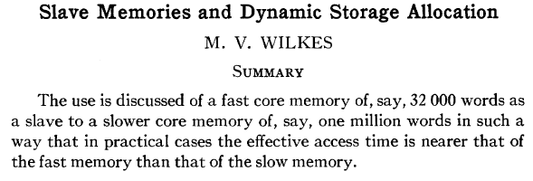
Automatic Management in Memory Hierarchy
Wilkes, “Slave Memories and Dynamic Storage Allocation,” IEEE Trans. On Electronic Computers, 1965.
“By a slave memory I mean one which automatically accumulates to itself words that come from a slower main memory, and keeps them available for subsequent use without it being necessary for the penalty of main memory access to be incurred again.”

Slide 49
A Modern Memory Hierarchy
Register File
32 words, sub-nsec
L1 cache
~32 KB, ~nsec
L2 cache
512 KB ~ 1MB, many nsec
L3 cache,
.....
Main memory (DRAM),
GB, ~100 nsec
Swap Disk
100 GB, ~10 msec
manual/compiler
register spilling
Memory
Abstraction
Automatic
HW cache
management
automatic
demand
paging

Slide 50
The DRAM Subsystem

Slide 51
DRAM Subsystem Organization
Channel
DIMM
Rank
Chip
Bank
Row/Column

Slide 52
Page Mode DRAM
A DRAM bank is a 2D array of cells: rows x columns
A “DRAM row” is also called a “DRAM page”
“Sense amplifiers” also called “row buffer”
Each address is a <row,column> pair
Access to a “closed row”
  Activate command opens row (placed into row buffer)
  Read/write command reads/writes column in the row buffer
  Precharge command closes the row and prepares the bank for next access
Access to an “open row”
  No need for activate command

Slide 53
DRAM Bank Operation
Access Address:
(Row 0, Column 0)
Columns
(Row 0, Column 1)
(Row 0, Column 85)
(Row 1, Column 0)
Row address 0
Row address 1
Row decoder
Rows
Row Buffer
CONFLICT !
HIT
Row 1
HIT
Row 0
Empty
Column address 0
Column mux
Column address 0
Column address 1
Column address 85
Data

Slide 54
The DRAM Chip
Consists of multiple banks (2-16 in Synchronous DRAM)
Banks share command/address/data buses
The chip itself has a narrow interface (4-16 bits per read)

Slide 55
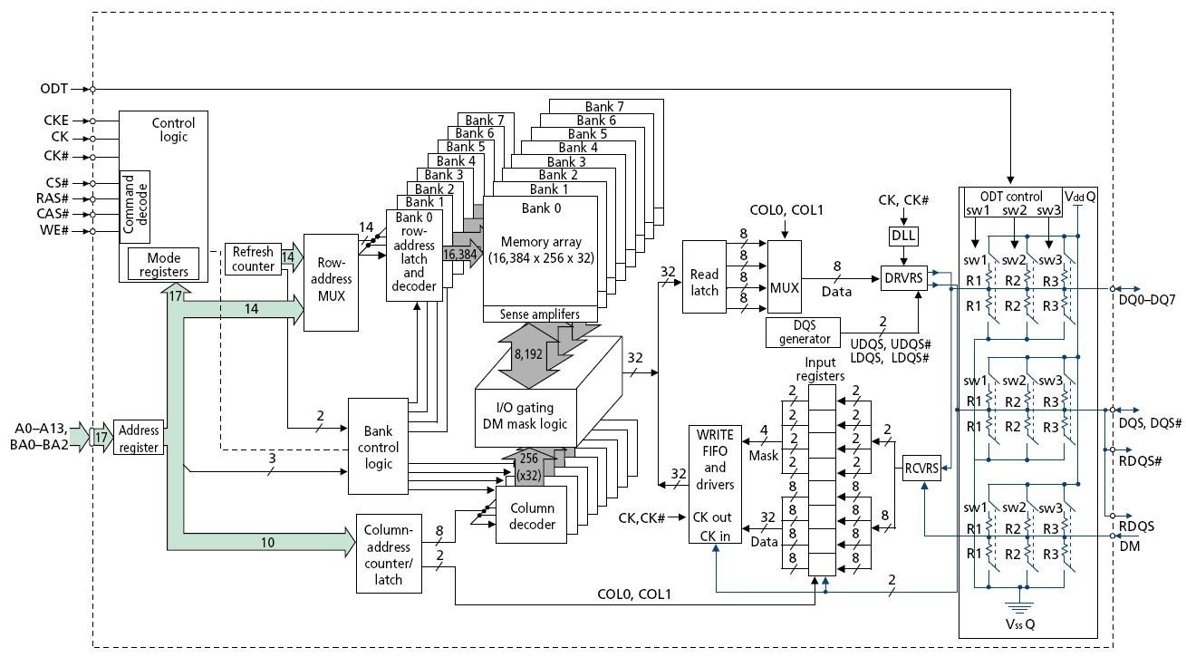
128M x 8-bit DRAM Chip

Slide 56
DRAM Rank and Module
Rank: Multiple chips operated together to form a wide interface
All chips comprising a rank are controlled at the same time
  Respond to a single command
  Share address and command buses, but provide different data
A DRAM module consists of one or more ranks
  E.g., DIMM (dual inline memory module)
  This is what you plug into your motherboard
If we have chips with 8-bit interface, to read 8 bytes in a single access, use 8 chips in a DIMM

Slide 57
A 64-bit Wide DIMM (One Rank)

Slide 58
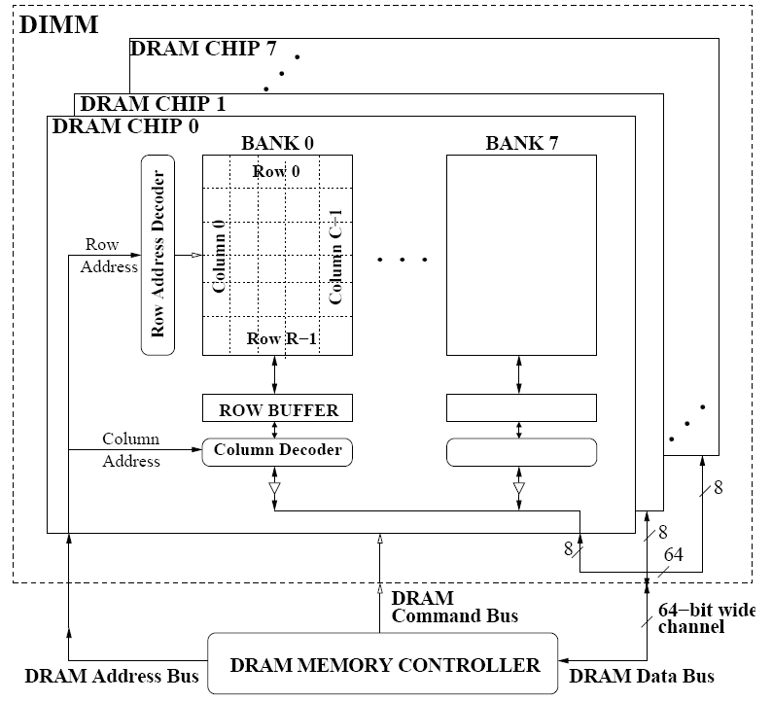
A 64-bit Wide DIMM (One Rank)
Advantages:
  Acts like a high-capacity DRAM chip with a wide interface
  Flexibility: memory controller does not need to deal with individual chips
Disadvantages:
  Granularity: Accesses cannot be smaller than the interface width

Slide 59
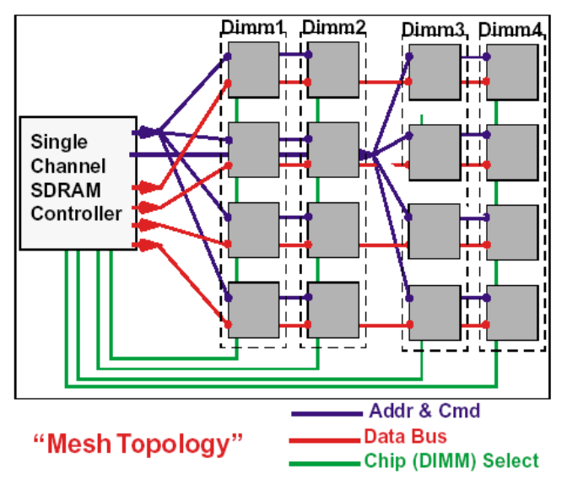
Multiple DIMMs
Advantages:
  Enables even higher capacity
Disadvantages:
  Interconnect complexity and energy consumption can be high

Slide 60
DRAM Channels
2 Independent Channels: 2 Memory Controllers (Above)
2 Dependent/Lockstep Channels: 1 Memory Controller with wide interface (Not shown above)

Slide 61
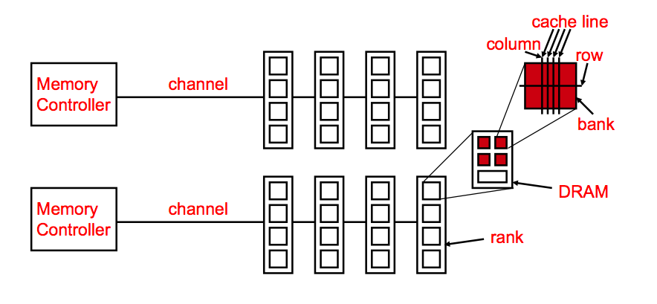
Generalized Memory Structure

Slide 62
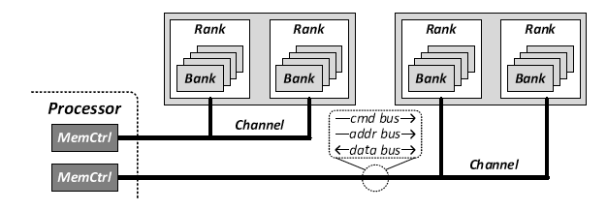
Generalized Memory Structure
Kim+, “A Case for Exploiting Subarray-Level Parallelism in DRAM,” ISCA 2012.

Slide 63
The DRAM Subsystem
The Top Down View

Slide 64
DRAM Subsystem Organization
Channel
DIMM
Rank
Chip
Bank
Row/Column

Slide 65
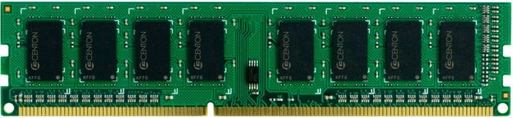
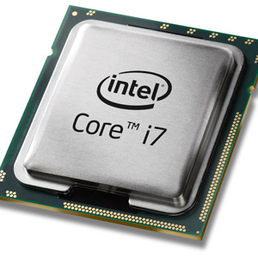
The DRAM subsystem
“Channel”
DIMM (Dual in-line memory module)
Processor
Memory channel
Memory channel

Slide 66
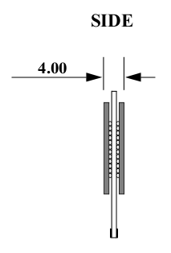
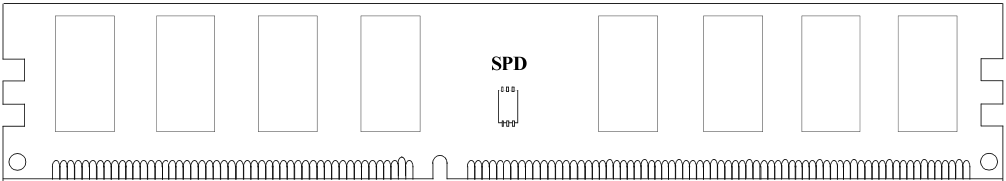
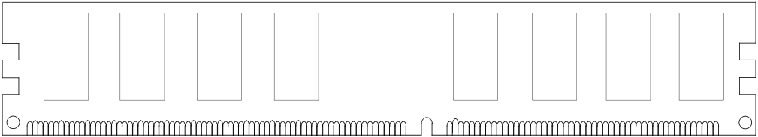
Breaking down a DIMM
DIMM (Dual in-line memory module)
Side view
Front of DIMM
Back of DIMM

Slide 67
Breaking down a DIMM
DIMM (Dual in-line memory module)
Side view
Front of DIMM
Back of DIMM
Rank 0: collection of 8 chips
Rank 1

Slide 68
Rank
Rank 0 (Front)
Rank 1 (Back)
<0:63>
<0:63>
Addr/Cmd
CS <0:1>
Data <0:63>
Memory channel

Slide 69
Breaking down a Rank
. . .
Chip 0
Chip 1
Chip 7
Rank 0
<0:63>
<0:7>
<8:15>
<56:63>
Data <0:63>

Slide 70
Breaking down a Chip
8 banks
Chip 0
Bank 0
<0:7>
<0:7>
<0:7>
...
<0:7>
<0:7>

Slide 71
Breaking down a Bank
2kB
1B (column)
row 16k-1
Bank 0
...
row 0
<0:7>
Row-buffer
1B
1B
1B
...
<0:7>

Slide 72
DRAM Subsystem Organization
Channel
DIMM
Rank
Chip
Bank
Row/Column

Slide 73
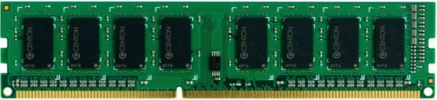


Example: Transferring a cache block
Physical memory space
0xFFFF…F
Channel 0
...
DIMM 0
Mapped to
0x40
Rank 0
64B
cache block
0x00

Slide 74
Example: Transferring a cache block
Physical memory space
Chip 0
Chip 1
Rank 0
Chip 7
0xFFFF…F
. . .
...
<0:7>
<8:15>
<56:63>
0x40
64B
cache block
Data <0:63>
0x00

Slide 75
Example: Transferring a cache block
Physical memory space
Chip 0
Chip 1
Rank 0
Chip 7
0xFFFF…F
. . .
Row 0
Col 0
...
<0:7>
<8:15>
<56:63>
0x40
64B
cache block
Data <0:63>
0x00

Slide 76
Example: Transferring a cache block
Physical memory space
Chip 0
Chip 1
Rank 0
Chip 7
0xFFFF…F
. . .
Row 0
Col 0
...
<0:7>
<8:15>
<56:63>
0x40
64B
cache block
Data <0:63>
8B
0x00
8B

Slide 77
Example: Transferring a cache block
Physical memory space
Chip 0
Chip 1
Rank 0
Chip 7
0xFFFF…F
. . .
Row 0
Col 1
...
<0:7>
<8:15>
<56:63>
0x40
64B
cache block
Data <0:63>
8B
0x00

Slide 78
Example: Transferring a cache block
Physical memory space
Chip 0
Chip 1
Rank 0
Chip 7
0xFFFF…F
. . .
Row 0
Col 1
...
<0:7>
<8:15>
<56:63>
0x40
8B
64B
cache block
Data <0:63>
8B
0x00
8B

Slide 79
Example: Transferring a cache block
Physical memory space
Chip 0
Chip 1
Rank 0
Chip 7
0xFFFF…F
. . .
Row 0
Col 1
...
<0:7>
<8:15>
<56:63>
0x40
8B
64B
cache block
Data <0:63>
8B
0x00
A 64B cache block takes 8 I/O cycles to transfer.
During the process, 8 columns are read sequentially.

Slide 80
Latency Components: Basic DRAM Operation
CPU → controller transfer time
Controller latency
  Queuing & scheduling delay at the controller
  Access converted to basic commands
Controller → DRAM transfer time
DRAM bank latency
  Simple CAS (column address strobe) if row is “open” OR
  RAS (row address strobe) + CAS if array precharged OR
  PRE + RAS + CAS (worst case)
DRAM → Controller transfer time
  Bus latency (BL)
Controller to CPU transfer time

Slide 81
Multiple Banks (Interleaving) and Channels
Multiple banks
  Enable concurrent DRAM accesses
  Bits in address determine which bank an address resides in
Multiple independent channels serve the same purpose
  But they are even better because they have separate data buses
  Increased bus bandwidth
Enabling more concurrency requires reducing
  Bank conflicts
  Channel conflicts
How to select/randomize bank/channel indices in address?
  Lower order bits have more entropy
  Randomizing hash functions (XOR of different address bits)

Slide 82
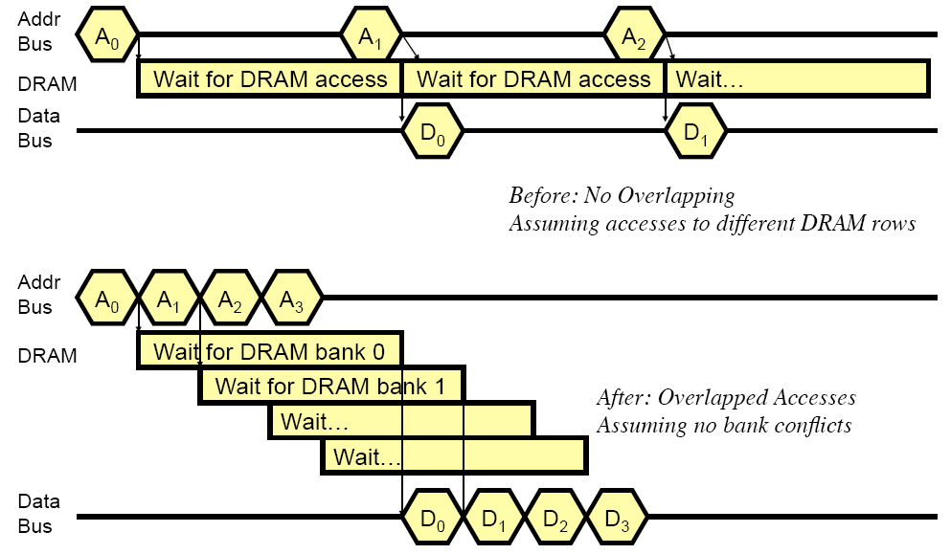
How Multiple Banks Help

Slide 83
Address Mapping (Single Channel)
Single-channel system with 8-byte memory bus
  2GB memory, 8 banks, 16K rows & 2K columns per bank
Row interleaving
  Consecutive rows of memory in consecutive banks
  Accesses to consecutive cache blocks serviced in a pipelined manner
Cache block interleaving
    Consecutive cache block addresses in consecutive banks
    64 byte cache blocks
    Accesses to consecutive cache blocks can be serviced in parallel
Row (14 bits)
Bank (3 bits)
Column (11 bits)
Byte in bus (3 bits)
Row (14 bits)
High Column
Bank (3 bits)
Low Col.
Byte in bus (3 bits)
8 bits
3 bits

Slide 84
Bank Mapping Randomization
DRAM controller can randomize the address mapping to banks so that bank conflicts are less likely
3 bits
Column (11 bits)
Byte in bus (3 bits)
XOR
Bank index (3 bits)

Slide 85
Address Mapping (Multiple Channels)
C
Row (14 bits)
Bank (3 bits)
Column (11 bits)
Byte in bus (3 bits)
Where are consecutive cache blocks?
Row (14 bits)
C
Bank (3 bits)
Column (11 bits)
Byte in bus (3 bits)
Row (14 bits)
Bank (3 bits)
C
Column (11 bits)
Byte in bus (3 bits)
Row (14 bits)
Bank (3 bits)
Column (11 bits)
C
Byte in bus (3 bits)
C
Row (14 bits)
High Column
Bank (3 bits)
Low Col.
Byte in bus (3 bits)
8 bits
3 bits
Row (14 bits)
C
High Column
Bank (3 bits)
Low Col.
Byte in bus (3 bits)
8 bits
3 bits
Row (14 bits)
High Column
C
Bank (3 bits)
Low Col.
Byte in bus (3 bits)
8 bits
3 bits
Row (14 bits)
High Column
Bank (3 bits)
C
Low Col.
Byte in bus (3 bits)
8 bits
3 bits
Row (14 bits)
High Column
Bank (3 bits)
Low Col.
C
Byte in bus (3 bits)
8 bits
3 bits

Slide 86
Interaction with Virtual→Physical Mapping
Operating System influences where an address maps to in DRAM
Operating system can influence which bank/channel/rank a virtual page is mapped to.
It can perform page coloring to
  Minimize bank conflicts
  Minimize inter-application interference [Muralidhara+ MICRO’11]
Virtual Page number (52 bits)
Page offset (12 bits)
VA
Physical Frame number (19 bits)
Page offset (12 bits)
PA
Row (14 bits)
Bank (3 bits)
Column (11 bits)
Byte in bus (3 bits)
PA

Slide 87
DRAM Refresh (I)
DRAM capacitor charge leaks over time
The memory controller needs to read each row periodically to restore the charge
  Activate + precharge each row every N ms
  Typical N = 64 ms
Implications on performance?
  -- DRAM bank unavailable while refreshed
  -- Long pause times: If we refresh all rows in burst, every 64ms the DRAM will be unavailable until refresh ends
Burst refresh: All rows refreshed immediately after one another
Distributed refresh: Each row refreshed at a different time, at regular intervals

Slide 88
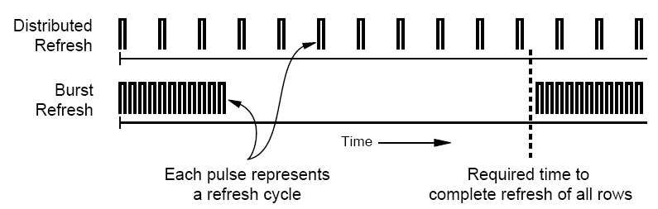
DRAM Refresh (II)
Distributed refresh eliminates long pause times
How else we can reduce the effect of refresh on performance?
  Can we reduce the number of refreshes?

Slide 89
Downsides of DRAM Refresh
-- Energy consumption: Each refresh consumes energy
-- Performance degradation: DRAM rank/bank unavailable while refreshed
-- QoS/predictability impact: (Long) pause times during refresh
-- Refresh rate limits DRAM density scaling
  Liu et al., “RAIDR: Retention-aware Intelligent DRAM Refresh,” ISCA 2012.

Slide 90
Memory Controllers

Slide 91
DRAM versus Other Types of Memories
Long latency memories have similar characteristics that need to be controlled.
The following discussion will use DRAM as an example, but many issues are similar in the design of controllers for other types of memories
  Flash memory
  Other emerging memory technologies
    Phase Change Memory
    Spin-Transfer Torque Magnetic Memory

Slide 92
DRAM Controller: Functions
Ensure correct operation of DRAM (refresh and timing)
Service DRAM requests while obeying timing constraints of DRAM chips
  Constraints: resource conflicts (bank, bus, channel), minimum write-to-read delays
  Translate requests to DRAM command sequences
Buffer and schedule requests to improve performance
  Reordering, row-buffer, bank, rank, bus management
Manage power consumption and thermals in DRAM
  Turn on/off DRAM chips, manage power modes

Slide 93
DRAM Controller: Where to Place
In chipset
  + More flexibility to plug different DRAM types into the system
+ Less power density in the CPU chip
On CPU chip
  + Reduced latency for main memory access
  + Higher bandwidth between cores and controller
    More information can be communicated (e.g. request’s importance in the processing core)

Slide 94
A Modern DRAM Controller

Slide 95
DRAM Scheduling Policies (I)
FCFS (first come first served)
  Oldest request first
FR-FCFS (first ready, first come first served)
  1. Row-hit first
  2. Oldest first
  Goal: Maximize row buffer hit rate → maximize DRAM throughput
  Actually, scheduling is done at the command level
    Column commands (read/write) prioritized over row commands (activate/precharge)
    Within each group, older commands prioritized over younger ones

Slide 96
DRAM Scheduling Policies (II)
A scheduling policy is essentially a prioritization order
Prioritization can be based on
  Request age
  Row buffer hit/miss status
  Request type (prefetch, read, write)
  Requestor type (load miss or store miss)
  Request criticality
    Oldest miss in the core?
    How many instructions in core are dependent on it?

Slide 97
Row Buffer Management Policies
Open row
  Keep the row open after an access
  + Next access might need the same row → row hit
  -- Next access might need a different row → row conflict, wasted energy
Closed row
  Close the row after an access (if no other requests already in the request buffer need the same row)
  + Next access might need a different row → avoid a row conflict
  -- Next access might need the same row → extra activate latency
Adaptive policies
  Predict whether or not the next access to the bank will be to the same row

Slide 98
Open vs. Closed Row Policies
Policy | First access | Next access | Commands needed for next access
Open row | Row 0 | Row 0 (row hit) | Read
Open row | Row 0 | Row 1 (row conflict) | Precharge + Activate Row 1 + Read
Closed row | Row 0 | Row 0 – access in request buffer (row hit) | Read
Closed row | Row 0 | Row 0 – access not in request buffer (row closed) | Activate Row 0 + Read + Precharge
Closed row | Row 0 | Row 1 (row closed) | Activate Row 1 + Read + Precharge

Slide 99
Why are DRAM Controllers Difficult to Design?
Need to obey DRAM timing constraints for correctness
  There are many (50+) timing constraints in DRAM
  tWTR: Minimum number of cycles to wait before issuing a read command after a write command is issued
  tRC: Minimum number of cycles between the issuing of two consecutive activate commands to the same bank
  …
Need to keep track of many resources to prevent conflicts
  Channels, banks, ranks, data bus, address bus, row buffers
Need to handle DRAM refresh
Need to optimize for performance (in the presence of constraints)
  Reordering is not simple
  Predicting the future?

Slide 100
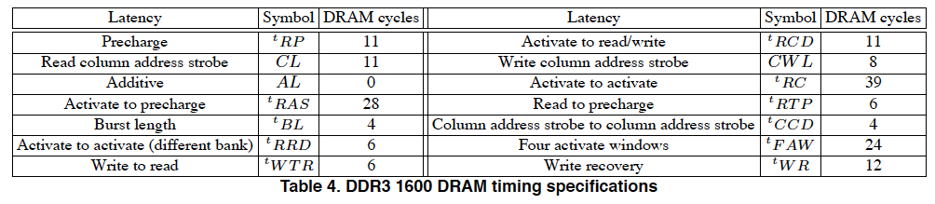
Many DRAM Timing Constraints
From Lee et al., “DRAM-Aware Last-Level Cache Writeback: Reducing Write-Caused Interference in Memory Systems,” HPS Technical Report, April 2010.

Slide 101
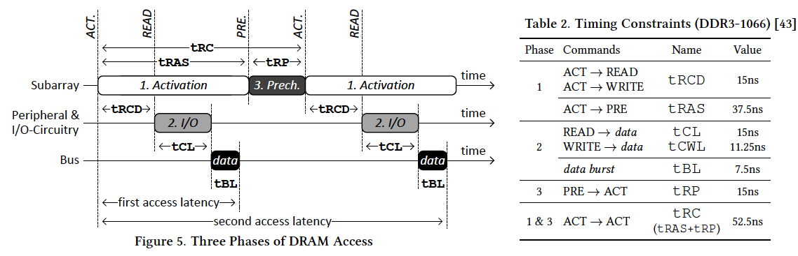
More on DRAM Operation
Kim et al., “A Case for Exploiting Subarray-Level Parallelism (SALP) in DRAM,” ISCA 2012.
Lee et al., “Tiered-Latency DRAM: A Low Latency and Low Cost DRAM Architecture,” HPCA 2013.

Slide 102
Computer Architecture:
Main Memory (Part I)
Prof. Onur Mutlu
Carnegie Mellon University

Slide 103
We did not cover the remaining slides.

Slide 104
Self-Optimizing DRAM Controllers
Problem: DRAM controllers difficult to design → It is difficult for human designers to design a policy that can adapt itself very well to different workloads and different system conditions
Idea: Design a memory controller that adapts its scheduling policy decisions to workload behavior and system conditions using machine learning.
Observation: Reinforcement learning maps nicely to memory control.
Design: Memory controller is a reinforcement learning agent that dynamically and continuously learns and employs the best scheduling policy.

Slide 105
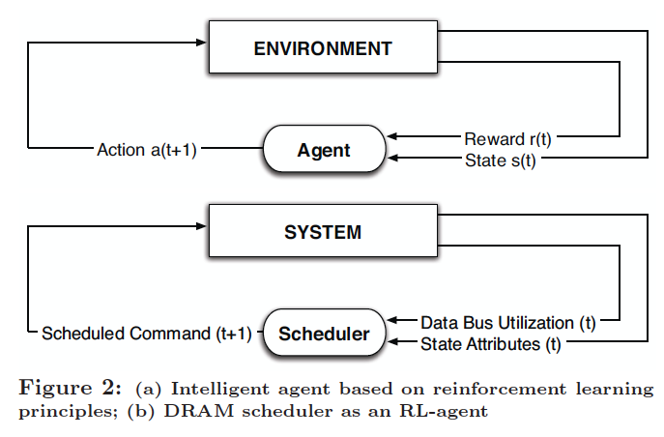
Self-Optimizing DRAM Controllers
Engin Ipek, Onur Mutlu, José F. Martínez, and Rich Caruana,
"Self Optimizing Memory Controllers: A Reinforcement Learning Approach"
Proceedings of the 35th International Symposium on Computer Architecture (ISCA), pages 39-50, Beijing, China, June 2008.

Slide 106
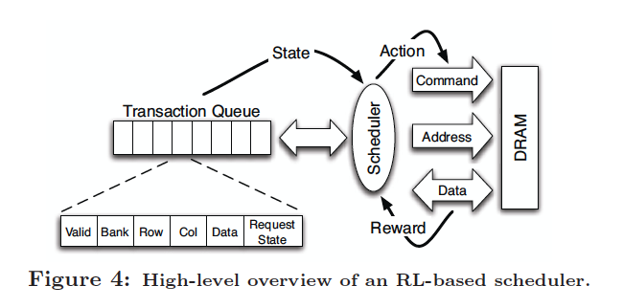
Self-Optimizing DRAM Controllers
Engin Ipek, Onur Mutlu, José F. Martínez, and Rich Caruana,
"Self Optimizing Memory Controllers: A Reinforcement Learning Approach"
Proceedings of the 35th International Symposium on Computer Architecture (ISCA), pages 39-50, Beijing, China, June 2008.

Slide 107
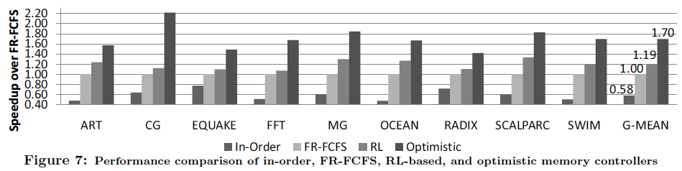
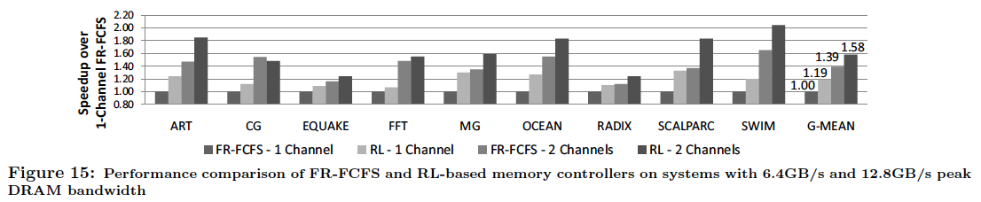
Performance Results

Slide 108
DRAM Power Management
DRAM chips have power modes
Idea: When not accessing a chip power it down
Power states
  Active (highest power)
  All banks idle
  Power-down
  Self-refresh (lowest power)
Tradeoff: State transitions incur latency during which the chip cannot be accessed

