Slide 1
Computer Architecture:
Main Memory (Part III)
Prof. Onur Mutlu
Carnegie Mellon University

Slide 2
Main Memory Lectures
These slides are from the Scalable Memory Systems course taught at ACACES 2013 (July 15-19, 2013)
Course Website:
    http://users.ece.cmu.edu/~omutlu/acaces2013-memory.html
This is the third lecture:
  Lecture 3a (July 17, 2013): DRAM Basics and DRAM Scaling: New DRAM Architectures II (pptx) (pdf)

Slide 3


Scalable Many-Core Memory Systems Lecture 3, Topic 1: DRAM Basics and
DRAM Scaling
Prof. Onur Mutlu
http://www.ece.cmu.edu/~omutlu
onur@cmu.edu
HiPEAC ACACES Summer School 2013
July 17, 2013

Slide 4
New DRAM Architectures
RAIDR: Reducing Refresh Impact
TL-DRAM: Reducing DRAM Latency
SALP: Reducing Bank Conflict Impact
RowClone: Fast Bulk Data Copy and Initialization

Slide 5
Subarray-Level Parallelism:
Reducing Bank Conflict Impact
Yoongu Kim, Vivek Seshadri, Donghyuk Lee, Jamie Liu, and Onur Mutlu,
"A Case for Exploiting Subarray-Level Parallelism (SALP) in DRAM"
Proceedings of the 39th International Symposium on Computer Architecture (ISCA),
Portland, OR, June 2012. Slides (pptx)

Slide 6
The Memory Bank Conflict Problem
Two requests to the same bank are serviced serially
Problem: Costly in terms of performance and power
Goal: We would like to reduce bank conflicts without increasing the number of banks (at low cost)
Idea: Exploit the internal sub-array structure of a DRAM bank to parallelize bank conflicts
  By reducing global sharing of hardware between sub-arrays
Kim, Seshadri, Lee, Liu, Mutlu, “A Case for Exploiting Subarray-Level Parallelism in DRAM,” ISCA 2012.

Slide 7
The Problem with Memory Bank Conflicts
Two Banks
Served in parallel
Bank
Wr
Rd
time
Bank
Wr
Rd
time
One Bank
Wasted
Bank
Wr
Wr
3
Wr
Wr
2
2
Wr
3
Rd
Wr
2
Rd
2
Rd
Rd
Rd
3
Rd
time
3. Thrashing Row-Buffer
1. Serialization
2. Write Penalty

Slide 8
Goal
Goal: Mitigate the detrimental effects of bank conflicts in a cost-effective manner
Naïve solution: Add more banks
  Very expensive
Cost-effective solution: Approximate the benefits of more banks without adding more banks

Slide 9
Key Observation #1
A DRAM bank is divided into subarrays
Logical Bank
Physical Bank
Row
Subarray₆₄
Row
Local Row-Buf
32k rows
Row
Subarray₁
Row
Local Row-Buf
Row-Buffer
Global Row-Buf
A single row-buffer cannot drive all rows
Many local row-buffers, one at each subarray
Notes:
Our key observation is that a DRAM bank is divided into subarrays.
Logically, a DRAM bank is viewed as a monolithic component with a single row-buffer connected to all rows. However, a single row-buffer cannot drive tens of thousands rows.
So, instead, a DRAM bank is physically divided into multiple subarrays, each equipped with a local row-buffer. Although each subarray has a local row-buffer, a single global row-buffer is still required to serve as an interface through which data can be transferred from and to the bank.

Slide 10
Key Observation #2
Each subarray is mostly independent…
  except occasionally sharing global structures
Subarray₆₄
Local Row-Buf
Global Decoder
···
Subarray₁
Local Row-Buf
Bank
Global Row-Buf
Notes:
Based on our observation, we propose two key ideas.
First, we realized that each subarray operates mostly independently of each other, except when occasionally sharing global structures, such as the global row-buffer. Additionally, each subarray has a row-decoder, which in turn is driven by the global row-decoder, another global structure.
Our first key idea is to reduce the sharing of global structures among subarrays to enable subarray-level parallelism.

Slide 11
Key Idea: Reduce Sharing of Globals
1. Parallel access to subarrays
Local Row-Buf
Global Decoder
···
Local Row-Buf
Bank
Global Row-Buf
2. Utilize multiple local row-buffers
Notes:
Based on our observation, we propose two key ideas.
First, we realized that each subarray operates mostly independently of each other, except when occasionally sharing global structures, such as the global row-buffer. Additionally, each subarray has a row-decoder, which in turn is driven by the global row-decoder, another global structure.
Our first key idea is to reduce the sharing of global structures among subarrays to enable subarray-level parallelism.

Slide 12
Overview of Our Mechanism
Subarray₆₄
Local Row-Buf
1. Parallelize
2. Utilize multiple local row-buffers
···
Req
Req
Req
Req
To same bank...
but diff. subarrays
Subarray₁
Local Row-Buf
Global Row-Buf
Notes:
Building on top of our key idea, here is a high-level overview of our mechanism. In existing DRAM, four requests to the same bank are serialized, even when they are to different subarrays within the bank. In contrast, our solution parallelizes requests to different subarrays, and simultaneously utilizes multiple row-buffers across the two subarrays.

Slide 13
Challenges: Global Structures
  1. Global Address Latch
  2. Global Bitlines
Notes:
First, let’s take a look at the problem caused by sharing of the global address latch.

Slide 14
Challenge #1. Global Address Latch
V_{DD}
PRECHARGED
ACTIVATED
Local
row-buffer
addr
addr
Global Decoder
···
Latch
Latch
Latch
V_{DD}
ACTIVATED
Local
row-buffer
Global
row-buffer
Notes:
Since there is only one global address latch, it can store only one row address, preventing multiple rows from being activated at the same time.
For example, if we are activating the blue row, the global address latch would store the address of that row, and subsequently activate it. However, at this point, we cannot immediately activate the yellow row, but we must first precharge the original subarray that contains the blue row, clearing the contents of the global address latch. Only then can the yellow row be activated.

Slide 15

Solution #1. Subarray Address Latch
V_{DD}
ACTIVATED
Local
row-buffer
Global Decoder
···
Latch
Latch
Latch
V_{DD}
ACTIVATED
Local
row-buffer
Global
row-buffer
Global latch → local latches
Notes:
As a solution, we propose to eliminate the global address latch and to push it to individual subarrays. Each of these latches, that we call subarray address latches, can store the row-address for each subarray, allowing multiple rows to be activated across different subarrays..

Slide 16
Challenges: Global Structures
  1. Global Address Latch
    Problem: Only one raised wordline
    Solution: Subarray Address Latch
  2. Global Bitlines
Notes:
We’ve seen how the shared global address latch allows only one raised wordline, or equivalently, only one activated row. As a solution we proposed the subarraay address latch.
Now let’s take a look at the problem caused by the sharing of the global bitlines.

Slide 17
Challenge #2. Global Bitlines
Global bitlines
Local
row-buffer
Switch
Collision
Local
row-buffer
Switch
READ
Global
row-buffer
Notes:
Typically, the global bitlines are routed over the subarrays, using the top metal layer. But for the sake of illustration, let’s assume for now that they are off to the side.
Each subarray’s local row-buffer is connected to the global bitlines, through switches that can be toggled on and off.
The problem is that for an access to either of the rows, both switches are turned on. As a result, both rows attempt to traverse the global bitlines, leading to a collision, or an electrical short-circuit on the global bitlines.

Slide 18
Solution #2. Designated-Bit Latch
Global bitlines
Wire
Local
row-buffer
D
D
Switch
Local
row-buffer
D
D
Switch
READ
READ
Global
row-buffer
Selectively connect local to global
Notes:
As a solution, we propose to selectively connect the local row-buffers to the global bitlines. We do this by augmenting each subarray with a single-bit latch, that we call the designated-bit latch, that controls the subarrays’ switchhes.
Before accessing a row, the DRAM controller ensures that only one subarray’s designated-bit is set, so that only one row traverses the global bitlines. To access a different row, the DRAM controller sets the designated-bit of only that subarray.
It is important to note that the blue row is kept activated, so that if there is another request to the blue row, it can be served quickly.
The designated bits are controlled by a control wire that is added.

Slide 19
Challenges: Global Structures
  1. Global Address Latch
    Problem: Only one raised wordline
    Solution: Subarray Address Latch
  2. Global Bitlines
    Problem: Collision during access
    Solution: Designated-Bit Latch
MASA (Multitude of Activated Subarrays)
Notes:
We’ve seen how the sharing of the global bitlines cause collisions during data access. As a solution, we’ve proposed the designed-bit latch to allow the DRAM controller to selectively connect only one subarray’s local row-buffer to the global bitlines

Slide 20
MASA: Advantages
Baseline (Subarray-Oblivious)
MASA
1. Serialization
Wr
2
3
Wr
2
3
Rd
3
Rd
time
2. Write Penalty
3. Thrashing
Saved
Wr
Rd
time
Wr
Rd
Notes:
Tying it all together, we’ve seen at the beginning of the presentation how a subarray-oblivious baseline suffers from three problems during bank conflicts: serialization, write-penalty, and thrashing of the row-buffer.
On the other hand, MASA, our mechanism, does not suffer from these problems, by parallelizing requests to different requests and utilizing multiple local row-buffers, leading to significant latency savings.

Slide 21
MASA: Overhead
DRAM Die Size: 0.15% increase
  Subarray Address Latches
  Designated-Bit Latches & Wire
DRAM Static Energy: Small increase
  0.56mW for each activated subarray
  But saves dynamic energy
Controller: Small additional storage
  Keep track of subarray status (< 256B)
  Keep track of new timing constraints
Notes:
To implement MASA, only a 0.15% increase in die size is required for the latches and the wire.
While MASA increases static energy by a small amount, requiring
Overall, MASA requires only a modest 0.15% increase in DRAM die size, to implement the subarray address latches and the designated bit latches and the wire.
Concerning static energy, MASA requires 0.56mW for each additional activated subarray. However, this comes at large savings in the dynamic energy, due to increased hit-rate in the local row-buffers that allows MASA to avoid energy-hungry activations.
At the DRAM controller, an additional storage of less than 256 bytes is required to keep track of the status of the subarrays, as well as some additional logic to keep track of new timing contraints.

Slide 22
Cheaper Mechanisms
Latches
3. Thrashing
1. Serialization
2. Wr-Penalty
D
MASA
SALP-2
D
SALP-1
Notes:
Although MASA does not require a lot of overhead, we further propose two additional mechanisms that are cheaper than MASA.
MASA, by utilizing the subarray address latch and the designated-bit latch, is able to address all three problems related to bank conflicts.
Starting from here, if we remove the designated-bit latch, we arrive at a mechanism that we call SALP-2, or subarray-level parallelism level-2, which addresses only two of the three problems. If we remove even the subarray address latch, we arrive at a mechanism that we call SALP-1, subarray-level parallelism level-1, which addresses only one of the three problems.

Slide 23
System Configuration
System Configuration
  CPU: 5.3GHz, 128 ROB, 8 MSHR
  LLC: 512kB per-core slice
Memory Configuration
  DDR3-1066
  (default) 1 channel, 1 rank, 8 banks, 8 subarrays-per-bank
  (sensitivity) 1-8 chans, 1-8 ranks, 8-64 banks, 1-128 subarrays
Mapping & Row-Policy
  (default) Line-interleaved & Closed-row
  (sensitivity) Row-interleaved & Open-row
DRAM Controller Configuration
  64-/64-entry read/write queues per-channel
  FR-FCFS, batch scheduling for writes

Slide 24
SALP: Single-core Results
17%
20%
MASA achieves most of the benefit of having more banks (“Ideal”)

Slide 25
SALP: Single-Core Results
20%
17%
13%
7%
DRAM Die Area | < 0.15% | 0.15% | 36.3%
SALP-1, SALP-2, MASA improve performance at low cost

Slide 26
Subarray-Level Parallelism: Results
-19%
+13%
MASA increases energy-efficiency

Slide 27
New DRAM Architectures
RAIDR: Reducing Refresh Impact
TL-DRAM: Reducing DRAM Latency
SALP: Reducing Bank Conflict Impact
RowClone: Fast Bulk Data Copy and Initialization

Slide 28
RowClone: Fast Bulk Data
Copy and Initialization
Vivek Seshadri, Yoongu Kim, Chris Fallin, Donghyuk Lee, Rachata Ausavarungnirun,
Gennady Pekhimenko, Yixin Luo, Onur Mutlu, Phillip B. Gibbons, Michael A. Kozuch, Todd C. Mowry,
"RowClone: Fast and Efficient In-DRAM Copy and Initialization of Bulk Data"
CMU Computer Science Technical Report, CMU-CS-13-108, Carnegie Mellon University, April 2013.

Slide 29
Today’s Memory: Bulk Data Copy
1) High latency
Memory
3) Cache pollution
L3
CPU
L2
L1
MC
2) High bandwidth utilization
4) Unwanted data movement

Slide 30
Future: RowClone (In-Memory Copy)
3) No cache pollution
1) Low latency
Memory
L3
CPU
L2
L1
MC
2) Low bandwidth utilization
4) No unwanted data movement
Seshadri et al., “RowClone: Fast and Efficient In-DRAM Copy and Initialization of Bulk Data,” CMU Tech Report 2013.

Slide 31
DRAM operation (load one byte)
4 Kbits
1. Activate row
2. Transfer
row
DRAM array
Row Buffer (4 Kbits)
3. Transfer
byte onto bus
Data pins (8 bits)
Memory Bus
Notes:
say you want a byte

Slide 32
RowClone: in-DRAM Row Copy (and Initialization)
4 Kbits
1. Activate row A
3. Activate row B
2. Transfer
row
DRAM array
4.
Transfer
row
Row Buffer (4 Kbits)
Data pins (8 bits)
Memory Bus
Notes:
copy

Slide 33
RowClone: Key Idea
DRAM banks contain
  Mutiple rows of DRAM cells – row = 8KB
  A row buffer shared by the DRAM rows
Large scale copy
  Copy data from source row to row buffer
  Copy data from row buffer to destination row
  Can be accomplished by two consecutive ACTIVATEs
  (if source and destination rows are in the same subarray)

Slide 34
RowClone: Intra-subarray Copy
0
1
0
0
1
1
0
0
0
1
1
0
src
1
dst
?
0
1
?
1
0
?
0
1
?
0
0
?
1
1
?
1
1
?
0
1
?
0
0
?
0
0
?
1
1
?
1
1
?
0
Sense Amplifiers
(row buffer)
0
1
0
0
1
1
0
0
0
1
1
0
Deactivate
(our proposal)
Activate (src)
Activate (dst)

Slide 35
RowClone: Inter-bank Copy
dst
src
Read
Write
I/O Bus
Transfer
(our proposal)

Slide 36
RowClone: Inter-subarray Copy
dst
src
temp
I/O Bus
1. Transfer (src to temp)
2. Transfer (temp to dst)

Slide 37
Fast Row Initialization
0
0
0
0
0
0
0
0
0
0
0
0
Fix a row at Zero
(0.5% loss in capacity)

Slide 38
RowClone: Latency and Energy Savings
11.5x
74x
Seshadri et al., “RowClone: Fast and Efficient In-DRAM Copy and Initialization of Bulk Data,” CMU Tech Report 2013.

Slide 39
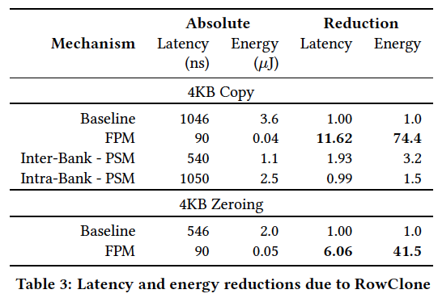
RowClone: Latency and Energy Savings
Intra-subarray
Intra-subarray

Slide 40
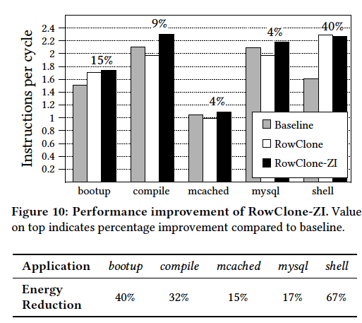
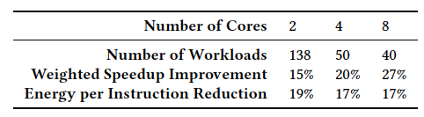
RowClone: Overall Performance

Slide 41
Agenda for Topic 1 (DRAM Scaling)
What Will You Learn in This Mini-Lecture Series
Main Memory Basics (with a Focus on DRAM)
Major Trends Affecting Main Memory
DRAM Scaling Problem and Solution Directions
Solution Direction 1: System-DRAM Co-Design
Ongoing Research
Summary

Slide 42
Sampling of Ongoing Research
Online retention time profiling
  Preliminary work in ISCA 2013
  Jamie Liu, Ben Jaiyen, Yoongu Kim, Chris Wilkerson, and Onur Mutlu,
  "An Experimental Study of Data Retention Behavior in Modern DRAM Devices: Implications for Retention Time Profiling Mechanisms"
  Proceedings of the 40th International Symposium on Computer Architecture (ISCA), Tel-Aviv, Israel, June 2013. Slides (pptx) Slides (pdf)
More computation in memory and controllers
Refresh/demand parallelization

Slide 43
Agenda for Topic 1 (DRAM Scaling)
What Will You Learn in This Mini-Lecture Series
Main Memory Basics (with a Focus on DRAM)
Major Trends Affecting Main Memory
DRAM Scaling Problem and Solution Directions
Solution Direction 1: System-DRAM Co-Design
Ongoing Research
Summary

Slide 44
Summary
Major problems with DRAM scaling and design: high refresh rate, high latency, low parallelism, bulk data movement
Four new DRAM designs
  RAIDR: Reduces refresh impact
  TL-DRAM: Reduces DRAM latency at low cost
  SALP: Improves DRAM parallelism
  RowClone: Reduces energy and performance impact of bulk data copy
All four designs
  Improve both performance and energy consumption
  Are low cost (low DRAM area overhead)
  Enable new degrees of freedom to software & controllers
Rethinking DRAM interface and design essential for scaling
  Co-design DRAM with the rest of the system

Slide 45
Further Reading: Data Retention and Power
Characterization of Commodity DRAM Chips
  Jamie Liu, Ben Jaiyen, Yoongu Kim, Chris Wilkerson, and Onur Mutlu,
  "An Experimental Study of Data Retention Behavior in Modern DRAM Devices: Implications for Retention Time Profiling Mechanisms"
  Proceedings of the 40th International Symposium on Computer Architecture (ISCA), Tel-Aviv, Israel, June 2013. Slides (pptx) Slides (pdf)
Voltage and Frequency Scaling in DRAM
  Howard David, Chris Fallin, Eugene Gorbatov, Ulf R. Hanebutte, and Onur Mutlu,
  "Memory Power Management via Dynamic Voltage/Frequency Scaling"
  Proceedings of the 8th International Conference on Autonomic Computing (ICAC), Karlsruhe, Germany, June 2011. Slides (pptx) (pdf)

Slide 46
Scalable Many-Core Memory Systems Topic 1: DRAM Basics and
DRAM Scaling
Prof. Onur Mutlu
http://www.ece.cmu.edu/~omutlu
onur@cmu.edu
HiPEAC ACACES Summer School 2013
July 15-19, 2013

Slide 47
Computer Architecture:
Main Memory (Part III)
Prof. Onur Mutlu
Carnegie Mellon University

Slide 48
Additional Material
(Not Covered in Lecture)

Slide 49
Three Papers
Howard David, Chris Fallin, Eugene Gorbatov, Ulf R. Hanebutte, and Onur Mutlu,
"Memory Power Management via Dynamic Voltage/Frequency Scaling"
Proceedings of the 8th International Conference on Autonomic Computing (ICAC), Karlsruhe, Germany, June 2011. Slides (pptx) (pdf)
Jamie Liu, Ben Jaiyen, Yoongu Kim, Chris Wilkerson, and Onur Mutlu,
"An Experimental Study of Data Retention Behavior in Modern DRAM Devices: Implications for Retention Time Profiling Mechanisms"
Proceedings of the 40th International Symposium on Computer Architecture (ISCA), Tel-Aviv, Israel, June 2013. Slides (pptx) Slides (pdf)
Yu Cai, Gulay Yalcin, Onur Mutlu, Erich F. Haratsch, Adrian Cristal, Osman Unsal, and Ken Mai,
"Error Analysis and Retention-Aware Error Management for NAND Flash Memory"
Intel Technology Journal (ITJ) Special Issue on Memory Resiliency, Vol. 17, No. 1, May 2013.

Slide 50


Memory Power Management via
Dynamic Voltage/Frequency Scaling
Howard David (Intel)
Eugene Gorbatov (Intel)
Ulf R. Hanebutte (Intel)
Chris Fallin (CMU)
Onur Mutlu (CMU)

Slide 51
Memory Power is Significant
Power consumption is a primary concern in modern servers
Many works: CPU, whole-system or cluster-level approach
But memory power is largely unaddressed
Our server system*: memory is 19% of system power (avg)
  Some work notes up to 40% of total system power
Goal: Can we reduce this figure?
*Dual 4-core Intel Xeon®, 48GB DDR3 (12 DIMMs), SPEC CPU2006, all cores active. Measured AC power, analytically modeled memory power.

Slide 52
Existing Solution: Memory Sleep States?
Most memory energy-efficiency work uses sleep states
  Shut down DRAM devices when no memory requests active
But, even low-memory-bandwidth workloads keep memory awake
  Idle periods between requests diminish in multicore workloads
  CPU-bound workloads/phases rarely completely cache-resident

Slide 53
Memory Bandwidth Varies Widely
Workload memory bandwidth requirements vary widely
Memory system is provisioned for peak capacity
  → often underutilized

Slide 54
Memory Power can be Scaled Down
DDR can operate at multiple frequencies → reduce power
  Lower frequency directly reduces switching power
  Lower frequency allows for lower voltage
  Comparable to CPU DVFS
Frequency scaling increases latency → reduce performance
  Memory storage array is asynchronous
  But, bus transfer depends on frequency
  When bus bandwidth is bottleneck, performance suffers
CPU Voltage/Freq. | System Power |  | Memory Freq. | System Power
↓ 15% | ↓ 9.9% |  | ↓ 40% | ↓ 7.6%

Slide 55
Observations So Far
Memory power is a significant portion of total power
  19% (avg) in our system, up to 40% noted in other works
Sleep state residency is low in many workloads
  Multicore workloads reduce idle periods
  CPU-bound applications send requests frequently enough
  to keep memory devices awake
Memory bandwidth demand is very low in some workloads
Memory power is reduced by frequency scaling
  And voltage scaling can give further reductions

Slide 56
DVFS for Memory
Key Idea: observe memory bandwidth utilization, then adjust memory frequency/voltage, to reduce power with minimal performance loss
  → Dynamic Voltage/Frequency Scaling (DVFS)
  for memory
Goal in this work:
  Implement DVFS in the memory system, by:
  Developing a simple control algorithm to exploit opportunity for reduced memory frequency/voltage by observing behavior
  Evaluating the proposed algorithm on a real system

Slide 57
Outline
Motivation
Background and Characterization
  DRAM Operation
  DRAM Power
  Frequency and Voltage Scaling
Performance Effects of Frequency Scaling
Frequency Control Algorithm
Evaluation and Conclusions
Notes:
Briefly go over outline

Slide 58
Outline
Motivation
Background and Characterization
  DRAM Operation
  DRAM Power
  Frequency and Voltage Scaling
Performance Effects of Frequency Scaling
Frequency Control Algorithm
Evaluation and Conclusions

Slide 59
DRAM Operation
Main memory consists of DIMMs of DRAM devices
Each DIMM is attached to a memory bus (channel)
Multiple DIMMs can connect to one channel
/8
/8
/8
/8
/8
/8
/8
/8
to Memory Controller
Memory Bus (64 bits)

Slide 60
Inside a DRAM Device
I/O Circuitry
Runs at bus speed
Clock sync/distribution
Bus drivers and receivers
Buffering/queueing
ODT
Row Decoder
Banks
Independent arrays
Asynchronous: independent of memory bus speed
Bank 0
Write FIFO
Registers
Recievers
On-Die Termination
Required by bus electrical characteristics
for reliable operation
Resistive element that dissipates power when bus is active
Drivers
Sense Amps
Column Decoder

Slide 61
Effect of Frequency Scaling on Power
Reduced memory bus frequency:
Does not affect bank power:
  Constant energy per operation
  Depends only on utilized memory bandwidth
Decreases I/O power:
  Dynamic power in bus interface and clock circuitry
  reduces due to less frequent switching
Increases termination power:
  Same data takes longer to transfer
  Hence, bus utilization increases
Tradeoff between I/O and termination results in a net power reduction at lower frequencies

Slide 62
Effects of Voltage Scaling on Power
Voltage scaling further reduces power because all parts of memory devices will draw less current (at less voltage)
Voltage reduction is possible because stable operation requires lower voltage at lower frequency:

Slide 63
Outline
Motivation
Background and Characterization
  DRAM Operation
  DRAM Power
  Frequency and Voltage Scaling
Performance Effects of Frequency Scaling
Frequency Control Algorithm
Evaluation and Conclusions

Slide 64
How Much Memory Bandwidth is Needed?

Slide 65
Performance Impact of Static Frequency Scaling
Performance impact is proportional to bandwidth demand
Many workloads tolerate lower frequency with minimal performance drop
::
::
::
::
::
:
:
:
::
::
::
::
::
:
:
:

Slide 66
Outline
Motivation
Background and Characterization
  DRAM Operation
  DRAM Power
  Frequency and Voltage Scaling
Performance Effects of Frequency Scaling
Frequency Control Algorithm
Evaluation and Conclusions

Slide 67
Memory Latency Under Load
At low load, most time is in array access and bus transfer
  → small constant offset between bus-frequency latency curves
As load increases, queueing delay begins to dominate
  → bus frequency significantly affects latency

Slide 68
Control Algorithm: Demand-Based Switching
T₈₀₀
T₁₀₆₆
After each epoch of length T_{epoch}:
Measure per-channel bandwidth BW
if BW < T₈₀₀ : switch to 800MHz
else if BW < T₁₀₆₆ : switch to 1066MHz
else : switch to 1333MHz

Slide 69
Implementing V/F Switching
Halt Memory Operations
  Pause requests
  Put DRAM in Self-Refresh
  Stop the DIMM clock
Transition Voltage/Frequency
  Begin voltage ramp
  Relock memory controller PLL at new frequency
  Restart DIMM clock
  Wait for DIMM PLLs to relock
Begin Memory Operations
  Take DRAM out of Self-Refresh
  Resume requests
C Memory frequency already adjustable statically
C Voltage regulators for CPU DVFS can work for
memory DVFS
C Full transition takes ~20µs

Slide 70
Outline
Motivation
Background and Characterization
  DRAM Operation
  DRAM Power
  Frequency and Voltage Scaling
Performance Effects of Frequency Scaling
Frequency Control Algorithm
Evaluation and Conclusions

Slide 71
Evaluation Methodology
Real-system evaluation
  Dual 4-core Intel Xeon®, 3 memory channels/socket
  48 GB of DDR3 (12 DIMMs, 4GB dual-rank, 1333MHz)
Emulating memory frequency for performance
  Altered memory controller timing registers (tRC, tB2BCAS)
  Gives performance equivalent to slower memory frequencies
Modeling power reduction
  Measure baseline system (AC power meter, 1s samples)
  Compute reductions with an analytical model (see paper)

Slide 72
Evaluation Methodology
Workloads
  SPEC CPU2006: CPU-intensive workloads
  All cores run a copy of the benchmark
Parameters
  T_{epoch} = 10ms
  Two variants of algorithm with different switching thresholds:
  BW(0.5, 1): T₈₀₀ = 0.5GB/s, T₁₀₆₆ = 1GB/s
  BW(0.5, 2): T₈₀₀ = 0.5GB/s, T₁₀₆₆ = 2GB/s
    → More aggressive frequency/voltage scaling

Slide 73
Performance Impact of Memory DVFS
Minimal performance degradation: 0.2% (avg), 1.7% (max)
Experimental error ~1%

Slide 74
Memory Frequency Distribution
Frequency distribution shifts toward higher memory
frequencies with more memory-intensive benchmarks

Slide 75
Memory Power Reduction
Memory power reduces by 10.4% (avg), 20.5% (max)

Slide 76
System Power Reduction
As a result, system power reduces by 1.9% (avg), 3.5% (max)

Slide 77
System Energy Reduction
System energy reduces by 2.4% (avg), 5.1% (max)

Slide 78
Related Work
MemScale [Deng11], concurrent work (ASPLOS 2011)
  Also proposes Memory DVFS
  Application performance impact model to decide voltage and frequency: requires specific modeling for a given system; our bandwidth-based approach avoids this complexity
  Simulation-based evaluation; our work is a real-system proof of concept
Memory Sleep States (Creating opportunity with data placement [Lebeck00,Pandey06], OS scheduling [Delaluz02], VM subsystem [Huang05]; Making better decisions with better models [Hur08,Fan01])
Power Limiting/Shifting (RAPL [David10] uses memory throttling for thermal limits; CPU throttling for memory traffic [Lin07,08]; Power shifting across system [Felter05])

Slide 79
Conclusions
Memory power is a significant component of system power
  19% average in our evaluation system, 40% in other work
Workloads often keep memory active but underutilized
  Channel bandwidth demands are highly variable
  Use of memory sleep states is often limited
Scaling memory frequency/voltage can reduce memory power with minimal system performance impact
  10.4% average memory power reduction
  Yields 2.4% average system energy reduction
Greater reductions are possible with wider frequency/voltage range and better control algorithms

Slide 80
Memory Power Management via
Dynamic Voltage/Frequency Scaling
Howard David (Intel)
Eugene Gorbatov (Intel)
Ulf R. Hanebutte (Intel)
Chris Fallin (CMU)
Onur Mutlu (CMU)

Slide 81
An Experimental Study of
Data Retention Behavior in Modern DRAM Devices
Implications for Retention Time Profiling Mechanisms
Jamie Liu¹ Ben Jaiyen¹ Yoongu Kim¹
Chris Wilkerson² Onur Mutlu¹
¹ Carnegie Mellon University
² Intel Corporation

Slide 82
Summary (I)
DRAM requires periodic refresh to avoid data loss
  Refresh wastes energy, reduces performance, limits DRAM density scaling
Many past works observed that different DRAM cells can retain data for different times without being refreshed; proposed reducing refresh rate for strong DRAM cells
  Problem: These techniques require an accurate profile of the retention time of all DRAM cells
Our goal: To analyze the retention time behavior of DRAM cells in modern DRAM devices to aid the collection of accurate profile information
Our experiments: We characterize 248 modern commodity DDR3 DRAM chips from 5 manufacturers using an FPGA based testing platform
Two Key Issues:
  1. Data Pattern Dependence: A cell’s retention time is heavily dependent on data values stored in itself and nearby cells, which cannot easily be controlled.
  2. Variable Retention Time: Retention time of some cells change unpredictably from high to low at large timescales.

Slide 83
Summary (II)
Key findings on Data Pattern Dependence
  There is no observed single data pattern that elicits the lowest retention times for a DRAM device → very hard to find this pattern
  DPD varies between devices due to variation in DRAM array circuit design between manufacturers
  DPD of retention time gets worse as DRAM scales to smaller feature sizes
Key findings on Variable Retention Time
  VRT is common in modern DRAM cells that are weak
  The timescale at which VRT occurs is very large (e.g., a cell can stay in high retention time state for a day or longer) → finding minimum retention time can take very long
Future work on retention time profiling must address these issues

Slide 84
Talk Agenda
DRAM Refresh: Background and Motivation
Challenges and Our Goal
DRAM Characterization Methodology
Foundational Results
  Temperature Dependence
  Retention Time Distribution
Data Pattern Dependence: Analysis and Implications
Variable Retention Time: Analysis and Implications
Conclusions

Slide 85
A DRAM Cell
A DRAM cell consists of a capacitor and an access transistor
It stores data in terms of charge in the capacitor
A DRAM chip consists of (10s of 1000s of) rows of such cells
wordline
(row enable)
bitline
bitline
bitline
bitline
bitline

Slide 86
DRAM Refresh
DRAM capacitor charge leaks over time
Each DRAM row is periodically refreshed to restore charge
  Activate each row every N ms
  Typical N = 64 ms
Downsides of refresh
-- Energy consumption: Each refresh consumes energy
  -- Performance degradation: DRAM rank/bank unavailable while refreshed
  -- QoS/predictability impact: (Long) pause times during refresh
  -- Refresh rate limits DRAM capacity scaling

Slide 87
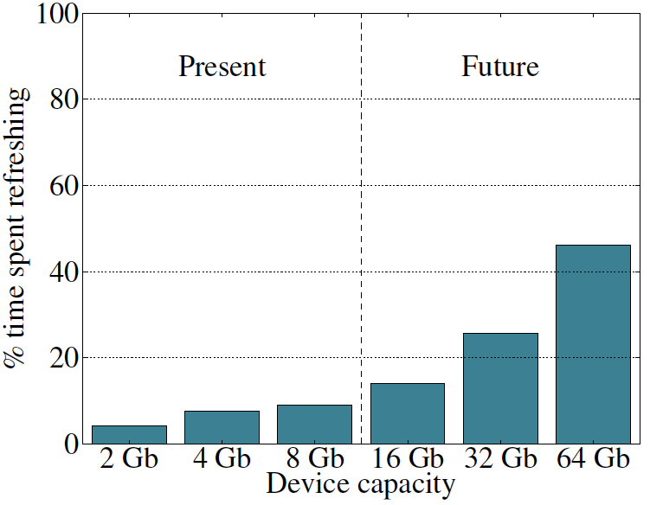
Refresh Overhead: Performance
46%
8%
Liu et al., “RAIDR: Retention-Aware Intelligent DRAM Refresh,” ISCA 2012.

Slide 88
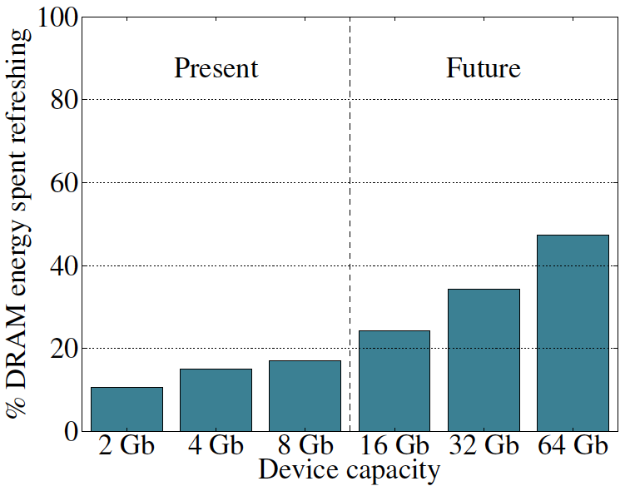
Refresh Overhead: Energy
47%
15%
Liu et al., “RAIDR: Retention-Aware Intelligent DRAM Refresh,” ISCA 2012.

Slide 89
Previous Work on Reducing Refreshes
Observed significant variation in data retention times of DRAM cells (due to manufacturing process variation)
  Retention time: maximum time a cell can go without being refreshed while maintaining its stored data
Proposed methods to take advantage of widely varying retention times among DRAM rows
  Reduce refresh rate for rows that can retain data for longer than 64 ms, e.g., [Liu+ ISCA 2012]
  Disable rows that have low retention times, e.g., [Venkatesan+ HPCA 2006]
Showed large benefits in energy and performance

Slide 90


An Example: RAIDR [Liu+, ISCA 2012]
1. Profiling: Profile the retention time of all DRAM rows
2. Binning: Store rows into bins by retention time
→ use Bloom Filters for efficient and scalable storage
3. Refreshing: Memory controller refreshes rows in different bins at different rates
→ probe Bloom Filters to determine refresh rate of a row
1.25KB storage in controller for 32GB DRAM memory
Problem: Requires accurate profiling of DRAM row retention times
Can reduce refreshes by ~75%
→ reduces energy consumption and improves performance
Liu et al., “RAIDR: Retention-Aware Intelligent DRAM Refresh,” ISCA 2012.

Slide 91
Motivation
Past works require accurate and reliable measurement of retention time of each DRAM row
  To maintain data integrity while reducing refreshes
Assumption: worst-case retention time of each row can be determined and stays the same at a given temperature
  Some works propose writing all 1’s and 0’s to a row, and measuring the time before data corruption
Question:
  Can we reliably and accurately determine retention times of all DRAM rows?

Slide 92
Talk Agenda
DRAM Refresh: Background and Motivation
Challenges and Our Goal
DRAM Characterization Methodology
Foundational Results
  Temperature Dependence
  Retention Time Distribution
Data Pattern Dependence: Analysis and Implications
Variable Retention Time: Analysis and Implications
Conclusions

Slide 93
Two Challenges to Retention Time Profiling
Data Pattern Dependence (DPD) of retention time
Variable Retention Time (VRT) phenomenon

Slide 94
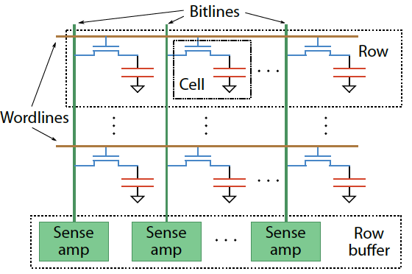
Two Challenges to Retention Time Profiling
Challenge 1: Data Pattern Dependence (DPD)
  Retention time of a DRAM cell depends on its value and the values of cells nearby it
  When a row is activated, all bitlines are perturbed simultaneously

Slide 95
Data Pattern Dependence
Electrical noise on the bitline affects reliable sensing of a DRAM cell
The magnitude of this noise is affected by values of nearby cells via
  Bitline-bitline coupling → electrical coupling between adjacent bitlines
  Bitline-wordline coupling → electrical coupling between each bitline and the activated wordline
Retention time of a cell depends on data patterns stored in nearby cells
→ need to find the worst data pattern to find worst-case retention time
Notes:
If a cell has lost enough charge, this noise can be large enough to cause a failure on a read
(normally, there is enough noise margin to tolerate the coupling noise)

Slide 96
Two Challenges to Retention Time Profiling
Challenge 2: Variable Retention Time (VRT)
  Retention time of a DRAM cell changes randomly over time
    a cell alternates between multiple retention time states
  Leakage current of a cell changes sporadically due to a charge trap in the gate oxide of the DRAM cell access transistor
  When the trap becomes occupied, charge leaks more readily from the transistor’s drain, leading to a short retention time
    Called Trap-Assisted Gate-Induced Drain Leakage
  This process appears to be a random process [Kim+ IEEE TED’11]
  Worst-case retention time depends on a random process
    → need to find the worst case despite this

Slide 97
Our Goal
Analyze the retention time behavior of DRAM cells in modern commodity DRAM devices
  to aid the collection of accurate profile information
Provide a comprehensive empirical investigation of two key challenges to retention time profiling
  Data Pattern Dependence (DPD)
  Variable Retention Time (VRT)

Slide 98
Talk Agenda
DRAM Refresh: Background and Motivation
Challenges and Our Goal
DRAM Characterization Methodology
Foundational Results
  Temperature Dependence
  Retention Time Distribution
Data Pattern Dependence: Analysis and Implications
Variable Retention Time: Analysis and Implications
Conclusions

Slide 99
DRAM Testing Platform and Method
Test platform: Developed a DDR3 DRAM testing platform using the Xilinx ML605 FPGA development board
  Temperature controlled
Tested DRAM chips: 248 commodity DRAM chips from five manufacturers (A,B,C,D,E)
Seven families based on equal capacity per device:
  A 1Gb, A 2Gb
  B 2Gb
  C 2Gb
  D 1Gb, D 2Gb
  E 2Gb
Notes:
Add number of chips

Slide 100
Experiment Design
Each module tested for multiple rounds of tests.
Each test searches for the set of cells with a retention time less than a threshold value for a particular data pattern
High-level structure of a test:
  Write data pattern to rows in a DRAM bank
  Prevent refresh for a period of time tWAIT, leave DRAM idle
  Read stored data pattern, compare to written pattern and record corrupt cells as those with retention time < tWAIT
Test details and important issues to pay attention to are discussed in paper

Slide 101
Experiment Structure
Tests both the data pattern
and its complement
Round
Test
Notes:
Highlight test and round here.
Say each data pattern and its complement is tested to account for true and anti cells

Slide 102
Experiment Parameters
Most tests conducted at 45 degrees Celsius
No cells observed to have a retention time less than 1.5 second at 45ºC
Tested tWAIT in increments of 128ms from 1.5 to 6.1 seconds

Slide 103
Tested Data Patterns
Fixed patterns
All 0s/1s: Value 0/1 is written to all bits
  Previous work suggested this is sufficient
Checkerboard: Consecutive bits alternate between 0 and 1
  Coupling noise increases with voltage difference between the neighboring bitlines → May induce worst case data pattern (if adjacent bits mapped to adjacent cells)
Walk: Attempts to ensure a single cell storing 1 is surrounded by cells storing 0
  This may lead to even worse coupling noise and retention time due to coupling between nearby bitlines [Li+ IEEE TCSI 2011]
  Walk pattern is permuted in each round to exercise different cells
Random: Randomly generated data is written to each row
  A new set of random data is generated for each round

Slide 104
Talk Agenda
DRAM Refresh: Background and Motivation
Challenges and Our Goal
DRAM Characterization Methodology
Foundational Results
  Temperature Dependence
  Retention Time Distribution
Data Pattern Dependence: Analysis and Implications
Variable Retention Time: Analysis and Implications
Conclusions

Slide 105
Temperature Stability
Tested chips at five different stable temperatures

Slide 106
Dependence of Retention Time on Temperature
Fraction of cells that
exhibited retention
time failure
at any tWAIT
for any data pattern
at 50ºC
Normalized retention
times of the same cells
at 55ºC
Best-fit exponential curves
for retention time change
with temperature
Normalized retention
times of the same cells
At 70ºC

Slide 107
Dependence of Retention Time on Temperature
Relationship between retention time and temperature is consistently bounded (predictable) within a device
Every 10ºC temperature increase
46.5% reduction in retention time in the worst case

Slide 108
Retention Time Distribution
NEWER
NEWER
OLDER
OLDER
Newer device families have more weak cells than older ones
Likely a result of technology scaling
Minimum tested retention time ~1.5s at 45C → ~126ms at 85C
Very few cells exhibit the lowest retention times
Shape of the curve consistent with previous works

Slide 109
Talk Agenda
DRAM Refresh: Background and Motivation
Challenges and Our Goal
DRAM Characterization Methodology
Foundational Results
  Temperature Dependence
  Retention Time Distribution
Data Pattern Dependence: Analysis and Implications
Variable Retention Time: Analysis and Implications
Conclusions

Slide 110
Some Terminology
Failure population of cells with Retention Time X: The set of all cells that exhibit retention failure in any test with any data pattern at that retention time (tWAIT)
Retention Failure Coverage of a Data Pattern DP: Fraction of cells with retention time X that exhibit retention failure with that particular data pattern DP
If retention times are not dependent on data pattern stored in cells, we would expect
  Coverage of any data pattern to be 100%
  In other words, if one data pattern causes a retention failure, any other data pattern also would

Slide 111
Recall the Tested Data Patterns
Fixed patterns
All 0s/1s: Value 0/1 is written to all bits
Checkerboard: Consecutive bits alternate between 0 and 1
Walk: Attempts to ensure a single cell storing 1 is surrounded by cells storing 0
Random: Randomly generated data is written to each row

Slide 112
Retention Failure Coverage of Data Patterns
A 2Gb chip family
6.1s retention time
Different data patterns have widely different coverage:
Data pattern dependence exists and is severe
Coverage of fixed patterns is low: ~30% for All 0s/1s
Walk is the most effective data pattern for this device
No data pattern achieves 100% coverage

Slide 113
Retention Failure Coverage of Data Patterns
B 2Gb chip family
6.1s retention time
Random is the most effective data pattern for this device
No data pattern achieves 100% coverage

Slide 114
Retention Failure Coverage of Data Patterns
C 2Gb chip family
6.1s retention time
Random is the most effective data pattern for this device
No data pattern achieves 100% coverage

Slide 115
Data Pattern Dependence: Observations (I)
A cell’s retention time is heavily influenced by data pattern stored in other cells
  Pattern affects the coupling noise, which affects cell leakage
No tested data pattern exercises the worst case retention time for all cells (no pattern has 100% coverage)
  No pattern is able to induce the worst-case coupling noise for every cell
  Problem: Underlying DRAM circuit organization is not known to the memory controller → very hard to construct a pattern that exercises the worst-case cell leakage
  → Opaque mapping of addresses to physical DRAM geometry
  → Internal remapping of addresses within DRAM to tolerate faults
  → Second order coupling effects are very hard to determine

Slide 116
Data Pattern Dependence: Observations (II)
Fixed, simple data patterns have low coverage
  They do not exercise the worst-case coupling noise
The effectiveness of each data pattern varies significantly between DRAM devices (of the same or different vendors)
  Underlying DRAM circuit organization likely differs between different devices → patterns leading to worst coupling are different in different devices
Technology scaling appears to increase the impact of data pattern dependence
  Scaling reduces the physical distance between circuit elements, increasing the magnitude of coupling effects

Slide 117
Effect of Technology Scaling on DPD
A 1Gb chip family
A 2Gb chip family
The lowest-coverage data pattern achieves much lower coverage for the smaller technology node

Slide 118
DPD: Implications on Profiling Mechanisms
Any retention time profiling mechanism must handle data pattern dependence of retention time
Intuitive approach: Identify the data pattern that induces the worst-case retention time for a particular cell or device
Problem 1: Very hard to know at the memory controller which bits actually interfere with each other due to
  Opaque mapping of addresses to physical DRAM geometry → logically consecutive bits may not be physically consecutive
  Remapping of faulty bitlines/wordlines to redundant ones internally within DRAM
Problem 2: Worst-case coupling noise is affected by non-obvious second order bitline coupling effects

Slide 119
DPD: Suggestions (for Future Work)
A mechanism for identifying worst-case data pattern(s) likely requires support from DRAM device
  DRAM manufacturers might be in a better position to do this
  But, the ability of the manufacturer to identify and expose the entire retention time profile is limited due to VRT
An alternative approach: Use random data patterns to increase coverage as much as possible; handle incorrect retention time estimates with ECC
  Need to keep profiling time in check
  Need to keep ECC overhead in check

Slide 120
Talk Agenda
DRAM Refresh: Background and Motivation
Challenges and Our Goal
DRAM Characterization Methodology
Foundational Results
  Temperature Dependence
  Retention Time Distribution
Data Pattern Dependence: Analysis and Implications
Variable Retention Time: Analysis and Implications
Conclusions

Slide 121
Variable Retention Time
Retention time of a cell can vary over time
A cell can randomly switch between multiple leakage current states due to Trap-Assisted Gate-Induced Drain Leakage, which appears to be a random process
[Yaney+ IEDM 1987, Restle+ IEDM 1992]

Slide 122
An Example VRT Cell
A cell from E 2Gb chip family

Slide 123
VRT: Questions and Methodology
Key Questions
  How prevalent is VRT in modern DRAM devices?
  What is the timescale of observation of the lowest retention time state?
  What are the implications on retention time profiling?
Test Methodology
  Each device was tested for at least 1024 rounds over 24 hours
  Temperature fixed at 45ºC
  Data pattern used is the most effective data pattern for each device
  For each cell that fails at any retention time, we record the minimum and the maximum retention time observed

Slide 124
Variable Retention Time
Many failing cells jump from
very high retention time to very low
Most failing cells
exhibit VRT
Min ret time = Max ret time
Expected if no VRT
A 2Gb chip family

Slide 125
Variable Retention Time
B 2Gb chip family

Slide 126
Variable Retention Time
C 2Gb chip family

Slide 127
VRT: Observations So Far
VRT is common among weak cells (i.e., those cells that experience low retention times)
VRT can result in significant retention time changes
  Difference between minimum and maximum retention times of a cell can be more than 4x, and may not be bounded
  Implication: Finding a retention time for a cell and using a guardband to ensure minimum retention time is “covered” requires a large guardband or may not work
Retention time profiling mechanisms must identify lowest retention time in the presence of VRT
  Question: How long to profile a cell to find its lowest retention time state?

Slide 128
Time Between Retention Time State Changes
How much time does a cell spend in a high retention state before switching to the minimum observed retention time state?

Slide 129
Time Spent in High Retention Time State
A 2Gb chip family
~4 hours
~1 day
Time scale at which a cell switches to the low retention time state can be very long (~ 1 day or longer)
Need to profile for a long time to
get to the minimum retention time state

Slide 130
Time Spent in High Retention Time State
B 2Gb chip family

Slide 131
Time Spent in High Retention Time State
C 2Gb chip family

Slide 132
VRT: Implications on Profiling Mechanisms
Problem 1: There does not seem to be a way of determining if a cell exhibits VRT without actually observing a cell exhibiting VRT
  VRT is a memoryless random process [Kim+ JJAP 2010]
Problem 2: VRT complicates retention time profiling by DRAM manufacturers
  Exposure to very high temperatures can induce VRT in cells that were not previously susceptible
  → can happen during soldering of DRAM chips
  → manufacturer’s retention time profile may not be accurate
One option for future work: Use ECC to continuously profile DRAM online while aggressively reducing refresh rate
  Need to keep ECC overhead in check

Slide 133
Talk Agenda
DRAM Refresh: Background and Motivation
Challenges and Our Goal
DRAM Characterization Methodology
Foundational Results
  Temperature Dependence
  Retention Time Distribution
Data Pattern Dependence: Analysis and Implications
Variable Retention Time: Analysis and Implications
Conclusions

Slide 134
Summary and Conclusions
DRAM refresh is a critical challenge in scaling DRAM technology efficiently to higher capacities and smaller feature sizes
Understanding the retention time of modern DRAM devices can enable old or new methods to reduce the impact of refresh
  Many mechanisms require accurate and reliable retention time profiles
We presented the first work that comprehensively examines data retention behavior in modern commodity DRAM devices
  Characterized 248 devices from five manufacturers
Key findings: Retention time of a cell significantly depends on data pattern stored in other cells (data pattern dependence) and changes over time via a random process (variable retention time)
  Discussed the underlying reasons and provided suggestions
Future research on retention time profiling should solve the challenges posed by the DPD and VRT phenomena

Slide 135
An Experimental Study of
Data Retention Behavior in Modern DRAM Devices
Implications for Retention Time Profiling Mechanisms
Jamie Liu¹ Ben Jaiyen¹ Yoongu Kim¹
Chris Wilkerson² Onur Mutlu¹
¹ Carnegie Mellon University
² Intel Corporation

Slide 136
Flash Memory Scaling

Slide 137
Aside: Scaling Flash Memory [Cai+, ICCD’12]
NAND flash memory has low endurance: a flash cell dies after 3k P/E cycles vs. 50k desired → Major scaling challenge for flash memory
Flash error rate increases exponentially over flash lifetime
Problem: Stronger error correction codes (ECC) are ineffective and undesirable for improving flash lifetime due to
  diminishing returns on lifetime with increased correction strength
  prohibitively high power, area, latency overheads
Our Goal: Develop techniques to tolerate high error rates w/o strong ECC
Observation: Retention errors are the dominant errors in MLC NAND flash
  flash cell loses charge over time; retention errors increase as cell gets worn out
Solution: Flash Correct-and-Refresh (FCR)
  Periodically read, correct, and reprogram (in place) or remap each flash page before it accumulates more errors than can be corrected by simple ECC
  Adapt “refresh” rate to the severity of retention errors (i.e., # of P/E cycles)
Results: FCR improves flash memory lifetime by 46X with no hardware changes and low energy overhead; outperforms strong ECCs

Slide 138
Readings in Flash Memory
Yu Cai, Gulay Yalcin, Onur Mutlu, Erich F. Haratsch, Adrian Cristal, Osman Unsal, and Ken Mai,
"Error Analysis and Retention-Aware Error Management for NAND Flash Memory"
Intel Technology Journal (ITJ) Special Issue on Memory Resiliency, Vol. 17, No. 1, May 2013.
Yu Cai, Erich F. Haratsch, Onur Mutlu, and Ken Mai,
"Threshold Voltage Distribution in MLC NAND Flash Memory: Characterization, Analysis and Modeling"
Proceedings of the Design, Automation, and Test in Europe Conference (DATE), Grenoble, France, March 2013. Slides (ppt)
Yu Cai, Gulay Yalcin, Onur Mutlu, Erich F. Haratsch, Adrian Cristal, Osman Unsal, and Ken Mai,
"Flash Correct-and-Refresh: Retention-Aware Error Management for Increased Flash Memory Lifetime"
Proceedings of the 30th IEEE International Conference on Computer Design (ICCD), Montreal, Quebec, Canada, September 2012. Slides (ppt) (pdf)
Yu Cai, Erich F. Haratsch, Onur Mutlu, and Ken Mai,
"Error Patterns in MLC NAND Flash Memory: Measurement, Characterization, and Analysis"
Proceedings of the Design, Automation, and Test in Europe Conference (DATE), Dresden, Germany, March 2012. Slides (ppt)

Slide 139
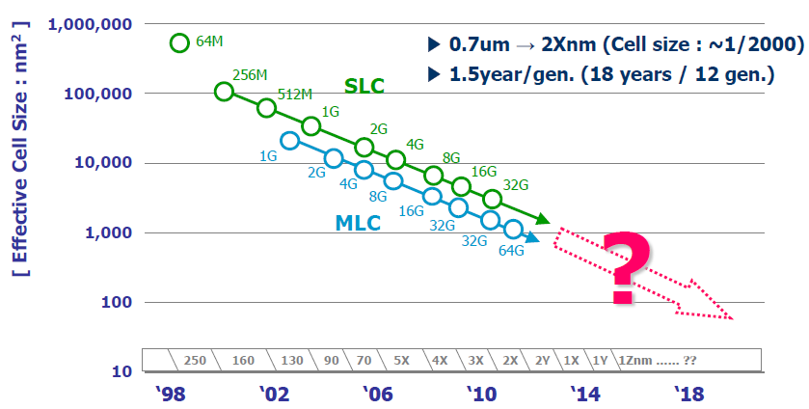
Evolution of NAND Flash Memory
CMOS scaling
More bits per Cell
Seaung Suk Lee, “Emerging Challenges in NAND Flash Technology”, Flash Summit 2011 (Hynix)
Flash memory widening its range of applications
  Portable consumer devices, laptop PCs and enterprise servers

Slide 140
Decreasing Endurance with Flash Scaling
100k
24-bit ECC
15-bit ECC
8-bit ECC
Error Correction Capability
(per 1 kB of data)
4-bit ECC
10k
5k
3k
1k
Ariel Maislos, “A New Era in Embedded Flash Memory”, Flash Summit 2011 (Anobit)
Endurance of flash memory decreasing with scaling and multi-level cells
Error correction capability required to guarantee storage-class reliability (UBER < 10⁻¹⁵) is increasing exponentially to reach less endurance
UBER: Uncorrectable bit error rate. Fraction of erroneous bits after error correction.

Slide 141
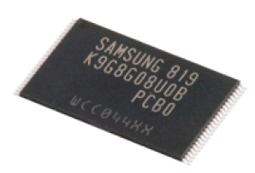
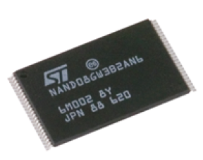
Future NAND Flash Storage Architecture
Memory
Signal
Processing
Raw Bit
Error Rate
Noisy
Error
Correction
BER < 10⁻¹⁵
Read voltage adjusting
Data scrambler
Data recovery
Soft-information estimation
Hamming codes
BCH codes
Reed-Solomon codes
LDPC codes
Other Flash friendly codes
Need to understand NAND flash error patterns

Slide 142
Test System Infrastructure
Algorithms
Wear Leveling
Address Mapping
Garbage Collection
ECC
(BCH, RS, LDPC)
Reset
Erase block
Program page
Read page
Control
Firmware
Signal Processing
Software Platform
USB
PHYChip
FPGA
USB controller
NAND
Controller
Flash
Memories
USB Driver
Host USB PHY
Host Computer
USB Daughter Board
Mother Board
Flash Board

Slide 143
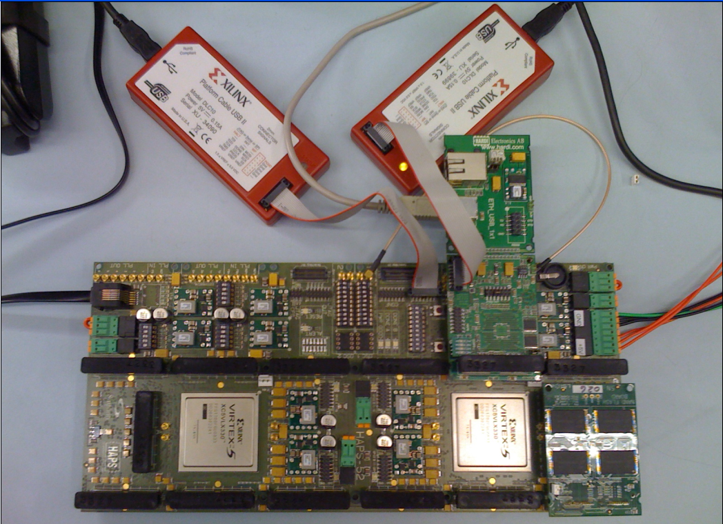
NAND Flash Testing Platform
USB Daughter Board
USB Jack
HAPS-52 Mother Board
Virtex-II Pro
(USB controller)
3x-nm
NAND Flash
Virtex-V FPGA
(NAND Controller)
NAND Daughter Board

Slide 144
NAND Flash Usage and Error Model
Erase Errors
Program Errors
Start
Erase
Block
Program
Page
P/E cycle 0
(Page0 - Page128)
…
Retention Errors
Read Errors
Retention1
(t₁ days)
Read
Page
P/E cycle i
…
Retention Errors
…
Read Errors
P/E cycle n
Retention j
(t_{j} days)
Read
Page
End of life
Notes:
13
lots of diagrams of boxes and text, need to find a way to differentiate them

Slide 145
Error Types and Testing Methodology
Erase errors
  Count the number of cells that fail to be erased to “11” state
Program interference errors
  Compare the data immediately after page programming and the data after the whole block being programmed
Read errors
  Continuously read a given block and compare the data between consecutive read sequences
Retention errors
  Compare the data read after an amount of time to data written
    Characterize short term retention errors under room temperature
    Characterize long term retention errors by baking in the oven under 125℃

Slide 146
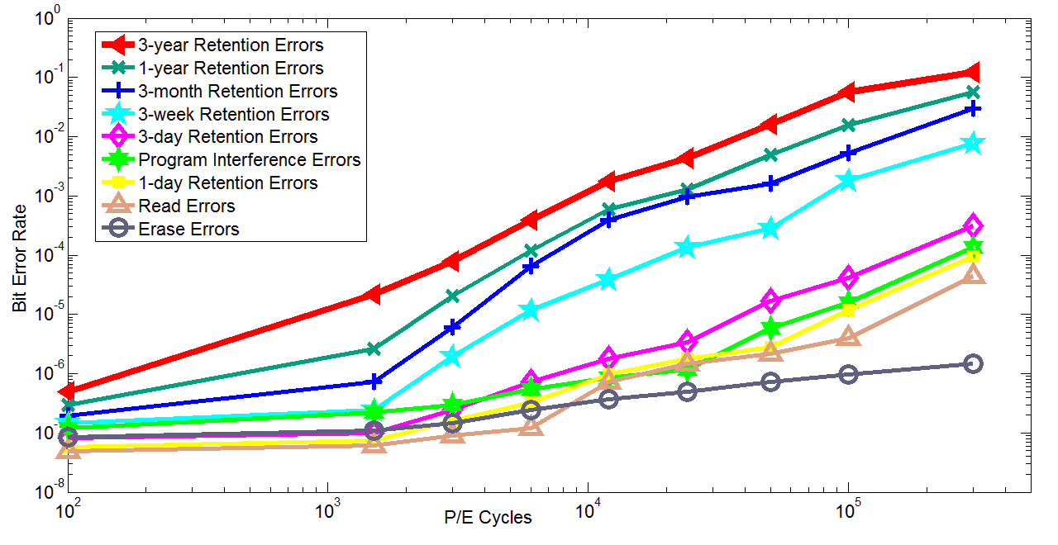
Observations: Flash Error Analysis
retention errors
Raw Bit Error Rate
P/E Cycles
Raw bit error rate increases exponentially with P/E cycles
Retention errors are dominant (>99% for 1-year ret. time)
Retention errors increase with retention time requirement

Slide 147

Retention Error Mechanism
LSB/MSB
Stress Induced Leakage Current (SILC)
Floating
Gate
REF1
REF2
REF3
11
10
01
00
V_{th}
Erased
Fully programmed
Electron loss from the floating gate causes retention errors
  Cells with more programmed electrons suffer more from retention errors
  Threshold voltage is more likely to shift by one window than by multiple
Notes:
16
explain what the diagram is showing
animate in distribution spread

Slide 148
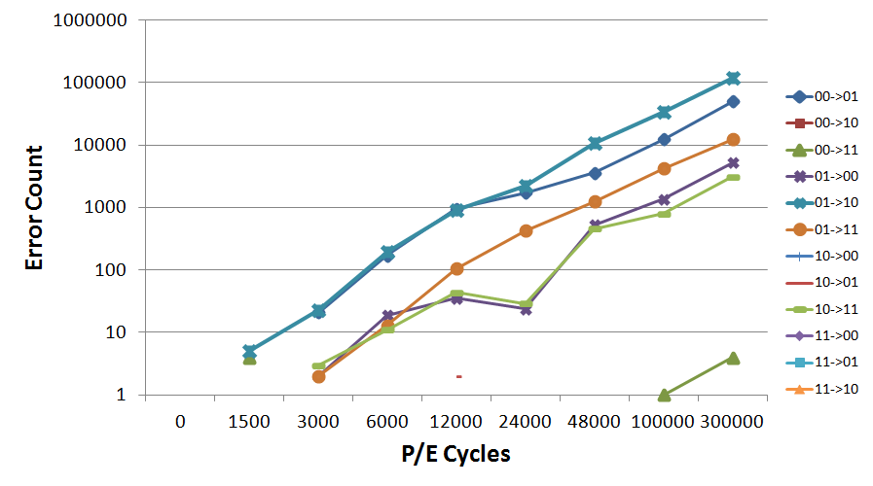
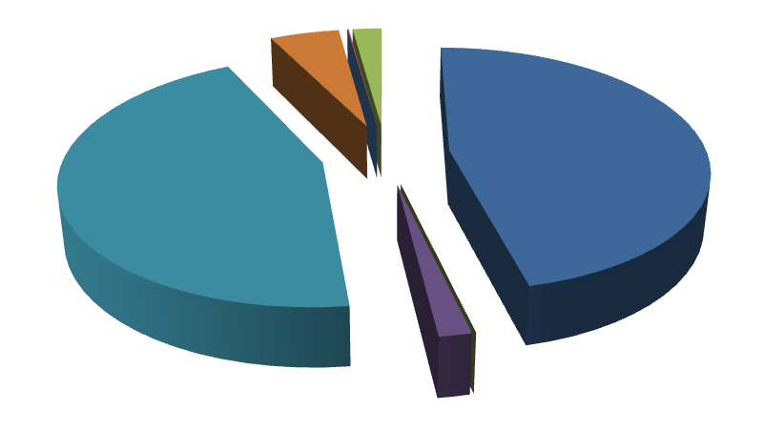
Retention Error Value Dependency
01 →10
00 →01
Cells with more programmed electrons tend to suffer more from retention noise (i.e. 00 and 01)

Slide 149
More Details on Flash Error Analysis
Yu Cai, Erich F. Haratsch, Onur Mutlu, and Ken Mai,
"Error Patterns in MLC NAND Flash Memory: Measurement, Characterization, and Analysis"
Proceedings of the Design, Automation, and Test in Europe Conference (DATE), Dresden, Germany, March 2012. Slides (ppt)

Slide 150
Threshold Voltage Distribution Shifts
As P/E cycles increase ...
Distribution shifts to the right
Distribution becomes wider
Notes:
This plot shows the probability density function of the cell threshold voltage as the number of program/erase cycles increases.
As the wear on the cells increase, we can see the distributions broadening and shifting to the right (higher voltages).
As around 30k cycles, the distributions in adjacent states begin to overlap, meaning that a read error is possible.
However, we note that the manufacturer cell lifetime is typically only around 5k cycles, so errors due to wear would not be evident at those wear levels.

Slide 151
More Detail
Yu Cai, Erich F. Haratsch, Onur Mutlu, and Ken Mai,
"Threshold Voltage Distribution in MLC NAND Flash Memory: Characterization, Analysis and Modeling"
Proceedings of the Design, Automation, and Test in Europe Conference (DATE), Grenoble, France, March 2013. Slides (ppt)

Slide 152

Flash Correct-and-Refresh
Retention-Aware Error Management for Increased Flash Memory Lifetime
Yu Cai¹ Gulay Yalcin² Onur Mutlu¹ Erich F. Haratsch³
Adrian Cristal² Osman S. Unsal² Ken Mai¹
¹ Carnegie Mellon University
² Barcelona Supercomputing Center
³ LSI Corporation

Slide 153
Executive Summary
NAND flash memory has low endurance: a flash cell dies after 3k P/E cycles vs. 50k desired → Major scaling challenge for flash memory
Flash error rate increases exponentially over flash lifetime
Problem: Stronger error correction codes (ECC) are ineffective and undesirable for improving flash lifetime due to
  diminishing returns on lifetime with increased correction strength
  prohibitively high power, area, latency overheads
Our Goal: Develop techniques to tolerate high error rates w/o strong ECC
Observation: Retention errors are the dominant errors in MLC NAND flash
  flash cell loses charge over time; retention errors increase as cell gets worn out
Solution: Flash Correct-and-Refresh (FCR)
  Periodically read, correct, and reprogram (in place) or remap each flash page before it accumulates more errors than can be corrected by simple ECC
  Adapt “refresh” rate to the severity of retention errors (i.e., # of P/E cycles)
Results: FCR improves flash memory lifetime by 46X with no hardware changes and low energy overhead; outperforms strong ECCs

Slide 154
Outline
Executive Summary
The Problem: Limited Flash Memory Endurance/Lifetime
Error and ECC Analysis for Flash Memory
Flash Correct and Refresh Techniques (FCR)
Evaluation
Conclusions

Slide 155
Problem: Limited Endurance of Flash Memory
NAND flash has limited endurance
  A cell can tolerate a small number of Program/Erase (P/E) cycles
  3x-nm flash with 2 bits/cell → 3K P/E cycles
Enterprise data storage requirements demand very high endurance
  >50K P/E cycles (10 full disk writes per day for 3-5 years)
Continued process scaling and more bits per cell will reduce flash endurance
One potential solution: stronger error correction codes (ECC)
  Stronger ECC not effective enough and inefficient

Slide 156
Decreasing Endurance with Flash Scaling
100k
24-bit ECC
15-bit ECC
8-bit ECC
Error Correction Capability
(per 1 kB of data)
4-bit ECC
10k
5k
3k
1k
Ariel Maislos, “A New Era in Embedded Flash Memory”, Flash Summit 2011 (Anobit)
Endurance of flash memory decreasing with scaling and multi-level cells
Error correction capability required to guarantee storage-class reliability (UBER < 10⁻¹⁵) is increasing exponentially to reach less endurance
UBER: Uncorrectable bit error rate. Fraction of erroneous bits after error correction.

Slide 157
The Problem with Stronger Error Correction
Stronger ECC detects and corrects more raw bit errors → increases P/E cycles endured
Two shortcomings of stronger ECC:
  1. High implementation complexity
  → Power and area overheads increase super-linearly, but correction capability increases sub-linearly with ECC strength
  2. Diminishing returns on flash lifetime improvement
  → Raw bit error rate increases exponentially with P/E cycles, but correction capability increases sub-linearly with ECC strength

Slide 158
Outline
Executive Summary
The Problem: Limited Flash Memory Endurance/Lifetime
Error and ECC Analysis for Flash Memory
Flash Correct and Refresh Techniques (FCR)
Evaluation
Conclusions

Slide 159
Methodology: Error and ECC Analysis
Characterized errors and error rates of 3x-nm MLC NAND flash using an experimental FPGA-based flash platform
  Cai et al., “Error Patterns in MLC NAND Flash Memory: Measurement, Characterization, and Analysis,” DATE 2012.
Quantified Raw Bit Error Rate (RBER) at a given P/E cycle
  Raw Bit Error Rate: Fraction of erroneous bits without any correction
Quantified error correction capability (and area and power consumption) of various BCH-code implementations
  Identified how much RBER each code can tolerate
  → how many P/E cycles (flash lifetime) each code can sustain

Slide 160
NAND Flash Error Types
Four types of errors [Cai+, DATE 2012]
Caused by common flash operations
  Read errors
  Erase errors
  Program (interference) errors
Caused by flash cell losing charge over time
  Retention errors
    Whether an error happens depends on required retention time
    Especially problematic in MLC flash because voltage threshold window to determine stored value is smaller

Slide 161
Observations: Flash Error Analysis
retention errors
Raw Bit Error Rate
P/E Cycles
Raw bit error rate increases exponentially with P/E cycles
Retention errors are dominant (>99% for 1-year ret. time)
Retention errors increase with retention time requirement

Slide 162
Methodology: Error and ECC Analysis
Characterized errors and error rates of 3x-nm MLC NAND flash using an experimental FPGA-based flash platform
  Cai et al., “Error Patterns in MLC NAND Flash Memory: Measurement, Characterization, and Analysis,” DATE 2012.
Quantified Raw Bit Error Rate (RBER) at a given P/E cycle
  Raw Bit Error Rate: Fraction of erroneous bits without any correction
Quantified error correction capability (and area and power consumption) of various BCH-code implementations
  Identified how much RBER each code can tolerate
  → how many P/E cycles (flash lifetime) each code can sustain

Slide 163
ECC Strength Analysis
Examined characteristics of various-strength BCH codes with the following criteria
  Storage efficiency: >89% coding rate (user data/total storage)
  Reliability: <10⁻¹⁵ uncorrectable bit error rate
  Code length: segment of one flash page (e.g., 4kB)
Error correction capability increases sub-linearly
Power and area overheads increase super-linearly

Slide 164
Resulting Flash Lifetime with Strong ECC
Lifetime improvement comparison of various BCH codes
4X Lifetime
Improvement
71X Power Consumption
85X Area Consumption
Strong ECC is very inefficient at improving lifetime

Slide 165
Our Goal
Develop new techniques
to improve flash lifetime
without relying on stronger ECC

Slide 166
Outline
Executive Summary
The Problem: Limited Flash Memory Endurance/Lifetime
Error and ECC Analysis for Flash Memory
Flash Correct and Refresh Techniques (FCR)
Evaluation
Conclusions

Slide 167
Flash Correct-and-Refresh (FCR)
Key Observations:
  Retention errors are the dominant source of errors in flash memory [Cai+ DATE 2012][Tanakamaru+ ISSCC 2011]
  → limit flash lifetime as they increase over time
  Retention errors can be corrected by “refreshing” each flash page periodically
Key Idea:
  Periodically read each flash page,
  Correct its errors using “weak” ECC, and
  Either remap it to a new physical page or reprogram it in-place,
  Before the page accumulates more errors than ECC-correctable
  Optimization: Adapt refresh rate to endured P/E cycles

Slide 168
FCR Intuition
Errors with
No refresh
Errors with
Periodic refresh
ProgramPage
×
×
After time T
×
×
×
×
×
×
×
After time 2T
×
×
×
×
×
×
×
×
×
After time 3T
×
×
×
×
×
×
×
×
×
×
×
×
Retention Error
×
Program Error

Slide 169
FCR: Two Key Questions
How to refresh?
  Remap a page to another one
  Reprogram a page (in-place)
  Hybrid of remap and reprogram
When to refresh?
  Fixed period
  Adapt the period to retention error severity

Slide 170
Outline
Executive Summary
The Problem: Limited Flash Memory Endurance/Lifetime
Error and ECC Analysis for Flash Memory
Flash Correct and Refresh Techniques (FCR)
  1. Remapping based FCR
  2. Hybrid Reprogramming and Remapping based FCR
  3. Adaptive-Rate FCR
Evaluation
Conclusions

Slide 171
Outline
Executive Summary
The Problem: Limited Flash Memory Endurance/Lifetime
Error and ECC Analysis for Flash Memory
Flash Correct and Refresh Techniques (FCR)
  1. Remapping based FCR
  2. Hybrid Reprogramming and Remapping based FCR
  3. Adaptive-Rate FCR
Evaluation
Conclusions

Slide 172
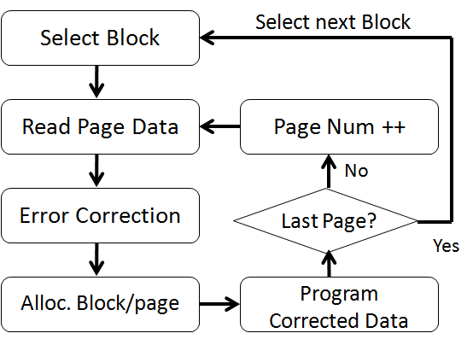
Remapping Based FCR
Idea: Periodically remap each page to a different physical page (after correcting errors)
  Also [Pan et al., HPCA 2012]
  FTL already has support for
  changing logical → physical
  flash block/page mappings
  Deallocated block is
  erased by garbage collector
Problem: Causes additional erase operations → more wearout
  Bad for read-intensive workloads (few erases really needed)
  Lifetime degrades for such workloads (see paper)

Slide 173
Outline
Executive Summary
The Problem: Limited Flash Memory Endurance/Lifetime
Error and ECC Analysis for Flash Memory
Flash Correct and Refresh Techniques (FCR)
  1. Remapping based FCR
  2. Hybrid Reprogramming and Remapping based FCR
  3. Adaptive-Rate FCR
Evaluation
Conclusions

Slide 174
In-Place Reprogramming Based FCR
Idea: Periodically reprogram (in-place) each physical page (after correcting errors)
  Flash programming techniques
  (ISPP) can correct retention
  errors in-place by recharging
  flash cells
Problem: Program errors accumulate on the same page → may not be correctable by ECC after some time
Reprogram corrected data
Notes:
Observations:
Retention errors occur due to loss of charge
Simply recharging the cells can correct the retention errors
Flash programming mechanisms can accomplish this recharging
ISPP (Incremental Step Pulse Programming)
Iterative programming mechanism that increases the voltage level of a flash cell step by step
After each step, voltage level compared to desired voltage threshold
Can inject more electrons but cannot remove electrons

Slide 175
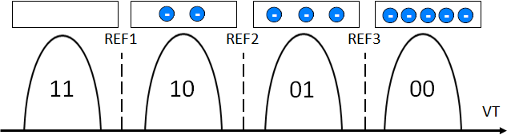
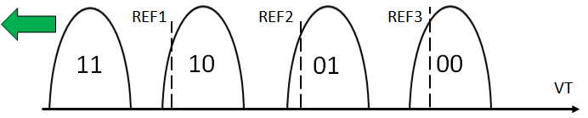
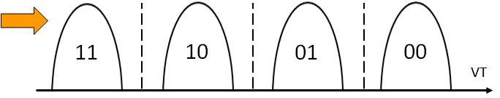
In-Place Reprogramming of Flash Cells
Floating Gate
Pro: No remapping needed → no additional erase operations
Con: Increases the occurrence of program errors
Floating Gate
Voltage Distribution
for each Stored Value
Retention errors are caused by cell voltage shifting to the left
ISPP moves cell voltage to the right; fixes retention errors

Slide 176
Program Errors in Flash Memory
When a cell is being programmed, voltage level of a neighboring cell changes (unintentionally) due to parasitic capacitance coupling
→ can change the data value stored
Also called program interference error
Program interference causes neighboring cell voltage to shift to the right

Slide 177
Problem with In-Place Reprogramming
Floating
Gate
REF1
REF2
REF3
Additional
Electrons Injected
Floating Gate
Voltage Distribution
11
10
01
00
VT
Original data
to be programmed
…
00
11
01
00
10
11
00
…
Program errors after
initial programming
…
00
10
01
00
10
11
00
…
Retention errors
after some time
…
01
10
10
00
11
11
01
…
1. Read data
2. Correct errors
3. Reprogram back
Errors after in-place
reprogramming
…
00
10
01
00
10
10
00
…
Problem: Program errors can accumulate over time

Slide 178
Hybrid Reprogramming/Remapping Based FCR
Idea:
  Monitor the count of right-shift errors (after error correction)
  If count < threshold, in-place reprogram the page
  Else, remap the page to a new page
Observation:
  Program errors much less frequent than retention errors → Remapping happens only infrequently
Benefit:
  Hybrid FCR greatly reduces erase operations due to remapping

Slide 179
Outline
Executive Summary
The Problem: Limited Flash Memory Endurance/Lifetime
Error and ECC Analysis for Flash Memory
Flash Correct and Refresh Techniques (FCR)
  1. Remapping based FCR
  2. Hybrid Reprogramming and Remapping based FCR
  3. Adaptive-Rate FCR
Evaluation
Conclusions

Slide 180
Adaptive-Rate FCR
Observation:
  Retention error rate strongly depends on the P/E cycles a flash page endured so far
  No need to refresh frequently (at all) early in flash lifetime
Idea:
  Adapt the refresh rate to the P/E cycles endured by each page
  Increase refresh rate gradually with increasing P/E cycles
Benefits:
  Reduces overhead of refresh operations
  Can use existing FTL mechanisms that keep track of P/E cycles

Slide 181
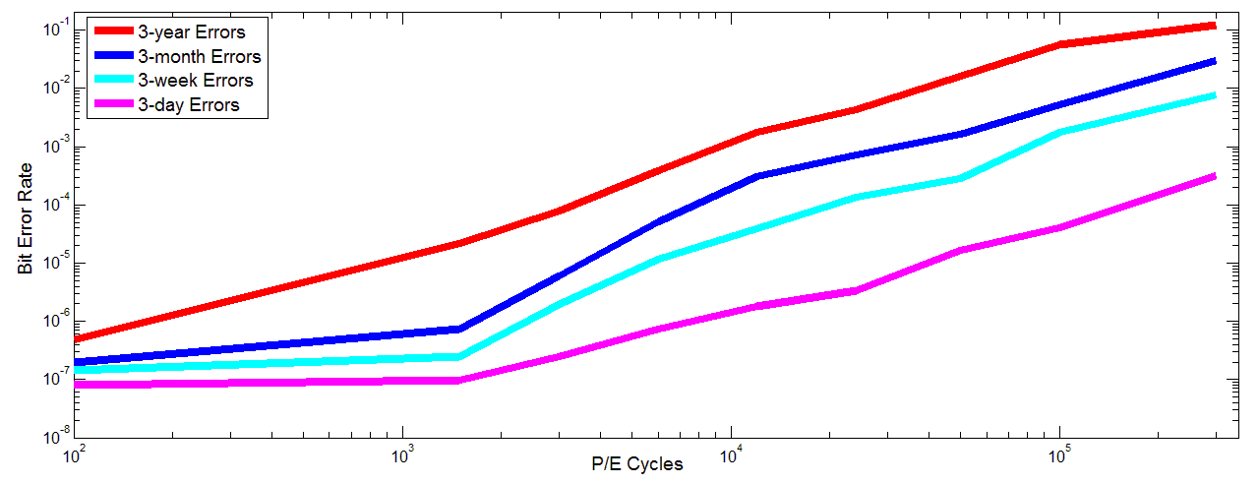
Adaptive-Rate FCR (Example)
3-year
FCR
3-month
FCR
3-week
FCR
3-day
FCR
Raw Bit Error Rate
Acceptable raw BER for 512b-BCH
P/E Cycles
Select refresh frequency such that error rate is below acceptable rate

Slide 182
Outline
Executive Summary
The Problem: Limited Flash Memory Endurance/Lifetime
Error and ECC Analysis for Flash Memory
Flash Correct and Refresh Techniques (FCR)
  1. Remapping based FCR
  2. Hybrid Reprogramming and Remapping based FCR
  3. Adaptive-Rate FCR
Evaluation
Conclusions

Slide 183
FCR: Other Considerations
Implementation cost
  No hardware changes
  FTL software/firmware needs modification
Response time impact
  FCR not as frequent as DRAM refresh; low impact
Adaptation to variations in retention error rate
  Adapt refresh rate based on, e.g., temperature [Liu+ ISCA 2012]
FCR requires power
  Enterprise storage systems typically powered on

Slide 184
Outline
Executive Summary
The Problem: Limited Flash Memory Endurance/Lifetime
Error and ECC Analysis for Flash Memory
Flash Correct and Refresh Techniques (FCR)
Evaluation
Conclusions

Slide 185
Evaluation Methodology
Experimental flash platform to obtain error rates at different P/E cycles [Cai+ DATE 2012]
Simulation framework to obtain P/E cycles of real workloads: DiskSim with SSD extensions
Simulated system: 256GB flash, 4 channels, 8 chips/channel, 8K blocks/chip, 128 pages/block, 8KB pages
Workloads
  File system applications, databases, web search
  Categories: Write-heavy, read-heavy, balanced
Evaluation metrics
  Lifetime (extrapolated)
  Energy overhead, P/E cycle overhead

Slide 186
Extrapolated Lifetime
Obtained from Experimental Platform Data
Maximum full disk P/E Cycles for a Technique
×
# of Days of Given Application
Total full disk P/E Cycles for a Workload
Real length (in time) of
each workload trace
Obtained from Workload Simulation

Slide 187
Normalized Flash Memory Lifetime
46x
4x
Lifetime of FCR much higher than lifetime of stronger ECC
Adaptive-rate FCR provides the highest lifetime

Slide 188
Lifetime Evaluation Takeaways
Significant average lifetime improvement over no refresh
  Adaptive-rate FCR: 46X
  Hybrid reprogramming/remapping based FCR: 31X
  Remapping based FCR: 9X
FCR lifetime improvement larger than that of stronger ECC
  46X vs. 4X with 32-kbit ECC (over 512-bit ECC)
  FCR is less complex and less costly than stronger ECC
Lifetime on all workloads improves with Hybrid FCR
  Remapping based FCR can degrade lifetime on read-heavy WL
  Lifetime improvement highest in write-heavy workloads

Slide 189
Energy Overhead
Adaptive-rate refresh: <1.8% energy increase until daily refresh is triggered
7.8%
5.5%
2.6%
1.8%
0.4%
0.3%
Refresh Interval

Slide 190
Overhead of Additional Erases
Additional erases happen due to remapping of pages
Low (2%-20%) for write intensive workloads
High (up to 10X) for read-intensive workloads
Improved P/E cycle lifetime of all workloads largely outweighs the additional P/E cycles due to remapping

Slide 191
More Results in the Paper
Detailed workload analysis
Effect of refresh rate

Slide 192
Outline
Executive Summary
The Problem: Limited Flash Memory Endurance/Lifetime
Error and ECC Analysis for Flash Memory
Flash Correct and Refresh Techniques (FCR)
Evaluation
Conclusions

Slide 193
Conclusion
NAND flash memory lifetime is limited due to uncorrectable errors, which increase over lifetime (P/E cycles)
Observation: Dominant source of errors in flash memory is retention errors → retention error rate limits lifetime
Flash Correct-and-Refresh (FCR) techniques reduce retention error rate to improve flash lifetime
  Periodically read, correct, and remap or reprogram each page before it accumulates more errors than can be corrected
  Adapt refresh period to the severity of errors
FCR improves flash lifetime by 46X at no hardware cost
  More effective and efficient than stronger ECC
  Can enable better flash memory scaling

Slide 194
Flash Correct-and-Refresh
Retention-Aware Error Management for Increased Flash Memory Lifetime
Yu Cai¹ Gulay Yalcin² Onur Mutlu¹ Erich F. Haratsch³
Adrian Cristal² Osman S. Unsal² Ken Mai¹
¹ Carnegie Mellon University
² Barcelona Supercomputing Center
³ LSI Corporation

