Slide 1
Scalable Many-Core Memory Systems Lecture 4, Topic 3: Memory Interference and QoS-Aware Memory Systems
Prof. Onur Mutlu
http://www.ece.cmu.edu/~omutlu
onur@cmu.edu
HiPEAC ACACES Summer School 2013
July 18, 2013

Slide 2
What Will You Learn in This Course?
Scalable Many-Core Memory Systems
July 15-19, 2013
Topic 1: Main memory basics, DRAM scaling
Topic 2: Emerging memory technologies and hybrid memories
Topic 3: Main memory interference and QoS
Topic 4 (unlikely): Cache management
Topic 5 (unlikely): Interconnects
Major Overview Reading:
Mutlu, “Memory Scaling: A Systems Architecture Perspective,” IMW 2013.

Slide 3
Main Memory Interference

Slide 4
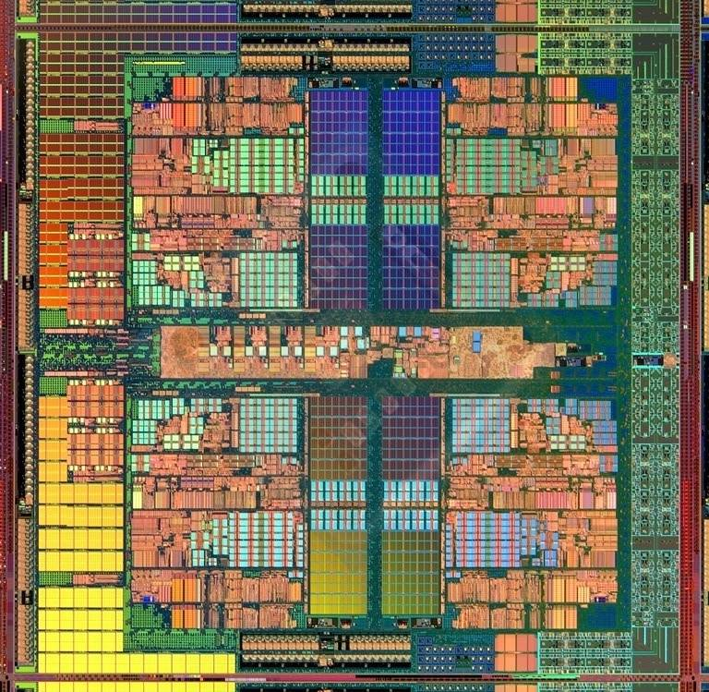
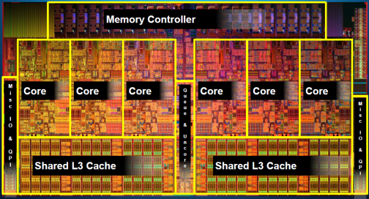
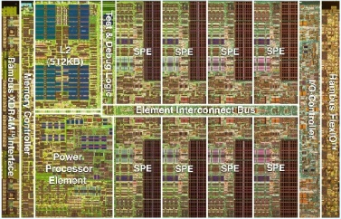
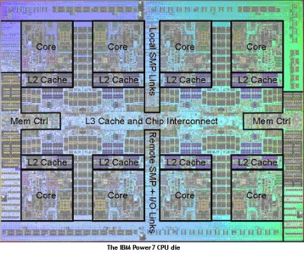
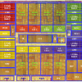
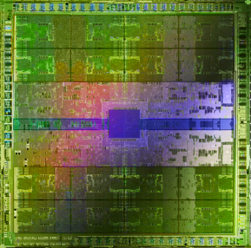
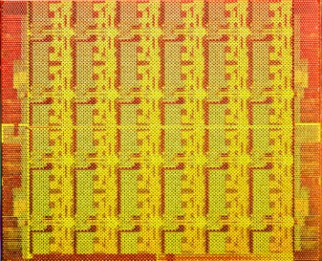
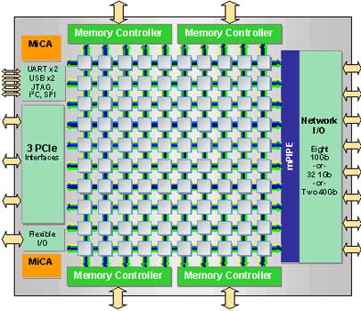
Trend: Many Cores on Chip
Simpler and lower power than a single large core
Large scale parallelism on chip
Intel Core i7 8 cores
IBM Cell BE 8+1 cores
IBM POWER7
8 cores
AMD Barcelona
4 cores
Nvidia Fermi
448 “cores”
Intel SCC
48 cores, networked
Tilera TILE Gx
100 cores, networked
Sun Niagara II
8 cores

Slide 5
Many Cores on Chip
What we want:
N times the system performance with N times the cores
What do we get today?

Slide 6
Unfair Slowdowns due to Interference
High priority
Memory Performance Hog
Low priority
matlab
(Core 1)
gcc
(Core 2)
(Core 0)
(Core 1)
Moscibroda and Mutlu, “Memory performance attacks: Denial of memory service
in multi-core systems,” USENIX Security 2007.
Notes:
What kind of performance do we expect when we run two applications on a multi-core system? To answer this question, we performed an experiment. We took two applications we cared about, ran them together on different cores in a dual-core system, and measured their slowdown compared to when each is run alone on the same system. This graph shows the slowdown each app experienced. (DATA explanation…)
Why do we get such a large disparity in the slowdowns?
Is it the priorities? No. We went back and gave high priority to gcc and low priority to matlab. The slowdowns did not change at all. Neither the software or the hardware enforced the priorities.
Is it the contention in the disk? We checked for this possibility, but found that these applications did not have any disk accesses in the steady state. They both fit in the physical memory and therefore did not interfere in the disk.
What is it then? Why do we get such large disparity in slowdowns in a dual core system?
I will call such an application a “memory performance hog”
Now, let me tell you why this disparity in slowdowns happens.
Is it that there are other applications or the OS interfering with gcc, stealing its time quantums? No.

Slide 7
Uncontrolled Interference: An Example
CORE 1
gcc
Multi-Core
Chip
matlab
CORE 2
L2
CACHE
L2
CACHE
unfairness
INTERCONNECT
Shared DRAM
Memory System
DRAM MEMORY CONTROLLER
DRAM
Bank 0
DRAM
Bank 1
DRAM
Bank 2
DRAM
Bank 3
Notes:
-In a multi-core chip, different cores share some hardware resources. In particular, they share the DRAM memory system. The shared memory system consists of this and that.
When we run matlab on one core, and gcc on another core, both cores generate memory requests to access the DRAM banks. When these requests arrive at the DRAM controller, the controller favors matlab’s requests over gcc’s requests. As a result, matlab can make progress and continues generating memory requests. These requests are again favored by the DRAM controller over gcc’s requests. Therefore, gcc starves waiting for its requests to be serviced in DRAM whereas matlab makes very quick progress as if it were running alone.
Why does this happen? This is because the algorithms employed by the DRAM controller are unfair.
But, why are these algorithms unfair? Why do they unfairly prioritize matlab accesses?
To understand this, we need to understand how a DRAM bank operates.
Almost all systems today contain multi-core chips
Multi-core systems consist of multiple on-chip cores and caches
Cores share the DRAM memory system
DRAM memory system consists of
DRAM banks that store data (multiple banks to allow parallel accesses)
DRAM memory controller that mediates between cores and DRAM memory
It schedules memory operations generated by cores to DRAM
This talk is about exploiting the unfair algorithms in the memory controllers to perform denial of service to running threads
To understand how this happens, we need to know about how each DRAM bank operates

Slide 8
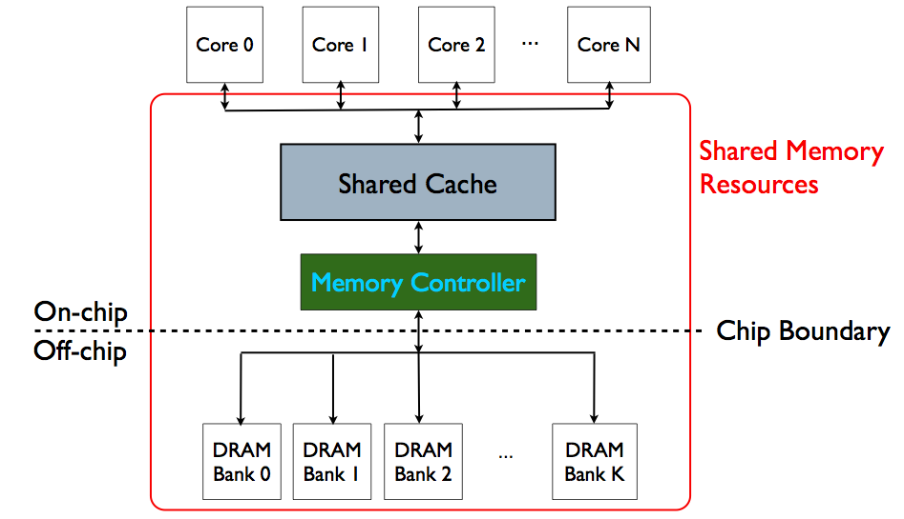
Memory System is the Major Shared Resource
threads’ requests
interfere

Slide 9
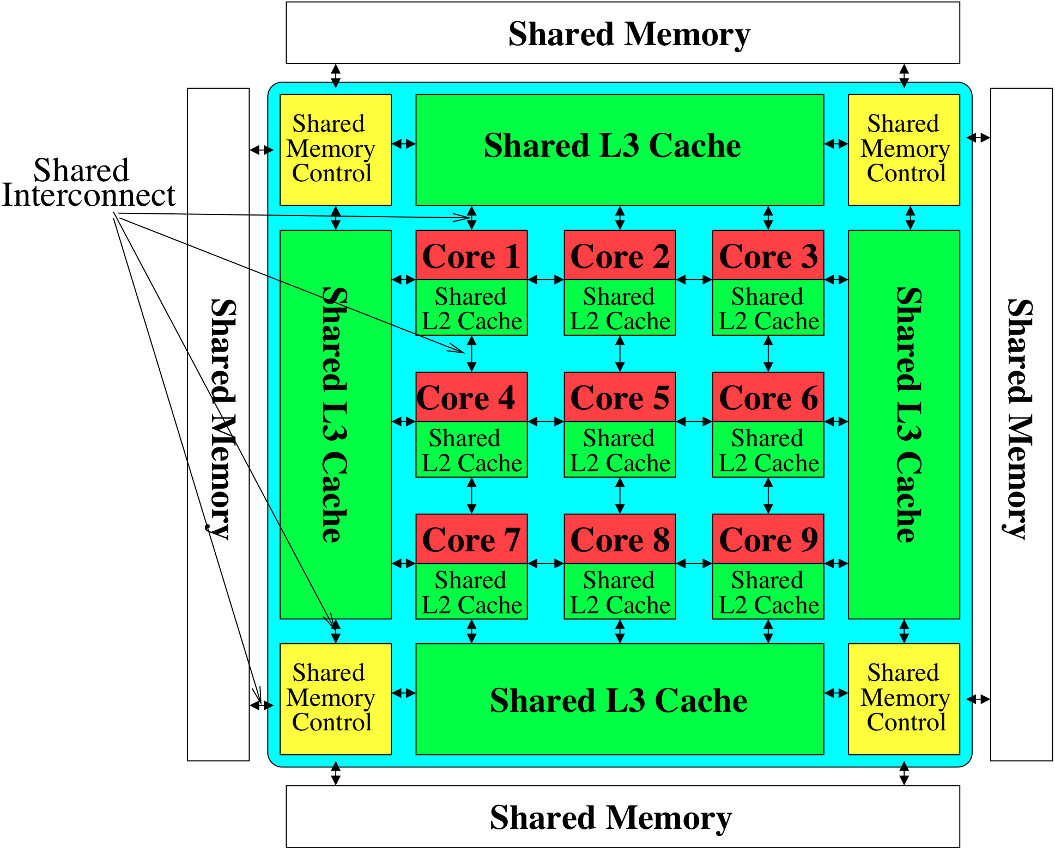
Much More of a Shared Resource in Future

Slide 10
Inter-Thread/Application Interference
Problem: Threads share the memory system, but memory system does not distinguish between threads’ requests
Existing memory systems
Free-for-all, shared based on demand
Control algorithms thread-unaware and thread-unfair
Aggressive threads can deny service to others
Do not try to reduce or control inter-thread interference

Slide 11
Unfair Slowdowns due to Interference
matlab
(Core 1)
gcc
(Core 2)
(Core 0)
(Core 1)
Moscibroda and Mutlu, “Memory performance attacks: Denial of memory service
in multi-core systems,” USENIX Security 2007.
Notes:
What kind of performance do we expect when we run two applications on a multi-core system? To answer this question, we performed an experiment. We took two applications we cared about, ran them together on different cores in a dual-core system, and measured their slowdown compared to when each is run alone on the same system. This graph shows the slowdown each app experienced. (DATA explanation…)
Why do we get such a large disparity in the slowdowns?
Is it the priorities? No. We went back and gave high priority to gcc and low priority to matlab. The slowdowns did not change at all. Neither the software or the hardware enforced the priorities.
Is it the contention in the disk? We checked for this possibility, but found that these applications did not have any disk accesses in the steady state. They both fit in the physical memory and therefore did not interfere in the disk.
What is it then? Why do we get such large disparity in slowdowns in a dual core system?
I will call such an application a “memory performance hog”
Now, let me tell you why this disparity in slowdowns happens.
Is it that there are other applications or the OS interfering with gcc, stealing its time quantums? No.

Slide 12
Uncontrolled Interference: An Example
CORE 1
random
Multi-Core
Chip
stream
CORE 2
L2
CACHE
L2
CACHE
unfairness
INTERCONNECT
Shared DRAM
Memory System
DRAM MEMORY CONTROLLER
DRAM
Bank 0
DRAM
Bank 1
DRAM
Bank 2
DRAM
Bank 3
Notes:
-In a multi-core chip, different cores share some hardware resources. In particular, they share the DRAM memory system. The shared memory system consists of this and that.
When we run matlab on one core, and gcc on another core, both cores generate memory requests to access the DRAM banks. When these requests arrive at the DRAM controller, the controller favors matlab’s requests over gcc’s requests. As a result, matlab can make progress and continues generating memory requests. These requests are again favored by the DRAM controller over gcc’s requests. Therefore, gcc starves waiting for its requests to be serviced in DRAM whereas matlab makes very quick progress as if it were running alone.
Why does this happen? This is because the algorithms employed by the DRAM controller are unfair.
But, why are these algorithms unfair? Why do they unfairly prioritize matlab accesses?
To understand this, we need to understand how a DRAM bank operates.
Almost all systems today contain multi-core chips
Multi-core systems consist of multiple on-chip cores and caches
Cores share the DRAM memory system
DRAM memory system consists of
DRAM banks that store data (multiple banks to allow parallel accesses)
DRAM memory controller that mediates between cores and DRAM memory
It schedules memory operations generated by cores to DRAM
This talk is about exploiting the unfair algorithms in the memory controllers to perform denial of service to running threads
To understand how this happens, we need to know about how each DRAM bank operates

Slide 13
A Memory Performance Hog
// initialize large arrays A, B
for (j=0; j<N; j++) {
index = j*linesize;
A[index] = B[index];
…
}
// initialize large arrays A, B
for (j=0; j<N; j++) {
index = rand();
A[index] = B[index];
…
}
streaming
random
STREAM
RANDOM
Sequential memory access
Very high row buffer locality (96% hit rate)
Memory intensive
Random memory access
Very low row buffer locality (3% hit rate)
Similarly memory intensive
Moscibroda and Mutlu, “Memory Performance Attacks,” USENIX Security 2007.
Notes:
Streaming through memory by performing operations on two 1D arrays.
Sequential memory access
Each access is a cache miss (elements of array larger than a cache line size) → hence, very memory intensive
Link to the real code…

Slide 14
What Does the Memory Hog Do?
Row decoder
T0: Row 0
T0: Row 0
T0: Row 0
T0: Row 0
T0: Row 0
T0: Row 0
T0: Row 0
T1: Row 5
T1: Row 111
T0: Row 0
T1: Row 16
T0: Row 0
Memory Request Buffer
Row 0
Row Buffer
Row 0
Column mux
Row size: 8KB, cache block size: 64B
128 (8KB/64B) requests of T0 serviced before T1
T0: STREAM
T1: RANDOM
Data
Moscibroda and Mutlu, “Memory Performance Attacks,” USENIX Security 2007.
Notes:
Pictorially demonstrate how stream denies memory service to rdarray
Stream continuously accesses columns in row 0 in a streaming manner (streams through a row after opening it)
In other words almost all its requests are row-hits
RDarray’s requests are row-conflicts (no locality)
The DRAM controller reorders streams requests to the open row over other requests (even older ones) to maximize DRAM throughput
Hence, rdarray’s requests do not get serviced as long as stream is issuing requests at a fast-enough rate
In this example, the red thread’s request to another row will not get serviced until stream stops issuing a request to row 0
With those parameters, 128 requests of stream would be serviced before 1 from rdarray
As row-buffer size increases, which is the industry trend, this problem will become more severe
This is not the worst case, but it is easy to construct and understand
Stream falls off the row buffer at some point
I leave it to the listeners to construct a case worse than this (it is possible)

Slide 15
DRAM Controllers
A row-conflict memory access takes significantly longer than a row-hit access
Current controllers take advantage of the row buffer
Commonly used scheduling policy (FR-FCFS) [Rixner 2000]*
(1) Row-hit first: Service row-hit memory accesses first
(2) Oldest-first: Then service older accesses first
This scheduling policy aims to maximize DRAM throughput
But, it is unfair when multiple threads share the DRAM system
*Rixner et al., “Memory Access Scheduling,” ISCA 2000.
*Zuravleff and Robinson, “Controller for a synchronous DRAM …,” US Patent 5,630,096, May 1997.

Slide 16
Effect of the Memory Performance Hog
2.82X slowdown
Slowdown
1.18X slowdown
Results on Intel Pentium D running Windows XP
(Similar results for Intel Core Duo and AMD Turion, and on Fedora Linux)
Moscibroda and Mutlu, “Memory Performance Attacks,” USENIX Security 2007.
Notes:
RANDOM was given higher OS priority in the experiments

Slide 17
Greater Problem with More Cores
Vulnerable to denial of service (DoS)
Unable to enforce priorities or SLAs
Low system performance
Uncontrollable, unpredictable system

Slide 18
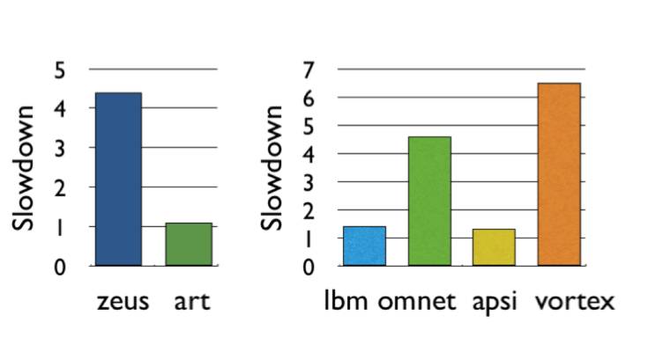
Greater Problem with More Cores
Vulnerable to denial of service (DoS)
Unable to enforce priorities or SLAs
Low system performance
Uncontrollable, unpredictable system

Slide 19
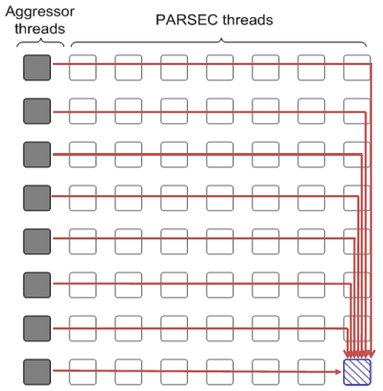
Distributed DoS in Networked Multi-Core Systems
Attackers
(Cores 1-8)
Stock option pricing application
(Cores 9-64)
Cores connected via
packet-switched
routers on chip
~5000X latency increase
Grot, Hestness, Keckler, Mutlu,
“Preemptive virtual clock: A Flexible,
Efficient, and Cost-effective QOS
Scheme for Networks-on-Chip,“
MICRO 2009.

Slide 20
How Do We Solve The Problem?
Inter-thread interference is uncontrolled in all memory resources
Memory controller
Interconnect
Caches
We need to control it
i.e., design an interference-aware (QoS-aware) memory system

Slide 21
QoS-Aware Memory Systems: Challenges
How do we reduce inter-thread interference?
Improve system performance and core utilization
Reduce request serialization and core starvation
How do we control inter-thread interference?
Provide mechanisms to enable system software to enforce QoS policies
While providing high system performance
How do we make the memory system configurable/flexible?
Enable flexible mechanisms that can achieve many goals
Provide fairness or throughput when needed
Satisfy performance guarantees when needed

Slide 22
Designing QoS-Aware Memory Systems: Approaches
Smart resources: Design each shared resource to have a configurable interference control/reduction mechanism
QoS-aware memory controllers [Mutlu+ MICRO’07] [Moscibroda+, Usenix Security’07] [Mutlu+ ISCA’08, Top Picks’09] [Kim+ HPCA’10] [Kim+ MICRO’10, Top Picks’11] [Ebrahimi+ ISCA’11, MICRO’11] [Ausavarungnirun+, ISCA’12][Subramanian+, HPCA’13]
QoS-aware interconnects [Das+ MICRO’09, ISCA’10, Top Picks ’11] [Grot+ MICRO’09, ISCA’11, Top Picks ’12]
QoS-aware caches
Dumb resources: Keep each resource free-for-all, but reduce/control interference by injection control or data mapping
Source throttling to control access to memory system [Ebrahimi+ ASPLOS’10, ISCA’11, TOCS’12] [Ebrahimi+ MICRO’09] [Nychis+ HotNets’10] [Nychis+ SIGCOMM’12]
QoS-aware data mapping to memory controllers [Muralidhara+ MICRO’11]
QoS-aware thread scheduling to cores [Das+ HPCA’13]

Slide 23
QoS-Aware Memory Scheduling
Resolves memory contention by scheduling requests
How to schedule requests to provide
High system performance
High fairness to applications
Configurability to system software
Memory controller needs to be aware of threads
Core
Core
Memory Controller
Memory
Core
Core

Slide 24
QoS-Aware Memory Scheduling: Evolution

Slide 25
QoS-Aware Memory Scheduling: Evolution
Stall-time fair memory scheduling [Mutlu+ MICRO’07]
Idea: Estimate and balance thread slowdowns
Takeaway: Proportional thread progress improves performance, especially when threads are “heavy” (memory intensive)
Parallelism-aware batch scheduling [Mutlu+ ISCA’08, Top Picks’09]
Idea: Rank threads and service in rank order (to preserve bank parallelism); batch requests to prevent starvation
Takeaway: Preserving within-thread bank-parallelism improves performance; request batching improves fairness
ATLAS memory scheduler [Kim+ HPCA’10]
Idea: Prioritize threads that have attained the least service from the memory scheduler
Takeaway: Prioritizing “light” threads improves performance

Slide 26
QoS-Aware Memory Scheduling: Evolution
Thread cluster memory scheduling [Kim+ MICRO’10]
Idea: Cluster threads into two groups (latency vs. bandwidth sensitive); prioritize the latency-sensitive ones; employ a fairness policy in the bandwidth sensitive group
Takeaway: Heterogeneous scheduling policy that is different based on thread behavior maximizes both performance and fairness
Integrated Memory Channel Partitioning and Scheduling [Muralidhara+ MICRO’11]
Idea: Only prioritize very latency-sensitive threads in the scheduler; mitigate all other applications’ interference via channel partitioning
Takeaway: Intelligently combining application-aware channel partitioning and memory scheduling provides better performance than either

Slide 27
QoS-Aware Memory Scheduling: Evolution
Parallel application memory scheduling [Ebrahimi+ MICRO’11]
Idea: Identify and prioritize limiter threads of a multithreaded application in the memory scheduler; provide fast and fair progress to non-limiter threads
Takeaway: Carefully prioritizing between limiter and non-limiter threads of a parallel application improves performance
Staged memory scheduling [Ausavarungnirun+ ISCA’12]
Idea: Divide the functional tasks of an application-aware memory scheduler into multiple distinct stages, where each stage is significantly simpler than a monolithic scheduler
Takeaway: Staging enables the design of a scalable and relatively simpler application-aware memory scheduler that works on very large request buffers

Slide 28
QoS-Aware Memory Scheduling: Evolution
MISE [Subramanian+ HPCA’13]
Idea: Estimate the performance of a thread by estimating its change in memory request service rate when run alone vs. shared → use this simple model to estimate slowdown to design a scheduling policy that provides predictable performance or fairness
Takeaway: Request service rate of a thread is a good proxy for its performance; alone request service rate can be estimated by giving high priority to the thread in memory scheduling for a while

Slide 29
QoS-Aware Memory Scheduling: Evolution
Prefetch-aware shared resource management [Ebrahimi+ ISCA’12] [Ebrahimi+ MICRO’09] [Lee+ MICRO’08]
Idea: Prioritize prefetches depending on how they affect system performance; even accurate prefetches can degrade performance of the system
Takeaway: Carefully controlling and prioritizing prefetch requests improves performance and fairness
DRAM-Aware last-level cache policies and write scheduling [Lee+ HPS Tech Report’10] [Lee+ HPS Tech Report’10]
Idea: Design cache eviction and replacement policies such that they proactively exploit the state of the memory controller and DRAM (e.g., proactively evict data from the cache that hit in open rows)
Takeaway: Coordination of last-level cache and DRAM policies improves performance and fairness

Slide 30
Stall-Time Fair Memory Scheduling
Onur Mutlu and Thomas Moscibroda, "Stall-Time Fair Memory Access Scheduling for Chip Multiprocessors" 40th International Symposium on Microarchitecture (MICRO),
pages 146-158, Chicago, IL, December 2007. Slides (ppt)
STFM Micro 2007 Talk

Slide 31
The Problem: Unfairness
Vulnerable to denial of service (DoS)
Unable to enforce priorities or SLAs
Low system performance
Uncontrollable, unpredictable system

Slide 32
How Do We Solve the Problem?
Stall-time fair memory scheduling [Mutlu+ MICRO’07]
Goal: Threads sharing main memory should experience similar slowdowns compared to when they are run alone → fair scheduling
Also improves overall system performance by ensuring cores make “proportional” progress
Idea: Memory controller estimates each thread’s slowdown due to interference and schedules requests in a way to balance the slowdowns
Mutlu and Moscibroda, “Stall-Time Fair Memory Access Scheduling for Chip Multiprocessors,” MICRO 2007.

Slide 33
Stall-Time Fairness in Shared DRAM Systems
A DRAM system is fair if it equalizes the slowdown of equal-priority threads relative to when each thread is run alone on the same system
DRAM-related stall-time: The time a thread spends waiting for DRAM memory
ST_{shared}: DRAM-related stall-time when the thread runs with other threads
ST_{alone}: DRAM-related stall-time when the thread runs alone
Memory-slowdown = ST_{shared}/ST_{alone}
Relative increase in stall-time
Stall-Time Fair Memory scheduler (STFM) aims to equalize Memory-slowdown for interfering threads, without sacrificing performance
Considers inherent DRAM performance of each thread
Aims to allow proportional progress of threads
Notes:
Memory-slowdown is the relative increase in the DRAM-related stall-time due to interference from other threads
For example, if a thread’s DRAM related stall time is 1 hour when running alone, and its stall-time is 2 hours when it runs together with other threads,
Its memory-slowdown is said to be 2.
Give an example at the end: If a thread waits for DRAM 1 hour running by itself and this increases to 2 hours (its slowdown is 2), then a thread that waits for DRAM 2 hours, should now wait for DRAM 4 hours.
Each thread experiences the same slowdown compared to its baseline DRAM performance
The amount of time a thread spends waiting for DRAM memory
Extra time a thread requires to run because DRAM access is not instant
PROPORTIONALITY: Each thread makes the same amount of progress relative to its baseline performance. This is consistent with priority based scheduling mechanisms that allocate the same time quantum for equal-priority threads.
We define two values to compute slowdown.
Proportional slowdown (proportionate progress)
Fairness notion similar to SMT [Cazorla, IEEE Micro’04][Luo, ISPASS’01], SoEMT [Gabor, Micro’06], and shared caches [Kim, PACT’04]

Slide 34
STFM Scheduling Algorithm [MICRO’07]
For each thread, the DRAM controller
Tracks ST_{shared}
Estimates ST_{alone}
Each cycle, the DRAM controller
Computes Slowdown = ST_{shared}/ST_{alone} for threads with legal requests
Computes unfairness = MAX Slowdown / MIN Slowdown
If unfairness < α
Use DRAM throughput oriented scheduling policy
If unfairness ≥ α
Use fairness-oriented scheduling policy
(1) requests from thread with MAX Slowdown first
(2) row-hit first , (3) oldest-first
Notes:
Except for pathological cases, best achievable unfairness value is 1
Maximizes DRAM throughput if it cannot improve fairness
WORK CONSERVING: Does not waste useful bandwidth to improve fairness
If a request does not interfere with any other, it is scheduled

Slide 35
How Does STFM Prevent Unfairness?
T0: Row 0
T1: Row 5
T0: Row 0
T0: Row 0
T1: Row 111
T0: Row 0
T0: Row 0
T0: Row 0
T0: Row 0
T1: Row 16
Row 111
Row Buffer
Row 16
Row 0
Row 0
T0 Slowdown
1.00
1.04
1.04
1.07
1.10
1.03
T1 Slowdown
1.03
1.06
1.08
1.14
1.06
1.11
1.00
Unfairness
1.03
1.06
1.03
1.04
1.06
1.04
1.03
1.00
Data
α
1.05
Notes:
A pictorial example of how our solution prevents stream from being a memory performance hog
Our technique requires the DRAM controller to keep track of slowdowns for each thread and the unfairness value based on these slowdowns
Alpha parameter (maximum tolerable unfairness until the fairness-oriented scheduling policy kicks in) is set to 1.05 in this example
As stream’s requests are prioritized over rdarray’s, rdarray’s slowdown increases and hence unfairness increases
Once unfairness crosses the alpha value, our algorithm kicks in and uses the fairness-oriented scheduling policy
This policy prioritizes requests from the thread with the maximum slowdown (rdarray – thread 1)
Hence, rdarray’s requests do not indefinitely starve
Servicing rdarray’s request increases stream’s slowdown and keeps in check rdarray’s slowdown (thus reduces unfairness)
Therefore, when unfairness becomes tolerable again, our algorithm switches back to the baseline scheduling policy to maximize throughput (i.e. it schedules stream’s row hit requests first, and then the oldest requests)

Slide 36
STFM Pros and Cons
Upsides:
Identifies fairness as an issue in multi-core memory scheduling
Good at providing fairness
Being fair improves performance
Downsides:
Does not handle all types of interference
Somewhat complex to implement
Slowdown estimations can be incorrect

Slide 37
Parallelism-Aware Batch Scheduling
Onur Mutlu and Thomas Moscibroda, "Parallelism-Aware Batch Scheduling: Enhancing both
Performance and Fairness of Shared DRAM Systems” 35th International Symposium on Computer Architecture (ISCA),
pages 63-74, Beijing, China, June 2008. Slides (ppt)
PAR-BS ISCA 2008 Talk

