Slide 1


Scalable Many-Core Memory Systems Topic 1: DRAM Basics and
DRAM Scaling
Prof. Onur Mutlu
http://www.ece.cmu.edu/~omutlu
onur@cmu.edu
HiPEAC ACACES Summer School 2013
July 15-19, 2013

Slide 2



The Main Memory System
Main memory is a critical component of all computing systems: server, mobile, embedded, desktop, sensor
Main memory system must scale (in size, technology, efficiency, cost, and management algorithms) to maintain performance growth and technology scaling benefits
Processor
and caches
Main Memory
Storage (SSD/HDD)

Slide 3
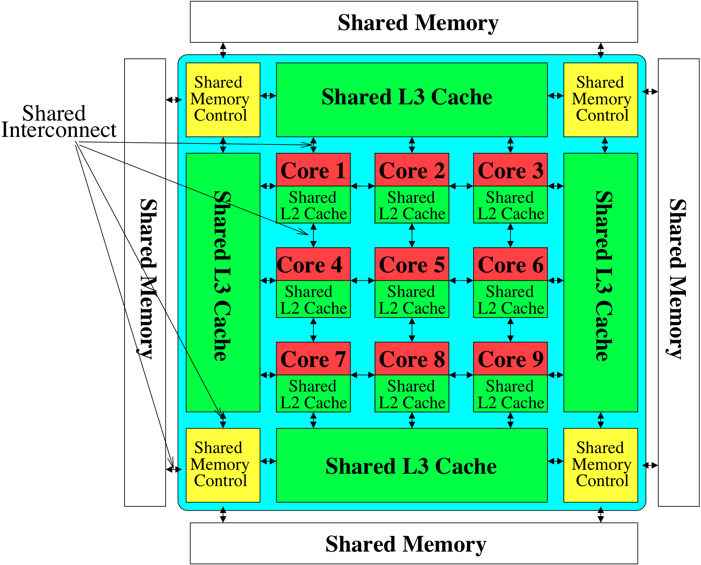
Memory System: A Shared Resource View
Storage

Slide 4
State of the Main Memory System
Recent technology, architecture, and application trends
  lead to new requirements
  exacerbate old requirements
DRAM and memory controllers, as we know them today, are (will be) unlikely to satisfy all requirements
Some emerging non-volatile memory technologies (e.g., PCM) enable new opportunities: memory+storage merging
We need to rethink the main memory system
  to fix DRAM issues and enable emerging technologies
  to satisfy all requirements

Slide 5
Major Trends Affecting Main Memory (I)
Need for main memory capacity, bandwidth, QoS increasing
Main memory energy/power is a key system design concern
DRAM technology scaling is ending

Slide 6
Major Trends Affecting Main Memory (II)
Need for main memory capacity, bandwidth, QoS increasing
  Multi-core: increasing number of cores
  Data-intensive applications: increasing demand/hunger for data
  Consolidation: cloud computing, GPUs, mobile
Main memory energy/power is a key system design concern
DRAM technology scaling is ending

Slide 7
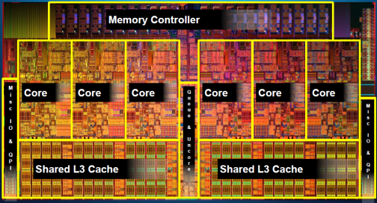
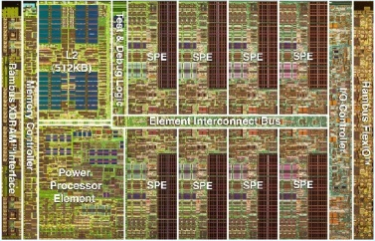
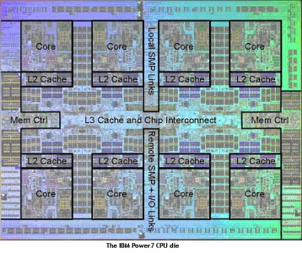
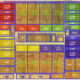
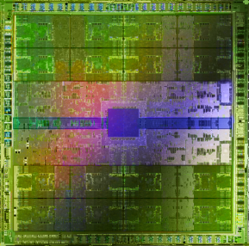
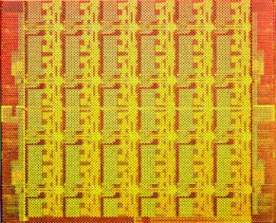
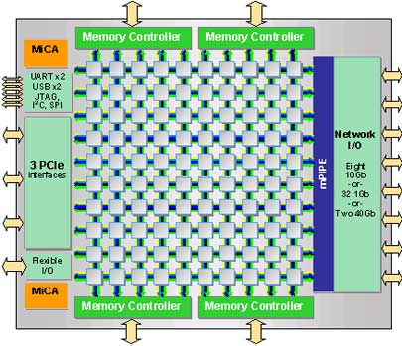
Example Trend: Many Cores on Chip
Simpler and lower power than a single large core
Large scale parallelism on chip
Intel Core i7
8 cores
IBM Cell BE
8+1 cores
IBM POWER7
8 cores
AMD Barcelona
4 cores
Nvidia Fermi
448 “cores”
Intel SCC
48 cores, networked
Tilera TILE Gx
100 cores, networked
Sun Niagara II
8 cores

Slide 8
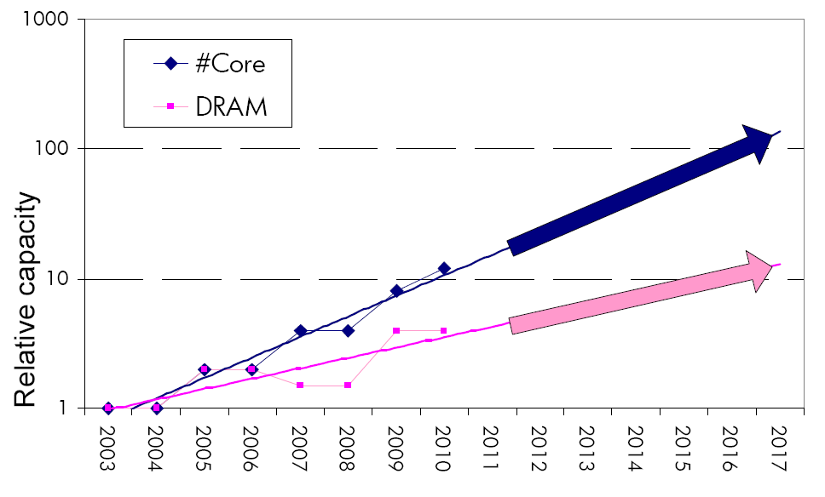
Consequence: The Memory Capacity Gap
Core count doubling ~ every 2 years
DRAM DIMM capacity doubling ~ every 3 years
Memory capacity per core expected to drop by 30% every two years
Trends worse for memory bandwidth per core!

Slide 9
Major Trends Affecting Main Memory (III)
Need for main memory capacity, bandwidth, QoS increasing
Main memory energy/power is a key system design concern
  ~40-50% energy spent in off-chip memory hierarchy [Lefurgy, IEEE Computer 2003]
  DRAM consumes power even when not used (periodic refresh)
DRAM technology scaling is ending

Slide 10
Major Trends Affecting Main Memory (IV)
Need for main memory capacity, bandwidth, QoS increasing
Main memory energy/power is a key system design concern
DRAM technology scaling is ending
  ITRS projects DRAM will not scale easily below X nm
  Scaling has provided many benefits:
    higher capacity (density), lower cost, lower energy

Slide 11
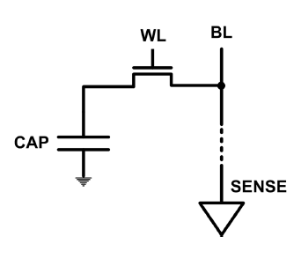
The DRAM Scaling Problem
DRAM stores charge in a capacitor (charge-based memory)
  Capacitor must be large enough for reliable sensing
  Access transistor should be large enough for low leakage and high retention time
  Scaling beyond 40-35nm (2013) is challenging [ITRS, 2009]
DRAM capacity, cost, and energy/power hard to scale

Slide 12
Solutions to the DRAM Scaling Problem
Two potential solutions
  Tolerate DRAM (by taking a fresh look at it)
  Enable emerging memory technologies to eliminate/minimize DRAM
Do both
  Hybrid memory systems

Slide 13
Solution 1: Tolerate DRAM
Overcome DRAM shortcomings with
  System-DRAM co-design
  Novel DRAM architectures, interface, functions
  Better waste management (efficient utilization)
Key issues to tackle
  Reduce refresh energy
  Improve bandwidth and latency
  Reduce waste
  Enable reliability at low cost
Liu, Jaiyen, Veras, Mutlu, “RAIDR: Retention-Aware Intelligent DRAM Refresh,” ISCA 2012.
Kim, Seshadri, Lee+, “A Case for Exploiting Subarray-Level Parallelism in DRAM,” ISCA 2012.
Lee+, “Tiered-Latency DRAM: A Low Latency and Low Cost DRAM Architecture,” HPCA 2013.
Liu+, “An Experimental Study of Data Retention Behavior in Modern DRAM Devices” ISCA’13.
Seshadri+, “RowClone: Fast and Efficient In-DRAM Copy and Initialization of Bulk Data,” 2013.

Slide 14
Solution 2: Emerging Memory Technologies
Some emerging resistive memory technologies seem more scalable than DRAM (and they are non-volatile)
Example: Phase Change Memory
  Expected to scale to 9nm (2022 [ITRS])
  Expected to be denser than DRAM: can store multiple bits/cell
But, emerging technologies have shortcomings as well
  Can they be enabled to replace/augment/surpass DRAM?
Lee, Ipek, Mutlu, Burger, “Architecting Phase Change Memory as a Scalable DRAM Alternative,” ISCA 2009, CACM 2010, Top Picks 2010.
Meza, Chang, Yoon, Mutlu, Ranganathan, “Enabling Efficient and Scalable Hybrid Memories,” IEEE Comp. Arch. Letters 2012.
Yoon, Meza et al., “Row Buffer Locality Aware Caching Policies for Hybrid Memories,” ICCD 2012 Best Paper Award.
Notes:
Even if DRAM continues to scale there could be benefits to examining and enabling these new technologies.

Slide 15
Hybrid Memory Systems
CPU
Meza+, “Enabling Efficient and Scalable Hybrid Memories,” IEEE Comp. Arch. Letters, 2012.
Yoon, Meza et al., “Row Buffer Locality Aware Caching Policies for Hybrid Memories,” ICCD 2012 Best Paper Award.
DRAMCtrl
PCM Ctrl
DRAM
Phase Change Memory (or Tech. X)
Fast, durable
Small,
leaky, volatile,
high-cost
Large, non-volatile, low-cost
Slow, wears out, high active energy
Hardware/software manage data allocation and movement
to achieve the best of multiple technologies

Slide 16
An Orthogonal Issue: Memory Interference
Problem: Memory interference is uncontrolled → uncontrollable, unpredictable, vulnerable system
Goal: We need to control it → Design a QoS-aware system
Solution: Hardware/software cooperative memory QoS
  Hardware designed to provide a configurable fairness substrate
    Application-aware memory scheduling, partitioning, throttling
  Software designed to configure the resources to satisfy different QoS goals
  E.g., fair, programmable memory controllers and on-chip networks provide QoS and predictable performance
  [2007-2012, Top Picks’09,’11a,’11b,’12]

Slide 17
Agenda for Today
What Will You Learn in This Course
Main Memory Basics (with a Focus on DRAM)
Major Trends Affecting Main Memory
DRAM Scaling Problem and Solution Directions
Solution Direction 1: System-DRAM Co-Design
Ongoing Research
Summary

Slide 18
What Will You Learn in This Course?
Scalable Many-Core Memory Systems
  July 15-19, 2013
Topic 1: Main memory basics, DRAM scaling
Topic 2: Emerging memory technologies and hybrid memories
Topic 3: Main memory interference and QoS
Topic 4 (unlikely): Cache management
Topic 5 (unlikely): Interconnects
Required Major Overview Reading:
  Mutlu, “Memory Scaling: A Systems Architecture Perspective,” IMW 2013.

Slide 19
This Course
Will cover many problems and potential solutions related to the design of memory systems in the many core era
The design of the memory system poses many
  Difficult research and engineering problems
  Important fundamental problems
  Industry-relevant problems
Many creative and insightful solutions are needed to solve these problems
Goal: Acquire the basics to develop such solutions (by covering fundamentals and cutting edge research)

Slide 20
Readings and Videos

Slide 21
Required Overview Reading
  Mutlu, “Memory Scaling: A Systems Architecture Perspective,” IMW 2013.
Onur Mutlu,
"Memory Scaling: A Systems Architecture Perspective"
Proceedings of the 5th International Memory Workshop (IMW), Monterey, CA, May 2013. Slides (pptx) (pdf)

Slide 22
Online Slides (Longer Versions)
Topic 1: DRAM Basics and DRAM Scaling
  http://users.ece.cmu.edu/~omutlu/pub/onur-ACACES2013-Topic1-dram-basics-and-scaling.pptx
  http://users.ece.cmu.edu/~omutlu/pub/onur-ACACES2013-Topic1-dram-basics-and-scaling.pdf
Topic 2: Emerging Technologies and Hybrid Memories
  http://users.ece.cmu.edu/~omutlu/pub/onur-ACACES2013-Topic2-emerging-and-hybrid-memory-technologies.pptx
  http://users.ece.cmu.edu/~omutlu/pub/onur-ACACES2013-Topic2-emerging-and-hybrid-memory-technologies.pdf
Topic 3: Memory Interference and QoS-Aware Memory Systems
  http://users.ece.cmu.edu/~omutlu/pub/onur-ACACES2013-Topic3-memory-qos.pptx
  http://users.ece.cmu.edu/~omutlu/pub/onur-ACACES2013-Topic3-memory-qos.pdf

Slide 23
Memory Lecture Videos
Memory Hierarchy (and Introduction to Caches)
  http://www.youtube.com/watch?v=JBdfZ5i21cs&list=PL5PHm2jkkXmidJOd59REog9jDnPDTG6IJ&index=22
Main Memory
  http://www.youtube.com/watch?v=ZLCy3pG7Rc0&list=PL5PHm2jkkXmidJOd59REog9jDnPDTG6IJ&index=25
Memory Controllers, Memory Scheduling, Memory QoS
  http://www.youtube.com/watch?v=ZSotvL3WXmA&list=PL5PHm2jkkXmidJOd59REog9jDnPDTG6IJ&index=26
  http://www.youtube.com/watch?v=1xe2w3_NzmI&list=PL5PHm2jkkXmidJOd59REog9jDnPDTG6IJ&index=27
Emerging Memory Technologies
  http://www.youtube.com/watch?v=LzfOghMKyA0&list=PL5PHm2jkkXmidJOd59REog9jDnPDTG6IJ&index=35
Multiprocessor Correctness and Cache Coherence
  http://www.youtube.com/watch?v=U-VZKMgItDM&list=PL5PHm2jkkXmidJOd59REog9jDnPDTG6IJ&index=32

Slide 24
Readings for Topic 1 (DRAM Scaling)
Lee et al., “Tiered-Latency DRAM: A Low Latency and Low Cost DRAM Architecture,” HPCA 2013.
Liu et al., “RAIDR: Retention-Aware Intelligent DRAM Refresh,” ISCA 2012.
Kim et al., “A Case for Exploiting Subarray-Level Parallelism in DRAM,” ISCA 2012.
Liu et al., “An Experimental Study of Data Retention Behavior in Modern DRAM Devices,” ISCA 2013.
Seshadri et al., “RowClone: Fast and Efficient In-DRAM Copy and Initialization of Bulk Data,” CMU CS Tech Report 2013.
David et al., “Memory Power Management via Dynamic Voltage/Frequency Scaling,” ICAC 2011.
Ipek et al., “Self Optimizing Memory Controllers: A Reinforcement Learning Approach,” ISCA 2008.

Slide 25
Readings for Topic 2 (Emerging Technologies)
Lee, Ipek, Mutlu, Burger, “Architecting Phase Change Memory as a Scalable DRAM Alternative,” ISCA 2009, CACM 2010, Top Picks 2010.
Qureshi et al., “Scalable high performance main memory system using phase-change memory technology,” ISCA 2009.
Meza et al., “Enabling Efficient and Scalable Hybrid Memories,” IEEE Comp. Arch. Letters 2012.
Yoon et al., “Row Buffer Locality Aware Caching Policies for Hybrid Memories,” ICCD 2012 Best Paper Award.
Meza et al., “A Case for Efficient Hardware-Software Cooperative Management of Storage and Memory,” WEED 2013.
Kultursay et al., “Evaluating STT-RAM as an Energy-Efficient Main Memory Alternative,” ISPASS 2013.

Slide 26
Readings for Topic 3 (Memory QoS)
Moscibroda and Mutlu, “Memory Performance Attacks,” USENIX Security 2007.
Mutlu and Moscibroda, “Stall-Time Fair Memory Access Scheduling,” MICRO 2007.
Mutlu and Moscibroda, “Parallelism-Aware Batch Scheduling,” ISCA 2008, IEEE Micro 2009.
Kim et al., “ATLAS: A Scalable and High-Performance Scheduling Algorithm for Multiple Memory Controllers,” HPCA 2010.
Kim et al., “Thread Cluster Memory Scheduling,” MICRO 2010, IEEE Micro 2011.
Muralidhara et al., “Memory Channel Partitioning,” MICRO 2011.
Ausavarungnirun et al., “Staged Memory Scheduling,” ISCA 2012.
Subramanian et al., “MISE: Providing Performance Predictability and Improving Fairness in Shared Main Memory Systems,” HPCA 2013.
Das et al., “Application-to-Core Mapping Policies to Reduce Memory System Interference in Multi-Core Systems,” HPCA 2013.

Slide 27
Readings for Topic 3 (Memory QoS)
Ebrahimi et al., “Fairness via Source Throttling,” ASPLOS 2010, ACM TOCS 2012.
Lee et al., “Prefetch-Aware DRAM Controllers,” MICRO 2008, IEEE TC 2011.
Ebrahimi et al., “Parallel Application Memory Scheduling,” MICRO 2011.
Ebrahimi et al., “Prefetch-Aware Shared Resource Management for Multi-Core Systems,” ISCA 2011.

Slide 28
Readings in Flash Memory
Yu Cai, Gulay Yalcin, Onur Mutlu, Erich F. Haratsch, Adrian Cristal, Osman Unsal, and Ken Mai,
"Error Analysis and Retention-Aware Error Management for NAND Flash Memory"
Intel Technology Journal (ITJ) Special Issue on Memory Resiliency, Vol. 17, No. 1, May 2013.
Yu Cai, Erich F. Haratsch, Onur Mutlu, and Ken Mai,
"Threshold Voltage Distribution in MLC NAND Flash Memory: Characterization, Analysis and Modeling"
Proceedings of the Design, Automation, and Test in Europe Conference (DATE), Grenoble, France, March 2013. Slides (ppt)
Yu Cai, Gulay Yalcin, Onur Mutlu, Erich F. Haratsch, Adrian Cristal, Osman Unsal, and Ken Mai,
"Flash Correct-and-Refresh: Retention-Aware Error Management for Increased Flash Memory Lifetime"
Proceedings of the 30th IEEE International Conference on Computer Design (ICCD), Montreal, Quebec, Canada, September 2012. Slides (ppt) (pdf)
Yu Cai, Erich F. Haratsch, Onur Mutlu, and Ken Mai,
"Error Patterns in MLC NAND Flash Memory: Measurement, Characterization, and Analysis"
Proceedings of the Design, Automation, and Test in Europe Conference (DATE), Dresden, Germany, March 2012. Slides (ppt)

Slide 29
Online Lectures and More Information
Online Computer Architecture Lectures
  http://www.youtube.com/playlist?list=PL5PHm2jkkXmidJOd59REog9jDnPDTG6IJ
Online Computer Architecture Courses
  Intro: http://www.ece.cmu.edu/~ece447/s13/doku.php
  Advanced: http://www.ece.cmu.edu/~ece740/f11/doku.php
  Advanced: http://www.ece.cmu.edu/~ece742/doku.php
Recent Research Papers
  http://users.ece.cmu.edu/~omutlu/projects.htm
  http://scholar.google.com/citations?user=7XyGUGkAAAAJ&hl=en

Slide 30
Agenda for Today
What Will You Learn in This Mini-Lecture Series
Main Memory Basics (with a Focus on DRAM)
Major Trends Affecting Main Memory
DRAM Scaling Problem and Solution Directions
Solution Direction 1: System-DRAM Co-Design
Ongoing Research
Summary

Slide 31
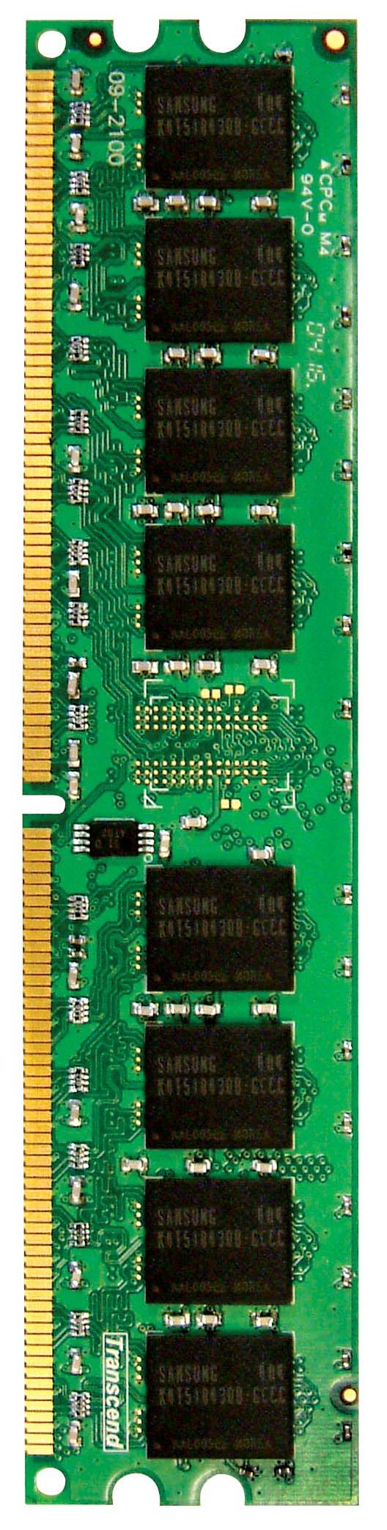
Main Memory in the System
CORE 0
L2 CACHE 1
CORE 1
L2 CACHE 0
SHARED L3 CACHE
DRAM INTERFACE
DRAM MEMORY CONTROLLER
DRAM BANKS
L2 CACHE 2
CORE 3
CORE 2
L2 CACHE 3

Slide 32
Ideal Memory
Zero access time (latency)
Infinite capacity
Zero cost
Infinite bandwidth (to support multiple accesses in parallel)

Slide 33
The Problem
Ideal memory’s requirements oppose each other
Bigger is slower
  Bigger → Takes longer to determine the location
Faster is more expensive
  Memory technology: SRAM vs. DRAM
Higher bandwidth is more expensive
  Need more banks, more ports, higher frequency, or faster technology

Slide 34
Memory Technology: DRAM
Dynamic random access memory
Capacitor charge state indicates stored value
  Whether the capacitor is charged or discharged indicates storage of 1 or 0
  1 capacitor
  1 access transistor
Capacitor leaks through the RC path
  DRAM cell loses charge over time
  DRAM cell needs to be refreshed
  Read Liu et al., “RAIDR: Retention-aware Intelligent DRAM Refresh,” ISCA 2012.
row enable
_bitline

Slide 35
Memory Technology: SRAM
Static random access memory
Two cross coupled inverters store a single bit
  Feedback path enables the stored value to persist in the “cell”
  4 transistors for storage
  2 transistors for access
row select
bitline
_bitline

Slide 36
Memory Bank: A Fundamental Concept
Interleaving (banking)
  Problem: a single monolithic memory array takes long to access and does not enable multiple accesses in parallel
  Goal: Reduce the latency of memory array access and enable multiple accesses in parallel
  Idea: Divide the array into multiple banks that can be accessed independently (in the same cycle or in consecutive cycles)
    Each bank is smaller than the entire memory storage
    Accesses to different banks can be overlapped
  Issue: How do you map data to different banks? (i.e., how do you interleave data across banks?)

Slide 37
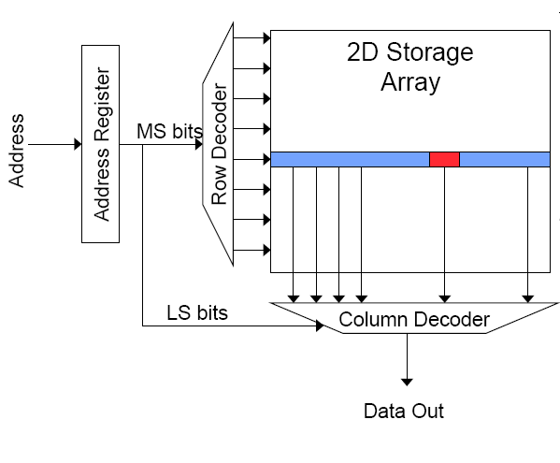
Memory Bank Organization and Operation
Read access sequence:
1. Decode row address & drive word-lines
2. Selected bits drive bit-lines
• Entire row read
3. Amplify row data
4. Decode column address & select subset of row
• Send to output
5. Precharge bit-lines
• For next access

Slide 38
Why Memory Hierarchy?
We want both fast and large
But we cannot achieve both with a single level of memory
Idea: Have multiple levels of storage (progressively bigger and slower as the levels are farther from the processor) and ensure most of the data the processor needs is kept in the fast(er) level(s)

Slide 39
Caching Basics: Exploit Temporal Locality
Idea: Store recently accessed data in automatically managed fast memory (called cache)
Anticipation: the data will be accessed again soon
Temporal locality principle
  Recently accessed data will be again accessed in the near future
  This is what Maurice Wilkes had in mind:
    Wilkes, “Slave Memories and Dynamic Storage Allocation,” IEEE Trans. On Electronic Computers, 1965.
    “The use is discussed of a fast core memory of, say 32000 words as a slave to a slower core memory of, say, one million words in such a way that in practical cases the effective access time is nearer that of the fast memory than that of the slow memory.”

Slide 40
Caching Basics: Exploit Spatial Locality
Idea: Store addresses adjacent to the recently accessed one in automatically managed fast memory
  Logically divide memory into equal size blocks
  Fetch to cache the accessed block in its entirety
Anticipation: nearby data will be accessed soon
Spatial locality principle
  Nearby data in memory will be accessed in the near future
    E.g., sequential instruction access, array traversal
  This is what IBM 360/85 implemented
    16 Kbyte cache with 64 byte blocks
    Liptay, “Structural aspects of the System/360 Model 85 II: the cache,” IBM Systems Journal, 1968.

Slide 41
A Note on Manual vs. Automatic Management
Manual: Programmer manages data movement across levels
  -- too painful for programmers on substantial programs
  “core” vs “drum” memory in the 50’s
  still done in some embedded processors (on-chip scratch pad SRAM in lieu of a cache)
Automatic: Hardware manages data movement across levels, transparently to the programmer
  ++ programmer’s life is easier
  simple heuristic: keep most recently used items in cache
  the average programmer doesn’t need to know about it
    You don’t need to know how big the cache is and how it works to write a “correct” program! (What if you want a “fast” program?)

Slide 42
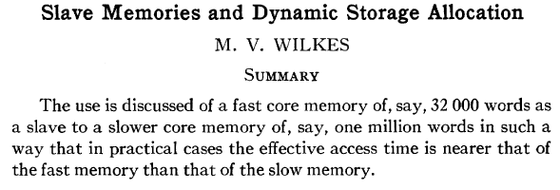
Automatic Management in Memory Hierarchy
Wilkes, “Slave Memories and Dynamic Storage Allocation,” IEEE Trans. On Electronic Computers, 1965.
“By a slave memory I mean one which automatically accumulates to itself words that come from a slower main memory, and keeps them available for subsequent use without it being necessary for the penalty of main memory access to be incurred again.”

Slide 43
A Modern Memory Hierarchy
Register File
32 words, sub-nsec
L1 cache
~32 KB, ~nsec
L2 cache
512 KB ~ 1MB, many nsec
L3 cache,
.....
Main memory (DRAM),
GB, ~100 nsec
Swap Disk
100 GB, ~10 msec
manual/compiler
register spilling
Memory
Abstraction
Automatic
HW cache
management
automatic
demand
paging

Slide 44
The DRAM Subsystem

Slide 45
Page Mode DRAM
A DRAM bank is a 2D array of cells: rows x columns
A “DRAM row” is also called a “DRAM page”
“Sense amplifiers” also called “row buffer”
Each address is a <row,column> pair
Access to a “closed row”
  Activate command opens row (placed into row buffer)
  Read/write command reads/writes column in the row buffer
  Precharge command closes the row and prepares the bank for next access
Access to an “open row”
  No need for activate command

Slide 46
DRAM Bank Operation
Access Address:
(Row 0, Column 0)
Columns
(Row 0, Column 1)
(Row 0, Column 85)
(Row 1, Column 0)
Row address 0
Row address 1
Row decoder
Rows
Row Buffer
CONFLICT !
HIT
Row 1
HIT
Row 0
Empty
Column address 0
Column mux
Column address 0
Column address 1
Column address 85
Data

Slide 47
The DRAM Chip
Consists of multiple banks (2-16 in Synchronous DRAM)
Banks share command/address/data buses
The chip itself has a narrow interface (4-16 bits per read)

Slide 48
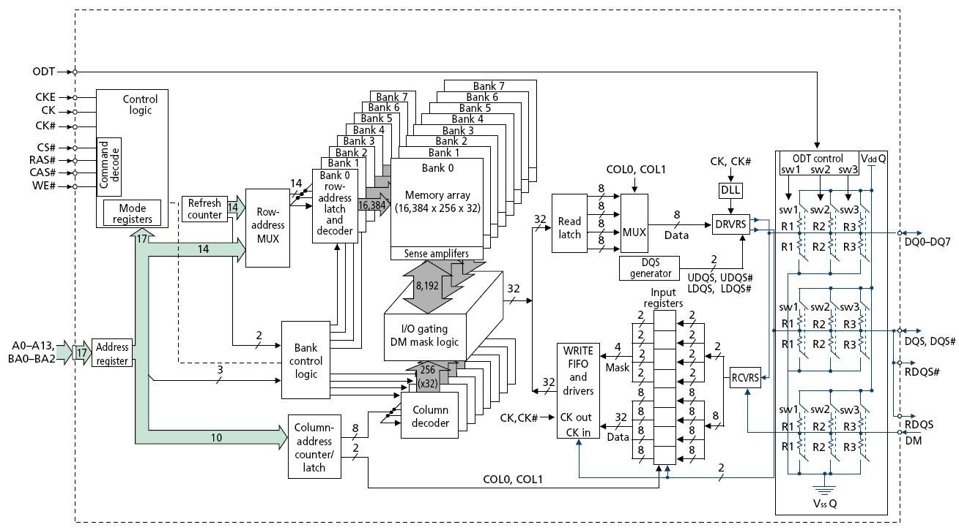
128M x 8-bit DRAM Chip

Slide 49
DRAM Rank and Module
Rank: Multiple chips operated together to form a wide interface
All chips comprising a rank are controlled at the same time
  Respond to a single command
  Share address and command buses, but provide different data
A DRAM module consists of one or more ranks
  E.g., DIMM (dual inline memory module)
  This is what you plug into your motherboard
If we have chips with 8-bit interface, to read 8 bytes in a single access, use 8 chips in a DIMM

Slide 50
A 64-bit Wide DIMM (One Rank)

Slide 51
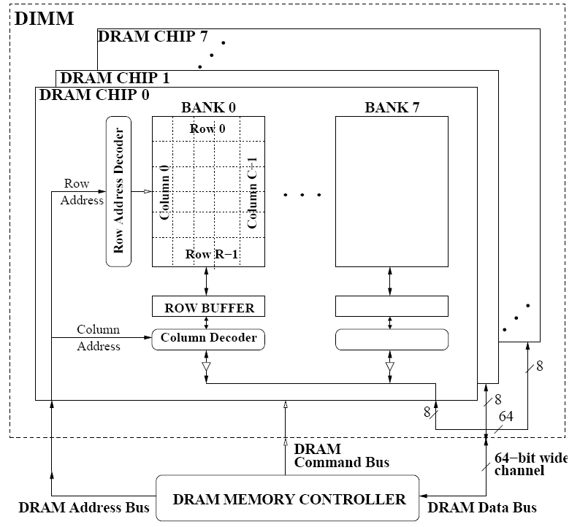
A 64-bit Wide DIMM (One Rank)
Advantages:
  Acts like a high-capacity DRAM chip with a wide interface
  Flexibility: memory controller does not need to deal with individual chips
Disadvantages:
  Granularity: Accesses cannot be smaller than the interface width

Slide 52
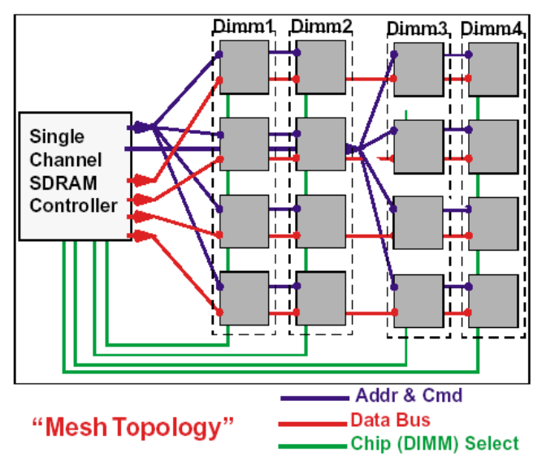
Multiple DIMMs
Advantages:
  Enables even higher capacity
Disadvantages:
  Interconnect complexity and energy consumption can be high

Slide 53
DRAM Channels
2 Independent Channels: 2 Memory Controllers (Above)
2 Dependent/Lockstep Channels: 1 Memory Controller with wide interface (Not Shown above)

Slide 54
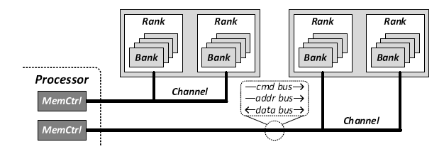
Generalized Memory Structure

Slide 55
DRAM Subsystem Organization
Channel
DIMM
Rank
Chip
Bank
Row/Column

Slide 56
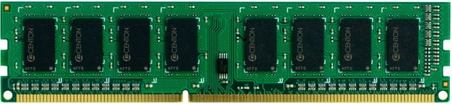
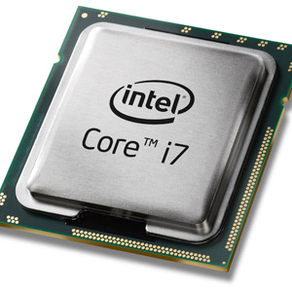
The DRAM subsystem
“Channel”
DIMM (Dual in-line memory module)
Processor
Memory channel
Memory channel

Slide 57
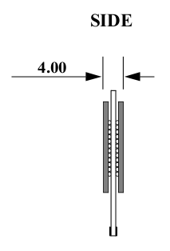
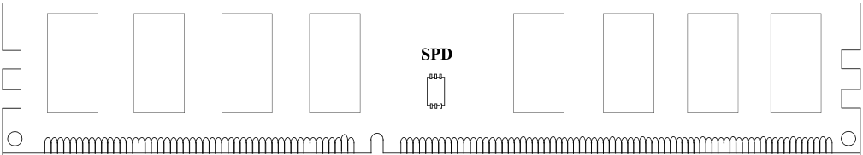
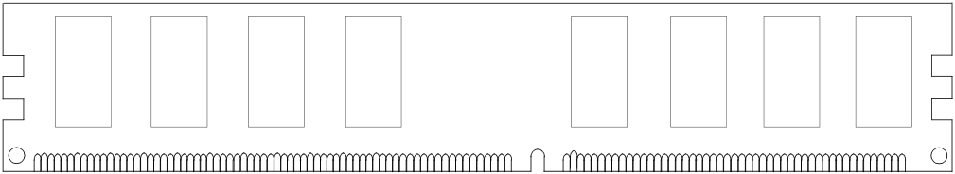
Breaking down a DIMM
DIMM (Dual in-line memory module)
Side view
Front of DIMM
Back of DIMM

Slide 58
Breaking down a DIMM
DIMM (Dual in-line memory module)
Side view
Front of DIMM
Back of DIMM
Rank 0: collection of 8 chips
Rank 1

Slide 59
Rank
Rank 0 (Front)
Rank 1 (Back)
<0:63>
<0:63>
Addr/Cmd
CS <0:1>
Data <0:63>
Memory channel

Slide 60
Breaking down a Rank
. . .
Chip 0
Chip 1
Chip 7
Rank 0
<0:63>
<0:7>
<8:15>
<56:63>
Data <0:63>

Slide 61
Breaking down a Chip
8 banks
Chip 0
Bank 0
<0:7>
<0:7>
<0:7>
...
<0:7>
<0:7>

Slide 62
Breaking down a Bank
2kB
1B (column)
row 16k-1
Bank 0
...
row 0
<0:7>
Row-buffer
1B
1B
1B
...
<0:7>

Slide 63
DRAM Subsystem Organization
Channel
DIMM
Rank
Chip
Bank
Row/Column

Slide 64
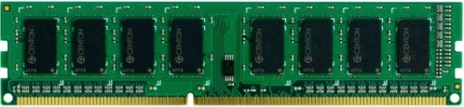


Example: Transferring a cache block
Physical memory space
0xFFFF…F
Channel 0
...
DIMM 0
Mapped to
0x40
Rank 0
64B
cache block
0x00

Slide 65
Example: Transferring a cache block
Physical memory space
Chip 0
Chip 1
Rank 0
Chip 7
0xFFFF…F
. . .
...
<0:7>
<8:15>
<56:63>
0x40
64B
cache block
Data <0:63>
0x00

Slide 66
Example: Transferring a cache block
Physical memory space
Chip 0
Chip 1
Rank 0
Chip 7
0xFFFF…F
. . .
Row 0
Col 0
...
<0:7>
<8:15>
<56:63>
0x40
64B
cache block
Data <0:63>
0x00

Slide 67
Example: Transferring a cache block
Physical memory space
Chip 0
Chip 1
Rank 0
Chip 7
0xFFFF…F
. . .
Row 0
Col 0
...
<0:7>
<8:15>
<56:63>
0x40
64B
cache block
Data <0:63>
8B
0x00
8B

Slide 68
Example: Transferring a cache block
Physical memory space
Chip 0
Chip 1
Rank 0
Chip 7
0xFFFF…F
. . .
Row 0
Col 1
...
<0:7>
<8:15>
<56:63>
0x40
64B
cache block
Data <0:63>
8B
0x00

Slide 69
Example: Transferring a cache block
Physical memory space
Chip 0
Chip 1
Rank 0
Chip 7
0xFFFF…F
. . .
Row 0
Col 1
...
<0:7>
<8:15>
<56:63>
0x40
8B
64B
cache block
Data <0:63>
8B
0x00
8B

Slide 70
Example: Transferring a cache block
Physical memory space
Chip 0
Chip 1
Rank 0
Chip 7
0xFFFF…F
. . .
Row 0
Col 1
...
<0:7>
<8:15>
<56:63>
0x40
8B
64B
cache block
Data <0:63>
8B
0x00
A 64B cache block takes 8 I/O cycles to transfer.
During the process, 8 columns are read sequentially.

Slide 71
Latency Components: Basic DRAM Operation
CPU → controller transfer time
Controller latency
  Queuing & scheduling delay at the controller
  Access converted to basic commands
Controller → DRAM transfer time
DRAM bank latency
  Simple CAS if row is “open” OR
  RAS + CAS if array precharged OR
  PRE + RAS + CAS (worst case)
DRAM → CPU transfer time (through controller)

Slide 72
Multiple Banks (Interleaving) and Channels
Multiple banks
  Enable concurrent DRAM accesses
  Bits in address determine which bank an address resides in
Multiple independent channels serve the same purpose
  But they are even better because they have separate data buses
  Increased bus bandwidth
Enabling more concurrency requires reducing
  Bank conflicts
  Channel conflicts
How to select/randomize bank/channel indices in address?
  Lower order bits have more entropy
  Randomizing hash functions (XOR of different address bits)

Slide 73
Address Mapping (Single Channel)
Single-channel system with 8-byte memory bus
  2GB memory, 8 banks, 16K rows & 2K columns per bank
Row interleaving
  Consecutive rows of memory in consecutive banks
Cache block interleaving
    Consecutive cache block addresses in consecutive banks
    64 byte cache blocks
    Accesses to consecutive cache blocks can be serviced in parallel
    How about random accesses? Strided accesses?
Row (14 bits)
Bank (3 bits)
Column (11 bits)
Byte in bus (3 bits)
Row (14 bits)
High Column
Bank (3 bits)
Low Col.
Byte in bus (3 bits)
8 bits
3 bits

Slide 74
Address Mapping (Multiple Channels)
C
Row (14 bits)
Bank (3 bits)
Column (11 bits)
Byte in bus (3 bits)
Where are consecutive cache blocks?
Row (14 bits)
C
Bank (3 bits)
Column (11 bits)
Byte in bus (3 bits)
Row (14 bits)
Bank (3 bits)
C
Column (11 bits)
Byte in bus (3 bits)
Row (14 bits)
Bank (3 bits)
Column (11 bits)
C
Byte in bus (3 bits)
C
Row (14 bits)
High Column
Bank (3 bits)
Low Col.
Byte in bus (3 bits)
8 bits
3 bits
Row (14 bits)
C
High Column
Bank (3 bits)
Low Col.
Byte in bus (3 bits)
8 bits
3 bits
Row (14 bits)
High Column
C
Bank (3 bits)
Low Col.
Byte in bus (3 bits)
8 bits
3 bits
Row (14 bits)
High Column
Bank (3 bits)
C
Low Col.
Byte in bus (3 bits)
8 bits
3 bits
Row (14 bits)
High Column
Bank (3 bits)
Low Col.
C
Byte in bus (3 bits)
8 bits
3 bits

Slide 75
Interaction with Virtual→Physical Mapping
Operating System influences where an address maps to in DRAM
Operating system can control which bank/channel/rank a virtual page is mapped to.
It can perform page coloring to minimize bank conflicts
Or to minimize inter-application interference
Virtual Page number (52 bits)
Page offset (12 bits)
VA
Physical Frame number (19 bits)
Page offset (12 bits)
PA
Row (14 bits)
Bank (3 bits)
Column (11 bits)
Byte in bus (3 bits)
PA

Slide 76
DRAM Refresh (I)
DRAM capacitor charge leaks over time
The memory controller needs to read each row periodically to restore the charge
  Activate + precharge each row every N ms
  Typical N = 64 ms
Implications on performance?
  -- DRAM bank unavailable while refreshed
  -- Long pause times: If we refresh all rows in burst, every 64ms the DRAM will be unavailable until refresh ends
Burst refresh: All rows refreshed immediately after one another
Distributed refresh: Each row refreshed at a different time, at regular intervals

Slide 77
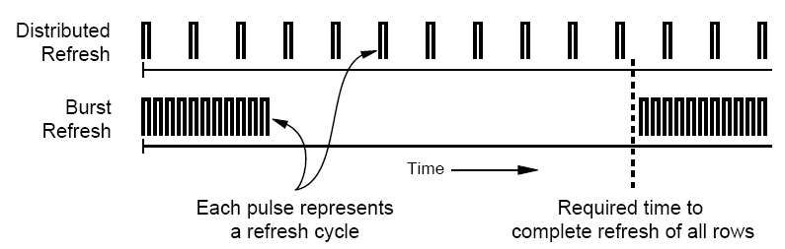
DRAM Refresh (II)
Distributed refresh eliminates long pause times
How else we can reduce the effect of refresh on performance?
  Can we reduce the number of refreshes?

Slide 78
Downsides of DRAM Refresh
Downsides of refresh
-- Energy consumption: Each refresh consumes energy
  -- Performance degradation: DRAM rank/bank unavailable while refreshed
  -- QoS/predictability impact: (Long) pause times during refresh
  -- Refresh rate limits DRAM density scaling

Slide 79
Memory Controllers

Slide 80
DRAM versus Other Types of Memories
Long latency memories have similar characteristics that need to be controlled.
The following discussion will use DRAM as an example, but many issues are similar in the design of controllers for other types of memories
  Flash memory
  Other emerging memory technologies
    Phase Change Memory
    Spin-Transfer Torque Magnetic Memory

Slide 81
DRAM Controller: Functions
Ensure correct operation of DRAM (refresh and timing)
Service DRAM requests while obeying timing constraints of DRAM chips
  Constraints: resource conflicts (bank, bus, channel), minimum write-to-read delays
  Translate requests to DRAM command sequences
Buffer and schedule requests to improve performance
  Reordering, row-buffer, bank, rank, bus management
Manage power consumption and thermals in DRAM
  Turn on/off DRAM chips, manage power modes

Slide 82
DRAM Controller: Where to Place
In chipset
  + More flexibility to plug different DRAM types into the system
+ Less power density in the CPU chip
On CPU chip
  + Reduced latency for main memory access
  + Higher bandwidth between cores and controller
    More information can be communicated (e.g. request’s importance in the processing core)

Slide 83
A Modern DRAM Controller

Slide 84
DRAM Scheduling Policies (I)
FCFS (first come first served)
  Oldest request first
FR-FCFS (first ready, first come first served)
  1. Row-hit first
  2. Oldest first
  Goal: Maximize row buffer hit rate → maximize DRAM throughput
  Actually, scheduling is done at the command level
    Column commands (read/write) prioritized over row commands (activate/precharge)
    Within each group, older commands prioritized over younger ones

Slide 85
DRAM Scheduling Policies (II)
A scheduling policy is essentially a prioritization order
Prioritization can be based on
  Request age
  Row buffer hit/miss status
  Request type (prefetch, read, write)
  Requestor type (load miss or store miss)
  Request criticality
    Oldest miss in the core?
    How many instructions in core are dependent on it?

Slide 86
Row Buffer Management Policies
Open row
  Keep the row open after an access
  + Next access might need the same row → row hit
  -- Next access might need a different row → row conflict, wasted energy
Closed row
  Close the row after an access (if no other requests already in the request buffer need the same row)
  + Next access might need a different row → avoid a row conflict
  -- Next access might need the same row → extra activate latency
Adaptive policies
  Predict whether or not the next access to the bank will be to the same row

Slide 87
Open vs. Closed Row Policies
Policy | First access | Next access | Commands needed for next access
Open row | Row 0 | Row 0 (row hit) | Read
Open row | Row 0 | Row 1 (row conflict) | Precharge + Activate Row 1 + Read
Closed row | Row 0 | Row 0 – access in request buffer (row hit) | Read
Closed row | Row 0 | Row 0 – access not in request buffer (row closed) | Activate Row 0 + Read + Precharge
Closed row | Row 0 | Row 1 (row closed) | Activate Row 1 + Read + Precharge

Slide 88
Why are DRAM Controllers Difficult to Design?
Need to obey DRAM timing constraints for correctness
  There are many (50+) timing constraints in DRAM
  tWTR: Minimum number of cycles to wait before issuing a read command after a write command is issued
  tRC: Minimum number of cycles between the issuing of two consecutive activate commands to the same bank
  …
Need to keep track of many resources to prevent conflicts
  Channels, banks, ranks, data bus, address bus, row buffers
Need to handle DRAM refresh
Need to optimize for performance (in the presence of constraints)
  Reordering is not simple
  Predicting the future?

Slide 89
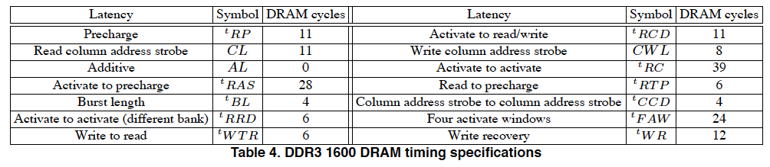
Many DRAM Timing Constraints
From Lee et al., “DRAM-Aware Last-Level Cache Writeback: Reducing Write-Caused Interference in Memory Systems,” HPS Technical Report, April 2010.

Slide 90
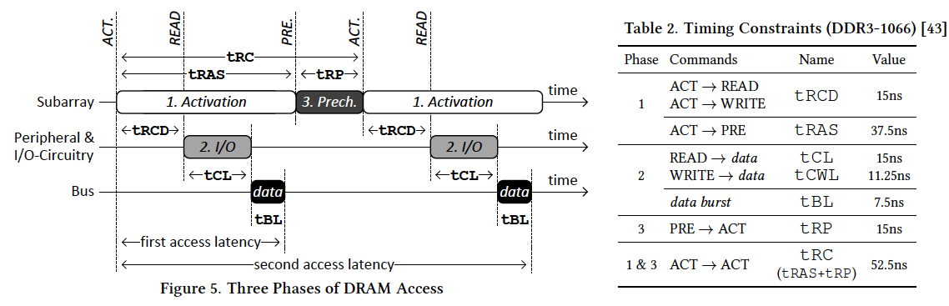
More on DRAM Operation
Kim et al., “A Case for Exploiting Subarray-Level Parallelism (SALP) in DRAM,” ISCA 2012.
Lee et al., “Tiered-Latency DRAM: A Low Latency and Low Cost DRAM Architecture,” HPCA 2013.

Slide 91
Self-Optimizing DRAM Controllers
Problem: DRAM controllers difficult to design → It is difficult for human designers to design a policy that can adapt itself very well to different workloads and different system conditions
Idea: Design a memory controller that adapts its scheduling policy decisions to workload behavior and system conditions using machine learning.
Observation: Reinforcement learning maps nicely to memory control.
Design: Memory controller is a reinforcement learning agent that dynamically and continuously learns and employs the best scheduling policy.

Slide 92
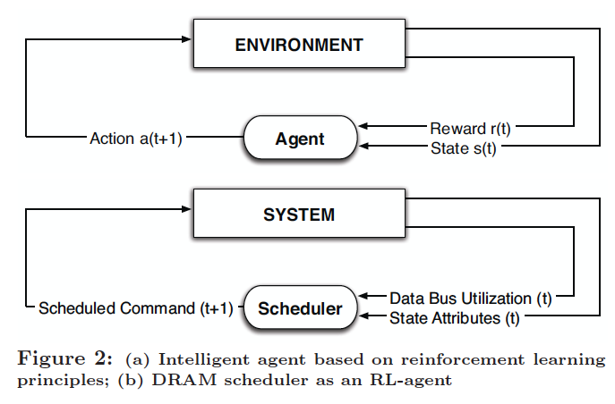
Self-Optimizing DRAM Controllers
Engin Ipek, Onur Mutlu, José F. Martínez, and Rich Caruana,
"Self Optimizing Memory Controllers: A Reinforcement Learning Approach"
Proceedings of the 35th International Symposium on Computer Architecture (ISCA), pages 39-50, Beijing, China, June 2008.

Slide 93
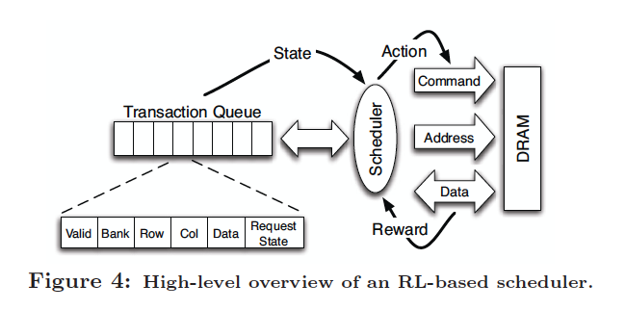
Self-Optimizing DRAM Controllers
Engin Ipek, Onur Mutlu, José F. Martínez, and Rich Caruana,
"Self Optimizing Memory Controllers: A Reinforcement Learning Approach"
Proceedings of the 35th International Symposium on Computer Architecture (ISCA), pages 39-50, Beijing, China, June 2008.

Slide 94
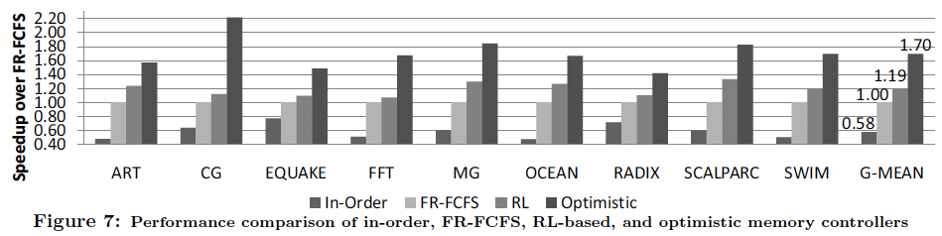
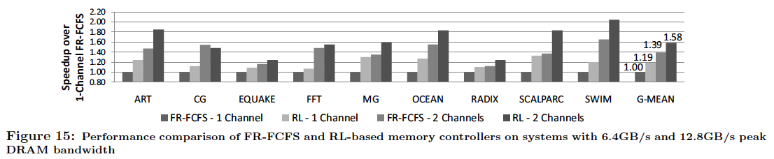
Performance Results

Slide 95
DRAM Power Management
DRAM chips have power modes
Idea: When not accessing a chip power it down
Power states
  Active (highest power)
  All banks idle
  Power-down
  Self-refresh (lowest power)
State transitions incur latency during which the chip cannot be accessed

Slide 96
Agenda for Today
What Will You Learn in This Mini-Lecture Series
Main Memory Basics (with a Focus on DRAM)
Major Trends Affecting Main Memory
DRAM Scaling Problem and Solution Directions
Solution Direction 1: System-DRAM Co-Design
Ongoing Research
Summary

Slide 97
Solution 1: Tolerate DRAM
Overcome DRAM shortcomings with
  System-DRAM co-design
  Novel DRAM architectures, interface, functions
  Better waste management (efficient utilization)
Key issues to tackle
  Reduce refresh energy
  Improve bandwidth and latency
  Reduce waste
  Enable reliability at low cost
Liu, Jaiyen, Veras, Mutlu, “RAIDR: Retention-Aware Intelligent DRAM Refresh,” ISCA 2012.
Kim, Seshadri, Lee+, “A Case for Exploiting Subarray-Level Parallelism in DRAM,” ISCA 2012.
Lee+, “Tiered-Latency DRAM: A Low Latency and Low Cost DRAM Architecture,” HPCA 2013.
Liu+, “An Experimental Study of Data Retention Behavior in Modern DRAM Devices” ISCA’13.
Seshadri+, “RowClone: Fast and Efficient In-DRAM Copy and Initialization of Bulk Data,” 2013.

Slide 98
New DRAM Architectures
RAIDR: Reducing Refresh Impact
TL-DRAM: Reducing DRAM Latency
SALP: Reducing Bank Conflict Impact
RowClone: Fast Bulk Data Copy and Initialization

Slide 99
RAIDR: Reducing
DRAM Refresh Impact
Jamie Liu, Ben Jaiyen, Richard Veras, and Onur Mutlu,
"RAIDR: Retention-Aware Intelligent DRAM Refresh"
Proceedings of the 39th International Symposium on Computer Architecture (ISCA),
Portland, OR, June 2012. Slides (pdf)

Slide 100
DRAM Refresh
DRAM capacitor charge leaks over time
The memory controller needs to refresh each row periodically to restore charge
  Activate + precharge each row every N ms
  Typical N = 64 ms
Downsides of refresh
-- Energy consumption: Each refresh consumes energy
  -- Performance degradation: DRAM rank/bank unavailable while refreshed
  -- QoS/predictability impact: (Long) pause times during refresh
  -- Refresh rate limits DRAM density scaling

Slide 101
Refresh Today: Auto Refresh
Columns
BANK 0
BANK 1
BANK 2
BANK 3
Rows
Row Buffer
DRAM Bus
A batch of rows are
periodically refreshed
via the auto-refresh command
DRAM CONTROLLER
Notes:
The DRAM system consists of the DRAM banks, the DRAM bus, and the DRAM memory controller. DRAM banks store the data in physical memory. There are multiple DRAM banks to allow multiple memory requests to proceed in parallel.
Each DRAM bank has a 2-dimensional structure, consisting of rows by columns. Data can only be read from a “row buffer”, which acts as a cache that “caches” the last accessed row. As a result, a request that hits in the row buffer can be serviced much faster than a request that misses in the row buffer.
Existing DRAM controllers take advantage of this fact. To maximize DRAM throughput, these controllers prioritize row-hit requests over other requests in their scheduling. All else being equal, they prioritize older accesses over younger accesses. This policy is called the FR-FCFS policy. Note that this scheduling policy is designed for maximizing DRAM throughput and does not distinguish between different threads’ requests at all.
-----------------------------
Explain bank operation at a high level
- An access that is to the row in the row buffer takes a shorter time than to an access that is to another row.
Multiple banks put together to allow for multiple requests to be serviced in parallel
The DRAM controller treats each bank as an independent entity
In each bank, the DRAM controller optimizes for improving row buffer locality to improve DRAM throughput
- It prioritizes row-hit requests over other requests and all else being equal, older requests over younger requests. It is not aware of the different threads accessing it.
The DRAM controller does not coordinate accesses to different banks.
As a result requests of different threads can be serviced in different banks even though a single thread’s requests might be outstanding to multiple banks

Slide 102
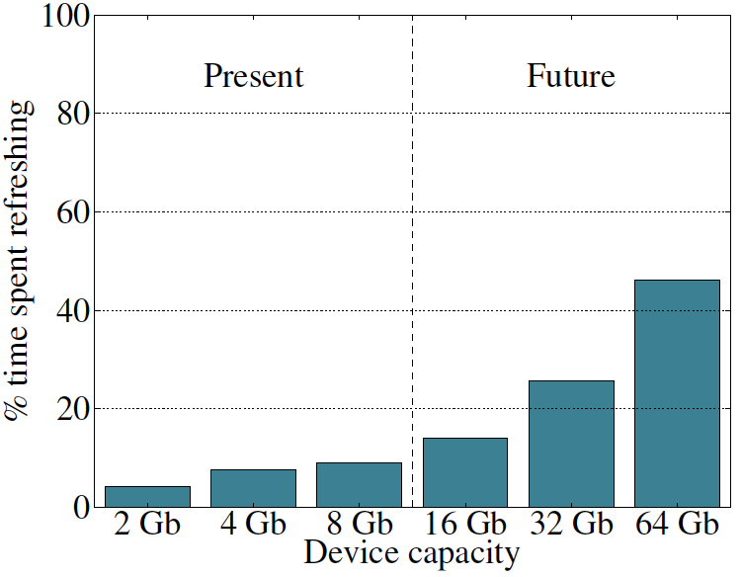
Refresh Overhead: Performance
46%
8%

Slide 103
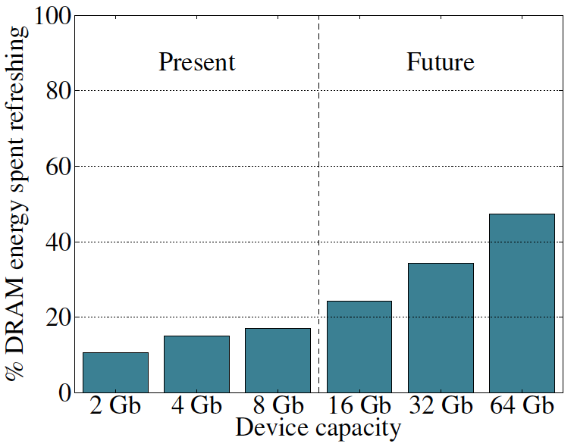
Refresh Overhead: Energy
47%
15%

Slide 104
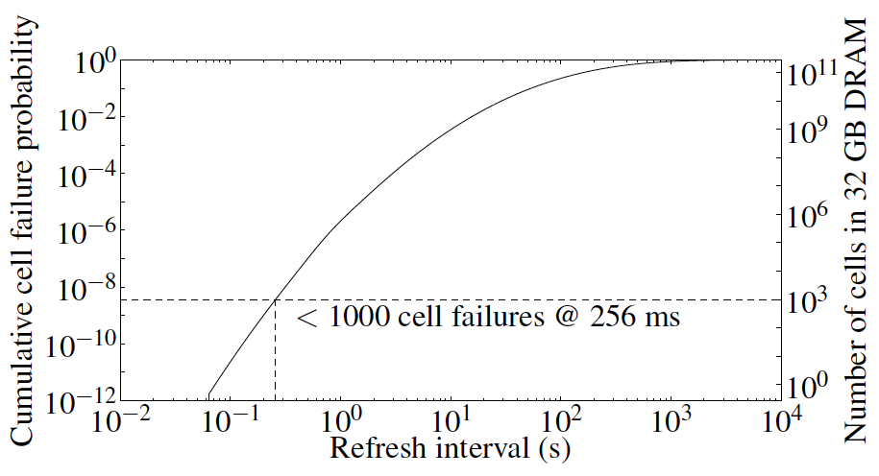
Problem with Conventional Refresh
Today: Every row is refreshed at the same rate
Observation: Most rows can be refreshed much less often without losing data [Kim+, EDL’09]
Problem: No support in DRAM for different refresh rates per row

Slide 105
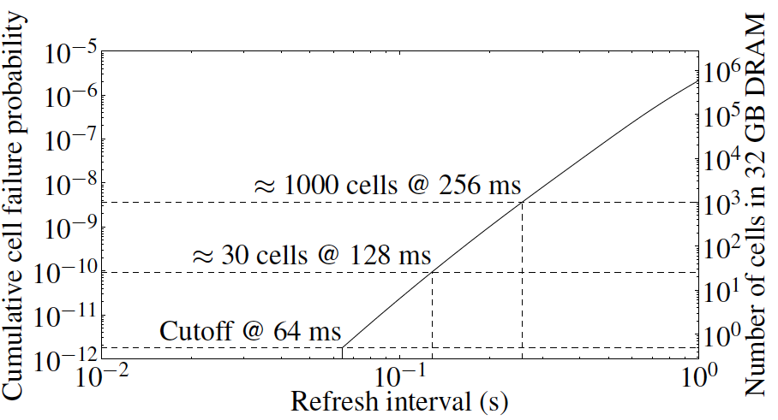
Retention Time of DRAM Rows
Observation: Only very few rows need to be refreshed at the worst-case rate
Can we exploit this to reduce refresh operations at low cost?

Slide 106
Reducing DRAM Refresh Operations
Idea: Identify the retention time of different rows and refresh each row at the frequency it needs to be refreshed
(Cost-conscious) Idea: Bin the rows according to their minimum retention times and refresh rows in each bin at the refresh rate specified for the bin
  e.g., a bin for 64-128ms, another for 128-256ms, …
Observation: Only very few rows need to be refreshed very frequently [64-128ms] → Have only a few bins → Low HW overhead to achieve large reductions in refresh operations
Liu et al., “RAIDR: Retention-Aware Intelligent DRAM Refresh,” ISCA 2012.

Slide 107


RAIDR: Mechanism
1. Profiling: Profile the retention time of all DRAM rows
→ can be done at DRAM design time or dynamically
2. Binning: Store rows into bins by retention time
→ use Bloom Filters for efficient and scalable storage
3. Refreshing: Memory controller refreshes rows in different bins at different rates
→ probe Bloom Filters to determine refresh rate of a row
1.25KB storage in controller for 32GB DRAM memory

Slide 108
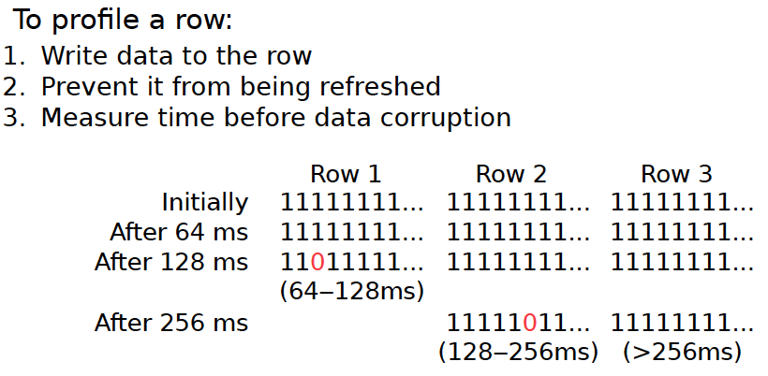
1. Profiling

Slide 109
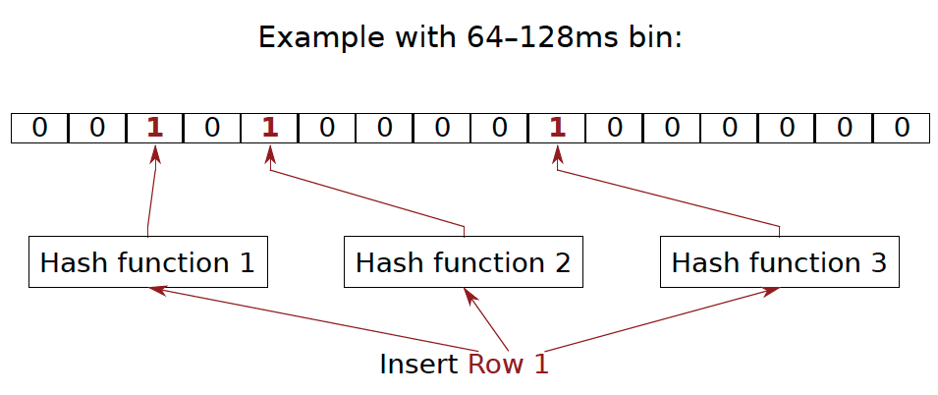
2. Binning
How to efficiently and scalably store rows into retention time bins?
  Use Hardware Bloom Filters [Bloom, CACM 1970]

Slide 110
Benefits of Bloom Filters as Bins
False positives: a row may be declared present in the Bloom filter even if it was never inserted
  Not a problem: Refresh some rows more frequently than needed
No false negatives: rows are never refreshed less frequently than needed (no correctness problems)
Scalable: a Bloom filter never overflows (unlike a fixed-size table)
Efficient: No need to store info on a per-row basis; simple hardware → 1.25 KB for 2 filters for 32 GB DRAM system

Slide 111
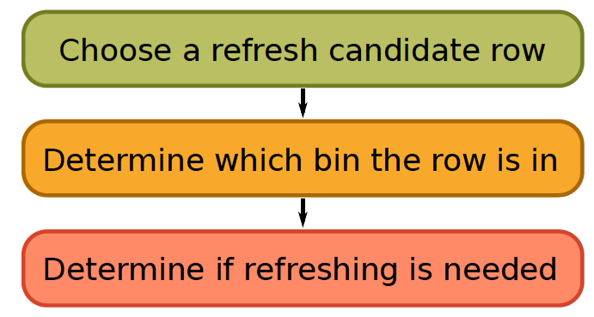
3. Refreshing (RAIDR Refresh Controller)

Slide 112
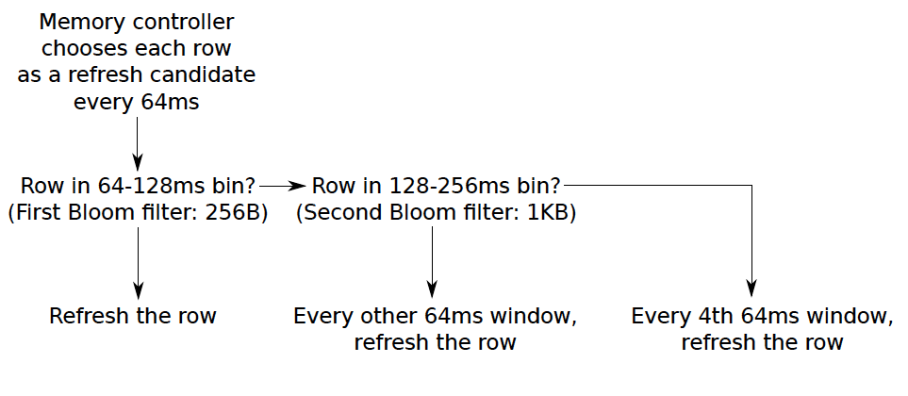
3. Refreshing (RAIDR Refresh Controller)
Liu et al., “RAIDR: Retention-Aware Intelligent DRAM Refresh,” ISCA 2012.

Slide 113
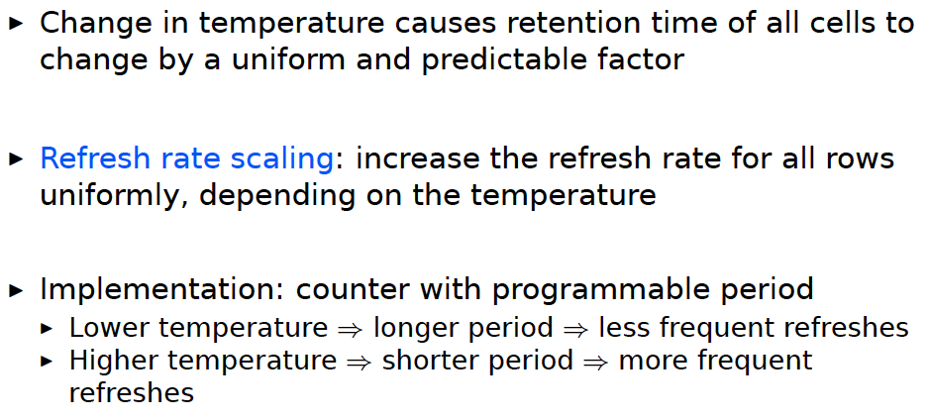
Tolerating Temperature Changes

Slide 114
RAIDR Results
Baseline:
  32 GB DDR3 DRAM system (8 cores, 512KB cache/core)
  64ms refresh interval for all rows
RAIDR:
  64–128ms retention range: 256 B Bloom filter, 10 hash functions
  128–256ms retention range: 1 KB Bloom filter, 6 hash functions
  Default refresh interval: 256 ms
Results on SPEC CPU2006, TPC-C, TPC-H benchmarks
  74.6% refresh reduction
  ~16%/20% DRAM dynamic/idle power reduction
  ~9% performance improvement

Slide 115
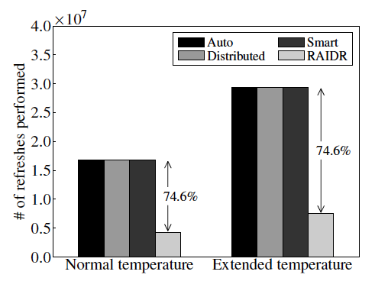
RAIDR Refresh Reduction
32 GB DDR3 DRAM system

Slide 116
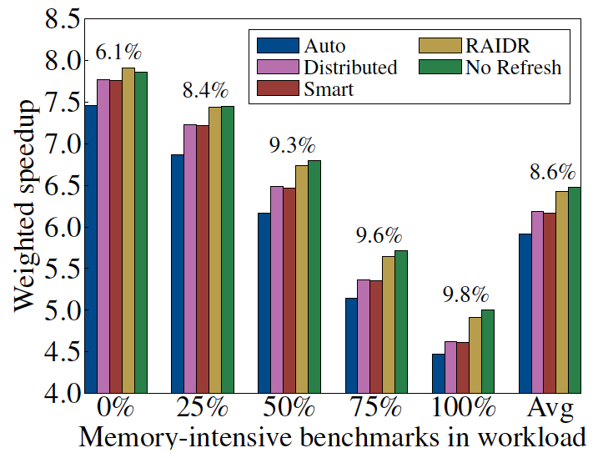
RAIDR: Performance
RAIDR performance benefits increase with workload’s memory intensity

Slide 117
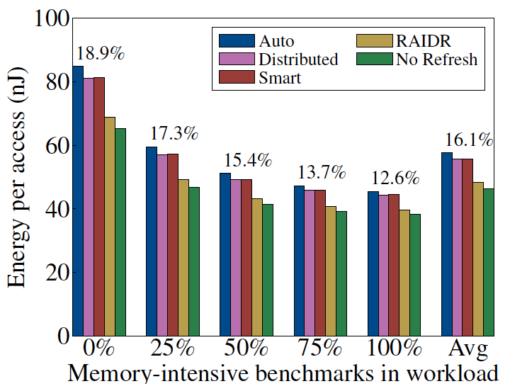
RAIDR: DRAM Energy Efficiency
RAIDR energy benefits increase with memory idleness

Slide 118
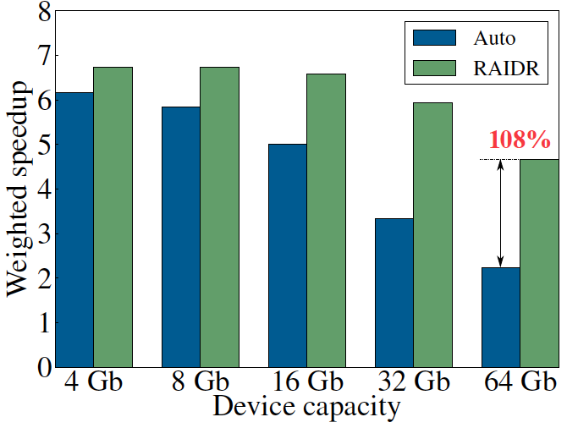
DRAM Device Capacity Scaling: Performance
RAIDR performance benefits increase with DRAM chip capacity

Slide 119
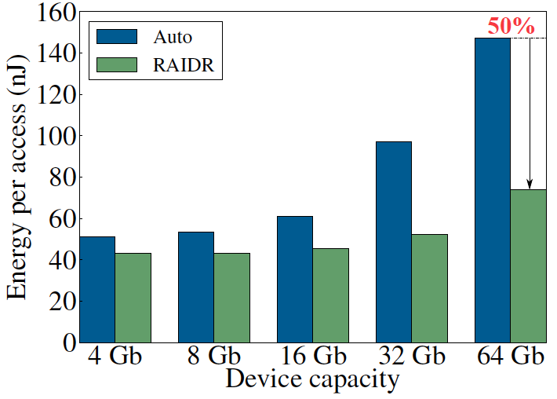
DRAM Device Capacity Scaling: Energy
RAIDR energy benefits increase with DRAM chip capacity
RAIDR slides

Slide 120
New DRAM Architectures
RAIDR: Reducing Refresh Impact
TL-DRAM: Reducing DRAM Latency
SALP: Reducing Bank Conflict Impact
RowClone: Fast Bulk Data Copy and Initialization

Slide 121
Tiered-Latency DRAM:
Reducing DRAM Latency
Donghyuk Lee, Yoongu Kim, Vivek Seshadri, Jamie Liu, Lavanya Subramanian, and Onur Mutlu,
"Tiered-Latency DRAM: A Low Latency and Low Cost DRAM Architecture"
19th International Symposium on High-Performance Computer Architecture (HPCA),
Shenzhen, China, February 2013. Slides (pptx)

Slide 122
Historical DRAM Latency-Capacity Trend
16X
-20%
DRAM latency continues to be a critical bottleneck
Notes:
The figure shows the historical trends of DRAM during the last 12-years, from 2000 to 2011.
We can see that, during this time, DRAM capacity has increased by 16 times.
On the other hand, during the same period of time, DRAM latency has reduced by only 20%.
As a result, the high DRAM latency continues to be a critical bottleneck for system performance.

Slide 123
What Causes the Long Latency?
DRAM Chip
subarray
banks
cell array
subarray
cell array
cell
I/O
I/O
wordline
channel
channel
row decoder
access
capacitor
transistor
bitline
sense amplifier
Notes:
To understand how to access DRAM, let me take a look at the DRAM organization.
DRAM consists of two components, the cell array and the I/O circuitry.
The cell array consists of multiple banks
and each bank consists of multiple subarray.
Each subarray consists of two dimensional grids of cell
and each cell has one capacitor and one access transistor.
The horizontal cell array is connected to a row decoder by a wire called wordline and
The vertical cell array is connected to sense amplifier by a wire called bitline.

Slide 124
What Causes the Long Latency?
DRAM Chip
row decoder
subarray
banks
cell array
subarray
cell array
sense amplifier
Subarray
row addr.
I/O
I/O
mux
I/O
column
addr.
channel
channel
DRAM Latency = Subarray Latency + I/O Latency
DRAM Latency = Subarray Latency + I/O Latency
Dominant
Notes:
To read from a DRAM chip, the subarray first accesses the data, which consists of two steps.
First, row decoder activate the row which has requested data.
Second, sense amplifiers detect the data of cells.
After these subarray access, IO circuitry transfers the data over channel.
Therefore, the DRAM latency is the sum of the subarray latency and the I/O latency.
We observed that the subarray latency is much higher than the I/O latency.
As a result, subarray is the dominant source of the DRAM latency as we explained in the paper.
--------------------------------------------------------------------------------------------------------------------------------------------
, again.
DRAM consists of two components, the cell array and the I/O circuitry. The cell array consists of multiple subarrays.
To read from a DRAM chip, the data is first accessed from the subarray and then the data is transferred over the channel by the I/O circuitry.

Slide 125
Why is the Subarray So Slow?
Subarray
Cell
cell
wordline
bitline: 512 cells
access
row decoder
row decoder
transistor
capacitor
sense amplifier
bitline
sense amplifier
large sense amplifier
Long bitline
  Amortizes sense amplifier cost → Small area
  Large bitline capacitance → High latency & power
Notes:
The cell’s capacitor is small and can store only a small amount of charge.
That is why a subarray also has sense-amplifiers, which are specialized circuits that can detect the small amount of charge.
Unfortunately, a sense-amplifier size is about *100* times the cell size.
So, to amortize the area of the sense-amplifiers,
hundreds of cells share the same sense-amplifier through a long bitline.
However, a long bitline has a large capacitance that increases latency and power consumption.
Therefore, the long bitline is one of the dominant sources of high latency and high power consumption.
To understand why the subarray is so slow,
let me take a look at the subarray organization.

Slide 126
Trade-Off: Area (Die Size) vs. Latency
Long Bitline
Short Bitline
Faster
Smaller
Trade-Off: Area vs. Latency
Notes:
A naïve way to reduce the DRAM latency is to have short bitlines that have lower latency.
Unfortunately, short bitlines significantly increase the DRAM area.
Therefore, the bitline length exposes an important trade-off between area and latency.

Slide 127
Trade-Off: Area (Die Size) vs. Latency
32
Fancy DRAM
Short Bitline
Commodity DRAM
Long Bitline
64
Cheaper
128
256
512 cells/bitline
GOAL
Faster
Notes:
This figure shows the trade-off between DRAM area and latency as we change the bitline length.
Y-axis is the normalized DRAM area compared to a DRAM using 512 cells/bitline. A lower value is cheaper.
X-axis shows the latency in terms of tRC, an important DRAM timing constraint. A lower value is faster.
Commodity DRAM chips use long bitlines to minimize area cost. On the other hand, shorter bitlines achieve lower latency at higher cost.
Our goal is to achieve the best of both worlds: low latency and low area cost.

Slide 128
Approximating the Best of Both Worlds
Long Bitline
Long Bitline
Our Proposal
Short Bitline
Short Bitline
Small Area
Large Area
Small Area
High Latency
Low Latency
Low Latency
Need Isolation
Add Isolation Transistors
Short Bitline ➔ Fast
Notes:
To sum up, both long and short bitline do not achieve small area and low latency.
Long bitline has small area but has high latency while short bitline has low latency but has large area.
To achieve the best of both worlds, we first start from long bitline, which has small area.
After that, to achieve the low latency of short bitline, we divide the long bitline into two smaller segments.
The bitline length of the segment nearby the sense-amplifier is same as the length of short bitline.
Therefore, the latency of the segment is as low as the latency of the short bitline.
To isolate this fast segment from the other segment, we add isolation transistors that selectively connect the two segments.

Slide 129
Approximating the Best of Both Worlds
Long Bitline
Tiered-Latency DRAM
Our Proposal
Short Bitline
Long Bitline
Short Bitline
Small Area
Small Area
Large Area
High Latency
Low Latency
Low Latency
Small area using long bitline
Low Latency
Notes:
This way, our proposed approach achieves small area and low latency.
We call this new DRAM architecture as Tiered-Latency DRAM

Slide 130
Tiered-Latency DRAM
Divide a bitline into two segments with an isolation transistor
Far Segment
Isolation Transistor
Near Segment
Sense Amplifier
Notes:
Again, the key idea is to divide a subarray into two segments with isolation transistors.
The segment, directly connected to the sense amplifier, is called the near segment.
The other segment is called the far segment.

Slide 131
Near Segment Access
Turn off the isolation transistor
Reduced bitline length
Reduced bitline capacitance
Far Segment
Far Segment
➔ Low latency & low power
Isolation Transistor (off)
Isolation Transistor
Near Segment
Sense Amplifier
Notes:
When accessing the near segment, the isolation transistor is truned off such that the near segment is electrically decoupled from the far segment.
which leads to the reduced bitline length, which leads to reduced bitline capacitance.
Due to these two reasons, the near segment can be accessed with low latency and low power.

Slide 132
Far Segment Access
Turn on the isolation transistor
Long bitline length
Large bitline capacitance
Additional resistance of isolation transistor
Far Segment
➔ High latency & high power
Isolation Transistor (on)
Isolation Transistor
Near Segment
Near Segment
Sense Amplifier
Notes:
When accessing the far segment, the isolation transistor is turned on
such that the far segment is electrically connected to the sense amplifier
and the entire bitline is exposed to sense amplifier,
which leads to long bitline,
which leads to large bitline capacitance.
and also isolation transistors have resistance.
Due to these three reasons, accessing the far segment incurs high latency and high power.

Slide 133
Latency, Power, and Area Evaluation
Commodity DRAM: 512 cells/bitline
TL-DRAM: 512 cells/bitline
  Near segment: 32 cells
  Far segment: 480 cells
Latency Evaluation
  SPICE simulation using circuit-level DRAM model
Power and Area Evaluation
  DRAM area/power simulator from Rambus
  DDR3 energy calculator from Micron
Notes:
We evaluated the latency, power consumption and area cost of TL-DRAM compared to commodity DRAM.
In our evaluations, we modeled a Commodity DRAM that has 512 cells/bitline.
TL-DRAM also has a total of 512 cells/bitline, which is segmented to 32-cell near segment and 480-cell far segment.
We simulated latency using SPICE simulator with circuit-level DRAM model.
We estimated the area and power consumption using Micron DRAM Power calculator and Rambus DRAM Area/Power simulator

Slide 134
Commodity DRAM vs. TL-DRAM
DRAM Latency (tRC)
DRAM Power
  +49%
  +23%
  (52.5ns)
Latency
Power
  –56%
  –51%
  Near Far
  Near Far
  Commodity DRAM
  Commodity DRAM
  TL-DRAM
  TL-DRAM
DRAM Area Overhead
  ~3%: mainly due to the isolation transistors
Notes:
This figure compares the latency.
Y-axis is normalized latency.
Compared to commodity DRAM, TL-DRAM’s near segment has 56% lower latency, while the far segment has 23% higher latency.
The right figure compares the power.
Y-axis is normalized power.
Compared to commodity DRAM, TL-DRAM’s near segment has 51% lower power consumption and the far segment has 49% higher power consumption.
Lastly, mainly due to the isolation transistor, Tiered-latency DRAM increases the die-size by about 3%.

Slide 135
Latency vs. Near Segment Length
Latency (ns)
Longer near segment length leads to
higher near segment latency
Notes:
The figure shows the latency of the near and far segments when varying near segment length.
X-axis is near segment length and Y-axis is Latency in nano seconds.
As the figure shows, a longer near segment length leads to higher near segment latency due to the increased bitline capacitance of the near segment.

Slide 136
Latency vs. Near Segment Length
Latency (ns)
  Far Segment Length = 512 – Near Segment Length
Far segment latency is higher than
commodity DRAM latency
Notes:
For the far segment, a shorter far segment length leads to lower latency. However, the far segment latency is higher than commodity DRAM latency.

Slide 137
Trade-Off: Area (Die-Area) vs. Latency
32
64
Cheaper
128
256
512 cells/bitline
Near Segment
Far Segment
GOAL
Faster
Notes:
Again, the figure shows the trade-off between area and latency in existing DRAM.
Unlike existing DRAM, TL-DRAM achieves low latency using the near segment while increasing the area by only 3%.
Although the far segment has higher latency than commodity DRAM, we show that efficient use of the near segment enables TL-DRAM to achieve high system performance.

Slide 138
Leveraging Tiered-Latency DRAM
TL-DRAM is a substrate that can be leveraged by the hardware and/or software
Many potential uses
  Use near segment as hardware-managed inclusive cache to far segment
  Use near segment as hardware-managed exclusive cache to far segment
  Profile-based page mapping by operating system
  Simply replace DRAM with TL-DRAM
Notes:
There are multiple ways to leverage the TL-DRAM substrate by hardware or software.
In this slide, I describe many such ways.
First, the near segment can be used as a hardware-managed inclusive cache to the far segment.
Second, the near segment can be used as a hardware-managed exclusive cache to the far segment.
Third, the operating system can intelligently allocate frequently-accessed pages to the near segment.
Forth mechanism is to simple replace DRAM with TL-DRAM without any near segment handling
While our paper provides detailed explanations and evaluations of first three mechanism,
in this talk, we will focus on the first approach, which is to use the near segment as a hardware managed cache for the far segment.

Slide 139
Near Segment as Hardware-Managed Cache
TL-DRAM
far segment
subarray
main
memory
near segment
cache
sense amplifier
I/O
channel
Challenge 1: How to efficiently migrate a row between segments?
Challenge 2: How to efficiently manage the cache?
Notes:
This diagram shows TL-DRAM organization.
Each subarray consists of the sense amplifier, near segment and far segment.
In this particular approach, only the far segment capacity is exposed to the operating system and the memory controller caches the frequently accessed rows in each subarray to the corresponding near segment.
This approach has two challenges.
First, how to migrate a row between segments efficiently?
Second, how to manage the near segment cache efficiently?
Let me first address first challenge.

Slide 140
Inter-Segment Migration
Goal: Migrate source row into destination row
Naïve way: Memory controller reads the source row byte by byte and writes to destination row byte by byte
→ High latency
Source
Far Segment
Isolation Transistor
Destination
Near Segment
Sense Amplifier
Notes:
Our goal is to migrate a source row in the far segment to a destination row in the near segment.
The naïve way to achieve this is that memory controller reads all the data from the source row and writes them back to the destination row.
However, this leads to high latency.

Slide 141
Inter-Segment Migration
Our way:
  Source and destination cells share bitlines
  Transfer data from source to destination across shared bitlines concurrently
Source
Far Segment
Isolation Transistor
Destination
Near Segment
Sense Amplifier
Notes:
Our observation is that cells in the source and the destination row share bitlines.
Our idea is to use these shared bitlines to transfer data from the source to the destination concurrently .
We’ll explain the migration procedure step by step.

Slide 142
Inter-Segment Migration
Our way:
  Source and destination cells share bitlines
  Transfer data from source to destination across shared bitlines concurrently
Step 1: Activate source row
Migration is overlapped with source row access
Additional ~4ns over row access latency
Far Segment
Step 2: Activate destination row to connect cell and bitline
Isolation Transistor
Near Segment
Sense Amplifier
Notes:
First, the memory controller accesses the source row in the far segment.
The isolation transistor is turned on and then the cells in the source row are connected to the bitlines.
After that, the sense amplifiers read the data of the source row.
Second, the memory controller accesses the destination row in the near segment.
Now, the cells in the destination row are also connected to the bitline.
Therefore, the data of sense amplifier are migrated to the destination row across the bitlines concurrently.
After these two steps, the all data of the source row are migrated to the destination row with low latency.
In fact, most of the migration latency is overlapped with the source row access latency.
Using SPICE simulation, we estimated that the additional migration latency over the row access latency is about 4ns.

Slide 143
Near Segment as Hardware-Managed Cache
TL-DRAM
far segment
subarray
main
memory
near segment
cache
sense amplifier
I/O
channel
Challenge 1: How to efficiently migrate a row between segments?
Challenge 2: How to efficiently manage the cache?
Notes:
Now, let me address the second challenge

Slide 144
Evaluation Methodology
System simulator
  CPU: Instruction-trace-based x86 simulator
  Memory: Cycle-accurate DDR3 DRAM simulator
Workloads
  32 Benchmarks from TPC, STREAM, SPEC CPU2006
Performance Metrics
  Single-core: Instructions-Per-Cycle
  Multi-core: Weighted speedup
Notes:
We use an x86 CPU simulator and a cycle-accurate DDR3 DRAM simulator for evaluating system performance.
We use TPC, STREAM and SPEC CPU2006 benchmarks.
We use Instructions-Per-Cycle to measure single-core performance and weighted speedup to measure multi-core performance.

Slide 145
Configurations
System configuration
  CPU: 5.3GHz
  LLC: 512kB private per core
  Memory: DDR3-1066
    1-2 channel, 1 rank/channel
    8 banks, 32 subarrays/bank, 512 cells/bitline
    Row-interleaved mapping & closed-row policy
TL-DRAM configuration
  Total bitline length: 512 cells/bitline
  Near segment length: 1-256 cells
  Hardware-managed inclusive cache: near segment
Notes:
For baseline commodity DRAM, We use DDR3-1066 which has 512 cells/bitline.
Our TL-DRAM has the same bitline length as the baseline DRAM.
We vary the near segment length from 1 to 256 cells.

Slide 146
Performance & Power Consumption
12.4%
11.5%
10.7%
–23%
–24%
–26%
Normalized Performance
Normalized Power
Core-Count (Channel)
Core-Count (Channel)
Using near segment as a cache improves performance and reduces power consumption
Notes:
This figure shows the IPC improvement of our three caching mechanisms over commodity DRAM.
All of them improve performance and benefit-based caching shows maximum performance improvement by 12.7%.
The right figure shows the normalized power reduction of our three caching mechanisms over commodity DRAM.
All of them reduce power consumption and benefit-based caching shows maximum power reduction by 23%.
Therefore, using near segment as a cache improves performance and reduces power consumption at the cost of 3% area overhead.

Slide 147
Single-Core: Varying Near Segment Length
Maximum IPC Improvement
Larger cache capacity
Performance Improvement
Higher cache access latency
Near Segment Length (cells)
By adjusting the near segment length, we can trade off cache capacity for cache latency
Notes:
This figure shows the performance improvement over commodity DRAM, when varying the near segment length.
X-axis is the near segment length and Y-axis is the IPC improvement over commodity DRAM.
Increasing the near segment length enables larger cache capacity but the trade-off is increasing the caching latency.
As a result, the peak performance improvement is at 32 cells/bitline.
We observe that by adjusting the near segment length, we can trade off cache capacity for cache latency.

Slide 148
Other Mechanisms & Results
More mechanisms for leveraging TL-DRAM
  Hardware-managed exclusive caching mechanism
  Profile-based page mapping to near segment
  TL-DRAM improves performance and reduces power consumption with other mechanisms
More than two tiers
  Latency evaluation for three-tier TL-DRAM
Detailed circuit evaluation for DRAM latency and power consumption
  Examination of tRC and tRCD
Implementation details and storage cost analysis in memory controller
Notes:
In our paper, we provide more mechanisms and results.
First, we provide detailed explanations and evaluations of two other mechanisms,
a hardware managed exclusive caching and a profile-based OS page mapping.
Second, We provide latency evaluation for three-tier TL-DRAM.
Third, we provide detailed circuit evaluation for DRAM latency and power consumption.
Forth, we provide implementation details and storage cost analysis in memory controller.

Slide 149
Summary of TL-DRAM
Problem: DRAM latency is a critical performance bottleneck
Our Goal: Reduce DRAM latency with low area cost
Observation: Long bitlines in DRAM are the dominant source of DRAM latency
Key Idea: Divide long bitlines into two shorter segments
  Fast and slow segments
Tiered-latency DRAM: Enables latency heterogeneity in DRAM
  Can leverage this in many ways to improve performance and reduce power consumption
Results: When the fast segment is used as a cache to the slow segment → Significant performance improvement (>12%) and power reduction (>23%) at low area cost (3%)
Notes:
Let me conclude.
The problem is that DRAM latency is a critical bottleneck for system performance.
Our goal is to reduce the DRAM latency with low cost.
Our observation is that long bitlines are the dominant source of high DRAM latency.
Our key idea is to divide the long bitlines into two smaller segments: a fast segment and a slow segment
Therefore, Tiered-latency DRAM, enables latency heterogeneity in DRAM.
We show many ways to utilize this latency heterogeneity to improve system performance and power reduction.
Among them, In this talk, we show that a system that uses the fast segment as a cache to the slow segment achieves significant performance improvement and power reduction with low cost for wide variety of both single and multi core workloads.

Slide 150
New DRAM Architectures
RAIDR: Reducing Refresh Impact
TL-DRAM: Reducing DRAM Latency
SALP: Reducing Bank Conflict Impact
RowClone: Fast Bulk Data Copy and Initialization

Slide 151
Subarray-Level Parallelism:
Reducing Bank Conflict Impact
Yoongu Kim, Vivek Seshadri, Donghyuk Lee, Jamie Liu, and Onur Mutlu,
"A Case for Exploiting Subarray-Level Parallelism (SALP) in DRAM"
Proceedings of the 39th International Symposium on Computer Architecture (ISCA),
Portland, OR, June 2012. Slides (pptx)

Slide 152
The Memory Bank Conflict Problem
Two requests to the same bank are serviced serially
Problem: Costly in terms of performance and power
Goal: We would like to reduce bank conflicts without increasing the number of banks (at low cost)
Idea: Exploit the internal sub-array structure of a DRAM bank to parallelize bank conflicts
  By reducing global sharing of hardware between sub-arrays
Kim, Seshadri, Lee, Liu, Mutlu, “A Case for Exploiting Subarray-Level Parallelism in DRAM,” ISCA 2012.

Slide 153
The Problem with Memory Bank Conflicts
Two Banks
Served in parallel
Bank
Wr
Rd
time
Bank
Wr
Rd
time
One Bank
Wasted
Bank
Wr
Wr
3
Wr
Wr
2
2
Wr
3
Rd
Wr
2
Rd
2
Rd
Rd
Rd
3
Rd
time
3. Thrashing Row-Buffer
1. Serialization
2. Write Penalty

Slide 154
Goal
Goal: Mitigate the detrimental effects of bank conflicts in a cost-effective manner
Naïve solution: Add more banks
  Very expensive
Cost-effective solution: Approximate the benefits of more banks without adding more banks

Slide 155
Key Observation #1
A DRAM bank is divided into subarrays
Logical Bank
Physical Bank
Row
Subarray₆₄
Row
Local Row-Buf
32k rows
Row
Subarray₁
Row
Local Row-Buf
Row-Buffer
Global Row-Buf
A single row-buffer cannot drive all rows
Many local row-buffers, one at each subarray
Notes:
Our key observation is that a DRAM bank is divided into subarrays.
Logically, a DRAM bank is viewed as a monolithic component with a single row-buffer connected to all rows. However, a single row-buffer cannot drive tens of thousands rows.
So, instead, a DRAM bank is physically divided into multiple subarrays, each equipped with a local row-buffer. Although each subarray has a local row-buffer, a single global row-buffer is still required to serve as an interface through which data can be transferred from and to the bank.

Slide 156
Key Observation #2
Each subarray is mostly independent…
  except occasionally sharing global structures
Subarray₆₄
Local Row-Buf
Global Decoder
···
Subarray₁
Local Row-Buf
Bank
Global Row-Buf
Notes:
Based on our observation, we propose two key ideas.
First, we realized that each subarray operates mostly independently of each other, except when occasionally sharing global structures, such as the global row-buffer. Additionally, each subarray has a row-decoder, which in turn is driven by the global row-decoder, another global structure.
Our first key idea is to reduce the sharing of global structures among subarrays to enable subarray-level parallelism.

Slide 157
Key Idea: Reduce Sharing of Globals
1. Parallel access to subarrays
Local Row-Buf
Global Decoder
···
Local Row-Buf
Bank
Global Row-Buf
2. Utilize multiple local row-buffers
Notes:
Based on our observation, we propose two key ideas.
First, we realized that each subarray operates mostly independently of each other, except when occasionally sharing global structures, such as the global row-buffer. Additionally, each subarray has a row-decoder, which in turn is driven by the global row-decoder, another global structure.
Our first key idea is to reduce the sharing of global structures among subarrays to enable subarray-level parallelism.

Slide 158
Overview of Our Mechanism
Subarray₆₄
Local Row-Buf
1. Parallelize
2. Utilize multiple local row-buffers
···
Req
Req
Req
Req
To same bank...
but diff. subarrays
Subarray₁
Local Row-Buf
Global Row-Buf
Notes:
Building on top of our key idea, here is a high-level overview of our mechanism. In existing DRAM, four requests to the same bank are serialized, even when they are to different subarrays within the bank. In contrast, our solution parallelizes requests to different subarrays, and simultaneously utilizes multiple row-buffers across the two subarrays.

Slide 159
Challenges: Global Structures
  1. Global Address Latch
  2. Global Bitlines
Notes:
First, let’s take a look at the problem caused by sharing of the global address latch.

Slide 160
Challenge #1. Global Address Latch
V_{DD}
PRECHARGED
ACTIVATED
Local
row-buffer
addr
addr
Global Decoder
···
Latch
Latch
Latch
V_{DD}
ACTIVATED
Local
row-buffer
Global
row-buffer
Notes:
Since there is only one global address latch, it can store only one row address, preventing multiple rows from being activated at the same time.
For example, if we are activating the blue row, the global address latch would store the address of that row, and subsequently activate it. However, at this point, we cannot immediately activate the yellow row, but we must first precharge the original subarray that contains the blue row, clearing the contents of the global address latch. Only then can the yellow row be activated.

Slide 161

Solution #1. Subarray Address Latch
V_{DD}
ACTIVATED
Local
row-buffer
Global Decoder
···
Latch
Latch
Latch
V_{DD}
ACTIVATED
Local
row-buffer
Global
row-buffer
Global latch → local latches
Notes:
As a solution, we propose to eliminate the global address latch and to push it to individual subarrays. Each of these latches, that we call subarray address latches, can store the row-address for each subarray, allowing multiple rows to be activated across different subarrays..

Slide 162
Challenges: Global Structures
  1. Global Address Latch
    Problem: Only one raised wordline
    Solution: Subarray Address Latch
  2. Global Bitlines
Notes:
We’ve seen how the shared global address latch allows only one raised wordline, or equivalently, only one activated row. As a solution we proposed the subarraay address latch.
Now let’s take a look at the problem caused by the sharing of the global bitlines.

Slide 163
Challenge #2. Global Bitlines
Global bitlines
Local
row-buffer
Switch
Collision
Local
row-buffer
Switch
READ
Global
row-buffer
Notes:
Typically, the global bitlines are routed over the subarrays, using the top metal layer. But for the sake of illustration, let’s assume for now that they are off to the side.
Each subarray’s local row-buffer is connected to the global bitlines, through switches that can be toggled on and off.
The problem is that for an access to either of the rows, both switches are turned on. As a result, both rows attempt to traverse the global bitlines, leading to a collision, or an electrical short-circuit on the global bitlines.

Slide 164
Solution #2. Designated-Bit Latch
Global bitlines
Wire
Local
row-buffer
D
D
Switch
Local
row-buffer
D
D
Switch
READ
READ
Global
row-buffer
Selectively connect local to global
Notes:
As a solution, we propose to selectively connect the local row-buffers to the global bitlines. We do this by augmenting each subarray with a single-bit latch, that we call the designated-bit latch, that controls the subarrays’ switchhes.
Before accessing a row, the DRAM controller ensures that only one subarray’s designated-bit is set, so that only one row traverses the global bitlines. To access a different row, the DRAM controller sets the designated-bit of only that subarray.
It is important to note that the blue row is kept activated, so that if there is another request to the blue row, it can be served quickly.
The designated bits are controlled by a control wire that is added.

Slide 165
Challenges: Global Structures
  1. Global Address Latch
    Problem: Only one raised wordline
    Solution: Subarray Address Latch
  2. Global Bitlines
    Problem: Collision during access
    Solution: Designated-Bit Latch
MASA (Multitude of Activated Subarrays)
Notes:
We’ve seen how the sharing of the global bitlines cause collisions during data access. As a solution, we’ve proposed the designed-bit latch to allow the DRAM controller to selectively connect only one subarray’s local row-buffer to the global bitlines

Slide 166
MASA: Advantages
Baseline (Subarray-Oblivious)
MASA
1. Serialization
Wr
2
3
Wr
2
3
Rd
3
Rd
time
2. Write Penalty
3. Thrashing
Saved
Wr
Rd
time
Wr
Rd
Notes:
Tying it all together, we’ve seen at the beginning of the presentation how a subarray-oblivious baseline suffers from three problems during bank conflicts: serialization, write-penalty, and thrashing of the row-buffer.
On the other hand, MASA, our mechanism, does not suffer from these problems, by parallelizing requests to different requests and utilizing multiple local row-buffers, leading to significant latency savings.

Slide 167
MASA: Overhead
DRAM Die Size: Only 0.15% increase
  Subarray Address Latches
  Designated-Bit Latches & Wire
DRAM Static Energy: Small increase
  0.56mW for each activated subarray
  But saves dynamic energy
Controller: Small additional storage
  Keep track of subarray status (< 256B)
  Keep track of new timing constraints
Notes:
To implement MASA, only a 0.15% increase in die size is required for the latches and the wire.
While MASA increases static energy by a small amount, requiring
Overall, MASA requires only a modest 0.15% increase in DRAM die size, to implement the subarray address latches and the designated bit latches and the wire.
Concerning static energy, MASA requires 0.56mW for each additional activated subarray. However, this comes at large savings in the dynamic energy, due to increased hit-rate in the local row-buffers that allows MASA to avoid energy-hungry activations.
At the DRAM controller, an additional storage of less than 256 bytes is required to keep track of the status of the subarrays, as well as some additional logic to keep track of new timing contraints.

Slide 168
Cheaper Mechanisms
Latches
3. Thrashing
1. Serialization
2. Wr-Penalty
D
MASA
SALP-2
D
SALP-1
Notes:
Although MASA does not require a lot of overhead, we further propose two additional mechanisms that are cheaper than MASA.
MASA, by utilizing the subarray address latch and the designated-bit latch, is able to address all three problems related to bank conflicts.
Starting from here, if we remove the designated-bit latch, we arrive at a mechanism that we call SALP-2, or subarray-level parallelism level-2, which addresses only two of the three problems. If we remove even the subarray address latch, we arrive at a mechanism that we call SALP-1, subarray-level parallelism level-1, which addresses only one of the three problems.

Slide 169
System Configuration
System Configuration
  CPU: 5.3GHz, 128 ROB, 8 MSHR
  LLC: 512kB per-core slice
Memory Configuration
  DDR3-1066
  (default) 1 channel, 1 rank, 8 banks, 8 subarrays-per-bank
  (sensitivity) 1-8 chans, 1-8 ranks, 8-64 banks, 1-128 subarrays
Mapping & Row-Policy
  (default) Line-interleaved & Closed-row
  (sensitivity) Row-interleaved & Open-row
DRAM Controller Configuration
  64-/64-entry read/write queues per-channel
  FR-FCFS, batch scheduling for writes

Slide 170
SALP: Single-core Results
17%
20%
MASA achieves most of the benefit of having more banks (“Ideal”)

Slide 171
SALP: Single-Core Results
20%
17%
13%
7%
DRAM Die Area | < 0.15% | 0.15% | 36.3%
SALP-1, SALP-2, MASA improve performance at low cost

Slide 172
Subarray-Level Parallelism: Results
-19%
+13%
MASA increases energy-efficiency

Slide 173
New DRAM Architectures
RAIDR: Reducing Refresh Impact
TL-DRAM: Reducing DRAM Latency
SALP: Reducing Bank Conflict Impact
RowClone: Fast Bulk Data Copy and Initialization

Slide 174
RowClone: Fast Bulk Data
Copy and Initialization
Vivek Seshadri, Yoongu Kim, Chris Fallin, Donghyuk Lee, Rachata Ausavarungnirun,
Gennady Pekhimenko, Yixin Luo, Onur Mutlu, Phillip B. Gibbons, Michael A. Kozuch, Todd C. Mowry,
"RowClone: Fast and Efficient In-DRAM Copy and Initialization of Bulk Data"
CMU Computer Science Technical Report, CMU-CS-13-108, Carnegie Mellon University, April 2013.

Slide 175
Today’s Memory: Bulk Data Copy
1) High latency
Memory
3) Cache pollution
L3
CPU
L2
L1
MC
2) High bandwidth utilization
4) Unwanted data movement

Slide 176
Future: RowClone (In-Memory Copy)
3) No cache pollution
1) Low latency
Memory
L3
CPU
L2
L1
MC
2) Low bandwidth utilization
4) No unwanted data movement
Seshadri et al., “RowClone: Fast and Efficient In-DRAM Copy and Initialization of Bulk Data,” CMU Tech Report 2013.

Slide 177
DRAM operation (load one byte)
4 Kbits
1. Activate row
2. Transfer
row
DRAM array
Row Buffer (4 Kbits)
3. Transfer
byte onto bus
Data pins (8 bits)
Memory Bus
Notes:
say you want a byte

Slide 178
RowClone: in-DRAM Row Copy (and Initialization)
4 Kbits
1. Activate row A
3. Activate row B
2. Transfer
row
DRAM array
4.
Transfer
row
Row Buffer (4 Kbits)
Data pins (8 bits)
Memory Bus
Notes:
copy

Slide 179
Our Approach: Key Idea
DRAM banks contain
  Mutiple rows of DRAM cells – row = 8KB
  A row buffer shared by the DRAM rows
Large scale copy
  Copy data from source row to row buffer
  Copy data from row buffer to destination row

Slide 180
DRAM Subarray Microarchitecture
DRAM Row
(share wordline)
(~8Kb)
Sense Amplifiers
(row buffer)
wordline
DRAM Cell

Slide 181
DRAM Operation
Raise wordline
0
?
1
?
0
?
0
?
1
?
1
?
0
?
0
?
0
?
1
?
1
?
0
?
src
1
1
0
1
0
1
1
1
0
0
1
1
dst
Sense Amplifiers
(row buffer)
0
-
1
+
0
-
0
-
1
+
1
+
0
-
0
-
0
-
1
+
1
+
0
-
Activate (src)
Precharge

Slide 182
RowClone: Intra-subarray Copy
0
1
0
0
1
1
0
0
0
1
1
0
src
1
dst
?
0
1
?
1
0
?
0
1
?
0
0
?
1
1
?
1
1
?
0
1
?
0
0
?
0
0
?
1
1
?
1
1
?
0
Sense Amplifiers
(row buffer)
0
1
0
0
1
1
0
0
0
1
1
0
Deactivate
(our proposal)
Activate (src)
Activate (dst)

Slide 183
RowClone: Inter-bank Copy
dst
src
Read
Write
I/O Bus
Transfer
(our proposal)

Slide 184
RowClone: Inter-subarray Copy
dst
src
temp
I/O Bus
1. Transfer (src to temp)
2. Transfer (temp to dst)

Slide 185
Fast Row Initialization
0
0
0
0
0
0
0
0
0
0
0
0
Fix a row at Zero
(0.5% loss in capacity)

Slide 186
RowClone: Latency and Energy Savings
11.5x
74x
Seshadri et al., “RowClone: Fast and Efficient In-DRAM Copy and Initialization of Bulk Data,” CMU Tech Report 2013.

Slide 187
Summary
Major problems with DRAM scaling and design: high refresh rate, high latency, low parallelism, bulk data movement
Four new DRAM designs
  RAIDR: Reduces refresh impact
  TL-DRAM: Reduces DRAM latency at low cost
  SALP: Improves DRAM parallelism
  RowClone: Reduces energy and performance impact of bulk data copy
All four designs
  Improve both performance and energy consumption
  Are low cost (low DRAM area overhead)
  Enable new degrees of freedom to software & controllers
Rethinking DRAM interface and design essential for scaling
  Co-design DRAM with the rest of the system

Slide 188
Scalable Many-Core Memory Systems Topic 1: DRAM Basics and
DRAM Scaling
Prof. Onur Mutlu
http://www.ece.cmu.edu/~omutlu
onur@cmu.edu
HiPEAC ACACES Summer School 2013
July 15-19, 2013

Slide 189
Additional Material

Slide 190
Three Papers
Yu Cai, Gulay Yalcin, Onur Mutlu, Erich F. Haratsch, Adrian Cristal, Osman Unsal, and Ken Mai,
"Error Analysis and Retention-Aware Error Management for NAND Flash Memory"
Intel Technology Journal (ITJ) Special Issue on Memory Resiliency, Vol. 17, No. 1, May 2013.
Howard David, Chris Fallin, Eugene Gorbatov, Ulf R. Hanebutte, and Onur Mutlu,
"Memory Power Management via Dynamic Voltage/Frequency Scaling"
Proceedings of the 8th International Conference on Autonomic Computing (ICAC), Karlsruhe, Germany, June 2011. Slides (pptx) (pdf)
Jamie Liu, Ben Jaiyen, Yoongu Kim, Chris Wilkerson, and Onur Mutlu,
"An Experimental Study of Data Retention Behavior in Modern DRAM Devices: Implications for Retention Time Profiling Mechanisms"
Proceedings of the 40th International Symposium on Computer Architecture (ISCA), Tel-Aviv, Israel, June 2013. Slides (pptx) Slides (pdf)

Slide 191
Aside: Scaling Flash Memory [Cai+, ICCD’12]
NAND flash memory has low endurance: a flash cell dies after 3k P/E cycles vs. 50k desired → Major scaling challenge for flash memory
Flash error rate increases exponentially over flash lifetime
Problem: Stronger error correction codes (ECC) are ineffective and undesirable for improving flash lifetime due to
  diminishing returns on lifetime with increased correction strength
  prohibitively high power, area, latency overheads
Our Goal: Develop techniques to tolerate high error rates w/o strong ECC
Observation: Retention errors are the dominant errors in MLC NAND flash
  flash cell loses charge over time; retention errors increase as cell gets worn out
Solution: Flash Correct-and-Refresh (FCR)
  Periodically read, correct, and reprogram (in place) or remap each flash page before it accumulates more errors than can be corrected by simple ECC
  Adapt “refresh” rate to the severity of retention errors (i.e., # of P/E cycles)
Results: FCR improves flash memory lifetime by 46X with no hardware changes and low energy overhead; outperforms strong ECCs

Slide 192
DRAM Experiments: Summary (I)
DRAM requires periodic refresh to avoid data loss
  Refresh wastes energy, reduces performance, limits DRAM density scaling
Many past works observed that different DRAM cells can retain data for different times without being refreshed; proposed reducing refresh rate for strong DRAM cells
  Problem: These techniques require an accurate profile of the retention time of all DRAM cells
Our goal: To analyze the retention time behavior of DRAM cells in modern DRAM devices to aid the collection of accurate profile information
Our experiments: We characterize 248 modern commodity DDR3 DRAM chips from 5 manufacturers using an FPGA based testing platform
Two Key Issues:
  1. Data Pattern Dependence: A cell’s retention time is heavily dependent on data values stored in itself and nearby cells, which cannot easily be controlled.
  2. Variable Retention Time: Retention time of some cells change unpredictably from high to low at large timescales.

Slide 193
DRAM Experiments: Summary (II)
Key findings on Data Pattern Dependence
  There is no observed single data pattern that elicits the lowest retention times for a DRAM device → very hard to find this pattern
  DPD varies between devices due to variation in DRAM array circuit design between manufacturers
  DPD of retention time gets worse as DRAM scales to smaller feature sizes
Key findings on Variable Retention Time
  VRT is common in modern DRAM cells that are weak
  The timescale at which VRT occurs is very large (e.g., a cell can stay in high retention time state for a day or longer) → finding minimum retention time can take very long
Future work on retention time profiling must address these issues

