Slide 1
Scalable Many-Core Memory Systems Topic 2: Emerging Technologies and Hybrid Memories
Prof. Onur Mutlu
http://www.ece.cmu.edu/~omutlu
onur@cmu.edu
HiPEAC ACACES Summer School 2013
July 15-19, 2013

Slide 2
Requirements from an Ideal Memory System
Traditional
Enough capacity
Low cost
High system performance (high bandwidth, low latency)
New
Technology scalability: lower cost, higher capacity, lower energy
Energy (and power) efficiency
QoS support and configurability (for consolidation)

Slide 3
Requirements from an Ideal Memory System
Traditional
Higher capacity
Continuous low cost
High system performance (higher bandwidth, low latency)
New
Technology scalability: lower cost, higher capacity, lower energy
Energy (and power) efficiency
QoS support and configurability (for consolidation)
Emerging, resistive memory technologies (NVM) can help

Slide 4
Agenda
Major Trends Affecting Main Memory
Requirements from an Ideal Main Memory System
Opportunity: Emerging Memory Technologies
Conclusions
Discussion

Slide 5
The Promise of Emerging Technologies
Likely need to replace/augment DRAM with a technology that is
Technology scalable
And at least similarly efficient, high performance, and fault-tolerant
or can be architected to be so
Some emerging resistive memory technologies appear promising
Phase Change Memory (PCM)?
Spin Torque Transfer Magnetic Memory (STT-MRAM)?
Memristors?
And, maybe there are other ones
Can they be enabled to replace/augment/surpass DRAM?

Slide 6
Agenda
Major Trends Affecting Main Memory
Requirements from an Ideal Main Memory System
Opportunity: Emerging Memory Technologies
Background
PCM (or Technology X) as DRAM Replacement
Hybrid Memory Systems
Conclusions
Discussion

Slide 7
Charge vs. Resistive Memories
Charge Memory (e.g., DRAM, Flash)
Write data by capturing charge Q
Read data by detecting voltage V
Resistive Memory (e.g., PCM, STT-MRAM, memristors)
Write data by pulsing current dQ/dt
Read data by detecting resistance R

Slide 8
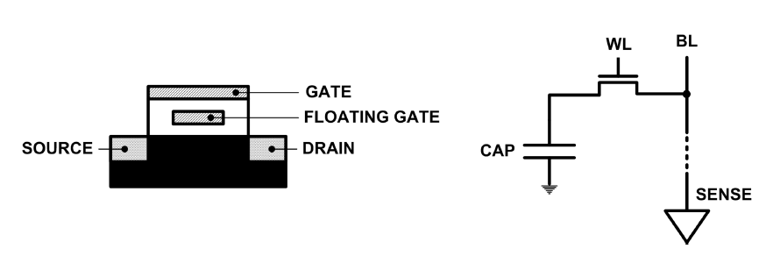
Limits of Charge Memory
Difficult charge placement and control
Flash: floating gate charge
DRAM: capacitor charge, transistor leakage
Reliable sensing becomes difficult as charge storage unit size reduces

Slide 9
Emerging Resistive Memory Technologies
PCM
Inject current to change material phase
Resistance determined by phase
STT-MRAM
Inject current to change magnet polarity
Resistance determined by polarity
Memristors
Inject current to change atomic structure
Resistance determined by atom distance

Slide 10
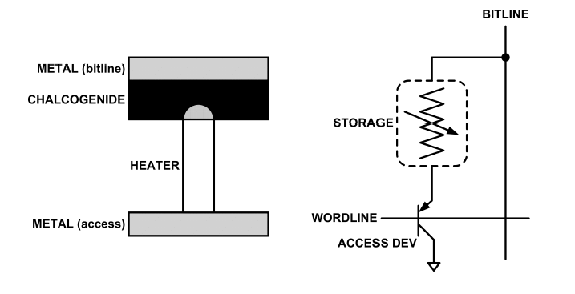
What is Phase Change Memory?
Phase change material (chalcogenide glass) exists in two states:
Amorphous: Low optical reflexivity and high electrical resistivity
Crystalline: High optical reflexivity and low electrical resistivity
PCM is resistive memory: High resistance (0), Low resistance (1)
PCM cell can be switched between states reliably and quickly

Slide 11
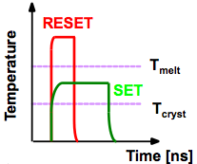
How Does PCM Work?
Write: change phase via current injection
SET: sustained current to heat cell above Tcryst
RESET: cell heated above Tmelt and quenched
Read: detect phase via material resistance
amorphous/crystalline
Large
Current
Small
Current
Memory
Element
SET (cryst)
Low resistance
Access
Device
RESET (amorph)
High resistance
10³-10⁴ Ω
10⁶-10⁷ Ω
Photo Courtesy: Bipin Rajendran, IBM
Slide Courtesy: Moinuddin Qureshi, IBM

Slide 12
Opportunity: PCM Advantages
Scales better than DRAM, Flash
Requires current pulses, which scale linearly with feature size
Expected to scale to 9nm (2022 [ITRS])
Prototyped at 20nm (Raoux+, IBM JRD 2008)
Can be denser than DRAM
Can store multiple bits per cell due to large resistance range
Prototypes with 2 bits/cell in ISSCC’08, 4 bits/cell by 2012
Non-volatile
Retain data for >10 years at 85C
No refresh needed, low idle power

Slide 13
Phase Change Memory Properties
Surveyed prototypes from 2003-2008 (ITRS, IEDM, VLSI, ISSCC)
Derived PCM parameters for F=90nm
Lee, Ipek, Mutlu, Burger, “Architecting Phase Change Memory as a Scalable DRAM Alternative,” ISCA 2009.

Slide 14
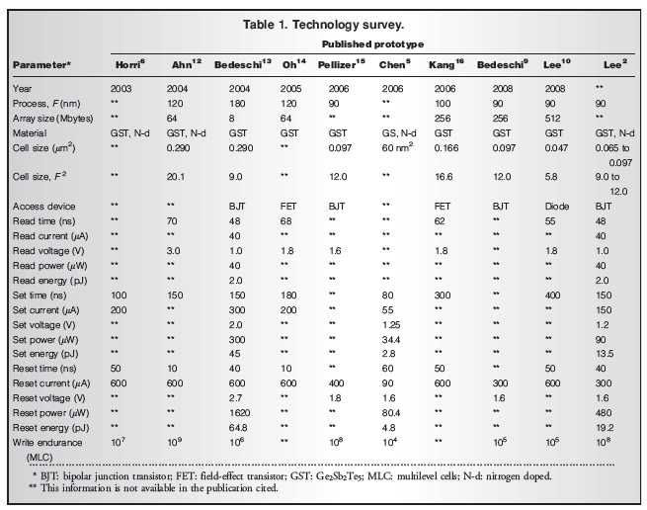

Slide 15
Phase Change Memory Properties: Latency
Latency comparable to, but slower than DRAM
Read Latency
50ns: 4x DRAM, 10⁻³x NAND Flash
Write Latency
150ns: 12x DRAM
Write Bandwidth
5-10 MB/s: 0.1x DRAM, 1x NAND Flash

Slide 16
Phase Change Memory Properties
Dynamic Energy
40 uA Rd, 150 uA Wr
2-43x DRAM, 1x NAND Flash
Endurance
Writes induce phase change at 650C
Contacts degrade from thermal expansion/contraction
10⁸ writes per cell
10⁻⁸x DRAM, 10³x NAND Flash
Cell Size
9-12F² using BJT, single-level cells
1.5x DRAM, 2-3x NAND (will scale with feature size, MLC)

Slide 17
Phase Change Memory: Pros and Cons
Pros over DRAM
Better technology scaling
Non volatility
Low idle power (no refresh)
Cons
Higher latencies: ~4-15x DRAM (especially write)
Higher active energy: ~2-50x DRAM (especially write)
Lower endurance (a cell dies after ~10⁸ writes)
Challenges in enabling PCM as DRAM replacement/helper:
Mitigate PCM shortcomings
Find the right way to place PCM in the system
Ensure secure and fault-tolerant PCM operation

Slide 18
PCM-based Main Memory: Research Challenges
Where to place PCM in the memory hierarchy?
Hybrid OS controlled PCM-DRAM
Hybrid OS controlled PCM and hardware-controlled DRAM
Pure PCM main memory
How to mitigate shortcomings of PCM?
How to minimize amount of DRAM in the system?
How to take advantage of (byte-addressable and fast) non-volatile main memory?
Can we design specific-NVM-technology-agnostic techniques?

Slide 19
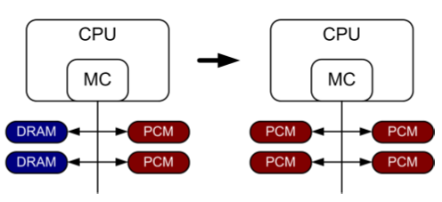
PCM-based Main Memory (I)
How should PCM-based (main) memory be organized?
Hybrid PCM+DRAM [Qureshi+ ISCA’09, Dhiman+ DAC’09, Meza+ IEEE CAL’12]:
How to partition/migrate data between PCM and DRAM

Slide 20
Hybrid Memory Systems: Challenges
Partitioning
Should DRAM be a cache or main memory, or configurable?
What fraction? How many controllers?
Data allocation/movement (energy, performance, lifetime)
Who manages allocation/movement?
What are good control algorithms?
How do we prevent degradation of service due to wearout?
Design of cache hierarchy, memory controllers, OS
Mitigate PCM shortcomings, exploit PCM advantages
Design of PCM/DRAM chips and modules
Rethink the design of PCM/DRAM with new requirements

Slide 21
PCM-based Main Memory (II)
How should PCM-based (main) memory be organized?
Pure PCM main memory [Lee et al., ISCA’09, Top Picks’10]:
How to redesign entire hierarchy (and cores) to overcome PCM shortcomings

Slide 22
Aside: STT-RAM Basics
Magnetic Tunnel Junction (MTJ)
Reference layer: Fixed
Free layer: Parallel or anti-parallel
Cell
Access transistor, bit/sense lines
Read and Write
Read: Apply a small voltage across bitline and senseline; read the current.
Write: Push large current through MTJ. Direction of current determines new orientation of the free layer.
Kultursay et al., “Evaluating STT-RAM as an Energy-Efficient Main Memory Alternative,” ISPASS 2013
Logical 0
Reference Layer
Barrier
Free Layer
Logical 1
Reference Layer
Barrier
Free Layer
Word Line
MTJ
Access
Transistor
Bit Line
Sense Line
Notes:
Moving from DRAM to STT-RAM, instead of a capacitor that stores charge, now we have a magnetic tunnel junction that has one reference layer with a fixed magnetic orientation, and a free layer that can be parallel or anti parallel to the reference layer; which determines the resistance, and in turn, the data stored in the MTJ. In addition to the MTJ, the cell, again, has an access transistor.
Reading requires a small voltage to be applied across the bitline and sense line; and the current is sensed. This current varies depending on the resistance of MTJ. To write data, we push a large current into the MTJ, which re-aligns the free layer. The direction of the current determines whether it becomes parallel or anti-parallel; i.e. logical 0 or 1.

Slide 23
Aside: STT MRAM: Pros and Cons
Pros over DRAM
Better technology scaling
Non volatility
Low idle power (no refresh)
Cons
Higher write latency
Higher write energy
Reliability?
Another level of freedom
Can trade off non-volatility for lower write latency/energy (by reducing the size of the MTJ)

Slide 24
Agenda
Major Trends Affecting Main Memory
Requirements from an Ideal Main Memory System
Opportunity: Emerging Memory Technologies
Background
PCM (or Technology X) as DRAM Replacement
Hybrid Memory Systems
Conclusions
Discussion

Slide 25
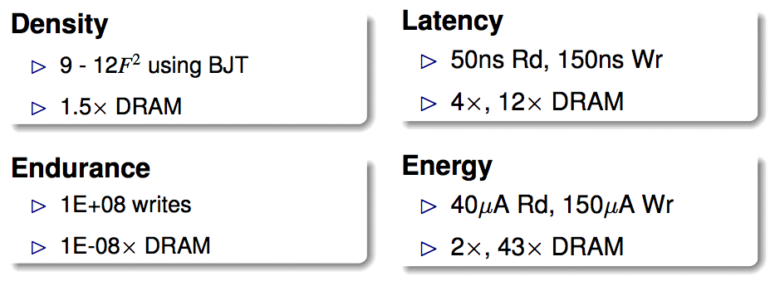
An Initial Study: Replace DRAM with PCM
Lee, Ipek, Mutlu, Burger, “Architecting Phase Change Memory as a Scalable DRAM Alternative,” ISCA 2009.
Surveyed prototypes from 2003-2008 (e.g. IEDM, VLSI, ISSCC)
Derived “average” PCM parameters for F=90nm

Slide 26
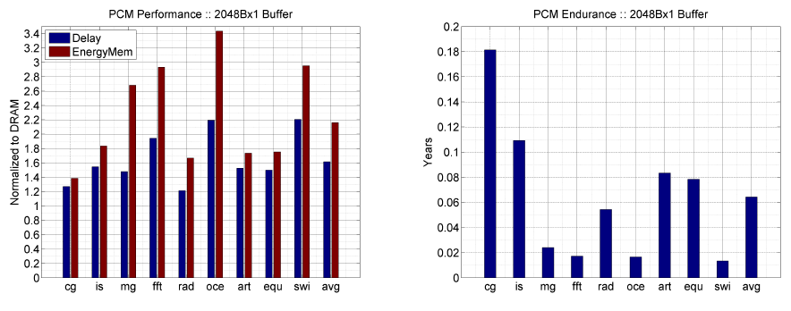
Results: Naïve Replacement of DRAM with PCM
Replace DRAM with PCM in a 4-core, 4MB L2 system
PCM organized the same as DRAM: row buffers, banks, peripherals
1.6x delay, 2.2x energy, 500-hour average lifetime
Lee, Ipek, Mutlu, Burger, “Architecting Phase Change Memory as a Scalable DRAM Alternative,” ISCA 2009.

Slide 27
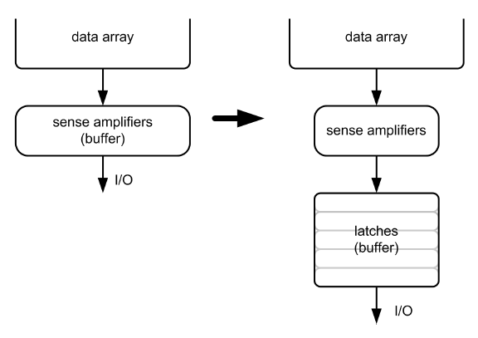
Architecting PCM to Mitigate Shortcomings
Idea 1: Use multiple narrow row buffers in each PCM chip
→ Reduces array reads/writes → better endurance, latency, energy
Idea 2: Write into array at
cache block or word
granularity
→ Reduces unnecessary wear
DRAM
PCM

Slide 28
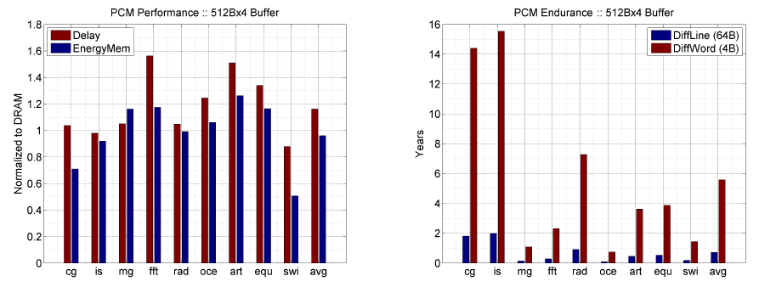
Results: Architected PCM as Main Memory
1.2x delay, 1.0x energy, 5.6-year average lifetime
Scaling improves energy, endurance, density
Caveat 1: Worst-case lifetime is much shorter (no guarantees)
Caveat 2: Intensive applications see large performance and energy hits
Caveat 3: Optimistic PCM parameters?

Slide 29
Agenda
Major Trends Affecting Main Memory
Requirements from an Ideal Main Memory System
Opportunity: Emerging Memory Technologies
Background
PCM (or Technology X) as DRAM Replacement
Hybrid Memory Systems
Conclusions
Discussion

Slide 30
Hybrid Memory Systems
CPU
Meza, Chang, Yoon, Mutlu, Ranganathan, “Enabling Efficient and Scalable Hybrid Memories,” IEEE Comp. Arch. Letters, 2012.
DRAMCtrl
PCM Ctrl
DRAM
Phase Change Memory (or Tech. X)
Fast, durable
Small,
leaky, volatile,
high-cost
Large, non-volatile, low-cost
Slow, wears out, high active energy
Hardware/software manage data allocation and movement
to achieve the best of multiple technologies

Slide 31
One Option: DRAM as a Cache for PCM
PCM is main memory; DRAM caches memory rows/blocks
Benefits: Reduced latency on DRAM cache hit; write filtering
Memory controller hardware manages the DRAM cache
Benefit: Eliminates system software overhead
Three issues:
What data should be placed in DRAM versus kept in PCM?
What is the granularity of data movement?
How to design a low-cost hardware-managed DRAM cache?
Two idea directions:
Locality-aware data placement [Yoon+ , ICCD 2012]
Cheap tag stores and dynamic granularity [Meza+, IEEE CAL 2012]

Slide 32
Row Buffer Locality Aware Caching Policies for Hybrid Memories
HanBin Yoon
Justin Meza
Rachata Ausavarungnirun Rachael Harding
Onur Mutlu

Slide 33
Hybrid Memory: A Closer Look
CPU
Memory channel
MC
MC
Row buffer
Bank
Bank
Bank
Bank
DRAM
(small capacity cache)
PCM (large capacity store)
Notes:
Here’s a closer look at a hybrid memory system employing both DRAM and PCM.
Typically, the DRAM is used as a small capacity cache, and the PCM is used as a large capacity store.
When the processor needs data, it will first look to see if the data is in DRAM. If the data is indeed in DRAM, the processor will retrieve the data from there. If the data is not in DRAM, the processor will retrieve the data from PCM.
Both DRAM and PCM are organized into banks that are capable of operating independently. Also, in each bank, there are peripheral circuitries known as the row buffers.

Slide 34
Key Observation
Row buffers exist in both DRAM and PCM
Row hit latency similar in DRAM & PCM [Lee+ ISCA’09]
Row miss latency small in DRAM, large in PCM
Place data in DRAM which
is likely to miss in the row buffer (low row buffer locality)→ miss penalty is smaller in DRAM
AND
is reused many times → cache only the data worth the movement cost and DRAM space
Notes:
Our key observation is that row buffers exist in both DRAM and PCM.
Row hit latency, which does not access the memory cell array, is similar in DRAM and PCM.
It is for a row miss that the memory access latency is small in DRAM and large in PCM.
Therefore we would like to place data in DRAM which:
Is likely to miss in the row buffer, which we call as having low row buffer locality, since the row buffer miss penalty is small in DRAM than it is in PCM.
And we would like to place data in DRAM which is reused many times, so that we cache only the data that is worth the movement cost.

Slide 35
RBL-Awareness: An Example
Let’s say a processor accesses four rows
Row A
Row B
Row C
Row D
Notes:
Let’s look at an example how row buffer locality affects hybrid memory performance.
Let’s say a processor accesses four rows…

Slide 36
RBL-Awareness: An Example
Let’s say a processor accesses four rows with different row buffer localities (RBL)
Row A
Row B
Row C
Row D
Low RBL
(Frequently miss
in row buffer)
High RBL
(Frequently hit
in row buffer)
Case 1: RBL-Unaware Policy (state-of-the-art)
Case 2: RBL-Aware Policy (RBLA)
Notes:
With different row buffer localities.
Rows A and B have low row buffer locality, which means that they frequently miss in the row buffer, and rows C and D have high row buffer locality, which means that they frequently hit in the row buffer.
We will look at two types of caching policies: Case 1 will be row buffer locality unaware, and case 2 will be row buffer locality aware.

Slide 37
Case 1: RBL-Unaware Policy
A row buffer locality-unaware policy could
place these rows in the following manner
Row C
Row A
Row D
Row B
DRAM (High RBL)
PCM (Low RBL)
Notes:
Here’s Case 1: The row buffer locality unaware policy.
A row buffer locality unaware policy could place rows A, B, C, and D in the following manner, where rows with high row buffer locality are placed in DRAM, and rows with low row buffer locality are placed in PCM.

Slide 38
Case 1: RBL-Unaware Policy
Access pattern to main memory:
A (oldest), B, C, C, C, A, B, D, D, D, A, B (youngest)
DRAM (High RBL)
time
C
C
C
D
D
D
PCM (Low RBL)
A
B
A
B
A
B
RBL-Unaware: Stall time is 6 PCM device accesses
Notes:
For such a policy, this diagram shows the amount of time it takes to serve a stream of memory requests.
This is the access pattern to memory.
Clearly, the high row buffer miss latency of PCM acts as a bottleneck to serving all of the memory requests, and this happens because the rows with low row buffer locality is placed in PCM.

Slide 39
Case 2: RBL-Aware Policy (RBLA)
A row buffer locality-aware policy would place these rows in the opposite manner
Row A
Row C
Row B
Row D
DRAM (Low RBL)
PCM (High RBL)
→ Access data at lower row buffer miss latency of DRAM
→ Access data at low row buffer hit latency of PCM
Notes:
Here’s Case 2: The row buffer locality aware policy, or RBLA.
A row buffer locality aware policy would place these rows in the following manner, where the rows with low row buffer locality are placed in DRAM, since the data can be accessed at the lower row buffer miss latency of DRAM.
Rows with high row buffer locality will be placed in PCM, since data can be frequently accessed at the low row buffer hit latency of PCM.

Slide 40
Case 2: RBL-Aware Policy (RBLA)
Access pattern to main memory:
A (oldest), B, C, C, C, A, B, D, D, D, A, B (youngest)
DRAM (High RBL)
time
C
C
C
D
D
D
PCM (Low RBL)
A
B
A
B
A
B
RBL-Unaware: Stall time is 6 PCM device accesses
DRAM (Low RBL)
A
B
A
B
A
B
PCM (High RBL)
C
C
C
D
D
D
Saved cycles
RBL-Aware: Stall time is 6 DRAM device accesses
Notes:
Now we compare the two policies in terms of the time it takes to serve the same stream of memory requests.
Remember, this was the timeline shown before for the row buffer locality-unaware policy.
For case 2, the row buffer locality aware policy, although the PCM row buffer miss latency is high, many of the accesses to PCM are row buffer hit accesses that can be served quickly.
And overall, it takes less time to serve all of the memory requests in the row buffer locality aware policy.
The row buffer locality aware policy gains because it places rows with low row buffer locality in DRAM.
This is the goal of our mechanism: To place rows with low row buffer locality in DRAM.

Slide 41
Our Mechanism: RBLA
For recently used rows in PCM:
Count row buffer misses as indicator of row buffer locality (RBL)
Cache to DRAM rows with misses ≥ threshold
Row buffer miss counts are periodically reset (only cache rows with high reuse)
Notes:
Our Mechanism is called RBLA, which stands for row buffer locality aware.
For recently used rows in PCM, our mechanism counts row buffer misses as indicator of row buffer locality of each row.
I will talk more about how this is physically achieved.
Then, we cache to DRAM rows with row buffer miss counts that exceed a certain threshold.
And row buffer miss counts are periodically reset, so that we only cache rows with high reuse.
That is our base mechanism, RBLA.

Slide 42
Our Mechanism: RBLA-Dyn
For recently used rows in PCM:
Count row buffer misses as indicator of row buffer locality (RBL)
Cache to DRAM rows with misses ≥ threshold
Row buffer miss counts are periodically reset (only cache rows with high reuse)
Dynamically adjust threshold to adapt to workload/system characteristics
Interval-based cost-benefit analysis
Notes:
We also extend RBLA to RBLA-Dyn, which performs an extra step.
RBLA-Dyn dynamically adjusts the threshold value to adapt to different workload and system characteristics.
This is based on an interval-based cost-benefit analysis, for which the details can be found in the paper.
I would encourage you to read the paper, and I’d be happy to answer any questions.

Slide 43
Implementation: “Statistics Store”
Goal: To keep count of row buffer misses to recently used rows in PCM
Hardware structure in memory controller
Operation is similar to a cache
Input: row address
Output: row buffer miss count
128-set 16-way statistics store (9.25KB) achieves system performance within 0.3% of an unlimited-sized statistics store
Notes:
The implementation of our mechanism requires a statistics store, or what we simply call a stats store.
The goal of the stats store is to keep count of the row buffer misses to recently used rows in PCM.
The stats store is a hardware structure in the memory controller, and its operation is similar to a cache.
It is organized into sets and ways, and is indexed using the row address of the row we wish to find the row buffer miss count for.
If the queried row is currently in the stats store, then its row buffer miss count will be output.
We find that a 128-set 16-way stats store, 9.25KB in size, achieves system performance within 0.3% of an unlimited-sized stats store.

Slide 44
Evaluation Methodology
Cycle-level x86 CPU-memory simulator
CPU: 16 out-of-order cores, 32KB private L1 per core, 512KB shared L2 per core
Memory: 1GB DRAM (8 banks), 16GB PCM (8 banks), 4KB migration granularity
36 multi-programmed server, cloud workloads
Server: TPC-C (OLTP), TPC-H (Decision Support)
Cloud: Apache (Webserv.), H.264 (Video), TPC-C/H
Metrics: Weighted speedup (perf.), perf./Watt (energy eff.), Maximum slowdown (fairness)
Notes:
Here’s our evaluation methodology.
We use a cycle-level x86 simulator to test our hybrid memory caching policies.
We simulate a 16-core system with 1GB of DRAM and 16GB of PCM.
We use 36 multi-programmed server and cloud workloads to test our caching policies.
For server workloads, we use TPC-C, which is an online transaction processing benchmark, and TPC-H, which is a decision support benchmark.
For cloud workloads, we use Apache, which is a webserver application, and H.264, a video processing application, as well as TPC-C and H.
We report multi-core performance in terms of weighted speedup, multi-core fairness in terms of maximum slowdown, and energy efficiency in terms of performance per Watt.

Slide 45
Comparison Points
Conventional LRU Caching
FREQ: Access-frequency-based caching
Places “hot data” in cache [Jiang+ HPCA’10]
Cache to DRAM rows with accesses ≥ threshold
Row buffer locality-unaware
FREQ-Dyn: Adaptive Freq.-based caching
FREQ + our dynamic threshold adjustment
Row buffer locality-unaware
RBLA: Row buffer locality-aware caching
RBLA-Dyn: Adaptive RBL-aware caching
Notes:
And here are our comparison points.
The standard conventional LRU caching caches any row from PCM to DRAM when the data is touched. We find this scheme to generate too much data movement between DRAM and PCM and consequently to not perform well. So we’re not going to use it as a comparison point in this talk.
Frek is access frequency based caching. It is inspired by prior work that selectively caches hot data.
The downsides of frek is that it is row buffer locality aware. Hence, it would place a row with high row buffer locality in DRAM, although that row may be accessed as efficiently in PCM.
Frek-Dyn augments frek with the adaptive threshold adjustment technique.
It has the same drawback as frek, in that it is row buffer locality unaware.
Our mechanisms, RBLA and RBLA-Dyn, are specifically designed to be aware of row buffer locality and to exploit it.

Slide 46
System Performance
10%
14%
17%
Benefit 1: Increased row buffer locality (RBL) in PCM by moving low RBL data to DRAM
Benefit 1: Increased row buffer locality (RBL) in PCM by moving low RBL data to DRAM
Benefit 2: Reduced memory bandwidth consumption due to stricter caching criteria
Benefit 2: Reduced memory bandwidth consumption due to stricter caching criteria
Benefit 3: Balanced memory request load between DRAM and PCM
Notes:
Here are the system performance results of the different hybrid memory caching policies.
RBLA-Dyn achieves 17% performance improvement over frek in server workloads, 10% in cloud, and 14% overall.
This is due to a number of reasons.
The first is that RBLA-Dyn increases row buffer locality in PCM by moving low row buffer locality data to DRAM.
The second is that RBLA-Dyn reduces memory bandwidth consumption due its stricter caching criteria.
And RBLA-Dyn also has the effect of balancing the memory request load between DRAM and PCM by letting rows with high row buffer locality remain in PCM, instead of fetching all accessed data to DRAM.

Slide 47
Average Memory Latency
14%
12%
9%
Notes:
These benefits are also reflected in the average memory latency, which RBLA-Dyn reduces by 14% over frek in server workloads, by 9% in cloud, and by 12% overall.

Slide 48
Memory Energy Efficiency
13%
7%
10%
Increased performance & reduced data movement between DRAM and PCM
Notes:
RBLA-Dyn improves memory system energy efficiency by 13% in server workloads, 7% in cloud, and 10% overall.
This is partly due to the increased system performance, and partly due to the reduced data movement between DRAM and PCM because of RBLA-Dyn’s stricter caching criteria.

Slide 49
Thread Fairness
7.6%
6.2%
4.8%
Notes:
And our mechanism also improves multi-core thread fairness by 7.6% in server workloads, by 4.8% in cloud, and by 6.2% overall.

Slide 50
Compared to All-PCM/DRAM
29%
31%
Our mechanism achieves 31% better performance than all PCM, within 29% of all DRAM performance
Notes:
Now let’s compare our mechanism to a homogeneous memory system.
Here the comparison points are a 16GB all-PCM and all-DRAM memory system.
Our mechanism achieves 31% better performance than the all-PCM memory system, and comes within 29% of the all-DRAM performance.
Note that we do not assume any capacity benefits of PCM over DRAM.
And yet, our mechanism bridges the performance gap between the two homogeneous memory systems.
If the capacity benefit of PCM was included, the hybrid memory system will perform even better.

Slide 51
Summary
Different memory technologies have different strengths
A hybrid memory system (DRAM-PCM) aims for best of both
Problem: How to place data between these heterogeneous memory devices?
Observation: PCM array access latency is higher than DRAM’s – But peripheral circuit (row buffer) access latencies are similar
Key Idea: Use row buffer locality (RBL) as a key criterion for data placement
Solution: Cache to DRAM rows with low RBL and high reuse
Improves both performance and energy efficiency over state-of-the-art caching policies
Notes:
Here’s a one-slide summary of what I’ll describe.
Different memory technologies have different strengths and weaknesses.
A hybrid memory system, for example, one that combines DRAM and Phase Change Memory, aims for the best of both memory technologies.
The Problem is how to place data between these heterogeneous devices in a way that exploits each memory technology’s strengths while minimizing its weaknesses.
Our key observation is that PCM array access latency is higher than DRAM’s, but peripheral circuit access latencies, or what is called row buffer access latencies, are similar.
Our key idea is to use row buffer locality as a key criterion for data placement in a hybrid memory system.
Our solution is to cache to DRAM rows with low row buffer locality and high reuse because these are the rows that would benefit most from DRAM.
This improves both performance and energy efficiency over state-of-the-art caching policies for hybrid memories.

Slide 52
Row Buffer Locality Aware Caching Policies for Hybrid Memories
HanBin Yoon
Justin Meza
Rachata Ausavarungnirun Rachael Harding
Onur Mutlu

Slide 53
Agenda
Major Trends Affecting Main Memory
Requirements from an Ideal Main Memory System
Opportunity: Emerging Memory Technologies
Background
PCM (or Technology X) as DRAM Replacement
Hybrid Memory Systems
Row-Locality Aware Data Placement
Efficient DRAM (or Technology X) Caches
Conclusions
Discussion

Slide 54
The Problem with Large DRAM Caches
A large DRAM cache requires a large metadata (tag + block-based information) store
How do we design an efficient DRAM cache?
CPU
LOAD X
Metadata:
X → DRAM
Mem Ctlr
Mem Ctlr
DRAM
PCM
X
(small, fast cache)
(high capacity)
Access X

Slide 55
Idea 1: Tags in Memory
Store tags in the same row as data in DRAM
Store metadata in same row as their data
Data and metadata can be accessed together
Benefit: No on-chip tag storage overhead
Downsides:
Cache hit determined only after a DRAM access
Cache hit requires two DRAM accesses
DRAM row
Cache block 0
Cache block 1
Cache block 2
Tag0
Tag1
Tag2

Slide 56
Idea 2: Cache Tags in SRAM
Recall Idea 1: Store all metadata in DRAM
To reduce metadata storage overhead
Idea 2: Cache in on-chip SRAM frequently-accessed metadata
Cache only a small amount to keep SRAM size small

Slide 57
Idea 3: Dynamic Data Transfer Granularity
Some applications benefit from caching more data
They have good spatial locality
Others do not
Large granularity wastes bandwidth and reduces cache utilization
Idea 3: Simple dynamic caching granularity policy
Cost-benefit analysis to determine best DRAM cache block size
Group main memory into sets of rows
Some row sets follow a fixed caching granularity
The rest of main memory follows the best granularity
Cost–benefit analysis: access latency versus number of cachings
Performed every quantum

Slide 58
TIMBER Tag Management
A Tag-In-Memory BuffER (TIMBER)
Stores recently-used tags in a small amount of SRAM
Benefits: If tag is cached:
no need to access DRAM twice
cache hit determined quickly
DRAM row
Cache block 0
Cache block 1
Cache block 2
Tag0
Tag1
Tag2
Row Tag
Row0
Tag0
Tag1
Tag2
LOAD X
Row27
Tag0
Tag1
Tag2

Slide 59
TIMBER Tag Management Example (I)
Case 1: TIMBER hit
Our proposal
TIMBER: X → DRAM
Row0
Tag0
Tag1
Tag2
Row27
Tag0
Tag1
Tag2
CPU
LOAD X
Mem Ctlr
Mem Ctlr
Bank
Bank
Bank
Bank
X
Access X

Slide 60
TIMBER Tag Management Example (II)
Case 2: TIMBER miss
2. Cache M(Y)
Access Metadata(Y)
Y → DRAM
Row0
Tag0
Tag1
Tag2
Row27
Tag0
Tag1
Tag2
CPU
Row143
Miss
LOAD Y
Mem Ctlr
Mem Ctlr
Bank
Bank
Bank
Bank
Y
M(Y)
1. Access M(Y)
3. Access Y (row hit)

Slide 61
Methodology
System: 8 out-of-order cores at 4 GHz
Memory: 512 MB direct-mapped DRAM, 8 GB PCM
128B caching granularity
DRAM row hit (miss): 200 cycles (400 cycles)
PCM row hit (clean / dirty miss): 200 cycles (640 / 1840 cycles)
Evaluated metadata storage techniques
All SRAM system (8MB of SRAM)
Region metadata storage
TIM metadata storage (same row as data)
TIMBER, 64-entry direct-mapped (8KB of SRAM)

Slide 62
Metadata Storage Performance
(Ideal)

Slide 63
Metadata Storage Performance
Performance degrades due to increased metadata lookup access latency
-48%
(Ideal)

Slide 64
Metadata Storage Performance
Increased row locality reduces average memory access latency
36%
(Ideal)

Slide 65
Metadata Storage Performance
Data with locality can access metadata at SRAM latencies
23%
(Ideal)

Slide 66
Dynamic Granularity Performance
10%
Reduced channel contention and improved spatial locality

Slide 67
TIMBER Performance
-6%
Reduced channel contention and improved spatial locality
Meza, Chang, Yoon, Mutlu, Ranganathan, “Enabling Efficient and Scalable Hybrid Memories,” IEEE Comp. Arch. Letters, 2012.

Slide 68
TIMBER Energy Efficiency
18%
Fewer migrations reduce transmitted data and channel contention
Meza, Chang, Yoon, Mutlu, Ranganathan, “Enabling Efficient and Scalable Hybrid Memories,” IEEE Comp. Arch. Letters, 2012.

Slide 69
Enabling and Exploiting NVM: Issues
Many issues and ideas from technology layer to algorithms layer
Enabling NVM and hybrid memory
How to tolerate errors?
How to enable secure operation?
How to tolerate performance and power shortcomings?
How to minimize cost?
Exploiting emerging technologies
How to exploit non-volatility?
How to minimize energy consumption?
How to exploit NVM on chip?
Problems
Algorithms
Programs
User
Runtime System
(VM, OS, MM)
ISA
Microarchitecture
Logic
Devices

Slide 70
Security Challenges of Emerging Technologies
1. Limited endurance → Wearout attacks
2. Non-volatility → Data persists in memory after powerdown
→ Easy retrieval of privileged or private information
3. Multiple bits per cell → Information leakage (via side channel)

Slide 71
Securing Emerging Memory Technologies
1. Limited endurance → Wearout attacks
Better architecting of memory chips to absorb writes
Hybrid memory system management
Online wearout attack detection
2. Non-volatility → Data persists in memory after powerdown
→ Easy retrieval of privileged or private information
Efficient encryption/decryption of whole main memory
Hybrid memory system management
3. Multiple bits per cell → Information leakage (via side channel)
System design to hide side channel information

Slide 72
Agenda
Major Trends Affecting Main Memory
Requirements from an Ideal Main Memory System
Opportunity: Emerging Memory Technologies
Background
PCM (or Technology X) as DRAM Replacement
Hybrid Memory Systems
Conclusions
Discussion

Slide 73
Summary: Memory Scaling (with NVM)
Main memory scaling problems are a critical bottleneck for system performance, efficiency, and usability
Solution 1: Tolerate DRAM (yesterday)
Solution 2: Enable emerging memory technologies
Replace DRAM with NVM by architecting NVM chips well
Hybrid memory systems with automatic data management
An exciting topic with many other solution directions & ideas
Hardware/software/device cooperation essential
Memory, storage, controller, software/app co-design needed
Coordinated management of persistent memory and storage
Application and hardware cooperative management of NVM

Slide 74
Scalable Many-Core Memory Systems Topic 2: Emerging Technologies and Hybrid Memories
Prof. Onur Mutlu
http://www.ece.cmu.edu/~omutlu
onur@cmu.edu
HiPEAC ACACES Summer School 2013
July 15-19, 2013

Slide 75
Additional Material

Slide 76
Overview Papers on Two Topics
Merging of Memory and Storage
Justin Meza, Yixin Luo, Samira Khan, Jishen Zhao, Yuan Xie, and Onur Mutlu, "A Case for Efficient Hardware-Software Cooperative Management of Storage and Memory" Proceedings of the 5th Workshop on Energy-Efficient Design (WEED), Tel-Aviv, Israel, June 2013. Slides (pptx) Slides (pdf)
Flash Memory Scaling
Yu Cai, Gulay Yalcin, Onur Mutlu, Erich F. Haratsch, Adrian Cristal, Osman Unsal, and Ken Mai, "Error Analysis and Retention-Aware Error Management for NAND Flash Memory" Intel Technology Journal (ITJ) Special Issue on Memory Resiliency, Vol. 17, No. 1, May 2013.

