Slide 1



Memory Systems and Memory-Centric Computing Systems
Lecture 2, Topic 1: Memory Trends and Basics
Prof. Onur Mutlu
omutlu@gmail.com
https://people.inf.ethz.ch/omutlu
10 July 2018
HiPEAC ACACES Summer School 2018

Slide 2
What Will You Learn in This Course?
Memory Systems and Memory-Centric Computing Systems
  July 9-13, 2018
Topic 1: Main Memory Trends and Basics
Topic 2: Memory Reliability & Security: RowHammer and Beyond
Topic 3: In-memory Computation
Topic 4: Low-Latency and Low-Energy Memory
Topic 5 (unlikely): Enabling and Exploiting Non-Volatile Memory
Topic 6 (unlikely): Flash Memory and SSD Scaling
Major Overview Reading:
  Mutlu and Subramanian, “Research Problems and Opportunities in Memory Systems,” SUPERFRI 2014.

Slide 3
Multiple Banks (Interleaving) and Channels
Multiple banks
  Enable concurrent DRAM accesses
  Bits in address determine which bank an address resides in
Multiple independent channels serve the same purpose
  But they are even better because they have separate data buses
  Increased bus bandwidth
Enabling more concurrency requires reducing
  Bank conflicts
  Channel conflicts
How to select/randomize bank/channel indices in address?
  Lower order bits have more entropy
  Randomizing hash functions (XOR of different address bits)

Slide 4
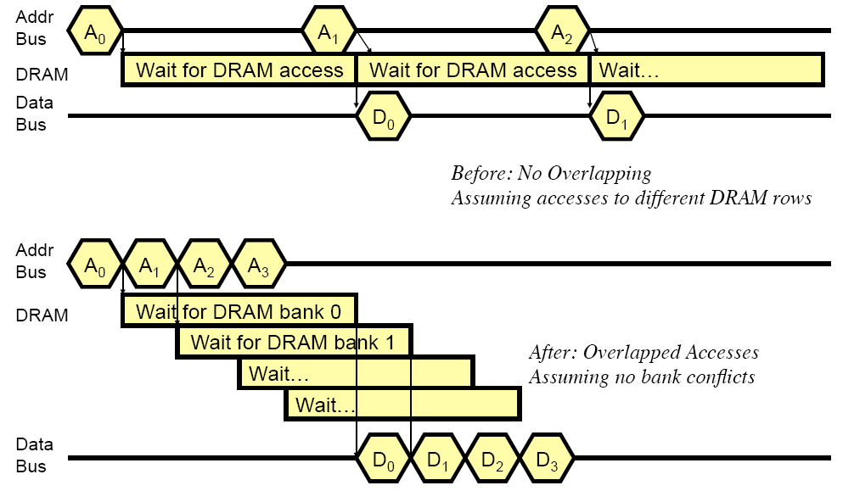
How Multiple Banks Help

Slide 5
Address Mapping (Single Channel)
Single-channel system with 8-byte memory bus
  2GB memory, 8 banks, 16K rows & 2K columns per bank
Row interleaving
  Consecutive rows of memory in consecutive banks
  Accesses to consecutive cache blocks serviced in a pipelined manner
Cache block interleaving
    Consecutive cache block addresses in consecutive banks
    64 byte cache blocks
    Accesses to consecutive cache blocks can be serviced in parallel
Row (14 bits)
Bank (3 bits)
Column (11 bits)
Byte in bus (3 bits)
Row (14 bits)
High Column
Bank (3 bits)
Low Col.
Byte in bus (3 bits)
8 bits
3 bits

Slide 6
Bank Mapping Randomization
DRAM controller can randomize the address mapping to banks so that bank conflicts are less likely
Reading:
  Rau, “Pseudo-randomly Interleaved Memory,” ISCA 1991.
3 bits
Column (11 bits)
Byte in bus (3 bits)
XOR
Bank index (3 bits)

Slide 7
Address Mapping (Multiple Channels)
C
Row (14 bits)
Bank (3 bits)
Column (11 bits)
Byte in bus (3 bits)
Where are consecutive cache blocks?
Row (14 bits)
C
Bank (3 bits)
Column (11 bits)
Byte in bus (3 bits)
Row (14 bits)
Bank (3 bits)
C
Column (11 bits)
Byte in bus (3 bits)
Row (14 bits)
Bank (3 bits)
Column (11 bits)
C
Byte in bus (3 bits)
C
Row (14 bits)
High Column
Bank (3 bits)
Low Col.
Byte in bus (3 bits)
8 bits
3 bits
Row (14 bits)
C
High Column
Bank (3 bits)
Low Col.
Byte in bus (3 bits)
8 bits
3 bits
Row (14 bits)
High Column
C
Bank (3 bits)
Low Col.
Byte in bus (3 bits)
8 bits
3 bits
Row (14 bits)
High Column
Bank (3 bits)
C
Low Col.
Byte in bus (3 bits)
8 bits
3 bits
Row (14 bits)
High Column
Bank (3 bits)
Low Col.
C
Byte in bus (3 bits)
8 bits
3 bits

Slide 8
Interaction with Virtual→Physical Mapping
Operating System influences where an address maps to in DRAM
Operating system can influence which bank/channel/rank a virtual page is mapped to.
It can perform page coloring to
  Minimize bank conflicts
  Minimize inter-application interference [Muralidhara+ MICRO’11]
  Minimize latency in the network [Das+ HPCA’13]
Virtual Page number (52 bits)
Page offset (12 bits)
VA
Physical Frame number (19 bits)
Page offset (12 bits)
PA
Row (14 bits)
Bank (3 bits)
Column (11 bits)
Byte in bus (3 bits)
PA

Slide 9
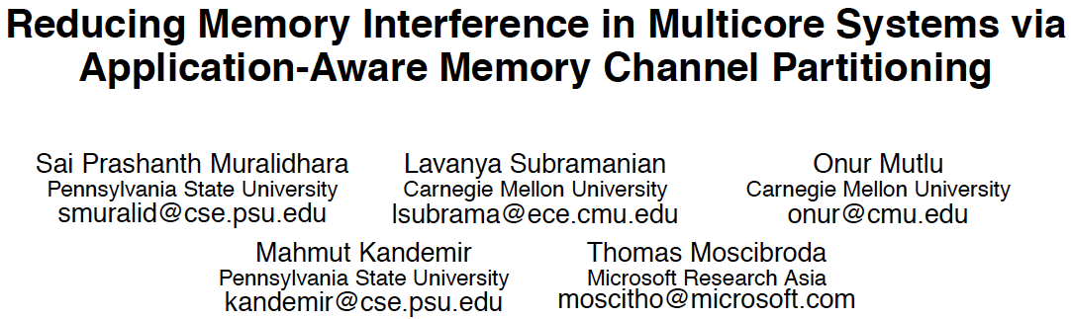
Memory Channel Partitioning
Sai Prashanth Muralidhara, Lavanya Subramanian, Onur Mutlu, Mahmut Kandemir, and Thomas Moscibroda,
"Reducing Memory Interference in Multicore Systems via Application-Aware Memory Channel Partitioning"
Proceedings of the 44th International Symposium on Microarchitecture (MICRO), Porto Alegre, Brazil, December 2011. Slides (pptx)

Slide 10
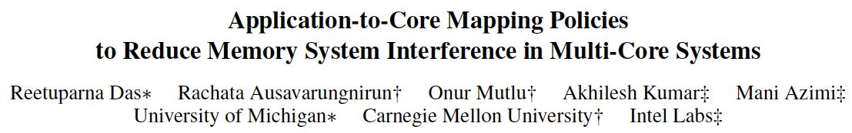
Application-to-Core Mapping
Reetuparna Das, Rachata Ausavarungnirun, Onur Mutlu, Akhilesh Kumar, and Mani Azimi,
"Application-to-Core Mapping Policies to Reduce Memory System Interference in Multi-Core Systems"
Proceedings of the 19th International Symposium on High-Performance Computer Architecture (HPCA), Shenzhen, China, February 2013. Slides (pptx)

Slide 11
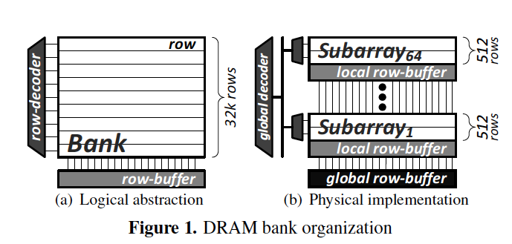
More on Reducing Bank Conflicts
Read Sections 1 through 4 of:
  Kim et al., “A Case for Exploiting Subarray-Level Parallelism in DRAM,” ISCA 2012.

Slide 12
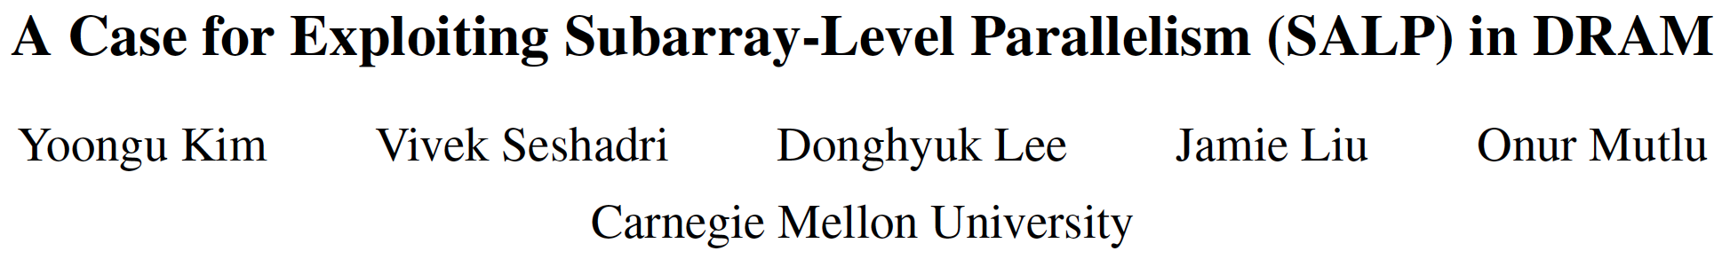
Subarray Level Parallelism
Yoongu Kim, Vivek Seshadri, Donghyuk Lee, Jamie Liu, and Onur Mutlu,
"A Case for Exploiting Subarray-Level Parallelism (SALP) in DRAM"
Proceedings of the 39th International Symposium on Computer Architecture (ISCA), Portland, OR, June 2012. Slides (pptx)

Slide 13
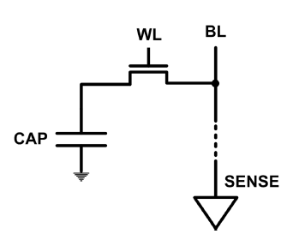
DRAM Refresh (I)
DRAM capacitor charge leaks over time
The memory controller needs to read each row periodically to restore the charge
  Activate + precharge each row every N ms
  Typical N = 64 ms
Implications on performance?
  -- DRAM bank unavailable while refreshed
  -- Long pause times: If we refresh all rows in burst, every 64ms the DRAM will be unavailable until refresh ends
Burst refresh: All rows refreshed immediately after one another
Distributed refresh: Each row refreshed at a different time, at regular intervals

Slide 14
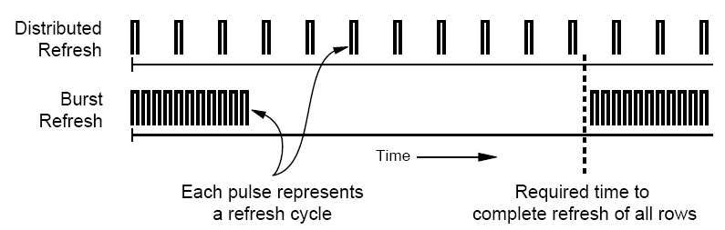
DRAM Refresh (II)
Distributed refresh eliminates long pause times
How else we can reduce the effect of refresh on performance?
  Can we reduce the number of refreshes?

Slide 15
Downsides of DRAM Refresh
-- Energy consumption: Each refresh consumes energy
-- Performance degradation: DRAM rank/bank unavailable while refreshed
-- QoS/predictability impact: (Long) pause times during refresh
-- Refresh rate limits DRAM density scaling
  Liu et al., “RAIDR: Retention-aware Intelligent DRAM Refresh,” ISCA 2012.

Slide 16
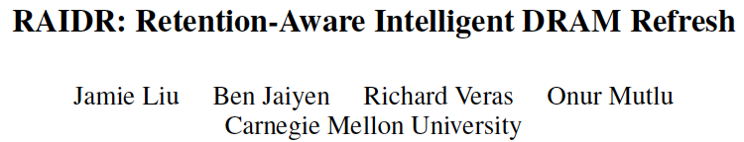
More on DRAM Refresh
Jamie Liu, Ben Jaiyen, Richard Veras, and Onur Mutlu,
"RAIDR: Retention-Aware Intelligent DRAM Refresh"
Proceedings of the 39th International Symposium on Computer Architecture (ISCA), Portland, OR, June 2012. Slides (pdf)

Slide 17
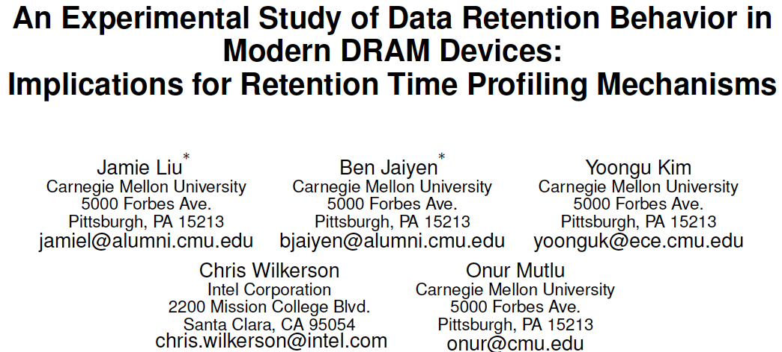
DRAM Retention Analysis
Jamie Liu, Ben Jaiyen, Yoongu Kim, Chris Wilkerson, and Onur Mutlu,
"An Experimental Study of Data Retention Behavior in Modern DRAM Devices: Implications for Retention Time Profiling Mechanisms"
Proceedings of the 40th International Symposium on Computer Architecture (ISCA), Tel-Aviv, Israel, June 2013. Slides (ppt) Slides (pdf)

Slide 18

Data Retention in Memory [Liu et al., ISCA 2013]
Data Retention Time Profile of DRAM looks like this:
Location dependent
Stored value pattern dependent
Time dependent

Slide 19
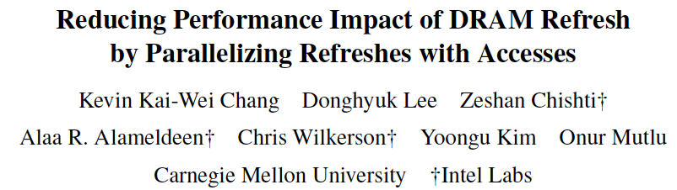
DRAM Refresh-Access Parallelization
Kevin Chang, Donghyuk Lee, Zeshan Chishti, Alaa Alameldeen, Chris Wilkerson, Yoongu Kim, and Onur Mutlu,
"Improving DRAM Performance by Parallelizing Refreshes with Accesses"
Proceedings of the 20th International Symposium on High-Performance Computer Architecture (HPCA), Orlando, FL, February 2014. [Summary] [Slides (pptx) (pdf)]

Slide 20
Memory Controllers

Slide 21
DRAM versus Other Types of Memories
Long latency memories have similar characteristics that need to be controlled.
The following discussion will use DRAM as an example, but many scheduling and control issues are similar in the design of controllers for other types of memories
  Flash memory
  Other emerging memory technologies
    Phase Change Memory
    Spin-Transfer Torque Magnetic Memory
  These other technologies can place other demands on the controller

Slide 22
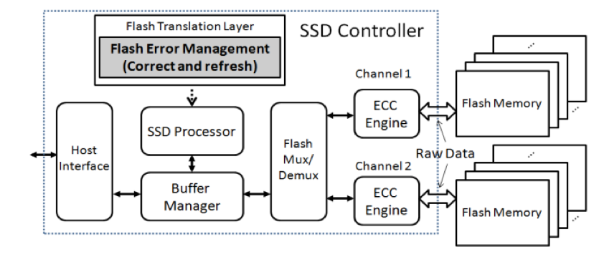
Flash Memory (SSD) Controllers
Similar to DRAM memory controllers, except:
  They are flash memory specific
  They do much more: error correction, garbage collection, page remapping, …
Cai+, “Flash Correct-and-Refresh: Retention-Aware Error Management for Increased Flash Memory Lifetime”, ICCD 2012.

Slide 23
Another View of the SSD Controller
Cai+, “Error Characterization, Mitigation, and Recovery in Flash Memory Based Solid State Drives,” Proc. IEEE 2017.
https://arxiv.org/pdf/1711.11427.pdf

Slide 24
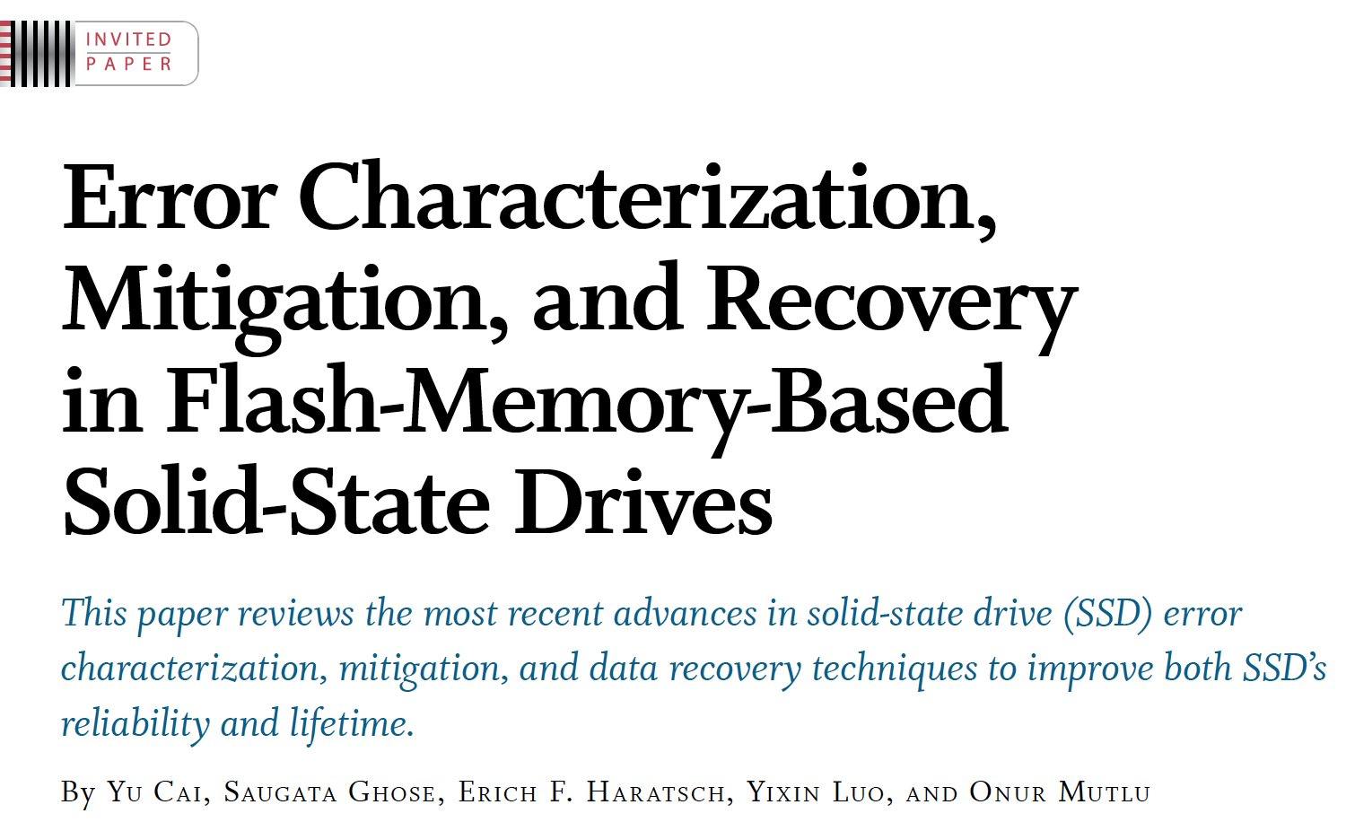
On Modern SSD Controllers (I)
Proceedings of the IEEE, Sept. 2017
https://arxiv.org/pdf/1706.08642

Slide 25
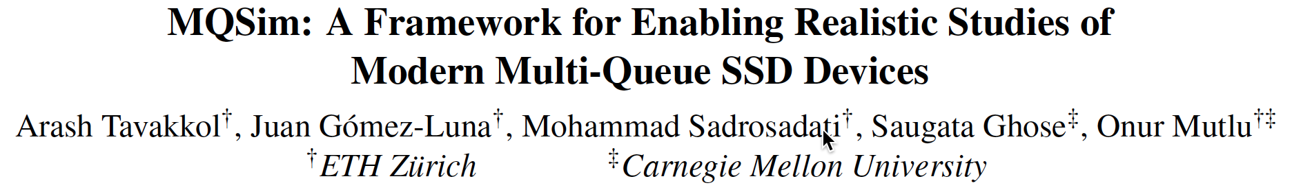
On Modern SSD Controllers (II)
Arash Tavakkol, Juan Gomez-Luna, Mohammad Sadrosadati, Saugata Ghose, and Onur Mutlu,
"MQSim: A Framework for Enabling Realistic Studies of Modern Multi-Queue SSD Devices"
Proceedings of the 16th USENIX Conference on File and Storage Technologies (FAST), Oakland, CA, USA, February 2018.
[Slides (pptx) (pdf)]
[Source Code]

Slide 26
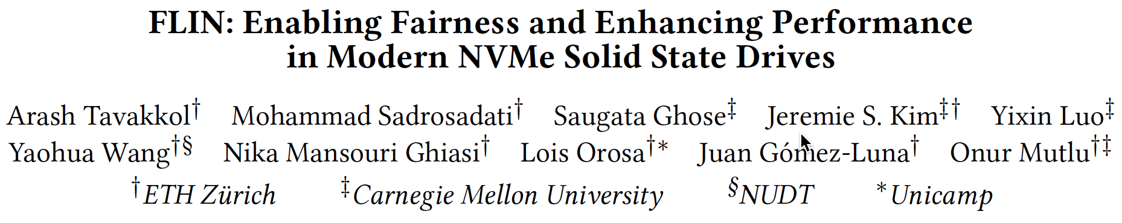
On Modern SSD Controllers (III)
Arash Tavakkol, Mohammad Sadrosadati, Saugata Ghose, Jeremie Kim, Yixin Luo, Yaohua Wang, Nika Mansouri Ghiasi, Lois Orosa, Juan G. Luna and Onur Mutlu,
"FLIN: Enabling Fairness and Enhancing Performance in Modern NVMe Solid State Drives"
Proceedings of the 45th International Symposium on Computer Architecture (ISCA), Los Angeles, CA, USA, June 2018.
[Slides (pptx) (pdf)] [Lightning Talk Slides (pptx) (pdf)]
[Lightning Talk Video]

Slide 27
DRAM Types
DRAM has different types with different interfaces optimized for different purposes
  Commodity: DDR, DDR2, DDR3, DDR4, …
  Low power (for mobile): LPDDR1, …, LPDDR5, …
  High bandwidth (for graphics): GDDR2, …, GDDR5, …
  Low latency: eDRAM, RLDRAM, …
  3D stacked: WIO, HBM, HMC, …
  …
Underlying microarchitecture is fundamentally the same
A flexible memory controller can support various DRAM types
This complicates the memory controller
  Difficult to support all types (and upgrades)

Slide 28
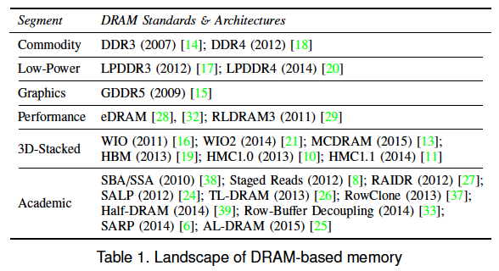
DRAM Types (circa 2015)
Kim et al., “Ramulator: A Fast and Extensible DRAM Simulator,” IEEE Comp Arch Letters 2015.

Slide 29
DRAM Controller: Functions
Ensure correct operation of DRAM (refresh and timing)
Service DRAM requests while obeying timing constraints of DRAM chips
  Constraints: resource conflicts (bank, bus, channel), minimum write-to-read delays
  Translate requests to DRAM command sequences
Buffer and schedule requests to for high performance + QoS
  Reordering, row-buffer, bank, rank, bus management
Manage power consumption and thermals in DRAM
  Turn on/off DRAM chips, manage power modes

Slide 30
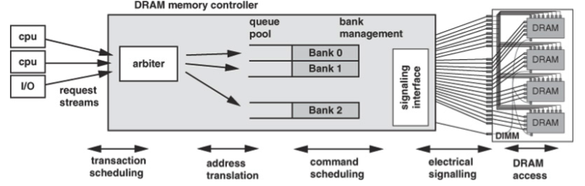
A Modern DRAM Controller (I)

Slide 31
A Modern DRAM Controller

Slide 32
DRAM Scheduling Policies (I)
FCFS (first come first served)
  Oldest request first
FR-FCFS (first ready, first come first served)
  1. Row-hit first
  2. Oldest first
  Goal: Maximize row buffer hit rate → maximize DRAM throughput
  Actually, scheduling is done at the command level
    Column commands (read/write) prioritized over row commands (activate/precharge)
    Within each group, older commands prioritized over younger ones

Slide 33
Review: DRAM Bank Operation
Access Address:
(Row 0, Column 0)
Columns
(Row 0, Column 1)
(Row 0, Column 85)
(Row 1, Column 0)
Row address 0
Row address 1
Row decoder
Rows
Row Buffer
CONFLICT !
HIT
Row 1
HIT
Row 0
Empty
Column address 0
Column mux
Column address 0
Column address 1
Column address 85
Data

Slide 34
DRAM Scheduling Policies (II)
A scheduling policy is a request prioritization order
Prioritization can be based on
  Request age
  Row buffer hit/miss status
  Request type (prefetch, read, write)
  Requestor type (load miss or store miss)
  Request criticality
    Oldest miss in the core?
    How many instructions in core are dependent on it?
    Will it stall the processor?
  Interference caused to other cores
  …

Slide 35
Row Buffer Management Policies
Open row
  Keep the row open after an access
  + Next access might need the same row → row hit
  -- Next access might need a different row → row conflict, wasted energy
Closed row
  Close the row after an access (if no other requests already in the request buffer need the same row)
  + Next access might need a different row → avoid a row conflict
  -- Next access might need the same row → extra activate latency
Adaptive policies
  Predict whether or not the next access to the bank will be to the same row and act accordingly

Slide 36
Open vs. Closed Row Policies
Policy | First access | Next access | Commands needed for next access
Open row | Row 0 | Row 0 (row hit) | Read
Open row | Row 0 | Row 1 (row conflict) | Precharge + Activate Row 1 + Read
Closed row | Row 0 | Row 0 – access in request buffer (row hit) | Read
Closed row | Row 0 | Row 0 – access not in request buffer (row closed) | Activate Row 0 + Read + Precharge
Closed row | Row 0 | Row 1 (row closed) | Activate Row 1 + Read + Precharge

Slide 37
DRAM Power Management
DRAM chips have power modes
Idea: When not accessing a chip power it down
Power states
  Active (highest power)
  All banks idle
  Power-down
  Self-refresh (lowest power)
Tradeoff: State transitions incur latency during which the chip cannot be accessed

Slide 38
Difficulty of DRAM Control

Slide 39
Why are DRAM Controllers Difficult to Design?
Need to obey DRAM timing constraints for correctness
  There are many (50+) timing constraints in DRAM
  tWTR: Minimum number of cycles to wait before issuing a read command after a write command is issued
  tRC: Minimum number of cycles between the issuing of two consecutive activate commands to the same bank
  …
Need to keep track of many resources to prevent conflicts
  Channels, banks, ranks, data bus, address bus, row buffers
Need to handle DRAM refresh
Need to manage power consumption
Need to optimize performance & QoS (in the presence of constraints)
  Reordering is not simple
  Fairness and QoS needs complicates the scheduling problem

Slide 40
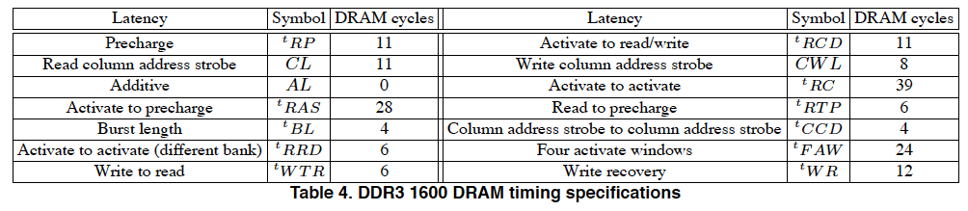
Many DRAM Timing Constraints
From Lee et al., “DRAM-Aware Last-Level Cache Writeback: Reducing Write-Caused Interference in Memory Systems,” HPS Technical Report, April 2010.

Slide 41
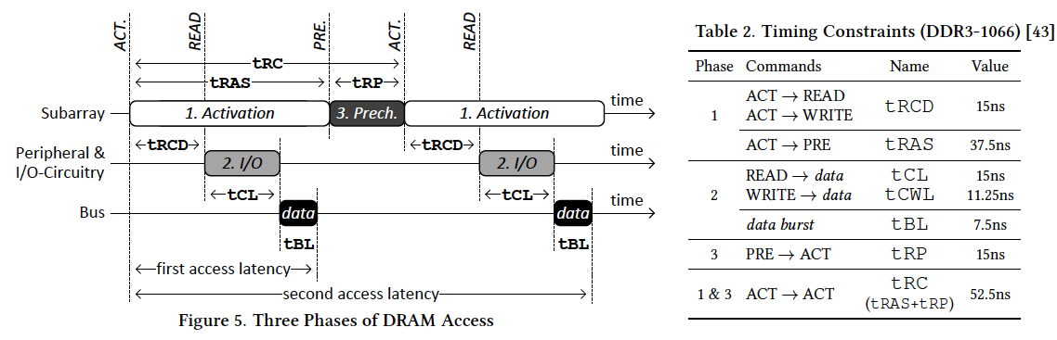
More on DRAM Operation
Kim et al., “A Case for Exploiting Subarray-Level Parallelism (SALP) in DRAM,” ISCA 2012.
Lee et al., “Tiered-Latency DRAM: A Low Latency and Low Cost DRAM Architecture,” HPCA 2013.

Slide 42
Why So Many Timing Constraints? (I)
Kim et al., “A Case for Exploiting Subarray-Level Parallelism (SALP) in DRAM,” ISCA 2012.

Slide 43
Why So Many Timing Constraints? (II)
Lee et al., “Tiered-Latency DRAM: A Low Latency and Low Cost DRAM Architecture,” HPCA 2013.

Slide 44
DRAM Controller Design Is Becoming More Difficult
CPU
CPU
CPU
CPU
GPU
HWA
HWA
Shared Cache
DRAM and Hybrid Memory Controllers
DRAM and Hybrid Memories
Heterogeneous agents: CPUs, GPUs, and HWAs
Main memory interference between CPUs, GPUs, HWAs
Many timing constraints for various memory types
Many goals at the same time: performance, fairness, QoS, energy efficiency, …

Slide 45
Reality and Dream
Reality: It difficult to optimize all these different constraints while maximizing performance, QoS, energy-efficiency, …
Dream: Wouldn’t it be nice if the DRAM controller automatically found a good scheduling policy on its own?

Slide 46
Self-Optimizing DRAM Controllers
Problem: DRAM controllers difficult to design → It is difficult for human designers to design a policy that can adapt itself very well to different workloads and different system conditions
Idea: Design a memory controller that adapts its scheduling policy decisions to workload behavior and system conditions using machine learning.
Observation: Reinforcement learning maps nicely to memory control.
Design: Memory controller is a reinforcement learning agent that dynamically and continuously learns and employs the best scheduling policy.
Ipek+, “Self Optimizing Memory Controllers: A Reinforcement Learning Approach,” ISCA 2008.

Slide 47
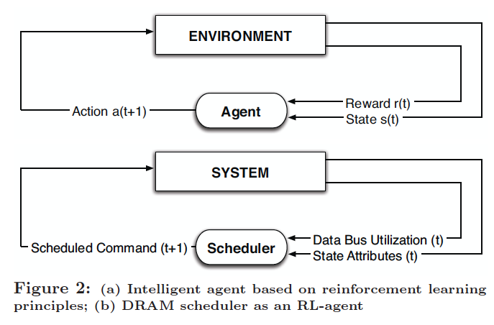
Self-Optimizing DRAM Controllers
Engin Ipek, Onur Mutlu, José F. Martínez, and Rich Caruana,
"Self Optimizing Memory Controllers: A Reinforcement Learning Approach"
Proceedings of the 35th International Symposium on Computer Architecture (ISCA), pages 39-50, Beijing, China, June 2008.
Goal: Learn to choose actions to maximize r₀ + γr₁ + γ²r₂ + … ( 0 ≤ γ < 1)

Slide 48
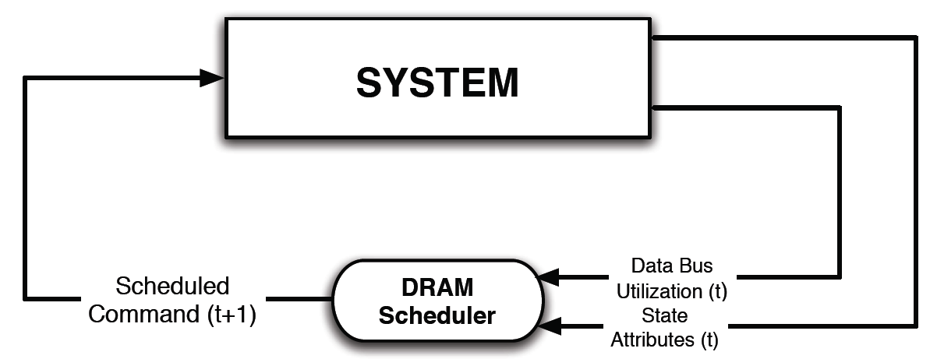
Self-Optimizing DRAM Controllers
Dynamically adapt the memory scheduling policy via interaction with the system at runtime
  Associate system states and actions (commands) with long term reward values: each action at a given state leads to a learned reward
  Schedule command with highest estimated long-term reward value in each state
  Continuously update reward values for <state, action> pairs based on feedback from system

Slide 49
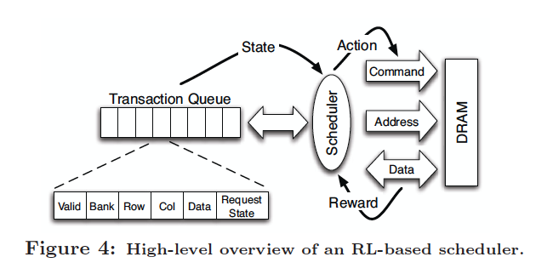
Self-Optimizing DRAM Controllers
Engin Ipek, Onur Mutlu, José F. Martínez, and Rich Caruana,
"Self Optimizing Memory Controllers: A Reinforcement Learning Approach"
Proceedings of the 35th International Symposium on Computer Architecture (ISCA), pages 39-50, Beijing, China, June 2008.

Slide 50
States, Actions, Rewards
Reward function
  +1 for scheduling Read and Write commands
  0 at all other times
  Goal is to maximize long-term data bus utilization
State attributes
  Number of reads, writes, and load misses in transaction queue
  Number of pending writes and ROB heads waiting for referenced row
  Request’s relative ROB order
Actions
  Activate
  Write
  Read - load miss
  Read - store miss
  Precharge - pending
  Precharge - preemptive
  NOP

Slide 51
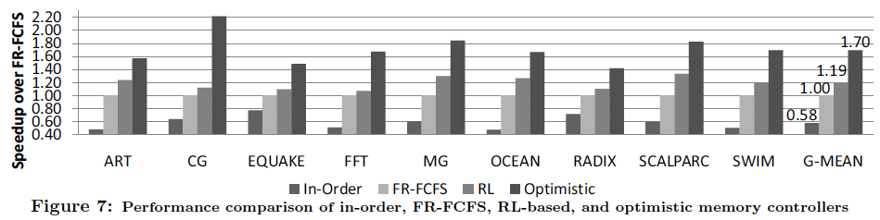
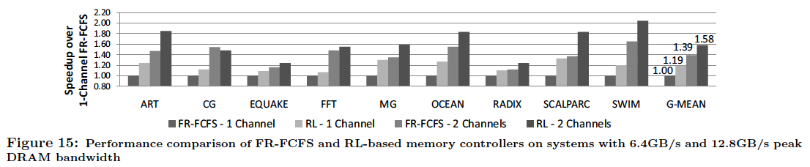
Performance Results

Slide 52
Self Optimizing DRAM Controllers
Advantages
  + Adapts the scheduling policy dynamically to changing workload behavior and to maximize a long-term target
  + Reduces the designer’s burden in finding a good scheduling policy. Designer specifies:
  1) What system variables might be useful
  2) What target to optimize, but not how to optimize it
Disadvantages and Limitations
  -- Black box: designer much less likely to implement what she cannot easily reason about
  -- How to specify different reward functions that can achieve different objectives? (e.g., fairness, QoS)
  -- Hardware complexity?

Slide 53
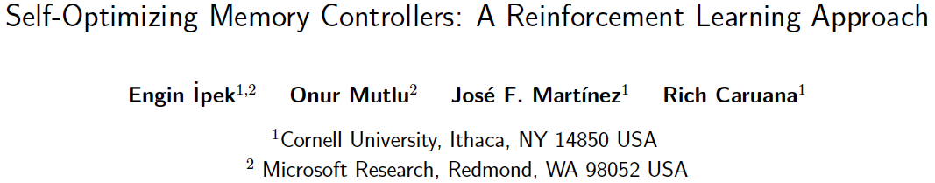
More on Self-Optimizing DRAM Controllers
Engin Ipek, Onur Mutlu, José F. Martínez, and Rich Caruana,
"Self Optimizing Memory Controllers: A Reinforcement Learning Approach"
Proceedings of the 35th International Symposium on Computer Architecture (ISCA), pages 39-50, Beijing, China, June 2008.

Slide 54
Simulating Memory

Slide 55
Ramulator: A Fast and Extensible DRAM Simulator
[IEEE Comp Arch Letters’15]

Slide 56
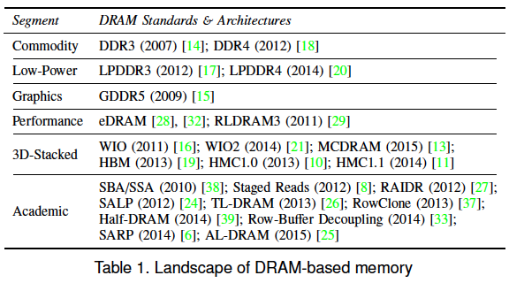
Ramulator Motivation
DRAM and Memory Controller landscape is changing
Many new and upcoming standards
Many new controller designs
A fast and easy-to-extend simulator is very much needed

Slide 57
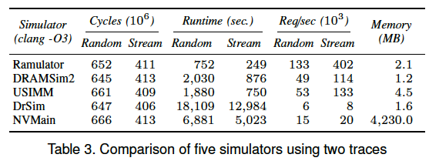
Ramulator
Provides out-of-the box support for many DRAM standards:
  DDR3/4, LPDDR3/4, GDDR5, WIO1/2, HBM, plus new proposals (SALP, AL-DRAM, TLDRAM, RowClone, and SARP)
~2.5X faster than fastest open-source simulator
Modular and extensible to different standards

Slide 58
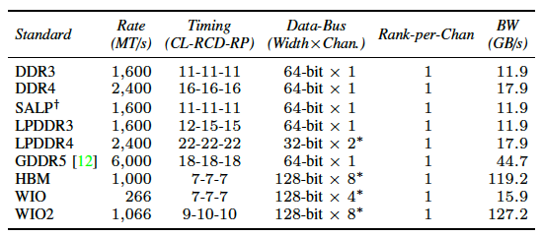
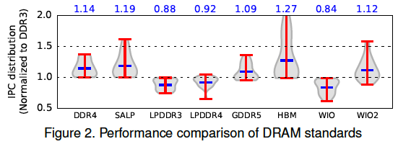
Case Study: Comparison of DRAM Standards
Across 22 workloads, simple CPU model

Slide 59
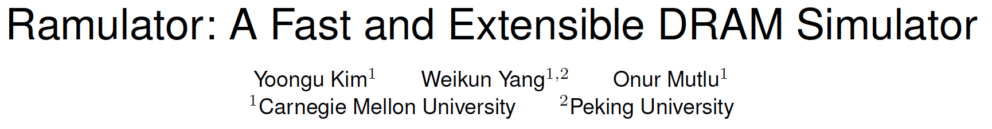
Ramulator Paper and Source Code
Yoongu Kim, Weikun Yang, and Onur Mutlu,
"Ramulator: A Fast and Extensible DRAM Simulator"
IEEE Computer Architecture Letters (CAL), March 2015.
[Source Code]
Source code is released under the liberal MIT License
  https://github.com/CMU-SAFARI/ramulator

Slide 60
Optional Assignment
Review the Ramulator paper
  Email me your review (omutlu@gmail.com)
Download and run Ramulator
  Compare DDR3, DDR4, SALP, HBM for the libquantum benchmark (provided in Ramulator repository)
  Email me your report (omutlu@gmail.com)
This may help you get into memory systems research quickly

Slide 61
Topics We Will Not Cover

Slide 62
No Time, Unfortunately, for:
Memory Interference and QoS
Predictable Performance
  QoS-aware Memory Controllers
Emerging Memory Technologies and Hybrid Memories
Cache Management
Interconnects
You can find many materials on these at my online lectures
  https://people.inf.ethz.ch/omutlu/teaching.html

Slide 63
Some More Suggested Readings

Slide 64
Some Key Readings on DRAM (I)
DRAM Organization and Operation
  Lee et al., “Tiered-Latency DRAM: A Low Latency and Low Cost DRAM Architecture,” HPCA 2013.
  https://people.inf.ethz.ch/omutlu/pub/tldram_hpca13.pdf
  Kim et al., “A Case for Subarray-Level Parallelism (SALP) in DRAM,” ISCA 2012.
  https://people.inf.ethz.ch/omutlu/pub/salp-dram_isca12.pdf
  Lee et al., “Simultaneous Multi-Layer Access: Improving 3D-Stacked Memory Bandwidth at Low Cost,” ACM TACO 2016.
  https://people.inf.ethz.ch/omutlu/pub/smla_high-bandwidth-3d-stacked-memory_taco16.pdf

Slide 65
Some Key Readings on DRAM (II)
DRAM Refresh
  Liu et al., “RAIDR: Retention-Aware Intelligent DRAM Refresh,” ISCA 2012. https://people.inf.ethz.ch/omutlu/pub/raidr-dram-refresh_isca12.pdf
  Chang et al., “Improving DRAM Performance by Parallelizing Refreshes with Accesses,” HPCA 2014.
  https://people.inf.ethz.ch/omutlu/pub/dram-access-refresh-parallelization_hpca14.pdf
  Patel et al., “The Reach Profiler (REAPER): Enabling the Mitigation of DRAM Retention Failures via Profiling at Aggressive Conditions,” ISCA 2017.
    https://people.inf.ethz.ch/omutlu/pub/reaper-dram-retention-profiling-lpddr4_isca17.pdf

Slide 66
Reading on Simulating Main Memory
How to evaluate future main memory systems?
An open-source simulator and its brief description
Yoongu Kim, Weikun Yang, and Onur Mutlu,
"Ramulator: A Fast and Extensible DRAM Simulator"
IEEE Computer Architecture Letters (CAL), March 2015.
[Source Code]

Slide 67
Some Key Readings on Memory Control 1
  Mutlu+, “Parallelism-Aware Batch Scheduling: Enhancing both Performance and Fairness of Shared DRAM Systems,” ISCA 2008.
    https://people.inf.ethz.ch/omutlu/pub/parbs_isca08.pdf
  Kim et al., “Thread Cluster Memory Scheduling: Exploiting Differences in Memory Access Behavior,” MICRO 2010.
    https://people.inf.ethz.ch/omutlu/pub/tcm_micro10.pdf
  Subramanian et al., “BLISS: Balancing Performance, Fairness and Complexity in Memory Access Scheduling,” TPDS 2016.
    https://people.inf.ethz.ch/omutlu/pub/bliss-memory-scheduler_ieee-tpds16.pdf
  Usui et al., “DASH: Deadline-Aware High-Performance Memory Scheduler for Heterogeneous Systems with Hardware Accelerators,” TACO 2016.
    https://people.inf.ethz.ch/omutlu/pub/dash_deadline-aware-heterogeneous-memory-scheduler_taco16.pdf

Slide 68
Some Key Readings on Memory Control 2
  Ipek+, “Self Optimizing Memory Controllers: A Reinforcement Learning Approach,” ISCA 2008.
    https://people.inf.ethz.ch/omutlu/pub/rlmc_isca08.pdf
  Ebrahimi et al., “Fairness via Source Throttling: A Configurable and High-Performance Fairness Substrate for Multi-Core Memory Systems,” ASPLOS 2010.
    https://people.inf.ethz.ch/omutlu/pub/fst_asplos10.pdf
  Subramanian et al., “The Application Slowdown Model: Quantifying and Controlling the Impact of Inter-Application Interference at Shared Caches and Main Memory,” MICRO 2015.
    https://people.inf.ethz.ch/omutlu/pub/application-slowdown-model_micro15.pdf
  Lee et al., “Decoupled Direct Memory Access: Isolating CPU and IO Traffic by Leveraging a Dual-Data-Port DRAM,” PACT 2015.
    https://people.inf.ethz.ch/omutlu/pub/decoupled-dma_pact15.pdf

Slide 69
More Readings
To come as we cover the future topics
Search for “DRAM” or “Memory” in:
  https://people.inf.ethz.ch/omutlu/projects.htm

Slide 70
Memory Systems and Memory-Centric Computing Systems
Lecture 2, Topic 1: Memory Trends and Basics
Prof. Onur Mutlu
omutlu@gmail.com
https://people.inf.ethz.ch/omutlu
10 July 2018
HiPEAC ACACES Summer School 2018

Slide 71
Backup Slides

Slide 72
Inside A DRAM Chip

Slide 73
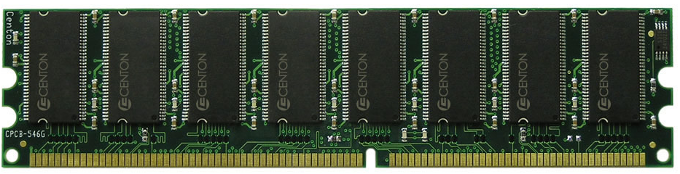
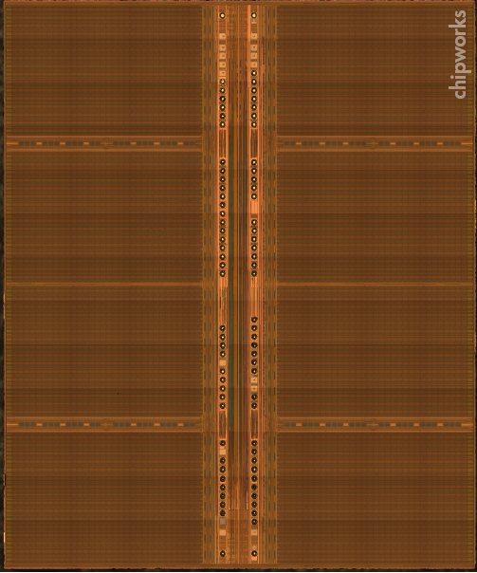
DRAM Module and Chip

Slide 74
Goals
Cost
Latency
Bandwidth
Parallelism
Power
Energy
Reliability
…

Slide 75
DRAM Chip
Row Decoder
Cell Array
Array of Sense Amplifiers
Cell Array
Row Decoder
Cell Array
Array of Sense Amplifiers
Cell Array
Bank I/O

Slide 76
Sense Amplifier
top
enable
Inverter
bottom

Slide 77
Sense Amplifier – Two Stable States
V_{DD}
0
1
1
0
V_{DD}
Logical “1”
Logical “0”

Slide 78
Sense Amplifier Operation
V_{T}
V_{DD}
0
V_{T} > V_{B}
1
V_{B}
0

Slide 79
DRAM Cell – Capacitor
Empty State
Fully Charged State
Logical “0”
Logical “1”
1
Small – Cannot drive circuits
2
Reading destroys the state

Slide 80
Capacitor to Sense Amplifier
0
V_{DD}
1
1
V_{DD}
0

Slide 81
DRAM Cell Operation
½V_{DD}
½V_{DD}+δ
V_{DD}
0
1
0
½V_{DD}

Slide 82
DRAM Subarray – Building Block for DRAM Chip
Row Decoder
Cell Array
Array of Sense Amplifiers (Row Buffer) 8Kb
Cell Array

Slide 83
DRAM Bank
Row Decoder
Cell Array
Array of Sense Amplifiers (8Kb)
Cell Array
Address
Row Decoder
Cell Array
Array of Sense Amplifiers
Cell Array
Bank I/O (64b)
Data
Address

Slide 84
DRAM Chip
Shared internal bus
Row Decoder
Cell Array
Row Decoder
Cell Array
Array of Sense Amplifiers
Array of Sense Amplifiers
Cell Array
Cell Array
Row Decoder
Cell Array
Row Decoder
Cell Array
Array of Sense Amplifiers
Array of Sense Amplifiers
Row Decoder
Cell Array
Row Decoder
Cell Array
Cell Array
Cell Array
Array of Sense Amplifiers
Array of Sense Amplifiers
Bank I/O
Bank I/O
Cell Array
Cell Array
Row Decoder
Cell Array
Row Decoder
Cell Array
Array of Sense Amplifiers
Array of Sense Amplifiers
Row Decoder
Cell Array
Row Decoder
Cell Array
Cell Array
Cell Array
Array of Sense Amplifiers
Array of Sense Amplifiers
Bank I/O
Bank I/O
Cell Array
Cell Array
Row Decoder
Cell Array
Row Decoder
Cell Array
Array of Sense Amplifiers
Array of Sense Amplifiers
Row Decoder
Cell Array
Row Decoder
Cell Array
Cell Array
Cell Array
Array of Sense Amplifiers
Array of Sense Amplifiers
Bank I/O
Bank I/O
Cell Array
Cell Array
Row Decoder
Cell Array
Row Decoder
Cell Array
Array of Sense Amplifiers
Array of Sense Amplifiers
Cell Array
Cell Array
Bank I/O
Bank I/O
Memory channel - 8bits

Slide 85
DRAM Operation
Row Decoder
ACTIVATE Row
1
Row Address
2
READ/WRITE Column
Row Decoder
Cell Array
Array of Sense Amplifiers
Cell Array
3
PRECHARGE
Bank I/O
Data
Column Address

Slide 86
Evaluating New Ideas for New (Memory) Architectures

Slide 87
Potential Evaluation Methods
How do we assess an idea will improve a target metric X?
A variety of evaluation methods are available:
  Theoretical proof
  Analytical modeling/estimation
  Simulation (at varying degrees of abstraction and accuracy)
  Prototyping with a real system (e.g., FPGAs)
  Real implementation

Slide 88
The Difficulty in Architectural Evaluation
The answer is usually workload dependent
  E.g., think caching
  E.g., think pipelining
  E.g., think any idea we talked about (RAIDR, Mem. Sched., …)
Workloads change
System has many design choices and parameters
  Architect needs to decide many ideas and many parameters for a design
  Not easy to evaluate all possible combinations!
System parameters may change

Slide 89
Simulation: The Field of Dreams

Slide 90
Dreaming and Reality
An architect is in part a dreamer, a creator
Simulation is a key tool of the architect
Simulation enables
  The exploration of many dreams
  A reality check of the dreams
  Deciding which dream is better
Simulation also enables
  The ability to fool yourself with false dreams

Slide 91
Why High-Level Simulation?
Problem: RTL simulation is intractable for design space exploration → too time consuming to design and evaluate
  Especially over a large number of workloads
  Especially if you want to predict the performance of a good chunk of a workload on a particular design
  Especially if you want to consider many design choices
    Cache size, associativity, block size, algorithms
    Memory control and scheduling algorithms
    In-order vs. out-of-order execution
    Reservation station sizes, ld/st queue size, register file size, …
    …
Goal: Explore design choices quickly to see their impact on the workloads we are designing the platform for

Slide 92
Different Goals in Simulation
Explore the design space quickly and see what you want to
  potentially implement in a next-generation platform
  propose as the next big idea to advance the state of the art
  the goal is mainly to see relative effects of design decisions
Match the behavior of an existing system so that you can
  debug and verify it at cycle-level accuracy
  propose small tweaks to the design that can make a difference in performance or energy
  the goal is very high accuracy
Other goals in-between:
  Refine the explored design space without going into a full detailed, cycle-accurate design
  Gain confidence in your design decisions made by higher-level design space exploration

Slide 93
Tradeoffs in Simulation
Three metrics to evaluate a simulator
  Speed
  Flexibility
  Accuracy
Speed: How fast the simulator runs (xIPS, xCPS, slowdown)
Flexibility: How quickly one can modify the simulator to evaluate different algorithms and design choices?
Accuracy: How accurate the performance (energy) numbers the simulator generates are vs. a real design (Simulation error)
The relative importance of these metrics varies depending on where you are in the design process (what your goal is)

Slide 94
Trading Off Speed, Flexibility, Accuracy
Speed & flexibility affect:
  How quickly you can make design tradeoffs
Accuracy affects:
  How good your design tradeoffs may end up being
  How fast you can build your simulator (simulator design time)
Flexibility also affects:
  How much human effort you need to spend modifying the simulator
You can trade off between the three to achieve design exploration and decision goals

Slide 95
High-Level Simulation
  Key Idea: Raise the abstraction level of modeling to give up some accuracy to enable speed & flexibility (and quick simulator design)
Advantage
  + Can still make the right tradeoffs, and can do it quickly
  + All you need is modeling the key high-level factors, you can omit corner case conditions
  + All you need is to get the “relative trends” accurately, not exact performance numbers
Disadvantage
  -- Opens up the possibility of potentially wrong decisions
  -- How do you ensure you get the “relative trends” accurately?

Slide 96
Simulation as Progressive Refinement
High-level models (Abstract, C)
…
Medium-level models (Less abstract)
…
Low-level models (RTL with everything modeled)
…
Real design
As you refine (go down the above list)
  Abstraction level reduces
  Accuracy (hopefully) increases (not necessarily, if not careful)
  Flexibility reduces; Speed likely reduces except for real design
  You can loop back and fix higher-level models

Slide 97
Making The Best of Architecture
A good architect is comfortable at all levels of refinement
  Including the extremes
A good architect knows when to use what type of simulation
  And, more generally, what type of evaluation method
Recall: A variety of evaluation methods are available:
  Theoretical proof
  Analytical modeling
  Simulation (at varying degrees of abstraction and accuracy)
  Prototyping with a real system (e.g., FPGAs)
  Real implementation

Slide 98
Ramulator: A Fast and Extensible DRAM Simulator
[IEEE Comp Arch Letters’15]

Slide 99
Ramulator Motivation
DRAM and Memory Controller landscape is changing
Many new and upcoming standards
Many new controller designs
A fast and easy-to-extend simulator is very much needed

Slide 100
Ramulator
Provides out-of-the box support for many DRAM standards:
  DDR3/4, LPDDR3/4, GDDR5, WIO1/2, HBM, plus new proposals (SALP, AL-DRAM, TLDRAM, RowClone, and SARP)
~2.5X faster than fastest open-source simulator
Modular and extensible to different standards

Slide 101
Case Study: Comparison of DRAM Standards
Across 22 workloads, simple CPU model

Slide 102
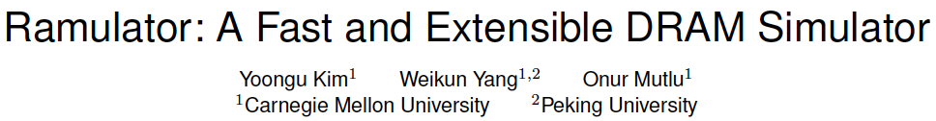
Ramulator Paper and Source Code
Yoongu Kim, Weikun Yang, and Onur Mutlu,
"Ramulator: A Fast and Extensible DRAM Simulator"
IEEE Computer Architecture Letters (CAL), March 2015.
[Source Code]
Source code is released under the liberal MIT License
  https://github.com/CMU-SAFARI/ramulator

Slide 103
Optional Assignment
Review the Ramulator paper
  Email me your review
Download and run Ramulator
  Compare DDR3, DDR4, SALP, HBM for the libquantum benchmark (provided in Ramulator repository)
  Email me your report
This may help you get into memory systems research quickly

Slide 104
End of Backup Slides

