Slide 1



Memory Systems and Memory-Centric Computing Systems
Topic 1: Memory Trends and Basics
Prof. Onur Mutlu
omutlu@gmail.com
https://people.inf.ethz.ch/omutlu
9-13 July 2018
HiPEAC ACACES Summer School 2018

Slide 2
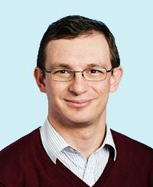
Brief Self Introduction
Onur Mutlu
  Full Professor @ ETH Zurich CS (EE), since September 2015
  Strecker Professor @ Carnegie Mellon University ECE (CS), 2009-2016, 2016-…
  PhD from UT-Austin, worked at Google, VMware, Microsoft Research, Intel, AMD
  https://people.inf.ethz.ch/omutlu/
  omutlu@gmail.com (Best way to reach me)
  https://people.inf.ethz.ch/omutlu/projects.htm
Research and Teaching in:
  Computer architecture, hardware security, bioinformatics, computing platforms
  Memory and storage systems
  Hardware security, safety, predictability
  Fault tolerance
  Hardware/software cooperation
  Architectures for bioinformatics, health, medicine
  …

Slide 3



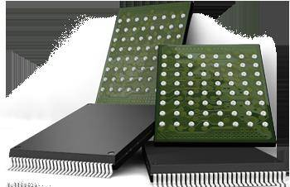

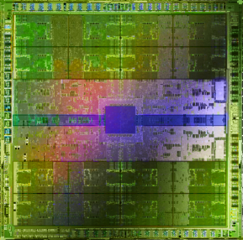
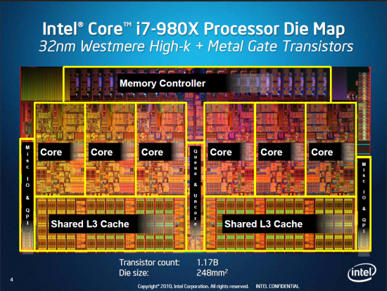
Current Research Focus Areas
Research Focus: Computer architecture, HW/SW, bioinformatics, security
Memory and storage (DRAM, flash, emerging), interconnects
Heterogeneous & parallel systems, GPUs, systems for data analytics
System/architecture interaction, new execution models, new interfaces
Hardware security, energy efficiency, fault tolerance, performance
Genome sequence analysis & assembly algorithms and architectures
Biologically inspired systems & system design for bio/medicine
Hybrid Main Memory
Heterogeneous
Processors and
Accelerators
Persistent Memory/Storage
Broad research
spanning apps, systems, logic
with architecture at the center
Graphics and Vision Processing
Notes:
Professor Mutlu’s research focus is all aspects of computer architecture, HW/SW interaction and bioinformatics.
He is looking for students to perform research in these areas.
He and his group, SAFARI, solve fundamental problems spanning:
Memory, memory, memory, storage, interconnects
Parallel architectures, heterogeneous architectures, GP-GPUs
System/architecture interaction, new execution models
Energy efficiency, fault tolerance, hardware security
Genome sequence analysis and assembly
His group does broad research spanning systems to logic with architecture at center

Slide 4
Four Key Directions
Fundamentally Secure/Reliable/Safe Architectures
Fundamentally Energy-Efficient Architectures
  Memory-centric (Data-centric) Architectures
Fundamentally Low-Latency Architectures
Architectures for Genomics, Medicine, Health

Slide 5
A Motivating Detour:
Genome Sequence Analysis

Slide 6
Our Dream
Can we build devices that can analyze a genome within a minute?

Slide 7
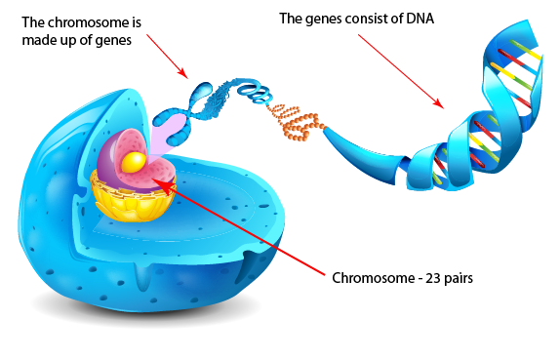
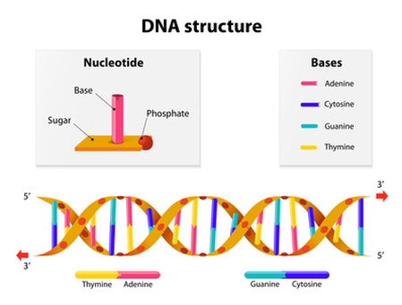
What Is a Genome Made Of?
Cell
Nucleus
The discovery of DNA’s double-helical structure (Watson+, 1953)
Notes:
Unlocking the life’s code requires diving into the nucleus of our body cells, where the double-stranded genome resides. Genome is literally the 'code of life' - it is the set of instructions for making everything from you to zebras, strawberries, and even yeast.
since the discovery of dna’s double-helical structure (watson et al. 1953)

Slide 8
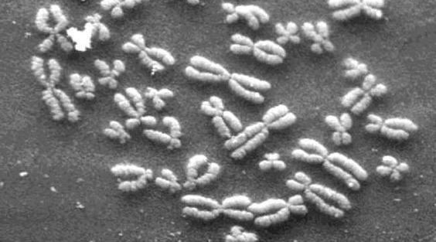
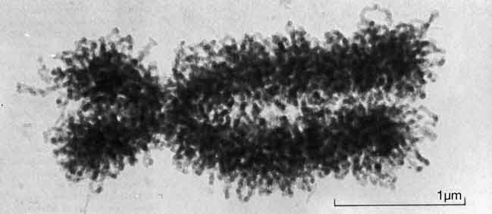
DNA Under Electron Microscope
human chromosome #12
from HeLa’s cell
Notes:
Henrietta Lacks,

Slide 9
DNA Sequencing
Goal:
  Find the complete sequence of A, C, G, T’s in DNA.
Challenge:
  There is no machine that takes long DNA as an input, and gives the complete sequence as output
  All sequencing machines chop DNA into pieces and identify relatively small pieces (but not how they fit together)

Slide 10

Untangling Yarn Balls & DNA Sequencing
Notes:
untangling yarn ball

Slide 11
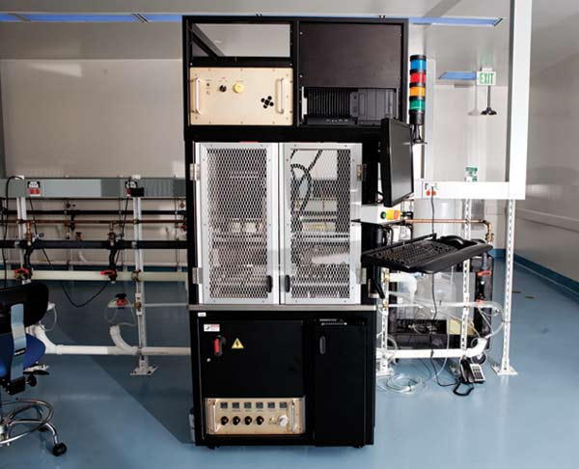
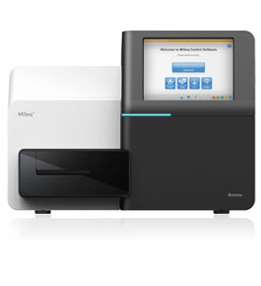
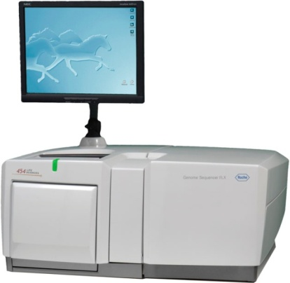
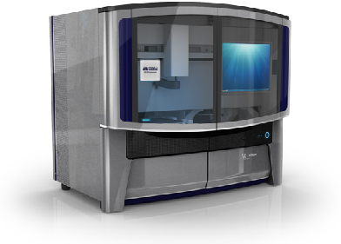

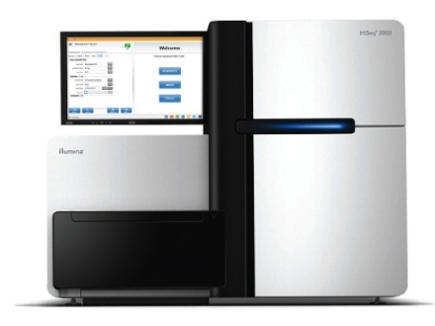
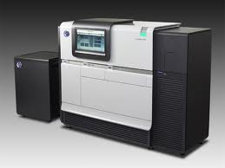
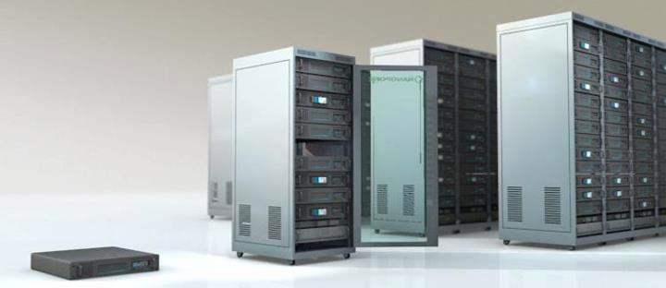
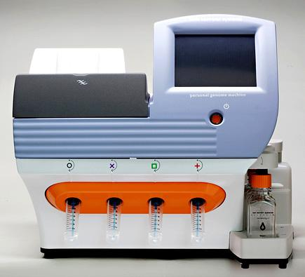
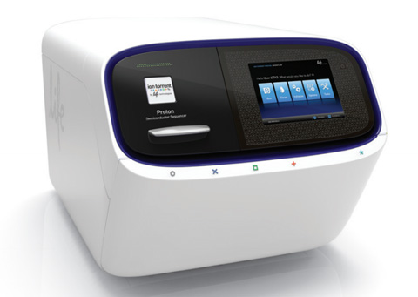
Genome Sequencers
Illumina MiSeq
Complete
Genomics
Roche/454
AB SOLiD
Oxford Nanopore MinION
Illumina
NovaSeq
6000
Illumina HiSeq2000
Pacific Biosciences RS
Oxford Nanopore GridION
Ion Torrent PGM
… and more! All produce data with different properties.
Ion Torrent Proton

Slide 12

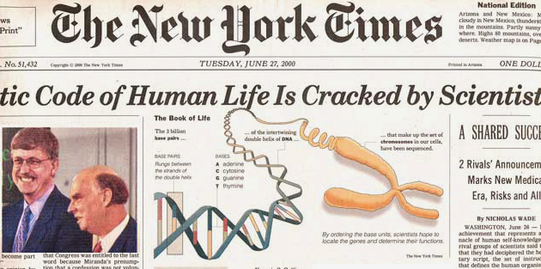

The Genomic Era
1990-2003: The Human Genome Project (HGP) provides a complete and accurate sequence of all DNA base pairs that make up the human genome and finds 20,000 to 25,000 human genes.
13 year-long
$3,000,000,000
Notes:
The 13-year long human project is the starting of the genomic era! It opened the door to remarkable biomedical discoveries by providing the first complete human genome sequence. It cost 3 billion dollars to read the entire sequence.

Slide 13
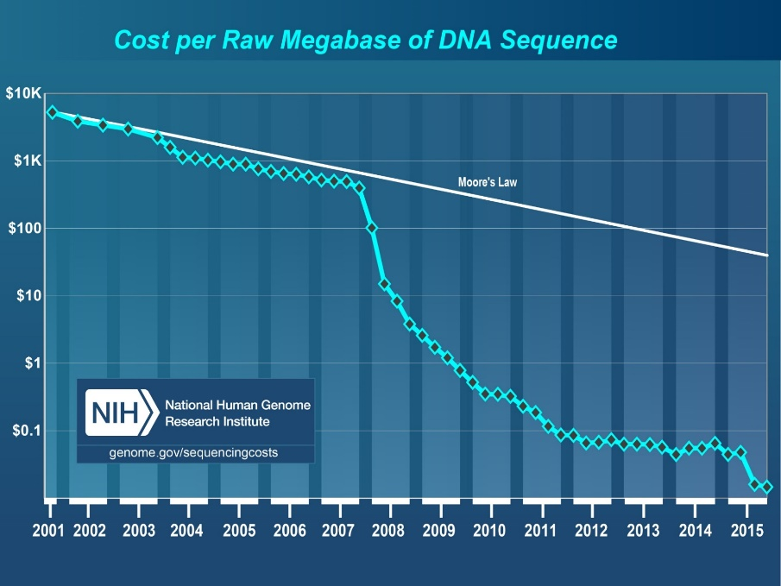
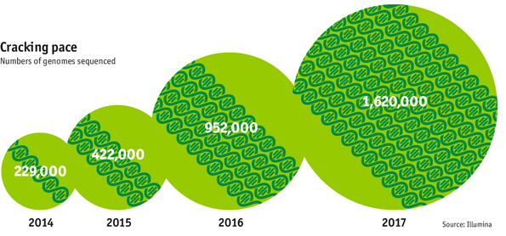

The Genomic Era (continued)
development of high-throughput sequencing (HTS) technologies
Number of Genomes Sequenced
http://www.economist.com/news/21631808-so-much-genetic-data-so-many-uses-genes-unzipped
Notes:
However, since the development of high throughput sequencing (HTS) technologies, the cost of genome sequencing has fallen off a cliff (<< 1,000$) making it viable for almost everyone's use.

Slide 14
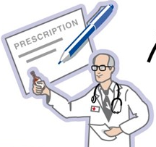
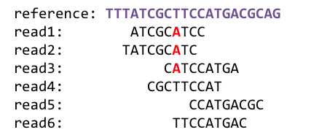
1
Sequencing
Genome Analysis
Read Mapping
2
Variant Calling
Scientific Discovery
3
4
Notes:
Genome analysis starts with sequencing random short DNA fragments of copies of the original molecule.
Unfortunately, these reads lack information about their order and which part of genome they are originated from.
Hence the second step is to map these reads to a long reference genome.

Slide 15
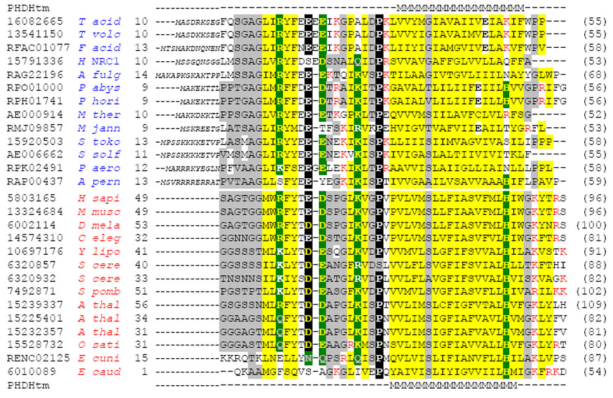
Multiple sequence alignment
Example Question: If I give you a bunch of sequences, tell me where they are the same and where they are different.

Slide 16
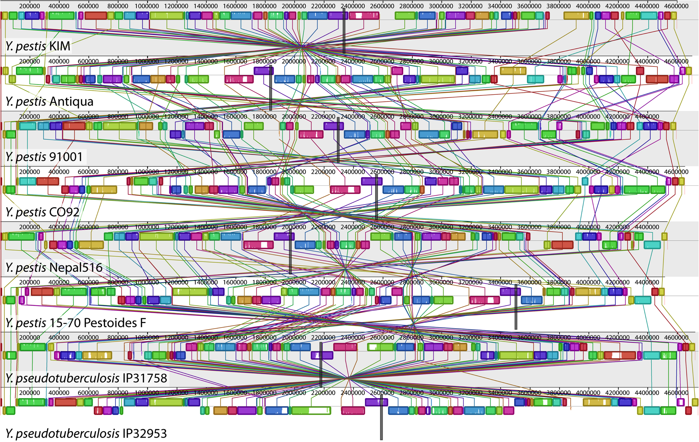
Genome Sequence Alignment: Example
Source: By Aaron E. Darling, István Miklós, Mark A. Ragan - Figure 1 from Darling AE, Miklós I, Ragan MA (2008).
"Dynamics of Genome Rearrangement in Bacterial Populations". PLOS Genetics. DOI:10.1371/journal.pgen.1000128., CC BY 2.5, https://commons.wikimedia.org/w/index.php?curid=30550950

Slide 17



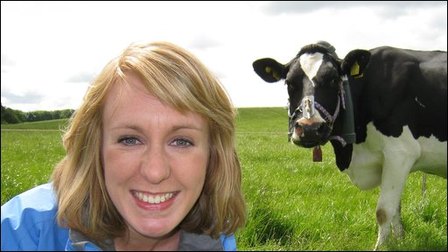

The Genetic Similarity Between Species
Human ~ Chimpanzee
96%
Human ~ Cat
90%
Human ~ Human
Human ~ Cow
99.9%
80%
Human ~ Banana
50-60%

Slide 18
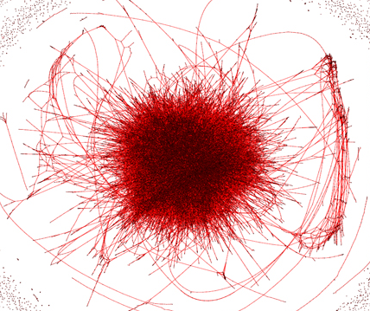
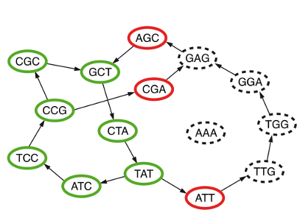
Metagenomics, genome assembly, de novo sequencing
Question 2: Given a bunch of short sequences, Can you identify the approximate species cluster for genomically unknown organisms (bacteria)?
uncleaned de Bruijn graph
http://math.oregonstate.edu/~koslickd
Notes:
organism detection in metagenomes

Slide 19
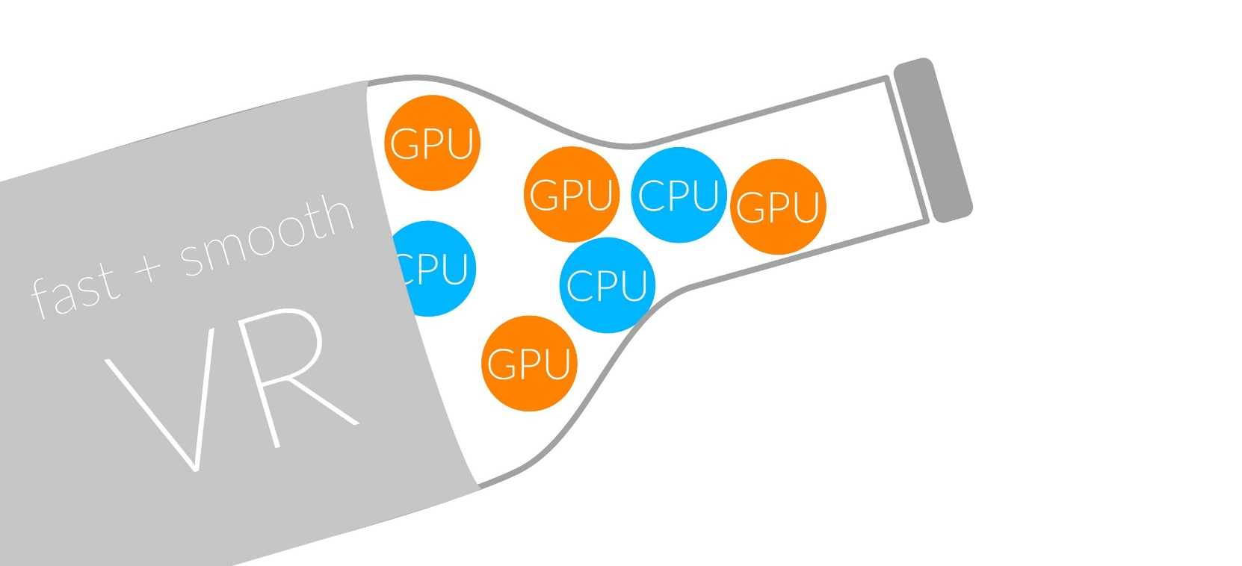
1
Sequencing
Read Mapping
2
Bottlenecked in Mapping!!
Illumina HiSeq4000
on average
GAGTCAGAATTTGAC
2 M
bases/min
300 M
bases/min
GAGTCAGAATTTGAC
GAGTCAGAATTTGAC
GAGTCAGAATTTGAC
GAGTCAGAATTTGAC
GAGTCAGAATTTGAC
GAGTCAGAATTTGAC
GAGTCAGAATTTGAC
GAGTCAGAATTTGAC
GAGTCAGAATTTGAC
GAGTCAGAATTTGAC
GAGTCAGAATTTGAC
GAGTCAGAATTTGAC
GAGTCAGAATTTGAC
GAGTCAGAATTTGAC
(0.6%)
Variant Calling
Scientific Discovery
3
4
Notes:
Typical sequencer machine generates a flood of reads, for example, Illumina HiSeq4000 generates 300 million bases/minute.
However, existing computer alignment algorithms can only process 0.6% of these reads in the same amount of time.
This gap is widening as more advanced sequencers are made available in the market.

Slide 20
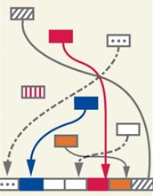
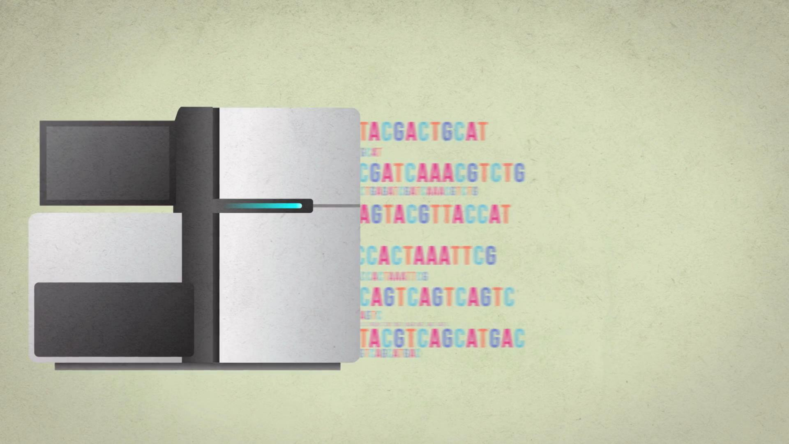

The Read Mapping Bottleneck
ACGTACGTACGTACGT
CCCCCCTATATATACGTACTAGTACGT
ACGACTTTAGTACGTACGT
TATATATACGTACTAGTACGT
ACGTACGCCCCTACGTA
TATATATACGTACTAGTACGT
ACGACTTTAGTACGTACGT
TATATATACGTACTAAAGTACGT
TATATATACGTACTAGTACGT
ACGTTTTTAAAACGTA
TATATATACGTACTAGTACGT
ACGACGGGGAGTACGTACGT
TATATATACGTACTAAAGTACGT
Illumina HiSeq4000
300
Million
bases/minute
2
Million
bases/minute
150X slower

Slide 21
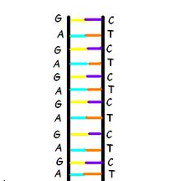
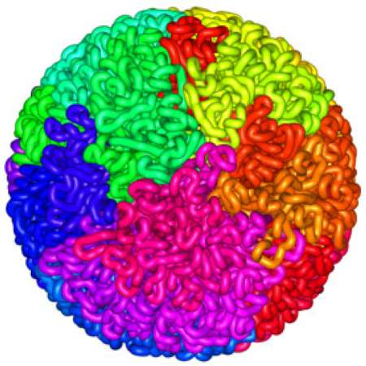
Read Mapping
Map many short DNA fragments (reads) to a known reference genome with some minor differences allowed
Reference genome
Reads
DNA, physically
DNA, logically
Mapping short reads to reference genome is challenging (billions of 50-300 base pair reads)
Notes:
Read mapping is a post processing procedure after DNA sequencing. It maps the data output from a DNA sequencer, which are many short DNA fragments, to a known reference genome, with some minor differences allowed.
To illustrate the problem better, let us take a closer look at the DNA itself. Logically, the DNA is a double stranded long string. In reality, within a cell they folded into a sphere in the nucleus like a ball of wool. Since it is very hard to disentangle the DNA at molecular level, to extract the information out, a sequencer cuts the mass into many short DNA pieces which are called reads.
A mapper’s job is to find where these DNA short reads are most likely to be originally placed so that later we can assemble them in the correct order to restore the original DNA.
Mapping these short reads, up to billions of them, with each one being 50 to 300 base-pairs long, to the reference genome is challenging.

Slide 22
Challenges in Read Mapping
Need to find many mappings of each read
  A short read may map to many locations, especially with High-Throughput DNA Sequencing technologies
  How can we find all mappings efficiently?
Need to tolerate small variances/errors in each read
  Each individual is different: Subject’s DNA may slightly differ from the reference (Mismatches, insertions, deletions)
  How can we efficiently map each read with up to e errors present?
Need to map each read very fast (i.e., performance is important)
  Human DNA is 3.2 billion base pairs long → Millions to billions of reads (State-of-the-art mappers take weeks to map a human’s DNA)
  How can we design a much higher performance read mapper?
Notes:
There are three main challenges.
First. The mapper needs to find many mappings for each read. Because the read is so short, they can map to multiple locations in the reference genome. How can we efficiently find all mappings of a read?
Second. The mapper needs to tolerate small variance or errors in each read. Since individuals are different, the subject’s DNA might slightly differs from the reference DNA, which can be mismatches, insertions or deletions of base pairs. How can we efficiently map each read with up to a number of e errors present?
Third. The mapper needs to map each read very fast. In another word, performance is important. Because the human DNA is 3.2 billion base-pairs long and each read is only hundreds of base-pairs long, there can be billions of reads subjected to mapping for an individual human. Current state of the art mappers take weeks to map a human’s DNA. So the question is, how can we design a much higher performance read mapper?

Slide 23
Our First Step: Comprehensive Mapping
+ Guaranteed to find all mappings → sensitive
+ Can tolerate up to e errors
http://mrfast.sourceforge.net/
Alkan+, "Personalized copy number and segmental duplication
maps using next-generation sequencing”, Nature Genetics 2009.
Notes:
It turned out the Hash Table based mappers solve the first 2 challenges pretty well. They guarantee to find all mappings with no more than e errors present.

Slide 24
Read Mapping Execution Time Breakdown
Notes:
An overwhelming majority of the read mapper’s execution time is spent in read alignment.

Slide 25
Read Alignment/Verification
Edit distance is defined as the minimum number of edits (i.e. insertions, deletions, or substitutions) needed to make the read exactly match the reference segment.
organization x operation
organization x translation
Ref
Read
o | - | - | r | g | a | n | i | z | a | t | i | o | n
o | p | e | r | - | - | - | - | - | a | t | i | o | n
Ref
Read
o | r | g | a | n | i | z | - | a | t | i | o | n
t | r | - | a | n | - | s | l | a | t | i | o | n
Ref
Read
o | - | - | r | g | a | n | i | z | a | t | i | o | n
o | p | e | r | - | a | - | - | - | - | t | i | o | n
Ref
Read
o | r | g | a | n | - | i | z | a | t | i | o | n
t | r | - | a | n | s | l | - | a | t | i | o | n
match
deletion
insertion
mismatch
Ref
Read
o | r | g | a | n | i | z | a | t | i | o | n
t | r | - | a | n | s | l | a | t | i | o | n
Notes:
http://www.let.rug.nl/kleiweg/lev/

Slide 26
Idea
Filter fast before you align
Minimize costly
“approximate string comparisons”

Slide 27
Our First Filter: Pure Software Approach
Download source code and try for yourself
  Download link to FastHASH

Slide 28
Next Step: SIMD Acceleration (New Algorithm)
Xin+, "Shifted Hamming Distance: A Fast and Accurate SIMD-friendly Filter
to Accelerate Alignment Verification in Read Mapping”, Bioinformatics 2015.

Slide 29
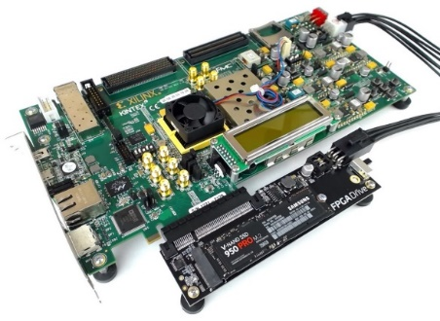
Our FPGA-based Filter: GateKeeper
1
st
Alignment Filter
FPGA-based Alignment Filter.
Notes:
To bridge the widening gap between the sequencer & the mapper, we propose the concept of pre-alignment filtering. We added a new examination step before the accurate alignment step. The main objective of this step is to detect the incorrect mappings accurately and rapidly. Only the mappings that pass our filter are examined by the alignment step. We also explore exploiting todays’ hardware accelerators to further boost the filtering speed of such filters.

Slide 30
FPGA-Based Alignment Filtering
Mohammed Alser, Hasan Hassan, Hongyi Xin, Oguz Ergin, Onur Mutlu, and Can Alkan
"GateKeeper: A New Hardware Architecture for Accelerating Pre-Alignment in DNA Short Read Mapping"
Bioinformatics, [published online, May 31], 2017.
[Source Code]
[Online link at Bioinformatics Journal]

Slide 31
DNA Read Mapping & Filtering
Problem: Heavily bottlenecked by Data Movement
GateKeeper FPGA performance limited by DRAM bandwidth [Alser+, Bioinformatics 2017]
Ditto for SHD on SIMD [Xin+, Bioinformatics 2015]
Solution: Processing-in-memory can alleviate the bottleneck
However, we need to design mapping & filtering algorithms to fit processing-in-memory

Slide 32
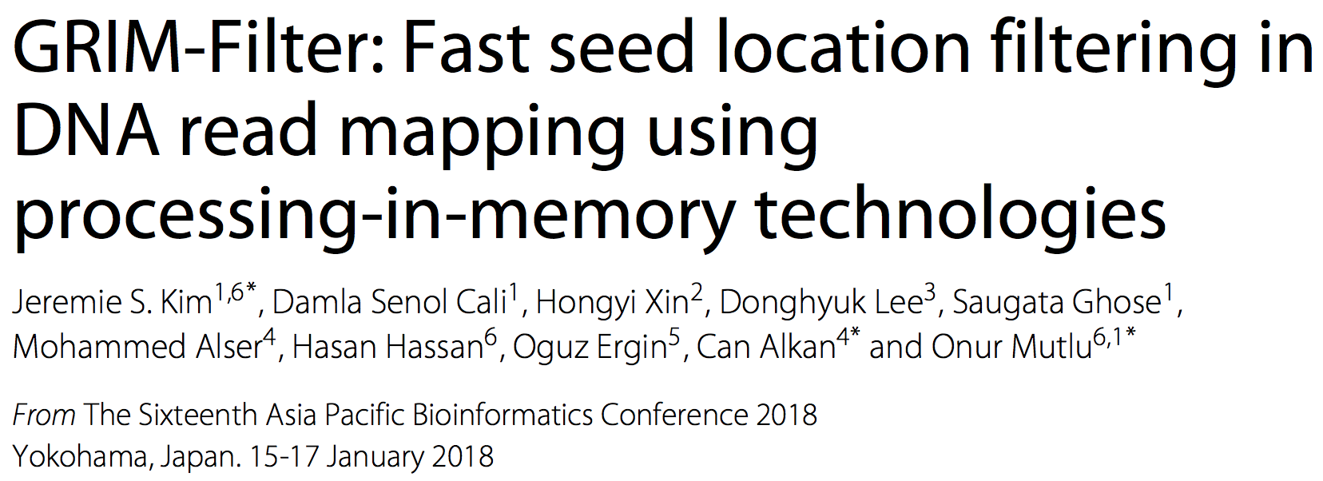
In-Memory DNA Sequence Analysis
Jeremie S. Kim, Damla Senol Cali, Hongyi Xin, Donghyuk Lee, Saugata Ghose, Mohammed Alser, Hasan Hassan, Oguz Ergin, Can Alkan, and Onur Mutlu,
"GRIM-Filter: Fast Seed Location Filtering in DNA Read Mapping Using Processing-in-Memory Technologies"
BMC Genomics, 2018.
Proceedings of the 16th Asia Pacific Bioinformatics Conference (APBC), Yokohama, Japan, January 2018.
arxiv.org Version (pdf)

Slide 33
Key Principles and Results
Two key principles:
  Exploit the structure of the genome to minimize computation
  Morph and exploit the structure of the underlying hardware to maximize performance and efficiency
Algorithm-architecture co-design for DNA read mapping
  Speeds up read mapping by ~200X (sometimes more)
  Improves accuracy of read mapping in the presence of errors
Xin et al., “Accelerating Read Mapping with FastHASH,” BMC Genomics 2013.
Xin et al., “Shifted Hamming Distance: A Fast and Accurate SIMD-friendly Filter to Accelerate
Alignment Verification in Read Mapping,” Bioinformatics 2015.
Alser et al., “GateKeeper: A New Hardware Architecture for Accelerating Pre-Alignment in DNA
Short Read Mapping,” Bioinformatics 2017.
Kim et al., “Genome Read In-Memory (GRIM) Filter,” BMC Genomics 2018.

Slide 34
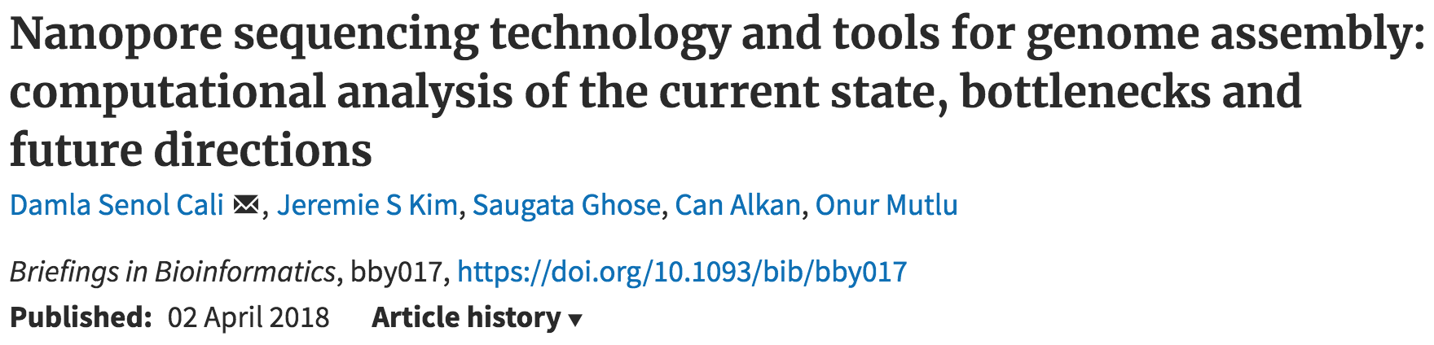
New Genome Sequencing Technologies
Oxford Nanopore MinION
Senol Cali+, “Nanopore Sequencing Technology and Tools for Genome
Assembly: Computational Analysis of the Current State, Bottlenecks
and Future Directions,” Briefings in Bioinformatics (BIB), 2018.
[Open arxiv.org version]

Slide 35
Nanopore Genome Assembly Pipeline
Senol Cali+, “Nanopore Sequencing Technology and Tools for Genome
Assembly”, Briefings in Bioinformatics, 2018. [Open arxiv.org version]

Slide 36

More on Genome Analysis: Another Talk

Slide 37
Recall Our Dream
Can we build devices that can analyze a genome within a minute?
Still a long ways to go
  Energy efficiency
  Performance (latency)
  Security
  Huge memory bottleneck

Slide 38
Four Key Directions
Fundamentally Secure/Reliable/Safe Architectures
Fundamentally Energy-Efficient Architectures
  Memory-centric (Data-centric) Architectures
Fundamentally Low-Latency Architectures
Architectures for Genomics, Medicine, Health

Slide 39
Memory & Storage

Slide 40
The Main Memory System
Main memory is a critical component of all computing systems: server, mobile, embedded, desktop, sensor
Main memory system must scale (in size, technology, efficiency, cost, and management algorithms) to maintain performance growth and technology scaling benefits
Processors
and caches
Main Memory
Storage (SSD/HDD)

Slide 41
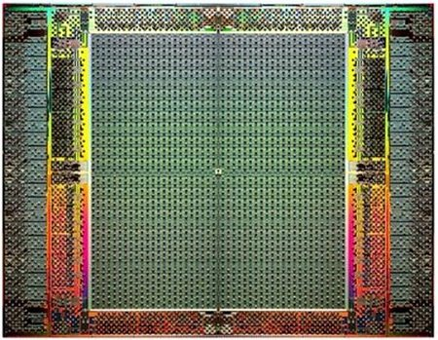
The Main Memory System
Main memory is a critical component of all computing systems: server, mobile, embedded, desktop, sensor
Main memory system must scale (in size, technology, efficiency, cost, and management algorithms) to maintain performance growth and technology scaling benefits
FPGAs
Main Memory
Storage (SSD/HDD)

Slide 42
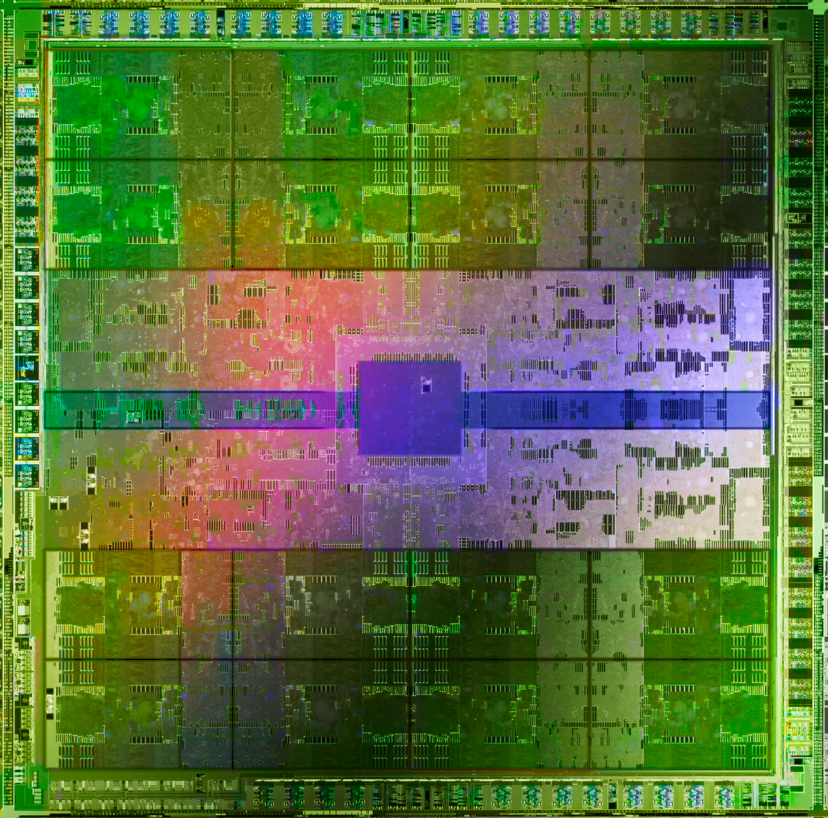
The Main Memory System
Main memory is a critical component of all computing systems: server, mobile, embedded, desktop, sensor
Main memory system must scale (in size, technology, efficiency, cost, and management algorithms) to maintain performance growth and technology scaling benefits
GPUs
Main Memory
Storage (SSD/HDD)

Slide 43
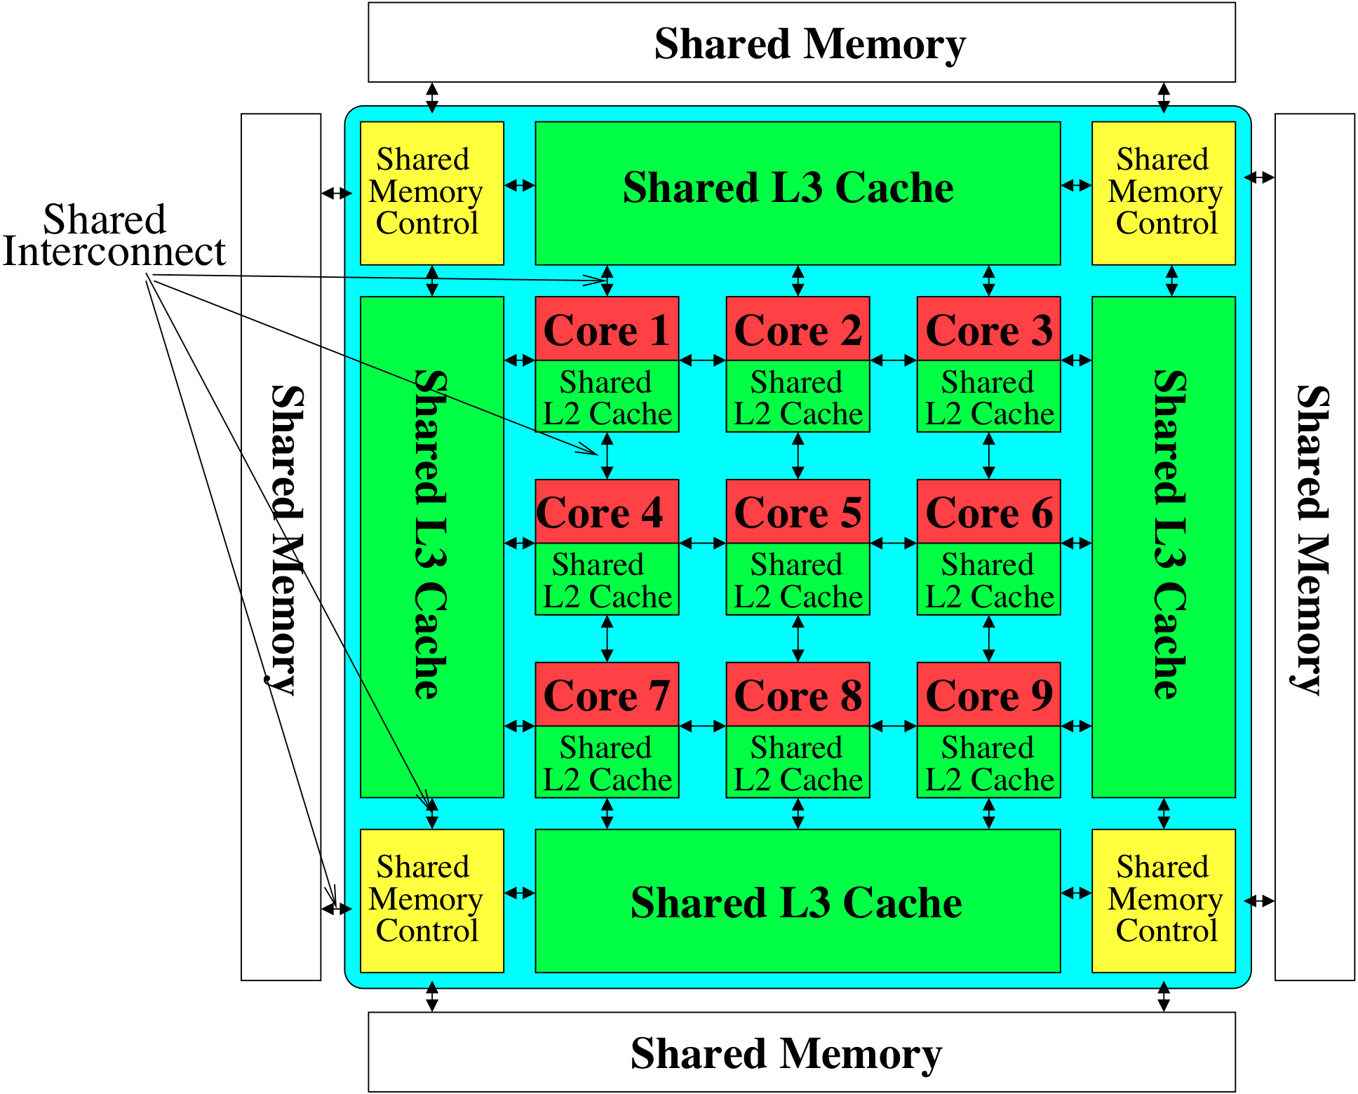
Memory System: A Shared Resource View
Storage
Most of the system is dedicated to storing and moving data

Slide 44
State of the Main Memory System
Recent technology, architecture, and application trends
  lead to new requirements
  exacerbate old requirements
DRAM and memory controllers, as we know them today, are (will be) unlikely to satisfy all requirements
Some emerging non-volatile memory technologies (e.g., PCM) enable new opportunities: memory+storage merging
We need to rethink the main memory system
  to fix DRAM issues and enable emerging technologies
  to satisfy all requirements

Slide 45
Major Trends Affecting Main Memory (I)
Need for main memory capacity, bandwidth, QoS increasing
Main memory energy/power is a key system design concern
DRAM technology scaling is ending

Slide 46
Major Trends Affecting Main Memory (II)
Need for main memory capacity, bandwidth, QoS increasing
  Multi-core: increasing number of cores/agents
  Data-intensive applications: increasing demand/hunger for data
  Consolidation: cloud computing, GPUs, mobile, heterogeneity
Main memory energy/power is a key system design concern
DRAM technology scaling is ending

Slide 47
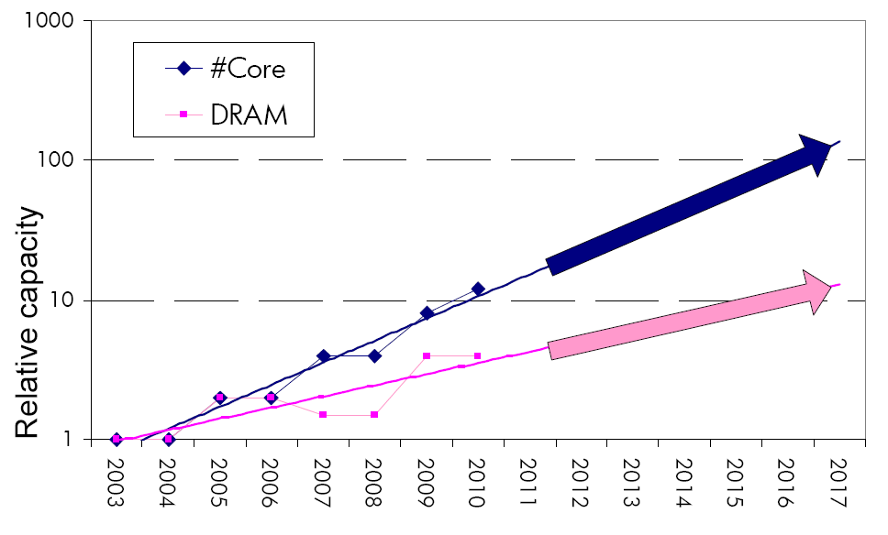
Consequence: The Memory Capacity Gap
Core count doubling ~ every 2 years
DRAM DIMM capacity doubling ~ every 3 years
Memory capacity per core expected to drop by 30% every two years
Trends worse for memory bandwidth per core!
Lim et al., ISCA 2009

Slide 48
Example: Capacity, Bandwidth & Latency
128x
20x
1.3x
Memory latency remains almost constant

Slide 49
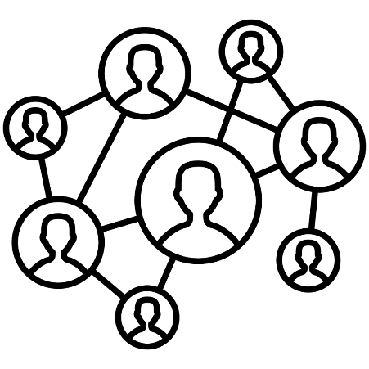



DRAM Latency Is Critical for Performance
In-memory Databases
[Mao+, EuroSys’12;
Clapp+ (Intel), IISWC’15]
Graph/Tree Processing
[Xu+, IISWC’12; Umuroglu+, FPL’15]
In-Memory Data Analytics
[Clapp+ (Intel), IISWC’15;
Awan+, BDCloud’15]
Datacenter Workloads
[Kanev+ (Google), ISCA’15]

Slide 50
DRAM Latency Is Critical for Performance
In-memory Databases
[Mao+, EuroSys’12;
Clapp+ (Intel), IISWC’15]
Graph/Tree Processing
[Xu+, IISWC’12; Umuroglu+, FPL’15]
Long memory latency → performance bottleneck
In-Memory Data Analytics
[Clapp+ (Intel), IISWC’15;
Awan+, BDCloud’15]
Datacenter Workloads
[Kanev+ (Google), ISCA’15]

Slide 51
Major Trends Affecting Main Memory (III)
Need for main memory capacity, bandwidth, QoS increasing
Main memory energy/power is a key system design concern
  ~40-50% energy spent in off-chip memory hierarchy [Lefurgy, IEEE Computer’03] >40% power in DRAM [Ware, HPCA’10][Paul,ISCA’15]
  DRAM consumes power even when not used (periodic refresh)
DRAM technology scaling is ending

Slide 52
Major Trends Affecting Main Memory (IV)
Need for main memory capacity, bandwidth, QoS increasing
Main memory energy/power is a key system design concern
DRAM technology scaling is ending
  ITRS projects DRAM will not scale easily below X nm
  Scaling has provided many benefits:
    higher capacity (density), lower cost, lower energy

Slide 53
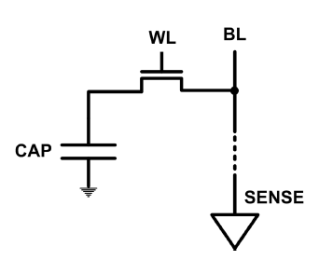
The DRAM Scaling Problem
DRAM stores charge in a capacitor (charge-based memory)
  Capacitor must be large enough for reliable sensing
  Access transistor should be large enough for low leakage and high retention time
  Scaling beyond 40-35nm (2013) is challenging [ITRS, 2009]
DRAM capacity, cost, and energy/power hard to scale

Slide 54
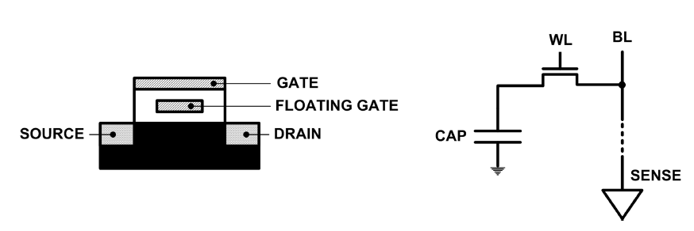
Limits of Charge Memory
Difficult charge placement and control
  Flash: floating gate charge
  DRAM: capacitor charge, transistor leakage
Reliable sensing becomes difficult as charge storage unit size reduces

Slide 55
Major Trends Affecting Main Memory (V)
DRAM scaling has already become increasingly difficult
  Increasing cell leakage current, reduced cell reliability, increasing manufacturing difficulties [Kim+ ISCA 2014],
  [Liu+ ISCA 2013], [Mutlu IMW 2013], [Mutlu DATE 2017]
  Difficult to significantly improve capacity, energy
Emerging memory technologies are promising
3D-Stacked DRAM | higher bandwidth | smaller capacity
Reduced-Latency DRAM (e.g., RLDRAM, TL-DRAM) | lower latency | higher cost
Low-Power DRAM (e.g., LPDDR3, LPDDR4) | lower power | higher latency higher cost
Non-Volatile Memory (NVM) (e.g., PCM, STTRAM, ReRAM, 3D Xpoint) | larger capacity | higher latency higher dynamic power lower endurance

Slide 56
Major Trends Affecting Main Memory (V)
DRAM scaling has already become increasingly difficult
  Increasing cell leakage current, reduced cell reliability, increasing manufacturing difficulties [Kim+ ISCA 2014],
  [Liu+ ISCA 2013], [Mutlu IMW 2013], [Mutlu DATE 2017]
  Difficult to significantly improve capacity, energy
Emerging memory technologies are promising
3D-Stacked DRAM | higher bandwidth | smaller capacity
Reduced-Latency DRAM (e.g., RL/TL-DRAM, FLY-RAM) | lower latency | higher cost
Low-Power DRAM (e.g., LPDDR3, LPDDR4, Voltron) | lower power | higher latency higher cost
Non-Volatile Memory (NVM) (e.g., PCM, STTRAM, ReRAM, 3D Xpoint) | larger capacity | higher latency higher dynamic power lower endurance

Slide 57
Major Trend: Hybrid Main Memory
CPU
Meza+, “Enabling Efficient and Scalable Hybrid Memories,” IEEE Comp. Arch. Letters, 2012.
Yoon+, “Row Buffer Locality Aware Caching Policies for Hybrid Memories,” ICCD 2012 Best Paper Award.
DRAMCtrl
PCM Ctrl
DRAM
Phase Change Memory (or Tech. X)
Fast, durable
Small,
leaky, volatile,
high-cost
Large, non-volatile, low-cost
Slow, wears out, high active energy
Hardware/software manage data allocation and movement
to achieve the best of multiple technologies

Slide 58
One Foreshadowing
Main Memory Needs
Intelligent Controllers

Slide 59
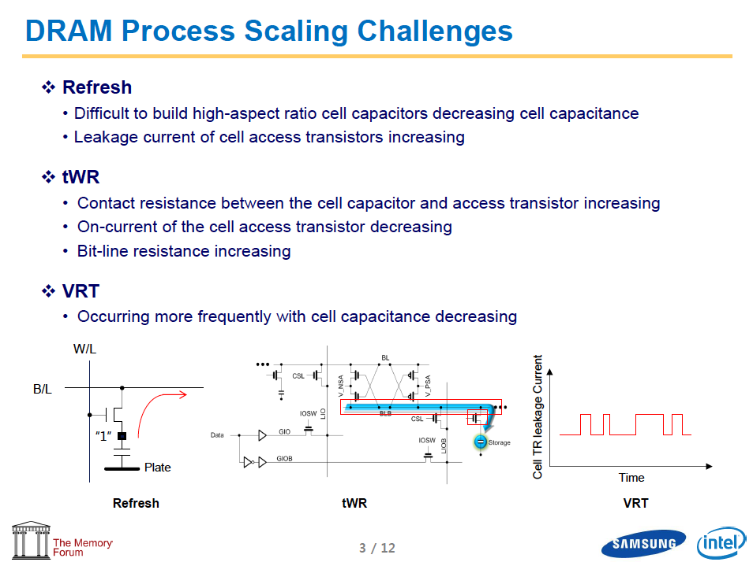
Industry Is Writing Papers About It, Too

Slide 60
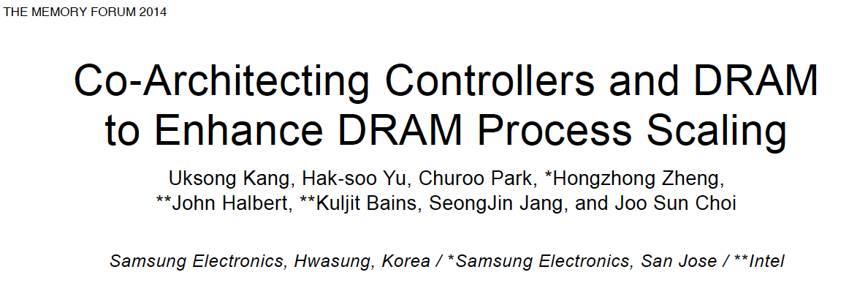
Call for Intelligent Memory Controllers

Slide 61
Agenda
Brief Introduction
A Motivating Example
Memory System Trends
What Will You Learn In This Course
  And, how to make the best of it…
Memory Fundamentals
Key Memory Challenges and Solution Directions
  Security, Reliability, Safety
  Energy and Performance: Data-Centric Systems
  Latency and Latency-Reliability Tradeoffs
Summary and Future Lookout

Slide 62
Course Logistics

Slide 63
What Will You Learn in This Course?
Memory Systems and Memory-Centric Computing Systems
  July 9-13, 2018
Topic 1: Main Memory Trends and Basics
Topic 2: Memory Reliability & Security: RowHammer and Beyond
Topic 3: In-memory Computation
Topic 4: Low-Latency and Low-Energy Memory
Topic 5 (unlikely): Enabling and Exploiting Non-Volatile Memory
Topic 6 (unlikely): Flash Memory and SSD Scaling
Major Overview Reading:
  Mutlu and Subramaniam, “Research Problems and Opportunities in Memory Systems,” SUPERFRI 2014.

Slide 64
This Course
Will cover many problems and potential solutions related to the design of memory systems in the many core era
The design of the memory system poses many
  Difficult research and engineering problems
  Important fundamental problems
  Industry-relevant problems
  Problems whose solutions can revolutionize the world
Many creative and insightful solutions are needed to solve these problems
Goal: Acquire the basics to develop such solutions (by covering fundamentals and cutting edge research)

Slide 65
Course Information
My Contact Information
  Onur Mutlu
  omutlu@gmail.com
  https://people.inf.ethz.ch/omutlu
  +41-79-572-1444 (my cell phone)
  Find me during breaks and/or email any time.
Website for Course Slides and Papers
  https://people.inf.ethz.ch/omutlu
  Click on ACACES 2018 course website

Slide 66
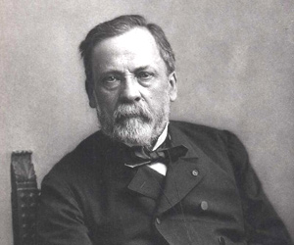
How To Make the Best Out of This Course
Be alert during lectures – they will be fast paced
Do the readings (and explore even more)
  I will provide many references
Go back and reinforce fundamentals (as needed)
  I will provide pointers to basic computer architecture materials (lecture videos, slides, readings, exams, …)
Remember “Chance favors the prepared mind.” (Pasteur)

Slide 67
Readings, Videos, Reference Materials

Slide 68
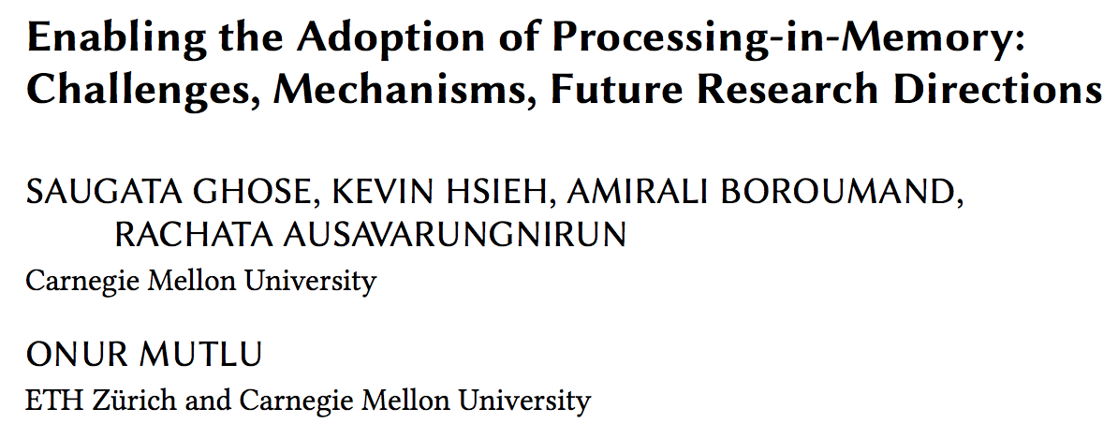
Reference Overview Paper I
https://arxiv.org/pdf/1802.00320.pdf

Slide 69
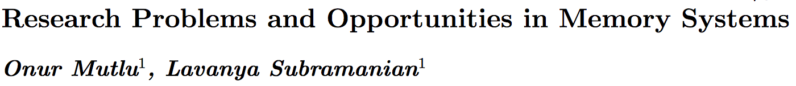
Reference Overview Paper II
Onur Mutlu and Lavanya Subramanian,
"Research Problems and Opportunities in Memory Systems"
Invited Article in Supercomputing Frontiers and Innovations (SUPERFRI), 2014/2015.
https://people.inf.ethz.ch/omutlu/pub/memory-systems-research_superfri14.pdf

Slide 70
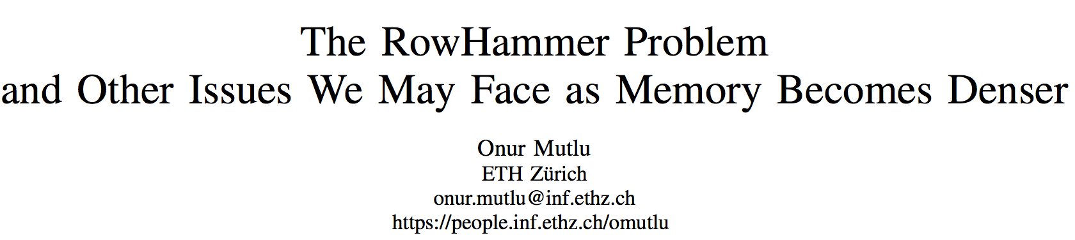
Reference Overview Paper III
Onur Mutlu,
"The RowHammer Problem and Other Issues We May Face as Memory Becomes Denser"
Invited Paper in Proceedings of the Design, Automation, and Test in Europe Conference (DATE), Lausanne, Switzerland, March 2017.
[Slides (pptx) (pdf)]
https://people.inf.ethz.ch/omutlu/pub/rowhammer-and-other-memory-issues_date17.pdf

Slide 71
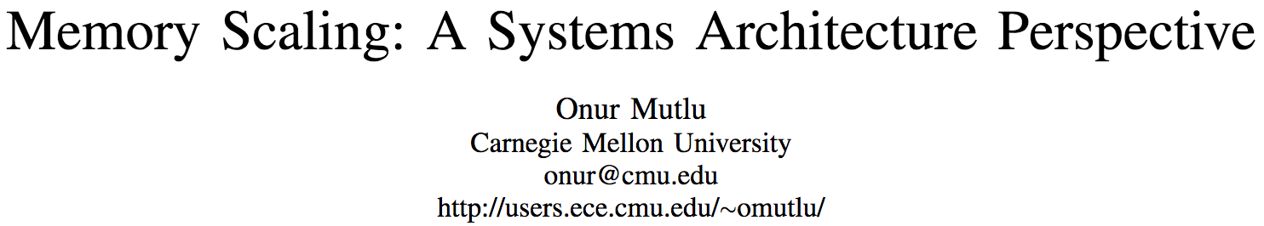
Reference Overview Paper IV
Onur Mutlu,
"Memory Scaling: A Systems Architecture Perspective"
Technical talk at MemCon 2013 (MEMCON), Santa Clara, CA, August 2013. [Slides (pptx) (pdf)]
[Video] [Coverage on StorageSearch]
https://people.inf.ethz.ch/omutlu/pub/memory-scaling_memcon13.pdf

Slide 72
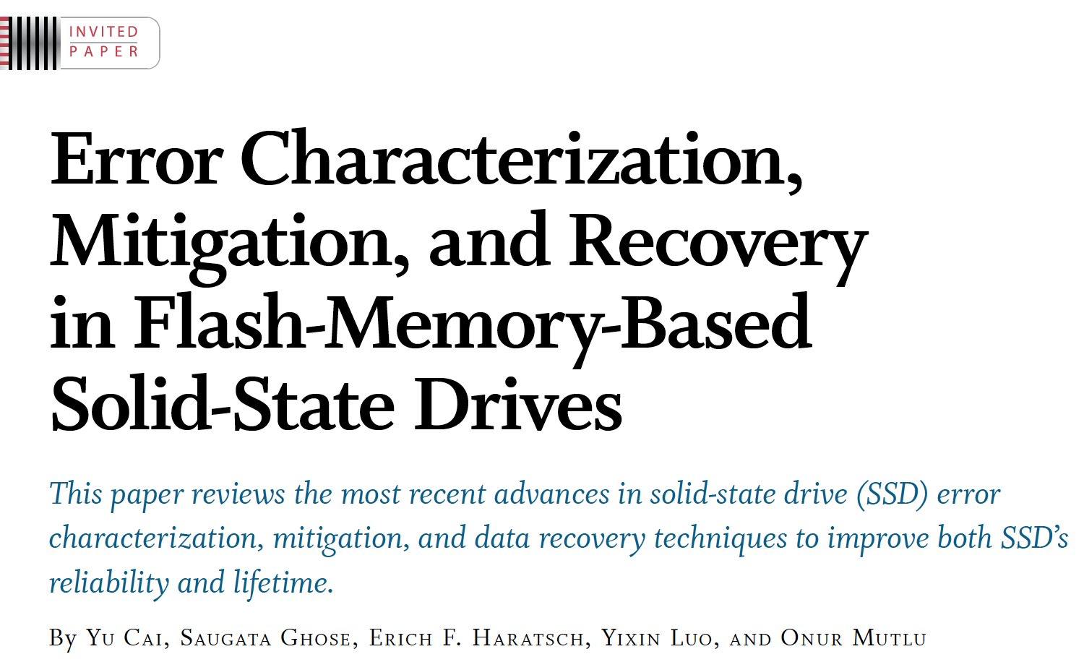
Reference Overview Paper V
Proceedings of the IEEE, Sept. 2017
https://arxiv.org/pdf/1706.08642

Slide 73
Related Videos and Course Materials (I)
Undergraduate Computer Architecture Course Lecture Videos (2015, 2014, 2013)
Undergraduate Computer Architecture Course Materials (2015, 2014, 2013)
Graduate Computer Architecture Course Lecture Videos (2017, 2015, 2013)
Graduate Computer Architecture Course Materials (2017, 2015, 2013)
Parallel Computer Architecture Course Materials (Lecture Videos)

Slide 74
Related Videos and Course Materials (II)
Freshman Digital Circuits and Computer Architecture Course Lecture Videos (2018, 2017)
Freshman Digital Circuits and Computer Architecture Course Materials (2018)
Memory Systems Short Course Materials
(Lecture Video on Main Memory and DRAM Basics)

Slide 75
Some Open Source Tools (I)
Rowhammer – Program to Induce RowHammer Errors
  https://github.com/CMU-SAFARI/rowhammer
Ramulator – Fast and Extensible DRAM Simulator
  https://github.com/CMU-SAFARI/ramulator
MemSim – Simple Memory Simulator
  https://github.com/CMU-SAFARI/memsim
NOCulator – Flexible Network-on-Chip Simulator
  https://github.com/CMU-SAFARI/NOCulator
SoftMC – FPGA-Based DRAM Testing Infrastructure
  https://github.com/CMU-SAFARI/SoftMC
Other open-source software from my group
  https://github.com/CMU-SAFARI/
  http://www.ece.cmu.edu/~safari/tools.html

Slide 76
Some Open Source Tools (II)
MQSim – A Fast Modern SSD Simulator
  https://github.com/CMU-SAFARI/MQSim
Mosaic – GPU Simulator Supporting Concurrent Applications
  https://github.com/CMU-SAFARI/Mosaic
IMPICA – Processing in 3D-Stacked Memory Simulator
  https://github.com/CMU-SAFARI/IMPICA
SMLA – Detailed 3D-Stacked Memory Simulator
  https://github.com/CMU-SAFARI/SMLA
HWASim – Simulator for Heterogeneous CPU-HWA Systems
  https://github.com/CMU-SAFARI/HWASim
Other open-source software from my group
  https://github.com/CMU-SAFARI/
  http://www.ece.cmu.edu/~safari/tools.html

Slide 77

More Open Source Tools (III)
A lot more open-source software from my group
  https://github.com/CMU-SAFARI/
  http://www.ece.cmu.edu/~safari/tools.html

Slide 78
Referenced Papers
All are available at
  https://people.inf.ethz.ch/omutlu/projects.htm
  http://scholar.google.com/citations?user=7XyGUGkAAAAJ&hl=en

Slide 79
Memory Fundamentals

Slide 80

Memory in a Modern System
CORE 0
L2 CACHE 1
CORE 1
L2 CACHE 0
SHARED L3 CACHE
DRAM INTERFACE
DRAM MEMORY CONTROLLER
DRAM BANKS
L2 CACHE 2
CORE 3
CORE 2
L2 CACHE 3

Slide 81
Ideal Memory
Zero access time (latency)
Infinite capacity
Zero cost
Infinite bandwidth (to support multiple accesses in parallel)

Slide 82
The Problem
Ideal memory’s requirements oppose each other
Bigger is slower
  Bigger → Takes longer to determine the location
Faster is more expensive
  Memory technology: SRAM vs. DRAM vs. Disk vs. Tape
Higher bandwidth is more expensive
  Need more banks, more ports, higher frequency, or faster technology

Slide 83
Memory Technology: DRAM
Dynamic random access memory
Capacitor charge state indicates stored value
  Whether the capacitor is charged or discharged indicates storage of 1 or 0
  1 capacitor
  1 access transistor
Capacitor leaks through the RC path
  DRAM cell loses charge over time
  DRAM cell needs to be refreshed
  Read Liu et al., “RAIDR: Retention-aware Intelligent DRAM Refresh,” ISCA 2012.
row enable
_bitline

Slide 84
Memory Technology: SRAM
Static random access memory
Two cross coupled inverters store a single bit
  Feedback path enables the stored value to persist in the “cell”
  4 transistors for storage
  2 transistors for access
row select
bitline
_bitline

Slide 85

An Aside: Phase Change Memory
Phase change material (chalcogenide glass) exists in two states:
  Amorphous: Low optical reflexivity and high electrical resistivity
  Crystalline: High optical reflexivity and low electrical resistivity
PCM is resistive memory: High resistance (0), Low resistance (1)
Lee, Ipek, Mutlu, Burger, “Architecting Phase Change Memory as a Scalable DRAM Alternative,” ISCA 2009.

Slide 86

Reading: PCM As Main Memory
Benjamin C. Lee, Engin Ipek, Onur Mutlu, and Doug Burger,
"Architecting Phase Change Memory as a Scalable DRAM Alternative"
Proceedings of the 36th International Symposium on Computer Architecture (ISCA), pages 2-13, Austin, TX, June 2009. Slides (pdf)

Slide 87

Reading: More on PCM As Main Memory
Benjamin C. Lee, Ping Zhou, Jun Yang, Youtao Zhang, Bo Zhao, Engin Ipek, Onur Mutlu, and Doug Burger,
"Phase Change Technology and the Future of Main Memory"
IEEE Micro, Special Issue: Micro's Top Picks from 2009 Computer Architecture Conferences (MICRO TOP PICKS), Vol. 30, No. 1, pages 60-70, January/February 2010.

Slide 88
Memory Bank: A Fundamental Concept
Interleaving (banking)
  Problem: a single monolithic memory array takes long to access and does not enable multiple accesses in parallel
  Goal: Reduce the latency of memory array access and enable multiple accesses in parallel
  Idea: Divide the array into multiple banks that can be accessed independently (in the same cycle or in consecutive cycles)
    Each bank is smaller than the entire memory storage
    Accesses to different banks can be overlapped
  An issue: How do you map data to different banks? (i.e., how do you interleave data across banks?)

Slide 89

Memory Bank Organization and Operation
Read access sequence:
1. Decode row address & drive word-lines
2. Selected bits drive bit-lines
• Entire row read
3. Amplify row data
4. Decode column address & select subset of row
• Send to output
5. Precharge bit-lines
• For next access

Slide 90
Why Memory Hierarchy?
We want both fast and large
But we cannot achieve both with a single level of memory
Idea: Have multiple levels of storage (progressively bigger and slower as the levels are farther from the processor) and ensure most of the data the processor needs is kept in the fast(er) level(s)

Slide 91
Memory Hierarchy
Fundamental tradeoff
  Fast memory: small
  Large memory: slow
Idea: Memory hierarchy
Latency, cost, size,
bandwidth
Hard Disk
Main
Memory
(DRAM)
CPU
Cache
RF

Slide 92
Caching Basics: Exploit Temporal Locality
Idea: Store recently accessed data in automatically managed fast memory (called cache)
Anticipation: the data will be accessed again soon
Temporal locality principle
  Recently accessed data will be again accessed in the near future
  This is what Maurice Wilkes had in mind:
    Wilkes, “Slave Memories and Dynamic Storage Allocation,” IEEE Trans. On Electronic Computers, 1965.
    “The use is discussed of a fast core memory of, say 32000 words as a slave to a slower core memory of, say, one million words in such a way that in practical cases the effective access time is nearer that of the fast memory than that of the slow memory.”

Slide 93
Caching Basics: Exploit Spatial Locality
Idea: Store addresses adjacent to the recently accessed one in automatically managed fast memory
  Logically divide memory into equal size blocks
  Fetch to cache the accessed block in its entirety
Anticipation: nearby data will be accessed soon
Spatial locality principle
  Nearby data in memory will be accessed in the near future
    E.g., sequential instruction access, array traversal
  This is what IBM 360/85 implemented
    16 Kbyte cache with 64 byte blocks
    Liptay, “Structural aspects of the System/360 Model 85 II: the cache,” IBM Systems Journal, 1968.

Slide 94
A Note on Manual vs. Automatic Management
Manual: Programmer manages data movement across levels
  -- too painful for programmers on substantial programs
  “core” vs “drum” memory in the 50’s
  still done in some embedded processors (on-chip scratch pad SRAM in lieu of a cache)
Automatic: Hardware manages data movement across levels, transparently to the programmer
  ++ programmer’s life is easier
  simple heuristic: keep most recently used items in cache
  the average programmer doesn’t need to know about it
    You don’t need to know how big the cache is and how it works to write a “correct” program! (What if you want a “fast” program?)

Slide 95

Automatic Management in Memory Hierarchy
Wilkes, “Slave Memories and Dynamic Storage Allocation,” IEEE Trans. On Electronic Computers, 1965.
“By a slave memory I mean one which automatically accumulates to itself words that come from a slower main memory, and keeps them available for subsequent use without it being necessary for the penalty of main memory access to be incurred again.”

Slide 96
A Modern Memory Hierarchy
Register File
32 words, sub-nsec
L1 cache
~32 KB, ~nsec
L2 cache
512 KB ~ 1MB, many nsec
L3 cache,
.....
Main memory (DRAM),
GB, ~100 nsec
Swap Disk
100 GB, ~10 msec
manual/compiler
register spilling
Memory
Abstraction
Automatic
HW cache
management
automatic
demand
paging

Slide 97
The DRAM Subsystem

Slide 98
DRAM Subsystem Organization
Channel
DIMM
Rank
Chip
Bank
Row/Column

Slide 99
Page Mode DRAM
A DRAM bank is a 2D array of cells: rows x columns
A “DRAM row” is also called a “DRAM page”
“Sense amplifiers” also called “row buffer”
Each address is a <row,column> pair
Access to a “closed row”
  Activate command opens row (placed into row buffer)
  Read/write command reads/writes column in the row buffer
  Precharge command closes the row and prepares the bank for next access
Access to an “open row”
  No need for activate command

Slide 100

The DRAM Bank Structure

Slide 101
DRAM Bank Operation
Access Address:
(Row 0, Column 0)
Columns
(Row 0, Column 1)
(Row 0, Column 85)
(Row 1, Column 0)
Row address 0
Row address 1
Row decoder
Rows
Row Buffer
CONFLICT !
HIT
Row 1
HIT
Row 0
Empty
Column address 0
Column mux
Column address 0
Column address 1
Column address 85
Data

Slide 102
The DRAM Chip
Consists of multiple banks (8 is a common number today)
Banks share command/address/data buses
The chip itself has a narrow interface (4-16 bits per read)
Changing the number of banks, size of the interface (pins), whether or not command/address/data buses are shared has significant impact on DRAM system cost

Slide 103

128M x 8-bit DRAM Chip

Slide 104
DRAM Rank and Module
Rank: Multiple chips operated together to form a wide interface
All chips comprising a rank are controlled at the same time
  Respond to a single command
  Share address and command buses, but provide different data
A DRAM module consists of one or more ranks
  E.g., DIMM (dual inline memory module)
  This is what you plug into your motherboard
If we have chips with 8-bit interface, to read 8 bytes in a single access, use 8 chips in a DIMM

Slide 105
A 64-bit Wide DIMM (One Rank)

Slide 106

A 64-bit Wide DIMM (One Rank)
Advantages:
  Acts like a high-capacity DRAM chip with a wide interface
  Flexibility: memory controller does not need to deal with individual chips
Disadvantages:
  Granularity: Accesses cannot be smaller than the interface width

Slide 107

Multiple DIMMs
Advantages:
  Enables even higher capacity
Disadvantages:
  Interconnect complexity and energy consumption can be high
  → Scalability is limited by this

Slide 108
DRAM Channels
2 Independent Channels: 2 Memory Controllers (Above)
2 Dependent/Lockstep Channels: 1 Memory Controller with wide interface (Not shown above)

Slide 109

Generalized Memory Structure

Slide 110

Generalized Memory Structure
Kim+, “A Case for Exploiting Subarray-Level Parallelism in DRAM,” ISCA 2012.

Slide 111
The DRAM Subsystem
The Top Down View

Slide 112
DRAM Subsystem Organization
Channel
DIMM
Rank
Chip
Bank
Row/Column

Slide 113


The DRAM subsystem
“Channel”
DIMM (Dual in-line memory module)
Processor
Memory channel
Memory channel

Slide 114



Breaking down a DIMM
DIMM (Dual in-line memory module)
Side view
Front of DIMM
Back of DIMM

Slide 115
Breaking down a DIMM
DIMM (Dual in-line memory module)
Side view
Front of DIMM
Back of DIMM
Rank 0: collection of 8 chips
Rank 1

Slide 116
Rank
Rank 0 (Front)
Rank 1 (Back)
<0:63>
<0:63>
Addr/Cmd
CS <0:1>
Data <0:63>
Memory channel

Slide 117
Breaking down a Rank
. . .
Chip 0
Chip 1
Chip 7
Rank 0
<0:63>
<0:7>
<8:15>
<56:63>
Data <0:63>

Slide 118
Breaking down a Chip
8 banks
Chip 0
Bank 0
<0:7>
<0:7>
<0:7>
...
<0:7>
<0:7>

Slide 119
Breaking down a Bank
2kB
1B (column)
row 16k-1
Bank 0
...
row 0
<0:7>
Row-buffer
1B
1B
1B
...
<0:7>

Slide 120
DRAM Subsystem Organization
Channel
DIMM
Rank
Chip
Bank
Row/Column

Slide 121



Example: Transferring a cache block
Physical memory space
0xFFFF…F
Channel 0
...
DIMM 0
Mapped to
0x40
Rank 0
64B
cache block
0x00

Slide 122
Example: Transferring a cache block
Physical memory space
Chip 0
Chip 1
Rank 0
Chip 7
0xFFFF…F
. . .
...
<0:7>
<8:15>
<56:63>
0x40
64B
cache block
Data <0:63>
0x00

Slide 123
Example: Transferring a cache block
Physical memory space
Chip 0
Chip 1
Rank 0
Chip 7
0xFFFF…F
. . .
Row 0
Col 0
...
<0:7>
<8:15>
<56:63>
0x40
64B
cache block
Data <0:63>
0x00

Slide 124
Example: Transferring a cache block
Physical memory space
Chip 0
Chip 1
Rank 0
Chip 7
0xFFFF…F
. . .
Row 0
Col 0
...
<0:7>
<8:15>
<56:63>
0x40
64B
cache block
Data <0:63>
8B
0x00
8B

Slide 125
Example: Transferring a cache block
Physical memory space
Chip 0
Chip 1
Rank 0
Chip 7
0xFFFF…F
. . .
Row 0
Col 1
...
<0:7>
<8:15>
<56:63>
0x40
64B
cache block
Data <0:63>
8B
0x00

Slide 126
Example: Transferring a cache block
Physical memory space
Chip 0
Chip 1
Rank 0
Chip 7
0xFFFF…F
. . .
Row 0
Col 1
...
<0:7>
<8:15>
<56:63>
0x40
8B
64B
cache block
Data <0:63>
8B
0x00
8B

Slide 127
Example: Transferring a cache block
Physical memory space
Chip 0
Chip 1
Rank 0
Chip 7
0xFFFF…F
. . .
Row 0
Col 1
...
<0:7>
<8:15>
<56:63>
0x40
8B
64B
cache block
Data <0:63>
8B
0x00
A 64B cache block takes 8 I/O cycles to transfer.
During the process, 8 columns are read sequentially.

Slide 128
Latency Components: Basic DRAM Operation
CPU → controller transfer time
Controller latency
  Queuing & scheduling delay at the controller
  Access converted to basic commands
Controller → DRAM transfer time
DRAM bank latency
  Simple CAS (column address strobe) if row is “open” OR
  RAS (row address strobe) + CAS if array precharged OR
  PRE + RAS + CAS (worst case)
DRAM → Controller transfer time
  Bus latency (BL)
Controller to CPU transfer time

Slide 129
Multiple Banks (Interleaving) and Channels
Multiple banks
  Enable concurrent DRAM accesses
  Bits in address determine which bank an address resides in
Multiple independent channels serve the same purpose
  But they are even better because they have separate data buses
  Increased bus bandwidth
Enabling more concurrency requires reducing
  Bank conflicts
  Channel conflicts
How to select/randomize bank/channel indices in address?
  Lower order bits have more entropy
  Randomizing hash functions (XOR of different address bits)

Slide 130

How Multiple Banks Help

Slide 131
Address Mapping (Single Channel)
Single-channel system with 8-byte memory bus
  2GB memory, 8 banks, 16K rows & 2K columns per bank
Row interleaving
  Consecutive rows of memory in consecutive banks
  Accesses to consecutive cache blocks serviced in a pipelined manner
Cache block interleaving
    Consecutive cache block addresses in consecutive banks
    64 byte cache blocks
    Accesses to consecutive cache blocks can be serviced in parallel
Row (14 bits)
Bank (3 bits)
Column (11 bits)
Byte in bus (3 bits)
Row (14 bits)
High Column
Bank (3 bits)
Low Col.
Byte in bus (3 bits)
8 bits
3 bits

Slide 132
Bank Mapping Randomization
DRAM controller can randomize the address mapping to banks so that bank conflicts are less likely
Reading:
  Rau, “Pseudo-randomly Interleaved Memory,” ISCA 1991.
3 bits
Column (11 bits)
Byte in bus (3 bits)
XOR
Bank index (3 bits)

Slide 133
Address Mapping (Multiple Channels)
C
Row (14 bits)
Bank (3 bits)
Column (11 bits)
Byte in bus (3 bits)
Where are consecutive cache blocks?
Row (14 bits)
C
Bank (3 bits)
Column (11 bits)
Byte in bus (3 bits)
Row (14 bits)
Bank (3 bits)
C
Column (11 bits)
Byte in bus (3 bits)
Row (14 bits)
Bank (3 bits)
Column (11 bits)
C
Byte in bus (3 bits)
C
Row (14 bits)
High Column
Bank (3 bits)
Low Col.
Byte in bus (3 bits)
8 bits
3 bits
Row (14 bits)
C
High Column
Bank (3 bits)
Low Col.
Byte in bus (3 bits)
8 bits
3 bits
Row (14 bits)
High Column
C
Bank (3 bits)
Low Col.
Byte in bus (3 bits)
8 bits
3 bits
Row (14 bits)
High Column
Bank (3 bits)
C
Low Col.
Byte in bus (3 bits)
8 bits
3 bits
Row (14 bits)
High Column
Bank (3 bits)
Low Col.
C
Byte in bus (3 bits)
8 bits
3 bits

Slide 134
Interaction with Virtual→Physical Mapping
Operating System influences where an address maps to in DRAM
Operating system can influence which bank/channel/rank a virtual page is mapped to.
It can perform page coloring to
  Minimize bank conflicts
  Minimize inter-application interference [Muralidhara+ MICRO’11]
  Minimize latency in the network [Das+ HPCA’13]
Virtual Page number (52 bits)
Page offset (12 bits)
VA
Physical Frame number (19 bits)
Page offset (12 bits)
PA
Row (14 bits)
Bank (3 bits)
Column (11 bits)
Byte in bus (3 bits)
PA

Slide 135

More on Reducing Bank Conflicts
Read Sections 1 through 4 of:
  Kim et al., “A Case for Exploiting Subarray-Level Parallelism in DRAM,” ISCA 2012.

Slide 136

Subarray Level Parallelism Paper
Yoongu Kim, Vivek Seshadri, Donghyuk Lee, Jamie Liu, and Onur Mutlu,
"A Case for Exploiting Subarray-Level Parallelism (SALP) in DRAM"
Proceedings of the 39th International Symposium on Computer Architecture (ISCA), Portland, OR, June 2012. Slides (pptx)

Slide 137
DRAM Refresh (I)
DRAM capacitor charge leaks over time
The memory controller needs to read each row periodically to restore the charge
  Activate + precharge each row every N ms
  Typical N = 64 ms
Implications on performance?
  -- DRAM bank unavailable while refreshed
  -- Long pause times: If we refresh all rows in burst, every 64ms the DRAM will be unavailable until refresh ends
Burst refresh: All rows refreshed immediately after one another
Distributed refresh: Each row refreshed at a different time, at regular intervals

Slide 138

DRAM Refresh (II)
Distributed refresh eliminates long pause times
How else we can reduce the effect of refresh on performance?
  Can we reduce the number of refreshes?

Slide 139
Downsides of DRAM Refresh
-- Energy consumption: Each refresh consumes energy
-- Performance degradation: DRAM rank/bank unavailable while refreshed
-- QoS/predictability impact: (Long) pause times during refresh
-- Refresh rate limits DRAM density scaling
  Liu et al., “RAIDR: Retention-aware Intelligent DRAM Refresh,” ISCA 2012.

Slide 140

More on DRAM Refresh (I)
Jamie Liu, Ben Jaiyen, Richard Veras, and Onur Mutlu,
"RAIDR: Retention-Aware Intelligent DRAM Refresh"
Proceedings of the 39th International Symposium on Computer Architecture (ISCA), Portland, OR, June 2012. Slides (pdf)

Slide 141

DRAM Retention Analysis
Jamie Liu, Ben Jaiyen, Yoongu Kim, Chris Wilkerson, and Onur Mutlu,
"An Experimental Study of Data Retention Behavior in Modern DRAM Devices: Implications for Retention Time Profiling Mechanisms"
Proceedings of the 40th International Symposium on Computer Architecture (ISCA), Tel-Aviv, Israel, June 2013. Slides (ppt) Slides (pdf)

Slide 142

Data Retention in Memory [Liu et al., ISCA 2013]
Data Retention Time Profile of DRAM looks like this:
Location dependent
Stored value pattern dependent
Time dependent

Slide 143

DRAM Refresh-Access Parallelization
Kevin Chang, Donghyuk Lee, Zeshan Chishti, Alaa Alameldeen, Chris Wilkerson, Yoongu Kim, and Onur Mutlu,
"Improving DRAM Performance by Parallelizing Refreshes with Accesses"
Proceedings of the 20th International Symposium on High-Performance Computer Architecture (HPCA), Orlando, FL, February 2014. [Summary] [Slides (pptx) (pdf)]

Slide 144
Inside A DRAM Chip

Slide 145


DRAM Module and Chip

Slide 146
Goals
Cost
Latency
Bandwidth
Parallelism
Power
Energy
Reliability
…

Slide 147
DRAM Chip
Row Decoder
Cell Array
Array of Sense Amplifiers
Cell Array
Row Decoder
Cell Array
Array of Sense Amplifiers
Cell Array
Bank I/O

Slide 148
Sense Amplifier
top
enable
Inverter
bottom

Slide 149
Sense Amplifier – Two Stable States
V_{DD}
0
1
1
0
V_{DD}
Logical “1”
Logical “0”

Slide 150
Sense Amplifier Operation
V_{T}
V_{DD}
0
V_{T} > V_{B}
1
V_{B}
0

Slide 151
DRAM Cell – Capacitor
Empty State
Fully Charged State
Logical “0”
Logical “1”
1
Small – Cannot drive circuits
2
Reading destroys the state

Slide 152
Capacitor to Sense Amplifier
0
V_{DD}
1
1
V_{DD}
0

Slide 153
DRAM Cell Operation
½V_{DD}
½V_{DD}+δ
V_{DD}
0
1
0
½V_{DD}

Slide 154
DRAM Subarray – Building Block for DRAM Chip
Row Decoder
Cell Array
Array of Sense Amplifiers (Row Buffer) 8Kb
Cell Array

Slide 155
DRAM Bank
Row Decoder
Cell Array
Array of Sense Amplifiers (8Kb)
Cell Array
Address
Row Decoder
Cell Array
Array of Sense Amplifiers
Cell Array
Bank I/O (64b)
Data
Address

Slide 156
DRAM Chip
Shared internal bus
Row Decoder
Cell Array
Row Decoder
Cell Array
Array of Sense Amplifiers
Array of Sense Amplifiers
Cell Array
Cell Array
Row Decoder
Cell Array
Row Decoder
Cell Array
Array of Sense Amplifiers
Array of Sense Amplifiers
Row Decoder
Cell Array
Row Decoder
Cell Array
Cell Array
Cell Array
Array of Sense Amplifiers
Array of Sense Amplifiers
Bank I/O
Bank I/O
Cell Array
Cell Array
Row Decoder
Cell Array
Row Decoder
Cell Array
Array of Sense Amplifiers
Array of Sense Amplifiers
Row Decoder
Cell Array
Row Decoder
Cell Array
Cell Array
Cell Array
Array of Sense Amplifiers
Array of Sense Amplifiers
Bank I/O
Bank I/O
Cell Array
Cell Array
Row Decoder
Cell Array
Row Decoder
Cell Array
Array of Sense Amplifiers
Array of Sense Amplifiers
Row Decoder
Cell Array
Row Decoder
Cell Array
Cell Array
Cell Array
Array of Sense Amplifiers
Array of Sense Amplifiers
Bank I/O
Bank I/O
Cell Array
Cell Array
Row Decoder
Cell Array
Row Decoder
Cell Array
Array of Sense Amplifiers
Array of Sense Amplifiers
Cell Array
Cell Array
Bank I/O
Bank I/O
Memory channel - 8bits

Slide 157
DRAM Operation
Row Decoder
ACTIVATE Row
1
Row Address
2
READ/WRITE Column
Row Decoder
Cell Array
Array of Sense Amplifiers
Cell Array
3
PRECHARGE
Bank I/O
Data
Column Address

Slide 158
Simulating Memory

Slide 159
Ramulator: A Fast and Extensible DRAM Simulator
[IEEE Comp Arch Letters’15]

Slide 160

Ramulator Motivation
DRAM and Memory Controller landscape is changing
Many new and upcoming standards
Many new controller designs
A fast and easy-to-extend simulator is very much needed

Slide 161

Ramulator
Provides out-of-the box support for many DRAM standards:
  DDR3/4, LPDDR3/4, GDDR5, WIO1/2, HBM, plus new proposals (SALP, AL-DRAM, TLDRAM, RowClone, and SARP)
~2.5X faster than fastest open-source simulator
Modular and extensible to different standards

Slide 162


Case Study: Comparison of DRAM Standards
Across 22 workloads, simple CPU model

Slide 163

Ramulator Paper and Source Code
Yoongu Kim, Weikun Yang, and Onur Mutlu,
"Ramulator: A Fast and Extensible DRAM Simulator"
IEEE Computer Architecture Letters (CAL), March 2015.
[Source Code]
Source code is released under the liberal MIT License
  https://github.com/CMU-SAFARI/ramulator

Slide 164
Optional Assignment
Review the Ramulator paper
  Email me your review (omutlu@gmail.com)
Download and run Ramulator
  Compare DDR3, DDR4, SALP, HBM for the libquantum benchmark (provided in Ramulator repository)
  Email me your report (omutlu@gmail.com)
This may help you get into memory systems research quickly

Slide 165
Memory Controllers

Slide 166
DRAM versus Other Types of Memories
Long latency memories have similar characteristics that need to be controlled.
The following discussion will use DRAM as an example, but many scheduling and control issues are similar in the design of controllers for other types of memories
  Flash memory
  Other emerging memory technologies
    Phase Change Memory
    Spin-Transfer Torque Magnetic Memory
  These other technologies can place other demands on the controller

Slide 167

Flash Memory (SSD) Controllers
Similar to DRAM memory controllers, except:
  They are flash memory specific
  They do much more: error correction, garbage collection, page remapping, …
Cai+, “Flash Correct-and-Refresh: Retention-Aware Error Management for Increased Flash Memory Lifetime”, ICCD 2012.

Slide 168
Another View of the SSD Controller
Cai+, “Error Characterization, Mitigation, and Recovery in Flash Memory Based Solid State Drives,” Proc. IEEE 2017.
https://arxiv.org/pdf/1711.11427.pdf

Slide 169
DRAM Types
DRAM has different types with different interfaces optimized for different purposes
  Commodity: DDR, DDR2, DDR3, DDR4, …
  Low power (for mobile): LPDDR1, …, LPDDR5, …
  High bandwidth (for graphics): GDDR2, …, GDDR5, …
  Low latency: eDRAM, RLDRAM, …
  3D stacked: WIO, HBM, HMC, …
  …
Underlying microarchitecture is fundamentally the same
A flexible memory controller can support various DRAM types
This complicates the memory controller
  Difficult to support all types (and upgrades)

Slide 170

DRAM Types (circa 2015)
Kim et al., “Ramulator: A Fast and Extensible DRAM Simulator,” IEEE Comp Arch Letters 2015.

Slide 171
DRAM Controller: Functions
Ensure correct operation of DRAM (refresh and timing)
Service DRAM requests while obeying timing constraints of DRAM chips
  Constraints: resource conflicts (bank, bus, channel), minimum write-to-read delays
  Translate requests to DRAM command sequences
Buffer and schedule requests to for high performance + QoS
  Reordering, row-buffer, bank, rank, bus management
Manage power consumption and thermals in DRAM
  Turn on/off DRAM chips, manage power modes

Slide 172

A Modern DRAM Controller (I)

Slide 173
A Modern DRAM Controller

Slide 174
DRAM Scheduling Policies (I)
FCFS (first come first served)
  Oldest request first
FR-FCFS (first ready, first come first served)
  1. Row-hit first
  2. Oldest first
  Goal: Maximize row buffer hit rate → maximize DRAM throughput
  Actually, scheduling is done at the command level
    Column commands (read/write) prioritized over row commands (activate/precharge)
    Within each group, older commands prioritized over younger ones

Slide 175
Review: DRAM Bank Operation
Access Address:
(Row 0, Column 0)
Columns
(Row 0, Column 1)
(Row 0, Column 85)
(Row 1, Column 0)
Row address 0
Row address 1
Row decoder
Rows
Row Buffer
CONFLICT !
HIT
Row 1
HIT
Row 0
Empty
Column address 0
Column mux
Column address 0
Column address 1
Column address 85
Data

Slide 176
DRAM Scheduling Policies (II)
A scheduling policy is a request prioritization order
Prioritization can be based on
  Request age
  Row buffer hit/miss status
  Request type (prefetch, read, write)
  Requestor type (load miss or store miss)
  Request criticality
    Oldest miss in the core?
    How many instructions in core are dependent on it?
    Will it stall the processor?
  Interference caused to other cores
  …

Slide 177
Row Buffer Management Policies
Open row
  Keep the row open after an access
  + Next access might need the same row → row hit
  -- Next access might need a different row → row conflict, wasted energy
Closed row
  Close the row after an access (if no other requests already in the request buffer need the same row)
  + Next access might need a different row → avoid a row conflict
  -- Next access might need the same row → extra activate latency
Adaptive policies
  Predict whether or not the next access to the bank will be to the same row

Slide 178
Open vs. Closed Row Policies
Policy | First access | Next access | Commands needed for next access
Open row | Row 0 | Row 0 (row hit) | Read
Open row | Row 0 | Row 1 (row conflict) | Precharge + Activate Row 1 + Read
Closed row | Row 0 | Row 0 – access in request buffer (row hit) | Read
Closed row | Row 0 | Row 0 – access not in request buffer (row closed) | Activate Row 0 + Read + Precharge
Closed row | Row 0 | Row 1 (row closed) | Activate Row 1 + Read + Precharge

Slide 179
DRAM Power Management
DRAM chips have power modes
Idea: When not accessing a chip power it down
Power states
  Active (highest power)
  All banks idle
  Power-down
  Self-refresh (lowest power)
Tradeoff: State transitions incur latency during which the chip cannot be accessed

Slide 180
Difficulty of DRAM Control

Slide 181
Why are DRAM Controllers Difficult to Design?
Need to obey DRAM timing constraints for correctness
  There are many (50+) timing constraints in DRAM
  tWTR: Minimum number of cycles to wait before issuing a read command after a write command is issued
  tRC: Minimum number of cycles between the issuing of two consecutive activate commands to the same bank
  …
Need to keep track of many resources to prevent conflicts
  Channels, banks, ranks, data bus, address bus, row buffers
Need to handle DRAM refresh
Need to manage power consumption
Need to optimize performance & QoS (in the presence of constraints)
  Reordering is not simple
  Fairness and QoS needs complicates the scheduling problem

Slide 182

Many DRAM Timing Constraints
From Lee et al., “DRAM-Aware Last-Level Cache Writeback: Reducing Write-Caused Interference in Memory Systems,” HPS Technical Report, April 2010.

Slide 183

More on DRAM Operation
Kim et al., “A Case for Exploiting Subarray-Level Parallelism (SALP) in DRAM,” ISCA 2012.
Lee et al., “Tiered-Latency DRAM: A Low Latency and Low Cost DRAM Architecture,” HPCA 2013.

Slide 184
Why So Many Timing Constraints? (I)
Kim et al., “A Case for Exploiting Subarray-Level Parallelism (SALP) in DRAM,” ISCA 2012.

Slide 185
Why So Many Timing Constraints? (II)
Lee et al., “Tiered-Latency DRAM: A Low Latency and Low Cost DRAM Architecture,” HPCA 2013.

Slide 186
DRAM Controller Design Is Becoming More Difficult
CPU
CPU
CPU
CPU
GPU
HWA
HWA
Shared Cache
DRAM and Hybrid Memory Controllers
DRAM and Hybrid Memories
Heterogeneous agents: CPUs, GPUs, and HWAs
Main memory interference between CPUs, GPUs, HWAs
Many timing constraints for various memory types
Many goals at the same time: performance, fairness, QoS, energy efficiency, …

Slide 187
Reality and Dream
Reality: It difficult to optimize all these different constraints while maximizing performance, QoS, energy-efficiency, …
Dream: Wouldn’t it be nice if the DRAM controller automatically found a good scheduling policy on its own?

Slide 188
Self-Optimizing DRAM Controllers
Problem: DRAM controllers difficult to design → It is difficult for human designers to design a policy that can adapt itself very well to different workloads and different system conditions
Idea: Design a memory controller that adapts its scheduling policy decisions to workload behavior and system conditions using machine learning.
Observation: Reinforcement learning maps nicely to memory control.
Design: Memory controller is a reinforcement learning agent that dynamically and continuously learns and employs the best scheduling policy.
Ipek+, “Self Optimizing Memory Controllers: A Reinforcement Learning Approach,” ISCA 2008.

Slide 189

Self-Optimizing DRAM Controllers
Engin Ipek, Onur Mutlu, José F. Martínez, and Rich Caruana,
"Self Optimizing Memory Controllers: A Reinforcement Learning Approach"
Proceedings of the 35th International Symposium on Computer Architecture (ISCA), pages 39-50, Beijing, China, June 2008.
Goal: Learn to choose actions to maximize r₀ + γr₁ + γ²r₂ + … ( 0 ≤ γ < 1)

Slide 190

Self-Optimizing DRAM Controllers
Dynamically adapt the memory scheduling policy via interaction with the system at runtime
  Associate system states and actions (commands) with long term reward values: each action at a given state leads to a learned reward
  Schedule command with highest estimated long-term reward value in each state
  Continuously update reward values for <state, action> pairs based on feedback from system

Slide 191

Self-Optimizing DRAM Controllers
Engin Ipek, Onur Mutlu, José F. Martínez, and Rich Caruana,
"Self Optimizing Memory Controllers: A Reinforcement Learning Approach"
Proceedings of the 35th International Symposium on Computer Architecture (ISCA), pages 39-50, Beijing, China, June 2008.

Slide 192
States, Actions, Rewards
Reward function
  +1 for scheduling Read and Write commands
  0 at all other times
  Goal is to maximize long-term data bus utilization
State attributes
  Number of reads, writes, and load misses in transaction queue
  Number of pending writes and ROB heads waiting for referenced row
  Request’s relative ROB order
Actions
  Activate
  Write
  Read - load miss
  Read - store miss
  Precharge - pending
  Precharge - preemptive
  NOP

Slide 193


Performance Results

Slide 194
Self Optimizing DRAM Controllers
Advantages
  + Adapts the scheduling policy dynamically to changing workload behavior and to maximize a long-term target
  + Reduces the designer’s burden in finding a good scheduling policy. Designer specifies:
  1) What system variables might be useful
  2) What target to optimize, but not how to optimize it
Disadvantages and Limitations
  -- Black box: designer much less likely to implement what she cannot easily reason about
  -- How to specify different reward functions that can achieve different objectives? (e.g., fairness, QoS)
  -- Hardware complexity?

Slide 195

More on Self-Optimizing DRAM Controllers
Engin Ipek, Onur Mutlu, José F. Martínez, and Rich Caruana,
"Self Optimizing Memory Controllers: A Reinforcement Learning Approach"
Proceedings of the 35th International Symposium on Computer Architecture (ISCA), pages 39-50, Beijing, China, June 2008.

Slide 196
Some More Suggested Readings

Slide 197
Some Key Readings on DRAM (I)
DRAM Organization and Operation
  Lee et al., “Tiered-Latency DRAM: A Low Latency and Low Cost DRAM Architecture,” HPCA 2013.
  https://people.inf.ethz.ch/omutlu/pub/tldram_hpca13.pdf
  Kim et al., “A Case for Subarray-Level Parallelism (SALP) in DRAM,” ISCA 2012.
  https://people.inf.ethz.ch/omutlu/pub/salp-dram_isca12.pdf
  Lee et al., “Simultaneous Multi-Layer Access: Improving 3D-Stacked Memory Bandwidth at Low Cost,” ACM TACO 2016.
  https://people.inf.ethz.ch/omutlu/pub/smla_high-bandwidth-3d-stacked-memory_taco16.pdf

Slide 198
Some Key Readings on DRAM (II)
DRAM Refresh
  Liu et al., “RAIDR: Retention-Aware Intelligent DRAM Refresh,” ISCA 2012. https://people.inf.ethz.ch/omutlu/pub/raidr-dram-refresh_isca12.pdf
  Chang et al., “Improving DRAM Performance by Parallelizing Refreshes with Accesses,” HPCA 2014.
  https://people.inf.ethz.ch/omutlu/pub/dram-access-refresh-parallelization_hpca14.pdf
  Patel et al., “The Reach Profiler (REAPER): Enabling the Mitigation of DRAM Retention Failures via Profiling at Aggressive Conditions,” ISCA 2017.
    https://people.inf.ethz.ch/omutlu/pub/reaper-dram-retention-profiling-lpddr4_isca17.pdf

Slide 199
Reading on Simulating Main Memory
How to evaluate future main memory systems?
An open-source simulator and its brief description
Yoongu Kim, Weikun Yang, and Onur Mutlu,
"Ramulator: A Fast and Extensible DRAM Simulator"
IEEE Computer Architecture Letters (CAL), March 2015.
[Source Code]

Slide 200
Some Key Readings on Memory Control 1
  Mutlu+, “Parallelism-Aware Batch Scheduling: Enhancing both Performance and Fairness of Shared DRAM Systems,” ISCA 2008.
    https://people.inf.ethz.ch/omutlu/pub/parbs_isca08.pdf
  Kim et al., “Thread Cluster Memory Scheduling: Exploiting Differences in Memory Access Behavior,” MICRO 2010.
    https://people.inf.ethz.ch/omutlu/pub/tcm_micro10.pdf
  Subramanian et al., “BLISS: Balancing Performance, Fairness and Complexity in Memory Access Scheduling,” TPDS 2016.
    https://people.inf.ethz.ch/omutlu/pub/bliss-memory-scheduler_ieee-tpds16.pdf
  Usui et al., “DASH: Deadline-Aware High-Performance Memory Scheduler for Heterogeneous Systems with Hardware Accelerators,” TACO 2016.
    https://people.inf.ethz.ch/omutlu/pub/dash_deadline-aware-heterogeneous-memory-scheduler_taco16.pdf

Slide 201
Some Key Readings on Memory Control 2
  Ipek+, “Self Optimizing Memory Controllers: A Reinforcement Learning Approach,” ISCA 2008.
    https://people.inf.ethz.ch/omutlu/pub/rlmc_isca08.pdf
  Ebrahimi et al., “Fairness via Source Throttling: A Configurable and High-Performance Fairness Substrate for Multi-Core Memory Systems,” ASPLOS 2010.
    https://people.inf.ethz.ch/omutlu/pub/fst_asplos10.pdf
  Subramanian et al., “The Application Slowdown Model: Quantifying and Controlling the Impact of Inter-Application Interference at Shared Caches and Main Memory,” MICRO 2015.
    https://people.inf.ethz.ch/omutlu/pub/application-slowdown-model_micro15.pdf
  Lee et al., “Decoupled Direct Memory Access: Isolating CPU and IO Traffic by Leveraging a Dual-Data-Port DRAM,” PACT 2015.
    https://people.inf.ethz.ch/omutlu/pub/decoupled-dma_pact15.pdf

Slide 202
More Readings
To be provided
Search for “DRAM” or “Memory” in:
  https://people.inf.ethz.ch/omutlu/projects.htm

Slide 203
Memory Systems and Memory-Centric Computing Systems
Topic 1: Memory Trends and Basics
Prof. Onur Mutlu
omutlu@gmail.com
https://people.inf.ethz.ch/omutlu
9-13 July 2018
HiPEAC ACACES Summer School 2018

Slide 204
Backup Slides

Slide 205
Evaluating New Ideas for New (Memory) Architectures

Slide 206
Potential Evaluation Methods
How do we assess an idea will improve a target metric X?
A variety of evaluation methods are available:
  Theoretical proof
  Analytical modeling/estimation
  Simulation (at varying degrees of abstraction and accuracy)
  Prototyping with a real system (e.g., FPGAs)
  Real implementation

Slide 207
The Difficulty in Architectural Evaluation
The answer is usually workload dependent
  E.g., think caching
  E.g., think pipelining
  E.g., think any idea we talked about (RAIDR, Mem. Sched., …)
Workloads change
System has many design choices and parameters
  Architect needs to decide many ideas and many parameters for a design
  Not easy to evaluate all possible combinations!
System parameters may change

Slide 208
Simulation: The Field of Dreams

Slide 209
Dreaming and Reality
An architect is in part a dreamer, a creator
Simulation is a key tool of the architect
Simulation enables
  The exploration of many dreams
  A reality check of the dreams
  Deciding which dream is better
Simulation also enables
  The ability to fool yourself with false dreams

Slide 210
Why High-Level Simulation?
Problem: RTL simulation is intractable for design space exploration → too time consuming to design and evaluate
  Especially over a large number of workloads
  Especially if you want to predict the performance of a good chunk of a workload on a particular design
  Especially if you want to consider many design choices
    Cache size, associativity, block size, algorithms
    Memory control and scheduling algorithms
    In-order vs. out-of-order execution
    Reservation station sizes, ld/st queue size, register file size, …
    …
Goal: Explore design choices quickly to see their impact on the workloads we are designing the platform for

Slide 211
Different Goals in Simulation
Explore the design space quickly and see what you want to
  potentially implement in a next-generation platform
  propose as the next big idea to advance the state of the art
  the goal is mainly to see relative effects of design decisions
Match the behavior of an existing system so that you can
  debug and verify it at cycle-level accuracy
  propose small tweaks to the design that can make a difference in performance or energy
  the goal is very high accuracy
Other goals in-between:
  Refine the explored design space without going into a full detailed, cycle-accurate design
  Gain confidence in your design decisions made by higher-level design space exploration

Slide 212
Tradeoffs in Simulation
Three metrics to evaluate a simulator
  Speed
  Flexibility
  Accuracy
Speed: How fast the simulator runs (xIPS, xCPS, slowdown)
Flexibility: How quickly one can modify the simulator to evaluate different algorithms and design choices?
Accuracy: How accurate the performance (energy) numbers the simulator generates are vs. a real design (Simulation error)
The relative importance of these metrics varies depending on where you are in the design process (what your goal is)

Slide 213
Trading Off Speed, Flexibility, Accuracy
Speed & flexibility affect:
  How quickly you can make design tradeoffs
Accuracy affects:
  How good your design tradeoffs may end up being
  How fast you can build your simulator (simulator design time)
Flexibility also affects:
  How much human effort you need to spend modifying the simulator
You can trade off between the three to achieve design exploration and decision goals

Slide 214
High-Level Simulation
  Key Idea: Raise the abstraction level of modeling to give up some accuracy to enable speed & flexibility (and quick simulator design)
Advantage
  + Can still make the right tradeoffs, and can do it quickly
  + All you need is modeling the key high-level factors, you can omit corner case conditions
  + All you need is to get the “relative trends” accurately, not exact performance numbers
Disadvantage
  -- Opens up the possibility of potentially wrong decisions
  -- How do you ensure you get the “relative trends” accurately?

Slide 215
Simulation as Progressive Refinement
High-level models (Abstract, C)
…
Medium-level models (Less abstract)
…
Low-level models (RTL with everything modeled)
…
Real design
As you refine (go down the above list)
  Abstraction level reduces
  Accuracy (hopefully) increases (not necessarily, if not careful)
  Flexibility reduces; Speed likely reduces except for real design
  You can loop back and fix higher-level models

Slide 216
Making The Best of Architecture
A good architect is comfortable at all levels of refinement
  Including the extremes
A good architect knows when to use what type of simulation
  And, more generally, what type of evaluation method
Recall: A variety of evaluation methods are available:
  Theoretical proof
  Analytical modeling
  Simulation (at varying degrees of abstraction and accuracy)
  Prototyping with a real system (e.g., FPGAs)
  Real implementation

Slide 217
Ramulator: A Fast and Extensible DRAM Simulator
[IEEE Comp Arch Letters’15]

Slide 218
Ramulator Motivation
DRAM and Memory Controller landscape is changing
Many new and upcoming standards
Many new controller designs
A fast and easy-to-extend simulator is very much needed

Slide 219
Ramulator
Provides out-of-the box support for many DRAM standards:
  DDR3/4, LPDDR3/4, GDDR5, WIO1/2, HBM, plus new proposals (SALP, AL-DRAM, TLDRAM, RowClone, and SARP)
~2.5X faster than fastest open-source simulator
Modular and extensible to different standards

Slide 220
Case Study: Comparison of DRAM Standards
Across 22 workloads, simple CPU model

Slide 221

Ramulator Paper and Source Code
Yoongu Kim, Weikun Yang, and Onur Mutlu,
"Ramulator: A Fast and Extensible DRAM Simulator"
IEEE Computer Architecture Letters (CAL), March 2015.
[Source Code]
Source code is released under the liberal MIT License
  https://github.com/CMU-SAFARI/ramulator

Slide 222
Optional Assignment
Review the Ramulator paper
  Email me your review
Download and run Ramulator
  Compare DDR3, DDR4, SALP, HBM for the libquantum benchmark (provided in Ramulator repository)
  Email me your report
This may help you get into memory systems research quickly

Slide 223
End of Backup Slides

