Slide 1


Memory Systems and Memory-Centric Computing
Lecture 4.1: Memory-Centric Computing III
Onur Mutlu
omutlu@gmail.com
https://people.inf.ethz.ch/omutlu
18 July 2024
HiPEAC ACACES Summer School 2024

Slide 2
Agenda For Today
Memory Systems and Memory-Centric Computing
  July 15-19, 2024
Topic 1: Memory Trends, Challenges, Opportunities, Basics
Topic 2: Memory-Centric Computing
Topic 3: Memory Robustness: RowHammer, RowPress & Beyond
Topic 4: Machine Learning Driven Memory Systems
Topic 5 (another course): Architectures for Genomics and ML
Topic 6 (unlikely): Non-Volatile Memories and Storage
Topic 7 (unlikely): Memory Latency, Predictability & QoS
Major Overview Reading:
  Mutlu et al., “A Modern Primer on Processing in Memory,” Book Chapter on Emerging Computing and Devices, 2022.
https://safari.ethz.ch/memory_systems/ACACES2024/doku.php?id=schedule

Slide 3
Processing in Memory:
Two Approaches
1. Processing using Memory
2. Processing near Memory

Slide 4
Processing in Memory:
Two Approaches
1. Processing using Memory
2. Processing near Memory

Slide 5
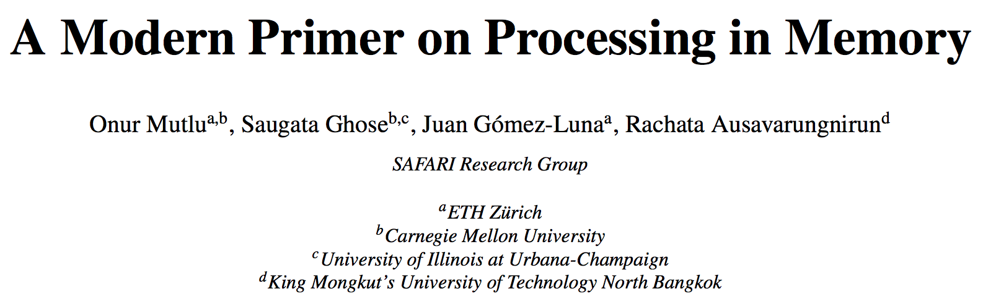
PIM Review and Open Problems
Onur Mutlu, Saugata Ghose, Juan Gomez-Luna, and Rachata Ausavarungnirun,
"A Modern Primer on Processing in Memory"
Invited Book Chapter in Emerging Computing: From Devices to Systems - Looking Beyond Moore and Von Neumann, Springer, to be published in 2021.
https://arxiv.org/pdf/2012.03112.pdf

Slide 6
Mindset: Memory as an Accelerator
CPU
core
CPU
core
mini-CPU
core
GPU
(throughput)
core
GPU
(throughput)
core
video
core
GPU
(throughput)
core
GPU
(throughput)
core
CPU
core
CPU
core
Memory
imaging
core
LLC
Specialized
compute-capability
in memory
Memory Controller
Memory Bus
Memory similar to a “conventional” accelerator

Slide 7
In-Storage Acceleration of Genome Analytics

Slide 8
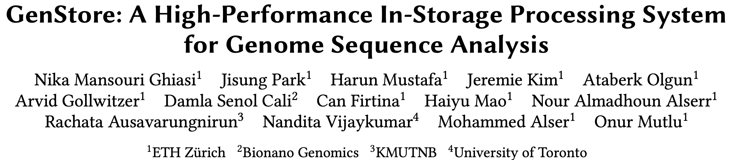
In-Storage Genomic Data Filtering [ASPLOS 2022]
Nika Mansouri Ghiasi, Jisung Park, Harun Mustafa, Jeremie Kim, Ataberk Olgun, Arvid Gollwitzer, Damla Senol Cali, Can Firtina, Haiyu Mao, Nour Almadhoun Alserr, Rachata Ausavarungnirun, Nandita Vijaykumar, Mohammed Alser, and Onur Mutlu,
"GenStore: A High-Performance and Energy-Efficient In-Storage Computing System for Genome Sequence Analysis"
Proceedings of the 27th International Conference on Architectural Support for Programming Languages and Operating Systems (ASPLOS), Virtual, February-March 2022.
[Lightning Talk Slides (pptx) (pdf)]
[Lightning Talk Video (90 seconds)]

Slide 9
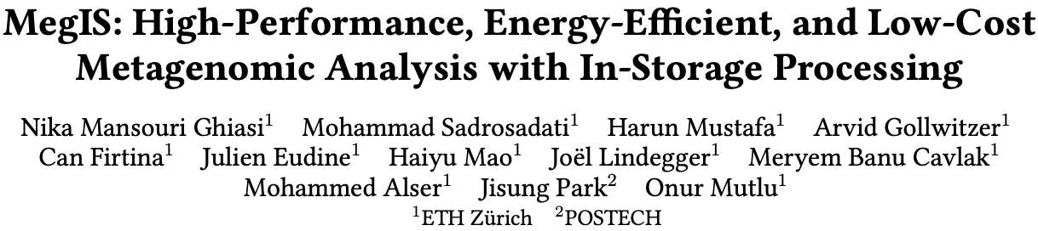
In-Storage Metagenomics [ISCA 2024]
Nika Mansouri Ghiasi, Mohammad Sadrosadati, Harun Mustafa, Arvid Gollwitzer, Can Firtina, Julien Eudine, Haiyu Mao, Joel Lindegger, Meryem Banu Cavlak, Mohammed Alser, Jisung Park, and Onur Mutlu,
"MegIS: High-Performance and Low-Cost Metagenomic Analysis with In-Storage Processing"
Proceedings of the 51st Annual International Symposium on Computer Architecture (ISCA), Buenos Aires, Argentina, July 2024.
[Slides (pptx) (pdf)]
[arXiv version]
https://arxiv.org/pdf/2406.19113

Slide 10


MegIS: Metagenomics In-Storage
First in-storage system for end-to-end metagenomic analysis
Idea: Cooperative in-storage processing for metagenomic analysis
  Hardware/software co-design between the storage system and host system
FTL
SSD
Controller
SSD DRAM
Cores
Standard
Metadata
Host System
MegIS-Enabled SSD
Cntrl
Cntrl
⋯
Channel#1
⋯
Channel#N
Notes:
Which is the first in-storage processing system for end-to-end metagenomic analysis
The key idea of megis is Cooperative ISP for metagenomics
Which is enabled by a synergistic hardware/software co-design between the storage system and the host system

Slide 11






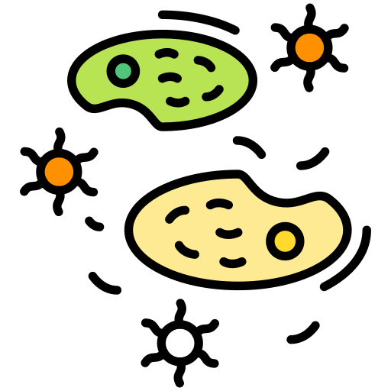




MegIS’s Steps
Step 1
GCTCA
Preparation
of Input Queries
Query
K-mers
CTCAT
TCATG
…
Step 2
Metagenomic sample
with species that
are not known in advance
V. cholerae
Presence/Absence Identification
SARS-CoV-2
E. coli
Step 3
Abundance
Estimation
A large database
containing information
on many species

Slide 12
MegIS Hardware-Software Co-Design
FTL
SSD
Controller
SSD DRAM
Cores
Standard
Metadata
Host System
MegIS-Enabled SSD
Cntrl
Cntrl
⋯
Channel#1
⋯
Channel#N
Notes:
To (i) leverage and (ii) orchestrate the capabilities of both systems, megis includes hw/sw co-design in 5 directions

Slide 13

MegIS Hardware-Software Co-Design
Task partitioning and mapping
Each step executes
in its most suitable system
Step 1
Step 2
Step 3
FTL
SSD
Controller
SSD DRAM
Cores
Standard
Metadata
Host System
MegIS-Enabled SSD
Cntrl
Cntrl
⋯
Channel#1
⋯
Channel#N

Slide 14
MegIS Hardware-Software Co-Design
Task partitioning and mapping
Each step executes
in its most suitable system
Data/computation flow coordination
Reduce communication overhead
Reduce #writes to flash chips
Step 1
Step 2
Step 3
FTL
SSD
Controller
SSD DRAM
Cores
Standard
Metadata
Host System
MegIS-Enabled SSD
Cntrl
Cntrl
⋯
Channel#1
⋯
Channel#N

Slide 15
MegIS Hardware-Software Co-Design
Task partitioning and mapping
Each step executes
in its most suitable system
Data/computation flow coordination
Reduce communication overhead
Reduce #writes to flash chips
Step 1
Step 2
Step 3
FTL
SSD
Controller
SSD DRAM
Cores
Standard
Metadata
Host System
MegIS-Enabled SSD
Cntrl
Cntrl
⋯
Channel#1
⋯
Channel#N
Storage-aware algorithms
Enable efficient
access patterns to the SSD

Slide 16
MegIS Hardware-Software Co-Design
Task partitioning and mapping
Each step executes
in its most suitable system
Data/computation flow coordination
Reduce communication overhead
Reduce #writes to flash chips
Step 1
Step 2
Step 3
FTL
SSD
Controller
SSD DRAM
Cores
Standard
Metadata
ACC
ACC
Host System
MegIS-Enabled SSD
Cntrl
Cntrl
⋯
Channel#1
⋯
Channel#N
Storage-aware algorithms
Enable efficient
access patterns to the SSD
Lightweight in-storage accelerators
Minimize SRAM/DRAM buffer spaces needed inside the SSD

Slide 17
MegIS Hardware-Software Co-Design
Task partitioning and mapping
Each step executes
in its most suitable system
Data/computation flow coordination
Reduce communication overhead
Reduce #writes to flash chips
Step 1
Step 2
Step 3
MegIS
FTL
SSD
Controller
SSD DRAM
FTL
Cores
Standard
Metadata
ACC
ACC
Host System
MegIS-Enabled SSD
Cntrl
Cntrl
MegIS
Metadata
⋯
Channel#1
⋯
Channel#N
Storage-aware algorithms
Enable efficient
access patterns to the SSD
Lightweight in-storage accelerators
Minimize SRAM/DRAM buffer spaces needed inside the SSD
Data mapping scheme and Flash Translation Layer (FTL)
Specialize to the characteristics of metagenomic analysis
Leverage the SSD’s full internal bandwidth
Notes:
6 mins until here

Slide 18
Evaluation: Methodology Overview
Performance, Energy, and Power Analysis
Hardware Components
Synthesized Verilog model for the in-storage accelerators
MQSim [Tavakkol+, FAST’18] for SSD’s internal operations
Ramulator [Kim+, CAL’15] for SSD’s internal DRAM
Software Components
Measure on a real system:
AMD® EPYC® CPU with 128 physical cores
1-TB DRAM
Baseline Comparison Points
Performance-optimized software, Kraken2 [Genome Biology’19]
Accuracy-optimized software, Metalign [Genome Biology’20]
PIM hardware-accelerated tool (using processing-in-memory), Sieve [ISCA’21]
SSD Configurations
SSD-C: with SATA3 interface (0.5 GB/s sequential read bandwidth)
SSD-P: with PCIe Gen4 interface (7 GB/s sequential read bandwidth)
Notes:
We model performance, energy, and power of the systems based on
the latency and throughput of each hardware-based and software-based component
We valuate the following baselines:
...
We evaluate these tools on systems with cost-optimized and performance-optimized SSD configurations

Slide 19
Evaluation: Speedup over the Software Baselines
Performance-Optimized
Accuracy-Optimized
MegIS
SSD-C
SSD-C
Speedup
5.8x
5.8x
14.9x
14.9x
Sample Genetic Diversity
Sample Genetic Diversity
MegIS provides significant speedup over both
Performance-Optimized and Accuracy-Optimized baselines
Notes:
We analyze the benefits of MegIS for samples with low, medium, and high genetic diversity,
And here I am showing for a cost optimized-SSD
We observe that compared to both P-Opt and A-Opt
MegIS provides significant speedups

Slide 20
Evaluation: Speedup over the Software Baselines
Performance-Optimized
Accuracy-Optimized
MegIS
SSD-P
Speedup
4.0x
12.1x
Sample Genetic Diversity
MegIS provides significant speedup over both
Performance-Optimized and Accuracy-Optimized baselines
MegIS improves performance on both
cost-optimized and performance-optimized SSDs

Slide 21
Evaluation: Speedup over the PIM Baseline
PIM
MegIS
PIM
MegIS
SSD-C
SSD-P
Speedup
4.9x
1.9x
Sample Genetic Diversity
Sample Genetic Diversity
MegIS provides significant speedup over the PIM baseline
Notes:
Similarly, we evaluate megis compared to the pim baseline
and show that on systems with cost-optimized
and performance-optimized ssds,
MegiS significantly outperforms the PIM baseline

Slide 22
Evaluation: Reduction in Energy Consumption
On average across different input sets and SSDs
5.4x
15.2x
1.9x
GeoMean Energy Reduction
(Higher is Better)
MegIS provides significant energy reduction over
the Performance-Optimized, Accuracy-Optimized, and PIM baselines
Notes:
Next, we show megis's energy reduction on average accross different input sets and SSDs and observe that megis provides...

Slide 23
Evaluation: Accuracy, Area, and Power
Accuracy
Same accuracy as the accuracy-optimized baseline
Significantly higher accuracy than the performance-optimized and PIM baselines
  4.6 – 5.2× higher F1 scores
  3 – 24% lower L1 norm error
Area and Power
Total for an 8-channel SSD:
Area: 0.04 mm² (Only 1.7% of the area of three ARM Cortex R4 cores in an SSD controller)
Power: 7.658 mW
Notes:
MegIS provides all these benefits while achieving high accuracy

Slide 24
Evaluation: System Cost-Efficiency
Cost-optimized system ($): With SSD-C and 64-GB DRAM
Performance-optimized system ($$$): With SSD-P and 1-TB DRAM
2.4x
7.2x
GMean Speedup
($)
($)
($$$)
($$$)
($)
MegIS outperforms the baselines
even when running on a much less costly system
Notes:
Self-note (copy from arxiv version): For the performance-optimized system, we calculate the cost of 1TB
DRAM to be roughly 7080 USD (8 x 128GB modules [230]) and the cost of
SSD-P to be roughly 875 USD. For the performance-optimized system, we calculate
the cost of 64GB DRAM to be roughly 312 USD (8 x 8GB modules [231],
assuming the same number of memory channels as the performance-optimized
system) and the cost of SSD-C to be roughly 346 USD. Note that the cost of
the total storage system depends not only on the price of each SSD but also on
the available interconnection slots in the systems, as systems typically have
fewer PCIe slots (needed for SSD-P) than SATA slots (needed for SSD-C).

Slide 25
Evaluation: System Cost-Efficiency
Cost-optimized system ($): With SSD-C and 64-GB DRAM
Performance-optimized system ($$$): With SSD-P and 1-TB DRAM
MegIS improves system cost-efficiency
and makes metagenomics more accessible
for wider adoption
2.4x
7.2x
GMean Speedup
($)
($)
($$$)
($$$)
($)
MegIS outperforms the baselines
even when running on a much less costly system
Notes:
Self-note (copy from arxiv version): For the performance-optimized system, we calculate the cost of 1TB
DRAM to be roughly 7080 USD (8 x 128GB modules [230]) and the cost of
SSD-P to be roughly 875 USD. For the performance-optimized system, we calculate
the cost of 64GB DRAM to be roughly 312 USD (8 x 8GB modules [231],
assuming the same number of memory channels as the performance-optimized
system) and the cost of SSD-C to be roughly 346 USD. Note that the cost of
the total storage system depends not only on the price of each SSD but also on
the available interconnection slots in the systems, as systems typically have
fewer PCIe slots (needed for SSD-P) than SATA slots (needed for SSD-C).

Slide 26
More in the Paper
MegIS’s performance when running in-storage processing operations on the cores existing in the SSD controller
MegIS’s performance when using the same accelerators outside SSD
Sensitivity analysis with varying
  Database sizes
  Memory capacities
  #SSDs
  #Channels
  #Samples
MegIS’s performance for abundance estimation
Notes:
Let me briefly talk about other results that are included in the paper before concluding this talk. These include the following:

Slide 27
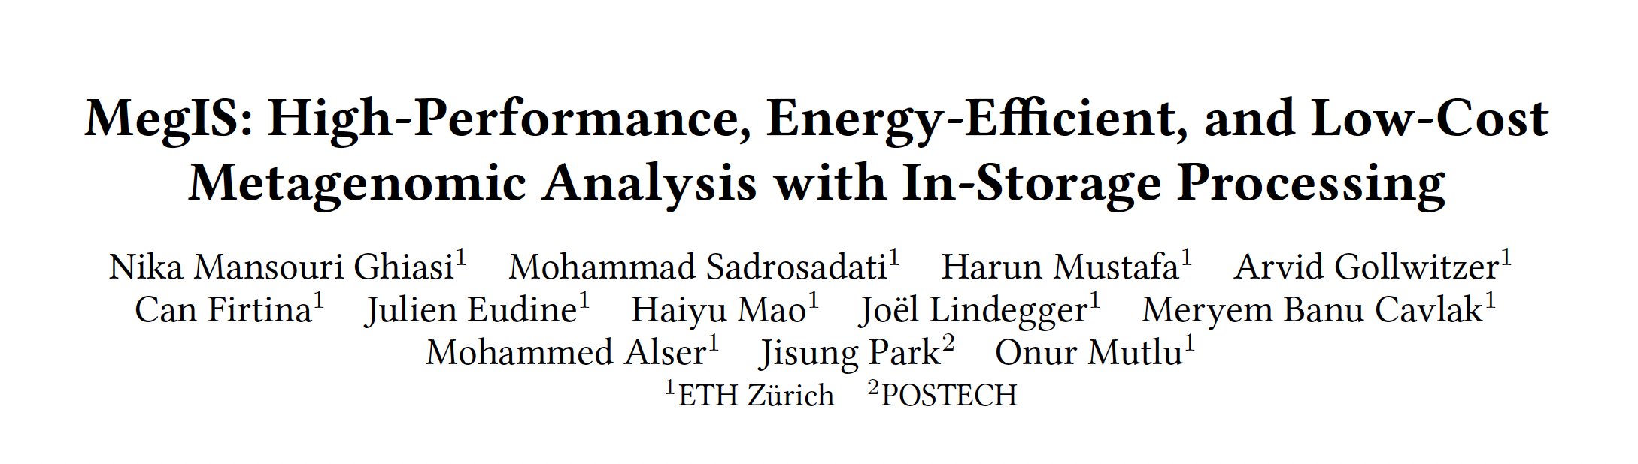

More in the Paper
MegIS’s performance with the cores in the SSD controller
MegIS’s performance outside SSD
Sensitivity analysis with varying
  Database sizes
  Memory capacities
  #SSDs
  #Channels
  #Samples
MegIS’s performance for abundance estimation
https://arxiv.org/abs/2406.19113

Slide 28




MegIS: Summary
Metagenomic analysis suffers from
significant storage I/O data movement overhead
MegIS
The first in-storage processing system for end-to-end metagenomic analysis
Leverages and orchestrates processing inside and outside the storage system
Improves performance
2.7×–37.2× over performance-optimized software
6.9×–100.2× over accuracy-optimized software
1.5×–5.1× over hardware-accelerated PIM baseline
High accuracy
Same as accuracy-optimized
4.8× higher F1 scores
over performance-optimized/PIM
Reduces energy consumption
5.4× over performance-optimized software
15.2× over accuracy-optimized software
1.9× over hardware-accelerated PIM baseline
Low area overhead
1.7% of the three cores
in an SSD controller

Slide 29
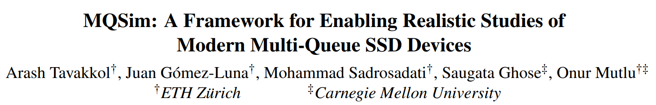
MQSim: Simulating Storage [FAST 2018]
Arash Tavakkol, Juan Gomez-Luna, Mohammad Sadrosadati, Saugata Ghose, and Onur Mutlu,
"MQSim: A Framework for Enabling Realistic Studies of Modern Multi-Queue SSD Devices"
Proceedings of the 16th USENIX Conference on File and Storage Technologies (FAST), Oakland, CA, USA, February 2018.
[Slides (pptx) (pdf)]
[Source Code]
https://github.com/CMU-SAFARI/MQSim
https://people.inf.ethz.ch/omutlu/pub/MQSim-SSD-simulation-framework_fast18.pdf

Slide 30
Tools to Decide
What to Execute Where

Slide 31
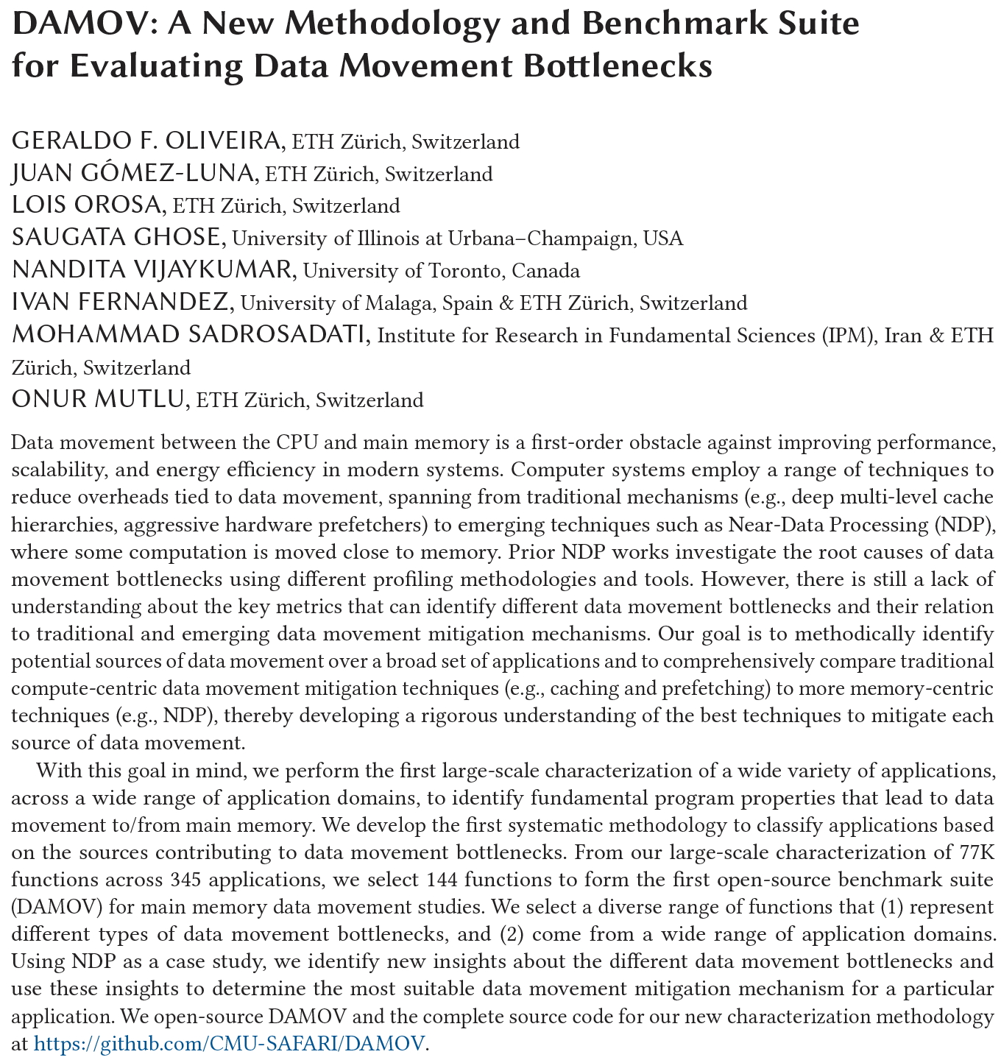
DAMOV Analysis Methodology & Workloads
https://arxiv.org/pdf/2105.03725.pdf

Slide 32
When to Employ Near-Data Processing?
Mobile consumer workloads
(GoogleWL²)
Graph processing
(Tesseract¹)
Neural networks
(GoogleWL²)
Near-Data
Processing
Databases
(Polynesia⁵)
DNA
sequence mapping
(GenASM³; GRIM-Filter⁴)
Time series analysis
(NATSA⁶)
...
[1] Ahn+, “A Scalable Processing-in-Memory Accelerator for Parallel Graph Processing," ISCA, 2015
[2] Boroumand+, "Google Workloads for Consumer Devices: Mitigating Data Movement Bottlenecks,” ASPLOS, 2018
[3] Cali+, "GenASM: A High-Performance, Low-Power Approximate String Matching Acceleration Framework for Genome Sequence Analysis,” MICRO, 2020
[4] Kim+, "GRIM-Filter: Fast Seed Location Filtering in DNA Read Mapping Using Processing-in-Memory Technologies,” BMC Genomics, 2018
[5] Boroumand+, "Polynesia: Enabling Effective Hybrid Transactional/Analytical Databases with Specialized Hardware/Software Co-Design,” arXiv:2103.00798 [cs.AR], 2021
[6] Fernandez+, “NATSA: A Near-Data Processing Accelerator for Time Series Analysis,” ICCD, 2020
Notes:
[CLICK] Many recent works explore how NDP can benefit various application domains like
[CLICK] Graph processing,
[CLICK] mobile consumer workloads
[CLICK] neural networks
[CLICK] DNA sequence mapping
[CLICK] Databases
[CLICK] Time series analysis
[CLICK] and more
[NEXT]

Slide 33

Step 1: Application Profiling
We analyze 345 applications from distinct domains:
Graph Processing
Deep Neural Networks
Physics
High-Performance Computing
Genomics
Machine Learning
Databases
Data Reorganization
Image Processing
Map-Reduce
Benchmarking
Linear Algebra
…
Signal processing
Machine learning
Data mining
Data analytics
Genomics
Deep Neural Networks
Security
Linear algebra
Image processing
Data reorganization
Graph processing
Database
Physics
Notes:
In this work, we analyzed 345 applications from distinct domains, from
[CLICK] GRAPH Processing [CLICK] Neural Networks
[CLICK] Physics [CLICK] High-performance computing
[CLICK]Genomics [CLICK] And more
[NEXT]

Slide 34
Step 3: Memory Bottleneck Analysis
Memory Bottleneck Class
High
Low
1a: DRAM Bandwidth
High
AI
MPKI
Low
1b: DRAM Latency
AI
Low
Low
  Six classes of
  data movement bottlenecks:
  each class ↔ data movement
  mitigation mechanism
LFMR
Low
Low
1c: L1/L2
Cache Capacity
Decreasing
MPKI
AI
Temporal Locality
Increasing
Low
Low
2a: L3 Cache Contention
MPKI
AI
LFMR
Low
2b: L1 Cache Capacity
High
MPKI
AI
Low
Low
2c: Compute-Bound
High
Notes:
[CLICK] With such classification, we analyze how the functions in each class correlates with different data movement mitigation mechanisms in terms of performance and energy using our scalability analysis.
[NEXT]

Slide 35
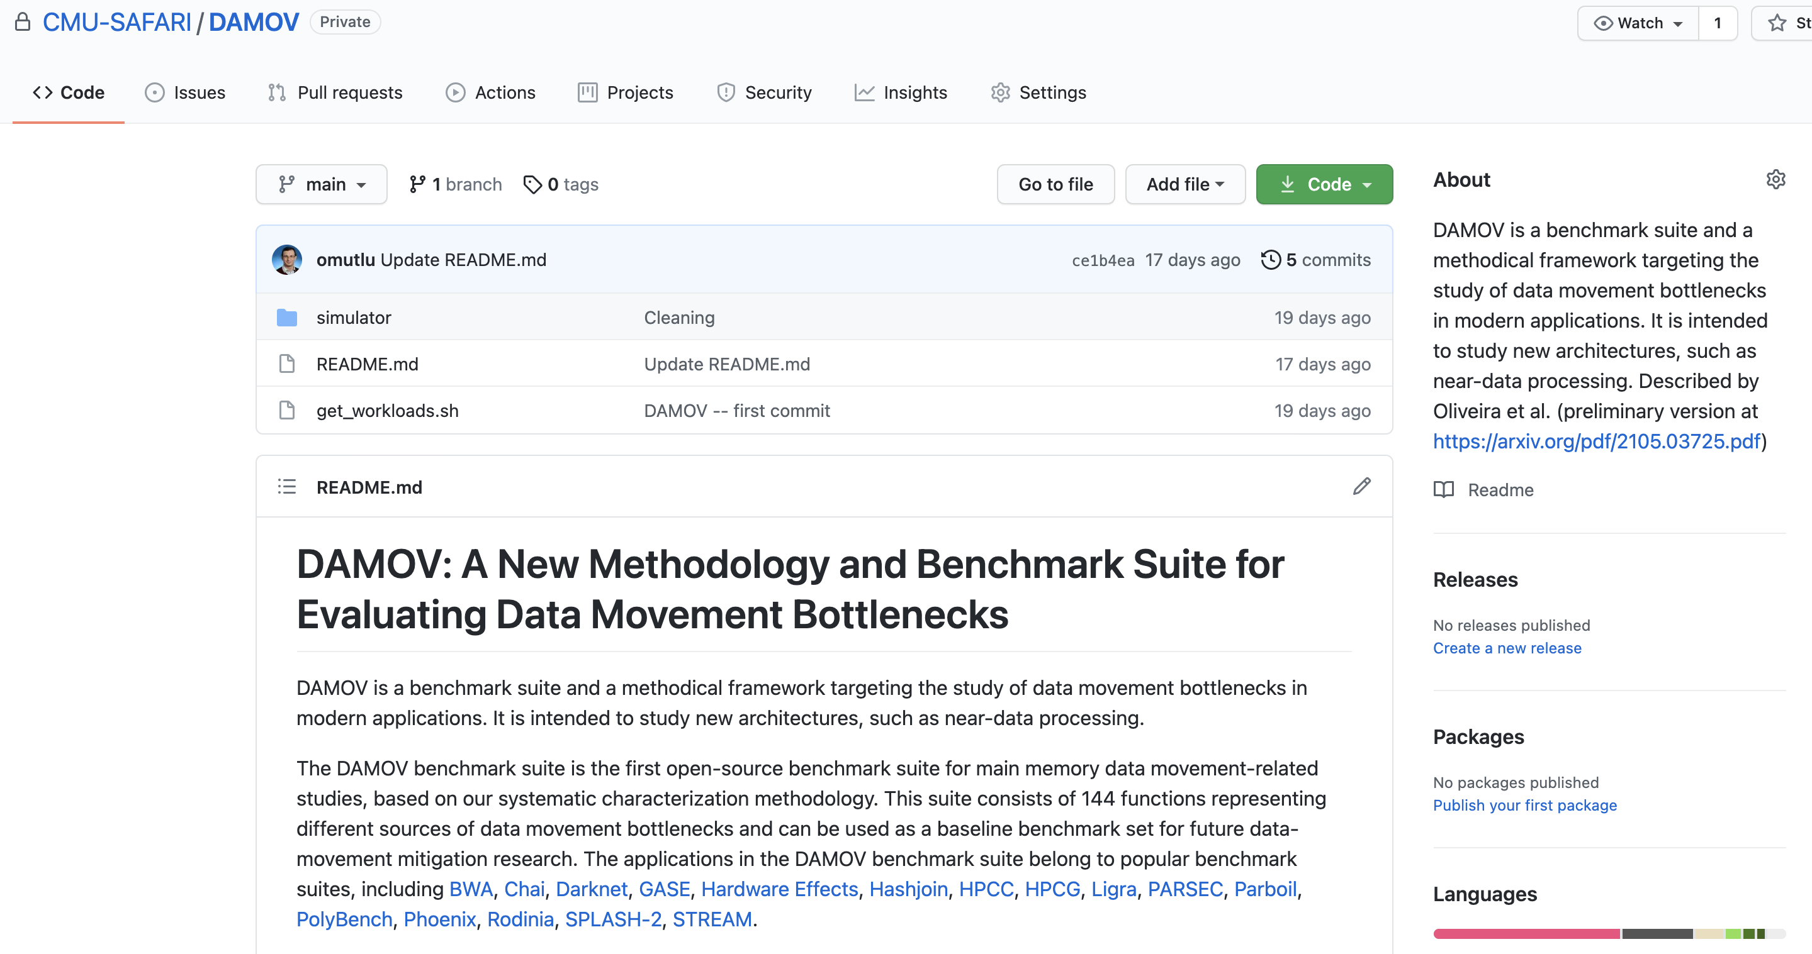
DAMOV is Open Source
We open-source our benchmark suite and our toolchain
DAMOV-SIM
DAMOV
Benchmarks
Notes:
We open source DAMOV to facilitate further research in mitigating data movement bottlenecks, including in near data processing.
[CLICK] In our DAMOV repository, we provide
[CLICK] The complete set of 144 application functions that compose our benchmark suite
[CLICK] And our DAMOV-SIM simulator
[NEXT]

Slide 36
DAMOV is Open Source
Benchmark suite and toolchain are open sourced
Get DAMOV at:
https://github.com/CMU-SAFARI/DAMOV
DAMOV-SIM
DAMOV
Benchmarks
Notes:
We open source DAMOV to facilitate further research in mitigating data movement bottlenecks, including in near data processing.
[CLICK] In our DAMOV repository, we provide
[CLICK] The complete set of 144 application functions that compose our benchmark suite
[CLICK] And our DAMOV-SIM simulator
[NEXT]

Slide 37
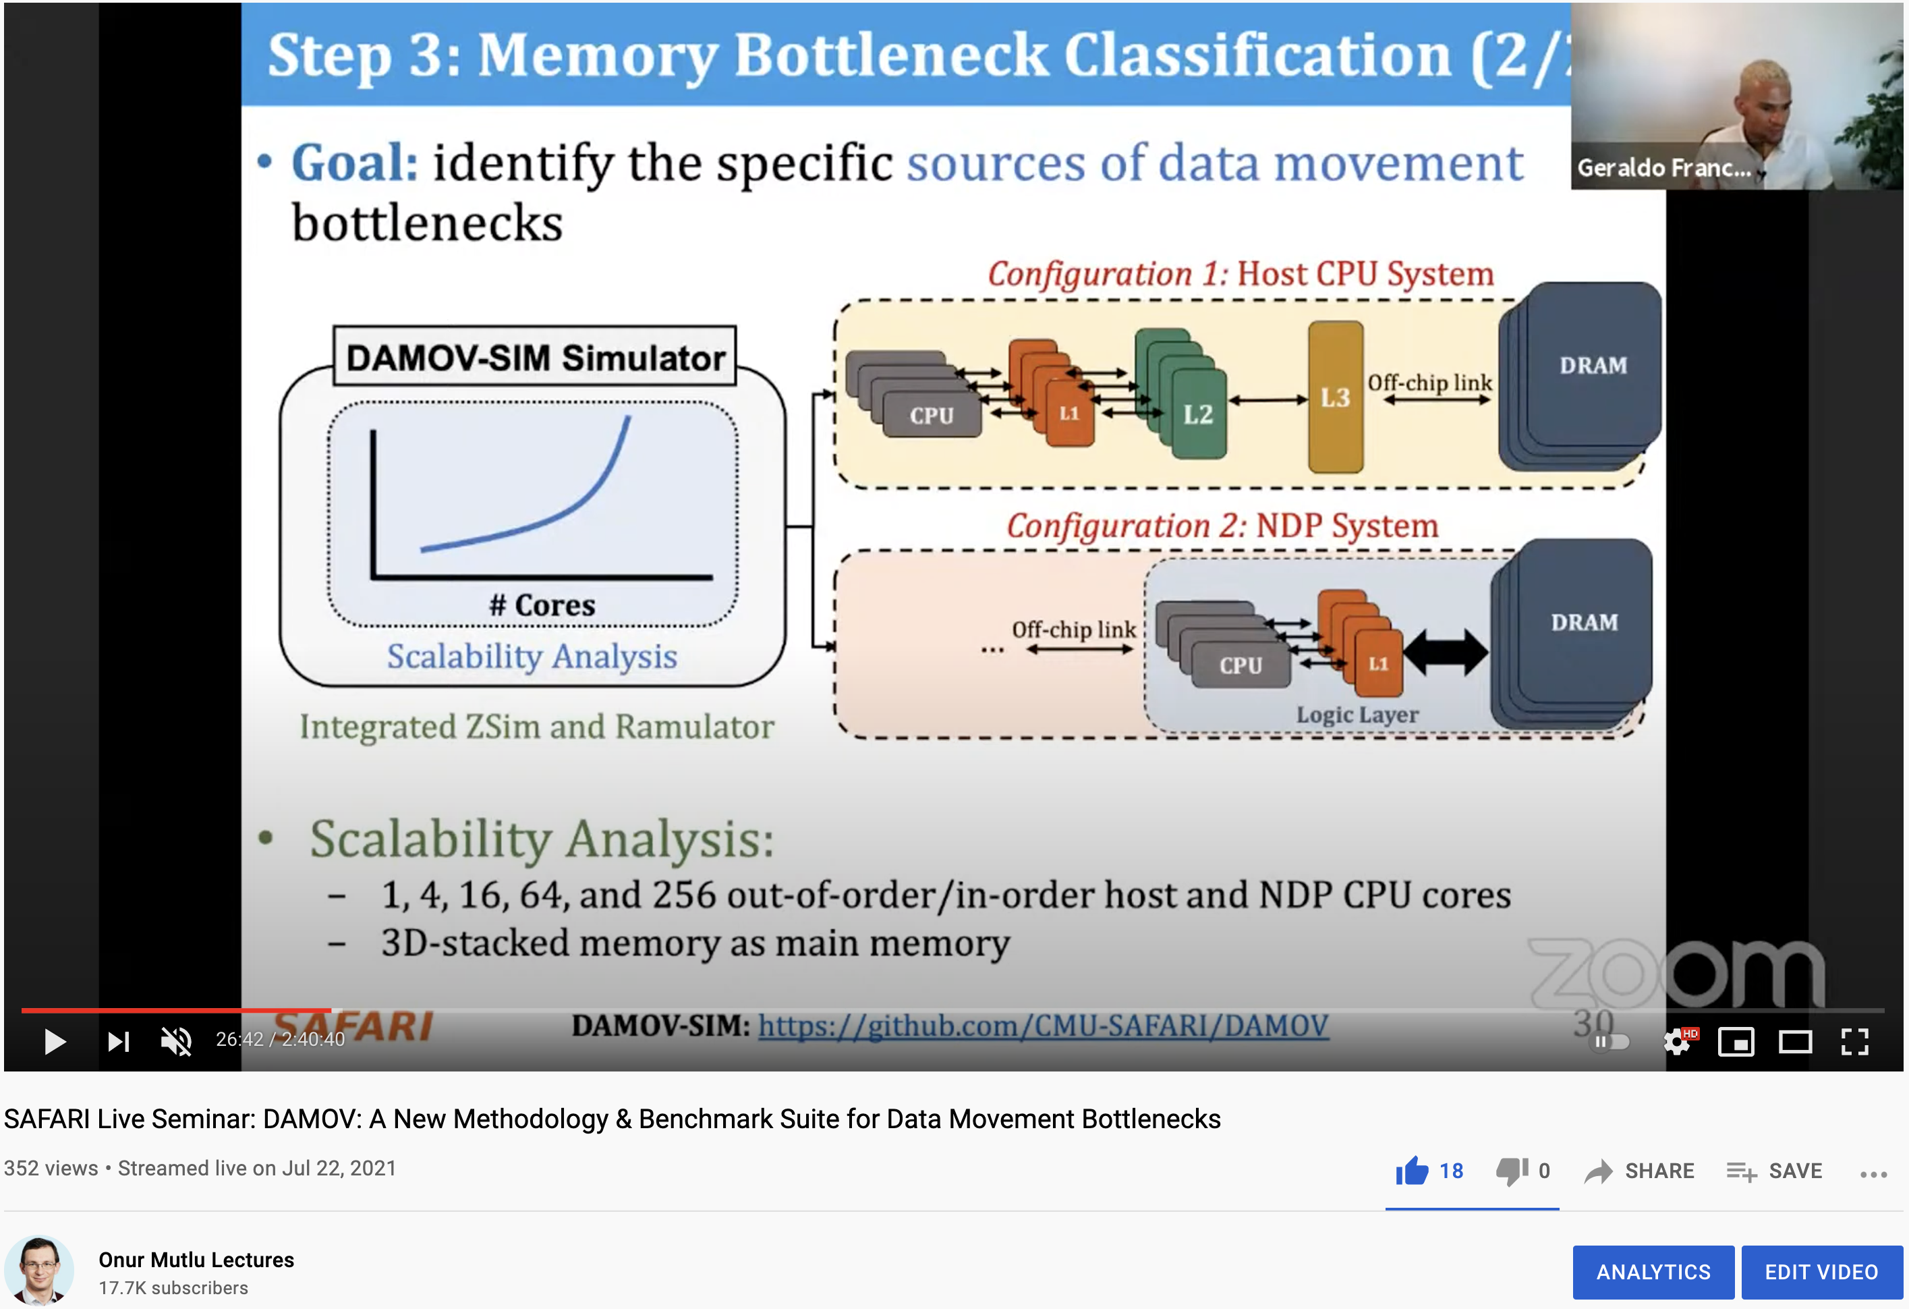
More on DAMOV Analysis Methodology & Workloads
https://www.youtube.com/watch?v=GWideVyo0nM&list=PL5Q2soXY2Zi_tOTAYm--dYByNPL7JhwR9&index=3

Slide 38
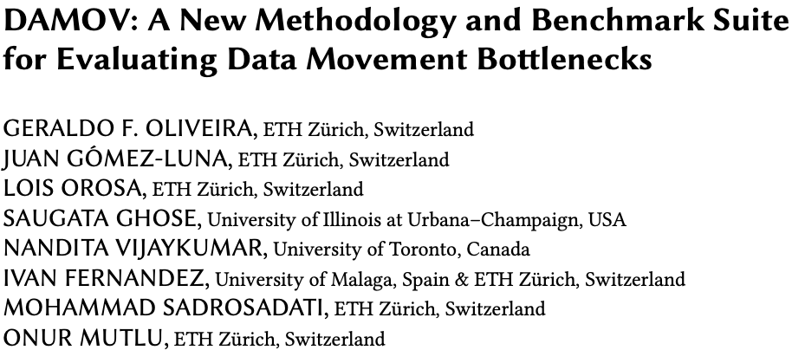
More on DAMOV Methods & Benchmarks
Geraldo F. Oliveira, Juan Gomez-Luna, Lois Orosa, Saugata Ghose, Nandita Vijaykumar, Ivan fernandez, Mohammad Sadrosadati, and Onur Mutlu,
"DAMOV: A New Methodology and Benchmark Suite for Evaluating Data Movement Bottlenecks"
IEEE Access, 8 September 2021.
Preprint in arXiv, 8 May 2021.
[arXiv preprint]
[IEEE Access version]
[DAMOV Suite and Simulator Source Code]
[SAFARI Live Seminar Video (2 hrs 40 mins)]
[Short Talk Video (21 minutes)]

Slide 39

Ramulator 2.0 for PIM Systems
Haocong Luo, Yahya Can Tugrul, F. Nisa Bostanci, Ataberk Olgun, A. Giray Yaglikci, and Onur Mutlu,
"Ramulator 2.0: A Modern, Modular, and Extensible DRAM Simulator"
Preprint on arxiv, August 2023.
[arXiv version]
[Ramulator 2.0 Source Code]
https://arxiv.org/pdf/2308.11030.pdf
https://github.com/CMU-SAFARI/ramulator2

Slide 40
We Need to Revisit the Entire Stack
With a memory-centric mindset
Problem
Algorithm
Program/Language
System Software
SW/HW Interface
Micro-architecture
Logic
Devices
Electrons
We can get there step by step

Slide 41
PIM Review and Open Problems
Onur Mutlu, Saugata Ghose, Juan Gomez-Luna, and Rachata Ausavarungnirun,
"A Modern Primer on Processing in Memory"
Invited Book Chapter in Emerging Computing: From Devices to Systems - Looking Beyond Moore and Von Neumann, Springer, to be published in 2021.
https://arxiv.org/pdf/2012.03112.pdf

Slide 42
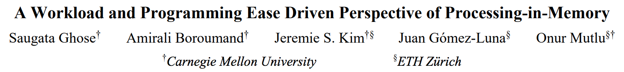
PIM Review and Open Problems (II)
Saugata Ghose, Amirali Boroumand, Jeremie S. Kim, Juan Gomez-Luna, and Onur Mutlu,
"Processing-in-Memory: A Workload-Driven Perspective"
Invited Article in IBM Journal of Research & Development, Special Issue on Hardware for Artificial Intelligence, to appear in November 2019.
[Preliminary arXiv version]
https://arxiv.org/pdf/1907.12947.pdf

Slide 43
Processing in Memory:
Adoption Challenges
1. Processing using Memory
2. Processing near Memory

Slide 44
Eliminating the Adoption Barriers
How to Enable Adoption of Processing in Memory

Slide 45
Potential Barriers to Adoption of PIM
1. Applications & software for PIM
2. Ease of programming (interfaces and compiler/HW support)
3. System and security support: coherence, synchronization, virtual memory, isolation, communication interfaces, …
4. Runtime and compilation systems for adaptive scheduling, data mapping, access/sharing control, …
5. Infrastructures to assess benefits and feasibility
All can be solved with change of mindset

Slide 46
We Need to Revisit the Entire Stack
With a memory-centric mindset
Problem
Algorithm
Program/Language
System Software
SW/HW Interface
Micro-architecture
Logic
Devices
Electrons
We can get there step by step

Slide 47
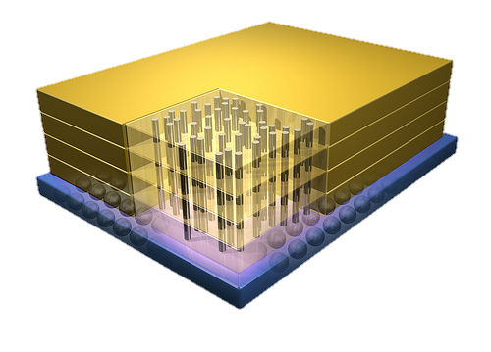


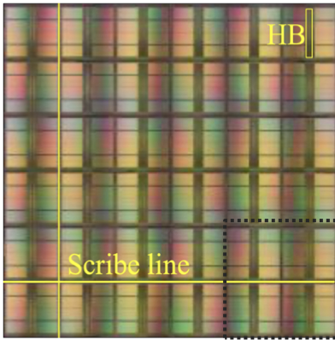
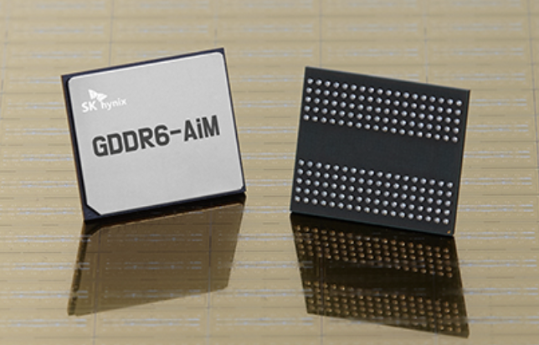
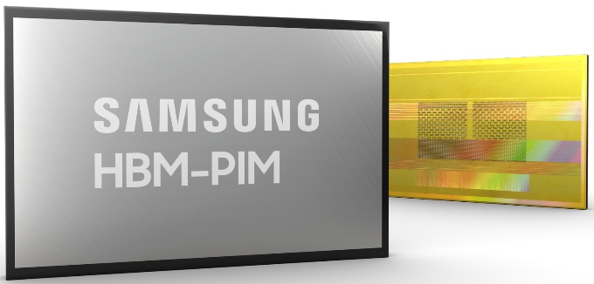
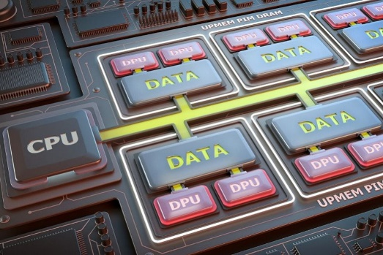
Processing-in-Memory Landscape Today
[Samsung 2021]
[Alibaba 2022]
[SK Hynix 2022]
[Samsung 2021]
[UPMEM 2019]
And, many other experimental chips and startups

Slide 48
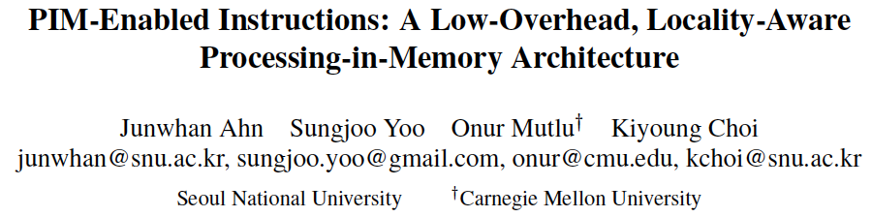
Adoption: How to Keep It Simple?
Junwhan Ahn, Sungjoo Yoo, Onur Mutlu, and Kiyoung Choi,
"PIM-Enabled Instructions: A Low-Overhead, Locality-Aware Processing-in-Memory Architecture"
Proceedings of the 42nd International Symposium on Computer Architecture (ISCA), Portland, OR, June 2015.
[Slides (pdf)] [Lightning Session Slides (pdf)]

Slide 49
PEI: PIM-Enabled Instructions (Ideas)
Goal: Develop mechanisms to get the most out of near-data processing with minimal cost, minimal changes to the system, no changes to the programming model
Key Idea 1: Expose each PIM operation as a cache-coherent, virtually-addressed host processor instruction (called PEI) that operates on only a single cache block
  e.g., __pim_add(&w.next_rank, value) → pim.add r1, (r2)
  No changes sequential execution/programming model
  No changes to virtual memory
  Minimal changes to cache coherence
  No need for data mapping: Each PEI restricted to a single memory module
Key Idea 2: Dynamically decide where to execute a PEI (i.e., the host processor or PIM accelerator) based on simple locality characteristics and simple hardware predictors
  Execute each operation at the location that provides the best performance

Slide 50
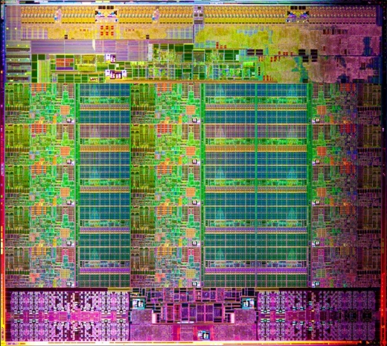
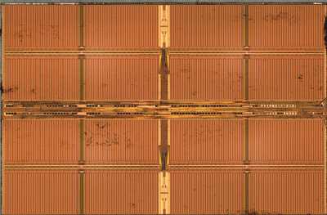
Simple PIM Operations as ISA Extensions (II)
for (v: graph.vertices) {
value = weight * v.rank;
for (w: v.successors) {
w.next_rank += value;
}
}
Host Processor
Main Memory
w.next_rank
w.next_rank
w.next_rank
w.next_rank
64 bytes in
64 bytes out
Conventional Architecture

Slide 51
Simple PIM Operations as ISA Extensions (III)
for (v: graph.vertices) {
value = weight * v.rank;
for (w: v.successors) {
__pim_add(&w.next_rank, value);
}
}
pim.add r1, (r2)
Host Processor
Main Memory
value
w.next_rank
w.next_rank
8 bytes in
0 bytes out
In-Memory Addition

Slide 52
Always Executing in Memory? Not A Good Idea
Increased
Memory Bandwidth Consumption
Caching very effective
Reduced Memory Bandwidth
Consumption due to
In-Memory Computation
More Vertices

Slide 53
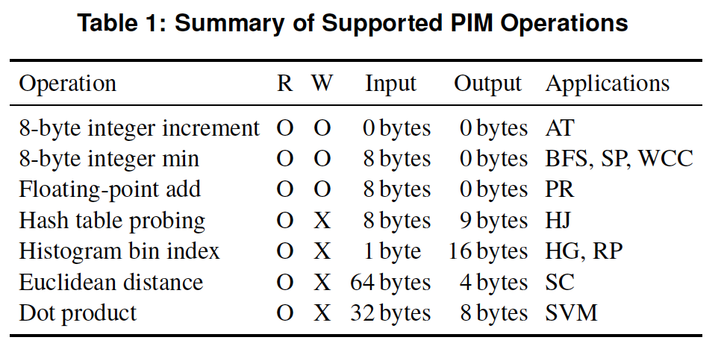
PEI: PIM-Enabled Instructions (Example)
for (v: graph.vertices) {
value = weight * v.rank;
for (w: v.successors) {
__pim_add(&w.next_rank, value);
}
}
pfence();
pim.add r1, (r2)
pfence
Executed either in memory or in the processor: dynamic decision
  Low-cost locality monitoring for a single instruction
Cache-coherent, virtually-addressed, single cache block only
Atomic between different PEIs
Not atomic with normal instructions (use pfence for ordering)

Slide 54
PIM-Enabled Instructions
Key to practicality: single-cache-block restriction
  Each PEI can access at most one last-level cache block
  Similar restrictions exist in atomic instructions
Benefits
  Localization: each PEI is bounded to one memory module
  Interoperability: easier support for cache coherence and virtual memory
  Simplified locality monitoring: data locality of PEIs can be identified simply by the cache control logic

Slide 55
Example (Abstract) PEI uArchitecture
Host Processor
3D-stacked Memory
Out-Of-Order Core
Last-Level Cache
DRAM Controller
L1 Cache
PCU
L2 Cache
PCU (PEI Computation Unit)
DRAM Controller
PCU
Network
HMC Controller
PMU (PEI
Mgmt Unit)
…
PIM Directory
Locality Monitor
DRAM Controller
PCU
Example PEI uArchitecture

Slide 56
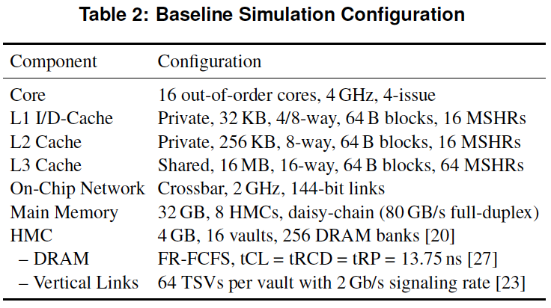
PEI: Initial Evaluation Results
Initial evaluations with 10 emerging data-intensive workloads
  Large-scale graph processing
  In-memory data analytics
  Machine learning and data mining
  Three input sets (small, medium, large) for each workload to analyze the impact of data locality
Pin-based cycle-level x86-64 simulation
  Performance Improvement and Energy Reduction:
    47% average speedup with large input data sets
    32% speedup with small input data sets
    25% avg. energy reduction in a single node with large input data sets

Slide 57
Evaluated Data-Intensive Applications
Ten emerging data-intensive workloads
  Large-scale graph processing
    Average teenage follower, BFS, PageRank, single-source shortest path, weakly connected components
  In-memory data analytics
    Hash join, histogram, radix partitioning
  Machine learning and data mining
    Streamcluster, SVM-RFE
Three input sets (small, medium, large) for each workload to show the impact of data locality

Slide 58
PEI Performance Delta: Large Data Sets
(Large Inputs, Baseline: Host-Only)

Slide 59
PEI Performance: Large Data Sets
(Large Inputs, Baseline: Host-Only)

Slide 60
PEI Performance Delta: Small Data Sets
(Small Inputs, Baseline: Host-Only)

Slide 61
PEI Performance: Small Data Sets
(Small Inputs, Baseline: Host-Only)

Slide 62
PEI Performance Delta: Medium Data Sets
(Medium Inputs, Baseline: Host-Only)

Slide 63
PEI Energy Consumption
Host-Only
PIM-Only
Locality-Aware

Slide 64
PEI: Advantages & Disadvantages
Advantages
+ Simple and low-cost approach to PIM
+ No changes to programming model, virtual memory
+ Dynamically decides where to execute an instruction
Disadvantages
- Does not take full advantage of PIM potential
- Single cache block restriction is limiting

Slide 65
Adoption: How to Keep It Simple?
Junwhan Ahn, Sungjoo Yoo, Onur Mutlu, and Kiyoung Choi,
"PIM-Enabled Instructions: A Low-Overhead, Locality-Aware Processing-in-Memory Architecture"
Proceedings of the 42nd International Symposium on Computer Architecture (ISCA), Portland, OR, June 2015.
[Slides (pdf)] [Lightning Session Slides (pdf)]

Slide 66
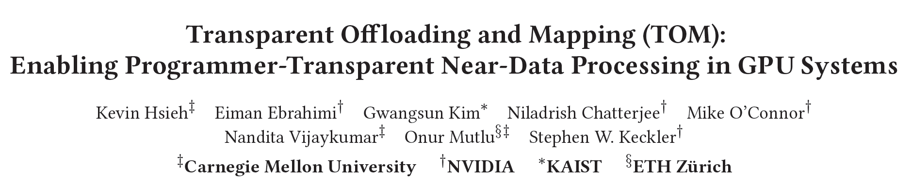
Adoption: How to Ease Programmability? (I)
Kevin Hsieh, Eiman Ebrahimi, Gwangsun Kim, Niladrish Chatterjee, Mike O'Connor, Nandita Vijaykumar, Onur Mutlu, and Stephen W. Keckler,
"Transparent Offloading and Mapping (TOM): Enabling Programmer-Transparent Near-Data Processing in GPU Systems"
Proceedings of the 43rd International Symposium on Computer Architecture (ISCA), Seoul, South Korea, June 2016.
[Slides (pptx) (pdf)]
[Lightning Session Slides (pptx) (pdf)]

Slide 67
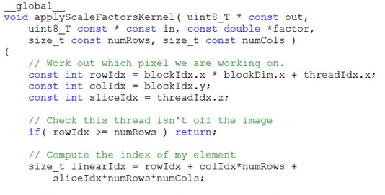
Truly Distributed GPU Processing with PIM
3D-stacked memory
(memory stack)
SM (Streaming Multiprocessor)
Logic layer
Logic layer SM
Main GPU
Crossbar switch
Vault Ctrl
….
Vault Ctrl

Slide 68
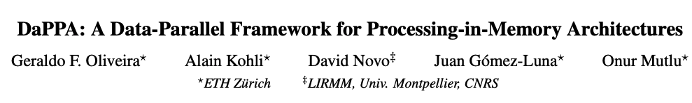
Adoption: How to Ease Programmability? (II)
Geraldo F. Oliveira, Alain Kohli, David Novo,
Juan Gómez-Luna, Onur Mutlu,
“DaPPA: A Data-Parallel Framework for Processing-in-Memory Architectures,”
in PACT SRC Student Competition, Vienna, Austria, October 2023.

Slide 69
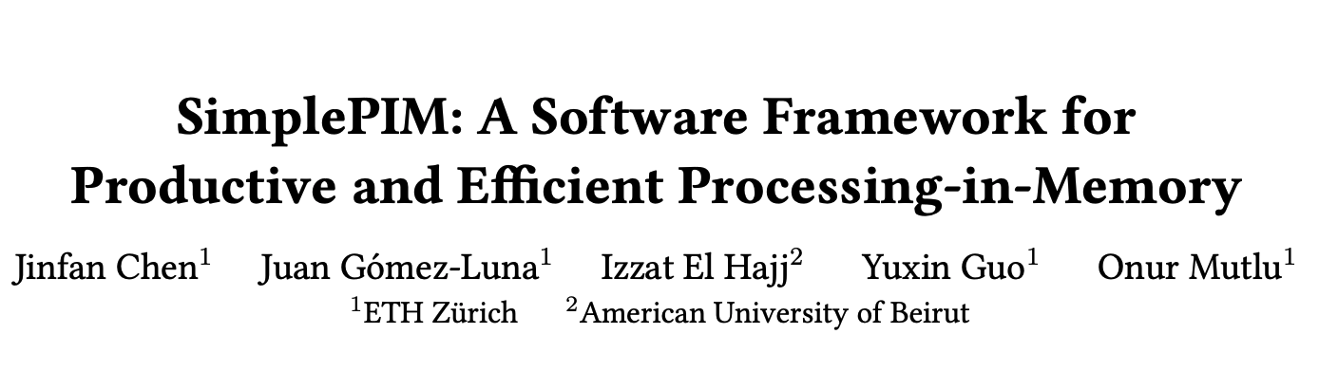
Adoption: How to Ease Programmability? (III)
Jinfan Chen, Juan Gómez-Luna, Izzat El Hajj, YuXin Guo, and Onur Mutlu,
"SimplePIM: A Software Framework for Productive and Efficient Processing in Memory"
Proceedings of the 32nd International Conference on Parallel Architectures and Compilation Techniques (PACT), Vienna, Austria, October 2023.

Slide 70
Adoption: How to Ease Programmability? (IV)
Geraldo F. Oliveira, Juan Gomez-Luna, Lois Orosa, Saugata Ghose, Nandita Vijaykumar, Ivan fernandez, Mohammad Sadrosadati, and Onur Mutlu,
"DAMOV: A New Methodology and Benchmark Suite for Evaluating Data Movement Bottlenecks"
IEEE Access, 8 September 2021.
Preprint in arXiv, 8 May 2021.
[arXiv preprint]
[IEEE Access version]
[DAMOV Suite and Simulator Source Code]
[SAFARI Live Seminar Video (2 hrs 40 mins)]
[Short Talk Video (21 minutes)]

Slide 71
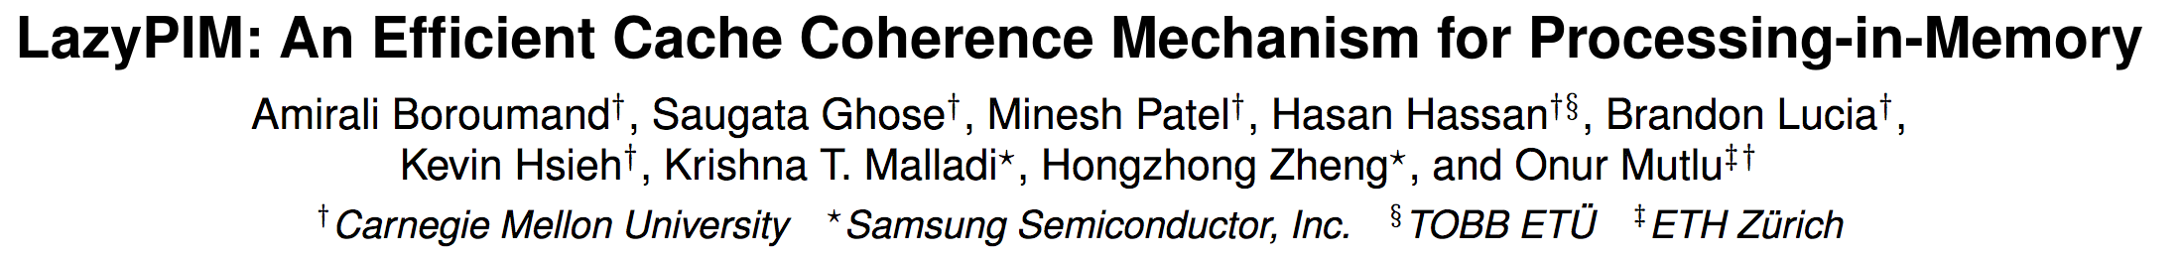
Adoption: How to Maintain Coherence? (I)
Amirali Boroumand, Saugata Ghose, Minesh Patel, Hasan Hassan, Brandon Lucia, Kevin Hsieh, Krishna T. Malladi, Hongzhong Zheng, and Onur Mutlu,
"LazyPIM: An Efficient Cache Coherence Mechanism for Processing-in-Memory"
IEEE Computer Architecture Letters (CAL), June 2016.

Slide 72
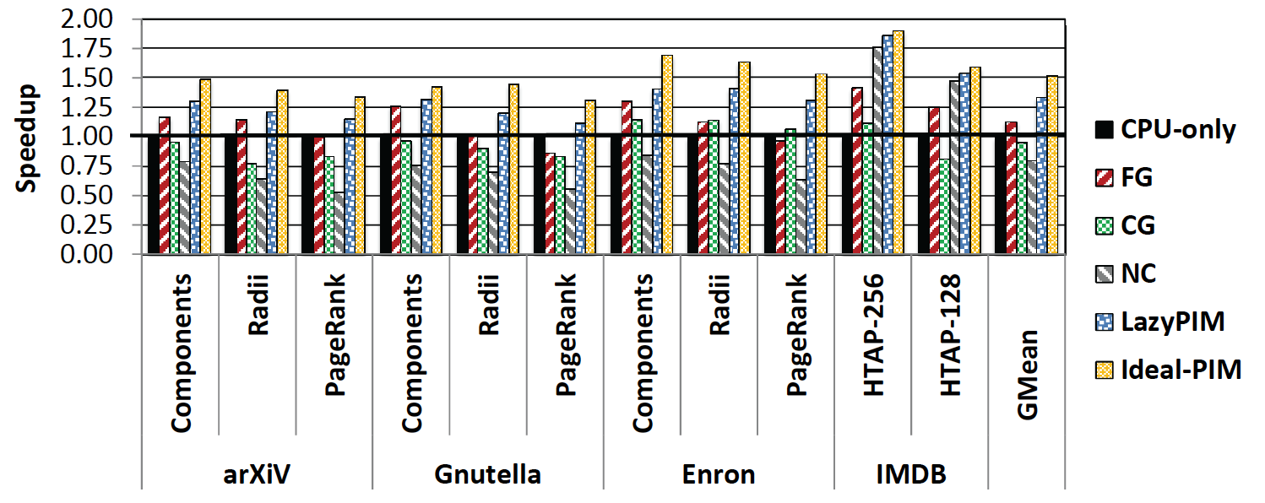
Challenge: Coherence for Hybrid CPU-PIM Apps
Traditional
coherence
No coherence
overhead

Slide 73
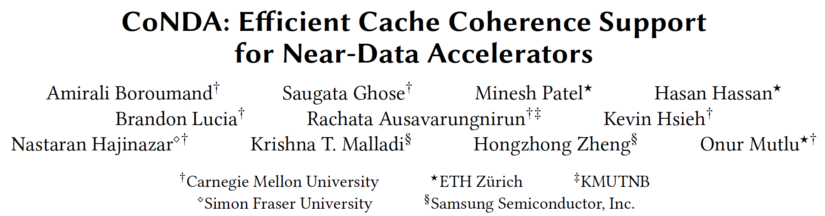
Adoption: How to Maintain Coherence? (II)
Amirali Boroumand, Saugata Ghose, Minesh Patel, Hasan Hassan, Brandon Lucia, Kevin Hsieh, Krishna T. Malladi, Hongzhong Zheng, and Onur Mutlu,
"CoNDA: Efficient Cache Coherence Support for Near-Data Accelerators"
Proceedings of the 46th International Symposium on Computer Architecture (ISCA), Phoenix, AZ, USA, June 2019.

Slide 74
Adoption: How to Support Synchronization?
Christina Giannoula, Nandita Vijaykumar, Nikela Papadopoulou, Vasileios Karakostas, Ivan Fernandez, Juan Gómez-Luna, Lois Orosa, Nectarios Koziris, Georgios Goumas, Onur Mutlu,
"SynCron: Efficient Synchronization Support for Near-Data-Processing Architectures"
Proceedings of the 27th International Symposium on High-Performance Computer Architecture (HPCA), Virtual, February-March 2021.
[Slides (pptx) (pdf)]
[Short Talk Slides (pptx) (pdf)]
[Talk Video (21 minutes)]
[Short Talk Video (7 minutes)]

Slide 75
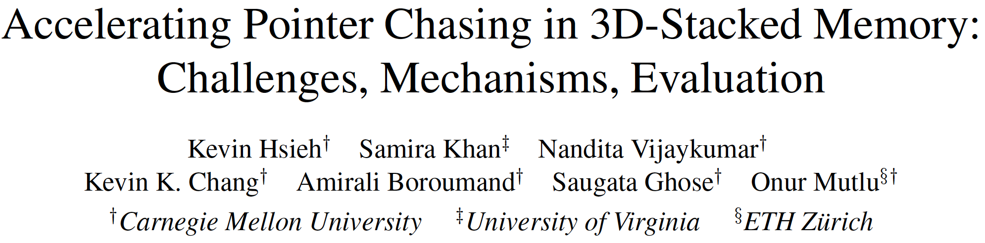
Adoption: How to Support Virtual Memory?
Kevin Hsieh, Samira Khan, Nandita Vijaykumar, Kevin K. Chang, Amirali Boroumand, Saugata Ghose, and Onur Mutlu,
"Accelerating Pointer Chasing in 3D-Stacked Memory: Challenges, Mechanisms, Evaluation"
Proceedings of the 34th IEEE International Conference on Computer Design (ICCD), Phoenix, AZ, USA, October 2016.

Slide 76
Adoption: Evaluation Infrastructures
Haocong Luo, Yahya Can Tugrul, F. Nisa Bostanci, Ataberk Olgun, A. Giray Yaglikci, and Onur Mutlu,
"Ramulator 2.0: A Modern, Modular, and Extensible DRAM Simulator"
Preprint on arxiv, August 2023.
[arXiv version]
[Ramulator 2.0 Source Code]
https://arxiv.org/pdf/2308.11030.pdf
https://github.com/CMU-SAFARI/ramulator2

Slide 77


Methodologies, Workloads, and Tools for Processing-in-Memory:
Enabling the Adoption of
Data-Centric Architectures
Geraldo F. Oliveira and Onur Mutlu
geraldofojunior@gmail.com
https://geraldofojunior.github.io/
Notes:
Hi, I’m Geraldo, a PhD Student under the supervision of professor Multu at ETH Zurich and I’ll be talking about our work DAMOV: A New Methodology and Benchmark Suite for Evaluating Data Movement Bottlenecks.
[NEXT]

Slide 78
Processing-in-Memory:
Challenges
  To fully support PIM systems, we need to develop:
1
Workload characterization methodologies and
benchmark suites targeting PIM architectures
2
Frameworks that can facilitate the implementation of
complex operations and algorithms using PIM primitives
3
Compiler support and compiler optimizations
targeting PIM architectures
4
Operating system support for PIM-aware virtual memory, memory management, data allocation and mapping
5
End-to-End System-on-Chip Design Beyond DRAM
  The lack of tools and system support for
  PIM architectures limit the adoption of PIM systems

Slide 79
An Example: SimplePIM Framework
Jinfan Chen, Juan Gómez-Luna, Izzat El Hajj, YuXin Guo, and Onur Mutlu,
"SimplePIM: A Software Framework for Productive and Efficient Processing in Memory"
Proceedings of the 32nd International Conference on Parallel Architectures and Compilation Techniques (PACT), Vienna, Austria, October 2023.

Slide 80
Executive Summary
Real PIM hardware is now available, e.g., UPMEM PIM
However, programming real PIM hardware is challenging, e.g., need to:
  Distribute data across PIM memory banks,
  Manage data transfers between host cores and PIM cores, between PIM cores, and between DRAM bank and PIM scratchpad
  Launch PIM kernels on the PIM cores, etc.
  Synchronize properly between threads
SimplePIM is a high-level programming framework for real PIM hardware
  Iterators such as map, reduce, and zip
  Collective communication with broadcast, scatter, and gather
Implementation on UPMEM and evaluation with six different workloads
  Reduction, vector add, histogram, linear/logistic regression, K-means
  4.4x fewer lines of code compared to hand-optimized code
  Between 15% and 43% faster than hand-optimized code for three workloads
Source code: https://github.com/CMU-SAFARI/SimplePIM

Slide 81
The SimplePIM Programming Framework
Our Goal
Design a high-level programming framework that abstracts hardware-specific complexities and provides a clean yet powerful interface for ease of use and high program performance
SimplePIM provides standard abstractions to build and deploy applications on PIM systems
  Management interface
    Metadata management for PIM-resident arrays
  Communication interface
    Abstractions for host-PIM and PIM-PIM communication
    Collective communication with broadcast, scatter, and gather
  Processing interface
    Iterators (map, reduce, zip) to implement workloads
Notes:
[CLICK] Our software framework, SimplePIM, leverages the massive memory bandwidth and parallelism offered by PIM hardware to operate on arrays of arbitrary size and dimensions. SimplePIM offers three key interfaces to support PIM systems like UPMEM.
[CLICK] The management interface stores metadata for the PIM-resident arrays, which can be accessed by the programmer and other parts of SimplePIM as needed.
[CLICK] The communication interface provides abstractions for both Host-PIM and PIM-PIM communication patterns.
These patterns are similar to communication patterns in other distributed frameworks such as MPI [71], which makes it easier for SimplePIM to be adopted.
[CLICK] The processing interface leverages PIM’s high memory bandwidth and parallelism to execute map, reduce, and zip iterators on PIM arrays.
Programmers can combine these iterators to implement many widely-used workloads ranging from simple vector addition to complex machine learning model training.
[CLICK] Let’s check each one of these interfaces next
[NEXT]

Slide 82
SimpePIM: General Code Optimizations
Strength reduction
Loop unrolling
Avoiding boundary checks
Function inlining
Adjustment of data transfer sizes

Slide 83
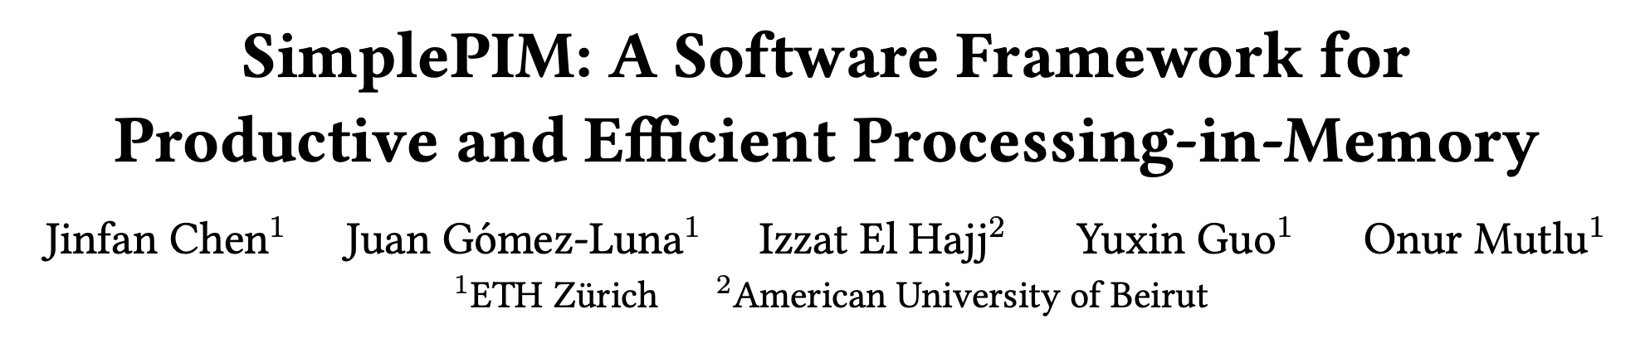
More in the Paper
https://arxiv.org/pdf/2310.01893.pdf

Slide 84
Productivity Improvement (I)
Example: Hand-optimized histogram with UPMEM SDK
... // Initialize global variables and functions for histogram
int main_kernel() {
if (tasklet_id == 0)
mem_reset(); // Reset the heap
... // Initialize variables and the histogram
T *input_buff_A = (T*)mem_alloc(2048); // Allocate buffer in scratchpad memory
for (unsigned int byte_index = base_tasklet; byte_index < input_size; byte_index += stride) {
// Boundary checking
uint32_t l_size_bytes = (byte_index + 2048 >= input_size) ? (input_size - byte_index) : 2048;
// Load scratchpad with a DRAM block
mram_read((const __mram_ptr void*)(mram_base_addr_A + byte_index), input_buff_A, l_size_bytes);
// Histogram calculation
histogram(hist, bins, input_buff_A, l_size_bytes/sizeof(uint32_t));
}
...
barrier_wait(&my_barrier); // Barrier to synchronize PIM threads
... // Merging histograms from different tasklets into one histo_dpu
// Write result from scratchpad to DRAM
if (tasklet_id == 0)
if (bins * sizeof(uint32_t) <= 2048)
mram_write(histo_dpu, (__mram_ptr void*)mram_base_addr_histo, bins * sizeof(uint32_t));
else
for (unsigned int offset = 0; offset < ((bins * sizeof(uint32_t)) >> 11); offset++) {
mram_write(histo_dpu + (offset << 9), (__mram_ptr void*)(mram_base_addr_histo +
(offset << 11)), 2048);
}
return 0;
}

Slide 85
Productivity Improvement (II)
Example: SimplePIM histogram
// Programmer-defined functions in the file "histo_filepath"
void init_func (uint32_t size, void* ptr) {
char* casted_value_ptr = (char*) ptr;
for (int i = 0; i < size; i++)
casted_value_ptr[i] = 0;
}
void acc_func (void* dest, void* src) {
*(uint32_t*)dest += *(uint32_t*)src;
}
void map_to_val_func (void* input, void* output, uint32_t* key) {
uint32_t d = *((uint32_t*)input);
*(uint32_t*)output = 1;
*key = d * bins >> 12;
}
// Host side handle creation and iterator call
handle_t* handle = simple_pim_create_handle("histo_filepath", REDUCE, NULL, 0);
// Transfer (scatter) data to PIM, register as "t1"
simple_pim_array_scatter("t1", src, bins, sizeof(T), management);
// Run histogram on "t1" and produce "t2"
simple_pim_array_red("t1", "t2", sizeof(T), bins, handle, management);

Slide 86
Productivity Improvement (III)
Lines of code (LoC) reduction
 | SimplePIM | Hand-optimized | LoC Reduction
Reduction | 14 | 83 | 5.93×
Vector Addition | 14 | 82 | 5.86×
Histogram | 21 | 114 | 5.43×
Linear Regression | 48 | 157 | 3.27×
Logistic Regression | 59 | 176 | 2.98×
K-Means | 68 | 206 | 3.03×
SimplePIM reduces the number of lines of effective code
by a factor of 2.98× to 5.93×

Slide 87
Performance Evaluation
Weak scaling analysis
SimplePIM achieves comparable performance for reduction, histogram, and linear regression
SimplePIM outperforms hand-optimized implementations for vector addition, logistic regression,
and k-means by 10%-37%

Slide 88
Truly Distributed GPU Processing with PIM
3D-stacked memory
(memory stack)
SM (Streaming Multiprocessor)
Logic layer
Logic layer SM
Main GPU
Crossbar switch
Vault Ctrl
….
Vault Ctrl

Slide 89
Accelerating GPU Execution with PIM (I)
Kevin Hsieh, Eiman Ebrahimi, Gwangsun Kim, Niladrish Chatterjee, Mike O'Connor, Nandita Vijaykumar, Onur Mutlu, and Stephen W. Keckler,
"Transparent Offloading and Mapping (TOM): Enabling Programmer-Transparent Near-Data Processing in GPU Systems"
Proceedings of the 43rd International Symposium on Computer Architecture (ISCA), Seoul, South Korea, June 2016.
[Slides (pptx) (pdf)]
[Lightning Session Slides (pptx) (pdf)]

Slide 90
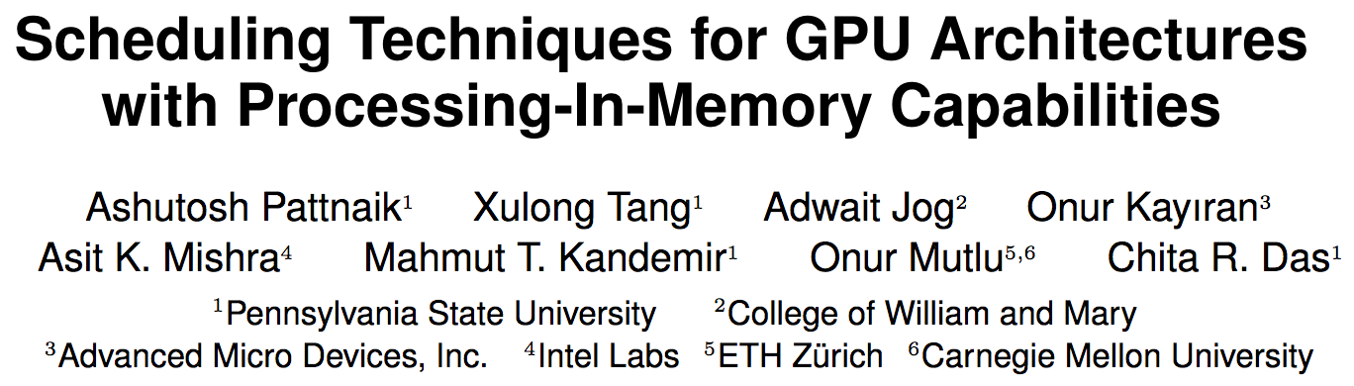
Accelerating GPU Execution with PIM (II)
Ashutosh Pattnaik, Xulong Tang, Adwait Jog, Onur Kayiran, Asit K. Mishra, Mahmut T. Kandemir, Onur Mutlu, and Chita R. Das,
"Scheduling Techniques for GPU Architectures with Processing-In-Memory Capabilities"
Proceedings of the 25th International Conference on Parallel Architectures and Compilation Techniques (PACT), Haifa, Israel, September 2016.

Slide 91
Accelerating Linked Data Structures
Kevin Hsieh, Samira Khan, Nandita Vijaykumar, Kevin K. Chang, Amirali Boroumand, Saugata Ghose, and Onur Mutlu,
"Accelerating Pointer Chasing in 3D-Stacked Memory: Challenges, Mechanisms, Evaluation"
Proceedings of the 34th IEEE International Conference on Computer Design (ICCD), Phoenix, AZ, USA, October 2016.

Slide 92
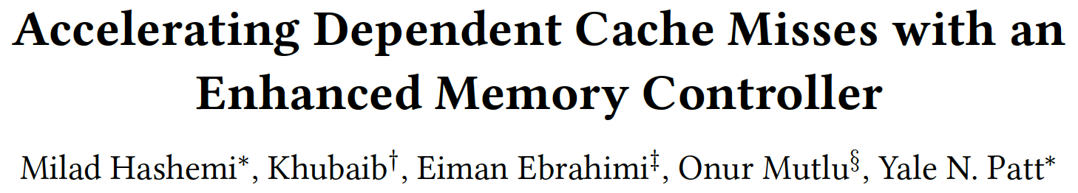
Accelerating Dependent Cache Misses
Milad Hashemi, Khubaib, Eiman Ebrahimi, Onur Mutlu, and Yale N. Patt,
"Accelerating Dependent Cache Misses with an Enhanced Memory Controller"
Proceedings of the 43rd International Symposium on Computer Architecture (ISCA), Seoul, South Korea, June 2016.
[Slides (pptx) (pdf)]
[Lightning Session Slides (pptx) (pdf)]

Slide 93
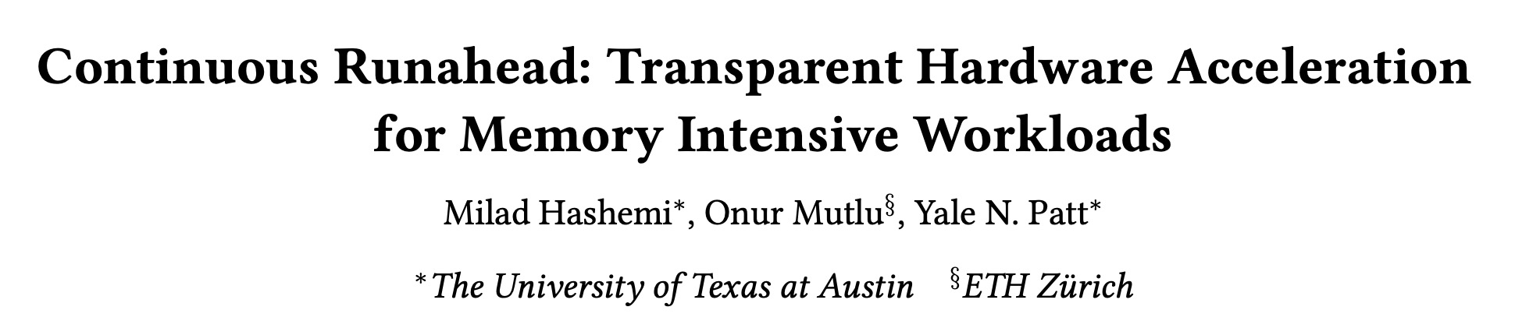
Accelerating Runahead Execution
Milad Hashemi, Onur Mutlu, and Yale N. Patt,
"Continuous Runahead: Transparent Hardware Acceleration for Memory Intensive Workloads"
Proceedings of the 49th International Symposium on Microarchitecture (MICRO), Taipei, Taiwan, October 2016.
[Slides (pptx) (pdf)] [Lightning Session Slides (pdf)] [Poster (pptx) (pdf)]
Best paper session.

Slide 94
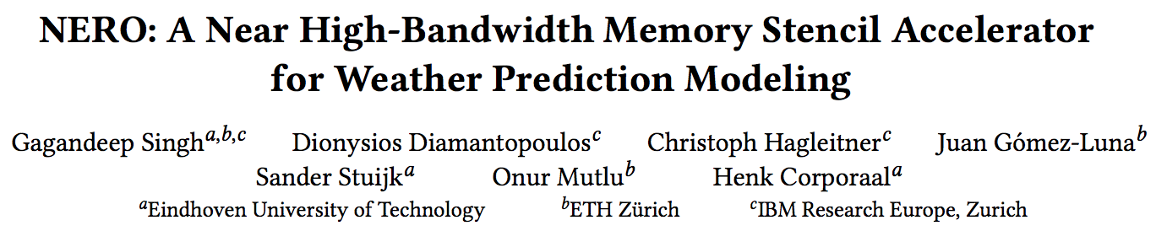
Accelerating Climate Modeling
Gagandeep Singh, Dionysios Diamantopoulos, Christoph Hagleitner, Juan Gómez-Luna, Sander Stuijk, Onur Mutlu, and Henk Corporaal,
"NERO: A Near High-Bandwidth Memory Stencil Accelerator for Weather Prediction Modeling"
Proceedings of the 30th International Conference on Field-Programmable Logic and Applications (FPL), Gothenburg, Sweden, September 2020.
[Slides (pptx) (pdf)]
[Lightning Talk Slides (pptx) (pdf)]
[Talk Video (23 minutes)]
Nominated for the Stamatis Vassiliadis Memorial Award.

Slide 95
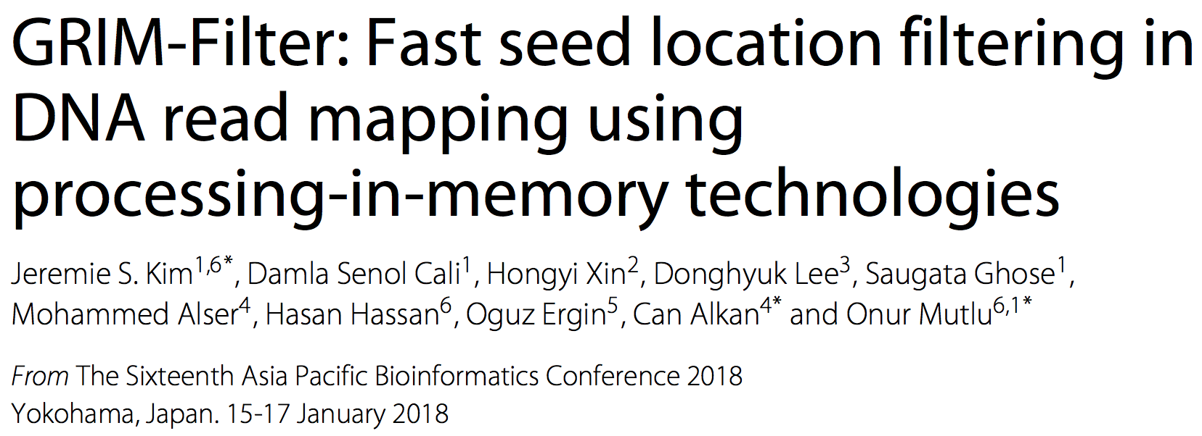
Accelerating DNA Read Mapping
Jeremie S. Kim, Damla Senol Cali, Hongyi Xin, Donghyuk Lee, Saugata Ghose, Mohammed Alser, Hasan Hassan, Oguz Ergin, Can Alkan, and Onur Mutlu,
"GRIM-Filter: Fast Seed Location Filtering in DNA Read Mapping Using Processing-in-Memory Technologies"
BMC Genomics, 2018.
Proceedings of the 16th Asia Pacific Bioinformatics Conference (APBC), Yokohama, Japan, January 2018.
[Slides (pptx) (pdf)]
[Source Code]
[arxiv.org Version (pdf)]
[Talk Video at AACBB 2019]

Slide 96
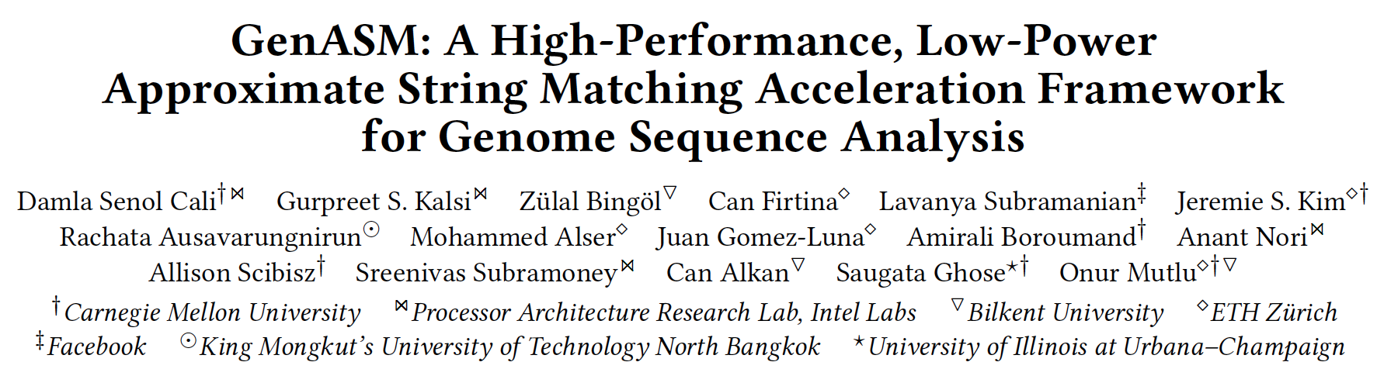
Accelerating Approximate String Matching
Damla Senol Cali, Gurpreet S. Kalsi, Zulal Bingol, Can Firtina, Lavanya Subramanian, Jeremie S. Kim, Rachata Ausavarungnirun, Mohammed Alser, Juan Gomez-Luna, Amirali Boroumand, Anant Nori, Allison Scibisz, Sreenivas Subramoney, Can Alkan, Saugata Ghose, and Onur Mutlu,
"GenASM: A High-Performance, Low-Power Approximate String Matching Acceleration Framework for Genome Sequence Analysis"
Proceedings of the 53rd International Symposium on Microarchitecture (MICRO), Virtual, October 2020.
[Lighting Talk Video (1.5 minutes)]
[Lightning Talk Slides (pptx) (pdf)]
[Talk Video (18 minutes)]
[Slides (pptx) (pdf)]

Slide 97
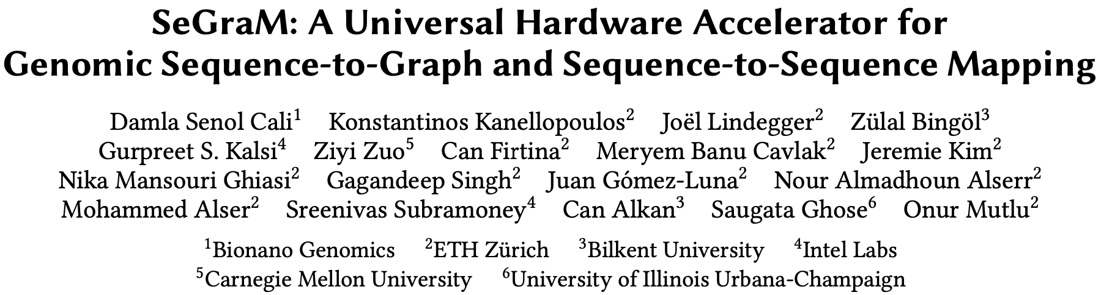
Accelerating Sequence-to-Graph Mapping
Damla Senol Cali, Konstantinos Kanellopoulos, Joel Lindegger, Zulal Bingol, Gurpreet S. Kalsi, Ziyi Zuo, Can Firtina, Meryem Banu Cavlak, Jeremie Kim, Nika MansouriGhiasi, Gagandeep Singh, Juan Gomez-Luna, Nour Almadhoun Alserr, Mohammed Alser, Sreenivas Subramoney, Can Alkan, Saugata Ghose, and Onur Mutlu,
"SeGraM: A Universal Hardware Accelerator for Genomic Sequence-to-Graph and Sequence-to-Sequence Mapping"
Proceedings of the 49th International Symposium on Computer Architecture (ISCA), New York, June 2022.
[arXiv version]
https://arxiv.org/pdf/2205.05883.pdf

Slide 98
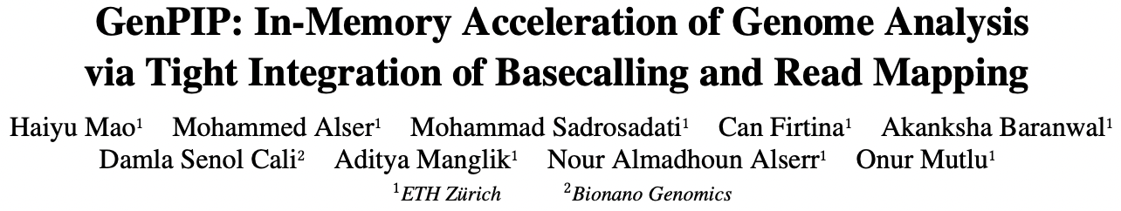
Accelerating Basecalling + Read Mapping
Haiyu Mao, Mohammed Alser, Mohammad Sadrosadati, Can Firtina, Akanksha Baranwal, Damla Senol Cali, Aditya Manglik, Nour Almadhoun Alserr, and Onur Mutlu,
"GenPIP: In-Memory Acceleration of Genome Analysis via Tight Integration of Basecalling and Read Mapping"
Proceedings of the 55th International Symposium on Microarchitecture (MICRO), Chicago, IL, USA, October 2022.
[Slides (pptx) (pdf)]
[Longer Lecture Slides (pptx) (pdf)]
[Lecture Video (25 minutes)]
[arXiv version]
https://arxiv.org/pdf/2209.08600.pdf

Slide 99
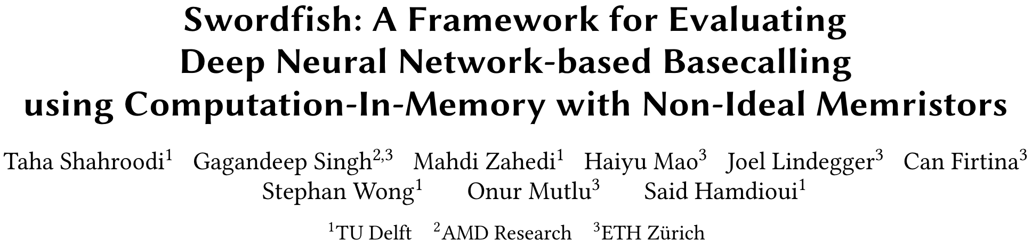
Accelerating Basecalling
Taha Shahroodi, Gagandeep Singh, Mahdi Zahedi, Haiyu Mao, Joel Lindegger, Can Firtina, Stephan Wong, Onur Mutlu, and Said Hamdioui,
"Swordfish: A Framework for Evaluating Deep Neural Network-based Basecalling using Computation-In-Memory with Non-Ideal Memristors"
Proceedings of the 56th International Symposium on Microarchitecture (MICRO), Toronto, ON, Canada, November 2023.
[Slides (pptx) (pdf)]
[arXiv version]
https://arxiv.org/pdf/2310.04366

Slide 100
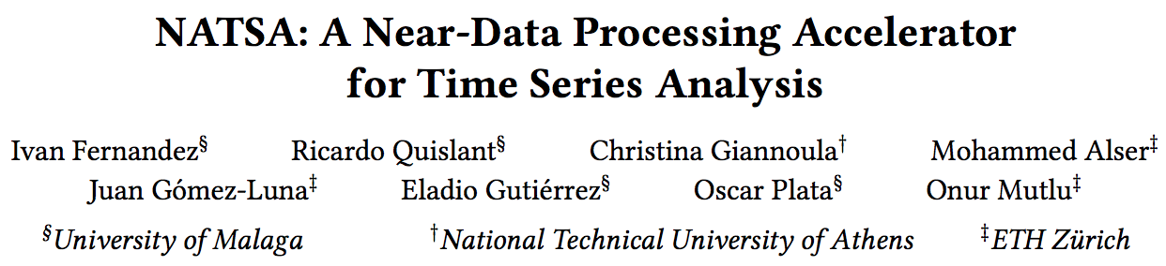
Accelerating Time Series Analysis (I)
Ivan Fernandez, Ricardo Quislant, Christina Giannoula, Mohammed Alser, Juan Gómez-Luna, Eladio Gutiérrez, Oscar Plata, and Onur Mutlu,
"NATSA: A Near-Data Processing Accelerator for Time Series Analysis"
Proceedings of the 38th IEEE International Conference on Computer Design (ICCD), Virtual, October 2020.
[Slides (pptx) (pdf)]
[Talk Video (10 minutes)]
[Source Code]
https://arxiv.org/pdf/2010.02079

Slide 101
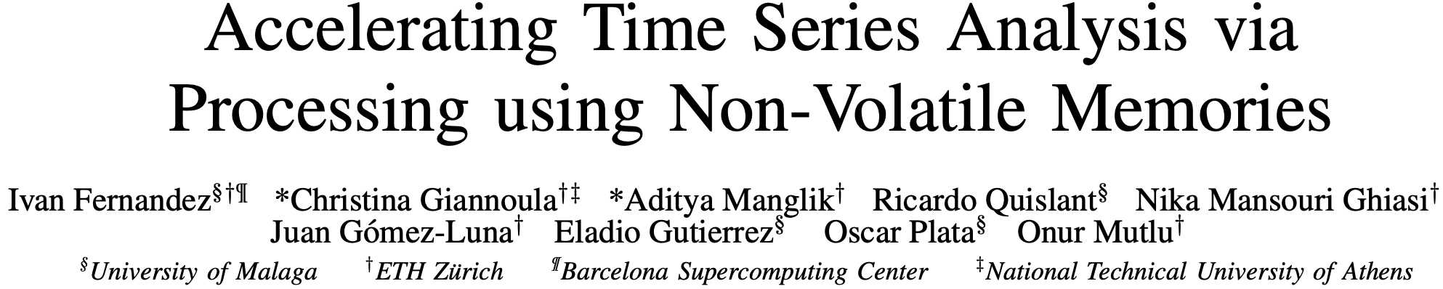
Accelerating Time Series Analysis (II)
Ivan Fernandez, Christina Giannoula, Aditya Manglik, Ricardo Quislant, Nika Mansouri Ghiasi, Juan Gomez Luna, Eladio Gutierrez, Oscar Plata and Onur Mutlu,
"MATSA: An MRAM-Based Energy-Efficient Accelerator for Time Series Analysis"
IEEE Access, March 2024.
[arXiv version]
[IEEE Access version]
https://arxiv.org/pdf/2211.04369

Slide 102
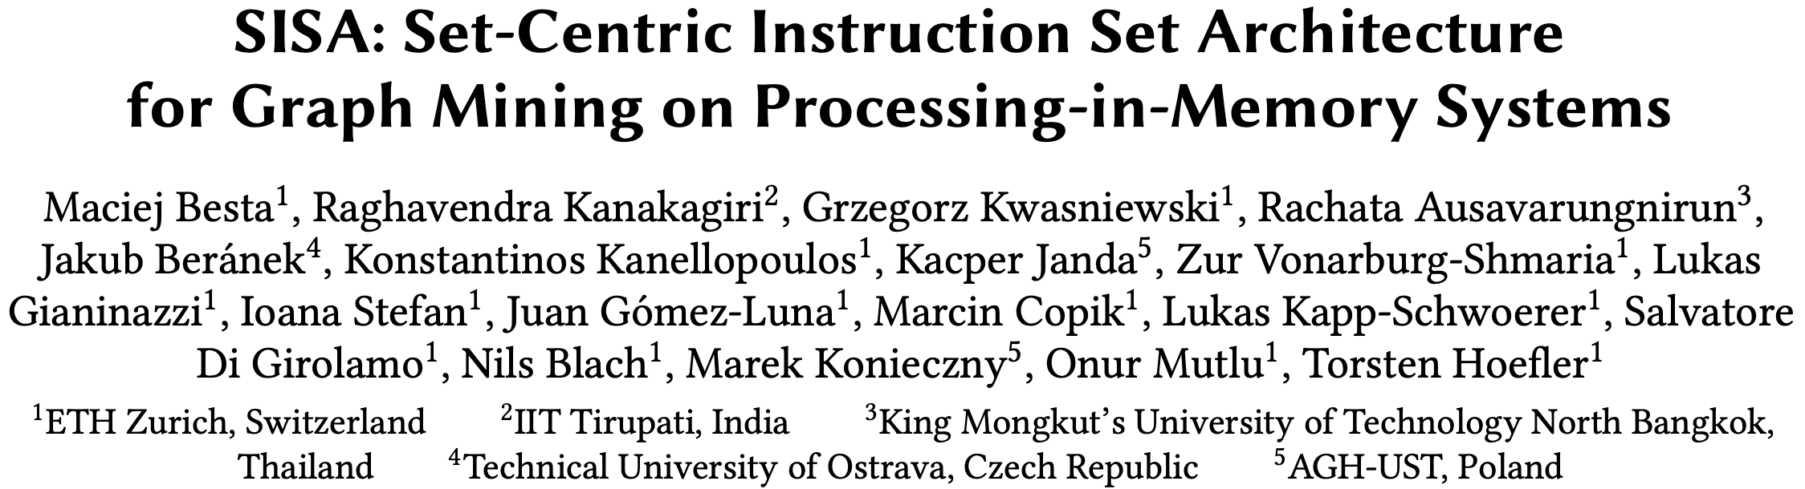
Accelerating Graph Pattern Mining
Maciej Besta, Raghavendra Kanakagiri, Grzegorz Kwasniewski, Rachata Ausavarungnirun, Jakub Beránek, Konstantinos Kanellopoulos, Kacper Janda, Zur Vonarburg-Shmaria, Lukas Gianinazzi, Ioana Stefan, Juan Gómez-Luna, Marcin Copik, Lukas Kapp-Schwoerer, Salvatore Di Girolamo, Nils Blach, Marek Konieczny, Onur Mutlu, and Torsten Hoefler,
"SISA: Set-Centric Instruction Set Architecture for Graph Mining on Processing-in-Memory Systems"
Proceedings of the 54th International Symposium on Microarchitecture (MICRO), Virtual, October 2021.
[Slides (pdf)]
[Talk Video (22 minutes)]
[Lightning Talk Video (1.5 minutes)]
[Full arXiv version]
https://arxiv.org/pdf/2104.07582

Slide 103
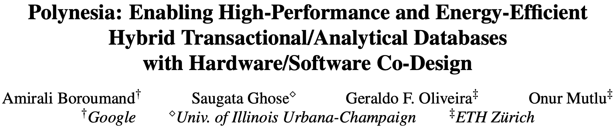
Accelerating HTAP Database Systems
Amirali Boroumand, Saugata Ghose, Geraldo F. Oliveira, and Onur Mutlu,
"Polynesia: Enabling High-Performance and Energy-Efficient Hybrid Transactional/Analytical Databases with Hardware/Software Co-Design"
Proceedings of the 38th International Conference on Data Engineering (ICDE), Virtual, May 2022.
[arXiv version]
[Slides (pptx) (pdf)]
[Short Talk Slides (pptx) (pdf)]
https://arxiv.org/pdf/2204.11275.pdf

Slide 104
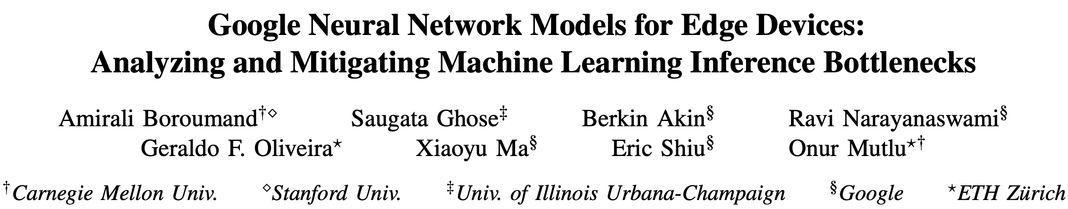
Accelerating ML Inference
Amirali Boroumand, Saugata Ghose, Berkin Akin, Ravi Narayanaswami, Geraldo F. Oliveira, Xiaoyu Ma, Eric Shiu, and Onur Mutlu,
"Google Neural Network Models for Edge Devices: Analyzing and Mitigating Machine Learning Inference Bottlenecks"
Proceedings of the 30th International Conference on Parallel Architectures and Compilation Techniques (PACT), Virtual, September 2021.
[Slides (pptx) (pdf)]
[Talk Video (14 minutes)]

Slide 105
Accelerating Data-Intensive Workloads
Junwhan Ahn, Sungjoo Yoo, Onur Mutlu, and Kiyoung Choi,
"PIM-Enabled Instructions: A Low-Overhead, Locality-Aware Processing-in-Memory Architecture"
Proceedings of the 42nd International Symposium on Computer Architecture (ISCA), Portland, OR, June 2015.
[Slides (pdf)] [Lightning Session Slides (pdf)]

Slide 106
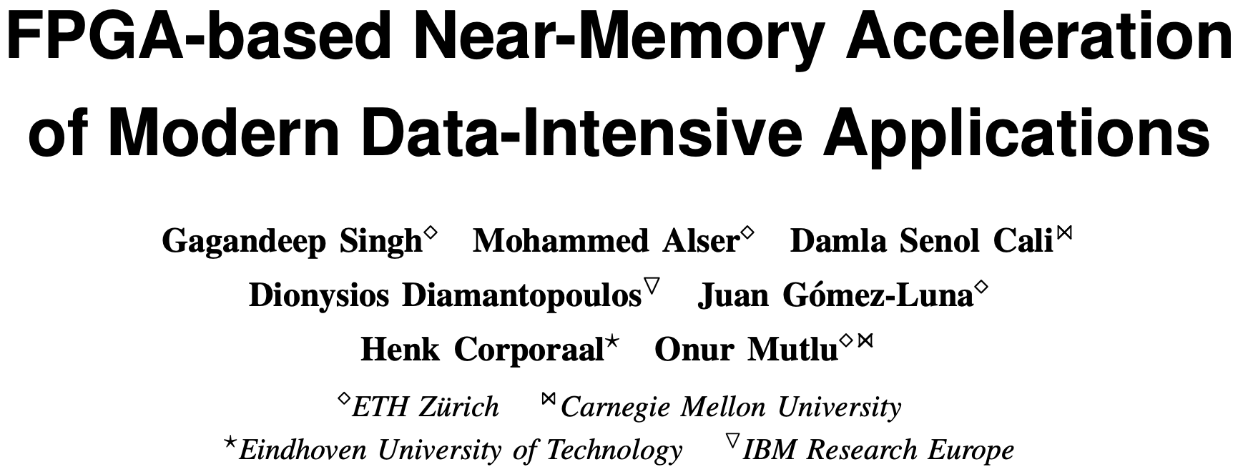
FPGA-based Processing Near Memory
Gagandeep Singh, Mohammed Alser, Damla Senol Cali, Dionysios Diamantopoulos, Juan Gómez-Luna, Henk Corporaal, and Onur Mutlu,
"FPGA-based Near-Memory Acceleration of Modern Data-Intensive Applications"
IEEE Micro (IEEE MICRO), 2021.

Slide 107
We Need to Revisit the Entire Stack
Problem
Algorithm
Program/Language
System Software
SW/HW Interface
Micro-architecture
Logic
Devices
Electrons
We can get there step by step

Slide 108
Security Issues in Processing in Memory
Does PIM make security better or easier?
Does PIM make security worse?
Many interesting questions here
Some recent papers:
  Evaluating Homomorphic Operations on a Real-World Processing-In-Memory System [IISWC 2023]
  Amplifying Main Memory-Based Timing Covert and Side Channels using Processing-in-Memory Operations [arxiv 2024]

Slide 109
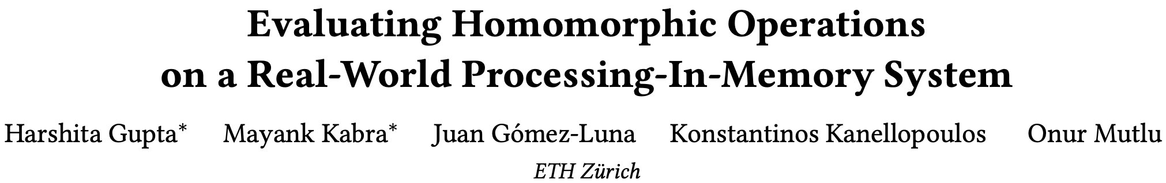
Homomorphic Operations on Real PIM Systems
Harshita Gupta, Mayank Kabra, Juan Gómez-Luna, Konstantinos Kanellopoulos, and Onur Mutlu,
"Evaluating Homomorphic Operations on a Real-World Processing-In-Memory System"
Proceedings of the 2023 IEEE International Symposium on Workload Characterization Poster Session (IISWC), Ghent, Belgium, October 2023.
[arXiv version]
[Lightning Talk Slides (pptx) (pdf)]
[Poster (pptx) (pdf)]
https://arxiv.org/pdf/2309.06545.pdf

Slide 110
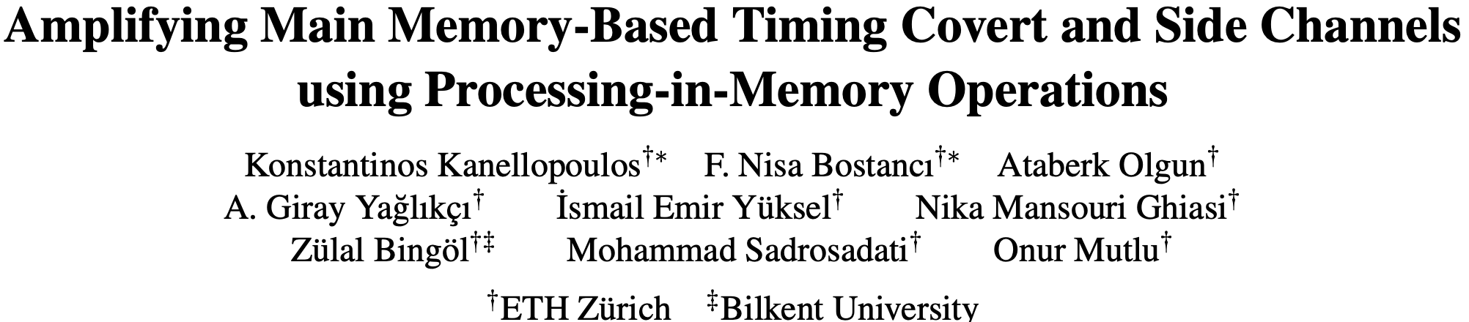
PIM Amplifies Covert & Side Channels
https://arxiv.org/pdf/2404.11284

Slide 111
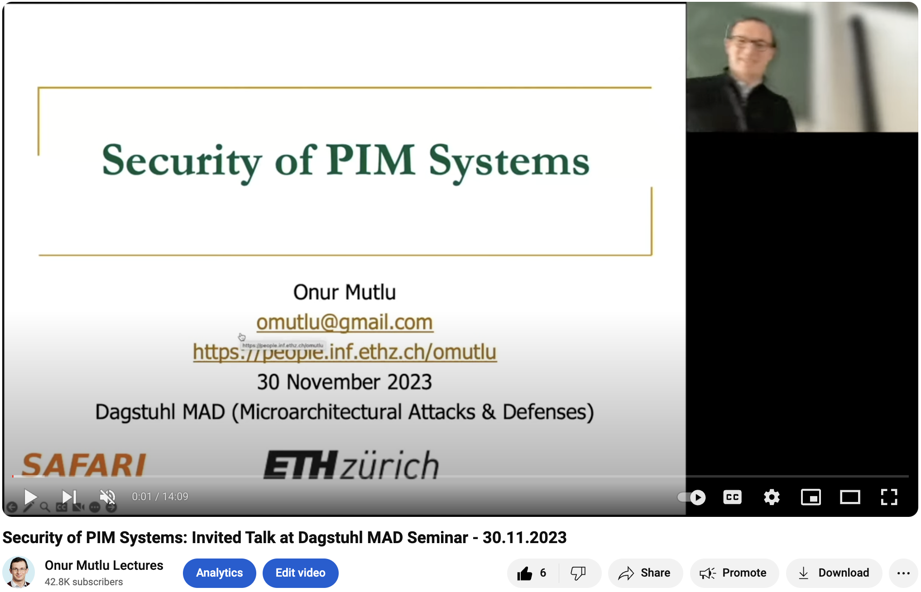
A Talk on Security of PIM Systems
https://www.youtube.com/watch?v=UjE9hygFXEM

Slide 112
Eliminating the Adoption Barriers
Processing-in-Memory
in the Real World

Slide 113
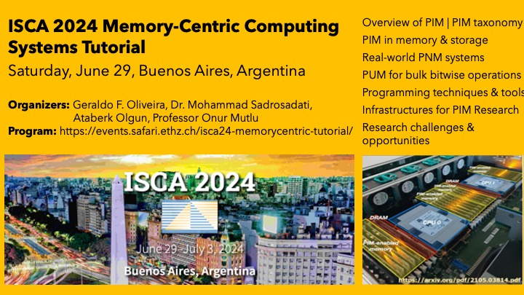
PIM Tutorial at ISCA 2024
https://www.youtube.com/watch?v=KV2MXvcBgb0
https://events.safari.ethz.ch/isca24-memorycentric-tutorial

Slide 114
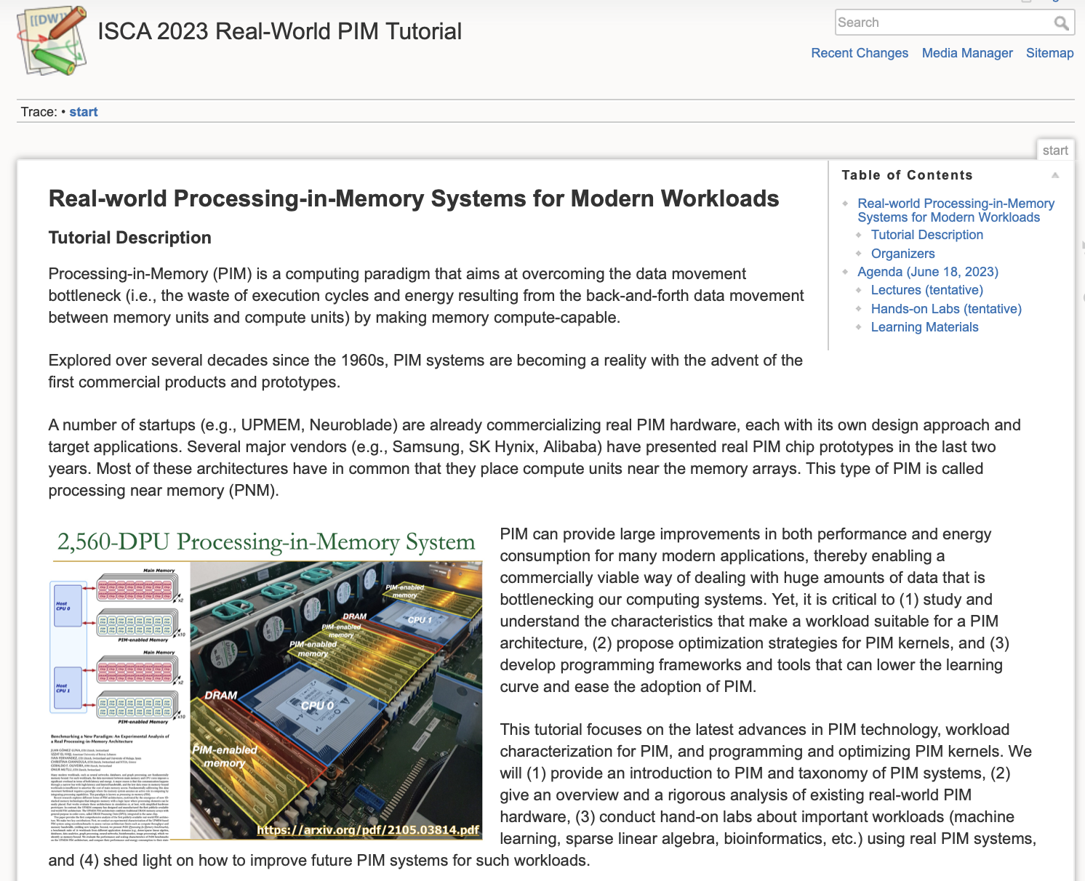
PIM Tutorials [MICRO’23, ISCA’23, ASPLOS’23, HPCA’23, ISCA’24]
Lectures + Hands-on labs + Invited talks
https://www.youtube.com/live/GIb5EgSrWk0
https://events.safari.ethz.ch/isca-pim-tutorial/

Slide 115



Real PIM Tutorial [ISCA 2023]
June 18: Lectures + Hands-on labs + Invited talks
https://www.youtube.com/live/GIb5EgSrWk0
https://events.safari.ethz.ch/isca-pim-tutorial/

Slide 116



Real PIM Tutorial [ASPLOS 2023]
March 26: Lectures + Hands-on labs + Invited talks
https://www.youtube.com/watch?v=oYCaLcT0Kmo
https://events.safari.ethz.ch/asplos-pim-tutorial/

Slide 117



Real PIM Tutorial [HPCA 2023]
February 26: Lectures + Hands-on labs + Invited Talks
https://www.youtube.com/watch?v=f5-nT1tbz5w
https://events.safari.ethz.ch/real-pim-tutorial/

Slide 118



Real PIM Tutorial [MICRO 2023]
October 29: Lectures + Hands-on labs + Invited talks
https://www.youtube.com/watch?v=ohU00NSIxOI
https://events.safari.ethz.ch/micro-pim-tutorial

Slide 119
FPGA-based Processing Near Memory
Gagandeep Singh, Mohammed Alser, Damla Senol Cali, Dionysios Diamantopoulos, Juan Gómez-Luna, Henk Corporaal, and Onur Mutlu,
"FPGA-based Near-Memory Acceleration of Modern Data-Intensive Applications"
IEEE Micro (IEEE MICRO), 2021.

Slide 120


Near-Memory Acceleration using FPGAs
OCAPI
Source: IBM
Source: AlphaData
IBM POWER9 CPU
HBM-based FPGA board
Near-HBM FPGA-based accelerator
Two communication technologies: CAPI2 and OCAPI
Two memory technologies: DDR4 and HBM
Two workloads: Weather Modeling and Genome Analysis
Notes:
To this end we build a [CLICK] near-HBM FPGA based accelerator which is connected to a server-grade IBM POWER9-based CPU system

Slide 121
Performance & Energy Greatly Improve
5-27× performance vs. a 16-core (64-thread) IBM POWER9 CPU
12-133× energy efficiency vs. a 16-core (64-thread) IBM POWER9 CPU
HBM alleviates memory bandwidth contention vs. DDR4
Notes:
[CLICK]

Slide 122
UPMEM Processing-in-DRAM Engine (2019)
Processing in DRAM Engine
Includes standard DIMM modules, with a large number of DPU processors combined with DRAM chips.
Replaces standard DIMMs
  DDR4 R-DIMM modules
    8GB+128 DPUs (16 PIM chips)
    Standard 2x-nm DRAM process
  Large amounts of compute & memory bandwidth
https://www.anandtech.com/show/14750/hot-chips-31-analysis-inmemory-processing-by-upmem
https://www.upmem.com/video-upmem-presenting-its-true-processing-in-memory-solution-hot-chips-2019/

Slide 123

Experimental Analysis of the UPMEM PIM Engine
https://arxiv.org/pdf/2105.03814.pdf

Slide 124
Key Takeaway 1
The throughput saturation point is as low as ¼ OP/B,
i.e., 1 integer addition per every 32-bit element fetched
Memory-bound region
Compute-bound region
KEY TAKEAWAY 1
The UPMEM PIM architecture is fundamentally compute bound.
As a result, the most suitable workloads are memory-bound.

Slide 125

Key Takeaway 2
KEY TAKEAWAY 2
The most well-suited workloads for the UPMEM PIM architecture use no arithmetic operations or use only simple operations (e.g., bitwise operations and integer addition/subtraction).

Slide 126
Key Takeaway 3
KEY TAKEAWAY 3
The most well-suited workloads for the UPMEM PIM architecture require little or no communication across DPUs (inter-DPU communication).

Slide 127

UPMEM PIM System Summary & Analysis
Juan Gomez-Luna, Izzat El Hajj, Ivan Fernandez, Christina Giannoula, Geraldo F. Oliveira, and Onur Mutlu,
"Benchmarking Memory-Centric Computing Systems: Analysis of Real Processing-in-Memory Hardware"
Invited Paper at Workshop on Computing with Unconventional Technologies (CUT), Virtual, October 2021.
[arXiv version]
[PrIM Benchmarks Source Code]
[Slides (pptx) (pdf)]
[Talk Video (37 minutes)]
[Lightning Talk Video (3 minutes)]

Slide 128
PrIM Benchmarks: Application Domains
Domain | Benchmark | Short name
Dense linear algebra | Vector Addition | VA
 | Matrix-Vector Multiply | GEMV
Sparse linear algebra | Sparse Matrix-Vector Multiply | SpMV
Databases | Select | SEL
 | Unique | UNI
Data analytics | Binary Search | BS
 | Time Series Analysis | TS
Graph processing | Breadth-First Search | BFS
Neural networks | Multilayer Perceptron | MLP
Bioinformatics | Needleman-Wunsch | NW
Image processing | Image histogram (short) | HST-S
 | Image histogram (large) | HST-L
Parallel primitives | Reduction | RED
 | Prefix sum (scan-scan-add) | SCAN-SSA
 | Prefix sum (reduce-scan-scan) | SCAN-RSS
 | Matrix transposition | TRNS

Slide 129

PrIM Benchmarks are Open Source
All microbenchmarks, benchmarks, and scripts
https://github.com/CMU-SAFARI/prim-benchmarks

Slide 130

Understanding a Modern PIM Architecture
https://arxiv.org/pdf/2105.03814.pdf
https://github.com/CMU-SAFARI/prim-benchmarks

Slide 131

Understanding a Modern PIM Architecture
https://www.youtube.com/watch?v=D8Hjy2iU9l4&list=PL5Q2soXY2Zi_tOTAYm--dYByNPL7JhwR9

Slide 132


ML Training on a Real PIM System
Short version: https://arxiv.org/pdf/2206.06022.pdf
Long version: https://arxiv.org/pdf/2207.07886.pdf
https://www.youtube.com/watch?v=qeukNs5XI3g&t=11226s

Slide 133
ML Training on a Real PIM System
Need to optimize data representation
  (1) fixed-point
  (2) quantization
  (3) hybrid precision
Use lookup tables (LUTs) to implement complex functions (e.g., sigmoid)
Optimize data placement & layout for streaming
Large speedups: 2.8X/27X vs. CPU, 1.3x/3.2x vs. GPU

Slide 134

ML Training on Real PIM Talk Video
https://www.youtube.com/watch?v=60pkaI5AeM4

Slide 135

ML Training on Real PIM Systems
Juan Gómez Luna, Yuxin Guo, Sylvan Brocard, Julien Legriel, Remy Cimadomo, Geraldo F. Oliveira, Gagandeep Singh, and Onur Mutlu,
"Evaluating Machine Learning Workloads on Memory-Centric Computing Systems"
Proceedings of the 2023 IEEE International Symposium on Performance Analysis of Systems and Software (ISPASS), Raleigh, North Carolina, USA, April 2023.
[arXiv version, 16 July 2022.]
[PIM-ML Source Code]
Best paper session.
https://github.com/CMU-SAFARI/pim-ml
https://arxiv.org/pdf/2207.07886.pdf

Slide 136

SpMV Multiplication on Real PIM Systems
Appears at SIGMETRICS 2022
https://arxiv.org/pdf/2201.05072.pdf
https://github.com/CMU-SAFARI/SparseP
https://www.youtube.com/watch?v=5kaOsJKlGrE

Slide 137




SparseP
Towards Efficient Sparse Matrix Vector Multiplication
on Real Processing-In-Memory Architectures
Christina Giannoula
Ivan Fernandez, Juan Gomez-Luna,
Nectarios Koziris, Georgios Goumas, Onur Mutlu

Slide 138

SparseP: Key Contributions
Efficient SpMV kernels for current & future PIM systems
  SparseP library = 25 SpMV kernels
    Compression, data types, data partitioning, synchronization, load balancing
Comprehensive analysis of SpMV on the first commercially-available real PIM system
  26 sparse matrices
  Comparisons to state-of-the-art CPU and GPU systems
  Recommendations for software, system and hardware designers
SparseP is Open-Source
SparseP: https://github.com/CMU-SAFARI/SparseP
Recommendations for Architects and Programmers
Full Paper: https://arxiv.org/pdf/2201.05072.pdf

Slide 139

SparseP Talk Video
https://www.youtube.com/watch?v=5kaOsJKlGrE

Slide 140
More on SparseP
Christina Giannoula, Ivan Fernandez, Juan Gomez-Luna, Nectarios Koziris, Georgios Goumas, and Onur Mutlu,
"SparseP: Towards Efficient Sparse Matrix Vector Multiplication on Real Processing-In-Memory Architectures"
Proceedings of the ACM International Conference on Measurement and Modeling of Computer Systems (SIGMETRICS), Mumbai, India, June 2022.
[Extended arXiv Version]
[Abstract]
[Slides (pptx) (pdf)]
[Long Talk Slides (pptx) (pdf)]
[SparseP Source Code]
[Talk Video (16 minutes)]
[Long Talk Video (55 minutes)]
https://github.com/CMU-SAFARI/SparseP
https://arxiv.org/pdf/2201.05072.pdf

Slide 141

Transcendental Functions on Real PIM Systems
Maurus Item, Juan Gómez Luna, Yuxin Guo, Geraldo F. Oliveira, Mohammad Sadrosadati, and Onur Mutlu,
"TransPimLib: Efficient Transcendental Functions for Processing-in-Memory Systems"
Proceedings of the 2023 IEEE International Symposium on Performance Analysis of Systems and Software (ISPASS), Raleigh, North Carolina, USA, April 2023.
[arXiv version]
[Slides (pptx) (pdf)]
[TransPimLib Source Code]
[Talk Video (17 minutes)]
https://github.com/CMU-SAFARI/transpimlib
https://arxiv.org/pdf/2304.01951.pdf

Slide 142

Sequence Alignment on Real PIM Systems
Safaa Diab, Amir Nassereldine, Mohammed Alser, Juan Gómez Luna, Onur Mutlu, and Izzat El Hajj,
"A Framework for High-throughput Sequence Alignment using Real Processing-in-Memory Systems"
Bioinformatics, [published online on] 27 March 2023.
[Online link at Bioinformatics Journal]
[arXiv preprint]
[AiM Source Code]
https://github.com/CMU-SAFARI/alignment-in-memory
https://arxiv.org/pdf/2208.01243.pdf

Slide 143
Summary
Sequence alignment on traditional systems is limited by the memory bandwidth bottleneck
Processing-in-memory (PIM) overcomes this bottleneck by placing cores near the memory
Our framework, Alignment-in-Memory (AIM), is a PIM framework that supports multiple alignment algorithms (NW, SWG, GenASM, WFA)
  Implemented on UPMEM, the first real PIM system
Results show substantial speedups over both CPUs (1.8X-28X) and GPUs (1.2X-2.7X)
AIM is available at:
  https://github.com/CMU-SAFARI/alignment-in-memory

Slide 144
Homomorphic Operations on Real PIM Systems
Harshita Gupta, Mayank Kabra, Juan Gómez-Luna, Konstantinos Kanellopoulos, and Onur Mutlu,
"Evaluating Homomorphic Operations on a Real-World Processing-In-Memory System"
Proceedings of the 2023 IEEE International Symposium on Workload Characterization Poster Session (IISWC), Ghent, Belgium, October 2023.
[arXiv version]
[Lightning Talk Slides (pptx) (pdf)]
[Poster (pptx) (pdf)]
https://arxiv.org/pdf/2309.06545.pdf

Slide 145

Accelerating Reinforcement Learning
Kailash Gogineni, Sai Santosh Dayapule, Juan Gomez-Luna, Karthikeya Gogineni, Peng Wei, Tian Lan, Mohammad Sadrosadati, Onur Mutlu, Guru Venkataramani,
"SwiftRL: Towards Efficient Reinforcement Learning on Real Processing-In-Memory Systems"
Proceedings of the 2024 IEEE International Symposium on Performance Analysis of Systems and Software (ISPASS), Indianapolis, Indiana, May 2024.
[Slides (pptx) (pdf)]
[arXiv version]
https://arxiv.org/pdf/2405.03967

Slide 146

Accelerating ML Training on Real PIM Systems
https://arxiv.org/pdf/2404.07164

Slide 147

Accelerating ML Training on Real PIM Systems
https://arxiv.org/pdf/2404.07164

Slide 148

Accelerating GNNs on Real PIM Systems
https://arxiv.org/pdf/2402.16731

Slide 149

Accelerating GNNs on Real PIM Systems
https://arxiv.org/pdf/2402.16731

Slide 150

Samsung Function-in-Memory DRAM (2021)
https://news.samsung.com/global/samsung-develops-industrys-first-high-bandwidth-memory-with-ai-processing-power

Slide 151


Samsung Function-in-Memory DRAM (2021)

Slide 152

Samsung Function-in-Memory DRAM (2021)

Slide 153

Samsung Function-in-Memory DRAM (2021)

Slide 154

Samsung Function-in-Memory DRAM (2021)

Slide 155



Samsung AxDIMM (2021)
DDRx-PIM
  DLRM recommendation system
Baseline System
AxDIMM System
Ke et al. "Near-Memory Processing in Action: Accelerating Personalized Recommendation with AxDIMM", IEEE Micro (2021)

Slide 156


SK Hynix Accelerator-in-Memory (2022)
https://news.skhynix.com/sk-hynix-develops-pim-next-generation-ai-accelerator/

Slide 157

SK Hynix Accelerator-in-Memory (2022)
https://www.youtube.com/watch?v=oYCaLcT0Kmo

Slide 158



AliBaba PIM Recommendation System (2022)

Slide 159


SK Hynix CXL Processing Near Memory (2023)

Slide 160

Samsung CXL Processing Near Memory (2023)
https://www.servethehome.com/samsung-processing-in-memory-technology-at-hot-chips-2023/

Slide 161
Concluding Remarks

Slide 162
Challenge and Opportunity for Future
Fundamentally
Energy-Efficient
(Data-Centric)
Computing Architectures

Slide 163
Challenge and Opportunity for Future
Fundamentally
High-Performance
(Data-Centric)
Computing Architectures

Slide 164
Challenge and Opportunity for Future
Computing Architectures
with
Minimal Data Movement

Slide 165

A Quote from A Famous Architect
“architecture […] based upon principle, and not upon precedent”

Slide 166

Precedent-Based Design?
“architecture […] based upon principle, and not upon precedent”

Slide 167

Principled Design
“architecture […] based upon principle, and not upon precedent”

Slide 168


Slide 169


The Overarching Principle

Slide 170

Another Example: Precedent-Based Design
Source: http://cookiemagik.deviantart.com/art/Train-station-207266944

Slide 171

Principled Design
Source: By Toni_V, CC BY-SA 2.0, https://commons.wikimedia.org/w/index.php?curid=4087256

Slide 172


Another Principled Design
Source: By Martín Gómez Tagle - Lisbon, Portugal, CC BY-SA 3.0, https://commons.wikimedia.org/w/index.php?curid=13764903
Source: http://www.arcspace.com/exhibitions/unsorted/santiago-calatrava/

Slide 173

Another Principled Design
Source: CC BY-SA 3.0, https://commons.wikimedia.org/w/index.php?curid=172107

Slide 174


Principle Applied to Another Structure
Source: By 準建築人手札網站 Forgemind ArchiMedia - Flickr: IMG_2489.JPG, CC BY 2.0,
https://commons.wikimedia.org/w/index.php?curid=31493356, https://en.wikipedia.org/wiki/Santiago_Calatrava
Source: https://www.dezeen.com/2016/08/29/santiago-calatrava-oculus-world-trade-center-transportation-hub-new-york-photographs-hufton-crow/

Slide 175


The Overarching Principle

Slide 176

Overarching Principles for Computing?
Source: http://spectrum.ieee.org/image/MjYzMzAyMg.jpeg

Slide 177
Concluding Remarks
It is time to design principled system architectures to solve the memory problem
We must design systems to be balanced, high-performance, and energy-efficient → memory-centric
  Enable computation capabilities in memory
This can
  Lead to orders-of-magnitude improvements
  Enable new applications & computing platforms
  Enable better understanding of nature
  …
Future of truly memory-centric computing is bright
  We need to do research & design across the computing stack
Notes:
Perhaps we have taken processor-centric system design a bit too far

Slide 178
Fundamentally Better Architectures
Data-centric
Data-driven
Data-aware

Slide 179
We Need to Revisit the Entire Stack
With a memory-centric mindset
Problem
Algorithm
Program/Language
System Software
SW/HW Interface
Micro-architecture
Logic
Devices
Electrons
We can get there step by step

Slide 180
PIM Review and Open Problems
Onur Mutlu, Saugata Ghose, Juan Gomez-Luna, and Rachata Ausavarungnirun,
"A Modern Primer on Processing in Memory"
Invited Book Chapter in Emerging Computing: From Devices to Systems - Looking Beyond Moore and Von Neumann, Springer, to be published in 2021.
https://arxiv.org/pdf/2012.03112.pdf

Slide 181














Open Source Tools: SAFARI GitHub
https://github.com/CMU-SAFARI/

Slide 182
Referenced Papers, Talks, Artifacts
All are available at
  https://people.inf.ethz.ch/omutlu/projects.htm
  https://www.youtube.com/onurmutlulectures
  https://github.com/CMU-SAFARI/

Slide 183
Funding Acknowledgments
Alibaba, AMD, ASML, Google, Facebook, Hi-Silicon, HP Labs, Huawei, IBM, Intel, Microsoft, Nvidia, Oracle, Qualcomm, Rambus, Samsung, Seagate, VMware, Xilinx
NSF
NIH
GSRC
SRC
CyLab
EFCL
SNSF
ACCESS
Thank you!

Slide 184
Memory Systems and Memory-Centric Computing
Lecture 4.1: Memory-Centric Computing III
Onur Mutlu
omutlu@gmail.com
https://people.inf.ethz.ch/omutlu
18 July 2024
HiPEAC ACACES Summer School 2024

