Slide 1


Memory Systems and Memory-Centric Computing
Topic 1.2: Memory Fundamentals
Onur Mutlu
omutlu@gmail.com
https://people.inf.ethz.ch/omutlu
16 July 2024
HiPEAC ACACES Summer School 2024

Slide 2
What Will You Learn in This Course?
Memory Systems and Memory-Centric Computing
  July 15-19, 2024
Topic 1: Memory Trends, Challenges, Opportunities, Basics
Topic 2: Memory-Centric Computing
Topic 3: Memory Robustness: RowHammer, RowPress & Beyond
Topic 4: Machine Learning Driven Memory Systems
Topic 5 (another course): Architectures for Genomics and ML
Topic 6 (unlikely): Non-Volatile Memories and Storage
Topic 7 (unlikely): Memory Latency, Predictability & QoS
Major Overview Reading:
  Mutlu et al., “A Modern Primer on Processing in Memory,” Book Chapter on Emerging Computing and Devices, 2022.

Slide 3
Memory Fundamentals

Slide 4
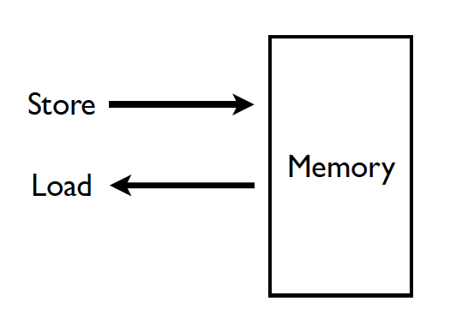
Memory (Programmer’s View)
Notes:
Supply an address and supply data to store a word/byte/whatever

Slide 5
Abstraction: Virtual vs. Physical Memory
Programmer sees virtual memory
  Can assume the memory is “infinite”
Reality: Physical memory size is much smaller than what the programmer assumes
The system (system software + hardware, cooperatively) maps virtual memory addresses to physical memory
  The system automatically manages the physical memory space transparently to the programmer
+ Programmer does not need to know the physical size of memory nor manage it → A small physical memory can appear as a huge one to the programmer → Life is easier for the programmer
-- More complex system software and architecture
A classic example of the programmer/(micro)architect tradeoff
Requires indirection and mapping between virtual and physical address spaces
Notes:
Today’s systems are virtualized
We will cover virtual memory in upcoming lectures

Slide 6
(Physical) Memory System
You need a larger level of storage to manage a small amount of physical memory automatically
  → Physical memory has a backing store: disk
We will first start with the physical memory system
For now, ignore the virtual→physical indirection
  However, virtual memory needs to be re-examined in modern systems, especially with memory-centric computing and heterogeneous memories and systems

Slide 7
Ideal Memory
Zero access time (latency)
Infinite capacity
Zero cost
Infinite bandwidth (to support multiple accesses in parallel)
Zero energy

Slide 8
The Problem
Ideal memory’s requirements oppose each other
Bigger is slower
  Bigger → Takes longer to determine the location
Faster is more expensive
  Memory technology: SRAM vs. DRAM vs. Disk vs. Tape
Higher bandwidth is more expensive
  Need more banks, more ports, higher frequency, or faster technology

Slide 9
Memory Technology: DRAM
Dynamic random access memory
Capacitor charge state indicates stored value
  Whether the capacitor is charged or discharged indicates storage of 1 or 0
  1 capacitor
  1 access transistor
Capacitor leaks through the RC path
  DRAM cell loses charge over time
  DRAM cell needs to be refreshed
  Read Liu et al., “RAIDR: Retention-aware Intelligent DRAM Refresh,” ISCA 2012.
row enable
_bitline

Slide 10
Accessing a DRAM Cell
wordline
capacitor
bitline
access transistor
Sense Amp
enable
bitline
[Seshadri+ MICRO’17]
Notes:
Now we will look at how we access this DRAM cell. This is a diagram showing how a DRAM cell is connected to a sense amplifier.
[CLICK] A DRAM cell contains two components, the capacitor stores data and the access transistor determines if the cell is being accessed.
[CLICK] The access transistor is controlled by the wordline, which is enabled to
[CLICK] connect the DRAM cell to its bitline
[CLICK] The bitline bar is esentially the inverse of the bitline
[CLICK] The DRAM sense amplifier has an enable signal which determines if the sense amplifier is currently active.

Slide 11
Accessing a DRAM Cell
4
deviation in bitline voltage
enable wordline
wordline
1
½ V_{DD} + δ
V_{DD}
½ V_{DD}
capacitor
bitline
access transistor
2
connects cell to bitline
3
cell charge restored
cell loses charge to bitline
6
Sense Amp
enable sense amp
enable
5
bitline
½ V_{DD}
0
[Seshadri+ MICRO’17]
Notes:
Initially, both the access transistor and the sense amplifier are disabled and both ends of the sense amplifier are maintained at half vdd. In this example, the capacitor is fully charged. To access the cell
[CLICK] we first enable the wordline, [CLICK] this connects the capacitor to its bitline.
[CLICK] Since the capacitor has a voltage level higher than the bitline, the charge starts flowing from the capacitor to the bitline, [CLICK] resulting in the bitline voltage to deviate slightly towards Vdd.
[CLICK] When we enable the sense amplifier, it will compare the voltage levels of bitline and bitline bar, and [CLICK] amplify the deviation until bitline voltage reaches Vdd.
[CLICK] Since the capacitor is still connected to the bitline, the amplification process also restores the charge in the capacitor.

Slide 12
Memory Technology: SRAM
Static random access memory
Two cross coupled inverters store a single bit
  Feedback path enables the stored value to persist in the “cell”
  4 transistors for storage
  2 transistors for access
row select
bitline
_bitline

Slide 13
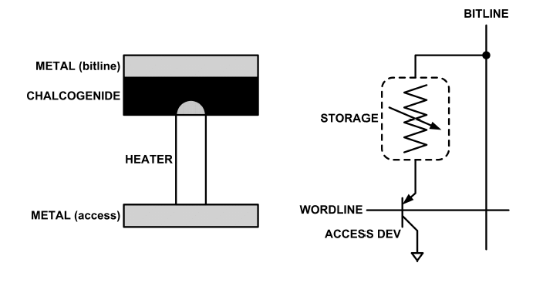
An Aside: Phase Change Memory
Phase change material (chalcogenide glass) exists in two states:
  Amorphous: Low optical reflexivity and high electrical resistivity
  Crystalline: High optical reflexivity and low electrical resistivity
PCM is resistive memory: High resistance (0), Low resistance (1)
Lee, Ipek, Mutlu, Burger, “Architecting Phase Change Memory as a Scalable DRAM Alternative,” ISCA 2009.

Slide 14
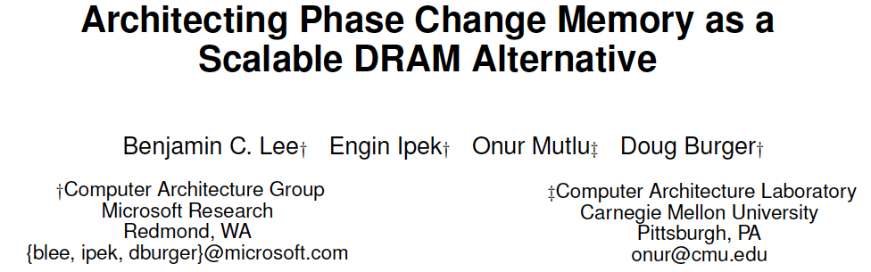
Reading: PCM as Main Memory: Idea in 2009
Benjamin C. Lee, Engin Ipek, Onur Mutlu, and Doug Burger,
"Architecting Phase Change Memory as a Scalable DRAM Alternative"
Proceedings of the 36th International Symposium on Computer Architecture (ISCA), pages 2-13, Austin, TX, June 2009. Slides (pdf)
One of the 13 computer architecture papers of 2009 selected as Top Picks by IEEE Micro. Selected as a CACM Research Highlight. 2022 Persistent Impact Prize.

Slide 15
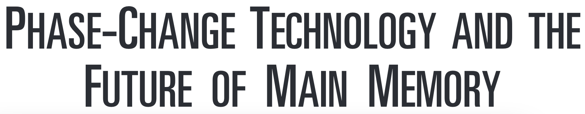
Reading: More on PCM As Main Memory
Benjamin C. Lee, Ping Zhou, Jun Yang, Youtao Zhang, Bo Zhao, Engin Ipek, Onur Mutlu, and Doug Burger,
"Phase Change Technology and the Future of Main Memory"
IEEE Micro, Special Issue: Micro's Top Picks from 2009 Computer Architecture Conferences (MICRO TOP PICKS), Vol. 30, No. 1, pages 60-70, January/February 2010.

Slide 16
Intel Optane Persistent Memory (2019)
Non-volatile main memory
Based on 3D-XPoint Technology
https://www.storagereview.com/intel_optane_dc_persistent_memory_module_pmm

Slide 17
Charge vs. Resistive Memories
Charge Memory (e.g., DRAM, Flash)
  Write data by capturing charge Q
  Read data by detecting voltage V
Resistive Memory (e.g., PCM, STT-MRAM, memristors)
  Write data by pulsing current dQ/dt
  Read data by detecting resistance R

Slide 18
Promising Resistive Memory Technologies
PCM
  Inject current to change material phase
  Resistance determined by phase
STT-MRAM
  Inject current to change magnet polarity
  Resistance determined by polarity
Memristors/RRAM/ReRAM
  Inject current to change atomic structure
  Resistance determined by atom distance

Slide 19
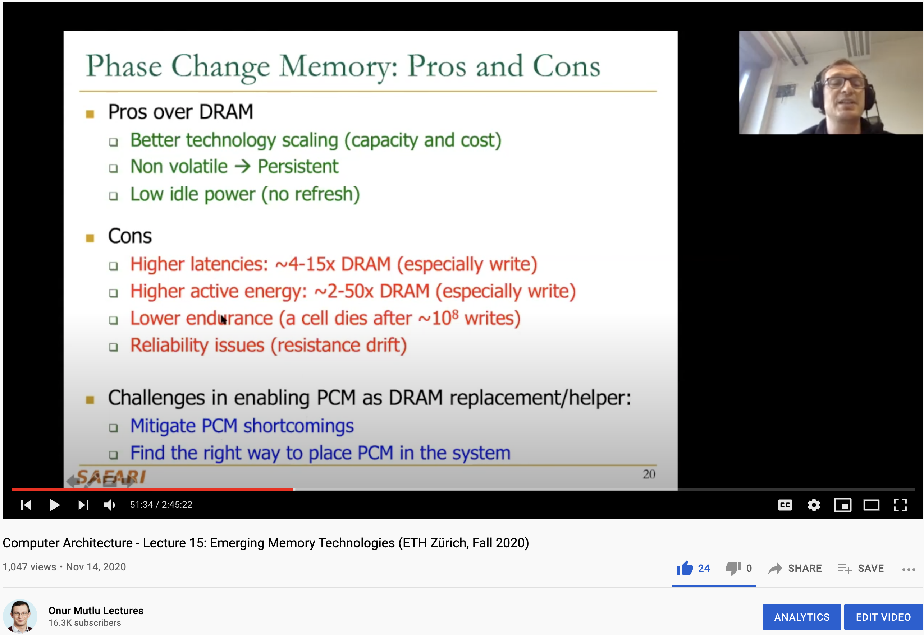
More on Emerging Memory Technologies
https://www.youtube.com/watch?v=AlE1rD9G_YU&list=PL5Q2soXY2Zi9xidyIgBxUz7xRPS-wisBN&index=28

Slide 20
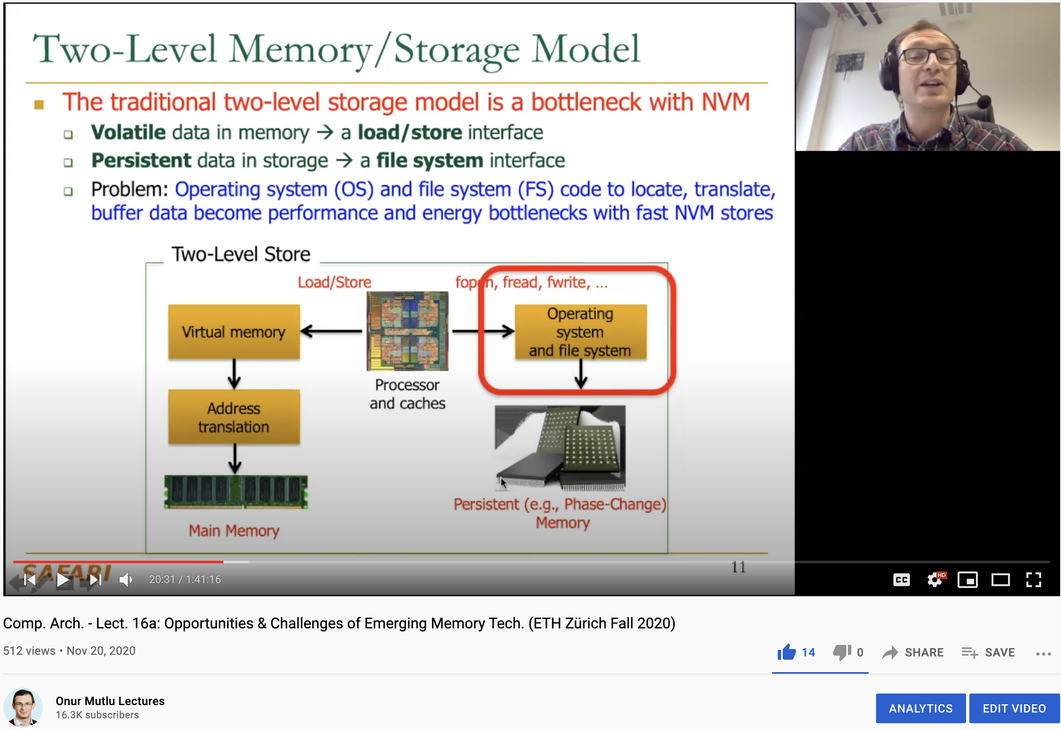
More on Emerging Memory Technologies
https://www.youtube.com/watch?v=pmLszWGmMGQ&list=PL5Q2soXY2Zi9xidyIgBxUz7xRPS-wisBN&index=29

Slide 21
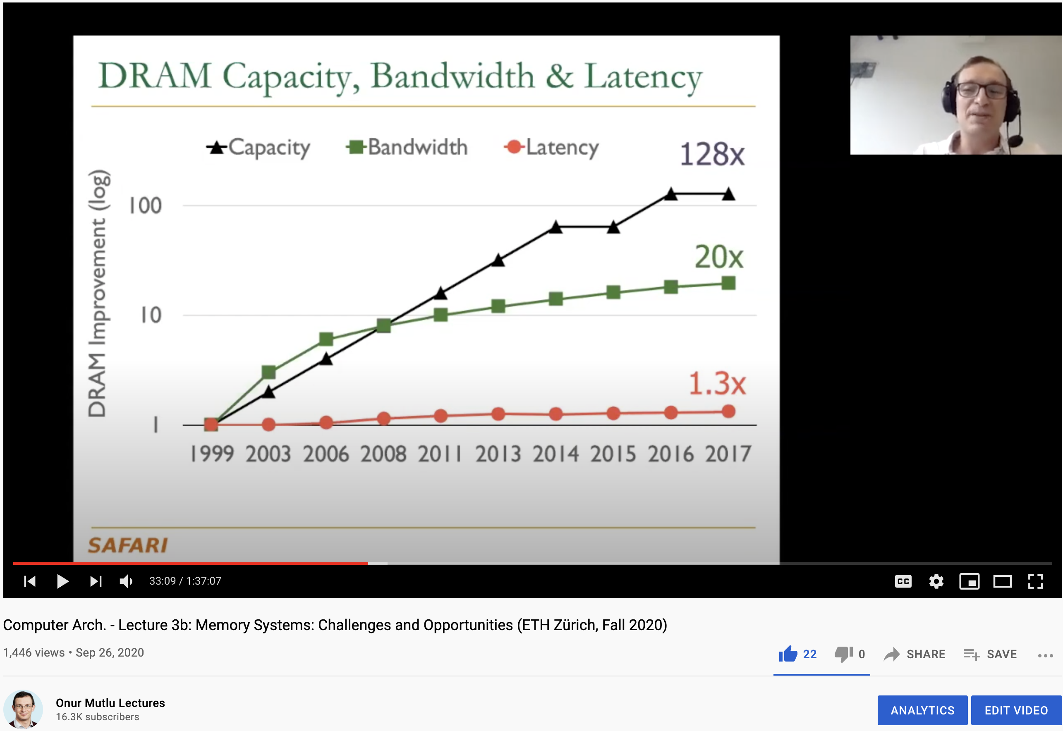
More on Memory Technologies
https://www.youtube.com/watch?v=pmLszWGmMGQ&list=PL5Q2soXY2Zi9xidyIgBxUz7xRPS-wisBN&index=29

Slide 22
A Bit on Flash Memory & SSDs
Flash memory was a very “doubtful” emerging technology
  for at least two decades
Proceedings of the IEEE, Sept. 2017
https://arxiv.org/pdf/1711.11427.pdf

Slide 23
A Flash Memory SSD Controller
Cai+, “Error Characterization, Mitigation, and Recovery in Flash Memory Based Solid State Drives,” Proc. IEEE 2017.
https://arxiv.org/pdf/1711.11427.pdf

Slide 24
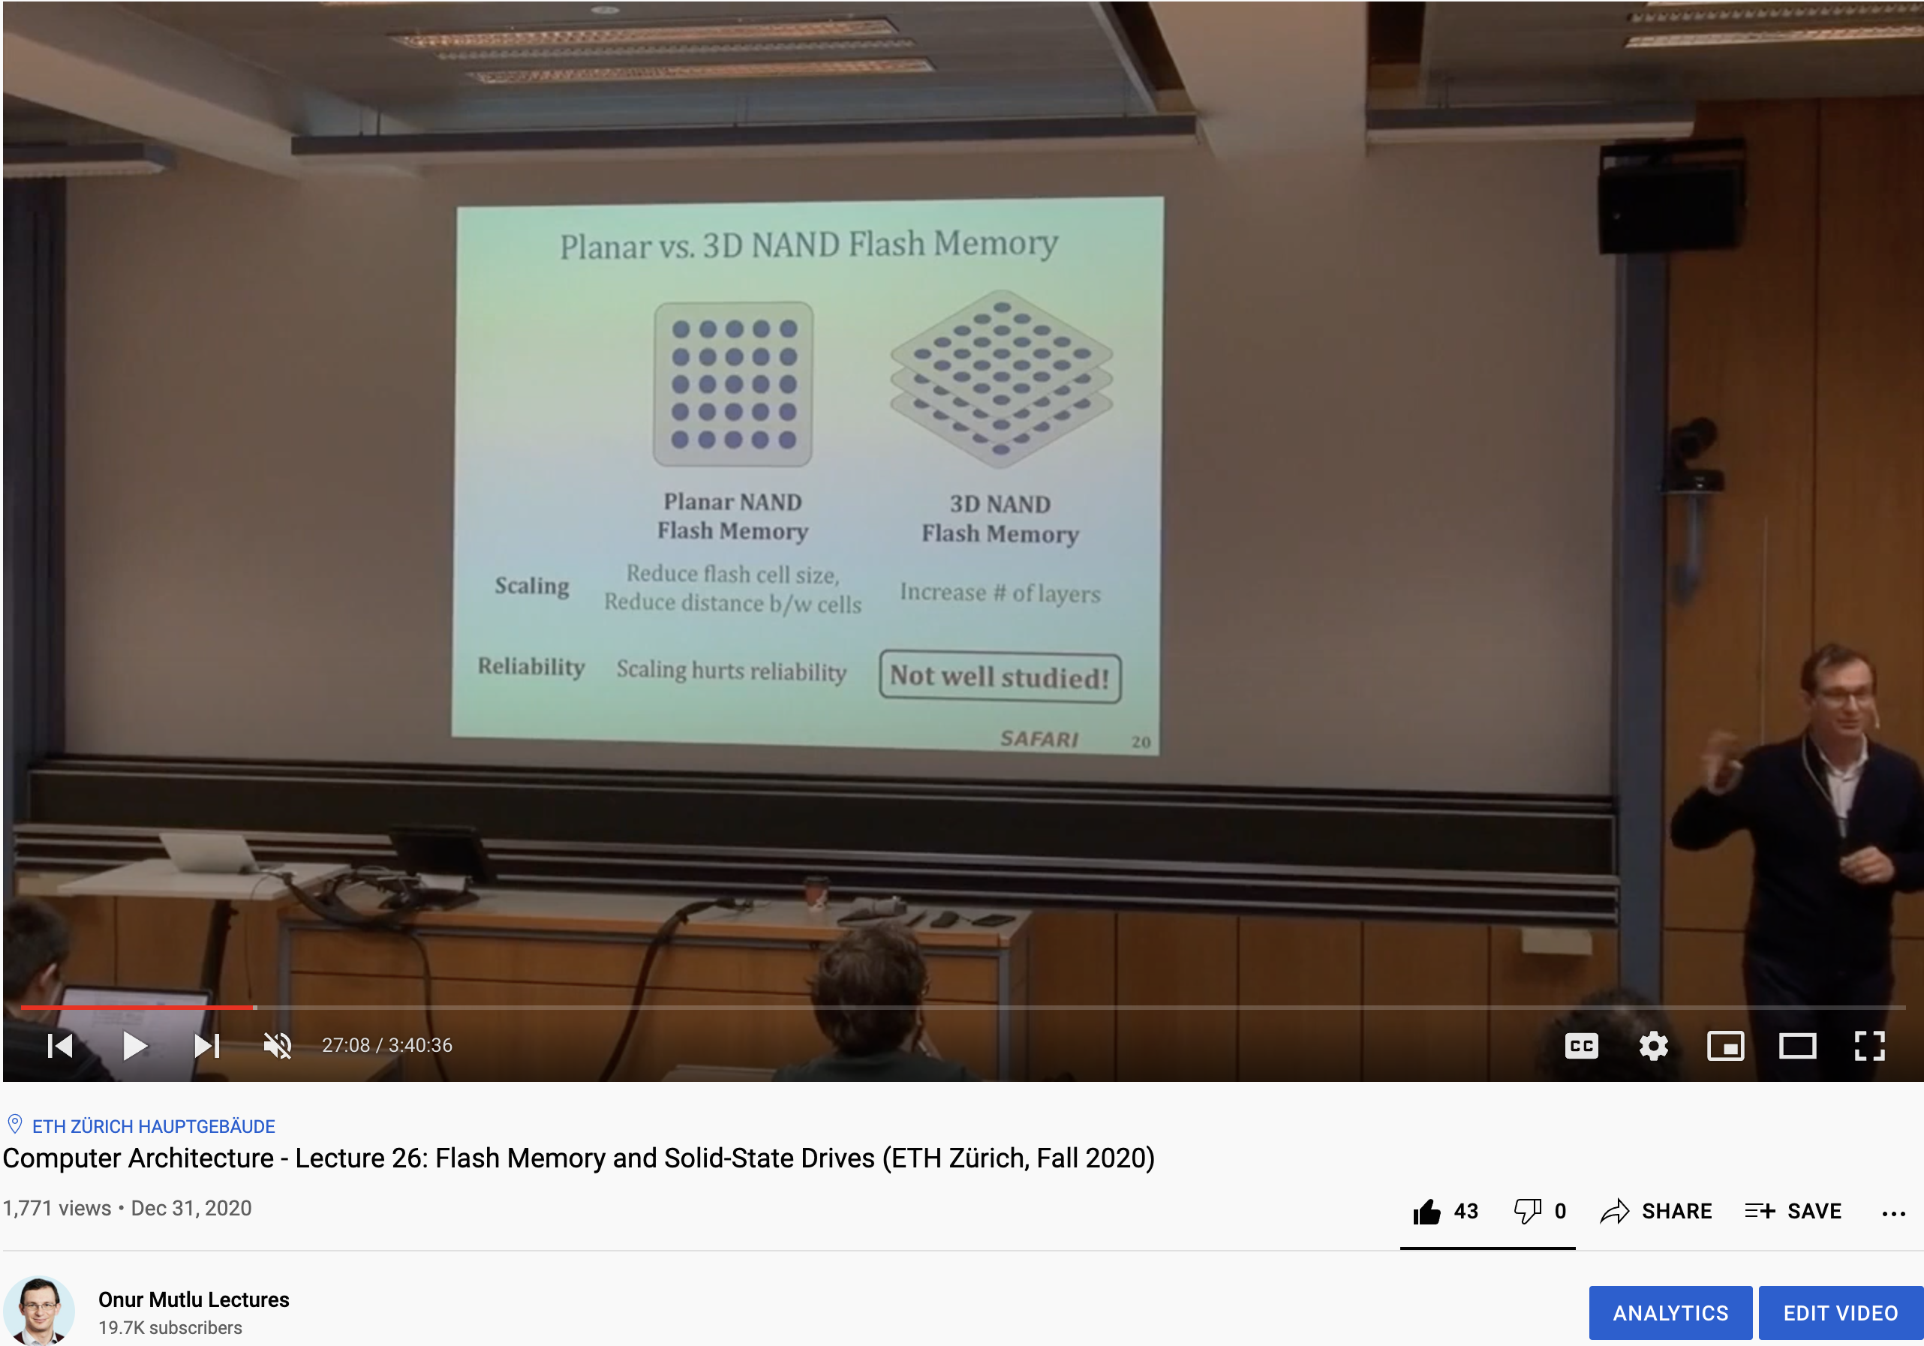
Lecture on Flash Memory & SSDs
https://www.youtube.com/watch?v=rninK6KWBeM&list=PL5Q2soXY2Zi9xidyIgBxUz7xRPS-wisBN&index=47

Slide 25
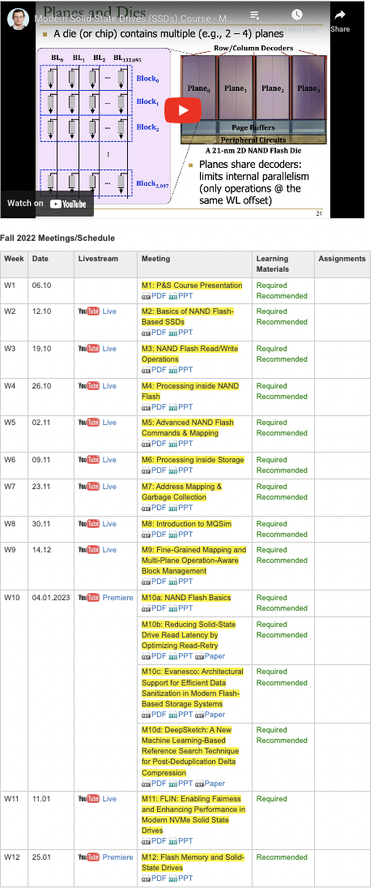
SSD Course (Spring 2023)
Spring 2023 Edition:
  https://safari.ethz.ch/projects_and_seminars/spring2023/doku.php?id=modern_ssds
Fall 2022 Edition:
  https://safari.ethz.ch/projects_and_seminars/fall2022/doku.php?id=modern_ssds
Youtube Livestream (Spring 2023):
  https://www.youtube.com/watch?v=4VTwOMmsnJY&list=PL5Q2soXY2Zi_8qOM5Icpp8hB2SHtm4z57&pp=iAQB
Youtube Livestream (Fall 2022):
  https://www.youtube.com/watch?v=hqLrd-Uj0aU&list=PL5Q2soXY2Zi9BJhenUq4JI5bwhAMpAp13&pp=iAQB
Project course
  Taken by Bachelor’s/Master’s students
  SSD Basics and Advanced Topics
  Hands-on research exploration
  Many research readings
https://www.youtube.com/onurmutlulectures

Slide 26
Lectures on Memory Technologies
Computer Architecture, Fall 2020, Lecture 15
  Emerging Memory Technologies (ETH, Fall 2020)
  https://www.youtube.com/watch?v=AlE1rD9G_YU&list=PL5Q2soXY2Zi9xidyIgBxUz7xRPS-wisBN&index=28
Computer Architecture, Fall 2020, Lecture 16a
  Opportunities & Challenges of Emerging Memory Tech (ETH, Fall 2020)
  https://www.youtube.com/watch?v=pmLszWGmMGQ&list=PL5Q2soXY2Zi9xidyIgBxUz7xRPS-wisBN&index=29
Computer Architecture, Fall 2020, Lecture 3b
  Memory Systems: Challenges & Opportunities (ETH, Fall 2020)
  https://www.youtube.com/watch?v=Q2FbUxD7GHs&list=PL5Q2soXY2Zi9xidyIgBxUz7xRPS-wisBN&index=6
https://www.youtube.com/onurmutlulectures

Slide 27
General Principle: Interleaving (Banking)
Interleaving (banking)
  Problem: a single monolithic large memory array takes long to access and does not enable multiple accesses in parallel
  Goal: Reduce the latency of memory array access and enable multiple accesses in parallel
  Idea: Divide a monolithic large array into multiple banks that can be accessed independently (in the same cycle or in consecutive cycles)
    Each bank is smaller than the entire memory storage
    Accesses to different banks can be overlapped
  A Key Issue: How do you map data to different banks? (i.e., how do you interleave data across banks?)
Notes:
We are not going to tackle the data mapping issue today. But you want to tackle this issue such that you can access a separate bank in every consecutive cycle ideally.

Slide 28
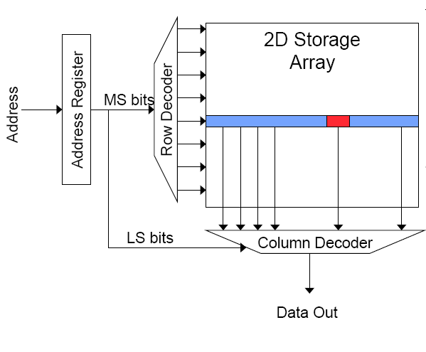
Memory Bank Organization and Operation
Read access sequence:
1. Decode row address & drive word-lines
2. Selected bits drive bit-lines
• Entire row read
3. Amplify row data
4. Decode column address & select subset of row
• Send to output
5. Precharge bit-lines
• For next access
Notes:
Memory bank organization and operation is similar between the two memory technologies (SRAM and DRAM)

Slide 29
Memory Banking
Memory is divided into banks that can be accessed independently; banks share address and data buses (to reduce memory chip pins)
Can start and complete one bank access per cycle
Can sustain N concurrent accesses if all N go to different banks
Bank
0
Bank
1
Bank
2
Bank
15
MDR
MAR
MDR
MAR
MDR
MAR
MDR
MAR
Data bus
Address bus
CPU
DDCA 2023 Lecture 19
https://www.youtube.com/watch?v=gkMaO3yJMz0&list=PL5Q2soXY2Zi-EImKxYYY1SZuGiOAOBKaf&index=24
Notes:
This picture resembles DRAM

Slide 30
Why Memory Hierarchy?
We want both fast and large
But we cannot achieve both with a single level of memory
Idea: Have multiple levels of storage (progressively bigger and slower as the levels are farther from the processor) and ensure most of the data the processor needs is kept in the fast(er) level(s)

Slide 31
Memory Hierarchy
Fundamental tradeoff
  Fast memory: small
  Large memory: slow
Idea: Memory hierarchy
Latency, cost, size,
bandwidth
Hard Disk
Main
Memory
(DRAM)
CPU
Cache
RF

Slide 32
Caching Basics: Exploit Temporal Locality
Idea: Store recently accessed data in automatically managed fast memory (called cache)
Anticipation: the data will be accessed again soon
Temporal locality principle
  Recently accessed data will be again accessed in the near future
  This is what Maurice Wilkes had in mind:
    Wilkes, “Slave Memories and Dynamic Storage Allocation,” IEEE Trans. On Electronic Computers, 1965.
    “The use is discussed of a fast core memory of, say 32000 words as a slave to a slower core memory of, say, one million words in such a way that in practical cases the effective access time is nearer that of the fast memory than that of the slow memory.”

Slide 33
Caching Basics: Exploit Spatial Locality
Idea: Store addresses adjacent to the recently accessed one in automatically managed fast memory
  Logically divide memory into equal size blocks
  Fetch to cache the accessed block in its entirety
Anticipation: nearby data will be accessed soon
Spatial locality principle
  Nearby data in memory will be accessed in the near future
    E.g., sequential instruction access, array traversal
  This is what IBM 360/85 implemented
    16 Kbyte cache with 64 byte blocks
    Liptay, “Structural aspects of the System/360 Model 85 II: the cache,” IBM Systems Journal, 1968.

Slide 34
A Note on Manual vs. Automatic Management
Manual: Programmer manages data movement across levels
  -- too painful for programmers on substantial programs
  “core” vs “drum” memory in the 50’s
  still done in some embedded processors (on-chip scratch pad SRAM in lieu of a cache)
Automatic: Hardware manages data movement across levels, transparently to the programmer
  ++ programmer’s life is easier
  simple heuristic: keep most recently used items in cache
  the average programmer doesn’t need to know about it
    You don’t need to know how big the cache is and how it works to write a “correct” program! (What if you want a “fast” program?)

Slide 35
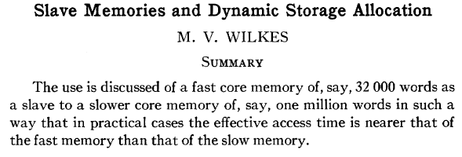
Automatic Management in Memory Hierarchy
Wilkes, “Slave Memories and Dynamic Storage Allocation,” IEEE Trans. On Electronic Computers, 1965.
“By a slave memory I mean one which automatically accumulates to itself words that come from a slower main memory, and keeps them available for subsequent use without it being necessary for the penalty of main memory access to be incurred again.”

Slide 36
Historical Aside: Other Cache Papers
Fotheringham, “Dynamic Storage Allocation in the Atlas Computer, Including an Automatic Use of a Backing Store,” CACM 1961.
  http://dl.acm.org/citation.cfm?id=366800
Bloom, Cohen, Porter, “Considerations in the Design of a Computer with High Logic-to-Memory Speed Ratio,” AIEE Gigacycle Computing Systems Winter Meeting, Jan. 1962.

Slide 37
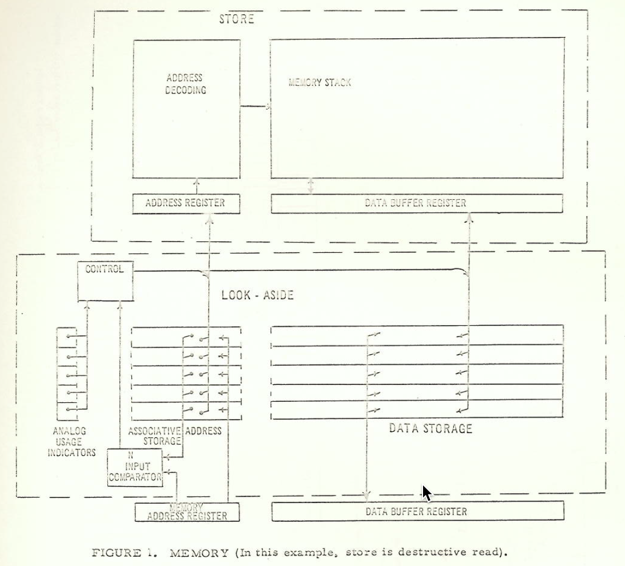
Cache in 1962 (Bloom, Cohen, Porter)

Slide 38
A Modern Memory Hierarchy
Register File
32 words, sub-nsec
L1 cache
~32 KB, ~nsec
L2 cache
512 KB ~ 1MB, many nsec
L3 cache,
.....
Main memory (DRAM),
GB, ~100 nsec
Swap Disk
100 GB, ~10 msec
manual/compiler
register spilling
Memory
Abstraction
Automatic
HW cache
management
automatic
demand
paging

Slide 39
The DRAM Subsystem

Slide 40
DRAM Subsystem Organization
Channel
DIMM
Rank
Chip
Bank
Row/Column

Slide 41
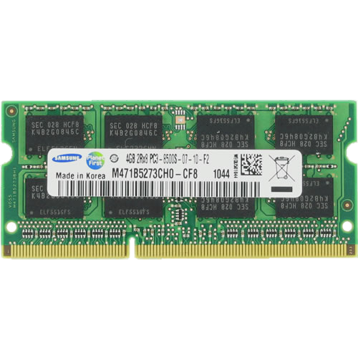
DRAM Organization
DRAM Rank
Subarray
Bitline
DRAM Cell
Bank
Wordline
Chip I/O
. . .
…
DRAM Row
…
…
…
…
…
Row Buffer
DRAM Chip
DRAM Bank
DRAM Subarray
Notes:
This is a DRAM module, used as the main memory in many computing systems. [CLICK]
Multiple chips in a DRAM module form a DRAM rank [CLICK]
Each chip contains multiple banks [CLICK]
Each bank is composed of multiple subarrays [CLICK]
And within each subarray, there is a two dimensional array of DRAM cells. [CLICK]
These cells are organized into rows that are selected using wordlines [CLICK]
And the cells are connected to a row buffer via bitlines [CLICK]

Slide 42
DRAM Operations
DRAM Subarray
ACTIVATE (ACT):
Fetch the row’s content
into the row buffer
1
1
1
1
1
Column Access (RD/WR):
Read/Write the target
column and drive to I/O
2
Row
Buffer
PRECHARGE (PRE):
Prepare the array
for a new ACTIVATE
3
I/O Circuitry
Notes:
Data is internally accessed in a row granularity. To access data, [CLICK]
the memory controller first needs to activate the row that contains the data and fetch the row’s content into the row buffer [CLICK]
Then, column accesses are serviced from the row buffer [CLICK]
Finally, the subarray needs to be precharged to get ready for the next row activation [CLICK]

Slide 43
DRAM Refresh
DRAM Subarray
DRAM cells leak charge over time
Fully
charged
1
1
1
1
time
DRAM Refresh
Row
Buffer
DRAM Refresh is the key maintenance operation
to avoid bit flips due to charge leakage
DRAM Refresh activates a row and precharges the bank
Problem: DRAM Refresh blocks accesses to the whole bank / rank
Notes:
DRAM cells leak charge over time [CLICK]
And need to be refreshed to avoid bit flips due to leakage [CLICK]
DRAM Refresh essentially activates a row [CLIcK] and precharges the bank after the cell charges are restored [CLICK]
Unfortunately, the whole DRAM bank or rank becomes unavailable during a refresh operation [CLICK]

Slide 44
Page Mode DRAM
A DRAM bank is a 2D array of cells: rows x columns
A “DRAM row” is also called a “DRAM page”
“Sense amplifiers” also called “row buffer”
Each address is a <row,column> pair
Access to a “closed row”
  Activate command opens row (placed into row buffer)
  Read/write command reads/writes column in the row buffer
  Precharge command closes the row and prepares the bank for next access
Access to an “open row”
  No need for activate command

Slide 45
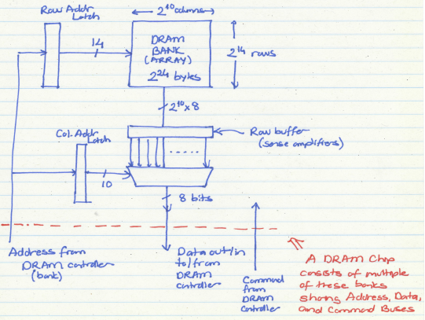
The DRAM Bank Structure

Slide 46
DRAM Bank Operation
Access Address:
(Row 0, Column 0)
Columns
(Row 0, Column 1)
(Row 0, Column 85)
(Row 1, Column 0)
Row address 0
Row address 1
Row decoder
Rows
Row Buffer
CONFLICT !
HIT
Row 1
HIT
Row 0
Empty
Column address 0
Column mux
Column address 0
Column address 1
Column address 85
Data

Slide 47
The DRAM Chip
Consists of multiple banks (8-16 are common today)
Banks share command/address/data buses
The chip itself has a narrow interface (4-16 bits per read)
Changing the number of banks, size of the interface (pins), whether or not command/address/data buses are shared has significant impact on DRAM system cost

Slide 48
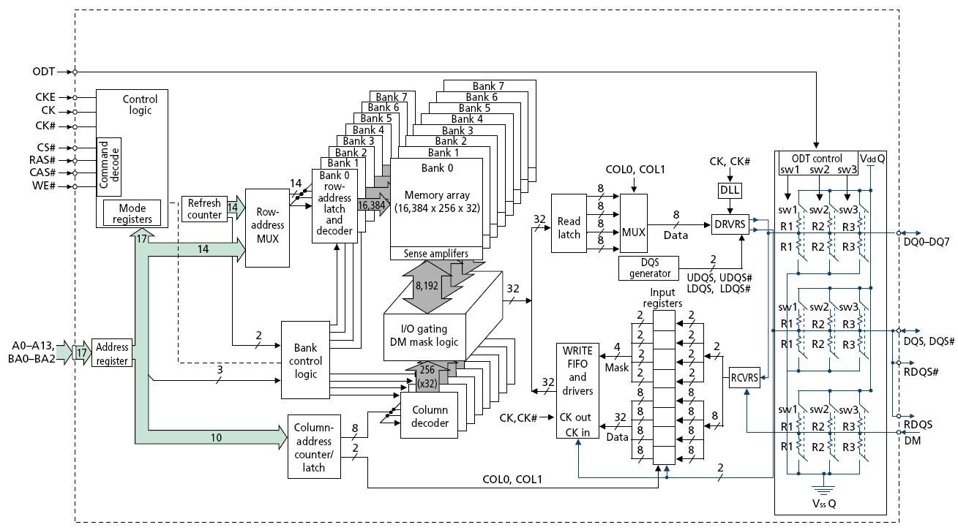
128M x 8-bit DRAM Chip

Slide 49
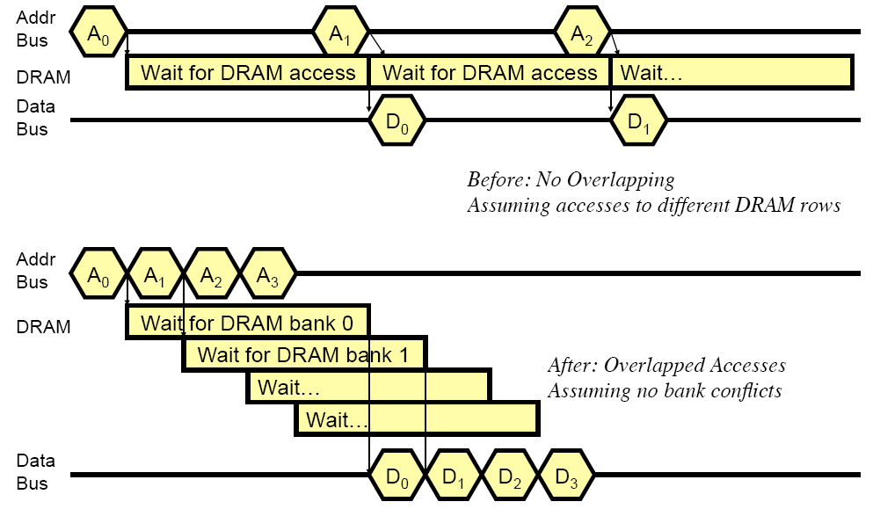
How Multiple Banks Help

Slide 50
Address Mapping (Single Channel)
Single-channel system with 8-byte memory bus
  2GB memory, 8 banks, 16K rows & 2K columns per bank
Row interleaving
  Consecutive rows of memory in consecutive banks
  Accesses to consecutive cache blocks serviced in a pipelined manner
Cache block interleaving
    Consecutive cache block addresses in consecutive banks
    64 byte cache blocks
    Accesses to consecutive cache blocks can be serviced in parallel
Row (14 bits)
Bank (3 bits)
Column (11 bits)
Byte in bus (3 bits)
Row (14 bits)
High Column
Bank (3 bits)
Low Col.
Byte in bus (3 bits)
8 bits
3 bits

Slide 51
Bank Mapping Randomization
DRAM controller can randomize the address mapping to banks so that bank conflicts are less likely
Reading:
  Rau, “Pseudo-randomly Interleaved Memory,” ISCA 1991.
3 bits
Column (11 bits)
Byte in bus (3 bits)
XOR
Bank index (3 bits)

Slide 52
Address Mapping (Multiple Channels)
C
Row (14 bits)
Bank (3 bits)
Column (11 bits)
Byte in bus (3 bits)
Where are consecutive cache blocks?
Row (14 bits)
C
Bank (3 bits)
Column (11 bits)
Byte in bus (3 bits)
Row (14 bits)
Bank (3 bits)
C
Column (11 bits)
Byte in bus (3 bits)
Row (14 bits)
Bank (3 bits)
Column (11 bits)
C
Byte in bus (3 bits)
C
Row (14 bits)
High Column
Bank (3 bits)
Low Col.
Byte in bus (3 bits)
8 bits
3 bits
Row (14 bits)
C
High Column
Bank (3 bits)
Low Col.
Byte in bus (3 bits)
8 bits
3 bits
Row (14 bits)
High Column
C
Bank (3 bits)
Low Col.
Byte in bus (3 bits)
8 bits
3 bits
Row (14 bits)
High Column
Bank (3 bits)
C
Low Col.
Byte in bus (3 bits)
8 bits
3 bits
Row (14 bits)
High Column
Bank (3 bits)
Low Col.
C
Byte in bus (3 bits)
8 bits
3 bits

Slide 53
Interaction with Virtual→Physical Mapping
Operating System influences where an address maps to in DRAM
Operating system can influence which bank/channel/rank a virtual page is mapped to.
It can perform page coloring to
  Minimize bank conflicts
  Minimize inter-application interference [Muralidhara+ MICRO’11]
  Minimize latency in the network [Das+ HPCA’13]
Virtual Page number (52 bits)
Page offset (12 bits)
VA
Physical Frame number (19 bits)
Page offset (12 bits)
PA
Row (14 bits)
Bank (3 bits)
Column (11 bits)
Byte in bus (3 bits)
PA

Slide 54
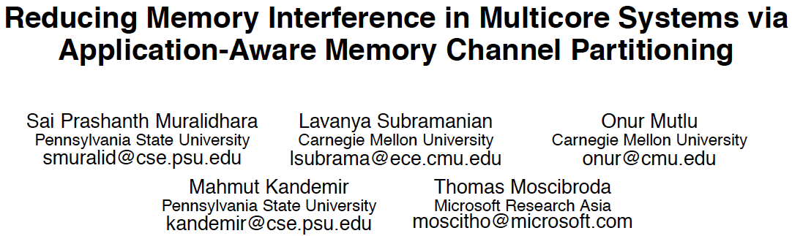
Memory Channel Partitioning
Sai Prashanth Muralidhara, Lavanya Subramanian, Onur Mutlu, Mahmut Kandemir, and Thomas Moscibroda,
"Reducing Memory Interference in Multicore Systems via Application-Aware Memory Channel Partitioning"
Proceedings of the 44th International Symposium on Microarchitecture (MICRO), Porto Alegre, Brazil, December 2011. Slides (pptx)

Slide 55
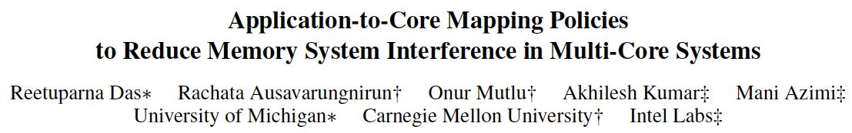
Application-to-Core Mapping
Reetuparna Das, Rachata Ausavarungnirun, Onur Mutlu, Akhilesh Kumar, and Mani Azimi,
"Application-to-Core Mapping Policies to Reduce Memory System Interference in Multi-Core Systems"
Proceedings of the 19th International Symposium on High-Performance Computer Architecture (HPCA), Shenzhen, China, February 2013. Slides (pptx)

Slide 56
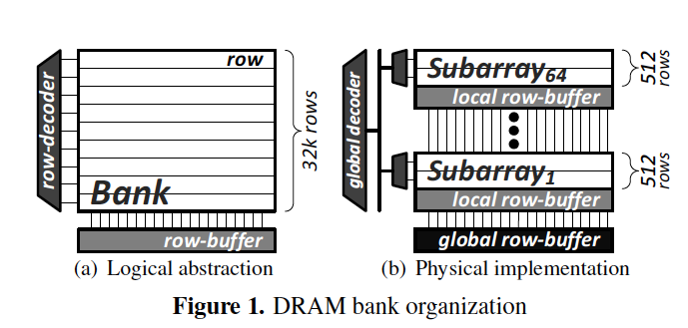
On Reducing Bank Conflicts
Read Sections 1 through 4 of:
  Kim et al., “A Case for Exploiting Subarray-Level Parallelism in DRAM,” ISCA 2012.

Slide 57
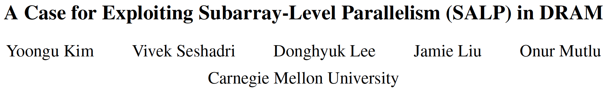
Subarray Level Parallelism
Yoongu Kim, Vivek Seshadri, Donghyuk Lee, Jamie Liu, and Onur Mutlu,
"A Case for Exploiting Subarray-Level Parallelism (SALP) in DRAM"
Proceedings of the 39th International Symposium on Computer Architecture (ISCA), Portland, OR, June 2012. Slides (pptx)

Slide 58
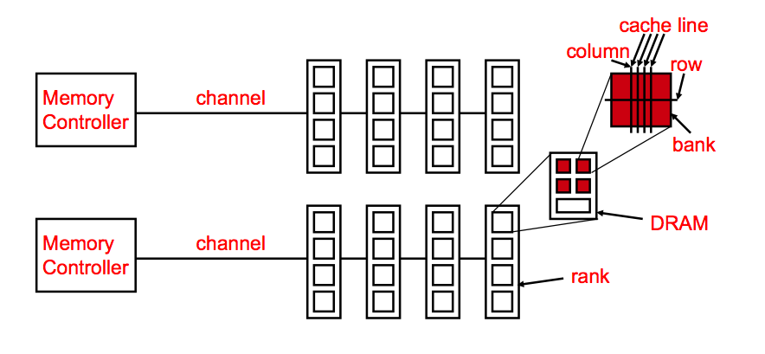
Generalized Memory Structure

Slide 59
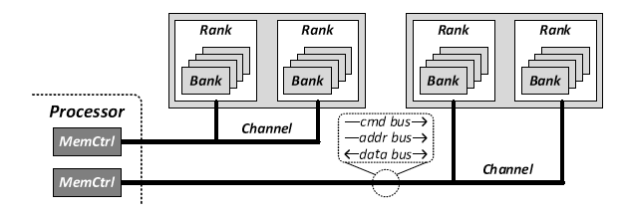
Generalized Memory Structure
Kim+, “A Case for Exploiting Subarray-Level Parallelism in DRAM,” ISCA 2012.
Lee+, “Decoupled Direct Memory Access,” PACT 2015.
Notes:
What is a channel? Cmd bus + addr bus + bidirectional data bus. These are controlled by the memory controller.
Ranks and banks share cmd/addr/data buses
You cannot have a ton of memory channels: each connection/memory controller costs you pins. Pins are very costly. You cannot very easily have 1 million pins going outside of the package over a PCB in a system.
If you are making connections inside a chip or on top of a chip (a.k.a 3D-stacking) these technologies allow you to implement more channels [next slide]

Slide 60
The DRAM Subsystem
A Top-Down View

Slide 61
DRAM Subsystem Organization
Channel
DIMM
Rank
Chip
Bank
Row/Column

Slide 62
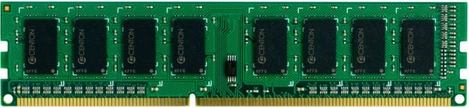
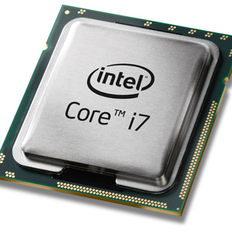
The DRAM Subsystem
“Channel”
DIMM (Dual in-line memory module)
Processor
Memory channel
Memory channel
Notes:
- Today’s processor can have multiple channels

Slide 63
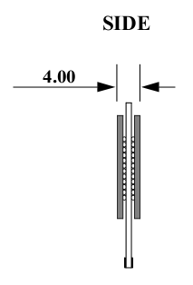
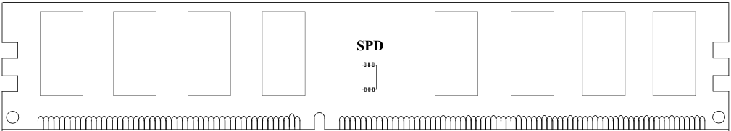
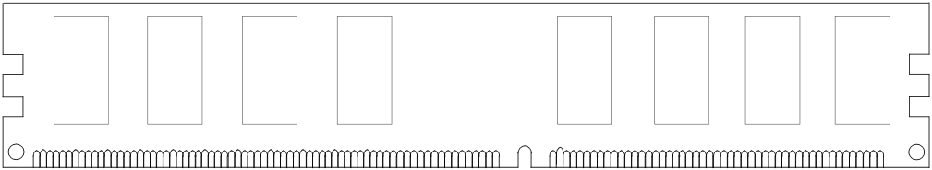
Breaking down a DIMM (module)
DIMM (Dual in-line memory module)
Side view
Front of DIMM
Back of DIMM

Slide 64
Breaking down a DIMM (module)
DIMM (Dual in-line memory module)
Side view
Front of DIMM
Back of DIMM
Rank 0: collection of 8 chips
Rank 1

Slide 65
Rank
Rank 0 (Front)
Rank 1 (Back)
<0:63>
<0:63>
Addr/Cmd
CS <0:1>
Data <0:63>
Memory channel

Slide 66
Breaking down a Rank
. . .
Chip 0
Chip 1
Chip 7
Rank 0
<0:63>
<0:7>
<8:15>
<56:63>
Data <0:63>
Notes:
Why do we connect chips like this in a rank? Each chip is essentially pin-limited. You distribute the data pins of the module like such. Memory today is very COST-DOMINATED

Slide 67
Breaking down a Chip
8 banks
Chip 0
Bank 0
<0:7>
<0:7>
<0:7>
...
<0:7>
<0:7>
Notes:
After describing the figure: Bank-level parallelism → send one command to a bank to retrieve 8 bits at some point in time, immediately in the next cycle send a command to another bank.

Slide 68
Breaking down a Bank
2kB
1B (column)
row 32k-1
Bank 0
...
row 0
<0:7>
Row-buffer
1B
1B
1B
...
<0:7>

Slide 69
Digging Deeper: DRAM Bank Operation
Access Address:
(Row 0, Column 0)
Columns
This view of a bank is an abstraction.
Internally, a bank consists of many cells (transistors & capacitors) and other structures that enable access
to cells
(Row 0, Column 1)
(Row 0, Column 85)
(Row 1, Column 0)
Row address 0
Row address 1
Row decoder
Rows
Row Buffer
CONFLICT !
HIT
Row 1
HIT
Row 0
Empty
Column address 0
Column mux
Column address 0
Column address 1
Column address 85
Data

Slide 70
A DRAM Bank Internally Has Sub-Banks
Kim et al., “A Case for Exploiting Subarray-Level Parallelism in DRAM,” ISCA 2012.
Notes:
Left picture is correct from the perspective of the memory controller
Right picture is actually what it looks like: [key idea] Distance to sense amplifier is very short
Global row buffer is actually smaller than the local row buffer
Key takeaway; divide into smaller arrays to keep latencies smaller

Slide 71
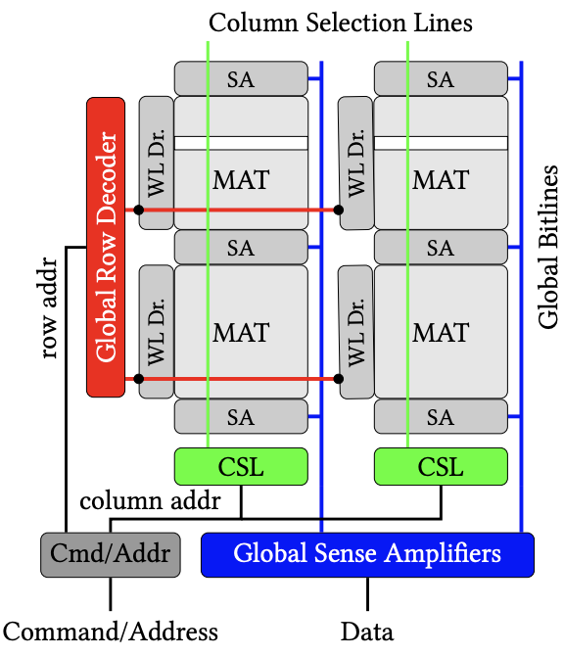
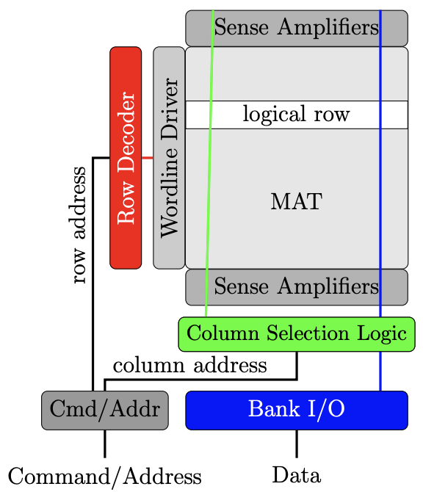
Another View of a DRAM Bank
Logical Abstraction
Physical View
Seshadri+, “In-DRAM Bulk Bitwise Execution Engine,” ADCOM 2020.
Notes:
You thought the array dividing recursion might have ended there but we also have MATs inside subarrays and we won’t cover these in detail.
I promise MATs are where the recursion ends (for now).

Slide 72
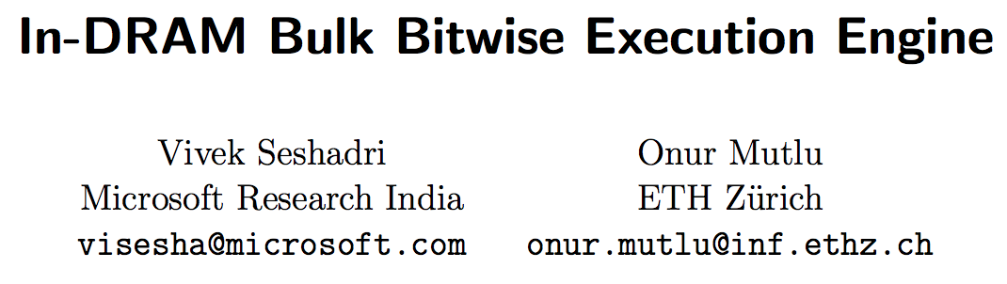
More on DRAM Basics & Organization
Vivek Seshadri and Onur Mutlu,
"In-DRAM Bulk Bitwise Execution Engine"
Invited Book Chapter in Advances in Computers, 2020.
[Preliminary arXiv version]
See Section 2 for comprehensive DRAM Background
https://arxiv.org/pdf/1905.09822.pdf

Slide 73
DRAM Subsystem Organization
Channel
DIMM
Rank
Chip
Bank
Row/Column

Slide 74
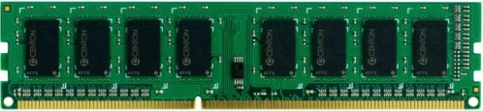


Example: Transferring a cache block
Physical memory space
0xFFFF…F
Channel 0
...
DIMM 0
Mapped to
0x40
Rank 0
64B
cache block
0x00

Slide 75
Example: Transferring a cache block
Physical memory space
Chip 0
Chip 1
Rank 0
Chip 7
0xFFFF…F
. . .
...
<0:7>
<8:15>
<56:63>
0x40
64B
cache block
Data <0:63>
0x00

Slide 76
Example: Transferring a cache block
Physical memory space
Chip 0
Chip 1
Rank 0
Chip 7
0xFFFF…F
. . .
Row 0
Col 0
...
<0:7>
<8:15>
<56:63>
0x40
64B
cache block
Data <0:63>
0x00

Slide 77
Example: Transferring a cache block
Physical memory space
Chip 0
Chip 1
Rank 0
Chip 7
0xFFFF…F
. . .
Row 0
Col 0
...
<0:7>
<8:15>
<56:63>
0x40
64B
cache block
Data <0:63>
8B
0x00
8B

Slide 78
Example: Transferring a cache block
Physical memory space
Chip 0
Chip 1
Rank 0
Chip 7
0xFFFF…F
. . .
Row 0
Col 1
...
<0:7>
<8:15>
<56:63>
0x40
64B
cache block
Data <0:63>
8B
0x00

Slide 79
Example: Transferring a cache block
Physical memory space
Chip 0
Chip 1
Rank 0
Chip 7
0xFFFF…F
. . .
Row 0
Col 1
...
<0:7>
<8:15>
<56:63>
0x40
8B
64B
cache block
Data <0:63>
8B
0x00
8B

Slide 80
Example: Transferring a cache block
Physical memory space
Chip 0
Chip 1
Rank 0
Chip 7
0xFFFF…F
. . .
Row 0
Col 1
...
<0:7>
<8:15>
<56:63>
0x40
8B
64B
cache block
Data <0:63>
8B
0x00
A 64B cache block takes 8 I/O cycles to transfer.
During the process, 8 columns are read sequentially.
Notes:
This operation is called a data transfer burst. You send a single READ command and receive data in a burst of 8 data transfer beats. Why: 1) pin limitations 2) fewer read commands every command clock cycle so that you can issue other commands to other banks

Slide 81
Simulating Memory

Slide 82
Ramulator: A Fast and Extensible DRAM Simulator
[IEEE Comp Arch Letters’15]

Slide 83
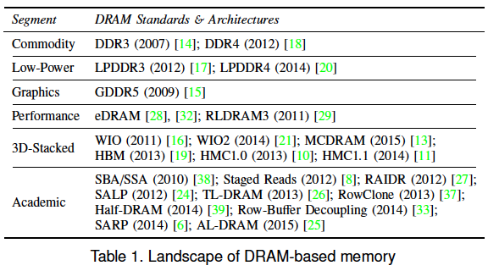
Ramulator Motivation
DRAM and Memory Controller landscape is changing
Many new and upcoming standards
Many new controller designs
A fast and easy-to-extend simulator is very much needed

Slide 84
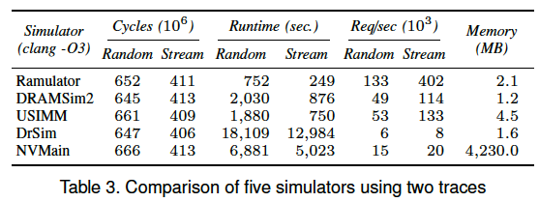
Ramulator
Provides out-of-the box support for many DRAM standards:
  DDR3/4, LPDDR3/4, GDDR5, WIO1/2, HBM, plus new proposals (SALP, AL-DRAM, TLDRAM, RowClone, and SARP)
~2.5X faster than fastest open-source simulator
Modular and extensible to different standards

Slide 85
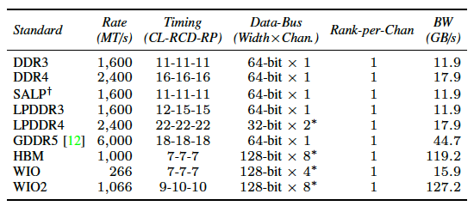
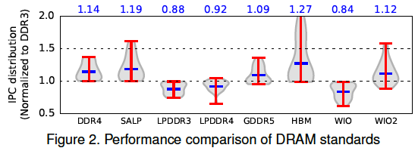
Case Study: Comparison of DRAM Standards
Across 22 workloads, simple CPU model

Slide 86
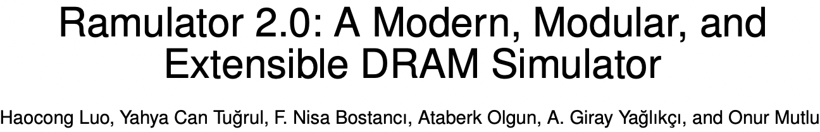
Ramulator 2.0
Haocong Luo, Yahya Can Tugrul, F. Nisa Bostanci, Ataberk Olgun, A. Giray Yaglikci, and Onur Mutlu,
"Ramulator 2.0: A Modern, Modular, and Extensible DRAM Simulator"
Preprint on arxiv, August 2023.
[arXiv version]
[Ramulator 2.0 Source Code]
https://arxiv.org/pdf/2308.11030.pdf
https://github.com/CMU-SAFARI/ramulator2

Slide 87
Optional Assignment: Ramulator 2.0
Review the Ramulator 2.0 paper
  Email me your review (omutlu@gmail.com)
Download and run Ramulator 2.0
  Compare DDR4, LPDDR5, HBM2 for benchmarks of your choice (provided in Ramulator repository)
  Email me your report (omutlu@gmail.com)
This may help you get into memory systems research quickly

Slide 88
On Virtual Memory

Slide 89
Access Control & Protection Mechanisms
Are based on virtual memory (VM), invented in 1950s
VM has not changed much even after decades of technology scaling and memory system improvements
VM causes large performance problems and is responsible for large complexity, power, energy
VM is poor for fine-grained security and access control
VM hinders innovation in heterogeneous (accelerator) systems and new architectures (e.g., processing near data)
It is time to rethink virtual memory

Slide 90
Virtual Memory: Parting Thoughts
Virtual Memory is one of the most successful examples of
  architectural support for programmers
  how to partition work between hardware and software
  hardware/software cooperation
  programmer/architect tradeoff
Going forward: How does virtual memory fare and scale into the future? Five key trends:
  Increasing, huge physical memory sizes (local & remote)
  Hybrid physical memory systems (DRAM + NVM + SSD)
  Many accelerators in the system accessing physical memory
  Virtualized systems (hypervisors, software virtualization, local and remote memories)
  Processing in memory systems – near-data accelerators

Slide 91
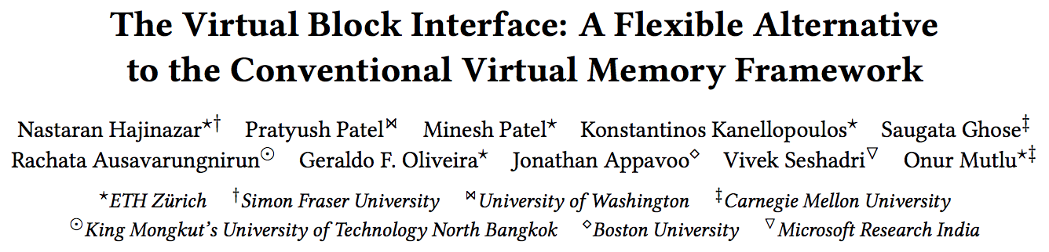
Rethinking Virtual Memory
Nastaran Hajinazar, Pratyush Patel, Minesh Patel, Konstantinos Kanellopoulos, Saugata Ghose, Rachata Ausavarungnirun, Geraldo Francisco de Oliveira Jr., Jonathan Appavoo, Vivek Seshadri, and Onur Mutlu,
"The Virtual Block Interface: A Flexible Alternative to the Conventional Virtual Memory Framework"
Proceedings of the 47th International Symposium on Computer Architecture (ISCA), Virtual, June 2020.
[Slides (pptx) (pdf)]
[Lightning Talk Slides (pptx) (pdf)]
[ARM Research Summit Poster (pptx) (pdf)]
[Talk Video (26 minutes)]
[Lightning Talk Video (3 minutes)]
[Lecture Video (43 minutes)]
https://people.inf.ethz.ch/omutlu/pub/VBI-virtual-block-interface_isca20.pdf

Slide 92
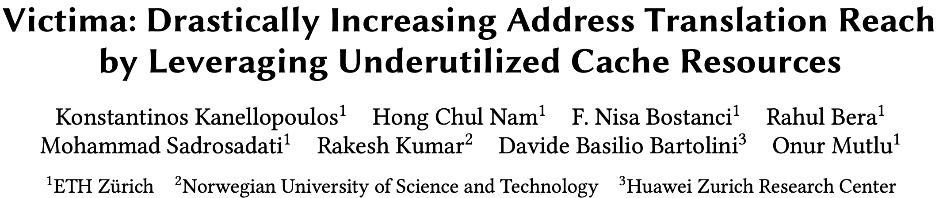
Better Virtual Memory (I)
Konstantinos Kanellopoulos, Hong Chul Nam, F. Nisa Bostanci, Rahul Bera, Mohammad Sadrosadati, Rakesh Kumar, Davide Basilio Bartolini, and Onur Mutlu,
"Victima: Drastically Increasing Address Translation Reach by Leveraging Underutilized Cache Resources"
Proceedings of the 56th International Symposium on Microarchitecture (MICRO), Toronto, ON, Canada, November 2023.
[Slides (pptx) (pdf)]
[arXiv version]
[Victima Source Code (Officially Artifact Evaluated with All Badges)]
Officially artifact evaluated as available, functional, reusable and reproducible.
Distinguished artifact award at MICRO 2023.
https://arxiv.org/pdf/2310.04158

Slide 93
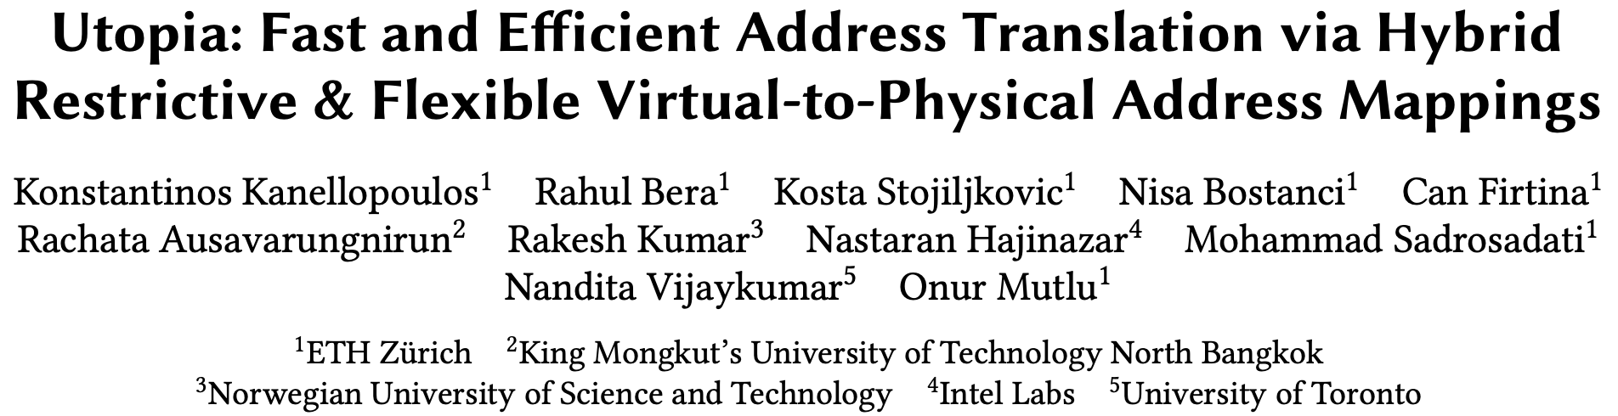
Better Virtual Memory (II)
Konstantinos Kanellopoulos, Rahul Bera, Kosta Stojiljkovic, Nisa Bostanci, Can Firtina, Rachata Ausavarungnirun, Rakesh Kumar, Nastaran Hajinazar, Mohammad Sadrosadati, Nandita Vijaykumar, and Onur Mutlu,
"Utopia: Fast and Efficient Address Translation via Hybrid Restrictive & Flexible Virtual-to-Physical Address Mappings"
Proceedings of the 56th International Symposium on Microarchitecture (MICRO), Toronto, ON, Canada, November 2023.
[Slides (pptx) (pdf)]
[arXiv version]
[Utopia Source Code]
https://arxiv.org/abs/2211.12205

Slide 94
Memory Systems and Memory-Centric Computing
Topic 1.2: Memory Fundamentals
Onur Mutlu
omutlu@gmail.com
https://people.inf.ethz.ch/omutlu
16 July 2024
HiPEAC ACACES Summer School 2024

