Slide 1


Memory Systems and Memory-Centric Computing
Topic 4: ML/AI-Driven Memory Systems
Onur Mutlu
omutlu@gmail.com
https://people.inf.ethz.ch/omutlu
19 July 2024
HiPEAC ACACES Summer School 2024

Slide 2
What Will You Learn in This Course?
Memory Systems and Memory-Centric Computing
  July 15-19, 2024
Topic 1: Memory Trends, Challenges, Opportunities, Basics
Topic 2: Memory-Centric Computing
Topic 3: Memory Robustness: RowHammer, RowPress & Beyond
Topic 4: Machine Learning Driven Memory Systems
Topic 5 (another course): Architectures for Genomics and ML
Topic 6 (unlikely): Non-Volatile Memories and Storage
Topic 7 (unlikely): Memory Latency, Predictability & QoS
Major Overview Reading:
  Mutlu et al., “A Modern Primer on Processing in Memory,” Book Chapter on Emerging Computing and Devices, 2022.

Slide 3
Data-Driven (Self-Optimizing) Architectures

Slide 4
System Architecture Design Today
Human-driven
  Humans design the policies (how to do things)
Many (too) simple, short-sighted policies all over the system
No automatic data-driven policy learning
(Almost) no learning: cannot take lessons from past actions
Can we design
fundamentally intelligent architectures?

Slide 5
An Intelligent Architecture
Data-driven
  Machine learns the “best” policies (how to do things)
Sophisticated, workload-driven, changing, far-sighted policies
Automatic data-driven policy learning
All controllers are intelligent data-driven agents
We need to rethink design
(of all controllers)

Slide 6
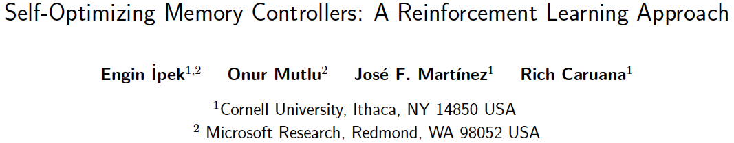
Self-Optimizing Memory Controllers
Engin Ipek, Onur Mutlu, José F. Martínez, and Rich Caruana,
"Self Optimizing Memory Controllers: A Reinforcement Learning Approach"
Proceedings of the 35th International Symposium on Computer Architecture (ISCA), pages 39-50, Beijing, China, June 2008. Selected to the ISCA-50 25-Year Retrospective Issue covering 1996-2020 in 2023 (Retrospective (pdf) Full Issue).

Slide 7
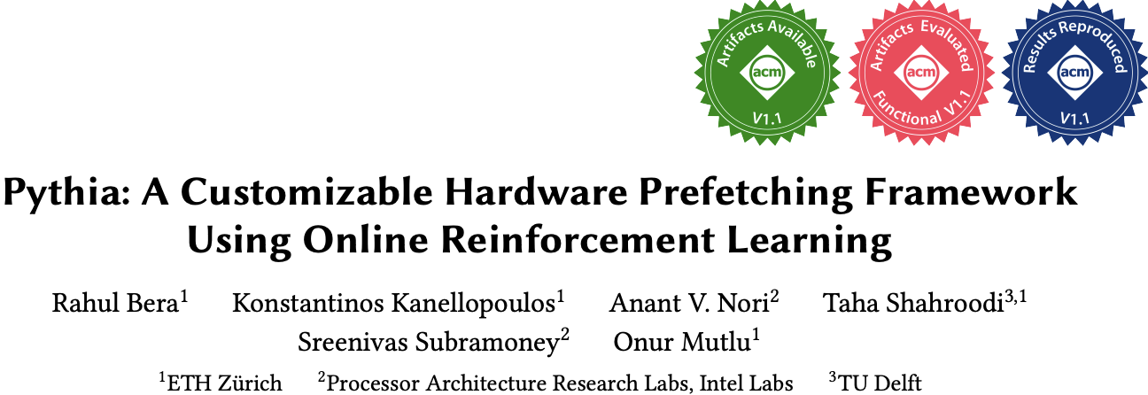
Self-Optimizing Memory Prefetchers
Rahul Bera, Konstantinos Kanellopoulos, Anant Nori, Taha Shahroodi, Sreenivas Subramoney, and Onur Mutlu,
"Pythia: A Customizable Hardware Prefetching Framework Using Online Reinforcement Learning"
Proceedings of the 54th International Symposium on Microarchitecture (MICRO), Virtual, October 2021.
[Slides (pptx) (pdf)]
[Short Talk Slides (pptx) (pdf)]
[Lightning Talk Slides (pptx) (pdf)]
[Talk Video (20 minutes)]
[Lightning Talk Video (1.5 minutes)]
[Pythia Source Code (Officially Artifact Evaluated with All Badges)]
[arXiv version]
Officially artifact evaluated as available, reusable and reproducible.
https://arxiv.org/pdf/2109.12021.pdf

Slide 8
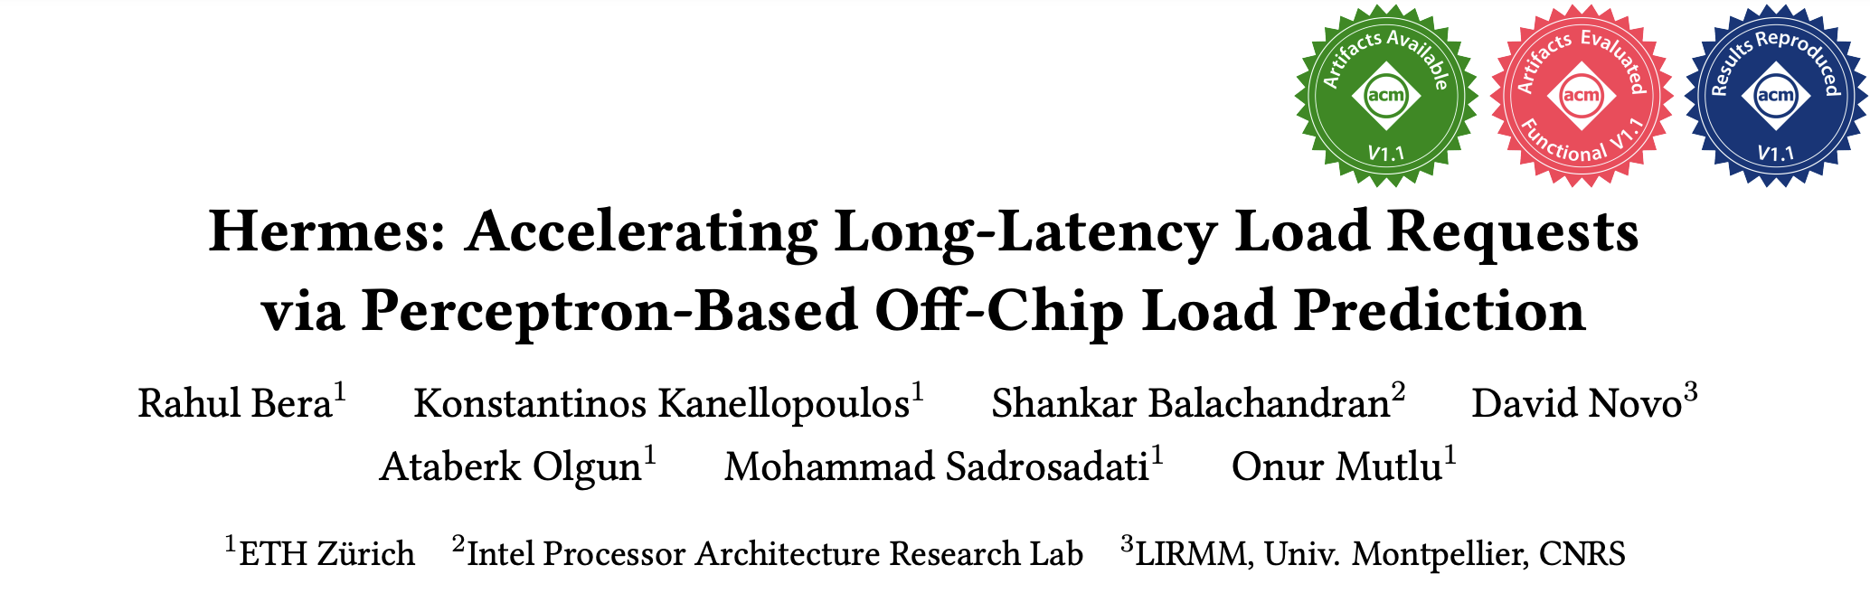
Learning-Based Off-Chip Load Predictors
Rahul Bera, Konstantinos Kanellopoulos, Shankar Balachandran, David Novo, Ataberk Olgun, Mohammad Sadrosadati, and Onur Mutlu,
"Hermes: Accelerating Long-Latency Load Requests via Perceptron-Based Off-Chip Load Prediction"
Proceedings of the 55th International Symposium on Microarchitecture (MICRO), Chicago, IL, USA, October 2022.
[Slides (pptx) (pdf)]
[Longer Lecture Slides (pptx) (pdf)]
[Talk Video (12 minutes)]
[Lecture Video (25 minutes)]
[arXiv version]
[Source Code (Officially Artifact Evaluated with All Badges)]
Officially artifact evaluated as available, reusable and reproducible.
Best paper award at MICRO 2022.
https://arxiv.org/pdf/2209.00188.pdf

Slide 9
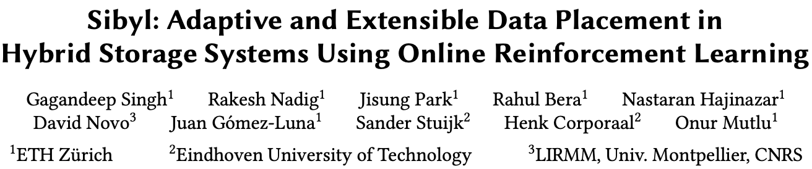
Self-Optimizing Hybrid SSD Controllers
Gagandeep Singh, Rakesh Nadig, Jisung Park, Rahul Bera, Nastaran Hajinazar, David Novo, Juan Gomez-Luna, Sander Stuijk, Henk Corporaal, and Onur Mutlu,
"Sibyl: Adaptive and Extensible Data Placement in Hybrid Storage Systems Using Online Reinforcement Learning"
Proceedings of the 49th International Symposium on Computer Architecture (ISCA), New York, June 2022.
[Slides (pptx) (pdf)]
[arXiv version]
[Sibyl Source Code]
[Talk Video (16 minutes)]
https://arxiv.org/pdf/2205.07394.pdf

Slide 10
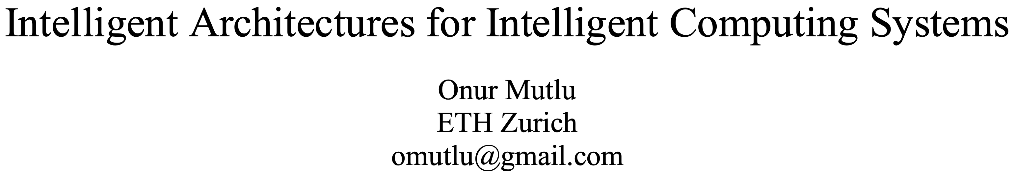
A Blueprint for Fundamentally Better Architectures
Onur Mutlu,
"Intelligent Architectures for Intelligent Computing Systems"
Invited Paper in Proceedings of the Design, Automation, and Test in Europe Conference (DATE), Virtual, February 2021.
[Slides (pptx) (pdf)]
[IEDM Tutorial Slides (pptx) (pdf)]
[Short DATE Talk Video (11 minutes)]
[Longer IEDM Tutorial Video (1 hr 51 minutes)]

Slide 11
Fundamentally Better Architectures
Data-centric
Data-driven
Data-aware

Slide 12
Pythia: Prefetching using
Reinforcement Learning

Slide 13
Self-Optimizing Memory Prefetchers
Rahul Bera, Konstantinos Kanellopoulos, Anant Nori, Taha Shahroodi, Sreenivas Subramoney, and Onur Mutlu,
"Pythia: A Customizable Hardware Prefetching Framework Using Online Reinforcement Learning"
Proceedings of the 54th International Symposium on Microarchitecture (MICRO), Virtual, October 2021.
[Slides (pptx) (pdf)]
[Short Talk Slides (pptx) (pdf)]
[Lightning Talk Slides (pptx) (pdf)]
[Talk Video (20 minutes)]
[Lightning Talk Video (1.5 minutes)]
[Pythia Source Code (Officially Artifact Evaluated with All Badges)]
[arXiv version]
Officially artifact evaluated as available, reusable and reproducible.
https://arxiv.org/pdf/2109.12021.pdf

Slide 14






Pythia
A Customizable Hardware Prefetching Framework Using Online Reinforcement Learning
Rahul Bera, Konstantinos Kanellopoulos, Anant V. Nori,
Taha Shahroodi, Sreenivas Subramoney, Onur Mutlu
https://github.com/CMU-SAFARI/Pythia
Notes:
Hi I am Rahul. Today, I’m going to present our work “…”
This work is done by researchers from SAFARI research group at ETH Zurich, in collaboration with Intel Labs and TU Delft.

Slide 15

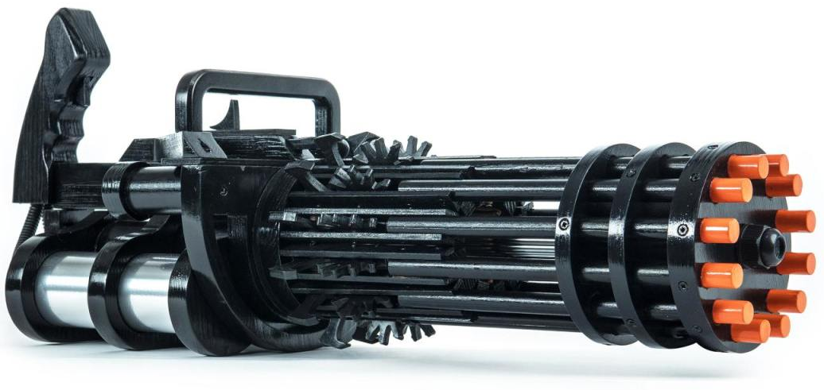

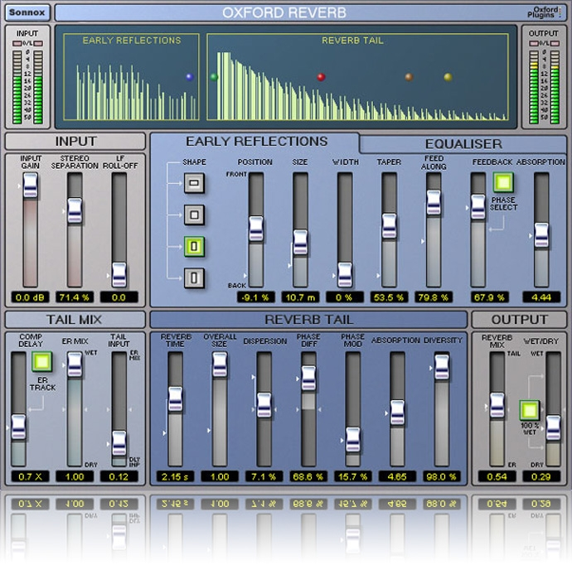


1
2
3
Mainly use one program context info. for prediction
Lack inherent system awareness
Lack in-silicon customizability
Why do prefetchers not perform well?
Notes:
We analyze many prior prefetchers and observe three key shortcomings that significantly limits their performance.
[CLICK] First, they use mainly a single program context for prefetch prediction
[CLICK] Second, they lack system awareness
[CLICK] Third, they lack in-silicon customizability

Slide 16


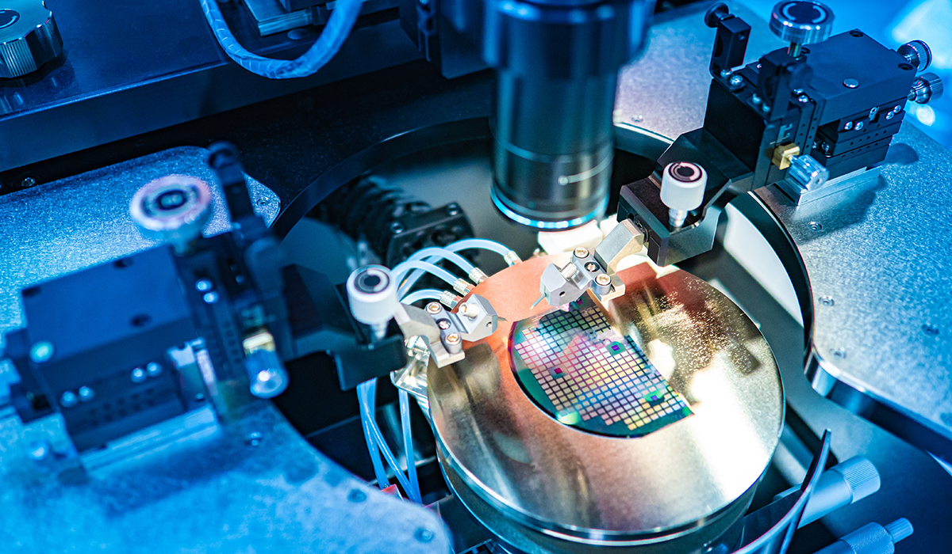
Lack of In-silicon Customizability
Feature statically selected at design time
  Rigid hardware designed specifically to exploit that feature
No way to change program feature and/or change prefetcher’s objective in silicon
  Cannot adapt to a wide range of workload demands
Design from scratch
Verify
Fabricate
Notes:
The third key shortcoming is that, all prior prefetcher lack in-silicon customizability.
These prefetchers statically selects the feature to exploit at design time and design a rigid hardware to specifically …
[CLICK] There is no way …
In order to exploit a new program feature, architects need to design a prefetcher from scratch …
[CLICK] and this cycle goes on for every new prefetcher. This wastes precious design time and human resource.

Slide 17
Our Goal
A prefetching framework that can:
Learn to prefetch using multiple features and inherent system-level feedback information
Be easily customized in silicon to use different features and/or change prefetcher’s objectives
Notes:
So our goal in this work is to … that
[CLICK] …
[CLICK] …

Slide 18

Our Proposal
Pythia
Formulates prefetching as a reinforcement learning problem
Pythia is named after the oracle of Delphi, who is known for her accurate prophecies
https://en.wikipedia.org/wiki/Pythia

Slide 19
Basics of Reinforcement Learning (RL)
Algorithmic approach to learn to take an action in a given situation to maximize a numerical reward
Agent stores Q-values for every state-action pair
  Expected return for taking an action in a state
  Given a state, selects action that provides highest Q-value
Notes:
First, let me briefly describe the basics of reinforcement learning.
Reinforcement learning, in its simplest form, is the ...
A RL system contains two components: [CLICK] the agent and the environment.
The agent observes the state of the environment in every timestep [CLICK], takes an action based on the state [CLICK], and receives a reward for that action [CLICK].
[CLICK] The agent stores …
Given a state, the agent …

Slide 20
Formulating Prefetching as RL
Notes:
In Pythia, we formulate prefetching as a reinforcement learning problem.
[CLICK] The prefetcher acts as the agent, while [CLICK] the processor and memory subsystem acts as the environment.
[CLICK] Pythia extracts the program features from every demand request and use it as a state information to take a prefetch action [CLICK]
[CLICK] For every prefetch action, Pythia receives a numerical reward that evaluates the usefulness of the prefetch request, while considering various system-level feedbacks.
Not let’s concretely define the state, action, and the reward for Pythia.

Slide 21

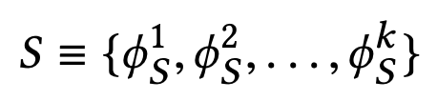
What is State?
k-dimensional vector of features
Feature = control-flow + data-flow
Control-flow examples
  PC
  Branch PC
  Last-3 PCs, …
Data-flow examples
  Cacheline address
  Physical page number
  Delta between two cacheline addresses
  Last 4 deltas, …
Notes:
We define the state as a k-dimensional vector of program features.
[CLICK] Each feature is composed of …
[CLICK] Some examples of control-flow information are …
[CLICK] Some examples of data-flow information are …
Though Pythia can theoretically learn from any number of such program features, we limit the size k as per storage budget.

Slide 22
What is Action?
Given a demand access to address A
the action is to select prefetch offset “O”
Action-space: 127 actions in the range [-63, +63]
  For a machine with 4KB page and 64B cacheline
Upper and lower limits ensure prefetches do not cross physical page boundary
A zero offset means no prefetch is generated
We further prune action-space by design-space exploration
Notes:
We define the action as the selection of a prefetch offset. Pythia adds this offset to the demanded cacheline to get the prefetched cacheline address.
[CLICK] Note that a zero offset is also a valid action for Pythia, which means no prefetch is generated.
[CLICK] As every post-L1 prefetcher …, the list of actions are limited to the range from -63 to +63 for a traditionally-sized …
[CLICK] However, we can prune the action list by automatic design-space exploration, as we show in the paper.

Slide 23
What is Reward?
Defines the objective of Pythia
Encapsulates two metrics:
  Prefetch usefulness (e.g., accurate, late, out-of-page, …)
  System-level feedback (e.g., mem. b/w usage, cache pollution, energy, …)
We demonstrate Pythia with memory bandwidth usage as the system-level feedback in the paper
Notes:
The reward defines the objective of Pythia
[CLICK] A reward encapsulates two metrics: …
[CLICK] Though Pythia can learn from any …, in this paper we demonstrate Pythia using a major system-level feedback: mem b/w usage

Slide 24
What is Reward?
Seven distinct reward levels
  Accurate and timely (R_{AT})
  Accurate but late (R_{AL})
  Loss of coverage (R_{CL})
  Inaccurate
    With low memory b/w usage (R_{IN}-L)
    With high memory b/w usage (R_{IN}-H)
  No-prefetch
    With low memory b/w usage (R_{NP}-L)
    With high memory b/w usage(R_{NP}-H)
Values are set at design time via automatic design-space exploration
  Can be customized further in silicon for higher performance
Notes:
We define reward in five distinct levels mentioned as follows [CLICK].
Each reward level corresponds to various usefulness of a prefetch request. The inaccurate and no-prefetch reward levels are further categorized based on the system memory bandwidth usage.
[CLICK] The values of each of these reward levels are set at design time via automatic design-space exploration.
[CLICK] However, one can customize the rewards in silicon via simple configuration registers to specify a dfferent objective for Pythia for extracting higher performance benefits in target workload suites.

Slide 25
Steering Pythia’s Objective via Reward Values
Example reward configuration for
  Generating accurate prefetches
  Making bandwidth-aware prefetch decisions
-14
-8
-4
-2
+12
+20
R_{IN}-H
R_{IN}-L
R_{NP}-L
R_{NP}-H
R_{AL}
R_{AT}
AT = Accurate & timely; AL = Accurate & late; NP = No-prefetching; IN = Inaccurate;
H = High mem. b/w; L = Low mem. b/w
1
Highly prefers to generate accurate prefetches
2
Prefers not to prefetch if memory bandwidth usage is low
3
Strongly prefers not to prefetch if memory bandwidth usage is high
Notes:
Now, let’s take a concrete example of reward values and how they specify the objectives for Pythia.
[CLICK] These are the reward level values in basic Pythia configuration.
Pythia sets three key objectives for prefetching by this reward configuration.
[CLICK] First, we provide much higher perks to Pythia for prefetching accurately, either timely or untimely. Thus, Pythia prefers to generate accurate prefetches.
[CLICK] Second, in case of low memory bandwidth usage, Pythia has higher perks in no prefetching, rather that prefetching inaccurately.
Thus, if the memory bandwidth usage is low, Pythia prefers not to prefetch, rather than prefetching inaccurately.
[CLICK] Third, in case of high memory bandwidth usage, Pythia has much higher perks in no prefetching than prefetching accurately.
Thus, if the memory bandwidth usage is low, Pythia strongly prefers not to prefetch, rather than prefetching inaccurately.
[] Let’s take a look at a reward values to steer Pythia to generate accurate prefetches and make fine-tuned decisions based on b/w usage.

Slide 26
Steering Pythia’s Objective via Reward Values
Customizing reward values to make Pythia conservative towards prefetching
-22
-20
+1
+2
+12
+20
R_{IN}-H
R_{IN}-L
R_{NP}-L
R_{NP}-H
R_{AL}
R_{AT}
AT = Accurate & timely; AL = Accurate & late; NP = No-prefetching; IN = Inaccurate;
H = High mem. b/w; L = Low mem. b/w
1
Highly prefers to generate accurate prefetches
2
Otherwise prefers not to prefetch
Notes:
Now, if we increase the reward for no prefetching while significantly decreasing the rewards for inaccurate prefetching, we set a different prefetching objective for Pythia.
[CLICK] We still provide much higher perks for prefetching accurately. Thus Pythia strives to generate accurate prefetches.
[CLICK] Otherwise, we provide much higher perks for no prefetching as compared to inaccurate prefetching, irrespective of the memory bandwidth usage. Thus, Pythia becomes conservative and simply do not prefetch at all.
This is particularly useful if we are repurposing Pythia for server-class processors which have modest per-core memory bandwidth
or workloads like Ligra whose performance improvement is sensitive to memory bandwidth usage.

Slide 27
Basic Pythia Configuration
Derived from automatic design-space exploration
State: 2 features
  PC+Delta
  Sequence of last-4 deltas
Actions: 16 prefetch offsets
  Ranging between -6 to +32. Including 0.
Rewards:
  R_{AT} = +20; R_{AL} = +12; R_{NP}-H=-2; R_{NP}-L=-4;
  R_{IN}-H=-14; R_{IN}-L=-8; R_{CL}=-12

Slide 28
More Detailed Pythia Overview
Q-Value Store: Records Q-values for all state-action pairs
Evaluation Queue: A FIFO queue of recently-taken actions
Find the Action with max Q-Value
A1
A2
A3
4
2
Look up
QVStore
Generate
prefetch
Demand Request
State
Vector
Memory
Hierarchy
S1
3
S2
Max
S3
S4
Q-Value Store
(QVStore)
6
Evict EQ entry and update QVStore
5
Evaluation Queue (EQ)
Insert prefetch action &
State-Action pair in EQ
1
7
Set filled bit
Assign reward to
corresponding EQ entry
Prefetch Fill
Notes:
Pythia consists of two key components:
[CLICK] Q-value store, which is responsible for …
[CLICK] Evaluation queue, which is a first-in-first-out queue that stores the recently taken action.
As Pythia cannot always immediately assign a reward to a taken action
because the usefulness of the corresponding prefetch request is known, Pythia stores the action
in evaluation queue to properly assign rewards to them.
[CLICK] For every demand request, Pythia first checks EQ with deamdned address. If a matching entry is found in EQ, it means the corresponding action in EQ entry has generated a useful prefetch, and Pythia assigns a reward accordingly.
[CLICK] Then Pythia extracts features from the attributes of the demand request to create the state-vector and uses the state-vector to lookup QVStore [CLICK]
[CLICK] For the given state-vector, Pythia finds the action that has the highest Q-value and generates prefetch request accordingly to the memory hierarchy [CLICK]
[CLICK] Next, Pythia inserts the action in the EQ along with the state-action pair.
[CLICK] Pythia uses the reward stored in the evicted EQ entry to update the QVStore.

Slide 29
Simulation Methodology
Champsim [3] trace-driven simulator
150 single-core memory-intensive workload traces
  SPEC CPU2006 and CPU2017
  PARSEC 2.1
  Ligra
  Cloudsuite
Homogeneous and heterogeneous multi-core mixes
Five state-of-the-art prefetchers
  SPP [Kim+, MICRO’16]
  Bingo [Bakhshalipour+, HPCA’19]
  MLOP [Shakerinava+, 3rd Prefetching Championship, 2019 ]
  SPP+DSPatch [Bera+, MICRO’19]
  SPP+PPF [Bhatia+, ISCA’20]
[3] https://github.com/ChampSim/ChampSim

Slide 30
Performance with Varying Core Count
Pythia
3.4%
7.7%
SPP
MLOP
Bingo

Slide 31
Performance with Varying Core Count
1. Pythia consistently provides the highest performance in all core configurations
Pythia
7.7%
3.4%
SPP
2. Pythia’s gain increases with core count
MLOP
Bingo

Slide 32
Performance with Varying DRAM Bandwidth
3%
Pythia
Bingo
MLOP
Baseline
SPP
~Intel Xeon 6258R (Cascade Lake, 28C/6ch)
~AMD EPYC Rome 7702P (Zen 2, 64C/8ch)
17%
~AMD Threadripper 3990x (Zen 2, 64C/4ch)

Slide 33
Performance with Varying DRAM Bandwidth
3%
Pythia
Bingo
MLOP
Baseline
SPP
~Intel Xeon 6258R (Cascade Lake, 28C/6ch)
Pythia outperforms prior best prefetchers for
a wide range of DRAM bandwidth configurations
~AMD EPYC Rome 7702P (Zen 2, 64C/8ch)
17%
~AMD Threadripper 3990x (Zen 2, 64C/4ch)

Slide 34
Performance Improvement via Customization
5.2%
7.8%
2%
2.8%
3.4%
3.1%
Customize reward values for graph analytics workloads
Notes:
[CLICK] As you can see, strict Pythia outperforms the basic Pythia configuration as much as 7.8% and
[CLICK] 2% on average over the entire Ligra workload suite.

Slide 35
Performance Improvement via Customization
5.2%
7.8%
Pythia can extract even higher performance via customization without changing hardware
2%
2.8%
3.4%
3.1%
Notes:
[CLICK] As you can see, strict Pythia outperforms the basic Pythia configuration as much as 7.8% and
[CLICK] 2% on average over the entire Ligra workload suite.

Slide 36

Pythia’s Overhead
25.5 KB of total metadata storage per core
  Only simple tables
We also model functionally-accurate Pythia with full complexity in Chisel [4] HDL
1.03% area overhead
0.4% power overhead
Satisfies prediction latency
of a desktop-class 4-core Skylake processor (Xeon D2132IT, 60W)
[4] https://www.chisel-lang.org
Notes:
All of Pythia’s performance benefits comes at a modest cost of 25.5KB of metadata storge, which is invested only in simple storage, without any need to complex structures.
[CLICK] We also model a fully-functionally-accurate Pythia with its full complexity in Chisel and show that, Pythia incurs
[CLICK] a modest area overhead of 1.03%
[CLICK] a power overhead of half-a-percent
[CLICK] while simultaneously satisfying the prediction latency at L2 cache frequency
Of a desktop-class …

Slide 37
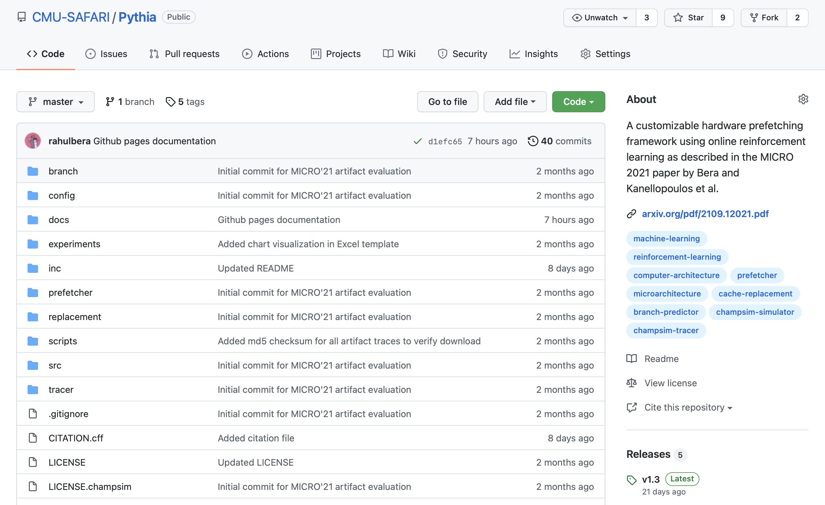
Pythia is Open Source
https://github.com/CMU-SAFARI/Pythia
MICRO’21 artifact evaluated
Champsim source code + Chisel modeling code
All traces used for evaluation

Slide 38
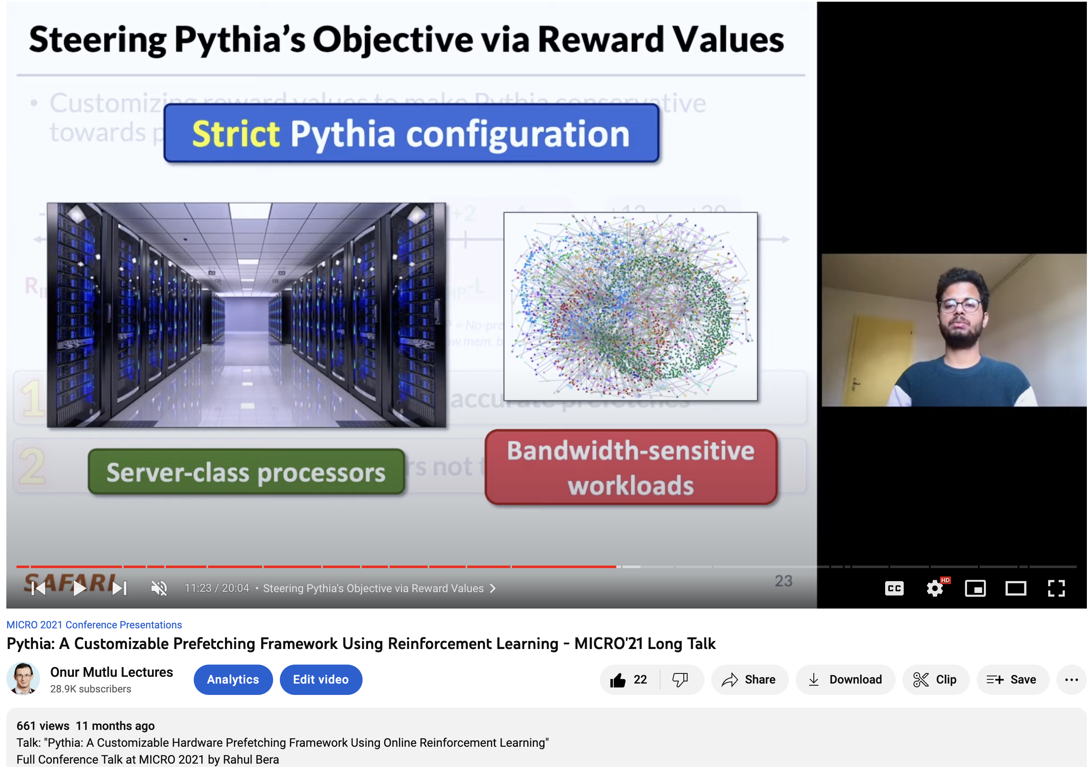
Pythia Talk Video
https://www.youtube.com/watch?v=6UMFRW3VFPo&list=PL5Q2soXY2Zi--0LrXSQ9sST3N0k0bXp51&index=8

Slide 39
A Lot More in the Pythia Paper
Rahul Bera, Konstantinos Kanellopoulos, Anant Nori, Taha Shahroodi, Sreenivas Subramoney, and Onur Mutlu,
"Pythia: A Customizable Hardware Prefetching Framework Using Online Reinforcement Learning"
Proceedings of the 54th International Symposium on Microarchitecture (MICRO), Virtual, October 2021.
[Slides (pptx) (pdf)]
[Short Talk Slides (pptx) (pdf)]
[Lightning Talk Slides (pptx) (pdf)]
[Talk Video (20 minutes)]
[Lightning Talk Video (1.5 minutes)]
[Pythia Source Code (Officially Artifact Evaluated with All Badges)]
[arXiv version]
Officially artifact evaluated as available, reusable and reproducible.
https://arxiv.org/pdf/2109.12021.pdf

Slide 40
Pythia
A Customizable Hardware Prefetching Framework Using Online Reinforcement Learning
Rahul Bera, Konstantinos Kanellopoulos, Anant V. Nori,
Taha Shahroodi, Sreenivas Subramoney, Onur Mutlu
https://github.com/CMU-SAFARI/Pythia
Notes:
Hi I am Rahul. Today, I’m going to present our work “…”
This work is done by researchers from SAFARI research group at ETH Zurich, in collaboration with Intel Labs and TU Delft.

Slide 41
Hermes: Perceptron-Based
Off-Chip Load Prediction

Slide 42
Learning-Based Off-Chip Load Predictors
Rahul Bera, Konstantinos Kanellopoulos, Shankar Balachandran, David Novo, Ataberk Olgun, Mohammad Sadrosadati, and Onur Mutlu,
"Hermes: Accelerating Long-Latency Load Requests via Perceptron-Based Off-Chip Load Prediction"
Proceedings of the 55th International Symposium on Microarchitecture (MICRO), Chicago, IL, USA, October 2022.
[Slides (pptx) (pdf)]
[Longer Lecture Slides (pptx) (pdf)]
[Talk Video (12 minutes)]
[Lecture Video (25 minutes)]
[arXiv version]
[Source Code (Officially Artifact Evaluated with All Badges)]
Officially artifact evaluated as available, reusable and reproducible.
Best paper award at MICRO 2022.
https://arxiv.org/pdf/2209.00188.pdf

Slide 43
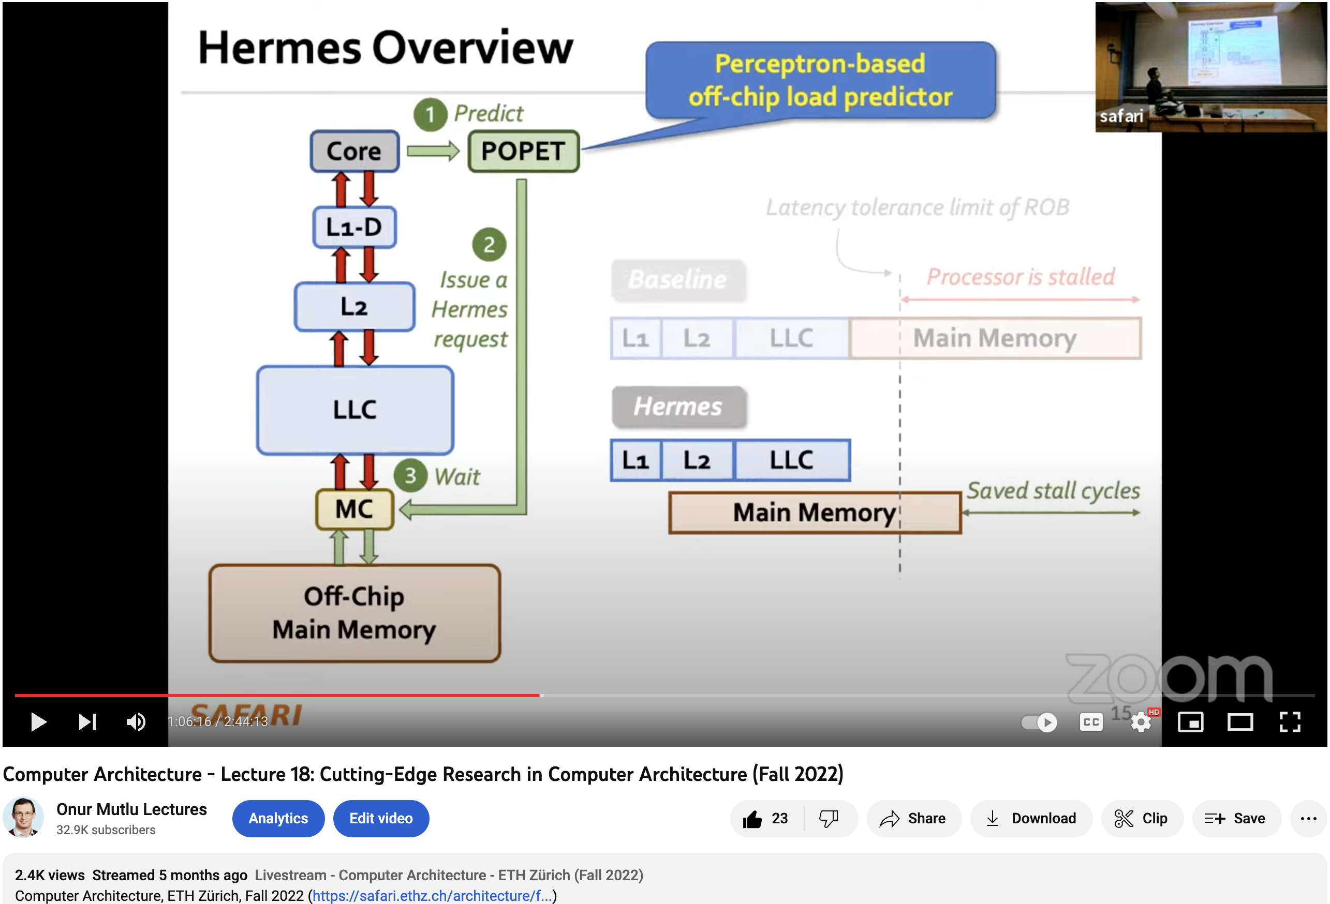
Hermes Talk Video
https://www.youtube.com/watch?v=PWWBtrL60dQ&t=3609s

Slide 44


Accelerating Long-Latency Load Requests
via Perceptron-Based Off-Chip Load Prediction
Rahul Bera, Konstantinos Kanellopoulos, Shankar Balachandran,
David Novo, Ataberk Olgun, Mohammad Sadrosadati, Onur Mutlu
https://github.com/CMU-SAFARI/Hermes

Slide 45
Problem
Long-latency off-chip load requests
Often stall processor by
blocking instruction retirement from
Reorder Buffer (ROB)
Limit performance
Notes:
The key problem that we are trying to address in this work is stemming from Off-chip load request
[CLICK] As we know, these off-chip load requests often stall…,
[CLICK] which severely limits the performance of a core.

Slide 46

Traditional Solutions
1
Employ sophisticated prefetchers
2
Increase size of on-chip caches
Notes:
Architects have primarily relied on two key techniques to reduce latency of such loads:
[CLICK] By employing sophisticated data prefetchers
[CLICK] And Increasing size of the on-chip cache hierarchy

Slide 47
Key Observation 1
Many loads still go off-chip
50%
still go off-chip even with
a state-of-the-art prefetcher
50%
successfully prefetched
70% of the off-chip loads
block the ROB
# off-chip loads without any prefetcher
Notes:
In this work, we show that prior prefetchers successfully prefetch a significant fraction of the off-chip load requests.
[CLICK] However, nearly 50% of the off-chip loads in a system without any prefetcher are still going off-chip even in presence of a state-of-the-art prefetcher
[CLICK] And 70% of these off-chip loads even block the ROB.

Slide 48
Key Observation 2
50% still go off-chip
On-chip cache access latency
significantly contributes to off-chip load latency
L1
L2
LLC
Main Memory
L1
L2
LLC
Main Memory
Saved cycles
40% of the stalls can be eliminated by removing
on-chip cache access latency from critical path
Notes:
Now, if we focus on the off-chip loads that are still going to the main memory even in presence of a state-of-the-art prefetcher,
We observe that the on-chip cache access latency…
[CLICK] We show that nearly 40% of …

Slide 49
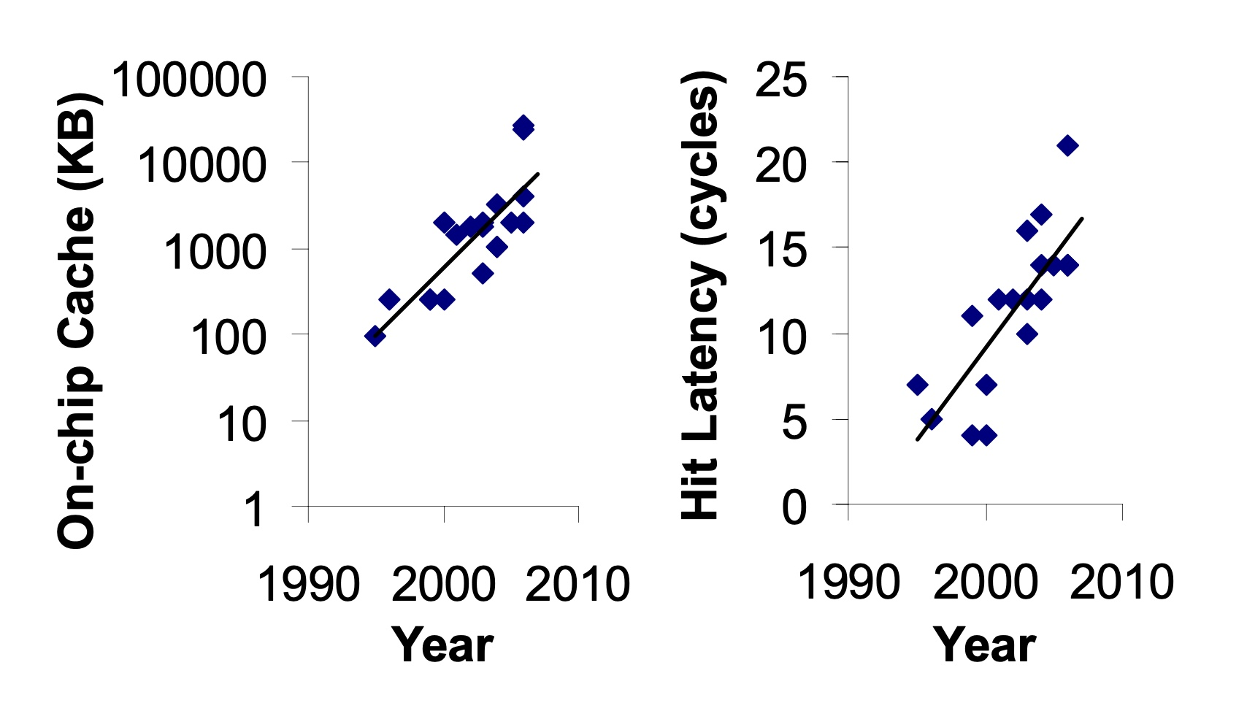
Caches are Getting Bigger and Slower…
On-chip Cache Size (KB)
Hardavellas+, “Database Servers on Chip Multiprocessors: Limitations and Opportunities”, CIDR, 2007
Notes:
As the cache hierarchy continue to grow in size and complexity, as noted by previous works,
As well as a trend that we see in recent processors,
This problem is only going to get exacerbated even more in future generation processors

Slide 50
Our Goal
Improve processor performance
by removing on-chip cache access latency
from the critical path of off-chip loads
Notes:
Thus to alleviate this problem, the goal of our work is to improve…

Slide 51

Predicts which load requests
are likely to go off-chip
Starts fetching data directly from main memory while concurrently accessing the cache hierarchy
Notes:
Towards this we propose Hermes, which is based on two key ideas.
[CLICK] Hermes predicts which…
[CLICK] Hermes starts fetching …

Slide 52




Hermes: Key Contribution
Hermes employs the first
perceptron-based off-chip load predictor
That predicts which loads are likely to go off-chip
By learning from
multiple program context information
Notes:
To enable accurate off-chip prediction,
Hermes employs the first perceptron-based off-chip load predictor
[CLICK] that identifies loads …
[CLICK] by only learning from multiple…

Slide 53
Hermes Overview
Core
Latency tolerance limit of ROB
L1-D
Baseline
Processor is stalled
L2
L1
L2
LLC
Main Memory
LLC
MC
Off-Chip
Main Memory
Notes:
Now let me give you a brief overview of Hermes.
This is how a traditional cache hierarchy looks like in today’s processor.
[CLICK] And this is how the memory latency timeline looks like for an off-chip load in the baseline system
[CLICK] If the ROB has a latency tolerance limit up till here, the processor stalls for the remaining cycles

Slide 54




Hermes Overview
Perceptron-based
off-chip load predictor
Predict
Core
POPET
Train
Latency tolerance limit of ROB
L1-D
Issue a Hermes request
Baseline
Processor is stalled
L2
L1
L2
LLC
Main Memory
LLC
Hermes
L1
L2
LLC
Wait
Saved stall cycles
MC
Main Memory
Off-Chip
Main Memory
Notes:
Now Hermes employs an off-chip predictor named POPET.
[CLICK] For every load generated in the core, Hermes consults POPET to predict whether this load would go off-chip or not
[CLICK] If the load is predicted to go off-chip, Hermes waits for the address translation to finish, which happens in parallel with L1 cache access
[CLICK] And then issues a speculative memory request, which we call a Hermes request,
directly to the main memory controller to start fetching the data from the main memory,
While also concurrently accessing the cache hierarchy for such a load.
[CLICK] If the off-chip prediction is correct, the load would eventually miss the LLC and arrive at the memory controller
Where it will simply wait for the ongoing Hermes request to finish, thus hiding the entire cache access latency from its critical path.
Once the data returns from the main memory, Hermes returns the data to the core [CLICK],
Thus, saving the precious stall cycles induced by the off-chip load [CLICK], which in turn provides performance benefit.
[CLICK] Hermes trains POPET when the data finally returns to the core, closing the feedback loop.

Slide 55

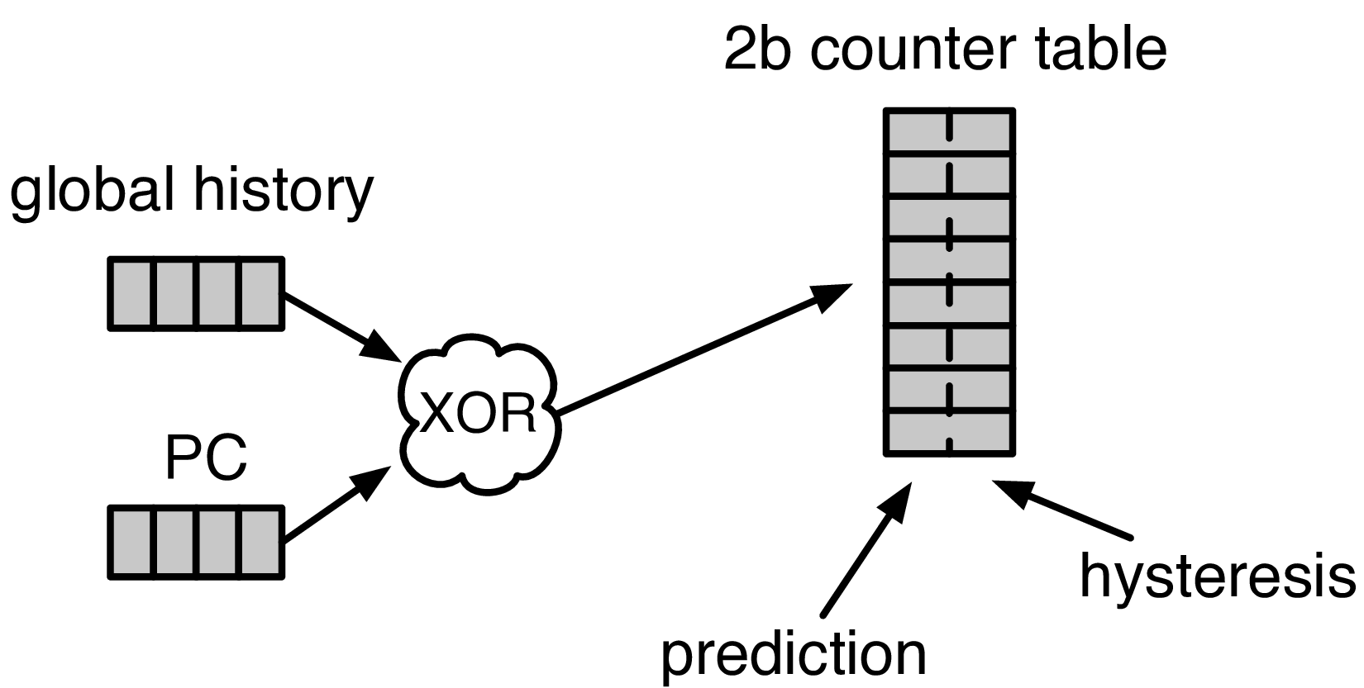


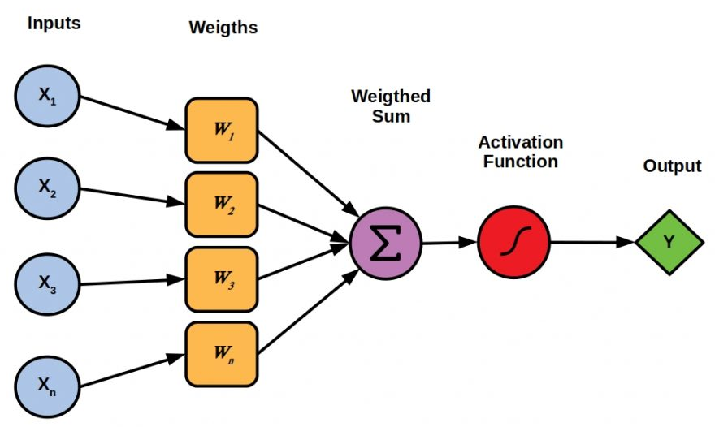

Designing the Off-Chip Load Predictor
History-based prediction
HMP [Yoaz+, ISCA’99] for the L1-D cache
Using branch-predictor-like hybrid predictor:
Global, Gshare, and GSkew
POPET provides
both higher accuracy and higher performance
than predictors inspired from these previous works
Tracking cache contents
MissMap [Loh+, MICRO’11] for the DRAM cache,
D2D [Sembrant+, ISCA’14], D2M [Sembrant+, HPCA’17], LP [Jalili+, HPCA’22] for the cache hierarchy
  Large metadata
  Metadata size increases with cache hierarchy size
  May need to track all cache operations
  Gets complex depending on the cache hierarchy configuration (e.g., inclusivity, bypassing,…)
Learning from program behavior
  Correlate different program features with off-chip loads
Low storage overhead
Low design complexity
Notes:
Now let’s discuss how to design this off-chip predictor.
So, there are multiple prior works that can be used either directly or with small modifications for off-chip load prediction.
These works can be broadly categorized into two classes.
[CLICK] History-based predictor introduced by HMP, uses a branch-predictor like hybrid predictor design
to identify which requests are going to miss L1 cache.
We can easily extend HMP’s design to predict loads that are going to miss the entire cache hierarchy.
[CLICK] Tracking-based methods, on the other hand, explicitly track cache contents
to predict which load requests are going to miss the cache hierarchy.
[CLICK] These tracking-based methods poses two key challenges…
[CLICK] First,…
[CLICK] Second,…
[CLICK] POPET takes a completely different approach to predict off-chip load requests by learning from program behavior.
[CLICK] It aims to correlate multiple different types of program features with off-chip load requests
to provide accurate predictions with much lower storage overhead and design complexity.
[CLICK] In our paper, we compare POPET against predictors inspired from these prior works and show that
[CLICK] POPET provides both higher accuracy and performance than them.

Slide 56
POPET: Perceptron-Based Off-Chip Predictor
Multi-feature hashed perceptron model^{[1]}
  Each feature has its own weight table
    Stores correlation between feature value and off-chip prediction
[1] D. Tarjan and K. Skadron, “Merging Path and Gshare Indexing in Perceptron Branch Prediction,” TACO, 2005
Notes:
Now let’s deep dive into our off-chip predictor design.
Our predictor, named as POPET, is designed using hashed-perceptron model.
[CLICK] where each feature has its own weight table
That stores the correlation between feature value and the off-chip prediction

Slide 57

Predicting using POPET
Uses simple table lookups, addition, and comparison
42
-4
0x7ffe0+12
3
3 >= -2
Predict that the load would go off-chip
Extract features from the load request
12
-5
Notes:
Hermes predicts using POPET using simple operations like table lookup, addition, and comparison.
Let me give you an example on how POPET’s prediction works.
POPET’s prediction works in three stages.
[CLICK] In the first stage, POPET extracts the features from the load request
[CLICK] In the second stage, each feature value is hashed and used as an index to retrieve the weights from each individual weight tables
[CLICK] In the third stage, the retrieved weights are accumulated and the cumulative weight is used to compute the activation function.
[CLICK] If the cumulative weight is higher than the activation threshold, POPET predicts that the load would go off-chip.

Slide 58
Training POPET
Uses simple increment or decrement of feature weights
42
-1
-4
0x7ffe0+12
3
3 >= -2
Predict that the load would go off-chip
-1
12
Shouldn’t be activated
-5
Cumulative weight < 𝜏_{act}
-1
Notes:
Now let’s understand how to train POPET.
For this let’s assume the previous example where the load is predicted to go off-chip.
[CLICK] But in reality, the load didn’t go off-chip
[CLICK] this means the activation which have triggered before, shouldn’t have triggered
Which means, the cumulative weight should be lower than the activation threshold
[CLICK] Now to adjust the feature weights, POPET again indexes each weight table using the hashed feature values
[CLICK] And simply decrement each weight from the individual weight tables.
Thus, by using simple increment and decrement operations, POPET continuously learns from program behavior to accurately predict off-chip loads.

Slide 59
Evaluation
Notes:
Now let’s evaluate Hermes.

Slide 60
Simulation Methodology
ChampSim trace driven simulator
110 single-core memory-intensive traces
  SPEC CPU 2006 and 2017
  PARSEC 2.1
  Ligra
  Real-world applications
220 eight-core memory-intensive trace mixes
LLC Prefetchers
Off-Chip Predictors
Pythia [Bera+, MICRO’21]
Bingo [Bakshalipour+, HPCA’19]
MLOP [Shakerinava+, 3rd Prefetching Championship’19]
SPP + Perceptron filter [Bhatia+, ISCA’20]
SMS [Somogyi+, ISCA’06]
History-based: HMP [Yoaz+, ISCA’99]
Tracking-based: Address Tag-Tracking based Predictor (TTP)
Ideal Off-chip Predictor
Notes:
We evaluate Hermes using ChampSim simulator,
[CLICK] using a wide range of memory-intensive traces spanning across SPEC CPU, PARSEC, Ligra, and real-world applications
[CLICK] We compare Hermes with five LLC prefetchers
[CLICK] and two off-chip predictors extended from prior works

Slide 61
Single-Core Performance Improvement
5.4%
20.3%
11.5%
Hermes alone provides nearly
50% performance benefits of Pythia
with only 1/5th storage overhead
Hermes provides nearly 90% performance benefit of Ideal Hermes that has an ideal off-chip load predictor
Hermes on top of Pythia
outperforms Pythia alone in every workload category
Notes:
Let’s first analyze the single-core performance improvement.
[CLICK] This is how Hermes and a state-of-the-art prefetcher Pythia improves performance on top of a no-prefetching system.
[CLICK] The first takeaway is that Hermes alone provides nearly 50%...
[CLICK] Now if we combine Hermes with Pythia, that provides an additional 5.4% performance improvement on top of a strong baseline that has Pythia.
[CLICK] And finally, if we compare Hermes’s performance benefit with the Ideal Hermes that has an ideal off-chip predictor,
We see that Hermes provides nearly 90% performance benefit of the Ideal Hermes

Slide 62
Increase in Main Memory Requests
20.3%
5.4%
11.5%
For every 1% performance benefit,
increase in main memory requests
Pythia
2%
5.9%
Hermes on top of Pythia
1%
38.5%
Hermes alone
0.5%
5.5%
Hermes is more bandwidth-efficient
than even an efficient prefetcher like Pythia
Notes:
This performance improvement comes at a cost of increase in main memory requests.
This graph shows the increase in the main memory request over the no-prefetching system provided by the three configurations.
[CLICK] As we can see, Hermes increases the main memory requests by 5.5% on average on top of the no-prefetching system..
Whereas Pythia increases …
If we combine two together, then it increases the main memory request by an additional 5.9%.
[CLICK] Now, if we compare this increase in the main memory request with the performance improvement each of these configurations are providing,
We see that
[CLICK] For every 1% performance benefit, Pythia …
[CLICK] This basically shows that Hermes is much more bandwidth efficient than a traditional data prefetcher like Pythia.
And for this reason [NEXT]

Slide 63
Performance with Varying Memory Bandwidth
Pythia+Hermes
Pythia
Hermes
Baseline
~Intel Xeon 6258R
(Cascade Lake, 28C/6ch, 2020)
~AMD EPYC Rome 7702P (Zen 2, 64C/8ch, 2019)
~AMD Threadripper 3990x (Zen 2, 64C/4ch, 2020)
In bandwidth-constrained configurations,
Hermes alone outperforms Pythia
Hermes+Pythia outperforms Pythia
across all bandwidth configurations
Notes:
If we evaluate Pythia and Hermes over a wide range of memory bandwidth configurations, we see that,
[CLICK] In these extremely-bandwidth constrained configurations, which are in fact roughly modeling per-core main memory bandwidth of commercial processors,
Hermes even outperforms Pythia.
[CLICK] And if we combine both of them, the combination of Hermes and Pythia outperforms Pythia in every bandwidth configurations.

Slide 64
Performance with Varying Baseline Prefetcher
5.4%
6.2%
7.6%
5.1%
Hermes consistently improves performance
on top of a wide range of baseline prefetchers
7.7%
Notes:
And these observations are not only true for Pythia.
We evaluate Hermes combined with multiple prior baseline state-of-the-art prefetchers and find that
Hermes consistently improves performance on top of a wide range of baseline prefetchers.

Slide 65
Overhead of Hermes
4 KB storage overhead
1.5% power overhead*
*On top of an Intel Alder Lake-like performance-core ^{[2]} configuration
[2] https://www.anandtech.com/show/16881/a-deep-dive-into-intels-alder-lake-microarchitectures/3
Notes:
All of these performance benefit comes at a
[CLICK] modest 4KB storage overhead per core and
[CLICK] 1.5% power overhead on top an Intel Alder Lake-like performance-core configuration

Slide 66
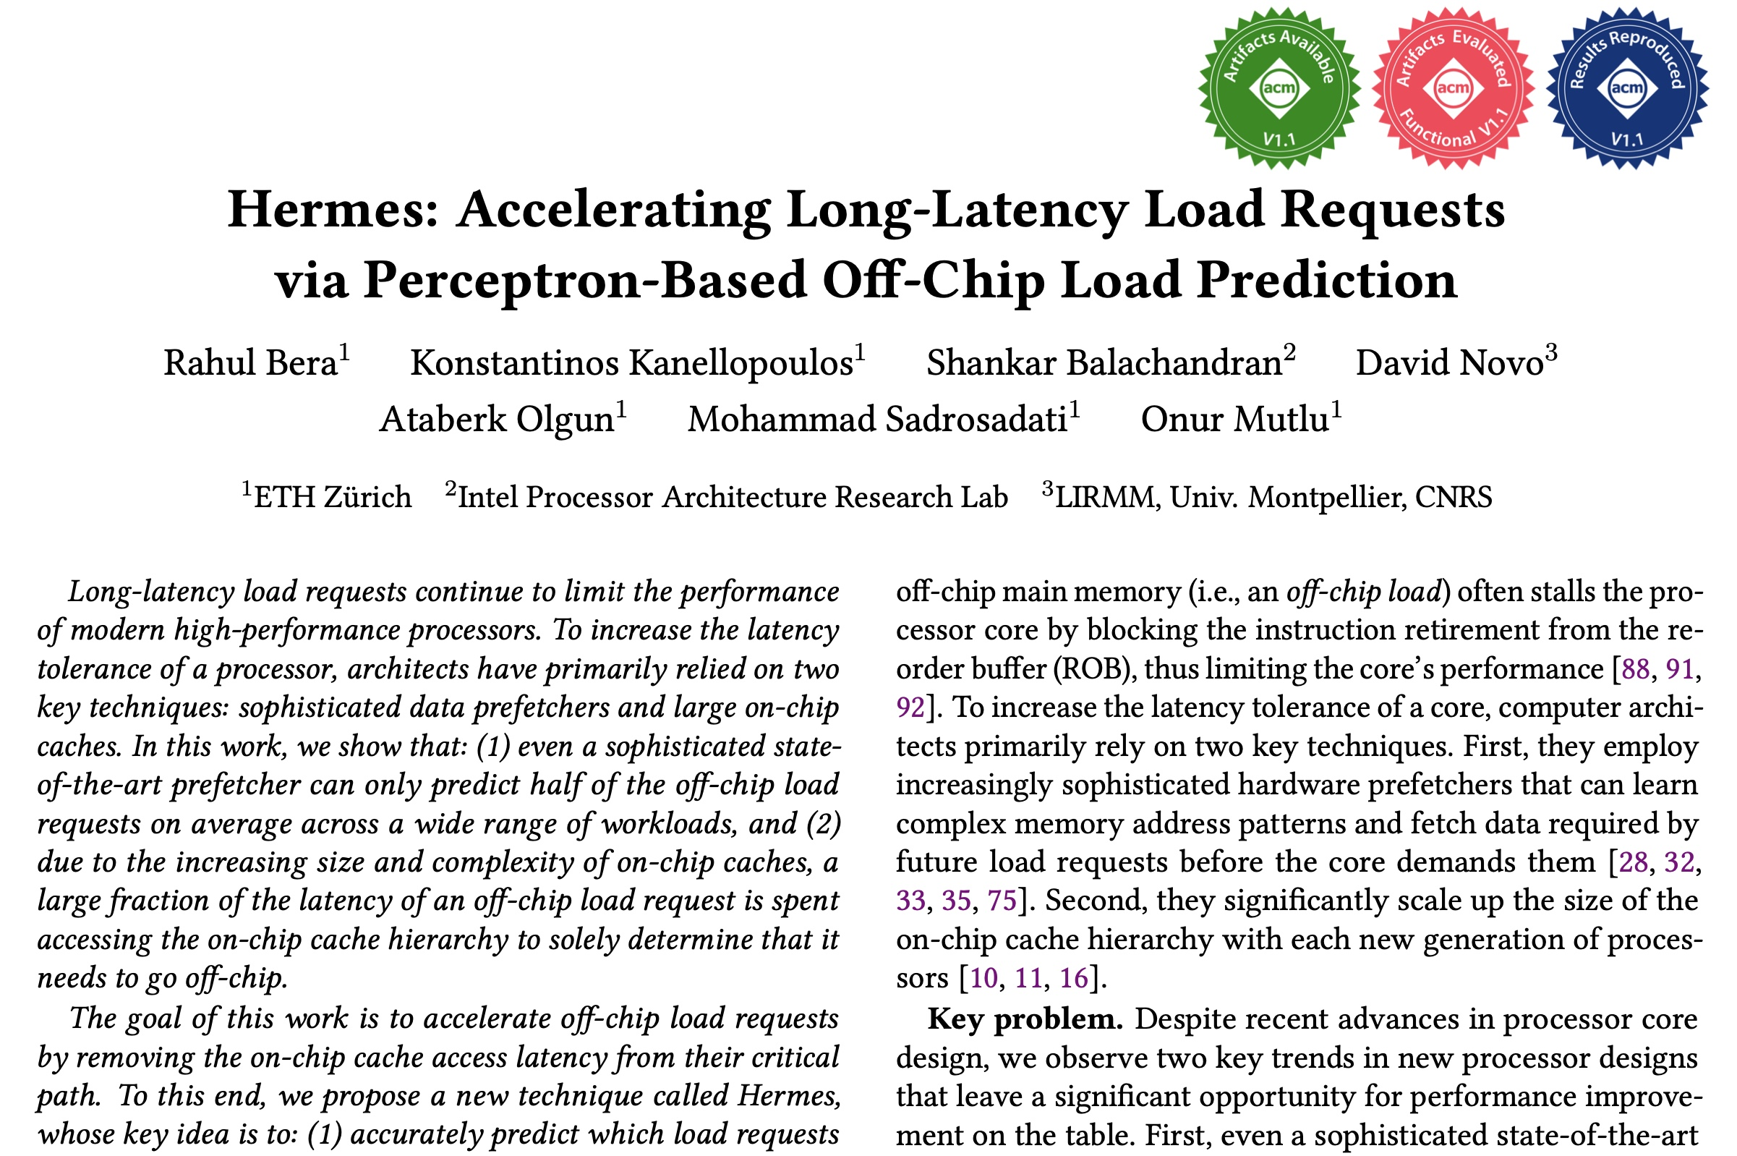
A Lot More in the Hermes Paper
Performance sensitivity to:
  Cache hierarchy access latency
  Hermes request issue latency
  Activation threshold
  ROB size (in extended version at arXiv)
  LLC size (in extended version at arXiv)
Accuracy, coverage, and performance analysis against HMP and TTP
Understanding usefulness of each program feature
Effect on stall cycle reduction
Performance analysis in eight-core system
https://arxiv.org/pdf/2209.00188.pdf
Notes:
We have many more evaluation results:
For example, a wide range of performance sensitivity study by varying…in the paper.

Slide 67
A New Approach to Latency Reduction
Hermes advocates for off-chip load prediction,
a different form of speculation than
load address prediction employed by prefetchers
Off-chip load prediction can be applied by itself
or combined with load address prediction
to provide performance improvement
Notes:
Hermes advocates …
[CLICK] We show that off-chip load prediction…

Slide 68





Hermes: Summary
Hermes employs the first
perceptron-based off-chip load predictor
High accuracy
(77%)
High coverage
(74%)
Low storage overhead
(4KB/core)
High performance improvement over best prior baseline
(5.4%)
High performance
per bandwidth

Slide 69
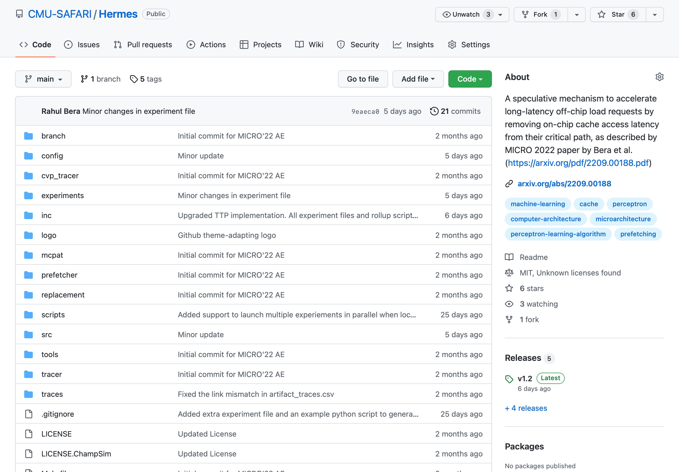
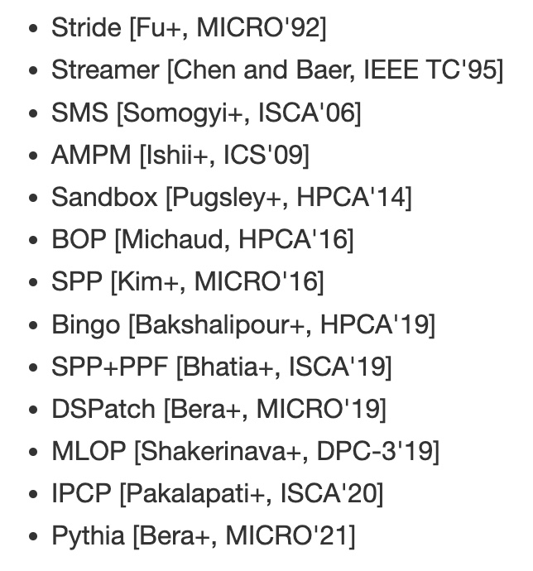
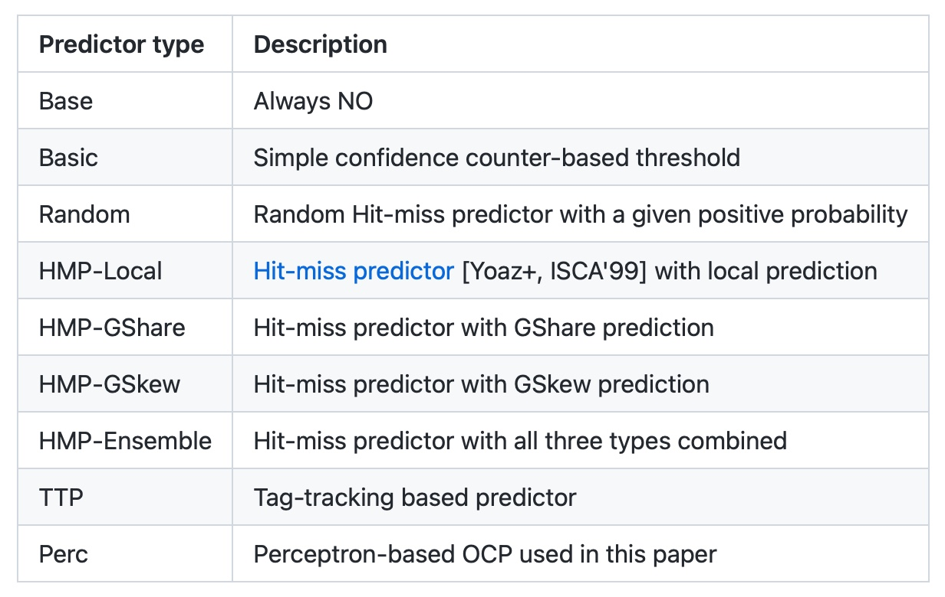
Hermes is Open Source
All workload traces
13 prefetchers
9 off-chip predictors
https://github.com/CMU-SAFARI/Hermes
Notes:
That’s why we open-source our artifact.
It can be freely downloaded from our GitHub repository.
In this artifact, [CLICK] you will get all the workload traces we have used to evaluate Hermes,
[CLICK] 13 types of data prefetchers proposed in the past and
[CLICK] 9 types of off-chip predictors out of the box

Slide 70
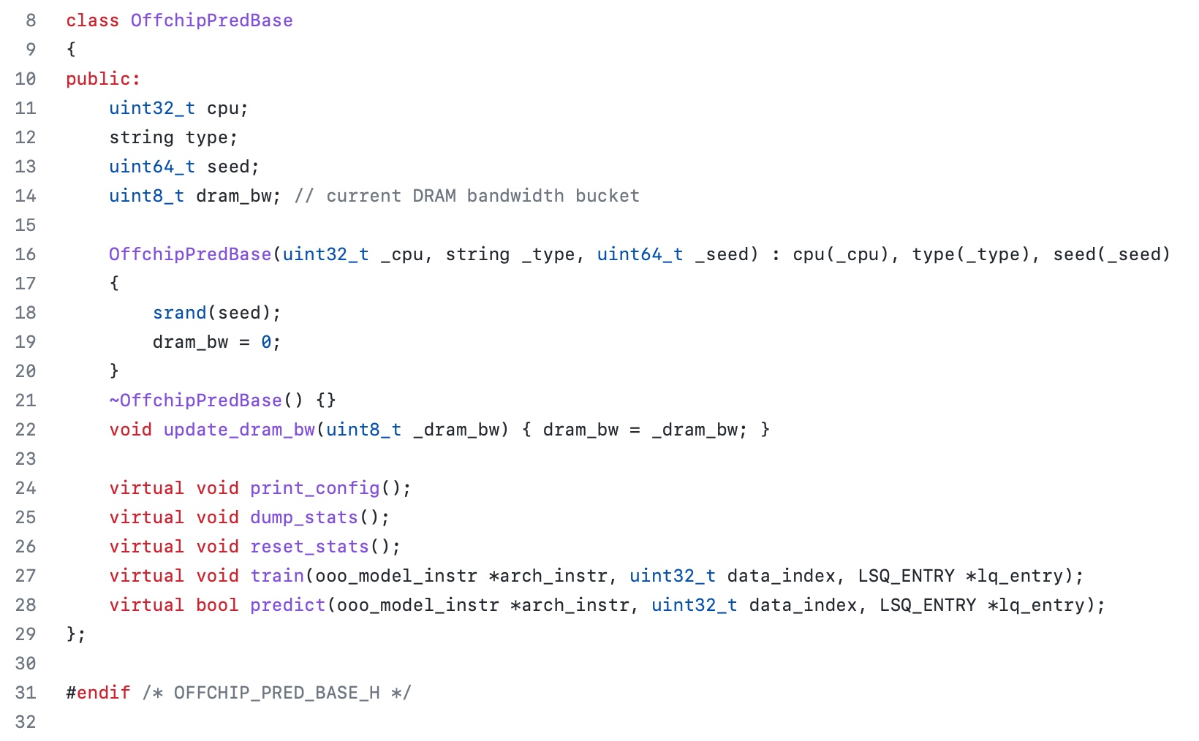
Easy To Define Your Own Off-Chip Predictor
Just extend the OffchipPredBase class
Notes:
But if you want to impalement your own off-chip predictor, that’s also very easy.
All you have to do is to extend the OffchipPred base class…

Slide 71
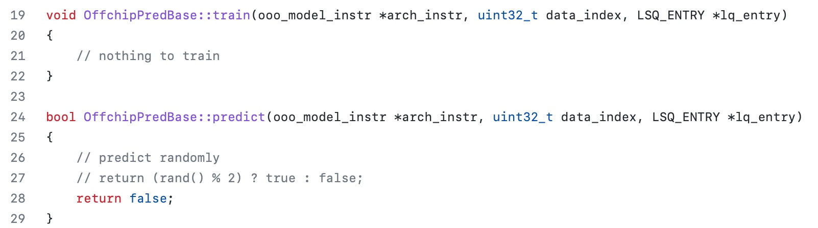
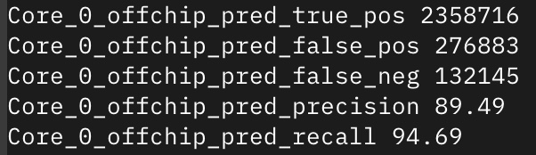
Easy To Define Your Own Off-Chip Predictor
Define your own train() and predict() functions
Get statistics like accuracy (stat name precision) and coverage (stat name recall) out of the box
Notes:
And define your own train() and predict() functions
[CLICK] the infrastructure will automatically provide statistics like precision and recall out of the box

Slide 72
Off-Chip Prediction Can Further Enable…
Prioritizing loads that are likely go off-chip
in cache queues and on-chip network routing
Better instruction scheduling
of data-dependent instructions
Other ideas to improve performance and fairness in multi-core system design...
Notes:
We hope that high-accuracy off-chip prediction can further enable a multitude of optimization possibilities, for example:
[CLICK] prioritizing loads … to improve performance and fairness in extreme core processors
[CLICK] better instruction scheduling for data dependent loads
[CLICK] and many more…

Slide 73
Learning-Based Off-Chip Load Predictors
Rahul Bera, Konstantinos Kanellopoulos, Shankar Balachandran, David Novo, Ataberk Olgun, Mohammad Sadrosadati, and Onur Mutlu,
"Hermes: Accelerating Long-Latency Load Requests via Perceptron-Based Off-Chip Load Prediction"
Proceedings of the 55th International Symposium on Microarchitecture (MICRO), Chicago, IL, USA, October 2022.
[Slides (pptx) (pdf)]
[Longer Lecture Slides (pptx) (pdf)]
[Talk Video (12 minutes)]
[Lecture Video (25 minutes)]
[arXiv version]
[Source Code (Officially Artifact Evaluated with All Badges)]
Officially artifact evaluated as available, reusable and reproducible.
Best paper award at MICRO 2022.
https://arxiv.org/pdf/2209.00188.pdf

Slide 74
Hermes Talk Video
https://www.youtube.com/watch?v=PWWBtrL60dQ&t=3609s

Slide 75
Accelerating Long-Latency Load Requests
via Perceptron-Based Off-Chip Load Prediction
Rahul Bera, Konstantinos Kanellopoulos, Shankar Balachandran,
David Novo, Ataberk Olgun, Mohammad Sadrosadati, Onur Mutlu
https://github.com/CMU-SAFARI/Hermes
Notes:
With that hope, I will conclude my talk.
I will be very happy to take any question from the audience.

Slide 76
Reinforcement Learning Based DRAM Controllers

Slide 77
DRAM Controller: Functions
Ensure correct operation of DRAM (refresh and timing)
Service DRAM requests while obeying timing constraints of DRAM chips
  Constraints: resource conflicts (bank, bus, channel), minimum write-to-read delays
  Translate requests to DRAM command sequences
Buffer and schedule requests for high performance + QoS
  Reordering, row-buffer, bank, rank, bus management
Manage power consumption and thermals in DRAM
  Turn on/off DRAM chips, manage power modes

Slide 78
Why Are DRAM Controllers Difficult to Design?
Need to obey DRAM timing constraints for correctness
  There are many (50+) timing constraints in DRAM
  tWTR: Minimum number of cycles to wait before issuing a read command after a write command is issued
  tRC: Minimum number of cycles between the issuing of two consecutive activate commands to the same bank
  …
Need to keep track of many resources to prevent conflicts
  Channels, banks, ranks, data bus, address bus, row buffers
Need to handle DRAM refresh
Need to manage power consumption
Need to optimize performance & QoS (in the presence of constraints)
  Reordering is not simple
  Fairness and QoS needs complicates the scheduling problem

Slide 79
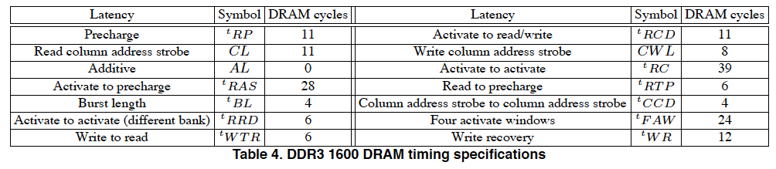
Many DRAM Timing Constraints
From Lee et al., “DRAM-Aware Last-Level Cache Writeback: Reducing Write-Caused Interference in Memory Systems,” HPS Technical Report, April 2010.

Slide 80
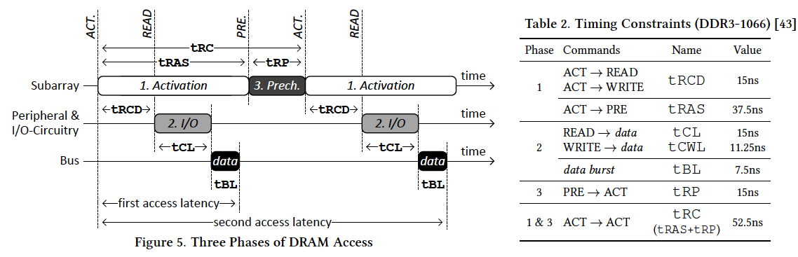
More on DRAM Operation
Kim et al., “A Case for Exploiting Subarray-Level Parallelism (SALP) in DRAM,” ISCA 2012.
Lee et al., “Tiered-Latency DRAM: A Low Latency and Low Cost DRAM Architecture,” HPCA 2013.

Slide 81
DRAM Scheduling Policies (I)
FCFS (first come first served)
  Oldest request first
FR-FCFS (first ready, first come first served)
  1. Row-hit first
  2. Oldest first
  Goal: Maximize row buffer hit rate → maximize DRAM throughput

Slide 82
DRAM Scheduling Policies (II)
A scheduling policy is a request prioritization order
Prioritization can be based on
  Request age
  Row buffer hit/miss status
  Request type (prefetch, read, write)
  Requestor type (load miss or store miss)
  Request criticality
    Oldest miss in the core?
    How many instructions in core are dependent on it?
    Will it stall the processor?
  Interference caused to other cores
  …

Slide 83
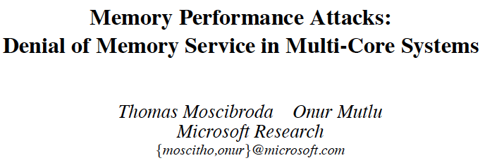
Memory Performance Attacks [USENIX SEC’07]
Thomas Moscibroda and Onur Mutlu,
"Memory Performance Attacks: Denial of Memory Service in Multi-Core Systems"
Proceedings of the 16th USENIX Security Symposium (USENIX SECURITY), pages 257-274, Boston, MA, August 2007. Slides (ppt)

Slide 84
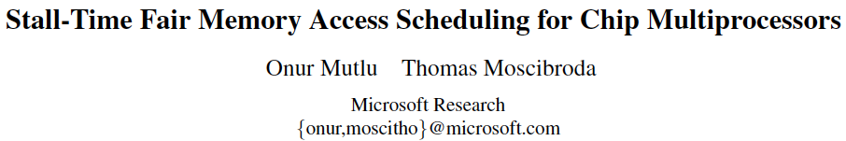
STFM [MICRO’07]
Onur Mutlu and Thomas Moscibroda,
"Stall-Time Fair Memory Access Scheduling for Chip Multiprocessors"
Proceedings of the 40th International Symposium on Microarchitecture (MICRO), pages 146-158, Chicago, IL, December 2007. [Summary] [Slides (ppt)]

Slide 85
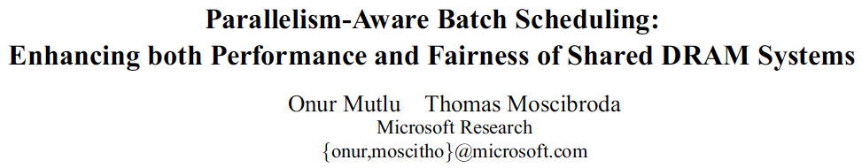
PAR-BS [ISCA’08]
Onur Mutlu and Thomas Moscibroda,
"Parallelism-Aware Batch Scheduling: Enhancing both Performance and Fairness of Shared DRAM Systems"
Proceedings of the 35th International Symposium on Computer Architecture (ISCA), pages 63-74, Beijing, China, June 2008. [Summary] [Slides (ppt)]

Slide 86
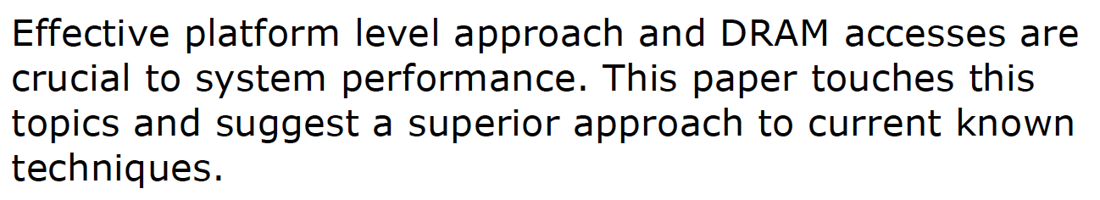
On PAR-BS
Variants implemented in Samsung SoC memory controllers
Review from ISCA 2008

Slide 87
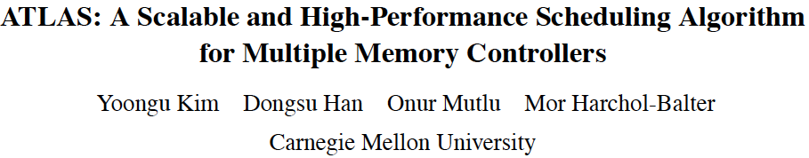
ATLAS Memory Scheduler [HPCA’10]
Yoongu Kim, Dongsu Han, Onur Mutlu, and Mor Harchol-Balter,
"ATLAS: A Scalable and High-Performance Scheduling Algorithm for Multiple Memory Controllers"
Proceedings of the 16th International Symposium on High-Performance Computer Architecture (HPCA), Bangalore, India, January 2010. Slides (pptx)

Slide 88

Thread Cluster Memory Scheduling [MICRO’10]
Yoongu Kim, Michael Papamichael, Onur Mutlu, and Mor Harchol-Balter,
"Thread Cluster Memory Scheduling: Exploiting Differences in Memory Access Behavior"
Proceedings of the 43rd International Symposium on Microarchitecture (MICRO), pages 65-76, Atlanta, GA, December 2010. Slides (pptx) (pdf)

Slide 89
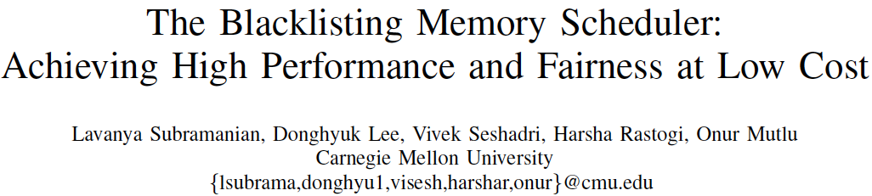
BLISS [ICCD’14, TPDS’16]
Lavanya Subramanian, Donghyuk Lee, Vivek Seshadri, Harsha Rastogi, and Onur Mutlu,
"The Blacklisting Memory Scheduler: Achieving High Performance and Fairness at Low Cost"
Proceedings of the 32nd IEEE International Conference on Computer Design (ICCD), Seoul, South Korea, October 2014. [Slides (pptx) (pdf)]

Slide 90
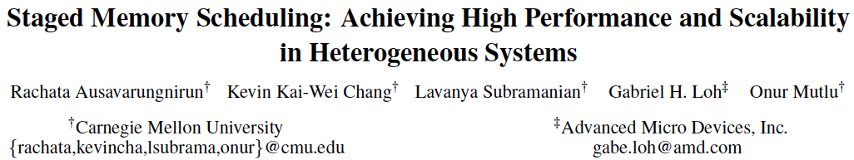
Staged Memory Scheduling: CPU-GPU [ISCA’12]
Rachata Ausavarungnirun, Kevin Chang, Lavanya Subramanian, Gabriel Loh, and Onur Mutlu,
"Staged Memory Scheduling: Achieving High Performance and Scalability in Heterogeneous Systems"
Proceedings of the 39th International Symposium on Computer Architecture (ISCA), Portland, OR, June 2012. Slides (pptx)

Slide 91
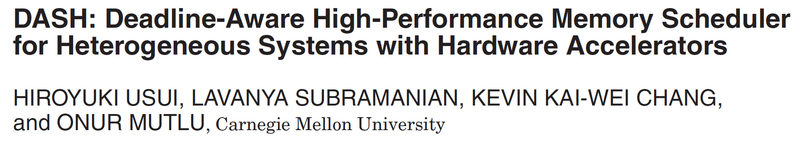
DASH: Heterogeneous Systems [TACO’16]
Hiroyuki Usui, Lavanya Subramanian, Kevin Kai-Wei Chang, and Onur Mutlu,
"DASH: Deadline-Aware High-Performance Memory Scheduler for Heterogeneous Systems with Hardware Accelerators"
ACM Transactions on Architecture and Code Optimization (TACO), Vol. 12, January 2016.
Presented at the 11th HiPEAC Conference, Prague, Czech Republic, January 2016.
[Slides (pptx) (pdf)]
[Source Code]

Slide 92
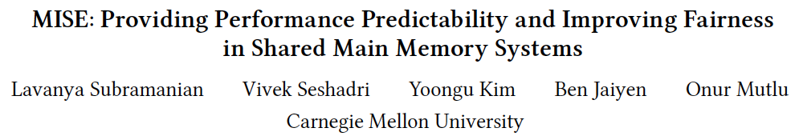
MISE: Predictable Performance [HPCA’13]
Lavanya Subramanian, Vivek Seshadri, Yoongu Kim, Ben Jaiyen, and Onur Mutlu,
"MISE: Providing Performance Predictability and Improving Fairness in Shared Main Memory Systems"
Proceedings of the 19th International Symposium on High-Performance Computer Architecture (HPCA), Shenzhen, China, February 2013. Slides (pptx)

Slide 93
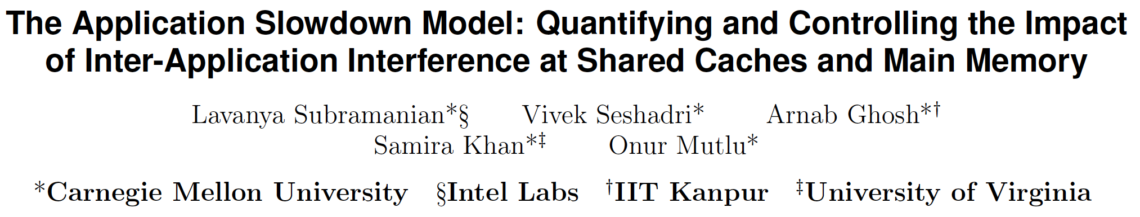
ASM: Predictable Performance [MICRO’15]
Lavanya Subramanian, Vivek Seshadri, Arnab Ghosh, Samira Khan, and Onur Mutlu,
"The Application Slowdown Model: Quantifying and Controlling the Impact of Inter-Application Interference at Shared Caches and Main Memory"
Proceedings of the 48th International Symposium on Microarchitecture (MICRO), Waikiki, Hawaii, USA, December 2015.
[Slides (pptx) (pdf)] [Lightning Session Slides (pptx) (pdf)] [Poster (pptx) (pdf)]
[Source Code]

Slide 94
The Future
Memory Controllers
are critical to research
They will become
even more important

Slide 95
Memory Control is Getting More Complex
CPU
CPU
CPU
CPU
GPU
HWA
HWA
Shared Cache
DRAM and Hybrid Memory Controllers
DRAM and Hybrid Memories
Heterogeneous agents: CPUs, GPUs, and HWAs
Main memory interference between CPUs, GPUs, HWAs
Many goals, many constraints, many metrics …

Slide 96

Reality and Dream
Reality: It is difficult to design a policy that maximizes performance, QoS, energy-efficiency, …
  Too many things to think about
  Continuously changing workload and system behavior
Dream: Wouldn’t it be nice if the DRAM controller automatically found a good scheduling policy on its own?

Slide 97
Self-Optimizing DRAM Controllers
Problem: DRAM controllers are difficult to design
  It is difficult for human designers to design a policy that can adapt itself very well to different workloads and different system conditions
Idea: A memory controller that adapts its scheduling policy to workload behavior and system conditions using machine learning.
Observation: Reinforcement learning maps nicely to memory control.
Design: Memory controller is a reinforcement learning agent
  It dynamically and continuously learns and employs the best scheduling policy to maximize long-term performance.
Ipek+, “Self Optimizing Memory Controllers: A Reinforcement Learning Approach,” ISCA 2008.

Slide 98
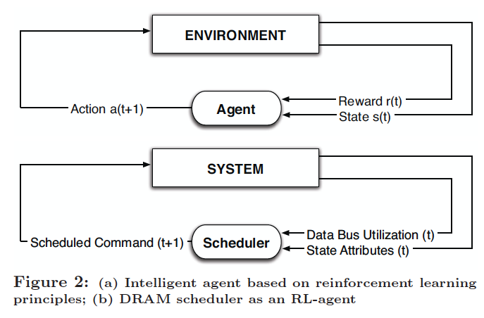
Self-Optimizing DRAM Controllers
Engin Ipek, Onur Mutlu, José F. Martínez, and Rich Caruana,
"Self Optimizing Memory Controllers: A Reinforcement Learning Approach"
Proceedings of the 35th International Symposium on Computer Architecture (ISCA), pages 39-50, Beijing, China, June 2008.
Goal: Learn to choose actions to maximize r₀ + γr₁ + γ²r₂ + … ( 0 ≤ γ < 1)

Slide 99
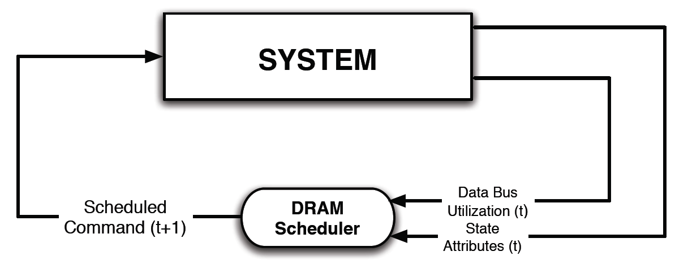
Self-Optimizing DRAM Controllers
Dynamically adapt the memory scheduling policy via interaction with the system at runtime
  Associate system states and actions (commands) with long term reward values: each action at a given state leads to a learned reward
  Schedule command with highest estimated long-term reward value in each state
  Continuously update reward values for <state, action> pairs based on feedback from system

Slide 100
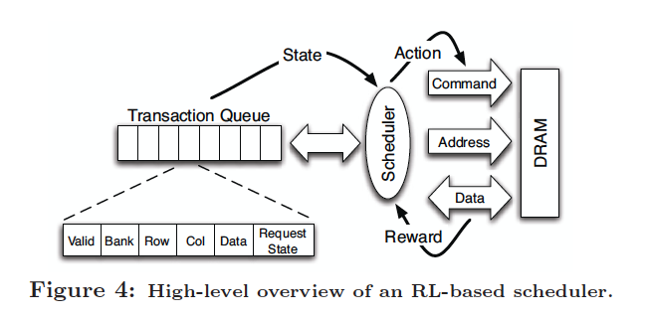
Self-Optimizing DRAM Controllers
Engin Ipek, Onur Mutlu, José F. Martínez, and Rich Caruana,
"Self Optimizing Memory Controllers: A Reinforcement Learning Approach"
Proceedings of the 35th International Symposium on Computer Architecture (ISCA), pages 39-50, Beijing, China, June 2008.

Slide 101
States, Actions, Rewards
Reward function
  +1 for scheduling Read and Write commands
  0 at all other times
  Goal is to maximize long-term data bus utilization
State attributes
  Number of reads, writes, and load misses in transaction queue
  Number of pending writes and ROB heads waiting for referenced row
  Request’s relative ROB order
Actions
  Activate
  Write
  Read - load miss
  Read - store miss
  Precharge - pending
  Precharge - preemptive
  NOP

Slide 102
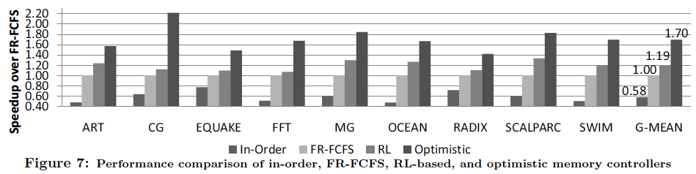
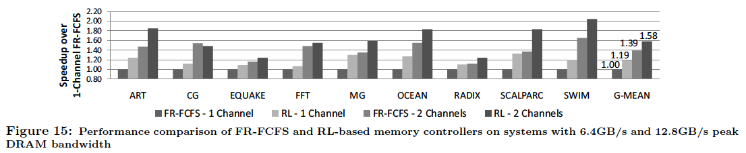
Performance Results
Large, robust performance improvements
over many human-designed policies

Slide 103
Self Optimizing DRAM Controllers
+ Continuous learning in the presence of changing environment
+ Reduced designer burden in finding a good scheduling policy. Designer specifies:
1) What system variables might be useful
2) What target to optimize, but not how to optimize it
-- How to specify different objectives? (e.g., fairness, QoS, …)
-- Hardware complexity?
-- Design mindset and flow

Slide 104
More on Self-Optimizing DRAM Controllers (I)
Engin Ipek, Onur Mutlu, José F. Martínez, and Rich Caruana,
"Self Optimizing Memory Controllers: A Reinforcement Learning Approach"
Proceedings of the 35th International Symposium on Computer Architecture (ISCA), pages 39-50, Beijing, China, June 2008.

Slide 105
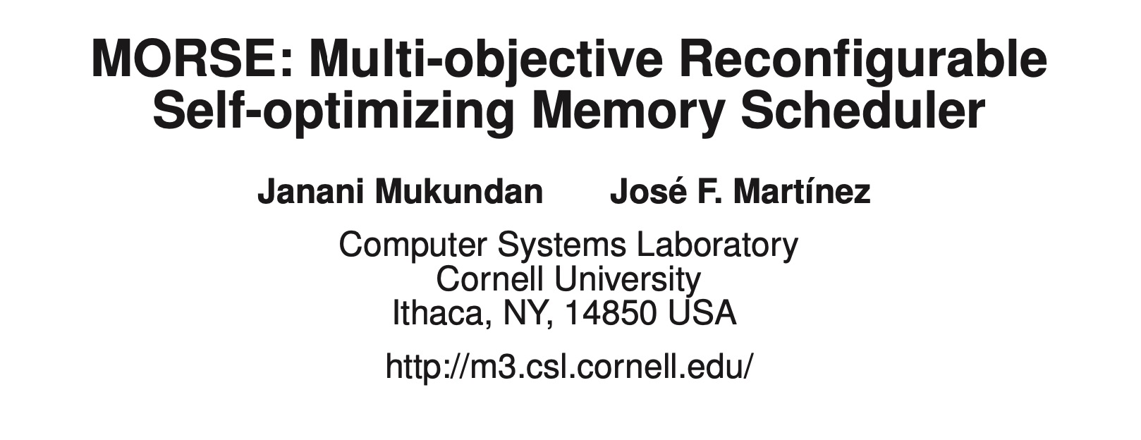
More on Self-Optimizing DRAM Controllers (II)
Janani Mukundan and José F. Martinez
“MORSE: Multi-Objective Reconfigurable Self-Optimizing Memory Scheduler”
Proceedings of the 18th International Symposium on High Performance Computer Architecture (HPCA), New Orleans, Louisiana, February 2012.

Slide 106
The Future
Memory Controllers
are critical to research
They will become
even more important

Slide 107
Sibyl: Reinforcement Learning based
Data Placement in Hybrid SSDs

Slide 108
Self-Optimizing Hybrid SSD Controllers
Gagandeep Singh, Rakesh Nadig, Jisung Park, Rahul Bera, Nastaran Hajinazar, David Novo, Juan Gomez-Luna, Sander Stuijk, Henk Corporaal, and Onur Mutlu,
"Sibyl: Adaptive and Extensible Data Placement in Hybrid Storage Systems Using Online Reinforcement Learning"
Proceedings of the 49th International Symposium on Computer Architecture (ISCA), New York, June 2022.
[Slides (pptx) (pdf)]
[arXiv version]
[Sibyl Source Code]
[Talk Video (16 minutes)]
https://arxiv.org/pdf/2205.07394.pdf

Slide 109
Sibyl
Adaptive and Extensible Data Placement in Hybrid Storage Systems
Using Online Reinforcement Learning
Gagandeep Singh, Rakesh Nadig, Jisung Park,
Rahul Bera, Nastaran Hajinazar, David Novo,
Juan Gómez Luna, Sander Stuijk, Henk Corporaal,
Onur Mutlu
109
Notes:
Hi First of all. Thank you very much for staying until this long.
I’m going to present our work “…”

Slide 110
Executive Summary
Background: A hybrid storage system (HSS) uses multiple different storage devices to provide high and scalable storage capacity at high performance
Problem: Two key shortcomings of prior data placement policies:
  Lack of adaptivity to:
    Workload changes
    Changes in device types and configurations
  Lack of extensibility to more devices
Goal: Design a data placement technique that provides:
  Adaptivity, by continuously learning and adapting to the application and underlying device characteristics
  Easy extensibility to incorporate a wide range of hybrid storage configurations
Contribution: Sibyl, the first reinforcement learning-based data placement technique in hybrid storage systems that:
  Provides adaptivity to changing workload demands and underlying device characteristics
  Can easily extend to any number of storage devices
  Provides ease of design and implementation that requires only a small computation overhead
Key Results: Evaluate on real systems using a wide range of workloads
  Sibyl improves performance by 21.6% compared to the best previous data placement technique in dual-HSS configuration
  In a tri-HSS configuration, Sibyl outperforms the state-of-the-art-policy policy by 48.2%
  Sibyl achieves 80% of the performance of an oracle policy with storage overhead of only 124.4 KiB
https://github.com/CMU-SAFARI/Sibyl
Notes:
First, I am going to start with an executive summary.
[CLICK] Hybrid storage systems use multiple different storage devices to provide high and scalable storage capacity at high performance
[CLICK] We observe two key shortcomings in prior data placement techniques:
First, lack of adaptivity to workload changes and changes in device types and configurations
Second, they also lack extensibility to to more devices.
[CLICK] Our goal in this work is to design a data placement technique that provides
Adaptivity, by continuously learning and adapting to the application and underlying device characteristics
Easy extensibility to incorporate a wide range of hybrid storage configurations
[CLICK] to this end we propose Sibyl, an online reinforcement learning-based data placement in Hybrid storage systems that:
Provides both adaptivity
and easy extensiblity
and also Provides ease of design and implementation that requires only a small computation overhead
[CLICK] We extensively evaluate Sibyl on real systems using a wide range of workloads
We show that Sibyl outperforms prior state-of-the-art data placement policeis by 21.6% in dual-hybrid storage system and upto 48.2% on trihybrid system
Sibyl achieves 80% of the performance of an oracle policy that has a complete knowledge of future access patterns while incurring a very modest storage overhead of only 124.4 KiB
The code will be opensourced on our GitHub repository.
https://github.com/CMU-SAFARI/Sibyl

Slide 111
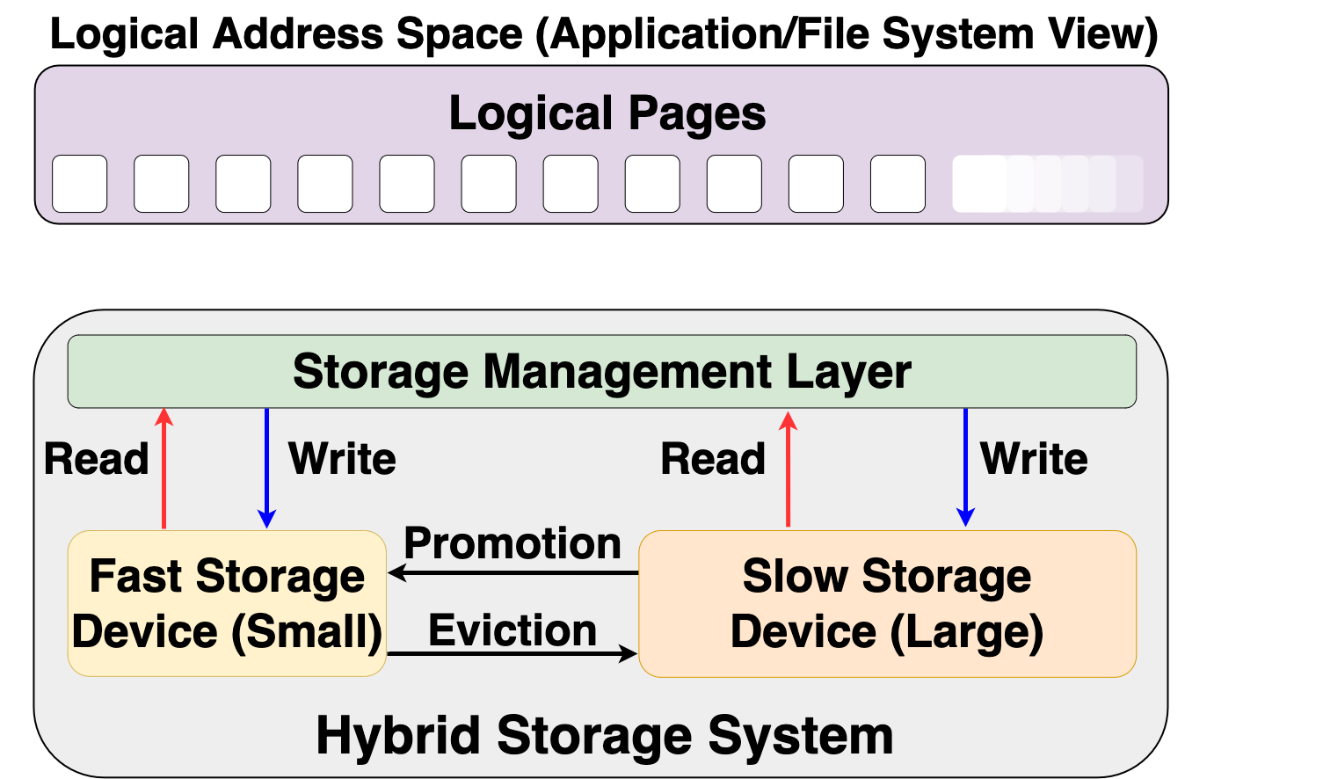


Hybrid Storage System Basics
Address Space (Application/File System View)
Read
Write
Storage Management Layer
Read
Write
Read
Write
Promotion
Eviction
Fast Device
Slow Device
Hybrid Storage System

Slide 112
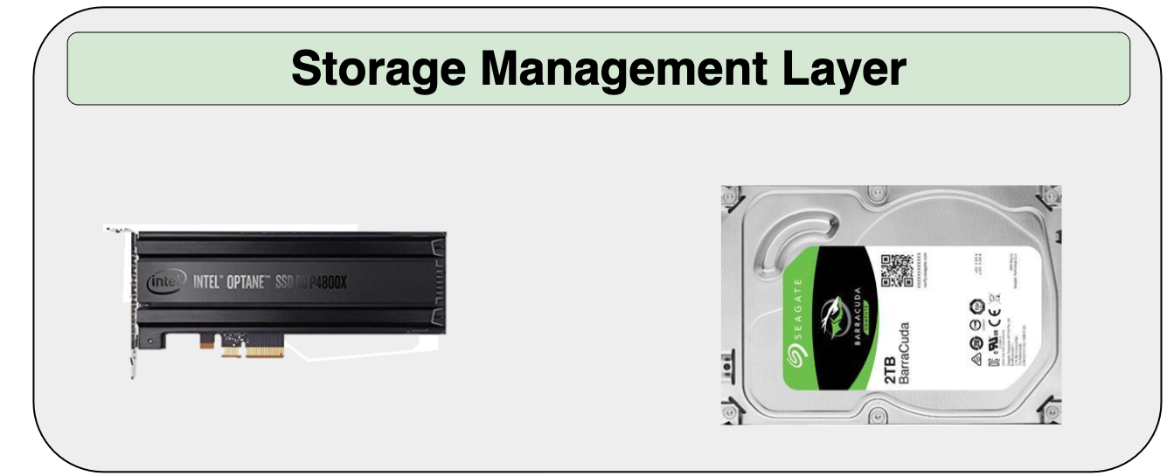
Hybrid Storage System Basics
Performance of a hybrid storage system
highly depends on the
storage management layer’s ability to
manage diverse devices and workloads
Read
Write
Read
Write
Read
Write
Promotion
Eviction
Hybrid Storage System

Slide 113
Key Shortcomings in Prior Techniques
We observe two key shortcomings that significantly limit the performance benefits of prior techniques
Lack of adaptivity to:
  Workload changes
  Changes in device types and configuration
Lack of extensibility to more devices

Slide 114

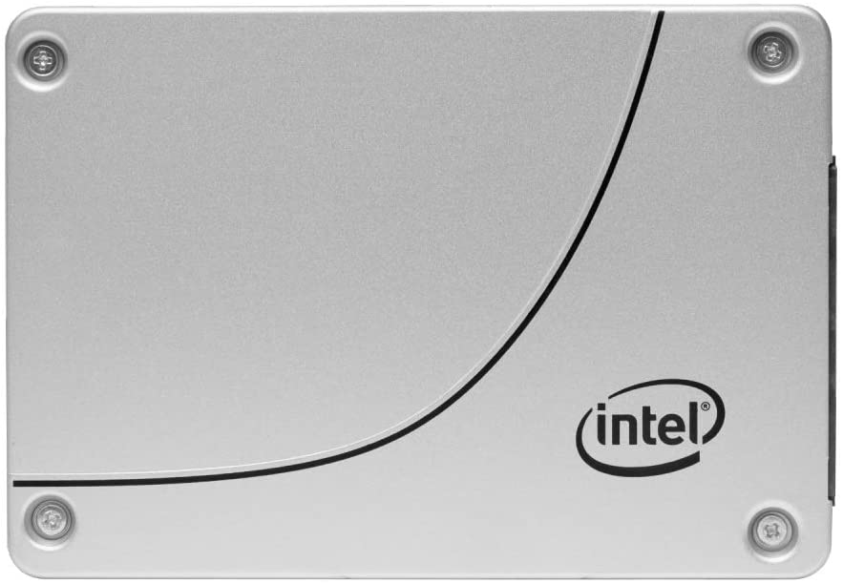
Lack of Extensibility (1/2)
Rigid techniques that require significant effort to accommodate more than two devices
Change in storage configuration
Dual-HSS

Slide 115

Lack of Extensibility (2/2)
Rigid techniques that require significant effort to accommodate more than two devices
Change in storage configuration
Design a new policy
Tri-HSS

Slide 116
Our Goal
A data-placement mechanism
that can provide:
Adaptivity, by continuously learning and adapting to the application and underlying device characteristics
Easy extensibility to incorporate a wide range of hybrid storage configurations

Slide 117

Our Proposal
Sibyl
Formulates data placement in hybrid storage systems as a reinforcement learning problem
Sibyl is an oracle that makes accurate prophecies
https://en.wikipedia.org/wiki/Sibyl

Slide 118
Basics of Reinforcement Learning (RL)
Agent learns to take an action in a given state
to maximize a numerical reward

Slide 119
Formulating Data Placement as RL
Agent
State (S_{t})
Reward (R_{t+1})
Action (A_{t})
Environment
Sibyl
Features of the current request and system
Request latency
(of last served request)
Select storage device to place the current page
Hybrid Storage System

Slide 120
What is State?
Sibyl
Features of the current request and system
Request latency
(of last served request)
Select storage device to place
the current page
Limited number of state features:
  Reduce the implementation overhead
  RL agent is more sensitive to reward
6-dimensional vector of state features
We quantize the state representation into bins to reduce storage overhead
Hybrid Storage System

Slide 121
What is Reward?
Sibyl
Features of the current request and system
Request latency
(of last served request)
Select storage device to place
the current page
Defines the objective of Sibyl
We formulate the reward as a function of the request latency
Encapsulates three key aspects:
  Internal state of the device (e.g., read/write latencies, the latency of garbage collection, queuing delays, …)
  Throughput
  Evictions
More details in the paper
Hybrid Storage System

Slide 122
What is Action?
Sibyl
Features of the current request and system
Request latency
(of last served request)
Select storage device to place
the current page
At every new page request, the action is to select a storage device
Action can be easily extended to any number of storage devices
Sibyl evicts a page when the fast device utilization is 100%
Sibyl promotes a page when there is an update from the application
Hybrid Storage System

Slide 123
Talk Outline
Key Shortcomings of Prior Data Placement Techniques
Formulating Data Placement as Reinforcement Learning
Sibyl: Overview
Evaluation of Sibyl and Key Results
Conclusion

Slide 124
Sibyl Execution
RL Training Thread
Asynchronous
Execution
State, Reward, and Action Information
Periodic Policy
Weight Update
Storage
Request
(from OS)
RL Decision Thread
Data Placement Decision
Sibyl

Slide 125
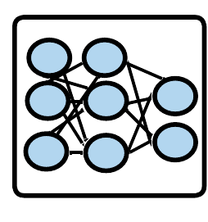
Sibyl Design: Overview
RL Training Thread
Training
Network
Training Dataset
Batch
Periodic Policy
Weight Update
Periodic Weights update
10
RL Decision Thread
Experience Buffer (in host DRAM)
State
Max
Action
Storage
Request
(from OS)
Inference
Network
Sibyl Policy
Observation
Vector
HSS
Reward
Collect
Experiences
State

Slide 126
RL Decision Thread
RL Training Thread
Training
Network
Training Dataset
Batch
Periodic Policy
Weight Update
RL Decision Thread
Experience Buffer (in host DRAM)
State
Max
Action
Storage
Request
(from OS)
Inference
Network
Sibyl Policy
Observation
Vector
HSS
Reward
Collect
Experiences
State

Slide 127
RL Decision Thread
RL Training Thread
Training
Network
Training Dataset
Batch
Periodic Policy
Weight Update
RL Decision Thread
Experience Buffer (in host DRAM)
State
Max
Action
Storage
Request
(from OS)
Inference
Network
Sibyl Policy
Observation
Vector
HSS
Reward
Collect
Experiences
State

Slide 128
RL Decision Thread
RL Training Thread
Training
Network
Training Dataset
Batch
Periodic Policy
Weight Update
RL Decision Thread
Experience Buffer (in host DRAM)
State
Max
Action
Storage
Request
(from OS)
Inference
Network
Sibyl Policy
Observation
Vector
HSS
Reward
Collect
Experiences
State

Slide 129
RL Decision Thread
RL Training Thread
Training
Network
Training Dataset
Batch
Periodic Policy
Weight Update
RL Decision Thread
Experience Buffer (in host DRAM)
State
Max
Action
Storage
Request
(from OS)
Inference
Network
Sibyl Policy
Observation
Vector
HSS
Reward
Collect
Experiences
State

Slide 130
RL Decision Thread
RL Training Thread
Training
Network
Training Dataset
Batch
Periodic Policy
Weight Update
RL Decision Thread
Experience Buffer (in host DRAM)
State
Max
Action
Storage
Request
(from OS)
Inference
Network
Sibyl Policy
Observation
Vector
HSS
Reward
Collect
Experiences
State

Slide 131
RL Training Thread
RL Training Thread
Training
Network
Training Dataset
Batch
Periodic Policy
Weight Update
Periodic Weights update
10
RL Decision Thread
Experience Buffer (in host DRAM)
State
Max
Action
Storage
Request
(from OS)
Inference
Network
Sibyl Policy
Observation
Vector
HSS
Reward
Collect
Experiences
State

Slide 132
Periodic Weight Transfer
RL Training Thread
Training
Network
Training Dataset
Batch
Periodic Policy
Weight Update
Periodic Weights update
10
RL Decision Thread
Experience Buffer (in host DRAM)
State
Max
Action
Storage
Request
(from OS)
Inference
Network
Sibyl Policy
Observation
Vector
HSS
Reward
Collect
Experiences
State

Slide 133
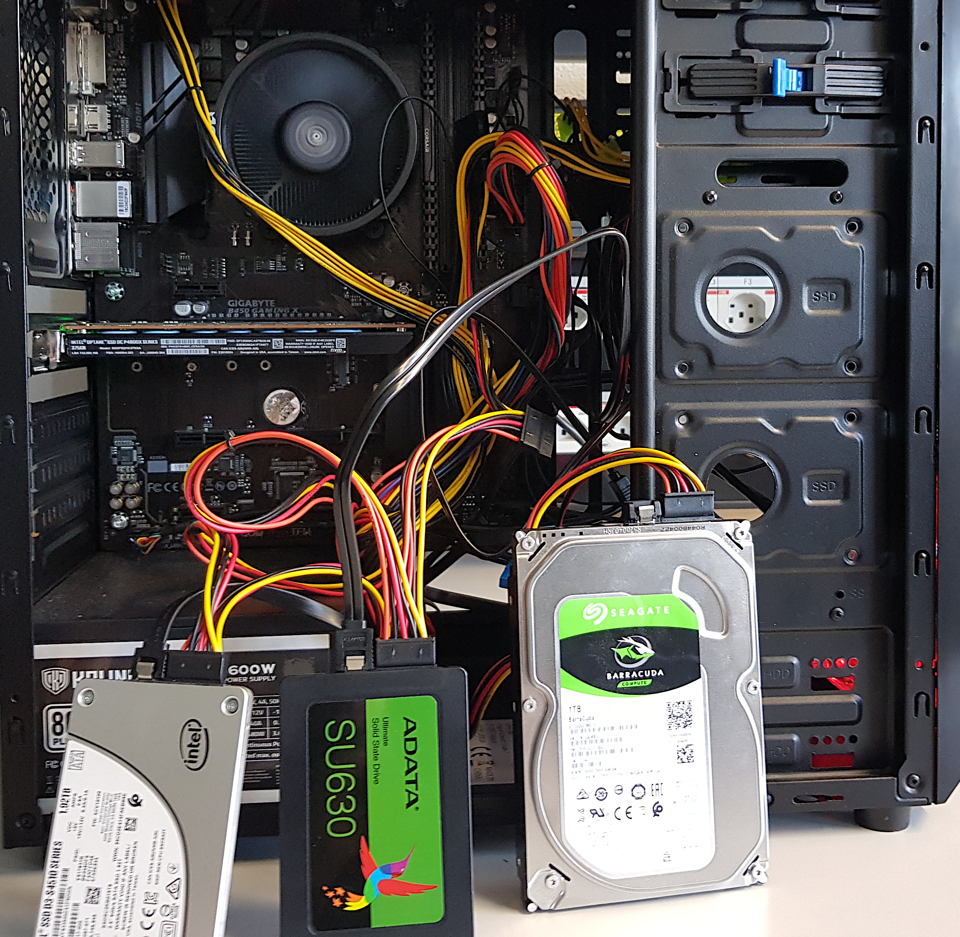
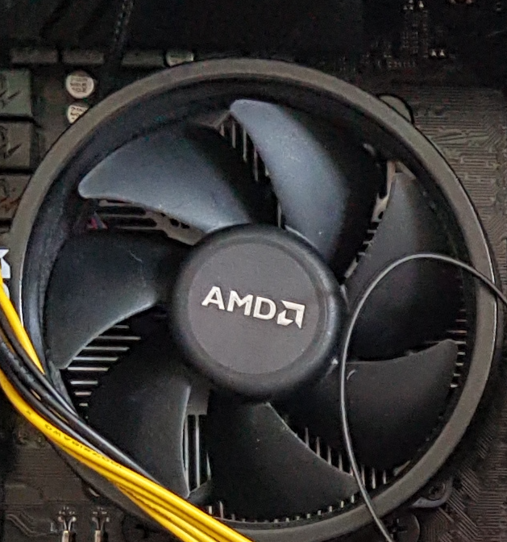
Evaluation Methodology (1/3)
Real system with various HSS configurations
  Dual-hybrid and tri-hybrid systems
AMD Ryzen7 2700G CPU
Intel Optane SSD P4800X
Seagate HDD
ST1000DM010
Intel SSD D3-S4510
ADATA
SU630 SSD

Slide 134
Evaluation Methodology (2/3)
Cost-Oriented HSS Configuration
High-end SSD
Low-end HDD
Performance-Oriented HSS Configuration
High-end SSD
Middle-end SSD

Slide 135
Evaluation Methodology (3/3)
18 different workloads from:
  MSR Cambridge and Filebench Suites
Four state-of-the-art data placement baselines:
  CDE [Matsui+, Proc. IEEE’17]
  HPS [Meswani+, HPCA’15]
  Archivist [Ren+, ICCD’19]
  RNN-HSS [Doudali+, HPDC’19]
Heuristic-based
Learning-based

Slide 136
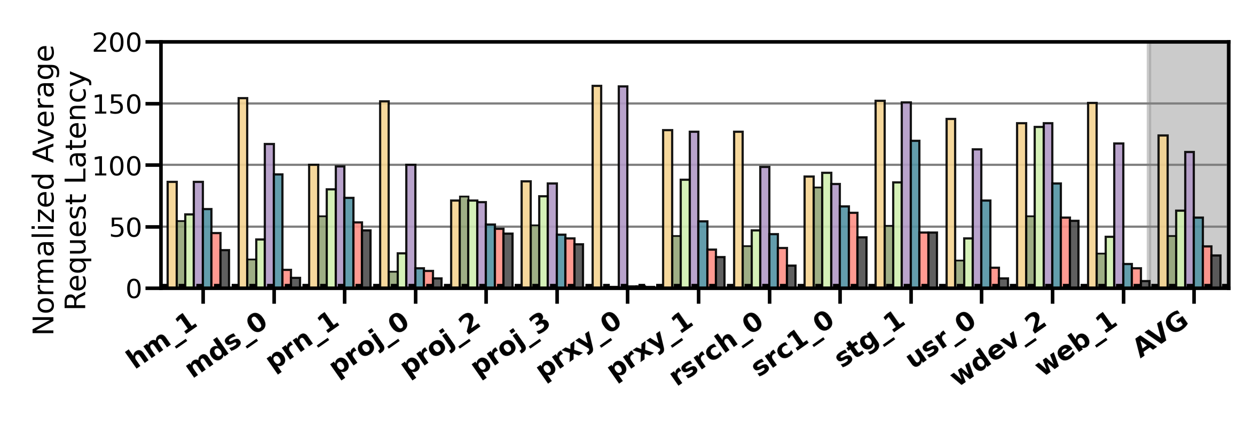
Performance Analysis
High-end SSD
Low-end HDD
Cost-Oriented HSS Configuration
Slow-Only
CDE
HPS
Archivist
RNN-HSS
Sibyl
Oracle

Slide 137
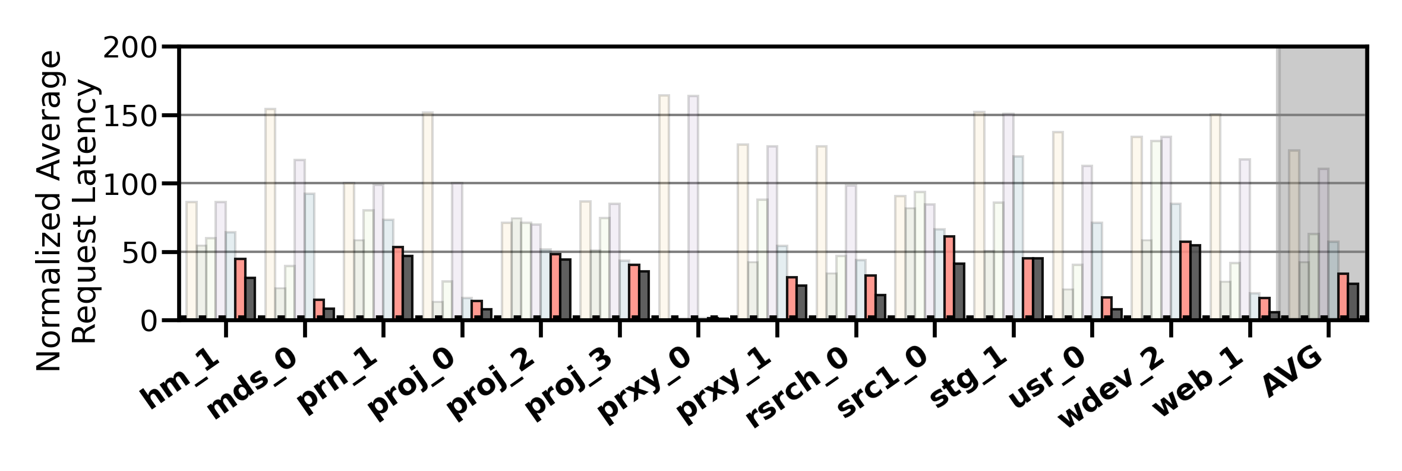
Performance Analysis
High-end SSD
Low-end HDD
Cost-Oriented HSS Configuration
Slow-Only
CDE
HPS
Archivist
RNN-HSS
Sibyl
Oracle
Sibyl consistently outperforms all the baselines
for all the workloads

Slide 138
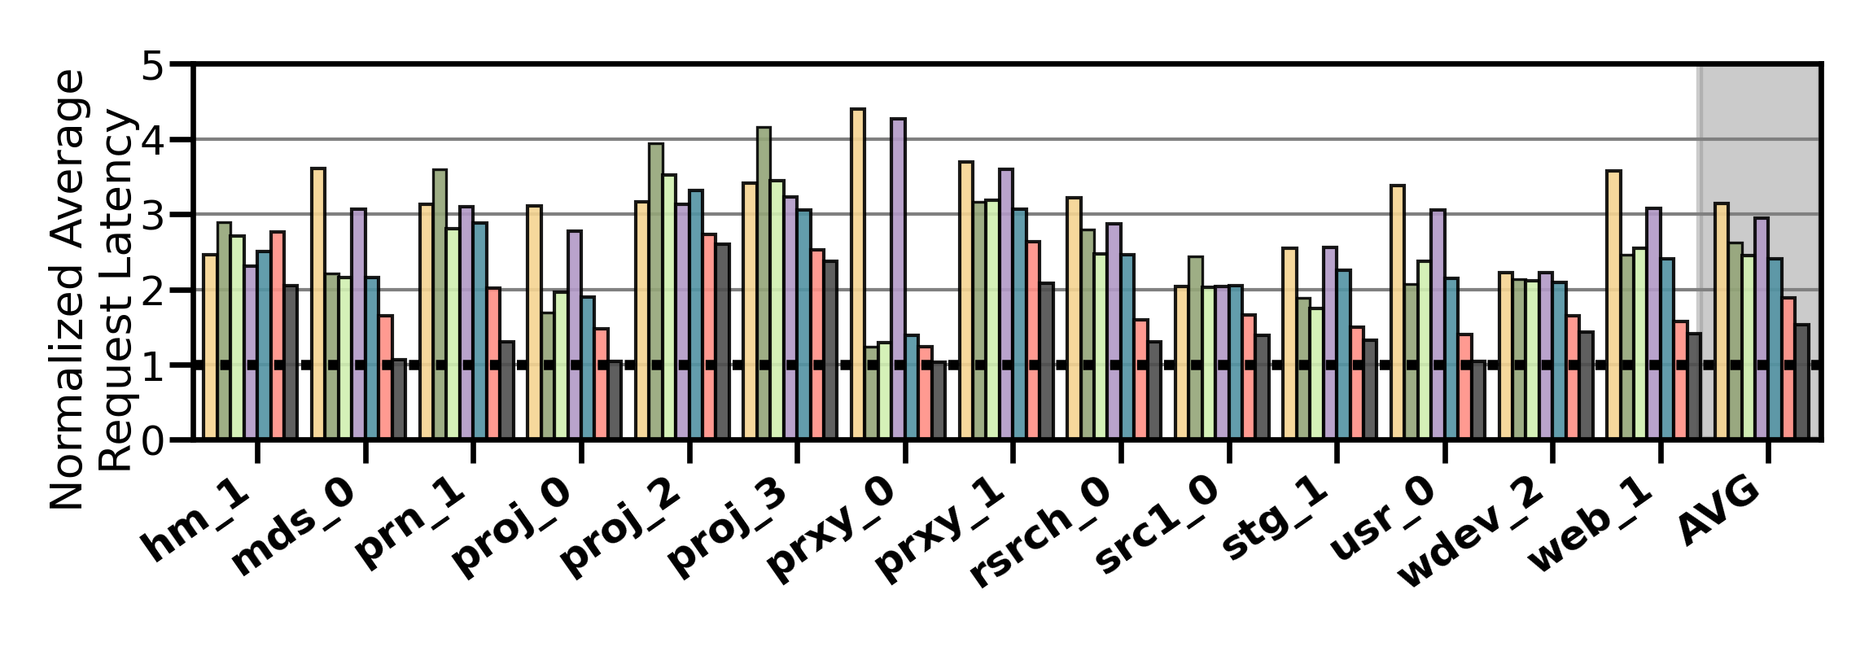
Performance Analysis
High-end SSD
Mid-end SSD
Performance-Oriented HSS Configuration
Slow-Only
CDE
HPS
Archivist
RNN-HSS
Sibyl
Oracle

Slide 139
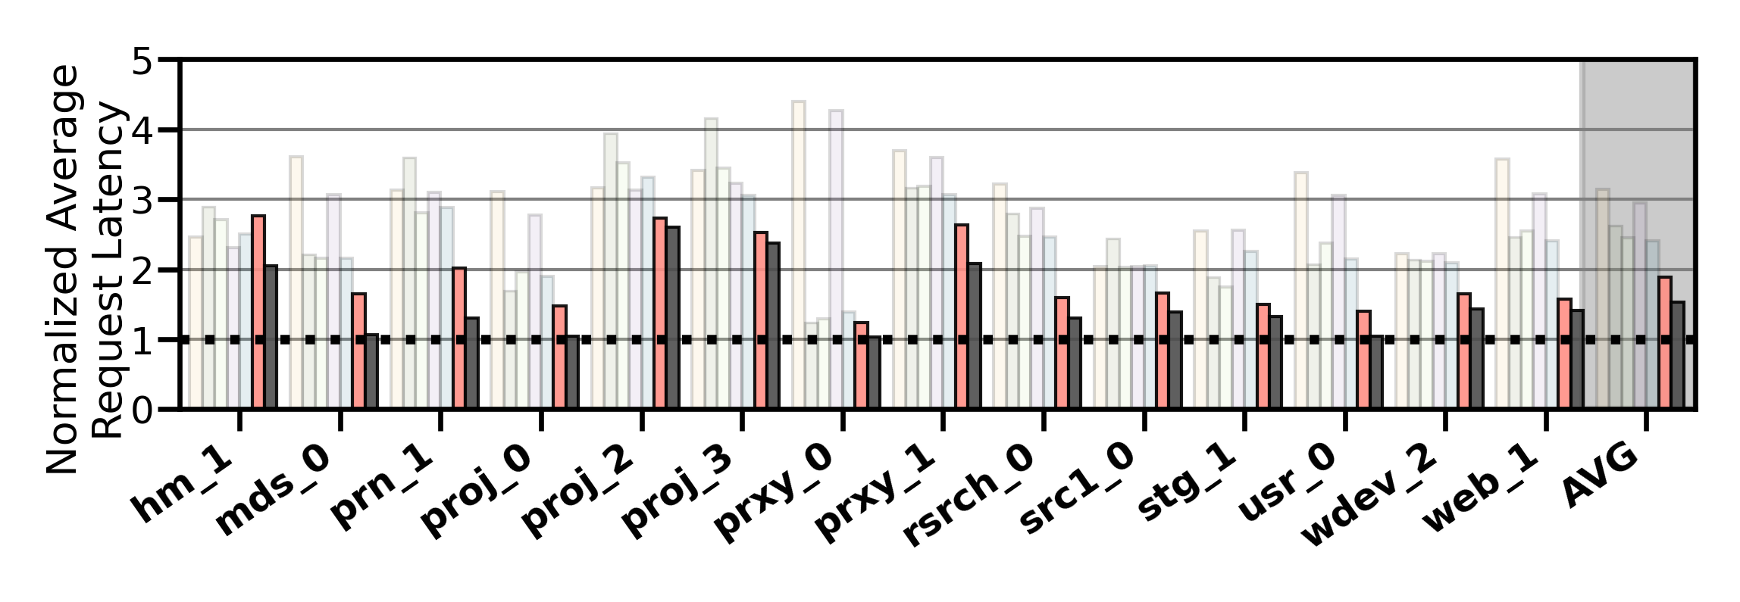
Performance Analysis
High-end SSD
Mid-end SSD
Performance-Oriented HSS Configuration
Slow-Only
CDE
HPS
Archivist
RNN-HSS
Sibyl
Oracle
Sibyl provides 21.6% performance improvement by dynamically adapting its data placement policy

Slide 140
Performance Analysis
High-end SSD
Mid-end SSD
Performance-Oriented HSS Configuration
Slow-Only
CDE
HPS
Archivist
RNN-HSS
Sibyl
Oracle
Sibyl achieves 80% of the performance
of an oracle policy that has
complete knowledge of future access patterns

Slide 141

Performance on Tri-HSS
High-end SSD
Mid-end SSD
Low-end HDD
Extending Sibyl for more devices:
Extending Sibyl for more devices:
  Add a new action
  Add the remaining capacity of the new device as a state feature
Heuristic_{Tri-hybrid}
Sibyl_{Tri-hybrid}

Slide 142

Performance on Tri-HSS
High-end SSD
Mid-end SSD
Low-end HDD
Extending Sibyl for more devices:
  Add a new action
  Add the remaining capacity of the new device as a state feature
Heuristic_{Tri-hybrid}
Sibyl_{Tri-hybrid}

Slide 143
Performance on Tri-HSS
High-end SSD
Mid-end SSD
Low-end HDD
Extending Sibyl for more devices:
  Add a new action
  Add the remaining capacity of the new device as a state feature
Sibyl outperforms the state-of-the-art
data placement policy by
48.2% in a real tri-hybrid system
Heuristic_{Tri-hybrid}
Sibyl_{Tri-hybrid}
Sibyl reduces the system architect's burden
by providing ease of extensibility

Slide 144
Sibyl’s Overhead
124.4 KiB of total storage cost
  Experience buffer, inference and training network
40-bit metadata overhead per page for state features
Inference latency of ~10ns
Training latency of ~2us
Small inference overhead
Satisfies prediction latency

Slide 145
More in the Paper (1/3)
Throughput (IOPS) evaluation
  Sibyl provides high IOPS compared to baseline policies because it indirectly captures throughput (size/latency)
Evaluation on unseen workloads
  Sibyl can effectively adapt its policy to highly dynamic workloads
Evaluation on mixed workloads
  Sibyl provides equally-high performance benefits as in single workloads

Slide 146
More in the Paper (2/3)
Evaluation on different features
  Sibyl autonomously decides which features are important to maximize the performance
Evaluation with different hyperparameter values
Sensitivity to fast storage capacity
  Sibyl provides scalability by dynamically adapting its policy to available storage size
Explainability analysis of Sibyl's decision making
  Explain Sibyl’s actions for different workload characteristics and device configurations

Slide 147

More in the Paper (3/3)
https://arxiv.org/pdf/2205.07394.pdf
https://github.com/CMU-SAFARI/Sibyl

Slide 148
Conclusion
We introduced Sibyl, the first reinforcement learning-based data placement technique in hybrid storage systems that provides
  Adaptivity
  Easily extensibility
  Ease of design and implementation
We evaluated Sibyl on real systems using many different workloads
  Sibyl improves performance by 21.6% compared to the best prior data placement policy in a dual-HSS configuration
  In a tri-HSS configuration, Sibyl outperforms the state-of-the-art-data placement policy by 48.2%
  Sibyl achieves 80% of the performance of an oracle policy with a storage overhead of only 124.4 KiB
https://github.com/CMU-SAFARI/Sibyl

Slide 149
Major Directions
Consider other optimization objectives
  Energy consumption, endurance of storage devices…..
  Design better reward structures
Optimize data migration in hybrid storage systems
  Explore machine learning (ML) techniques to make
  data migration adaptive and extensible
  How do we coordinate multiple ML techniques?
How do we improve these policies in other
heterogeneous memory systems?
  DRAM + NVM, CPU Caches + DRAM
  Design RL models keeping latency constraints in mind

Slide 150
ISCA 2022 Paper, Slides, Videos
Gagandeep Singh, Rakesh Nadig, Jisung Park, Rahul Bera, Nastaran Hajinazar, David Novo, Juan Gomez-Luna, Sander Stuijk, Henk Corporaal, and Onur Mutlu,
"Sibyl: Adaptive and Extensible Data Placement in Hybrid Storage Systems Using Online Reinforcement Learning"
Proceedings of the 49th International Symposium on Computer Architecture (ISCA), New York, June 2022.
[Slides (pptx) (pdf)]
[arXiv version]
[Sibyl Source Code]
[Talk Video (16 minutes)]
https://arxiv.org/pdf/2205.07394.pdf

Slide 151

SSD Course (Spring 2023)
Spring 2023 Edition:
  https://safari.ethz.ch/projects_and_seminars/spring2023/doku.php?id=modern_ssds
Fall 2022 Edition:
  https://safari.ethz.ch/projects_and_seminars/fall2022/doku.php?id=modern_ssds
Youtube Livestream (Spring 2023):
  https://www.youtube.com/watch?v=4VTwOMmsnJY&list=PL5Q2soXY2Zi_8qOM5Icpp8hB2SHtm4z57&pp=iAQB
Youtube Livestream (Fall 2022):
  https://www.youtube.com/watch?v=hqLrd-Uj0aU&list=PL5Q2soXY2Zi9BJhenUq4JI5bwhAMpAp13&pp=iAQB
Project course
  Taken by Bachelor’s/Master’s students
  SSD Basics and Advanced Topics
  Hands-on research exploration
  Many research readings
https://www.youtube.com/onurmutlulectures

Slide 152

Comp Arch (Fall 2021)
Fall 2021 Edition:
  https://safari.ethz.ch/architecture/fall2021/doku.php?id=schedule
Fall 2020 Edition:
  https://safari.ethz.ch/architecture/fall2020/doku.php?id=schedule
Youtube Livestream (2021):
  https://www.youtube.com/watch?v=4yfkM_5EFgo&list=PL5Q2soXY2Zi-Mnk1PxjEIG32HAGILkTOF
Youtube Livestream (2020):
  https://www.youtube.com/watch?v=c3mPdZA-Fmc&list=PL5Q2soXY2Zi9xidyIgBxUz7xRPS-wisBN
Master’s level course
  Taken by Bachelor’s/Masters/PhD students
  Cutting-edge research topics + fundamentals in Computer Architecture
  5 Simulator-based Lab Assignments
  Potential research exploration
  Many research readings
https://www.youtube.com/onurmutlulectures

Slide 153
Memory Systems and Memory-Centric Computing
Topic 4: ML/AI-Driven Memory Systems
Onur Mutlu
omutlu@gmail.com
https://people.inf.ethz.ch/omutlu
19 July 2024
HiPEAC ACACES Summer School 2024

