Slide 1



Memory System Design for AI/ML Accelerators & ML/AI Techniques for Memory System Design
Onur Mutlu
omutlu@gmail.com
https://people.inf.ethz.ch/omutlu
10 November 2022
Intel/SRC Research Program Review

Slide 2
The Problem
Computing
is Bottlenecked by Data

Slide 3
Data is Key for AI, ML, Genomics, …
Important workloads are all data intensive
They require rapid and efficient processing of large amounts of data
Data is increasing
  We can generate more than we can process
  Our systems need to make more adaptive and better decisions

Slide 4
In This Task… (Task #2946.001)
We focus on designing memory systems to handle large amounts of data and emerging data-intensive workloads
Goal: solve two different yet related & synergistic problems
We explore (and exploit the synergy between)
  Memory system design for AI/ML workloads/accelerators
  AI/ML techniques for improving memory system designs

Slide 5
Anticipated Primary Results
Realistic, practical and effective novel (memory) system designs for ML/AI accelerators
New ML-based techniques to improve (memory) system efficiency and performance
Open-source workloads, metrics, methodologies & infrastructures to analyze such designs and techniques

Slide 6

Task Description

Slide 7
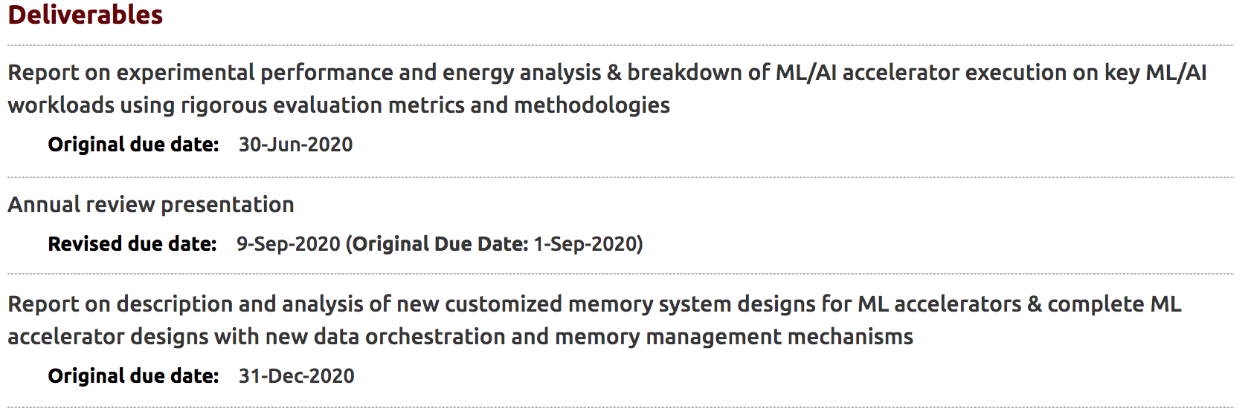
Task Deliverables (2020)

Slide 8
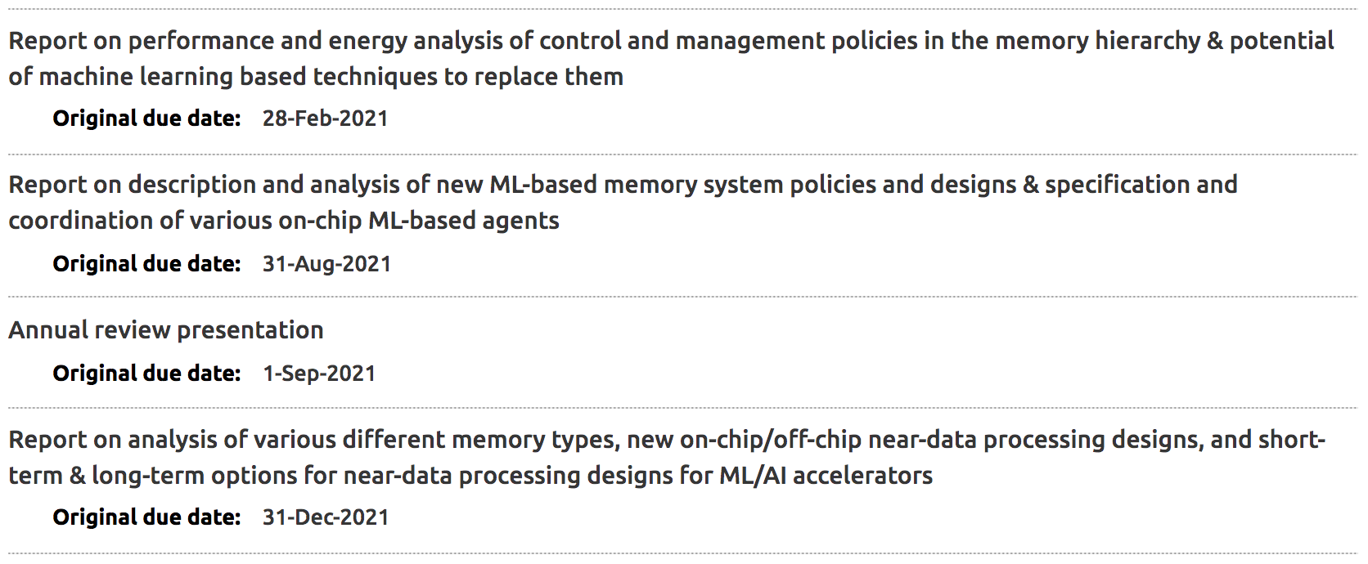
Task Deliverables (2021)

Slide 9
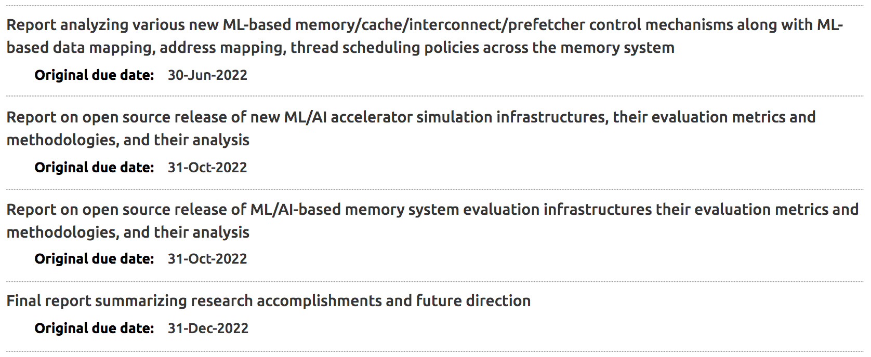
Task Deliverables (2022)

Slide 10
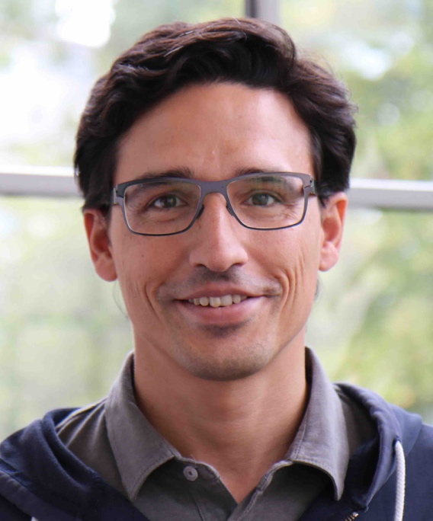



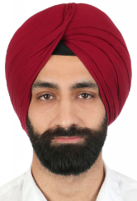
Task Information #2946.001 (2)
Senior Researchers
  Juan Gomez Luna (ETH)
  Haiyu Mao (ETH)
  Lois Orosa (ETH)
  Jisung Park (ETH)
  Gagandeep Singh (ETH)
More students/postdocs to be added as the task evolves

Slide 11
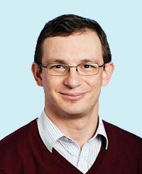

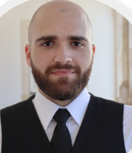
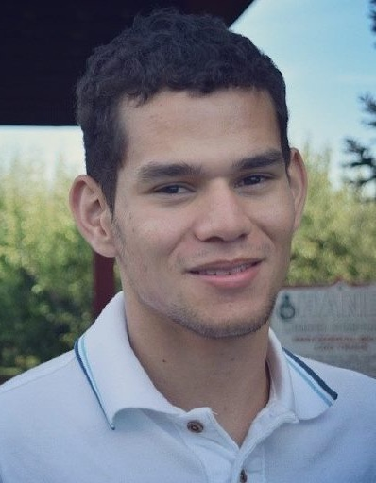




Task Information #2946.001 (1)
Thrust: AI Hardware
Task Leader: Onur Mutlu
  https://people.inf.ethz.ch/omutlu/
  onur.mutlu@inf.ethz.ch
Students
  Rahul Bera (ETH)
  Joao Ferreira (ETH)
  Geraldo Francisco de Oliveira Junior (ETH)
  Konstantinos Kanellopoulos (ETH)
  Joel Lindegger (ETH)
  Aditya Manglik (ETH)
  Rakesh Nadig (ETH)

Slide 12
Industry Liaisons
Charles Augustine, Intel
Pradip Bose, IBM
Alper Buyuktosunoglu, IBM
Rosario Cammarota, Intel
Ramesh Chauhan, Qualcomm
Prokash Ghosh, NXP
Jose Joao, ARM
Arun Joseph, IBM
Preetham Lobo, IBM
Nithyakalyani Sampath, TI
Willem Sanberg, NXP
Pushkar Sareen, NXP
Sreenivas Subramoney, Intel
Xin Zhang, IBM
We are having and will have regular and irregular meetings with all liaison companies
Very open to other collaborators, feedback, internships, visits

Slide 13
Two Major Thrusts
  1. (Memory) system design for AI/ML workloads/accelerators
  2. AI/ML techniques for improving (memory) system designs

Slide 14
Challenge and Opportunity for Future
Self-Optimizing
(Data-Driven)
Computing Architectures

Slide 15
System Architecture Design Today
Human-driven
  Humans design the policies (how to do things)
Many (too) simple, short-sighted policies all over the system
No automatic data-driven policy learning
(Almost) no learning: cannot take lessons from past actions
Can we design
fundamentally intelligent architectures?

Slide 16
An Intelligent Architecture
Data-driven
  Machine learns the “best” policies (how to do things)
Sophisticated, workload-driven, changing, far-sighted policies
Automatic data-driven policy learning
All controllers are intelligent data-driven agents
We need to rethink design
(of all controllers)

Slide 17
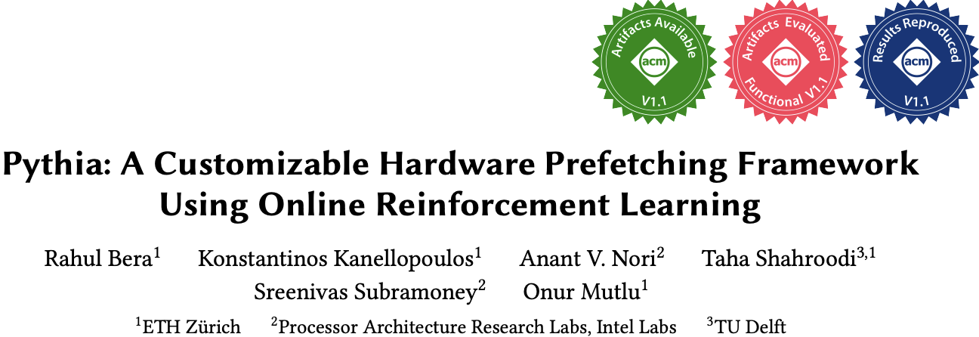
Self-Optimizing Memory Prefetchers
Rahul Bera, Konstantinos Kanellopoulos, Anant Nori, Taha Shahroodi, Sreenivas Subramoney, and Onur Mutlu,
"Pythia: A Customizable Hardware Prefetching Framework Using Online Reinforcement Learning"
Proceedings of the 54th International Symposium on Microarchitecture (MICRO), Virtual, October 2021.
[Slides (pptx) (pdf)]
[Short Talk Slides (pptx) (pdf)]
[Lightning Talk Slides (pptx) (pdf)]
[Talk Video (20 minutes)]
[Lightning Talk Video (1.5 minutes)]
[Pythia Source Code (Officially Artifact Evaluated with All Badges)]
[arXiv version]
Officially artifact evaluated as available, reusable and reproducible.
https://arxiv.org/pdf/2109.12021.pdf

Slide 18
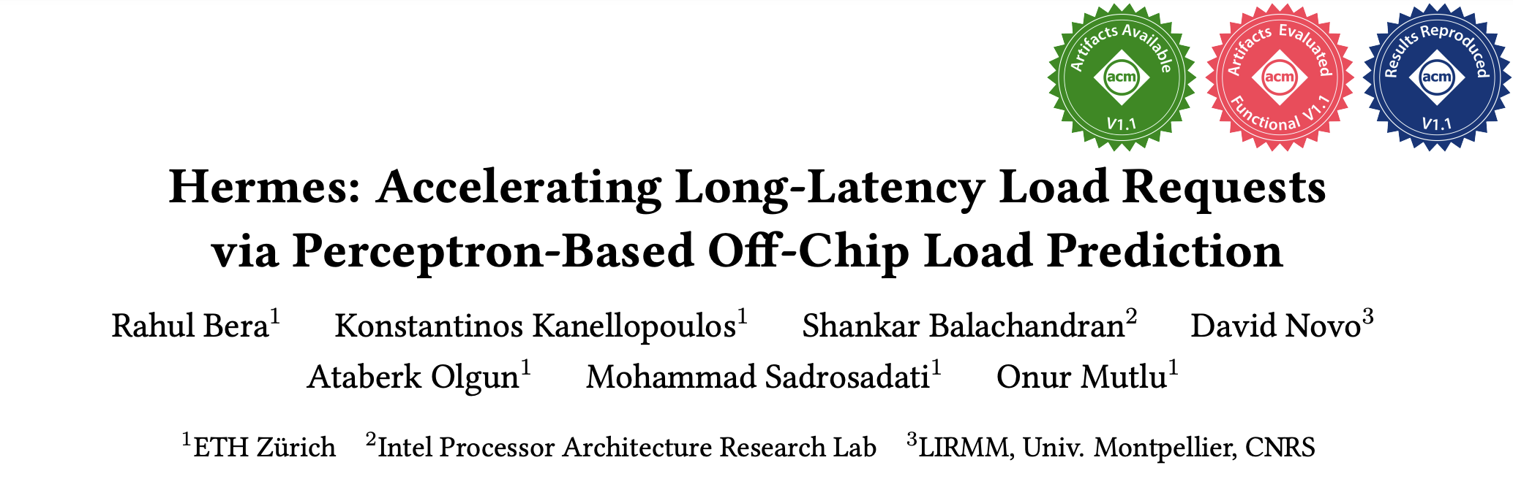
Learning-Based Off-Chip Load Predictors
Best Paper Award at MICRO 2022
https://arxiv.org/pdf/2209.00188.pdf

Slide 19
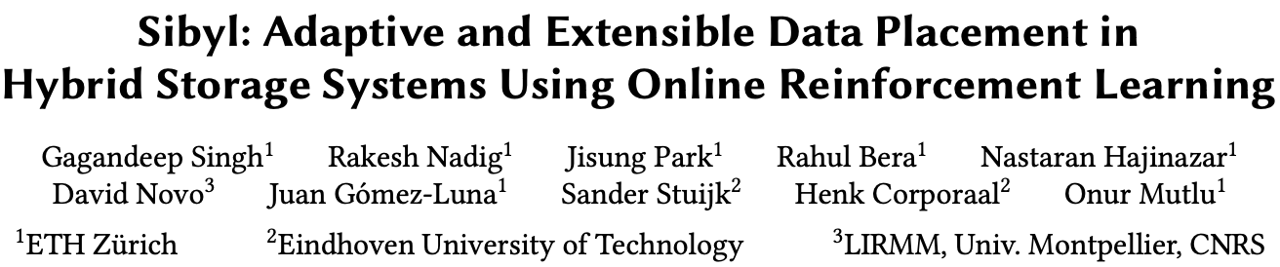
Self-Optimizing Hybrid SSD Controllers
Gagandeep Singh, Rakesh Nadig, Jisung Park, Rahul Bera, Nastaran Hajinazar, David Novo, Juan Gomez-Luna, Sander Stuijk, Henk Corporaal, and Onur Mutlu,
"Sibyl: Adaptive and Extensible Data Placement in Hybrid Storage Systems Using Online Reinforcement Learning"
Proceedings of the 49th International Symposium on Computer Architecture (ISCA), New York, June 2022.
[Slides (pptx) (pdf)]
[arXiv version]
[Sibyl Source Code]
[Talk Video (16 minutes)]
https://arxiv.org/pdf/2205.07394.pdf

Slide 20
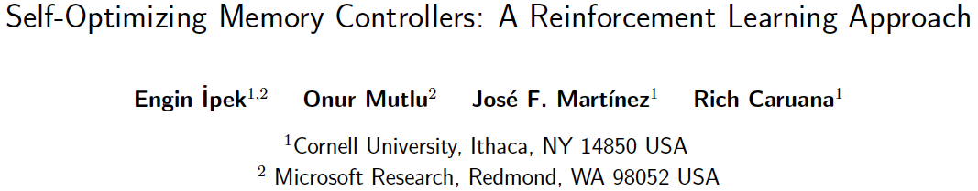
Self-Optimizing Memory Controllers
Engin Ipek, Onur Mutlu, José F. Martínez, and Rich Caruana,
"Self Optimizing Memory Controllers: A Reinforcement Learning Approach"
Proceedings of the 35th International Symposium on Computer Architecture (ISCA), pages 39-50, Beijing, China, June 2008.

Slide 21
Pythia: Prefetching using
Reinforcement Learning

Slide 22
Self-Optimizing Memory Prefetchers
Rahul Bera, Konstantinos Kanellopoulos, Anant Nori, Taha Shahroodi, Sreenivas Subramoney, and Onur Mutlu,
"Pythia: A Customizable Hardware Prefetching Framework Using Online Reinforcement Learning"
Proceedings of the 54th International Symposium on Microarchitecture (MICRO), Virtual, October 2021.
[Slides (pptx) (pdf)]
[Short Talk Slides (pptx) (pdf)]
[Lightning Talk Slides (pptx) (pdf)]
[Talk Video (20 minutes)]
[Lightning Talk Video (1.5 minutes)]
[Pythia Source Code (Officially Artifact Evaluated with All Badges)]
[arXiv version]
Officially artifact evaluated as available, reusable and reproducible.
https://arxiv.org/pdf/2109.12021.pdf

Slide 23






Pythia
A Customizable Hardware Prefetching Framework Using Online Reinforcement Learning
Rahul Bera, Konstantinos Kanellopoulos, Anant V. Nori,
Taha Shahroodi, Sreenivas Subramoney, Onur Mutlu
https://github.com/CMU-SAFARI/Pythia
Notes:
Hi I am Rahul. Today, I’m going to present our work “…”
This work is done by researchers from SAFARI research group at ETH Zurich, in collaboration with Intel Labs and TU Delft.

Slide 24

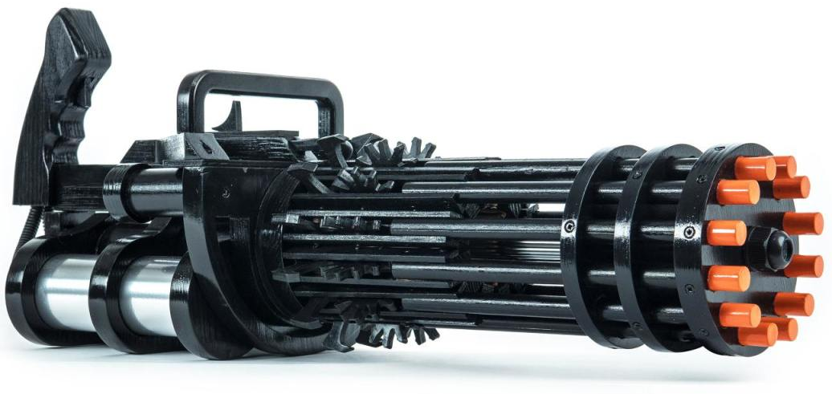

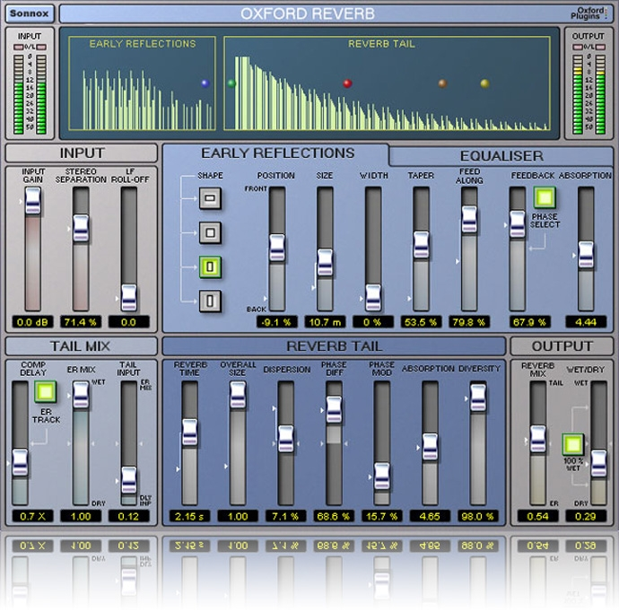


1
2
3
Mainly use one program context info. for prediction
Lack inherent system awareness
Lack in-silicon customizability
Why do prefetchers not perform well?
Notes:
We analyze many prior prefetchers and observe three key shortcomings that significantly limits their performance.
[CLICK] First, they use mainly a single program context for prefetch prediction
[CLICK] Second, they lack system awareness
[CLICK] Third, they lack in-silicon customizability

Slide 25



Pythia
Autonomously learns to prefetch using multiple program context information
and system-level feedback
Can be customized in silicon to change program context information or prefetching objective on the fly
Notes:
To alleviate these challenges, we introduce Pythia that:
[CLICK] autonomously learns to prefetch using multiple program context information and system-level feedback
[CLICK] and can be customizable in silicon to alter the program context information or the objective of the prefetcher

Slide 26
Brief Overview of Pythia
Pythia formulates prefetching as a reinforcement learning problem
Notes:
Pythia formulates prefetching as a reinforcement learning problem where,
[CLICK] the prefetcher acts as the agent, ….

Slide 27

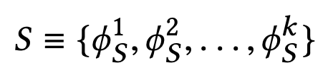
What is State?
k-dimensional vector of features
Feature = control-flow + data-flow
Control-flow examples
  PC
  Branch PC
  Last-3 PCs, …
Data-flow examples
  Cacheline address
  Physical page number
  Delta between two cacheline addresses
  Last 4 deltas, …
Notes:
We define the state as a k-dimensional vector of program features.
[CLICK] Each feature is composed of …
[CLICK] Some examples of control-flow information are …
[CLICK] Some examples of data-flow information are …
Though Pythia can theoretically learn from any number of such program features, we limit the size k as per storage budget.

Slide 28
What is Action?
Given a demand access to address A
the action is to select prefetch offset “O”
Action-space: 127 actions in the range [-63, +63]
  For a machine with 4KB page and 64B cacheline
Upper and lower limits ensure prefetches do not cross physical page boundary
A zero offset means no prefetch is generated
We further prune action-space by design-space exploration
Notes:
We define the action as the selection of a prefetch offset. Pythia adds this offset to the demanded cacheline to get the prefetched cacheline address.
[CLICK] Note that a zero offset is also a valid action for Pythia, which means no prefetch is generated.
[CLICK] As every post-L1 prefetcher …, the list of actions are limited to the range from -63 to +63 for a traditionally-sized …
[CLICK] However, we can prune the action list by automatic design-space exploration, as we show in the paper.

Slide 29
What is Reward?
Defines the objective of Pythia
Encapsulates two metrics:
  Prefetch usefulness (e.g., accurate, late, out-of-page, …)
  System-level feedback (e.g., mem. b/w usage, cache pollution, energy, …)
We demonstrate Pythia with memory bandwidth usage as the system-level feedback in the paper
Notes:
The reward defines the objective of Pythia
[CLICK] A reward encapsulates two metrics: …
[CLICK] Though Pythia can learn from any …, in this paper we demonstrate Pythia using a major system-level feedback: mem b/w usage

Slide 30
What is Reward?
Seven distinct reward levels
  Accurate and timely (R_{AT})
  Accurate but late (R_{AL})
  Loss of coverage (R_{CL})
  Inaccurate
    With low memory b/w usage (R_{IN}-L)
    With high memory b/w usage (R_{IN}-H)
  No-prefetch
    With low memory b/w usage (R_{NP}-L)
    With high memory b/w usage(R_{NP}-H)
Values are set at design time via automatic design-space exploration
  Can be customized further in silicon for higher performance
Notes:
We define reward in five distinct levels mentioned as follows [CLICK].
Each reward level corresponds to various usefulness of a prefetch request. The inaccurate and no-prefetch reward levels are further categorized based on the system memory bandwidth usage.
[CLICK] The values of each of these reward levels are set at design time via automatic design-space exploration.
[CLICK] However, one can customize the rewards in silicon via simple configuration registers to specify a dfferent objective for Pythia for extracting higher performance benefits in target workload suites.

Slide 31
Basic Pythia Configuration
Derived from automatic design-space exploration
State: 2 features
  PC+Delta
  Sequence of last-4 deltas
Actions: 16 prefetch offsets
  Ranging between -6 to +32. Including 0.
Rewards:
  R_{AT} = +20; R_{AL} = +12; R_{NP}-H=-2; R_{NP}-L=-4;
  R_{IN}-H=-14; R_{IN}-L=-8; R_{CL}=-12

Slide 32
More Detailed Pythia Overview
Q-Value Store: Records Q-values for all state-action pairs
Evaluation Queue: A FIFO queue of recently-taken actions
Find the Action with max Q-Value
A1
A2
A3
4
2
Look up
QVStore
Generate
prefetch
Demand Request
State
Vector
Memory
Hierarchy
S1
3
S2
Max
S3
S4
Q-Value Store
(QVStore)
6
Evict EQ entry and update QVStore
5
Evaluation Queue (EQ)
Insert prefetch action &
State-Action pair in EQ
1
7
Set filled bit
Assign reward to
corresponding EQ entry
Prefetch Fill
Notes:
Pythia consists of two key components:
[CLICK] Q-value store, which is responsible for …
[CLICK] Evaluation queue, which is a first-in-first-out queue that stores the recently taken action.
As Pythia cannot always immediately assign a reward to a taken action
because the usefulness of the corresponding prefetch request is known, Pythia stores the action
in evaluation queue to properly assign rewards to them.
[CLICK] For every demand request, Pythia first checks EQ with deamdned address. If a matching entry is found in EQ, it means the corresponding action in EQ entry has generated a useful prefetch, and Pythia assigns a reward accordingly.
[CLICK] Then Pythia extracts features from the attributes of the demand request to create the state-vector and uses the state-vector to lookup QVStore [CLICK]
[CLICK] For the given state-vector, Pythia finds the action that has the highest Q-value and generates prefetch request accordingly to the memory hierarchy [CLICK]
[CLICK] Next, Pythia inserts the action in the EQ along with the state-action pair.
[CLICK] Pythia uses the reward stored in the evicted EQ entry to update the QVStore.

Slide 33
Simulation Methodology
Champsim [3] trace-driven simulator
150 single-core memory-intensive workload traces
  SPEC CPU2006 and CPU2017
  PARSEC 2.1
  Ligra
  Cloudsuite
Homogeneous and heterogeneous multi-core mixes
Five state-of-the-art prefetchers
  SPP [Kim+, MICRO’16]
  Bingo [Bakhshalipour+, HPCA’19]
  MLOP [Shakerinava+, 3rd Prefetching Championship, 2019 ]
  SPP+DSPatch [Bera+, MICRO’19]
  SPP+PPF [Bhatia+, ISCA’20]
[3] https://github.com/ChampSim/ChampSim

Slide 34
Performance with Varying Core Count
Pythia
3.4%
7.7%
SPP
MLOP
Bingo

Slide 35
Performance with Varying Core Count
1. Pythia consistently provides the highest performance in all core configurations
Pythia
7.7%
3.4%
SPP
2. Pythia’s gain increases with core count
MLOP
Bingo

Slide 36
Performance with Varying DRAM Bandwidth
3%
Pythia
Bingo
MLOP
Baseline
SPP
~Intel Xeon 6258R (Cascade Lake, 28C/6ch)
~AMD EPYC Rome 7702P (Zen 2, 64C/8ch)
17%
~AMD Threadripper 3990x (Zen 2, 64C/4ch)

Slide 37
Performance with Varying DRAM Bandwidth
3%
Pythia
Bingo
MLOP
Baseline
SPP
~Intel Xeon 6258R (Cascade Lake, 28C/6ch)
Pythia outperforms prior best prefetchers for
a wide range of DRAM bandwidth configurations
~AMD EPYC Rome 7702P (Zen 2, 64C/8ch)
17%
~AMD Threadripper 3990x (Zen 2, 64C/4ch)

Slide 38
Performance Improvement via Customization
5.2%
7.8%
2%
2.8%
3.4%
3.1%
Customize reward values for graph analytics workloads
Notes:
[CLICK] As you can see, strict Pythia outperforms the basic Pythia configuration as much as 7.8% and
[CLICK] 2% on average over the entire Ligra workload suite.

Slide 39
Performance Improvement via Customization
5.2%
7.8%
Pythia can extract even higher performance via customization without changing hardware
2%
2.8%
3.4%
3.1%
Notes:
[CLICK] As you can see, strict Pythia outperforms the basic Pythia configuration as much as 7.8% and
[CLICK] 2% on average over the entire Ligra workload suite.

Slide 40

Pythia’s Overhead
25.5 KB of total metadata storage per core
  Only simple tables
We also model functionally-accurate Pythia with full complexity in Chisel [4] HDL
1.03% area overhead
0.4% power overhead
Satisfies prediction latency
of a desktop-class 4-core Skylake processor (Xeon D2132IT, 60W)
[4] https://www.chisel-lang.org
Notes:
All of Pythia’s performance benefits comes at a modest cost of 25.5KB of metadata storge, which is invested only in simple storage, without any need to complex structures.
[CLICK] We also model a fully-functionally-accurate Pythia with its full complexity in Chisel and show that, Pythia incurs
[CLICK] a modest area overhead of 1.03%
[CLICK] a power overhead of half-a-percent
[CLICK] while simultaneously satisfying the prediction latency at L2 cache frequency
Of a desktop-class …

Slide 41
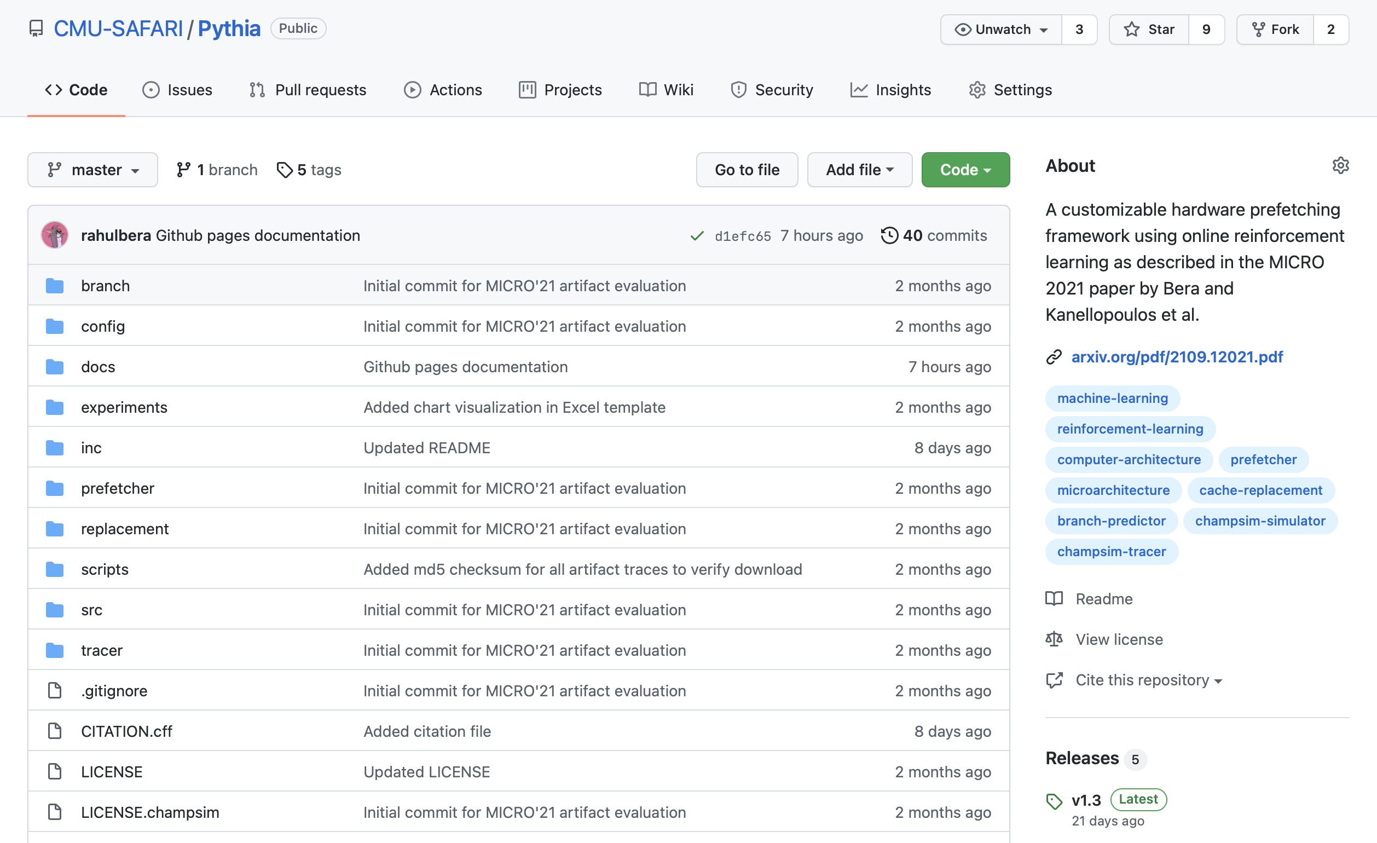
Pythia is Open Source
https://github.com/CMU-SAFARI/Pythia
MICRO’21 artifact evaluated
Champsim source code + Chisel modeling code
All traces used for evaluation

Slide 42
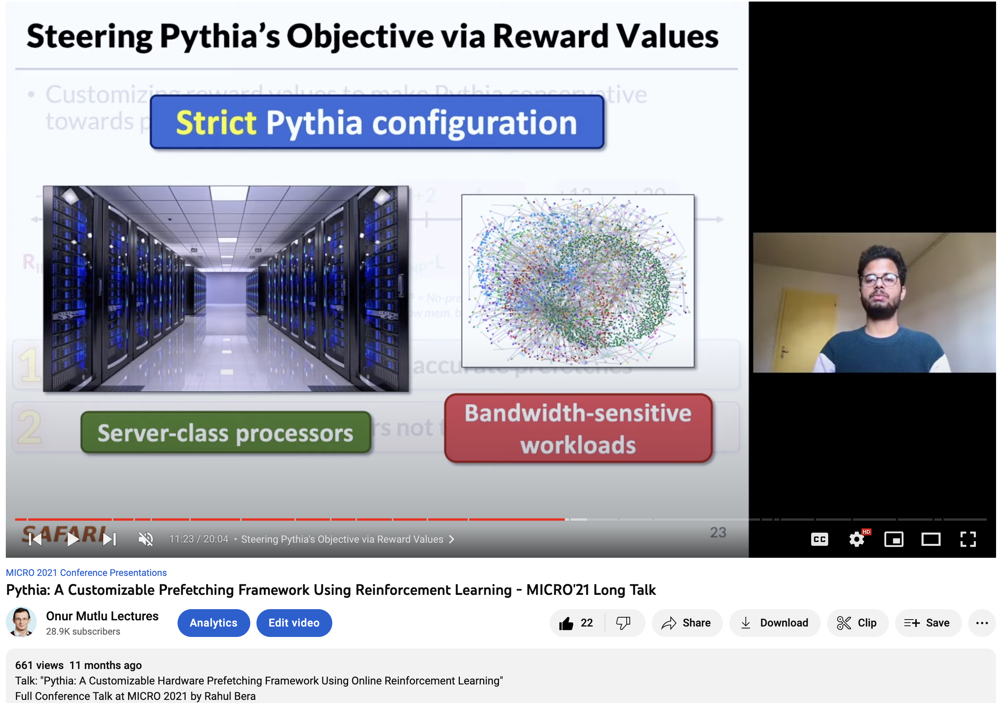
Pythia Talk Video
https://www.youtube.com/watch?v=6UMFRW3VFPo&list=PL5Q2soXY2Zi--0LrXSQ9sST3N0k0bXp51&index=8

Slide 43
A Lot More in the Pythia Paper
Rahul Bera, Konstantinos Kanellopoulos, Anant Nori, Taha Shahroodi, Sreenivas Subramoney, and Onur Mutlu,
"Pythia: A Customizable Hardware Prefetching Framework Using Online Reinforcement Learning"
Proceedings of the 54th International Symposium on Microarchitecture (MICRO), Virtual, October 2021.
[Slides (pptx) (pdf)]
[Short Talk Slides (pptx) (pdf)]
[Lightning Talk Slides (pptx) (pdf)]
[Talk Video (20 minutes)]
[Lightning Talk Video (1.5 minutes)]
[Pythia Source Code (Officially Artifact Evaluated with All Badges)]
[arXiv version]
Officially artifact evaluated as available, reusable and reproducible.
https://arxiv.org/pdf/2109.12021.pdf

Slide 44
Pythia
A Customizable Hardware Prefetching Framework Using Online Reinforcement Learning
Rahul Bera, Konstantinos Kanellopoulos, Anant V. Nori,
Taha Shahroodi, Sreenivas Subramoney, Onur Mutlu
https://github.com/CMU-SAFARI/Pythia
Notes:
Hi I am Rahul. Today, I’m going to present our work “…”
This work is done by researchers from SAFARI research group at ETH Zurich, in collaboration with Intel Labs and TU Delft.

Slide 45
Hermes: Perceptron-Based
Off-Chip Load Prediction

Slide 46
Learning-Based Off-Chip Load Predictors
Best Paper Award at MICRO 2022
https://arxiv.org/pdf/2209.00188.pdf

Slide 47


Accelerating Long-Latency Load Requests
via Perceptron-Based Off-Chip Load Prediction
Rahul Bera, Konstantinos Kanellopoulos, Shankar Balachandran,
David Novo, Ataberk Olgun, Mohammad Sadrosadati, Onur Mutlu
https://github.com/CMU-SAFARI/Hermes

Slide 48
Problem
Long-latency off-chip load requests
Often stall processor by
blocking instruction retirement from
Reorder Buffer (ROB)
Limit performance
Notes:
The key problem that we are trying to address in this work is stemming from Off-chip load request
[CLICK] As we know, these off-chip load requests often stall…,
[CLICK] which severely limits the performance of a core.

Slide 49

Traditional Solutions
1
Employ sophisticated prefetchers
2
Increase size of on-chip caches
Notes:
Architects have primarily relied on two key techniques to reduce latency of such loads:
[CLICK] By employing sophisticated data prefetchers
[CLICK] And Increasing size of the on-chip cache hierarchy

Slide 50
Key Observation 1
Many loads still go off-chip
50%
still go off-chip even with
a state-of-the-art prefetcher
50%
successfully prefetched
70% of the off-chip loads
block the ROB
# off-chip loads without any prefetcher
Notes:
In this work, we show that prior prefetchers successfully prefetch a significant fraction of the off-chip load requests.
[CLICK] However, nearly 50% of the off-chip loads in a system without any prefetcher are still going off-chip even in presence of a state-of-the-art prefetcher
[CLICK] And 70% of these off-chip loads even block the ROB.

Slide 51
Key Observation 2
50% still go off-chip
On-chip cache access latency
significantly contributes to off-chip load latency
L1
L2
LLC
Main Memory
L1
L2
LLC
Main Memory
Saved cycles
40% of the stalls can be eliminated by removing
on-chip cache access latency from critical path
Notes:
Now, if we focus on the off-chip loads that are still going to the main memory even in presence of a state-of-the-art prefetcher,
We observe that the on-chip cache access latency…
[CLICK] We show that nearly 40% of …

Slide 52
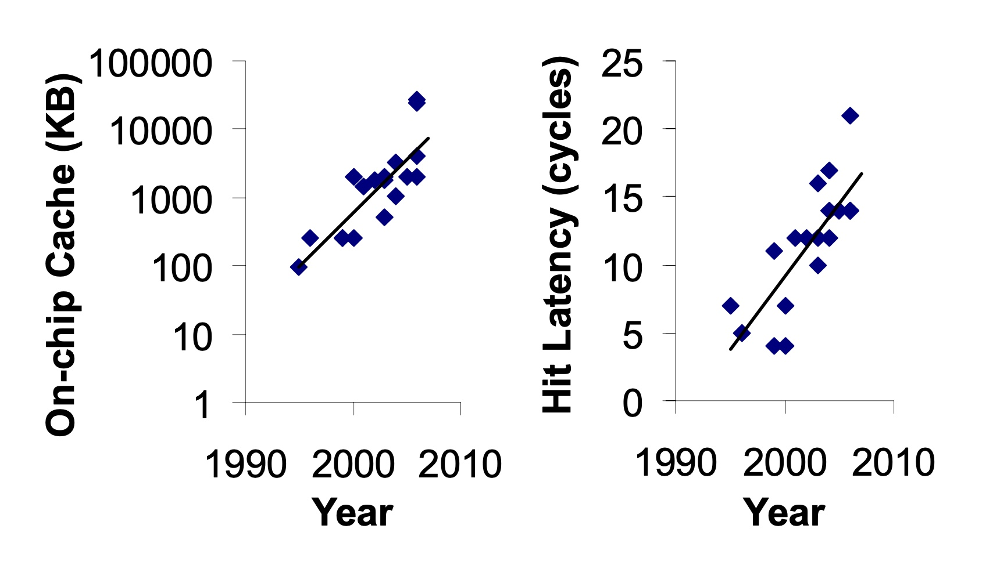
Caches are Getting Bigger and Slower…
On-chip Cache Size (KB)
Hardavellas+, “Database Servers on Chip Multiprocessors: Limitations and Opportunities”, CIDR, 2007
Notes:
As the cache hierarchy continue to grow in size and complexity, as noted by previous works,
As well as a trend that we see in recent processors,
This problem is only going to get exacerbated even more in future generation processors

Slide 53
Our Goal
Improve processor performance
by removing on-chip cache access latency
from the critical path of off-chip loads
Notes:
Thus to alleviate this problem, the goal of our work is to improve…

Slide 54

Predicts which load requests
are likely to go off-chip
Starts fetching data directly from main memory while concurrently accessing the cache hierarchy
Notes:
Towards this we propose Hermes, which is based on two key ideas.
[CLICK] Hermes predicts which…
[CLICK] Hermes starts fetching …

Slide 55




Hermes: Key Contribution
Hermes employs the first
perceptron-based off-chip load predictor
That predicts which loads are likely to go off-chip
By learning from
multiple program context information
Notes:
To enable accurate off-chip prediction,
Hermes employs the first perceptron-based off-chip load predictor
[CLICK] that identifies loads …
[CLICK] by only learning from multiple…

Slide 56
Hermes Overview
Core
Latency tolerance limit of ROB
L1-D
Baseline
Processor is stalled
L2
L1
L2
LLC
Main Memory
LLC
MC
Off-Chip
Main Memory
Notes:
Now let me give you a brief overview of Hermes.
This is how a traditional cache hierarchy looks like in today’s processor.
[CLICK] And this is how the memory latency timeline looks like for an off-chip load in the baseline system
[CLICK] If the ROB has a latency tolerance limit up till here, the processor stalls for the remaining cycles

Slide 57




Hermes Overview
Perceptron-based
off-chip load predictor
Predict
Core
POPET
Train
Latency tolerance limit of ROB
L1-D
Issue a Hermes request
Baseline
Processor is stalled
L2
L1
L2
LLC
Main Memory
LLC
Hermes
L1
L2
LLC
Wait
Saved stall cycles
MC
Main Memory
Off-Chip
Main Memory
Notes:
Now Hermes employs an off-chip predictor named POPET.
[CLICK] For every load generated in the core, Hermes consults POPET to predict whether this load would go off-chip or not
[CLICK] If the load is predicted to go off-chip, Hermes waits for the address translation to finish, which happens in parallel with L1 cache access
[CLICK] And then issues a speculative memory request, which we call a Hermes request,
directly to the main memory controller to start fetching the data from the main memory,
While also concurrently accessing the cache hierarchy for such a load.
[CLICK] If the off-chip prediction is correct, the load would eventually miss the LLC and arrive at the memory controller
Where it will simply wait for the ongoing Hermes request to finish, thus hiding the entire cache access latency from its critical path.
Once the data returns from the main memory, Hermes returns the data to the core [CLICK],
Thus, saving the precious stall cycles induced by the off-chip load [CLICK], which in turn provides performance benefit.
[CLICK] Hermes trains POPET when the data finally returns to the core, closing the feedback loop.

Slide 58

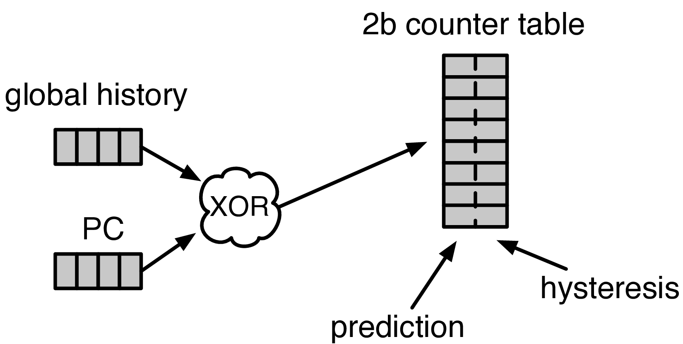


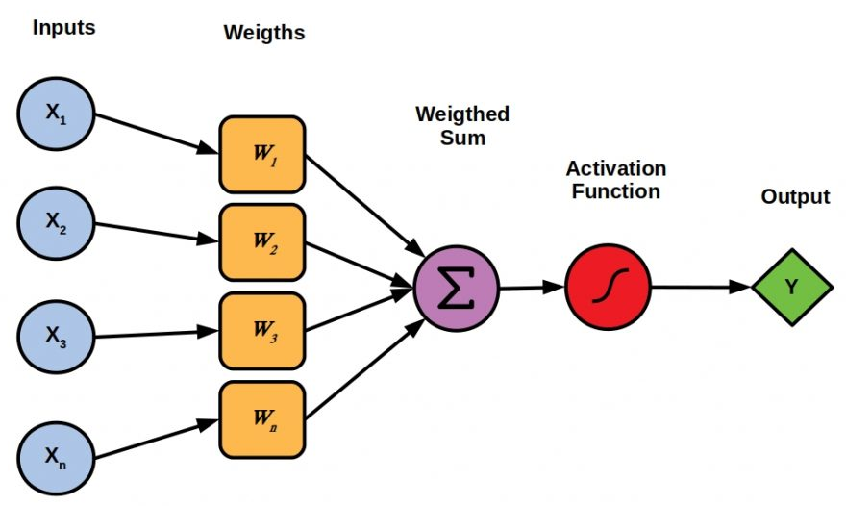

Designing the Off-Chip Load Predictor
History-based prediction
HMP [Yoaz+, ISCA’99] for the L1-D cache
Using branch-predictor-like hybrid predictor:
Global, Gshare, and GSkew
POPET provides
both higher accuracy and higher performance
than predictors inspired from these previous works
Tracking cache contents
MissMap [Loh+, MICRO’11] for the DRAM cache,
D2D [Sembrant+, ISCA’14], D2M [Sembrant+, HPCA’17], LP [Jalili+, HPCA’22] for the cache hierarchy
  Large metadata
  Metadata size increases with cache hierarchy size
  May need to track all cache operations
  Gets complex depending on the cache hierarchy configuration (e.g., inclusivity, bypassing,…)
Learning from program behavior
  Correlate different program features with off-chip loads
Low storage overhead
Low design complexity
Notes:
Now let’s discuss how to design this off-chip predictor.
So, there are multiple prior works that can be used either directly or with small modifications for off-chip load prediction.
These works can be broadly categorized into two classes.
[CLICK] History-based predictor introduced by HMP, uses a branch-predictor like hybrid predictor design
to identify which requests are going to miss L1 cache.
We can easily extend HMP’s design to predict loads that are going to miss the entire cache hierarchy.
[CLICK] Tracking-based methods, on the other hand, explicitly track cache contents
to predict which load requests are going to miss the cache hierarchy.
[CLICK] These tracking-based methods poses two key challenges…
[CLICK] First,…
[CLICK] Second,…
[CLICK] POPET takes a completely different approach to predict off-chip load requests by learning from program behavior.
[CLICK] It aims to correlate multiple different types of program features with off-chip load requests
to provide accurate predictions with much lower storage overhead and design complexity.
[CLICK] In our paper, we compare POPET against predictors inspired from these prior works and show that
[CLICK] POPET provides both higher accuracy and performance than them.

Slide 59
POPET: Perceptron-Based Off-Chip Predictor
Multi-feature hashed perceptron model^{[1]}
  Each feature has its own weight table
    Stores correlation between feature value and off-chip prediction
[1] D. Tarjan and K. Skadron, “Merging Path and Gshare Indexing in Perceptron Branch Prediction,” TACO, 2005
Notes:
Now let’s deep dive into our off-chip predictor design.
Our predictor, named as POPET, is designed using hashed-perceptron model.
[CLICK] where each feature has its own weight table
That stores the correlation between feature value and the off-chip prediction

Slide 60

Predicting using POPET
Uses simple table lookups, addition, and comparison
42
-4
0x7ffe0+12
3
3 >= -2
Predict that the load would go off-chip
Extract features from the load request
12
-5
Notes:
Hermes predicts using POPET using simple operations like table lookup, addition, and comparison.
Let me give you an example on how POPET’s prediction works.
POPET’s prediction works in three stages.
[CLICK] In the first stage, POPET extracts the features from the load request
[CLICK] In the second stage, each feature value is hashed and used as an index to retrieve the weights from each individual weight tables
[CLICK] In the third stage, the retrieved weights are accumulated and the cumulative weight is used to compute the activation function.
[CLICK] If the cumulative weight is higher than the activation threshold, POPET predicts that the load would go off-chip.

Slide 61
Training POPET
Uses simple increment or decrement of feature weights
42
-1
-4
0x7ffe0+12
3
3 >= -2
Predict that the load would go off-chip
-1
12
Shouldn’t be activated
-5
Cumulative weight < 𝜏_{act}
-1
Notes:
Now let’s understand how to train POPET.
For this let’s assume the previous example where the load is predicted to go off-chip.
[CLICK] But in reality, the load didn’t go off-chip
[CLICK] this means the activation which have triggered before, shouldn’t have triggered
Which means, the cumulative weight should be lower than the activation threshold
[CLICK] Now to adjust the feature weights, POPET again indexes each weight table using the hashed feature values
[CLICK] And simply decrement each weight from the individual weight tables.
Thus, by using simple increment and decrement operations, POPET continuously learns from program behavior to accurately predict off-chip loads.

Slide 62
Evaluation
Notes:
Now let’s evaluate Hermes.

Slide 63
Simulation Methodology
ChampSim trace driven simulator
110 single-core memory-intensive traces
  SPEC CPU 2006 and 2017
  PARSEC 2.1
  Ligra
  Real-world applications
220 eight-core memory-intensive trace mixes
LLC Prefetchers
Off-Chip Predictors
Pythia [Bera+, MICRO’21]
Bingo [Bakshalipour+, HPCA’19]
MLOP [Shakerinava+, 3rd Prefetching Championship’19]
SPP + Perceptron filter [Bhatia+, ISCA’20]
SMS [Somogyi+, ISCA’06]
History-based: HMP [Yoaz+, ISCA’99]
Tracking-based: Address Tag-Tracking based Predictor (TTP)
Ideal Off-chip Predictor
Notes:
We evaluate Hermes using ChampSim simulator,
[CLICK] using a wide range of memory-intensive traces spanning across SPEC CPU, PARSEC, Ligra, and real-world applications
[CLICK] We compare Hermes with five LLC prefetchers
[CLICK] and two off-chip predictors extended from prior works

Slide 64
Single-Core Performance Improvement
5.4%
20.3%
11.5%
Hermes alone provides nearly
50% performance benefits of Pythia
with only 1/5th storage overhead
Hermes provides nearly 90% performance benefit of Ideal Hermes that has an ideal off-chip load predictor
Hermes on top of Pythia
outperforms Pythia alone in every workload category
Notes:
Let’s first analyze the single-core performance improvement.
[CLICK] This is how Hermes and a state-of-the-art prefetcher Pythia improves performance on top of a no-prefetching system.
[CLICK] The first takeaway is that Hermes alone provides nearly 50%...
[CLICK] Now if we combine Hermes with Pythia, that provides an additional 5.4% performance improvement on top of a strong baseline that has Pythia.
[CLICK] And finally, if we compare Hermes’s performance benefit with the Ideal Hermes that has an ideal off-chip predictor,
We see that Hermes provides nearly 90% performance benefit of the Ideal Hermes

Slide 65
Increase in Main Memory Requests
20.3%
5.4%
11.5%
For every 1% performance benefit,
increase in main memory requests
Pythia
2%
5.9%
Hermes on top of Pythia
1%
38.5%
Hermes alone
0.5%
5.5%
Hermes is more bandwidth-efficient
than even an efficient prefetcher like Pythia
Notes:
This performance improvement comes at a cost of increase in main memory requests.
This graph shows the increase in the main memory request over the no-prefetching system provided by the three configurations.
[CLICK] As we can see, Hermes increases the main memory requests by 5.5% on average on top of the no-prefetching system..
Whereas Pythia increases …
If we combine two together, then it increases the main memory request by an additional 5.9%.
[CLICK] Now, if we compare this increase in the main memory request with the performance improvement each of these configurations are providing,
We see that
[CLICK] For every 1% performance benefit, Pythia …
[CLICK] This basically shows that Hermes is much more bandwidth efficient than a traditional data prefetcher like Pythia.
And for this reason [NEXT]

Slide 66
Performance with Varying Memory Bandwidth
Pythia+Hermes
Pythia
Hermes
Baseline
~Intel Xeon 6258R
(Cascade Lake, 28C/6ch, 2020)
~AMD EPYC Rome 7702P (Zen 2, 64C/8ch, 2019)
~AMD Threadripper 3990x (Zen 2, 64C/4ch, 2020)
In bandwidth-constrained configurations,
Hermes alone outperforms Pythia
Hermes+Pythia outperforms Pythia
across all bandwidth configurations
Notes:
If we evaluate Pythia and Hermes over a wide range of memory bandwidth configurations, we see that,
[CLICK] In these extremely-bandwidth constrained configurations, which are in fact roughly modeling per-core main memory bandwidth of commercial processors,
Hermes even outperforms Pythia.
[CLICK] And if we combine both of them, the combination of Hermes and Pythia outperforms Pythia in every bandwidth configurations.

Slide 67
Performance with Varying Baseline Prefetcher
5.4%
6.2%
7.6%
5.1%
Hermes consistently improves performance
on top of a wide range of baseline prefetchers
7.7%
Notes:
And these observations are not only true for Pythia.
We evaluate Hermes combined with multiple prior baseline state-of-the-art prefetchers and find that
Hermes consistently improves performance on top of a wide range of baseline prefetchers.

Slide 68
Overhead of Hermes
4 KB storage overhead
1.5% power overhead*
*On top of an Intel Alder Lake-like performance-core ^{[2]} configuration
[2] https://www.anandtech.com/show/16881/a-deep-dive-into-intels-alder-lake-microarchitectures/3
Notes:
All of these performance benefit comes at a
[CLICK] modest 4KB storage overhead per core and
[CLICK] 1.5% power overhead on top an Intel Alder Lake-like performance-core configuration

Slide 69
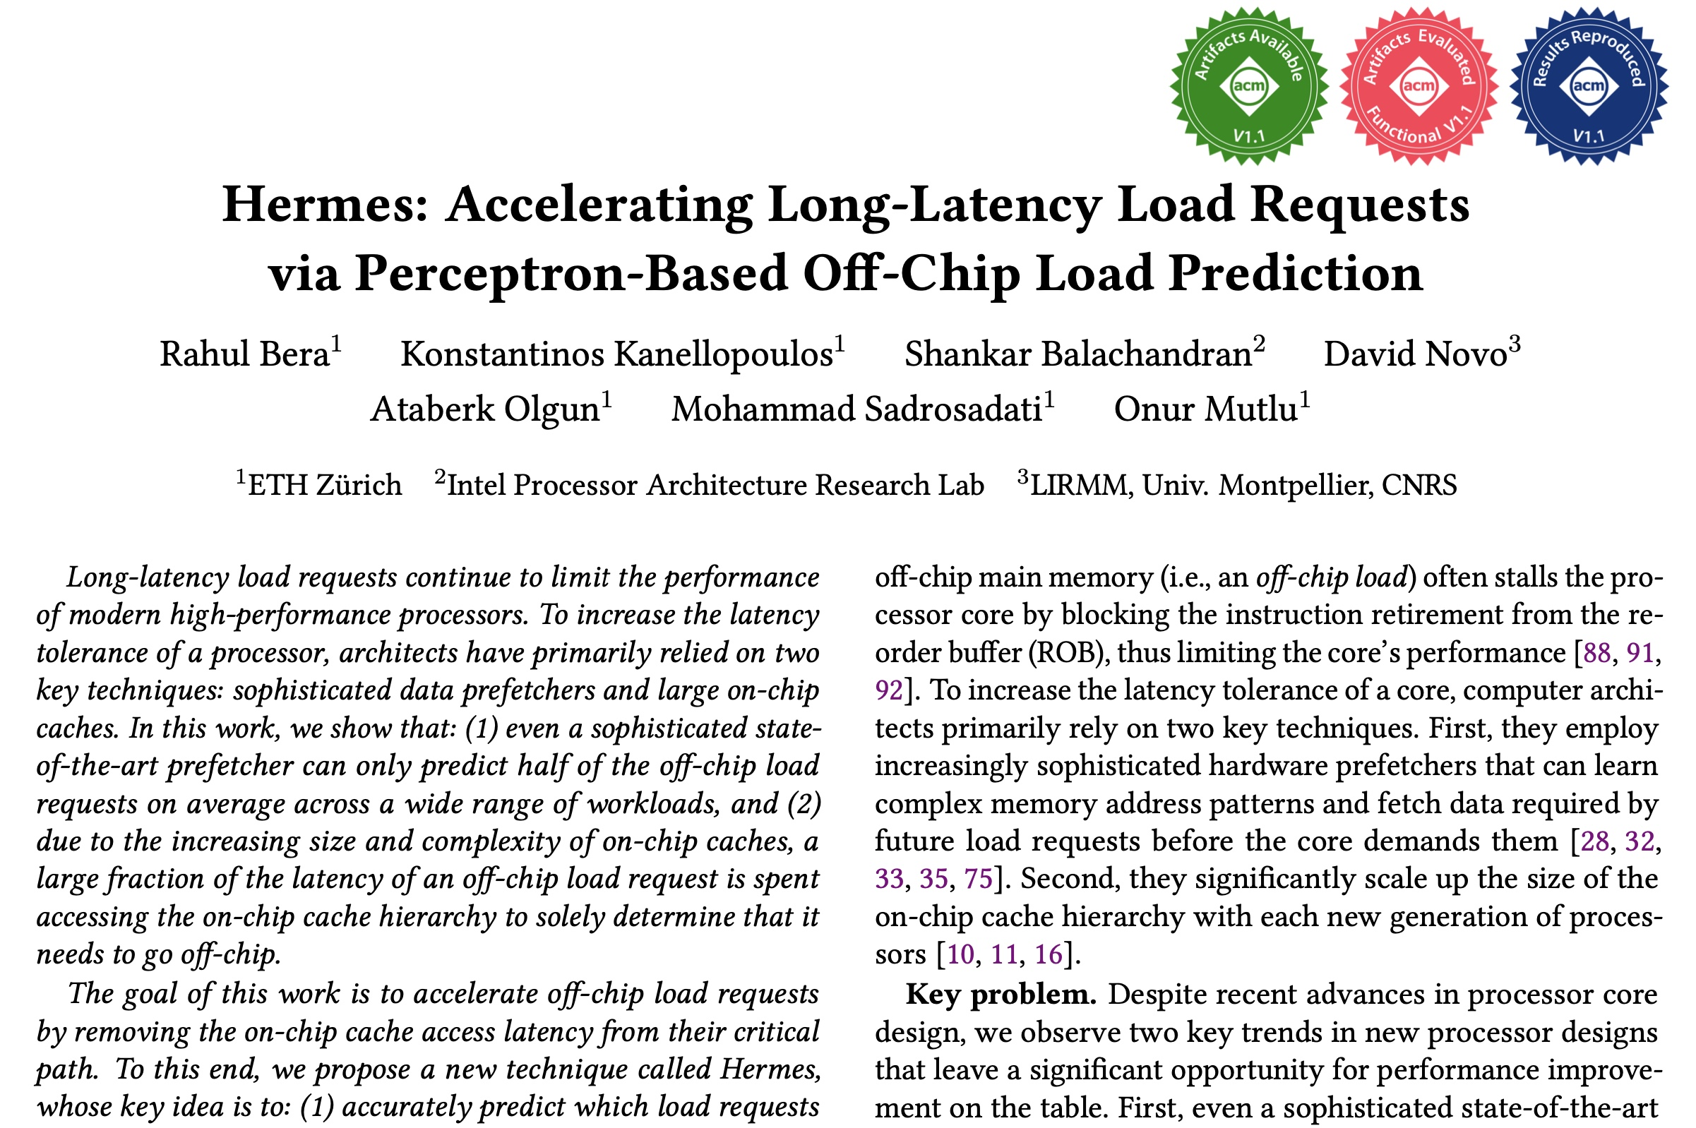
A Lot More in the Hermes Paper
Performance sensitivity to:
  Cache hierarchy access latency
  Hermes request issue latency
  Activation threshold
  ROB size (in extended version at arXiv)
  LLC size (in extended version at arXiv)
Accuracy, coverage, and performance analysis against HMP and TTP
Understanding usefulness of each program feature
Effect on stall cycle reduction
Performance analysis in eight-core system
https://arxiv.org/pdf/2209.00188.pdf
Notes:
We have many more evaluation results:
For example, a wide range of performance sensitivity study by varying…in the paper.

Slide 70
A New Approach to Latency Reduction
Hermes advocates for off-chip load prediction,
a different form of speculation than
load address prediction employed by prefetchers
Off-chip load prediction can be applied by itself
or combined with load address prediction
to provide performance improvement
Notes:
Hermes advocates …
[CLICK] We show that off-chip load prediction…

Slide 71





Hermes: Summary
Hermes employs the first
perceptron-based off-chip load predictor
High accuracy
(77%)
High coverage
(74%)
Low storage overhead
(4KB/core)
High performance improvement over best prior baseline
(5.4%)
High performance
per bandwidth

Slide 72
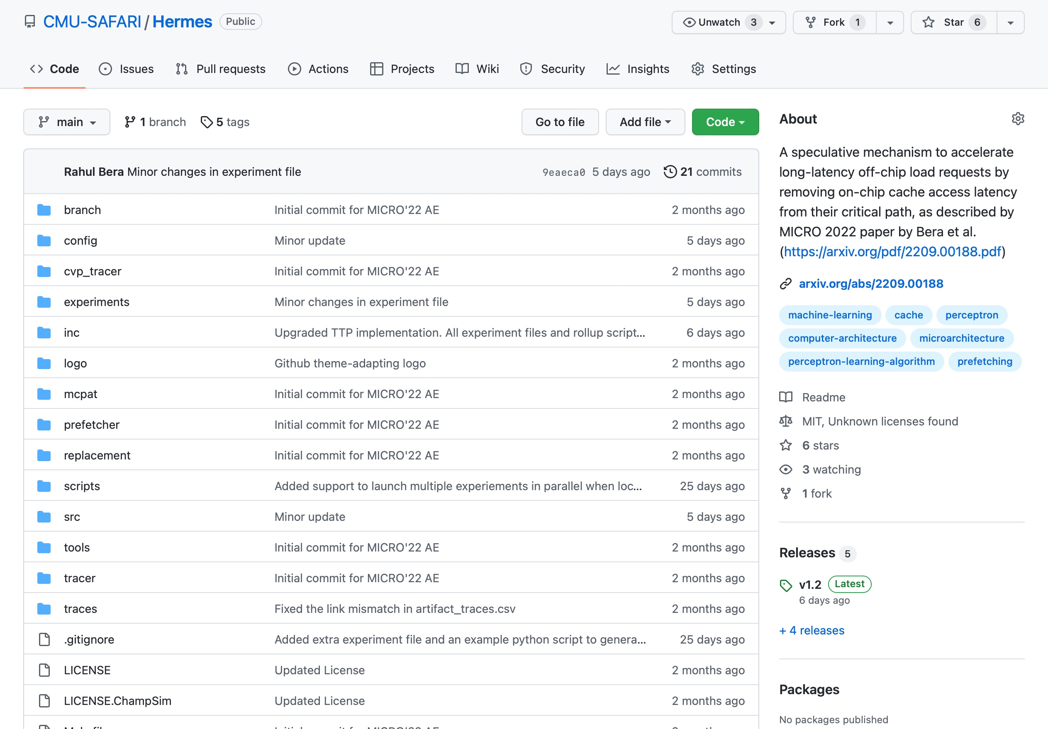
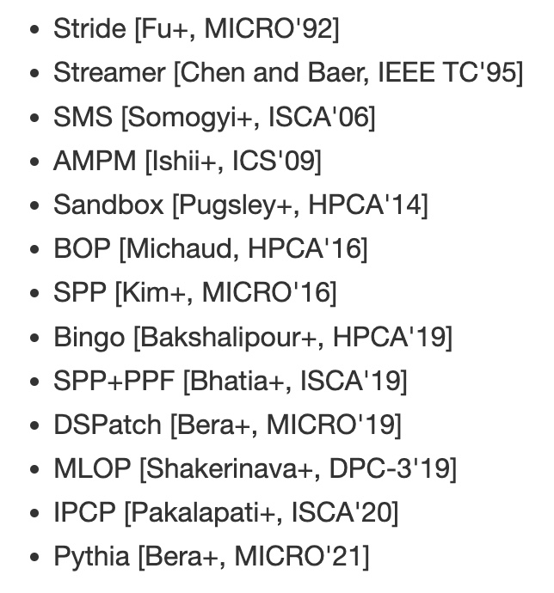
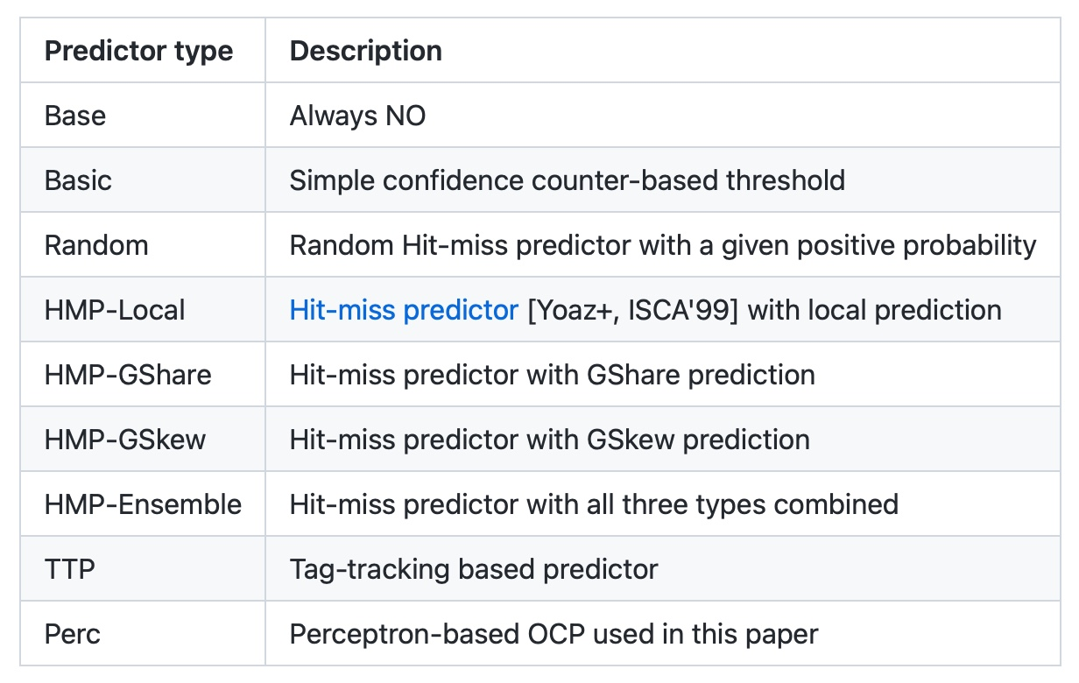
Hermes is Open Source
All workload traces
13 prefetchers
9 off-chip predictors
https://github.com/CMU-SAFARI/Hermes
Notes:
That’s why we open-source our artifact.
It can be freely downloaded from our GitHub repository.
In this artifact, [CLICK] you will get all the workload traces we have used to evaluate Hermes,
[CLICK] 13 types of data prefetchers proposed in the past and
[CLICK] 9 types of off-chip predictors out of the box

Slide 73
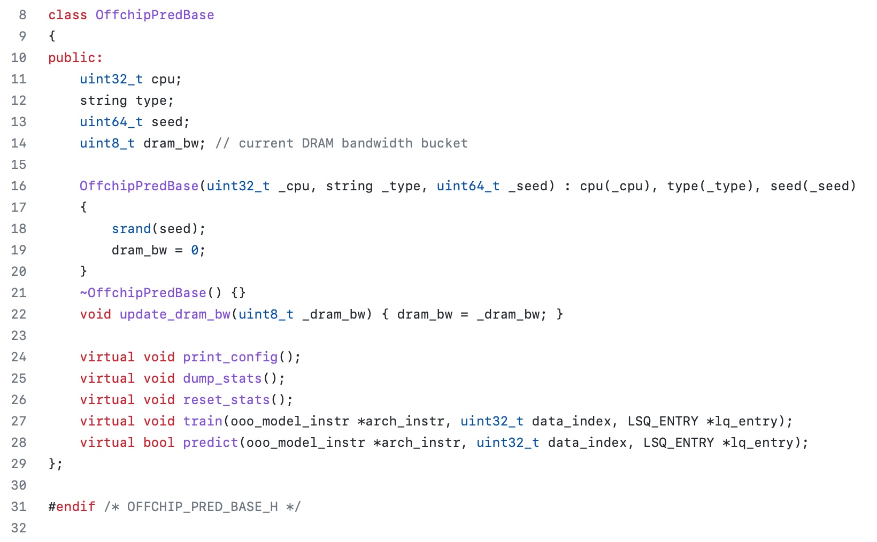
Easy To Define Your Own Off-Chip Predictor
Just extend the OffchipPredBase class
Notes:
But if you want to impalement your own off-chip predictor, that’s also very easy.
All you have to do is to extend the OffchipPred base class…

Slide 74
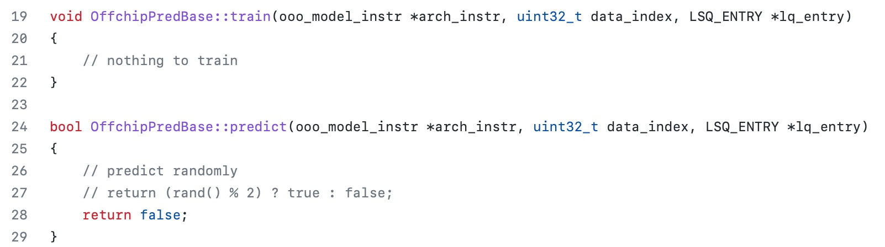
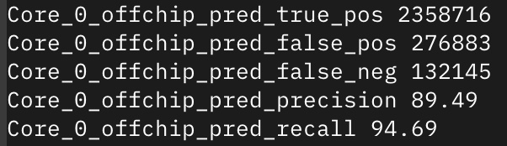
Easy To Define Your Own Off-Chip Predictor
Define your own train() and predict() functions
Get statistics like accuracy (stat name precision) and coverage (stat name recall) out of the box
Notes:
And define your own train() and predict() functions
[CLICK] the infrastructure will automatically provide statistics like precision and recall out of the box

Slide 75
Off-Chip Prediction Can Further Enable…
Prioritizing loads that are likely go off-chip
in cache queues and on-chip network routing
Better instruction scheduling
of data-dependent instructions
Other ideas to improve performance and fairness in multi-core system design...
Notes:
We hope that high-accuracy off-chip prediction can further enable a multitude of optimization possibilities, for example:
[CLICK] prioritizing loads … to improve performance and fairness in extreme core processors
[CLICK] better instruction scheduling for data dependent loads
[CLICK] and many more…

Slide 76
Learning-Based Off-Chip Load Predictors
Best Paper Award at MICRO 2022
https://arxiv.org/pdf/2209.00188.pdf

Slide 77
Accelerating Long-Latency Load Requests
via Perceptron-Based Off-Chip Load Prediction
Rahul Bera, Konstantinos Kanellopoulos, Shankar Balachandran,
David Novo, Ataberk Olgun, Mohammad Sadrosadati, Onur Mutlu
https://github.com/CMU-SAFARI/Hermes
Notes:
With that hope, I will conclude my talk.
I will be very happy to take any question from the audience.

Slide 78
Two Major Thrusts
  1. (Memory) system design for AI/ML workloads/accelerators
  2. AI/ML techniques for improving (memory) system designs

Slide 79
Challenge and Opportunity for Future
Accelerating
Emerging Workloads

Slide 80
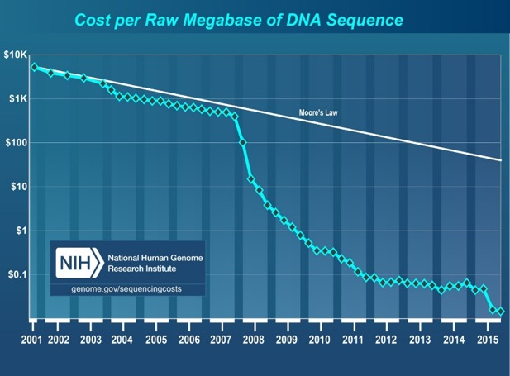
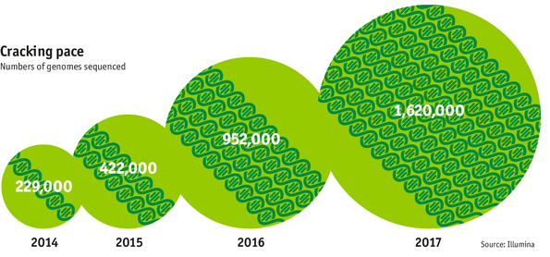

Data is Key for Future Workloads
development of high-throughput sequencing (HTS) technologies
Number of Genomes Sequenced
http://www.economist.com/news/21631808-so-much-genetic-data-so-many-uses-genes-unzipped
Notes:
However, since the development of high throughput sequencing (HTS) technologies, the cost of genome sequencing has fallen off a cliff (<< 1,000$) making it viable for almost everyone's use.

Slide 81

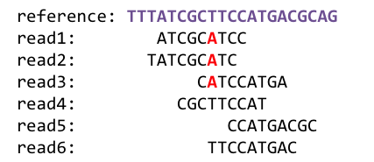
1
Sequencing
Genome Analysis
Read Mapping
2
Data → performance & energy bottleneck
Variant Calling
Scientific Discovery
3
4
Notes:
Genome analysis starts with sequencing random short DNA fragments of copies of the original molecule.
Unfortunately, these reads lack information about their order and which part of genome they are originated from.
Hence the second step is to map these reads to a long reference genome.

Slide 82




We Need Faster & Scalable Genome Analysis
Understanding genetic variations, species, evolution, …
Predicting the presence and relative abundance of microbes in a sample
Rapid surveillance of disease outbreaks
Developing personalized medicine
And, many, many other applications …
Notes:
Knowing what organisms are present in a given environmental sample and how abundant are they

Slide 83
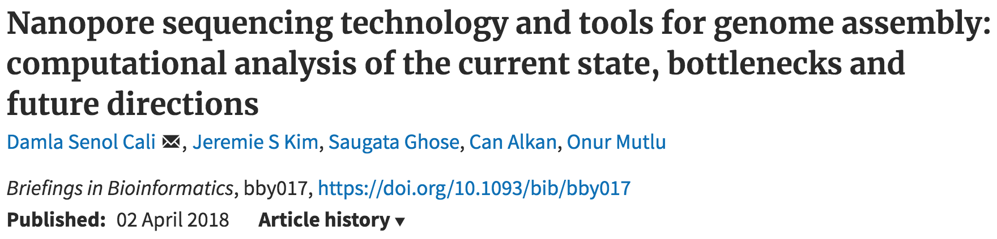
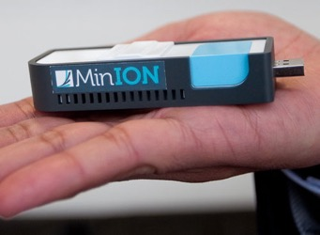
New Genome Sequencing Technologies
Oxford Nanopore MinION
Senol Cali+, “Nanopore Sequencing Technology and Tools for Genome
Assembly: Computational Analysis of the Current State, Bottlenecks
and Future Directions,” Briefings in Bioinformatics, 2018.
[Open arxiv.org version]

Slide 84
New Genome Sequencing Technologies
Oxford Nanopore MinION
Senol Cali+, “Nanopore Sequencing Technology and Tools for Genome
Assembly: Computational Analysis of the Current State, Bottlenecks
and Future Directions,” Briefings in Bioinformatics, 2018.
[Preliminary arxiv.org version]
Data → performance & energy bottleneck

Slide 85



Problems with (Genome) Analysis Today
Special-Purpose Machine
for Data Generation
General-Purpose Machine
for Data Analysis
FAST SLOW
Slow and inefficient processing capability
Large amounts of data movement
This picture is similar for many “data generators & analyzers” today

Slide 86
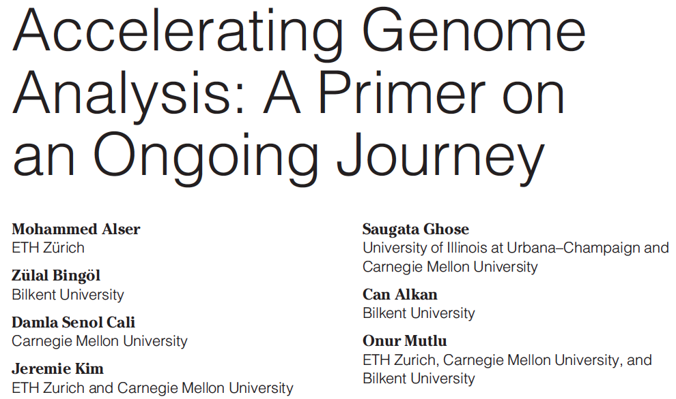
Accelerating Genome Analysis [IEEE MICRO 2020]
Mohammed Alser, Zulal Bingol, Damla Senol Cali, Jeremie Kim, Saugata Ghose, Can Alkan, and Onur Mutlu,
"Accelerating Genome Analysis: A Primer on an Ongoing Journey"
IEEE Micro (IEEE MICRO), Vol. 40, No. 5, pages 65-75, September/October 2020.
[Slides (pptx)(pdf)]
[Talk Video (1 hour 2 minutes)]

Slide 87

Beginner Reading on Genome Analysis
Mohammed Alser, Joel Lindegger, Can Firtina, Nour Almadhoun, Haiyu Mao, Gagandeep Singh, Juan Gomez-Luna, Onur Mutlu
“From Molecules to Genomic Variations to Scientific Discovery: Intelligent Algorithms and Architectures for Intelligent Genome Analysis”
Computational and Structural Biotechnology Journal, 2022
[Source code]
https://arxiv.org/pdf/2205.07957.pdf

Slide 88
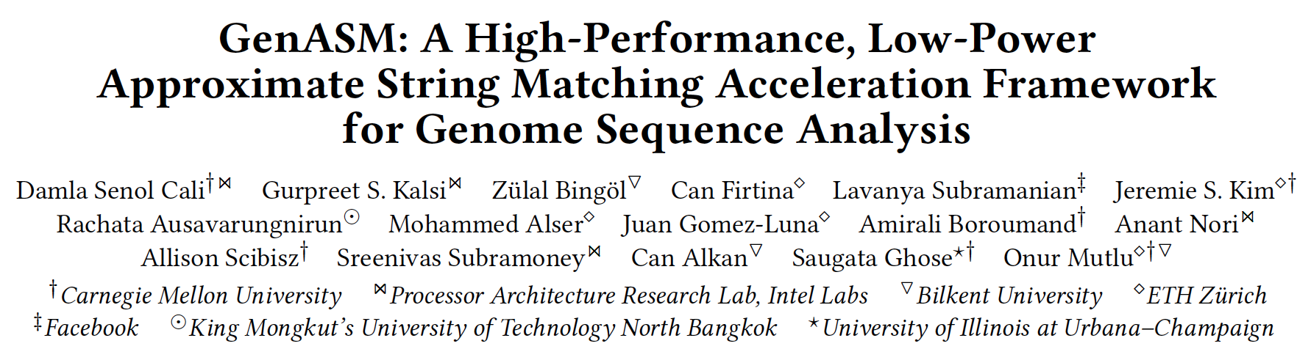
Accelerating Approximate String Matching
Damla Senol Cali, Gurpreet S. Kalsi, Zulal Bingol, Can Firtina, Lavanya Subramanian, Jeremie S. Kim, Rachata Ausavarungnirun, Mohammed Alser, Juan Gomez-Luna, Amirali Boroumand, Anant Nori, Allison Scibisz, Sreenivas Subramoney, Can Alkan, Saugata Ghose, and Onur Mutlu,
"GenASM: A High-Performance, Low-Power Approximate String Matching Acceleration Framework for Genome Sequence Analysis"
Proceedings of the 53rd International Symposium on Microarchitecture (MICRO), Virtual, October 2020.
[Lighting Talk Video (1.5 minutes)]
[Lightning Talk Slides (pptx) (pdf)]
[Talk Video (18 minutes)]
[Slides (pptx) (pdf)]

Slide 89
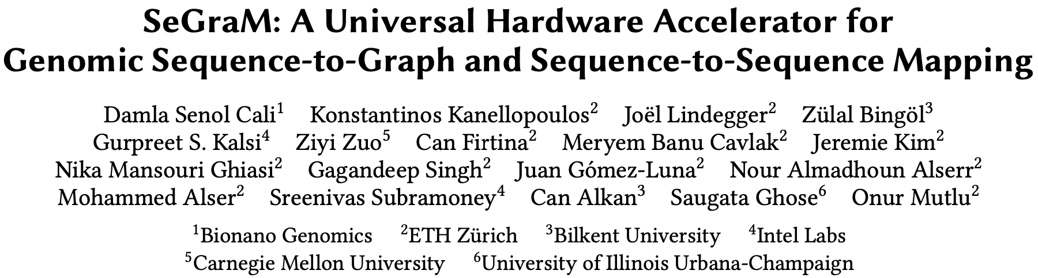
Accelerating Sequence-to-Graph Mapping
Damla Senol Cali, Konstantinos Kanellopoulos, Joel Lindegger, Zulal Bingol, Gurpreet S. Kalsi, Ziyi Zuo, Can Firtina, Meryem Banu Cavlak, Jeremie Kim, Nika MansouriGhiasi, Gagandeep Singh, Juan Gomez-Luna, Nour Almadhoun Alserr, Mohammed Alser, Sreenivas Subramoney, Can Alkan, Saugata Ghose, and Onur Mutlu,
"SeGraM: A Universal Hardware Accelerator for Genomic Sequence-to-Graph and Sequence-to-Sequence Mapping"
Proceedings of the 49th International Symposium on Computer Architecture (ISCA), New York, June 2022.
[arXiv version]
https://arxiv.org/pdf/2205.05883.pdf

Slide 90
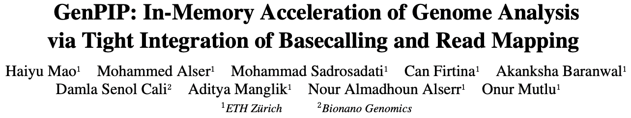
Accelerating Basecalling + Read Mapping
Appears at MICRO 2022
https://arxiv.org/pdf/2209.08600.pdf

Slide 91
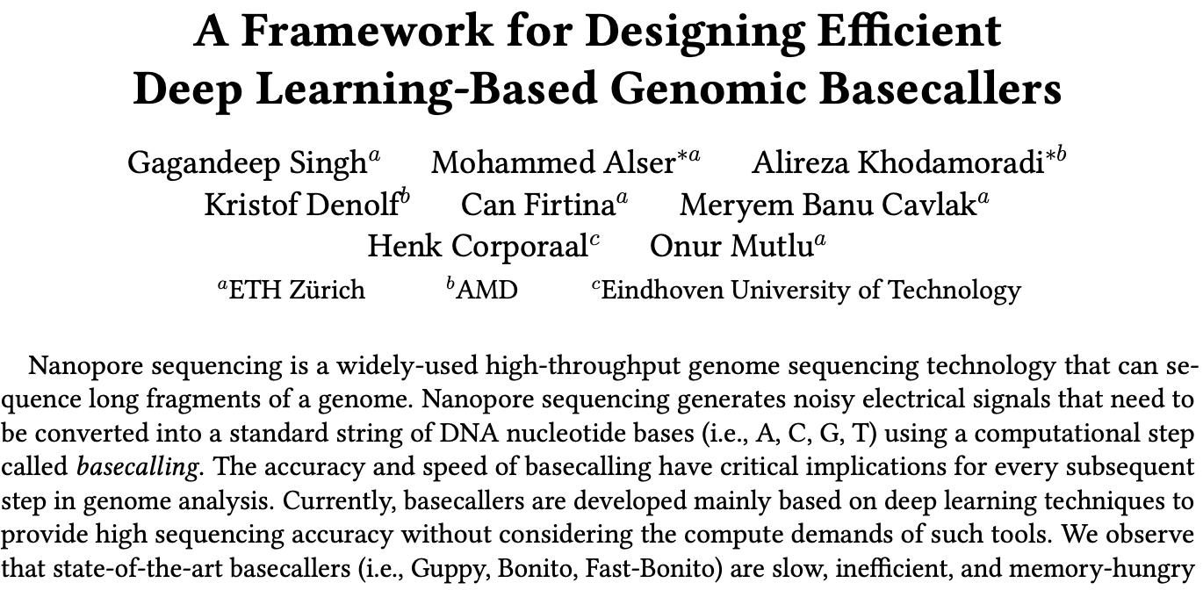
Designing & Accelerating Basecallers
https://arxiv.org/pdf/2211.03079.pdf

Slide 92
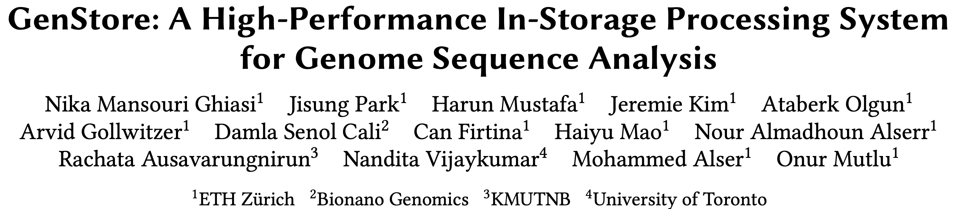
In-Storage Genome Filtering [ASPLOS 2022]
Nika Mansouri Ghiasi, Jisung Park, Harun Mustafa, Jeremie Kim, Ataberk Olgun, Arvid Gollwitzer, Damla Senol Cali, Can Firtina, Haiyu Mao, Nour Almadhoun Alserr, Rachata Ausavarungnirun, Nandita Vijaykumar, Mohammed Alser, and Onur Mutlu,
"GenStore: A High-Performance and Energy-Efficient In-Storage Computing System for Genome Sequence Analysis"
Proceedings of the 27th International Conference on Architectural Support for Programming Languages and Operating Systems (ASPLOS), Virtual, February-March 2022.
[Talk Slides (pptx) (pdf)]
[Lightning Talk Slides (pptx) (pdf)]
[Lightning Talk Video (90 seconds)]
[Talk Video (17 minutes)]

Slide 93
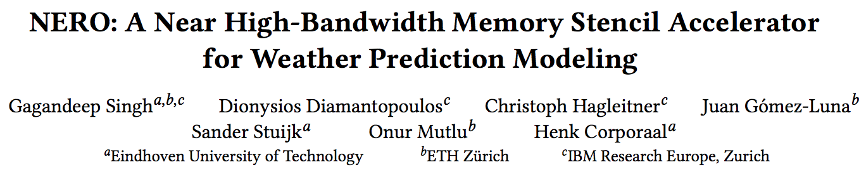
Accelerating Climate Modeling
Gagandeep Singh, Dionysios Diamantopoulos, Christoph Hagleitner, Juan Gómez-Luna, Sander Stuijk, Onur Mutlu, and Henk Corporaal,
"NERO: A Near High-Bandwidth Memory Stencil Accelerator for Weather Prediction Modeling"
Proceedings of the 30th International Conference on Field-Programmable Logic and Applications (FPL), Gothenburg, Sweden, September 2020.
[Slides (pptx) (pdf)]
[Lightning Talk Slides (pptx) (pdf)]
[Talk Video (23 minutes)]
Nominated for the Stamatis Vassiliadis Memorial Award.

Slide 94
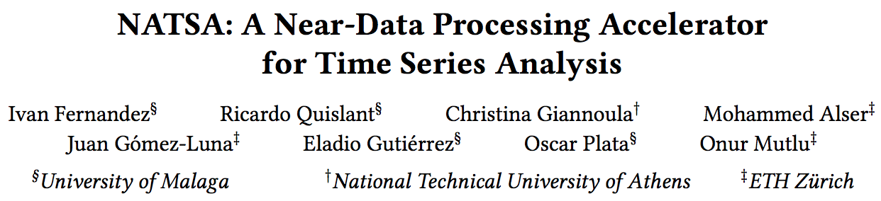
Accelerating Time Series Analysis
Ivan Fernandez, Ricardo Quislant, Christina Giannoula, Mohammed Alser, Juan Gómez-Luna, Eladio Gutiérrez, Oscar Plata, and Onur Mutlu,
"NATSA: A Near-Data Processing Accelerator for Time Series Analysis"
Proceedings of the 38th IEEE International Conference on Computer Design (ICCD), Virtual, October 2020.
[Slides (pptx) (pdf)]
[Talk Video (10 minutes)]
[Source Code]

Slide 95
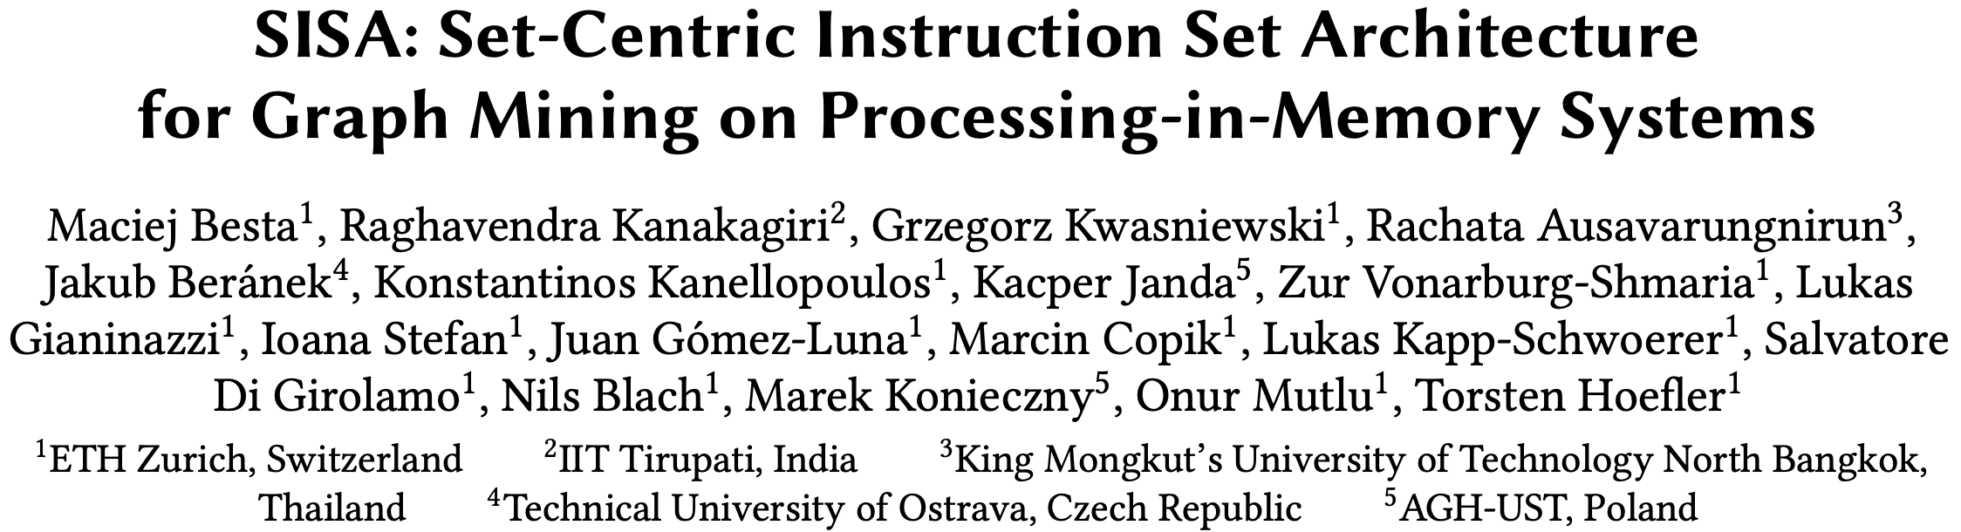
Accelerating Graph Pattern Mining
Maciej Besta, Raghavendra Kanakagiri, Grzegorz Kwasniewski, Rachata Ausavarungnirun, Jakub Beránek, Konstantinos Kanellopoulos, Kacper Janda, Zur Vonarburg-Shmaria, Lukas Gianinazzi, Ioana Stefan, Juan Gómez-Luna, Marcin Copik, Lukas Kapp-Schwoerer, Salvatore Di Girolamo, Nils Blach, Marek Konieczny, Onur Mutlu, and Torsten Hoefler,
"SISA: Set-Centric Instruction Set Architecture for Graph Mining on Processing-in-Memory Systems"
Proceedings of the 54th International Symposium on Microarchitecture (MICRO), Virtual, October 2021.
[Slides (pdf)]
[Talk Video (22 minutes)]
[Lightning Talk Video (1.5 minutes)]
[Full arXiv version]

Slide 96
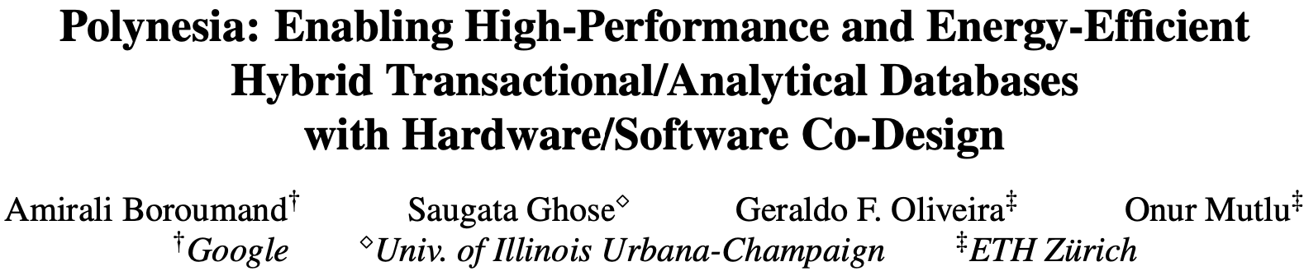
Accelerating HTAP Database Systems
Amirali Boroumand, Saugata Ghose, Geraldo F. Oliveira, and Onur Mutlu,
"Polynesia: Enabling High-Performance and Energy-Efficient Hybrid Transactional/Analytical Databases with Hardware/Software Co-Design"
Proceedings of the 38th International Conference on Data Engineering (ICDE), Virtual, May 2022.
[arXiv version]
[Slides (pptx) (pdf)]
[Short Talk Slides (pptx) (pdf)]
https://arxiv.org/pdf/2204.11275.pdf

Slide 97
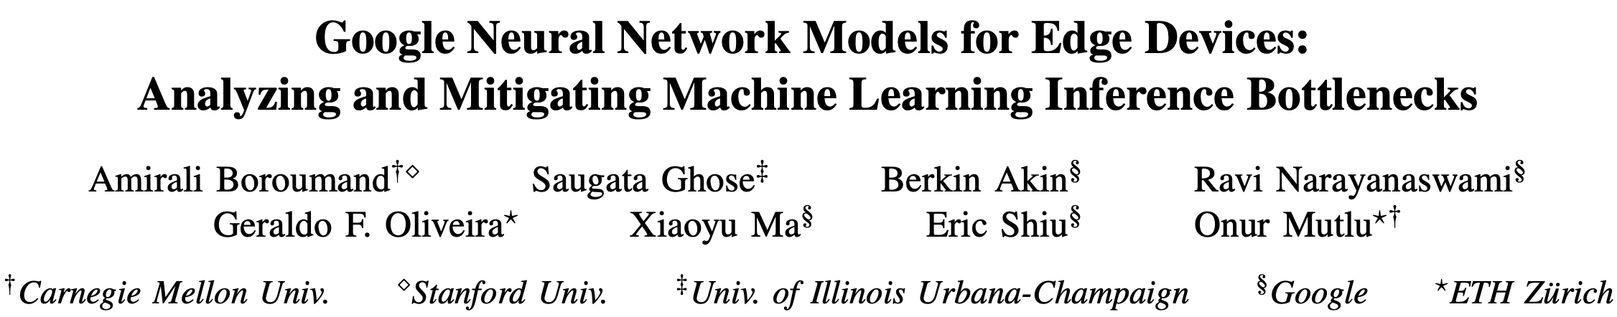
Accelerating Neural Network Inference
Amirali Boroumand, Saugata Ghose, Berkin Akin, Ravi Narayanaswami, Geraldo F. Oliveira, Xiaoyu Ma, Eric Shiu, and Onur Mutlu,
"Google Neural Network Models for Edge Devices: Analyzing and Mitigating Machine Learning Inference Bottlenecks"
Proceedings of the 30th International Conference on Parallel Architectures and Compilation Techniques (PACT), Virtual, September 2021.
[Slides (pptx) (pdf)]
[Talk Video (14 minutes)]

Slide 98
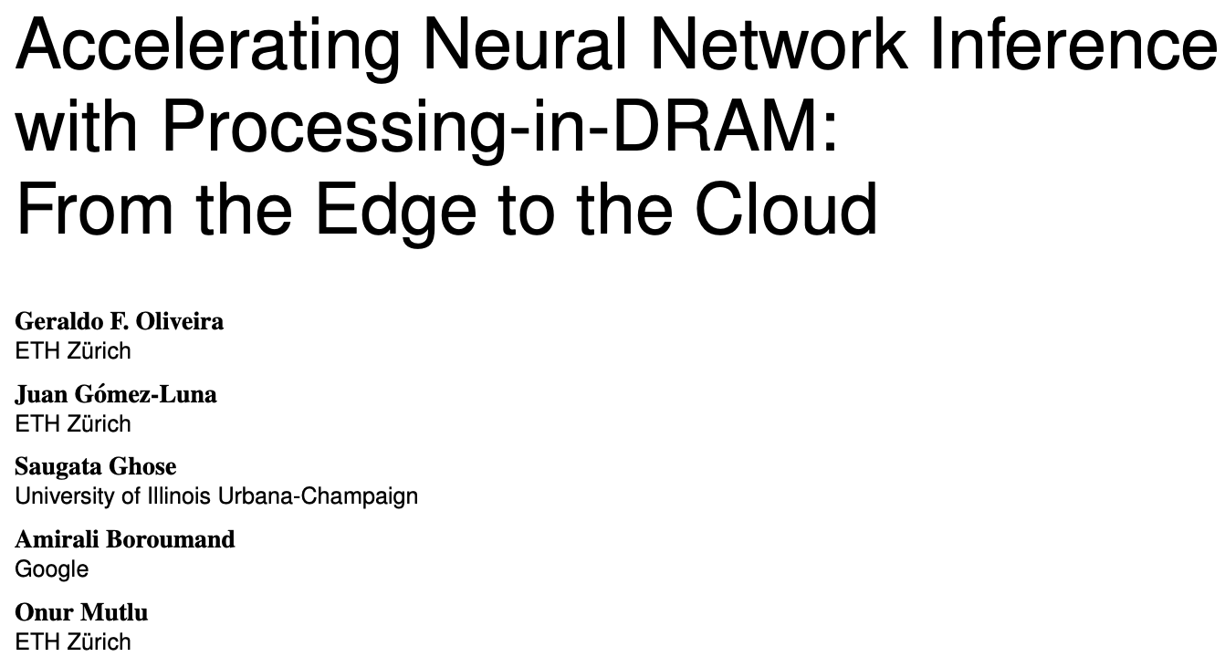
Accelerating Neural Network Inference
Appears in IEEE Micro
https://arxiv.org/pdf/2209.08938.pdf

Slide 99
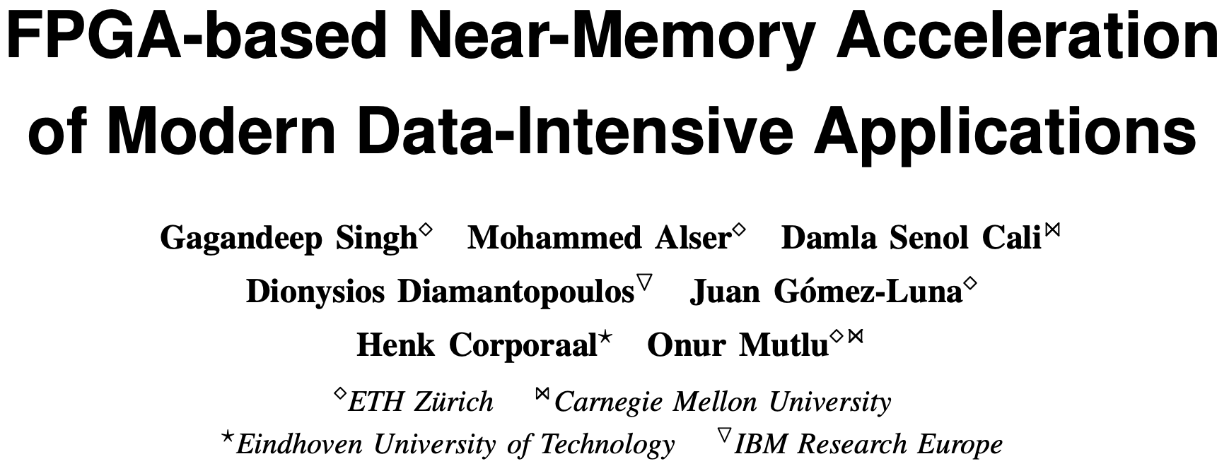
FPGA-based Near-Memory Analytics
Gagandeep Singh, Mohammed Alser, Damla Senol Cali, Dionysios Diamantopoulos, Juan Gómez-Luna, Henk Corporaal, and Onur Mutlu,
"FPGA-based Near-Memory Acceleration of Modern Data-Intensive Applications"
IEEE Micro (IEEE MICRO), 2021.

Slide 100
GenASM: Approximate String Matching Accelerator for Genomics

Slide 101
GenASM Framework [MICRO 2020]
Damla Senol Cali, Gurpreet S. Kalsi, Zulal Bingol, Can Firtina, Lavanya Subramanian, Jeremie S. Kim, Rachata Ausavarungnirun, Mohammed Alser, Juan Gomez-Luna, Amirali Boroumand, Anant Nori, Allison Scibisz, Sreenivas Subramoney, Can Alkan, Saugata Ghose, and Onur Mutlu,
"GenASM: A High-Performance, Low-Power Approximate String Matching Acceleration Framework for Genome Sequence Analysis"
Proceedings of the 53rd International Symposium on Microarchitecture (MICRO), Virtual, October 2020.
[Lighting Talk Video (1.5 minutes)]
[Lightning Talk Slides (pptx) (pdf)]
[Talk Video (18 minutes)]
[Slides (pptx) (pdf)]

Slide 102




GenASM: A High Performance, Low-Power Approximate String Matching Acceleration Framework for Genome Sequence Analysis
Damla Senol Cali
Carnegie Mellon University
(dsenol@andrew.cmu.edu)
Gurpreet S. Kalsi², Zulal Bingol³, Can Firtina⁴, Lavanya Subramanian⁵,
Jeremie Kim^{1,4}, Rachata Ausavarungnirun^{6,1}, Mohammed Alser⁴,
Juan Gomez-Luna⁴, Amirali Boroumand¹, Anant Nori², Allison Scibisz¹,
Sreenivas Subramoney², Can Alkan³, Saugata Ghose^{7,1}, and Onur Mutlu^{4,1,3}
1 2 3 4
5 6 7 1,4
Notes:
Hello, I am Damla Senol Cali. Today, I'll be presenting our work "GenASM: A High Performance, Low-Power Approximate String Matching Acceleration Framework for Genome Sequence Analysis".

Slide 103
Genome Sequencing
Genome sequencing: Enables us to determine the order of the DNA sequence in an organism’s genome
  Plays a pivotal role in:
    Personalized medicine
    Outbreak tracing
    Understanding of evolution
    …
Modern genome sequencing machines extract smaller randomized fragments of the original DNA sequence, known as reads
  Short reads: a few hundred base pairs, error rate of ∼0.1%
  Long reads: thousands to millions of base pairs, error rate of 10–15%
Notes:
[CLICK] Genome sequencing, which enables us to determine the DNA sequence of an organism, [CLICK] plays a pivotal role in areas such as personalized medicine, outbreak tracing (like COVID-19), and the understanding of evolution.
[CLICK] Modern genome sequencing machines extract small randomized fragments of the original DNA sequence, which we call reads.
[CLICK] State-of-the-art sequencing machines produce either short reads or long reads

Slide 104
Genome Sequence Analysis
Read mapping: First key step in genome sequence analysis (GSA)
  Aligns reads to one or more possible locations within the reference genome, and
  Finds the matches and differences between the read and the reference genome segment at that location
Multiple steps of read mapping require approximate string matching
  Approximate string matching (ASM) enables read mapping to account for sequencing errors and genetic variations in the reads
Bottlenecked by the computational power and memory bandwidth limitations of existing systems
Notes:
[CLICK] Read mapping is the first key step in genome sequence analysis, [CLICK] where we align each read to one or more possible locations within the reference genome, and find the matches and differences between the read and the reference genome segment at that location.
[CLICK] Multiple steps of read mapping must account for the sequencing errors, and for the differences caused by genetic variations. As a result, read mapping must perform approximate string matching (ASM).
[CLICK] However, it is currently bottlenecked by the computational power and memory bandwidth limitations of existing systems.

Slide 105
GenASM: ASM Framework for GSA
Our Goal:
Accelerate approximate string matching
by designing a fast and flexible framework,
which can accelerate multiple steps of genome sequence analysis
GenASM: First ASM acceleration framework for GSA
  Based upon the Bitap algorithm
    Uses fast and simple bitwise operations to perform ASM
  Modified and extended ASM algorithm
    Highly-parallel Bitap with long read support
    Bitvector-based novel algorithm to perform traceback
  Co-design of our modified scalable and memory-efficient algorithms with low-power and area-efficient hardware accelerators
Notes:
[CLICK] Our goal in this work is to design a fast and flexible framework for both short and long reads, which can accelerate multiple steps of genome sequence analysis (GSA).
[CLICK] To this end, we propose GenASM
[CLICK] We base GenASM on Bitap, an ASM algorithm that uses only fast and simple bitwise operations, making it amenable to efficient hardware acceleration. To our knowledge, GenASM is the first work that enhances and accelerates Bitap, and also it is the first ASM acceleration framework for genome sequence analysis.
[CLICK] We modify Bitap to support long reads and to enable parallelization.
We also develop a novel Bitap-compatible algorithm for traceback, which uses information collected during ASM about the different types of errors to identify the optimal alignment of reads.
[CLICK] And, we co-design specialized, low-power and area-efficient hardware for both algorithms.

Slide 106
GenASM: Hardware Design
Main Memory
GenASM-DC
GenASM-DC
GenASM-TB
GenASM-DC
Accelerator
GenASM-TB
GenASM-DC
Accelerator
DC-SRAM
DC-SRAM
TB-SRAM₁
TB-SRAM₁
GenASM-TB
Accelerator
GenASM-TB
Accelerator
TB-SRAM₂
Host CPU
TB-SRAM₂
.
.
.
TB-SRAM_{n}
TB-SRAM_{n}
GenASM-DC:
generates bitvectors
and performs edit
Distance Calculation
GenASM-TB: performs TraceBack and assembles the optimal alignment
Notes:
Our co-designed hardware consists of two components:
(1) GenASM-DC, which provides hardware support to efficiently execute our modified Bitap algorithm to perform distance calculation; and
(2) GenASM-TB, which provides hardware support to efficiently execute our novel traceback algorithm to find the optimal alignment.
GenASM also has two types of SRAM buffers:
DC-SRAM, and
TB-SRAMs

Slide 107
GenASM: Hardware Design
Main Memory
GenASM-DC
GenASM-DC
GenASM-TB
GenASM-DC
Accelerator
GenASM-TB
GenASM-DC
Accelerator
DC-SRAM
DC-SRAM
TB-SRAM₁
TB-SRAM₁
GenASM-TB
Accelerator
GenASM-TB
Accelerator
TB-SRAM₂
Host CPU
TB-SRAM₂
.
.
.
TB-SRAM_{n}
TB-SRAM_{n}
GenASM-DC:
generates bitvectors
and performs edit
Distance Calculation
GenASM-TB: performs TraceBack and assembles the optimal alignment
Our specialized compute units and on-chip SRAMs help us to:
Match the rate of computation with memory capacity and bandwidth
Achieve high performance and power efficiency
Scale linearly in performance with the number of parallel compute units that we add to the system
Notes:
Our specialized compute units and on-chip SRAMs help us to:
[CLICK] (1) Match the rate of computation with memory capacity and bandwidth
[CLICK] (2) Achieve high performance and power efficiency
[CLICK] (3) Scale linearly in performance with the number of parallel compute units that we add to the system

Slide 108
GenASM-DC: Hardware Design
Linear cyclic systolic array based accelerator
  Designed to maximize parallelism and minimize memory bandwidth and memory footprint
Processing Block (PB)
Processing Core (PC)
Notes:
[CLICK] We implement GenASM-DC as a linear cyclic systolic array based accelerator, using small and very simple logic components.
[CLICK] This design helps us to maximize parallelism and minimize memory BW and footprint.
[CLICK] Processing Core is the basic compute component which computes the intermediate bitvectors
[CLICK] and when we add the flip-flop-based storage logic around Processing Core, we define a Processing Element (PE)
[CLICK] Multiple PEs are concatenated to define a Processing Block
[CLICK] We also have DC-SRAM, which stores the reference text, the pattern bitmasks for the query read, and the intermediate data generated from PEs, and we also have
[CLICK] TB-SRAMs, which store the intermediate bitvectors generated by each PE of GenASM-DC for later use by GenASM-TB.

Slide 109
GenASM-TB: Hardware Design
1
1
Last CIGAR
1
2
.
.
64
Last CIGAR
1
2
.
.
64
64
64
match
match
2
2
CIGAR string
CIGAR string
Bitwise Comparisons
64
Bitwise Comparisons
64
insertion
insertion
CIGAR
out
192
CIGAR
out
192
deletion
64
deletion
64
3
3
Next Rd Addr Compute
subs
Next Rd Addr Compute
64
subs
64
<<
<<
1.5KB
TB-SRAM₁
1.5KB
TB-SRAM₂
GenASM-TB
1.5KB
TB-SRAM₆₄
to main
memory
Very simple logic:
  ❶Reads the bitvectors from one of the TB-SRAMs using the computed address
  ❷Performs the required bitwise comparisons to find the traceback output for the current position
  ❸Computes the next TB-SRAM address to read the new set of bitvectors
1
2
3
Notes:
[CLICK] We implement GenASM-TB hardware using very simple logic, which
[CLICK] 1) reads the bitvectors from one of the TB-SRAMs using the computed address,
[CLICK] 2) performs the required bitwise comparisons to find the traceback output for the current position, and
[CLICK] 3) computes the next TB-SRAM address to read the new set of bitvectors.
After GenASM-TB finds the complete traceback output, [CLICK] it writes this output to main memory and completes its execution.

Slide 110
Key Results – Area and Power
Based on our synthesis of GenASM-DC and GenASM-TB accelerator datapaths using the Synopsys Design Compiler with a 28nm LP process:
  Both GenASM-DC and GenASM-TB operate @ 1GHz
  Total (1 vault): 0.334 mm² 0.101 W
  Total (32 vaults): 10.69 mm² 3.23 W
  % of a Xeon CPU core: 1% 1%
Notes:
[CLICK] We synthesize our DC and TB accelerator datapaths with a typical 28nm low-power process:
[CLICK] Both accelerators operates at 1GHz.
[CLICK] We find that for 32 GenASM accelerator (one for each HMC vault), total area overhead is ten point sixty nine millimeter square and total power consumption is three point twenty-three watts.
We observe that both area and power consumption of GenASM (at 1 vault) is around 1% of the area and power consumption of a single Xeon CPU core.

Slide 111
Key Results – Area and Power
Based on our synthesis of GenASM-DC and GenASM-TB accelerator datapaths using the Synopsys Design Compiler with a 28nm LP process:
  Both GenASM-DC and GenASM-TB operate @ 1GHz
  GenASM has low area and power overheads
Notes:
Thus, GenASM has low area and power overheads.

Slide 112
Use Cases of GenASM
Indexing
Reference genome
Indexing
Hash table based index
Reads from sequenced genome
Seeding
Seeding
Candidate mapping locations
Pre-Alignment Filtering
Remaining candidate mapping locations
Read Alignment
Optimal alignment
Notes:
GenASM is flexible and can be used for a number of use cases.
In this work, we evaluate three of them in detail and two of them are from the read mapping pipeline:
Pre-alignment filtering and read alignment

Slide 113
Use Cases of GenASM (cont’d.)
Read Alignment Step of Read Mapping
  Find the optimal alignment of how reads map to candidate reference regions
Pre-Alignment Filtering for Short Reads
  Quickly identify and filter out the unlikely candidate reference regions for each read
Edit Distance Calculation
  Measure the similarity or distance between two sequences
Other possible use cases of GenASM in our paper:
  Read-to-read overlap finding, hash-table based indexing, whole genome alignment, generic text search
Notes:
[CLICK] (1) read alignment
is the most time consuming step of read mapping that we align each read to all of its candidate reference regions and then find the optimal alignment.
[CLICK] (2) in pre-alignment filtering for short reads,
we aim to quickly identify and filter out the unlikely candidate reference regions of each read by approximating the edit distance between them and filter out if it is above a threshold.
[CLICK] And our third use case is edit distance calculation
Which is one of the fundamental operations in genomics that measures the similarity or distance btw two sequences
In our paper, we also briefly discuss several other use cases such as generic text search

Slide 114
Key Results
Read Alignment
116× speedup, 37× less power than Minimap2 (state-of-the-art SW)
111× speedup, 33× less power than BWA-MEM (state-of-the-art SW)
3.9× better throughput, 2.7× less power than Darwin (state-of-the-art HW)
1.9× better throughput, 82% less logic power than GenAx (state-of-the-art HW)
Pre-Alignment Filtering
3.7× speedup, 1.7× less power than Shouji (state-of-the-art HW)
Edit Distance Calculation
22–12501× speedup, 548–582× less power than Edlib (state-of-the-art SW)
9.3–400× speedup, 67× less power than ASAP (state-of-the-art HW)
Notes:
We find that, for all the three use cases, GenASM is significantly more efficient in terms of both speed and power consumption than state-of-the-art software and hardware baselines

Slide 115
More on GenASM Framework [MICRO 2020]
Damla Senol Cali, Gurpreet S. Kalsi, Zulal Bingol, Can Firtina, Lavanya Subramanian, Jeremie S. Kim, Rachata Ausavarungnirun, Mohammed Alser, Juan Gomez-Luna, Amirali Boroumand, Anant Nori, Allison Scibisz, Sreenivas Subramoney, Can Alkan, Saugata Ghose, and Onur Mutlu,
"GenASM: A High-Performance, Low-Power Approximate String Matching Acceleration Framework for Genome Sequence Analysis"
Proceedings of the 53rd International Symposium on Microarchitecture (MICRO), Virtual, October 2020.
[Lighting Talk Video (1.5 minutes)]
[Lightning Talk Slides (pptx) (pdf)]
[Talk Video (18 minutes)]
[Slides (pptx) (pdf)]

Slide 116
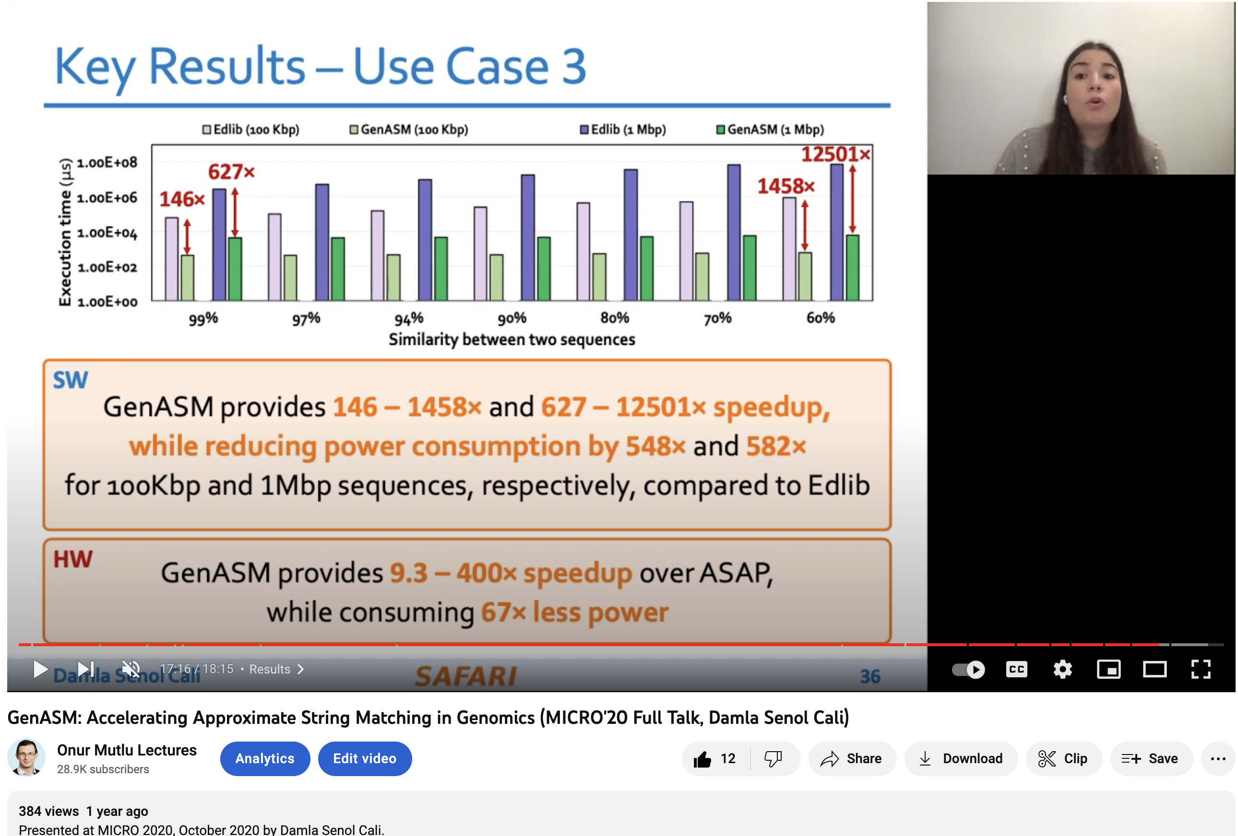
GenASM Talk Video
https://www.youtube.com/watch?v=NFU2GANPJNU

Slide 117
GenASM: A High Performance, Low-Power Approximate String Matching Acceleration Framework for Genome Sequence Analysis
Damla Senol Cali
Carnegie Mellon University
(dsenol@andrew.cmu.edu)
Gurpreet S. Kalsi², Zulal Bingol³, Can Firtina⁴, Lavanya Subramanian⁵,
Jeremie Kim^{1,4}, Rachata Ausavarungnirun^{6,1}, Mohammed Alser⁴,
Juan Gomez-Luna⁴, Amirali Boroumand¹, Anant Nori², Allison Scibisz¹,
Sreenivas Subramoney², Can Alkan³, Saugata Ghose^{7,1}, and Onur Mutlu^{4,1,3}
1 2 3 4
5 6 7 1,4
Notes:
Hello, I am Damla Senol Cali. Today, I'll be presenting our work "GenASM: A High Performance, Low-Power Approximate String Matching Acceleration Framework for Genome Sequence Analysis".

Slide 118
SeGraM: Sequence-to-Graph Mapping Accelerator for Genomics

Slide 119
Accelerating Sequence-to-Graph Mapping
Damla Senol Cali, Konstantinos Kanellopoulos, Joel Lindegger, Zulal Bingol, Gurpreet S. Kalsi, Ziyi Zuo, Can Firtina, Meryem Banu Cavlak, Jeremie Kim, Nika MansouriGhiasi, Gagandeep Singh, Juan Gomez-Luna, Nour Almadhoun Alserr, Mohammed Alser, Sreenivas Subramoney, Can Alkan, Saugata Ghose, and Onur Mutlu,
"SeGraM: A Universal Hardware Accelerator for Genomic Sequence-to-Graph and Sequence-to-Sequence Mapping"
Proceedings of the 49th International Symposium on Computer Architecture (ISCA), New York, June 2022.
[arXiv version]
https://arxiv.org/pdf/2205.05883.pdf

Slide 120
SeGraM: A Universal Hardware Accelerator for Genomic Sequence-to-Graph and
Sequence-to-Sequence Mapping
Damla Senol Cali, Ph.D.
damlasenolcali@gmail.com
https://damlasenolcali.github.io/
Konstantinos Kanellopoulos, Joel Lindegger, Zulal Bingol, Gurpreet S. Kalsi, Ziyi Zuo, Can Firtina, Meryem Banu Cavlak, Jeremie S. Kim, Nika Mansouri Ghiasi,
Gagandeep Singh, Juan Gomez-Luna, Nour Almadhoun Alserr, Mohammed Alser, Sreenivas Subramoney, Can Alkan, Saugata Ghose, Onur Mutlu
Notes:
Hello, I am Damla Senol Cali. Today, I'll be presenting our work “SeGraM: A Universal Hardware Accelerator for Genomic Sequence-to-Graph and Sequence-to-Sequence Mapping ".

Slide 121
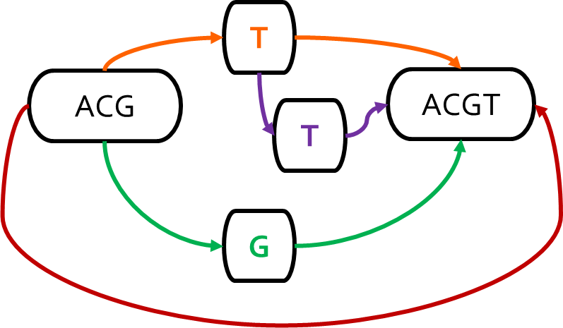
Problem: Sequence-to-Graph Mapping
Mapping the reads to a reference genome (i.e., read mapping) is a
critical step in genome sequence analysis
Sequence-to-Sequence (S2S) Mapping
Sequence-to-Graph (S2G) Mapping
Linear Reference: ACGTACGT
Read: ACGG
Alternative Sequence: ACGGACGT
Alternative Sequence: ACGTTACGT
Alternative Sequence: ACG‒ACGT
Graph-based Reference:
Read: ACGG
Sequence-to-graph mapping results in notable quality improvements.
However, it is a more difficult computational problem,
with no prior hardware design.
Notes:
Read mapping, which is the process of mapping the reads to a reference genome is a critical step in genome sequence analysis
Traditionally, we perform seq2seq mapping, where we
Map reads collected from an individual to a known linear reference genome sequence
Emphasizes the genetic variations that are present in the single reference genome
Ignores other variations that are not represented in the single linear reference sequence
Introduces reference bias
However, s2s mapping is a well studied problem with many available tools and accelerators
Recent works replace the linear reference sequence with a graph-based representation of the reference genome (genome graph). Thus, we can perform seq2graph mapping.
Captures the genetic variations and diversity across many individuals in a population
[CLICK] Results in notable quality improvements in GSA

Slide 122
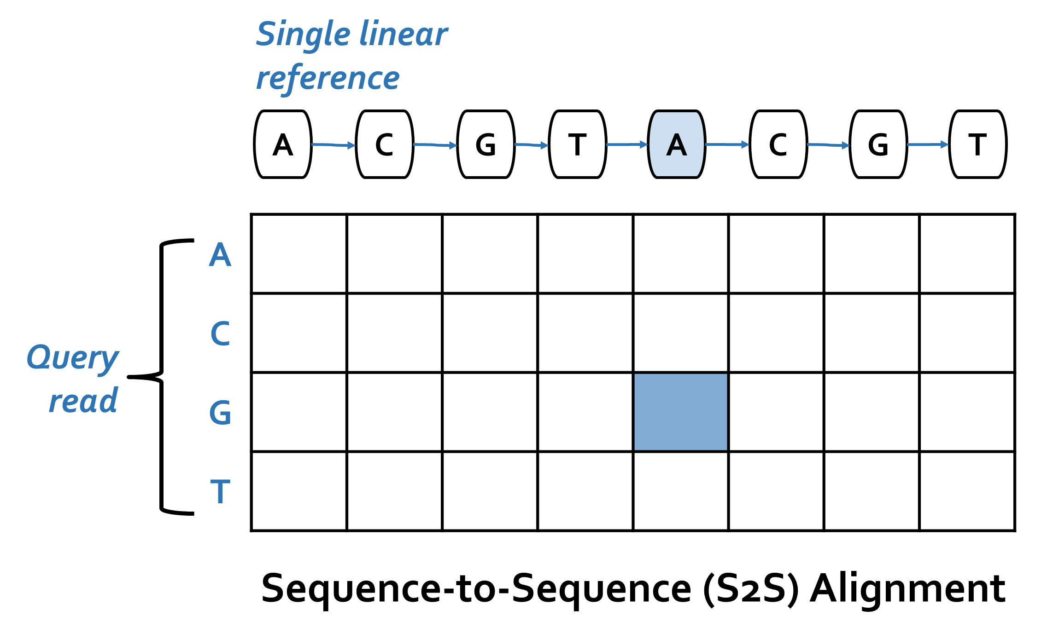
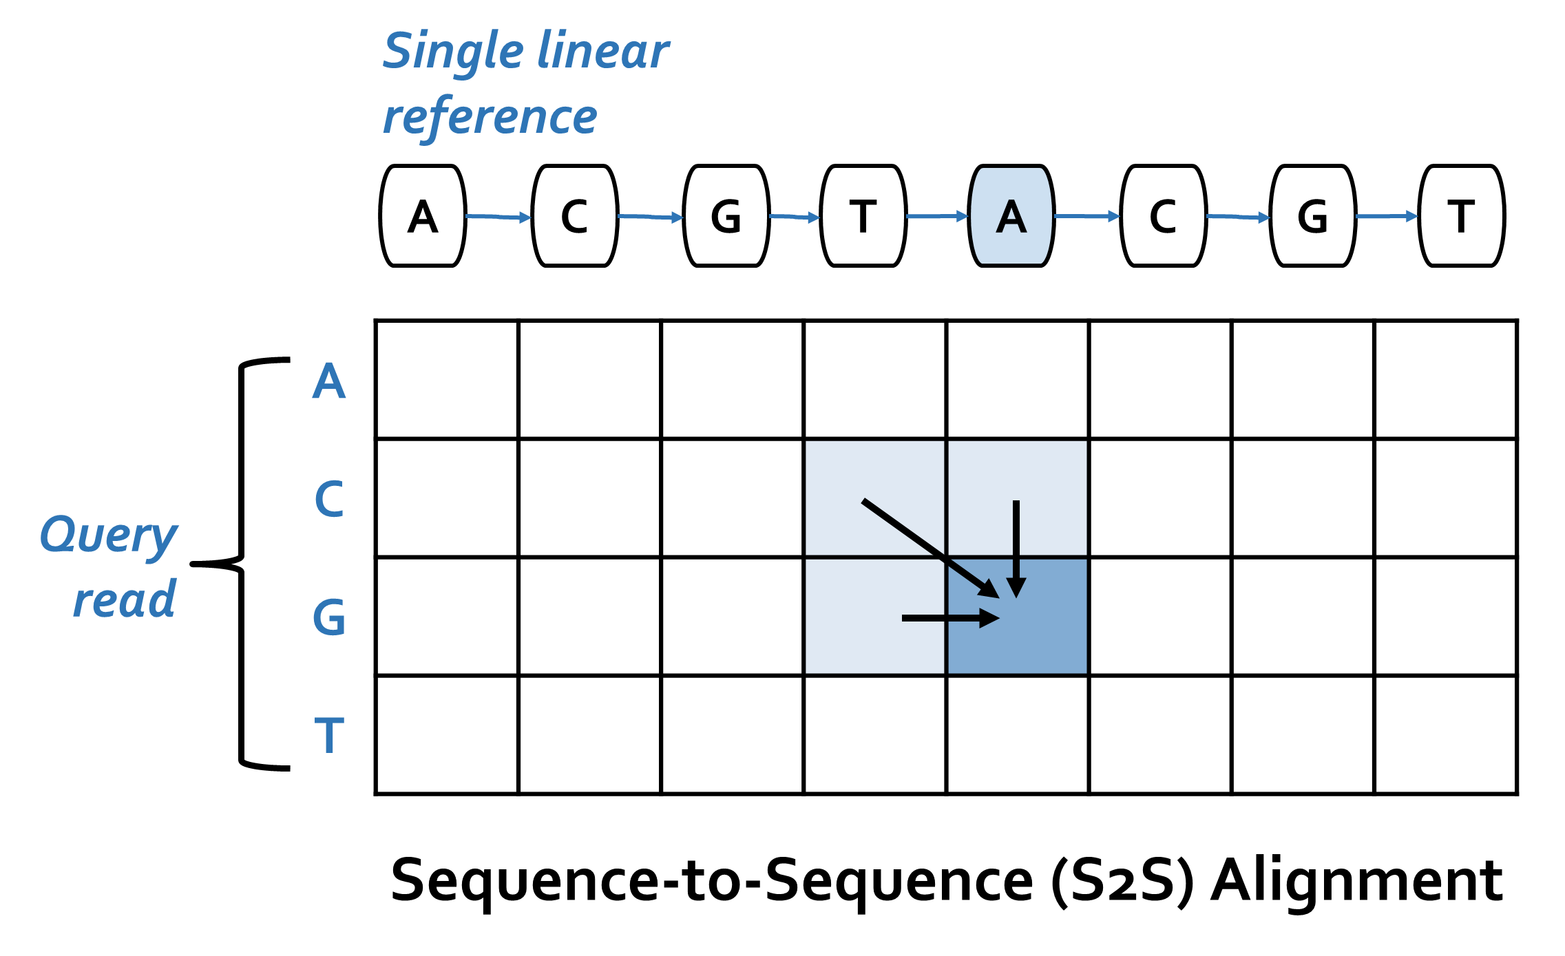
S2S vs. S2G Alignment
Notes:
[CLICK] Traditional sequence-to-sequence (S2S) alignment typically employs DP-based algorithms with quadratic time and space complexity.
A DP-based algorithm operates on a table, where each column of the table corresponds to a reference character, and each row of the table corresponds to a query read character.
[HIGHLIGHT] In S2S alignment, a new cell in the table is determined with simple rules from 3 of its neighbor cells.

Slide 123
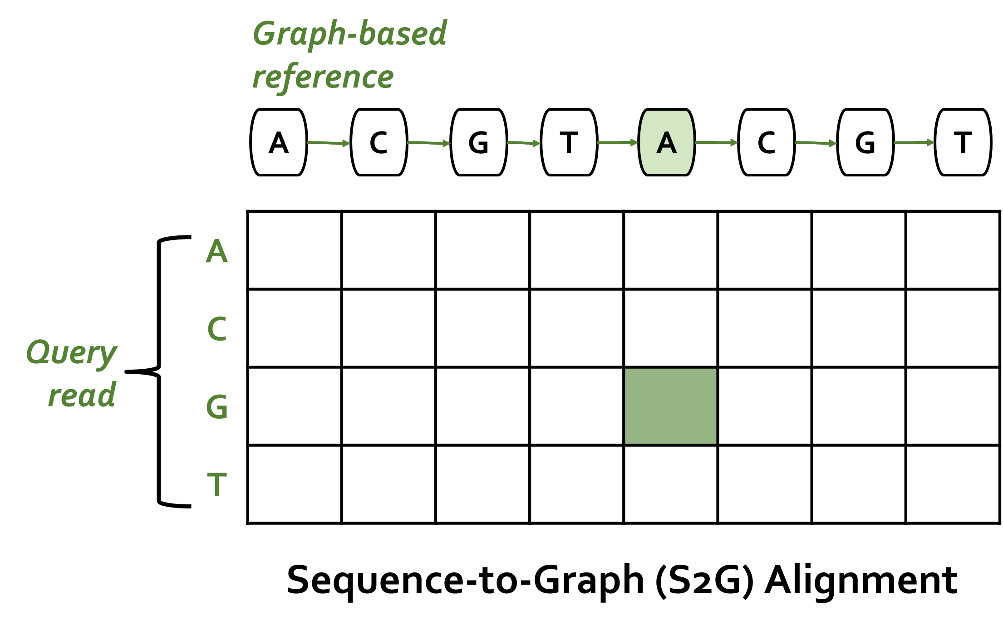


S2S vs. S2G Alignment
In contrast to S2S alignment,
S2G alignment must incorporate non-neighboring characters
as well whenever there is an edge (i.e., hop)
from the non-neighboring character to the current character
Notes:
[CLICK] In contrast to S2S alignment, S2G alignment must incorporate non-neighboring characters as well whenever there is an edge (i.e., hop) from the non-neighboring character to the current character. [HIGHLIGHT] For example, when computing the green-shaded cell, we need information from all of the light green-shaded cells.
=======================================================================================================
Even though sequence-to-sequence mapping is a well-studied problem, given the additional complexities and overheads of processing a genome graph instead of a linear reference genome, sequence-to-graph mapping is a more difficult computational problem with a smaller number of practical software tools currently available.

Slide 124
SeGraM: First Graph Mapping Accelerator
Our Goal:
Specialized, high-performance, scalable, and low-cost algorithm/hardware co-design that alleviates bottlenecks in multiple steps of sequence-to-graph mapping
SeGraM: First universal algorithm/hardware co-designed genomic mapping accelerator that can effectively and efficiently support:
Sequence-to-graph mapping
Sequence-to-sequence mapping
Both short and long reads
Notes:
[CLICK] Thus, our goal is to come up with a specialized, high-performance, scalable, and low-cost algorithm/hardware co-design that alleviates bottlenecks in both the seeding and alignment steps of sequence-to-graph mapping.
[CLICK] To this end, we propose SeGraM, a universal algorithm/hardware co-designed genomic mapping accelerator that can effectively and efficiently support both sequence-to-graph mapping and sequence-to-sequence mapping, for both short and long reads. To our knowledge, SeGraM is the first algorithm/hardware co-design for accelerating
sequence-to-graph mapping.

Slide 125
Sequence-to-Graph Mapping Pipeline
0.1
Pre-Processing
Steps (Offline)
Seed-and-Extend
Steps (Online)
Linear reference genome
Known genetic variations
Genome Graph Construction
(construct the graph using a linear reference genome and variations)
Genome graph
0.2
Indexing
(index the nodes of the graph)
Hash-table-based index (of graph nodes)
Reads from sequenced
genome
1
Seeding
(query the index & find the seed matches)
Candidate mapping locations (subgraphs)
2
Filtering/Chaining/Clustering
(filter out dissimilar query read and subgraph pairs)
Remaining candidate mapping locations (subgraphs)
3
S2G Alignment
(perform distance/score calculation & traceback)
Optimal alignment between read & subgraph
Notes:
Which brings us to seq2graph mapping.
Sequence-to-graph mapping pipeline has [CLICK] two pre-processing and [CLICK] three main steps.
[CLICK] The first pre-processing step constructs the genome graph using a linear reference genome and the associated variations for that genome.
[CLICK] The second pre-processing step indexes the nodes of the graph. The resulting index is used in the first main step of the pipeline, [CLICK] seeding, which aims to find seed matches between the query read and a region of the graph.
[CLICK] After optionally filtering these seed matches with a filtering, chaining, or clustering step, [CLICK] alignment is performed between all of the non-filtered seed locations within the graph and the query read to find the optimal alignment. Alignment is the most expensive step of the pipeline, so let’s look at it in detail.

Slide 126
SeGraM Hardware Design
Main Memory (graph-based reference & index)
Main Memory (graph-based reference & index)
frequencies
seed locations
graph nodes
3
5
7
SeGraM Accelerator
MinSeed (MS)
BitAlign (BA)
Minimizer Scratchpad
Seed Scratchpad
Input Scratchpad
8
Generate Bitvectors
Hop Queues
9
minimizers
2
4
6
Find Minimizers
Filter
Minimizers by Frequency
Find Candidate
Seed Regions
10
Bitvector Scratchpad
query k-mers
Host CPU
Host CPU
11
1
Read
Scratchpad
Perform
Traceback
query
read
optimal alignment information
12
MinSeed (MS): first hardware
accelerator for
Minimizer-based Seeding
BitAlign (BA): first hardware accelerator for (Bitvector-based) sequence-to-graph Alignment
Notes:
Let’s look at the overview of our hardware design.
[CLICK] Before SeGraM execution starts, as pre-processing steps, we (1) generate each chromosome’s graph structure, (2) index each graph’s nodes, and (3) pre-load both the resulting graph and hash table index into the main memory. Both the graph and its index are static data structures that can be generated only once and reused for multiple mapping executions.
[CLICK] SeGraM execution starts when the query read is streamed from the host and MinSeed writes it to the read scratchpad ( 1 ).
[CLICK] Using all of the k-length subsequences (i.e., k-mers) of the query read, [CLICK] MinSeed finds the minimum representative set of these k-mers (i.e., minimizers) according to a scoring mechanism and [CLICK] writes them to the minimizer scratchpad ( 2 ).
[CLICK] For each minimizer, MinSeed fetches its occurrence frequency from the hash table in main memory ( 3 ) and [CLICK] filters out each minimizer whose occurrence frequency is above a user-defined threshold ( 4 ). We aim to select the least frequent minimizers and filter out the most frequent minimizers such that we minimize the number of seed locations to be considered for the expensive alignment step.
[CLICK] Next, MinSeed fetches the seed locations of the remaining minimizers from main memory, and writes them to the seed scratchpad ( 5 ).
[CLICK] Finally, MinSeed calculates the candidate reference region (i.e., subgraph surrounding the seed) for each seed ( 6 ), [CLICK] fetches the graph nodes from memory for each candidate region in the reference and writes the nodes to the input scratchpad of BitAlign. ( 7 ).
[CLICK] BitAlign starts by reading the subgraph and the query read from the input scratchpad, and generates the bitvectors ( 8 ) required for performing approximate string matching and edit distance calculation.
While generating these bitvectors, [CLICK] BitAlign writes them to the hop queues ( 9 ) in order to handle the hops required for graph-based alignment, and also, [CLICK] to the bitvector scratchpad ( 10 ) to be later used as part of the traceback operation.
Once BitAlign finishes generating and writing all the bitvectors, [CLICK] it starts reading them back from the bitvector scratchpad, performs the traceback operation ( 11 ), finds the optimal alignment between the subgraph and the query read, and [CLICK] streams the optimal alignment information back to the host ( 12 ).

Slide 127

Overall System Design of SeGraM
High Bandwidth Memory (HBM2E) Stack
High Bandwidth Memory (HBM2E) Stack
. . .
CH1
. . .
CH0
CH2
CH6
CH7
SeGraM Module (1 x per HBM2E stack)
Host
SeGraM Module (1 x per HBM2E stack)
Host
MS
MS
MS
MS
MS
X
4
. . .
BA
BA
BA
BA
BA
SeGraM
Acc.
SeGraM
Acc.
SeGraM
Acc.
SeGraM
Acc.
SeGraM
Acc.
Notes:
[CLICK] SeGraM is connected to a host system that is responsible for the pre-processing steps and for transferring the query read to the accelerator.
[CLICK] Next to each HBM2E channel, we place one SeGraM accelerator, such that it will have exclusive access without any interference from other SeGraM accelerators.
[CLICK] Each SeGraM accelerator is a combination of one MinSeed accelerator and one BitAlign accelerator.
[CLICK] Each HBM2E stack has eight memory channels, thus connected to 8 SeGraM accelerators, which define one SeGraM module.
[CLICK] Our hardware platform includes four off-chip HBM2E stacks, thus 4 SeGraM modules, thus 32 SeGraM accelerators in total. ====================================================================================================================
Each SeGraM accelerator has exclusive access to one HBM2E channel to ensure low-latency memory access, without any interference from other SeGraM accelerators in each module.
There is no communication required between different SeGraM accelerators in a single SeGraM module, and each SeGraM accelerator communicates with the host independently of other SeGraM accelerators.
[CLICK] We replicate the graph-based reference and hash-table-based index across all 4 independent HBM2E stacks, which enables us to have 32 independent SeGraM accelerators running in parallel.
[CLICK] Within each stack, to balance the memory footprint across all channels, we distribute the graph and index structures of all chromosomes (1–22, X, Y) based on their sizes across the eight independent channels
[CLICK] We design each SeGraM accelerator (MinSeed + BitAlign) to operate in a pipelined fashion and we employ double buffering technique for all MS scratchpads, such that we can hide the latency of the MinSeed accelerator.

Slide 128
Use Cases of SeGraM
(1) Sequence-to-Graph
Mapping
(2) Sequence-to-Graph
Alignment
(3) Sequence-to-Sequence
Alignment
(4) Seeding
MS
BA
MS or
Other
BA
MS or
Other
BA
MS
BA or
Other
Notes:
As a result of the flexibility and modularity of the SeGraM framework, we can run each accelerator together or separately. Thus, we describe four use cases of SeGraM: [CLICK] (1) end-to-end mapping w/ SeGraM, [CLICK] (2) standalone s2g alignment w/ BitAlign and can be coupled with any seeding tool or accelerator, [CLICK] (3) similarly, standalone s2s alignment w/ BitAlign, and [CLICK] (4) standalone seeding for both s2g and s2s w/ MinSeed and can be coupled with any alignment tool or accelerator.
=========================================================================================================
[CLICK] For sequence-to-graph mapping, the whole SeGraM design (MinSeed + BitAlign) should be employed, since both seeding and alignment steps are required. With the help of the divide-and-conquer approach inherited from the GenASM algorithm, we can use SeGraM to perform sequence-to-graph mapping for both short reads and long reads.
[CLICK] Since BitAlign takes in a graph-based reference and a query read as its inputs, it can be used as a standalone sequence-to-graph aligner, without MinSeed. BitAlign is orthogonal to and can be coupled with any seeding (or filtering) tool/accelerator.
[CLICK] BitAlign can also be used for sequence-to-sequence alignment, as sequence-to-sequence alignment is a special and simpler variant of sequence-to-graph alignment. [CLICK] Similarly, MinSeed can be used without BitAlign as a standalone seeding accelerator for both graph-based mapping and traditional linear mapping. MinSeed is orthogonal to and can be coupled with any alignment tool or accelerator.

Slide 129
Use Cases & Key Results
Sequence-to-Graph (S2G) Mapping
5.9×/106× speedup, 4.1×/3.0× less power than GraphAligner
for long and short reads, respectively (state-of-the-art SW)
3.9×/742× speedup, 4.4×/3.2× less power than vg
for long and short reads, respectively (state-of-the-art SW)
Sequence-to-Graph (S2G) Alignment
41×–539× speedup over PaSGAL with AVX-512 support (state-of-the-art SW)
Sequence-to-Sequence (S2S) Alignment
1.2×/4.8× higher throughput than GenASM and GACT of Darwin
for long reads (state-of-the-art HW)
1.3×/2.4× higher throughput than GenASM and SillaX of GenAX
for short reads (state-of-the-art HW)
Notes:
[CLICK] [CLICK] [CLICK] We demonstrate that SeGraM provides significant improvements for multiple steps of the sequence-to-graph (i.e., S2G) and sequence-to-sequence (i.e., S2S) mapping pipelines.
==================================================================================================================
[CLICK] We show that (1) SeGraM provides greatly higher throughput and lower power consumption on both short and long reads compared to state-of-the-art software tools for sequence-to-graph mapping, and
[CLICK] (2) BitAlign significantly outperforms a state-of-the-art sequence-to-graph alignment tool and [CLICK] three state-of-the-art hardware solutions that are specifically designed for sequence-to-sequence alignment.
===========================================================================================================
We also show that MinSeed can be employed for the seeding step of both sequence-to-graph and sequence-to-sequence mapping pipelines.

Slide 130


SeGraM is Open Source
https://github.com/CMU-SAFARI/SeGraM
Notes:
And we will be releasing our SW implementations and the datasets we use in our GitHub page soon.

Slide 131

SeGraM Talk Video
https://www.youtube.com/watch?v=gyjqYoyDP9s

Slide 132
More on SeGraM
Damla Senol Cali, Konstantinos Kanellopoulos, Joel Lindegger, Zulal Bingol, Gurpreet S. Kalsi, Ziyi Zuo, Can Firtina, Meryem Banu Cavlak, Jeremie Kim, Nika MansouriGhiasi, Gagandeep Singh, Juan Gomez-Luna, Nour Almadhoun Alserr, Mohammed Alser, Sreenivas Subramoney, Can Alkan, Saugata Ghose, and Onur Mutlu,
"SeGraM: A Universal Hardware Accelerator for Genomic Sequence-to-Graph and Sequence-to-Sequence Mapping"
Proceedings of the 49th International Symposium on Computer Architecture (ISCA), New York, June 2022.
[arXiv version]
https://arxiv.org/pdf/2205.05883.pdf

Slide 133
SeGraM: A Universal Hardware Accelerator for Genomic Sequence-to-Graph and
Sequence-to-Sequence Mapping
Damla Senol Cali, Ph.D.
damlasenolcali@gmail.com
https://damlasenolcali.github.io/
Konstantinos Kanellopoulos, Joel Lindegger, Zulal Bingol, Gurpreet S. Kalsi, Ziyi Zuo, Can Firtina, Meryem Banu Cavlak, Jeremie S. Kim, Nika Mansouri Ghiasi,
Gagandeep Singh, Juan Gomez-Luna, Nour Almadhoun Alserr, Mohammed Alser, Sreenivas Subramoney, Can Alkan, Saugata Ghose, Onur Mutlu
Notes:
Hello, I am Damla Senol Cali. Today, I'll be presenting our work “SeGraM: A Universal Hardware Accelerator for Genomic Sequence-to-Graph and Sequence-to-Sequence Mapping ".

Slide 134
Summary: Two Major Thrusts
  1. (Memory) system design for AI/ML workloads/accelerators
  2. AI/ML techniques for improving (memory) system designs

Slide 135
Challenge and Opportunity for Future
Self-Optimizing
(Data-Driven)
Computing Architectures

Slide 136
Challenge and Opportunity for Future
Accelerating
Emerging Workloads

Slide 137
Memory System Design for AI/ML Accelerators & ML/AI Techniques for Memory System Design
Onur Mutlu
omutlu@gmail.com
https://people.inf.ethz.ch/omutlu
10 November 2022
Intel/SRC Research Program Review

Slide 138
Backup Slides: SRC Task

Slide 139
Our Goals in This Task
Two Major Goals:
  1. Memory system design for AI/ML workloads/accelerators
  → in-depth exploration of memory system designs for cutting-edge and emerging machine learning accelerators
  → more efficient on-chip and off-chip memory systems
  2. AI/ML techniques for improving memory system designs
  → take a comprehensive look at memory system design and make it data driven, i.e., based on machine learning
  → more effective cache/memory/prefetch/thread controllers and data/resource management/mapping/scheduling policies

Slide 140
Backup Slides: Pythia

Slide 141
Performance Improvement via Customization
Reward value customization
Strict Pythia configuration
  Increasing the rewards for no prefetching
  Decreasing the rewards for inaccurate prefetching
Strict Pythia is more conservative in generating prefetch requests than the basic Pythia
Evaluate on all Ligra graph processing workloads
Notes:
Next, we analyze performance improvement of Pythia via customization.
[CLICK] We show an example of reward value customization, where,
[CLICK] We devise a strict Pythia configuration by increasing the reward level values for no prefetching, while decreasing the rewards values for inaccurate prefetching.
In short, strict Pythia is more conservative than the basic Pythia and strongly prefers not to prefetch, rather than prefetching inaccurately.
We evaluate both basic Pythia and strict Pythia on Ligra workload suite.

Slide 142
More in the Paper
Performance comparison with unseen traces
  Pythia provides equally high performance benefits
Comparison against multi-level prefetchers
  Pythia outperforms prior best multi-level prefetchers
Understanding Pythia’s learning with a case study
  We reason towards the correctness of Pythia’s decision
Performance sensitivity towards different features and hyperparameter values
Detailed single-core and four-core performance
Notes:
We have many more exciting results including, ….
We encourage everyone to read it.

Slide 143

More in the Paper
Performance comparison with unseen traces
  Pythia provides equally high performance benefits
Comparison against multi-level prefetchers
  Pythia outperforms prior best multi-level prefetchers
Understanding Pythia’s learning with a case study
  We reason towards the correctness of Pythia’s decision
Performance sensitivity towards different features and hyperparameter values
Detailed single-core and four-core performance
https://arxiv.org/pdf/2109.12021.pdf
Notes:
We have many more exciting results including, ….
We encourage everyone to read it.

Slide 144
Backup Slides: Hermes

Slide 145

Latency Configuration
Cache round-trip latency
  L1-D: 5 cycles
  L2: 15 cycles
  LLC: 55 cycles
Hermes request issue latency (incurred after address translation)
Depends on
  Interconnect between POPET and MC
0 cycles
24 cycles
6 cycles
Notes:
For our evaluation, we consider
[CLICK] a 5 cycle L1-D
[CLICK] 15 cycle L2
[CLICK] and 55 cycle LLC round-trip latency.
[CLICK] The latency for Hermes to issue a request directly to the main memory controller (after the address translation) depends on …
[CLICK] For this reason we sweep this latency from 0-cycles to 24-cycles in our paper.
[CLICK] But in this presentation, I am going to show you results considering a 6-cycle latency.

Slide 146
More in the Paper
Performance sensitivity to:
  Cache hierarchy access latency
  Hermes request issue latency
  Activation threshold
  ROB size (in extended version on arXiv)
  LLC size (in extended version on arXiv)
Accuracy, coverage, and performance analysis against HMP and TTP
Understanding usefulness of each program feature
Effect on stall cycle reduction
Performance analysis on an eight-core system
Notes:
We have many more evaluation results:
For example, a wide range of performance sensitivity study by varying…in the paper.

Slide 147
Backup Slides: SeGraM

Slide 148
Genome Graphs
Genome graphs:
Combine the linear reference genome with the known genetic variations in the entire population as a graph-based data structure
Enable us to move away from aligning with a single linear reference genome (reference bias) and more accurately express the genetic diversity in a population
T
Sequence #1: ACGTACGT
Sequence #2: ACGGACGT
Sequence #3: ACGTTACGT
Sequence #4: ACGACGT
ACG
ACGT
T
G
Notes:
With increasing importance and usage of genome graphs, having accurate and efficient tools for mapping genomic sequences to these genome graphs has become crucial. [CLICK]

Slide 149
Analysis of State-of-the-Art Tools
SW
Based on our analysis with GraphAligner and vg:
Observation 1: Alignment step is the bottleneck
Observation 2: Alignment suffers from high cache miss rates
Observation 3: Seeding suffers from the DRAM latency bottleneck
Observation 4: Baseline tools scale sublinearly
Observation 5: Existing S2S mapping accelerators are unsuitable
for the S2G mapping problem
Observation 6: Existing graph accelerators are unable to handle
S2G alignment
HW
Notes:
In order to further understand the performance bottlenecks of the state-of-the-art sequence-to-graph mapping tools, we rigorously analyze two such tools, GraphAligner [61] and vg [36], and we make four key observations.
[CLICK] (1) Among the three online steps of the read mapping pipeline alignment i) constitutes majority of the end-to-end execution of sequence-to-graph mapping, and ii) is even more expensive than its counterpart in the traditional read mapping pipeline.
[CLICK] (2) Alignment suffers from high cache miss rates, due to the high amount of internal data that is generated and reused during this step.
[CLICK} (3) Seeding suffers from the main memory (DRAM) latency bottleneck, due to the high number of irregular memory accesses.
[CLICK] (4) Both state-of-the-art tools scale sublinearly as thread count increases, wasting available thread-level parallelism in hardware.
[CLICK] We also investigate the existing HW accelerators. It is important to note that there is no existing hardware accelerator for sequence-to-graph mapping or alignment problems.
[CLICK] Even though there are several hardware accelerators designed to alleviate bottlenecks in several steps of traditional sequence-to-sequence (S2S) mapping, none of these
designs can be directly employed for the sequence-to-graph (S2G) mapping problem. This is because S2S mapping is a special case of S2G mapping, where all nodes have only one incoming edge. Existing accelerators are limited to only this special case, and are unsuitable for the more general S2G mapping problem, where we also need to consider multiple edges (i.e., hops) that a node can have.
[CLICK] We also look at the possibility of exploiting existing several graph accelerators. While existing graph accelerators could potentially be customized to help the seeding step of the sequence-to-graph mapping pipeline, they are unable to handle the major bottleneck of sequence-to-graph mapping, which is alignment. Alignment is not a graph traversal workload, and instead is an expensive bitvector-based or DP-based computational problem.
Thus, we need to have a specialized, balanced, and scalable design for compute units, on-chip memory, and main memory accesses for both the seeding and alignment steps of sequence-to-graph mapping.

Slide 150
SeGraM: Universal Genomic Mapping Accelerator
First universal genomic mapping accelerator that can support both sequence-to-graph mapping and sequence-to-sequence mapping, for both short and long reads
First algorithm/hardware co-design for accelerating
sequence-to-graph mapping
We base SeGraM upon a minimizer-based seeding algorithm
We propose a novel bitvector-based alignment algorithm to perform approximate string matching between a read and a graph-based reference genome
We co-design both algorithms with high-performance, scalable, and efficient hardware accelerators
SW
HW
Notes:
[CLICK] the first universal genomic mapping accelerator that can support both sequence-to-graph mapping and sequence-to-sequence mapping, for both short and
long reads.
[CLICK] To our knowledge, SeGraM is the first algorithm/hardware co-design for accelerating sequence-to-graph mapping.
[CLICK] We base SeGraM upon a minimizer-based seeding algorithm and we propose a novel bitvector-based alignment algorithm for sequence-to-graph alignment.
[CLICK] these cover the algorithmic contributions of SeGraM
[CLICK] We co-design both algorithms with high-performance, scalable, and efficient hardware accelerators.
[CLICK] and this covers the hardware-level contributions of SeGraM

Slide 151
SeGraM Hardware Design
Main Memory (graph-based reference & index)
SeGraM Accelerator
MinSeed (MS)
BitAlign (BA)
MinSeed (MS)
BitAlign (BA)
Minimizer Scratchpad
Seed Scratchpad
Input Scratchpad
Minimizer Scratchpad
Seed Scratchpad
Input Scratchpad
Generate Bitvectors
Hop Queues
Generate Bitvectors
Hop Queues
Find Minimizers
Filter
Minimizers by Frequency
Find Candidate
Seed Regions
Find Minimizers
Filter
Frequencies by Frequency
Find Candidate
Seed Regions
Bitvector Scratchpad
Bitvector Scratchpad
Host CPU
Read
Scratchpad
Perform
Traceback
Read
Scratchpad
Perform
Traceback
MinSeed: first hardware
accelerator for
Minimizer-based Seeding
BitAlign: first hardware accelerator for (Bitvector-based) sequence-to-graph Alignment
Notes:
A SeGraM accelerator consists of two main components:
[CLICK] MinSeed (MS), which is responsible for the seeding step and it is the first hardware accelerator for minimizer-based seeding, and second component is
[CLICK] (2) BitAlign (BA), which is responsible for the alignment step and it is the first hardware accelerator for sequence-to-graph alignment.

Slide 152
SeGraM Hardware Design
Main Memory (graph-based reference & index)
Main Memory (graph-based reference & index)
frequencies
seed locations
graph nodes
3
5
7
SeGraM Accelerator
MinSeed (MS)
BitAlign (BA)
Minimizer Scratchpad
Seed Scratchpad
Input Scratchpad
8
Generate Bitvectors
Hop Queues
9
minimizers
2
4
6
Find Minimizers
Filter
Minimizers by Frequency
Find Candidate
Seed Regions
10
Bitvector Scratchpad
query k-mers
Host CPU
Host CPU
11
1
Read
Scratchpad
Perform
Traceback
query
read
optimal alignment information
12
MinSeed: first hardware
accelerator for
Minimizer-based Seeding
BitAlign: first hardware accelerator for (Bitvector-based) sequence-to-graph Alignment
Notes:
Let’s look at the overview of our hardware design.
[CLICK] Before SeGraM execution starts, as pre-processing steps, we (1) generate each chromosome’s graph structure, (2) index each graph’s nodes, and (3) pre-load both the resulting graph and hash table index into the main memory. Both the graph and its index are static data structures that can be generated only once and reused for multiple mapping executions.
[CLICK] SeGraM execution starts when the query read is streamed from the host and MinSeed writes it to the read scratchpad ( 1 ).
[CLICK] Using all of the k-length subsequences (i.e., k-mers) of the query read, [CLICK] MinSeed finds the minimum representative set of these k-mers (i.e., minimizers) according to a scoring mechanism and [CLICK] writes them to the minimizer scratchpad ( 2 ).
[CLICK] For each minimizer, MinSeed fetches its occurrence frequency from the hash table in main memory ( 3 ) and [CLICK] filters out each minimizer whose occurrence frequency is above a user-defined threshold ( 4 ). We aim to select the least frequent minimizers and filter out the most frequent minimizers such that we minimize the number of seed locations to be considered for the expensive alignment step.
[CLICK] Next, MinSeed fetches the seed locations of the remaining minimizers from main memory, and writes them to the seed scratchpad ( 5 ).
[CLICK] Finally, MinSeed calculates the candidate reference region (i.e., subgraph surrounding the seed) for each seed ( 6 ), [CLICK] fetches the graph nodes from memory for each candidate region in the reference and writes the nodes to the input scratchpad of BitAlign. ( 7 ).
[CLICK] BitAlign starts by reading the subgraph and the query read from the input scratchpad, and generates the bitvectors ( 8 ) required for performing approximate string matching and edit distance calculation.
While generating these bitvectors, [CLICK] BitAlign writes them to the hop queues ( 9 ) in order to handle the hops required for graph-based alignment, and also, [CLICK] to the bitvector scratchpad ( 10 ) to be later used as part of the traceback operation.
Once BitAlign finishes generating and writing all the bitvectors, [CLICK] it starts reading them back from the bitvector scratchpad, performs the traceback operation ( 11 ), finds the optimal alignment between the subgraph and the query read, and [CLICK] streams the optimal alignment information back to the host ( 12 ).

Slide 153
MinSeed HW
MinSeed = 3 computation modules + 3 scratchpads + memory interface
  Computation modules: Implemented with simple logic
  Scratchpads: 50kB in total; employ double buffering technique to hide the latency of MinSeed
  High-Bandwidth Memory (HBM): Enables low-latency and
  highly-parallel memory access
Main Memory (High Bandwidth Memory)
Main Memory (High Bandwidth Memory)
Read
Scratchpad
(6 kB)
Minimizer
Finder
Minimizer Scratchpad
(40 kB)
Minimizer Filter
by
Frequency
(<?)
Seed Scratchpad
(4 kB)
Candidate
Seed Region
Calculator
(+/−/×)
Read
Scratchpad
(6 kB)
Minimizer
Finder
Minimizer Scratchpad
(40 kB)
Minimizer Filter
by
Frequency
(<?)
Seed Scratchpad
(4 kB)
Candidate
Seed Region
Calculator
(+/−/×)
query read
(INPUT)
candidate
subgraph
(OUTPUT)
frequency
threshold
(INPUT)
error rate,
read length
(INPUT)
Notes:
Let’s look at the HW design of MinSeed.
MinSeed accelerator consists of three computation modules, three scratchpads, and the memory interface
Computation modules are implemented with simple logic, since we require only basic operations (e.g., comparisons, simple arithmetic operations, scratchpad R/W operations)
For all three scratchpads, we employ a double buffering technique to hide the latency of the MinSeed accelerator.
We couple MinSeed with High-Bandwidth Memory (HBM) to enable low-latency and highly-parallel memory access.

Slide 154
Overall System Design of SeGraM
High Bandwidth Memory (HBM2E) Stack
High Bandwidth Memory (HBM2E) Stack
. . .
CH1
. . .
CH0
CH2
CH6
CH7
SeGraM Module (1 x per HBM2E stack)
Host
SeGraM Module (1 x per HBM2E stack)
Host
MS
MS
MS
MS
MS
X
4
. . .
BA
BA
BA
BA
BA
SeGraM
Acc.
SeGraM
Acc.
SeGraM
Acc.
SeGraM
Acc.
SeGraM
Acc.
Notes:
[CLICK] SeGraM is connected to a host system that is responsible for the pre-processing steps and for transferring the query read to the accelerator.
[CLICK] Next to each HBM2E channel, we place one SeGraM accelerator, such that it will have exclusive access without any interference from other SeGraM accelerators.
[CLICK] Each SeGraM accelerator is a combination of one MinSeed accelerator and one BitAlign accelerator.
[CLICK] Each HBM2E stack has eight memory channels, thus connected to 8 SeGraM accelerators, which define one SeGraM module.
[CLICK] Our hardware platform includes four off-chip HBM2E stacks, thus 4 SeGraM modules, thus 32 SeGraM accelerators in total. ====================================================================================================================
Each SeGraM accelerator has exclusive access to one HBM2E channel to ensure low-latency memory access, without any interference from other SeGraM accelerators in each module.
There is no communication required between different SeGraM accelerators in a single SeGraM module, and each SeGraM accelerator communicates with the host independently of other SeGraM accelerators.
[CLICK] We replicate the graph-based reference and hash-table-based index across all 4 independent HBM2E stacks, which enables us to have 32 independent SeGraM accelerators running in parallel.
[CLICK] Within each stack, to balance the memory footprint across all channels, we distribute the graph and index structures of all chromosomes (1–22, X, Y) based on their sizes across the eight independent channels
[CLICK] We design each SeGraM accelerator (MinSeed + BitAlign) to operate in a pipelined fashion and we employ double buffering technique for all MS scratchpads, such that we can hide the latency of the MinSeed accelerator.

Slide 155
Use Cases of SeGraM
(1) Sequence-to-Graph
Mapping
(2) Sequence-to-Graph
Alignment
(3) Sequence-to-Sequence
Alignment
(4) Seeding
MS
BA
MS or
Other
BA
MS or
Other
BA
MS
BA or
Other
Notes:
As a result of the flexibility and modularity of the SeGraM framework, we can run each accelerator together or separately. Thus, we describe four use cases of SeGraM: [CLICK] (1) end-to-end mapping w/ SeGraM, [CLICK] (2) standalone s2g alignment w/ BitAlign and can be coupled with any seeding tool or accelerator, [CLICK] (3) similarly, standalone s2s alignment w/ BitAlign, and [CLICK] (4) standalone seeding for both s2g and s2s w/ MinSeed and can be coupled with any alignment tool or accelerator.
=========================================================================================================
[CLICK] For sequence-to-graph mapping, the whole SeGraM design (MinSeed + BitAlign) should be employed, since both seeding and alignment steps are required. With the help of the divide-and-conquer approach inherited from the GenASM algorithm, we can use SeGraM to perform sequence-to-graph mapping for both short reads and long reads.
[CLICK] Since BitAlign takes in a graph-based reference and a query read as its inputs, it can be used as a standalone sequence-to-graph aligner, without MinSeed. BitAlign is orthogonal to and can be coupled with any seeding (or filtering) tool/accelerator.
[CLICK] BitAlign can also be used for sequence-to-sequence alignment, as sequence-to-sequence alignment is a special and simpler variant of sequence-to-graph alignment. [CLICK] Similarly, MinSeed can be used without BitAlign as a standalone seeding accelerator for both graph-based mapping and traditional linear mapping. MinSeed is orthogonal to and can be coupled with any alignment tool or accelerator.

Slide 156

Key Results – Area & Power
Based on our synthesis of MinSeed and BitAlign accelerator datapaths using the Synopsys Design Compiler with a 28nm process (@ 1GHz):
Notes:
Based on our synthesis of MinSeed and BitAlign accelerator datapaths, [CLICK] total area overhead of SeGraM attached to all 32 channels is around 28mm2 and the total power consumption is around 28 W, including the HBM power.
[CLICK] We find that the main contributors for the area overhead and power consumption are (1) hopQueueRegisters since they constitute more than 60% of the area and power of BitAlign logic, and (2) the bitvector scratchpads.

Slide 157

Key Results – SeGraM with Long Reads
  SeGraM provides 5.9× and 3.9× throughput improvement over GraphAligner and vg,
  while reducing the power consumption by 4.1× and 4.4×
Notes:
Let’s look at our long read analysis for s2g mapping with SeGraM. Here we only show our throughput numbers in the plot, not the power numbers.
Compared to two state-of-the-art s2g mapping software tools, GraphAligner and vg, we find that [CLICK]

Slide 158

Key Results – SeGraM with Short Reads
  SeGraM provides 106× and 742× throughput improvement over GraphAligner and vg,
  while reducing the power consumption by 3.0× and 3.2×
Notes:
and when we look at our short read analysis, we find that [CLICK][CLICK]

Slide 159

Key Results – BitAlign (S2G Alignment)
  BitAlign provides 41×-539× speedup over PaSGAL
Notes:
Let’s look at the key results for the sequence-to-graph alignment module of SeGraM, which is BitAlign.

Slide 160
Conclusion
SeGraM: First universal algorithm/hardware co-designed genomic mapping accelerator that supports:
    Sequence-to-graph (S2G) & sequence-to-sequence (S2S) mapping
    Short & long reads
  MinSeed: First minimizer-based seeding accelerator
  BitAlign: First (bitvector-based) S2G alignment accelerator
SeGraM supports multiple use cases:
  End-to-end S2G mapping
  S2G alignment
  S2S alignment
  Seeding
SeGraM outperforms state-of-the-art software & hardware solutions
Notes:
[CLICK] To conclude, in this work, we propose SeGraM, the first universal… To our knowledge, SeGraM is also the first alg/hw co-design for accelerating S2G mapping.
[CLICK] SeGraM consists of 2 components: MinSeed … and BitAlign …
[CLICK] SeGraM supports multiple steps of S2G and S2S mapping pipelines, and
[CLICK] Based on our extensive analysis, we show that SeGraM outperforms state-of-the-art SW and HW solutions

