Slide 1


ASPLOS 2015 Debate
Onur Mutlu
onur@cmu.edu
http://users.ece.cmu.edu/~omutlu/
March 17, 2014
Istanbul

Slide 2
Debate Statement
It's time: systems venues should require authors to make their code and data publicly available; those that do not will be held to a higher standard.
Clarification: in PLDI, for example, papers by PC members are "held to a higher standard". The term doesn't have a strict definition. I'm told, however, that it means that no weak rejects are allowed (e.g. AAAC will get rejected) and that AABB papers get occasionally rejected (A=accept, B=weak accept). In the discussion, the PC notes that the paper being discuss is written by a member, and they consider whether the higher bar criterion is met.

Slide 3
Debate Abstract
Abstract: Most scientific disciplines take reproducibility of experimental results much more seriously than computer science. (See, for example, the polices concerning supporting artifacts—such as code and data—of the Nature and Science journals.) In this panel, two teams of highly-opinionated experts will debate whether it is time to adopt a similar policy in top-tier systems conferences and journals. The idea is to change the review process such that papers that do not make their code and data available will be held to a higher standard when making the accept/reject decision, thereby incentivizing authors to share. Attendees will be asked to vote whether they are in favor or against at the beginning and end of the panel.

Slide 4
My Bottom Line
I like the spirit of sharing source and data with publications.
Everyone should want to do it.
Everyone should be educated to do it (perhaps over time and with other incentives).
But …
I disagree with the “debate statement.”
Having to share source code and data should not be a requirement for publication.
Authors should not be forced to do it in our field.

Slide 5
Many Reasons for My Opposition
1. The main goal of publishing is to contribute insight (quickly)
2. Strict rules have unintended consequences
3. Double standards are a bad idea
4. Do we not want industry to publish papers?
5. There is great value to developing one’s own infrastructure
I will not have time to cover my suggestion for alternative models, but there are many:
encouragement, education, and rewards for publishing source code and data
without tying paper publication to source code publication

Slide 6
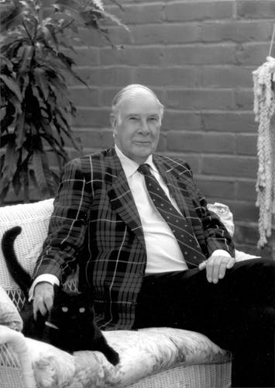
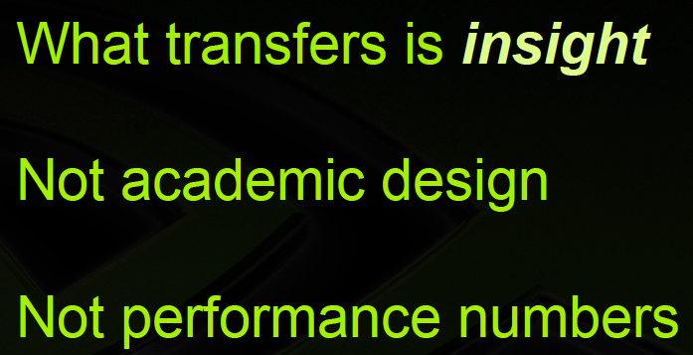

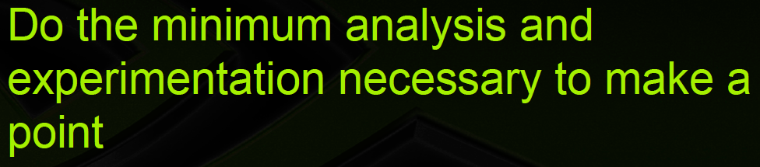
Some Basic Beliefs
Research (in engineering) is a hunt for insight that can eventually impact the world; evaluation is secondary
  “New insight” (not numbers) should be the bar for publication
  “Evaluation craze” can hinder our ability to reach big insights
“The purpose of computing is insight, not numbers”
Richard Hamming
Notes:
Too much focus on evaluation can …

Slide 7
Some Basic Beliefs
Research (in engineering) is a hunt for insight that can eventually impact the world; evaluation is secondary
  “New insight” (not numbers) should be the bar for publication
  “Evaluation craze” can hinder the ability to reach big insights
“Insight” is the most important determinant for publication
  Any other criterion that goes against a purely merit based process will lead to unintended consequences and unfairness
Industry publications are valuable in our field and we should make it easier (not harder) for industry to share
Developing and exploiting good infrastructure should not be penalized by requiring authors to give it out right away
The proposed statement goes against all these basic beliefs
Notes:
Hamming: The goal of computing is insight (with a picture)

Slide 8
1. Unintended Consequences
Strict rules governing publication → unintended consequences
What about authors who cannot make the source code and often times even absolute data available?
  E.g., industry, government, industry-academia collaborations, …
Will they stop publishing?
Will they be forced to hide even more such that they can publish with minimal exposure?
Will they be forced to form their own conferences/tracks?
What about industry/academia collaborative papers?
Will we have to sign NDAs to see some source code and data?
Will we have to deal with more and more bureaucracy?
Add your own questions here…

Slide 9
2. Double Standards
a set of principles that applies differently and usually more rigorously to one group of people or circumstances than to another
Requiring a higher bar for some papers over others is a terrible idea
Our goal is to publish the works that can advance the field
Any other criterion than merit leads to unintended consequences and some form of unfairness
It could deter some people from publishing
It could skew the balance of papers
It could slow us down (collectively as a field) from reaching bigger and other new insights
It’s just bad for the spirit of fairness
…

Slide 10
My Favorite Double Standard Example
PC Summary of a Rejected paper:
“The PC discussed this paper at length. The reviewers felt the solution was incremental with respect to the prior work, but that there was a contribution here. However, the fact that there was an overlap in the authorship of the two papers caused some concern, and it was felt that the minimum research increment when the papers come from the same group should be higher than if they came from separate groups.”
Rejected!
Notes:
I agree with you, this seems pretty outrageous. Reviewer #5 obviously killed the paper, and the point about "minimum research increment when the papers come from the same group should be higher than if they came from separate groups" seems completely wrong, I am surprised the Program Chair let this argument stand. This is a double-blind review, and it comes across that Reviewer 5 changed his/her mind when he saw the authors (which were revealed during the PC meeting).

Slide 11

My Suggestion
Do not allow double standards -- ever
And, if you were not affected so far, you may be in the future
Notes:
Long live the snake that does not touch me! (Calkan, 2015, Istanbul 360)

Slide 12
3. Industry Papers
Requiring source code would deter industry from publishing
It is already difficult for the industry to publish (for various reasons)
Making it even harder would reduce progress in our field
Subjecting industry papers to a higher bar would make it harder for industry to publish
Could we make it work?
  → Not without unintended consequences

Slide 13
4. Freeloading
Putting out source code may penalize researchers who take the pains to develop infrastructure to get to new insights
Developing and exploiting good infrastructure should not be penalized by requiring authors to give it out right away
A big idea may be barred from publication due to small versions of it being published (thx to the free infrastructure)
Plus, there is great educational and research value in developing one’s own infrastructure
If you have lots of free options available, you may not want to develop your own infrastructure
Thus, you may not be able to look at problems from a different angle
And, you may actually inherit the bugs of other people!

Slide 14

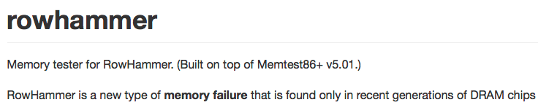
That Said …

Slide 15
ASPLOS 2015 Debate
Onur Mutlu
onur@cmu.edu
http://users.ece.cmu.edu/~omutlu/
March 17, 2014
Istanbul

Slide 16
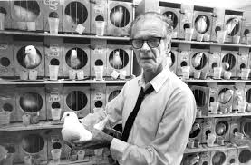
The Solution?
A good reward system
Positive reinforcement instead of negative reinforcement and double standards
  Awards, education, culture change

