Slide 1


Accelerating Genome Analysis
A Primer on an Ongoing Journey
Onur Mutlu
omutlu@gmail.com
https://people.inf.ethz.ch/omutlu
January 24, 2018
AACBB Keynote, Vienna

Slide 2
Overview
System design for bioinformatics is a critical problem
  It has large scientific, medical, societal, personal implications
This talk is about accelerating a key step in bioinformatics: genome sequence analysis
  In particular, read mapping
Many bottlenecks exist in accessing and manipulating huge amounts of genomic data during analysis
We will cover various recent ideas to accelerate read mapping
  My personal journey since September 2006

Slide 3
Agenda
The Problem: DNA Read Mapping
  State-of-the-art Read Mapper Design
Algorithmic Acceleration
  Exploiting Structure of the Genome
  Exploiting SIMD Instructions
Hardware Acceleration
  Specialized Architectures
  Processing in Memory
Future Opportunities: New Sequencing Technologies

Slide 4
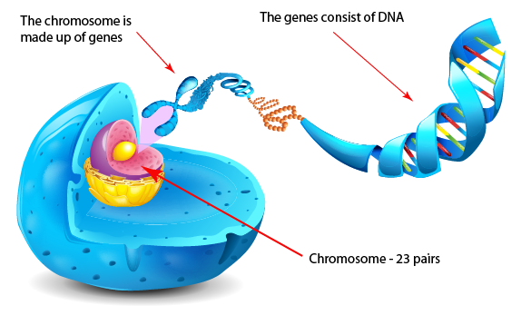
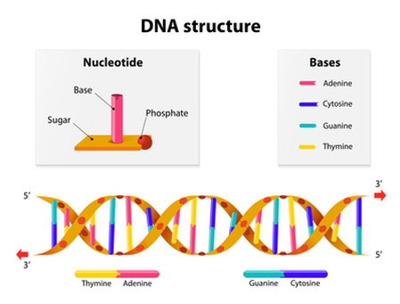
What Is a Genome Made Of?
Cell
Nucleus
The discovery of DNA’s double-helical structure (Watson+, 1953)
Notes:
Unlocking the life’s code requires diving into the nucleus of our body cells, where the double-stranded genome resides. Genome is literally the 'code of life' - it is the set of instructions for making everything from you to zebras, strawberries, and even yeast.
since the discovery of dna’s double-helical structure (watson et al. 1953)

Slide 5
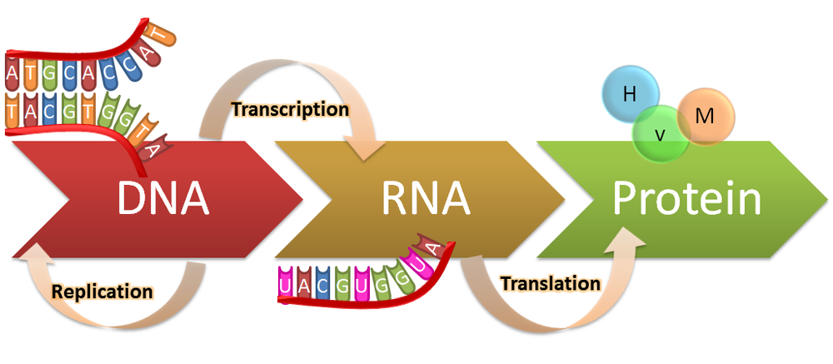


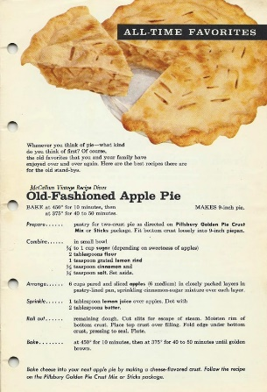

The Central Dogma of Molecular Biology
Genotypes
Phenotypes
Notes:
Our DNA is literally a cookbook that contains the information needed to make all of our phenotypes and traits. Our genes are the recipes for making us what we are physically.

Slide 6
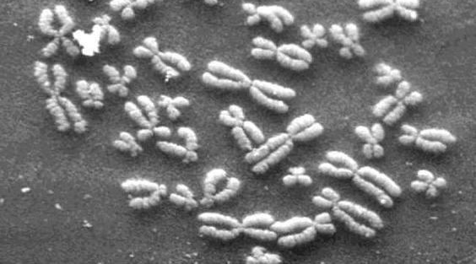
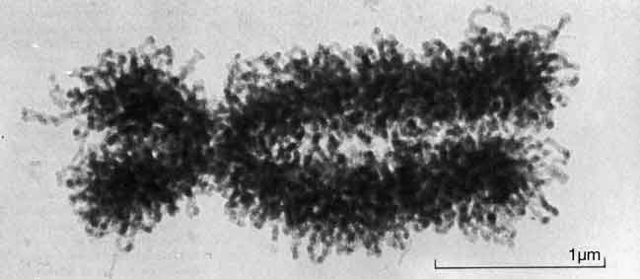
DNA Under Electron Microscope
human chromosome #12
from HeLa’s cell
Notes:
Henrietta Lacks,

Slide 7
DNA Sequencing
Goal:
  Find the complete sequence of A, C, G, T’s in DNA.
Challenge:
  There is no machine that takes long DNA as an input, and gives the complete sequence as output
  All sequencing machines chop DNA into pieces and identify relatively small pieces (but not how they fit together)

Slide 8
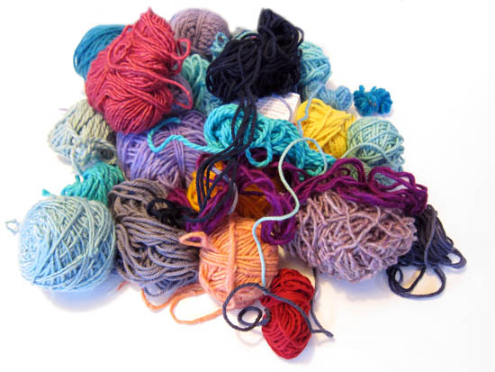
Untangling Yarn Balls & DNA Sequencing
Notes:
untangling yarn ball

Slide 9
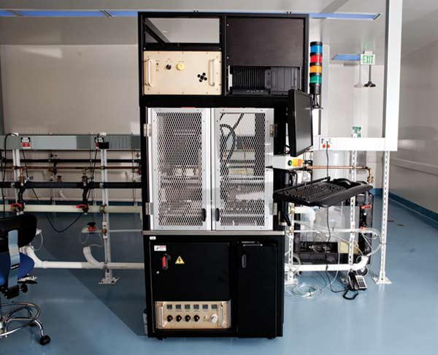
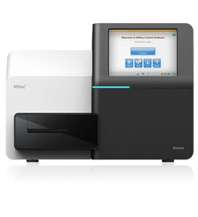
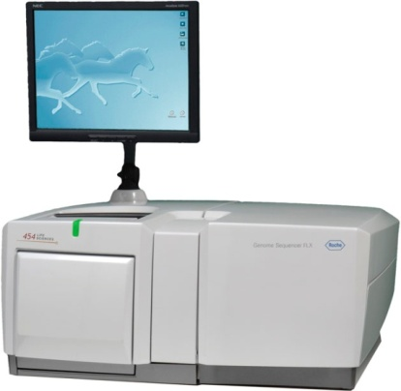
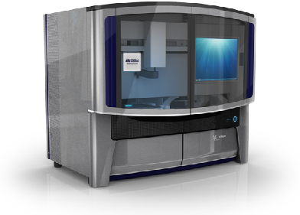

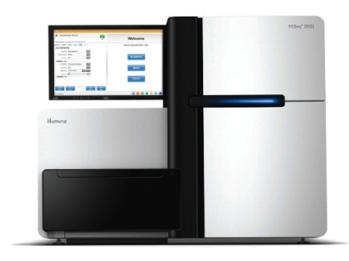
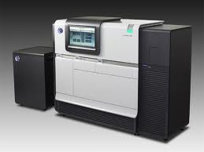
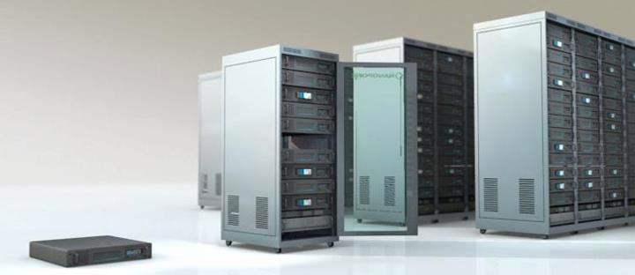
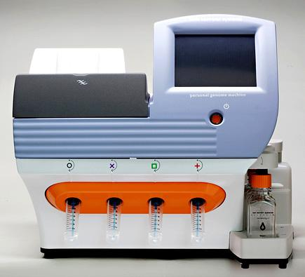
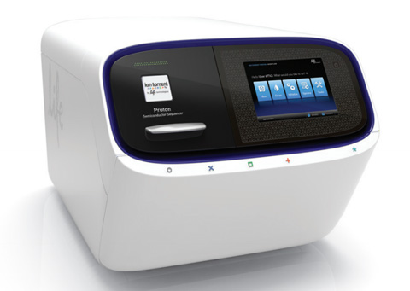
Genome Sequencers
Illumina MiSeq
Complete
Genomics
Roche/454
AB SOLiD
Oxford Nanopore MinION
Illumina
NovaSeq
6000
Illumina HiSeq2000
Pacific Biosciences RS
Oxford Nanopore GridION
Ion Torrent PGM
… and more! All produce data with different properties.
Ion Torrent Proton

Slide 10

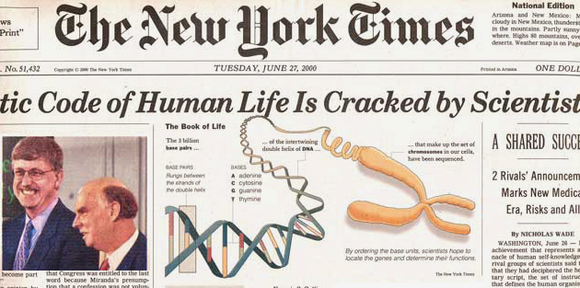

The Genomic Era
1990-2003: The Human Genome Project (HGP) provides a complete and accurate sequence of all DNA base pairs that make up the human genome and finds 20,000 to 25,000 human genes.
13 year-long
$3,000,000,000
Notes:
The 13-year long human project is the starting of the genomic era! It opened the door to remarkable biomedical discoveries by providing the first complete human genome sequence. It cost 3 billion dollars to read the entire sequence.

Slide 11
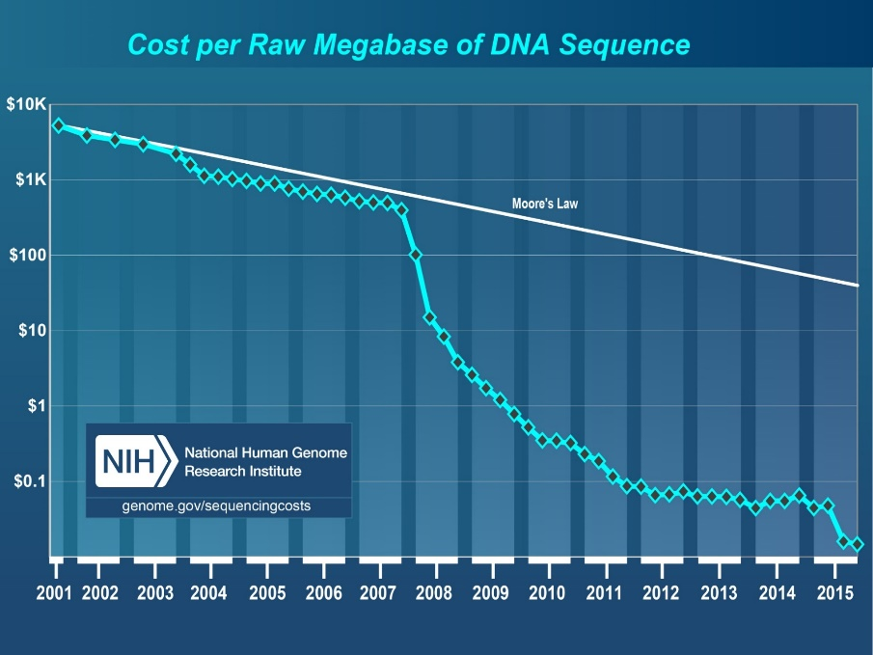
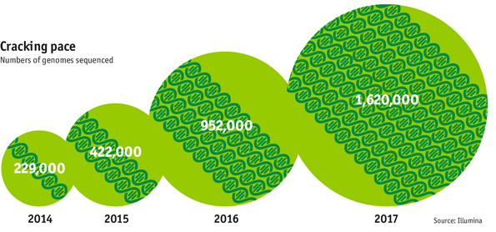

The Genomic Era (continued)
development of high-throughput sequencing (HTS) technologies
Number of Genomes Sequenced
http://www.economist.com/news/21631808-so-much-genetic-data-so-many-uses-genes-unzipped
Notes:
However, since the development of high throughput sequencing (HTS) technologies, the cost of genome sequencing has fallen off a cliff (<< 1,000$) making it viable for almost everyone's use.

Slide 12
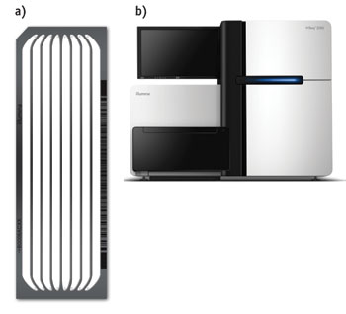
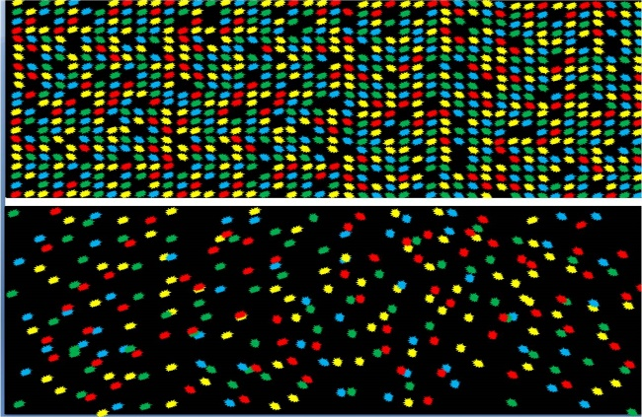
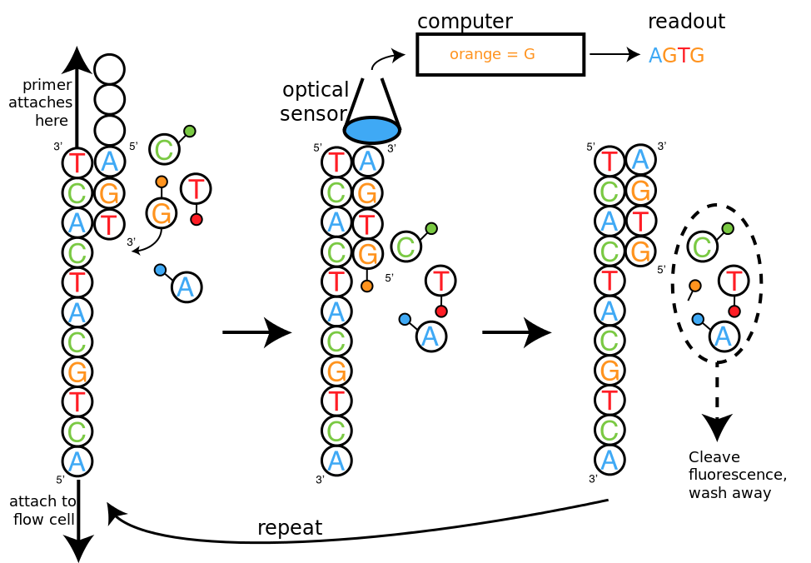
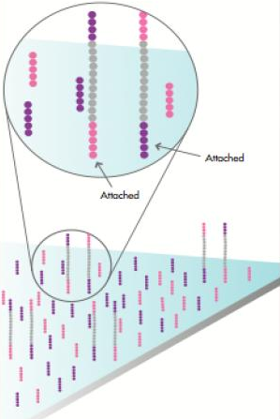
High-Throughput Sequencing (HTS)
flow cell
= Second Generation
= Next Generation
= Massively Parallel Sequencing
= High Throughput Sequencing (HTS) = Sequencing by Synthesis
Notes:
Second generation = next generation = massively parallel sequencing = high throughput sequencing (HTS) = Sequencing by Synthesis
Attach large number of DNA molecules to the flow cell then sequence by synthesis using CMOS light sensor to observe the chemical interactions

Slide 13
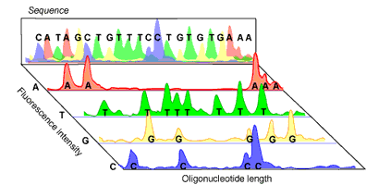
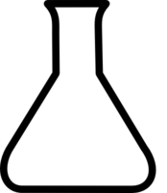
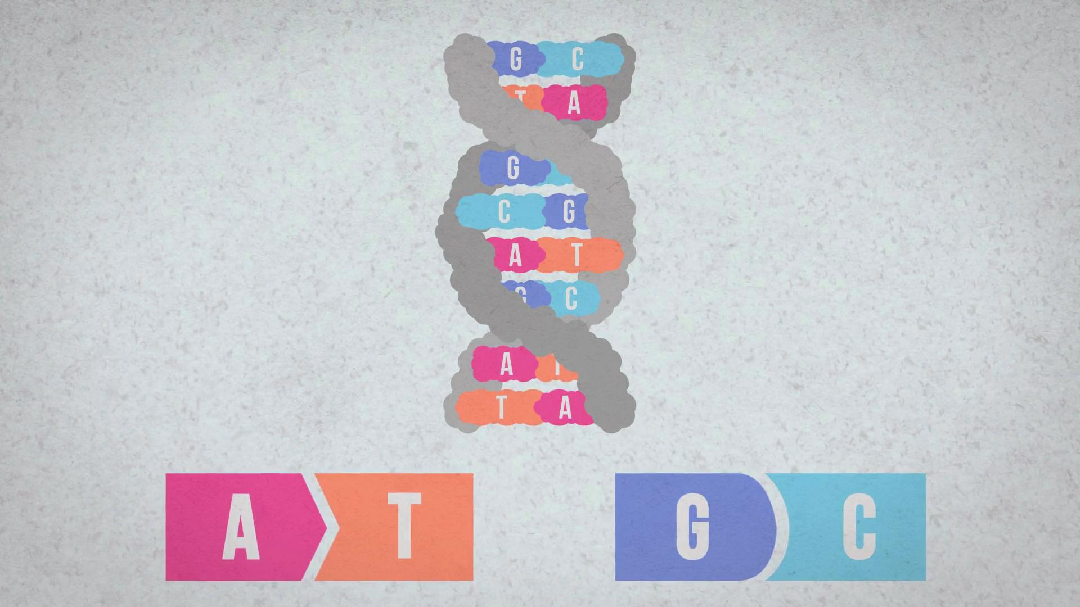

High-Throughput Sequencing (HTS)
The sequencer adds the molecule “T”
to all bases near the flow cell surface and
observes the chemical reaction via a CMOS sensor.
If a reaction happens then the base is “A”
T
A
C
G
T
A
C
G
T
A
C
G
T
A
C
G
T
A
A
C
G
T
A
A
G
A
A
C
G
T
A
C
G
T
T
T
T
T
A
C
G
T
A
C
G
T
A
C
G
A
A
C
G
T
A
C
G
T
G
C
G
T
A
C
G
T
A
C
G
T
G
C
G
G
A
C
G
T
A
C
G
T
G
C
G
T
A
C
G
C
A
C
G G G C
G
C
A
C
G
T
A
C
G
C
A
C
G
C
C
C
G
T
C
G
Glass flow cell surface
As a workaround, HTS technologies sequence random short DNA fragments (75-300 basepairs long) of copies of the original molecule.
Notes:
Until today, there is no machine takes genomic sample and produces the full sequence of the donor. I
nstead, HTS technology is used to sequence/read random short DNA fragments of copies of the original molecule.
The sequencer adds the molecule “T” to all bases near the flow cell surface and observes the chemical reaction by a CMOS sensor. If a reaction happens then the base is “A” (A reacts with T, C with G and vice versa).
This step is repeated for A, C, and G molecules for each base of the fragments.
Bases are sequenced concurrently, hence the name “high throughput”.

Slide 14
High-Throughput Sequencing
Massively parallel sequencing technology
  Illumina, Roche 454, Ion Torrent, SOLID…
Small DNA fragments are first amplified and then sequenced in parallel, leading to
  High throughput
  High speed
  Low cost
  Short reads
    Amplification step limits the read length since too short or too long fragments are not amplified well.
Sequencing is done by either reading optical signals as each base is added, or by detecting hydrogen ions instead of light, leading to:
  Low error rates (relatively)
  Reads lack information about their order and which part of genome they are originated from

Slide 15

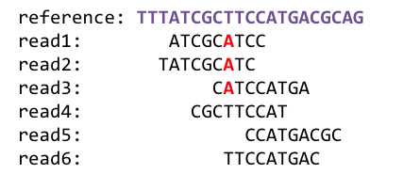
1
Sequencing
Genome Analysis
Read Mapping
2
Variant Calling
Scientific Discovery
3
4
Notes:
Genome analysis starts with sequencing random short DNA fragments of copies of the original molecule.
Unfortunately, these reads lack information about their order and which part of genome they are originated from.
Hence the second step is to map these reads to a long reference genome.

Slide 16
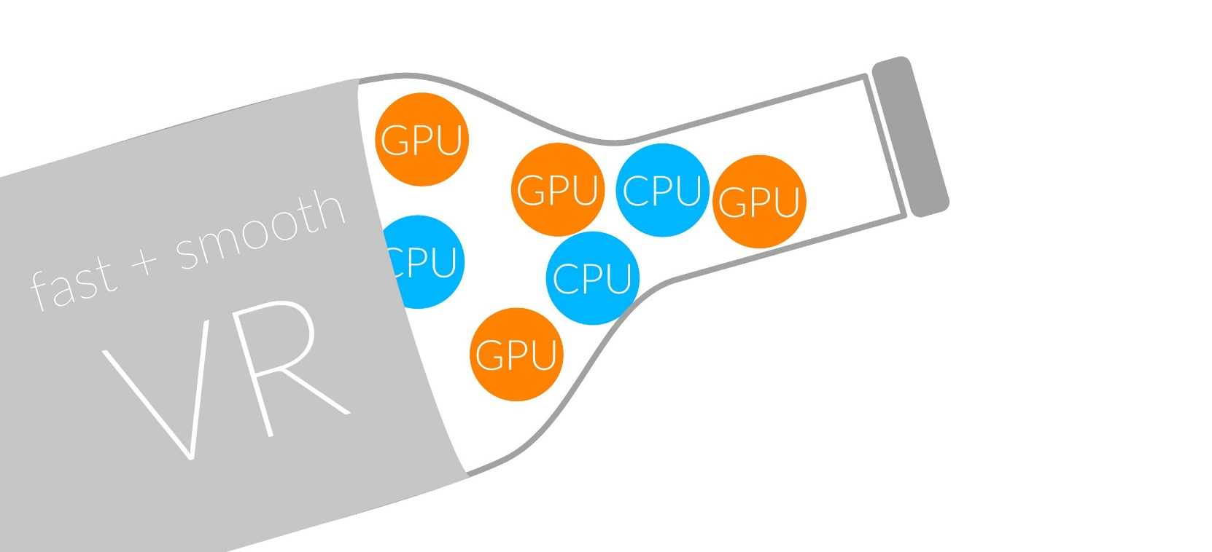
1
Sequencing
Read Mapping
2
Bottlenecked in Mapping!!
Illumina HiSeq4000
on average
GAGTCAGAATTTGAC
2 M
bases/min
300 M
bases/min
GAGTCAGAATTTGAC
GAGTCAGAATTTGAC
GAGTCAGAATTTGAC
GAGTCAGAATTTGAC
GAGTCAGAATTTGAC
GAGTCAGAATTTGAC
GAGTCAGAATTTGAC
GAGTCAGAATTTGAC
GAGTCAGAATTTGAC
GAGTCAGAATTTGAC
GAGTCAGAATTTGAC
GAGTCAGAATTTGAC
GAGTCAGAATTTGAC
GAGTCAGAATTTGAC
(0.6%)
Variant Calling
Scientific Discovery
3
4
Notes:
Typical sequencer machine generates a flood of reads, for example, Illumina HiSeq4000 generates 300 million bases/minute.
However, existing computer alignment algorithms can only process 0.6% of these reads in the same amount of time.
This gap is widening as more advanced sequencers are made available in the market.

Slide 17

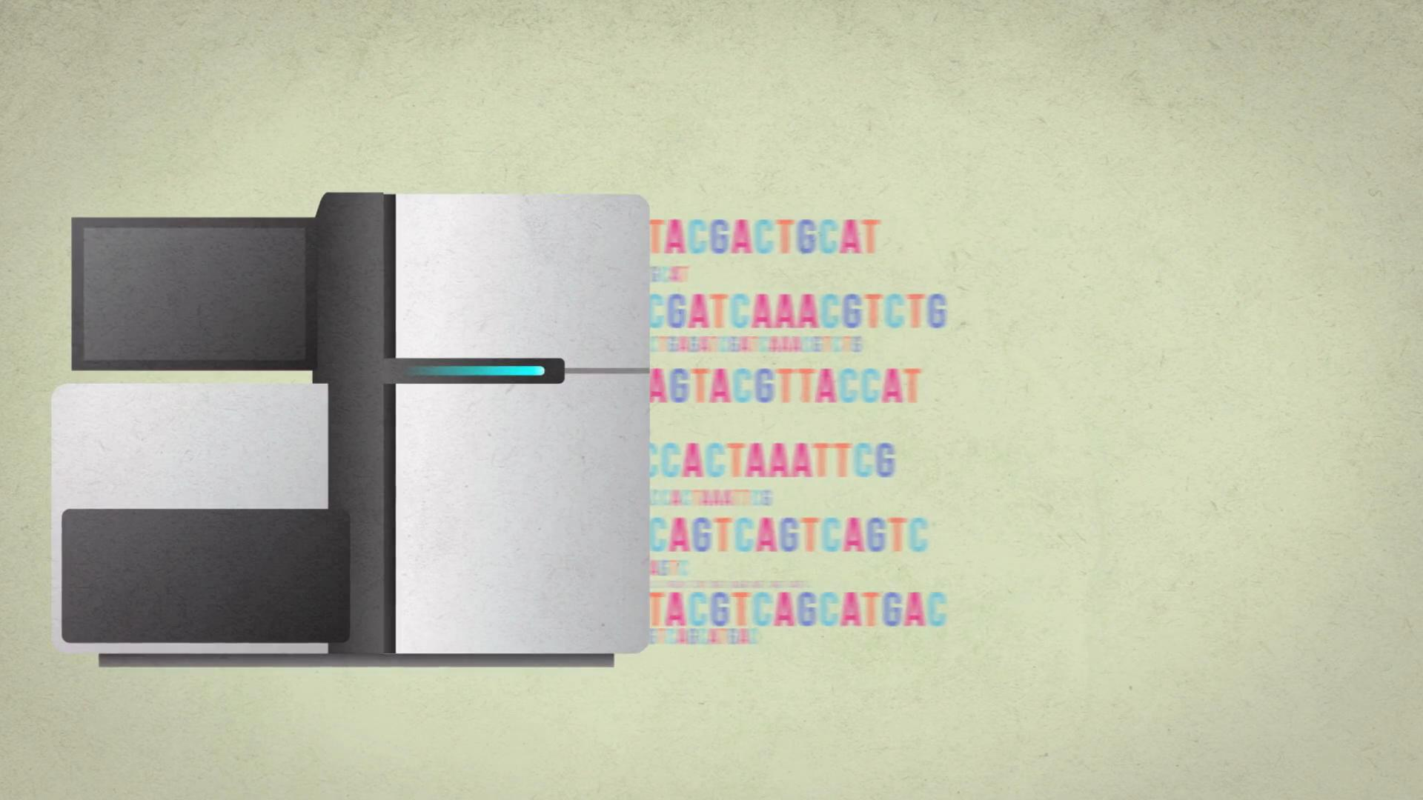

The Read Mapping Bottleneck
ACGTACGTACGTACGT
CCCCCCTATATATACGTACTAGTACGT
ACGACTTTAGTACGTACGT
TATATATACGTACTAGTACGT
ACGTACGCCCCTACGTA
TATATATACGTACTAGTACGT
ACGACTTTAGTACGTACGT
TATATATACGTACTAAAGTACGT
TATATATACGTACTAGTACGT
ACGTTTTTAAAACGTA
TATATATACGTACTAGTACGT
ACGACGGGGAGTACGTACGT
TATATATACGTACTAAAGTACGT
Illumina HiSeq4000
300
Million
bases/minute
2
Million
bases/minute
150X slower

Slide 18
Read Mapping Execution Time Breakdown
Notes:
An overwhelming majority of the read mapper’s execution time is spent in read alignment.

Slide 19
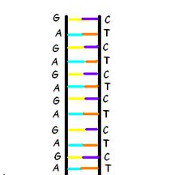
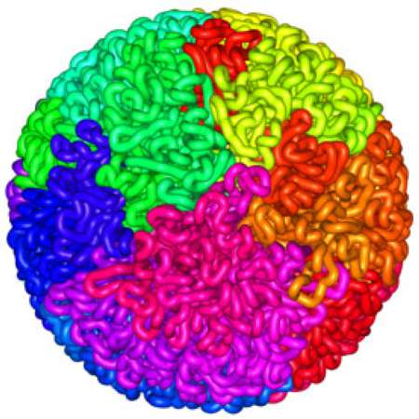
Read Mapping
Map many short DNA fragments (reads) to a known reference genome with some minor differences allowed
Reference genome
Mapping short reads to reference genome is challenging (billions of 50-300 base pair reads)
Reads
DNA, physically
DNA, logically
Notes:
Read mapping is a post processing procedure after DNA sequencing. It maps the data output from a DNA sequencer, which are many short DNA fragments, to a known reference genome, with some minor differences allowed.
To illustrate the problem better, let us take a closer look at the DNA itself. Logically, the DNA is a double stranded long string. In reality, within a cell they folded into a sphere in the nucleus like a ball of wool. Since it is very hard to disentangle the DNA at molecular level, to extract the information out, a sequencer cuts the mass into many short DNA pieces which are called reads.
A mapper’s job is to find where these DNA short reads are most likely to be originally placed so that later we can assemble them in the correct order to restore the original DNA.
Mapping these short reads, up to billions of them, with each one being 50 to 300 base-pairs long, to the reference genome is challenging.

Slide 20
Challenges in Read Mapping
Need to find many mappings of each read
  A short read may map to many locations, especially with High-Throughput DNA Sequencing technologies
  How can we find all mappings efficiently?
Need to tolerate small variances/errors in each read
  Each individual is different: Subject’s DNA may slightly differ from the reference (Mismatches, insertions, deletions)
  How can we efficiently map each read with up to e errors present?
Need to map each read very fast (i.e., performance is important)
  Human DNA is 3.2 billion base pairs long → Millions to billions of reads (State-of-the-art mappers take weeks to map a human’s DNA)
  How can we design a much higher performance read mapper?
Notes:
There are three main challenges.
First. The mapper needs to find many mappings for each read. Because the read is so short, they can map to multiple locations in the reference genome. How can we efficiently find all mappings of a read?
Second. The mapper needs to tolerate small variance or errors in each read. Since individuals are different, the subject’s DNA might slightly differs from the reference DNA, which can be mismatches, insertions or deletions of base pairs. How can we efficiently map each read with up to a number of e errors present?
Third. The mapper needs to map each read very fast. In another word, performance is important. Because the human DNA is 3.2 billion base-pairs long and each read is only hundreds of base-pairs long, there can be billions of reads subjected to mapping for an individual human. Current state of the art mappers take weeks to map a human’s DNA. So the question is, how can we design a much higher performance read mapper?

Slide 21
Read Alignment/Verification
Edit distance is defined as the minimum number of edits (i.e. insertions, deletions, or substitutions) needed to make the read exactly match the reference segment.
organization x operation
organization x translation
Ref
Read
o | - | - | r | g | a | n | i | z | a | t | i | o | n
o | p | e | r | - | - | - | - | - | a | t | i | o | n
Ref
Read
o | r | g | a | n | i | z | - | a | t | i | o | n
t | r | - | a | n | - | s | l | a | t | i | o | n
Ref
Read
o | - | - | r | g | a | n | i | z | a | t | i | o | n
o | p | e | r | - | a | - | - | - | - | t | i | o | n
Ref
Read
o | r | g | a | n | - | i | z | a | t | i | o | n
t | r | - | a | n | s | l | - | a | t | i | o | n
match
deletion
insertion
mismatch
Ref
Read
o | r | g | a | n | i | z | a | t | i | o | n
t | r | - | a | n | s | l | a | t | i | o | n
Notes:
http://www.let.rug.nl/kleiweg/lev/

Slide 22
Agenda
The Problem: DNA Read Mapping
  State-of-the-art Read Mapper Design
Algorithmic Acceleration
  Exploiting Structure of the Genome
  Exploiting SIMD Instructions
Hardware Acceleration
  Specialized Architectures
  Processing in Memory
Future Opportunities: New Sequencing Technologies

Slide 23
Read Mapping Algorithms: Two Styles
Hash based seed-and-extend (hash table, suffix array, suffix tree)
  Index the “k-mers” in the genome into a hash table (pre-processing)
  When searching a read, find the location of a k-mer in the read; then extend through alignment
  More sensitive, but slow
  Requires large memory; this can be reduced with cost to run time
Burrows-Wheeler Transform & Ferragina-Manzini Index based aligners
  BWT is a compression method used to compress the genome index
  Perfect matches can be found very quickly, memory lookup costs increase for imperfect matches
  Reduced sensitivity

Slide 24
Hash Table Based Read Mappers
Key Idea
  Preprocess the reference into a Hash Table
  Use Hash Table to map reads

Slide 25
Hash Table-Based Mappers [Alkan+ Nature Gen’09]
k-mer or 12-mer
(string of length k)
Location list—where the k-mer
occurs in reference gnome
AAAAAAAAAAAA
12 | 324 | 577 | 940
Reference genome
AAAAAAAAAAAC
13 | 421 | 412 | 765 | 889
AAAAAAAAAAAT
NULL
......
CCCCCCCCCCCC
24 | 459 | 744 | 988 | 989
......
......
......
TTTTTTTTTTTT
36 | 535 | 123
Once for a reference
Notes:
In preprocessing, the mapper stores the full permutations of a short fixed-length DNA string called k-mers, with k denoting the length of the string. In this example, k = 12 and they are also called 12-mers. For each k-mer, the mapper sweeps through the reference genome and stores all of the occurrence locations of the k-mer into a location list. The mapper then do this for all k-mers. If a permutation never appeared in the reference genome, there will be an empty list for it.
This data structure, usually implemented as the hash table is only constructed once for a reference genome

Slide 26
Hash Table Based Read Mappers
Key Idea
  Preprocess the reference into a Hash Table
  Use Hash Table to map reads

Slide 27
Hash Table-Based Mappers [Alkan+ Nature Gen’09]
AAAAAAAAAAAACCCCCCCCCCCCTTTTTTTTTTT
read
TTTTTTTTTTTT
k-mers
CCCCCCCCCCCC
AAAAAAAAAAAA
Reference Genome
Hash Table (HT)
12
324
***
Invalid mapping
Valid mapping
AAAAAAAAAAAA
✔
12 | 324 | 557 | 940
..****************************************..
…AAAAAAAAAAAACCCCCCCCCCCCTTTTTTTTTTTT…
.. AAAAAAAAAAAAAACGCTTCCACCTTAATCTGGTTG..
CCCCCCCCCCCC
24 | 459 | 744 | 988 | 989
TTTTTTTTTTTT
AAAAAAAAAAAACCCCCCCCCCCCTTTTTTTTTTTT
36 | 535 | 823
Verification/Local Alignment
read
Notes:
For a single read, the mapper first divides the read into non-overlapping k-mers, and uses the k-mers to query the hash table. The hash table returns the locations lists of the k-mers and traverses them one by one.
For each location in the list, the mapper retrieves the reference sequence at the location from the database and verifies if the read differs from the reference with more than e errors. The verification itself, is an expensive string comparison (edit distance computation) function. It compares the two DNA strings base pair by base pair, until the end. Then the mapper moves on to the next step, repeats, until it examined all locations.
This is the best previous work circa 2013.

Slide 28
Advantages of Hash Table Based Mappers
+ Guaranteed to find all mappings → sensitive
+ Can tolerate up to e errors
http://mrfast.sourceforge.net/
Alkan+, "Personalized copy number and segmental duplication
maps using next-generation sequencing”, Nature Genetics 2009.
Notes:
It turned out the Hash Table based mappers solve the first 2 challenges pretty well. They guarantee to find all mappings with no more than e errors present.

Slide 29
Problem and Goal
Poor performance of existing read mappers: Very slow
  Verification/alignment takes too long to execute
  Verification requires a memory access for reference genome + many base-pair-wise comparisons between the reference and the read (edit distance computation)
Goal: Speed up the mapper by reducing the cost of verification
95%
Notes:
It turns out the performance of existing hash table based mappers is very poor. They are very slow.
This is because of the expensive verification computation. To perform a verification, the mapper has to access the memory once for the reference genome and conduct many base-pair wise comparisons between the reference genome and the read, in order to locate the errors.
In fact, from our profiling result, the verification process can consume up to 95% of the execution time. Moreover, most of the verification calculations are unnecessary.
Our goal is to speedup the mapper by reducing the execution time of the verification process.

Slide 30
Agenda
The Problem: DNA Read Mapping
  State-of-the-art Read Mapper Design
Algorithmic Acceleration
  Exploiting Structure of the Genome
  Exploiting SIMD Instructions
Hardware Acceleration
  Specialized Architectures
  Processing in Memory
Future Opportunities: New Sequencing Technologies

Slide 31
Reducing the Cost of Verification
We observe that most verification (edit distance computation) calculations are unnecessary
  1 out of 1000 potential locations passes the verification process
We observe that we can get rid of unnecessary verification calculations by
  Detecting and rejecting early invalid mappings (filtering)
  Reducing the number of potential mappings
Notes:
How can we do that? It turns out most of the verification calculations are unnecessary. We observe that usually only 1 out of 1000 potential mapping locations passes the verification process becoming a valid mapping.
We also observe that we can get rid of unnecessary verification calculations by
Detecting and rejecting early invalid mappings
and by Reducing the number of potential mappings

Slide 32
Key Observations [Xin+, BMC Genomics 2013]
Observation 1
  Adjacent k-mers in the read should also be adjacent in the reference genome
  Read mapper can quickly reject mappings that do not satisfy this property
Observation 2
  Some k-mers are cheaper to verify than others because they have shorter location lists (they occur less frequently in the reference genome)
    Mapper needs to examine only e+1 k-mers’ locations to tolerate e errors
  Read mapper can choose the cheapest e+1 k-mers and verify their locations
Notes:
Observation 1: For valid mappings, Adjacent k-mers in the read should also be adjacent in the reference genome.
Hence, mapper can quickly reject mappings that do not satisfy this property.
Observation 2: Some k-mers are cheaper than others because they have shorter location lists, which means they occur less frequently in the reference genome. Previous work proved that the mapper only needs to examine e+1 k-mers’ locations to tolerate e errors.
Hense, the mapper can choose the cheapest e+1 k-mers and verify their locations.

Slide 33
FastHASH Mechanisms [Xin+, BMC Genomics 2013]
Adjacency Filtering (AF): Rejects obviously invalid mapping locations at early stage to avoid unnecessary verifications
Cheap K-mer Selection (CKS): Reduces the absolute number of potential mapping locations
Notes:
In our work, FastHASH, we have two mechanisms to leverage the two observations respectively.
Mechanism 1: Adjacency Filtering, which ….
Mechanism 2: Cheap k-mer Selection, which ….
Let us first take a look at Adjacency Filtering.

Slide 34
Adjacency Filtering (AF)
Goal: detect and filter out invalid mappings at early stage
Key Insight: For a valid mapping, adjacent k-mers in the read are also adjacent in the reference genome
Key Idea: search for adjacent locations in the k-mers’ location lists
  If more than e k-mers fail → there must be more than e errors → invalid mapping
AAAAAAAAAAAACCCCCCCCCCCCTTTTTTTTTTT
read
Reference genome
Valid mapping
Invalid mapping
Notes:
The goal of AF is to detect invalid mappings at early stage.
This is based on the insight that, for a valid mapping, adjacent k-mers in the read are also adjacent in the reference genome.
Let’s take a look at the previous example. The read is divided into 3 k-mers and they occur at different locations in the reference genome
From the figure, we can see that, only the location in the blue box is a valid mapping, as the three adjacent k-mers of the read are adjacent in the reference genome. Other locations are all invalid mappings because they only map to a single isolated k-mers from the read.
The key idea is instead of performing the expensive verification calculation, we can search for adjacent locations in the k-mers’ location lists and if more than e k-mers fail this process, we know there must be more than e errors present, concluding that the mapping is invalid

Slide 35
Adjacency Filtering (AF)
AAAAAAAAAAAACCCCCCCCCCCCTTTTTTTTTTT
read
+12
+24
TTTTTTTTTTTT
k-mers
CCCCCCCCCCCC
AAAAAAAAAAAA
Reference Genome
Hash Table (HT)
12
940
***
557
324
569?
952?
336?
36?
24?
AAAAAAAAAAAA
12 | 324 | 557 | 940
…AAAAAAAAAAAACCCCCCCCCCCCTTTTTTTTTTTT…
✗
CCCCCCCCCCCC
24 | 459 | 744 | 988 | 989
TTTTTTTTTTTT
AAAAAAAAAAAACCCCCCCCCCCCTTTTTTTTTTTT
36 | 535 | 123
Notes:
Let us look back to the previous example. With Adjacency Filtering, we still traverse the location lists but with each location, before the verification, we check if adjacent locations are in adjacent k-mers’ location lists.
In this case, with location 12 from the first k-mer, and the k-mer length being 12, we will be looking for location 24 in the second k-mer’s location lists, which is there and the third k-mer’s location list, which is also there. Because all adjacent locations are found in adjacent k-mers, we pass location 12 towards the verification process.
For the next location, 324, we search for adjacent location 336 in 2nd k-mer and it’s not there. We conclude there must be at least an error and skip the verification process and move on to the next location 577. We search for adjacent location 589, which is also not there. Then we move to the next 940 and search for 952, which is also not there. So on and so forth for all locations. In this way, we only do verification once and that is for the single valid mapping of this read.

Slide 36
FastHASH Mechanisms [Xin+, BMC Genomics 2013]
Adjacency Filtering (AF): Rejects obviously invalid mapping locations at early stage to avoid unnecessary verifications
Cheap K-mer Selection (CKS): Reduces the absolute number of potential mapping locations
Notes:
In our work, FastHASH, we have two mechanisms to leverage the two observations respectively.
Mechanism 1: Adjacency Filtering, which ….
Mechanism 2: Cheap k-mer Selection, which ….
Let us first take a look at Adjacency Filtering.

Slide 37
Cheap K-mer Selection (CKS)
Goal: Reduce the number of potential mappings
Key insight:
  K-mers have different cost to examine: Some k-mers are cheaper as they have fewer locations than others (occur less frequently in reference genome)
Key idea:
  Sort the k-mers based on their number of locations
  Select the k-mers with fewest locations to verify
Notes:
The goal of Cheap K-mer Selection is to reduce the number of potential mappings
The key insight is that the k-mers have different cost to examine. Some k-mers are cheaper as they have fewer locations in their location lists than others, which also means they occur less frequently in the reference genome.
The key idea is to sort the k-mers based on their number of locations and select the k-mers with fewest locations to verify.

Slide 38
Cheap K-mer Selection
read
e=2 (examine 3 k-mers)
AAGCTCAATTTC CCTCCTTAATTT TCCTCTTAAGAA GGGTATGGCTAG AAGGTTGAGAGC CTTAGGCTTACC
314
1231
4414
9219
4 loc.
326
1451
2 loc.
338
…
…
…
…
1K loc.
326
1451
2 loc.
376
…
…
…
…
2K loc.
388
…
…
…
…
1K loc.
Locations
Number of Locations
Expensive 3 k-mers
Cheapest 3 k-mers
Previous work needs to verify:
3004 locations
FastHASH verifies only:
8 locations
Notes:
In this example, we have a longer read which can be divided into 6 k-mers. The error tolerance threshold e is set to 2, which means we need to select at least 3 k-mers to verify their locations.
Here is the location list of a k-mer. The first several entries here are locations while the last entry summarizes the number of locations of this k-mer.
We can see that for this read, some of the k-mers are cheap, having fewer than 10 locations, whereas some of them are expensive, having morethan thousands of locations.
Previous work selects k-mers at uniform locations, hence verifying 3004 locations. FastHASH however, selects only the cheap k-mers and verifies only 6 locations.

Slide 39
Methodology
Implemented FastHASH on top of state-of-the-art mapper: mrFAST
  New version mrFAST-2.5.0.0 over mrFAST-2.1.0.6
Tested with real read sets generated from Illumina platform
  1M reads of a human (160 base pairs)
  500K reads of a chimpanzee (101 base pairs)
  500K reads of a orangutan (70 base pairs)
Tested with simulated reads generated from reference genome
  1M simulated reads of human (180 base pairs)
Evaluation system
  Intel Core i7 Sandy Bridge machine
  16 GB of main memory
Notes:
We implemented FastHASH on top of state-of-the-art mapper mrFAST, updating it to a new version 2.5
We evaluated the algorithm on two data sets.
Data set one are real read sets generated from illumina platform.
Data set two are simulated read sets generated from the reference genome.
All the evaluations were obtained from an Intel Core i7 Sandy Bridge machine with 16GB of main memory

Slide 40
FastHASH Speedup
human
19x
chimpanzee
orangutan
simulated
With FastHASH, new mrFAST obtains up to 19x speedup over previous version, without losing valid mappings
Notes:
Here we present the performance result of FastHASH, which is the speedup verses the old mrFAST.
We run the program with different error threshold e.
And the x axis shows the error threshold e.
The y axis shows the times of speedup.
The data is obtained with different read sets as well.
From this graph, we can see that With FastHASH, mrFAST obtains up to 19x speedup over previous version.

Slide 41
Analysis
Reduction of potential mappings with FastHASH
99%
99%
99%
99%
99%
FastHASH filters out over 99% of the potential mappings without sacrificing any valid mappings
Notes:
This graph shows where the speedup comes from.
In this graph, we show the reduction of potential mappings with FastHASH. The x axis shows the error threshold e and the y axis shows the number of potential mappings. Notice that y axis is log10 scaled.
With FastHASH, we observe that over 99% of the potential mappings are filtered out at low cost, reducing a large amount of verification calculation.

Slide 42
FastHASH Conclusion
Problem: Existing read mappers perform poorly in mapping billions of short reads to the reference genome, in the presence of errors
Observation: Most of the verification calculations are unnecessary → filter them out
Key Idea: To reduce the cost of unnecessary verification
  Reject invalid mappings early (Adjacency Filtering)
  Reduce the number of possible mappings to examine (Cheap K-mer Selection)
Key Result: FastHASH obtains up to 19x speedup over the state-of-the-art mapper without losing valid mappings
Notes:
In this work, we talked about the problem, which is poor performance of existing read mappers to map billion of short reads to the reference genome, in the presence of errors.
We made the observation that most of the verification calculations are unnecessary.
The key idea of FastHASH is to reduce the cost of unnecessary verification calculations.
We have 2 mechanisms:
The first one rejects invalid mappings early, which is AF.
The second one Reduces the number of possible mappings to examine, which is Cheap K-mer Selection
As a result, we achieved up to 19x speedup over previous state-of-the-art mapper

Slide 43
More on FastHASH
Download source code and try for yourself
  Download link to FastHASH

Slide 44
Agenda
The Problem: DNA Read Mapping
  State-of-the-art Read Mapper Design
Algorithmic Acceleration
  Exploiting Structure of the Genome
  Exploiting SIMD Instructions
Hardware Acceleration
  Specialized Architectures
  Processing in Memory
Future Opportunities: New Sequencing Technologies

Slide 45
An Example: Shifted Hamming Distance
Xin+, "Shifted Hamming Distance: A Fast and Accurate SIMD-friendly Filter
to Accelerate Alignment Verification in Read Mapping”, Bioinformatics 2015.

Slide 46
Shifted Hamming Distance
Key observation:
  If two strings differ by E edits, then every bp match can be aligned in at most 2E shifts.
Key idea:
  Compute “Shifted Hamming Distance”: AND of 2E Hamming Distances of two strings, to identify invalid mappings
    Uses bit-parallel operations that nicely map to SIMD instructions
Key result:
  SHD is 3x faster than SeqAn (the best implementation of Gene Myers’ bit-vector algorithm), with only a 7% false positive rate
  The fastest CPU-based filtering (pre-alignment) mechanism
Notes:
To the best of our knowledge, SHD is the fastest CPU-based filter. It depends on the fact the a deleted character causes all trailing characters to be shifted to the left direction. To correctly pairwise compare this sequence, we need to shift it back to the right direction then compare. Generally we need 2E shifts to compare any two sequences regardless the edit is insertion or deletion.
GateKeeper is another recent filter that uses FPGA to improve the speed and the read length support of SHD.

Slide 47
New Bottleneck: Filtering (Pre-Alignment)
Sequencing generates many reads, each of which potentially mapping to many locations
→
Filtering (Pre-alignment) eliminates the need to verify/align read to invalid mapping locations
→
Alignment/verification (costly edit distance computation) is performed only on reads that pass the filter)
New bottleneck in read mapping becomes the “filtering (pre-alignment)” step

Slide 48
Agenda
The Problem: DNA Read Mapping
  State-of-the-art Read Mapper Design
Algorithmic Acceleration
  Exploiting Structure of the Genome
  Exploiting SIMD Instructions
Hardware Acceleration
  Specialized Architectures
  Processing in Memory
Future Opportunities: New Sequencing Technologies

Slide 49
Location Filtering
Alignment is expensive
  We need to align millions to billions of reads
  Modern read mappers reduce the time spent on alignment for increased performance. Can be done in two ways:
    Optimize the algorithm for alignment
    Reduce the number of alignments necessary by filtering out mismatches quickly
  Both methods are used by mappers today, but filtering has replaced alignment as the bottleneck [Xin+, BMC Genomics 2013]
Our goal is to accelerate read mapping
by improving the filtering step
Notes:
[CLICK]
Alignment is the algorithm for determining a match between a read and a reference substring. This is very expensive and requires the use of an O(n2) dynamic programming algorithm.
[CLICK]
To give the scale of required computation, a single human can generate millions to billions of reads, and each read results in multiple locations
[CLICK]
Modern read mappers reduce the time spent on alignment for increased performance. This can be done in two ways:
[CLICK]
By further optimizing the alignment algorithm, which many prior works have done.. OR
[CLICK]
By reducing the number of alignments necessary by quickly discarding mismatches. We refer to this as filtering.
[CLICK]
Both methods are used by mappers today, but now filtering has replaced alignment as the bottleneck.
[CLICK]
Our goal is to improve the filtering step in read mappers
[END-CLICK]

Slide 50
Ideal Filtering Algorithm
Minimal False Accept Rate
Maximal True Reject Rate
Filter out all
incorrect mappings
Zero False Reject Rate
Faster Than Mapper
Do not filter out any
correct mappings
Notes:
Ideal pre-alignment filter should be both accurate and fast:
1- Faster than typical aligners to compensate the computation overhead introduced by its filtering technique (as we added an extra filtering stage).
2- We define the accuracy of pre-alignment filtering as follows: It’s the ability of the filter to reject most of the incorrect mappings (i.e., maximizing the true reject rate and minimizing the false accept rate) while keeping all the correct ones (i.e., zero false reject rate).

Slide 51
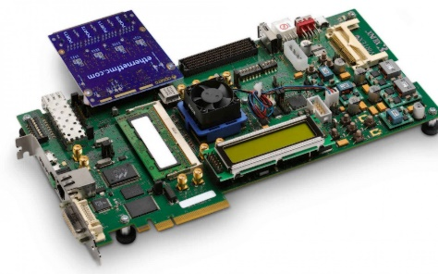
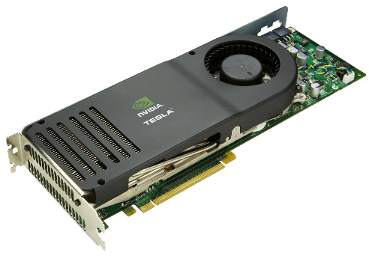
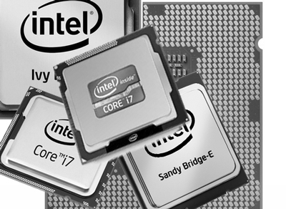
Alignment vs. Pre-alignment (Filtering)
Needleman-Wunsch GateKeeper
Independent vectors can be processed in parallel using hardware technologies
|dp[i][j-1] // Inser.
dp[i][j]=1+max|dp[i-1][j] // Del.
|dp[i-1][j-1]// Subs.
dp[i][j]=|0 if X[i]=Y[j]
|1 if X[i]≠Y[j]
Each cell depends on three pre-computed cells!
No data dependencies!
Notes:
How to achieve a filter that is even much faster than the banded alignment algorithm?
1- Removing the data dependencies between the cells of the dynamic programming matrix.
In NW algorithm, each cell depends on three pre-computed cells (top, diagonal, and left cells). This restricts the way we computed the entire matrix (left to right, or top to bottom, or anti-diagonal), which limits the parallelism effort. In GateKeeper, we just perform a pairwise comparison (ZERO means a match and ONE means a mismatch). NO data dependencies in GateKeeper!!
2- Generating a binary matrix and backtrack the solution using only bitwise operations.

Slide 52
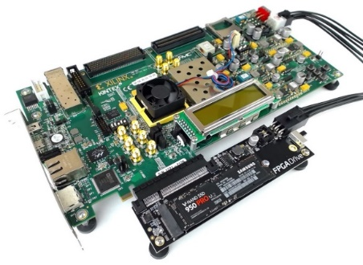
Our Solution: GateKeeper
1
st
Alignment Filter
FPGA-based Alignment Filter.
Notes:
To bridge the widening gap between the sequencer & the mapper, we propose the concept of pre-alignment filtering. We added a new examination step before the accurate alignment step. The main objective of this step is to detect the incorrect mappings accurately and rapidly. Only the mappings that pass our filter are examined by the alignment step. We also explore exploiting todays’ hardware accelerators to further boost the filtering speed of such filters.

Slide 53
GateKeeper Walkthrough
Generate 2E+1 masks
Amend random zeros:
101 → 111 & 1001 → 1111
AND all masks,
ACCEPT iff number of ‘1’ ≤ Threshold
Notes:
After computing the binary matrix of GateKeeper, we need to backtrack all matches (consecutive zeros highlighted in green) between the two sequences. In GateKeeper, we AND all diagonal bit-vectors of the matrix together and produce a single bit-vector that represents the largest possible number of matches between the two sequences. Due to the use of AND operation, we need to ignore the meaningless short zeros (one or two zeros). Final step is to count the number of zeros in the AND mask and if exceeds the threshold then the filter passes the two sequences.

Slide 54
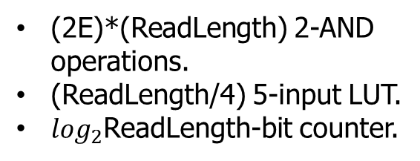
GateKeeper Walkthrough (cont’d)
Generate 2E+1 masks
Amend random zeros:
101 → 111 & 1001 → 1111
AND all masks,
ACCEPT iff number of ‘1’ ≤ Threshold
(2E)*(ReadLength) 2-AND operations.
(ReadLength/4) 5-input LUT.
$\log_{2}$ReadLength-bit counter.
E right-shift registers (length=ReadLength)
E left-shift registers (length=ReadLength)
(2E+1) * (ReadLength) 2-XOR operations.
(2E+1)*(ReadLength) 5-input LUT.
Notes:
So basically we have three main steps in GateKeeper:
Step 1: Building the matrix that involves 2E shift registers (each diagonal bit-vector is generated by shifting the read then pairwise compare the shifted read with the reference), each of length =ReadLength.
Step 2: Cancelling the meaningless short zeros by changing them to ones (101 is changed to 111 and 1001 to 1111) using 5-input LUT of the VC709 FPGA.
Step 3: AND all vectors and count the number of zeros in the AND mask.
Alignment filters do not replace the alignment verification.
Alignment filters eliminate most of incorrect mappings.
Alignment filters keep the correct (or nearly correct) mappings.

Slide 55
GateKeeper Accelerator Architecture
Maximum data throughput =~13.3 billion bases/sec
Can examine 8 (300 bp) or 16 (100 bp) mappings concurrently at 250 MHz
Occupies 50% (100 bp) to 91% (300 bp) of the FPGA slice LUTs and registers
Notes:
Here, we present the architecture of GateKeeper. Each processing core is able to examine a single mapping in a single clock cycle. We integrate many hardware processing cores in the architecture of GateKeeper for examining many mappings in a parallel fashion. The input read-reference pairs are transferred from the host to the FPGA via PCIe third generation 4-lane at the rate of 13.3 billion bases/sec. With this data throughput, we can have 16 processing cores work concurrently to examine 16 read-reference pairs. Our architecture occupies only 50% of the FPGA resource for a read length of 100 bp and 91% for a read length of 300 bp.

Slide 56
GateKeeper vs. SHD
GateKeeper
SHD
FPGA (Xilinx VC709)
Multi-core (parallel)
Examines a single mapping @ 125 MHz
Limited to PCIe Gen3(4x) transfer rate (128 bits @ 250MHz)
Amending requires:
  (2E+1) 5-input LUT.
Intel SIMD
Single-core (sequential)
Examines a single mapping @ ~2MHz
Limited to a read length of 128 bp (SSE register size)
Amending requires:
  4(2E+1) bitwise OR.
  4(2E+1) packed shuffle.
  3(2E+1) shift.

Slide 57
GateKeeper: Speed & Accuracy Results
90x-130x faster filter
than SHD (Xin et al., 2015) and the Adjacency Filter (Xin et al., 2013)
4x lower false accept rate
than the Adjacency Filter (Xin et al., 2013)
10x speedup in read mapping
with the addition of GateKeeper to the mrFAST mapper (Alkan et al., 2009)
Freely available online github.com/BilkentCompGen/GateKeeper

Slide 58
Conclusions
FPGA-based pre-alignment greatly speeds up read mapping
  10x speedup of a state-of-the-art mapper (mrFAST)
FPGA-based pre-alignment can be integrated with the sequencer
  It can help to hide the complexity and details of the FPGA
  Enables real-time filtering while sequencing

Slide 59
More on GateKeeper
Download and test for yourself https://github.com/BilkentCompGen/GateKeeper
Alser+, "GateKeeper: A New Hardware Architecture for Accelerating
Pre-Alignment in DNA Short Read Mapping”, Bioinformatics, 2017.

Slide 60
Next Talk: MAGNET
Key observation: the use of AND operation to check if a zero (match) exists in a column introduces filtering inaccuracy.
Key Idea: count the consecutive zeros in each mask and select the longest in a divide-and-conquer approach.
MAGNET is 17x to 105x more accurate than GateKeeper and SHD.
Notes:
MAGNET will be presented in the next talk.

Slide 61
Agenda
The Problem: DNA Read Mapping
  State-of-the-art Read Mapper Design
Algorithmic Acceleration
  Exploiting Structure of the Genome
  Exploiting SIMD Instructions
Hardware Acceleration
  Specialized Architectures
  Processing in Memory
Future Opportunities: New Sequencing Technologies

Slide 62
Read Mapping & Filtering
Problem: Heavily bottlenecked by Data Movement
GateKeeper performance limited by DRAM bandwidth [Alser+, Bioinformatics 2017]
Ditto for SHD [Xin+, Bioinformatics 2015]
Solution: Processing-in-memory can alleviate the bottleneck
However, we need to design mapping & filtering algorithms to fit processing-in-memory

Slide 63
Hash Tables in Read Mapping
Read Sequence (100 bp)
✘
✔
Aligning
Match!
Mismatch
Aligning
.
.
.
.
.
.
False Negative
Filter
Hash Table
Reference Genome
140
37
1564
894
1203
✘
140
1203
1564
37
140
✘
894
1203
✘
1564
Notes:
[CLICK]
Again, we split the read into k-mers of length 5 and query the hash table for their location lists
[CLICK]
We then pass the locations through the filter and attempt to efficiently discard as many locations as possible before having to run alignment. Here we see that locations that are obviously mismatches get discarded, before needing alignment.
[CLICK]
The read must then be aligned against the strings that pass the filter to determine location matches
[CLICK]
Any location that passes through the filter, but then fails the alignment is called a false negative. False negative rates and filtering speed are important metrics for analyzing a filter.
note that when the filter was added, we were able to forego 3 instances of alignment thus saving us execution time.
[END-CLICK]

Slide 64
Read Mapping & Filtering in Memory
We need to design
mapping & filtering algorithms
that fit processing-in-memory

Slide 65
Our Proposal: GRIM-Filter
Data Structures: Bins & Bitvectors
Checking a Bin
Integrating GRIM-Filter into a Mapper

Slide 66
GRIM-Filter: Bins
We partition the genome into large sequences (bins).
Bin x - 3
Bin x - 1
… GGAAATACGTTCAGTCAGTTGGAAATACGTTTTGGGCGTTACTTCTCAGTACGTACAGTACAGTAAAAATGACAGTAAGAC …
Bin x - 2
Bin x
  Represent each bin with a bitvector that holds the occurrence of all permutations of a small string (token) in the bin
  To account for matches that straddle bins, we employ overlapping bins
    A read will now always completely fall within a single bin
Bitvector
AAAAA
AAAAC
AAAAT
…
CCCCC
CCCCT
CCCCG
…
GGGGG
1
0
1
…
1
0
0
…
1
AAAAA exists in bin x
CCCCT doesn’t exist in bin x
Notes:
[CLICK]
We first partition the genome in large sequences that we refer to as bins
[CLICK]
[CLICK]
We show the genome with an arbitrary bin highlighted
[CLICK]
We then generate a bitvector that represents the bin and holds the occurrence of all permutations of a small string called a token in the bin
we see in the figure that tokens that exist in the bin are represented with a 1, and those not in the bin are a 0.
[CLICK]
so AAAAA exists in Bin x
and CCCCT does not exist in bin x
[CLICK]
to account for matches straddling two bins, we employ overlapping bins so that a read will now always fall within a single bin
[END-CLICK]

Slide 67
GRIM-Filter: Bitvectors
… C G T G A G T C …
C G T G A
T G A G T
G A G T C
G T G A G
Bin x
AAAAA
…
CGTGA
…
TGAGT
…
GAGTC
…
GTGAG
…
0
…
…
…
…
…
0
1
Bin x Bitvector
1
0
1
0
1
0
  Reasonable memory footprint to hold pre-computed vectors which are generated per bin
    Only simple add/compare operations on vectors for likelihood
  At the cost of
    Lower approximate string matching accuracy
    Becoming a memory-bound process

Slide 68
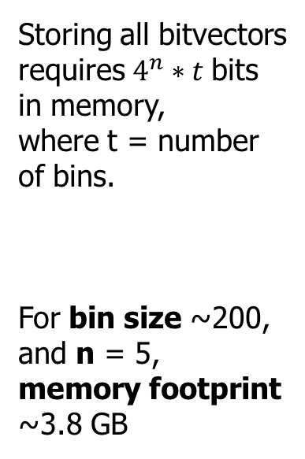
GRIM-Filter: Bitvectors
Storing all bitvectors
requires $4^{n}∗t$bits
in memory,
where t = number of bins.
For bin size ~200, and n = 5,
memory footprint
~3.8 GB
b₁
b₂
AAAAA
AAAAC
AAAAG
AAAAT
.
CCCCT
.
.
.
.
GCATG
.
TTGCA
.
TTTTT
1
1
0
0
.
1
.
.
.
.
1
.
1
.
0
AAAAA
AAAAC
AAAAG
.
AGAAA
.
GAAAA
.
GACAG
.
GCATG
.
.
.
TTTTT
0
1
0
.
1
.
1
.
1
.
1
.
.
.
0
tokens
• • •
Notes:
We use bitvectors to quickly figure out existence within a bin
We see here a list of bit vectors that are associated with a particular bin. The memory required to store all bit vectors is found by multiplying the number of bins by 4^q bits (which is the size of the bit vectors)
For a bin size of 200 and a q of 5, the memory footprint comes to around 3.8 GB
[END-CLICK]

Slide 69
Our Proposal: GRIM-Filter
Data Structures: Bins & Bitvectors
Checking a Bin
Integrating GRIM-Filter into a Mapper

Slide 70
GRIM-Filter: Checking a Bin
How GRIM-Filter determines whether to discard potential match locations in a given bin prior to alignment
INPUT: Read Sequence r
AACTT
...
GAACT
TTGGA
Read bitvector for bin_num(x)
CTTGG
2
GAACTTGGAGTCTA CGAG
ACTTG
1
Get tokens
1
0
1
0
1
1
1
0
0
.
4
Sum
5
Compare
.
.
...
+
≥ Threshold?
tokens
NO
YES
.
.
.
Discard
Send to
Read Mapper
for Sequence
Alignment
Match tokens to bitvector
3
Notes:
Talk about why GRIM-Filter is faster than alignment. This is obviously faster than dynamic programming.
This threshold value changes error tolerance
In this example, we will use a token size of 5
We show how GRIM-Filter determines the need for alignment in a bin X. We use the read to generate a mask to selectively sum bit vectors.
[CLICK]
For the given read sequence in red, we find all indices corresponding to the q-grams found in the read.
[CLICK]
We then query and [CLICK] sum the bits of bin X’s pre-computed bit vector of the reference genome.
This final value is then compared to a threshold to determine the likelihood of this read’s existence in Bin X
These are all very simple operations and can be run in parallel across different bins
[END-CLICK]

Slide 71
Our Proposal: GRIM-Filter
Data Structures: Bins & Bitvectors
Checking a Bin
Integrating GRIM-Filter into a Mapper

Slide 72
Our Proposal: GRIM-Filter
Data Structures: Bins & Bitvectors
Checking a Bin
Integrating GRIM-Filter into a Mapper

Slide 73
Integrating GRIM-Filter into a Read Mapper
INPUT: All Potential Seed Locations
...
...
...
...
INPUT: Read Sequence
020128
020131
414415
...
GAACTTGCGAG GTATT
GRIM-Filter:
Seed Location Checker
2
GRIM-Filter:
Filter Bitmask Generator
KEEP
KEEP
1
...
...
...
0001010 011010
DISCARD
x
...
...
...
Reference Segment Storage
0001010 011010
3
Seed Location Filter Bitmask
reference segment
@ 020131
. . .
reference segment
@ 414415
Read Mapper:
Sequence Alignment
4
Edit-Distance Calculation
OUTPUT: Correct Mappings
Notes:
REWRITE
In this example, we will use a token size of 5
We show how GRIM-Filter determines the need for alignment in a bin X. We use the read to generate a mask to selectively sum bit vectors.
[CLICK]
For the given read sequence in red, we find all indices corresponding to the q-grams found in the read.
[CLICK]
We then query and [CLICK] sum the bits of bin X’s pre-computed bit vector of the reference genome.
This final value is then compared to a threshold to determine the likelihood of this read’s existence in Bin X
These are all very simple operations and can be run in parallel across different bins
[END-CLICK]

Slide 74
Key Properties of GRIM-Filter
Simple Operations:
  To check a given bin, find the sum of all bits corresponding to each token in the read
  Compare against threshold to determine whether to align
Highly Parallel: Each bin is operated on independently and there are many many bins
Memory Bound: Given the frequent accesses to the large bitvectors, we find that GRIM-Filter is memory bound
These properties together make GRIM-Filter a good algorithm to be run in 3D-Stacked DRAM
Notes:
As a recap,
[CLICK]
GRIM-Filter is comprised of very simple addition/comparison operations
[CLICK]
To check a given bin, we sum the bits corresponding to each token in the read
[CLICK]
and then we compare the sum against a threshold to determine whether we need to align
[CLICK]
It is also highly parallel
each bin is operated on independently and there are many many bins
[CLICK]
These three properties together make it a suitable algorithm to be run in 3D stacked DRAM
[END-CLICK]

Slide 75
3D-Stacked Memory
DRAM Layers
TSVs
Logic Layer
3D-Stacked DRAM architecture has extremely high bandwidth as well as a stacked customizable logic layer
  Logic Layer enables Processing-in-Memory, via high-bandwidth low-latency access to DRAM layers
  Embed GRIM-Filter operations into DRAM logic layer and appropriately distribute bitvectors throughout memory
Memory Array
Customized Logic
Notes:
THICKEN TSV lines
[CLICK]
3D stacked memory stacks a logic layer and DRAM layers with vertical connections called TSVs. This vertical structure allows for a much higher number of connections increasing the available bandwidth. The customizable logic layer enables processing-in-memory, which avoids overloading the memory bus by offloading computation to this layer in the 3D stacked module.
We can design the simple operations required for GRIM-Filter into the customizable logic layer and appropriately distribute the bitvectors to enable an efficient filter
[CLICK]
Real 3D-stacked DRAM technologies are commercially available now such as high bandwidth memory
[CLICK]
And micron’s hybrid memory cube, among others
[END-CLICK]

Slide 76
3D-Stacked Memory
3D-Stacked DRAM architecture has extremely high bandwidth as well as a stacked customizable logic layer
  Logic Layer enables Processing in Memory, offloading computation to this layer and alleviating the memory bus
  Embed GRIM-Filter operations into DRAM logic layer and appropriately distribute bitvectors throughout memory
http://i1-news.softpedia-static.com/images/news2/Micron-and-Samsung-Join-Force-to-Create-Next-Gen-Hybrid-Memory-2.png
Memory Array
Customized Logic
Notes:
[CLICK]
3D stacked memory stacks a logic layer and DRAM layers with vertical connections called TSVs. This vertical structure allows for a much higher number of connections increasing the available bandwidth. The customizable logic layer allows for processing-in-memory, which avoids overloading the memory bus by offloading computation to this layer in the 3D stacked module.
We can design the simple operations required for GRIM-Filter into the customizable logic layer and appropriately distribute the bit vectors to enable an efficient filter
[CLICK]
Real 3D-stacked DRAM technologies are commercially available now such as high bandwidth memory
[CLICK]
And micron’s hybrid memory cube, among others
[END-CLICK]

Slide 77
3D-Stacked Memory
3D-stacked DRAM architecture has extremely high bandwidth as well as a stacked customizable logic layer
  Logic Layer enables Processing in Memory, offloading computation to this layer and alleviating the memory bus
  Embed GRIM-Filter operations into DRAM logic layer and appropriately distribute bitvectors throughout memory
http://images.anandtech.com/doci/9266/HBMCar_678x452.jpg
http://i1-news.softpedia-static.com/images/news2/Micron-and-Samsung-Join-Force-to-Create-Next-Gen-Hybrid-Memory-2.png
Memory Array
Customized Logic
Notes:
[CLICK]
3D stacked memory stacks a logic layer and DRAM layers with vertical connections called TSVs. This vertical structure allows for a much higher number of connections increasing the available bandwidth. The customizable logic layer allows for processing-in-memory, which avoids overloading the memory bus by offloading computation to this layer in the 3D stacked module.
We can design the simple operations required for GRIM-Filter into the customizable logic layer and appropriately distribute the bit vectors to enable an efficient filter
[CLICK]
Real 3D-stacked DRAM technologies are commercially available now such as high bandwidth memory
[CLICK]
And micron’s hybrid memory cube, among others
[END-CLICK]

Slide 78
GRIM-Filter in 3D-Stacked DRAM
Each DRAM layer is organized as an array of banks
  A bank is an array of cells with a row buffer to transfer data
The layout of bitvectors in a bank enables filtering many bins in parallel
Notes:
[CLICK]
Each DRAM layer is organized as an array of Banks
[CLICK]
and a bank is an array of cells with a row buffer. The row buffer holds one row at a time and uses this structure to transfer data with high bandwidth into the logic layer via TSVs
[CLICK]
We now show the distribution of bit vectors across the DRAM arrays to enable parallel processing of many bins.
[CLICK]
Each row represents a token's occurrence across many sequential bins. and the row of the appropriate token gets queried to find a vector showing the occurrence of the token across many bins.
These are the vectors are brought down into the logic layer to be operated on.
[CLICK]
[END-CLICK]

Slide 79
GRIM-Filter in 3D-Stacked DRAM
Customized logic for accumulation and comparison
per genome segment
  Low area overhead, simple implementation
  For HBM2, we use 4096 incrementer LUTs, 7-bit counters, and comparators in logic layer
Details are in [Kim+, BMC Genomics 2018]
Notes:
[CLICK]
We now look at the implementation of logic in the logic layer
[CLICK]
GRIM-Filter only requires a very simple design for enabling the bitvector sum and threshold compare across many bins simultaneously. One comparator, incrementer, accumulator, and buffer for each bin that we are checking in parallel
[CLICK]
This results in a very low area overhead and ease of implementation
[END-CLICK]

Slide 80
Methodology
Performance simulated using an in-house 3D-Stacked DRAM simulator
Evaluate 10 real read data sets (From the 1000 Genomes Project)
  Each data set consists of 4 million reads of length 100
Evaluate two key metrics
  Performance
  False negative rate
    The fraction of locations that pass the filter but result in a mismatch
  Compare against a state-of-the-art filter, FastHASH [Xin+, BMC Genomics 2013] when using mrFAST, but GRIM-Filter can be used with ANY read mapper

Slide 81
GRIM-Filter Performance
Benchmarks and their Execution Times
FastHASH filter
GRIM-Filter
Sequence Alignment
Error Tolerance (e)
Time (×1000 seconds)
e = 0.05
1.8x-3.7x performance benefit across real data sets
2.1x average performance benefit
GRIM-Filter gets performance due to its hardware-software co-design
Notes:
We ran 10 separate experiments with real read data sets, consisting of approximately 4 million reads each, and got the following results. Compared to the previous best filter, our filter enjoys a 2x average end-to-end read mapper performance gain across the data sets, and a 6x average lower false negative rate. Again, these are the locations that were not discarded by the filter, but were then later discarded after alignment

Slide 82
GRIM-Filter False Negative Rate
Benchmarks and their False Negative Rates
FastHASH filter
GRIM-Filter
Sequence Alignment
Error Tolerance (e)
False Negative Rate
e = 0.05
5.6x-6.4x False Negative reduction across real data sets
6.0x average reduction in False Negative Rate
GRIM-Filter utilizes more information available in the read to filter
Notes:
We ran 10 separate experiments with real read data sets, consisting of approximately 4 million reads each, and got the following results. Compared to the previous best filter, our filter enjoys a 2x average end-to-end read mapper performance gain across the data sets, and a 6x average lower false negative rate. Again, these are the locations that were not discarded by the filter, but were then later discarded after alignment

Slide 83
More on GRIM-Filter
Jeremie S. Kim, Damla Senol Cali, Hongyi Xin, Donghyuk Lee, Saugata Ghose, Mohammed Alser, Hasan Hassan, Oguz Ergin, Can Alkan, and Onur Mutlu,
"GRIM-Filter: Fast Seed Location Filtering in DNA Read Mapping Using Processing-in-Memory Technologies"
to appear in BMC Genomics, 2018.
Proceedings of the 16th Asia Pacific Bioinformatics Conference (APBC), Yokohama, Japan, January 2018.
arxiv.org Version (pdf)

Slide 84
Agenda
The Problem: DNA Read Mapping
  State-of-the-art Read Mapper Design
Algorithmic Acceleration
  Exploiting Structure of the Genome
  Exploiting SIMD Instructions
Hardware Acceleration
  Specialized Architectures
  Processing in Memory
Future Opportunities: New Sequencing Technologies

Slide 85
Recall: High-Throughput Sequencing
Massively parallel sequencing technology
  Illumina, Roche 454, Ion Torrent, SOLID…
Small DNA fragments are first amplified and then sequenced in parallel, leading to
  High throughput
  High speed
  Low cost
  Short reads
    Amplification step limits the read length since too short or too long fragments are not amplified well.
Sequencing is done by either reading optical signals as each base is added, or by detecting hydrogen ions instead of light, leading to:
  Low error rates (relatively)
  Reads lack information about their order and which part of genome they are originated from

Slide 86
Nanopore Sequencing Technology
Nanopore sequencing is an emerging and a promising single-molecule DNA sequencing technology
  No amplification → Less limit on read length → Longer read length
First nanopore sequencing device, MinION, made commercially available by Oxford Nanopore Technologies (ONT) in May 2014.
  Inexpensive
  Long read length (> 882K bp)
  Portable: Pocket-sized
  Produces data in real-time
Notes:
MinION is an inexpensive, pocket-sized, portable, high-throughput sequencing apparatus that produces data in real-time. These properties enable new potential applications of genome sequencing, such as rapid surveillance of Ebola, Zika or other epidemics, near-patient testing, and other applications that require real- time data analysis.
In addition, the MinION technology has two major advantages. First, it is capable of generating ultra-long reads (e.g., 882 kilobase pairs or longer). MinION’s long reads greatly simplify the genome assembly process by decreasing the computational requirements. Second, it is small and portable. MinION is named as the first DNA sequencing device used in outer space to help the detection of life elsewhere in the universe with the help of its size and portability.
With the help of continuous updates to the MinION device and the nanopore chemistry, the first nanopore human reference genome was generated by using only MinION devices.

Slide 87
Nanopore Sequencing Technology
Nanopore sequencing is an emerging and a promising single-molecule DNA sequencing technology
  No amplification → Less limit on read length → Longer read length
First nanopore sequencing device, MinION, made commercially available by Oxford Nanopore Technologies (ONT) in May 2014.
  Inexpensive
  Long read length (> 882K bp)
  Portable: Pocket-sized
  Produces data in real-time
Notes:
MinION is an inexpensive, pocket-sized, portable, high-throughput sequencing apparatus that produces data in real-time. These properties enable new potential applications of genome sequencing, such as rapid surveillance of Ebola, Zika or other epidemics, near-patient testing, and other applications that require real- time data analysis.
In addition, the MinION technology has two major advantages. First, it is capable of generating ultra-long reads (e.g., 882 kilobase pairs or longer). MinION’s long reads greatly simplify the genome assembly process by decreasing the computational requirements. Second, it is small and portable. MinION is named as the first DNA sequencing device used in outer space to help the detection of life elsewhere in the universe with the help of its size and portability.
With the help of continuous updates to the MinION device and the nanopore chemistry, the first nanopore human reference genome was generated by using only MinION devices.

Slide 88
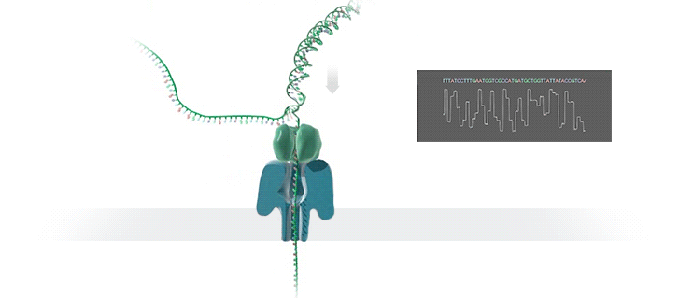
Nanopore Sequencing
Nanopore is a nano-scale hole
In nanopore sequencers, an ionic current passes through the nanopores
When the DNA strand passes through the nanopore, the sequencer measures the the change in current
This change is used to identify the bases in the strand with the help of different electrochemical structures of the different bases

Slide 89
Advantages of Nanopore Sequencing
Nanopores:
Do not require any labeling of the DNA or nucleotide for detection during sequencing
Rely on the electronic or chemical structure of the different nucleotides for identification
Allow sequencing very long reads, and
Provide portability, low cost, and high throughput.

Slide 90
Challenges of Nanopore Sequencing
One major drawback: high error rates
Nanopore sequence analysis tools have a critical role to:
  overcome high error rates
  take better advantage of the technology
Faster tools are critically needed to:
  Take better advantage of the real-time data production capability of MinION
  Enable fast, real-time data analysis

Slide 91
Nanopore Genome Assembly Pipeline
Senol Cali+, “Nanopore Sequencing Technology and Tools for Genome
Assembly” to appear in Briefings in Bioinformatics, 2018.

Slide 92
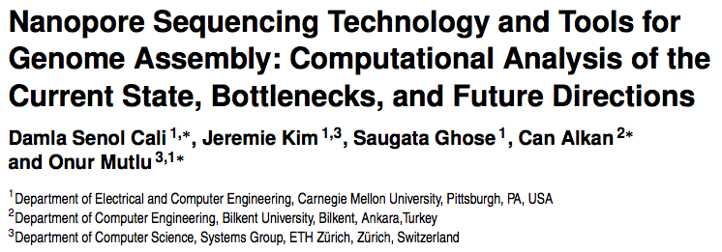
More on Nanopore Sequencing & Tools
Senol Cali+, “Nanopore Sequencing Technology and Tools for Genome
Assembly: Computational Analysis of the Current State, Bottlenecks
and Future Directions,” to appear in Briefings in Bioinformatics, 2018.
[Preliminary arxiv.org version]

Slide 93
Agenda
The Problem: DNA Read Mapping
  State-of-the-art Read Mapper Design
Algorithmic Acceleration
  Exploiting Structure of the Genome
  Exploiting SIMD Instructions
Hardware Acceleration
  Specialized Architectures
  Processing in Memory
Future Opportunities: New Sequencing Technologies

Slide 94
Conclusion
System design for bioinformatics is a critical problem
  It has large scientific, medical, societal, personal implications
This talk is about accelerating a key step in bioinformatics: genome sequence analysis
  In particular, read mapping
We covered various recent ideas to accelerate read mapping
  My personal journey since September 2006
Many future opportunities exist
  Especially with new sequencing technologies

Slide 95
Acknowledgments
Prof. Can Alkan, Bilkent University
Many students
  Mohammed Alser, Damla Senol Cali, Jeremie Kim
  Hasan Hassan
  Hongyi Xin
  …

Slide 96
Accelerating Genome Analysis
A Primer on an Ongoing Journey
Onur Mutlu
omutlu@gmail.com
https://people.inf.ethz.ch/omutlu
January 24, 2018
AACBB Keynote, Vienna

Slide 97
High-Throughput Sequencing
Notes:
First one shows the Illumina sequencing. The nucleotides are fluorescently labelled, with the color corresponding to the base. Only one base is added at a time. At each iteration, an image is taken and there will be a fluorescent signal indicating the base that has been added. The process is repeated, adding one nucleotide at a time and imaging in between. Computers are then used to detect the base at each site in each image and these are used to construct a sequence.
Second one shows the Ion Torrent sequencing. In Ion Torrent sequencing, instead of optical signals, they exploit the fact that addition of each nucleotide releases an H+ ion. In each iteration, one of the four nucleotide type is added to the system. When this nucleotide is next in the sequence, it is added to the sequence read. If that single base repeats, then more will be added. The pH is detected at each iteration, as each H⁺ ion released will decrease the pH. The process is repeated. The pH change, if any, is used to determine how many bases (if any) were added with each cycle.
Illumina: https://www.ebi.ac.uk/training/online/course/ebi-next-generation-sequencing-practical-course/what-next-generation-dna-sequencing/illumina-
454: https://www.ebi.ac.uk/training/online/course/ebi-next-generation-sequencing-practical-course/what-next-generation-dna-sequencing/454-seque
Ion Torrent: https://www.ebi.ac.uk/training/online/course/ebi-next-generation-sequencing-practical-course/what-next-generation-dna-sequencing/ion-torre

Slide 98
Nanopore Sequencing
Basecalling translates the raw signal output of the nanopore sequencer into bases (A, C, G, T) to generate DNA reads.
  1) The raw current signal is divided into discrete blocks (events).
  2) Each event is decoded into a most-likely set of bases.
Deletions are the dominant error of nanopore sequencing.
  In the ideal case, each consecutive event should differ by one base. However, in practice, this is not the case because of the non-stable speed of the translocation.
  Determining the correct length of the homopolymers (i.e., repeating stretches of one kind of base, e.g., AAAAAAA) is challenging.

Slide 99
The Importance of Genome Analysis?
Helps, for example, to answer the following 3 questions:

Slide 100

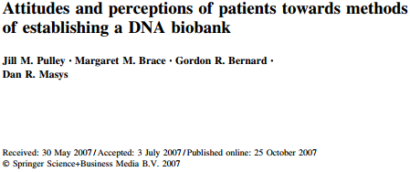
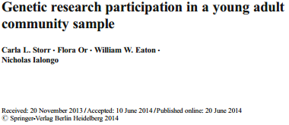
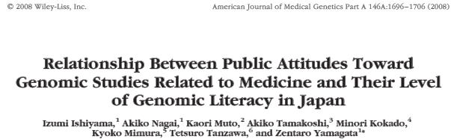
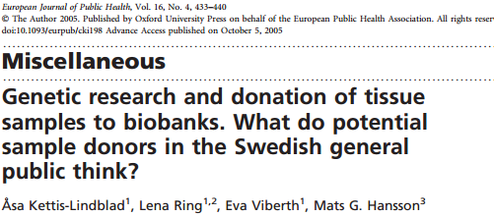
69–92% of the respondents in these studies had positive attitudes towards genomics research and donating their DNA samples.
Notes:
Country (USA, Sweden, Japan, Singapore), Education, Income, Age.

Slide 101
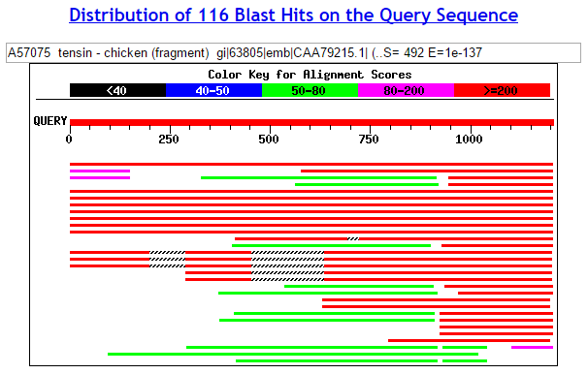
Pairwise sequence alignment
BLAST
Question #1: If I give you a gene sequence, tell me which of the billions of known sequences is most similar to it.

Slide 102

CODIS: Combined DNA Index System
FBI’s program of support for criminal justice.
CODIS defines 13 human DNA regions (loci) to be stored in the database for personal identification purposes.
Stored 14.5 million DNA profiles (for offenders, arrestees ..)
As of September 2016, CODIS has produced over 346,880 hits assisting in more than 332,776 investigations.
https://www.fbi.gov/services/laboratory/biometric-analysis/codis/ndis-statistics

Slide 103
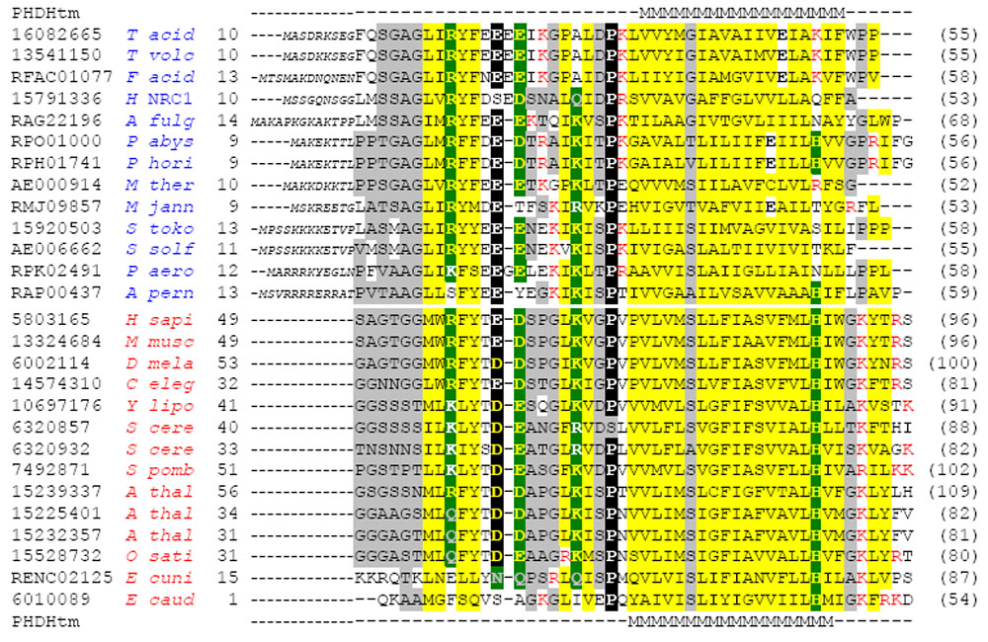
Multiple sequence alignment
Question #2: If I give you a bunch of sequences, tell me where they are the same and where they are different.

Slide 104
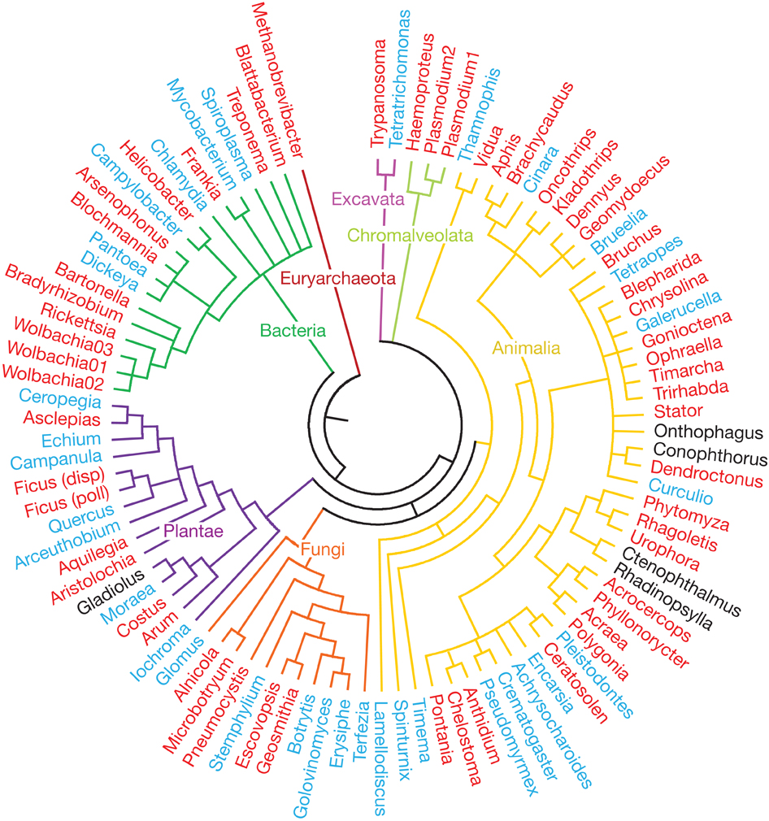
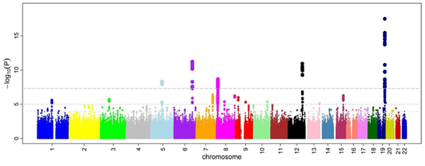
Phylogenetic tree
Reveals the genomic variants that cause diseases.
Helps understanding the evolutionary relationships among various species.
Evolutionary Tree
Manhattan plot
http://www.nature.com/nature/journal/v465/n7300/fig_tab/nature09113_F3.html

Slide 105



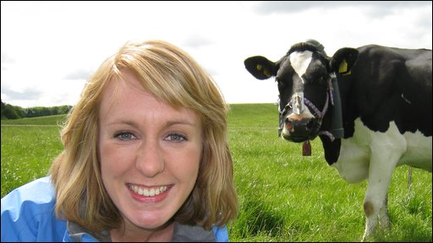

The genetic similarity between species
Human ~ Chimpanzee
96%
Human ~ Cat
90%
Human ~ Human
Human ~ Cow
99.9%
80%
Human ~ Banana
50-60%

Slide 106
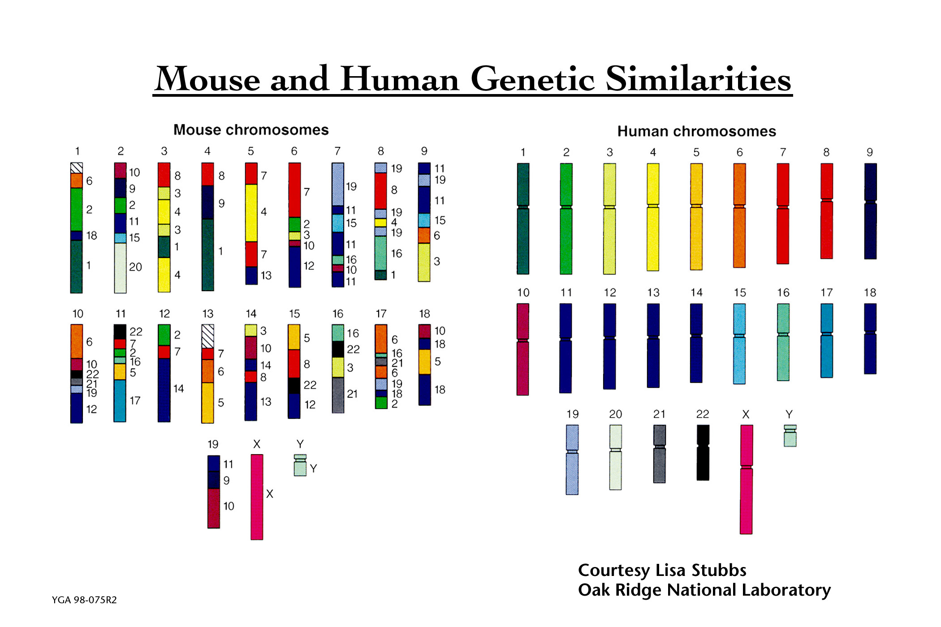
Human and Mouse Genetic Similarities
The similarity is such that human chromosomes can be cut (schematically at least) into about 150 pieces (only about 100 are large enough to appear here), then reassembled into a reasonable approximation of the mouse genome.
http://www.ornl.gov/TechResources/Human_Genome/graphics/slides/ttmousehuman.html

Slide 107
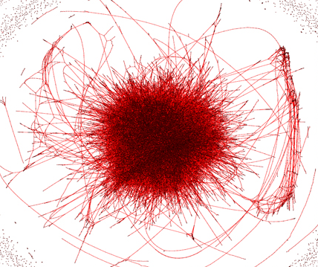

Metagenomics, genome assembly, de novo sequencing
Question #3: Given a bunch of short sequences, Can you identify the approximate species cluster for genomically unknown organisms (bacteria)?
uncleaned de Bruijn graph
http://math.oregonstate.edu/~koslickd
Notes:
organism detection in metagenomes

Slide 108
Analyzing the problem

Slide 109
Read Mapping
We want ultra fast and accurate alignment.
Detection of genomic variation.

Slide 110
Key Observations:
Alignment Verification → 90% of mapper’s execution time.
>98% of candidate locations have high dissimilarity with a given read.
Cheng et al, BMC bioinformatics (2015)
Xin et al, BMC genomics (2013)
Notes:
H. Cheng, et al., "BitMapper: an efficient all-mapper based on bit-vector computing," BMC bioinformatics, vol. 16, p. 1, 2015.
H. Xin, et al., "Accelerating read mapping with FastHASH," BMC genomics, vol. 14, p. S13, 2013.

Slide 111
Read Mappers Timeline

Slide 112
Filters, Alignment, and Mappers
Year | Purpose | Architecture | Platform | alignments#/1sec
2015 | Filter | Shifted Hamming Distance | Intel SSE | 3583
 | Alignment | Myers’s bit-vector [45] | Intel SSE | 409
 | Alignment | Smith-Waterman [40] | Intel SSE | 38
 | Mapper | BWT-FM | FPGA(Stratix5) | 16
2014 | Mapper | BWT-FM | FPGA(Stratix5) | 13
 | Alignment | Smith-Waterman | GPU | 1
 | Mapper | Hash-Based (BFAST) | FPGA(Virtex7) | 60
2013 | Mapper | BWT-FM | GPU | 17
 | Mapper | Hash-Based | FPGA(Virtex5) | 4
 | Mapper | Hash-Based (BFAST) | FPGA(Virtex7) | 15
 | Mapper | BWT-FM | FPGA(Virtex6) | 1092
2012 | Mapper | BWT-FM | GPU | 17
 | Mapper | Hash-Based (BFAST) | FPGA(Virtex6) | 35
 | Alignment | Smith-Waterman | FPGA(Virtex4) GPU Cell BE CPU | 131 16 41
3x faster
ideal filter → fast & accurate to compensate the computation overhead
Alignment performance for various state-of-the-art mappers and filters for 100 bp reads with at most 2% mismatch rate.

