Slide 1


Scaling the Memory System in the Many-Core Era
Onur Mutlu
onur@cmu.edu
July 26, 2013
BSC/UPC

Slide 2
Course Materials and Beyond
These slides are a shortened version of the Scalable Memory Systems course at ACACES 2013
Website for Course Slides, Papers, and Videos
  http://users.ece.cmu.edu/~omutlu/acaces2013-memory.html
  http://users.ece.cmu.edu/~omutlu
  Includes extended lecture notes and readings
Overview Reading
  Onur Mutlu,
  "Memory Scaling: A Systems Architecture Perspective"
  Proceedings of the 5th International Memory Workshop (IMW), Monterey, CA, May 2013. Slides (pptx) (pdf)

Slide 3



The Main Memory System
Main memory is a critical component of all computing systems: server, mobile, embedded, desktop, sensor
Main memory system must scale (in size, technology, efficiency, cost, and management algorithms) to maintain performance growth and technology scaling benefits
Processor
and caches
Main Memory
Storage (SSD/HDD)

Slide 4
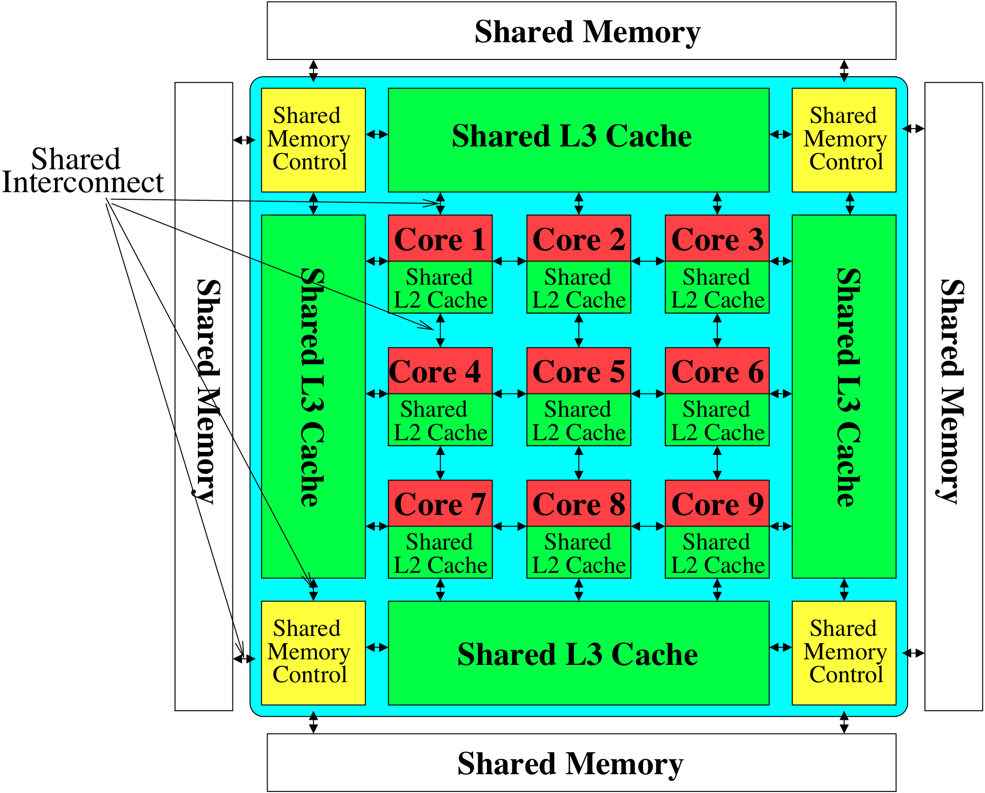
Memory System: A Shared Resource View
Storage

Slide 5
State of the Main Memory System
Recent technology, architecture, and application trends
  lead to new requirements
  exacerbate old requirements
DRAM and memory controllers, as we know them today, are (will be) unlikely to satisfy all requirements
Some emerging non-volatile memory technologies (e.g., PCM) enable new opportunities: memory+storage merging
We need to rethink the main memory system
  to fix DRAM issues and enable emerging technologies
  to satisfy all requirements

Slide 6
Agenda
Major Trends Affecting Main Memory
The DRAM Scaling Problem and Solution Directions
  Tolerating DRAM: New DRAM Architectures
  Enabling Emerging Technologies: Hybrid Memory Systems
The Memory Interference/QoS Problem and Solutions
  QoS-Aware Memory Systems
How Can We Do Better?
Summary

Slide 7
Major Trends Affecting Main Memory (I)
Need for main memory capacity, bandwidth, QoS increasing
Main memory energy/power is a key system design concern
DRAM technology scaling is ending

Slide 8
Major Trends Affecting Main Memory (II)
Need for main memory capacity, bandwidth, QoS increasing
  Multi-core: increasing number of cores/agents
  Data-intensive applications: increasing demand/hunger for data
  Consolidation: cloud computing, GPUs, mobile, heterogeneity
Main memory energy/power is a key system design concern
DRAM technology scaling is ending

Slide 9
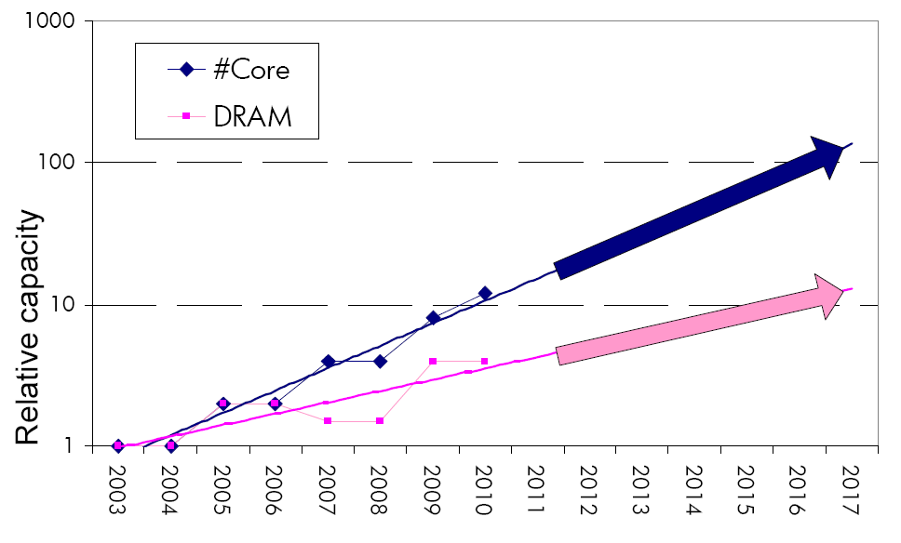
Example: The Memory Capacity Gap
Core count doubling ~ every 2 years
DRAM DIMM capacity doubling ~ every 3 years
Memory capacity per core expected to drop by 30% every two years
Trends worse for memory bandwidth per core!

Slide 10
Major Trends Affecting Main Memory (III)
Need for main memory capacity, bandwidth, QoS increasing
Main memory energy/power is a key system design concern
  ~40-50% energy spent in off-chip memory hierarchy [Lefurgy, IEEE Computer 2003]
  DRAM consumes power even when not used (periodic refresh)
DRAM technology scaling is ending

Slide 11
Major Trends Affecting Main Memory (IV)
Need for main memory capacity, bandwidth, QoS increasing
Main memory energy/power is a key system design concern
DRAM technology scaling is ending
  ITRS projects DRAM will not scale easily below X nm
  Scaling has provided many benefits:
    higher capacity (density), lower cost, lower energy

Slide 12
Agenda
Major Trends Affecting Main Memory
The DRAM Scaling Problem and Solution Directions
  Tolerating DRAM: New DRAM Architectures
  Enabling Emerging Technologies: Hybrid Memory Systems
The Memory Interference/QoS Problem and Solutions
  QoS-Aware Memory Systems
How Can We Do Better?
Summary

Slide 13
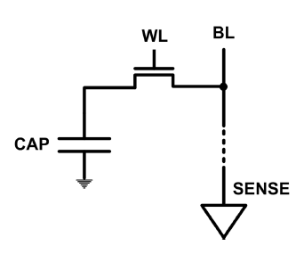
The DRAM Scaling Problem
DRAM stores charge in a capacitor (charge-based memory)
  Capacitor must be large enough for reliable sensing
  Access transistor should be large enough for low leakage and high retention time
  Scaling beyond 40-35nm (2013) is challenging [ITRS, 2009]
DRAM capacity, cost, and energy/power hard to scale

Slide 14
Solutions to the DRAM Scaling Problem
Two potential solutions
  Tolerate DRAM (by taking a fresh look at it)
  Enable emerging memory technologies to eliminate/minimize DRAM
Do both
  Hybrid memory systems

Slide 15
Solution 1: Tolerate DRAM
Overcome DRAM shortcomings with
  System-DRAM co-design
  Novel DRAM architectures, interface, functions
  Better waste management (efficient utilization)
Key issues to tackle
  Reduce refresh energy
  Improve bandwidth and latency
  Reduce waste
  Enable reliability at low cost
Liu, Jaiyen, Veras, Mutlu, “RAIDR: Retention-Aware Intelligent DRAM Refresh,” ISCA 2012.
Kim, Seshadri, Lee+, “A Case for Exploiting Subarray-Level Parallelism in DRAM,” ISCA 2012.
Lee+, “Tiered-Latency DRAM: A Low Latency and Low Cost DRAM Architecture,” HPCA 2013.
Liu+, “An Experimental Study of Data Retention Behavior in Modern DRAM Devices” ISCA’13.
Seshadri+, “RowClone: Fast and Efficient In-DRAM Copy and Initialization of Bulk Data,” 2013.

Slide 16
Solution 2: Emerging Memory Technologies
Some emerging resistive memory technologies seem more scalable than DRAM (and they are non-volatile)
Example: Phase Change Memory
  Expected to scale to 9nm (2022 [ITRS])
  Expected to be denser than DRAM: can store multiple bits/cell
But, emerging technologies have shortcomings as well
  Can they be enabled to replace/augment/surpass DRAM?
Lee, Ipek, Mutlu, Burger, “Architecting Phase Change Memory as a Scalable DRAM Alternative,” ISCA 2009, CACM 2010, Top Picks 2010.
Meza, Chang, Yoon, Mutlu, Ranganathan, “Enabling Efficient and Scalable Hybrid Memories,” IEEE Comp. Arch. Letters 2012.
Yoon, Meza et al., “Row Buffer Locality Aware Caching Policies for Hybrid Memories,” ICCD 2012.
Kultursay+, “Evaluating STT-RAM as an Energy-Efficient Main Memory Alternative,” ISPASS 2013.
Notes:
Even if DRAM continues to scale there could be benefits to examining and enabling these new technologies.

Slide 17
Hybrid Memory Systems
CPU
Meza+, “Enabling Efficient and Scalable Hybrid Memories,” IEEE Comp. Arch. Letters, 2012.
Yoon, Meza et al., “Row Buffer Locality Aware Caching Policies for Hybrid Memories,” ICCD 2012 Best Paper Award.
DRAMCtrl
PCM Ctrl
DRAM
Phase Change Memory (or Tech. X)
Fast, durable
Small,
leaky, volatile,
high-cost
Large, non-volatile, low-cost
Slow, wears out, high active energy
Hardware/software manage data allocation and movement
to achieve the best of multiple technologies

Slide 18
An Orthogonal Issue: Memory Interference
Problem: Memory interference is uncontrolled → uncontrollable, unpredictable, vulnerable system
Goal: We need to control it → Design a QoS-aware system
Solution: Hardware/software cooperative memory QoS
  Hardware designed to provide a configurable fairness substrate
    Application-aware memory scheduling, partitioning, throttling
  Software designed to configure the resources to satisfy different QoS goals
E.g., fair, programmable memory controllers and on-chip networks provide QoS and predictable performance
  [2007-2012, Top Picks’09,’11a,’11b,’12]

Slide 19
Agenda
Major Trends Affecting Main Memory
The DRAM Scaling Problem and Solution Directions
  Tolerating DRAM: New DRAM Architectures
  Enabling Emerging Technologies: Hybrid Memory Systems
The Memory Interference/QoS Problem and Solutions
  QoS-Aware Memory Systems
How Can We Do Better?
Summary

Slide 20
Tolerating DRAM: Example Techniques
Retention-Aware DRAM Refresh: Reducing Refresh Impact
Tiered-Latency DRAM: Reducing DRAM Latency
RowClone: In-Memory Page Copy and Initialization
Subarray-Level Parallelism: Reducing Bank Conflict Impact

Slide 21
DRAM Refresh
DRAM capacitor charge leaks over time
The memory controller needs to refresh each row periodically to restore charge
  Read and close each row every N ms
  Typical N = 64 ms
Downsides of refresh
-- Energy consumption: Each refresh consumes energy
  -- Performance degradation: DRAM rank/bank unavailable while refreshed
  -- QoS/predictability impact: (Long) pause times during refresh
  -- Refresh rate limits DRAM capacity scaling

Slide 22
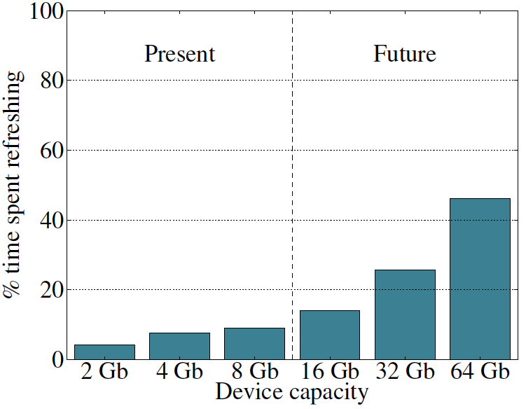
Refresh Overhead: Performance
46%
8%

Slide 23
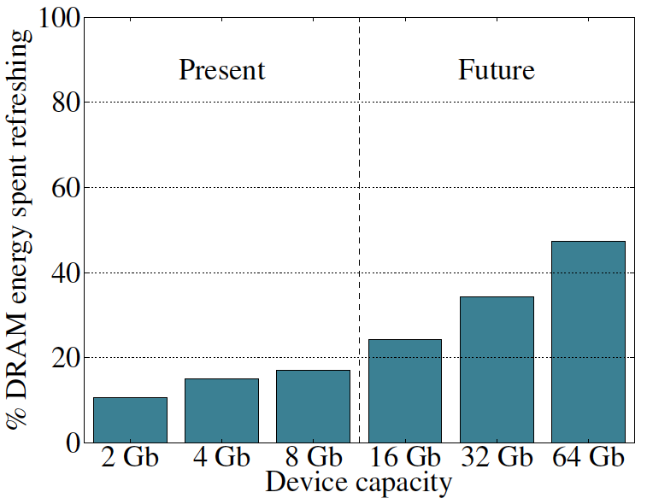
Refresh Overhead: Energy
47%
15%

Slide 24

Retention Time Profile of DRAM

Slide 25
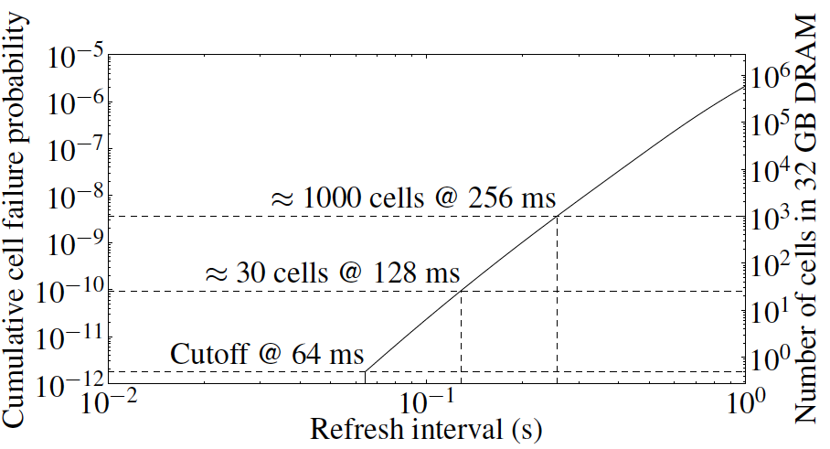
Retention Time Profile of DRAM
Observation: Only very few rows need to be refreshed at the worst-case rate

Slide 26
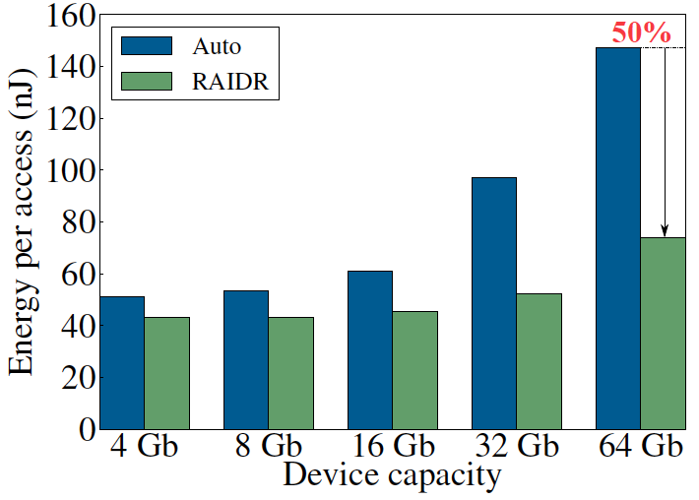
RAIDR: Eliminating Unnecessary Refreshes
Observation: Most DRAM rows can be refreshed much less often without losing data [Kim+, EDL’09]
Key idea: Refresh rows containing weak cells
more frequently, other rows less frequently
  1. Profiling: Profile retention time of all rows
  2. Binning: Store rows into bins by retention time in memory controller
  Efficient storage with Bloom Filters (only 1.25KB for 32GB memory)
  3. Refreshing: Memory controller refreshes rows in different bins at different rates
Results: 8-core, 32GB, SPEC, TPC-C, TPC-H
  74.6% refresh reduction @ 1.25KB storage
  ~16%/20% DRAM dynamic/idle power reduction
  ~9% performance improvement
  Energy benefits increase with DRAM capacity
Liu et al., “RAIDR: Retention-Aware Intelligent DRAM Refresh,” ISCA 2012.

Slide 27
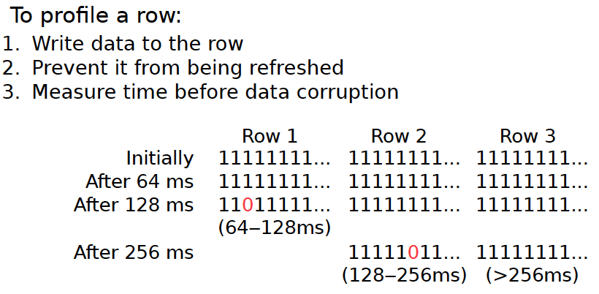
1. Profiling

Slide 28
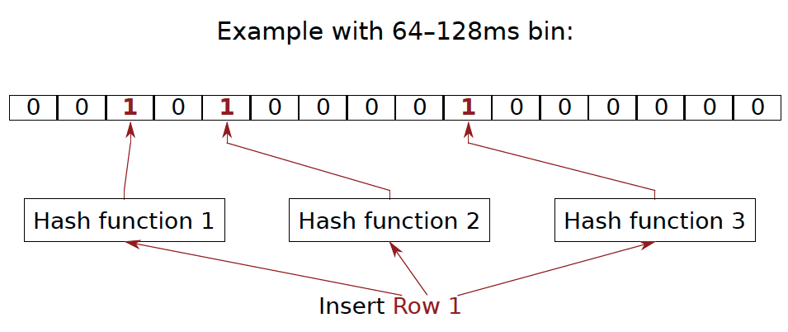
2. Binning
How to efficiently and scalably store rows into retention time bins?
  Use Hardware Bloom Filters [Bloom, CACM 1970]

Slide 29
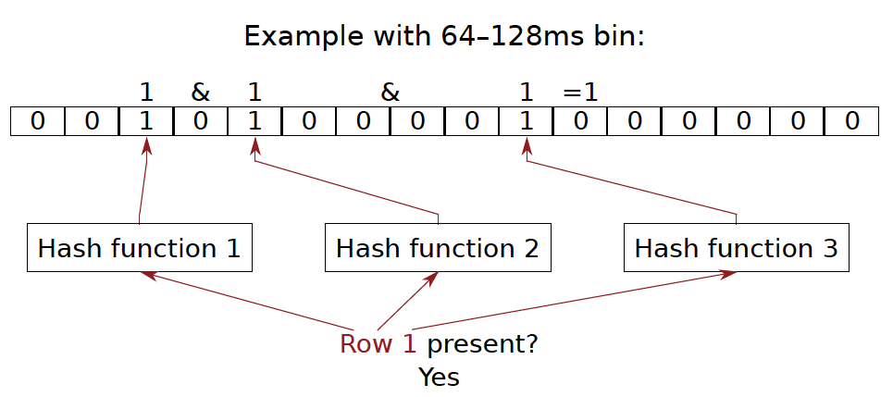
Bloom Filter Operation Example

Slide 30
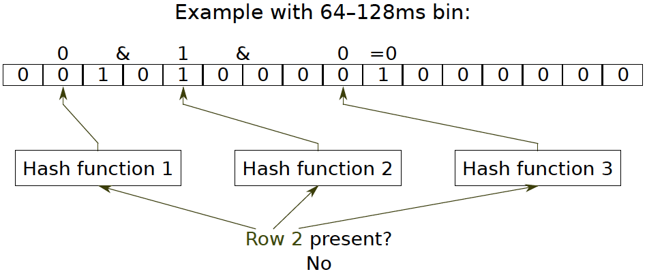
Bloom Filter Operation Example

Slide 31
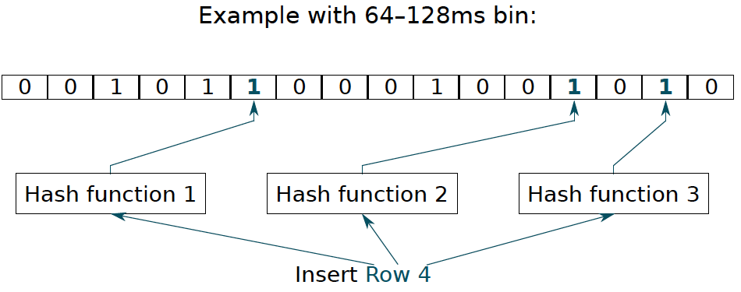
Bloom Filter Operation Example

Slide 32
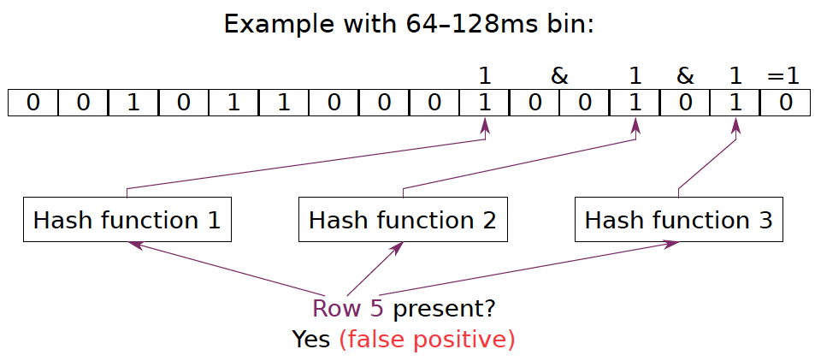
Bloom Filter Operation Example

Slide 33
Benefits of Bloom Filters as Bins
False positives: a row may be declared present in the Bloom filter even if it was never inserted
  Not a problem: Refresh some rows more frequently than needed
No false negatives: rows are never refreshed less frequently than needed (no correctness problems)
Scalable: a Bloom filter never overflows (unlike a fixed-size table)
Efficient: No need to store info on a per-row basis; simple hardware → 1.25 KB for 2 filters for 32 GB DRAM system

Slide 34
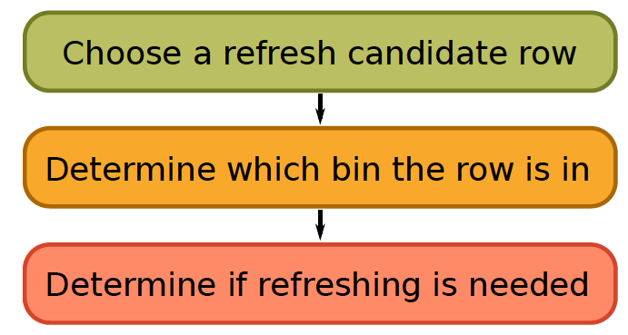
3. Refreshing (RAIDR Refresh Controller)

Slide 35
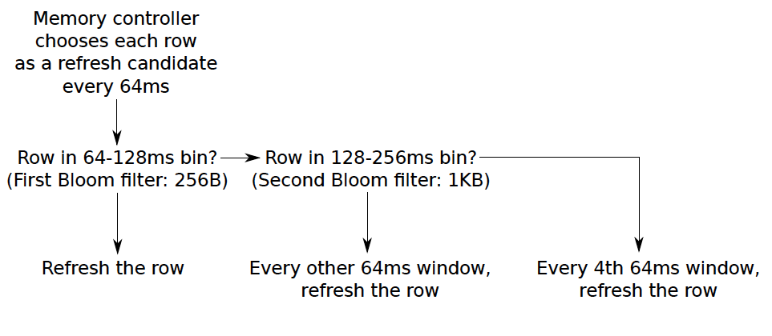
3. Refreshing (RAIDR Refresh Controller)
Liu et al., “RAIDR: Retention-Aware Intelligent DRAM Refresh,” ISCA 2012.

Slide 36
Going Forward
How to find out and expose weak memory cells/rows
  Retention time profiling
  Early analysis of modern DRAM chips:
    Liu+, “An Experimental Study of Data Retention Behavior in Modern DRAM Devices: Implications for Retention Time Profiling Mechanisms”, ISCA 2013.
Tolerating cell-to-cell interference at the system level
  Flash and DRAM

Slide 37
More on RAIDR and Refresh
Jamie Liu, Ben Jaiyen, Richard Veras, and Onur Mutlu,
"RAIDR: Retention-Aware Intelligent DRAM Refresh"
Proceedings of the 39th International Symposium on Computer Architecture (ISCA), Portland, OR, June 2012. Slides (pdf)
Jamie Liu, Ben Jaiyen, Yoongu Kim, Chris Wilkerson, and Onur Mutlu,
"An Experimental Study of Data Retention Behavior in Modern DRAM Devices: Implications for Retention Time Profiling Mechanisms"
Proceedings of the 40th International Symposium on Computer Architecture (ISCA), Tel-Aviv, Israel, June 2013. Slides (pptx) Slides (pdf)

Slide 38
Tolerating DRAM: Example Techniques
Retention-Aware DRAM Refresh: Reducing Refresh Impact
Tiered-Latency DRAM: Reducing DRAM Latency
RowClone: In-Memory Page Copy and Initialization
Subarray-Level Parallelism: Reducing Bank Conflict Impact

Slide 39
DRAM Latency-Capacity Trend
16X
-20%
DRAM latency continues to be a critical bottleneck
Notes:
The figure shows the historical trends of DRAM during the last 12-years, from 2000 to 2011.
We can see that, during this time, DRAM capacity has increased by 16 times.
On the other hand, during the same period of time, DRAM latency has reduced by only 20%.
As a result, the high DRAM latency continues to be a critical bottleneck for system performance.

Slide 40
What Causes the Long Latency?
DRAM Chip
subarray
banks
cell array
subarray
cell array
cell
I/O
I/O
wordline
channel
channel
row decoder
access
capacitor
transistor
bitline
sense amplifier
Notes:
To understand how to access DRAM, let me take a look at the DRAM organization.
DRAM consists of two components, the cell array and the I/O circuitry.
The cell array consists of multiple banks
and each bank consists of multiple subarray.
Each subarray consists of two dimensional grids of cell
and each cell has one capacitor and one access transistor.
The horizontal cell array is connected to a row decoder by a wire called wordline and
The vertical cell array is connected to sense amplifier by a wire called bitline.

Slide 41
What Causes the Long Latency?
DRAM Chip
row decoder
subarray
banks
cell array
subarray
cell array
sense amplifier
Subarray
row addr.
I/O
I/O
mux
I/O
column
addr.
channel
channel
DRAM Latency = Subarray Latency + I/O Latency
DRAM Latency = Subarray Latency + I/O Latency
Dominant
Notes:
To read from a DRAM chip, the subarray first accesses the data, which consists of two steps.
First, row decoder activate the row which has requested data.
Second, sense amplifiers detect the data of cells.
After these subarray access, IO circuitry transfers the data over channel.
Therefore, the DRAM latency is the sum of the subarray latency and the I/O latency.
We observed that the subarray latency is much higher than the I/O latency.
As a result, subarray is the dominant source of the DRAM latency as we explained in the paper.
--------------------------------------------------------------------------------------------------------------------------------------------
, again.
DRAM consists of two components, the cell array and the I/O circuitry. The cell array consists of multiple subarrays.
To read from a DRAM chip, the data is first accessed from the subarray and then the data is transferred over the channel by the I/O circuitry.

Slide 42
Why is the Subarray So Slow?
Subarray
Cell
cell
wordline
bitline: 512 cells
access
row decoder
row decoder
transistor
capacitor
sense amplifier
bitline
sense amplifier
large sense amplifier
Long bitline
  Amortizes sense amplifier cost → Small area
  Large bitline capacitance → High latency & power
Notes:
The cell’s capacitor is small and can store only a small amount of charge.
That is why a subarray also has sense-amplifiers, which are specialized circuits that can detect the small amount of charge.
Unfortunately, a sense-amplifier size is about *100* times the cell size.
So, to amortize the area of the sense-amplifiers,
hundreds of cells share the same sense-amplifier through a long bitline.
However, a long bitline has a large capacitance that increases latency and power consumption.
Therefore, the long bitline is one of the dominant sources of high latency and high power consumption.
To understand why the subarray is so slow,
let me take a look at the subarray organization.

Slide 43
Trade-Off: Area (Die Size) vs. Latency
Long Bitline
Short Bitline
Faster
Smaller
Trade-Off: Area vs. Latency
Notes:
A naïve way to reduce the DRAM latency is to have short bitlines that have lower latency.
Unfortunately, short bitlines significantly increase the DRAM area.
Therefore, the bitline length exposes an important trade-off between area and latency.

Slide 44
Trade-Off: Area (Die Size) vs. Latency
32
Fancy DRAM
Short Bitline
Commodity DRAM
Long Bitline
64
Cheaper
128
256
512 cells/bitline
GOAL
Faster
Notes:
This figure shows the trade-off between DRAM area and latency as we change the bitline length.
Y-axis is the normalized DRAM area compared to a DRAM using 512 cells/bitline. A lower value is cheaper.
X-axis shows the latency in terms of tRC, an important DRAM timing constraint. A lower value is faster.
Commodity DRAM chips use long bitlines to minimize area cost. On the other hand, shorter bitlines achieve lower latency at higher cost.
Our goal is to achieve the best of both worlds: low latency and low area cost.

Slide 45
Approximating the Best of Both Worlds
Long Bitline
Long Bitline
Our Proposal
Short Bitline
Short Bitline
Small Area
Large Area
Small Area
High Latency
Low Latency
Low Latency
Need Isolation
Add Isolation Transistors
Short Bitline ➔ Fast
Notes:
To sum up, both long and short bitline do not achieve small area and low latency.
Long bitline has small area but has high latency while short bitline has low latency but has large area.
To achieve the best of both worlds, we first start from long bitline, which has small area.
After that, to achieve the low latency of short bitline, we divide the long bitline into two smaller segments.
The bitline length of the segment nearby the sense-amplifier is same as the length of short bitline.
Therefore, the latency of the segment is as low as the latency of the short bitline.
To isolate this fast segment from the other segment, we add isolation transistors that selectively connect the two segments.

Slide 46
Approximating the Best of Both Worlds
Long Bitline
Tiered-Latency DRAM
Our Proposal
Short Bitline
Long Bitline
Short Bitline
Small Area
Small Area
Large Area
High Latency
Low Latency
Low Latency
Small area using long bitline
Low Latency
Notes:
This way, our proposed approach achieves small area and low latency.
We call this new DRAM architecture as Tiered-Latency DRAM

Slide 47
Tiered-Latency DRAM
Divide a bitline into two segments with an isolation transistor
Far Segment
Isolation Transistor
Near Segment
Sense Amplifier
Notes:
Again, the key idea is to divide a subarray into two segments with isolation transistors.
The segment, directly connected to the sense amplifier, is called the near segment.
The other segment is called the far segment.

Slide 48
Near Segment Access
Turn off the isolation transistor
Reduced bitline length
Reduced bitline capacitance
Far Segment
Far Segment
➔ Low latency & low power
Isolation Transistor (off)
Isolation Transistor
Near Segment
Sense Amplifier
Notes:
When accessing the near segment, the isolation transistor is truned off such that the near segment is electrically decoupled from the far segment.
which leads to the reduced bitline length, which leads to reduced bitline capacitance.
Due to these two reasons, the near segment can be accessed with low latency and low power.

Slide 49
Far Segment Access
Turn on the isolation transistor
Long bitline length
Large bitline capacitance
Additional resistance of isolation transistor
Far Segment
➔ High latency & high power
Isolation Transistor (on)
Isolation Transistor
Near Segment
Near Segment
Sense Amplifier
Notes:
When accessing the far segment, the isolation transistor is turned on
such that the far segment is electrically connected to the sense amplifier
and the entire bitline is exposed to sense amplifier,
which leads to long bitline,
which leads to large bitline capacitance.
and also isolation transistors have resistance.
Due to these three reasons, accessing the far segment incurs high latency and high power.

Slide 50
Commodity DRAM vs. TL-DRAM
DRAM Latency (tRC)
DRAM Power
  +49%
  +23%
  (52.5ns)
Latency
Power
  –56%
  –51%
  Near Far
  Near Far
  Commodity DRAM
  Commodity DRAM
  TL-DRAM
  TL-DRAM
DRAM Area Overhead
  ~3%: mainly due to the isolation transistors
Notes:
This figure compares the latency.
Y-axis is normalized latency.
Compared to commodity DRAM, TL-DRAM’s near segment has 56% lower latency, while the far segment has 23% higher latency.
The right figure compares the power.
Y-axis is normalized power.
Compared to commodity DRAM, TL-DRAM’s near segment has 51% lower power consumption and the far segment has 49% higher power consumption.
Lastly, mainly due to the isolation transistor, Tiered-latency DRAM increases the die-size by about 3%.

Slide 51
Trade-Off: Area (Die-Area) vs. Latency
32
64
Cheaper
128
256
512 cells/bitline
Near Segment
Far Segment
GOAL
Faster
Notes:
Again, the figure shows the trade-off between area and latency in existing DRAM.
Unlike existing DRAM, TL-DRAM achieves low latency using the near segment while increasing the area by only 3%.
Although the far segment has higher latency than commodity DRAM, we show that efficient use of the near segment enables TL-DRAM to achieve high system performance.

Slide 52
Leveraging Tiered-Latency DRAM
TL-DRAM is a substrate that can be leveraged by the hardware and/or software
Many potential uses
  Use near segment as hardware-managed inclusive cache to far segment
  Use near segment as hardware-managed exclusive cache to far segment
  Profile-based page mapping by operating system
  Simply replace DRAM with TL-DRAM
Notes:
There are multiple ways to leverage the TL-DRAM substrate by hardware or software.
In this slide, I describe many such ways.
First, the near segment can be used as a hardware-managed inclusive cache to the far segment.
Second, the near segment can be used as a hardware-managed exclusive cache to the far segment.
Third, the operating system can intelligently allocate frequently-accessed pages to the near segment.
Forth mechanism is to simple replace DRAM with TL-DRAM without any near segment handling
While our paper provides detailed explanations and evaluations of first three mechanism,
in this talk, we will focus on the first approach, which is to use the near segment as a hardware managed cache for the far segment.

Slide 53
Performance & Power Consumption
12.4%
11.5%
10.7%
–23%
–24%
–26%
Normalized Performance
Normalized Power
Core-Count (Channel)
Core-Count (Channel)
Using near segment as a cache improves performance and reduces power consumption
Notes:
This figure shows the IPC improvement of our three caching mechanisms over commodity DRAM.
All of them improve performance and benefit-based caching shows maximum performance improvement by 12.7%.
The right figure shows the normalized power reduction of our three caching mechanisms over commodity DRAM.
All of them reduce power consumption and benefit-based caching shows maximum power reduction by 23%.
Therefore, using near segment as a cache improves performance and reduces power consumption at the cost of 3% area overhead.

Slide 54
More on TL-DRAM
Donghyuk Lee, Yoongu Kim, Vivek Seshadri, Jamie Liu, Lavanya Subramanian, and Onur Mutlu,
"Tiered-Latency DRAM: A Low Latency and Low Cost DRAM Architecture"
Proceedings of the 19th International Symposium on High-Performance Computer Architecture (HPCA), Shenzhen, China, February 2013. Slides (pptx)

Slide 55
Tolerating DRAM: Example Techniques
Retention-Aware DRAM Refresh: Reducing Refresh Impact
Tiered-Latency DRAM: Reducing DRAM Latency
RowClone: In-Memory Page Copy and Initialization
Subarray-Level Parallelism: Reducing Bank Conflict Impact

Slide 56
Today’s Memory: Bulk Data Copy
1) High latency
Memory
3) Cache pollution
L3
CPU
L2
L1
MC
2) High bandwidth utilization
4) Unwanted data movement

Slide 57
Future: RowClone (In-Memory Copy)
3) No cache pollution
1) Low latency
Memory
L3
CPU
L2
L1
MC
2) Low bandwidth utilization
4) No unwanted data movement

Slide 58
DRAM operation (load one byte)
4 Kbits
1. Activate row
2. Transfer
row
DRAM array
Row Buffer (4 Kbits)
3. Transfer
byte onto bus
Data pins (8 bits)
Memory Bus
Notes:
say you want a byte

Slide 59
RowClone: in-DRAM Row Copy (and Initialization)
4 Kbits
1. Activate row A
3. Activate row B
2. Transfer
row
DRAM array
4.
Transfer
row
Row Buffer (4 Kbits)
Data pins (8 bits)
Memory Bus
Notes:
copy

Slide 60
RowClone: Key Idea
DRAM banks contain
  Mutiple rows of DRAM cells – row = 8KB
  A row buffer shared by the DRAM rows
Large scale copy
  Copy data from source row to row buffer
  Copy data from row buffer to destination row
  Can be accomplished by two consecutive ACTIVATEs
  (if source and destination rows are in the same subarray)

Slide 61
RowClone: Intra-subarray Copy
0
1
0
0
1
1
0
0
0
1
1
0
src
1
dst
?
0
1
?
1
0
?
0
1
?
0
0
?
1
1
?
1
1
?
0
1
?
0
0
?
0
0
?
1
1
?
1
1
?
0
Sense Amplifiers
(row buffer)
0
1
0
0
1
1
0
0
0
1
1
0
Deactivate
(our proposal)
Activate (src)
Activate (dst)

Slide 62
RowClone: Inter-bank Copy
dst
src
Read
Write
I/O Bus
Transfer
(our proposal)

Slide 63
RowClone: Inter-subarray Copy
dst
src
temp
I/O Bus
1. Transfer (src to temp)
2. Transfer (temp to dst)

Slide 64
Fast Row Initialization
0
0
0
0
0
0
0
0
0
0
0
0
Fix a row at Zero
(0.5% loss in capacity)

Slide 65
RowClone: Latency and Energy Savings
11.5x
74x
Seshadri et al., “RowClone: Fast and Efficient In-DRAM Copy and Initialization of Bulk Data,” CMU Tech Report 2013.

Slide 66
Goal: Ultra-efficient heterogeneous architectures
CPU
core
CPU
core
mini-CPU
core
GPU
(throughput)
core
GPU
(throughput)
core
video
core
GPU
(throughput)
core
GPU
(throughput)
core
CPU
core
CPU
core
Memory
imaging
core
LLC
Specialized
compute-capability
in memory
Memory Controller
Memory Bus
Slide credit: Prof. Kayvon Fatahalian, CMU

Slide 67
Enabling Ultra-efficient (Visual) Search
What is the right partitioning of computation capability?
What is the right low-cost memory substrate?
What memory technologies are the best enablers?
How do we rethink/ease (visual) search algorithms/applications?
Main Memory
Processor
Core
Database (of images)
Cache
Query vector
Memory Bus
Results
Picture credit: Prof. Kayvon Fatahalian, CMU

Slide 68
More on RowClone
Vivek Seshadri, Yoongu Kim, Chris Fallin, Donghyuk Lee, Rachata Ausavarungnirun, Gennady Pekhimenko, Yixin Luo, Onur Mutlu, Phillip B. Gibbons, Michael A. Kozuch, Todd C. Mowry,
"RowClone: Fast and Efficient In-DRAM Copy and Initialization of Bulk Data"
CMU Computer Science Technical Report, CMU-CS-13-108, Carnegie Mellon University, April 2013.

Slide 69
Tolerating DRAM: Example Techniques
Retention-Aware DRAM Refresh: Reducing Refresh Impact
Tiered-Latency DRAM: Reducing DRAM Latency
RowClone: In-Memory Page Copy and Initialization
Subarray-Level Parallelism: Reducing Bank Conflict Impact

Slide 70
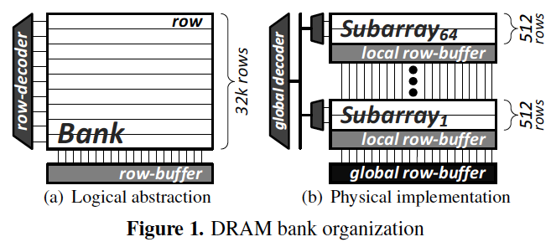
SALP: Reducing DRAM Bank Conflicts
Problem: Bank conflicts are costly for performance and energy
  serialized requests, wasted energy (thrashing of row buffer, busy wait)
Goal: Reduce bank conflicts without adding more banks (low cost)
Key idea: Exploit the internal subarray structure of a DRAM bank to parallelize bank conflicts to different subarrays
  Slightly modify DRAM bank to reduce subarray-level hardware sharing
Results on Server, Stream/Random, SPEC
  19% reduction in dynamic DRAM energy
  13% improvement in row hit rate
  17% performance improvement
  0.15% DRAM area overhead
-19%
+13%
Kim, Seshadri+ “A Case for Exploiting Subarray-Level
Parallelism in DRAM,” ISCA 2012.

Slide 71
More on SALP
Yoongu Kim, Vivek Seshadri, Donghyuk Lee, Jamie Liu, and Onur Mutlu,
"A Case for Exploiting Subarray-Level Parallelism (SALP) in DRAM"
Proceedings of the 39th International Symposium on Computer Architecture (ISCA), Portland, OR, June 2012. Slides (pptx)

Slide 72
Tolerating DRAM: Summary
Major problems with DRAM scaling and design: high refresh rate, high latency, low parallelism, bulk data movement
Four new DRAM designs
  RAIDR: Reduces refresh impact
  TL-DRAM: Reduces DRAM latency at low cost
  SALP: Improves DRAM parallelism
  RowClone: Reduces energy and performance impact of bulk data copy
All four designs
  Improve both performance and energy consumption
  Are low cost (low DRAM area overhead)
  Enable new degrees of freedom to software & controllers
Rethinking DRAM interface and design essential for scaling
  Co-design DRAM with the rest of the system

Slide 73
Further Reading: Data Retention and Power
Characterization of Commodity DRAM Chips
  Jamie Liu, Ben Jaiyen, Yoongu Kim, Chris Wilkerson, and Onur Mutlu,
  "An Experimental Study of Data Retention Behavior in Modern DRAM Devices: Implications for Retention Time Profiling Mechanisms"
  Proceedings of the 40th International Symposium on Computer Architecture (ISCA), Tel-Aviv, Israel, June 2013. Slides (pptx) Slides (pdf)
Voltage and Frequency Scaling in DRAM
  Howard David, Chris Fallin, Eugene Gorbatov, Ulf R. Hanebutte, and Onur Mutlu,
  "Memory Power Management via Dynamic Voltage/Frequency Scaling"
  Proceedings of the 8th International Conference on Autonomic Computing (ICAC), Karlsruhe, Germany, June 2011. Slides (pptx) (pdf)

Slide 74
Agenda
Major Trends Affecting Main Memory
The DRAM Scaling Problem and Solution Directions
  Tolerating DRAM: New DRAM Architectures
  Enabling Emerging Technologies: Hybrid Memory Systems
The Memory Interference/QoS Problem and Solutions
  QoS-Aware Memory Systems
How Can We Do Better?
Summary

Slide 75
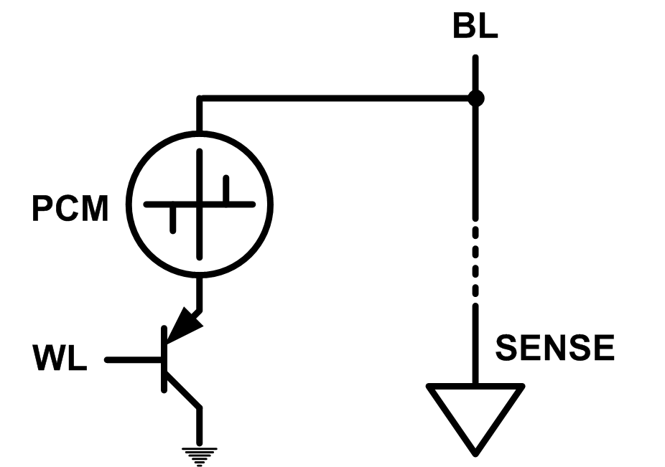
Solution 2: Emerging Memory Technologies
Some emerging resistive memory technologies seem more scalable than DRAM (and they are non-volatile)
Example: Phase Change Memory
  Data stored by changing phase of material
  Data read by detecting material’s resistance
  Expected to scale to 9nm (2022 [ITRS])
  Prototyped at 20nm (Raoux+, IBM JRD 2008)
  Expected to be denser than DRAM: can store multiple bits/cell
But, emerging technologies have (many) shortcomings
  Can they be enabled to replace/augment/surpass DRAM?
Notes:
Even if DRAM continues to scale there could be benefits to examining and enabling these new technologies.

Slide 76
Phase Change Memory: Pros and Cons
Pros over DRAM
  Better technology scaling (capacity and cost)
  Non volatility
  Low idle power (no refresh)
Cons
  Higher latencies: ~4-15x DRAM (especially write)
  Higher active energy: ~2-50x DRAM (especially write)
  Lower endurance (a cell dies after ~10⁸ writes)
Challenges in enabling PCM as DRAM replacement/helper:
  Mitigate PCM shortcomings
  Find the right way to place PCM in the system

Slide 77
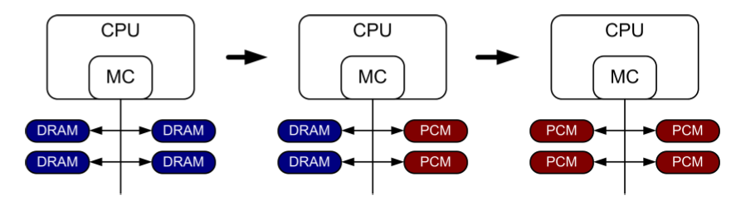
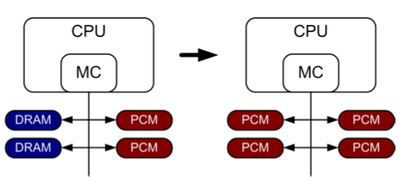
PCM-based Main Memory (I)
How should PCM-based (main) memory be organized?
Hybrid PCM+DRAM [Qureshi+ ISCA’09, Dhiman+ DAC’09]:
  How to partition/migrate data between PCM and DRAM

Slide 78
PCM-based Main Memory (II)
How should PCM-based (main) memory be organized?
Pure PCM main memory [Lee et al., ISCA’09, Top Picks’10]:
  How to redesign entire hierarchy (and cores) to overcome PCM shortcomings

Slide 79
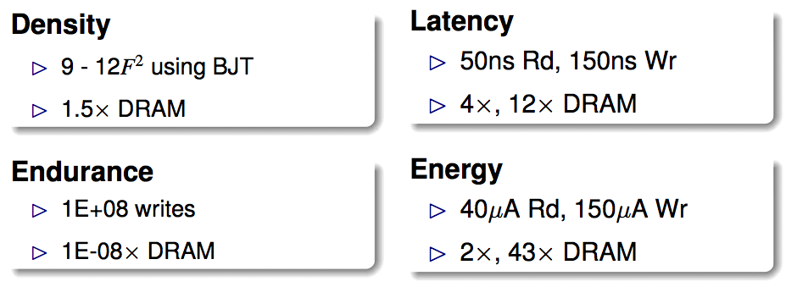
An Initial Study: Replace DRAM with PCM
Lee, Ipek, Mutlu, Burger, “Architecting Phase Change Memory as a Scalable DRAM Alternative,” ISCA 2009.
  Surveyed prototypes from 2003-2008 (e.g. IEDM, VLSI, ISSCC)
  Derived “average” PCM parameters for F=90nm

Slide 80
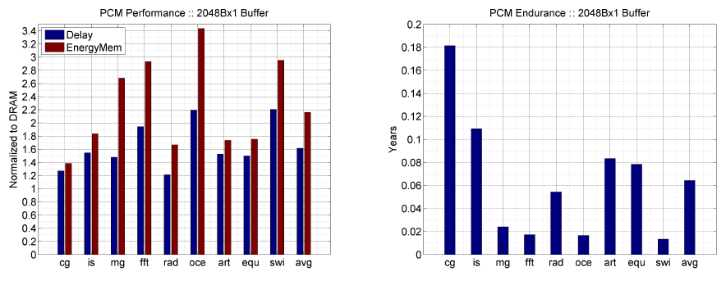
Results: Naïve Replacement of DRAM with PCM
Replace DRAM with PCM in a 4-core, 4MB L2 system
PCM organized the same as DRAM: row buffers, banks, peripherals
1.6x delay, 2.2x energy, 500-hour average lifetime
Lee, Ipek, Mutlu, Burger, “Architecting Phase Change Memory as a Scalable DRAM Alternative,” ISCA 2009.

Slide 81
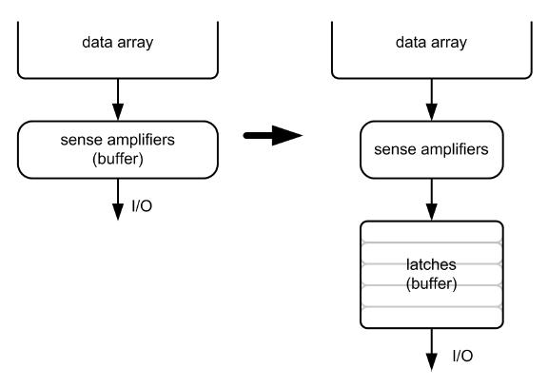
Architecting PCM to Mitigate Shortcomings
Idea 1: Use multiple narrow row buffers in each PCM chip
    → Reduces array reads/writes → better endurance, latency, energy
Idea 2: Write into array at
cache block or word
granularity
→ Reduces unnecessary wear
DRAM
PCM

Slide 82
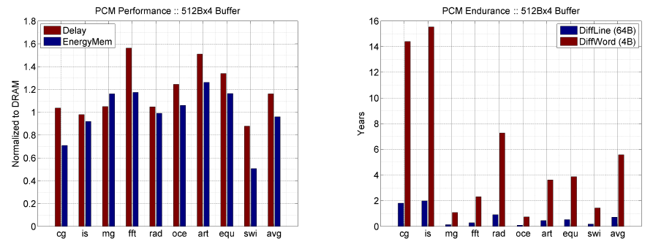
Results: Architected PCM as Main Memory
1.2x delay, 1.0x energy, 5.6-year average lifetime
Scaling improves energy, endurance, density
Caveat 1: Worst-case lifetime is much shorter (no guarantees)
Caveat 2: Intensive applications see large performance and energy hits
Caveat 3: Optimistic PCM parameters?

Slide 83
Hybrid Memory Systems
CPU
Meza+, “Enabling Efficient and Scalable Hybrid Memories,” IEEE Comp. Arch. Letters, 2012.
Yoon, Meza et al., “Row Buffer Locality Aware Caching Policies for Hybrid Memories,” ICCD 2012 Best Paper Award.
DRAMCtrl
PCM Ctrl
DRAM
Phase Change Memory (or Tech. X)
Fast, durable
Small,
leaky, volatile,
high-cost
Large, non-volatile, low-cost
Slow, wears out, high active energy
Hardware/software manage data allocation and movement
to achieve the best of multiple technologies

Slide 84
One Option: DRAM as a Cache for PCM
PCM is main memory; DRAM caches memory rows/blocks
  Benefits: Reduced latency on DRAM cache hit; write filtering
Memory controller hardware manages the DRAM cache
  Benefit: Eliminates system software overhead
Three issues:
  What data should be placed in DRAM versus kept in PCM?
  What is the granularity of data movement?
  How to design a low-cost hardware-managed DRAM cache?
Two solutions:
  Locality-aware data placement [Yoon+ , ICCD 2012]
  Cheap tag stores and dynamic granularity [Meza+, IEEE CAL 2012]

Slide 85
DRAM vs. PCM: An Observation
Row buffers are the same in DRAM and PCM
Row buffer hit latency same in DRAM and PCM
Row buffer miss latency small in DRAM, large in PCM
Accessing the row buffer in PCM is fast
What incurs high latency is the PCM array access → avoid this
CPU
Row buffer
DRAMCtrl
PCM Ctrl
DRAM Cache
PCM Main Memory
Bank
Bank
Bank
Bank
N ns row hit
Fast row miss
N ns row hit
Slow row miss

Slide 86
Row-Locality-Aware Data Placement
Idea: Cache in DRAM only those rows that
  Frequently cause row buffer conflicts → because row-conflict latency is smaller in DRAM
  Are reused many times → to reduce cache pollution and bandwidth waste
Simplified rule of thumb:
  Streaming accesses: Better to place in PCM
  Other accesses (with some reuse): Better to place in DRAM
Yoon et al., “Row Buffer Locality-Aware Data Placement in Hybrid Memories,” ICCD 2012.

Slide 87
Row-Locality-Aware Data Placement: Results
10%
14%
17%
Memory energy-efficiency and fairness also improve correspondingly

Slide 88
Hybrid vs. All-PCM/DRAM
29%
31%
31% better performance than all PCM,
within 29% of all DRAM performance
Notes:
Now let’s compare our mechanism to a homogeneous memory system.
Here the comparison points are a 16GB all-PCM and all-DRAM memory system.
Our mechanism achieves 31% better performance than the all-PCM memory system, and comes within 29% of the all-DRAM performance.
Note that we do not assume any capacity benefits of PCM over DRAM.
And yet, our mechanism bridges the performance gap between the two homogeneous memory systems.
If the capacity benefit of PCM was included, the hybrid memory system will perform even better.

Slide 89
The Problem with Large DRAM Caches
A large DRAM cache requires a large metadata (tag + block-based information) store
How do we design an efficient DRAM cache?
CPU
LOAD X
Metadata:
X → DRAM
Mem
Ctlr
Mem
Ctlr
DRAM
PCM
X
(small, fast cache)
(high capacity)
Access X

Slide 90
Idea 1: Store Tags in Main Memory
Store tags in the same row as data in DRAM
  Data and metadata can be accessed together
Benefit: No on-chip tag storage overhead
Downsides:
  Cache hit determined only after a DRAM access
  Cache hit requires two DRAM accesses
DRAM row
Cache block 0
Cache block 1
Cache block 2
Tag0
Tag1
Tag2

Slide 91
Idea 2: Cache Tags in On-Chip SRAM
Recall Idea 1: Store all metadata in DRAM
  To reduce metadata storage overhead
Idea 2: Cache in on-chip SRAM frequently-accessed metadata
  Cache only a small amount to keep SRAM size small

Slide 92
Idea 3: Dynamic Data Transfer Granularity
Some applications benefit from caching more data
  They have good spatial locality
Others do not
  Large granularity wastes bandwidth and reduces cache utilization
Idea 3: Simple dynamic caching granularity policy
  Cost-benefit analysis to determine best DRAM cache block size
  Group main memory into sets of rows
  Some row sets follow a fixed caching granularity
  The rest of main memory follows the best granularity
    Cost–benefit analysis: access latency versus number of cachings
    Performed every quantum

Slide 93
TIMBER Performance
-6%
Meza, Chang, Yoon, Mutlu, Ranganathan, “Enabling Efficient and Scalable Hybrid Memories,” IEEE Comp. Arch. Letters, 2012.

Slide 94
TIMBER Energy Efficiency
18%
Meza, Chang, Yoon, Mutlu, Ranganathan, “Enabling Efficient and Scalable Hybrid Memories,” IEEE Comp. Arch. Letters, 2012.

Slide 95
More on Hybrid Memories
Justin Meza, Jichuan Chang, HanBin Yoon, Onur Mutlu, and Parthasarathy Ranganathan,
"Enabling Efficient and Scalable Hybrid Memories Using Fine-Granularity DRAM Cache Management"
IEEE Computer Architecture Letters (CAL), February 2012.
HanBin Yoon, Justin Meza, Rachata Ausavarungnirun, Rachael Harding, and Onur Mutlu,
"Row Buffer Locality Aware Caching Policies for Hybrid Memories"
Proceedings of the 30th IEEE International Conference on Computer Design (ICCD), Montreal, Quebec, Canada, September 2012. Slides (pptx) (pdf)
Benjamin C. Lee, Engin Ipek, Onur Mutlu, and Doug Burger,
"Architecting Phase Change Memory as a Scalable DRAM Alternative"
Proceedings of the 36th International Symposium on Computer Architecture (ISCA), pages 2-13, Austin, TX, June 2009. Slides (pdf)

Slide 96
Further: Overview Papers on Two Topics
Merging of Memory and Storage
  Justin Meza, Yixin Luo, Samira Khan, Jishen Zhao, Yuan Xie, and Onur Mutlu,
  "A Case for Efficient Hardware-Software Cooperative Management of Storage and Memory"
  Proceedings of the 5th Workshop on Energy-Efficient Design (WEED), Tel-Aviv, Israel, June 2013. Slides (pptx) Slides (pdf)
Flash Memory Scaling
  Yu Cai, Gulay Yalcin, Onur Mutlu, Erich F. Haratsch, Adrian Cristal, Osman Unsal, and Ken Mai,
  "Error Analysis and Retention-Aware Error Management for NAND Flash Memory"
  Intel Technology Journal (ITJ) Special Issue on Memory Resiliency, Vol. 17, No. 1, May 2013.

Slide 97
Agenda
Major Trends Affecting Main Memory
The DRAM Scaling Problem and Solution Directions
  Tolerating DRAM: New DRAM Architectures
  Enabling Emerging Technologies: Hybrid Memory Systems
The Memory Interference/QoS Problem and Solutions
  QoS-Aware Memory Systems
How Can We Do Better?
Summary

Slide 98
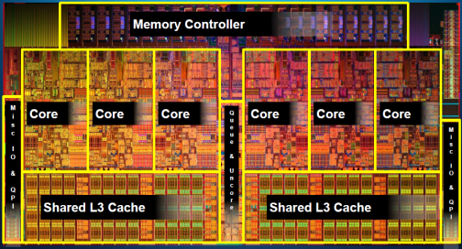
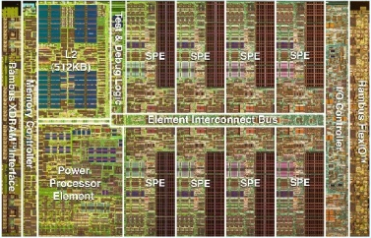
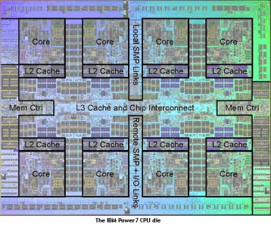
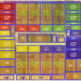
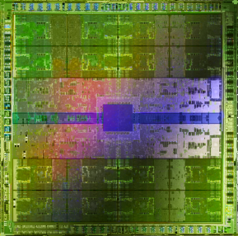
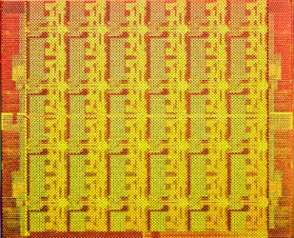
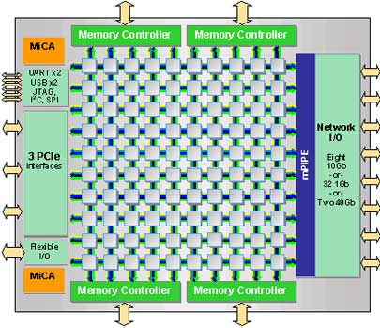
Trend: Many Cores on Chip
Simpler and lower power than a single large core
Large scale parallelism on chip
Intel Core i7
8 cores
IBM Cell BE
8+1 cores
IBM POWER7
8 cores
AMD Barcelona
4 cores
Nvidia Fermi
448 “cores”
Intel SCC
48 cores, networked
Tilera TILE Gx
100 cores, networked
Sun Niagara II
8 cores

Slide 99
Many Cores on Chip
What we want:
  N times the system performance with N times the cores
What do we get today?

Slide 100
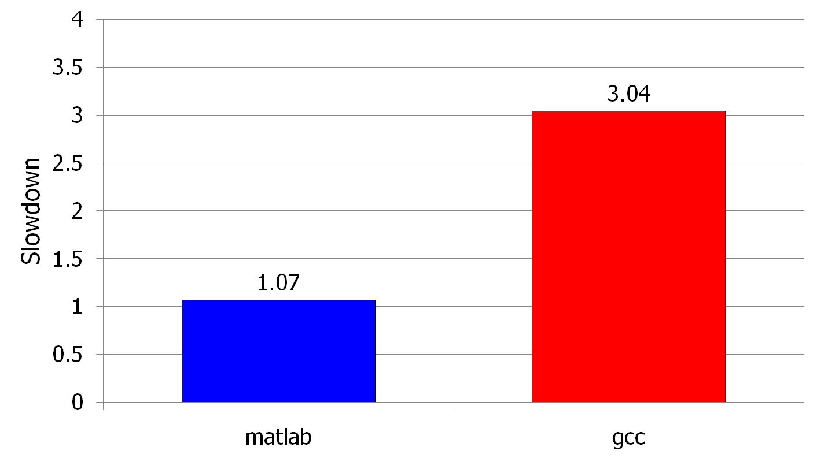
(Un)expected Slowdowns
High priority
Memory Performance Hog
Low priority
Attacker
(Core 1)
Movie player
(Core 2)
(Core 0)
(Core 1)
Moscibroda and Mutlu, “Memory performance attacks: Denial of memory service
in multi-core systems,” USENIX Security 2007.
Notes:
What kind of performance do we expect when we run two applications on a multi-core system? To answer this question, we performed an experiment. We took two applications we cared about, ran them together on different cores in a dual-core system, and measured their slowdown compared to when each is run alone on the same system. This graph shows the slowdown each app experienced. (DATA explanation…)
Why do we get such a large disparity in the slowdowns?
Is it the priorities? No. We went back and gave high priority to gcc and low priority to matlab. The slowdowns did not change at all. Neither the software or the hardware enforced the priorities.
Is it the contention in the disk? We checked for this possibility, but found that these applications did not have any disk accesses in the steady state. They both fit in the physical memory and therefore did not interfere in the disk.
What is it then? Why do we get such large disparity in slowdowns in a dual core system?
I will call such an application a “memory performance hog”
Now, let me tell you why this disparity in slowdowns happens.
Is it that there are other applications or the OS interfering with gcc, stealing its time quantums? No.

Slide 101
Why? Uncontrolled Memory Interference
CORE 1
movie player
Multi-Core
Chip
attacker
CORE 2
L2
CACHE
L2
CACHE
unfairness
INTERCONNECT
Shared DRAM
Memory System
DRAM MEMORY CONTROLLER
DRAM
Bank 0
DRAM
Bank 1
DRAM
Bank 2
DRAM
Bank 3
Notes:
-In a multi-core chip, different cores share some hardware resources. In particular, they share the DRAM memory system. The shared memory system consists of this and that.
When we run matlab on one core, and gcc on another core, both cores generate memory requests to access the DRAM banks. When these requests arrive at the DRAM controller, the controller favors matlab’s requests over gcc’s requests. As a result, matlab can make progress and continues generating memory requests. These requests are again favored by the DRAM controller over gcc’s requests. Therefore, gcc starves waiting for its requests to be serviced in DRAM whereas matlab makes very quick progress as if it were running alone.
Why does this happen? This is because the algorithms employed by the DRAM controller are unfair.
But, why are these algorithms unfair? Why do they unfairly prioritize matlab accesses?
To understand this, we need to understand how a DRAM bank operates.
Almost all systems today contain multi-core chips
Multi-core systems consist of multiple on-chip cores and caches
Cores share the DRAM memory system
DRAM memory system consists of
DRAM banks that store data (multiple banks to allow parallel accesses)
DRAM memory controller that mediates between cores and DRAM memory
It schedules memory operations generated by cores to DRAM
This talk is about exploiting the unfair algorithms in the memory controllers to perform denial of service to running threads
To understand how this happens, we need to know about how each DRAM bank operates

Slide 102
A Memory Performance Hog
// initialize large arrays A, B
for (j=0; j<N; j++) {
index = j*linesize;
A[index] = B[index];
…
}
// initialize large arrays A, B
for (j=0; j<N; j++) {
index = rand();
A[index] = B[index];
…
}
streaming
random
STREAM
RANDOM
Sequential memory access
Very high row buffer locality (96% hit rate)
Memory intensive
Random memory access
Very low row buffer locality (3% hit rate)
Similarly memory intensive
Moscibroda and Mutlu, “Memory Performance Attacks,” USENIX Security 2007.
Notes:
Streaming through memory by performing operations on two 1D arrays.
Sequential memory access
Each access is a cache miss (elements of array larger than a cache line size) → hence, very memory intensive
Link to the real code…

Slide 103
What Does the Memory Hog Do?
Row decoder
T0: Row 0
T0: Row 0
T0: Row 0
T0: Row 0
T0: Row 0
T0: Row 0
T0: Row 0
T1: Row 5
T1: Row 111
T0: Row 0
T1: Row 16
T0: Row 0
Memory Request Buffer
Row 0
Row Buffer
Row 0
Column mux
Row size: 8KB, cache block size: 64B
128 (8KB/64B) requests of T0 serviced before T1
T0: STREAM
T1: RANDOM
Data
Moscibroda and Mutlu, “Memory Performance Attacks,” USENIX Security 2007.
Notes:
Pictorially demonstrate how stream denies memory service to rdarray
Stream continuously accesses columns in row 0 in a streaming manner (streams through a row after opening it)
In other words almost all its requests are row-hits
RDarray’s requests are row-conflicts (no locality)
The DRAM controller reorders streams requests to the open row over other requests (even older ones) to maximize DRAM throughput
Hence, rdarray’s requests do not get serviced as long as stream is issuing requests at a fast-enough rate
In this example, the red thread’s request to another row will not get serviced until stream stops issuing a request to row 0
With those parameters, 128 requests of stream would be serviced before 1 from rdarray
As row-buffer size increases, which is the industry trend, this problem will become more severe
This is not the worst case, but it is easy to construct and understand
Stream falls off the row buffer at some point
I leave it to the listeners to construct a case worse than this (it is possible)

Slide 104
Effect of the Memory Performance Hog
2.82X slowdown
Slowdown
1.18X slowdown
Results on Intel Pentium D running Windows XP
(Similar results for Intel Core Duo and AMD Turion, and on Fedora Linux)
Moscibroda and Mutlu, “Memory Performance Attacks,” USENIX Security 2007.
Notes:
RANDOM was given higher OS priority in the experiments

Slide 105
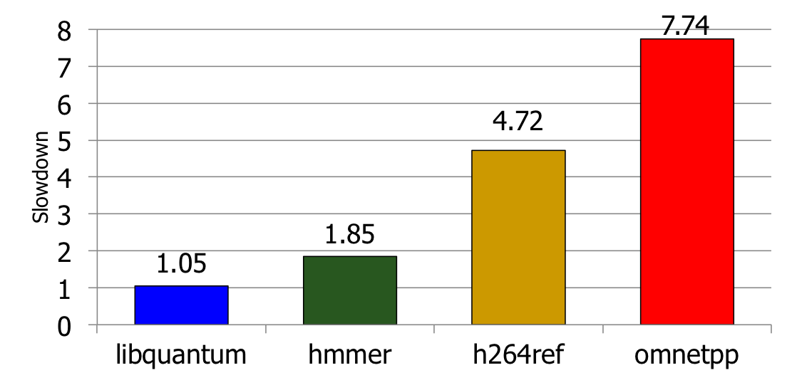
Greater Problem with More Cores
Vulnerable to denial of service (DoS) [Usenix Security’07]
Unable to enforce priorities or SLAs [MICRO’07,’10,’11, ISCA’08’11’12, ASPLOS’10]
Low system performance [IEEE Micro Top Picks ’09,’11a,’11b,’12]
Uncontrollable, unpredictable system

Slide 106
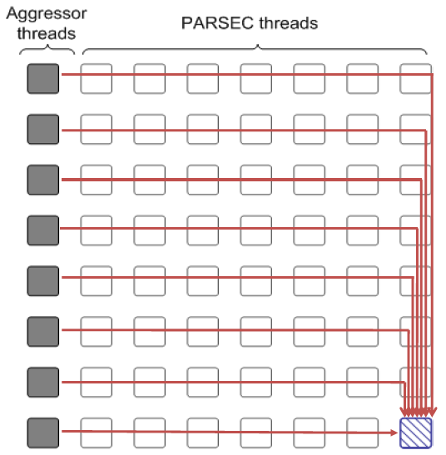
Distributed DoS in Networked Multi-Core Systems
Attackers
(Cores 1-8)
Stock option pricing application
(Cores 9-64)
Cores connected via
packet-switched
routers on chip
~5000X slowdown
Grot, Hestness, Keckler, Mutlu,
“Preemptive virtual clock: A Flexible,
Efficient, and Cost-effective QOS
Scheme for Networks-on-Chip,“
MICRO 2009.

Slide 107
Solution: QoS-Aware, Predictable Memory
Problem: Memory interference is uncontrolled → uncontrollable, unpredictable, vulnerable system
Goal: We need to control it → Design a QoS-aware system
Solution: Hardware/software cooperative memory QoS
  Hardware designed to provide a configurable fairness substrate
    Application-aware memory scheduling, partitioning, throttling
  Software designed to configure the resources to satisfy different QoS goals
  E.g., fair, programmable memory controllers and on-chip networks provide QoS and predictable performance
  [2007-2012, Top Picks’09,’11a,’11b,’12]

Slide 108
Designing QoS-Aware Memory Systems: Approaches
Smart resources: Design each shared resource to have a configurable interference control/reduction mechanism
  QoS-aware memory controllers [Mutlu+ MICRO’07] [Moscibroda+, Usenix Security’07] [Mutlu+ ISCA’08, Top Picks’09] [Kim+ HPCA’10] [Kim+ MICRO’10, Top Picks’11] [Ebrahimi+ ISCA’11, MICRO’11] [Ausavarungnirun+, ISCA’12][Subramanian+, HPCA’13]
  QoS-aware interconnects [Das+ MICRO’09, ISCA’10, Top Picks ’11] [Grot+ MICRO’09, ISCA’11, Top Picks ’12]
  QoS-aware caches
Dumb resources: Keep each resource free-for-all, but reduce/control interference by injection control or data mapping
  Source throttling to control access to memory system [Ebrahimi+ ASPLOS’10, ISCA’11, TOCS’12] [Ebrahimi+ MICRO’09] [Nychis+ HotNets’10] [Nychis+ SIGCOMM’12]
  QoS-aware data mapping to memory controllers [Muralidhara+ MICRO’11]
  QoS-aware thread scheduling to cores [Das+ HPCA’13]

Slide 109
A Mechanism to Reduce Memory Interference
Memory Channel Partitioning
  Idea: System software maps badly-interfering applications’ pages to different channels [Muralidhara+, MICRO’11]
Separate data of low/high intensity and low/high row-locality applications
Especially effective in reducing interference of threads with “medium” and “heavy” memory intensity
  11% higher performance over existing systems (200 workloads)
Time Units
Time Units
Channel 0
Channel 0
5
4
3
2
1
5
4
3
2
1
Bank 0
Bank 0
Core 0
App A
Core 0
App A
Bank 1
Bank 1
Bank 0
Core 1
App B
Bank 0
Core 1
App B
Bank 1
Bank 1
Channel 1
Channel 1
Conventional Page Mapping
Channel Partitioning

Slide 110
More on Memory Channel Partitioning
Sai Prashanth Muralidhara, Lavanya Subramanian, Onur Mutlu, Mahmut Kandemir, and Thomas Moscibroda,
"Reducing Memory Interference in Multicore Systems via Application-Aware Memory Channel Partitioning"
Proceedings of the 44th International Symposium on Microarchitecture (MICRO), Porto Alegre, Brazil, December 2011. Slides (pptx)

Slide 111
Designing QoS-Aware Memory Systems: Approaches
Smart resources: Design each shared resource to have a configurable interference control/reduction mechanism
  QoS-aware memory controllers [Mutlu+ MICRO’07] [Moscibroda+, Usenix Security’07] [Mutlu+ ISCA’08, Top Picks’09] [Kim+ HPCA’10] [Kim+ MICRO’10, Top Picks’11] [Ebrahimi+ ISCA’11, MICRO’11] [Ausavarungnirun+, ISCA’12][Subramanian+, HPCA’13]
  QoS-aware interconnects [Das+ MICRO’09, ISCA’10, Top Picks ’11] [Grot+ MICRO’09, ISCA’11, Top Picks ’12]
  QoS-aware caches
Dumb resources: Keep each resource free-for-all, but reduce/control interference by injection control or data mapping
  Source throttling to control access to memory system [Ebrahimi+ ASPLOS’10, ISCA’11, TOCS’12] [Ebrahimi+ MICRO’09] [Nychis+ HotNets’10] [Nychis+ SIGCOMM’12]
  QoS-aware data mapping to memory controllers [Muralidhara+ MICRO’11]
  QoS-aware thread scheduling to cores [Das+ HPCA’13]

Slide 112
QoS-Aware Memory Scheduling
Resolves memory contention by scheduling requests
How to schedule requests to provide
  High system performance
  High fairness to applications
  Configurability to system software
Memory controller needs to be aware of threads
Core
Core
Memory Controller
Memory
Core
Core

Slide 113
QoS-Aware Memory Scheduling: Evolution
Stall-time fair memory scheduling [Mutlu+ MICRO’07]
  Idea: Estimate and balance thread slowdowns
  Takeaway: Proportional thread progress improves performance, especially when threads are “heavy” (memory intensive)
Parallelism-aware batch scheduling [Mutlu+ ISCA’08, Top Picks’09]
  Idea: Rank threads and service in rank order (to preserve bank parallelism); batch requests to prevent starvation
  Takeaway: Preserving within-thread bank-parallelism improves performance; request batching improves fairness
ATLAS memory scheduler [Kim+ HPCA’10]
  Idea: Prioritize threads that have attained the least service from the memory scheduler
  Takeaway: Prioritizing “light” threads improves performance

Slide 114
Throughput vs. Fairness
Throughput biased approach
Fairness biased approach
  Prioritize less memory-intensive threads
  Take turns accessing memory
  Good for throughput
  Does not starve
thread A
less memory
intensive
thread B
higher
priority
thread C
thread A
thread B
thread C
not prioritized ➔
reduced throughput
starvation ➔ unfairness
Single policy for all threads is insufficient
Notes:
So why do previous algorithms fail?
On the one hand there is the throughput biased approach that prioritizes less memory-intensive threads.
Servicing memory requests from such threads allow them to make progress in the processor, increasing throughput.
However, the most memory-intensive thread, thread C, remains persistently deprioritized and and becomes prone to starvation causing large slowdowns and, ultimately, unfairness.
On the other hand there is the fairness biased approach where threads take turns accessing the memory.
In this case, the most memory-intensive thread does not starve.
However, the least memory-intensive thread, thread A, is not prioritized, leading to reduced throughput.
As you can see, a single policy applied to all threads is insufficient since different threads have different memory access needs.

Slide 115

Achieving the Best of Both Worlds
higher
priority
For Throughput
  Prioritize memory-non-intensive threads
thread
thread
thread
For Fairness
thread
  Unfairness caused by memory-intensive being prioritized over each other
    Shuffle thread ranking
  Memory-intensive threads have
  different vulnerability to interference
    Shuffle asymmetrically
thread
thread
thread
thread
thread
thread
thread
thread
Notes:
So how do we achieve the best of both worlds? Our algorithm is based on the following insights:
First, we would like to prioritize the memory-non-intensive threads to increase system throughput.
Doing so does not degrade unfairness, since memory-non-intensive threads are inherently “light” and rarely cause interference for the memory-intensive threads.
For fairness, we discovered that unfairness is usually caused when one memory-intensive thread is prioritized over another.
As we’ve seen, the most deprioritized thread can starve.
To address this problem, we would like to shuffle their priority so that no single thread is persistently prioritized over another thread.
However, memory-intensive threads are not created equal.
They have different vulnerability to memory interference.
To address their differences, shuffling should be performed in an asymmetric manner.

Slide 116
Thread Cluster Memory Scheduling [Kim+ MICRO’10]
Group threads into two clusters
Prioritize non-intensive cluster
Different policies for each cluster
higher
priority
Memory-non-intensive
Non-intensive
cluster
thread
Throughput
thread
thread
thread
thread
thread
Prioritized
higher
priority
thread
thread
thread
thread
Threads in the system
Memory-intensive
Intensive cluster
Fairness
Notes:
Our algorithm, Thread Cluster Memory Scheduling, first groups threads into two clusters.
Among the threads executing in the system, some are memory-non-intensive whereas some are memory-intensive.
We isolate the memory-non-intensive threads into the non-intensive cluster and the memory-intensive threads into the intensive cluster.
This is so that we can apply different policies for different threads.
Subsequently, we prioritize the non-intensive cluster over the intensive cluster since the non-intensive threads have greater potential for making progress IN THEIR CORES [ONUR].
Finally, we apply different policies within each cluster, one optimized for throughput and the other for fairness.

Slide 117
TCM: Throughput and Fairness
24 cores, 4 memory controllers, 96 workloads
Better fairness
Better system throughput
TCM, a heterogeneous scheduling policy,
provides best fairness and system throughput
Notes:
This figure shows the performance of the four previous scheduling algorithms in addition to TCM, averaged over 96 workloads.
FRFCFS has low system throughput and fairness.
STFM and PAR-BS is biased towards fairness, while ATLAS is biased towards system throughput.
TCM lies towards the lower right part of the figure and provides the best fairness and system throughput.
Compared to ATLAS, TCM provides approx 5% better throughput and 39% better fairness.
Compared to PAR-BS, TCM provides approx 5% better fairness and 8% better throughput.

Slide 118
TCM: Fairness-Throughput Tradeoff
When configuration parameter is varied…
Better fairness
FRFCFS
STFM
Better system throughput
ATLAS
PAR-BS
TCM
Adjusting ClusterThreshold
TCM allows robust fairness-throughput tradeoff

Slide 119
Memory QoS in a Parallel Application
Threads in a multithreaded application are inter-dependent
Some threads can be on the critical path of execution due to synchronization; some threads are not
How do we schedule requests of inter-dependent threads to maximize multithreaded application performance?
  Idea: Estimate limiter threads likely to be on the critical path and prioritize their requests; shuffle priorities of non-limiter threads to reduce memory interference among them [Ebrahimi+, MICRO’11]
  Hardware/software cooperative limiter thread estimation:
    Thread executing the most contended critical section
    Thread that is falling behind the most in a parallel for loop

Slide 120
Summary: Memory QoS Approaches and Techniques
Approaches: Smart vs. dumb resources
  Smart resources: QoS-aware memory scheduling
  Dumb resources: Source throttling; channel partitioning
  Both approaches are effective in reducing interference
  No single best approach for all workloads
Techniques: Request/thread scheduling, source throttling, memory partitioning
  All approaches are effective in reducing interference
  Can be applied at different levels: hardware vs. software
  No single best technique for all workloads
Combined approaches and techniques are the most powerful
  Integrated Memory Channel Partitioning and Scheduling [MICRO’11]
MCP Micro 2011 Talk

Slide 121
Summary: Memory Interference and QoS
QoS-unaware memory →
uncontrollable and unpredictable system
Providing QoS awareness improves performance, predictability, fairness, and utilization of the memory system
Designed new techniques to:
  Minimize memory interference
  Provide predictable performance
Many new research ideas needed for integrated techniques and closing the interaction with software

Slide 122
Readings on Memory QoS (I)
Moscibroda and Mutlu, “Memory Performance Attacks,” USENIX Security 2007.
Mutlu and Moscibroda, “Stall-Time Fair Memory Access Scheduling,” MICRO 2007.
Mutlu and Moscibroda, “Parallelism-Aware Batch Scheduling,” ISCA 2008, IEEE Micro 2009.
Kim et al., “ATLAS: A Scalable and High-Performance Scheduling Algorithm for Multiple Memory Controllers,” HPCA 2010.
Kim et al., “Thread Cluster Memory Scheduling,” MICRO 2010, IEEE Micro 2011.
Muralidhara et al., “Memory Channel Partitioning,” MICRO 2011.
Ausavarungnirun et al., “Staged Memory Scheduling,” ISCA 2012.
Subramanian et al., “MISE: Providing Performance Predictability and Improving Fairness in Shared Main Memory Systems,” HPCA 2013.
Das et al., “Application-to-Core Mapping Policies to Reduce Memory System Interference in Multi-Core Systems,” HPCA 2013.

Slide 123
Readings on Memory QoS (II)
Ebrahimi et al., “Fairness via Source Throttling,” ASPLOS 2010, ACM TOCS 2012.
Lee et al., “Prefetch-Aware DRAM Controllers,” MICRO 2008, IEEE TC 2011.
Ebrahimi et al., “Parallel Application Memory Scheduling,” MICRO 2011.
Ebrahimi et al., “Prefetch-Aware Shared Resource Management for Multi-Core Systems,” ISCA 2011.

Slide 124
Agenda
Major Trends Affecting Main Memory
The DRAM Scaling Problem and Solution Directions
  Tolerating DRAM: New DRAM Architectures
  Enabling Emerging Technologies: Hybrid Memory Systems
The Memory Interference/QoS Problem and Solutions
  QoS-Aware Memory Systems
How Can We Do Better?
Summary

Slide 125
Principles (So Far)
Better cooperation between devices/circuits, hardware and the system
  Expose more information about devices and controllers to upper layers
Better-than-worst-case design
  Do not optimize for worst case
  Worst case should not determine the common case
Heterogeneity in parameters/design
  Enables a more efficient design (No one size fits all)

Slide 126
Other Opportunities with Emerging Technologies
Merging of memory and storage
  e.g., a single interface to manage all data [Meza+, WEED’13]
New applications
  e.g., ultra-fast checkpoint and restore
More robust system design
  e.g., reducing data loss
Memory as an accelerator (or computing element)
  e.g., enabling efficient search and filtering

Slide 127
Agenda
Major Trends Affecting Main Memory
The DRAM Scaling Problem and Solution Directions
  Tolerating DRAM: New DRAM Architectures
  Enabling Emerging Technologies: Hybrid Memory Systems
How Can We Do Better?
Summary

Slide 128
Summary: Scalable Memory Systems
Main memory scaling problems are a critical bottleneck for system performance, efficiency, and usability
Solution 1: Tolerate DRAM with novel architectures
  RAIDR: Retention-aware refresh
  TL-DRAM: Tiered-Latency DRAM
  RowClone: Fast Page Copy and Initialization
  SALP: Subarray-Level Parallelism
Solution 2: Enable emerging memory technologies
  Replace DRAM with NVM by architecting NVM chips well
  Hybrid memory systems with automatic data management
QoS-aware Memory Systems
  Required to reduce and control memory interference
Software/hardware/device cooperation essential for effective scaling of main memory

Slide 129
Thank you.

Slide 130
Scaling the Memory System in the Many-Core Era
Onur Mutlu
onur@cmu.edu
July 26, 2013
BSC/UPC

Slide 131
Backup Slides

Slide 132
Backup Slides Agenda
RAIDR: Retention-Aware DRAM Refresh
Building Large DRAM Caches for Hybrid Memories
Memory QoS and Predictable Performance
Subarray-Level Parallelism (SALP) in DRAM

Slide 133
RAIDR: Reducing
DRAM Refresh Impact

Slide 134
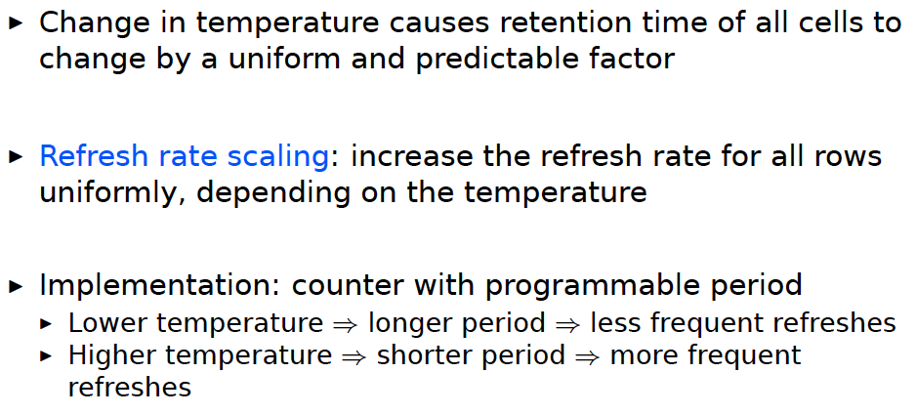
Tolerating Temperature Changes

Slide 135
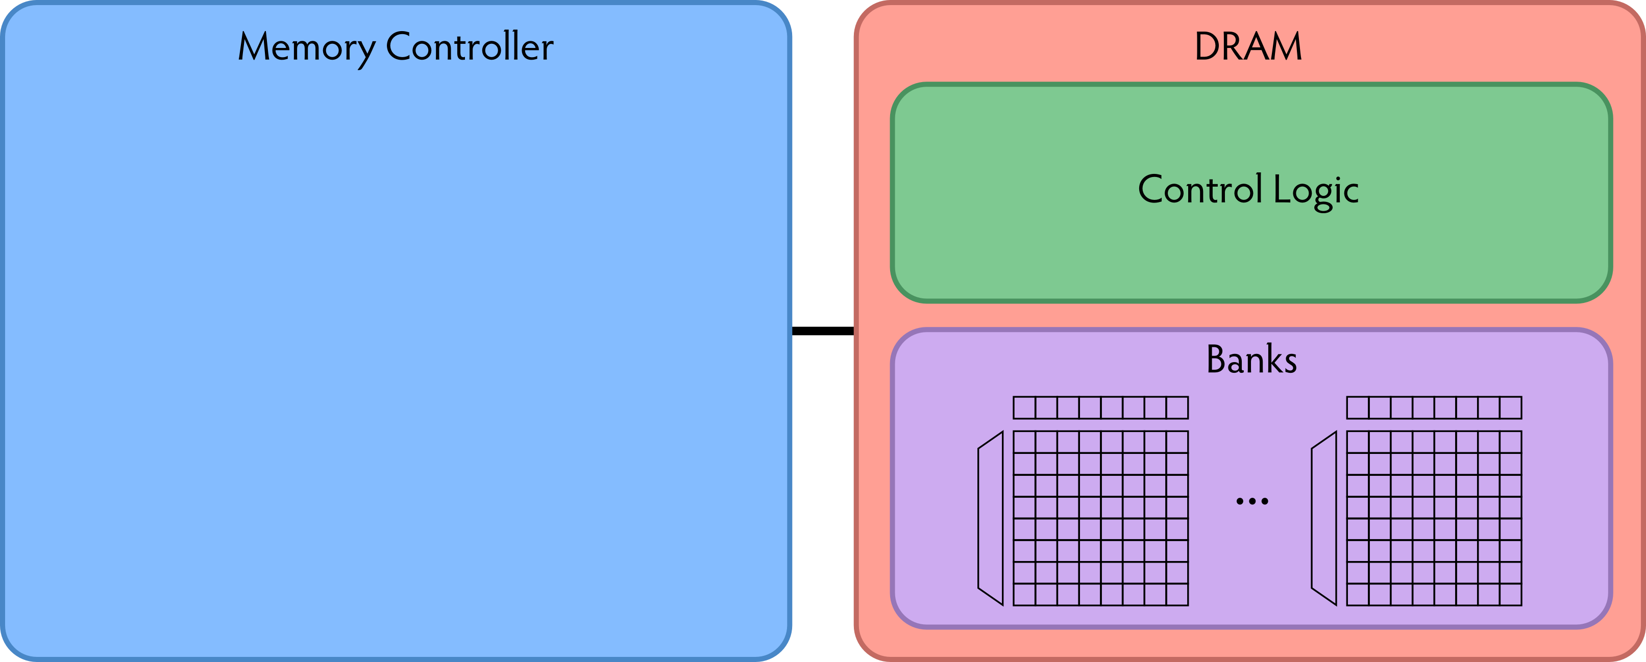
RAIDR: Baseline Design
Refresh control is in DRAM in today’s auto-refresh systems
RAIDR can be implemented in either the controller or DRAM

Slide 136
RAIDR in Memory Controller: Option 1
Overhead of RAIDR in DRAM controller:
1.25 KB Bloom Filters, 3 counters, additional commands issued for per-row refresh (all accounted for in evaluations)

Slide 137
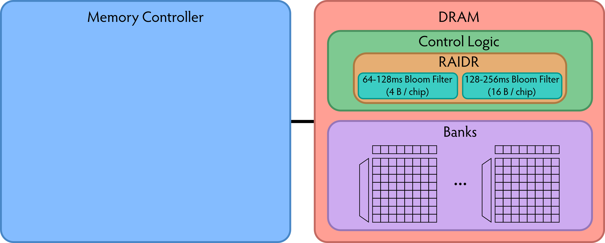
RAIDR in DRAM Chip: Option 2
Overhead of RAIDR in DRAM chip:
Per-chip overhead: 20B Bloom Filters, 1 counter (4 Gbit chip)
Total overhead: 1.25KB Bloom Filters, 64 counters (32 GB DRAM)

Slide 138
RAIDR Results
Baseline:
  32 GB DDR3 DRAM system (8 cores, 512KB cache/core)
  64ms refresh interval for all rows
RAIDR:
  64–128ms retention range: 256 B Bloom filter, 10 hash functions
  128–256ms retention range: 1 KB Bloom filter, 6 hash functions
  Default refresh interval: 256 ms
Results on SPEC CPU2006, TPC-C, TPC-H benchmarks
  74.6% refresh reduction
  ~16%/20% DRAM dynamic/idle power reduction
  ~9% performance improvement

Slide 139
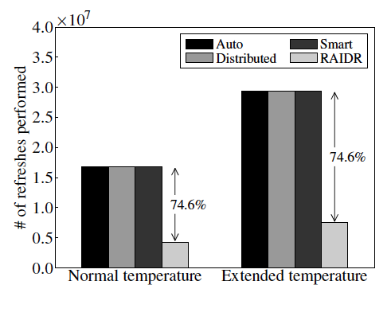
RAIDR Refresh Reduction
32 GB DDR3 DRAM system

Slide 140
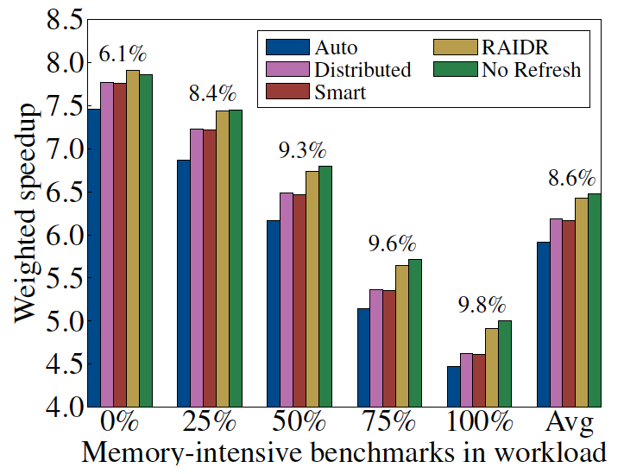
RAIDR: Performance
RAIDR performance benefits increase with workload’s memory intensity

Slide 141
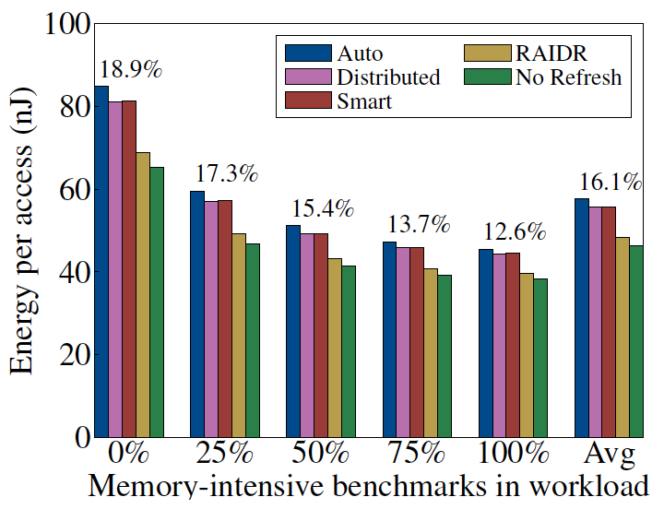
RAIDR: DRAM Energy Efficiency
RAIDR energy benefits increase with memory idleness

Slide 142
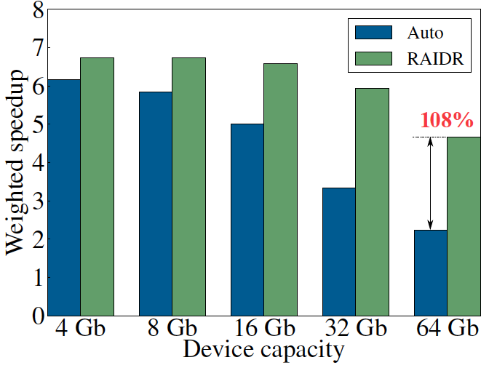
DRAM Device Capacity Scaling: Performance
RAIDR performance benefits increase with DRAM chip capacity

Slide 143
DRAM Device Capacity Scaling: Energy
RAIDR energy benefits increase with DRAM chip capacity
RAIDR slides

Slide 144
SALP: Reducing DRAM Bank Conflict Impact
Kim, Seshadri, Lee, Liu, Mutlu
A Case for Exploiting Subarray-Level Parallelism (SALP) in DRAM
ISCA 2012.

Slide 145
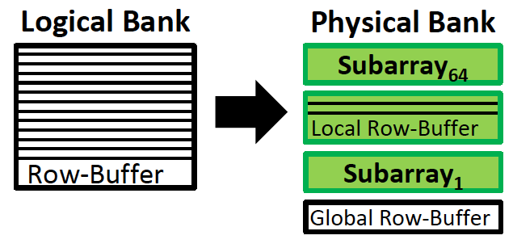
SALP: Problem, Goal, Observations
Problem: Bank conflicts are costly for performance and energy
  serialized requests, wasted energy (thrashing of row buffer, busy wait)
Goal: Reduce bank conflicts without adding more banks (low cost)
Observation 1: A DRAM bank is divided into subarrays and each subarray has its own local row buffer

Slide 146
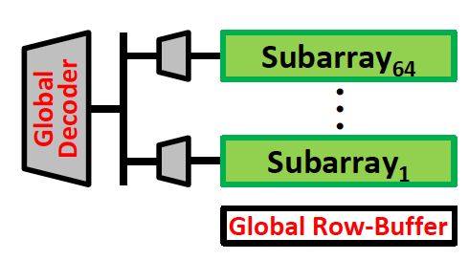
SALP: Key Ideas
Observation 2: Subarrays are mostly independent
  Except when sharing global structures to reduce cost
Key Idea of SALP: Minimally reduce sharing of global structures
Reduce the sharing of …
Global decoder → Enables almost parallel access to subarrays
Global row buffer → Utilizes multiple local row buffers

Slide 147
SALP: Reduce Sharing of Global Decoder
Instead of a global latch, have per-subarray latches
Local
row-buffer
Global Decoder
···
Latch
Latch
Latch
Local
row-buffer
Global
row-buffer

Slide 148
SALP: Reduce Sharing of Global Row-Buffer
Selectively connect local row-buffers to global row-buffer using a Designated single-bit latch
Global bitlines
Local
row-buffer
D
D
Switch
Wire
Local
row-buffer
D
D
Switch
READ
READ
Global
row-buffer

Slide 149
SALP: Baseline Bank Organization
Global
bitlines
Local
row-buffer
Global Decoder
Latch
Local
row-buffer
Global
row-buffer

Slide 150
SALP: Proposed Bank Organization
Global
bitlines
Latch
Local
row-buffer
D
Global Decoder
Latch
Local
row-buffer
D
Overhead of SALP in DRAM chip: 0.15%
1. Global latch → per-subarray local latches
2. Designated bit latches and wire to selectively enable a subarray
Global
row-buffer

Slide 151
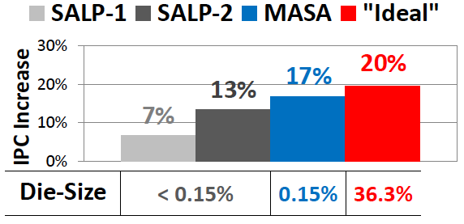
SALP: Results
Wide variety of systems with different #channels, banks, ranks, subarrays
Server, streaming, random-access, SPEC workloads
Dynamic DRAM energy reduction: 19%
  DRAM row hit rate improvement: 13%
System performance improvement: 17%
  Within 3% of ideal (all independent banks)
DRAM die area overhead: 0.15%
  vs. 36% overhead of independent banks

