Slide 1


Multi-Core Architectures and
Shared Resource Management
Lecture 3: Interconnects
Prof. Onur Mutlu
http://www.ece.cmu.edu/~omutlu
onur@cmu.edu
Bogazici University
June 10, 2013

Slide 2
Last Lecture
Wrap up Asymmetric Multi-Core Systems
  Handling Private Data Locality
  Asymmetry Everywhere
Resource Sharing vs. Partitioning
Cache Design for Multi-core Architectures
  MLP-aware Cache Replacement
  The Evicted-Address Filter Cache
  Base-Delta-Immediate Compression
  Linearly Compressed Pages
  Utility Based Cache Partitioning
  Fair Shared Cache Partitinoning
  Page Coloring Based Cache Partitioning

Slide 3
Agenda for Today
Interconnect design for multi-core systems
(Prefetcher design for multi-core systems)
(Data Parallelism and GPUs)

Slide 4
Readings for Lecture June 6 (Lecture 1.1)
Required – Symmetric and Asymmetric Multi-Core Systems
  Mutlu et al., “Runahead Execution: An Alternative to Very Large Instruction Windows for Out-of-order Processors,” HPCA 2003, IEEE Micro 2003.
  Suleman et al., “Accelerating Critical Section Execution with Asymmetric Multi-Core Architectures,” ASPLOS 2009, IEEE Micro 2010.
  Suleman et al., “Data Marshaling for Multi-Core Architectures,” ISCA 2010, IEEE Micro 2011.
  Joao et al., “Bottleneck Identification and Scheduling for Multithreaded Applications,” ASPLOS 2012.
  Joao et al., “Utility-Based Acceleration of Multithreaded Applications on Asymmetric CMPs,” ISCA 2013.
Recommended
  Amdahl, “Validity of the single processor approach to achieving large scale computing capabilities,” AFIPS 1967.
  Olukotun et al., “The Case for a Single-Chip Multiprocessor,” ASPLOS 1996.
  Mutlu et al., “Techniques for Efficient Processing in Runahead Execution Engines,” ISCA 2005, IEEE Micro 2006.

Slide 5
Videos for Lecture June 6 (Lecture 1.1)
Runahead Execution
  http://www.youtube.com/watch?v=z8YpjqXQJIA&list=PL5PHm2jkkXmidJOd59REog9jDnPDTG6IJ&index=28
Multiprocessors
  Basics:http://www.youtube.com/watch?v=7ozCK_Mgxfk&list=PL5PHm2jkkXmidJOd59REog9jDnPDTG6IJ&index=31
  Correctness and Coherence: http://www.youtube.com/watch?v=U-VZKMgItDM&list=PL5PHm2jkkXmidJOd59REog9jDnPDTG6IJ&index=32
  Heterogeneous Multi-Core: http://www.youtube.com/watch?v=r6r2NJxj3kI&list=PL5PHm2jkkXmidJOd59REog9jDnPDTG6IJ&index=34

Slide 6
Readings for Lecture June 7 (Lecture 1.2)
Required – Caches in Multi-Core
  Qureshi et al., “A Case for MLP-Aware Cache Replacement,” ISCA 2005.
  Seshadri et al., “The Evicted-Address Filter: A Unified Mechanism to Address both Cache Pollution and Thrashing,” PACT 2012.
  Pekhimenko et al., “Base-Delta-Immediate Compression: Practical Data Compression for On-Chip Caches,” PACT 2012.
  Pekhimenko et al., “Linearly Compressed Pages: A Main Memory Compression Framework with Low Complexity and Low Latency,” SAFARI Technical Report 2013.
Recommended
  Qureshi et al., “Utility-Based Cache Partitioning: A Low-Overhead, High-Performance, Runtime Mechanism to Partition Shared Caches,” MICRO 2006.

Slide 7
Videos for Lecture June 7 (Lecture 1.2)
Cache basics:
  http://www.youtube.com/watch?v=TpMdBrM1hVc&list=PL5PHm2jkkXmidJOd59REog9jDnPDTG6IJ&index=23
Advanced caches:
  http://www.youtube.com/watch?v=TboaFbjTd-E&list=PL5PHm2jkkXmidJOd59REog9jDnPDTG6IJ&index=24

Slide 8
Readings for Lecture June 10 (Lecture 1.3)
Required – Interconnects in Multi-Core
  Moscibroda and Mutlu, “A Case for Bufferless Routing in On-Chip Networks,” ISCA 2009.
  Fallin et al., “CHIPPER: A Low-Complexity Bufferless Deflection Router,” HPCA 2011.
  Fallin et al., “MinBD: Minimally-Buffered Deflection Routing for Energy-Efficient Interconnect,” NOCS 2012.
  Das et al., “Application-Aware Prioritization Mechanisms for On-Chip Networks,” MICRO 2009.
  Das et al., “Aergia: Exploiting Packet Latency Slack in On-Chip Networks,” ISCA 2010, IEEE Micro 2011.
Recommended
  Grot et al. “Preemptive Virtual Clock: A Flexible, Efficient, and Cost-effective QOS Scheme for Networks-on-Chip,” MICRO 2009.
  Grot et al., “Kilo-NOC: A Heterogeneous Network-on-Chip Architecture for Scalability and Service Guarantees,” ISCA 2011, IEEE Micro 2012.

Slide 9
More Readings for Lecture 1.3
Studies of congestion and congestion control in on-chip vs. internet-like networks
George Nychis, Chris Fallin, Thomas Moscibroda, Onur Mutlu, and Srinivasan Seshan,
"On-Chip Networks from a Networking Perspective: Congestion and Scalability in Many-core Interconnects"
Proceedings of the 2012 ACM SIGCOMM Conference (SIGCOMM), Helsinki, Finland, August 2012. Slides (pptx)
George Nychis, Chris Fallin, Thomas Moscibroda, and Onur Mutlu,
"Next Generation On-Chip Networks: What Kind of Congestion Control Do We Need?"
Proceedings of the 9th ACM Workshop on Hot Topics in Networks (HOTNETS), Monterey, CA, October 2010. Slides (ppt) (key)

Slide 10
Videos for Lecture June 10 (Lecture 1.3)
Interconnects
  http://www.youtube.com/watch?v=6xEpbFVgnf8&list=PL5PHm2jkkXmidJOd59REog9jDnPDTG6IJ&index=33
GPUs and SIMD processing
  Vector/array processing basics: http://www.youtube.com/watch?v=f-XL4BNRoBA&list=PL5PHm2jkkXmidJOd59REog9jDnPDTG6IJ&index=15
  GPUs versus other execution models: http://www.youtube.com/watch?v=dl5TZ4-oao0&list=PL5PHm2jkkXmidJOd59REog9jDnPDTG6IJ&index=19
  GPUs in more detail: http://www.youtube.com/watch?v=vr5hbSkb1Eg&list=PL5PHm2jkkXmidJOd59REog9jDnPDTG6IJ&index=20

Slide 11
Readings for Prefetching
Prefetching
  Srinath et al., “Feedback Directed Prefetching: Improving the Performance and Bandwidth-Efficiency of Hardware Prefetchers,” HPCA 2007.
  Ebrahimi et al., “Coordinated Control of Multiple Prefetchers in Multi-Core Systems,” MICRO 2009.
  Ebrahimi et al., “Techniques for Bandwidth-Efficient Prefetching of Linked Data Structures in Hybrid Prefetching Systems,” HPCA 2009.
  Ebrahimi et al., “Prefetch-Aware Shared Resource Management for Multi-Core Systems,” ISCA 2011.
  Lee et al., “Prefetch-Aware DRAM Controllers,” MICRO 2008.
Recommended
  Lee et al., “Improving Memory Bank-Level Parallelism in the Presence of Prefetching,” MICRO 2009.

Slide 12
Videos for Prefetching
Prefetching
  http://www.youtube.com/watch?v=IIkIwiNNl0c&list=PL5PHm2jkkXmidJOd59REog9jDnPDTG6IJ&index=29
  http://www.youtube.com/watch?v=yapQavK6LUk&list=PL5PHm2jkkXmidJOd59REog9jDnPDTG6IJ&index=30

Slide 13
Readings for GPUs and SIMD
GPUs and SIMD processing
  Narasiman et al., “Improving GPU Performance via Large Warps and Two-Level Warp Scheduling,” MICRO 2011.
  Jog et al., “OWL: Cooperative Thread Array Aware Scheduling Techniques for Improving GPGPU Performance,” ASPLOS 2013.
  Jog et al., “Orchestrated Scheduling and Prefetching for GPGPUs,” ISCA 2013.
  Lindholm et al., “NVIDIA Tesla: A Unified Graphics and Computing Architecture,” IEEE Micro 2008.
  Fung et al., “Dynamic Warp Formation and Scheduling for Efficient GPU Control Flow,” MICRO 2007.

Slide 14
Videos for GPUs and SIMD
GPUs and SIMD processing
  Vector/array processing basics: http://www.youtube.com/watch?v=f-XL4BNRoBA&list=PL5PHm2jkkXmidJOd59REog9jDnPDTG6IJ&index=15
  GPUs versus other execution models: http://www.youtube.com/watch?v=dl5TZ4-oao0&list=PL5PHm2jkkXmidJOd59REog9jDnPDTG6IJ&index=19
  GPUs in more detail: http://www.youtube.com/watch?v=vr5hbSkb1Eg&list=PL5PHm2jkkXmidJOd59REog9jDnPDTG6IJ&index=20

Slide 15
Online Lectures and More Information
Online Computer Architecture Lectures
  http://www.youtube.com/playlist?list=PL5PHm2jkkXmidJOd59REog9jDnPDTG6IJ
Online Computer Architecture Courses
  Intro: http://www.ece.cmu.edu/~ece447/s13/doku.php
  Advanced: http://www.ece.cmu.edu/~ece740/f11/doku.php
  Advanced: http://www.ece.cmu.edu/~ece742/doku.php
Recent Research Papers
  http://users.ece.cmu.edu/~omutlu/projects.htm
  http://scholar.google.com/citations?user=7XyGUGkAAAAJ&hl=en

Slide 16
Interconnect Basics

Slide 17
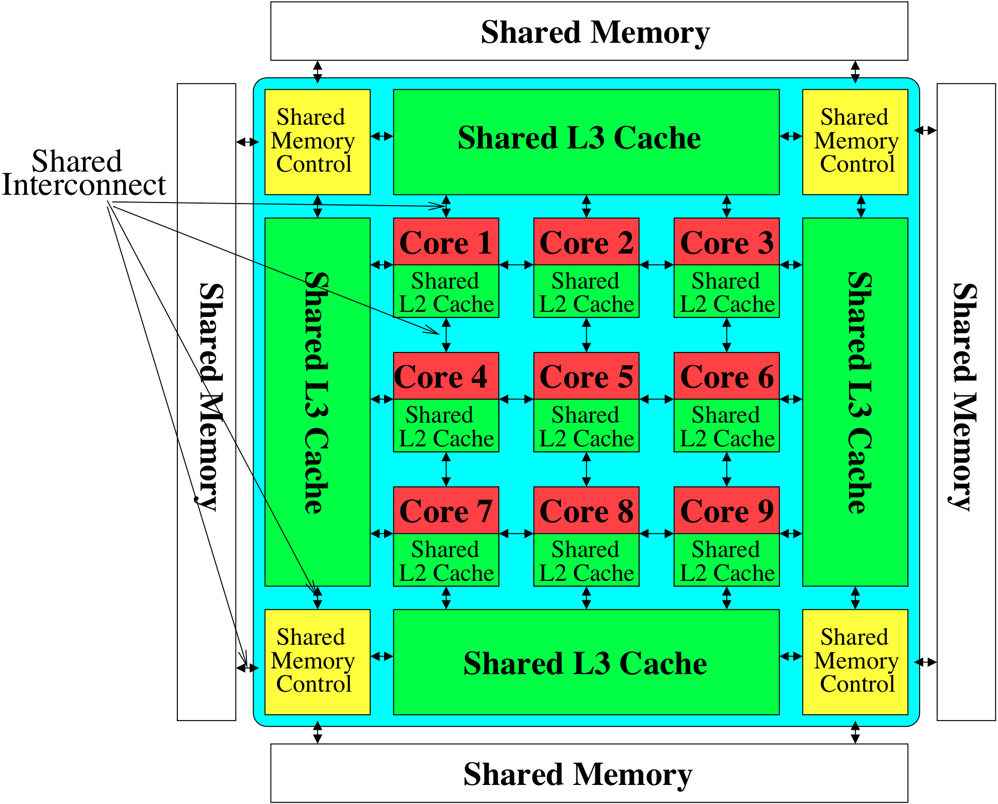

Interconnect in a Multi-Core System
Shared
Storage

Slide 18
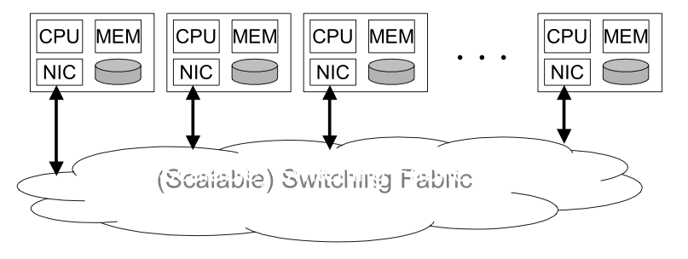
Where Is Interconnect Used?
To connect components
Many examples
  Processors and processors
  Processors and memories (banks)
  Processors and caches (banks)
  Caches and caches
  I/O devices
Interconnection network

Slide 19
Why Is It Important?
Affects the scalability of the system
  How large of a system can you build?
  How easily can you add more processors?
Affects performance and energy efficiency
  How fast can processors, caches, and memory communicate?
  How long are the latencies to memory?
  How much energy is spent on communication?

Slide 20
Interconnection Network Basics
Topology
  Specifies the way switches are wired
  Affects routing, reliability, throughput, latency, building ease
Routing (algorithm)
  How does a message get from source to destination
  Static or adaptive
Buffering and Flow Control
  What do we store within the network?
    Entire packets, parts of packets, etc?
  How do we throttle during oversubscription?
  Tightly coupled with routing strategy

Slide 21
Topology
Bus (simplest)
Point-to-point connections (ideal and most costly)
Crossbar (less costly)
Ring
Tree
Omega
Hypercube
Mesh
Torus
Butterfly
…

Slide 22
Metrics to Evaluate Interconnect Topology
Cost
Latency (in hops, in nanoseconds)
Contention
Many others exist you should think about
  Energy
  Bandwidth
  Overall system performance

Slide 23
Bus
+ Simple
+ Cost effective for a small number of nodes
+ Easy to implement coherence (snooping and serialization)
- Not scalable to large number of nodes (limited bandwidth, electrical loading → reduced frequency)
- High contention → fast saturation
0
1
2
3
4
5
6
7

Slide 24
Point-to-Point
0
Every node connected to every other
+ Lowest contention
+ Potentially lowest latency
+ Ideal, if cost is not an issue
-- Highest cost
O(N) connections/ports
per node
O(N²) links
-- Not scalable
-- How to lay out on chip?
7
1
6
2
5
3
4

Slide 25
Crossbar
Every node connected to every other (non-blocking) except one can be using the connection at any given time
Enables concurrent sends to non-conflicting destinations
Good for small number of nodes
+ Low latency and high throughput
- Expensive
- Not scalable → O(N²) cost
- Difficult to arbitrate as N increases
Used in core-to-cache-bank
networks in
- IBM POWER5
- Sun Niagara I/II
7
6
5
4
3
2
1
0
0
1
2
3
4
5
6
7

Slide 26
Another Crossbar Design
0
1
2
3
4
5
6
7
0
1
2
3
4
5
6
7

Slide 27
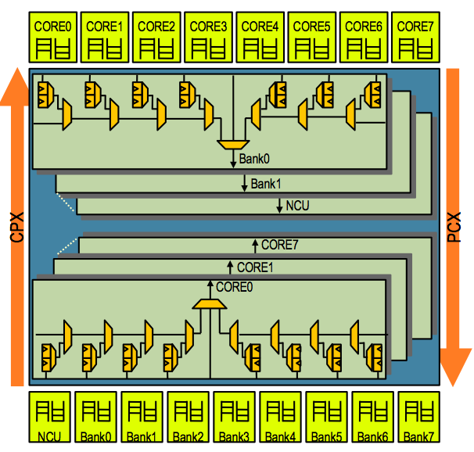
Sun UltraSPARC T2 Core-to-Cache Crossbar
High bandwidth interface between 8 cores and 8 L2 banks & NCU
4-stage pipeline: req, arbitration, selection, transmission
2-deep queue for each src/dest pair to hold data transfer request

Slide 28
Buffered Crossbar
0
+ Simpler arbitration/
scheduling
+ Efficient support for variable-size packets
- Requires
N² buffers
0
NI
NI
Flow
Control
1
1
NI
NI
Flow
Control
2
2
NI
NI
Flow
Control
3
3
NI
NI
Flow
Control
Buffered
Crossbar
Output
Arbiter
Output
Arbiter
Output
Arbiter
Output
Arbiter
Bufferless
Crossbar

Slide 29
Can We Get Lower Cost than A Crossbar?
Yet still have low contention?
Idea: Multistage networks

Slide 30
Multistage Logarithmic Networks
Idea: Indirect networks with multiple layers of switches between terminals/nodes
Cost: O(NlogN), Latency: O(logN)
Many variations (Omega, Butterfly, Benes, Banyan, …)
Omega Network:
conflict

Slide 31
Multistage Circuit Switched
0
0
More restrictions on feasible concurrent Tx-Rx pairs
But more scalable than crossbar in cost, e.g., O(N logN) for Butterfly
1
1
2
2
3
3
4
4
5
5
6
6
7
7
2-by-2 crossbar

Slide 32
Multistage Packet Switched
0
0
Packets “hop” from router to router, pending availability of the next-required switch and buffer
1
1
2
2
3
3
4
4
5
5
6
6
7
7
2-by-2 router

Slide 33
Aside: Circuit vs. Packet Switching
Circuit switching sets up full path
  Establish route then send data
  (no one else can use those links)
  + faster arbitration
  -- setting up and bringing down links takes time
Packet switching routes per packet
  Route each packet individually (possibly via different paths)
  if link is free, any packet can use it
  -- potentially slower --- must dynamically switch
  + no setup, bring down time
  + more flexible, does not underutilize links

Slide 34
Switching vs. Topology
Circuit/packet switching choice independent of topology
It is a higher-level protocol on how a message gets sent to a destination
However, some topologies are more amenable to circuit vs. packet switching

Slide 35
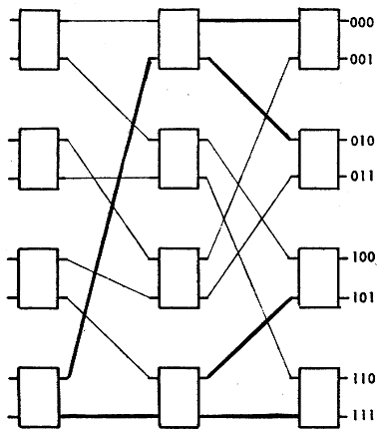
Another Example: Delta Network
Single path from source to destination
Does not support all possible permutations
Proposed to replace costly crossbars as processor-memory interconnect
Janak H. Patel ,“Processor-Memory Interconnections for Multiprocessors,” ISCA 1979.
8x8 Delta network

Slide 36
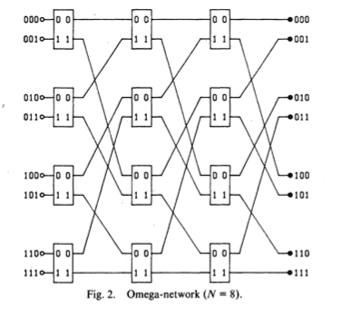
Another Example: Omega Network
Single path from source to destination
All stages are the same
Used in NYU Ultracomputer
Gottlieb et al. “The NYU Ultracomputer-designing a MIMD, shared-memory parallel machine,” ISCA 1982.

Slide 37
Ring
+ Cheap: O(N) cost
- High latency: O(N)
- Not easy to scale
- Bisection bandwidth remains constant
Used in Intel Haswell, Intel Larrabee, IBM Cell, many commercial systems today
Notes:
KSR machine, Hector

Slide 38
Unidirectional Ring
Simple topology and implementation
  Reasonable performance if N and performance needs (bandwidth & latency) still moderately low
  O(N) cost
  N/2 average hops; latency depends on utilization
R
R
R
R
2x2 router
0
1
N-2
N-1
2

Slide 39
Bidirectional Rings
+ Reduces latency
+ Improves scalability
- Slightly more complex injection policy (need to select which ring to inject a packet into)

Slide 40
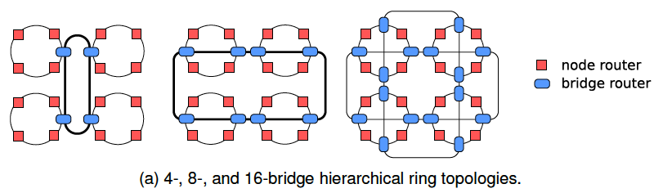
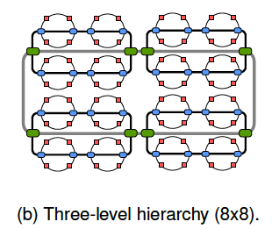
Hierarchical Rings
+ More scalable
+ Lower latency
- More complex

Slide 41
More on Hierarchical Rings
Chris Fallin, Xiangyao Yu, Kevin Chang, Rachata Ausavarungnirun, Greg Nazario, Reetuparna Das, and Onur Mutlu,
"HiRD: A Low-Complexity, Energy-Efficient Hierarchical Ring Interconnect"
SAFARI Technical Report, TR-SAFARI-2012-004, Carnegie Mellon University, December 2012.
Discusses the design and implementation of a mostly-bufferless hierarchical ring

Slide 42
Mesh
O(N) cost
Average latency: O(sqrt(N))
Easy to layout on-chip: regular and equal-length links
Path diversity: many ways to get from one node to another
Used in Tilera 100-core
And many on-chip network
prototypes
Notes:
e.g. Tile64

Slide 43
Torus
Mesh is not symmetric on edges: performance very sensitive to placement of task on edge vs. middle
Torus avoids this problem
+ Higher path diversity (and bisection bandwidth) than mesh
- Higher cost
- Harder to lay out on-chip
- Unequal link lengths

Slide 44
Torus, continued
Weave nodes to make inter-node latencies ~constant

Slide 45
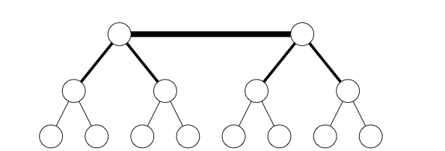
Trees
Planar, hierarchical topology
Latency: O(logN)
Good for local traffic
+ Cheap: O(N) cost
+ Easy to Layout
- Root can become a bottleneck
Fat trees avoid this problem (CM-5)
Fat Tree

Slide 46
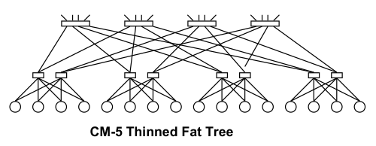
CM-5 Fat Tree
Fat tree based on 4x2 switches
Randomized routing on the way up
Combining, multicast, reduction operators supported in hardware
  Thinking Machines Corp., “The Connection Machine CM-5 Technical Summary,” Jan. 1992.

Slide 47
Hypercube
Latency: O(logN)
Radix: O(logN)
#links: O(NlogN)
+ Low latency
- Hard to lay out in 2D/3D
1101
1111
1100
0101
0111
1110
0100
1001
1011
0110
1000
1010
0001
0011
0000
0010
Notes:
Popular in early message-passing computers (e.g., intel iPSC, NCUBE)

Slide 48
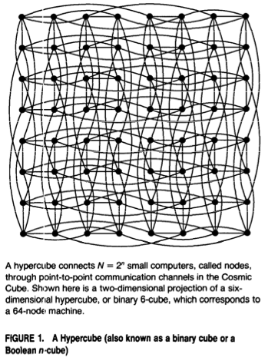
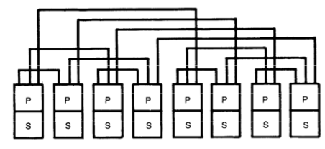
Caltech Cosmic Cube
64-node message passing machine
Seitz, “The Cosmic Cube,” CACM 1985.

Slide 49
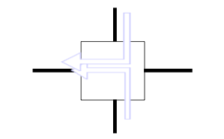
Handling Contention
Two packets trying to use the same link at the same time
What do you do?
  Buffer one
  Drop one
  Misroute one (deflection)
Tradeoffs?

Slide 50
Bufferless Deflection Routing
Key idea: Packets are never buffered in the network. When two packets contend for the same link, one is deflected.¹
New traffic can be injected
whenever there is a free
output link.
Destination
¹Baran, “On Distributed Communication Networks.” RAND Tech. Report., 1962 / IEEE Trans.Comm., 1964.

Slide 51
Bufferless Deflection Routing
Input buffers are eliminated: flits are buffered in
pipeline latches and on network links
Input Buffers
North
North
South
South
East
East
West
West
Local
Local
Deflection Routing Logic

Slide 52
Routing Algorithm
Types
  Deterministic: always chooses the same path for a communicating source-destination pair
  Oblivious: chooses different paths, without considering network state
  Adaptive: can choose different paths, adapting to the state of the network
How to adapt
  Local/global feedback
  Minimal or non-minimal paths

Slide 53
Deterministic Routing
All packets between the same (source, dest) pair take the same path
Dimension-order routing
  E.g., XY routing (used in Cray T3D, and many on-chip networks)
  First traverse dimension X, then traverse dimension Y
+ Simple
+ Deadlock freedom (no cycles in resource allocation)
- Could lead to high contention
- Does not exploit path diversity

Slide 54
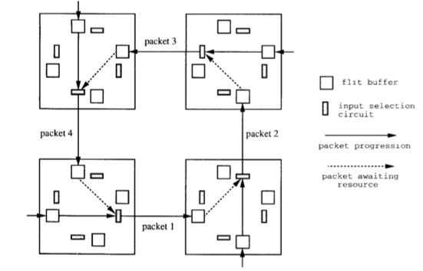
Deadlock
No forward progress
Caused by circular dependencies on resources
Each packet waits for a buffer occupied by another packet downstream

Slide 55
Handling Deadlock
Avoid cycles in routing
  Dimension order routing
    Cannot build a circular dependency
  Restrict the “turns” each packet can take
Avoid deadlock by adding more buffering (escape paths)
Detect and break deadlock
  Preemption of buffers

Slide 56
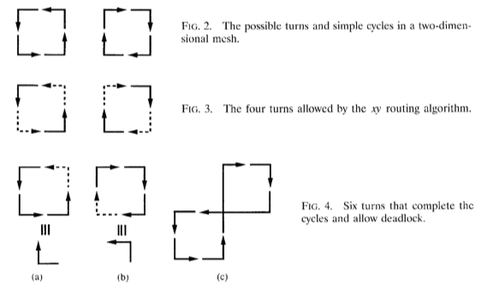
Turn Model to Avoid Deadlock
Idea
  Analyze directions in which packets can turn in the network
  Determine the cycles that such turns can form
  Prohibit just enough turns to break possible cycles
Glass and Ni, “The Turn Model for Adaptive Routing,” ISCA 1992.

Slide 57
Oblivious Routing: Valiant’s Algorithm
An example of oblivious algorithm
Goal: Balance network load
Idea: Randomly choose an intermediate destination, route to it first, then route from there to destination
  Between source-intermediate and intermediate-dest, can use dimension order routing
+ Randomizes/balances network load
- Non minimal (packet latency can increase)
Optimizations:
  Do this on high load
  Restrict the intermediate node to be close (in the same quadrant)

Slide 58
Adaptive Routing
Minimal adaptive
  Router uses network state (e.g., downstream buffer occupancy) to pick which “productive” output port to send a packet to
  Productive output port: port that gets the packet closer to its destination
  + Aware of local congestion
  - Minimality restricts achievable link utilization (load balance)
Non-minimal (fully) adaptive
  “Misroute” packets to non-productive output ports based on network state
  + Can achieve better network utilization and load balance
  - Need to guarantee livelock freedom

Slide 59
On-Chip Networks
Connect cores, caches, memory controllers, etc
  Buses and crossbars are not scalable
Packet switched
2D mesh: Most commonly used topology
Primarily serve cache misses and memory requests
PE
PE
PE
R
R
R
PE
PE
PE
R
R
R
PE
PE
PE
R
R
R
R
Router
Processing Element
(Cores, L2 Banks, Memory Controllers, etc)
PE
Notes:
One commonly proposed solution is on-chip network (NoC), which allows cores to communicate with a packet switched substrate.
Here is a figure showing an on-chip network that uses a 2d-mesh topology which
is commonly used due to its low layout complexity.
This is also the topology we used for our evaluations, but our mechanism is also applicable to other topologies.
In most multi-core systems, NoC primarily serves cache misses and memory requests.

Slide 60
On-chip Networks
PE
PE
PE
PE
R
R
R
R
Input Port with Buffers
PE
PE
PE
PE
VC Identifier
Control Logic
R
R
R
R
From East
VC 0
Routing Unit
VC 1
(
RC
)
PE
PE
PE
PE
VC 2
VC Allocator
(
VA
)
R
R
R
R
From West
Switch
(SA)
Allocator
PE
PE
PE
PE
From North
To East
R
R
R
R
To West
To North
From South
To South
To PE
R
Router
Crossbar
(
5
x
5
)
PE
Processing Element
(Cores, L2 Banks, Memory Controllers etc)
From PE
Crossbar

Slide 61
On-Chip vs. Off-Chip Interconnects
On-chip advantages
  Low latency between cores
  No pin constraints
  Rich wiring resources
  Very high bandwidth
  Simpler coordination
On-chip constraints/disadvantages
  2D substrate limits implementable topologies
  Energy/power consumption a key concern
  Complex algorithms undesirable
  Logic area constrains use of wiring resources

Slide 62
On-Chip vs. Off-Chip Interconnects (II)
Cost
  Off-chip: Channels, pins, connectors, cables
  On-chip: Cost is storage and switches (wires are plentiful)
  Leads to networks with many wide channels, few buffers
Channel characteristics
  On chip short distance → low latency
  On chip RC lines → need repeaters every 1-2mm
    Can put logic in repeaters
Workloads
  Multi-core cache traffic vs. supercomputer interconnect traffic

Slide 63
Motivation for Efficient Interconnect
In many-core chips, on-chip interconnect (NoC) consumes significant power
  Intel Terascale: ~28% of chip power
  Intel SCC: ~10%
  MIT RAW: ~36%
Recent work¹ uses bufferless deflection routing to reduce power and die area
Core
L1
L2 Slice
Router
¹Moscibroda and Mutlu, “A Case for Bufferless Deflection Routing in On-Chip Networks.” ISCA 2009.

Slide 64
Research in Interconnects

Slide 65
Research Topics in Interconnects
Plenty of topics in interconnection networks. Examples:
Energy/power efficient and proportional design
Reducing Complexity: Simplified router and protocol designs
Adaptivity: Ability to adapt to different access patterns
QoS and performance isolation
  Reducing and controlling interference, admission control
Co-design of NoCs with other shared resources
  End-to-end performance, QoS, power/energy optimization
Scalable topologies to many cores, heterogeneous systems
Fault tolerance
Request prioritization, priority inversion, coherence, …
New technologies (optical, 3D)

Slide 66
One Example: Packet Scheduling
Which packet to choose for a given output port?
  Router needs to prioritize between competing flits
  Which input port?
  Which virtual channel?
  Which application’s packet?
Common strategies
  Round robin across virtual channels
  Oldest packet first (or an approximation)
  Prioritize some virtual channels over others
Better policies in a multi-core environment
  Use application characteristics
  Minimize energy

Slide 67
Bufferless Routing
  Thomas Moscibroda and Onur Mutlu,
  "A Case for Bufferless Routing in On-Chip Networks"
  Proceedings of the 36th International Symposium on Computer Architecture (ISCA), pages 196-207, Austin, TX, June 2009. Slides (pptx)

Slide 68
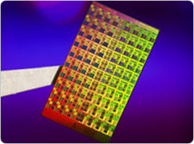

On-Chip Networks (NoC)
Connect cores, caches, memory controllers, etc…
Examples:
  Intel 80-core Terascale chip
  MIT RAW chip
Design goals in NoC design:
  High throughput, low latency
  Fairness between cores, QoS, …
  Low complexity, low cost
  Power, low energy consumption
Energy/Power in On-Chip Networks
Power is a key constraint in the design
of high-performance processors
NoCs consume substantial portion of system
power
  ~30% in Intel 80-core Terascale [IEEE Micro’07]
  ~40% in MIT RAW Chip [ISCA’04]
NoCs estimated to consume 100s of Watts
[Borkar, DAC’07]

Slide 69
Current NoC Approaches
Existing approaches differ in numerous ways:
  Network topology [Kim et al, ISCA’07, Kim et al, ISCA’08 etc]
  Flow control [Michelogiannakis et al, HPCA’09, Kumar et al, MICRO’08, etc]
  Virtual Channels [Nicopoulos et al, MICRO’06, etc]
  QoS & fairness mechanisms [Lee et al, ISCA’08, etc]
  Routing algorithms [Singh et al, CAL’04]
  Router architecture [Park et al, ISCA’08]
  Broadcast, Multicast [Jerger et al, ISCA’08, Rodrigo et al, MICRO’08]
Existing work assumes existence of
buffers in routers!

Slide 70
A Typical Router
Input Channel 1
VC1
Scheduler
Routing Computation
VC2
VC Arbiter
Credit Flow
to upstream
router
Switch Arbiter
VCv
Input Port 1
Output Channel 1
Input Channel N
VC1
VC2
Output Channel N
Credit Flow
to upstream
router
VCv
Input Port N
N x N Crossbar
Buffers are integral part of
existing NoC Routers

Slide 71

Buffers in NoC Routers
Buffers are necessary for high network throughput
→ buffers increase total available bandwidth in network
small
buffers
medium
buffers
large
buffers
Avg. packet latency
Injection Rate

Slide 72
Buffers in NoC Routers
Buffers are necessary for high network throughput
→ buffers increase total available bandwidth in network
Buffers consume significant energy/power
  Dynamic energy when read/write
  Static energy even when not occupied
Buffers add complexity and latency
  Logic for buffer management
  Virtual channel allocation
  Credit-based flow control
Buffers require significant chip area
  E.g., in TRIPS prototype chip, input buffers occupy 75% of
  total on-chip network area [Gratz et al, ICCD’06]

Slide 73

Going Bufferless…?
How much throughput do we lose?
  → How is latency affected?
Up to what injection rates can we use bufferless routing?
→ Are there realistic scenarios in which NoC is
operated at injection rates below the threshold?
Can we achieve energy reduction?
  → If so, how much…?
Can we reduce area, complexity, etc…?
no
buffers
buffers
latency
Injection Rate

Slide 74

BLESS: Bufferless Routing
Always forward all incoming flits to some output port
If no productive direction is available, send to another direction
→ packet is deflected
→ Hot-potato routing [Baran’64, etc]
Deflected!
Buffered
BLESS

Slide 75
BLESS: Bufferless Routing
Routing
Flit-Ranking
VC Arbiter
arbitration policy
Port-Prioritization
Switch Arbiter
Flit-Ranking
Create a ranking over all incoming flits
Port-Prioritization
For a given flit in this ranking, find the best free output-port
Apply to each flit in order of ranking

Slide 76
FLIT-BLESS: Flit-Level Routing
Each flit is routed independently.
Oldest-first arbitration (other policies evaluated in paper)
Network Topology:
→ Can be applied to most topologies (Mesh, Torus, Hypercube, Trees, …)
1) #output ports ¸ #input ports at every router
2) every router is reachable from every other router
Flow Control & Injection Policy:
  → Completely local, inject whenever input port is free
Absence of Deadlocks: every flit is always moving
Absence of Livelocks: with oldest-first ranking
Flit-Ranking
Oldest-first ranking
Port-Prioritization
Assign flit to productive port, if possible.
Otherwise, assign to non-productive port.

Slide 77
BLESS with Buffers
BLESS without buffers is extreme end of a continuum
BLESS can be integrated with buffers
  FLIT-BLESS with Buffers
  WORM-BLESS with Buffers
Whenever a buffer is full, it’s first flit becomes
must-schedule
must-schedule flits must be deflected if necessary
See paper for details…

Slide 78
BLESS: Advantages & Disadvantages
Advantages
No buffers
Purely local flow control
Simplicity
- no credit-flows
- no virtual channels
- simplified router design
No deadlocks, livelocks
Adaptivity
- packets are deflected around congested areas!
Router latency reduction
Area savings
Disadvantages
Increased latency
Reduced bandwidth
Increased buffering at receiver
Header information at each flit
Oldest-first arbitration complex
QoS becomes difficult
Impact on energy…?

Slide 79
Reduction of Router Latency
BW: Buffer Write
RC: Route Computation
VA: Virtual Channel Allocation
SA: Switch Allocation
ST: Switch Traversal
LT: Link Traversal
LA LT: Link Traversal of Lookahead
BLESS gets rid of input buffers
and virtual channels
Baseline
Router
(speculative)
head
flit
BW
RC
VA
SA
ST
LT
[Dally, Towles’04]
body
flit
BW
SA
ST
LT
Router Latency = 3
our evaluations
Can be improved to 2.
BLESS
Router
(standard)
RC
ST
LT
Router 1
Router Latency = 2
RC
ST
LT
Router 2
LT
BLESS
Router
(optimized)
Router 1
RC
ST
Router Latency = 1
LA LT
LT
Router 2
RC
ST

Slide 80
BLESS: Advantages & Disadvantages
Advantages
No buffers
Purely local flow control
Simplicity
- no credit-flows
- no virtual channels
- simplified router design
No deadlocks, livelocks
Adaptivity
- packets are deflected around congested areas!
Router latency reduction
Area savings
Disadvantages
Increased latency
Reduced bandwidth
Increased buffering at receiver
Header information at each flit
Extensive evaluations in the paper!
Impact on energy…?

Slide 81
Evaluation Methodology
2D mesh network, router latency is 2 cycles
  4x4, 8 core, 8 L2 cache banks (each node is a core or an L2 bank)
  4x4, 16 core, 16 L2 cache banks (each node is a core and an L2 bank)
  8x8, 16 core, 64 L2 cache banks (each node is L2 bank and may be a core)
  128-bit wide links, 4-flit data packets, 1-flit address packets
  For baseline configuration: 4 VCs per physical input port, 1 packet deep
Benchmarks
  Multiprogrammed SPEC CPU2006 and Windows Desktop applications
  Heterogeneous and homogenous application mixes
  Synthetic traffic patterns: UR, Transpose, Tornado, Bit Complement
x86 processor model based on Intel Pentium M
  2 GHz processor, 128-entry instruction window
  64Kbyte private L1 caches
  Total 16Mbyte shared L2 caches; 16 MSHRs per bank
  DRAM model based on Micron DDR2-800

Slide 82
Evaluation Methodology
Energy model provided by Orion simulator [MICRO’02]
  70nm technology, 2 GHz routers at 1.0 V_{dd}
For BLESS, we model
  Additional energy to transmit header information
  Additional buffers needed on the receiver side
  Additional logic to reorder flits of individual packets at receiver
We partition network energy into
buffer energy, router energy, and link energy,
each having static and dynamic components.
Comparisons against non-adaptive and aggressive
adaptive buffered routing algorithms (DO, MIN-AD, ROMM)

Slide 83
Evaluation – Synthetic Traces
BLESS
Best
Baseline
First, the bad news ☺
Uniform random injection
BLESS has significantly lower
saturation throughput
compared to buffered
baseline.

Slide 84
Evaluation – Homogenous Case Study
Baseline
BLESS
RL=1
milc benchmarks
(moderately intensive)
Perfect caches!
Very little performance
degradation with BLESS
(less than 4% in dense
network)
With router latency 1,
BLESS can even
outperform baseline
(by ~10%)
Significant energy
improvements
(almost 40%)

Slide 85
Evaluation – Homogenous Case Study
Baseline
BLESS
RL=1
milc benchmarks
(moderately intensive)
Perfect caches!
Very little performance
degradation with BLESS
(less than 4% in dense
network)
With router latency 1,
BLESS can even
outperform baseline
(by ~10%)
Significant energy
improvements
(almost 40%)
Observations:
Injection rates not extremely high
on average
→ self-throttling!
For bursts and temporary hotspots, use network links as buffers!

Slide 86
Evaluation – Further Results
BLESS increases buffer requirement
at receiver by at most 2x
→ overall, energy is still reduced
Impact of memory latency
→ with real caches, very little slowdown! (at most 1.5%)
See paper for details…

Slide 87
Evaluation – Further Results
BLESS increases buffer requirement
at receiver by at most 2x
→ overall, energy is still reduced
Impact of memory latency
→ with real caches, very little slowdown! (at most 1.5%)
Heterogeneous application mixes
(we evaluate several mixes of intensive and non-intensive applications)
→ little performance degradation
→ significant energy savings in all cases
→ no significant increase in unfairness across different applications
Area savings: ~60% of network area can be saved!
See paper for details…

Slide 88
Evaluation – Aggregate Results
Aggregate results over all 29 applications
Sparse Network | Perfect L2 |  | Realistic L2
 | Average | Worst-Case | Average | Worst-Case
∆ Network Energy | -39.4% | -28.1% | -46.4% | -41.0%
∆ System Performance | -0.5% | -3.2% | -0.15% | -0.55%
BASE
FLIT
WORM
BASE
FLIT
WORM
BASE
FLIT
WORM

Slide 89
Evaluation – Aggregate Results
Aggregate results over all 29 applications
Sparse Network | Perfect L2 |  | Realistic L2
 | Average | Worst-Case | Average | Worst-Case
∆ Network Energy | -39.4% | -28.1% | -46.4% | -41.0%
∆ System Performance | -0.5% | -3.2% | -0.15% | -0.55%
Dense Network | Perfect L2 |  | Realistic L2
 | Average | Worst-Case | Average | Worst-Case
∆ Network Energy | -32.8% | -14.0% | -42.5% | -33.7%
∆ System Performance | -3.6% | -17.1% | -0.7% | -1.5%

Slide 90
BLESS Conclusions
For a very wide range of applications and network settings, buffers are not needed in NoC
  Significant energy savings
  (32% even in dense networks and perfect caches)
  Area-savings of 60%
  Simplified router and network design (flow control, etc…)
  Performance slowdown is minimal (can even increase!)
A strong case for a rethinking of NoC design!
Future research:
  Support for quality of service, different traffic classes, energy-management, etc…

Slide 91
CHIPPER: A Low-complexity
Bufferless Deflection Router
Chris Fallin, Chris Craik, and Onur Mutlu,
"CHIPPER: A Low-Complexity Bufferless Deflection Router"
Proceedings of the 17th International Symposium on High-Performance Computer Architecture (HPCA), pages 144-155, San Antonio, TX, February 2011. Slides (pptx)

Slide 92
Motivation
Recent work has proposed bufferless deflection routing (BLESS [Moscibroda, ISCA 2009])
  Energy savings: ~40% in total NoC energy
  Area reduction: ~40% in total NoC area
  Minimal performance loss: ~4% on average
  Unfortunately: unaddressed complexities in router
    ➔ long critical path, large reassembly buffers
Goal: obtain these benefits while simplifying the router
in order to make bufferless NoCs practical.
Notes:
Router area: see 7.7 in BLESS paper → 60.4% * 75% - 18.75% * 25% = 40.6%

Slide 93
Problems that Bufferless Routers Must Solve
  1. Must provide livelock freedom
  ➔ A packet should not be deflected forever
  2. Must reassemble packets upon arrival
Flit: atomic routing unit
Packet: one or multiple flits
0 1 2 3

Slide 94
A Bufferless Router: A High-Level View
Crossbar
Deflection
Routing
Logic
Router
Local Node
Problem 2: Packet Reassembly
Inject
Eject
Problem 1: Livelock Freedom
Reassembly
Buffers

Slide 95
Complexity in Bufferless Deflection Routers
  1. Must provide livelock freedom
    Flits are sorted by age, then assigned in age order to output ports
    ➔ 43% longer critical path than buffered router
  2. Must reassemble packets upon arrival
    Reassembly buffers must be sized for worst case
    ➔ 4KB per node
    (8x8, 64-byte cache block)

Slide 96
Problem 1: Livelock Freedom
Crossbar
Deflection
Routing
Logic
Inject
Eject
Problem 1: Livelock Freedom
Reassembly
Buffers

Slide 97
Livelock Freedom in Previous Work
What stops a flit from deflecting forever?
All flits are timestamped
Oldest flits are assigned their desired ports
Total order among flits
But what is the cost of this?
Guaranteed
progress!
New traffic is lowest priority
<
<
<
<
<
Flit age forms total order

Slide 98
Age-Based Priorities are Expensive: Sorting
Router must sort flits by age: long-latency sort network
  Three comparator stages for 4 flits
4
1
2
3

Slide 99
Age-Based Priorities Are Expensive: Allocation
After sorting, flits assigned to output ports in priority order
Port assignment of younger flits depends on that of older flits
  sequential dependence in the port allocator
1
East?
GRANT: Flit 1 ➔ East
{N,S,W}
2
East?
DEFLECT: Flit 2 ➔ North
{S,W}
3
South?
GRANT: Flit 3 ➔ South
{W}
4
South?
DEFLECT: Flit 4 ➔ West
Age-Ordered Flits

Slide 100
Age-Based Priorities Are Expensive
Overall, deflection routing logic based on Oldest-First has a 43% longer critical path than a buffered router
Question: is there a cheaper way to route while guaranteeing livelock-freedom?
Priority Sort
Port Allocator

Slide 101
Solution: Golden Packet for Livelock Freedom
What is really necessary for livelock freedom?
Key Insight: No total order. it is enough to:
1. Pick one flit to prioritize until arrival
2. Ensure any flit is eventually picked
Guaranteed
progress!
New traffic is
lowest-priority
Guaranteed
progress!
Flit age forms total order
<
<
<
<
partial ordering is sufficient!
“Golden Flit”

Slide 102
What Does Golden Flit Routing Require?
Only need to properly route the Golden Flit
First Insight: no need for full sort
Second Insight: no need for sequential allocation
Priority Sort
Port Allocator

Slide 103
Golden Flit Routing With Two Inputs
Let’s route the Golden Flit in a two-input router first
Step 1: pick a “winning” flit: Golden Flit, else random
Step 2: steer the winning flit to its desired output
and deflect other flit
  ➔ Golden Flit always routes toward destination

Slide 104
Golden Flit Routing with Four Inputs
Each block makes decisions independently!
  Deflection is a distributed decision
N
N
E
S
S
E
W
W

Slide 105
Permutation Network Operation
wins → swap!
wins → swap!
x
Golden:
N
N
N
Priority Sort
Port Allocator
E
E
S
S
S
E
deflected
W
W
W
wins → no swap!
wins → no swap!

Slide 106
Problem 2: Packet Reassembly
Inject/Eject
Inject
Eject
Reassembly
Buffers

Slide 107
Reassembly Buffers are Large
Worst case: every node sends a packet to one receiver
Why can’t we make reassembly buffers smaller?
Node 0
Node 1
…
Node N-1
N sending nodes
one packet in flight
per node
Receiver
O(N) space!

Slide 108
Small Reassembly Buffers Cause Deadlock
What happens when reassembly buffer is too small?
Many Senders
cannot inject new traffic
network full
Network
Remaining flits
must inject for
forward progress
cannot eject:
reassembly
buffer full
reassembly
buffer
One Receiver

Slide 109
Reserve Space to Avoid Deadlock?
What if every sender asks permission from the receiver before it sends?
➔ adds additional delay to every request
Reserve Slot
ACK
Send Packet
Sender
Receiver
Reserve Slot?
reassembly buffers
ACK
Reserved

Slide 110
Escaping Deadlock with Retransmissions
Sender is optimistic instead: assume buffer is free
  If not, receiver drops and NACKs; sender retransmits
  → no additional delay in best case
  → transmit buffering overhead for all packets
  → potentially many retransmits
Send (2 flits)
Drop, NACK
Other packet completes
Retransmit packet
ACK
Sender frees data
Sender
Receiver
Retransmit
Buffers
NACK!
ACK
Reassembly
Buffers

Slide 111
Solution: Retransmitting Only Once
Key Idea: Retransmit only when space becomes available.
  → Receiver drops packet if full; notes which packet it drops
  → When space frees up, receiver reserves space so
  retransmit is successful
  → Receiver notifies sender to retransmit
Pending: Node 0 Req 0
Sender
Receiver
Retransmit
Buffers
NACK
Reserved
Reassembly
Buffers

Slide 112
Using MSHRs as Reassembly Buffers
Inject/Eject
C Using miss buffers for reassembly makes this a
truly bufferless network.
Inject
Eject
Reassembly
Buffers
Miss Buffers (MSHRs)

Slide 113
CHIPPER: Cheap Interconnect Partially-Permuting Router
Baseline Bufferless Deflection Router
Crossbar
Long critical path:
1. Sort by age
2. Allocate ports sequentially
Golden Packet
→ Permutation Network
Deflection
Routing
Logic
Large buffers for worst case
Retransmit-Once
→Cache buffers
Inject
Eject
Reassembly
Buffers

Slide 114
CHIPPER: Cheap Interconnect Partially-Permuting Router
Inject/Eject
Inject
Eject
Miss Buffers (MSHRs)

Slide 115
EVALUATION

Slide 116
Methodology
Multiprogrammed workloads: CPU2006, server, desktop
  8x8 (64 cores), 39 homogeneous and 10 mixed sets
Multithreaded workloads: SPLASH-2, 16 threads
  4x4 (16 cores), 5 applications
System configuration
  Buffered baseline: 2-cycle router, 4 VCs/channel, 8 flits/VC
  Bufferless baseline: 2-cycle latency, FLIT-BLESS
  Instruction-trace driven, closed-loop, 128-entry OoO window
  64KB L1, perfect L2 (stresses interconnect), XOR mapping

Slide 117
Methodology
Hardware modeling
  Verilog models for CHIPPER, BLESS, buffered logic
    Synthesized with commercial 65nm library
  ORION for crossbar, buffers and links
Power
  Static and dynamic power from hardware models
  Based on event counts in cycle-accurate simulations

Slide 118
Results: Performance Degradation
1.8%
13.6%
C Minimal loss for low-to-medium-intensity workloads
3.6%
49.8%

Slide 119
Results: Power Reduction
73.4%
54.9%
C Removing buffers ➔ majority of power savings
C Slight savings from BLESS to CHIPPER

Slide 120
Results: Area and Critical Path Reduction
-29.1%
+1.1%
-36.2%
-1.6%
C CHIPPER maintains area savings of BLESS
C Critical path becomes competitive to buffered

Slide 121
Conclusions
Two key issues in bufferless deflection routing
  livelock freedom and packet reassembly
Bufferless deflection routers were high-complexity and impractical
  Oldest-first prioritization → long critical path in router
  No end-to-end flow control for reassembly → prone to deadlock with reasonably-sized reassembly buffers
CHIPPER is a new, practical bufferless deflection router
  Golden packet prioritization → short critical path in router
  Retransmit-once protocol → deadlock-free packet reassembly
  Cache miss buffers as reassembly buffers → truly bufferless network
CHIPPER frequency comparable to buffered routers at much lower area and power cost, and minimal performance loss

Slide 122
MinBD:
Minimally-Buffered Deflection Routing for Energy-Efficient Interconnect
Chris Fallin, Greg Nazario, Xiangyao Yu, Kevin Chang, Rachata Ausavarungnirun, and Onur Mutlu,
"MinBD: Minimally-Buffered Deflection Routing for Energy-Efficient Interconnect"
Proceedings of the 6th ACM/IEEE International Symposium on Networks on Chip (NOCS), Lyngby, Denmark, May 2012. Slides (pptx) (pdf)

Slide 123
Bufferless Deflection Routing
Key idea: Packets are never buffered in the network. When two packets contend for the same link, one is deflected.
Removing buffers yields significant benefits
  Reduces power (CHIPPER: reduces NoC power by 55%)
  Reduces die area (CHIPPER: reduces NoC area by 36%)
But, at high network utilization (load), bufferless deflection routing causes unnecessary link & router traversals
  Reduces network throughput and application performance
  Increases dynamic power
Goal: Improve high-load performance of low-cost deflection networks by reducing the deflection rate.

Slide 124
Outline: This Talk
Motivation
Background: Bufferless Deflection Routing
MinBD: Reducing Deflections
  Addressing Link Contention
  Addressing the Ejection Bottleneck
  Improving Deflection Arbitration
Results
Conclusions

Slide 125
Outline: This Talk
Motivation
Background: Bufferless Deflection Routing
MinBD: Reducing Deflections
  Addressing Link Contention
  Addressing the Ejection Bottleneck
  Improving Deflection Arbitration
Results
Conclusions

Slide 126
Issues in Bufferless Deflection Routing
Correctness: Deliver all packets without livelock
  CHIPPER¹: Golden Packet
  Globally prioritize one packet until delivered
Correctness: Reassemble packets without deadlock
  CHIPPER¹: Retransmit-Once
Performance: Avoid performance degradation at high load
  MinBD
¹ Fallin et al., “CHIPPER: A Low-complexity Bufferless Deflection Router”, HPCA 2011.

Slide 127
Key Performance Issues
1. Link contention: no buffers to hold traffic →
any link contention causes a deflection
→ use side buffers
2. Ejection bottleneck: only one flit can eject per router per cycle → simultaneous arrival causes deflection
→ eject up to 2 flits/cycle
3. Deflection arbitration: practical (fast) deflection arbiters deflect unnecessarily
→ new priority scheme (silver flit)

Slide 128
Outline: This Talk
Motivation
Background: Bufferless Deflection Routing
MinBD: Reducing Deflections
  Addressing Link Contention
  Addressing the Ejection Bottleneck
  Improving Deflection Arbitration
Results
Conclusions

Slide 129
Outline: This Talk
Motivation
Background: Bufferless Deflection Routing
MinBD: Reducing Deflections
  Addressing Link Contention
  Addressing the Ejection Bottleneck
  Improving Deflection Arbitration
Results
Conclusions

Slide 130
Addressing Link Contention
Problem 1: Any link contention causes a deflection
Buffering a flit can avoid deflection on contention
But, input buffers are expensive:
  All flits are buffered on every hop → high dynamic energy
  Large buffers necessary → high static energy and large area
Key Idea 1: add a small buffer to a bufferless deflection router to buffer only flits that would have been deflected

Slide 131
How to Buffer Deflected Flits
Destination
Destination
DEFLECTED
Eject
Inject
Baseline Router
¹ Fallin et al., “CHIPPER: A Low-complexity Bufferless Deflection Router”, HPCA 2011.

Slide 132
How to Buffer Deflected Flits
Side Buffer
Step 2. Buffer this flit in a small FIFO “side buffer.”
Destination
Destination
Step 3. Re-inject this flit into pipeline when a slot is available.
Step 1. Remove up to one deflected flit per cycle from the outputs.
DEFLECTED
Eject
Inject
Side-Buffered Router

Slide 133
Why Could A Side Buffer Work Well?
Buffer some flits and deflect other flits at per-flit level
  Relative to bufferless routers, deflection rate reduces
  (need not deflect all contending flits)
  → 4-flit buffer reduces deflection rate by 39%
  Relative to buffered routers, buffer is more efficiently used (need not buffer all flits)
    → similar performance with 25% of buffer space

Slide 134
Outline: This Talk
Motivation
Background: Bufferless Deflection Routing
MinBD: Reducing Deflections
  Addressing Link Contention
  Addressing the Ejection Bottleneck
  Improving Deflection Arbitration
Results
Conclusions

Slide 135
Addressing the Ejection Bottleneck
Problem 2: Flits deflect unnecessarily because only one flit can eject per router per cycle
In 20% of all ejections, ≥ 2 flits could have ejected
→ all but one flit must deflect and try again
→ these deflected flits cause additional contention
Ejection width of 2 flits/cycle reduces deflection rate 21%
Key idea 2: Reduce deflections due to a single-flit ejection port by allowing two flits to eject per cycle

Slide 136
Addressing the Ejection Bottleneck
DEFLECTED
Eject
Inject
Single-Width Ejection

Slide 137
Addressing the Ejection Bottleneck
For fair comparison, baseline routers have dual-width ejection for perf. (not power/area)
Eject
Inject
Dual-Width Ejection

Slide 138
Outline: This Talk
Motivation
Background: Bufferless Deflection Routing
MinBD: Reducing Deflections
  Addressing Link Contention
  Addressing the Ejection Bottleneck
  Improving Deflection Arbitration
Results
Conclusions

Slide 139
Improving Deflection Arbitration
Problem 3: Deflections occur unnecessarily because fast arbiters must use simple priority schemes
Age-based priorities (several past works): full priority order gives fewer deflections, but requires slow arbiters
State-of-the-art deflection arbitration (Golden Packet & two-stage permutation network)
  Prioritize one packet globally (ensure forward progress)
  Arbitrate other flits randomly (fast critical path)
Random common case leads to uncoordinated arbitration

Slide 140
Fast Deflection Routing Implementation
Let’s route in a two-input router first:
Step 1: pick a “winning” flit (Golden Packet, else random)
Step 2: steer the winning flit to its desired output
and deflect other flit
  ➔ Highest-priority flit always routes to destination

Slide 141
Fast Deflection Routing with Four Inputs
Each block makes decisions independently
  Deflection is a distributed decision
N
N
E
S
S
E
W
W

Slide 142
Unnecessary Deflections in Fast Arbiters
How does lack of coordination cause unnecessary deflections?
  1. No flit is golden (pseudorandom arbitration)
  2. Red flit wins at first stage
  3. Green flit loses at first stage (must be deflected now)
  4. Red flit loses at second stage; Red and Green are deflected
Destination
unnecessary
deflection!
all flits have
equal priority
Destination

Slide 143
Improving Deflection Arbitration
Key idea 3: Add a priority level and prioritize one flit
to ensure at least one flit is not deflected in each cycle
Highest priority: one Golden Packet in network
  Chosen in static round-robin schedule
  Ensures correctness
Next-highest priority: one silver flit per router per cycle
  Chosen pseudo-randomly & local to one router
  Enhances performance

Slide 144
Adding A Silver Flit
Randomly picking a silver flit ensures one flit is not deflected
  1. No flit is golden but Red flit is silver
  2. Red flit wins at first stage (silver)
  3. Green flit is deflected at first stage
  4. Red flit wins at second stage (silver); not deflected
Destination
red flit has
higher priority
At least one flit
is not deflected
all flits have
equal priority
Destination

Slide 145
Minimally-Buffered Deflection Router
Problem 1: Link Contention
Solution 1: Side Buffer
Problem 2: Ejection Bottleneck
Solution 2: Dual-Width Ejection
Problem 3: Unnecessary Deflections
Solution 3: Two-level priority scheme
Eject
Inject

Slide 146
Outline: This Talk
Motivation
Background: Bufferless Deflection Routing
MinBD: Reducing Deflections
  Addressing Link Contention
  Addressing the Ejection Bottleneck
  Improving Deflection Arbitration

Slide 147
Outline: This Talk
Motivation
Background: Bufferless Deflection Routing
MinBD: Reducing Deflections
  Addressing Link Contention
  Addressing the Ejection Bottleneck
  Improving Deflection Arbitration
Results
Conclusions

Slide 148
Methodology: Simulated System
Chip Multiprocessor Simulation
  64-core and 16-core models
  Closed-loop core/cache/NoC cycle-level model
  Directory cache coherence protocol (SGI Origin-based)
  64KB L1, perfect L2 (stresses interconnect), XOR-mapping
  Performance metric: Weighted Speedup
  (similar conclusions from network-level latency)
  Workloads: multiprogrammed SPEC CPU2006
    75 randomly-chosen workloads
    Binned into network-load categories by average injection rate

Slide 149
Methodology: Routers and Network
Input-buffered virtual-channel router
  8 VCs, 8 flits/VC [Buffered(8,8)]: large buffered router
  4 VCs, 4 flits/VC [Buffered(4,4)]: typical buffered router
  4 VCs, 1 flit/VC [Buffered(4,1)]: smallest deadlock-free router
  All power-of-2 buffer sizes up to (8, 8) for perf/power sweep
Bufferless deflection router: CHIPPER¹
Bufferless-buffered hybrid router: AFC²
  Has input buffers and deflection routing logic
  Performs coarse-grained (multi-cycle) mode switching
Common parameters
  2-cycle router latency, 1-cycle link latency
  2D-mesh topology (16-node: 4x4; 64-node: 8x8)
  Dual ejection assumed for baseline routers (for perf. only)
¹Fallin et al., “CHIPPER: A Low-complexity Bufferless Deflection Router”, HPCA 2011.
²Jafri et al., “Adaptive Flow Control for Robust Performance and Energy”, MICRO 2010.

Slide 150
Methodology: Power, Die Area, Crit. Path
Hardware modeling
  Verilog models for CHIPPER, MinBD, buffered control logic
    Synthesized with commercial 65nm library
  ORION 2.0 for datapath: crossbar, muxes, buffers and links
Power
  Static and dynamic power from hardware models
  Based on event counts in cycle-accurate simulations
  Broken down into buffer, link, other

Slide 151
Reduced Deflections & Improved Perf.
All mechanisms individually reduce deflections
3. Overall, 5.8% over baseline, 2.7% over dual-eject
by reducing deflections 64% / 54%
2. Side buffer alone is not sufficient for performance
(ejection bottleneck remains)
2.7%
5.8%
Deflection
28%
17%
22%
27%
11%
10%
Rate

Slide 152
Overall Performance Results
2.7%
2.7%
8.3%
8.1%
Improves 2.7% over CHIPPER (8.1% at high load)
Similar perf. to Buffered (4,1) @ 25% of buffering space
Within 2.7% of Buffered (4,4) (8.3% at high load)

Slide 153
Overall Power Results
Dynamic power increases with deflection routing
Buffers are significant fraction of power in baseline routers
Buffer power is much smaller in MinBD (4-flit buffer)
Dynamic power reduces in MinBD relative to CHIPPER

Slide 154
Performance-Power Spectrum
More Perf/Power
Less Perf/Power
Buf (8,8)
Buf (4,4)
MinBD
AFC
Buf (4,1)
CHIPPER
Most energy-efficient (perf/watt) of any evaluated network router design

Slide 155
Die Area and Critical Path
+8%
+7%
-36%
+3%
Only 3% area increase over CHIPPER (4-flit buffer)
Reduces area by 36% from Buffered (4,4)
Increases by 7% over CHIPPER, 8% over Buffered (4,4)

Slide 156
Conclusions
Bufferless deflection routing offers reduced power & area
But, high deflection rate hurts performance at high load
MinBD (Minimally-Buffered Deflection Router) introduces:
  Side buffer to hold only flits that would have been deflected
  Dual-width ejection to address ejection bottleneck
  Two-level prioritization to avoid unnecessary deflections
MinBD yields reduced power (31%) & reduced area (36%)
relative to buffered routers
MinBD yields improved performance (8.1% at high load)
relative to bufferless routers → closes half of perf. gap
MinBD has the best energy efficiency of all evaluated designs with competitive performance

Slide 157
More Readings
Studies of congestion and congestion control in on-chip vs. internet-like networks
George Nychis, Chris Fallin, Thomas Moscibroda, Onur Mutlu, and Srinivasan Seshan,
"On-Chip Networks from a Networking Perspective: Congestion and Scalability in Many-core Interconnects"
Proceedings of the 2012 ACM SIGCOMM Conference (SIGCOMM), Helsinki, Finland, August 2012. Slides (pptx)
George Nychis, Chris Fallin, Thomas Moscibroda, and Onur Mutlu,
"Next Generation On-Chip Networks: What Kind of Congestion Control Do We Need?"
Proceedings of the 9th ACM Workshop on Hot Topics in Networks (HOTNETS), Monterey, CA, October 2010. Slides (ppt) (key)

Slide 158
HAT: Heterogeneous Adaptive Throttling for On-Chip Networks
Kevin Chang, Rachata Ausavarungnirun, Chris Fallin, and Onur Mutlu,
"HAT: Heterogeneous Adaptive Throttling for On-Chip Networks"
Proceedings of the 24th International Symposium on Computer Architecture and High Performance Computing (SBAC-PAD), New York, NY, October 2012. Slides (pptx) (pdf)
Notes:
Name: … phd student from CMU
Ttitle
collaborative work done with rachata, chris, and Dr. Onur Mutlu

Slide 159
Executive Summary
Problem: Packets contend in on-chip networks (NoCs), causing congestion, thus reducing performance
Observations:
1) Some applications are more sensitive to network latency than others
2) Applications must be throttled differently to achieve peak performance
Key Idea: Heterogeneous Adaptive Throttling (HAT)
1) Application-aware source throttling
2) Network-load-aware throttling rate adjustment
Result: Improves performance and energy efficiency over state-of-the-art source throttling policies
Notes:
Here is a one slide summary of what I’ll present today
One major problems is that packets … which causes congestion. As a result, this reduces system performance due to increased network latency.
We make two key observations in this work:
First, some apps are more sen to network latency than others
Second, apps ……
Based on these two key observations, we develop a new source throttling mechanism called HAT to mitigate the detrimental effect of congestion.
It has two key components:
First, HAT performs app-aware source throttling, which selectively throttles certain applications.
Second, BLUE, which dynamically adjusts throttling rate to achieve high perf
Our evaluation shows that HAT improves perf…..

Slide 160
Outline
Background and Motivation
Mechanism
Prior Works
Results
Notes:
Here is the outline for the talk.
I’ve briefly talked about some background on nocs.
Next I’ll talk about the motivation and key idea of our work.

Slide 161
On-Chip Networks
Connect cores, caches, memory controllers, etc
Packet switched
2D mesh: Most commonly used topology
Primarily serve cache misses and memory requests
Router designs
  Buffered: Input buffers to hold contending packets
  Bufferless: Misroute (deflect)
  contending packets
PE
PE
PE
R
R
R
PE
PE
PE
R
R
R
PE
PE
PE
R
R
R
R
Router
Processing Element
(Cores, L2 Banks, Memory Controllers, etc)
PE
Notes:
In multi-core processors, interconnect serves as a communication substrate for cores, caches, ….
However as core count continues to increase, conventional interconnects such as busses and crossbards no longer scale adequately.
The commonly proposed solution is on-chip network, which allows cores to communicate with a packet switched substrate.
Here is a figure showing an on-chip network that uses a 2d-mesh topology which
Is commonly used due to its low layout complexity.
In most multi-core systems, NoC primarily serves cache misses and memory requests.
A conventional router design for an on-chip network often have input buffers to hold ….
Alternatively, some other router designs have proposed eliminating these buffers and instead deflect contending packets to different links.

Slide 162
Network Congestion Reduces Performance
Limited shared resources (buffers and links)
Design constraints: power, chip area, and timing
PE
PE
PE
P
R
R
R
PE
PE
PE
Congestion
P
P
P
R
R
R
Network congestion:
⬇Network throughput
⬇Application performance
PE
PE
PE
P
R
R
R
R
Router
P
Packet
Processing Element
(Cores, L2 Banks, Memory Controllers, etc)
PE
Notes:
In modern multicore systems, NoC has limited shared resources due to various design constraints, such as power, chip area and timing.
Therefore, Noc will sometimes experience network congestion when there is a large amount of traffic.
Network congestion reduces network throughput, and hence application performance.
Here is a quick illustration on showing how congestion can occur in a network. Four different nodes send their packets (the red packets) to a central node.
since there is no free output link at the central node, the yellow packet cannot be injected into the network, which produces congestion.
------------------------------------------------------------------------------------------------
Injection only when output link is free. Put this in the slide?
Network congestion has detrimental an effect on the system performance.
--------------
Content: Higher network load leads to more congestion

Slide 163
Goal
Improve performance in a highly congested NoC
Reducing network load decreases network congestion, hence improves performance
Approach: source throttling to reduce network load
  Temporarily delay new traffic injection
Naïve mechanism: throttle every single node
Notes:
In this work, our goal is to improve application performance in a highly congested noc.
To achieve this, we observe that reducing network load leads to lower network congestion, hence improving performance.
To reduce network load, we take the approach of source throttling, which temporarily delays new traffic injection.
Although packet injections are delayed due to throttling, performance can still be improved b/c of less congestion in the network.
A naïve way of source throttling is to block injection of every node. However, this does not work well.
Now we will go through some key observations on how to design high-performance source throttling mechanism.
Soft throttling: inject with non-zero probability
Throttling rate: 0% (unthrottled) <-> 100% (fully blocked)
Key question:
Which application to throttle?
How aggressive do we throttle them?

Slide 164
Key Observation #1
Different applications respond differently to changes in network latency
gromacs: network-non-intensive
mcf: network-intensive
+ 9%
- 2%
Throttling mcf reduces congestion
gromacs is more sensitive to network latency
Throttling network-intensive applications benefits system performance more
Notes:
Our first key observation is that different apps…..
To illustrate this point, we set up an experiment with a 16-node system running 8 copies of gromacs, which is a network-non-intensive spec benchmark,
and 8 copies of mcf, which is a network-intensive spec benchmark.
The figure shows the performance of this workload when different app is throttled at a fixed throttling rate.
The blue bar corresponds to throttling only gromcas
and the red bar corresponds to throttling only mcf
The yaxis indicate normalized performance to the baseline without throttling.
The xaxis shows three throughput measurements
The figure shows that when ONLY gromacs is throttled, the average system performance actually decreases by 2%,
On the other hand, when mcf is throttled the average perf increases by 9%.
This is because throttling mcf, which is network instensive, “significantly” reduces network load, and
it allows gromacs to make much faster progress with less latency since it’s more sensitive to latency.
**** Allowing gromacs to send packets with less latency is more beneficial because gromacs injects fewer number of packets and each packet represents a greater forward progress for the application ****
X: Therefore, non-intensive application is more sensitive to increases in network latency.
In the sum, throttling network-intensive applications benefits system performance more than ….
Gromacs:
1) not only do we not reduce congestion, but we also decrease performance by 2%
2)
Delete lines:
gromacs benefits more from reduced network latency
gromacs injects fewer packets, thus each packet represents a greater forward progress

Slide 165
Key Observation #2
Different workloads achieve peak performance at different throttling rates
90%
92%
94%
Dynamically adjusting throttling rate yields better performance than a single static rate
Notes:
Our second key observation is that ….
To illustrate the benefits of using different throttling rate,
we evaluate system performance of three heterogeneous application workloads on a 16-core system with varying throttling rate.
The yaxis indicates sys perf in terms of WS
X-axis: shows the static throttling rate applied to each workload.
As we can see, different workloads require different throttling rate to achieve peak performance (in the example, 94% for wk1)
As a result, dynamically adjusting throttling rate yields better perf than a single static rate.

Slide 166
Outline
Background and Motivation
Mechanism
Prior Works
Results
Notes:
Next we will talk about our mechanism which is built on top of these key observations.

Slide 167
Heterogeneous Adaptive Throttling (HAT)
Application-aware throttling:
Throttle network-intensive applications that interfere with network-non-intensive applications
Network-load-aware throttling rate adjustment:
Dynamically adjusts throttling rate to adapt to different workloads
Notes:
Putting these observations together, we propose a new source throttling mechanism called Heterogeneous Adaptive Throttling (HAT)
There are two key components:
The first key component is app-aware throttling.
HAT throttles network-intensive apps that interfere with network-non-intensive applications to reduce network congestion
X: and allow non-intensive app to make faster forward progress.
2.The second key component is network-load….
HAT … read bullet, so that it provides high performance

Slide 168
Heterogeneous Adaptive Throttling (HAT)
Application-aware throttling:
Throttle network-intensive applications that interfere with network-non-intensive applications
Network-load-aware throttling rate adjustment:
Dynamically adjusts throttling rate to adapt to different workloads
Notes:
Next I will talk about how HAT achieves app-aware throttling

Slide 169
Application-Aware Throttling
Measure Network Intensity
Use L1 MPKI (misses per thousand instructions) to estimate network intensity
Classify Application
  Sort applications by L1 MPKI
Throttle network-intensive applications
Network-non-intensive
Network-intensive
Throttle
App
Σ MPKI < NonIntensiveCap
Higher L1 MPKI
Notes:
To perform app throttling, HAT first measures each application’s network intensity.
Since NoC primarily serves L1 cache misses in our evaluated system, we use L1 MPKI as a proxy to intensity.
Once applications’ intensity is measured,
HAT needs to classify applications as network-intensive or network-non intensive.
To do so, HAT first sorts apps by their measured L1 MPKI. Next starting from the least mpki app,
the applications are classified as network non intensive until their sum of MPKI exceeds a pre-set threshold,
which we call it NonIntensiveCap.
CAP ensures that the traffic of non-intensive applications provides sufficient load without causing severe network congestion.
So it should be scaled with network capacity and tuned for the particular network design.
All remaining applications are then considered as network intensive.
When all applications are classified, HAT applies throttling to network-intensive applications.
****** KEY idea again*******
Again, the reason to throttle them is to reduce congestion and allow non-intensive app,
which are more sensitive to network latency, to send packets through the network more quickly.
X: because a singe packet of a net-non-intensive app represents a greater forward progress,
so throttling intensive app allows non-intensive app to get through the network more quickly.

Slide 170
Heterogeneous Adaptive Throttling (HAT)
Application-aware throttling:
Throttle network-intensive applications that interfere with network-non-intensive applications
Network-load-aware throttling rate adjustment:
Dynamically adjusts throttling rate to adapt to different workloads
Notes:
Now we will talk about the second key component of HAT

Slide 171
Dynamic Throttling Rate Adjustment
For a given network design, peak performance tends to occur at a fixed network load point
Dynamically adjust throttling rate to achieve that network load point
Notes:
We observe that *PT1.
Thus, we dyn****
In our work, we empirically determine the peak network load point.

Slide 172
Dynamic Throttling Rate Adjustment
Goal: maintain network load at a peak performance point
Measure network load
Compare and adjust throttling rate
  If network load > peak point:
  Increase throttling rate
  elif network load ≤ peak point:
  Decrease throttling rate
Notes:
To achieve the goal of maintaining ….
HAT performs the following operations.
First it measures network load
HAT compares the current network load with the peak point and adjust throttling rate accordingly.
Increase th rate to reduce network load
Else…. Rate to allow more traffic to inject into the network

Slide 173
Epoch-Based Operation
Continuous HAT operation is expensive
Solution: performs HAT at epoch granularity
During epoch:
Measure L1 MPKI
of each application
Measure network
load
Beginning of epoch:
Classify applications
Adjust throttling rate
Reset measurements
Time
Current Epoch
(100K cycles)
Next Epoch
(100K cycles)
Notes:
Since continuously performing HAT’s operations is expensive,
we want to reduce the computation overhead by performing HAT at epoch gran.
Epoch length is 100K cycles
During an epoch….
Once an epoch finishes, hat uses these measurements to classify applications, and adjust throttling rate.
At the end, we reset the monitor counters to start new measurements.

Slide 174
Outline
Background and Motivation
Mechanism
Prior Works
Results
Notes:
To this end, we have presented HAT.
Now let’s take a look at prior works

Slide 175
Prior Source Throttling Works
Source throttling for bufferless NoCs
[Nychis+ Hotnets’10, SIGCOMM’12]
  Application-aware throttling based on starvation rate
  Does not adaptively adjust throttling rate
  “Heterogeneous Throttling”
Source throttling off-chip buffered networks
[Thottethodi+ HPCA’01]
  Dynamically trigger throttling based on fraction of buffer occupancy
  Not application-aware: fully block packet injections of every node
  “Self-tuned Throttling”
Notes:
Here are two prior source throttling works that we will compare to in our evaluations.
The first work by Nychis et al. proposes source throttling for bufferless NoCs.
In particular, they propose an application-aware throttling based on starvation rate, which is metric they use to make throttling decision.
However, their mechanism does not adaptively adjust throttling rate based on network load.
We will call this work heterogeneous throttling for short in the evaluation section
The second work by thottethodi proposes source throttling for off-chip
It dynamically triggers throttling based on buffer occupancy.
One disadvantage of this work is that it is not app-aware, and it fully blocks packet injections of every node
Although it’s not originally designed for NoC, we still adapt it to NoC for comparison.
We will call this work self-tuned for short in the eval section.

Slide 176
Outline
Background and Motivation
Mechanism
Prior Works
Results
Notes:
Now let’s take a look at our results

Slide 177
Methodology
Chip Multiprocessor Simulator
  64-node multi-core systems with a 2D-mesh topology
  Closed-loop core/cache/NoC cycle-level model
  64KB L1, perfect L2 (always hits to stress NoC)
Router Designs
  Virtual-channel buffered router: 4 VCs, 4 flits/VC [Dally+ IEEE TPDS’92]
  Bufferless deflection routers: BLESS [Moscibroda+ ISCA’09]
Workloads
  60 multi-core workloads: SPEC CPU2006 benchmarks
  Categorized based on their network intensity
    Low/Medium/High intensity categories
Metrics: Weighted Speedup (perf.), perf./Watt (energy eff.),
and maximum slowdown (fairness)
Notes:
Here is our methodology.
We simulate 64-node multi-core systems …
The CPU cores model stalls, and interact with the caches and network in a closed-loop way.
We eval our throttling mechanism on top of different router designs.
1.
We form 60 multi-core workloads using spec
For measuring performance, we use weighted speedup which has been shown to a good multicore throughput metric

Slide 178
Performance: Bufferless NoC (BLESS)
7.4%
HAT provides better performance improvement than past work
Highest improvement on heterogeneous workload mixes
- L and M are more sensitive to network latency
Notes:
We will first present performance results on BUFFERLESS NOCs USING BLESS
Y-axis
X-axis different workload categories, each category contains 15 wklds
In each bar group, the blue bar is for the baseline system without any throttling.
The second red bar uses heterogeneous throttling proposed by Nychis et al..
The last green bar is HAT.
Sevaral observations can be made:
First, HAT CONSISTENLY provides…BLUE. On average it achieve 7.4% performance improvement over hetero.
Second, GREEN
b/c L & M intensity applications are more sensitive to network latency and can benefit more from reduced congestion.

Slide 179
Performance: Buffered NoC
+ 3.5%
Congestion is much lower in Buffered NoC, but HAT still provides performance benefit
Notes:
Here we show the performance on buffered network.
In addition to HAT and hetero., we also show perf of self-tuned by thottethodi
We see similar perf trend as in bufferless noc. HAT consistently provides higher perf improvement over the previous designs
BLUE → 3.5%
3. Little gain for self-tuned b/c it performs hard throttling by completely blocking traffic injection until congestion is cleared.
This will only temporarily reduces congestion, but congestion will return soon once packet injections are allowed again.

Slide 180
Application Fairness
- 5%
- 15%
HAT provides better fairness than prior works
Notes:
Next we show that HAT does not unfairly penalize any application through throttling
By reducing congestion in the network, HAT is actually able to improve performance of maximum slowed down application.

Slide 181
Network Energy Efficiency
8.5%
5%
HAT increases energy efficiency by reducing congestion
Notes:
In addition, we evaluate HAT’s effect on network energy efficiency
Y:
X:
We use an improved ORION power model to evaluate static and dynamic power consumed by the on-chip network.
On average, HAT increases energy efficiency by 8.5% and 5% for BLESS and buffered networks, respectively.
This is because HAT allows packets to traverse through the network more quickly with less congestion.
X: HAT shows better improvement on BLESS because dynamic power dominated the total power due to higher deflection rate.

Slide 182
Other Results in Paper
Performance on CHIPPER
Performance on multithreaded workloads
Parameters sensitivity sweep of HAT
Notes:
Here’s a highlight of other results in the paper.
We evaluate the performance of different throttling works on another bufferless router design called CHIPPER.

Slide 183
Conclusion
Problem: Packets contend in on-chip networks (NoCs), causing congestion, thus reducing performance
Observations:
1) Some applications are more sensitive to network latency than others
2) Applications must be throttled differently to achieve peak performance
Key Idea: Heterogeneous Adaptive Throttling (HAT)
1) Application-aware source throttling
2) Network-load-aware throttling rate adjustment
Result: Improves performance and energy efficiency over state-of-the-art source throttling policies
Notes:
In conclusion,
We address the problem of network congestion.
We make two key observations in this work:
First, some apps are more sen to network latency than others
Second, apps ……
Based on these two key observations, we propose our source throttling mechanism called HAT, which has two key components:
First, HAT performs app-aware source throttling, which selectively throttles certain applications.
Second, HAT dynamically adjusts throttling rate based on network load to achieve good performance.
Our evaluation shows that HAT improves perf…..

Slide 184
Application-Aware Packet Scheduling
  Reetuparna Das, Onur Mutlu, Thomas Moscibroda, and Chita R. Das,
  "Application-Aware Prioritization Mechanisms for On-Chip Networks"
  Proceedings of the 42nd International Symposium on Microarchitecture (MICRO), pages 280-291, New York, NY, December 2009. Slides (pptx)

Slide 185
The Problem: Packet Scheduling
App1
App2
App N
App N+1
P
P
P
P
P
P
P
P
On-chip Network
Network-on-Chip
L2$
L2$
L2$
Bank
mem
cont
L2$
Bank
L2$
L2$
Bank
Memory
Controller
Accelerator
On-chip Network is a critical resource
shared by multiple applications

Slide 186
The Problem: Packet Scheduling
PE
PE
PE
PE
R
R
R
R
Input Port with Buffers
PE
PE
PE
PE
VC Identifier
Control Logic
R
R
R
R
From East
VC 0
Routing Unit
VC 1
(
RC
)
PE
PE
PE
PE
VC 2
VC Allocator
(
VA
)
R
R
R
R
From West
Switch
(SA)
Allocator
PE
PE
PE
PE
From North
To East
R
R
R
R
To West
To North
From South
To South
To PE
R
Routers
Crossbar
(
5
x
5
)
PE
Processing Element
(Cores, L2 Banks, Memory Controllers etc)
From PE
Crossbar
186

Slide 187
The Problem: Packet Scheduling
From East
VC
0
Routing Unit
VC
1
(
RC
)
VC
2
VC Allocator
(
VA
)
Switch
From West
Allocator
(SA)
From North
From South
From PE
187

Slide 188
The Problem: Packet Scheduling
VC 0
From East
VC
0
Routing Unit
From East
VC 1
VC
1
(
RC
)
VC 2
VC
2
VC Allocator
(
VA
)
Switch
From West
From West
Allocator
(SA)
Conceptual
From North
View
From North
From South
From South
From PE
From PE
App1
App2
App3
App4
App5
App6
App7
App8
188

Slide 189
The Problem: Packet Scheduling
VC 0
From East
VC
0
Routing Unit
From East
VC 1
VC
1
(
RC
)
VC 2
VC
2
VC Allocator
(
VA
)
Switch
From West
Allocator
(SA)
From West
Scheduler
Conceptual
From North
View
From North
From South
Which packet to choose?
From South
From PE
From PE
App1
App2
App3
App4
App5
App6
App7
App8
189

Slide 190
The Problem: Packet Scheduling
Existing scheduling policies
  Round Robin
  Age
Problem 1: Local to a router
  Lead to contradictory decision making between routers: packets from one application may be prioritized at one router, to be delayed at next.
Problem 2: Application oblivious
  Treat all applications packets equally
  But applications are heterogeneous
Solution: Application-aware global scheduling policies.

Slide 191
Motivation: Stall-Time Criticality
Applications are not homogenous
Applications have different criticality with respect to the network
  Some applications are network latency sensitive
  Some applications are network latency tolerant
Application’s Stall Time Criticality (STC) can be measured by its average network stall time per packet (i.e. NST/packet)
  Network Stall Time (NST) is number of cycles the processor stalls waiting for network transactions to complete

Slide 192
Motivation: Stall-Time Criticality
Why do applications have different network stall time criticality (STC)?
  Memory Level Parallelism (MLP)
    Lower MLP leads to higher criticality
  Shortest Job First Principle (SJF)
    Lower network load leads to higher criticality

Slide 193
STC Principle 1: MLP
Compute
Observation 1: Packet Latency != Network Stall Time
STALL of Red Packet = 0
STALL
STALL
Application with high MLP
LATENCY
LATENCY
LATENCY

Slide 194
STC Principle 1: MLP
Compute
Observation 1: Packet Latency != Network Stall Time
Observation 2: A low MLP application’s packets have higher criticality than a high MLP application’s
STALL of Red Packet = 0
STALL
STALL
Application with high MLP
LATENCY
LATENCY
LATENCY
Application with low MLP
STALL
STALL
STALL
LATENCY
LATENCY
LATENCY

Slide 195
STC Principle 2: Shortest-Job-First
Light Application
Heavy Application
Running ALONE
Baseline (RR) Scheduling
4X network slow down
1.3X network slow down
SJF Scheduling
1.2X network slow down
1.6X network slow down
Overall system throughput (weighted speedup) increases by 34%

Slide 196
Solution: Application-Aware Policies
Idea
  Identify critical applications (i.e. network sensitive applications) and prioritize their packets in each router.
Key components of scheduling policy:
  Application Ranking
  Packet Batching
Propose low-hardware complexity solution

Slide 197
Component 1: Ranking
Ranking distinguishes applications based on Stall Time Criticality (STC)
Periodically rank applications based on STC
Explored many heuristics for estimating STC
  Heuristic based on outermost private cache Misses Per Instruction (L1-MPI) is the most effective
  Low L1-MPI => high STC => higher rank
Why Misses Per Instruction (L1-MPI)?
  Easy to Compute (low complexity)
  Stable Metric (unaffected by interference in network)

Slide 198
Component 1 : How to Rank?
Execution time is divided into fixed “ranking intervals”
  Ranking interval is 350,000 cycles
At the end of an interval, each core calculates their L1-MPI and sends it to the Central Decision Logic (CDL)
  CDL is located in the central node of mesh
CDL forms a rank order and sends back its rank to each core
  Two control packets per core every ranking interval
Ranking order is a “partial order”
Rank formation is not on the critical path
  Ranking interval is significantly longer than rank computation time
  Cores use older rank values until new ranking is available

Slide 199
Component 2: Batching
Problem: Starvation
  Prioritizing a higher ranked application can lead to starvation of lower ranked application
Solution: Packet Batching
  Network packets are grouped into finite sized batches
  Packets of older batches are prioritized over younger batches
Time-Based Batching
  New batches are formed in a periodic, synchronous manner across all nodes in the network, every T cycles

Slide 200
Putting it all together: STC Scheduling Policy
Before injecting a packet into the network, it is tagged with
  Batch ID (3 bits)
  Rank ID (3 bits)
Three tier priority structure at routers
  Oldest batch first (prevent starvation)
  Highest rank first (maximize performance)
  Local Round-Robin (final tie breaker)
Simple hardware support: priority arbiters
Global coordinated scheduling
  Ranking order and batching order are same across all routers

Slide 201
STC Scheduling Example
Router
8
5
7
Batch 2
8
4
Injection Cycles
6
Scheduler
2
5
7
1
4
Batch 1
6
2
3
3
1
2
2
2
1
Batch 0
3
1
Applications

Slide 202
STC Scheduling Example
Router
Round Robin
Time
3
2
8
7
6
5
8
4
Scheduler
3
7
1
6
2
2
STALL CYCLES |  |  |  | Avg
RR | 8 | 6 | 11 | 8.3
Age
STC
3
2

Slide 203
STC Scheduling Example
Router
Round Robin
Time
5
4
3
1
2
2
3
2
8
7
6
5
8
4
Age
Time
Scheduler
3
3
5
4
6
7
8
3
7
1
6
2
2
STALL CYCLES |  |  |  | Avg
RR | 8 | 6 | 11 | 8.3
Age | 4 | 6 | 11 | 7.0
STC
3
2

Slide 204
STC Scheduling Example
Rank order
Router
Round Robin
Time
5
4
3
1
2
2
3
2
8
7
6
5
8
4
Age
Time
Scheduler
1
2
2
2
3
3
5
4
6
7
8
3
STC
7
1
Time
3
5
4
6
7
8
6
2
2
STALL CYCLES |  |  |  | Avg
RR | 8 | 6 | 11 | 8.3
Age | 4 | 6 | 11 | 7.0
STC | 1 | 3 | 11 | 5.0
3
2

Slide 205
STC Evaluation Methodology
64-core system
  x86 processor model based on Intel Pentium M
  2 GHz processor, 128-entry instruction window
  32KB private L1 and 1MB per core shared L2 caches, 32 miss buffers
  4GB DRAM, 320 cycle access latency, 4 on-chip DRAM controllers
Detailed Network-on-Chip model
  2-stage routers (with speculation and look ahead routing)
  Wormhole switching (8 flit data packets)
  Virtual channel flow control (6 VCs, 5 flit buffer depth)
  8x8 Mesh (128 bit bi-directional channels)
Benchmarks
  Multiprogrammed scientific, server, desktop workloads (35 applications)
  96 workload combinations

Slide 206
Comparison to Previous Policies
Round Robin & Age (Oldest-First)
  Local and application oblivious
  Age is biased towards heavy applications
    heavy applications flood the network
    higher likelihood of an older packet being from heavy application
Globally Synchronized Frames (GSF) [Lee et al., ISCA 2008]
  Provides bandwidth fairness at the expense of system performance
  Penalizes heavy and bursty applications
    Each application gets equal and fixed quota of flits (credits) in each batch.
    Heavy application quickly run out of credits after injecting into all active batches & stalls until oldest batch completes and frees up fresh credits.
    Underutilization of network resources

Slide 207
STC System Performance and Fairness
9.1% improvement in weighted speedup over the best existing policy (averaged across 96 workloads)

Slide 208
Enforcing Operating System Priorities
Existing policies cannot enforce operating system (OS) assigned priorities in Network-on-Chip
Proposed framework can enforce OS assigned priorities
  Weight of applications => Ranking of applications
  Configurable batching interval based on application weight
W. Speedup 0.49 0.49 0.46 0.52
W. Speedup 0.46 0.44 0.27 0.43

Slide 209
Application Aware Packet Scheduling: Summary
Packet scheduling policies critically impact performance and fairness of NoCs
Existing packet scheduling policies are local and application oblivious
STC is a new, global, application-aware approach to packet scheduling in NoCs
  Ranking: differentiates applications based on their criticality
  Batching: avoids starvation due to rank-based prioritization
Proposed framework
  provides higher system performance and fairness than existing policies
  can enforce OS assigned priorities in network-on-chip

Slide 210
Slack-Driven Packet Scheduling
  Reetuparna Das, Onur Mutlu, Thomas Moscibroda, and Chita R. Das,
  "Aergia: Exploiting Packet Latency Slack in On-Chip Networks"
  Proceedings of the 37th International Symposium on Computer Architecture (ISCA), pages 106-116, Saint-Malo, France, June 2010. Slides (pptx)

Slide 211
Packet Scheduling in NoC
Existing scheduling policies
  Round robin
  Age
Problem
  Treat all packets equally
  Application-oblivious
Packets have different criticality
  Packet is critical if latency of a packet affects application’s performance
  Different criticality due to memory level parallelism (MLP)
All packets are not the same…!!!
Notes:
There are two existing scheduling policies
RR {explain}
Age {explain}
Lead to contradictory decision making between routers: packets from one application may be prioritized at one router, to be delayed at next.
Stress bullets of application-oblivious
Transition:
Lets look at the motivation behind our proposed application-aware policies

Slide 212
MLP Principle
Stall ( ) = 0
Compute
Stall
Latency ( )
Latency ( )
Latency ( )
Packet Latency != Network Stall Time
Different Packets have different criticality due to MLP
Criticality( ) >
Criticality( ) >
Criticality( )
Notes:
with MLP cores issue several memory requests in parallel in the hope of overlapping future load misses with current load misses.
First I show an application with high MLP, it does some computation and sends a bunch of packets(in this case three, green, blue, red).
The core stalls for the packets to return.
Note that blue packet’s latency is overlapped and hence it has much fewer stall cycles.
Stall cycles of red packet is 0 because its latency is completely overlapped.
Thus our first observation packet latency != NST and different packets have different stalll / impact on execution time

Slide 213
Outline
Introduction
  Packet Scheduling
  Memory Level Parallelism
Aérgia
  Concept of Slack
  Estimating Slack
Evaluation
Conclusion

Slide 214

What is Aérgia?
Aérgia is the spirit of laziness in Greek mythology
Some packets can afford to slack!

Slide 215
Outline
Introduction
  Packet Scheduling
  Memory Level Parallelism
Aérgia
  Concept of Slack
  Estimating Slack
Evaluation
Conclusion

Slide 216
Slack of Packets
What is slack of a packet?
  Slack of a packet is number of cycles it can be delayed in a router without (significantly) reducing application’s performance
  Local network slack
Source of slack: Memory-Level Parallelism (MLP)
  Latency of an application’s packet hidden from application due to overlap with latency of pending cache miss requests
Prioritize packets with lower slack

Slide 217
Concept of Slack
Instruction
Window
Execution Time
Network-on-Chip
Latency ( )
Latency ( )
Load Miss
Causes
Slack
Stall
Compute
Load Miss
Causes
Slack
returns earlier than necessary
Slack ( ) = Latency ( ) – Latency ( ) = 26 – 6 = 20 hops
Packet( ) can be delayed for available slack cycles
without reducing performance!
Notes:
We have two cores, core A colored green and core B colored red

Slide 218
Prioritizing using Slack
Core A
Packet | Latency | Slack
 | 13 hops | 0 hops
 | 3 hops | 10 hops
 | 10 hops | 0 hops
 | 4 hops | 6 hops
Load Miss
Causes
Load Miss
Causes
Core B
Interference at 3 hops
Load Miss
Causes
Load Miss
Causes
Slack( ) > Slack ( )
Prioritize
Notes:
Now the packets B-1 and A-0 interfere in the network for 3 hops, and we can choose one over the other
A-0 has slack of 0 hops and B-1 has a slack of 6 hops
So we can Prioritize A-0 over B-1 to reduce stall cycles of Core-A without increasing stall cycles of Core-B

Slide 219
Slack in Applications
Non-critical
50% of packets have 350+ slack cycles
critical
10% of packets have <50 slack cycles

Slide 220
Slack in Applications
68% of packets have zero slack cycles

Slide 221
Diversity in Slack

Slide 222
Diversity in Slack
Slack varies between packets of different applications
Slack varies between packets of a single application

Slide 223
Outline
Introduction
  Packet Scheduling
  Memory Level Parallelism
Aérgia
  Concept of Slack
  Estimating Slack
Evaluation
Conclusion

Slide 224
Estimating Slack Priority
Slack (P) = Max (Latencies of P’s Predecessors) – Latency of P
  Predecessors(P) are the packets of outstanding cache miss requests when P is issued
Packet latencies not known when issued
Predicting latency of any packet Q
  Higher latency if Q corresponds to an L2 miss
  Higher latency if Q has to travel farther number of hops
Notes:
Difficult to predict packet latency
Predicting Max (Predecessors’ Latencies)
Number of predecessors
Higher predecessor latency if predecessor is L2 miss
Predicting latency of a packet P
Higher latency if P corresponds to an L2 miss
Higher latency if P has to travel farther number of hops

Slide 225
Estimating Slack Priority
Slack of P = Maximum Predecessor Latency – Latency of P
Slack(P) =
  PredL2: Set if any predecessor packet is servicing L2 miss
  MyL2: Set if P is NOT servicing an L2 miss
  HopEstimate: Max (# of hops of Predecessors) – hops of P
PredL2
(2 bits)
MyL2
(1 bit)
HopEstimate
(2 bits)

Slide 226
Estimating Slack Priority
How to predict L2 hit or miss at core?
  Global Branch Predictor based L2 Miss Predictor
    Use Pattern History Table and 2-bit saturating counters
  Threshold based L2 Miss Predictor
    If #L2 misses in “M” misses >= “T” threshold then next load is a L2 miss.
Number of miss predecessors?
  List of outstanding L2 Misses
Hops estimate?
  Hops => ∆X + ∆ Y distance
  Use predecessor list to calculate slack hop estimate

Slide 227
Starvation Avoidance
Problem: Starvation
  Prioritizing packets can lead to starvation of lower priority packets
Solution: Time-Based Packet Batching
  New batches are formed at every T cycles
  Packets of older batches are prioritized over younger batches

Slide 228
Putting it all together
Tag header of the packet with priority bits before injection
Priority(P)?
  P’s batch (highest priority)
  P’s Slack
  Local Round-Robin (final tie breaker)
Priority (P) =
Batch
(3 bits)
PredL2
(2 bits)
MyL2
(1 bit)
HopEstimate
(2 bits)
Notes:
Say “older batches are prioritized over younger batches”

Slide 229
Outline
Introduction
  Packet Scheduling
  Memory Level Parallelism
Aérgia
  Concept of Slack
  Estimating Slack
Evaluation
Conclusion

Slide 230
Evaluation Methodology
64-core system
  x86 processor model based on Intel Pentium M
  2 GHz processor, 128-entry instruction window
  32KB private L1 and 1MB per core shared L2 caches, 32 miss buffers
  4GB DRAM, 320 cycle access latency, 4 on-chip DRAM controllers
Detailed Network-on-Chip model
  2-stage routers (with speculation and look ahead routing)
  Wormhole switching (8 flit data packets)
  Virtual channel flow control (6 VCs, 5 flit buffer depth)
  8x8 Mesh (128 bit bi-directional channels)
Benchmarks
  Multiprogrammed scientific, server, desktop workloads (35 applications)
  96 workload combinations
Notes:
We do our evaluations on a detailed cycle accurate CMP simulator with state-of-art NoC model.
Our evaluations are across 35 diverse applications.
Our results are for 96 workload combinations.

Slide 231
Qualitative Comparison
Round Robin & Age
  Local and application oblivious
  Age is biased towards heavy applications
Globally Synchronized Frames (GSF)
[Lee et al., ISCA 2008]
  Provides bandwidth fairness at the expense of system performance
  Penalizes heavy and bursty applications
Application-Aware Prioritization Policies (SJF)
[Das et al., MICRO 2009]
  Shortest-Job-First Principle
  Packet scheduling policies which prioritize network sensitive applications which inject lower load
Notes:
Age
heavy applications flood the network
higher likelihood of an older packet being from heavy application
GSF
Each application gets equal and fixed quota of flits (credits) in each batch.
Heavy application quickly run out of credits after injecting into all active batches & stall till oldest batch completes and frees up fresh credits.
Underutilization of network resources

Slide 232
System Performance
SJF provides 8.9% improvement
in weighted speedup
Aérgia improves system
throughput by 10.3%
Aérgia+SJF improves system
throughput by 16.1%

Slide 233
Network Unfairness
SJF does not imbalance
network fairness
Aergia improves network
unfairness by 1.5X
SJF+Aergia improves
network unfairness by 1.3X

Slide 234
Conclusions & Future Directions
Packets have different criticality, yet existing packet scheduling policies treat all packets equally
We propose a new approach to packet scheduling in NoCs
  We define Slack as a key measure that characterizes the relative importance of a packet.
  We propose Aérgia a novel architecture to accelerate low slack critical packets
Result
  Improves system performance: 16.1%
  Improves network fairness: 30.8%

Slide 235
Express-Cube Topologies
  Boris Grot, Joel Hestness, Stephen W. Keckler, and Onur Mutlu,
  "Express Cube Topologies for On-Chip Interconnects"
  Proceedings of the 15th International Symposium on High-Performance Computer Architecture (HPCA), pages 163-174, Raleigh, NC, February 2009. Slides (ppt)

Slide 236
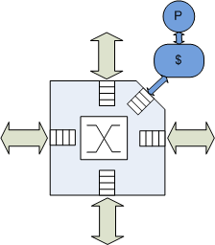
2-D Mesh

Slide 237
2-D Mesh
Pros
  Low design & layout complexity
  Simple, fast routers
Cons
  Large diameter
  Energy & latency impact

Slide 238
Concentration (Balfour & Dally, ICS ‘06)
Pros
  Multiple terminals attached to a router node
  Fast nearest-neighbor communication via the crossbar
  Hop count reduction proportional to concentration degree
Cons
  Benefits limited by crossbar complexity

Slide 239
Concentration
Side-effects
  Fewer channels
  Greater channel width

Slide 240
Replication
Benefits
  Restores bisection channel count
  Restores channel width
  Reduced crossbar complexity
CMesh-X2

Slide 241
Flattened Butterfly (Kim et al., Micro ‘07)
Objectives:
  Improve connectivity
  Exploit the wire budget

Slide 242
Flattened Butterfly (Kim et al., Micro ‘07)

Slide 243
Flattened Butterfly (Kim et al., Micro ‘07)

Slide 244
Flattened Butterfly (Kim et al., Micro ‘07)

Slide 245
Flattened Butterfly (Kim et al., Micro ‘07)

Slide 246
Flattened Butterfly (Kim et al., Micro ‘07)
Pros
  Excellent connectivity
  Low diameter: 2 hops
Cons
  High channel count:
  k²/2 per row/column
  Low channel utilization
  Increased control (arbitration) complexity

Slide 247
Multidrop Express Channels (MECS)
Objectives:
  Connectivity
  More scalable channel count
  Better channel utilization

Slide 248
Multidrop Express Channels (MECS)

Slide 249
Multidrop Express Channels (MECS)

Slide 250
Multidrop Express Channels (MECS)

Slide 251
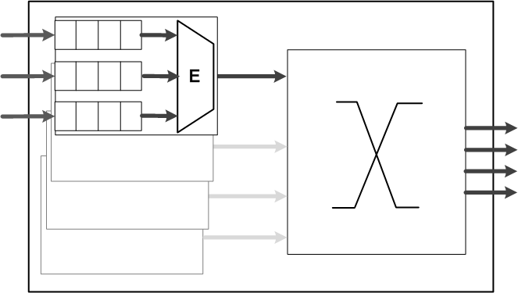
Multidrop Express Channels (MECS)

Slide 252
Multidrop Express Channels (MECS)

Slide 253
Multidrop Express Channels (MECS)
Pros
  One-to-many topology
  Low diameter: 2 hops
  k channels row/column
  Asymmetric
Cons
  Asymmetric
  Increased control (arbitration) complexity

Slide 254




Partitioning: a GEC Example
MECS
MECS-X2
Partitioned
MECS
Flattened
Butterfly

Slide 255
Analytical Comparison
 | CMesh |  | FBfly |  | MECS
Network Size | 64 | 256 | 64 | 256 | 64 | 256
Radix (conctr’d) | 4 | 8 | 4 | 8 | 4 | 8
Diameter | 6 | 14 | 2 | 2 | 2 | 2
Channel count | 2 | 2 | 8 | 32 | 4 | 8
Channel width | 576 | 1152 | 144 | 72 | 288 | 288
Router inputs | 4 | 4 | 6 | 14 | 6 | 14
Router outputs | 4 | 4 | 6 | 14 | 4 | 4

Slide 256
Experimental Methodology
Topologies | Mesh, CMesh, CMesh-X2, FBFly, MECS, MECS-X2
Network sizes | 64 & 256 terminals
Routing | DOR, adaptive
Messages | 64 & 576 bits
Synthetic traffic | Uniform random, bit complement, transpose, self-similar
PARSEC benchmarks | Blackscholes, Bodytrack, Canneal, Ferret, Fluidanimate, Freqmine, Vip, x264
Full-system config | M5 simulator, Alpha ISA, 64 OOO cores
Energy evaluation | Orion + CACTI 6

Slide 257
64 nodes: Uniform Random

Slide 258
256 nodes: Uniform Random

Slide 259
Energy (100K pkts, Uniform Random)

Slide 260
64 Nodes: PARSEC

Slide 261
Summary
MECS
  A new one-to-many topology
  Good fit for planar substrates
  Excellent connectivity
  Effective wire utilization
Generalized Express Cubes
  Framework & taxonomy for NOC topologies
  Extension of the k-ary n-cube model
  Useful for understanding and exploring
  on-chip interconnect options
  Future: expand & formalize

Slide 262
Kilo-NoC: Topology-Aware QoS
Boris Grot, Joel Hestness, Stephen W. Keckler, and Onur Mutlu,
"Kilo-NOC: A Heterogeneous Network-on-Chip Architecture for Scalability and Service Guarantees"
Proceedings of the 38th International Symposium on Computer Architecture (ISCA), San Jose, CA, June 2011. Slides (pptx)

Slide 263
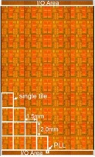
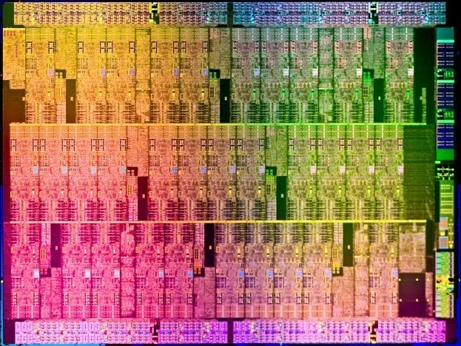
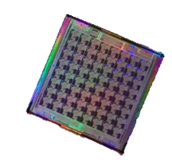
Motivation
Extreme-scale chip-level integration
  Cores
  Cache banks
  Accelerators
  I/O logic
  Network-on-chip (NOC)
10-100 cores today
1000+ assets in the near future

Slide 264
Kilo-NOC requirements
High efficiency
  Area
  Energy
Good performance
Strong service guarantees (QoS)

Slide 265
Topology-Aware QoS
Problem: QoS support in each router is expensive (in terms of buffering, arbitration, bookkeeping)
  E.g., Grot et al., “Preemptive Virtual Clock: A Flexible, Efficient, and Cost-effective QOS Scheme for Networks-on-Chip,” MICRO 2009.
Goal: Provide QoS guarantees at low area and power cost
Idea:
  Isolate shared resources in a region of the network, support QoS within that area
  Design the topology so that applications can access the region without interference

Slide 266
Baseline QOS-enabled CMP
Multiple VMs
sharing a die
Shared resources
(e.g., memory controllers)
VM-private resources
(cores, caches)
Q
QOS-enabled router

Slide 267
Conventional NOC QOS
Contention scenarios:
Shared resources
  memory access
Intra-VM traffic
  shared cache access
Inter-VM traffic
  VM page sharing

Slide 268
Conventional NOC QOS
Contention scenarios:
Shared resources
  memory access
Intra-VM traffic
  shared cache access
Inter-VM traffic
  VM page sharing
Network-wide guarantees without network-wide QOS support

Slide 269
Kilo-NOC QOS
Insight: leverage rich network connectivity
  Naturally reduce interference among flows
  Limit the extent of hardware QOS support
Requires a low-diameter topology
  This work: Multidrop Express Channels (MECS)
  Grot et al., HPCA 2009

Slide 270
Topology-Aware QOS
Dedicated, QOS-enabled regions
  Rest of die: QOS-free
Richly-connected topology
  Traffic isolation
Special routing rules
  Manage interference
QOS-free

Slide 271
Topology-Aware QOS
Dedicated, QOS-enabled regions
  Rest of die: QOS-free
Richly-connected topology
  Traffic isolation
Special routing rules
  Manage interference

Slide 272
Topology-Aware QOS
Dedicated, QOS-enabled regions
  Rest of die: QOS-free
Richly-connected topology
  Traffic isolation
Special routing rules
  Manage interference

Slide 273
Topology-Aware QOS
Dedicated, QOS-enabled regions
  Rest of die: QOS-free
Richly-connected topology
  Traffic isolation
Special routing rules
  Manage interference

Slide 274
Kilo-NOC view
Topology-aware QOS support
  Limit QOS complexity to a fraction of the die
Optimized flow control
  Reduce buffer requirements in QOS-free regions
QOS-free

Slide 275
Evaluation Methodology
Parameter | Value
Technology | 15 nm
Vdd | 0.7 V
System | 1024 tiles: 256 concentrated nodes (64 shared resources)
Networks:
MECS+PVC | VC flow control, QOS support (PVC) at each node
MECS+TAQ | VC flow control, QOS support only in shared regions
MECS+TAQ+EB | EB flow control outside of SRs, Separate Request and Reply networks
K-MECS | Proposed organization: TAQ + hybrid flow control

Slide 276
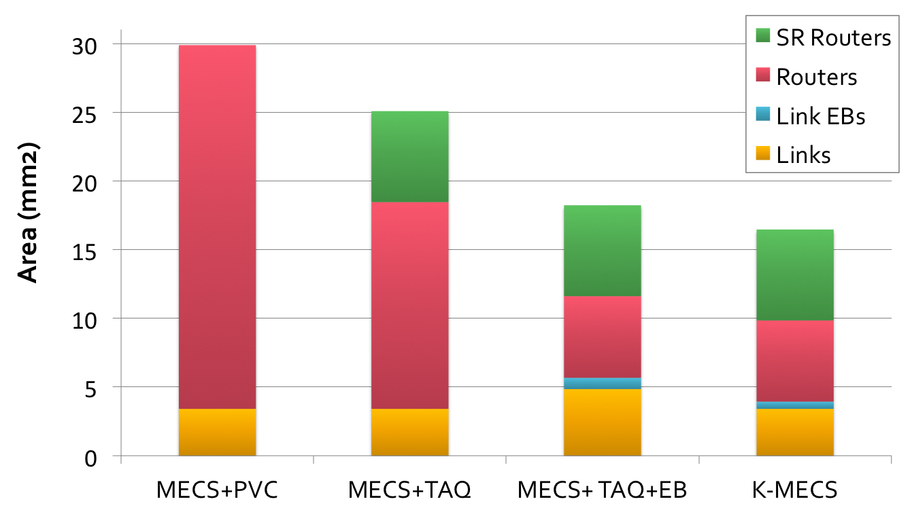
Area comparison

Slide 277
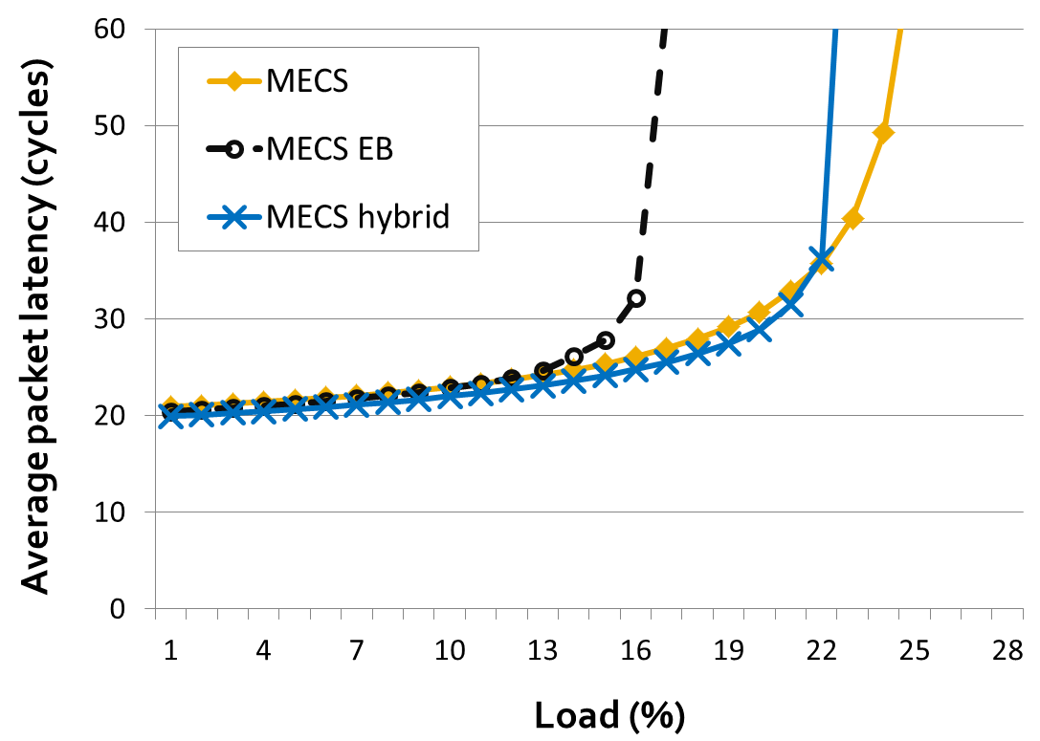
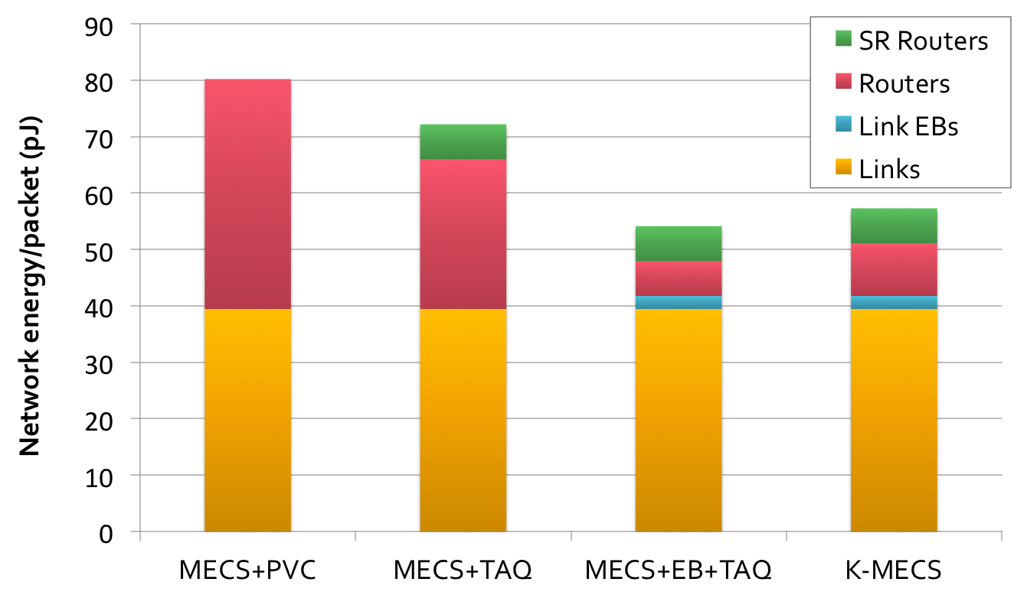
Energy comparison

Slide 278
Summary
Kilo-NOC: a heterogeneous NOC architecture for kilo-node substrates
Topology-aware QOS
  Limits QOS support to a fraction of the die
  Leverages low-diameter topologies
  Improves NOC area- and energy-efficiency
  Provides strong guarantees

