Slide 1


Memory Systems in the Multi-Core Era
Lecture 2.2: Emerging Technologies and Hybrid Memories
Prof. Onur Mutlu
http://www.ece.cmu.edu/~omutlu
onur@cmu.edu
Bogazici University
June 14, 2013

Slide 2
What Will You Learn in Mini Course 2?
Memory Systems in the Multi-Core Era
  June 13, 14, 17 (1-4pm)
Lecture 1: Main memory basics, DRAM scaling
Lecture 2: Emerging memory technologies and hybrid memories
Lecture 3: Main memory interference and QoS
Major Overview Reading:
  Mutlu, “Memory Scaling: A Systems Architecture Perspective,” IMW 2013.

Slide 3
Readings and Videos

Slide 4
Memory Lecture Videos
Memory Hierarchy (and Introduction to Caches)
  http://www.youtube.com/watch?v=JBdfZ5i21cs&list=PL5PHm2jkkXmidJOd59REog9jDnPDTG6IJ&index=22
Main Memory
  http://www.youtube.com/watch?v=ZLCy3pG7Rc0&list=PL5PHm2jkkXmidJOd59REog9jDnPDTG6IJ&index=25
Memory Controllers, Memory Scheduling, Memory QoS
  http://www.youtube.com/watch?v=ZSotvL3WXmA&list=PL5PHm2jkkXmidJOd59REog9jDnPDTG6IJ&index=26
  http://www.youtube.com/watch?v=1xe2w3_NzmI&list=PL5PHm2jkkXmidJOd59REog9jDnPDTG6IJ&index=27
Emerging Memory Technologies
  http://www.youtube.com/watch?v=LzfOghMKyA0&list=PL5PHm2jkkXmidJOd59REog9jDnPDTG6IJ&index=35
Multiprocessor Correctness and Cache Coherence
  http://www.youtube.com/watch?v=U-VZKMgItDM&list=PL5PHm2jkkXmidJOd59REog9jDnPDTG6IJ&index=32

Slide 5
Readings for Lecture 2.1 (DRAM Scaling)
Lee et al., “Tiered-Latency DRAM: A Low Latency and Low Cost DRAM Architecture,” HPCA 2013.
Liu et al., “RAIDR: Retention-Aware Intelligent DRAM Refresh,” ISCA 2012.
Kim et al., “A Case for Exploiting Subarray-Level Parallelism in DRAM,” ISCA 2012.
Liu et al., “An Experimental Study of Data Retention Behavior in Modern DRAM Devices,” ISCA 2013.
Seshadri et al., “RowClone: Fast and Efficient In-DRAM Copy and Initialization of Bulk Data,” CMU CS Tech Report 2013.
David et al., “Memory Power Management via Dynamic Voltage/Frequency Scaling,” ICAC 2011.
Ipek et al., “Self Optimizing Memory Controllers: A Reinforcement Learning Approach,” ISCA 2008.

Slide 6
Readings for Lecture 2.2 (Emerging Technologies)
Lee, Ipek, Mutlu, Burger, “Architecting Phase Change Memory as a Scalable DRAM Alternative,” ISCA 2009, CACM 2010, Top Picks 2010.
Qureshi et al., “Scalable high performance main memory system using phase-change memory technology,” ISCA 2009.
Meza et al., “Enabling Efficient and Scalable Hybrid Memories,” IEEE Comp. Arch. Letters 2012.
Yoon et al., “Row Buffer Locality Aware Caching Policies for Hybrid Memories,” ICCD 2012 Best Paper Award.
Meza et al., “A Case for Efficient Hardware-Software Cooperative Management of Storage and Memory,” WEED 2013.
Kultursay et al., “Evaluating STT-RAM as an Energy-Efficient Main Memory Alternative,” ISPASS 2013.

Slide 7
Readings for Lecture 2.3 (Memory QoS)
Moscibroda and Mutlu, “Memory Performance Attacks,” USENIX Security 2007.
Mutlu and Moscibroda, “Stall-Time Fair Memory Access Scheduling,” MICRO 2007.
Mutlu and Moscibroda, “Parallelism-Aware Batch Scheduling,” ISCA 2008, IEEE Micro 2009.
Kim et al., “ATLAS: A Scalable and High-Performance Scheduling Algorithm for Multiple Memory Controllers,” HPCA 2010.
Kim et al., “Thread Cluster Memory Scheduling,” MICRO 2010, IEEE Micro 2011.
Muralidhara et al., “Memory Channel Partitioning,” MICRO 2011.
Ausavarungnirun et al., “Staged Memory Scheduling,” ISCA 2012.
Subramanian et al., “MISE: Providing Performance Predictability and Improving Fairness in Shared Main Memory Systems,” HPCA 2013.
Das et al., “Application-to-Core Mapping Policies to Reduce Memory System Interference in Multi-Core Systems,” HPCA 2013.

Slide 8
Readings for Lecture 2.3 (Memory QoS)
Ebrahimi et al., “Fairness via Source Throttling,” ASPLOS 2010, ACM TOCS 2012.
Lee et al., “Prefetch-Aware DRAM Controllers,” MICRO 2008, IEEE TC 2011.
Ebrahimi et al., “Parallel Application Memory Scheduling,” MICRO 2011.
Ebrahimi et al., “Prefetch-Aware Shared Resource Management for Multi-Core Systems,” ISCA 2011.
More to come in next lecture…

Slide 9
Readings in Flash Memory
Yu Cai, Gulay Yalcin, Onur Mutlu, Erich F. Haratsch, Adrian Cristal, Osman Unsal, and Ken Mai,
"Error Analysis and Retention-Aware Error Management for NAND Flash Memory"
Intel Technology Journal (ITJ) Special Issue on Memory Resiliency, Vol. 17, No. 1, May 2013.
Yu Cai, Erich F. Haratsch, Onur Mutlu, and Ken Mai,
"Threshold Voltage Distribution in MLC NAND Flash Memory: Characterization, Analysis and Modeling"
Proceedings of the Design, Automation, and Test in Europe Conference (DATE), Grenoble, France, March 2013. Slides (ppt)
Yu Cai, Gulay Yalcin, Onur Mutlu, Erich F. Haratsch, Adrian Cristal, Osman Unsal, and Ken Mai,
"Flash Correct-and-Refresh: Retention-Aware Error Management for Increased Flash Memory Lifetime"
Proceedings of the 30th IEEE International Conference on Computer Design (ICCD), Montreal, Quebec, Canada, September 2012. Slides (ppt) (pdf)
Yu Cai, Erich F. Haratsch, Onur Mutlu, and Ken Mai,
"Error Patterns in MLC NAND Flash Memory: Measurement, Characterization, and Analysis"
Proceedings of the Design, Automation, and Test in Europe Conference (DATE), Dresden, Germany, March 2012. Slides (ppt)

Slide 10
Online Lectures and More Information
Online Computer Architecture Lectures
  http://www.youtube.com/playlist?list=PL5PHm2jkkXmidJOd59REog9jDnPDTG6IJ
Online Computer Architecture Courses
  Intro: http://www.ece.cmu.edu/~ece447/s13/doku.php
  Advanced: http://www.ece.cmu.edu/~ece740/f11/doku.php
  Advanced: http://www.ece.cmu.edu/~ece742/doku.php
Recent Research Papers
  http://users.ece.cmu.edu/~omutlu/projects.htm
  http://scholar.google.com/citations?user=7XyGUGkAAAAJ&hl=en

Slide 11
Emerging Memory Technologies

Slide 12
Agenda
Major Trends Affecting Main Memory
Requirements from an Ideal Main Memory System
Opportunity: Emerging Memory Technologies
Conclusions
Discussion

Slide 13
Major Trends Affecting Main Memory (I)
Need for main memory capacity and bandwidth increasing
Main memory energy/power is a key system design concern
DRAM technology scaling is ending

Slide 14

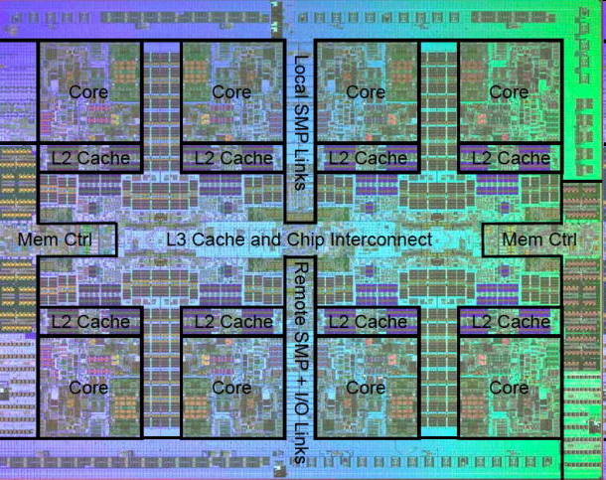
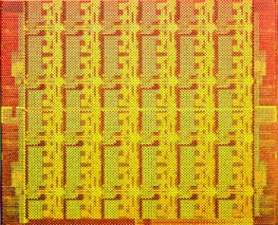
Demand for Memory Capacity
More cores ➔ More concurrency ➔ Larger working set
Emerging applications are data-intensive
Many applications/virtual machines (will) share main memory
  Cloud computing/servers: Consolidation to improve efficiency
  GP-GPUs: Many threads from multiple parallel applications
  Mobile: Interactive + non-interactive consolidation
AMD Barcelona: 4 cores
IBM Power7: 8 cores
Intel SCC: 48 cores

Slide 15
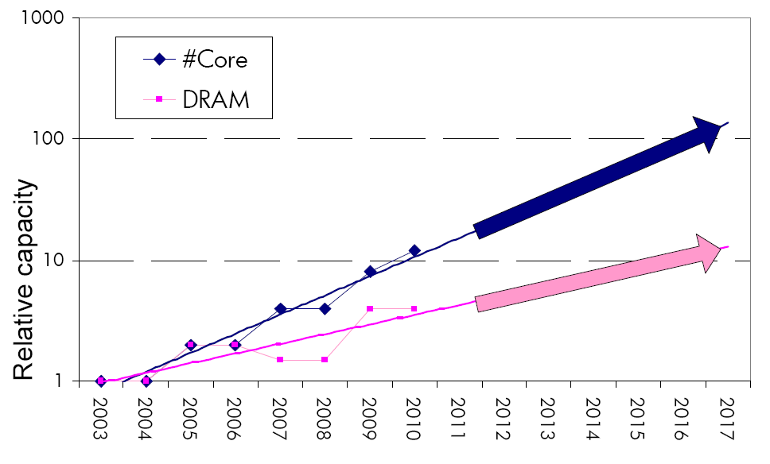
The Memory Capacity Gap
Memory capacity per core expected to drop by 30% every two years
Core count doubling ~ every 2 years
DRAM DIMM capacity doubling ~ every 3 years

Slide 16
Major Trends Affecting Main Memory (II)
Need for main memory capacity and bandwidth increasing
  Multi-core: increasing number of cores
  Data-intensive applications: increasing demand/hunger for data
  Consolidation: Cloud computing, GPUs, mobile
Main memory energy/power is a key system design concern
DRAM technology scaling is ending

Slide 17
Major Trends Affecting Main Memory (III)
Need for main memory capacity and bandwidth increasing
Main memory energy/power is a key system design concern
  IBM servers: ~50% energy spent in off-chip memory hierarchy [Lefurgy, IEEE Computer 2003]
  DRAM consumes power when idle and needs periodic refresh
DRAM technology scaling is ending

Slide 18
Major Trends Affecting Main Memory (IV)
Need for main memory capacity and bandwidth increasing
Main memory energy/power is a key system design concern
DRAM technology scaling is ending
  ITRS projects DRAM will not scale easily below 40nm
  Scaling has provided many benefits:
    higher capacity, higher density, lower cost, lower energy

Slide 19
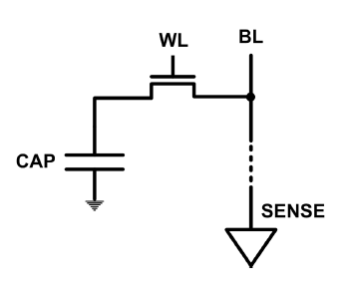
The DRAM Scaling Problem
DRAM stores charge in a capacitor (charge-based memory)
  Capacitor must be large enough for reliable sensing
  Access transistor should be large enough for low leakage and high retention time
  Scaling beyond 40-35nm (2013) is challenging [ITRS, 2009]
DRAM capacity, cost, and energy/power hard to scale

Slide 20
Trends: Problems with DRAM as Main Memory
Need for main memory capacity and bandwidth increasing
  DRAM capacity hard to scale
Main memory energy/power is a key system design concern
  DRAM consumes high power due to leakage and refresh
DRAM technology scaling is ending
  DRAM capacity, cost, and energy/power hard to scale

Slide 21
Agenda
Major Trends Affecting Main Memory
Requirements from an Ideal Main Memory System
Opportunity: Emerging Memory Technologies
Conclusions
Discussion

Slide 22
Requirements from an Ideal Memory System
Traditional
  Enough capacity
  Low cost
  High system performance (high bandwidth, low latency)
New
  Technology scalability: lower cost, higher capacity, lower energy
  Energy (and power) efficiency
  QoS support and configurability (for consolidation)

Slide 23
Requirements from an Ideal Memory System
Traditional
  Higher capacity
  Continuous low cost
  High system performance (higher bandwidth, low latency)
New
  Technology scalability: lower cost, higher capacity, lower energy
  Energy (and power) efficiency
  QoS support and configurability (for consolidation)
Emerging, resistive memory technologies (NVM) can help

Slide 24
Agenda
Major Trends Affecting Main Memory
Requirements from an Ideal Main Memory System
Opportunity: Emerging Memory Technologies
Conclusions
Discussion

Slide 25
The Promise of Emerging Technologies
Likely need to replace/augment DRAM with a technology that is
  Technology scalable
  And at least similarly efficient, high performance, and fault-tolerant
    or can be architected to be so
Some emerging resistive memory technologies appear promising
  Phase Change Memory (PCM)?
  Spin Torque Transfer Magnetic Memory (STT-MRAM)?
  Memristors?
  And, maybe there are other ones
  Can they be enabled to replace/augment/surpass DRAM?

Slide 26
Agenda
Major Trends Affecting Main Memory
Requirements from an Ideal Main Memory System
Opportunity: Emerging Memory Technologies
  Background
  PCM (or Technology X) as DRAM Replacement
  Hybrid Memory Systems
Conclusions
Discussion

Slide 27
Charge vs. Resistive Memories
Charge Memory (e.g., DRAM, Flash)
  Write data by capturing charge Q
  Read data by detecting voltage V
Resistive Memory (e.g., PCM, STT-MRAM, memristors)
  Write data by pulsing current dQ/dt
  Read data by detecting resistance R

Slide 28
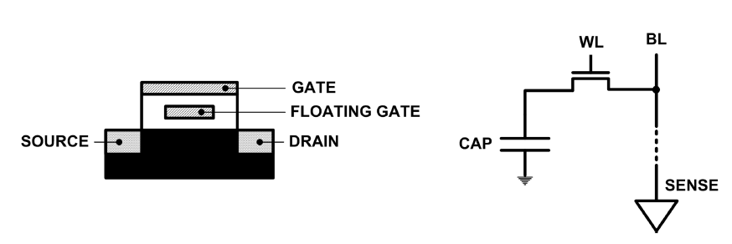
Limits of Charge Memory
Difficult charge placement and control
  Flash: floating gate charge
  DRAM: capacitor charge, transistor leakage
Reliable sensing becomes difficult as charge storage unit size reduces

Slide 29
Emerging Resistive Memory Technologies
PCM
  Inject current to change material phase
  Resistance determined by phase
STT-MRAM
  Inject current to change magnet polarity
  Resistance determined by polarity
Memristors
  Inject current to change atomic structure
  Resistance determined by atom distance

Slide 30
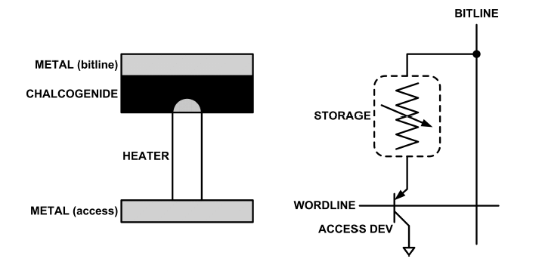
What is Phase Change Memory?
Phase change material (chalcogenide glass) exists in two states:
  Amorphous: Low optical reflexivity and high electrical resistivity
  Crystalline: High optical reflexivity and low electrical resistivity
PCM is resistive memory: High resistance (0), Low resistance (1)
PCM cell can be switched between states reliably and quickly

Slide 31
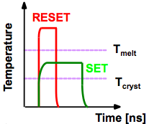
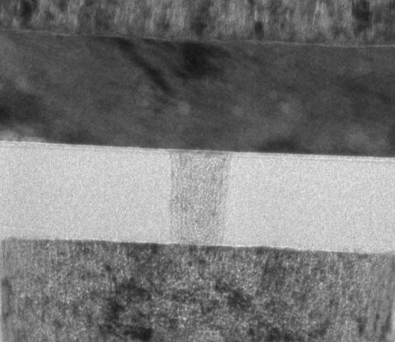
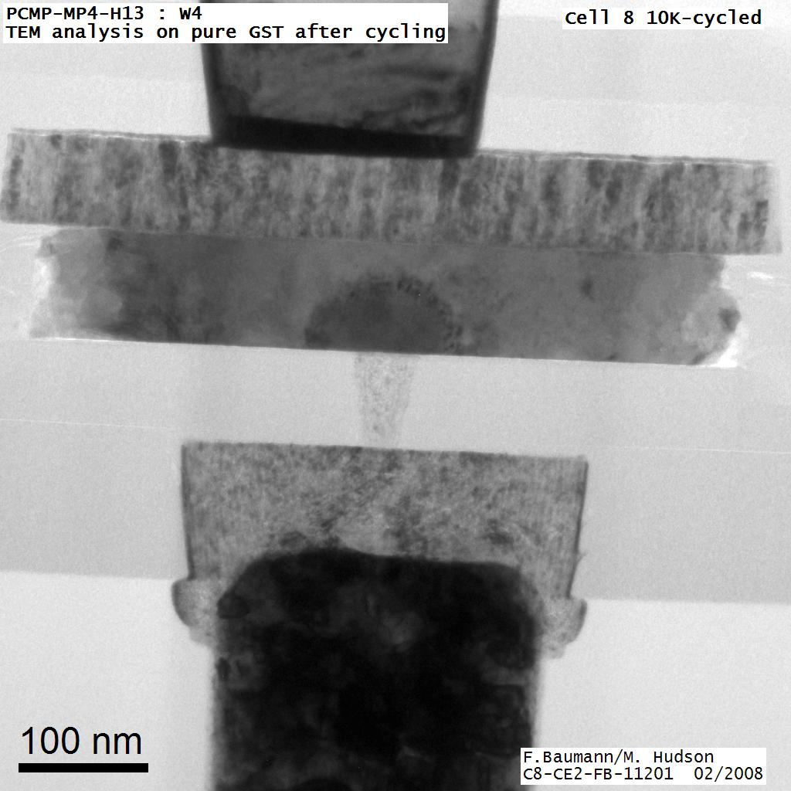
How Does PCM Work?
Write: change phase via current injection
  SET: sustained current to heat cell above Tcryst
  RESET: cell heated above Tmelt and quenched
Read: detect phase via material resistance
  amorphous/crystalline
Large
Current
Small
Current
Memory
Element
SET (cryst)
Low resistance
Access
Device
RESET (amorph)
High resistance
10³-10⁴ Ω
10⁶-10⁷ Ω
Photo Courtesy: Bipin Rajendran, IBM
Slide Courtesy: Moinuddin Qureshi, IBM

Slide 32
Opportunity: PCM Advantages
Scales better than DRAM, Flash
  Requires current pulses, which scale linearly with feature size
  Expected to scale to 9nm (2022 [ITRS])
  Prototyped at 20nm (Raoux+, IBM JRD 2008)
Can be denser than DRAM
  Can store multiple bits per cell due to large resistance range
  Prototypes with 2 bits/cell in ISSCC’08, 4 bits/cell by 2012
Non-volatile
  Retain data for >10 years at 85C
No refresh needed, low idle power

Slide 33
Phase Change Memory Properties
Surveyed prototypes from 2003-2008 (ITRS, IEDM, VLSI, ISSCC)
Derived PCM parameters for F=90nm
Lee, Ipek, Mutlu, Burger, “Architecting Phase Change Memory as a Scalable DRAM Alternative,” ISCA 2009.

Slide 34
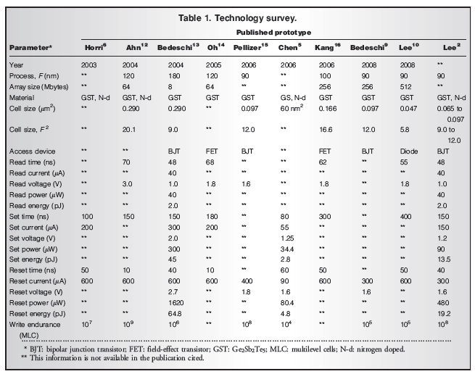

Slide 35
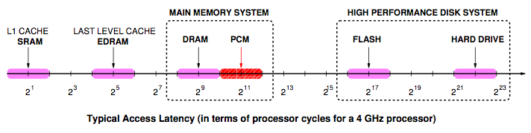
Phase Change Memory Properties: Latency
Latency comparable to, but slower than DRAM
Read Latency
  50ns: 4x DRAM, 10⁻³x NAND Flash
Write Latency
  150ns: 12x DRAM
Write Bandwidth
  5-10 MB/s: 0.1x DRAM, 1x NAND Flash

Slide 36
Phase Change Memory Properties
Dynamic Energy
  40 uA Rd, 150 uA Wr
  2-43x DRAM, 1x NAND Flash
Endurance
  Writes induce phase change at 650C
  Contacts degrade from thermal expansion/contraction
  10⁸ writes per cell
  10⁻⁸x DRAM, 10³x NAND Flash
Cell Size
  9-12F² using BJT, single-level cells
  1.5x DRAM, 2-3x NAND (will scale with feature size, MLC)

Slide 37
Phase Change Memory: Pros and Cons
Pros over DRAM
  Better technology scaling
  Non volatility
  Low idle power (no refresh)
Cons
  Higher latencies: ~4-15x DRAM (especially write)
  Higher active energy: ~2-50x DRAM (especially write)
  Lower endurance (a cell dies after ~10⁸ writes)
Challenges in enabling PCM as DRAM replacement/helper:
  Mitigate PCM shortcomings
  Find the right way to place PCM in the system
  Ensure secure and fault-tolerant PCM operation

Slide 38
PCM-based Main Memory: Research Challenges
Where to place PCM in the memory hierarchy?
  Hybrid OS controlled PCM-DRAM
  Hybrid OS controlled PCM and hardware-controlled DRAM
  Pure PCM main memory
How to mitigate shortcomings of PCM?
How to minimize amount of DRAM in the system?
How to take advantage of (byte-addressable and fast) non-volatile main memory?
Can we design specific-NVM-technology-agnostic techniques?

Slide 39
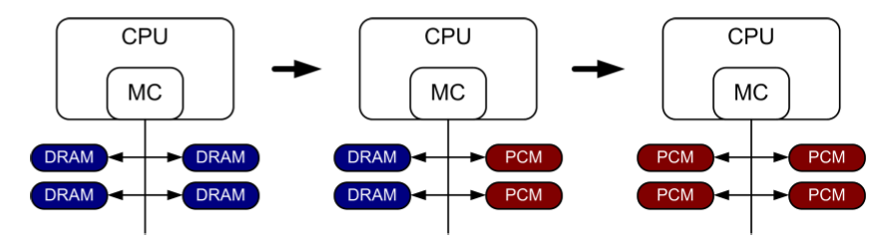
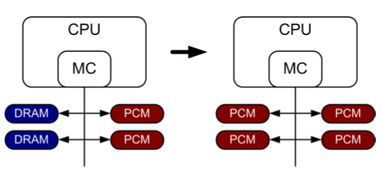
PCM-based Main Memory (I)
How should PCM-based (main) memory be organized?
Hybrid PCM+DRAM [Qureshi+ ISCA’09, Dhiman+ DAC’09, Meza+ IEEE CAL’12]:
  How to partition/migrate data between PCM and DRAM

Slide 40
Hybrid Memory Systems: Challenges
Partitioning
  Should DRAM be a cache or main memory, or configurable?
  What fraction? How many controllers?
Data allocation/movement (energy, performance, lifetime)
  Who manages allocation/movement?
  What are good control algorithms?
  How do we prevent degradation of service due to wearout?
Design of cache hierarchy, memory controllers, OS
  Mitigate PCM shortcomings, exploit PCM advantages
Design of PCM/DRAM chips and modules
  Rethink the design of PCM/DRAM with new requirements

Slide 41
PCM-based Main Memory (II)
How should PCM-based (main) memory be organized?
Pure PCM main memory [Lee et al., ISCA’09, Top Picks’10]:
  How to redesign entire hierarchy (and cores) to overcome PCM shortcomings

Slide 42
Aside: STT-RAM Basics
Magnetic Tunnel Junction (MTJ)
  Reference layer: Fixed
  Free layer: Parallel or anti-parallel
Cell
  Access transistor, bit/sense lines
Read and Write
  Read: Apply a small voltage across bitline and senseline; read the current.
  Write: Push large current through MTJ. Direction of current determines new orientation of the free layer.
Kultursay et al., “Evaluating STT-RAM as an Energy-Efficient Main Memory Alternative,” ISPASS 2013
Logical 0
Reference Layer
Barrier
Free Layer
Logical 1
Reference Layer
Barrier
Free Layer
Word Line
MTJ
Access
Transistor
Bit Line
Sense Line
Notes:
Moving from DRAM to STT-RAM, instead of a capacitor that stores charge, now we have a magnetic tunnel junction that has one reference layer with a fixed magnetic orientation, and a free layer that can be parallel or anti parallel to the reference layer; which determines the resistance, and in turn, the data stored in the MTJ. In addition to the MTJ, the cell, again, has an access transistor.
Reading requires a small voltage to be applied across the bitline and sense line; and the current is sensed. This current varies depending on the resistance of MTJ. To write data, we push a large current into the MTJ, which re-aligns the free layer. The direction of the current determines whether it becomes parallel or anti-parallel; i.e. logical 0 or 1.

Slide 43
Aside: STT MRAM: Pros and Cons
Pros over DRAM
  Better technology scaling
  Non volatility
  Low idle power (no refresh)
Cons
  Higher write latency
  Higher write energy
  Reliability?
Another level of freedom
  Can trade off non-volatility for lower write latency/energy (by reducing the size of the MTJ)

Slide 44
Agenda
Major Trends Affecting Main Memory
Requirements from an Ideal Main Memory System
Opportunity: Emerging Memory Technologies
  Background
  PCM (or Technology X) as DRAM Replacement
  Hybrid Memory Systems
Conclusions
Discussion

Slide 45
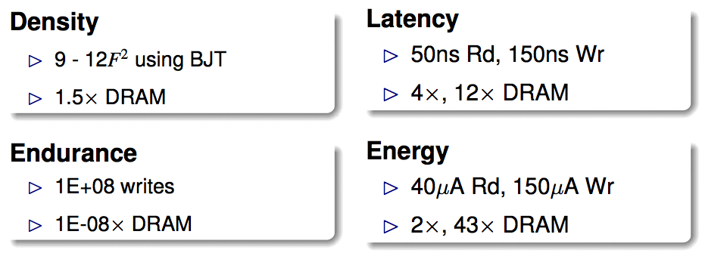
An Initial Study: Replace DRAM with PCM
Lee, Ipek, Mutlu, Burger, “Architecting Phase Change Memory as a Scalable DRAM Alternative,” ISCA 2009.
  Surveyed prototypes from 2003-2008 (e.g. IEDM, VLSI, ISSCC)
  Derived “average” PCM parameters for F=90nm

Slide 46
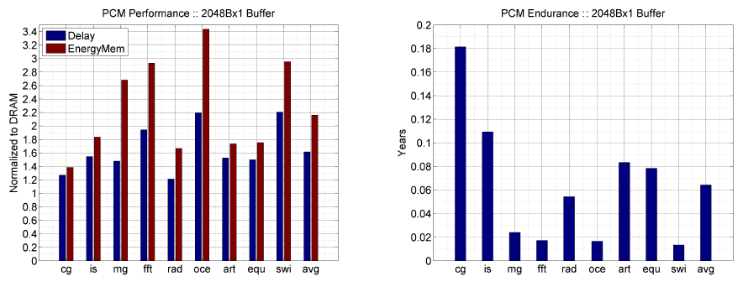
Results: Naïve Replacement of DRAM with PCM
Replace DRAM with PCM in a 4-core, 4MB L2 system
PCM organized the same as DRAM: row buffers, banks, peripherals
1.6x delay, 2.2x energy, 500-hour average lifetime
Lee, Ipek, Mutlu, Burger, “Architecting Phase Change Memory as a Scalable DRAM Alternative,” ISCA 2009.

Slide 47
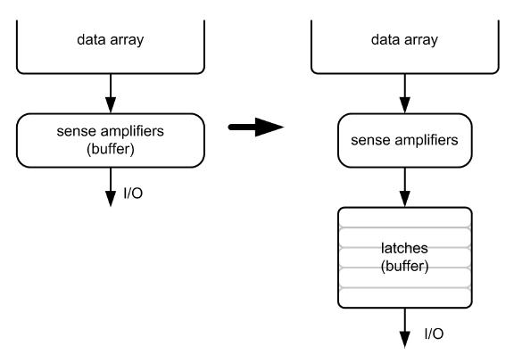
Architecting PCM to Mitigate Shortcomings
Idea 1: Use multiple narrow row buffers in each PCM chip
    → Reduces array reads/writes → better endurance, latency, energy
Idea 2: Write into array at
cache block or word
granularity
→ Reduces unnecessary wear
DRAM
PCM

Slide 48
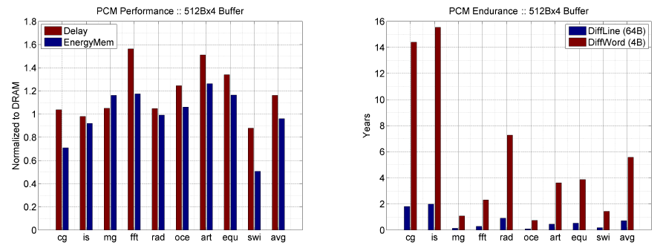
Results: Architected PCM as Main Memory
1.2x delay, 1.0x energy, 5.6-year average lifetime
Scaling improves energy, endurance, density
Caveat 1: Worst-case lifetime is much shorter (no guarantees)
Caveat 2: Intensive applications see large performance and energy hits
Caveat 3: Optimistic PCM parameters?

Slide 49
Agenda
Major Trends Affecting Main Memory
Requirements from an Ideal Main Memory System
Opportunity: Emerging Memory Technologies
  Background
  PCM (or Technology X) as DRAM Replacement
  Hybrid Memory Systems
Conclusions
Discussion

Slide 50
Hybrid Memory Systems
CPU
Meza, Chang, Yoon, Mutlu, Ranganathan, “Enabling Efficient and Scalable Hybrid Memories,” IEEE Comp. Arch. Letters, 2012.
DRAMCtrl
PCM Ctrl
DRAM
Phase Change Memory (or Tech. X)
Fast, durable
Small,
leaky, volatile,
high-cost
Large, non-volatile, low-cost
Slow, wears out, high active energy
Hardware/software manage data allocation and movement
to achieve the best of multiple technologies

Slide 51
One Option: DRAM as a Cache for PCM
PCM is main memory; DRAM caches memory rows/blocks
  Benefits: Reduced latency on DRAM cache hit; write filtering
Memory controller hardware manages the DRAM cache
  Benefit: Eliminates system software overhead
Three issues:
  What data should be placed in DRAM versus kept in PCM?
  What is the granularity of data movement?
  How to design a low-cost hardware-managed DRAM cache?
Two idea directions:
  Locality-aware data placement [Yoon+ , ICCD 2012]
  Cheap tag stores and dynamic granularity [Meza+, IEEE CAL 2012]

Slide 52
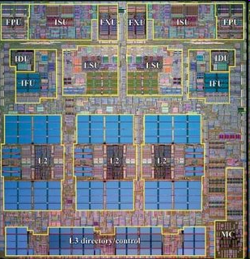
DRAM as a Cache for PCM
Goal: Achieve the best of both DRAM and PCM/NVM
  Minimize amount of DRAM w/o sacrificing performance, endurance
  DRAM as cache to tolerate PCM latency and write bandwidth
  PCM as main memory to provide large capacity at good cost and power
PCM Main Memory
DATA
Processor
DRAM Buffer
T
DATA
Flash
Or
HDD
T=Tag-Store
PCM Write Queue

Slide 53
Write Filtering Techniques
Lazy Write: Pages from disk installed only in DRAM, not PCM
Partial Writes: Only dirty lines from DRAM page written back
Page Bypass: Discard pages with poor reuse on DRAM eviction
Qureshi et al., “Scalable high performance main memory system using phase-change memory technology,” ISCA 2009.
PCM Main Memory
DATA
Processor
DRAM Buffer
T
DATA
Flash
Or
HDD

Slide 54
Results: DRAM as PCM Cache (I)
Simulation of 16-core system, 8GB DRAM main-memory at 320 cycles, HDD (2 ms) with Flash (32 us) with Flash hit-rate of 99%
Assumption: PCM 4x denser, 4x slower than DRAM
DRAM block size = PCM page size (4kB)
Notes:
Workloads:
Database workloads & Data parallel kernels
1. Database workloads: db1 and db2
2. Unix utilities: qsort and binary search
3. Data Mining : K-means and Gauss Seidal
4. Streaming: DAXPY and Vector Dot Product

Slide 55
Results: DRAM as PCM Cache (II)
PCM-DRAM Hybrid performs similarly to similar-size DRAM
Significant power and energy savings with PCM-DRAM Hybrid
Average lifetime: 9.7 years (no guarantees)

Slide 56
Agenda
Major Trends Affecting Main Memory
Requirements from an Ideal Main Memory System
Opportunity: Emerging Memory Technologies
  Background
  PCM (or Technology X) as DRAM Replacement
  Hybrid Memory Systems
    Row-Locality Aware Data Placement
    Efficient DRAM (or Technology X) Caches
Conclusions
Discussion

Slide 57
Row Buffer Locality Aware
Caching Policies for Hybrid Memories
HanBin Yoon
Justin Meza
Rachata Ausavarungnirun
Rachael Harding
Onur Mutlu

Slide 58
Hybrid Memory
Key question: How to place data between the heterogeneous memory devices?
CPU
MC
MC
DRAM
PCM
Notes:
One key question in the design of a hybrid memory system is: How to place data between the heterogeneous memory devices?
Our goal in this work is to answer this question.

Slide 59
Outline
Background: Hybrid Memory Systems
Motivation: Row Buffers and Implications on Data Placement
Mechanisms: Row Buffer Locality-Aware Caching Policies
Evaluation and Results
Conclusion
Notes:
Here’s the outline for the talk.
I’ve talked about some background in hybrid memory systems.
Next I will talk about row buffers and their implications on data placement.

Slide 60
Hybrid Memory: A Closer Look
CPU
Memory channel
MC
MC
Row buffer
Bank
Bank
Bank
Bank
DRAM
(small capacity cache)
PCM
(large capacity store)
Notes:
Here’s a closer look at a hybrid memory system employing both DRAM and PCM.
Typically, the DRAM is used as a small capacity cache, and the PCM is used as a large capacity store.
When the processor needs data, it will first look to see if the data is in DRAM. If the data is indeed in DRAM, the processor will retrieve the data from there. If the data is not in DRAM, the processor will retrieve the data from PCM.
Both DRAM and PCM are organized into banks that are capable of operating independently. Also, in each bank, there are peripheral circuitries known as the row buffers.

Slide 61
Row Buffers and Latency
Row (buffer) hit: Access data from row buffer → fast
Row (buffer) miss: Access data from cell array → slow
ROW ADDRESS
Bank
CELL ARRAY
ROW DATA
Row buffer hit!
Row buffer
Row buffer miss!
LOAD X
LOAD X
LOAD X+1
LOAD X+1
Notes:
Row buffers affect memory latency is a profound way.
Row buffers effectively store the most recently accessed row in memory.
They are typically 2 to 8KB in length, for a single rank.
When data is requested in memory, it is first checked to see if the data is in the row buffer. If the data is not in the row buffer, this is called a row buffer miss. In this case, we need to read a row full of data from the memory cell array into the row buffer, and the memory request is served. In a subsequent memory request, if the requested data is already latched in the row buffer, this is called a row buffer hit, and the data can be retrieved without having to access the memory cell array, which in the case of PCM, is a high latency operation.
In summary, on a row hit, data is accessed from the row buffer, which is fast. On a row miss, data is accessed from the cell array, which is slow.

Slide 62
Key Observation
Row buffers exist in both DRAM and PCM
  Row hit latency similar in DRAM & PCM [Lee+ ISCA’09]
  Row miss latency small in DRAM, large in PCM
Place data in DRAM which
  is likely to miss in the row buffer (low row buffer locality)→ miss penalty is smaller in DRAM
  AND
  is reused many times → cache only the data worth the movement cost and DRAM space
Notes:
Our key observation is that row buffers exist in both DRAM and PCM.
Row hit latency, which does not access the memory cell array, is similar in DRAM and PCM.
It is for a row miss that the memory access latency is small in DRAM and large in PCM.
Therefore we would like to place data in DRAM which:
Is likely to miss in the row buffer, which we call as having low row buffer locality, since the row buffer miss penalty is small in DRAM than it is in PCM.
And we would like to place data in DRAM which is reused many times, so that we cache only the data that is worth the movement cost.

Slide 63
RBL-Awareness: An Example
Let’s say a processor accesses four rows
Row A
Row B
Row C
Row D
Notes:
Let’s look at an example how row buffer locality affects hybrid memory performance.
Let’s say a processor accesses four rows…

Slide 64
RBL-Awareness: An Example
Let’s say a processor accesses four rows
with different row buffer localities (RBL)
Row A
Row B
Row C
Row D
Low RBL
(Frequently miss
in row buffer)
High RBL
(Frequently hit
in row buffer)
Case 1: RBL-Unaware Policy (state-of-the-art)
Case 2: RBL-Aware Policy (RBLA)
Notes:
With different row buffer localities.
Rows A and B have low row buffer locality, which means that they frequently miss in the row buffer, and rows C and D have high row buffer locality, which means that they frequently hit in the row buffer.
We will look at two types of caching policies: Case 1 will be row buffer locality unaware, and case 2 will be row buffer locality aware.

Slide 65
Case 1: RBL-Unaware Policy
A row buffer locality-unaware policy could
place these rows in the following manner
Row C
Row A
Row D
Row B
DRAM
(High RBL)
PCM
(Low RBL)
Notes:
Here’s Case 1: The row buffer locality unaware policy.
A row buffer locality unaware policy could place rows A, B, C, and D in the following manner, where rows with high row buffer locality are placed in DRAM, and rows with low row buffer locality are placed in PCM.

Slide 66
Case 1: RBL-Unaware Policy
Access pattern to main memory:
A (oldest), B, C, C, C, A, B, D, D, D, A, B (youngest)
DRAM (High RBL)
time
C
C
C
D
D
D
PCM (Low RBL)
A
B
A
B
A
B
RBL-Unaware: Stall time is 6 PCM device accesses
Notes:
For such a policy, this diagram shows the amount of time it takes to serve a stream of memory requests.
This is the access pattern to memory.
Clearly, the high row buffer miss latency of PCM acts as a bottleneck to serving all of the memory requests, and this happens because the rows with low row buffer locality is placed in PCM.

Slide 67
Case 2: RBL-Aware Policy (RBLA)
A row buffer locality-aware policy would
place these rows in the opposite manner
Row A
Row C
Row B
Row D
DRAM
(Low RBL)
PCM
(High RBL)
→ Access data at lower row buffer miss latency of DRAM
→ Access data at low row buffer hit latency of PCM
Notes:
Here’s Case 2: The row buffer locality aware policy, or RBLA.
A row buffer locality aware policy would place these rows in the following manner, where the rows with low row buffer locality are placed in DRAM, since the data can be accessed at the lower row buffer miss latency of DRAM.
Rows with high row buffer locality will be placed in PCM, since data can be frequently accessed at the low row buffer hit latency of PCM.

Slide 68
Case 2: RBL-Aware Policy (RBLA)
Access pattern to main memory:
A (oldest), B, C, C, C, A, B, D, D, D, A, B (youngest)
DRAM (High RBL)
time
C
C
C
D
D
D
PCM (Low RBL)
A
B
A
B
A
B
RBL-Unaware: Stall time is 6 PCM device accesses
DRAM (Low RBL)
A
B
A
B
A
B
PCM (High RBL)
C
C
C
D
D
D
Saved cycles
RBL-Aware: Stall time is 6 DRAM device accesses
Notes:
Now we compare the two policies in terms of the time it takes to serve the same stream of memory requests.
Remember, this was the timeline shown before for the row buffer locality-unaware policy.
For case 2, the row buffer locality aware policy, although the PCM row buffer miss latency is high, many of the accesses to PCM are row buffer hit accesses that can be served quickly.
And overall, it takes less time to serve all of the memory requests in the row buffer locality aware policy.
The row buffer locality aware policy gains because it places rows with low row buffer locality in DRAM.
This is the goal of our mechanism: To place rows with low row buffer locality in DRAM.

Slide 69
Outline
Background: Hybrid Memory Systems
Motivation: Row Buffers and Implications on Data Placement
Mechanisms: Row Buffer Locality-Aware Caching Policies
Evaluation and Results
Conclusion
Notes:
Now I will talk about how we do that.

Slide 70
Our Mechanism: RBLA
For recently used rows in PCM:
  Count row buffer misses as indicator of row buffer locality (RBL)
Cache to DRAM rows with misses ≥ threshold
  Row buffer miss counts are periodically reset (only cache rows with high reuse)
Notes:
Our Mechanism is called RBLA, which stands for row buffer locality aware.
For recently used rows in PCM, our mechanism counts row buffer misses as indicator of row buffer locality of each row.
I will talk more about how this is physically achieved.
Then, we cache to DRAM rows with row buffer miss counts that exceed a certain threshold.
And row buffer miss counts are periodically reset, so that we only cache rows with high reuse.
That is our base mechanism, RBLA.

Slide 71
Our Mechanism: RBLA-Dyn
For recently used rows in PCM:
  Count row buffer misses as indicator of row buffer locality (RBL)
Cache to DRAM rows with misses ≥ threshold
  Row buffer miss counts are periodically reset (only cache rows with high reuse)
Dynamically adjust threshold to adapt to workload/system characteristics
  Interval-based cost-benefit analysis
Notes:
We also extend RBLA to RBLA-Dyn, which performs an extra step.
RBLA-Dyn dynamically adjusts the threshold value to adapt to different workload and system characteristics.
This is based on an interval-based cost-benefit analysis, for which the details can be found in the paper.
I would encourage you to read the paper, and I’d be happy to answer any questions.

Slide 72
Implementation: “Statistics Store”
Goal: To keep count of row buffer misses to recently used rows in PCM
Hardware structure in memory controller
  Operation is similar to a cache
    Input: row address
    Output: row buffer miss count
  128-set 16-way statistics store (9.25KB) achieves system performance within 0.3% of an unlimited-sized statistics store
Notes:
The implementation of our mechanism requires a statistics store, or what we simply call a stats store.
The goal of the stats store is to keep count of the row buffer misses to recently used rows in PCM.
The stats store is a hardware structure in the memory controller, and its operation is similar to a cache.
It is organized into sets and ways, and is indexed using the row address of the row we wish to find the row buffer miss count for.
If the queried row is currently in the stats store, then its row buffer miss count will be output.
We find that a 128-set 16-way stats store, 9.25KB in size, achieves system performance within 0.3% of an unlimited-sized stats store.

Slide 73
Outline
Background: Hybrid Memory Systems
Motivation: Row Buffers and Implications on Data Placement
Mechanisms: Row Buffer Locality-Aware Caching Policies
Evaluation and Results
Conclusion
Notes:
Now let’s take a look at our results.

Slide 74
Evaluation Methodology
Cycle-level x86 CPU-memory simulator
  CPU: 16 out-of-order cores, 32KB private L1 per core, 512KB shared L2 per core
  Memory: 1GB DRAM (8 banks), 16GB PCM (8 banks), 4KB migration granularity
36 multi-programmed server, cloud workloads
  Server: TPC-C (OLTP), TPC-H (Decision Support)
  Cloud: Apache (Webserv.), H.264 (Video), TPC-C/H
Metrics: Weighted speedup (perf.), perf./Watt (energy eff.), Maximum slowdown (fairness)
Notes:
Here’s our evaluation methodology.
We use a cycle-level x86 simulator to test our hybrid memory caching policies.
We simulate a 16-core system with 1GB of DRAM and 16GB of PCM.
We use 36 multi-programmed server and cloud workloads to test our caching policies.
For server workloads, we use TPC-C, which is an online transaction processing benchmark, and TPC-H, which is a decision support benchmark.
For cloud workloads, we use Apache, which is a webserver application, and H.264, a video processing application, as well as TPC-C and H.
We report multi-core performance in terms of weighted speedup, multi-core fairness in terms of maximum slowdown, and energy efficiency in terms of performance per Watt.

Slide 75
Comparison Points
Conventional LRU Caching
FREQ: Access-frequency-based caching
  Places “hot data” in cache [Jiang+ HPCA’10]
  Cache to DRAM rows with accesses ≥ threshold
  Row buffer locality-unaware
FREQ-Dyn: Adaptive Freq.-based caching
  FREQ + our dynamic threshold adjustment
  Row buffer locality-unaware
RBLA: Row buffer locality-aware caching
RBLA-Dyn: Adaptive RBL-aware caching
Notes:
And here are our comparison points.
The standard conventional LRU caching caches any row from PCM to DRAM when the data is touched. We find this scheme to generate too much data movement between DRAM and PCM and consequently to not perform well. So we’re not going to use it as a comparison point in this talk.
Frek is access frequency based caching. It is inspired by prior work that selectively caches hot data.
The downsides of frek is that it is row buffer locality aware. Hence, it would place a row with high row buffer locality in DRAM, although that row may be accessed as efficiently in PCM.
Frek-Dyn augments frek with the adaptive threshold adjustment technique.
It has the same drawback as frek, in that it is row buffer locality unaware.
Our mechanisms, RBLA and RBLA-Dyn, are specifically designed to be aware of row buffer locality and to exploit it.

Slide 76
System Performance
10%
14%
17%
Benefit 1: Increased row buffer locality (RBL) in PCM by moving low RBL data to DRAM
Benefit 1: Increased row buffer locality (RBL) in PCM by moving low RBL data to DRAM
Benefit 2: Reduced memory bandwidth consumption due to stricter caching criteria
Benefit 2: Reduced memory bandwidth consumption due to stricter caching criteria
Benefit 3: Balanced memory request load between DRAM and PCM
Notes:
Here are the system performance results of the different hybrid memory caching policies.
RBLA-Dyn achieves 17% performance improvement over frek in server workloads, 10% in cloud, and 14% overall.
This is due to a number of reasons.
The first is that RBLA-Dyn increases row buffer locality in PCM by moving low row buffer locality data to DRAM.
The second is that RBLA-Dyn reduces memory bandwidth consumption due its stricter caching criteria.
And RBLA-Dyn also has the effect of balancing the memory request load between DRAM and PCM by letting rows with high row buffer locality remain in PCM, instead of fetching all accessed data to DRAM.

Slide 77
Average Memory Latency
14%
12%
9%
Notes:
These benefits are also reflected in the average memory latency, which RBLA-Dyn reduces by 14% over frek in server workloads, by 9% in cloud, and by 12% overall.

Slide 78
Memory Energy Efficiency
13%
7%
10%
Increased performance & reduced data movement between DRAM and PCM
Notes:
RBLA-Dyn improves memory system energy efficiency by 13% in server workloads, 7% in cloud, and 10% overall.
This is partly due to the increased system performance, and partly due to the reduced data movement between DRAM and PCM because of RBLA-Dyn’s stricter caching criteria.

Slide 79
Thread Fairness
7.6%
6.2%
4.8%
Notes:
And our mechanism also improves multi-core thread fairness by 7.6% in server workloads, by 4.8% in cloud, and by 6.2% overall.

Slide 80
Compared to All-PCM/DRAM
29%
31%
Our mechanism achieves 31% better performance than all PCM, within 29% of all DRAM performance
Notes:
Now let’s compare our mechanism to a homogeneous memory system.
Here the comparison points are a 16GB all-PCM and all-DRAM memory system.
Our mechanism achieves 31% better performance than the all-PCM memory system, and comes within 29% of the all-DRAM performance.
Note that we do not assume any capacity benefits of PCM over DRAM.
And yet, our mechanism bridges the performance gap between the two homogeneous memory systems.
If the capacity benefit of PCM was included, the hybrid memory system will perform even better.

Slide 81
Other Results in Paper
RBLA-Dyn increases the portion of PCM row buffer hit by 6.6 times
RBLA-Dyn has the effect of balancing memory request load between DRAM and PCM
  PCM channel utilization increases by 60%.
Notes:
Here’s a highlight of our other results in the paper.
RBLA-Dyn increases the portion of PCM row buffer hit accesses significantly.
It has the effect of balancing memory request load between DRAM and PCM.

Slide 82
Summary
Different memory technologies have different strengths
A hybrid memory system (DRAM-PCM) aims for best of both
Problem: How to place data between these heterogeneous memory devices?
Observation: PCM array access latency is higher than DRAM’s – But peripheral circuit (row buffer) access latencies are similar
Key Idea: Use row buffer locality (RBL) as a key criterion for data placement
Solution: Cache to DRAM rows with low RBL and high reuse
Improves both performance and energy efficiency over state-of-the-art caching policies
Notes:
Here’s a one-slide summary of what I’ll describe.
Different memory technologies have different strengths and weaknesses.
A hybrid memory system, for example, one that combines DRAM and Phase Change Memory, aims for the best of both memory technologies.
The Problem is how to place data between these heterogeneous devices in a way that exploits each memory technology’s strengths while minimizing its weaknesses.
Our key observation is that PCM array access latency is higher than DRAM’s, but peripheral circuit access latencies, or what is called row buffer access latencies, are similar.
Our key idea is to use row buffer locality as a key criterion for data placement in a hybrid memory system.
Our solution is to cache to DRAM rows with low row buffer locality and high reuse because these are the rows that would benefit most from DRAM.
This improves both performance and energy efficiency over state-of-the-art caching policies for hybrid memories.

Slide 83
Row Buffer Locality Aware
Caching Policies for Hybrid Memories
HanBin Yoon
Justin Meza
Rachata Ausavarungnirun
Rachael Harding
Onur Mutlu

Slide 84
Agenda
Major Trends Affecting Main Memory
Requirements from an Ideal Main Memory System
Opportunity: Emerging Memory Technologies
  Background
  PCM (or Technology X) as DRAM Replacement
  Hybrid Memory Systems
    Row-Locality Aware Data Placement
    Efficient DRAM (or Technology X) Caches
Conclusions
Discussion

Slide 85
The Problem with Large DRAM Caches
A large DRAM cache requires a large metadata (tag + block-based information) store
How do we design an efficient DRAM cache?
CPU
LOAD X
Metadata:
X → DRAM
Mem
Ctlr
Mem
Ctlr
DRAM
PCM
X
(small, fast cache)
(high capacity)
Access X

Slide 86
Idea 1: Tags in Memory
Store tags in the same row as data in DRAM
  Store metadata in same row as their data
  Data and metadata can be accessed together
Benefit: No on-chip tag storage overhead
Downsides:
  Cache hit determined only after a DRAM access
  Cache hit requires two DRAM accesses
DRAM row
Cache block 0
Cache block 1
Cache block 2
Tag0
Tag1
Tag2

Slide 87
Idea 2: Cache Tags in SRAM
Recall Idea 1: Store all metadata in DRAM
  To reduce metadata storage overhead
Idea 2: Cache in on-chip SRAM frequently-accessed metadata
  Cache only a small amount to keep SRAM size small

Slide 88
Idea 3: Dynamic Data Transfer Granularity
Some applications benefit from caching more data
  They have good spatial locality
Others do not
  Large granularity wastes bandwidth and reduces cache utilization
Idea 3: Simple dynamic caching granularity policy
  Cost-benefit analysis to determine best DRAM cache block size
  Group main memory into sets of rows
  Some row sets follow a fixed caching granularity
  The rest of main memory follows the best granularity
    Cost–benefit analysis: access latency versus number of cachings
    Performed every quantum

Slide 89
TIMBER Tag Management
A Tag-In-Memory BuffER (TIMBER)
  Stores recently-used tags in a small amount of SRAM
Benefits: If tag is cached:
  no need to access DRAM twice
  cache hit determined quickly
DRAM row
Cache block 0
Cache block 1
Cache block 2
Tag0
Tag1
Tag2
Row Tag
Row0
Tag0
Tag1
Tag2
LOAD X
Row27
Tag0
Tag1
Tag2

Slide 90
TIMBER Tag Management Example (I)
Case 1: TIMBER hit
Our proposal
TIMBER: X → DRAM
Row0
Tag0
Tag1
Tag2
Row27
Tag0
Tag1
Tag2
CPU
LOAD X
Mem
Ctlr
Mem
Ctlr
Bank
Bank
Bank
Bank
X
Access X

Slide 91
TIMBER Tag Management Example (II)
Case 2: TIMBER miss
2. Cache M(Y)
Access Metadata(Y)
Y → DRAM
Row0
Tag0
Tag1
Tag2
Row27
Tag0
Tag1
Tag2
CPU
Row143
Miss
LOAD Y
Mem
Ctlr
Mem
Ctlr
Bank
Bank
Bank
Bank
Y
M(Y)
1. Access M(Y)
3. Access Y (row hit)

Slide 92
Methodology
System: 8 out-of-order cores at 4 GHz
Memory: 512 MB direct-mapped DRAM, 8 GB PCM
  128B caching granularity
  DRAM row hit (miss): 200 cycles (400 cycles)
  PCM row hit (clean / dirty miss): 200 cycles (640 / 1840 cycles)
Evaluated metadata storage techniques
  All SRAM system (8MB of SRAM)
  Region metadata storage
  TIM metadata storage (same row as data)
  TIMBER, 64-entry direct-mapped (8KB of SRAM)

Slide 93
Metadata Storage Performance
(Ideal)

Slide 94
Metadata Storage Performance
Performance degrades due to increased metadata lookup access latency
-48%
(Ideal)

Slide 95
Metadata Storage Performance
Increased row locality reduces average memory access latency
36%
(Ideal)

Slide 96
Metadata Storage Performance
Data with locality can access metadata at SRAM latencies
23%
(Ideal)

Slide 97
Dynamic Granularity Performance
10%
Reduced channel contention and improved spatial locality

Slide 98
TIMBER Performance
-6%
Reduced channel contention and improved spatial locality
Meza, Chang, Yoon, Mutlu, Ranganathan, “Enabling Efficient and Scalable Hybrid Memories,” IEEE Comp. Arch. Letters, 2012.

Slide 99
TIMBER Energy Efficiency
18%
Fewer migrations reduce transmitted data and channel contention
Meza, Chang, Yoon, Mutlu, Ranganathan, “Enabling Efficient and Scalable Hybrid Memories,” IEEE Comp. Arch. Letters, 2012.

Slide 100
Enabling and Exploiting NVM: Issues
Many issues and ideas from technology layer to algorithms layer
Enabling NVM and hybrid memory
  How to tolerate errors?
  How to enable secure operation?
  How to tolerate performance and power shortcomings?
  How to minimize cost?
Exploiting emerging technologies
  How to exploit non-volatility?
  How to minimize energy consumption?
  How to exploit NVM on chip?
Problems
Algorithms
Programs
User
Runtime System
(VM, OS, MM)
ISA
Microarchitecture
Logic
Devices

Slide 101
Security Challenges of Emerging Technologies
1. Limited endurance → Wearout attacks
2. Non-volatility → Data persists in memory after powerdown
→ Easy retrieval of privileged or private information
3. Multiple bits per cell → Information leakage (via side channel)

Slide 102
Securing Emerging Memory Technologies
1. Limited endurance → Wearout attacks
Better architecting of memory chips to absorb writes
Hybrid memory system management
Online wearout attack detection
2. Non-volatility → Data persists in memory after powerdown
→ Easy retrieval of privileged or private information
Efficient encryption/decryption of whole main memory
Hybrid memory system management
3. Multiple bits per cell → Information leakage (via side channel)
System design to hide side channel information

Slide 103
Agenda
Major Trends Affecting Main Memory
Requirements from an Ideal Main Memory System
Opportunity: Emerging Memory Technologies
  Background
  PCM (or Technology X) as DRAM Replacement
  Hybrid Memory Systems
Conclusions
Discussion

Slide 104
Summary: Memory Scaling (with NVM)
Main memory scaling problems are a critical bottleneck for system performance, efficiency, and usability
Solution 1: Tolerate DRAM (yesterday)
Solution 2: Enable emerging memory technologies
  Replace DRAM with NVM by architecting NVM chips well
  Hybrid memory systems with automatic data management
We are examining many other solution directions and ideas
  Hardware/software/device cooperation essential
  Memory, storage, controller, software/app co-design needed
  Coordinated management of persistent memory and storage
  Application and hardware cooperative management of NVM

Slide 105
Flash Memory Scaling

Slide 106
Readings in Flash Memory
Yu Cai, Gulay Yalcin, Onur Mutlu, Erich F. Haratsch, Adrian Cristal, Osman Unsal, and Ken Mai,
"Error Analysis and Retention-Aware Error Management for NAND Flash Memory"
Intel Technology Journal (ITJ) Special Issue on Memory Resiliency, Vol. 17, No. 1, May 2013.
Yu Cai, Erich F. Haratsch, Onur Mutlu, and Ken Mai,
"Threshold Voltage Distribution in MLC NAND Flash Memory: Characterization, Analysis and Modeling"
Proceedings of the Design, Automation, and Test in Europe Conference (DATE), Grenoble, France, March 2013. Slides (ppt)
Yu Cai, Gulay Yalcin, Onur Mutlu, Erich F. Haratsch, Adrian Cristal, Osman Unsal, and Ken Mai,
"Flash Correct-and-Refresh: Retention-Aware Error Management for Increased Flash Memory Lifetime"
Proceedings of the 30th IEEE International Conference on Computer Design (ICCD), Montreal, Quebec, Canada, September 2012. Slides (ppt) (pdf)
Yu Cai, Erich F. Haratsch, Onur Mutlu, and Ken Mai,
"Error Patterns in MLC NAND Flash Memory: Measurement, Characterization, and Analysis"
Proceedings of the Design, Automation, and Test in Europe Conference (DATE), Dresden, Germany, March 2012. Slides (ppt)

Slide 107
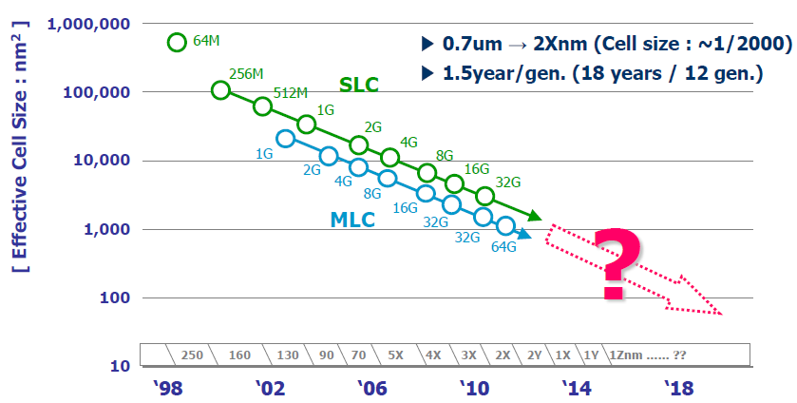
Evolution of NAND Flash Memory
CMOS scaling
More bits per Cell
Seaung Suk Lee, “Emerging Challenges in NAND Flash Technology”, Flash Summit 2011 (Hynix)
Flash memory widening its range of applications
  Portable consumer devices, laptop PCs and enterprise servers

Slide 108
Decreasing Endurance with Flash Scaling
100k
24-bit ECC
15-bit ECC
8-bit ECC
Error Correction Capability
(per 1 kB of data)
4-bit ECC
10k
5k
3k
1k
Ariel Maislos, “A New Era in Embedded Flash Memory”, Flash Summit 2011 (Anobit)
Endurance of flash memory decreasing with scaling and multi-level cells
Error correction capability required to guarantee storage-class reliability (UBER < 10⁻¹⁵) is increasing exponentially to reach less endurance
UBER: Uncorrectable bit error rate. Fraction of erroneous bits after error correction.

Slide 109
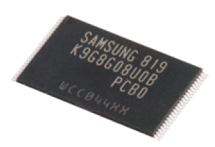
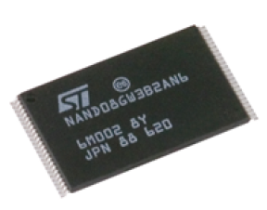
Future NAND Flash Storage Architecture
Memory
Signal
Processing
Raw Bit
Error Rate
Noisy
Error
Correction
BER < 10⁻¹⁵
Read voltage adjusting
Data scrambler
Data recovery
Soft-information estimation
Hamming codes
BCH codes
Reed-Solomon codes
LDPC codes
Other Flash friendly codes
Need to understand NAND flash error patterns

Slide 110
Test System Infrastructure
Algorithms
Wear Leveling
Address Mapping
Garbage Collection
ECC
(BCH, RS, LDPC)
Reset
Erase block
Program page
Read page
Control
Firmware
Signal Processing
Software Platform
USB
PHYChip
FPGA
USB controller
NAND
Controller
Flash
Memories
USB Driver
Host USB PHY
Host Computer
USB Daughter Board
Mother Board
Flash Board

Slide 111
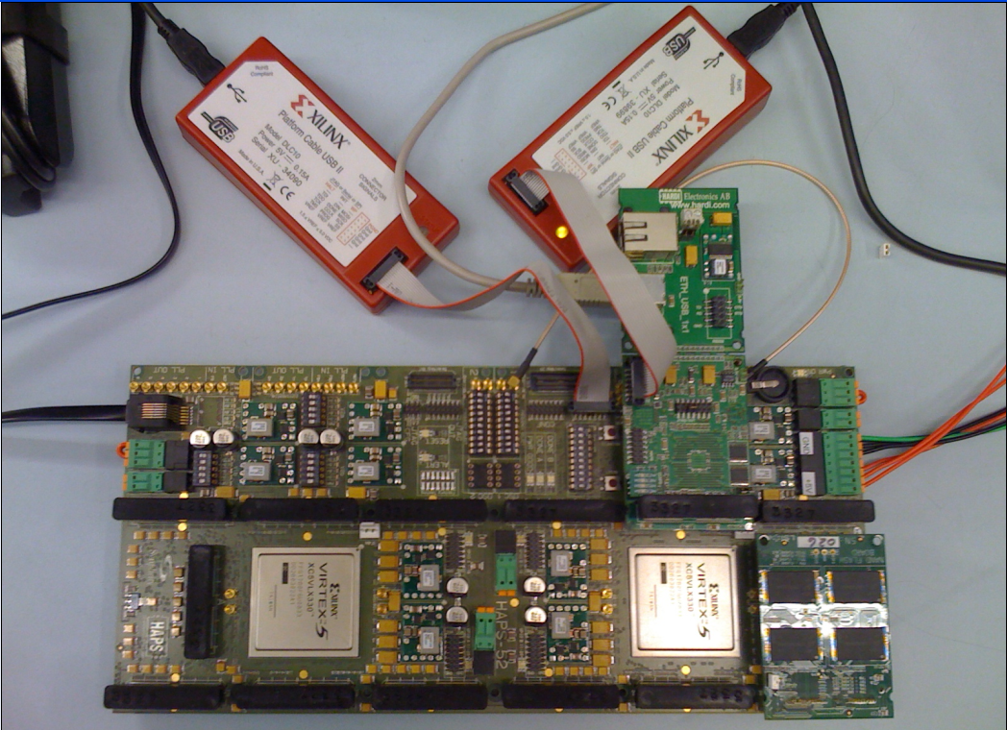
NAND Flash Testing Platform
USB Daughter Board
USB Jack
HAPS-52 Mother Board
Virtex-II Pro
(USB controller)
3x-nm
NAND Flash
Virtex-V FPGA
(NAND Controller)
NAND Daughter Board

Slide 112
NAND Flash Usage and Error Model
Erase Errors
Program Errors
Start
Erase
Block
Program
Page
P/E cycle 0
(Page0 - Page128)
…
Retention Errors
Read Errors
Retention1
(t₁ days)
Read
Page
P/E cycle i
…
Retention Errors
…
Read Errors
P/E cycle n
Retention j
(t_{j} days)
Read
Page
End of life
Notes:
13
lots of diagrams of boxes and text, need to find a way to differentiate them

Slide 113
Error Types and Testing Methodology
Erase errors
  Count the number of cells that fail to be erased to “11” state
Program interference errors
  Compare the data immediately after page programming and the data after the whole block being programmed
Read errors
  Continuously read a given block and compare the data between consecutive read sequences
Retention errors
  Compare the data read after an amount of time to data written
    Characterize short term retention errors under room temperature
    Characterize long term retention errors by baking in the oven under 125℃

Slide 114
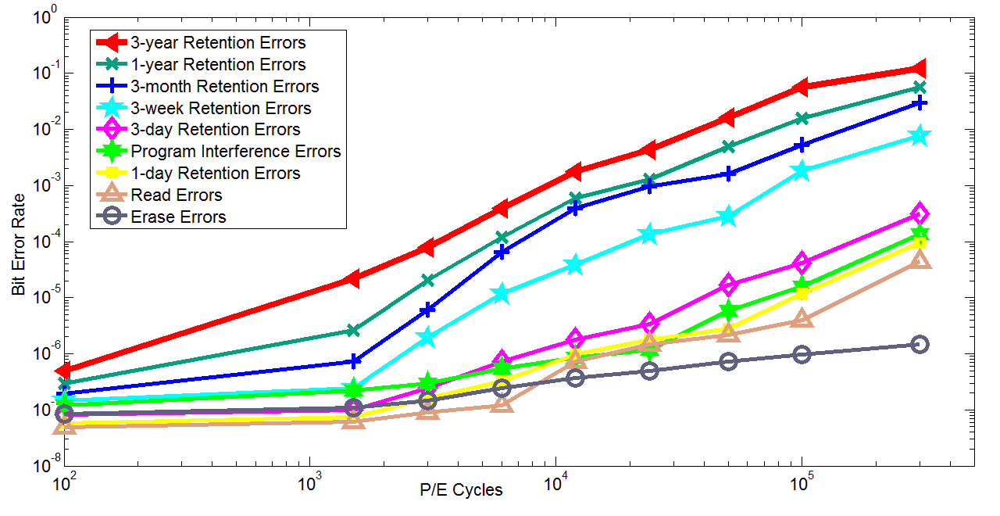
Observations: Flash Error Analysis
retention errors
Raw Bit Error Rate
P/E Cycles
Raw bit error rate increases exponentially with P/E cycles
Retention errors are dominant (>99% for 1-year ret. time)
Retention errors increase with retention time requirement

Slide 115

Retention Error Mechanism
LSB/MSB
Stress Induced Leakage Current (SILC)
Floating
Gate
REF1
REF2
REF3
11
10
01
00
V_{th}
Erased
Fully programmed
Electron loss from the floating gate causes retention errors
  Cells with more programmed electrons suffer more from retention errors
  Threshold voltage is more likely to shift by one window than by multiple
Notes:
16
explain what the diagram is showing
animate in distribution spread

Slide 116
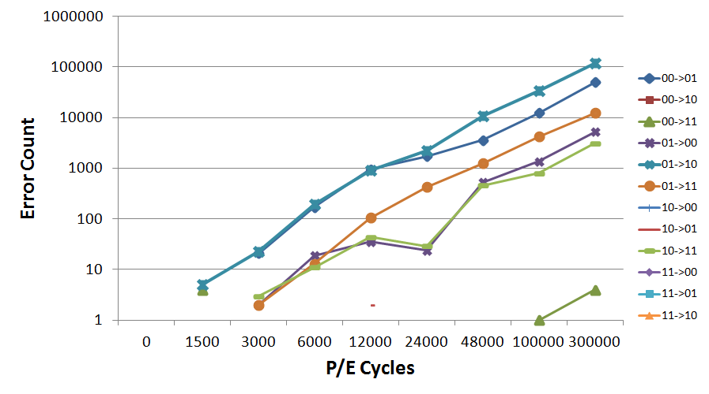
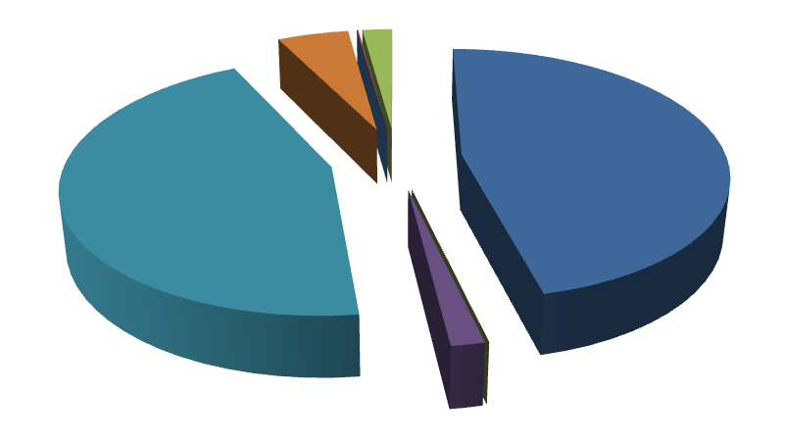
Retention Error Value Dependency
01 →10
00 →01
Cells with more programmed electrons tend to suffer more from retention noise (i.e. 00 and 01)

Slide 117
More Details on Flash Error Analysis
Yu Cai, Erich F. Haratsch, Onur Mutlu, and Ken Mai,
"Error Patterns in MLC NAND Flash Memory: Measurement, Characterization, and Analysis"
Proceedings of the Design, Automation, and Test in Europe Conference (DATE), Dresden, Germany, March 2012. Slides (ppt)

Slide 118
Threshold Voltage Distribution Shifts
As P/E cycles increase ...
Distribution shifts to the right
Distribution becomes wider
Notes:
This plot shows the probability density function of the cell threshold voltage as the number of program/erase cycles increases.
As the wear on the cells increase, we can see the distributions broadening and shifting to the right (higher voltages).
As around 30k cycles, the distributions in adjacent states begin to overlap, meaning that a read error is possible.
However, we note that the manufacturer cell lifetime is typically only around 5k cycles, so errors due to wear would not be evident at those wear levels.

Slide 119
More Detail
Yu Cai, Erich F. Haratsch, Onur Mutlu, and Ken Mai,
"Threshold Voltage Distribution in MLC NAND Flash Memory: Characterization, Analysis and Modeling"
Proceedings of the Design, Automation, and Test in Europe Conference (DATE), Grenoble, France, March 2013. Slides (ppt)

Slide 120

Flash Correct-and-Refresh
Retention-Aware Error Management for Increased Flash Memory Lifetime
Yu Cai¹ Gulay Yalcin² Onur Mutlu¹ Erich F. Haratsch³
Adrian Cristal² Osman S. Unsal² Ken Mai¹
¹ Carnegie Mellon University
² Barcelona Supercomputing Center
³ LSI Corporation

Slide 121
Executive Summary
NAND flash memory has low endurance: a flash cell dies after 3k P/E cycles vs. 50k desired → Major scaling challenge for flash memory
Flash error rate increases exponentially over flash lifetime
Problem: Stronger error correction codes (ECC) are ineffective and undesirable for improving flash lifetime due to
  diminishing returns on lifetime with increased correction strength
  prohibitively high power, area, latency overheads
Our Goal: Develop techniques to tolerate high error rates w/o strong ECC
Observation: Retention errors are the dominant errors in MLC NAND flash
  flash cell loses charge over time; retention errors increase as cell gets worn out
Solution: Flash Correct-and-Refresh (FCR)
  Periodically read, correct, and reprogram (in place) or remap each flash page before it accumulates more errors than can be corrected by simple ECC
  Adapt “refresh” rate to the severity of retention errors (i.e., # of P/E cycles)
Results: FCR improves flash memory lifetime by 46X with no hardware changes and low energy overhead; outperforms strong ECCs

Slide 122
Outline
Executive Summary
The Problem: Limited Flash Memory Endurance/Lifetime
Error and ECC Analysis for Flash Memory
Flash Correct and Refresh Techniques (FCR)
Evaluation
Conclusions

Slide 123
Problem: Limited Endurance of Flash Memory
NAND flash has limited endurance
  A cell can tolerate a small number of Program/Erase (P/E) cycles
  3x-nm flash with 2 bits/cell → 3K P/E cycles
Enterprise data storage requirements demand very high endurance
  >50K P/E cycles (10 full disk writes per day for 3-5 years)
Continued process scaling and more bits per cell will reduce flash endurance
One potential solution: stronger error correction codes (ECC)
  Stronger ECC not effective enough and inefficient

Slide 124
Decreasing Endurance with Flash Scaling
100k
24-bit ECC
15-bit ECC
8-bit ECC
Error Correction Capability
(per 1 kB of data)
4-bit ECC
10k
5k
3k
1k
Ariel Maislos, “A New Era in Embedded Flash Memory”, Flash Summit 2011 (Anobit)
Endurance of flash memory decreasing with scaling and multi-level cells
Error correction capability required to guarantee storage-class reliability (UBER < 10⁻¹⁵) is increasing exponentially to reach less endurance
UBER: Uncorrectable bit error rate. Fraction of erroneous bits after error correction.

Slide 125
The Problem with Stronger Error Correction
Stronger ECC detects and corrects more raw bit errors → increases P/E cycles endured
Two shortcomings of stronger ECC:
  1. High implementation complexity
  → Power and area overheads increase super-linearly, but correction capability increases sub-linearly with ECC strength
  2. Diminishing returns on flash lifetime improvement
  → Raw bit error rate increases exponentially with P/E cycles, but correction capability increases sub-linearly with ECC strength

Slide 126
Outline
Executive Summary
The Problem: Limited Flash Memory Endurance/Lifetime
Error and ECC Analysis for Flash Memory
Flash Correct and Refresh Techniques (FCR)
Evaluation
Conclusions

Slide 127
Methodology: Error and ECC Analysis
Characterized errors and error rates of 3x-nm MLC NAND flash using an experimental FPGA-based flash platform
  Cai et al., “Error Patterns in MLC NAND Flash Memory: Measurement, Characterization, and Analysis,” DATE 2012.
Quantified Raw Bit Error Rate (RBER) at a given P/E cycle
  Raw Bit Error Rate: Fraction of erroneous bits without any correction
Quantified error correction capability (and area and power consumption) of various BCH-code implementations
  Identified how much RBER each code can tolerate
  → how many P/E cycles (flash lifetime) each code can sustain

Slide 128
NAND Flash Error Types
Four types of errors [Cai+, DATE 2012]
Caused by common flash operations
  Read errors
  Erase errors
  Program (interference) errors
Caused by flash cell losing charge over time
  Retention errors
    Whether an error happens depends on required retention time
    Especially problematic in MLC flash because voltage threshold window to determine stored value is smaller

Slide 129
Observations: Flash Error Analysis
retention errors
Raw Bit Error Rate
P/E Cycles
Raw bit error rate increases exponentially with P/E cycles
Retention errors are dominant (>99% for 1-year ret. time)
Retention errors increase with retention time requirement

Slide 130
Methodology: Error and ECC Analysis
Characterized errors and error rates of 3x-nm MLC NAND flash using an experimental FPGA-based flash platform
  Cai et al., “Error Patterns in MLC NAND Flash Memory: Measurement, Characterization, and Analysis,” DATE 2012.
Quantified Raw Bit Error Rate (RBER) at a given P/E cycle
  Raw Bit Error Rate: Fraction of erroneous bits without any correction
Quantified error correction capability (and area and power consumption) of various BCH-code implementations
  Identified how much RBER each code can tolerate
  → how many P/E cycles (flash lifetime) each code can sustain

Slide 131
ECC Strength Analysis
Examined characteristics of various-strength BCH codes with the following criteria
  Storage efficiency: >89% coding rate (user data/total storage)
  Reliability: <10⁻¹⁵ uncorrectable bit error rate
  Code length: segment of one flash page (e.g., 4kB)
Error correction capability increases sub-linearly
Power and area overheads increase super-linearly

Slide 132
Resulting Flash Lifetime with Strong ECC
Lifetime improvement comparison of various BCH codes
4X Lifetime
Improvement
71X Power Consumption
85X Area Consumption
Strong ECC is very inefficient at improving lifetime

Slide 133
Our Goal
Develop new techniques
to improve flash lifetime
without relying on stronger ECC

Slide 134
Outline
Executive Summary
The Problem: Limited Flash Memory Endurance/Lifetime
Error and ECC Analysis for Flash Memory
Flash Correct and Refresh Techniques (FCR)
Evaluation
Conclusions

Slide 135
Flash Correct-and-Refresh (FCR)
Key Observations:
  Retention errors are the dominant source of errors in flash memory [Cai+ DATE 2012][Tanakamaru+ ISSCC 2011]
  → limit flash lifetime as they increase over time
  Retention errors can be corrected by “refreshing” each flash page periodically
Key Idea:
  Periodically read each flash page,
  Correct its errors using “weak” ECC, and
  Either remap it to a new physical page or reprogram it in-place,
  Before the page accumulates more errors than ECC-correctable
  Optimization: Adapt refresh rate to endured P/E cycles

Slide 136
FCR Intuition
Errors with
No refresh
Errors with
Periodic refresh
ProgramPage
×
×
After time T
×
×
×
×
×
×
×
After time 2T
×
×
×
×
×
×
×
×
×
After time 3T
×
×
×
×
×
×
×
×
×
×
×
×
Retention Error
×
Program Error

Slide 137
FCR: Two Key Questions
How to refresh?
  Remap a page to another one
  Reprogram a page (in-place)
  Hybrid of remap and reprogram
When to refresh?
  Fixed period
  Adapt the period to retention error severity

Slide 138
Outline
Executive Summary
The Problem: Limited Flash Memory Endurance/Lifetime
Error and ECC Analysis for Flash Memory
Flash Correct and Refresh Techniques (FCR)
  1. Remapping based FCR
  2. Hybrid Reprogramming and Remapping based FCR
  3. Adaptive-Rate FCR
Evaluation
Conclusions

Slide 139
Outline
Executive Summary
The Problem: Limited Flash Memory Endurance/Lifetime
Error and ECC Analysis for Flash Memory
Flash Correct and Refresh Techniques (FCR)
  1. Remapping based FCR
  2. Hybrid Reprogramming and Remapping based FCR
  3. Adaptive-Rate FCR
Evaluation
Conclusions

Slide 140
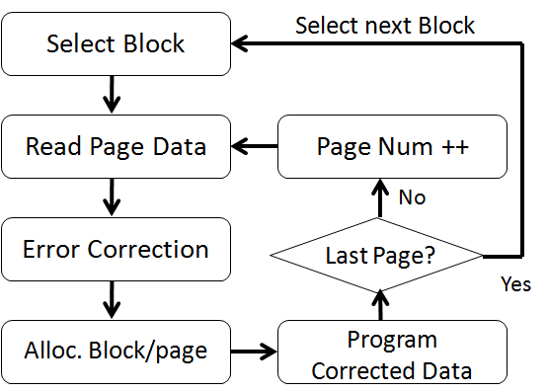
Remapping Based FCR
Idea: Periodically remap each page to a different physical page (after correcting errors)
  Also [Pan et al., HPCA 2012]
  FTL already has support for
  changing logical → physical
  flash block/page mappings
  Deallocated block is
  erased by garbage collector
Problem: Causes additional erase operations → more wearout
  Bad for read-intensive workloads (few erases really needed)
  Lifetime degrades for such workloads (see paper)

Slide 141
Outline
Executive Summary
The Problem: Limited Flash Memory Endurance/Lifetime
Error and ECC Analysis for Flash Memory
Flash Correct and Refresh Techniques (FCR)
  1. Remapping based FCR
  2. Hybrid Reprogramming and Remapping based FCR
  3. Adaptive-Rate FCR
Evaluation
Conclusions

Slide 142
In-Place Reprogramming Based FCR
Idea: Periodically reprogram (in-place) each physical page (after correcting errors)
  Flash programming techniques
  (ISPP) can correct retention
  errors in-place by recharging
  flash cells
Problem: Program errors accumulate on the same page → may not be correctable by ECC after some time
Reprogram corrected data
Notes:
Observations:
Retention errors occur due to loss of charge
Simply recharging the cells can correct the retention errors
Flash programming mechanisms can accomplish this recharging
ISPP (Incremental Step Pulse Programming)
Iterative programming mechanism that increases the voltage level of a flash cell step by step
After each step, voltage level compared to desired voltage threshold
Can inject more electrons but cannot remove electrons

Slide 143
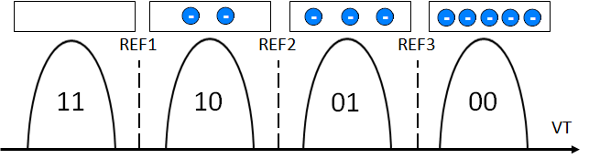
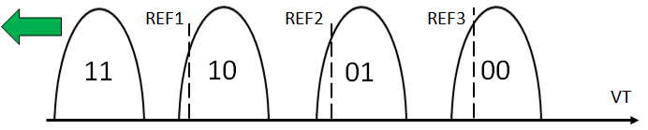
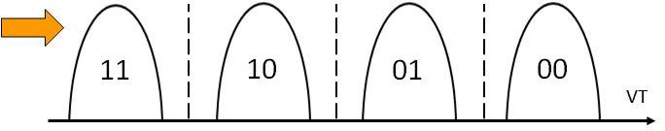
In-Place Reprogramming of Flash Cells
Floating Gate
Pro: No remapping needed → no additional erase operations
Con: Increases the occurrence of program errors
Floating Gate
Voltage Distribution
for each Stored Value
Retention errors are caused by cell voltage shifting to the left
ISPP moves cell voltage to the right; fixes retention errors

Slide 144
Program Errors in Flash Memory
When a cell is being programmed, voltage level of a neighboring cell changes (unintentionally) due to parasitic capacitance coupling
→ can change the data value stored
Also called program interference error
Program interference causes neighboring cell voltage to shift to the right

Slide 145
Problem with In-Place Reprogramming
Floating
Gate
REF1
REF2
REF3
Additional
Electrons Injected
Floating Gate
Voltage Distribution
11
10
01
00
VT
Original data
to be programmed
…
00
11
01
00
10
11
00
…
Program errors after
initial programming
…
00
10
01
00
10
11
00
…
Retention errors
after some time
…
01
10
10
00
11
11
01
…
1. Read data
2. Correct errors
3. Reprogram back
Errors after in-place
reprogramming
…
00
10
01
00
10
10
00
…
Problem: Program errors can accumulate over time

Slide 146
Hybrid Reprogramming/Remapping Based FCR
Idea:
  Monitor the count of right-shift errors (after error correction)
  If count < threshold, in-place reprogram the page
  Else, remap the page to a new page
Observation:
  Program errors much less frequent than retention errors → Remapping happens only infrequently
Benefit:
  Hybrid FCR greatly reduces erase operations due to remapping

Slide 147
Outline
Executive Summary
The Problem: Limited Flash Memory Endurance/Lifetime
Error and ECC Analysis for Flash Memory
Flash Correct and Refresh Techniques (FCR)
  1. Remapping based FCR
  2. Hybrid Reprogramming and Remapping based FCR
  3. Adaptive-Rate FCR
Evaluation
Conclusions

Slide 148
Adaptive-Rate FCR
Observation:
  Retention error rate strongly depends on the P/E cycles a flash page endured so far
  No need to refresh frequently (at all) early in flash lifetime
Idea:
  Adapt the refresh rate to the P/E cycles endured by each page
  Increase refresh rate gradually with increasing P/E cycles
Benefits:
  Reduces overhead of refresh operations
  Can use existing FTL mechanisms that keep track of P/E cycles

Slide 149
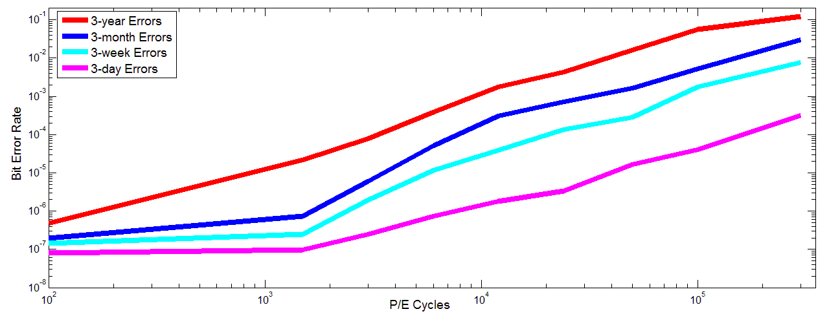
Adaptive-Rate FCR (Example)
3-year
FCR
3-month
FCR
3-week
FCR
3-day
FCR
Raw Bit Error Rate
Acceptable raw BER for 512b-BCH
P/E Cycles
Select refresh frequency such that error rate is below acceptable rate

Slide 150
Outline
Executive Summary
The Problem: Limited Flash Memory Endurance/Lifetime
Error and ECC Analysis for Flash Memory
Flash Correct and Refresh Techniques (FCR)
  1. Remapping based FCR
  2. Hybrid Reprogramming and Remapping based FCR
  3. Adaptive-Rate FCR
Evaluation
Conclusions

Slide 151
FCR: Other Considerations
Implementation cost
  No hardware changes
  FTL software/firmware needs modification
Response time impact
  FCR not as frequent as DRAM refresh; low impact
Adaptation to variations in retention error rate
  Adapt refresh rate based on, e.g., temperature [Liu+ ISCA 2012]
FCR requires power
  Enterprise storage systems typically powered on

Slide 152
Outline
Executive Summary
The Problem: Limited Flash Memory Endurance/Lifetime
Error and ECC Analysis for Flash Memory
Flash Correct and Refresh Techniques (FCR)
Evaluation
Conclusions

Slide 153
Evaluation Methodology
Experimental flash platform to obtain error rates at different P/E cycles [Cai+ DATE 2012]
Simulation framework to obtain P/E cycles of real workloads: DiskSim with SSD extensions
Simulated system: 256GB flash, 4 channels, 8 chips/channel, 8K blocks/chip, 128 pages/block, 8KB pages
Workloads
  File system applications, databases, web search
  Categories: Write-heavy, read-heavy, balanced
Evaluation metrics
  Lifetime (extrapolated)
  Energy overhead, P/E cycle overhead

Slide 154
Extrapolated Lifetime
Obtained from Experimental Platform Data
Maximum full disk P/E Cycles for a Technique
×
# of Days of Given Application
Total full disk P/E Cycles for a Workload
Real length (in time) of
each workload trace
Obtained from Workload Simulation

Slide 155
Normalized Flash Memory Lifetime
46x
4x
Lifetime of FCR much higher than lifetime of stronger ECC
Adaptive-rate FCR provides the highest lifetime

Slide 156
Lifetime Evaluation Takeaways
Significant average lifetime improvement over no refresh
  Adaptive-rate FCR: 46X
  Hybrid reprogramming/remapping based FCR: 31X
  Remapping based FCR: 9X
FCR lifetime improvement larger than that of stronger ECC
  46X vs. 4X with 32-kbit ECC (over 512-bit ECC)
  FCR is less complex and less costly than stronger ECC
Lifetime on all workloads improves with Hybrid FCR
  Remapping based FCR can degrade lifetime on read-heavy WL
  Lifetime improvement highest in write-heavy workloads

Slide 157
Energy Overhead
Adaptive-rate refresh: <1.8% energy increase until daily refresh is triggered
7.8%
5.5%
2.6%
1.8%
0.4%
0.3%
Refresh Interval

Slide 158
Overhead of Additional Erases
Additional erases happen due to remapping of pages
Low (2%-20%) for write intensive workloads
High (up to 10X) for read-intensive workloads
Improved P/E cycle lifetime of all workloads largely outweighs the additional P/E cycles due to remapping

Slide 159
More Results in the Paper
Detailed workload analysis
Effect of refresh rate

Slide 160
Outline
Executive Summary
The Problem: Limited Flash Memory Endurance/Lifetime
Error and ECC Analysis for Flash Memory
Flash Correct and Refresh Techniques (FCR)
Evaluation
Conclusions

Slide 161
Conclusion
NAND flash memory lifetime is limited due to uncorrectable errors, which increase over lifetime (P/E cycles)
Observation: Dominant source of errors in flash memory is retention errors → retention error rate limits lifetime
Flash Correct-and-Refresh (FCR) techniques reduce retention error rate to improve flash lifetime
  Periodically read, correct, and remap or reprogram each page before it accumulates more errors than can be corrected
  Adapt refresh period to the severity of errors
FCR improves flash lifetime by 46X at no hardware cost
  More effective and efficient than stronger ECC
  Can enable better flash memory scaling

Slide 162
Flash Correct-and-Refresh
Retention-Aware Error Management for Increased Flash Memory Lifetime
Yu Cai¹ Gulay Yalcin² Onur Mutlu¹ Erich F. Haratsch³
Adrian Cristal² Osman S. Unsal² Ken Mai¹
¹ Carnegie Mellon University
² Barcelona Supercomputing Center
³ LSI Corporation

